Slide 1


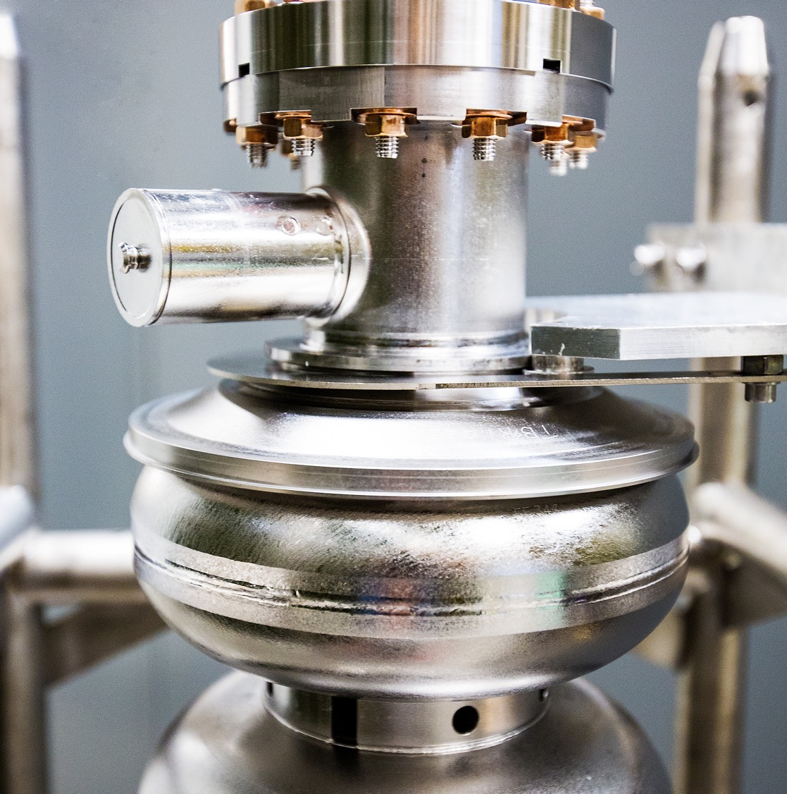
Overall Update on SoLID
Hall A Collaboration Winter Meeting
January 22th, 2026
K. Dehmelt (TJNAF)
On behalf of the SoLID Collaboration
Notes:
Tip: Keep titles under 60 characters for readability
To change the photo: Right-click on photo and select change photo

Slide 2
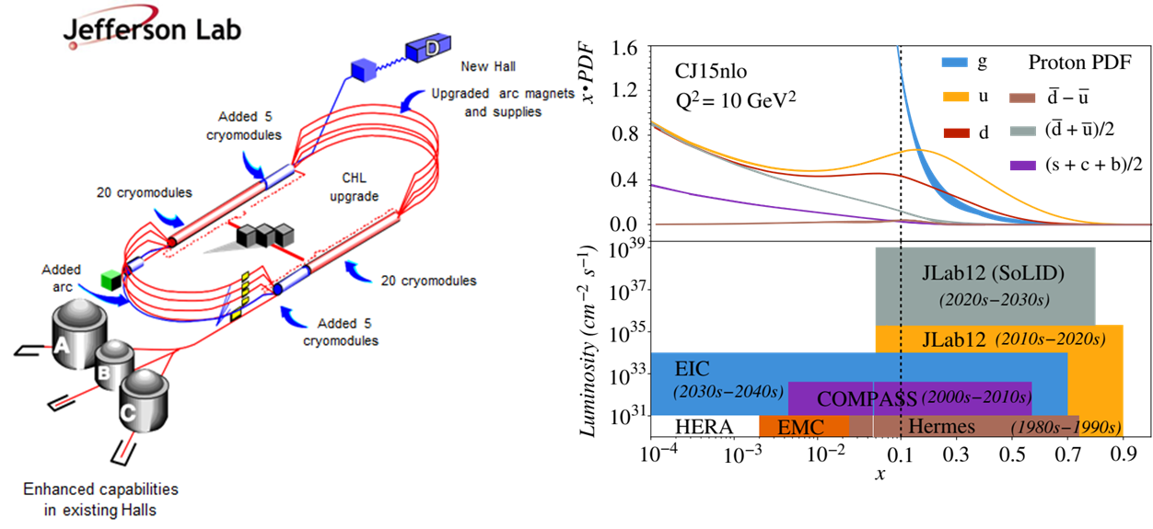
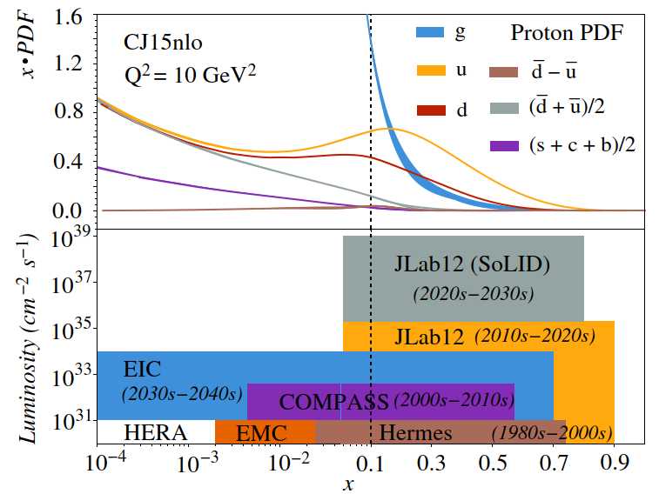
Solenoidal Large Intensity Device – SoLID in Hall A
Notes:
Guidelines: 6-8 bullets per slide; Use sentence fragments for bullets

Slide 3
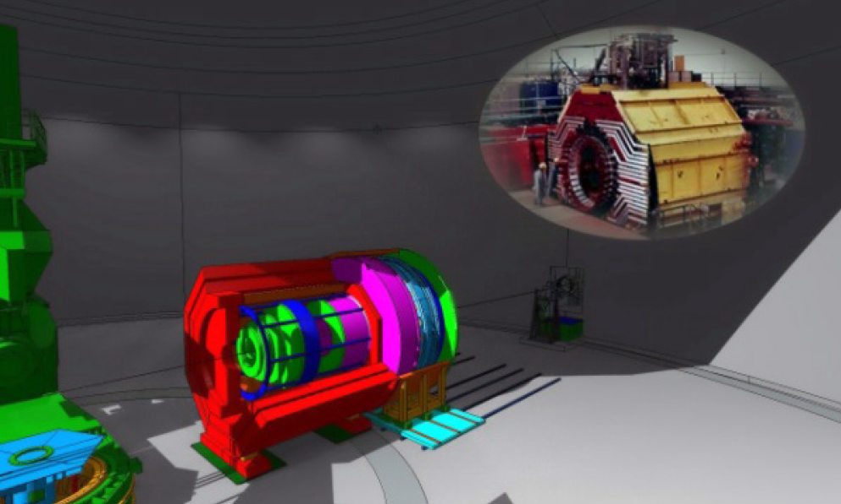
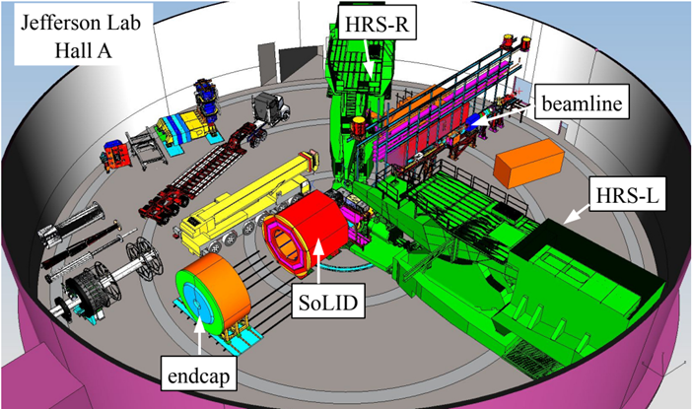
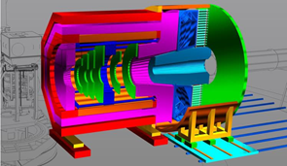
Proposed Apparatus in Hall A – Around CLEO-II Magnet
Notes:
Guidelines: 6-8 bullets per slide; Use sentence fragments for bullets

Slide 4
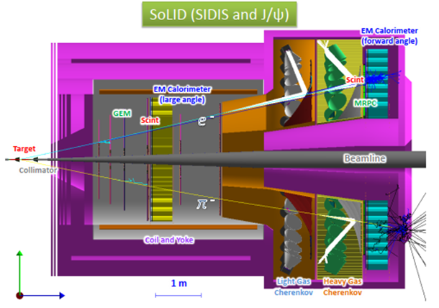
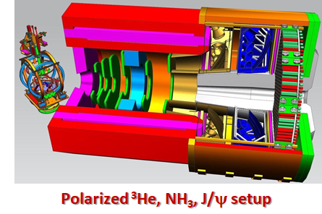
SoLID – The Apparatus
Three Science Pillars with two configurations
Precision tomography in 3-D momentum space
Proton mass, mass radius, gravitational form factors
Notes:
Guidelines: 6-8 bullets per slide; Use sentence fragments for bullets

Slide 5
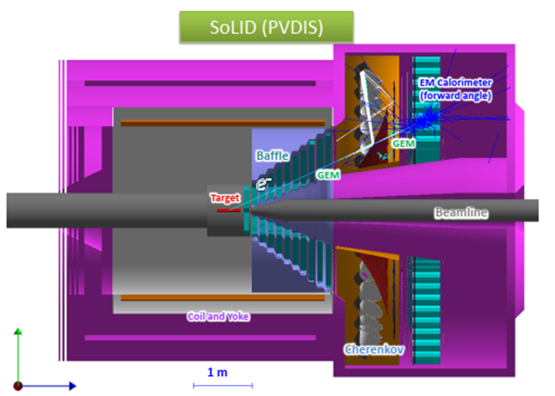
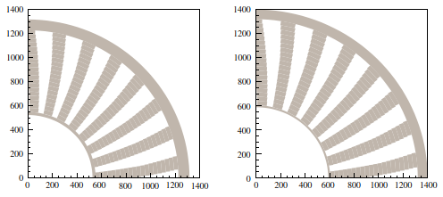
SoLID – The Apparatus
Three Science Pillars with two configurations
Standard model test, BSM, QCD via parity violating Deep Inelastic Scattering
Face on view (ﬁrst quadrant only) of the 10th and 11th plates in the PVDIS baﬄe system.
Notes:
Guidelines: 6-8 bullets per slide; Use sentence fragments for bullets

Slide 6
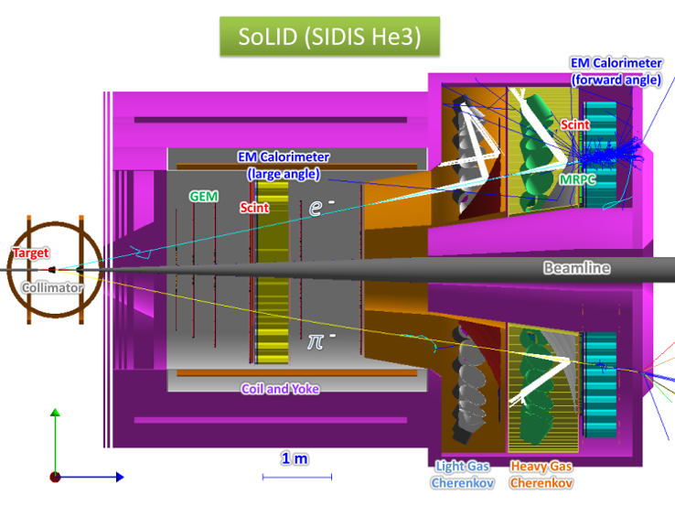
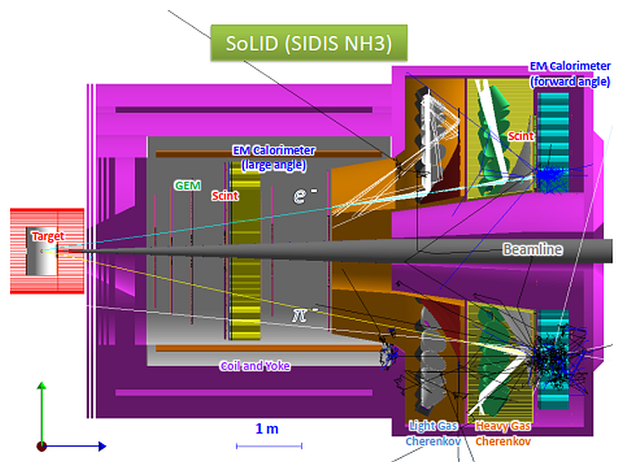
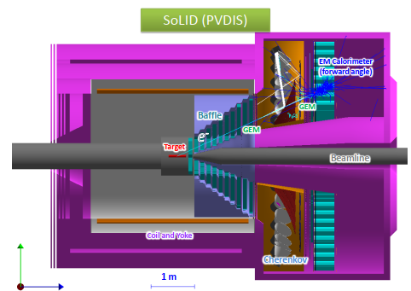
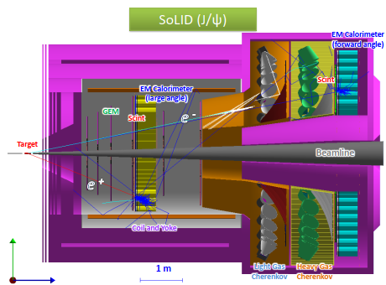
SoLID – The Apparatus
Notes:
Guidelines: 6-8 bullets per slide; Use sentence fragments for bullets

Slide 7
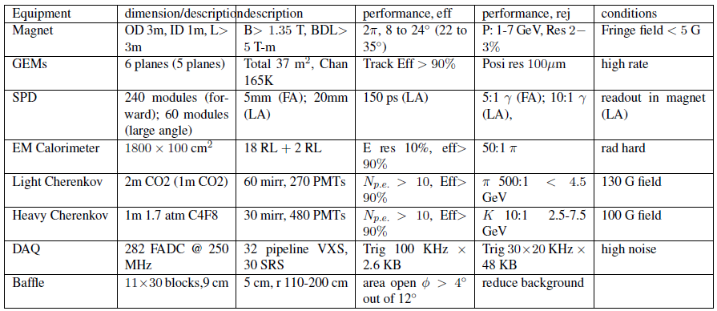
SoLID – The Apparatus
Notes:
Guidelines: 6-8 bullets per slide; Use sentence fragments for bullets

Slide 8
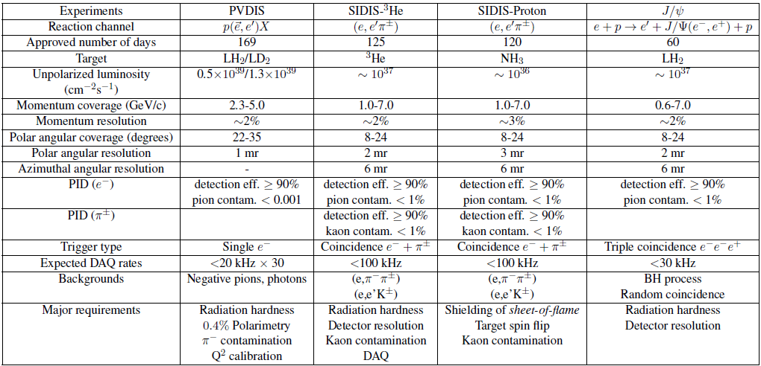
SoLID – The Experiments
Notes:
Guidelines: 6-8 bullets per slide; Use sentence fragments for bullets

Slide 9
SoLID – The Development
Rich and diverse physics program ⇨ started in 2010
  Total of 6 PAC approved SoLID experiments
  High Rating
    5 A
    1 A⁻
  3 SIDIS (3-D structure)
  1 PVDIS (BSM)
  1 Threshold J/ψ (gluon force)
  1 Beam-Normal asymmetry A_{n} (test beyond parton model)
  Plus 2 conditional approval Plus 6 run-group experiments (3-D and spin structure) Plus 1 Endorsed
Notes:
Guidelines: 6-8 bullets per slide; Use sentence fragments for bullets

Slide 10
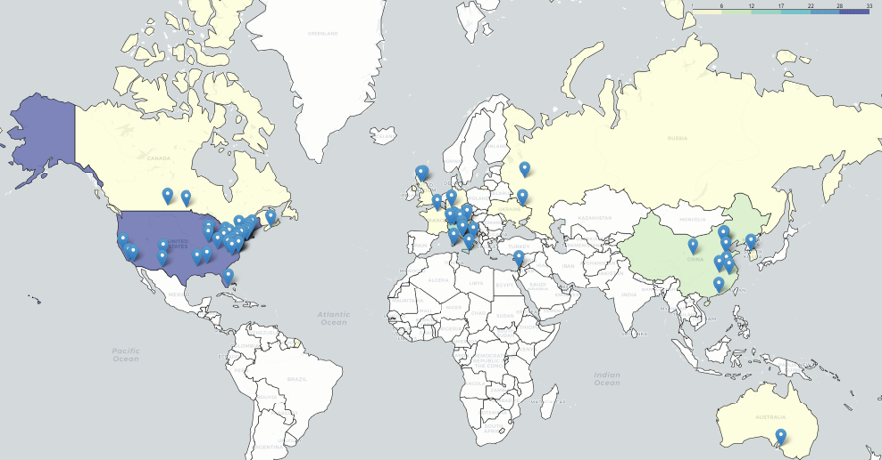
SoLID – The Collaboration
270+ collaborators
70+ institutions
13 countries
4 continents
Website
  https://solid.jlab.org/
Notes:
Guidelines: 6-8 bullets per slide; Use sentence fragments for bullets

Slide 11
SoLID – History
Pre-conceptual design, Pre-R&D, reviews, and current status
2014: pCDR submitted to JLab with cost estimation, updated in 2017, 2019
Director’s Reviews in 2015, 2019 and 2021
2015: Long Range Plan, SoLID highlighted
2020: SoLID MIE (with updated pCDR/estimated cost) submitted to DOE
2020-now: DOE funded pre-R&D activities
2021: DOE Science Review for SoLID, positive feedback
2023: Long Range Plan, SoLID highlighted, one of the recommendations
2024: Facility Review: Ready to Launch
2025: pre-R&D proposal submitted to DOE (approval postponed)
White Paper for MPGD – ASIC development submitted to DOE
Notes:
Guidelines: 6-8 bullets per slide; Use sentence fragments for bullets

Slide 12
SoLID – The Present
Two Capital Equipment projects in place
  Magnet refurbishment and testing
  DAQ ⇨ in hand: can be reduced from funding request
Working with DOE research to identify pre-R&D opportunities
  Supporting electronics testing and trigger development
  Supporting optional tracker technology Y μRWell/μRGroove
  Submitted White Paper for MPGD ASIC development (Big Interest by DOE-NP)
  Proposal in preparation: Jefferson Lab AI effort (Gagik Gavalian)
Staff assignment to SoLID
Parasitic Test-Beam activities during Run 2026 in Hall C
SoLID went through Science Review but has yet to go through CD-0 process
Notes:
Guidelines: 6-8 bullets per slide; Use sentence fragments for bullets

Slide 13
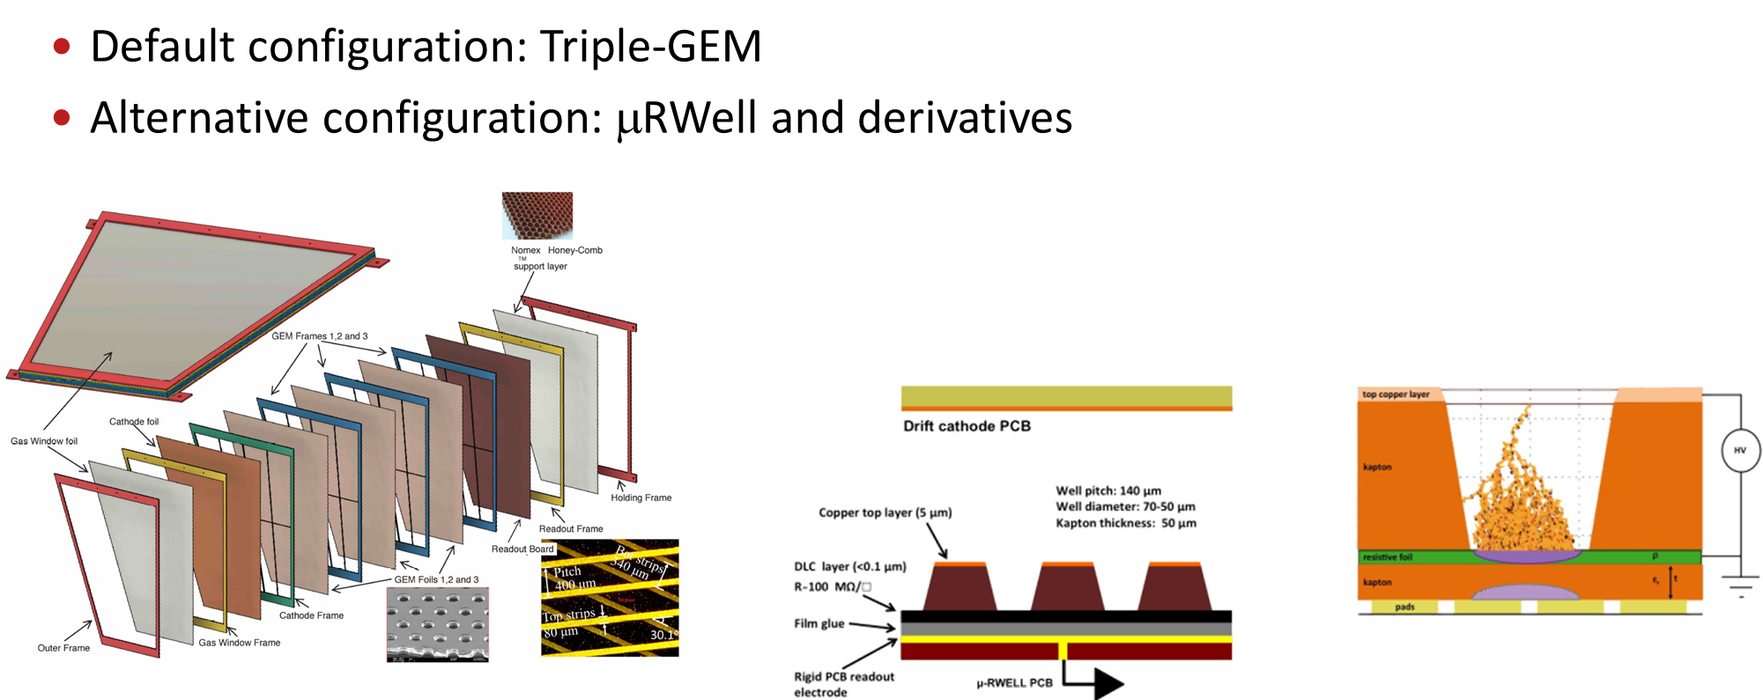
SoLID – Default Tracker Configuration
Triple – GEM à la MOLLER
Alternative configuration: μRWell and derivatives
Notes:
Guidelines: 6-8 bullets per slide; Use sentence fragments for bullets

Slide 14
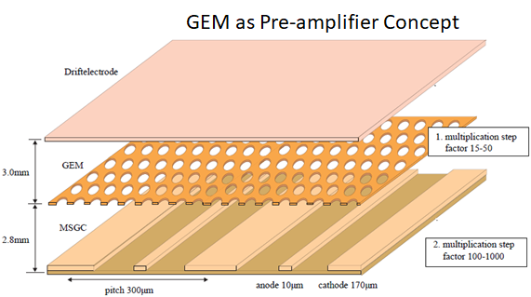
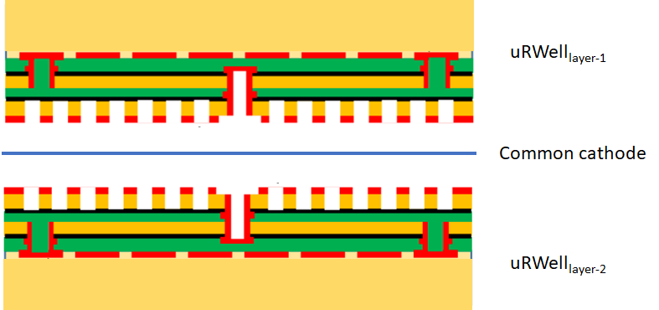
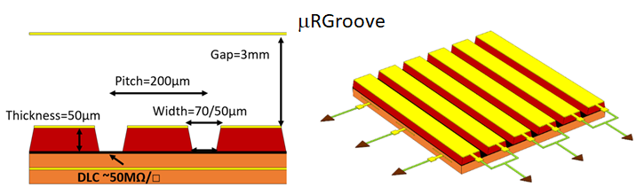
SoLID – Optional Tracker Technology
μRWell and Derivatives Y To be tested in 2026 Test-Beam
Notes:
Guidelines: 6-8 bullets per slide; Use sentence fragments for bullets

Slide 15
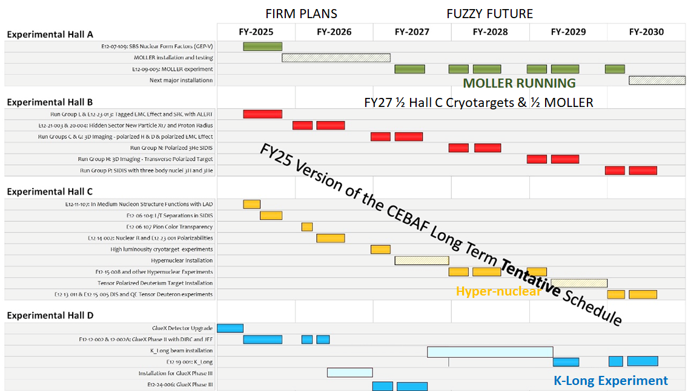
SoLID – The Future
Notes:
Guidelines: 6-8 bullets per slide; Use sentence fragments for bullets

Slide 16
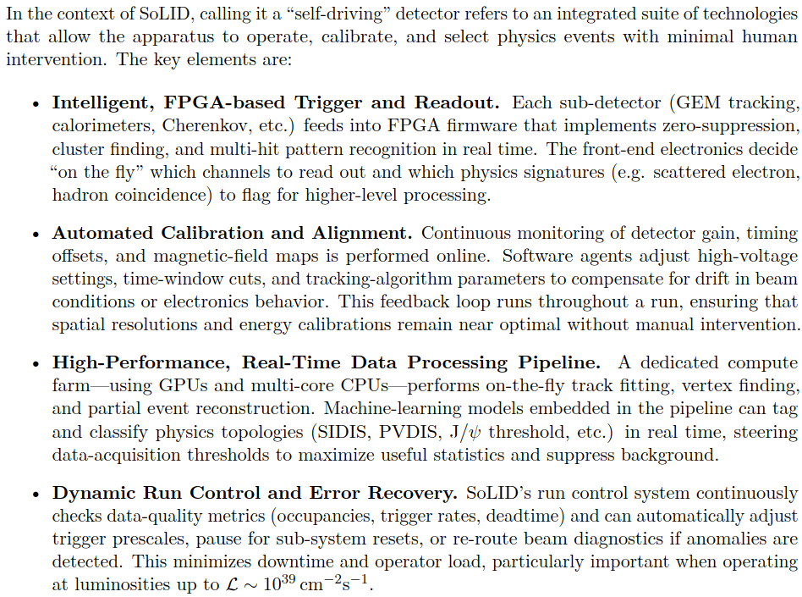
SoLID – The Self-Driving Detector
Notes:
Guidelines: 6-8 bullets per slide; Use sentence fragments for bullets

Slide 17
SoLID – Summary
SoLID collaboration looks back a decade of intensive planning and executing activities
SoLID collaboration developed a mature pre-conceptual design
SoLID is a core part of JLab’s 12-GeV program and beyond
SoLID is prominently highlighted in the 2023 NSAC LRP
SoLID has strong support from Jefferson Lab
Pre-R&D topics
  MPGD readout
  Tracking options
  MCP-PMT
  Submitted to G. Rai ⇨ budget constraints postpone the pre-R&D projects
Test Beam Campaign to be performed in 2026
Notes:
Guidelines: 6-8 bullets per slide; Use sentence fragments for bullets

Slide 18

Notes:
Guidelines: 6-8 bullets per slide; Use sentence fragments for bullets

Slide 19
SoLID Detectors – SIDIS – Requirements
Solenoid magnet (CLEO-II)
Enables tracking/momentum measurement and sweeps low-energy background
High-luminosity open geometry with full azimuthal coverage
Central axial field 1.5 T, field uniformity ±0.2%, clear bore 2.9 m
GEM tracking (FAD: 5 planes; LAD: 4 planes)
High-rate, large-area tracking; ~70 µm position resolution; sustain >100 MHz/cm² rates
Electron ID / triggers
Light Gas Cherenkov (LGC) for e/π separation, segmented in 30 sectors; nominal π rejection ~10³ at ~95% e efficiency; participates in electron trigger
Notes:
Guidelines: 6-8 bullets per slide; Use sentence fragments for bullets

Slide 20
SoLID Detectors – SIDIS – Requirements
Scintillator Pad Detector (SPD)
Photon rejection and trigger-rate reduction via SPD–ECal coincidence; photon rejection 5:1 (forward) and 10:1 (large angle)
Heavy Gas Cherenkov (HGC)
π/K and π /p separation for 2.5–7.5 GeV/c; expected π efficiency ~90%, K rejection ~10
Notes:
Guidelines: 6-8 bullets per slide; Use sentence fragments for bullets

