Slide 1
Hall A Collaboration Winter Meeting
MOLLER Spectrometer Overview
Spectrometer team and Sandesh G
Jefferson Lab
Moller – Spectrometer Team
Jan 21st 2026

Slide 2
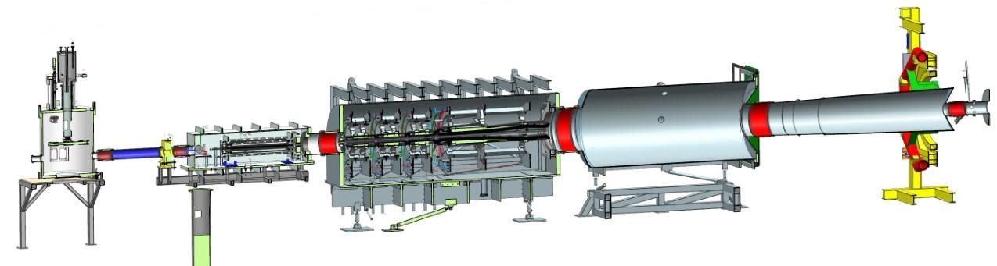
Spectrometer Overview - Moller Spectrometer Scope
Bellows #4
Detector Window Shutter
US Toroid
1x Magnet (TM0)
Collimation
Upstream Enclosure
SAM Pipe
DS Toroid
4x Magnets, (TM1-TM4)
Collimation
Downstream Enclosure
Bellows #5
Collar 0
Bellows #7
US Beam Pipe
Detector Window
Pion Donut and Detector Pipe Support
Bellows #2
Drift Pipe
Bellows #1
Bellows #3
Detector Pipe
Note: Target shown just for reference; detectors not show for clarity
Major Items not shown: MPS, magnet cooling controls, vacuum pumping system, bunker shielding, and beam dump entry pipe and its support system.

Slide 3
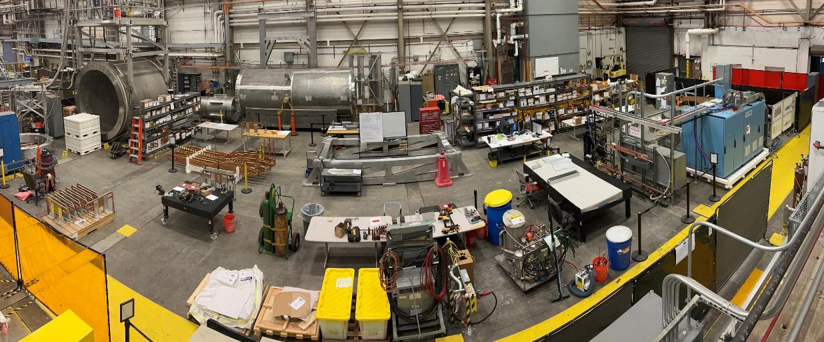
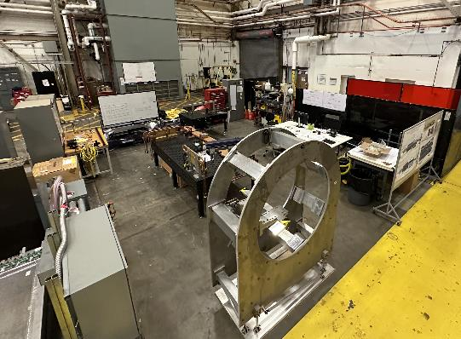
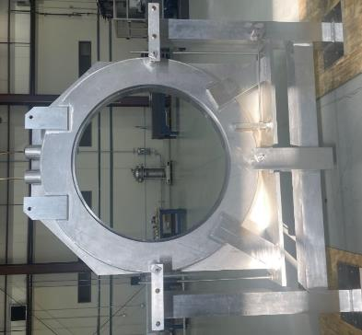
Workspace FEB 2025
Spectrometer team includes
  JLab support: Magnet Group, Detector Support Group, Mechanical Engineering, Metrology, DC Power, Hall-A, ES&H
  Contracted Engineering Services (US): Bartoszek Engineering, MIT-Bates
  Contracts with many companies to provide hardware
Workspace 02/2025
Workspace 08/2023
Collar 1

Slide 4
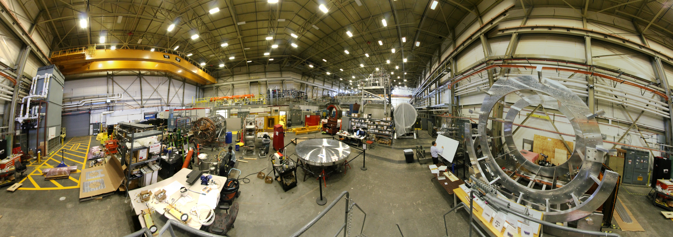
Workspace JAN 2026

Slide 5
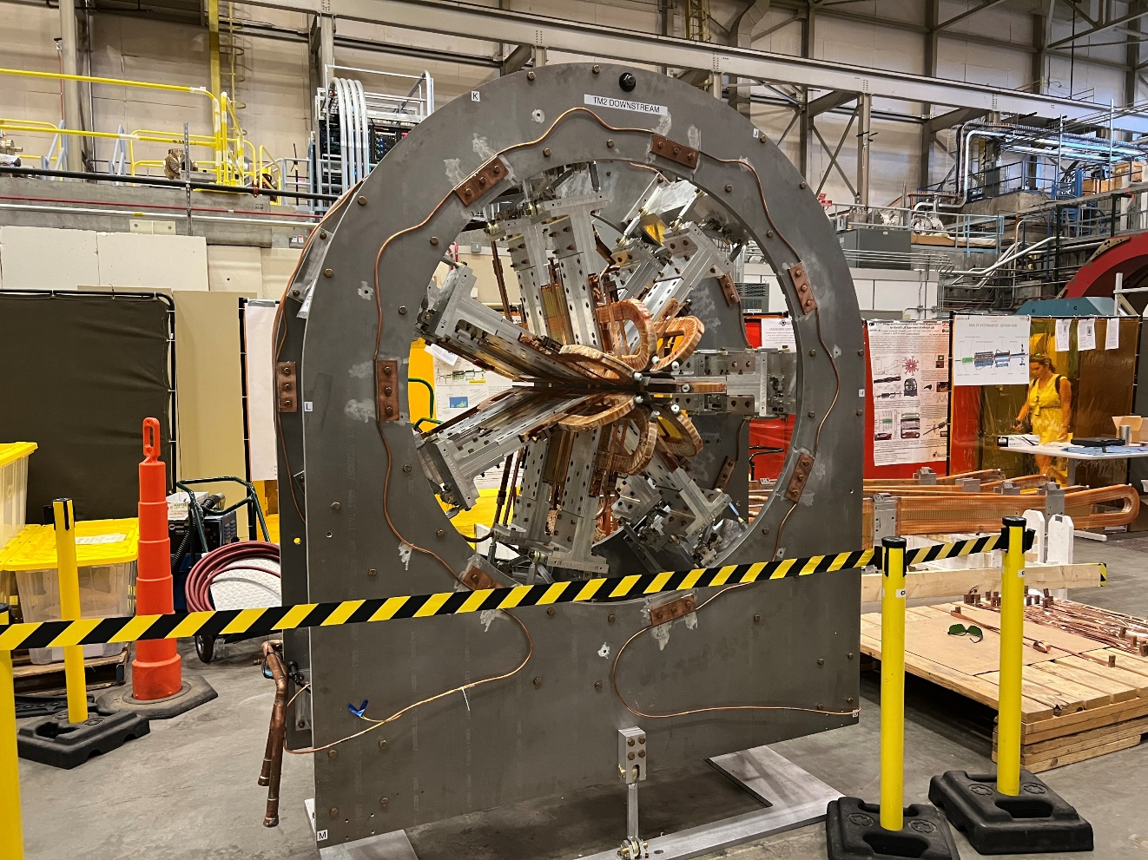
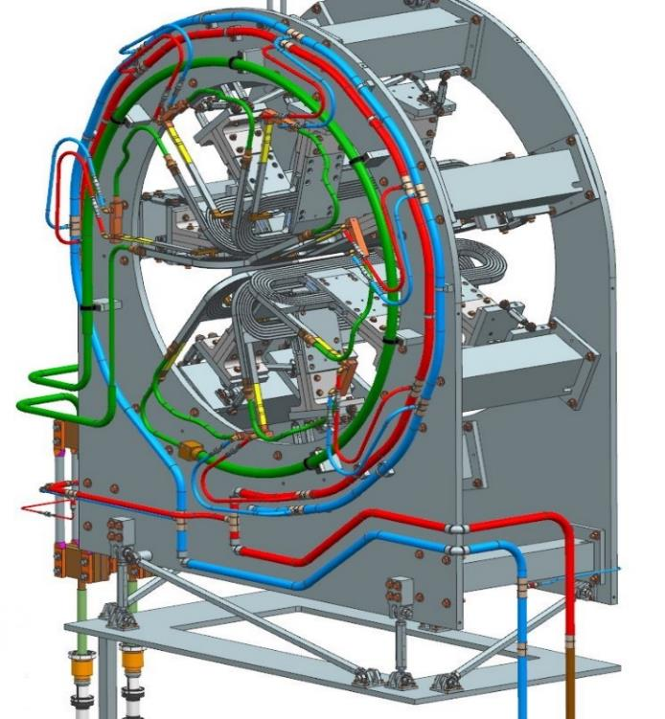
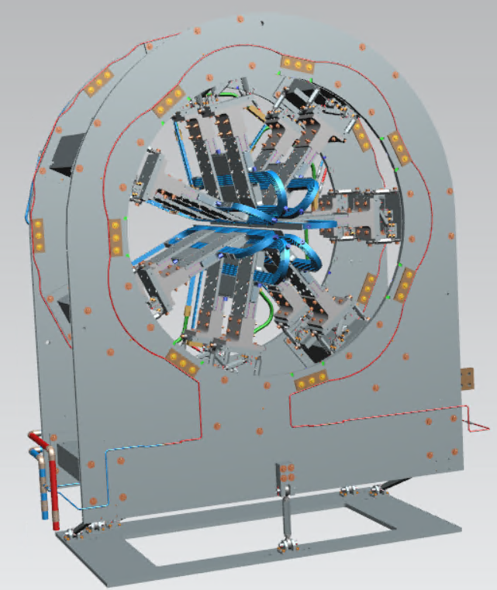
TM2
TM2 as designed
TM2 as fabricated and hydrostatically tested

Slide 6
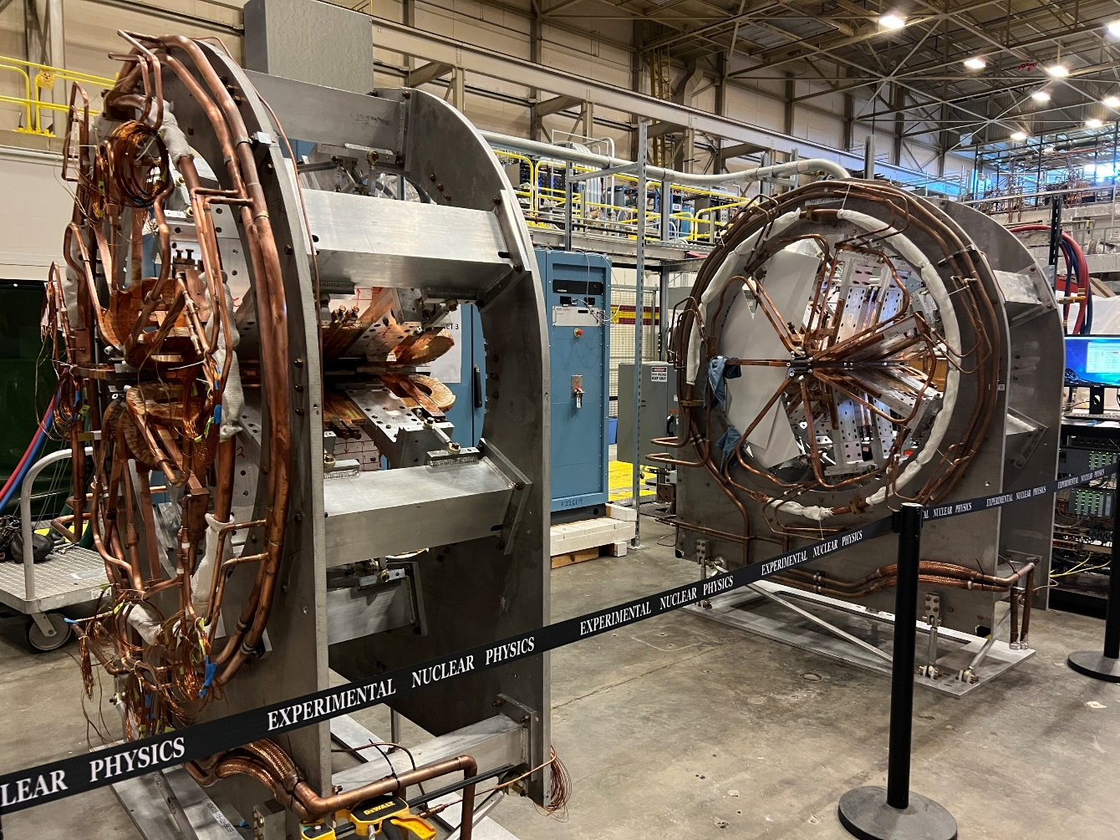
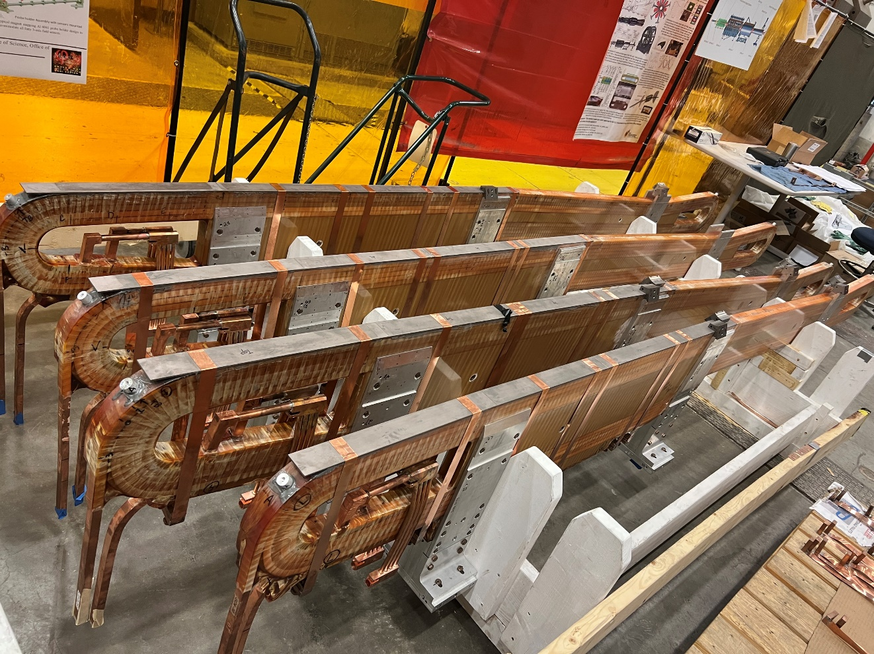
TM1, TM3 & TM4 Coils
TM1 & TM3 fabricated and tested
4 x TM4 coils, SC4 coils in safely stored and being prepared to load into frame

Slide 7
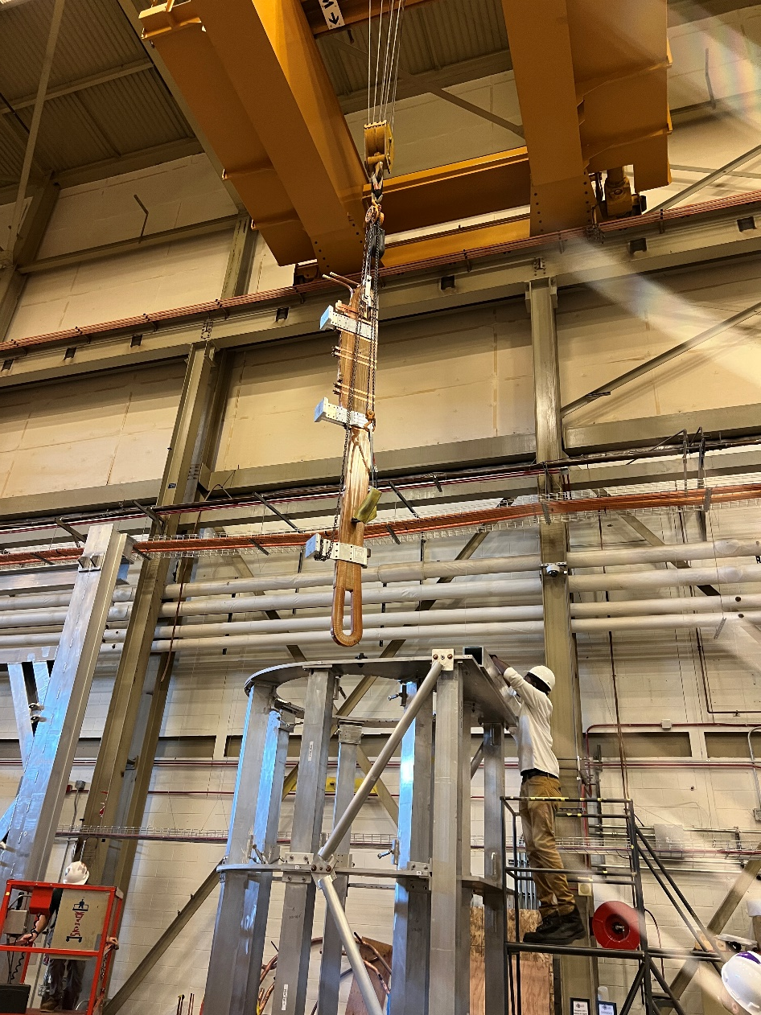
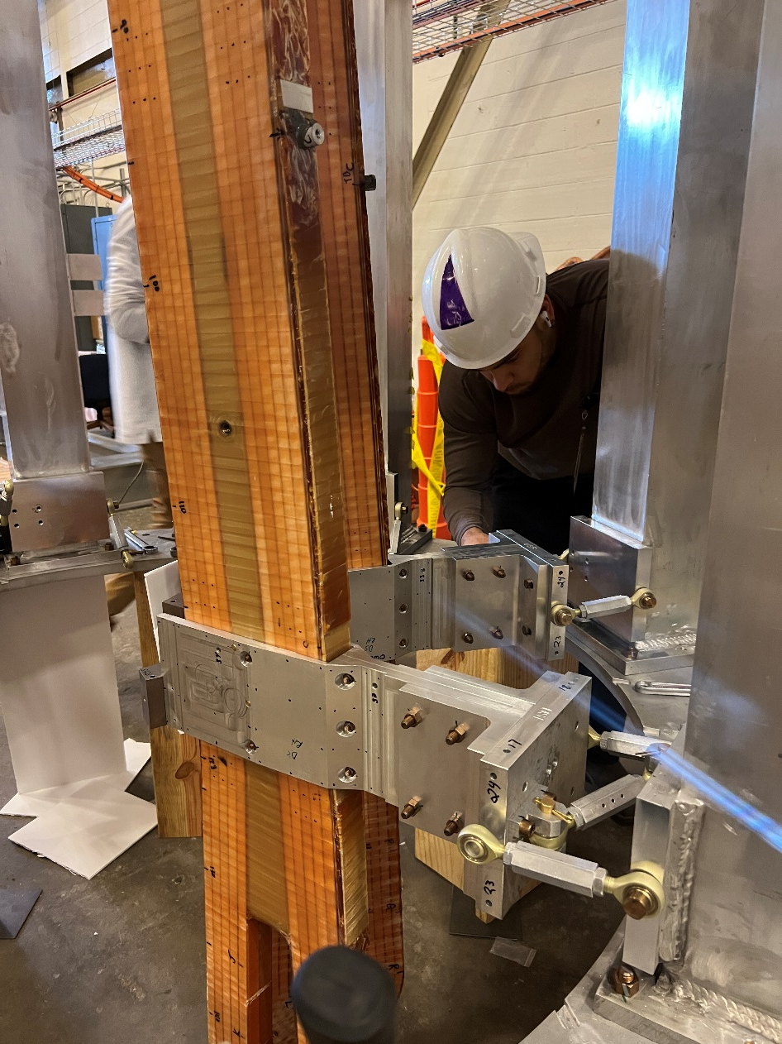
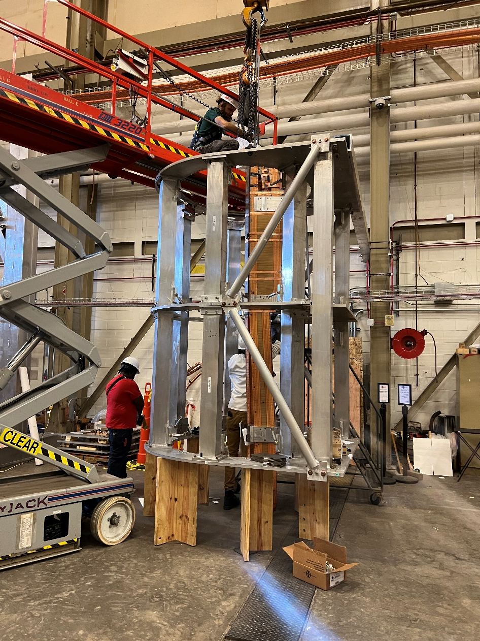
Loading of TM4 coils
Loading first coil
Loading second coil
Loading second coil

Slide 8
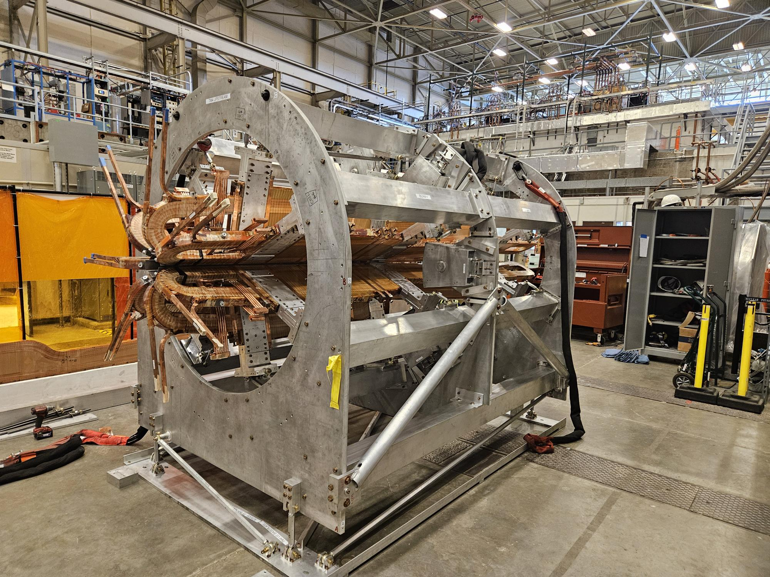
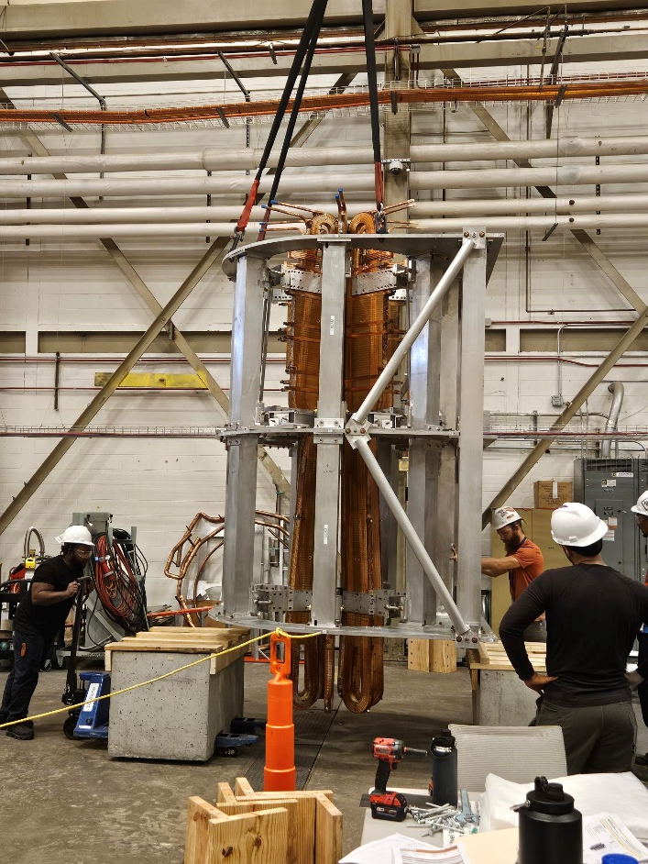
Loading of TM4 coils…
All 7 coils Loading completed
Assembled magnet (TM#4) rested horizontal

Slide 9
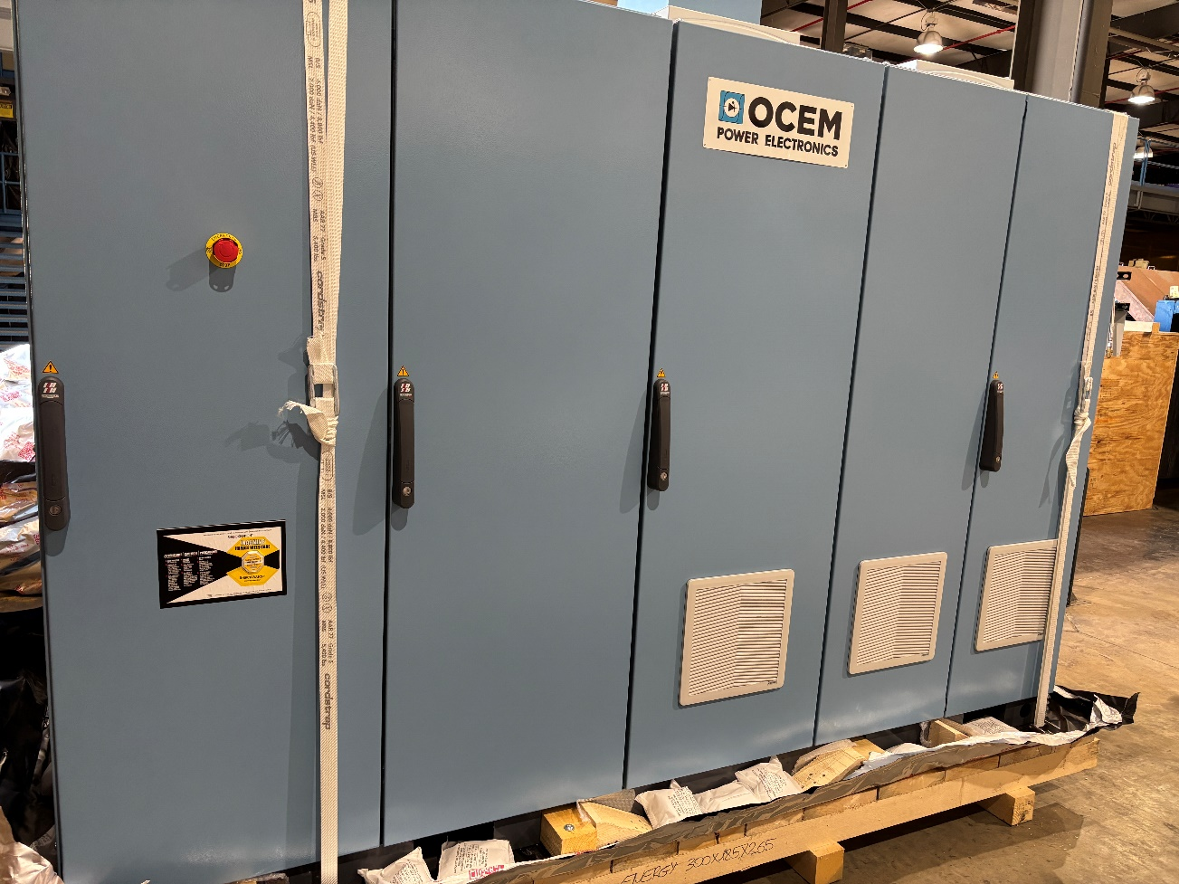
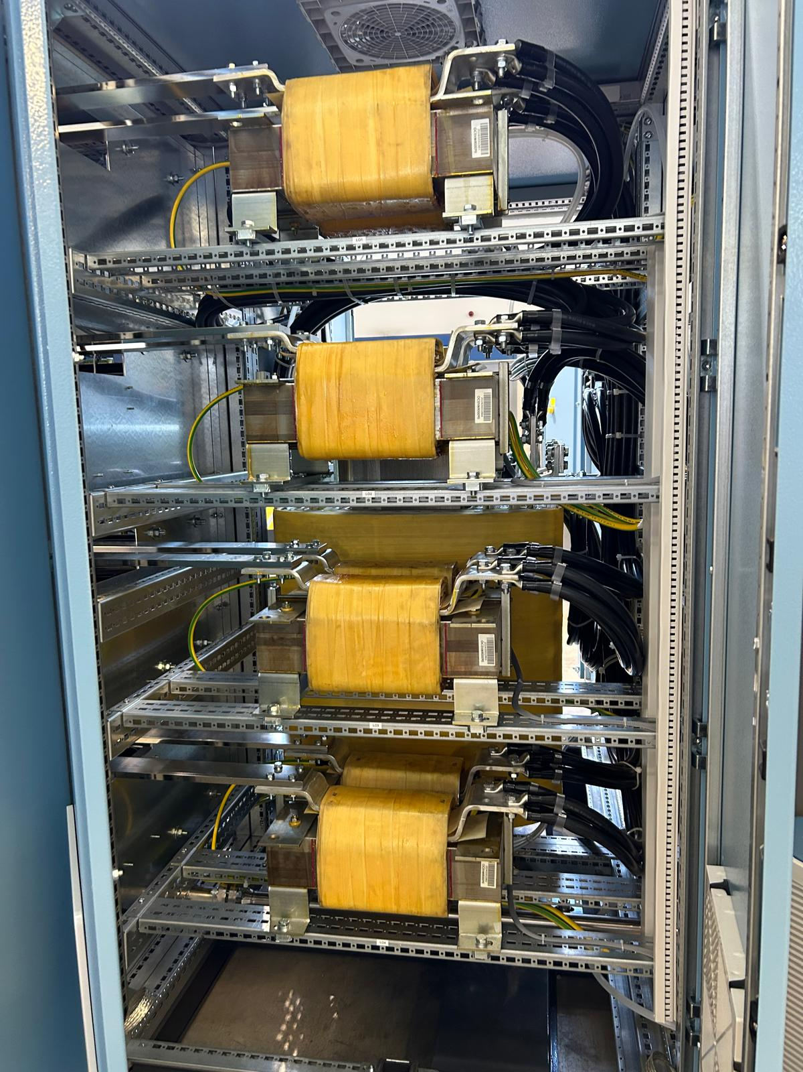
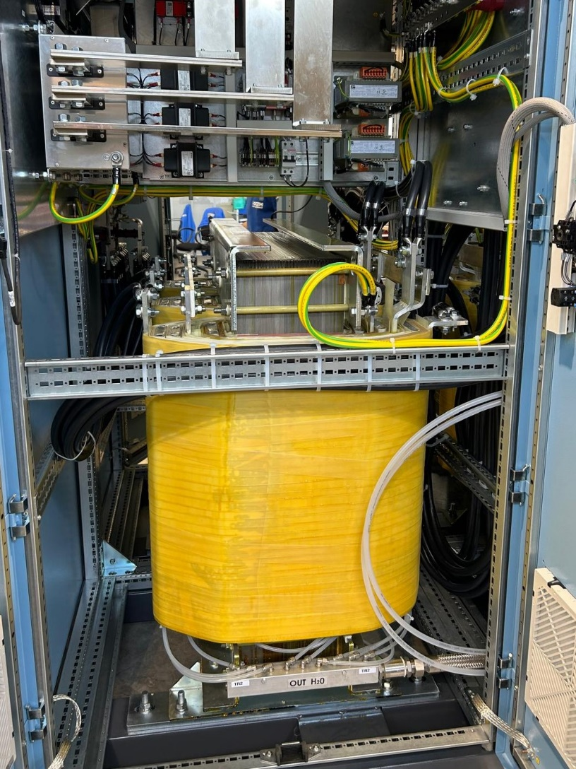
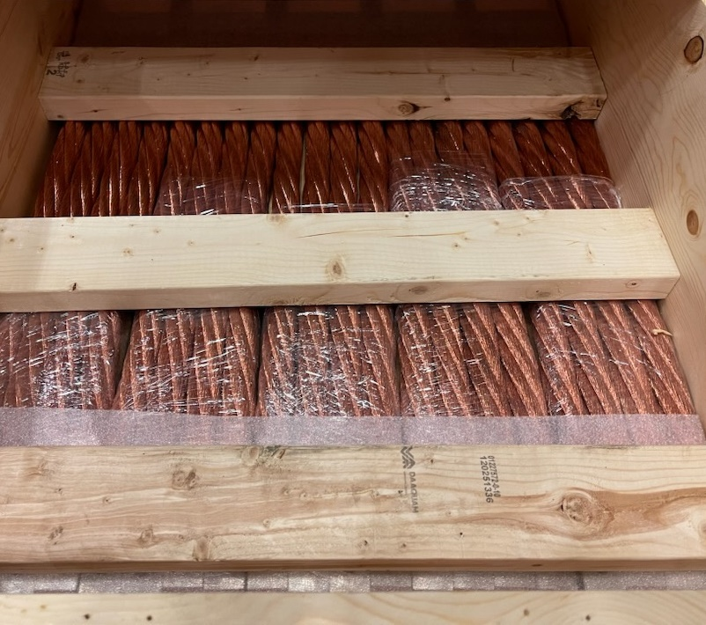
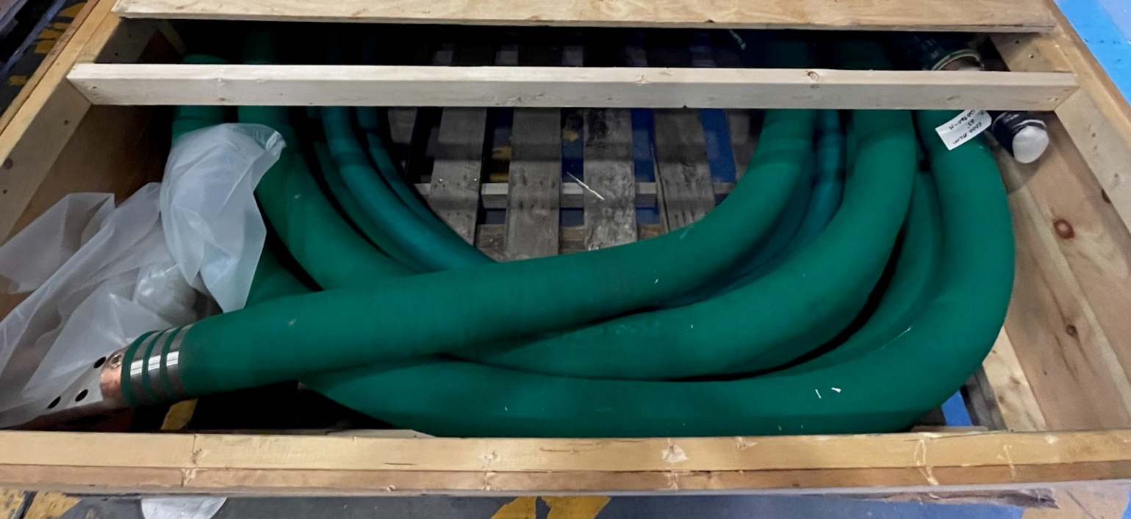
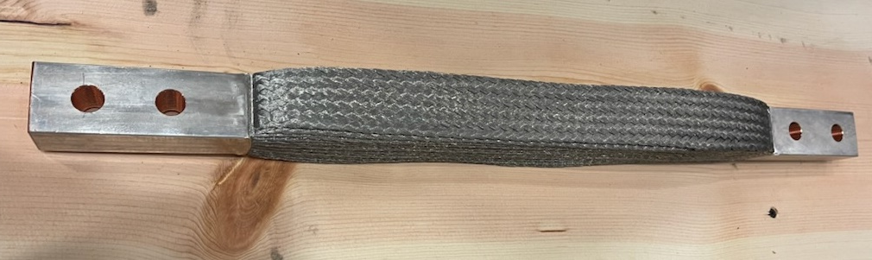
Magnet power supplies, leads and jumpers
TM-0, 1, 2 in Physics Storage
TM-4 (virtual) FAT 7/24/25
WCL – 5000 MCM
3000 MCM flex jumper
1575 MCM flex jumper

Slide 10
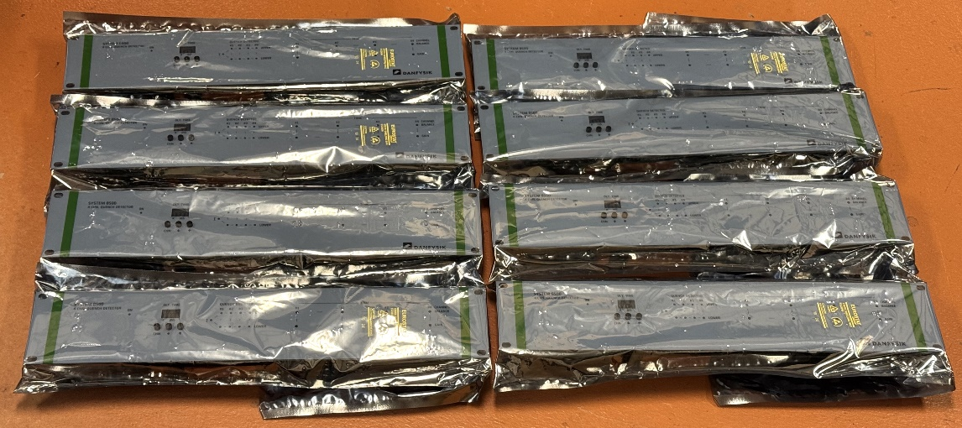
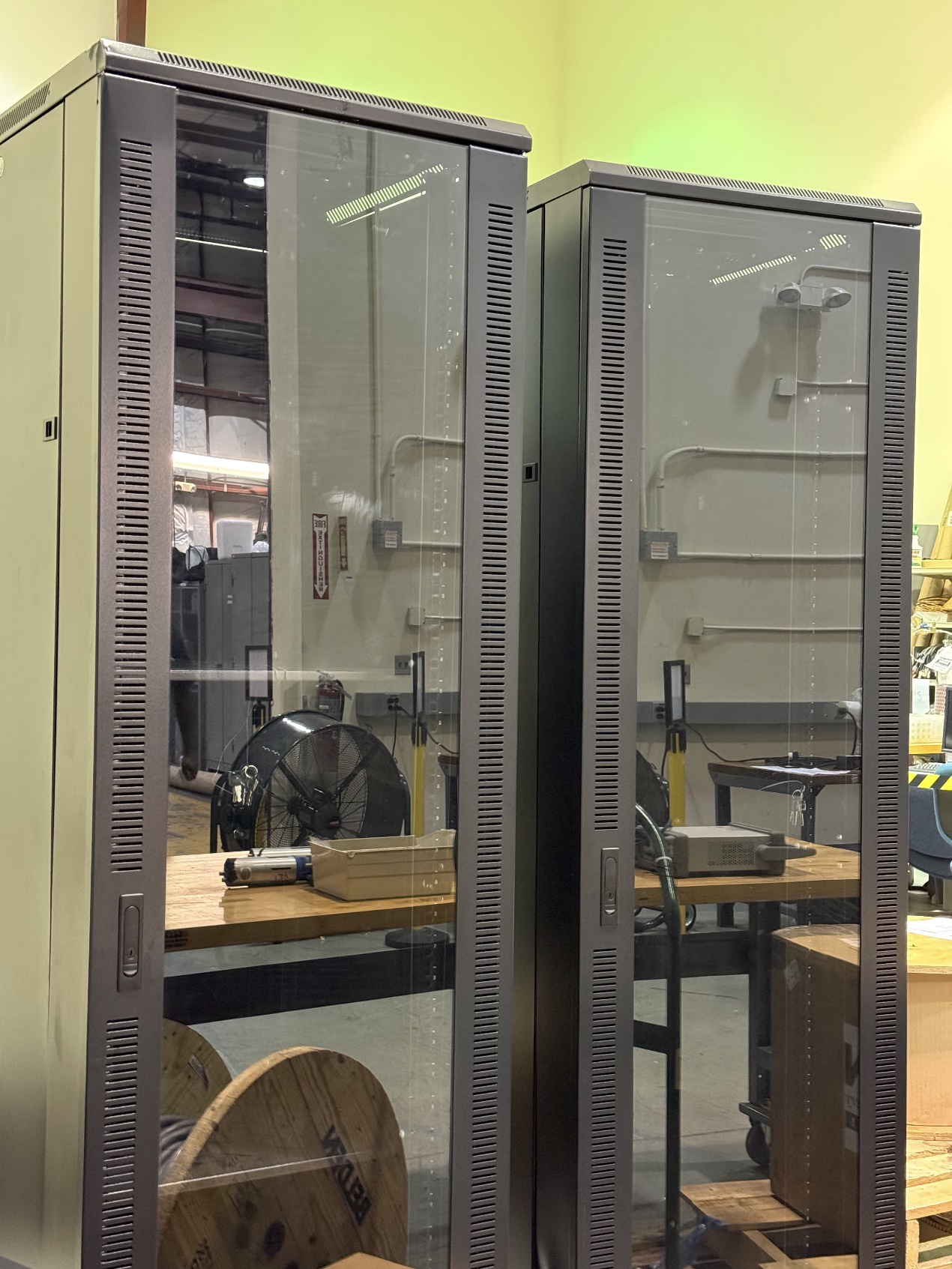
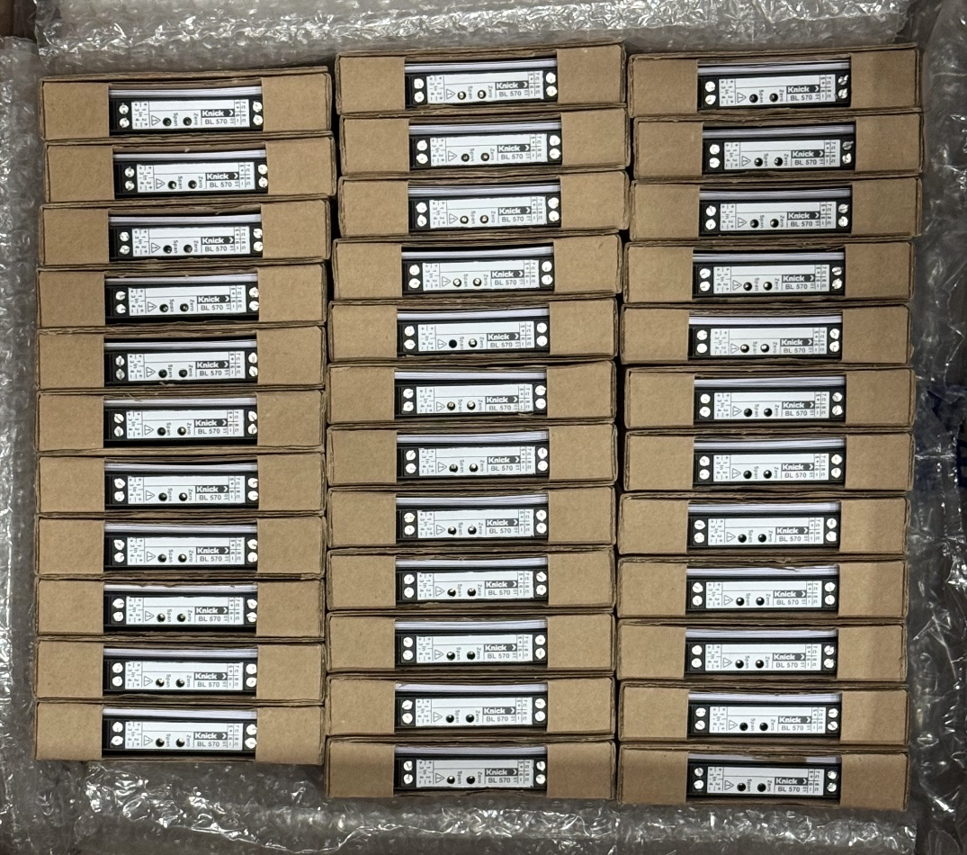
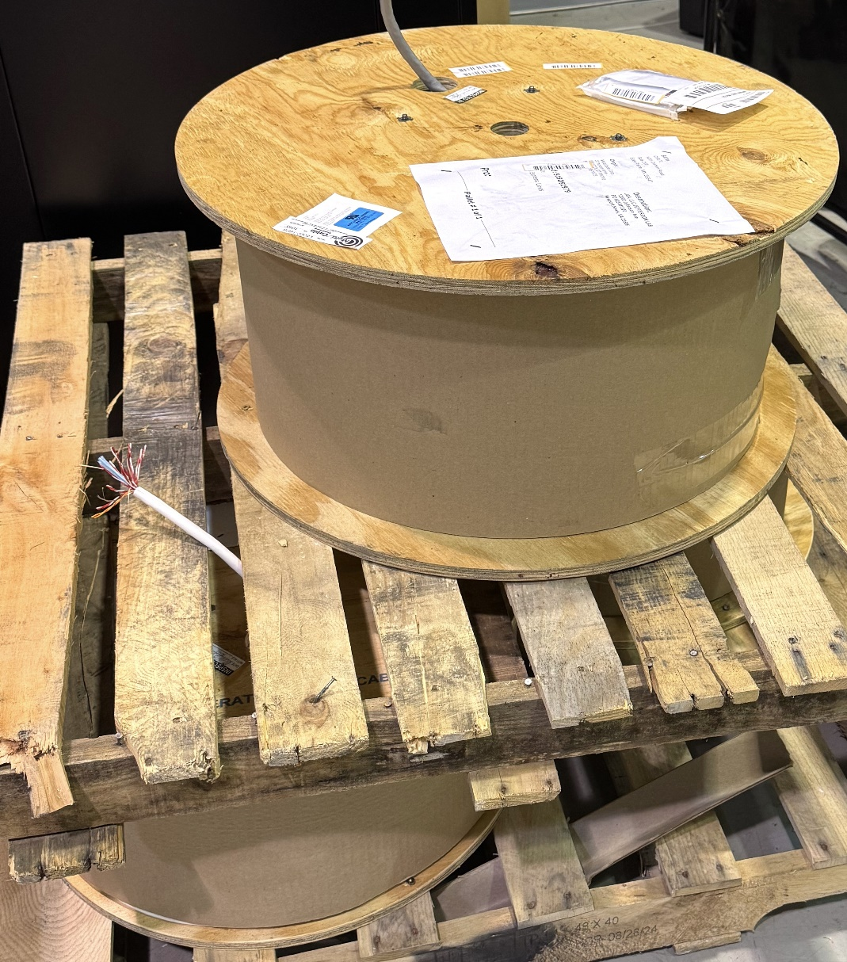
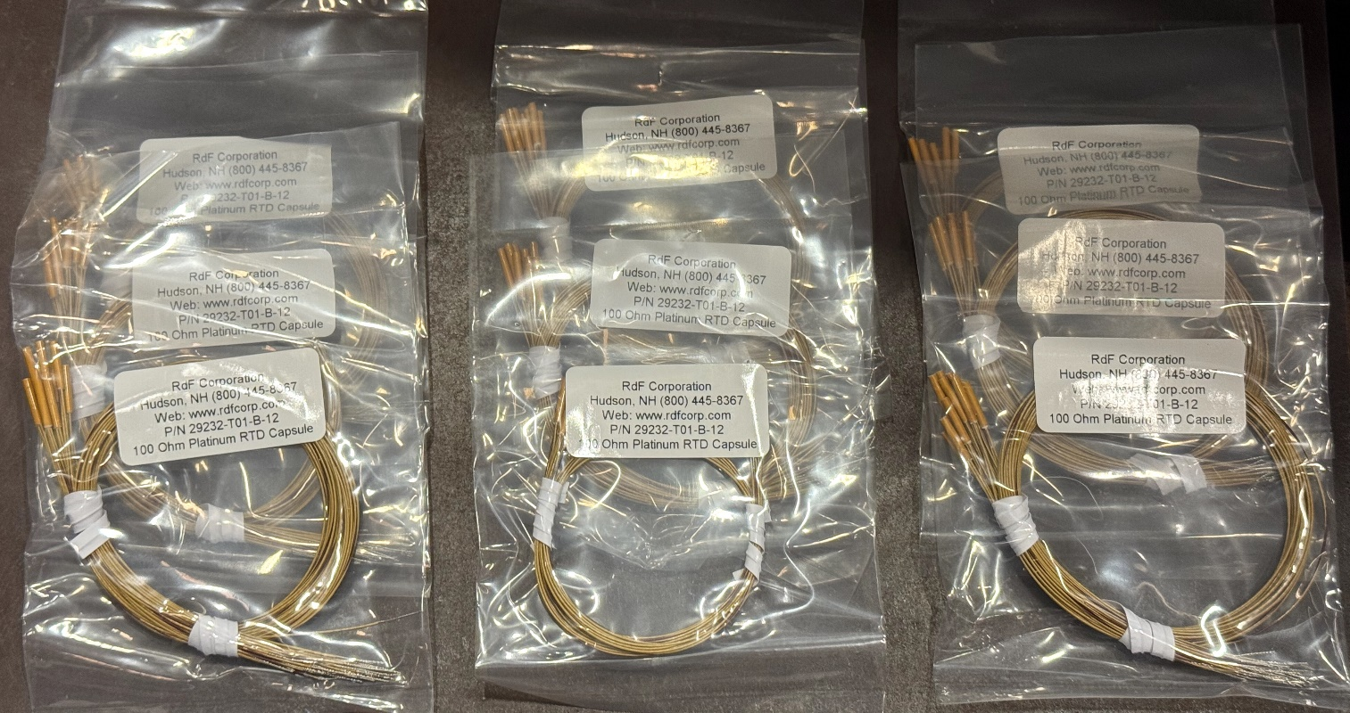
Instrumentation
Spectrometer - All procurements complete including PLC modules and racks, TM cables and connectors, I&C PC, current transducers, RTD, ISO amps, sensors, etc.
Voltage Comparators
Racks
Iso-amps
RTDs
Cable Spools
10

Slide 11
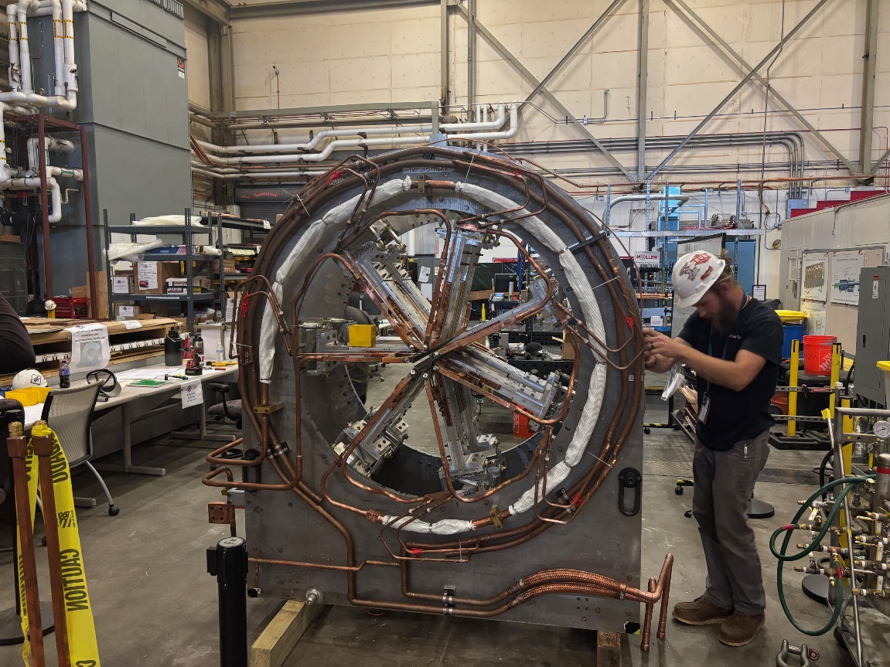
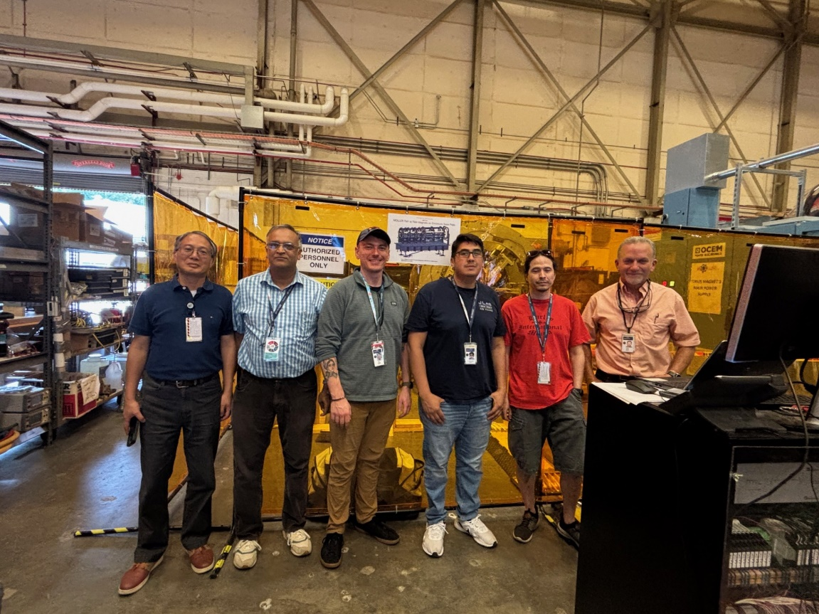
First Magnet(TM3) Powering
Team Prepared for the Moller - First magnet (TM#3) out of 5 energized to 110% of Normal operating current (3710A)
Team - Magnet Group, Detector Support Group, Hall-A

Slide 12
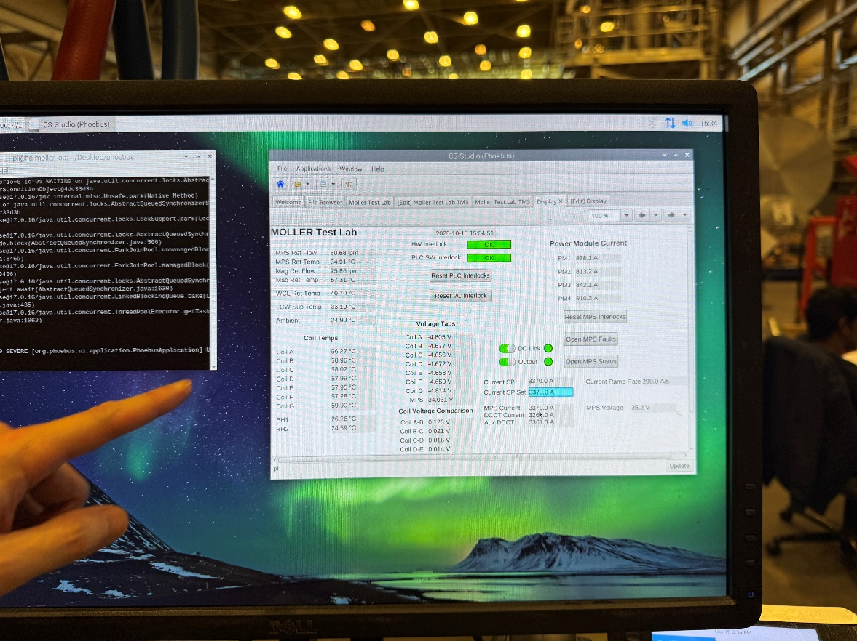
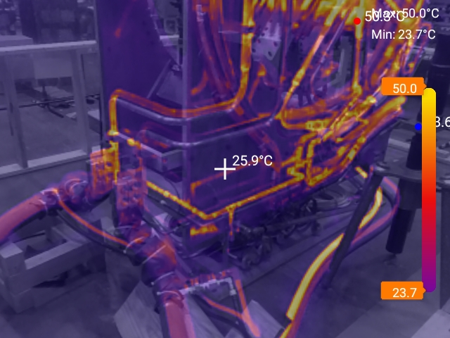
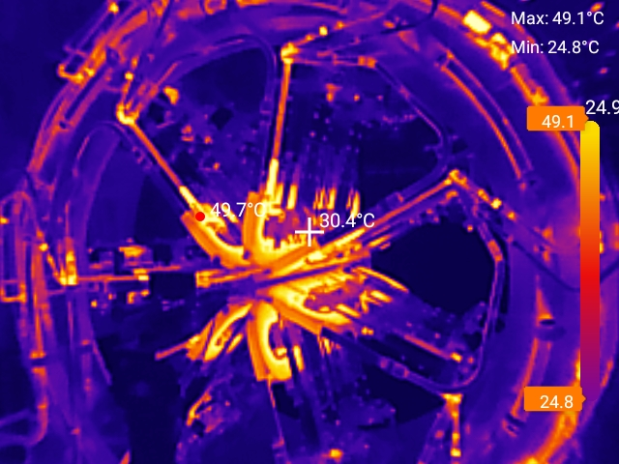
Magnet Powering
Powered to normal and then to 110% of normal Op current and thermal images
Magnet TM#3 thermal images to verify any local hot spots at Normal operating current
Magnet TM#3 reached 110% full field (3710A) and down to normal operating current 3370A and parked for mapping

Slide 13
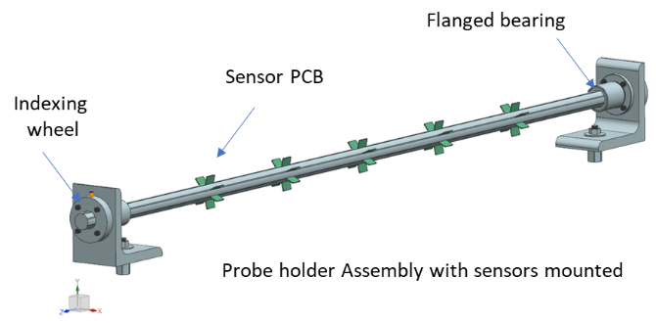
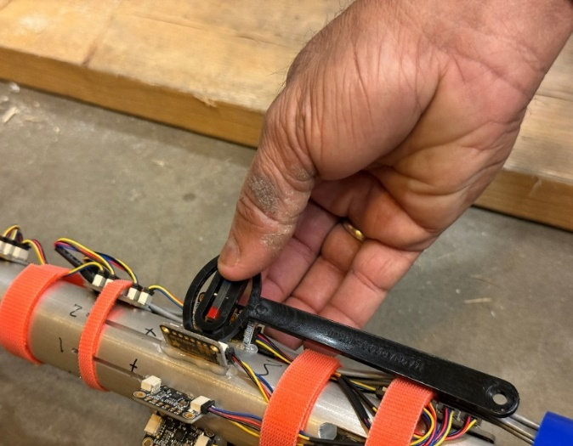
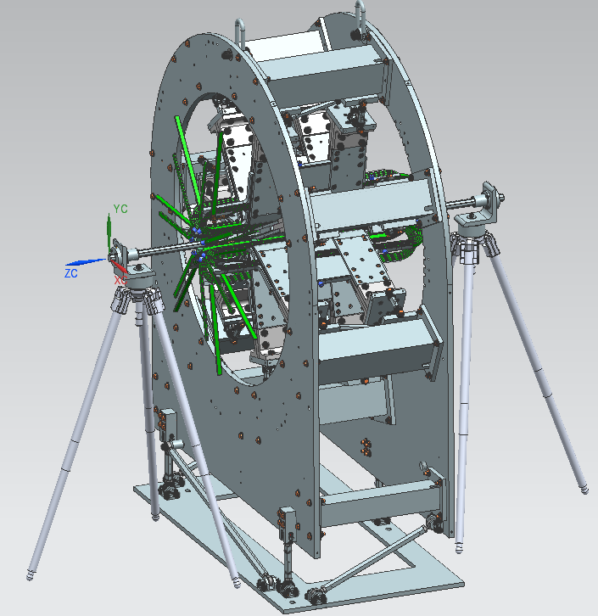
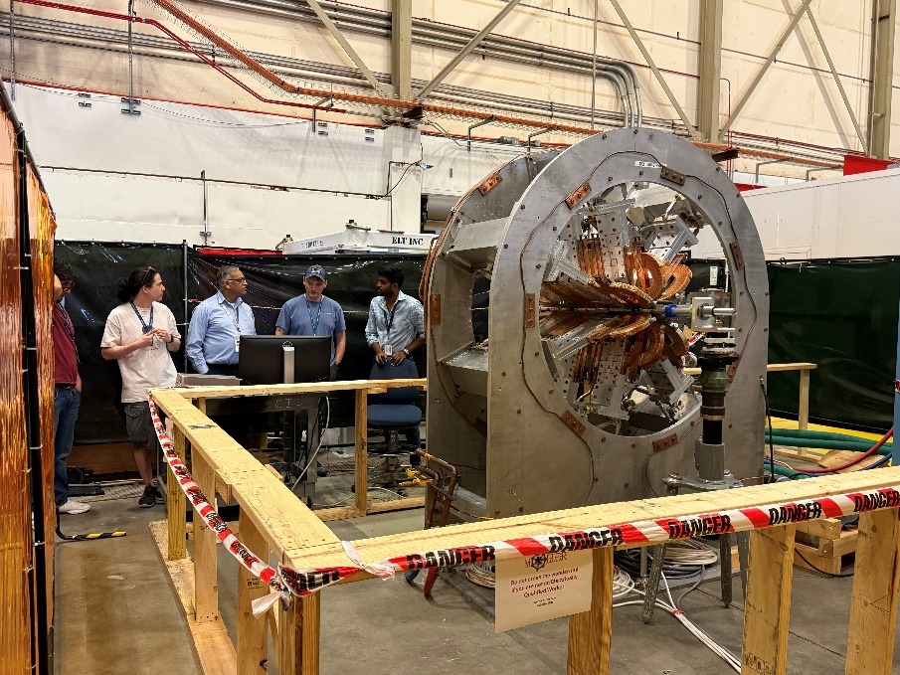
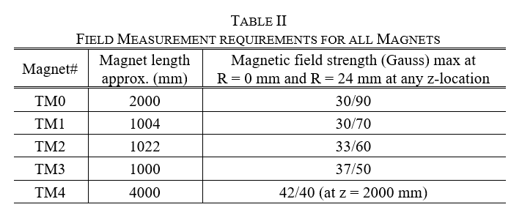
Magnetic Field Mapper
Field Measurement (Mechanics)
Field sensor verification wrt to the field direction
Assembly allows field measurement at a radius of 25mm from the beamline and along the beamline
Al 6061 Probe holder designed to accommodate sensors
  35 sensors for radial measurement
  5 sensors for field measurement along the beamline (between the r=25mm stations)
7 each 5 locations
@25mm
5 locations@0mm
Team setting up the mapper and stability of the magnet

Slide 14
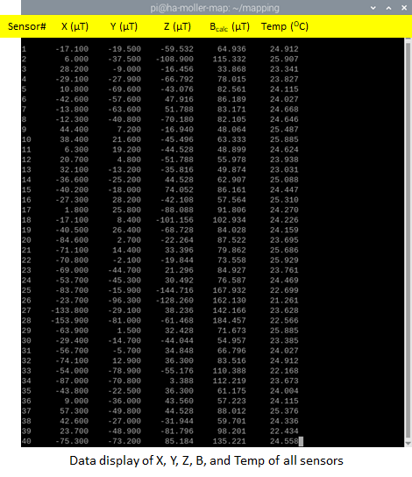
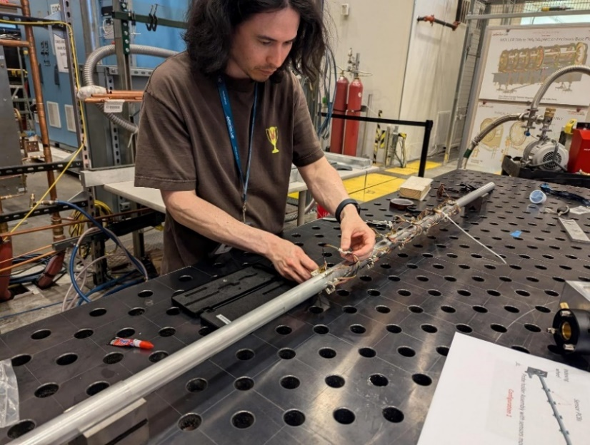
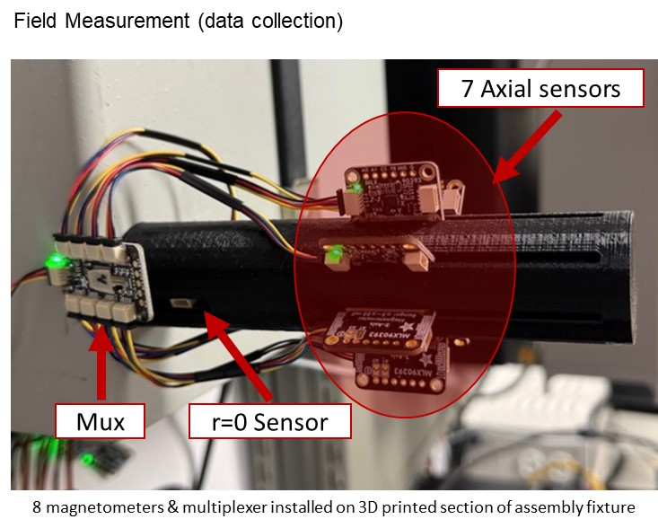
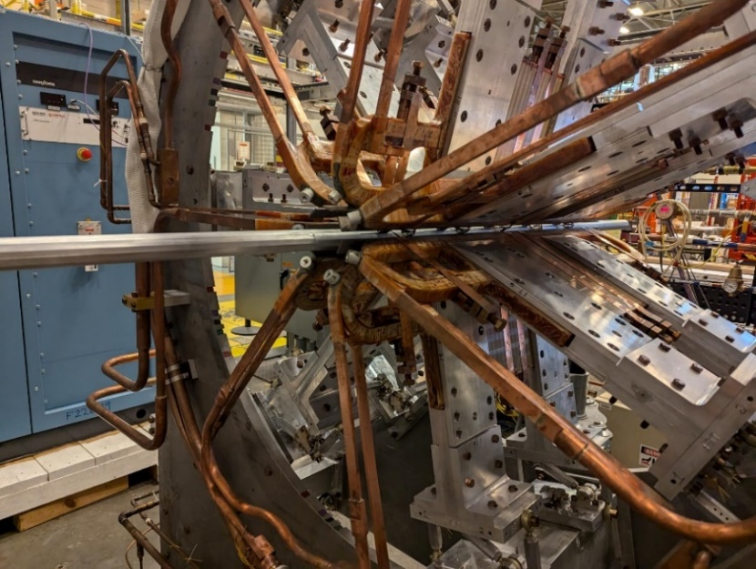
Mapper final assembly and test fit
  Field Mapping Fixture
    Probe holder received and inspected
    Probes installed
    Mapping assembly mechanical dry fit and survey in process

Slide 15
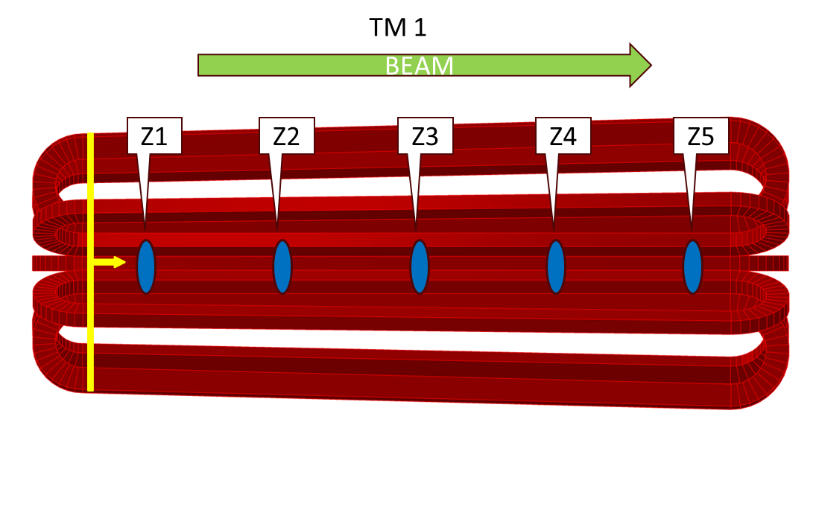
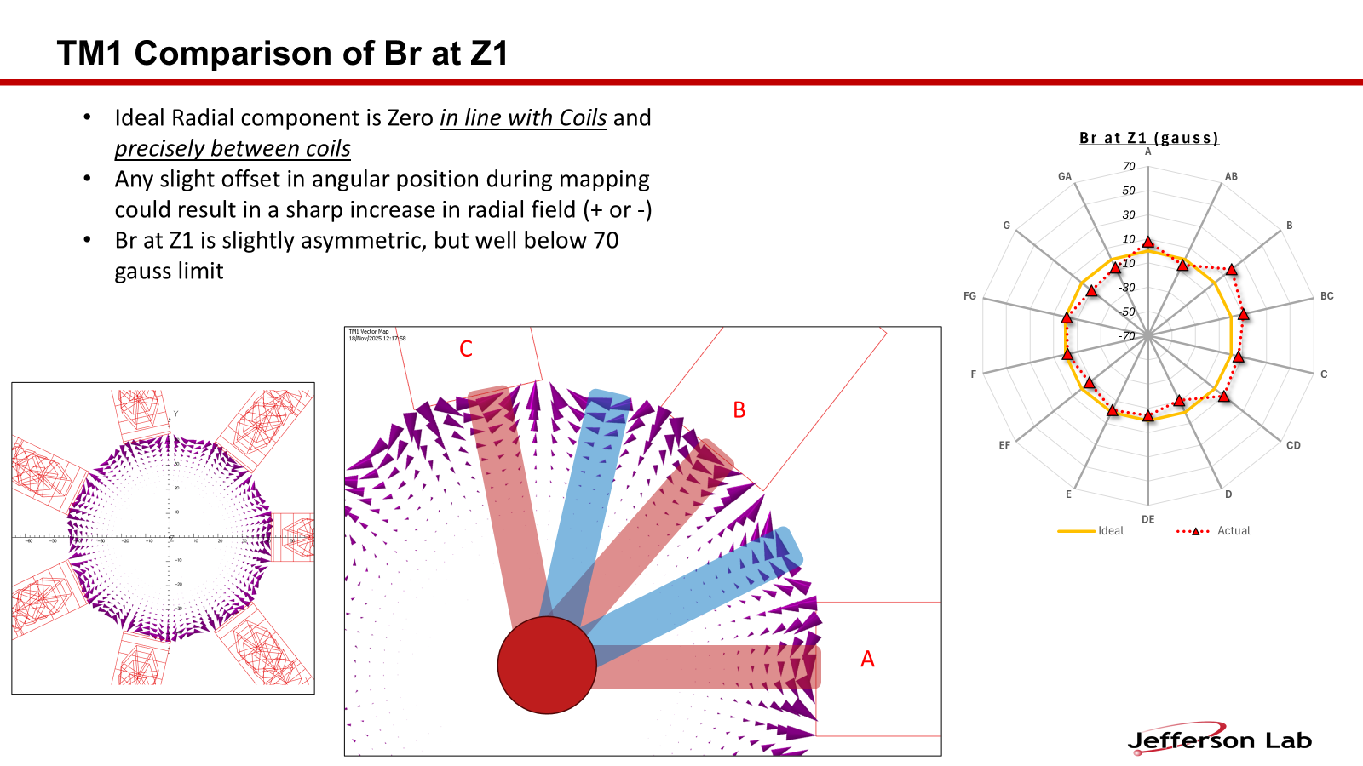
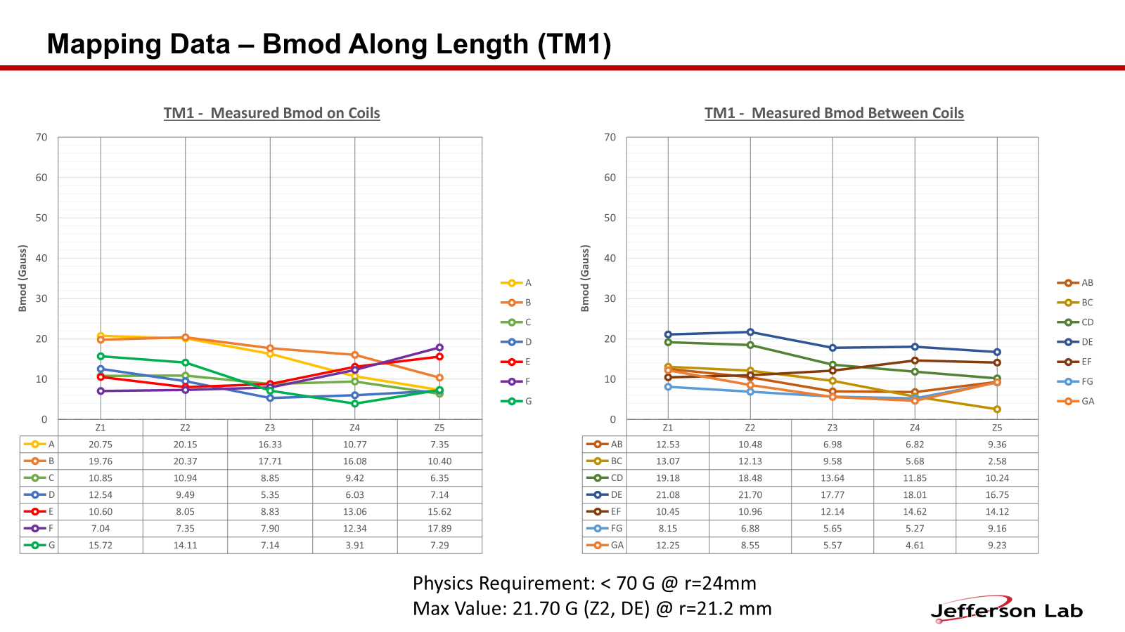
Mapping – Data Analysis
Mapping fixtures alignment and survey - data collection and anslysis for mapping TM3, TM2, and TM1
OPERA simulation and analysis of TM1 to obtain ‘ideal’ field map data and distorted map to evaluate the error bar
Analyzed data from mapping of TM1 to compare with the simulated data
Prepared graphs, tables and presented to the MOLLER collaboration (been reviewed)
Sensors located at approximately r=21.2 mm at five Z-locations.
Z1 is approximately 69.85mm DS from the beginning of the coil curvature
Z2 and following sensors are approximately 165mm further downstream Z2 = 234.95mm, Z3=400.05mm, Z4=565.15mm, Z5=730.25mm
Z location of the R=0 sensors are an average of 64mm downstream of the radial sensors

Slide 16
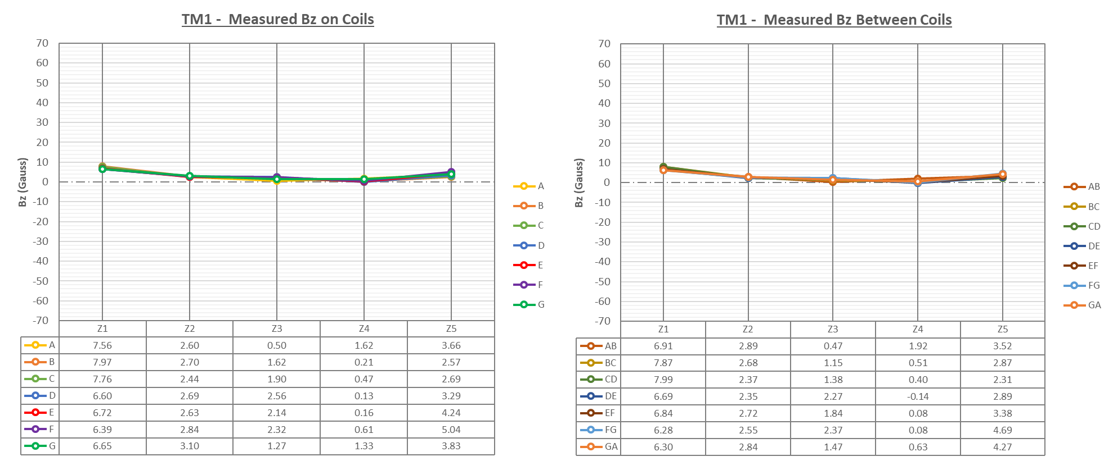
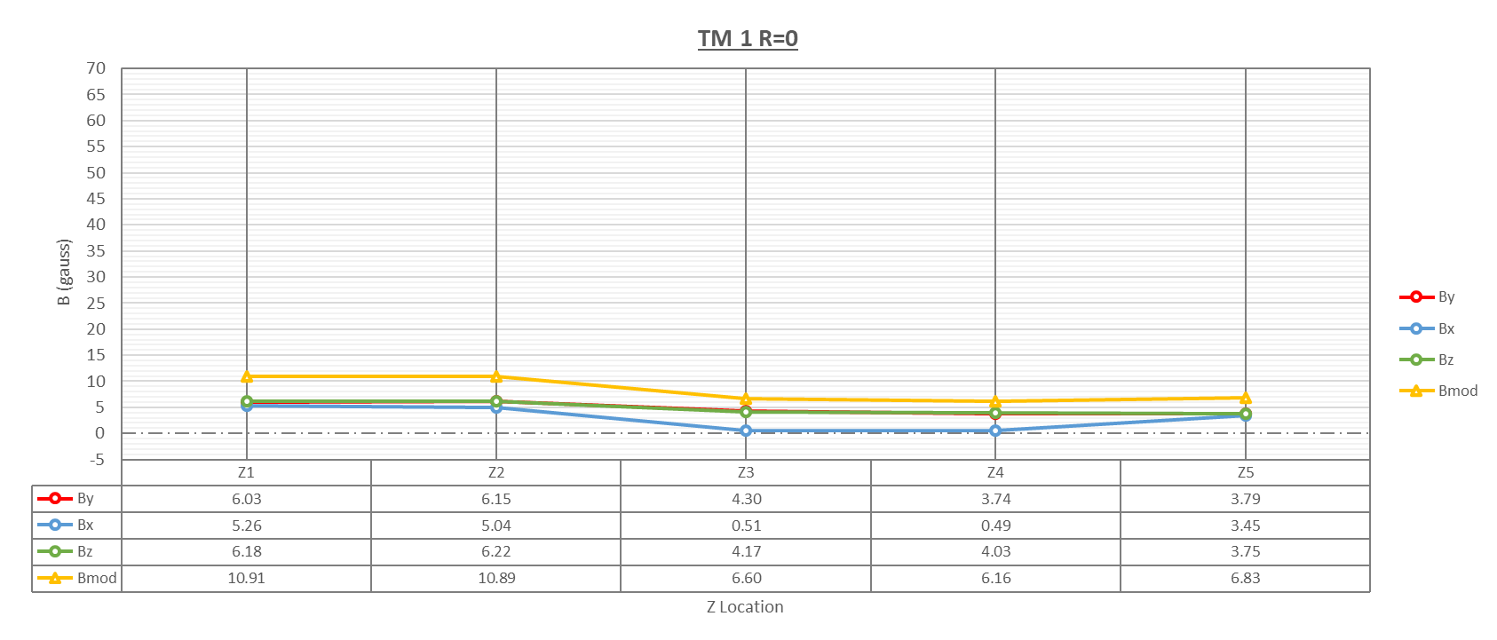
Mapping – Data Analysis…
Mapping Data - B along Coils
Mapping Data – Bz Along Length (TM1)
All values normalized with 0V readings
Plotted vector components of B along each coil and between coils at each Z location
Bz is positive for all coils - Positive or close to zero for all in-between locations
Bphi mostly negative on coils, mostly positive between coils.
This aligns with the ideal case
Max Value: 7.99 gauss (Z1, CD)
In the “Ideal” case, all components equal zero at r=0
Sensor not located at exact r=0
  Real By and Bz values flip signs depending on rotation angle
  Absolute values averaged across rotated readings
Physics Requirement: <30 G Bx or By, ∫B dl < 20 G m
Measured - Bx,By max = 6.22 G, ∫B dl ≈ 10 G m

Slide 17
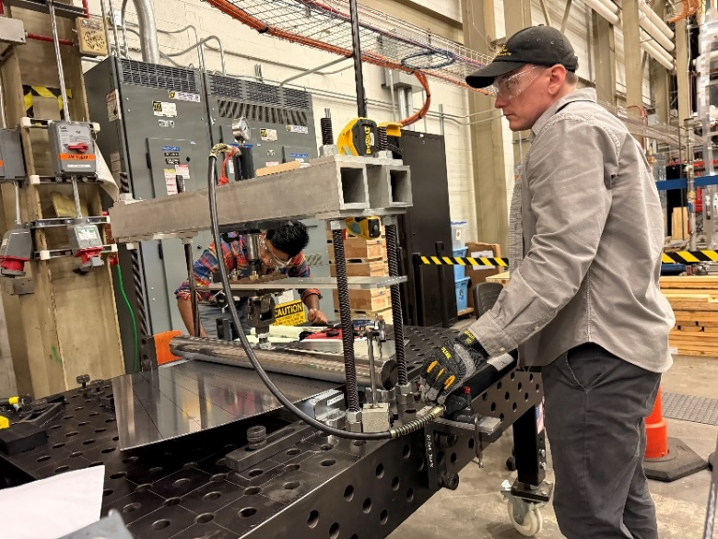
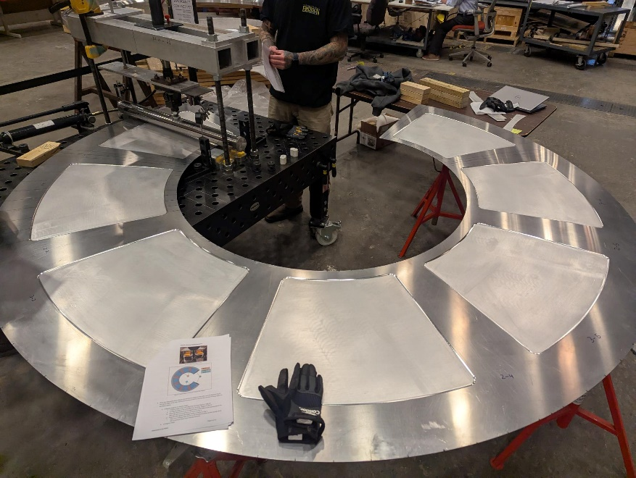
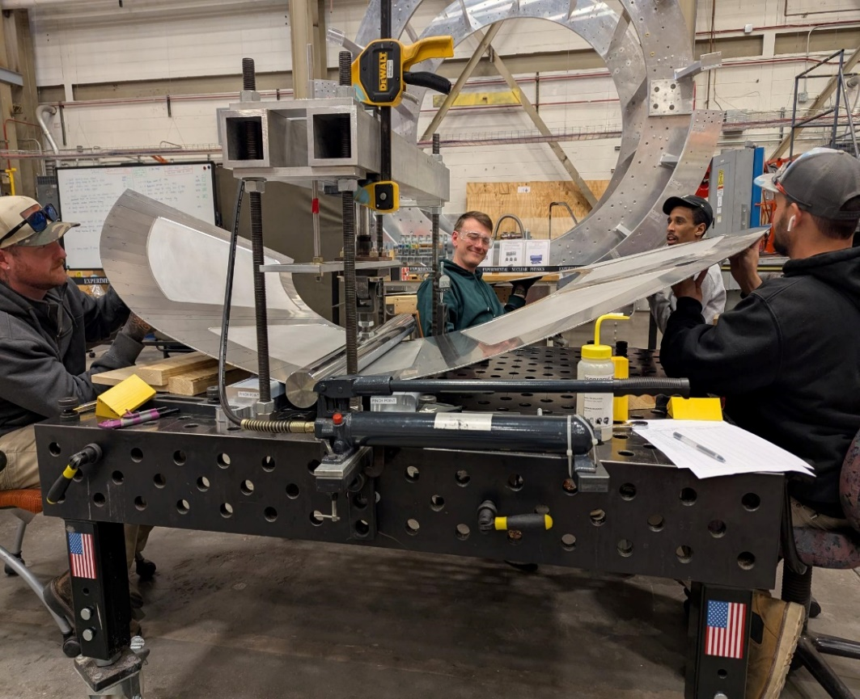
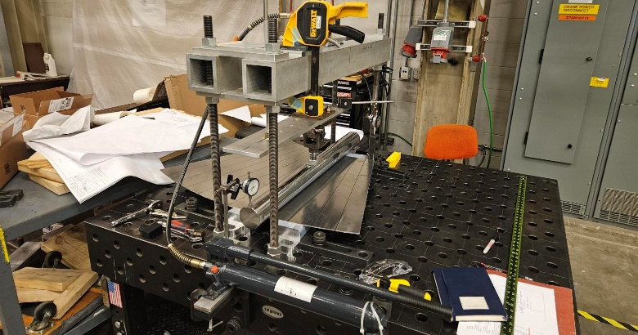
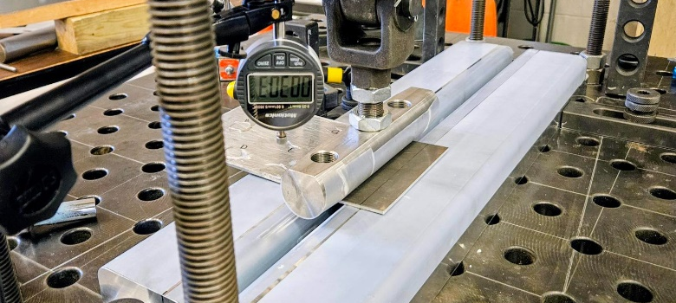
Detector Window - Preparing the forming fixture and forming
Un-formed window
Window forming
  Window Forming - Successfully completed window forming, improved forming fixture
Designed shortened press-bar to form edges of detector window
  Conducted test pressing with short bar to test efficacy of this technique
  In process of revising testing procedure & fleshing out procedure to form full window
  Revised press bar design for detector window forming - to finalize parameters for final production
  Dry fit completed with window seam and outer weld seam completed with Steve D (Hall B)

Slide 18




Detector Window - Aluminum Welding and fitting window nipple
Formed window
Window welded to outer Flange and tacked to inner flange
Pressure test on 12/23/2025
Window Seam weld prep

Slide 19


LCW Distribution & Manifold
LCW
221 gpm 1.33 MW
LCW Distribution

Slide 20



LCW Distribution & Manifold…
Developed procedure for hydro-pneumatic pressure testing of the Magnet LCW Valve manifolds - mitigated by defining the approach boundary for testing based on stored-energy calculations
Successfully completed the test
Model complete for the LCW Distribution Assembly

Slide 21









Beam Pipes and Bellows Received
Bellows 1 and 2
Bellows 3
Bellows 4
Bellows 5
Bellows 7
Beam pipe
All meet specs, have been tested and are ready to install
Detector Pipe with Neckdown window
Drift Pipe
SAM Pipe

Slide 22


US Spectrometer Overview
The US enclosure houses the first toroidal magnet (TM-0) in the MOLLER spectrometer (7 coils in the magnet)
Each resistive coil carries 1075 A, creating a peak field of 0.13 T
The total weight of the US Enclosure with the internal components is approx. 12000 lbs.
The US Enclosure supports experimental equipment, approximately 5000 lbs.
Drawings completed
Lead Wall
Lead Ring
Ordered
Collimator 4
TM0
On-hand
Coils and Frame received
Blocker Sieve
Collimator 1-2
US Enclosure
On-hand
Prototype developed
Drawings completed

Slide 23





US Spectrometer Overview…
TM0 Bulkhead
TM0 Coils
US Girder and Support Weldments
2BS
Collimator Stands

Slide 24




Issues
Resolved
Issue between Z Link Jam Nut and Bracket Bolts
Resolved
TM4 header repair
Resolved
Resolved
Interference between Collimator 6A DS and Mid Clamp Brackets
Tungsten Machining

Slide 25




DS Enclosure
Pumpdown in NOV 2025
Spool piece removed
Leak at weld
New spool piece

Slide 26



Test lab/MOLLER Magnet Assembly and test area – With Moller Spectrometer team. Glenn Youngkin, Chris Wright, Paul Mantica, Krishna Kumar, David Dean, Jens Dilling during DOE Secretary visit to JLAB

Slide 27
Summary
TM 1-4 magnets assembled
  All flow circuits hydrostatically tested
LCW manifold complete and tested
All power supplies received and tested
TM 1-3 magnetic field mapping complete
  All values acceptable
Detector window assembly complete
  Pressure testing in progress
US Spectrometer design & procurement progressing
Ongoing SAM pipe installation in Hall A

Slide 28




Thank you!

Slide 29
backup

Slide 30


Jefferson Lab MAGNET GROUP
Aug 5th, 2025
 | Moller | Test Lab with Spectrometer team
Leak Test of Water/Buss and Pressure Test of TM1
Leak Test of Water/Buss Assembly
Pressure tested to 390 psi

Slide 31



Jefferson Lab MAGNET GROUP
April 8th, 2025
 | Moller | Magnet Grp, Engineering, Assembly team
Loading Six TM1 Coils and Three TM2 Coils into their Frames
Loading TM1 coil
Six TM1 Coils
Three TM2 Coils

Slide 32


Jefferson Lab MAGNET GROUP
Aug 5th, 2025
 | Moller | Magnet Grp
All Models Complete for the Moller Hall A LCW Distribution System Rubber Tubing
LCW Model modified for MPS Supply with added relief valve and updated pressure regulating valve (July 2025 Revised)

Slide 33


Jefferson Lab MAGNET GROUP
Aug 5th, 2025
 | Moller | Magnet Grp, DSG
Updated for MPS Supply Relief
Updated for MPS #4 Closed Loop Glycol Cooler
LCW Model modified for MPS Supply with added relief valve and updated pressure regulating valve (July 2025 Revised)

Slide 34


Jefferson Lab MAGNET GROUP
Aug 5th, 2025
 | Moller – TM4 Collimator 6A | Magnet Grp, DSG
Path Forward (Option 4) for Collimator 6A Interference
Unload only one TM4 coil to create space to uninstall all 6a DS collimators
Machine off 0.12”x0.35”x3.0” notches on the 6a DS collimators
Reinstall collimators
Load the unloaded TM4 coil
Risk: Low
0.0103” Interference at all Collimator 6A-DS locations with the Mid-Clamp on TM4 Coils
Closeup of Collimator interference with adjacent Mid-Clamp. The interference is 0.0103” in ideal position, and the minimum distance between the top of the Mid-Clamp is also approximately 0.0174”.
Ideally both edges would be removed to provide >0.03” of clearance to provide adjustability for the Survey team. Care should be taken to avoid damaging Collimator 6A-DS, 6A-US , or the belly plate of the coil.
MOLLER Spectrometer team is working with – PM, CAM, L2 Tech and L2 Physics

Slide 35


Jefferson Lab MAGNET GROUP
Jan 13th 2026
Detector Window (Cont’d) | First try alignment better than 0.5mm in all directions
Window to Flange Welding Started
11-24-2025
    First try alignment better than 0.5mm in all directions, verified by Survey and Alignment crew!
Pressure test on 12/23/2025

Slide 36


