Slide 1
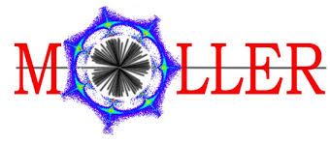

Møller Polarimetry for MOLLER
Addison Arcuri, Wednesday January 21 2026
Hall A Collaboration Winter Meeting

Slide 2
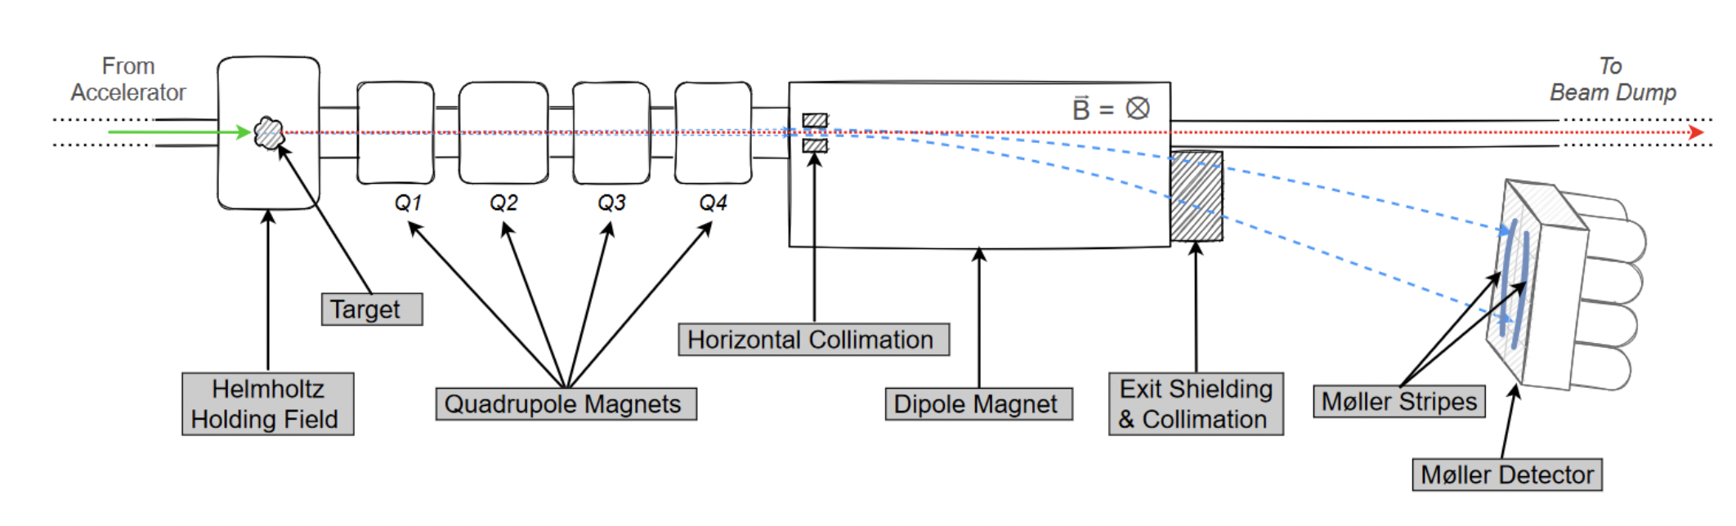
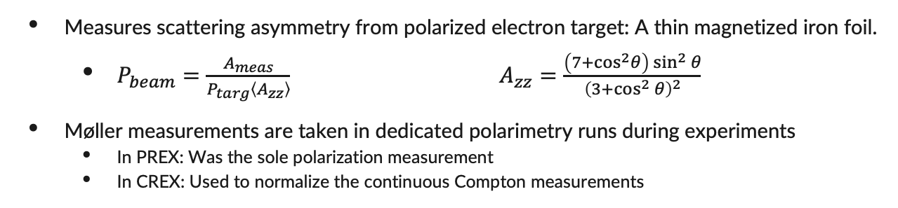
Background: The Hall A Møller Polarimeter
Measures scattering asymmetry from polarized electron target: A thin magnetized iron foil.
  $P_{beam}=\frac{A_{meas}}{P_{targ}\left\langle A_{zz}\right\rangle } A_{zz}=\frac{\left(7+cos^{2}θ\right)\sin^{2}{θ}}{{\left(3+\cos^{2}{θ}\right)}^{2}}$
Møller measurements are taken in dedicated polarimetry runs during experiments
  In PREX: Was the sole polarization measurement
  In CREX: Used to normalize the continuous Compton measurements
Fig. 1: Hall A Møller polarimeter beamline & detectors, with basic coincidence logic.
Notes:
The Hall A Møller polarimeter measures scattering asymmetry from polarized electron target: A thin magnetized iron foil.
Beam pol is function of measured asymmetry, known target polarization, and angle averaged analyzing power Azz
Angle averaged Azz is determined from Azz formula via well-characterized Monte Carlo simulations
Diagram: Passes the target, defocus and focus mags, collimators, detectors. Two side b side blocks of 4. Møller stripes. L/R sums, Coincidences. Accidentals use delayed line to get real time measure of coincidences from backgrounds.
Møller measurements are taken in dedicated polarimetry runs during experiments, not continuously like the Compton measurements
In PREX: Møller polarimetry was the sole polarization measurement
In CREX: It was used to normalize the continuous Compton measurements

Slide 3
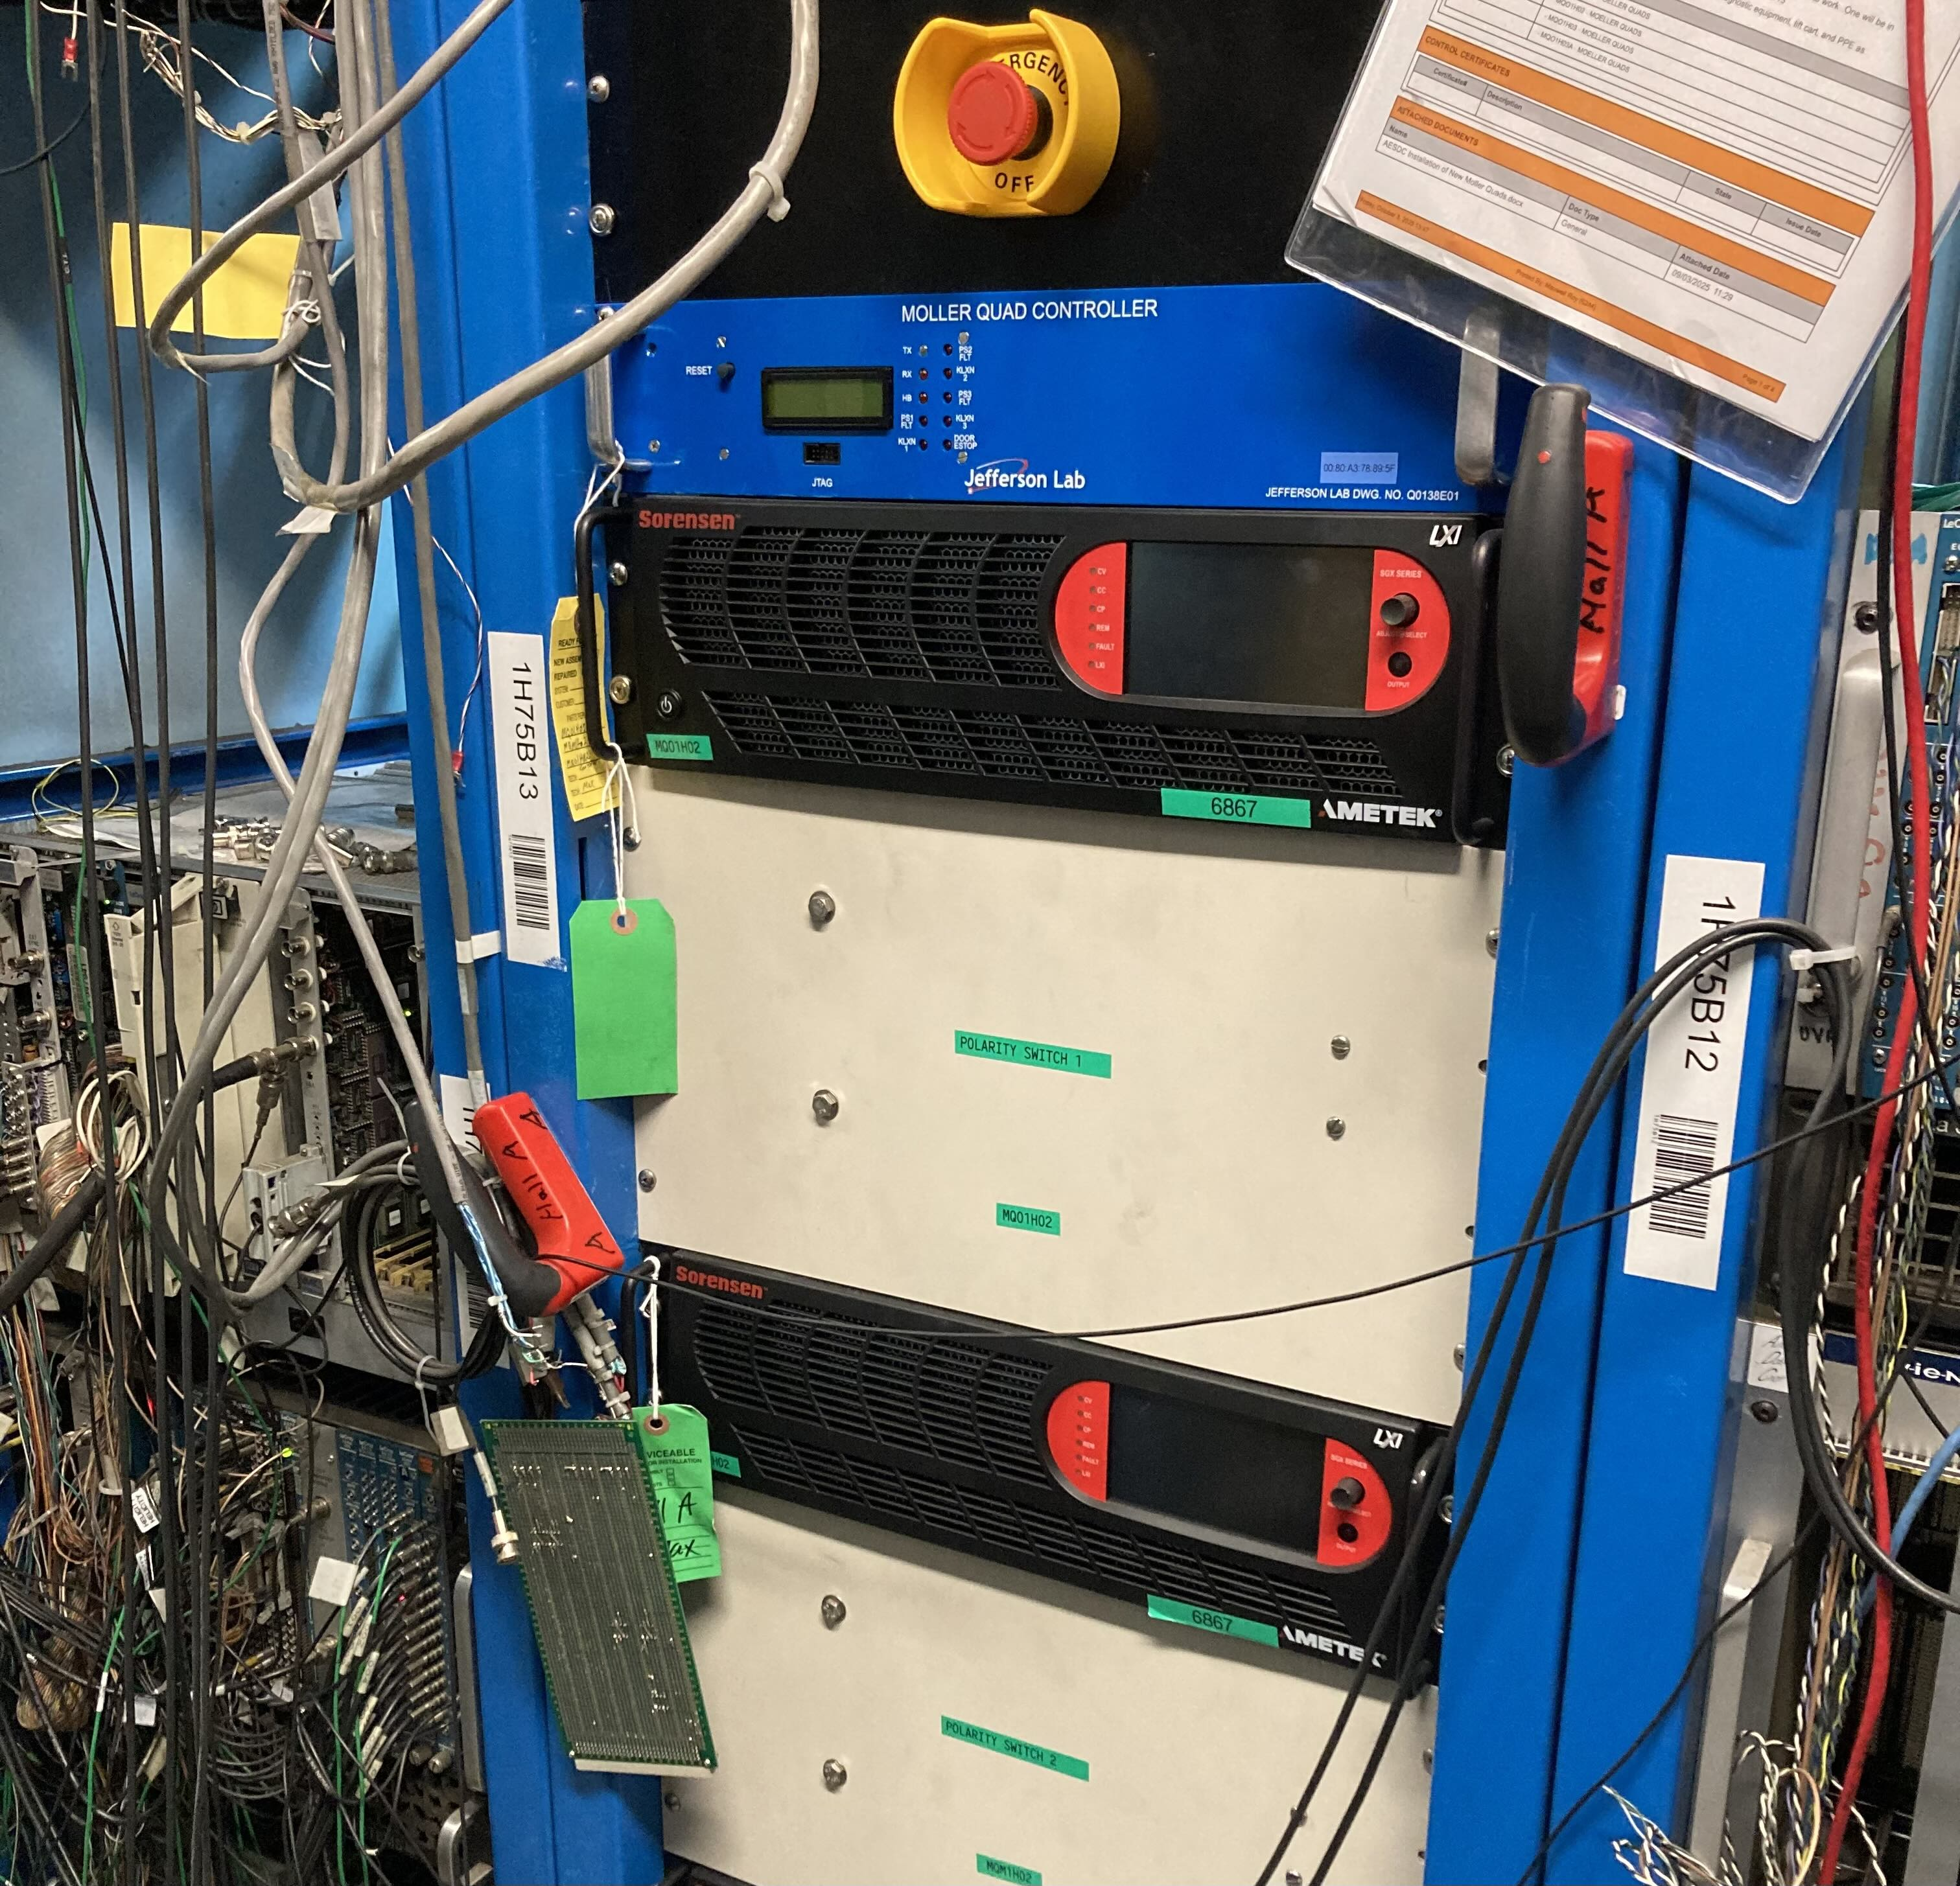
Hardware: Power Supplies + Magnets
Final SBS runs taken over the summer saw stability issues with the quadrupole and dipole power supplies.
New power supplies have been ordered for all 4 quadrupoles, and 3 have been installed. All will be installed in time for MOLLER.
A new dipole power supply has not been ordered
Existing unit can reach 480 A (11 GeV) but struggles to reach 550 A specified by upper end of hysteresis loop
Should not be a problem to drop upper end of hysteresis loop to 520 A.
Notes:
SBS concluded by August 2025. The down period has allowed for hardware changes in preparation for MOLLER
Final SBS runs taken over the summer saw stability issues with the quadrupole and dipole power supplies.
New power supplies have been ordered for all 4 quadrupoles, and 3 have been installed. All will be installed in time for MOLLER.
A new dipole power supply has not been ordered
Existing unit can reach 480 A (11 GeV) but struggles to reach 550 A specified by upper end of hysteresis loop
Should not be a problem to drop upper end of hysteresis loop to 520 A.

Slide 4
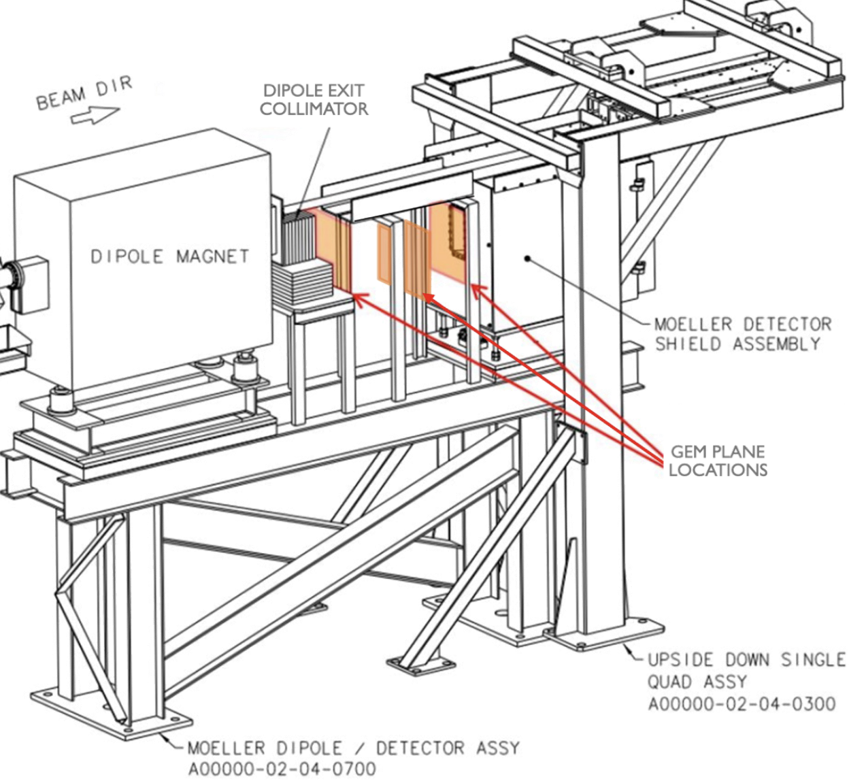
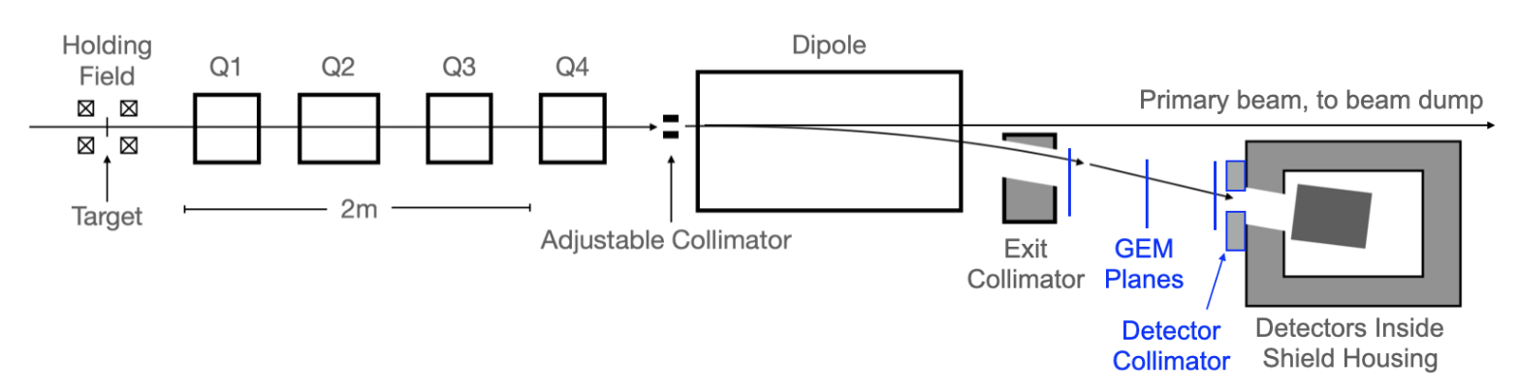
New Hardware: GEMs and Collimator
GEM detectors for particle tracking will be installed between the exit collimator and the main calorimeter
GEM construction & testing completed summer 2025 at UVa
Delivery from UVa & installation of GEMs is pending
DAQ and analysis will be led by Syracuse University group
Detector collimator built; not yet installed
  Limits vertical acceptance to reduce Levchuk Effect issues
Above: GEMs and GEM rack schematic.
Left: Polarimeter beam line with new GEM and collimator locations highlighted in blue.
Notes:
For MOLLER, GEM detectors will be installed between the exit collimator and the main calorimeter to allow for particle tracking
The new elements are highlighted in blue in this updated beamline diagram, and is shown in orange on the schematic at right
GEM construction & testing completed last year at UVa
Delivery & installation of GEMs is pending
DAQ integration will follow
Analysis will be Syracuse University group
New tungsten collimator has been built; not yet installed
This is also highlighted in blue, immediately in front of the detector assembly
Will limit vertical acceptance, cutting down on the Levchuk effect

Slide 5
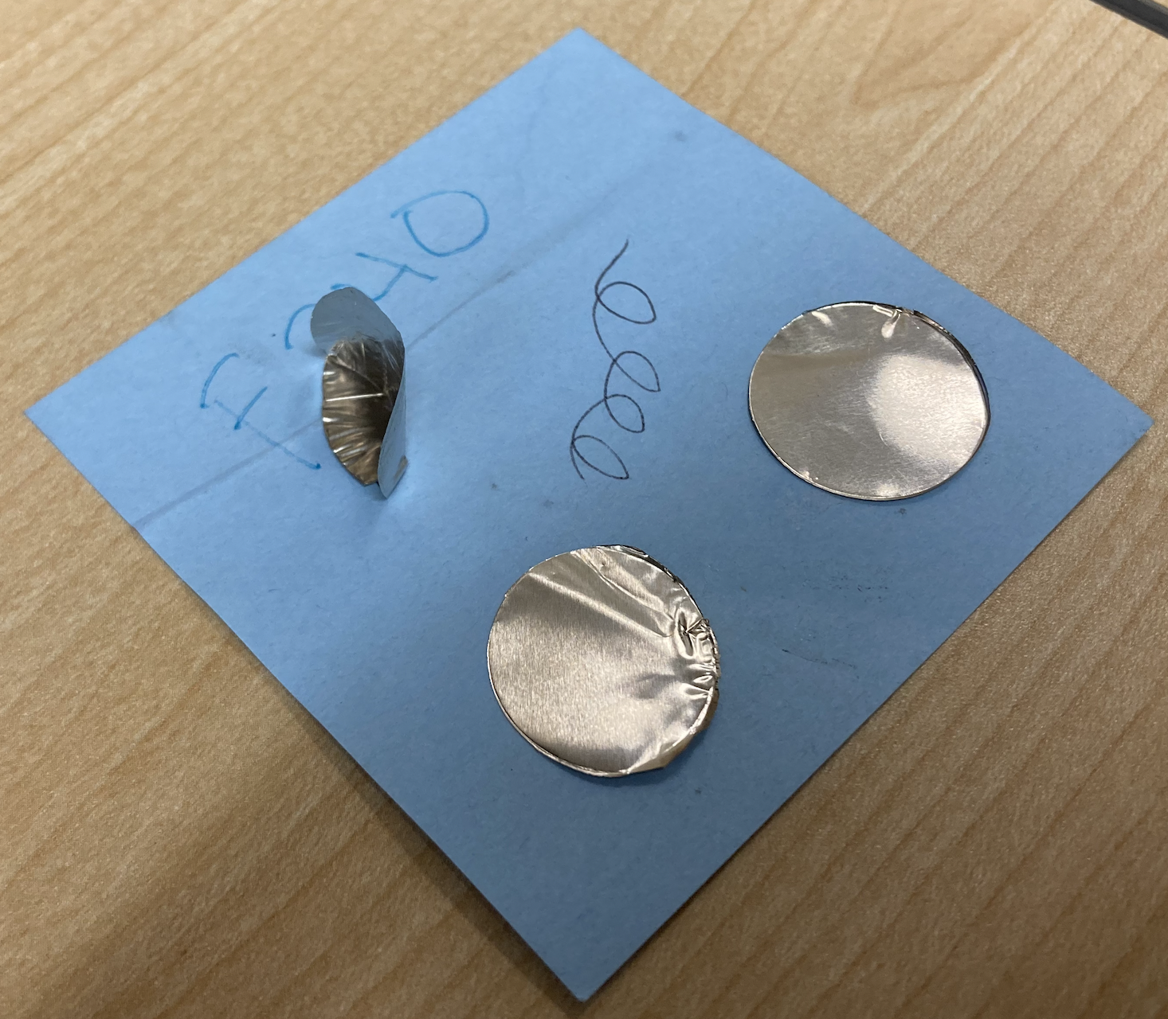
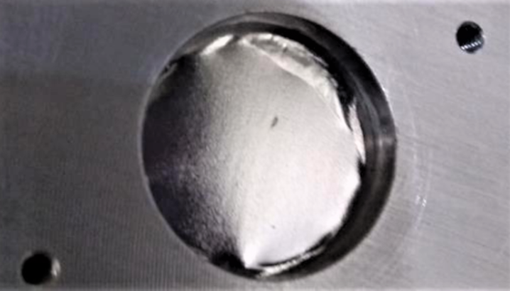
Hardware: Targets
Target position to be moved upstream 30 cm
  Reduces Levchuk Effect issues
  Allows natural drift; less quad defocusing needed
  Keeps us in linear-response region for quad magnets
Currently developing precise mounting procedure for target foils:
  Small deviations from field normal impede proper saturation of target foils.
  Most methods of stamping out and mounting 10–25 µm foils warp them or create wrinkles.
  Warping was issue in previous experiments, causing ~1% deviation in analyzing power.
Foils stamped out by various methods
A PREX target foil with problematic wrinkling near the edges
Notes:
Target position to be moved upstream 30 cm
Reduces Levchuk Effect issues
Allows natural drift; less quad defocusing needed
Keeps us in linear-response region for quad magnets
Currently developing precise mounting procedure for target foils:
Small deviations from field normal impede proper saturation of target foils.
Most methods of stamping out and mounting 10–25 µm foils warp them or create wrinkles.
Warping of foils was issue during previous experiments PREX & CREX, causing 1% deviation in analyzing power.
Even the PREX foil pictured here was warped enough to cause issues

Slide 6
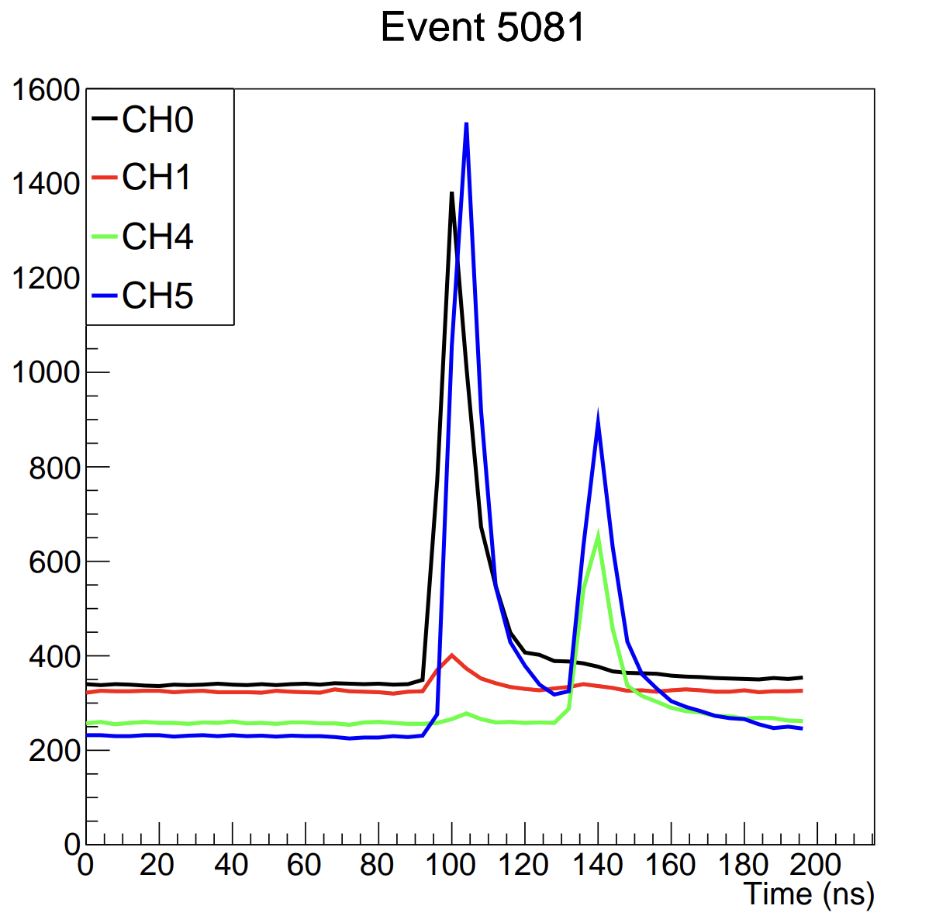
New Hardware: New DAQ
While we will use the polarimeter’s old NIM/CAMAC counting DAQ for MOLLER, it will be supplemental to a new DAQ.
FADC-based DAQ developed by Hanjie & Zhongling reads out waveforms and creates coincidence counts in software.
We will need to develop a new analyzer & decoder for this system
Emulator Dead Time and Accidental studies to be conducted on the new DAQ after conclusion of old DAQ studies
At right: An example of waveform readout from the new DAQ. Pictured is a pileup event.
Notes:
While we plan to use the polarimeter’s old NIM/CAMAC counting DAQ for MOLLER, it will be supplemental to and a check on a new DAQ.
This new FADC-based DAQ developed by Hanjie & Zhongling reads out waveforms and forms coincidences in software.
We will need to develop a new analyzer for this system
Dead Time and Accidental studies using the emulator will be conducted on the new DAQ after the conclusion of studies on the old DAQ.
At right: An example of waveform readout from the new DAQ. Pictured is a pileup event. This waveform info is something that we do not have with the previous system, its output is scaler counters.

Slide 7
Møller Polarimetry Systematics
Problem | CREX (%) | MOLLER Goal (%)
Foil Saturation Polarization | 0.28 | 0.24
Foil Degree of Saturation | 0.50 | 0.10
Azz + Levchuk | 0.16 | 0.15
Radiative Corrections | — | 0.10?
Dead Time | 0.15 | 0.10
Accidentals | 0.04 | 0.10
Current Dependence | 0.50 | 0.15
Aperture Transmission | 0.10 | 0.10
Null Asymmetry | 0.22 | 0.10
Electron Source Variation | 0.06 | 0.02
Leakage Currents | 0.18 | 0.10
Overall | 0.85 | 0.42
Foil Saturation Polarization is global knowledge of iron saturation.
A_{zz}+Levchuk improvements previously mentioned
Current Dependence and Aperture Transmission will require dedicated studies during MOLLER
Null Asymmetry, Electron Source Variation, and Leakage Currents will be measured during MOLLER runs
Foil Degree of Saturation, Radiative Corrections, Dead Time, and Accidentals have ongoing or planned pre-MOLLER studies.
Notes:
Foil Saturation Polarization: Limited by global knowledge of the saturation curve of iron.
A_zz + Levchuk: A_zz is accuracy of simulations used to determine <A_zz> over acceptance. Levchuk refers to the uncertainties in the iron wavefunctions used to account for the Levchuk effect, which refers to the wider angular momentum distribution for unpolarized inner orbital iron electrons. Since the polarimeter has a finite acceptance, the unpolarized electrons in the momentum “tails” are more likely to be cut off by the limited acceptance, which has the effect of increasing the analyzing power.
Current Dependence: For higher beam current more laser is needed on photocathode. This causes greater heating, which could in principle change the strain in the strained GaAs superlattice. This could change the polarization of the output electrons. This uncertainty is currently dependent on a 2007 test.
Aperture Transmission: Reducing leakage currents sometimes requires narrowing the “main aperture in the source” to limit the effect. This aperture reduction could introduce uncertainty if there is a polarization gradient on the electron pulses. This has not been observed. The uncertainty is the size of the error on that test.
Null Asymmetry: Null asymmetry measurements are used to monitor for helicity-correlated beam properties unrelated to polarization. Pure copper foil target is used. Uncertainty represents upper bound (meas at 0.12±0.10 for 0.22 uncert for CREX).
Electron Source Variation: Pockels cell.
Leakage Currents: Laser alternates pulses for each of the 3 halls ABC in turn, generating electron bunches for each of the 3. Time between pulses is much longer than the pulses themselves, but there is low-level residual light (and therefore current) after the end of each planned bunch. Given the low current of a Mol pol run these residual currents that leak through from the previous hall bunches are not negligible.
Foil Degree of Saturation: Incomplete saturation of the iron foil. Estimate of incomplete polarization caused by foil misalignment from field normal.
Dead Time: Dead time of the DAQ can result in a false asymmetry
Accidentals: A real-time measure of uncorrelated background events.

Slide 8
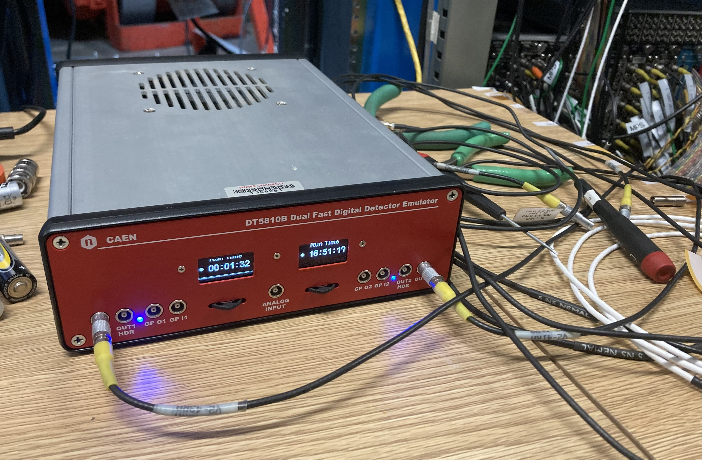
Systematic Uncertainties: Dead Time + Accidentals
“Accidental” coincidences are measured by AND-ing delayed left signal with right.
Dead time correction factor is e^{R𝜏} times detection rate, where 𝜏 is a dead time constant. Previously 𝜏 = 15.7 ns from LED tests was used.
Don Jones, Eric King, and myself have conducted studies using a detector emulator.
  2 output channels. An internal channel can inject coincident pulses into the two physical output channels
  Pulse shape, amplitude, and frequency are tunable, and either constant or Poisson distributed pulses can be output at a given frequency.
Above: The CAEN DT 5810B detector emulator in use. Input lines connect to DAQ at the FIFO the detector feeds into.
Notes:
In the old DAQ “accidental” coincidences are measured by AND-ing a delayed left signal with an undelayed right to provide a measure of accidental coincidence counts from background events. The accidental rate is subtracted from the measured coincidence rate when calculating the asymmetry.
Dead time is corrected by applying an e^{R𝜏} factor to the measured coincidence rate, where 𝜏 is a dead time constant of the DAQ. Previously 𝜏 = 15.7 ns value from LED tests was used.
Don Jones, Eric King, and myself have conducted Dead Time and Accidental studies on the old DAQ over the past several weeks using a CAEN detector emulator.
The emulator has two independent output channels and a third internal channel which can inject coincident pulses into the two physical output channels
Pulse shape, amplitude, and frequency are tunable, and either constant or Poisson distributed pulses can be output.

Slide 9
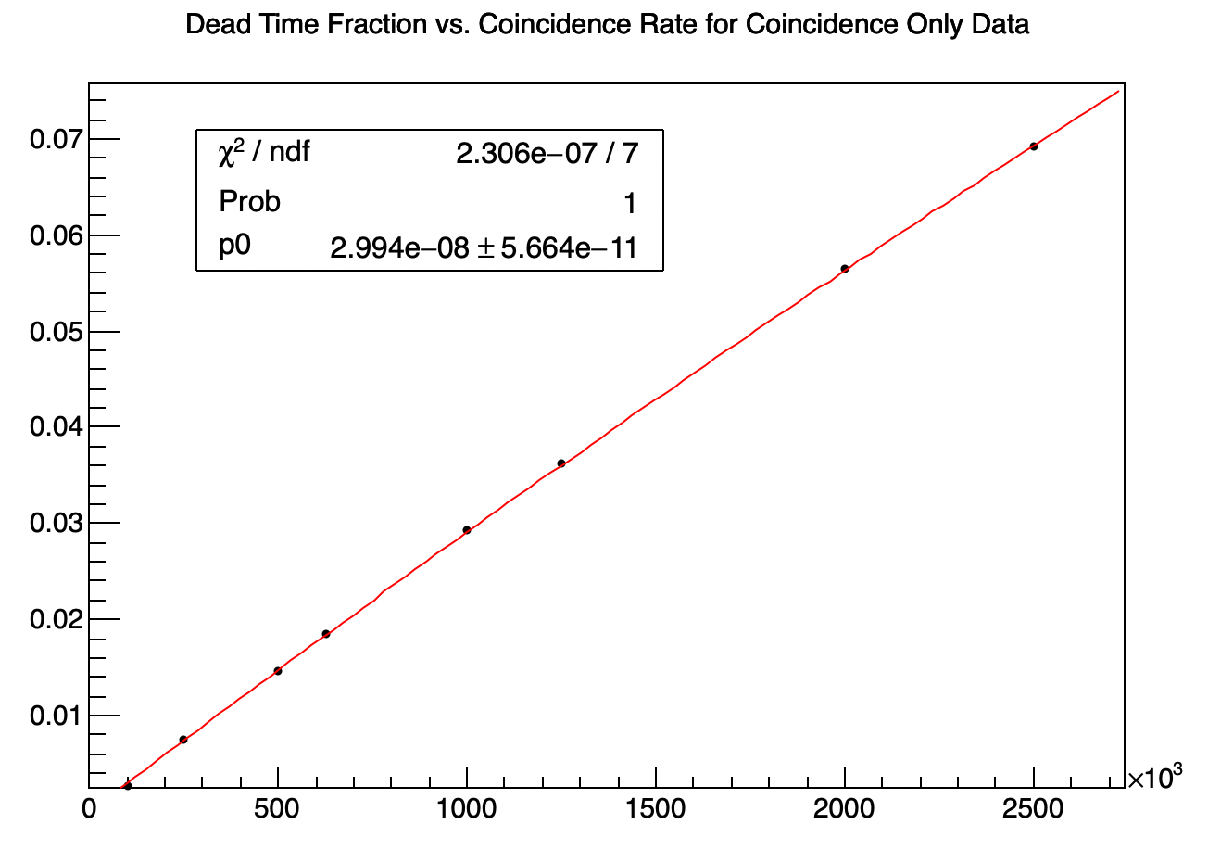
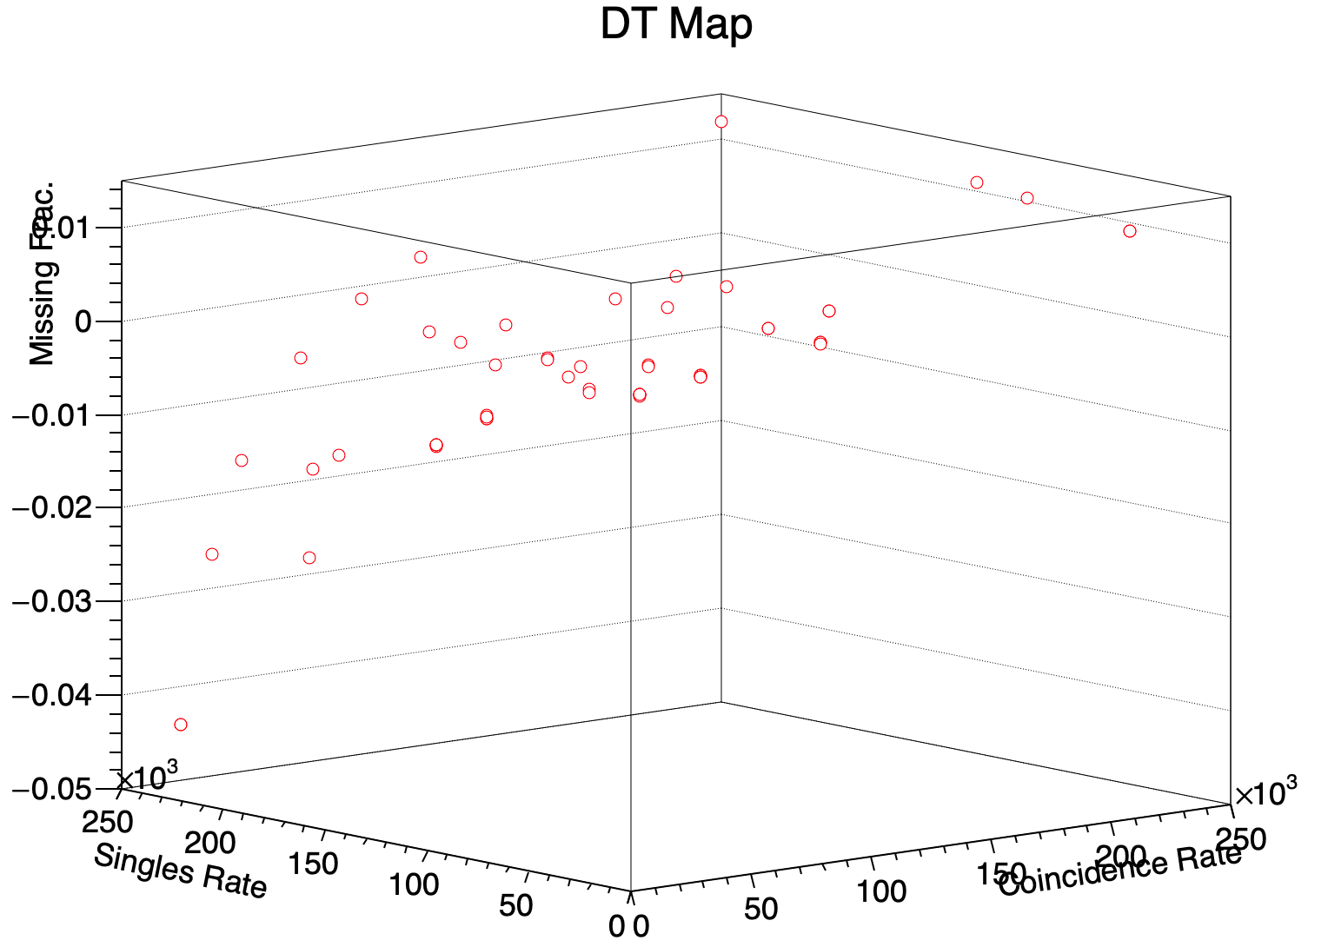
Systematic Uncertainties: Dead Time + Accidentals
Studies have not been internally consistent but imply a dead time constant (𝜏) in the 22–32 ns range:
  Coincident pulse tests result in dead time of 𝜏 = 29 ns
  Singles tests result in dead time of 𝜏 = 26–28 ns
  Minimum pulse spacing resolution suggests 𝜏 = 22–23 ns.
  We have been unable to develop a consistent and predictive model from this data.
Recently used the emulator to generate a “map” of the % Difference Between Input and Measured Rates vs. Input Rates across a wide range of input rates.
  Combined DT + Accidental correction can then be made by interpolation from the map points
  Thus far asymmetry correction is accurate to within 15%, tests ongoing.
  Unclear if correction undergoes drift over time. Would complicate usage.
Notes:
Studies have not been internally consistent but imply a dead time constant (𝜏) in the 22–32 ns range:
Coincident pulse tests result in dead time of 𝜏 = 29 ns, fit shown in graph at right.
Singles tests (dead time on a single side) result in dead time of 𝜏 = 26–28 ns, longer on right than left.
Minimum pulse spacing resolution suggests 𝜏 = 22–23 ns. Using emulator to output pulses closer and closer together until measured rate falls off.
We have been unable to develop a consistent and predictive model from this data.
Recently used the emulator to generate a “map” of the measured vs. input rate across a wide range of input frequencies.
Combined DT + Acc correction can then be made by comparison to best fit surface.
Thus far asymmetry correction is accurate to within 15%, tests ongoing
Unclear if correction undergoes drift over time. Would complicate usage.

Slide 10
More Systematic Uncertainties
A dedicated Foil Degree of Saturation measurement was previously planned but is currently on hold.
  Planned to use Kerr/RMCD effects to measure foil saturation using a laser, at a variety of foil deviations from magnetic field normal.
  Experiment may not be feasible due to issues with stability of laser over longer distances than were required for tabletop tests.
  Need to perform Helmholtz saturation study on the mounted foils
Radiative Corrections: Work on radiative correction simulations planned for later this year.
  Radiative corrections were of less concern in previous experiments given their higher polarimetry error budgets but must now be reconsidered.
Notes:
A dedicated Foil Degree of Saturation measurement was previously planned but is currently on hold.
Planned to use Kerr/RMCD effects to measure foil saturation using a laser, at a variety of foil deviations from magnetic field normal.
Experiment may not be feasible due to issues with stability of laser over longer distances than were required for tabletop tests.
Need to perform Helmholtz saturation study on the mounted foils
Radiative Corrections: Work on radiative correction simulations planned for later this year.
Radiative corrections were of less concern in previous experiments given their higher polarimetry error budgets but must now be reconsidered.

Slide 11



Polarimetry Contributors & Questions
Dave Gaskell, Don Jones, Hanjie Liu, William Henry (Jefferson Lab)
Addison Arcuri, Eric King, Jim Napolitano (Temple University)
Faraz Chahili, Paul Souder, Zhongling Ji (Syracuse University)
Kent Paschke, Nilanga Liyanage (UVa)
Thank you for listening. I’ll be happy to take questions now.

Slide 12
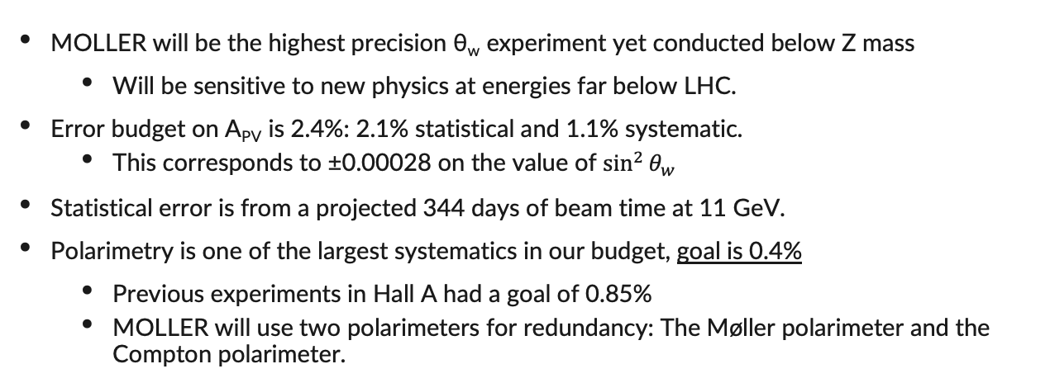
Recap: MOLLER Error Goals [Backup?]
MOLLER will be the highest precision θ_{w} experiment yet conducted below Z mass
  Will be sensitive to new physics at energies far below LHC.
Error budget on A_{PV} is 2.4%: 2.1% statistical and 1.1% systematic.
  This corresponds to ±0.00028 on the value of $\sin^{2}{θ_{w}}$
Statistical error is from a projected 344 days of beam time at 11 GeV.
Polarimetry is one of the largest systematics in our budget, goal is 0.4%
  Previous experiments in Hall A had a goal of 0.85%
  MOLLER will use two polarimeters for redundancy: The Møller polarimeter and the Compton polarimeter.
Notes:
MOLLER is the highest precision WMA experiment yet conducted below Z mass
Will be sensitive to new physics at energies far below LHC; need potential discoveries to be significant.
Error budget on A_{PV} is 2.4%: 2.1% statistical and 1.1% systematic, added in quadrature
This corresponds to ±0.00028 on the value of $\sin^{2}{θ_{w}}$.
Error bars on Fig. 1.
Statistical error is from projected 344 days of beam time.
Polarimetry is one of the largest systematics with a goal of 0.4%.
Previous CREX experiment in Hall A had 0.85% systematic uncertainty
MOLLER will use two polarimeters for redundancy: The Møller polarimeter and the Compton polarimeter.
Describe Compton at all?
My research is in improving precision Møller polarimetry.

