Slide 1
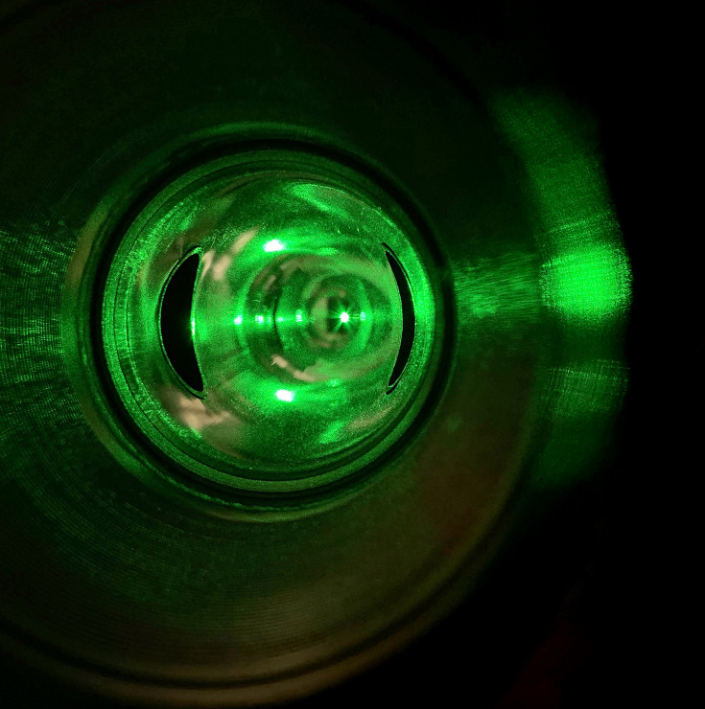
Compton Polarimetry Preparations for MOLLER
Allie Zec
she/her/hers
2026-01-21
Hall A Winter Meeting

Slide 2
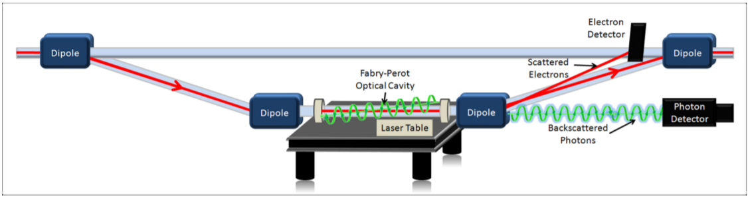
Compton Goals for MOLLER
0.4% beam polarimetry measurement
Functional photon and electron detector polarimetry measurement
CREX had a 0.4% Compton measurement from photon det alone… problem solved?
  Not solved! Old CMU Compton DAQ can’t handle MOLLER event rates
Subsystems to revive:
  Laser
  Photon Detector & DAQ
  Electron Detector & DAQ
  New analyzers for both DAQs
  Online & offline polarization analysis for both DAQs

Slide 3
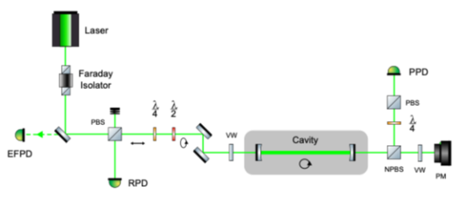
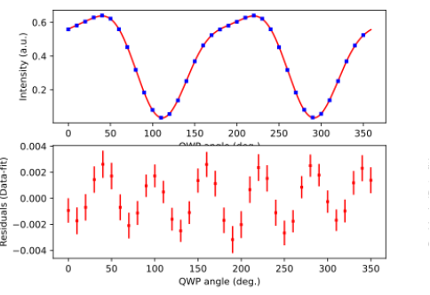
Laser Work
Polarization measured on table using quarter and half waveplate optics
Characterizing optical components such as waveplates and beam splitters
Stokes parameters characterization and fit
  Periodic “wiggle” in the fit residuals has since been fixed by X. Zhang
Fiber amplifier:
  Needs to be replaced
  Looking into possibility of moving amplifier out of hall into labyrinth
Figures courtesy D. Gaskell

Slide 4
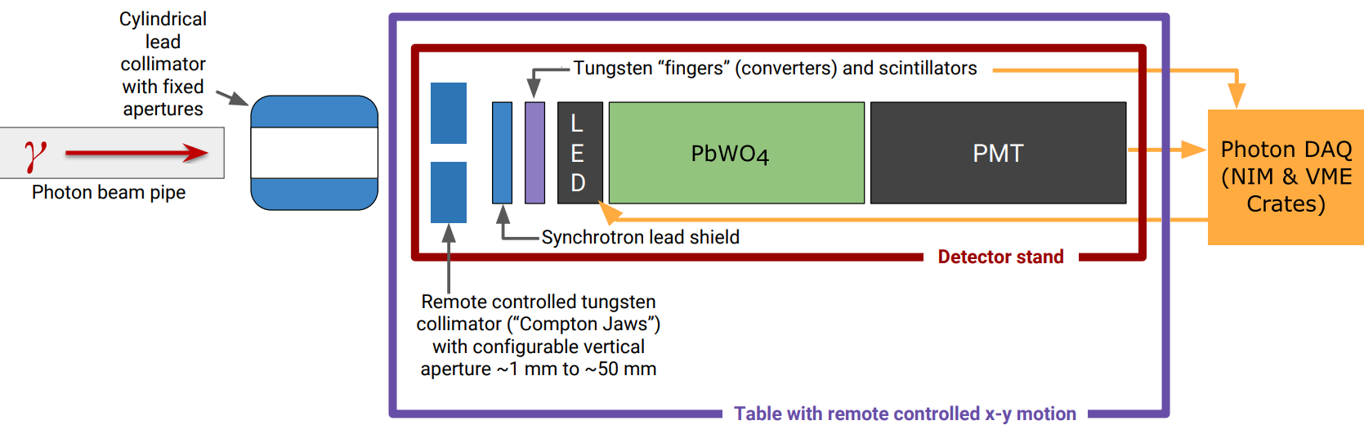
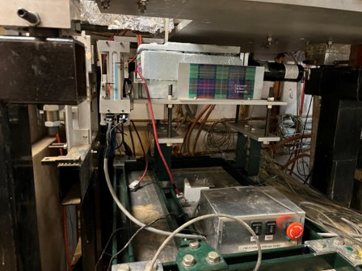
Photon Detector
PbWO₄ scintillator
Cylindrical + jaws collimators, synchrotron shielding, high linearity* PMT + base
  *linearity hasn’t been measured for awhile
Detector used for hall A DVCS measurements in 2016
Beam tests with this detector were planned for GeP running
  Laser wasn’t working when tests were scheduled, didn’t happen
Cable integrity between detector & DAQ isn’t great
  May need to pull some, full testing yet to be done
Bottom figure courtesy of D. Gaskell

Slide 5
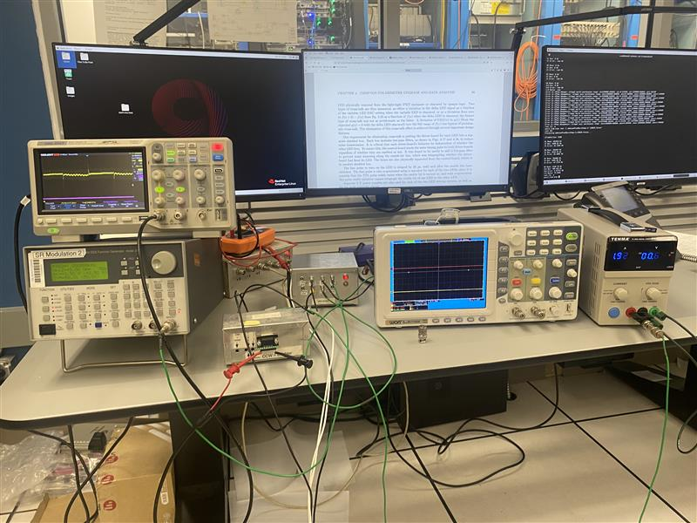
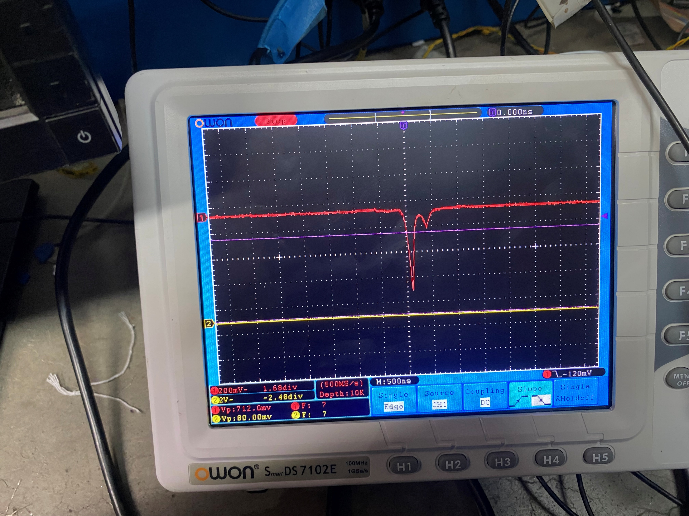
LED Pulser Recovery
LED pulser uses two flashing LEDs to measure PMT + base linearity
  One constant brightness (“delta”), one variable brightness (“variable”)
  Variable hasn’t worked since October 2020
Benchtop tests revealed variable LED control board was faulty
After reinstallation in hall, variable started working again
LED brightness can be manually (but not automatically) controlled from HAPPEX TB DAC’s
  16-bit and 12-bit
Not fully working yet! Still need to:
  Fix DACs on HAPPEX TB
  Reassemble pulser trigger in CMU DAQ

Slide 6
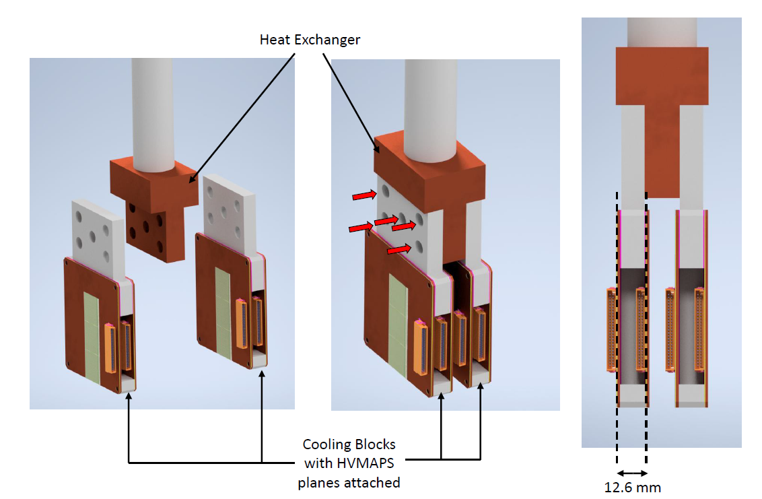
Electron Detector Design
Figures courtesy of N. Niloy
Two planes diamond strip, two planes HVMAPS
Complication: detector cooling
  CFD simulations suggest 12 W heat deposition
Cooling element comes from copper blocks and baffles
  Metal-core PCBs for additional cooling
CFD simulation with baffles and cooling: 25 C max temp
Sealed in specialized vacuum chamber

Slide 7
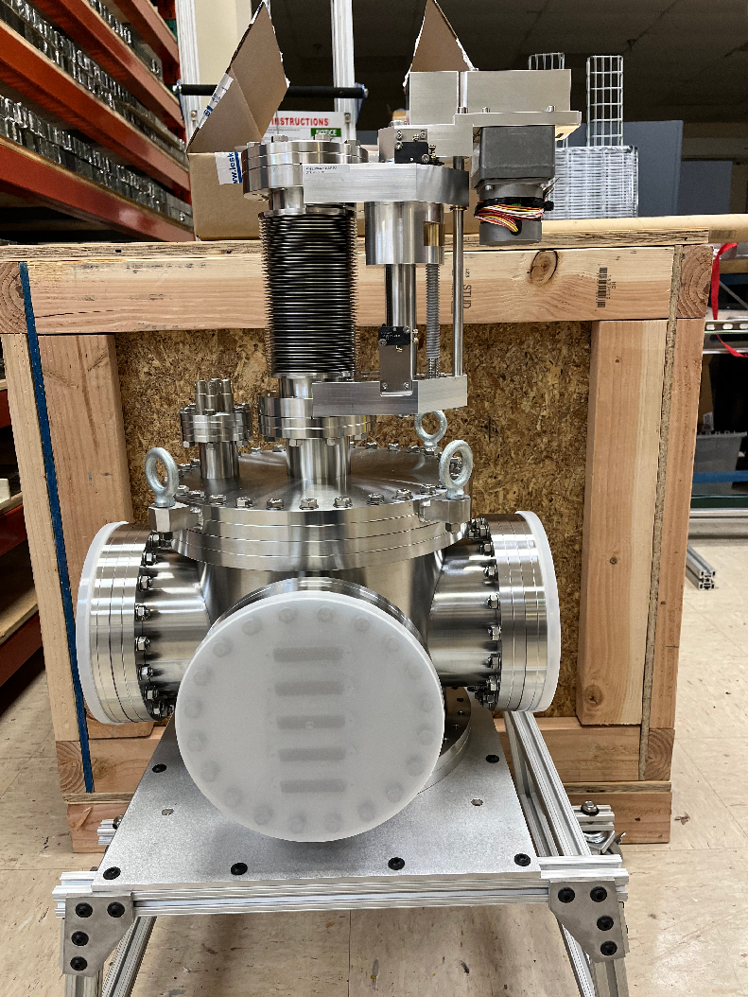
Electron Detector Parts
Figures courtesy of N. Niloy and H. Liu
Above: partial assembly with cooling blocks, heat exchanger, and coolant system
Below: prototype heat exchanger + baffle
Above: four copper core PCBs
Left: electron detector vacuum chamber

Slide 8
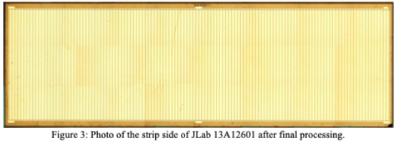
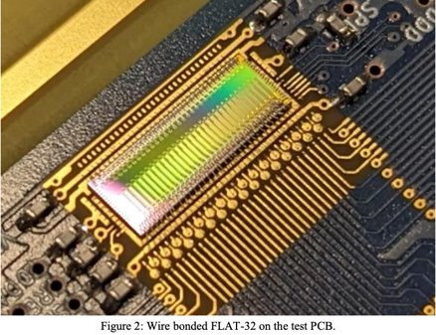
Diamond Detectors
Figures courtesy of D. Gaskell and SenseICs Corporation
Two planes of diamond strip detectors
FLAT-32 analog electronics for detector readout on PCBs
  Diamonds strips and FLAT-32s from SenseICs
120 diamond strips per row x 2 rows per plane x 4 planes = 960 total channels
  Plan is to run with just 2 planes to start
FLAT-32 is built-for-purpose
Will run compatibly with the Manitoba HVMAPS detector planes

Slide 9
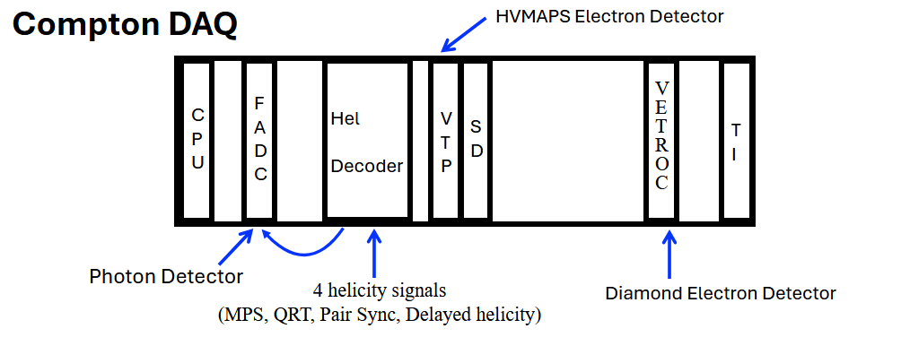
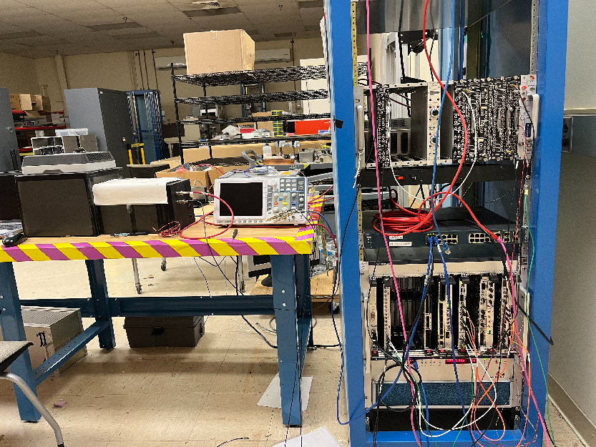
Photon & Electron DAQ
MOLLER Compton Photon DAQ
  Internally triggered fADC (no latching scaler!)
  New fADC firmware
  Faster trigger rate
  Lower prescales needed (if prescaling at all)
  Simultaneous integrating/counting mode (like the CMU DAQ)
MOLLER Compton Electron DAQ
  VETROC readout for diamond planes
  HVMAPS planes get fed to VTP
  VTP also receives photon fADC information
  Photon/electron coincidences handled in VTP firmware
DAQ test stand in EEL
Figures courtesy of H. Liu
Notes:
Snapshots… has a new name “samples,” “waveform” call it a “self pulse”
Simultaneous accumulator and counting mode. In counting mode we’re taking pulse integrals
Allows readouts of the pulse waveforms, but that is prescaled
Very low prescale needed

Slide 10
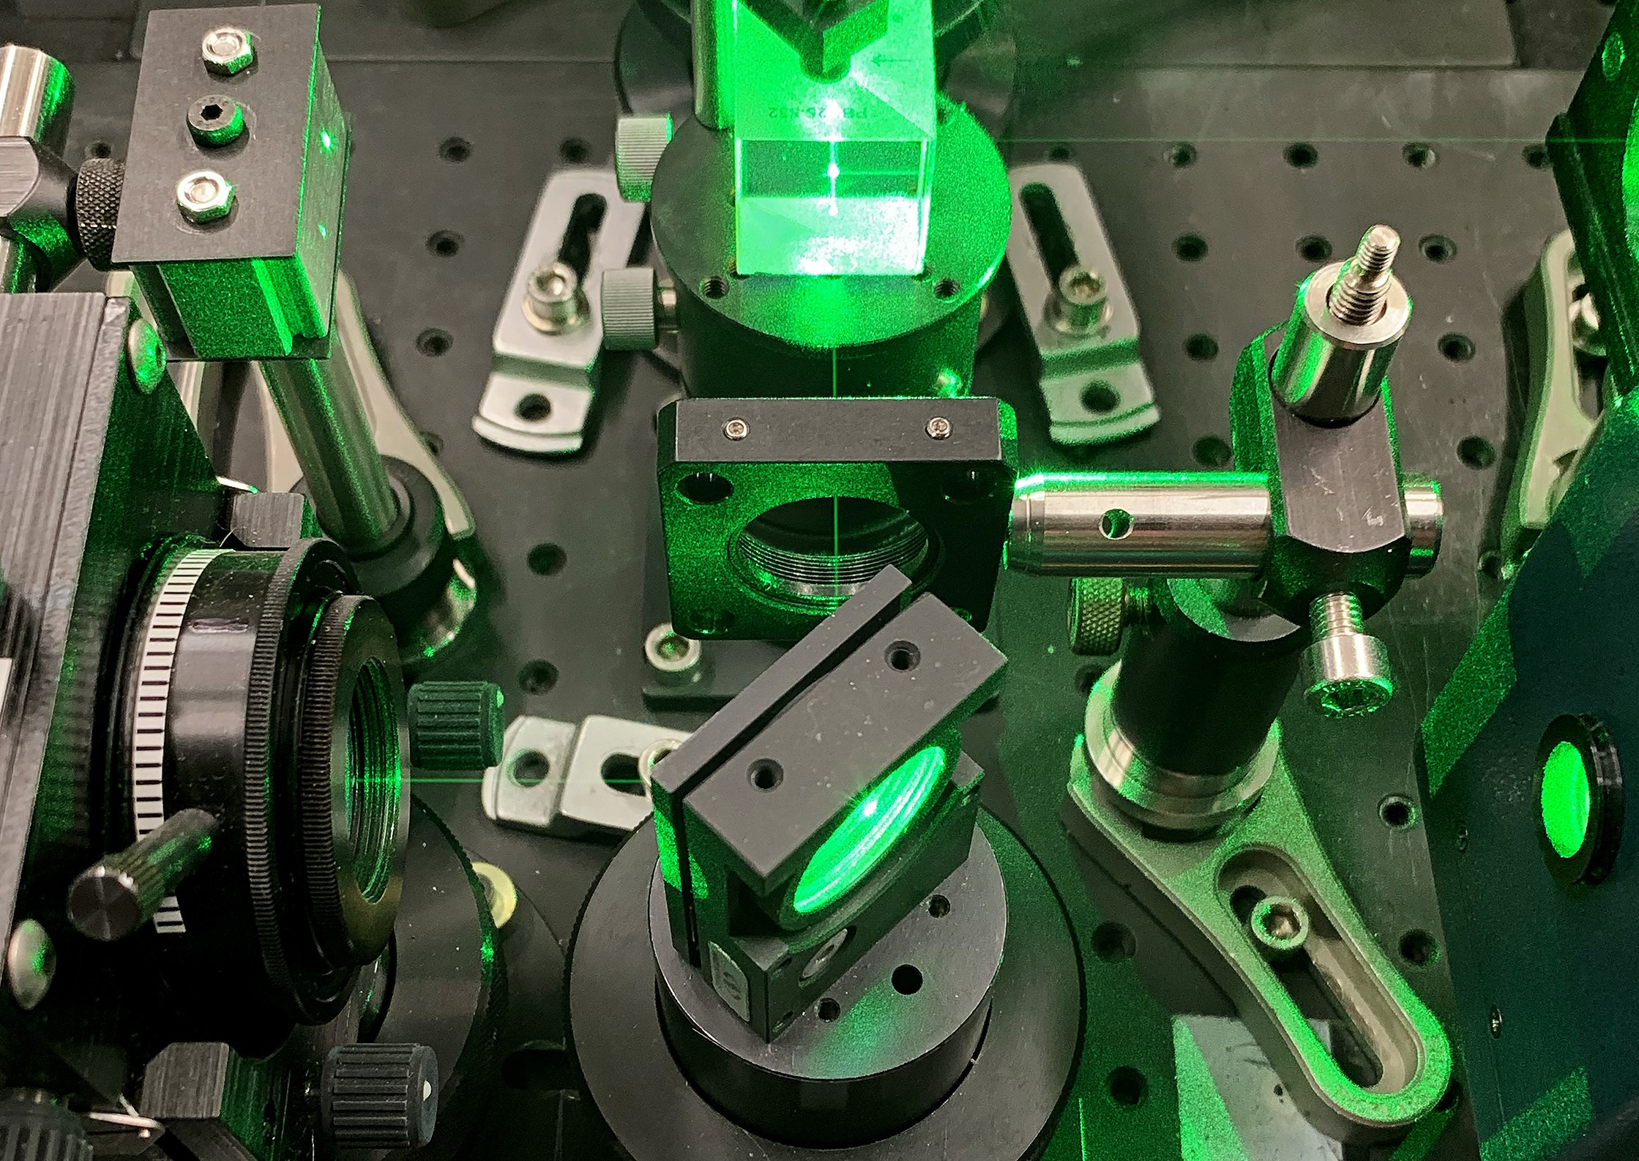
Summary
Laser components characterized, in need of new amplifier
Photon detector from DVCS installed, in principle functioning
LED pulser system still being revived
Electron detector components being built and assembled
  Not fully tested yet
  HVMAPS not at JLab yet
DAQ being redone, work ongoing
Brand new analyzer
Compton still on track for MOLLER usage!

Slide 11
Backup Slides

Slide 12
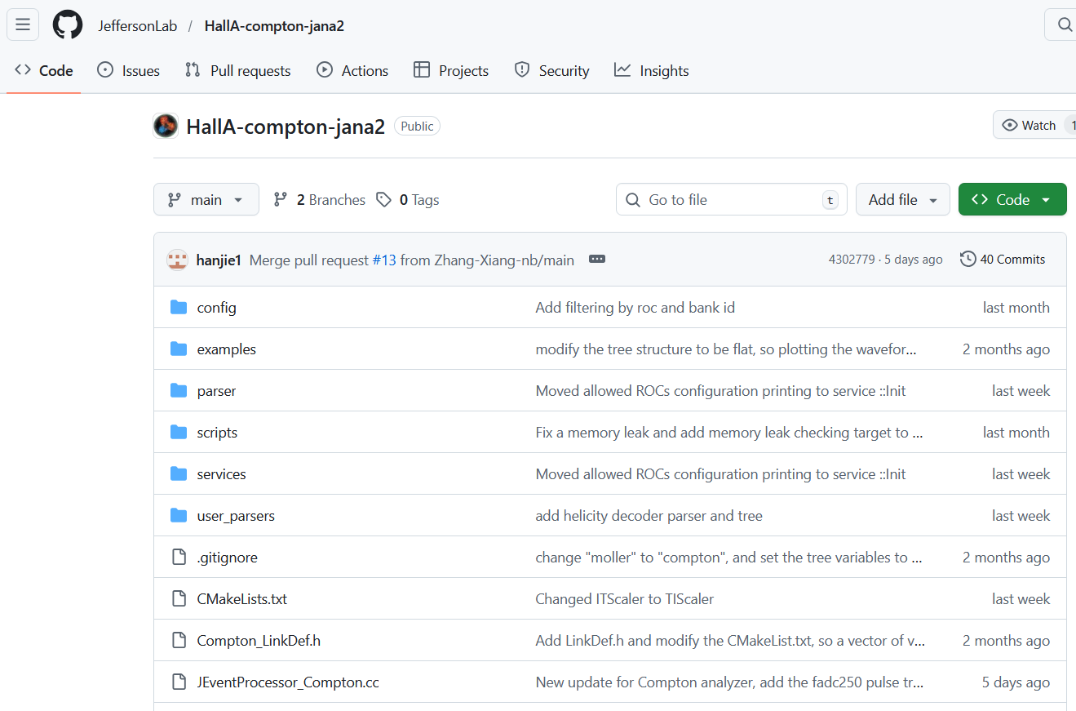
Analyzer
New JANA2-based analyzer
  Replaces CMU-written CompMon
JANA2 new features
  Multithreading!
  Results match decoder based on PODD
  Support from EPSCI group at Jlab
Simultaneous photon and electron DAQ analysis
HallA-Compton-jana2 will be the Compton analyzer for the new DAQ

