Slide 1

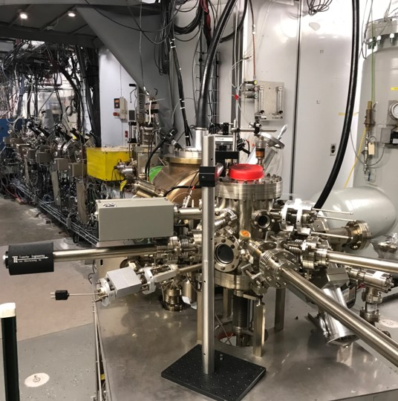
Polarized Beam for MOLLER
Hall A Collaboration Meeting
January 21, 2026
Riad Suleiman
Notes:
Tip: Keep titles under 60 characters for readability
To change the photo: Right-click on photo and select change photo

Slide 2
Outline
MOLLER Polarized Beam Requirements
MOLLER Accelerator Tasks
Update since Hall A 2025 Winter Collaboration Meeting:
  RTP Pockels Cell HV Driver, Intensity Attenuator HV Driver, Helicity Magnets Controller
  Laser Table Configuration, MOLLER Compton AI/ML, SBIR Phase II MeV Wiens
  Plans to Test 2 kHz Helicity Reversal and Helicity Decoder Board
Notes:
Guidelines: 6-8 bullets per slide; Use sentence fragments for bullets
To change the photo: Right-click on photo and select change photo

Slide 3
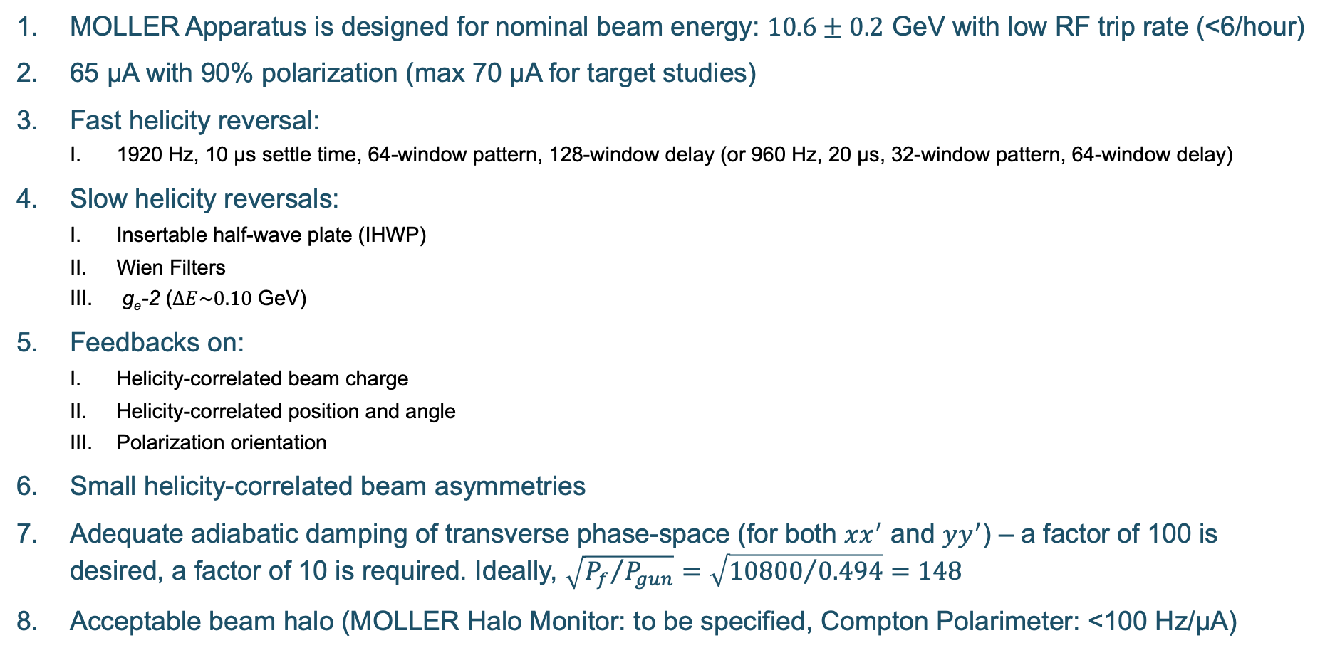
MOLLER Polarized Beam Requirements
MOLLER Apparatus is designed for nominal beam energy: $10.6±0.2$ GeV with low RF trip rate (<6/hour)
65 µA with 90% polarization (max 70 µA for target studies)
Fast helicity reversal:
  1920 Hz, 10 µs settle time, 64-window pattern, 128-window delay (or 960 Hz, 20 µs, 32-window pattern, 64-window delay)
Slow helicity reversals:
  Insertable half-wave plate (IHWP)
  Wien Filters
  g_{e}-2 ($∆E\sim 0.10$ GeV)
Feedbacks on:
  Helicity-correlated beam charge
  Helicity-correlated position and angle
  Polarization orientation
Small helicity-correlated beam asymmetries
Adequate adiabatic damping of transverse phase-space (for both $xx^{′}$ and $yy^{′}$) – a factor of 100 is desired, a factor of 10 is required. Ideally, $\sqrt{{P_{f}}/{P_{gun}}}=\sqrt{{10800}/{0.494}}=148$
Acceptable beam halo (MOLLER Halo Monitor: to be specified, Compton Polarimeter: <100 Hz/µA)
Notes:
Guidelines: 6-8 bullets per slide; Use sentence fragments for bullets

Slide 4
Attenuator
IA
Gain-switched Diode Laser and Fiber Amplifier
Rotatable Strained
Superlattice GaAs
Photocathode
LP HWP LP
WP PC LP
Laser
Electron Beam
Com. Fiber
Controls
HV Supply
(-45 – 45 V)
nHelicity
Fibers
Helicity Controller
15° Dipole Magnet
Delayed
Helicity Fiber
Helicity
Fibers
Vacuum
Window
T-Settle
Fiber
Hall
200 keV
Charge
Feedback
(IA)
RHWP
V-Wien Filter
Target
DAQ
Spin Solenoids
BCMs
H-Wien Filter
BPMs
Position
Feedback
Charge and Position
Feedbacks
RTP
Cell
HV Supply
(-2 kV – 2 kV)
10.6 GeV
CEBAF
6.8 MeV
Helicity Magnets
PSS
Shutters
IHWP
g_{e}-2 Reversal
Notes:
Guidelines: 6-8 bullets per slide; Use sentence fragments for bullets

Slide 5
Accelerator MOLLER Tasks
Task ID | Topic | Scope | Status | Comment | Completion
1 | Helicity Generator | Helicity board with new settings | Settings are available and tested at 2 kHz and 1 kHz | Perform CEBAF-wide beam test to check readiness | 100%
2 | Helicity Decoder | New Boards for delayed helicity reporting | Built and distributed to few users | All DAQs must use – distribute boards to halls | 100%
3 | RTP Pockels Cell HV | Build, install a new 8-channel driver, with 10 µs risetime, electrically isolated | Final optimization | Install in SAM25 | 90%
4 | IA HV Driver | Build, install a new 4-channel driver, with 10 µs risetime, electrically isolated | Prototype design is ready | Build, test, and install in 2026 | 60%
5 | Helicity Magnets Controller | Build, install new control system, with 10 µs rise-time, electrically isolated | Requirement document is ready. Bench testing. | Build, test, and install in 2026 | 30%
6 | Polarization Feedback | Provide Wien feedback to keep longitudinal polarization within 0.03° | Beam tests showed viability of using keV Wiens | Possible Phase II SBIR to build MeV Wiens | 90%
7 | Wien Filter Slow Reversal | Study Wiens Flip-Right and Flip-Left setups | Initial beam studies showed a reasonable reversal | Implemented water cooling | 75%
8 | Injector Transmission and PQB | Optimize injector transmission for > 95% | Initial beam studies showed acceptable transmission | Evaluate apertures (A1, A2, A3, and A4) | 50%
9 | Matching and Adiabatic Damping | Deliver matched beam and adequate damping | Measured across Booster, Accelerator will use raytrace | Finish raytrace analysis | 80%
10 | Fast Feedback | Test and maintain existing system | FFB works as designed | Measure current noise affecting vertical position | 90%
11 | Compton Polarimeter Background | Setup beam thru polarimeter with low halo > 100 Hz/µA | Added harp. No beam to Hall A till 2027 | Working on Compton AI/ML | 50%
12 | Beam Modulation | Hot checkout and maintain system | Beam study showed a working system | Need final results | 100%
13 | Phase Advance | Design Hall A beam optics with sufficient phase advance | Was done before and designed optics with phase advance | Test in 2027 | 100%
14 | Low Beam Current | Deliver low beam current for detectors calibration | New Task, ERR Recommendation | Have requirements – planning beam studies | 10%
15 | Control of Charge Asymmetry | Measure and control charge asymmetry of Halls B, C, D | New IA system was added in Hall D laser | Perform feedback tests for Hall B and D beams | 25%
16 | PQB in Injector and Hall A | Setup PQB in injector and Hall A and perform beam studies | Performed initial beam studies | More beam studies and reduce vertical position noise | 60%
17 | Hallo Monitors in Hall A | Install halo target and detectors and provide FSD and EPICS controls | New halo monitor is being built | Install halo monitor in Hall A beamline | 50%
18 | MOLLER Apparatus Protection | Protect apparatus from beam mis-steering | Comprehensive scheme has been outlined | Implement with Ops and RadCon Group (ERR Comment) | 10%
19 | BPM Receivers | New receivers in Hall A line instead of old SEE electronics | Digital receivers are ready | Implement during MOLLER installation | 60%
20 | BCM Receivers | New BCM receivers in Hall A line to meet linearity and noise requirements | Receivers meet linearity requirement but not resolution | Identify source of noise and rebuild digital receivers | 30%
21 | Laser Table Configuration | Configure laser table and injector for MOLLER | A laser will be reference | Common practice. Coordinating with MOLLER Coll | 10%
22 | Intensity Modulation | Build, install new control system to modulate beam current by <1% | Waiting on approval and requirements document | New task | 0%
Notes:
Guidelines: 6-8 bullets per slide; Use sentence fragments for bullets

Slide 6
MOLLER Preparations – I
Wiens vacuum spikes were due to heating from magnet – implementing water cooling
Hardware Installation:
  New HV driver for Pockels Cell
  New HV driver for laser Intensity Attenuator system
  New controller for Helicity Magnets
Laser Table Configuration:
  Change reference laser from B laser to A laser (A laser is high current and MOLLER laser)
  Replace half-wave plates of Intensity Attenuator systems with lambda/10 plates
  Move steering lens approximately 4 cm in front of vacuum window (now it is at 61 cm)
Electron Beam Studies:
  Injector transmission: evaluate apertures (A1, A2, A3, and A4)
  Characterize low beam currents needed for MOLLER detector calibration
  Identify source of beam current noise affecting vertical position
Notes:
Guidelines: 6-8 bullets per slide; Use sentence fragments for bullets

Slide 7
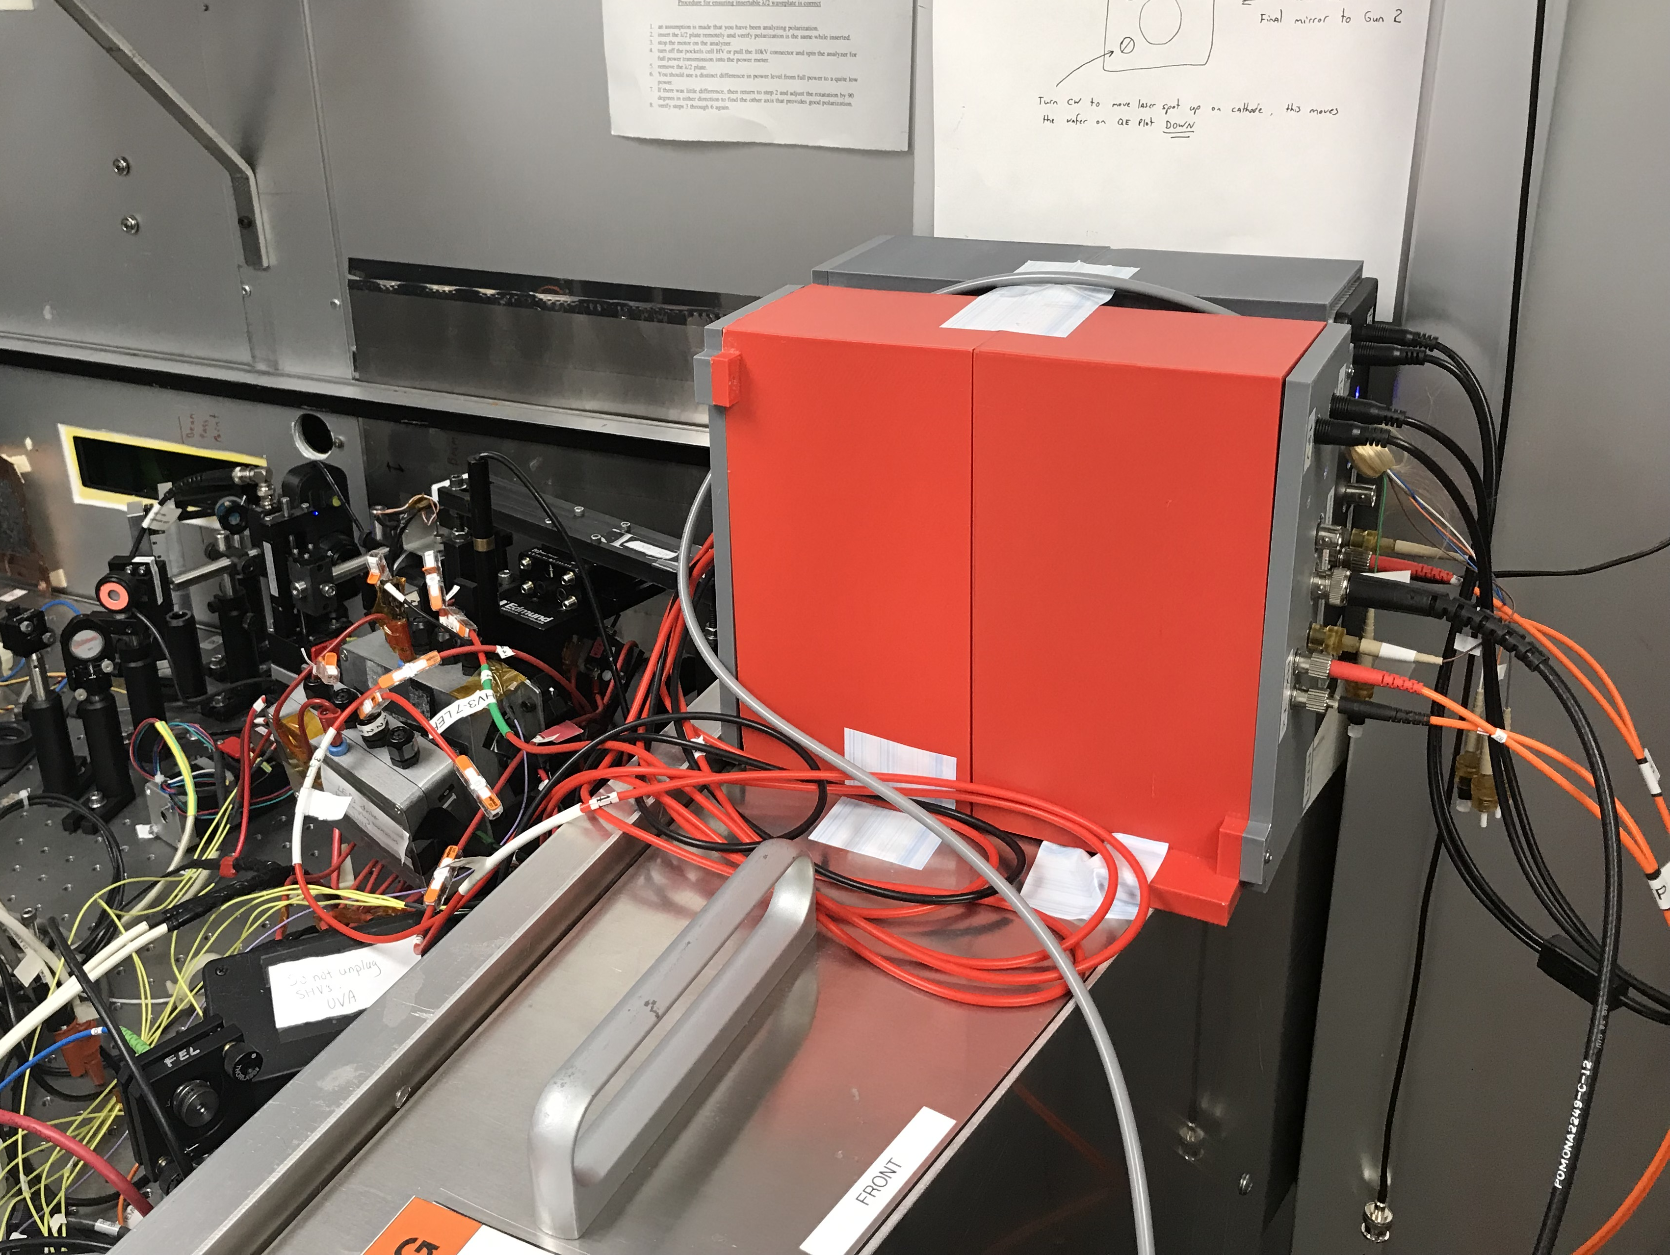
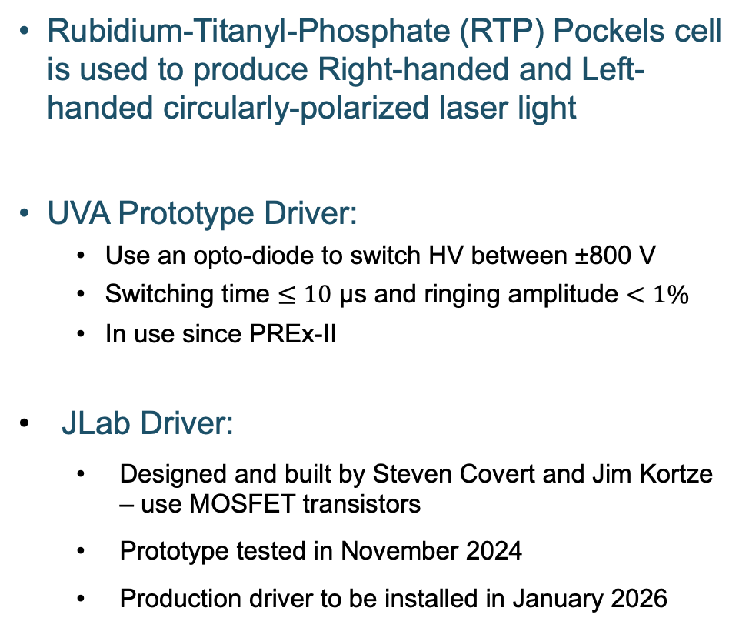
New JLab RTP HV Driver
Rubidium-Titanyl-Phosphate (RTP) Pockels cell is used to produce Right-handed and Left-handed circularly-polarized laser light
UVA Prototype Driver:
  Use an opto-diode to switch HV between ±800 V
  Switching time $≤10$ µs and ringing amplitude $<1\%$
  In use since PREx-II
JLab Driver:
  Designed and built by Steven Covert and Jim Kortze – use MOSFET transistors
  Prototype tested in November 2024
  Production driver to be installed in January 2026
RTP Crystals
HV Driver

Slide 8
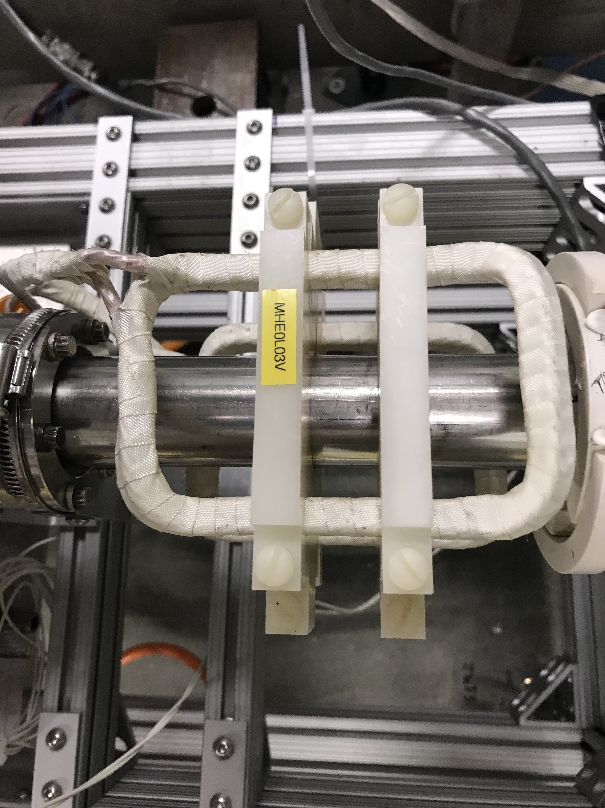
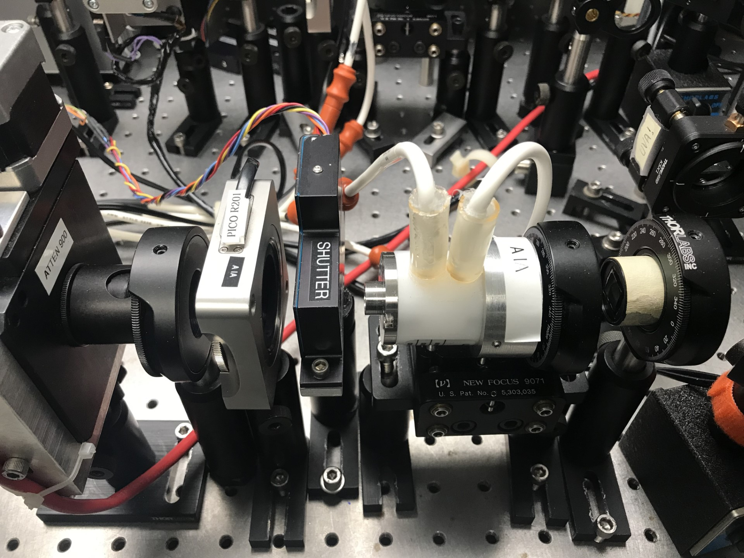


IA HV Driver and Helicity Magnets Controller – FY2026
New Intensity Attenuator (IA) HV Driver is planned
Use ±45 V precision Operational Amplifiers
Switching time $≤10$ µs
IA system for each Hall (A, B, C, and D)
New Helicity Magnets controller is planned
Switching time $≤10$ µs – will overdrive magnets (ERR Comment)
Four air-core magnets made of Litz wire are installed in Injector MeV region
LP
λ/2 WP
KD*P PC
LP
Notes:
Guidelines: 6-8 bullets per slide; Use sentence fragments for bullets

Slide 9
MOLLER Preparations – II
Rebuild digital receivers of beam current monitors
MOLLER Compton AI/ML (DOE NOFO funded): minimize Compton detector background and deliver beam that achieves several competing objectives (e.g., beam sizes, phase advances)
Support SBIR Phase II proposal (to be submitted): will build new 6.8 MeV Wiens for MOLLER polarization feedback
Test 2 kHz helicity reversal:
  Perform CEBAF-wide beam test during 2026 physics run to check readiness to run at this high reversal rate
  Use Helicity Decoder Board to account for electron beam and helicity signals travel times
Notes:
Guidelines: 6-8 bullets per slide; Use sentence fragments for bullets

Slide 10
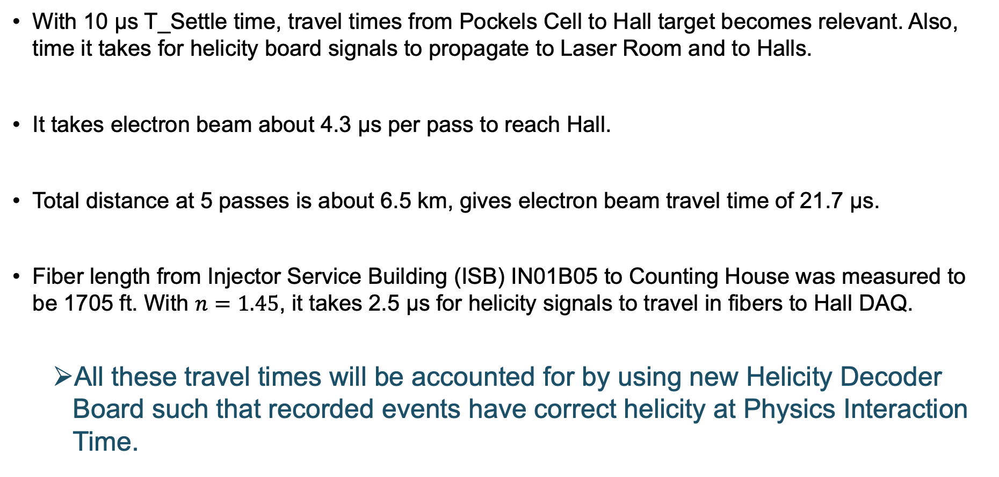
Travel Times
With 10 µs T_Settle time, travel times from Pockels Cell to Hall target becomes relevant. Also, time it takes for helicity board signals to propagate to Laser Room and to Halls.
It takes electron beam about 4.3 µs per pass to reach Hall.
Total distance at 5 passes is about 6.5 km, gives electron beam travel time of 21.7 µs.
Fiber length from Injector Service Building (ISB) IN01B05 to Counting House was measured to be 1705 ft. With $n=1.45$, it takes 2.5 µs for helicity signals to travel in fibers to Hall DAQ.
  All these travel times will be accounted for by using new Helicity Decoder Board such that recorded events have correct helicity at Physics Interaction Time.
Notes:
Guidelines: 6-8 bullets per slide; Use sentence fragments for bullets

Slide 11
Board Programmable Common Delay
How to set input common time delay:
  Helicity Board: 60 Hz Line Sync Mode.
  Electron Beam: VL, 60 Hz Beam Sync, 50 ns pulses.
  Check relative timing of laser VL Generator and Real Helicity signal at RTP cell.
  Check relative timing of Detector Signal and Delayed Helicity signal at Hall DAQ.
  Adjust board common delay to match relative timing at RTP cell.
60 Hz Beam Sync
Check relative timing
ISB
Helicity Generator
VL
Generator
Helicity Decoder Board
Check relative timing
Delayed
Helicity
Fiber
Real
Helicity
Fiber
DAQ
Detector
Signal
HV Supply
RTP
Cell
Hall
Board Common Input Delay (0-32 µs)
Target
CEBAF
Notes:
Guidelines: 6-8 bullets per slide; Use sentence fragments for bullets

Slide 12
Thank you

Slide 13
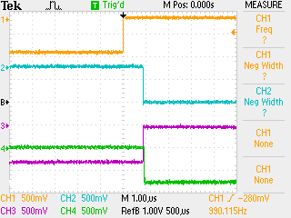
Helicity Board Timing
Helicity Board output signals timing relative to T_Settle:
  All signals: Pair Sync, Pattern Sync, Helicity Flip, nHelicity Flip, and Delayed Helicity start 1.0 μs after T_Settle.
CH1: T_Settle
CH2: Helicity Flip
CH3: nHelicity Flip
CH4: Delayed Helicity
Notes:
Guidelines: 6-8 bullets per slide; Use sentence fragments for bullets

