Slide 1


SBS $G_{M}^{n}$ Analysis Status
Hall-A Winter Collaboration Meeting – Jan. 22, 2026
Anuruddha Rathnayake On behalf of the GMN analysis group

Slide 2
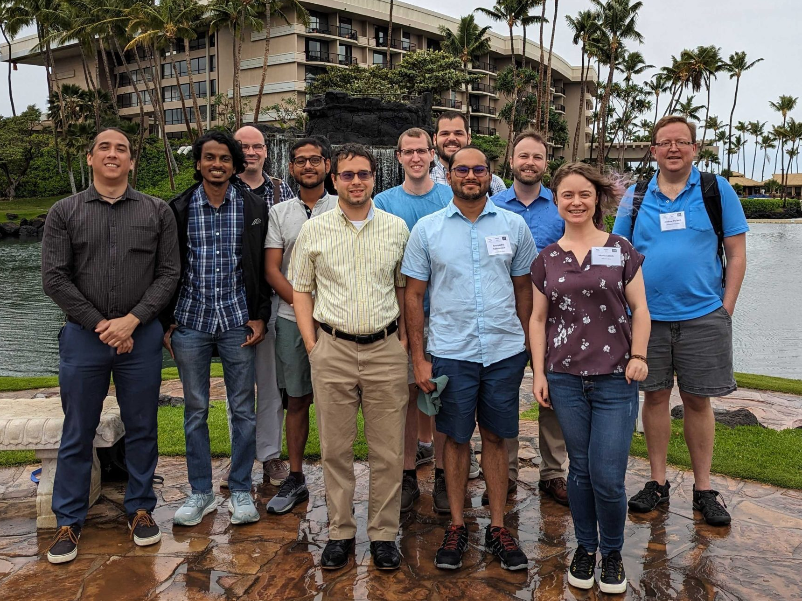
Acknowledgements
GMN and nTPE Graduate Students (all graduated) – Vanessa Brio (Catania U.), John Boyd (UVA), Provakar Datta (Uconn), Nathaniel Lashley-Colthrist (Hampton U.), Ralph Marinaro (U. of Glasgow), Anuruddha Rathnayake (UVA), Maria Satnik (W&M), Sebastian Seeds (Uconn), Ezekiel Wertz (W&M).
Provakar Datta for extensive analysis efforts and lending me the results/plots.
Andrew Puckett and Eric Fuchey for their continuous leadership on analysis efforts.
GMN spokespeople – Bogdan Wojtsekhowski (JLab), Brain Quinn (CMU), Alexandre Camsonne (JLab), and David Hamilton (U. of Glasgow).
Jefferson Lab SBS collaboration and Hall-A collaboration.
Everyone who supported experiment design, installation, and running.
Department of Energy Office of Science, Office of Nuclear Physics.

Slide 3
Outline
SBS GMN experiment brief overview
Analysis methodology
Preliminary analysis results from Pass-2 mass replay
Calibration for Pass-3 mass replay
Summary and outlook

Slide 4
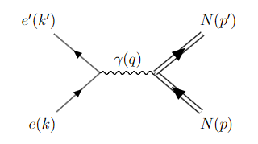
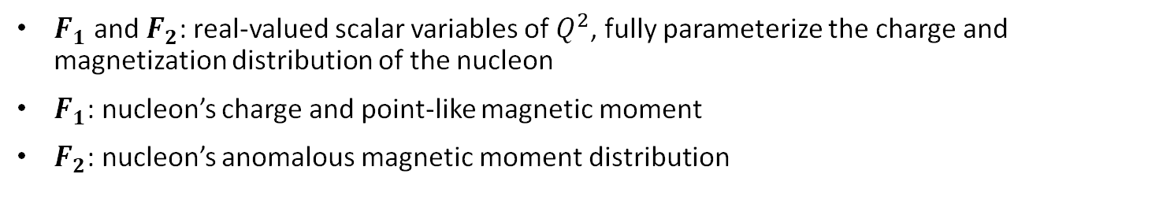
e-N scattering in QED framework
Scattering amplitude One Photon Exchange (OPE) approx. or Born approx.
$$M=4πα\left[\overline{u}{\left(k^{′}\right)γ}^{μ}u(k)\right]\left(\frac{g_{μυ}}{q^{2}}\right)\left[\overline{u}(p′)\left[γ_{μ}F_{1}\left(Q^{2}\right)+\frac{iσ^{μν}q_{ν}}{2M}F_{2}\left(Q^{2}\right)\right]u(p)\right]$$
electron current
Hadron/nucleon current
Pauli form factor
Dirac form factor
$F_{1}$ and $F_{2}$: real-valued scalar variables of $Q^{2}$, fully parameterize the charge and magnetization distribution of the nucleon
$F_{1}$: nucleon’s charge and point-like magnetic moment
$F_{2}$: nucleon’s anomalous magnetic moment distribution

Slide 5
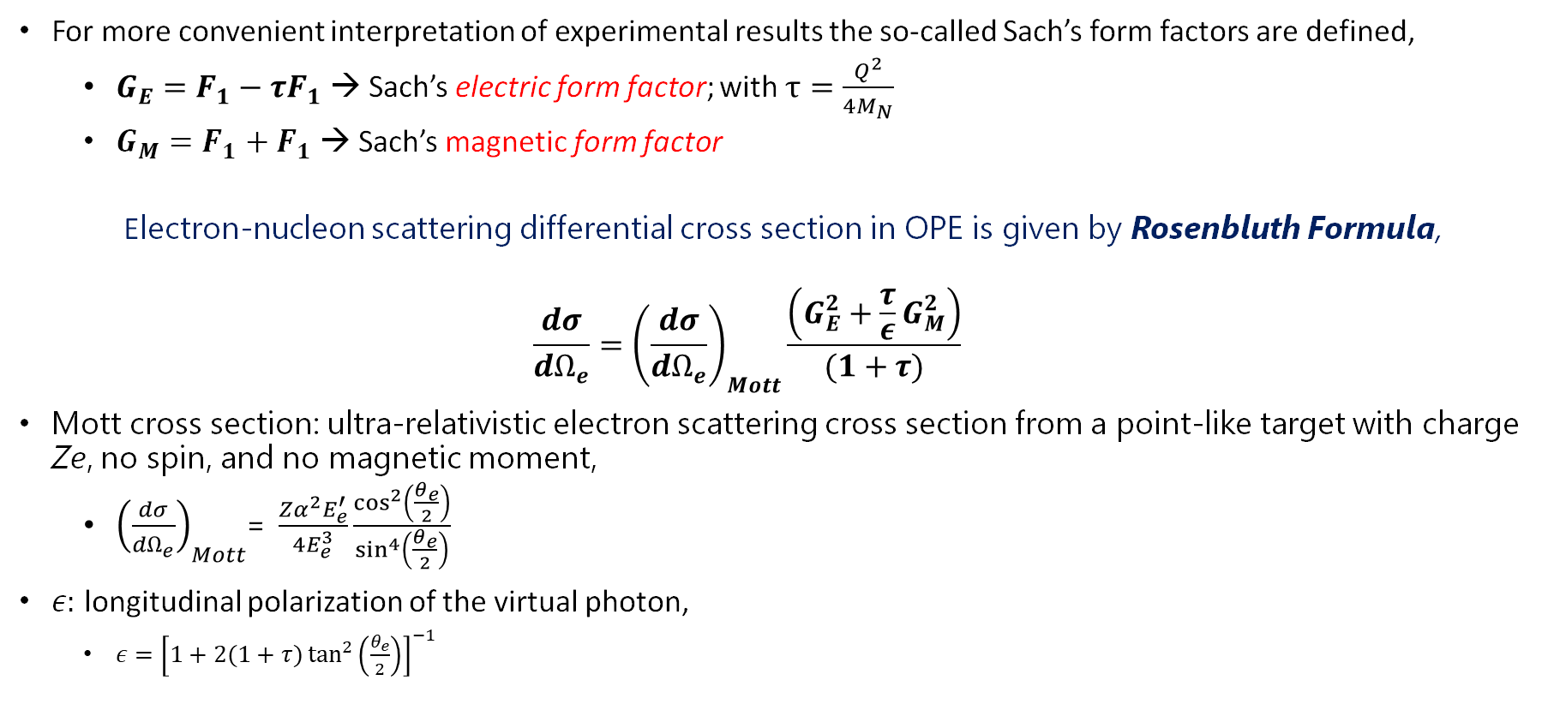
Sach’s form factors
For more convenient interpretation of experimental results the so-called Sach’s form factors are defined,
$G_{E}=F_{1}−τF_{1}$ → Sach’s electric form factor; with $τ=\frac{Q^{2}}{4M_{N}}$
$G_{M}=F_{1}+F_{1}$ → Sach’s magnetic form factor
Electron-nucleon scattering differential cross section in OPE is given by Rosenbluth Formula,
$$\frac{dσ}{dΩ_{e}}={\left(\frac{dσ}{dΩ_{e}}\right)}_{Mott}\frac{\left(G_{E}^{2}+\frac{τ}{ε}G_{M}^{2}\right)}{(1+τ)}$$
Mott cross section: ultra-relativistic electron scattering cross section from a point-like target with charge Ze, no spin, and no magnetic moment,
${\left(\frac{dσ}{dΩ_{e}}\right)}_{Mott}$= $\frac{Zα^{2}E_{e}^{′}}{4E_{e}^{3}}\frac{\cos^{2}\left(\frac{θ_{e}}{2}\right)}{\sin^{4}\left(\frac{θ_{e}}{2}\right)}$
$ε:$ longitudinal polarization of the virtual photon,
$ε={\left[1+2(1+τ)\tan^{2}\left(\frac{θ_{e}}{2}\right)\right]}^{−1}$

Slide 6
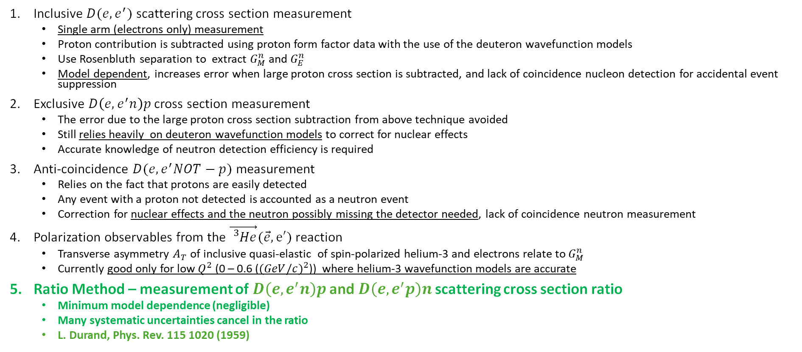
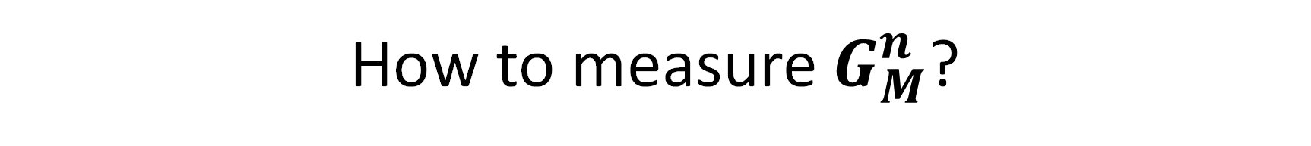
How to measure $G_{M}^{n}$?
Inclusive $D(e,e^{′})$ scattering cross section measurement
Single arm (electrons only) measurement
Proton contribution is subtracted using proton form factor data with the use of the deuteron wavefunction models
Use Rosenbluth separation to extract $G_{M}^{n}$ and $G_{E}^{n}$
Model dependent, increases error when large proton cross section is subtracted, and lack of coincidence nucleon detection for accidental event suppression
Exclusive $D\left(e,e^{′}n\right)p$ cross section measurement
The error due to the large proton cross section subtraction from above technique avoided
Still relies heavily on deuteron wavefunction models to correct for nuclear effects
Accurate knowledge of neutron detection efficiency is required
Anti-coincidence $D(e,e^{′}NOT−p)$ measurement
Relies on the fact that protons are easily detected
Any event with a proton not detected is accounted as a neutron event
Correction for nuclear effects and the neutron possibly missing the detector needed, lack of coincidence neutron measurement
Polarization observables from the $\vec{{}_{}^{3}{He}}(\vec{e},e′)$ reaction
Transverse asymmetry $A_{T}$ of inclusive quasi-elastic of spin-polarized helium-3 and electrons relate to $G_{M}^{n}$
Currently good only for low $Q^{2}$ (0 – 0.6 (${(GeV/c)}^{2}$)) where helium-3 wavefunction models are accurate
Ratio Method – measurement of $D\left(e,e^{′}n\right)p$ and $D\left(e,e^{′}p\right)n$ scattering cross section ratio
Minimum model dependence (negligible)
Many systematic uncertainties cancel in the ratio
L. Durand, Phys. Rev. 115 1020 (1959)

Slide 7




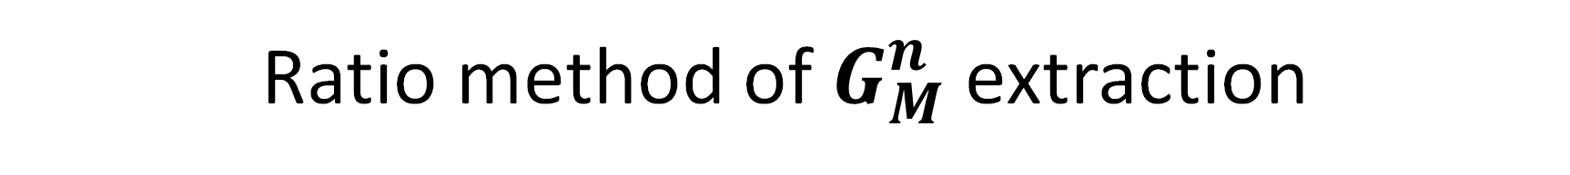



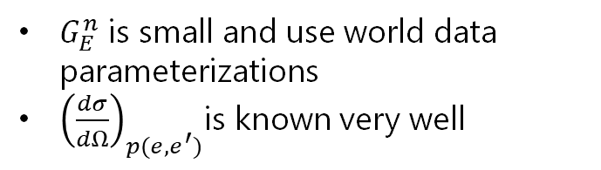

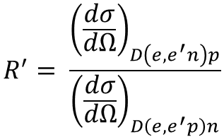
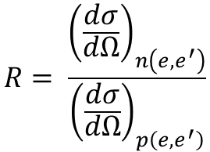
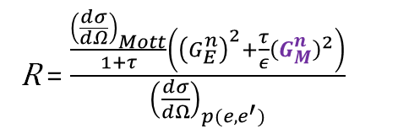
Ratio method of $G_{M}^{n}$ extraction
Simultaneous measurement of tagged quasi-elastic neutrons $D\left(e,e^{′}n\right)p$ and quasi-elastic protons $D\left(e,e^{′}n\right)p$, along with the electron.
$$R^{′}= \frac{{\left(\frac{dσ}{dΩ}\right)}_{D\left(e,e^{′}n\right)p}}{{\left(\frac{dσ}{dΩ}\right)}_{D\left(e,e^{′}p\right)n}}$$
$$e′$$
$$e′$$
Quasi-elastic ratio
e
n
p
e
n
p
$$n′$$
$$p′$$
Nuclear corrections to get ”elastic ratio” → large cancellations in the ratio
$$R= \frac{{\left(\frac{dσ}{dΩ}\right)}_{n\left(e,e^{′}\right)}}{{\left(\frac{dσ}{dΩ}\right)}_{p\left(e,e^{′}\right)}}$$
$$e′$$
$$e′$$
Elastic ratio
e
n
e
p
$$n′$$
$$p′$$
R = $\frac{\frac{{\left(\frac{dσ}{dΩ}\right)}_{Mott}}{1+τ}\left({\left(G_{E}^{n}\right)}^{2}+\frac{τ}{ε}{\left(G_{M}^{n}\right)}^{2}\right)}{{\left(\frac{dσ}{dΩ}\right)}_{p(e,e^{′})}}$
$G_{E}^{n}$ is small and use world data parameterizations
${\left(\frac{dσ}{dΩ}\right)}_{p(e,e^{′})}$is known very well
From OPE approx.

Slide 8
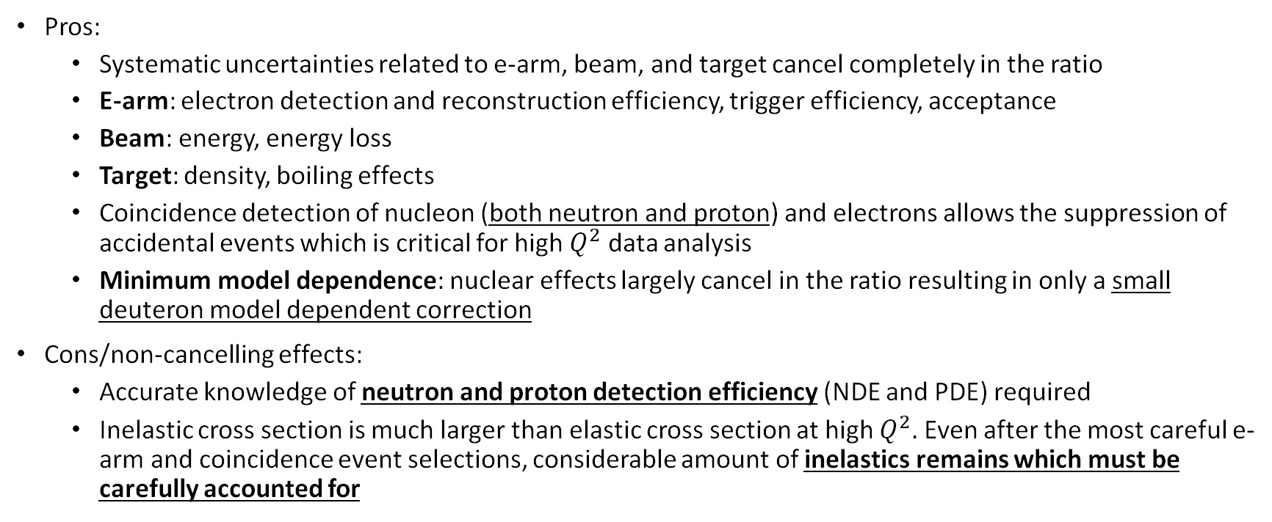
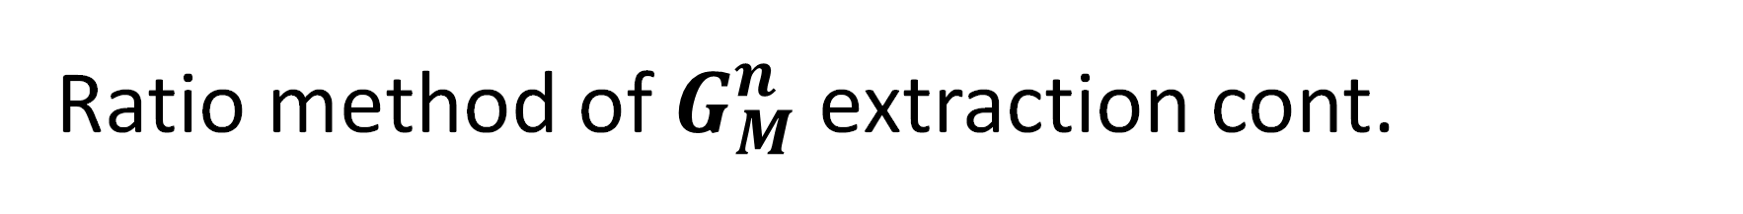
Ratio method of $G_{M}^{n}$ extraction cont.
Pros:
Systematic uncertainties related to e-arm, beam, and target cancel completely in the ratio
E-arm: electron detection and reconstruction efficiency, trigger efficiency, acceptance
Beam: energy, energy loss
Target: density, boiling effects
Coincidence detection of nucleon (both neutron and proton) and electrons allows the suppression of accidental events which is critical for high $Q^{2}$ data analysis
Minimum model dependence: nuclear effects largely cancel in the ratio resulting in only a small deuteron model dependent correction
Cons/non-cancelling effects:
Accurate knowledge of neutron and proton detection efficiency (NDE and PDE) required
Inelastic cross section is much larger than elastic cross section at high $Q^{2}.$ Even after the most careful e-arm and coincidence event selections, considerable amount of inelastics remains which must be carefully accounted for

Slide 9
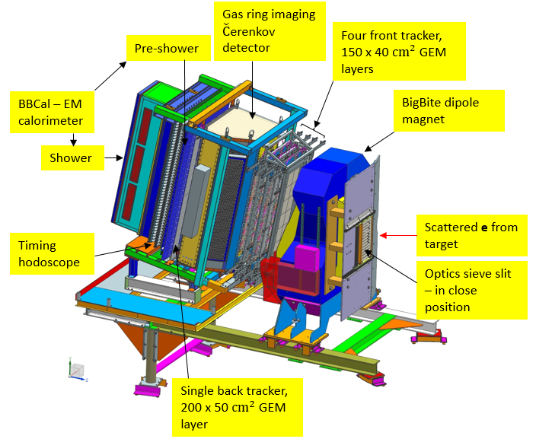
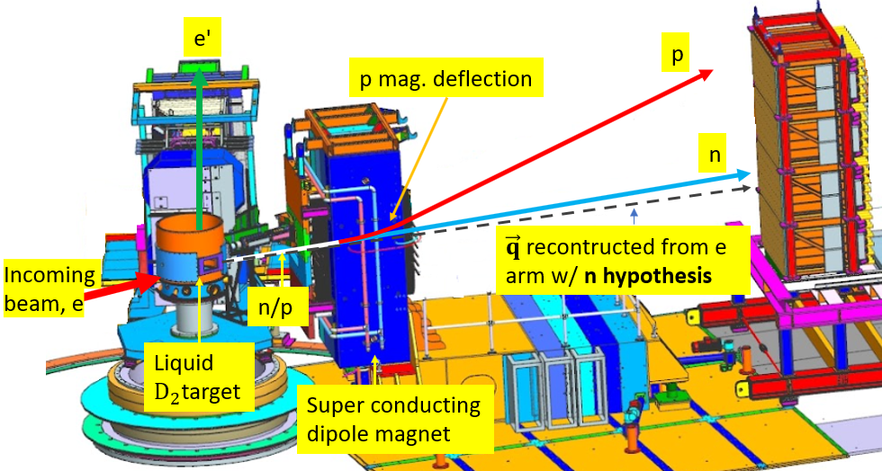
GMN experimental setup
Experiment setup 3D diagram
BigBite spectrometer 3D diagram
Electron arm (BigBite Spectrometer): reconstruct the q – vector of the scattering reaction and the scattering vertex
BigBite magnet → dipole magnet for momentum reconstruction of scattered electrons
GEM detectors → reconstruct charged particle tracks, scat. vertex, and momentum along with the BigBite magnet optics
GRINCH → PID Cherenkov detector
Timing hodoscope → high precision timing information
Pre-shower and Shower → electron energy and PID, provides the trigger
Hadron arm (SuperBigBite Spectrometer): detect the scattered neutrons and protons
SuperBigBite magnet (48D48) → deflects protons vertically w.r.t the neutrons that are unaffected
Hadron Calorimeter (HCal) → sampling calorimeter for position, energy, and timing information of n and p

Slide 10
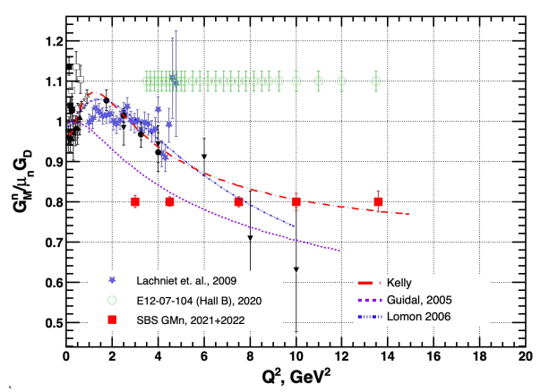
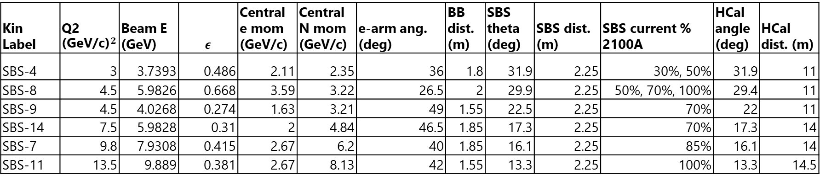
GMN kinematic points
Plot: P. Datta
Kin Label | Q2 ${\text{(}\text{GeV}\text{/}\text{c}\text{)}}^{2}$ | Beam E (GeV) | $$ε$$ | Central e mom (GeV/c) | Central N mom (GeV/c) | e-arm ang. (deg) | BB dist. (m) | SBS theta (deg) | SBS dist. (m) | SBS current % 2100A | HCal angle (deg) | HCal dist. (m)
SBS-4 | 3 | 3.7393 | 0.486 | 2.11 | 2.35 | 36 | 1.8 | 31.9 | 2.25 | 30%, 50% | 31.9 | 11
SBS-8 | 4.5 | 5.9826 | 0.668 | 3.59 | 3.22 | 26.5 | 2 | 29.9 | 2.25 | 50%, 70%, 100% | 29.4 | 11
SBS-9 | 4.5 | 4.0268 | 0.274 | 1.63 | 3.21 | 49 | 1.55 | 22.5 | 2.25 | 70% | 22 | 11
SBS-14 | 7.5 | 5.9828 | 0.31 | 2 | 4.84 | 46.5 | 1.85 | 17.3 | 2.25 | 70% | 17.3 | 14
SBS-7 | 9.8 | 7.9308 | 0.415 | 2.67 | 6.2 | 40 | 1.85 | 16.1 | 2.25 | 85% | 16.1 | 14
SBS-11 | 13.5 | 9.889 | 0.381 | 2.67 | 8.13 | 42 | 1.55 | 13.3 | 2.25 | 100% | 13.3 | 14.5
nTEP points. Next talk by Z. Wertz

Slide 11
Outline
SBS GMN experiment brief overview
Analysis methodology
Preliminary analysis results from Pass-2 mass replay
Calibration for Pass-3 mass replay
Summary and outlook

Slide 12
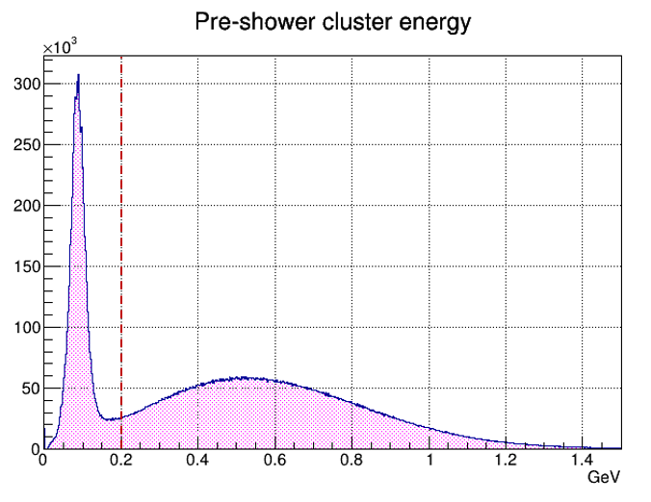
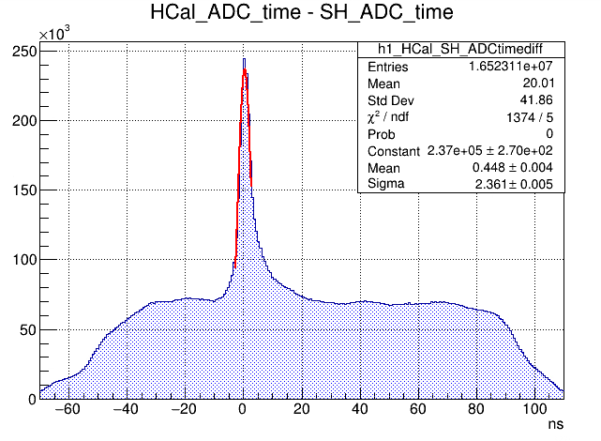
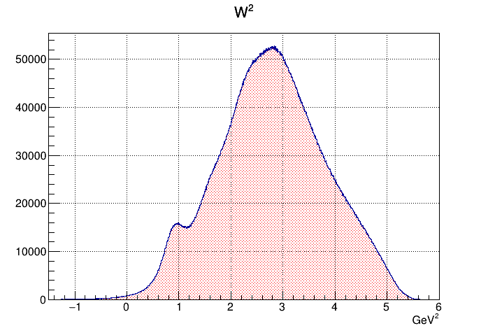
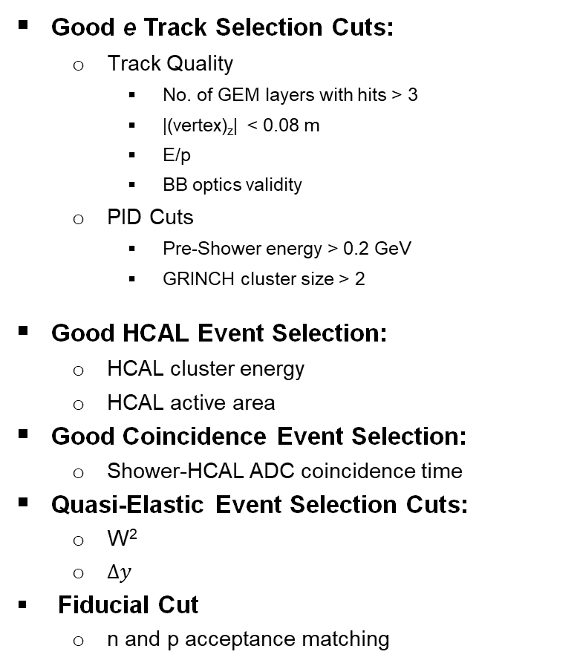
Event selection
Good e Track Selection Cuts:
Track Quality
No. of GEM layers with hits > 3
|(vertex)_{z}| < 0.08 m
E/p
BB optics validity
PID Cuts
Pre-Shower energy > 0.2 GeV
GRINCH cluster size > 2
Good HCAL Event Selection:
HCAL cluster energy
HCAL active area
Good Coincidence Event Selection:
Shower-HCAL ADC coincidence time
Quasi-Elastic Event Selection Cuts:
W²
$∆y$
Fiducial Cut
n and p acceptance matching

Slide 13
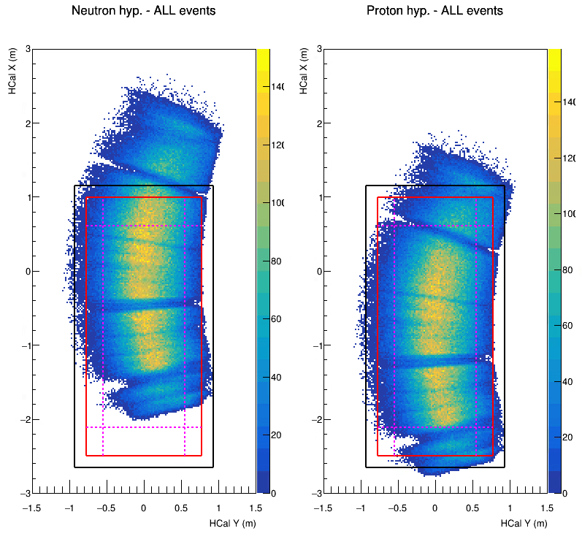
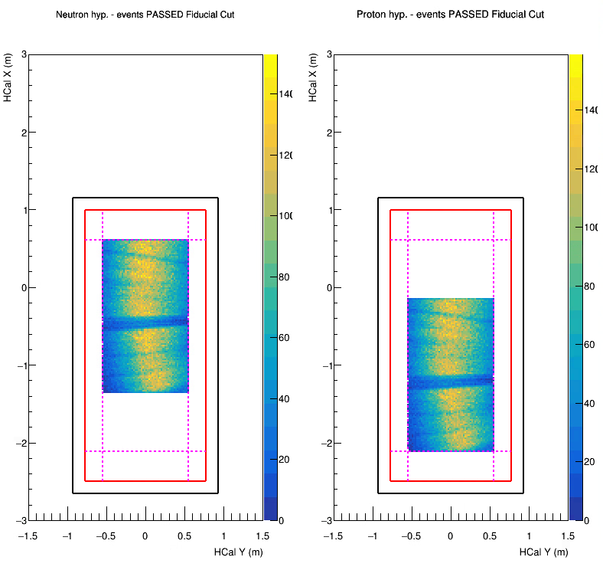
Event selection cnt.
Prior to Fiducial Cut
After Fiducial Cut
proton deflection
HCAL Physical Boundary
Matches the acceptance of D(e,e’n) and D(e,e’p) events which otherwise could be different due to the deflection of protons by the magnet.
Essential for accurate cross section ratio R.
HCAL Active Area Boundary
HCAL Safety Margin

Slide 14
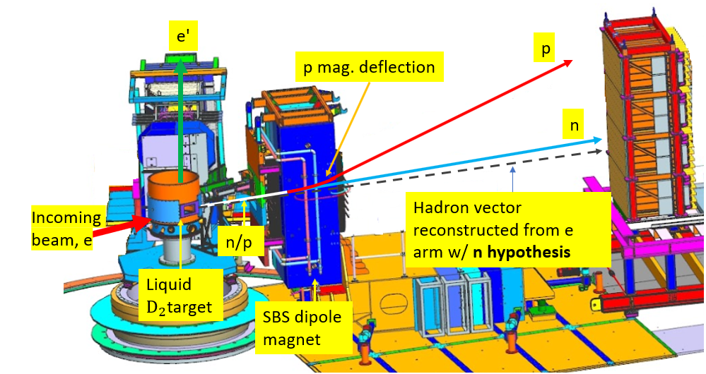
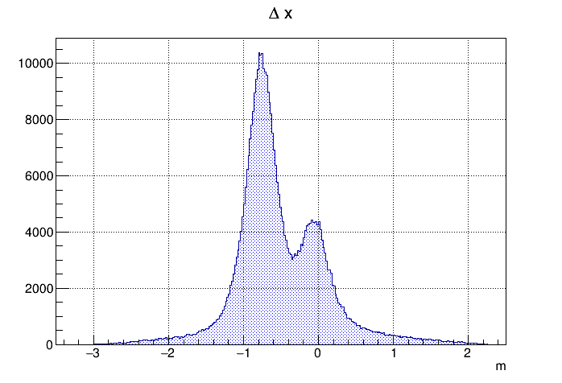
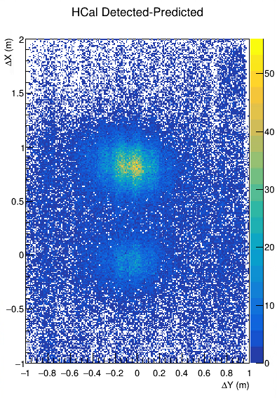
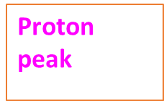

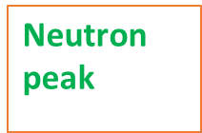


D(e,e’n) and D(e,e’p) yield extraction
The $Δx$ plot
Project on dispersive direction
Inelastic background
Detected HCal cluster pos. – Predicted pos. of a neutron hit on HCal from e’ kinematics
Multiple scattering, radiative effects, nuclear effects (in the Deuteron target), detector resolution, and detector efficiencies; all contribute to the signal and background profile.
Extracting quasi-elastic n and p yield ratio requires accurate knowledge of the shape of quasi-elastic peaks, and inelastic background → accomplished by event gen. + detector response simulations.

Slide 15

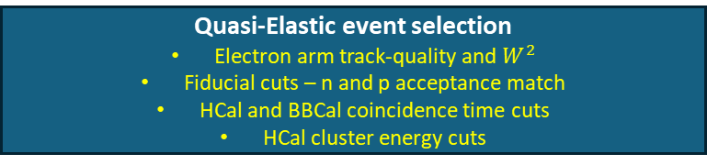
GMn analysis workflow
Raw data
SIMC D(e,e’n) and D(e,e’p) event generation
Nuclear effects
Radiative effects
Event reconstruction
Analyzer + SBS-OFFLINE + SBS-REPLAY
G4SBS Realistic detector simulation
Quasi-Elastic event selection
Electron arm track-quality and $W^{2}$
Fiducial cuts – n and p acceptance match
HCal and BBCal coincidence time cuts
HCal cluster energy cuts
Digitization pseudo raw-data
Event reconstruction
Analyzer + SBS-OFFLINE + SBS-REPLAY
D(e,e’n) and D(e,e’p) yield plot creation
Calculate q vector from e-arm variables
Using the neutron hypothesis (assuming no mag. deflection), calculate predicted hadron hit position on HCal
Create an Expected pos. – Detected pos. plot projection along the magnet dispersive direction
Apply same cuts as in real data analysis and make the same yield plots
Add inelastic + accidental background
Extract ratio R by fitting simulated data to real data
Systematic uncertainty studies on R
R and parameterization for $σ_{(e,e^{′}p)}$ and $G_{E}^{n}$
$$G_{M}^{n}$$

Slide 16
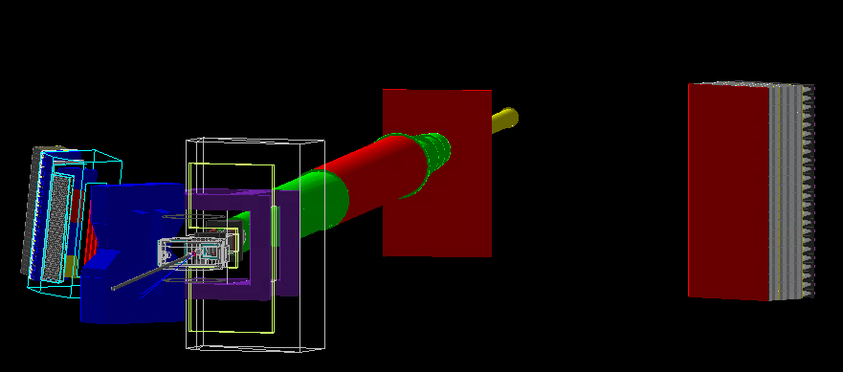
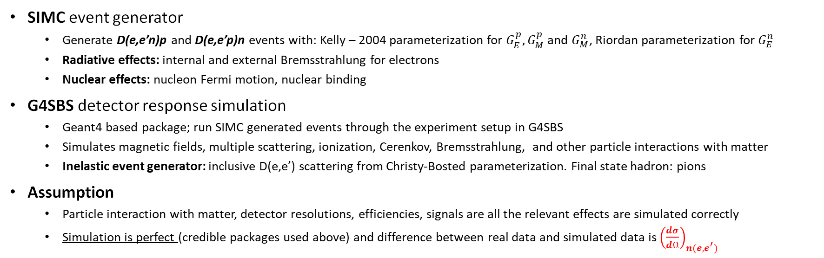
Quasi-elastic data simulation
SIMC event generator
Generate D(e,e’n)p and D(e,e’p)n events with: Kelly – 2004 parameterization for $G_{E}^{p},G_{M}^{p}$ and $G_{M}^{n}$, Riordan parameterization for $G_{E}^{n}$
Radiative effects: internal and external Bremsstrahlung for electrons
Nuclear effects: nucleon Fermi motion, nuclear binding
G4SBS detector response simulation
Geant4 based package; run SIMC generated events through the experiment setup in G4SBS
Simulates magnetic fields, multiple scattering, ionization, Cerenkov, Bremsstrahlung, and other particle interactions with matter
Inelastic event generator: inclusive D(e,e’) scattering from Christy-Bosted parameterization. Final state hadron: pions
Assumption
Particle interaction with matter, detector resolutions, efficiencies, signals are all the relevant effects are simulated correctly
Simulation is perfect (credible packages used above) and difference between real data and simulated data is ${\left(\frac{dσ}{dΩ}\right)}_{n(e,e^{′})}$
HCal
e-arm
Simulation environment
Target
h-arm magnet

Slide 17
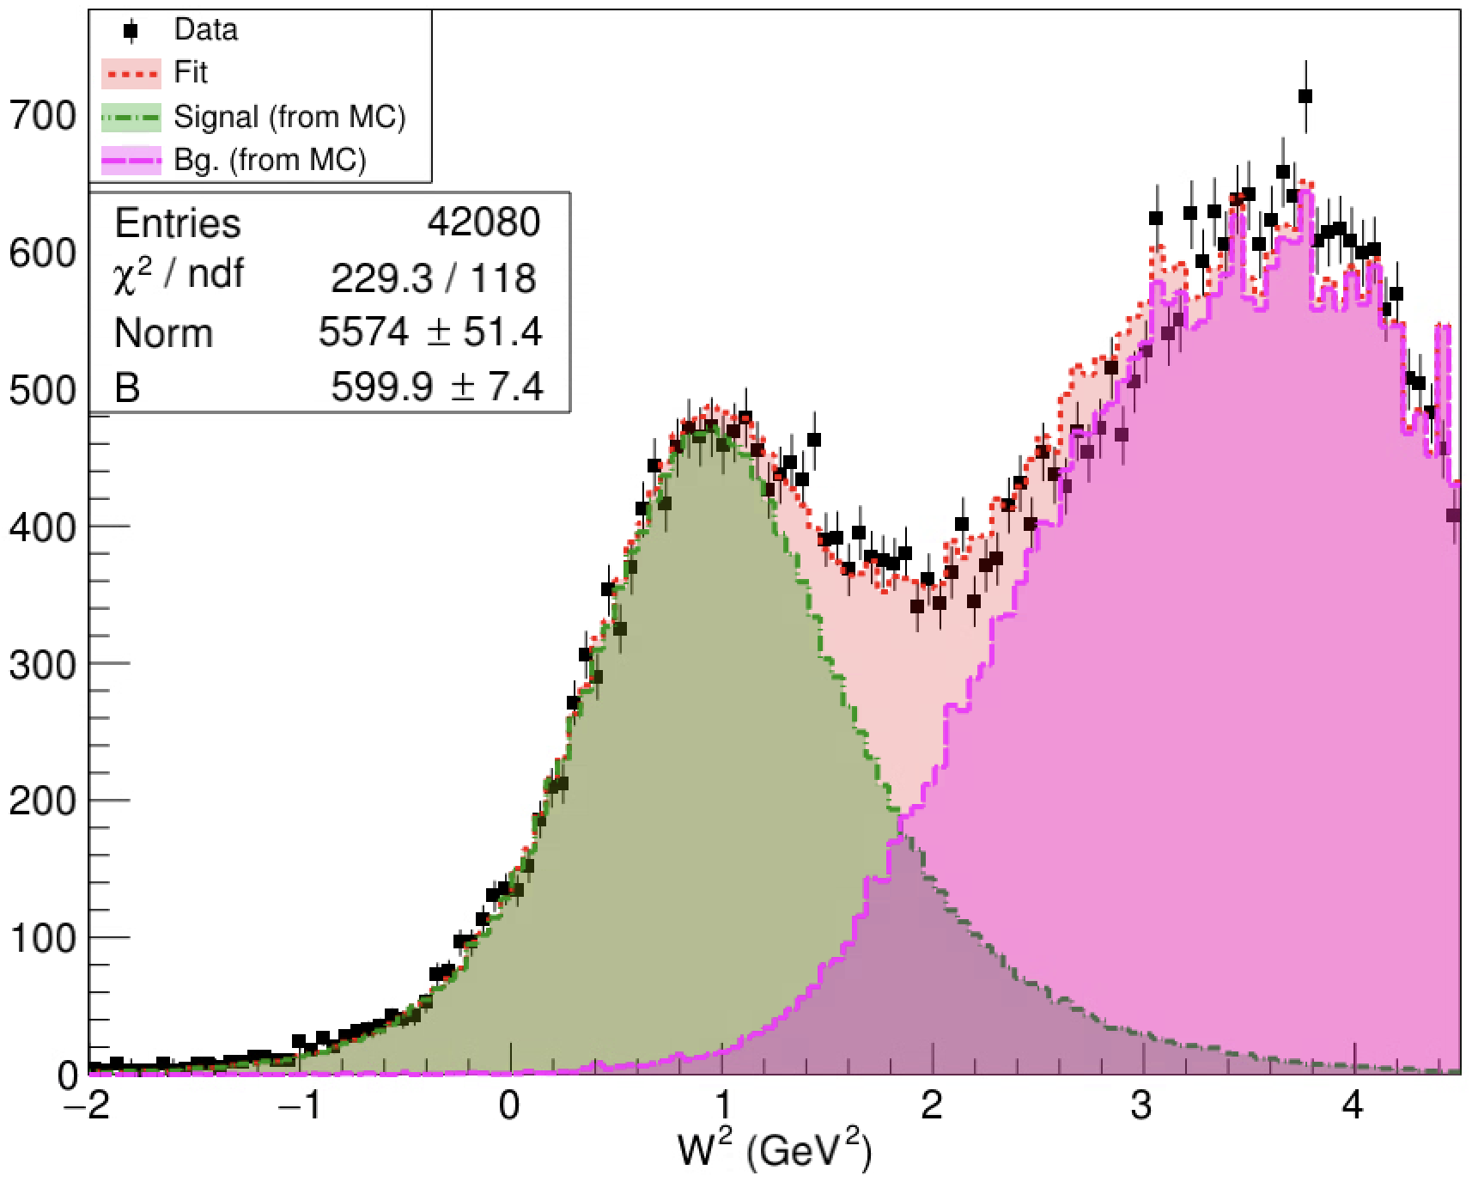
Qualitative Data/MC Comparison of the $W^{2}$ Distribution
Data/MC Comparison for Q² = 13.5 (GeV/c)²
Qualitative data/MC comparison looks encouraging even for the most challenging kinematics.
Notes:
Next, let us do a direct comparison of the W2 distributions from data and MC. Here is an example from the highest Q2 point. The black histogram represents data and the red line is the overall fit obtained by combining signal shape from QE MC and the background shape from inelastic MC. There are only two fit parameters here-a normalization parameter for the signal and one for the background. Clearly, the qualitative agreement of the overall fit to data is good over the entire range of interest, even at this kinematics, which is the most challenging one.

Slide 18
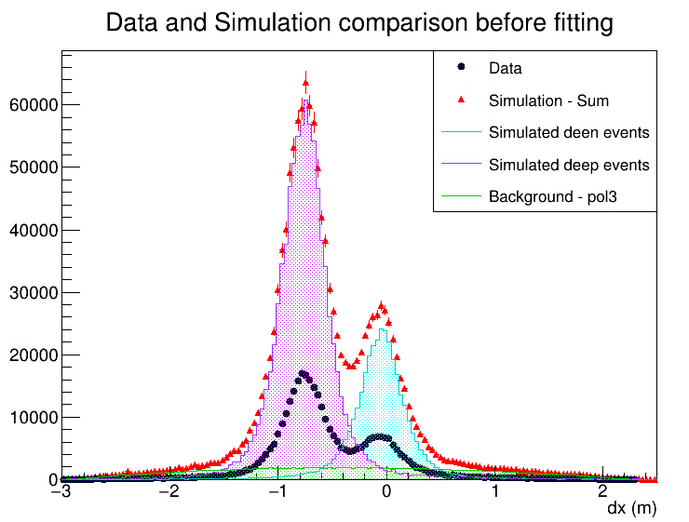
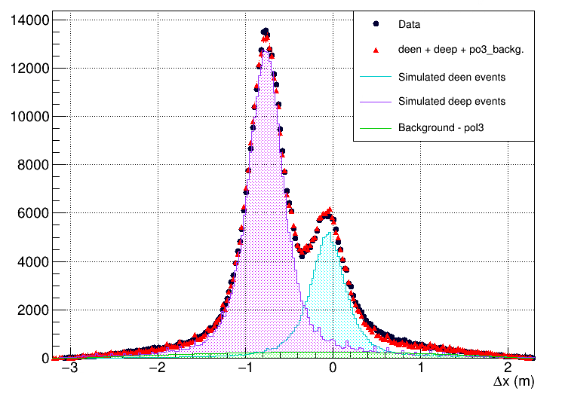
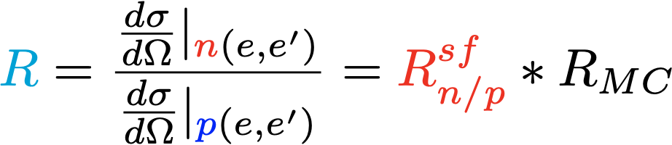
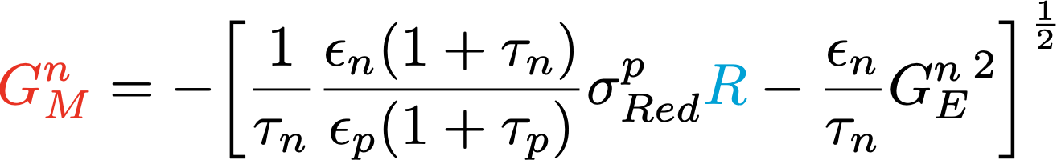

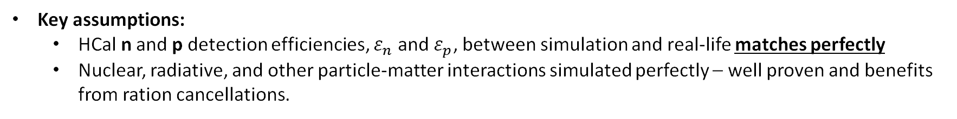




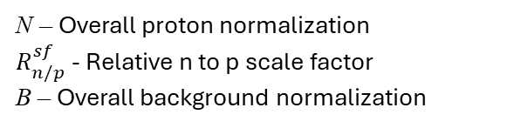
Extracting ratio R and GMN calculation
Before fit
Minimize $χ^{2}=\sum{\frac{{\left(D_{i}−S_{i}\right)}^{2}}{S_{i}}}$
After fit
N – Overall proton normalization $R_{n/p}^{sf}$ - Relative n to p scale factor
B – Overall background normalization
$$R_{MC}=\frac{{\left(\frac{dσ}{dΩ}\right)}_{n\left(e,e^{′}\right), MC}}{{\left(\frac{dσ}{dΩ}\right)}_{p\left(e,e^{′}\right), MC}}$$
$G_{M}^{n}$ calculation:
$Q^{2}=3.0 {(GeV/c)}^{2}$ data
Key assumptions:
HCal n and p detection efficiencies, $ε_{n}$ and $ε_{p}$, between simulation and real-life matches perfectly
Nuclear, radiative, and other particle-matter interactions simulated perfectly – well proven and benefits from ration cancellations.

Slide 19
Outline
SBS GMN experiment brief overview
Analysis methodology
Preliminary analysis results from Pass-2 mass replay
Calibration for Pass-3 mass replay
Summary and outlook

Slide 20
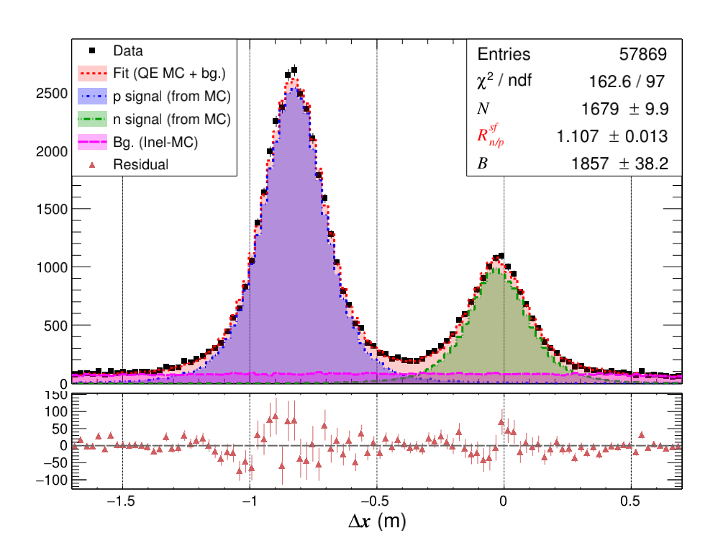
GMn Extraction from Data/MC Fit : $Q^{2}=7.4 {(GeV/c)}^{2}$
Residual
Notes:
Now, the question is how do we extract GMn from such a fit. Well, we begin with an assumption that our QE simulation accurately represents all the physics and detector effects that are known to be present in data. As mentioned earlier, we put in a lot of effort to make sure that it is the case. In light of that assumption, the fit parameter rnpsf, i.e. the …, becomes a measure of the .. and data. We can then multiply Rnpsf with the born cross-section calculated from MC, to get R, which is the born cross section ratio from data. Next, all that is left to do is to substitute R in this equation and get GMn. Now, the next step is to estimate the associated systematic uncertainties.

Slide 21
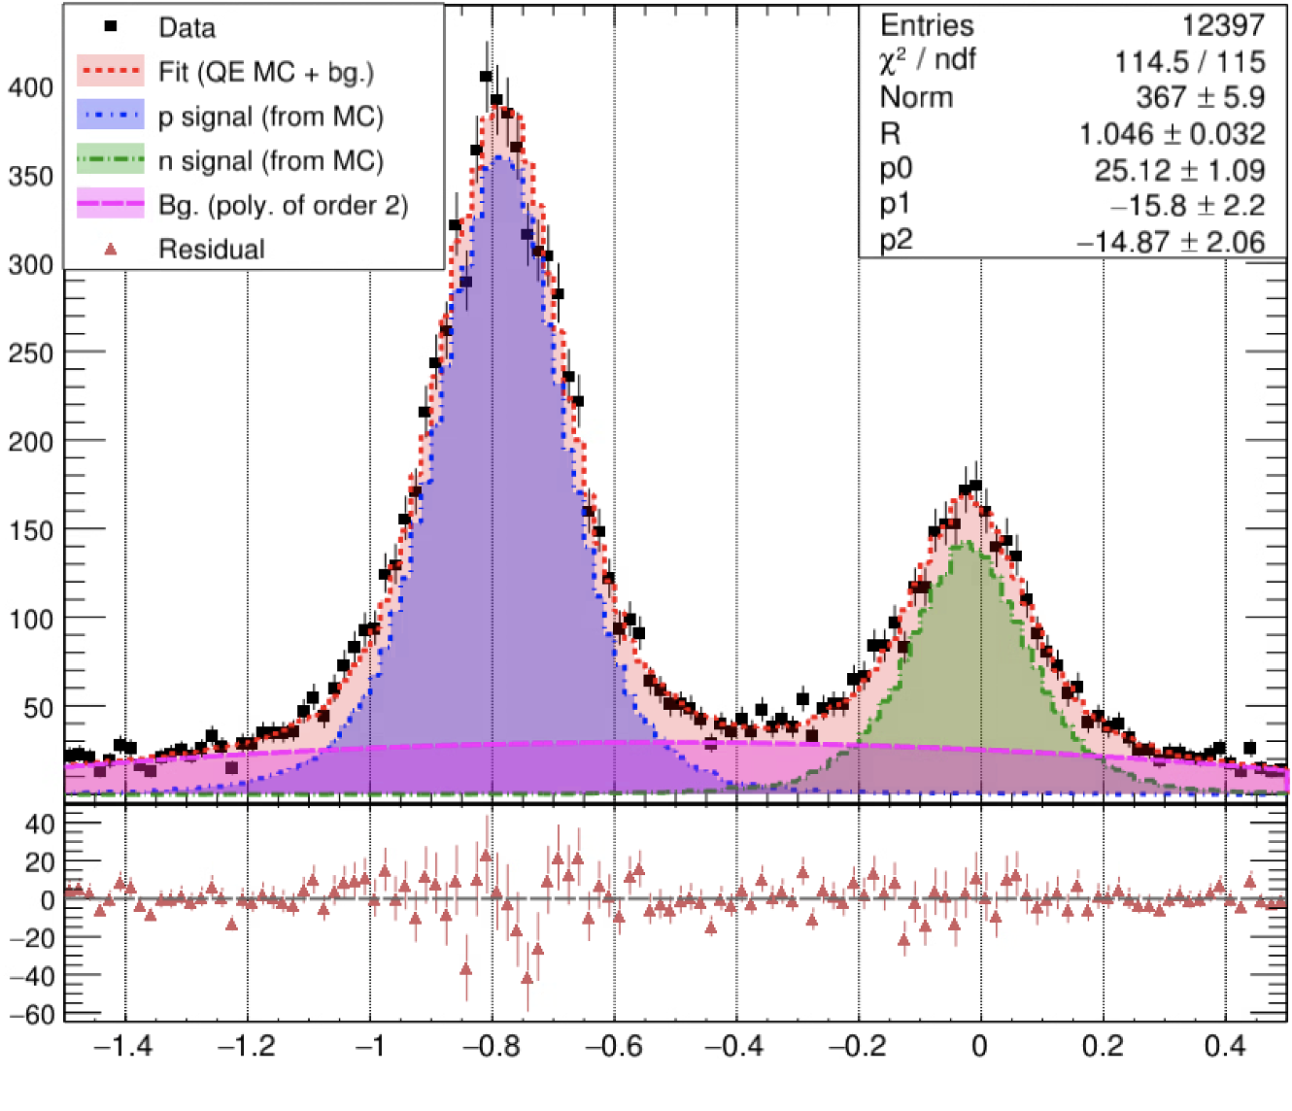
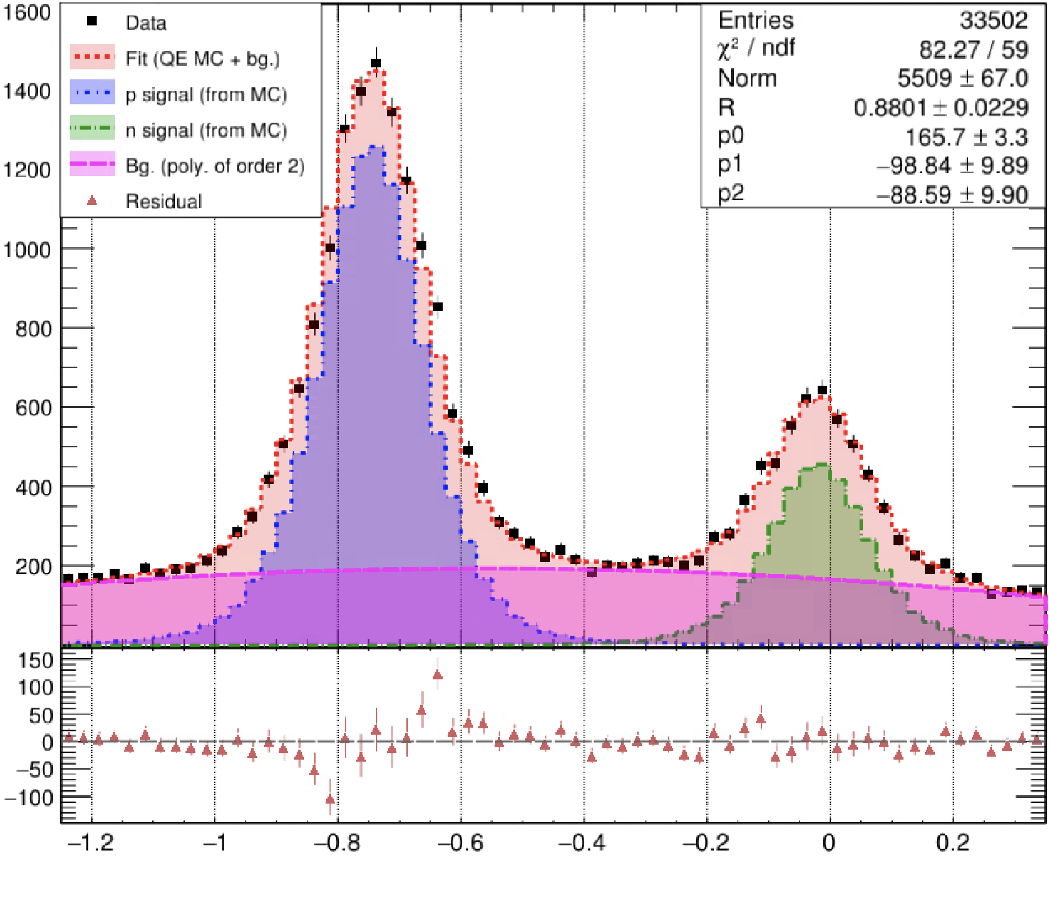

Data/MC Fit to $∆x$ Distribution for Higher $Q^{2}$ Points
Q² = 9.9 GeV², 0.2 $≤$ W² $≤$ 1.32 GeV², Fiducial Cuts
Q² = 13.6 GeV², 0.16 $≤$ W² $≤$ 1.44 GeV², Fiducial Cuts
$∆x$(m)
$∆x$(m)

Slide 22
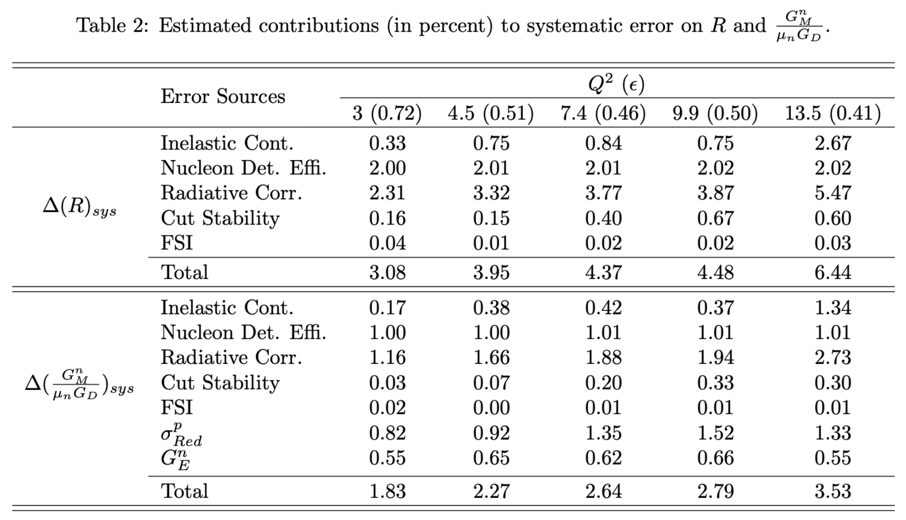
Total Systematic Error Budget (Preliminary)
Preliminary
Preliminary
Notes:
Our measurement is systematics dominated and here is the preliminary systematic error budget. Sorry, my intention was not to overwhelm you with information here. I just wanted to point out that inelastic cont, nde, and radiative corr are the most prevalent sources of systematic errors for our measurements. Also, note that the extraction of GMn from the ratio R, gives rise to two additional sources of systematic errors associated to the proton cross section and gen. Now, with the systematics estimation in hand we are ready to extract the preliminary results.

Slide 23
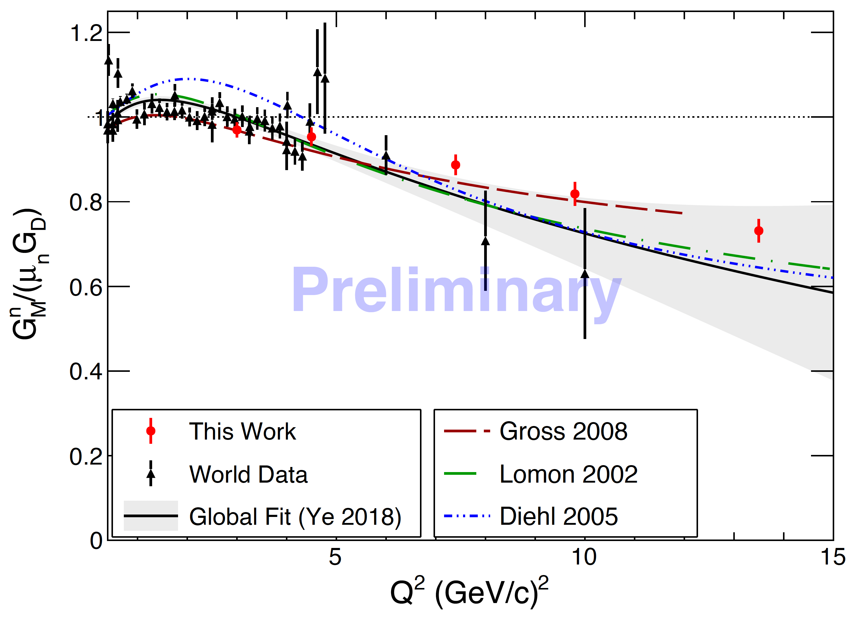
Preliminary Results from Pass-2 data (and MC)
Analysis credit: P. Datta
Statistical and Systematic errors have been added in quadrature.
Notes:
Here, the red filled circles represent the results from this work, where the statistical and systematic errors have been added in quadrature. The low Q2 results agree with the existing world data, represented by black filled triangles here, and the high Q2 results significantly extend the region in which GMn is known precisely! The precision of the highest Q2 point is expected to stay unmatched for many years to come, as there aren’t any approved experiment at the moment which will reach such high Q2, as far as I am aware. Here, the black line is the global fit to the existing world data from 2018. Clearly, our data shows a slower fall-off of GMn, providing new insights into the internal structure of the neutron.
Now, as you can imagine, the impact of these results on the quark form factors is significant and very interesting.
“covariant spectator model, where the photon interacts with one quark and the other two quarks are treated as an on-shell diquark with a definite mass.”

Slide 24
Outline
SBS GMN experiment brief overview
Analysis methodology
Preliminary analysis results from Pass-2 mass replay
Calibration for Pass-3 mass replay
Summary and outlook

Slide 25
Improved Timing Calibration
BB Hodoscope was supposed to give the event “start-time” 0.1-0.2 ns res.
Corrections for TOF variation of electrons within the BB acceptance needed.
Long-standing complications (trigger-phase) in comparing the TDC times from BB Hodoscope to the FADC times of BB SH,PS, and HCal prevented a timing calibration of the latter sub-systems w.r.t. the BB Hodoscope in Pass-1 and Pass2.
For Pass-3, the all the above tasks/roadblocks have been cleared and now we have aligned each sub-system w.r.t. the calibrated timing hodoscope – Thank you, Andrew Puckett and everyone who contributed!!!

Slide 26
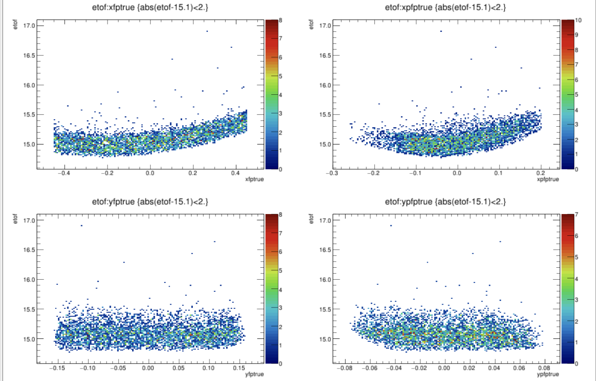
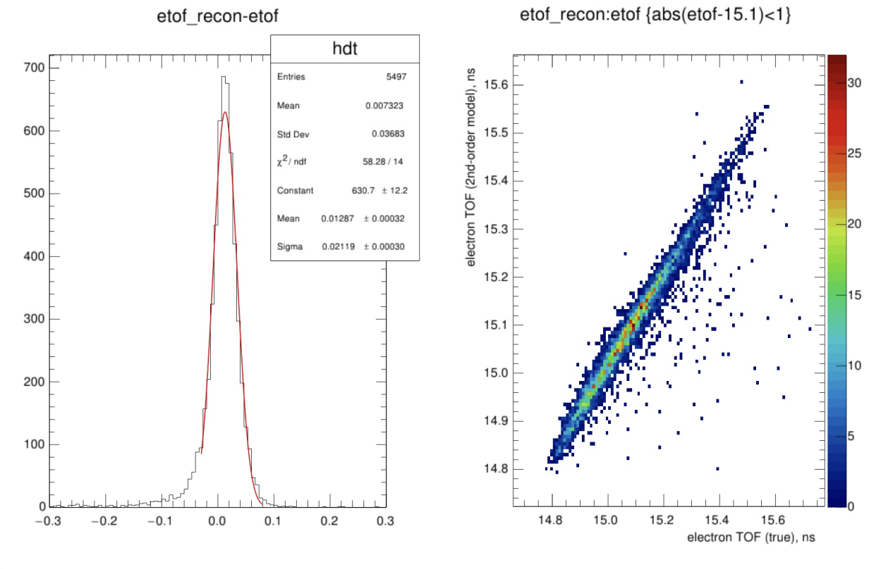
TOF within BB acceptance
In MC, electron TOF w/ focal plane variables observed.
Fit a 2nd –order expansion of the TOF (relative to the acceptance average) in all the fp variables just as it is done for the optics calibration.
Obtain TOF to within about 0.02 ns.
Replay new data w/ TOF corrections included.
Analysis: A. Puckett

Slide 27
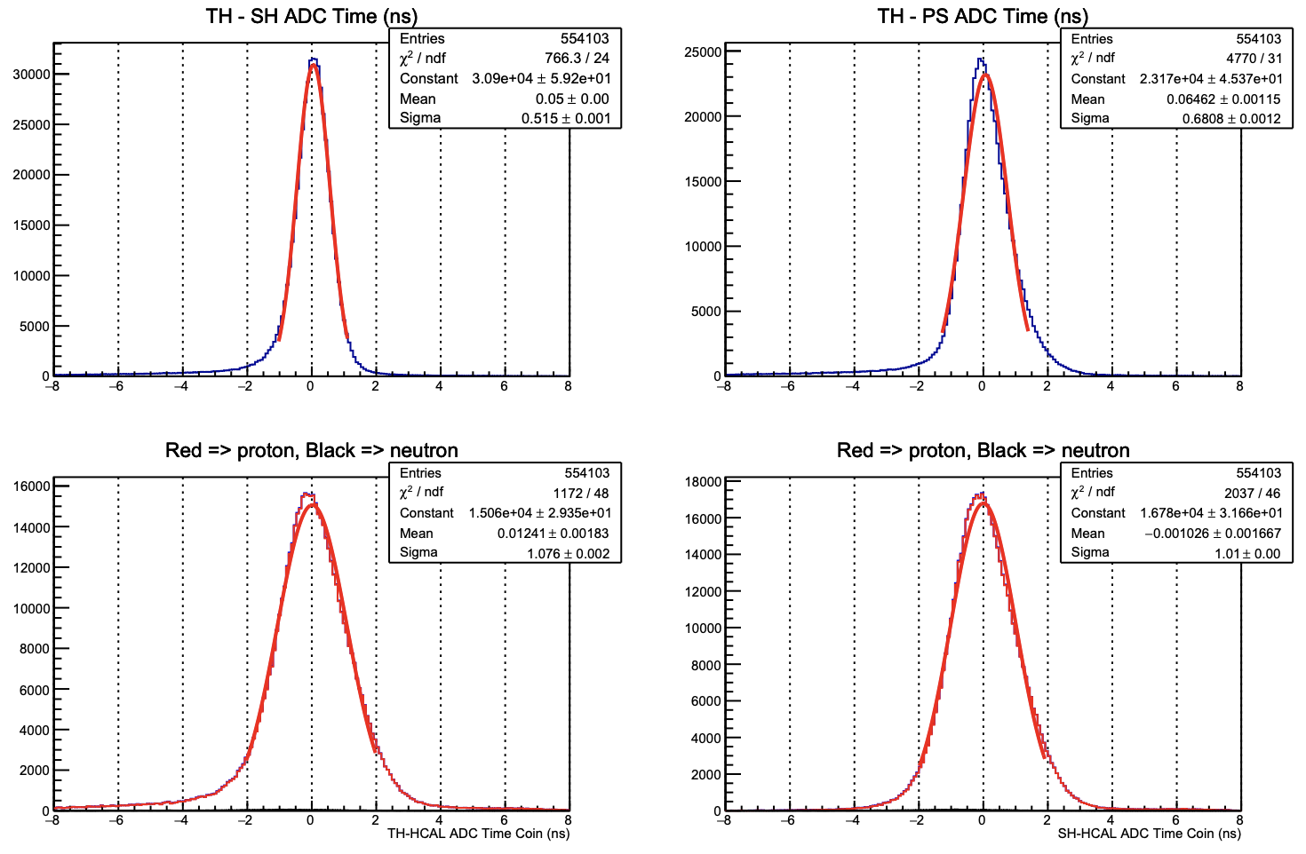
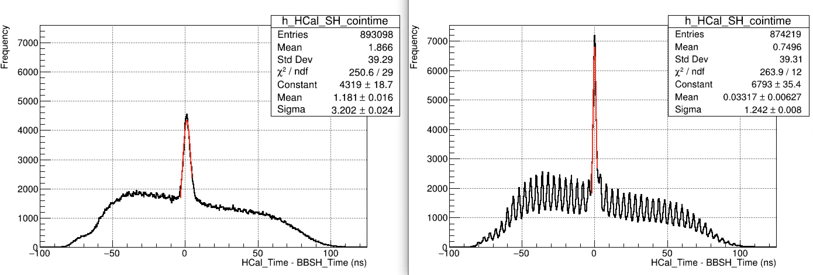
Consolidate Timing Calibration script brief overview
$SBS_REPLAY/scripts/hodo/TOFcal_consolidated.C now does the entire SBS neutron FF experiment timing calibrations of ALL subsystems. 4 loops of analysis on the same data set.
Loop1 : Internal alignment of hodoscope (i.e. minimize a chi-2 statistic defined by the squared differences between the hodoscope bars from the same cluster)
Loop2: Determine RF offsets for hodoscope paddles
Loop3: Fit hodoscope walk correction slop, propagation delay, and t0 offset, and set up internal alignment of BBCAL and HCAL FADC times and GRINCH TDC times.
Loop4: Align BB SH, PS, and HCAL w.r.t. to hodoscope.
Q2 = 13.5 GeV2 HCal – BB SH coincidence time improvements.
Pass-2
Pass-3
4 ns beam bunches

Slide 28
Outline
SBS GMN experiment brief overview
Analysis methodology
Preliminary analysis results from Pass-2 mass replay
Calibration for Pass-3 mass replay
Summary and outlook

Slide 29
Pass-3, final analysis, and publication…
Pass-3 mass replay is on-going as of right now: expect ~ 2 weeks.
Final Physics analysis to follow.
1-2 months expected timeline.
No major additions to the analysis and simulation machinery planned.
Paper drafting has commenced. To be completed once the Pass-3 results are ready.
A BIG THANK YOU TO GMN analysis team once again!!!
Thank You!

Slide 30
Backup

Slide 31
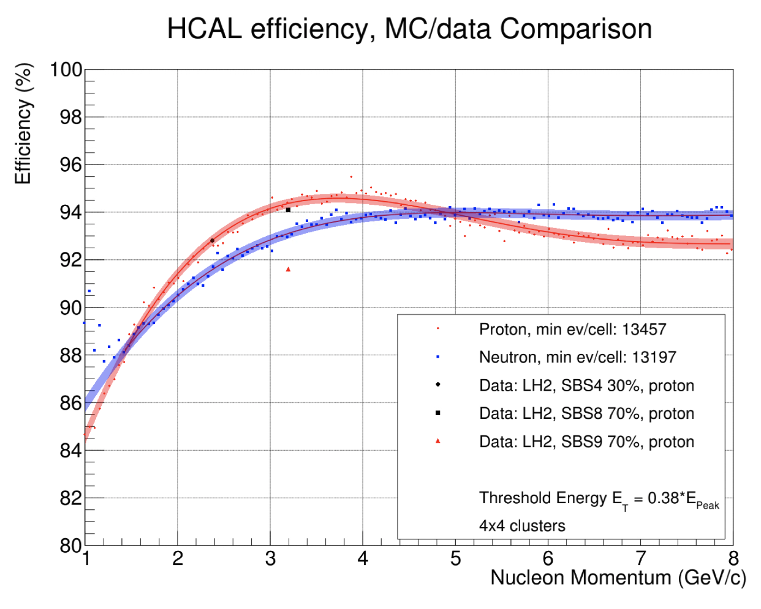

HCal detection efficiency calibrations
Courtesy of S. Seeds
Use elastic scattering data from liquid $H_{2}$ target for proton det. efficiency
For neutron, more complicated
In the process of using a separate reaction channel in the liquid $H_{2}$ data
Exclusive single pion photo-production: $γ+p→π^{+}+n$
$π^{+}$ detected in the electron arm which are bent down by the magnet as opposed to the e bent up
Will have to completely rely on Bremsstrahlung photons generated within the target as no radiator was used

Slide 32




HCal neutron detection efficiency
HCal boundary
Any down-bending track in the e-arm is not from $p(γ,π^{+})n$ !
Multi-body final state reactions also generate $π^{+}$
But they have smaller momentum loosely speaking
There could be overlap between single-pion and multi-body channel’s pion momenta
Use $p(γ,π^{+})π^{0}n$ to find max $π^{+}$ momentum threshold of multi-body channels for a given beam E and polar scattering ang $θ$ → “End-Point” technique
Select tracks that have momentum 1.5% higher → Account for the BigBite momentum resolution
Reconstruct the neutron track and see whether it will hit HCal → Denominator
See whether there is a good HCal cluster within a reasonable radial dis → Numerator
neutron spot →
HCal cluster pos - predicted pos.
Will be used to extract numerator of the efficiency calculation
Denominator events – only a small portion ($≈$15%) of the detector is illuminated

Slide 33


Inelastic Contamination
Q² = 7.4 (GeV/c)²
Bg. shape from data
Bg. Shape from Inelastic MC
2nd order polynomial
Perform data/MC fit to $∆x$ distribution using multiple background models.
Compute standard deviation of $R_{n/p}^{sf}$ values extracted from these fits.
Quote the result as the systematic uncertainty due to inelastic contamination.

Slide 34



Cut Stability
The choice of optimal cut region has some associated uncertainty.
We vary each cut range by +10% and -10% while keeping the other cuts constant at their optimized values. Then, for each variation extract $R_{n/p}^{sf}$.
One standard deviation of the resulting $R_{n/p}^{sf}$ distribution is quoted as the associated systematic uncertainty.

Slide 35




HCAL pDE – Data/MC Comparison
Dispersive
Non-Dispersive
Data
MC
Data
MC

Slide 36

TOF consolidated – RF offsets

