Slide 1

GEp-V High Rate Tracking Using GEMs
Jacob McMurtry
for Hall A Collaboration Winter
January 22nd, 2026
on behalf of the Jefferson Lab SBS Collaboration

Slide 2




Acknowledgements
The UVA Group: N. Liyanage, H. Nguyen, A. Ahmed, B. Dharmasena, N. Kularatne, V. Vishvanath, V. Gamage & Alumni: A. Rathnayake, J. Boyd, S. Jeffas, X. Bai
The entire SBS Collaboration, in particular GEp spokespeople: A. Puckett, B. Wojtsekhowski, E. Cisbani, L. Pentchev M. Jones, N. Liyanage; GEp Grad students: B. Spaude, J. Su, N. Hunt, M. Gomina, V. Vishvanath
Jefferson Lab Staff for their support
US Department of Energy, Office of science, Office of Nuclear physics award number DE-FG02-03ER41240

Slide 3
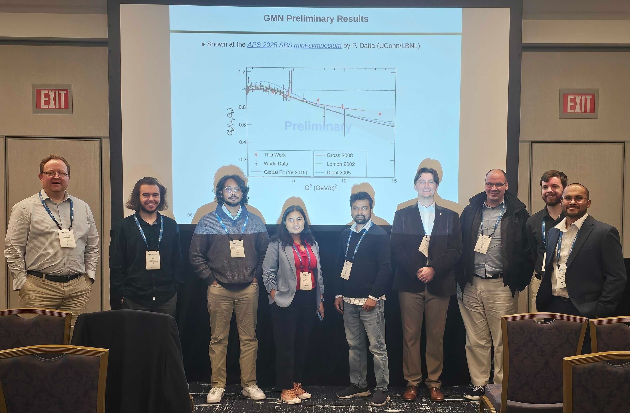
Special Thanks
Andrew Puckett
Anuruddha Rathnayake
Vidura Vishvanath
Notes:
Andrew Puckett, the brains behind SBS tracking, Anu (Uconn post doc and former fellow UVA grad student) who is one of the leaders in Gep tracking efforts and who’s been of monumental help, and fellow UVA graduate student Vidura with whom I’ve worked closely with on GEM and tracking analysis

Slide 4
Overview
GEM Tracking Detectors:
Selection criteria
Working Principle
Use in GEp-V
Event Reconstruction
Hit and track finding algorithms
Region of Interest and track constraints
Challenges
Occupancies
Electronic Saturation
Ongoing Efforts

Slide 5
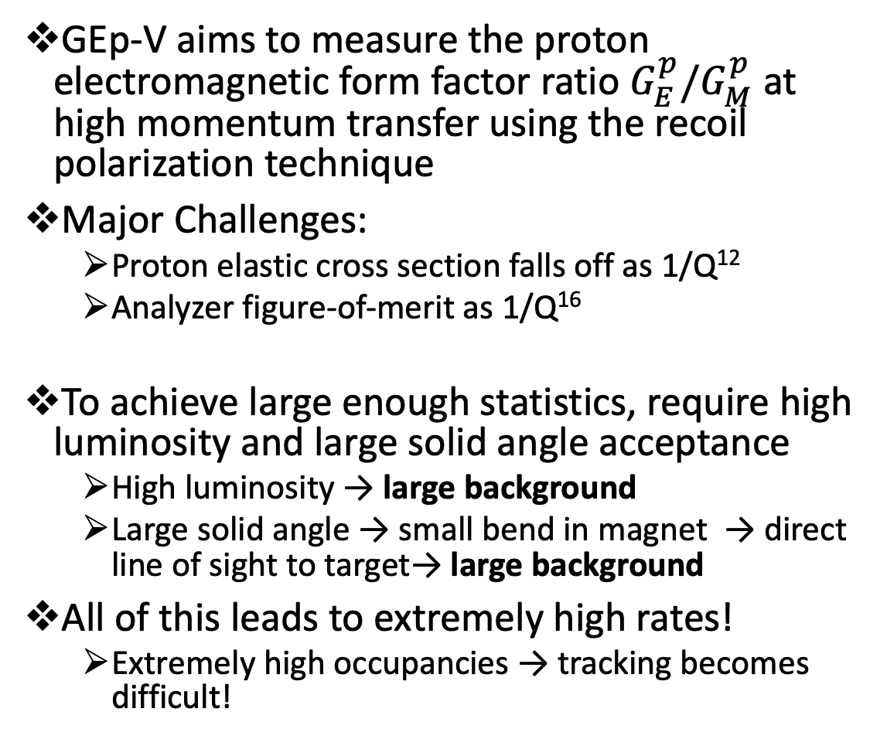
GEp-V Experiment & Requirements
GEp-V aims to measure the proton electromagnetic form factor ratio $G_{E}^{p}/G_{M}^{p}$ at high momentum transfer using the recoil polarization technique
Major Challenges:
Proton elastic cross section falls off as 1/Q¹²
Analyzer figure-of-merit as 1/Q¹⁶
To achieve large enough statistics, require high luminosity and large solid angle acceptance
High luminosity → large background
Large solid angle → small bend in magnet → direct line of sight to target→ large background
All of this leads to extremely high rates!
Extremely high occupancies → tracking becomes difficult!
Plot: A. Puckett

Slide 6
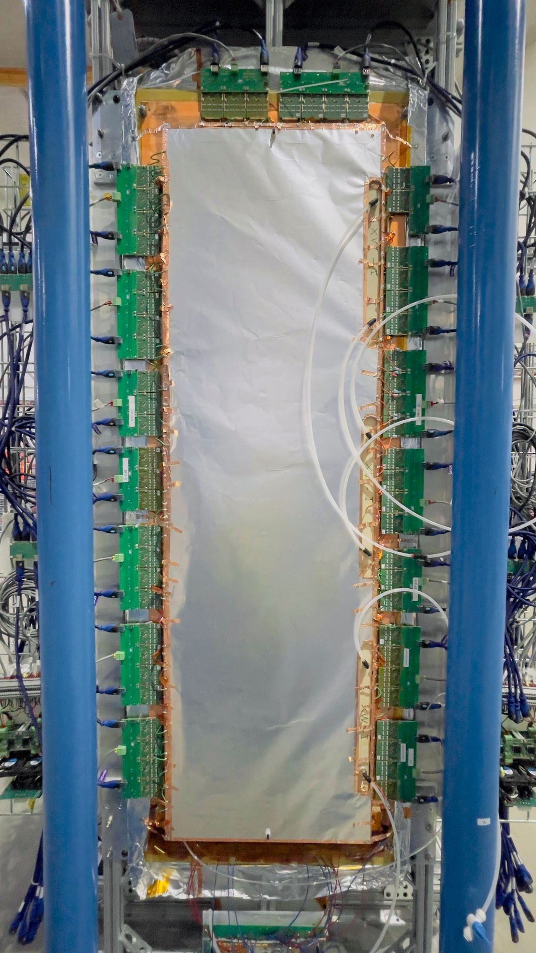
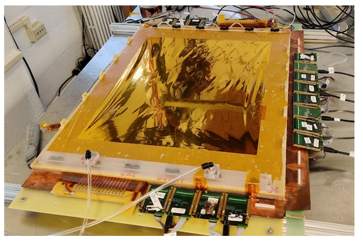
Gas Electron Multiplier Tracking Detectors
Choice of tracking detector must meet the requirements:
Large active area (~0.5 – 1.5 m²)
High-rate capabilities (~500kHz/cm²)
Excellent spatial and timing resolution
Gas Electron Multiplier (GEM) tracking detectors
Can withstand rates on the order of MHz/cm²
Spatial resolution < 70 µm
Timing resolution < 10 ns
Large area coverage capability
Low thickness minimizing multiple scattering (X₀ ~ 0.5%)
Less expensive than alternatives

Slide 7
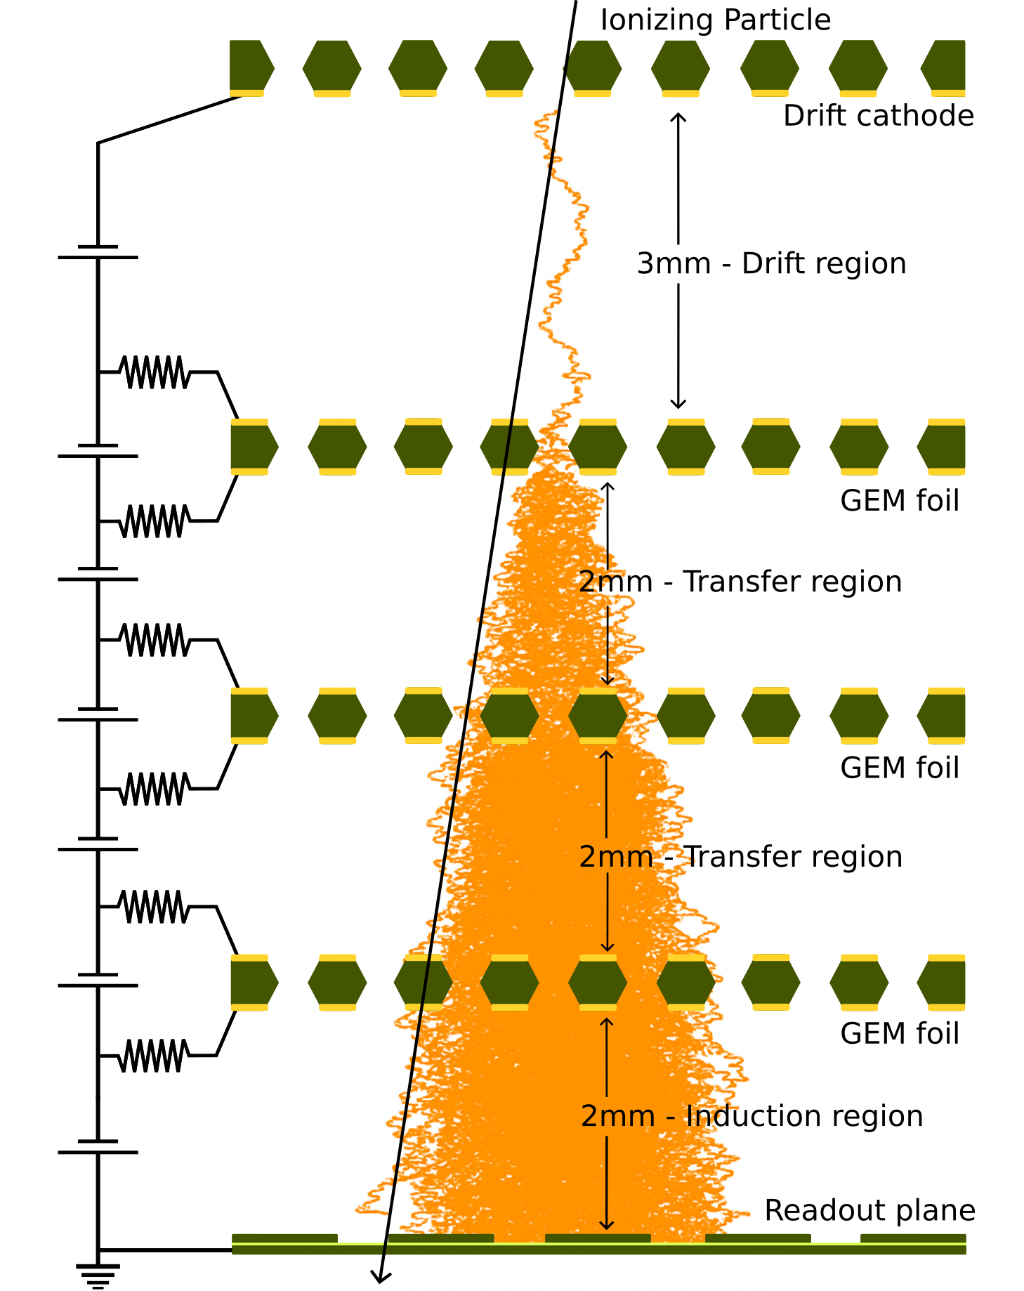
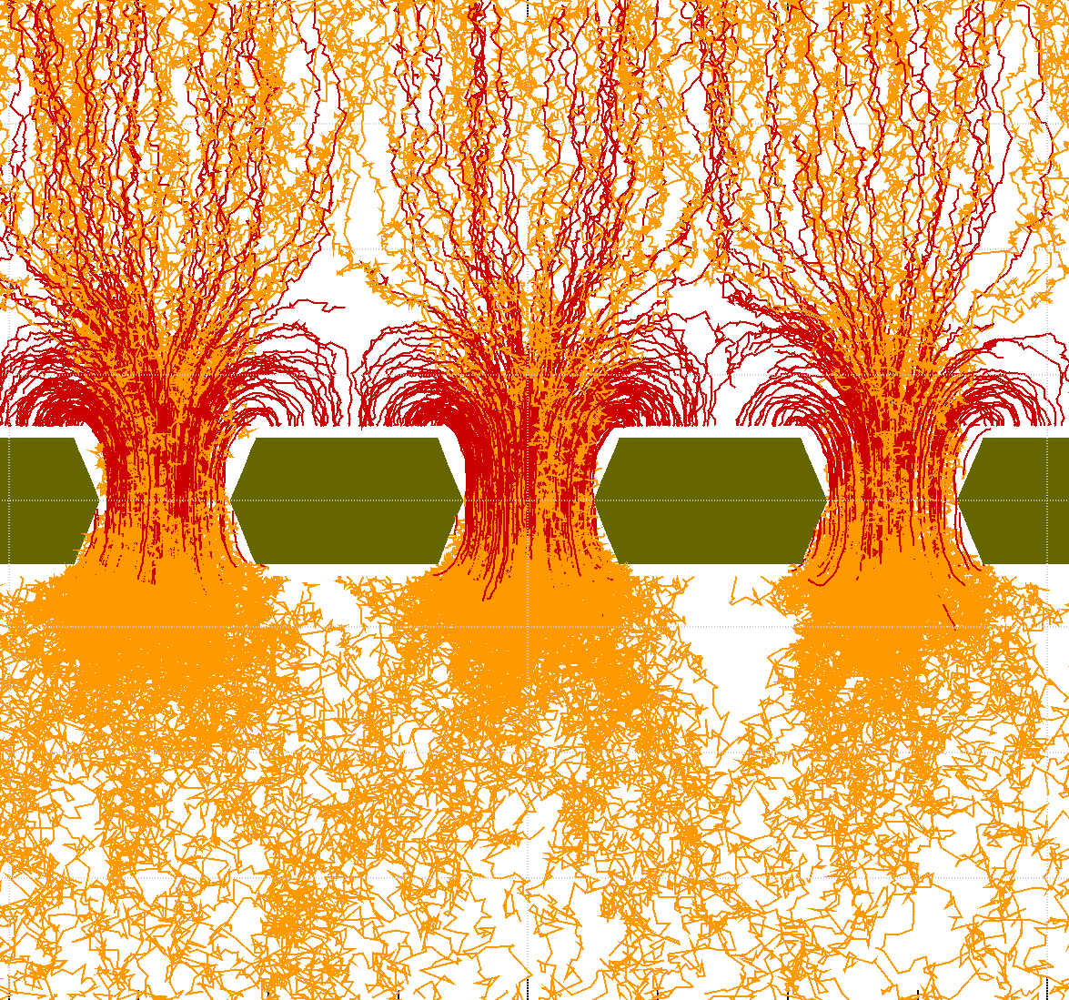
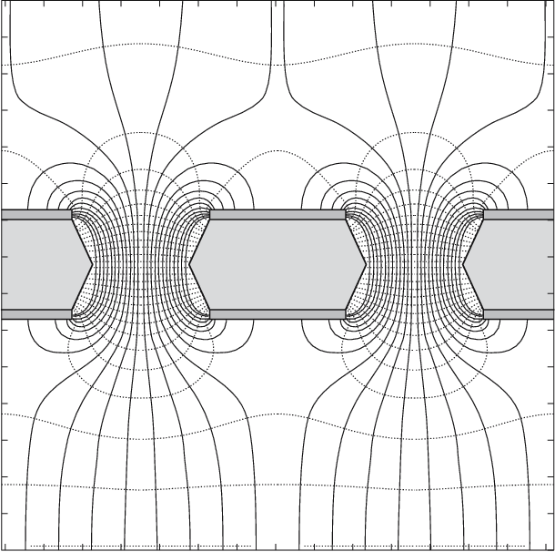
GEM Working Principle
Detector consists of cathode and anode (readout plane) separated by GEM foils
Layers are spaced only a few millimeters apart
Entire region filled with inert ionizable gas (ArCO2 73:27)
A GEM foil is a perforated film double sided with copper, high voltage applied between copper layers induces a strong electric field within the hole
Incident particle ionizes gas producing a small shower of primary electrons in the drift region
Electrons undergo avalanche multiplication while moving through the strong electric fields generated in GEM
Signal is induced on a 2D strip based readout plane by the avalanching electron cloud
APV25 based readout electronics provide an ADC value for each strip discretized into 25 ns bins, X and Y position reconstructed
F. Sauli, Development and applications of gas electron multiplier detectors, Nucl. Instrum. Meth. A 505 (2003) 195–198.
Figure: V. Vishvanath

Slide 8
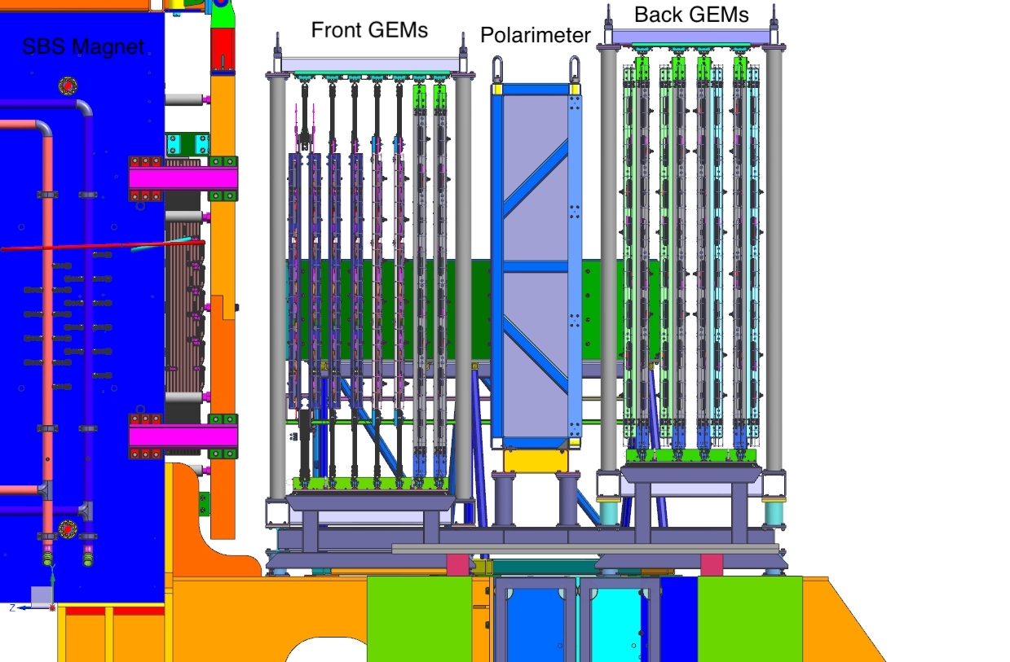
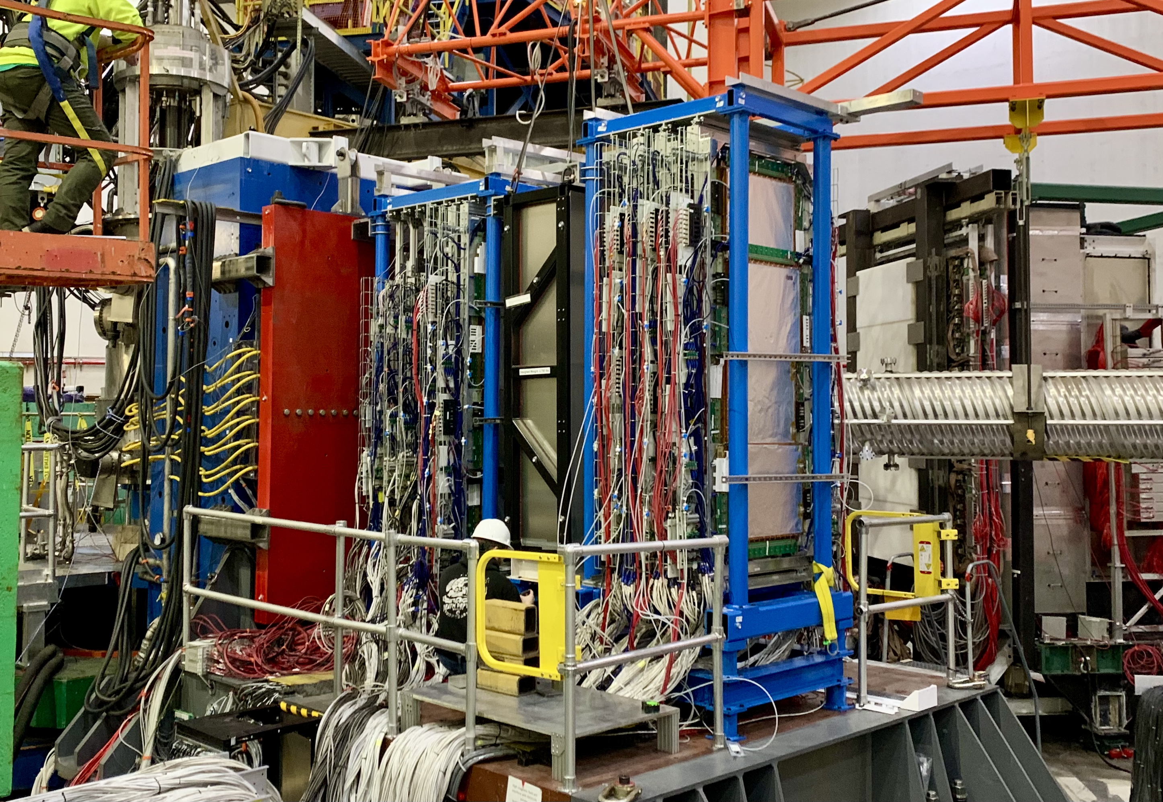
Configuration in the Experiment
46 individual modules and over 150,000 read-out channels
Largest collection of GEM detectors at the time, surpassed now by the CMS upgrade
Front Tracker:
Momentum reconstruction
Track proton from target into the analyzer
6 XW and UV GEM layers (40x150 cm²)
2 XY layers (60x200 cm²)
Focal Plane Polarimeter
Polarimetry
Track proton out of the analyzer
8 XY layers (60x200 cm²)

Slide 9
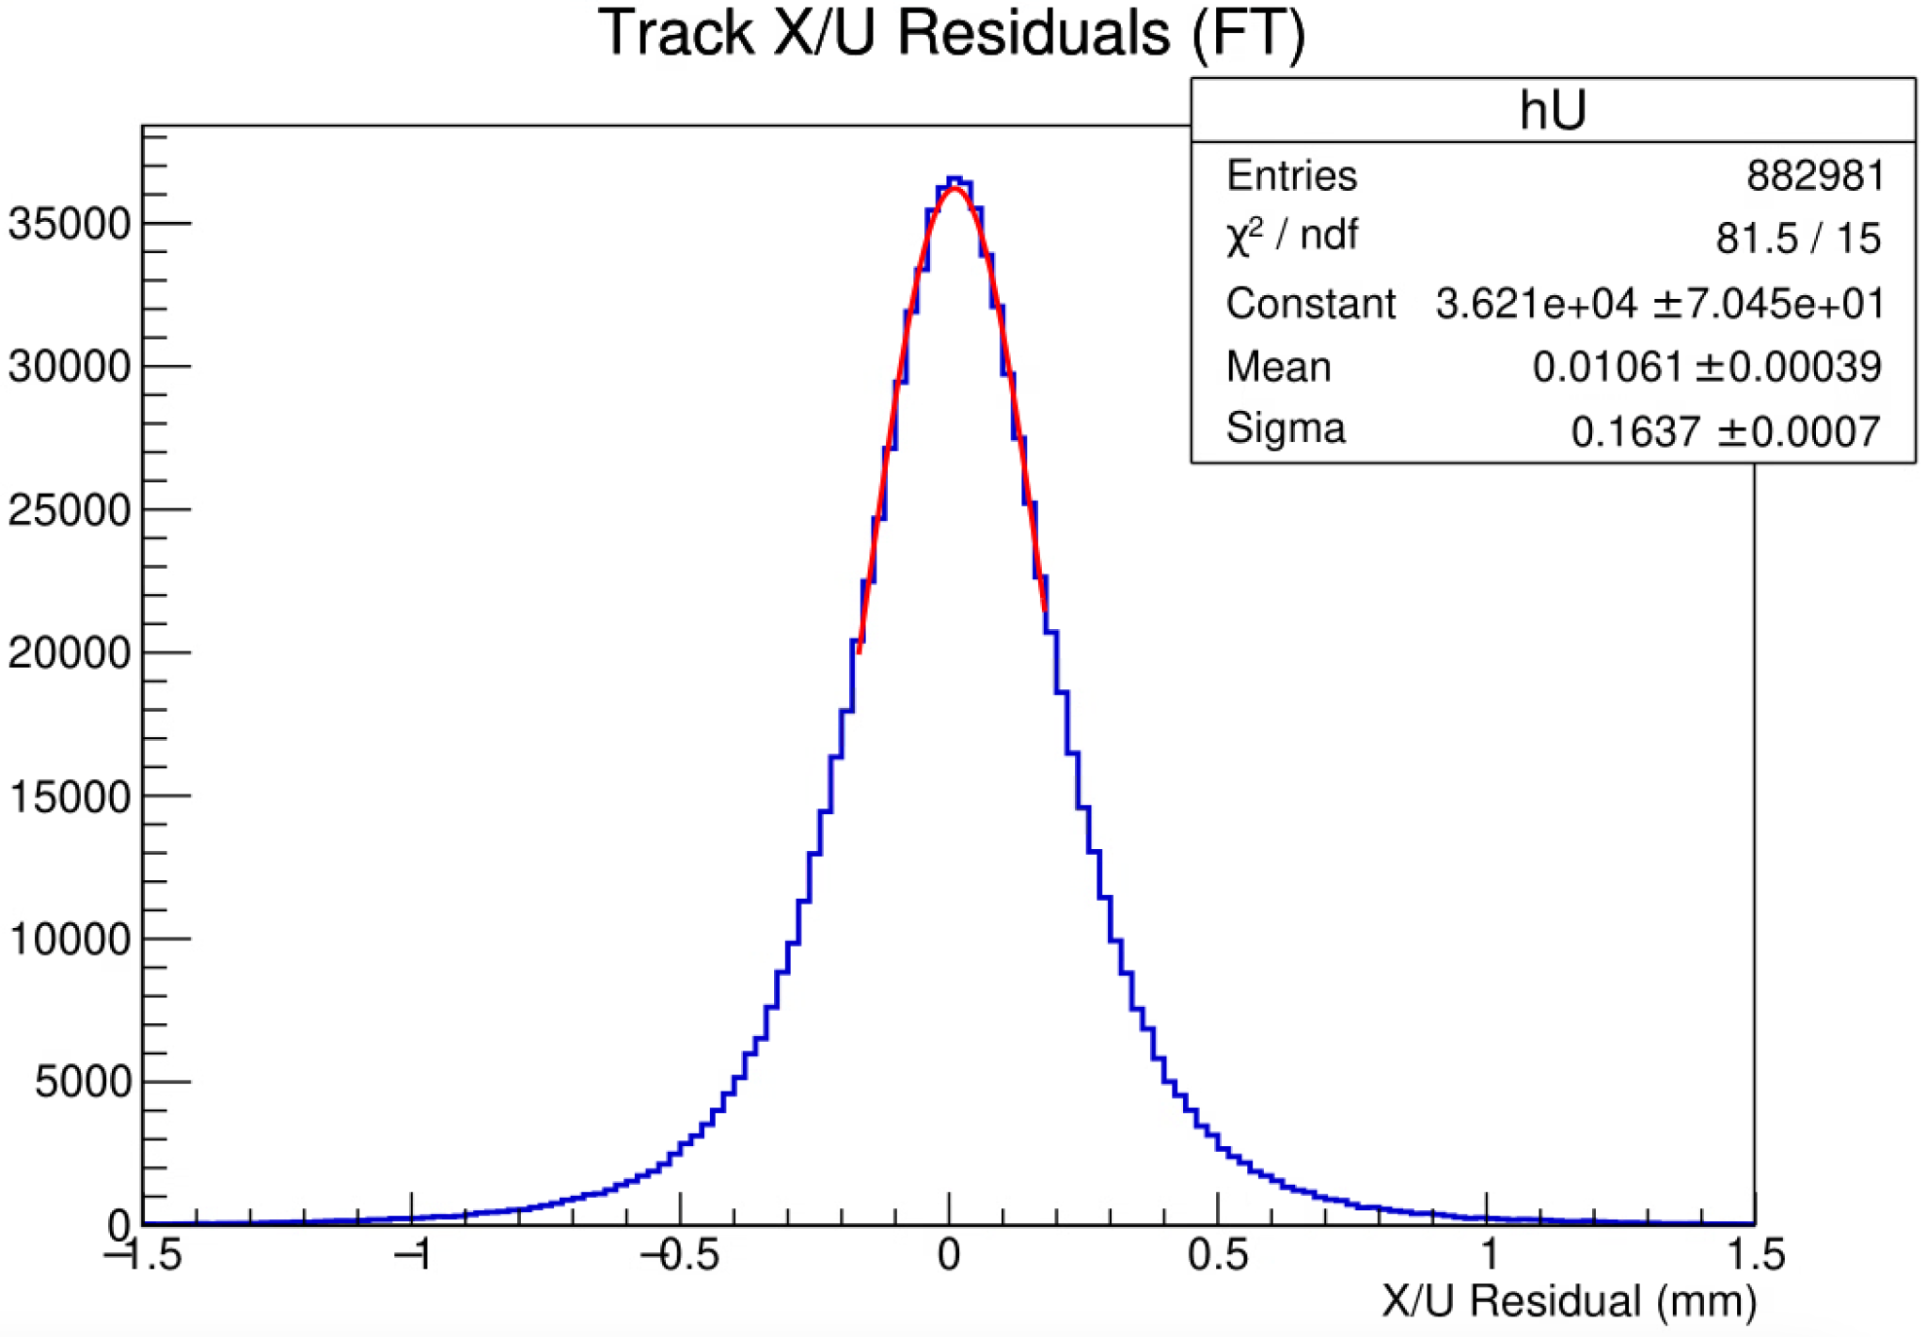
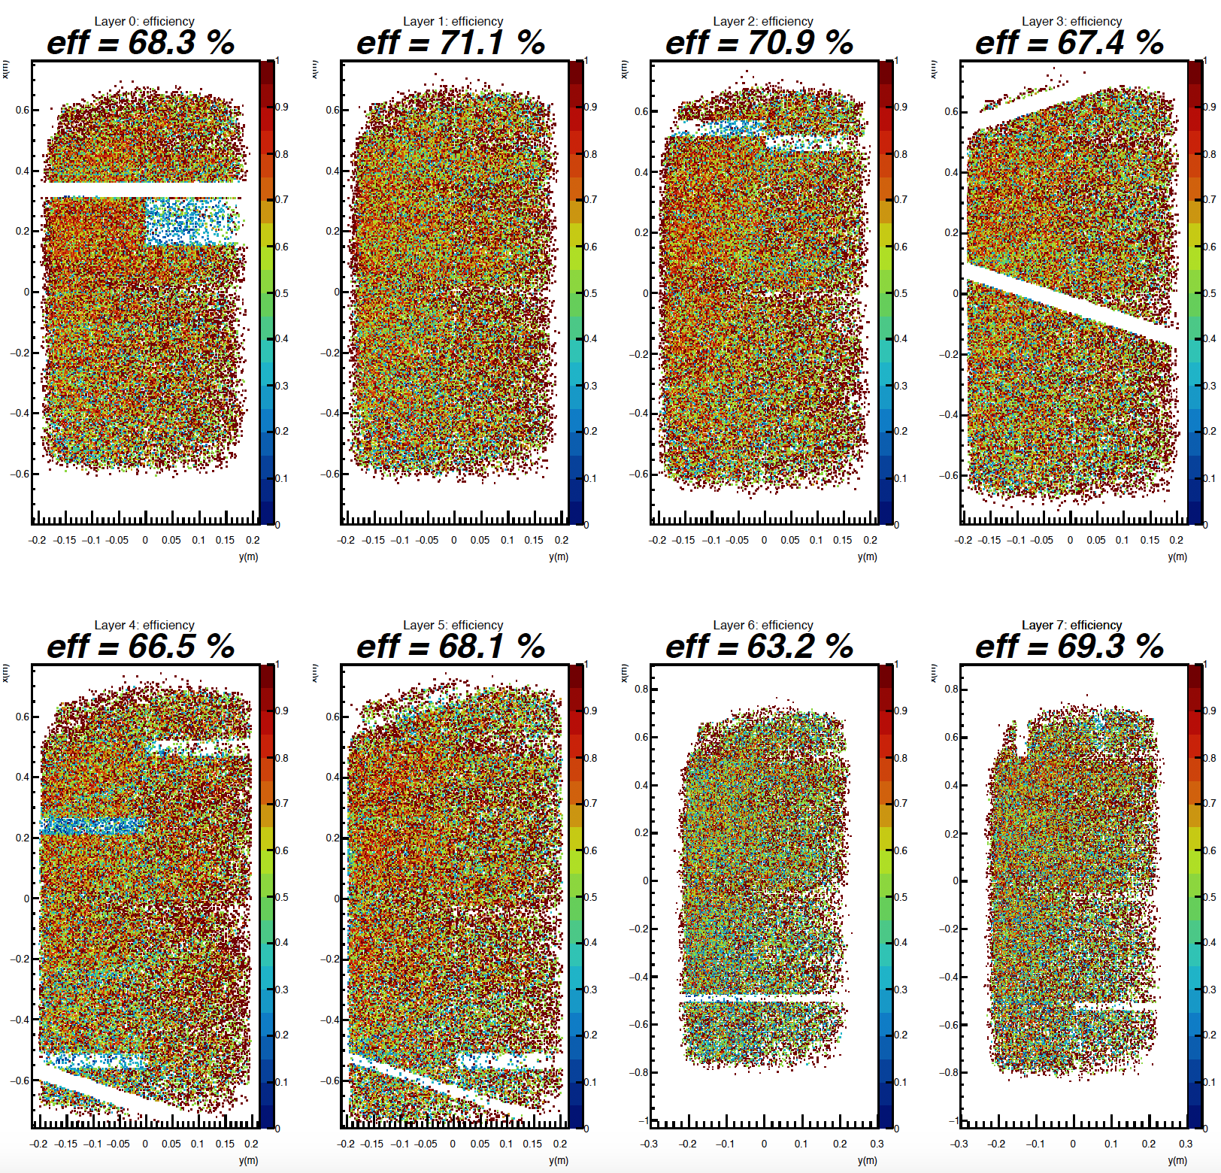
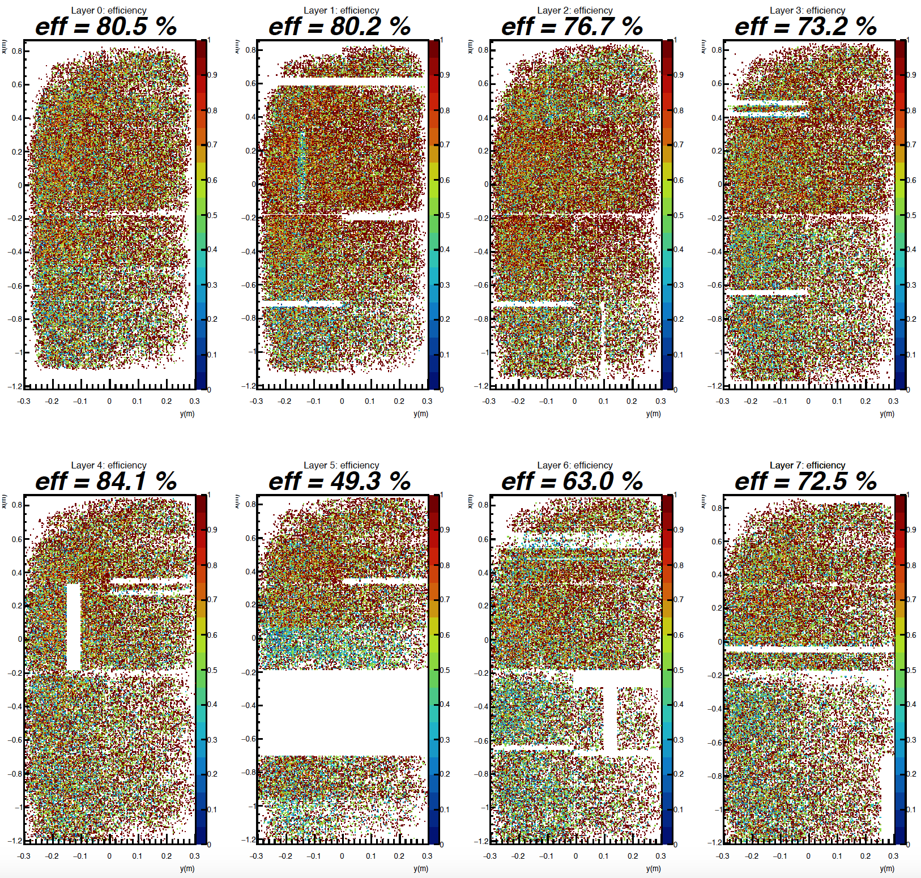
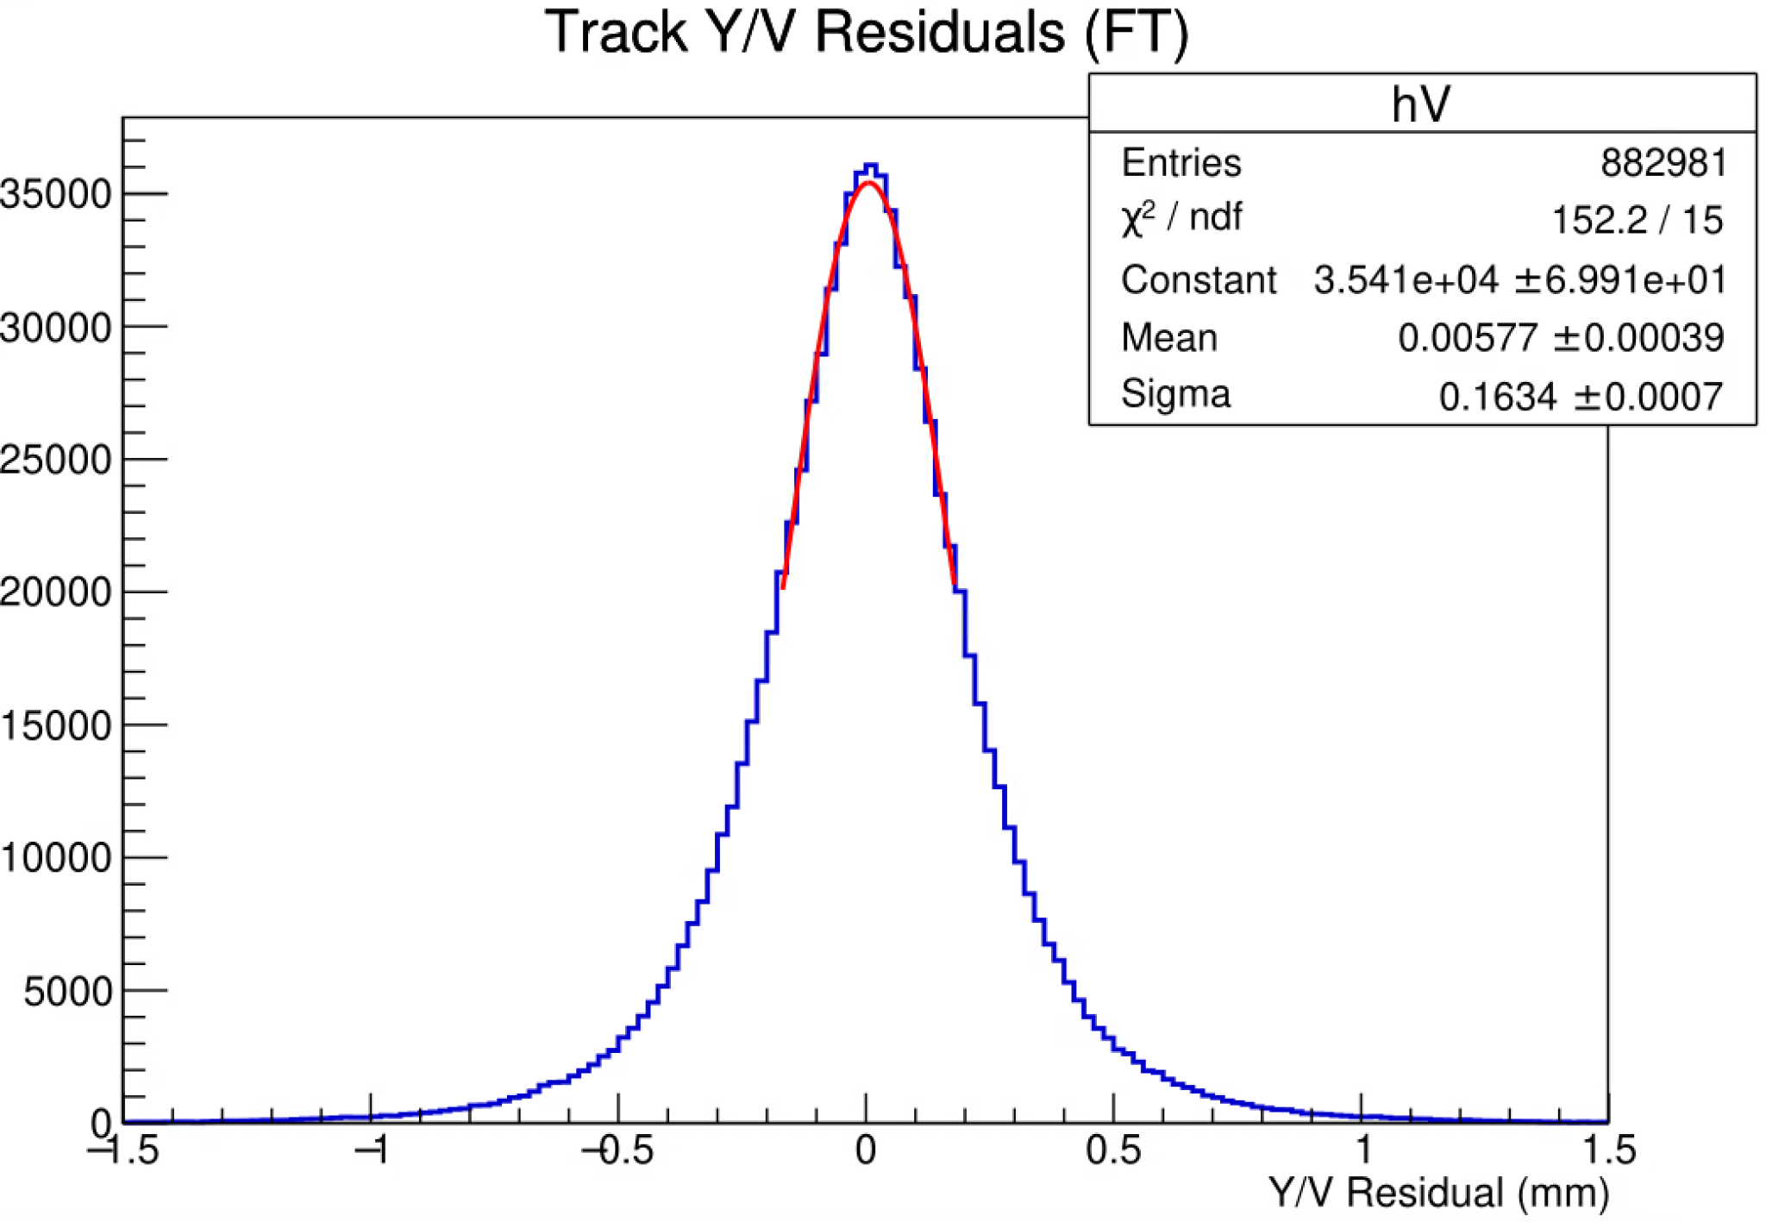
Performance During GEp
Front Tracker efficiencies (Q² = 11.1 GeV²)
Back Tracker efficiencies (Q² = 11.1 GeV²)
Empty regions are due to readout electronic malfunctions.
Less illuminated horizontal regions across half width are due to dead HV sectors in gem foils.
Intrinsic track residuals for the FT (Q² = 11.1 GeV²)
(σ_{x}, σ_{y} ) ~ 164μm, 163μm
This module was off
Plots above show the first look into to the track-based efficiencies of the both front and back trackers
Proton tracks used here have passed a series of coincident ECal and HCal timing cuts, GEM track quality cuts, and calorimeter energy and position matching cuts, in order to select elastic ep events
Only ~10 out of 1560 HV sectors failed during the experiment

Slide 10
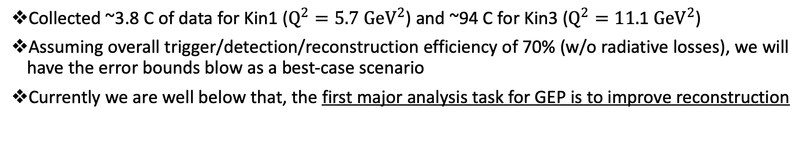
Importance of GEp Event Reconstruction
Collected ~3.8 C of data for Kin1 ($Q^{2}=5.7 {GeV}^{2}$) and ~94 C for Kin3 ($Q^{2}=11.\text{1} {GeV}^{2}$)
Assuming overall trigger/detection/reconstruction efficiency of 70% (w/o radiative losses), we will have the error bounds blow as a best-case scenario
Currently we are well below that, the first major analysis task for GEP is to improve reconstruction
Plot: A. Puckett

Slide 11
Overview of GEp/SBS Analysis Machinery
“.evio” Raw data files from CODA
G4SBS
Geant4 based simulation for SBS experiments
Elastic/inelastic/gun event generation
Detector/spectrometer response simulation
Returns energy depositions
Event Reconstruction
SBS_OFFLINE
Built “on” Hall-A analyzer / Podd
Inherits from a lot of base classes in Podd but includes extensive additions
Decoding
Detector level reconstruction
Spectrometer level reconstruction
Physics variables for further analysis
SBS_REPLAY
Data Bases to store detector / spectrometer specific information like channel maps
Set replay parameters/thresholds
Definitions of outputs from replay
Replay scripts that use SBS_OFFLINE machinery to steer analysis
LIBSBSDIG
Library for digitization of simulation output
Converts g4sbs time, position, energy deposit etc., into ADC, TDC, crate, slot, channel, etc.
ROOT files with output TTree branches for interactive physics analysis
Notes:
Analysis machinery for GEp has been largely developed from previous SBS experiments. Raw data “evio” files are generated by the daq. From there SBS_offline is software built on the hall-a analyzer which handles decoding and detector level reconstruction. SBS_Replay is used to configure SBS offline and contains important detector parameters and output definitions. The output of SBS_offline are root files containing branches for interactive physics analysis. In addition to these are G4SBS, which is used for simulating elastic events, and Libsbsdig, which converts G4SBS energy deposition information to detector level information. SBS_offline then uses a simulation decoder class to convert digitized info to the same output we expect from real data.

Slide 12
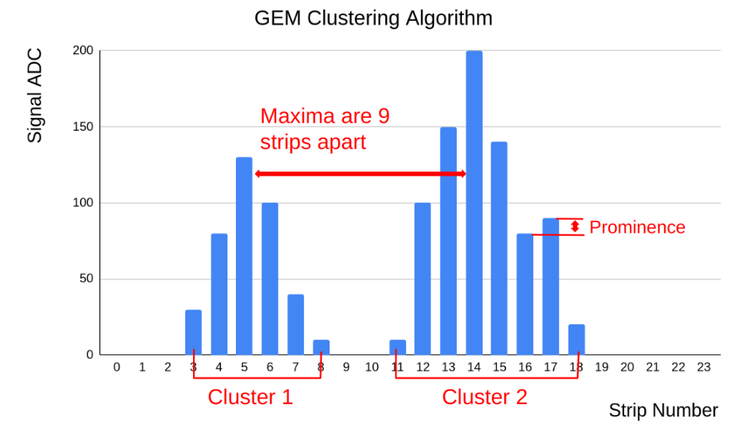
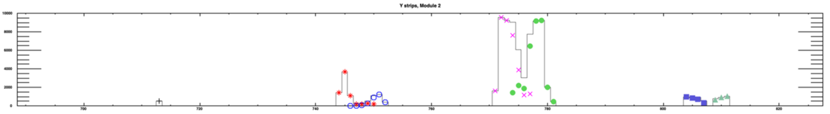
GEM Hit Reconstruction: 1D Clustering
1D clustering: combine “strip hits” caused by the same MIP/ionization cloud in each dimension (U/V)
Loop on all fired strips and make a list of strips with “local maxima” of ADC values → apply thresholds and timing cuts
For each local maxima, check for contiguous higher peaks either to the left or to the right and evaluate the current peak’s “prominence” compared to the higher peak if found. If “not-prominent”, remove the current strip from list of local maxima
Now using the above list of refined local maxima as “cluster seeds”, grow the local maxima into individual clusters
However, there could be still overlapping clusters and therefore cluster splitting is needed
If there is another local maxima within a specified distance to the local maxima in question, consider that to be from a different cluster, and calculate the contribution from that cluster to the current cluster as a function of local maxima ADC strength and distance
Continue growing the cluster around the seed considering the ADC weighted time differences and Pearson correlation coefficient
Calculate cluster properties such as position, avg ADC, ADC asymmetry, avg time, and etc.
Plot from S. Jeffas
Plot from A.Puckett

Slide 13
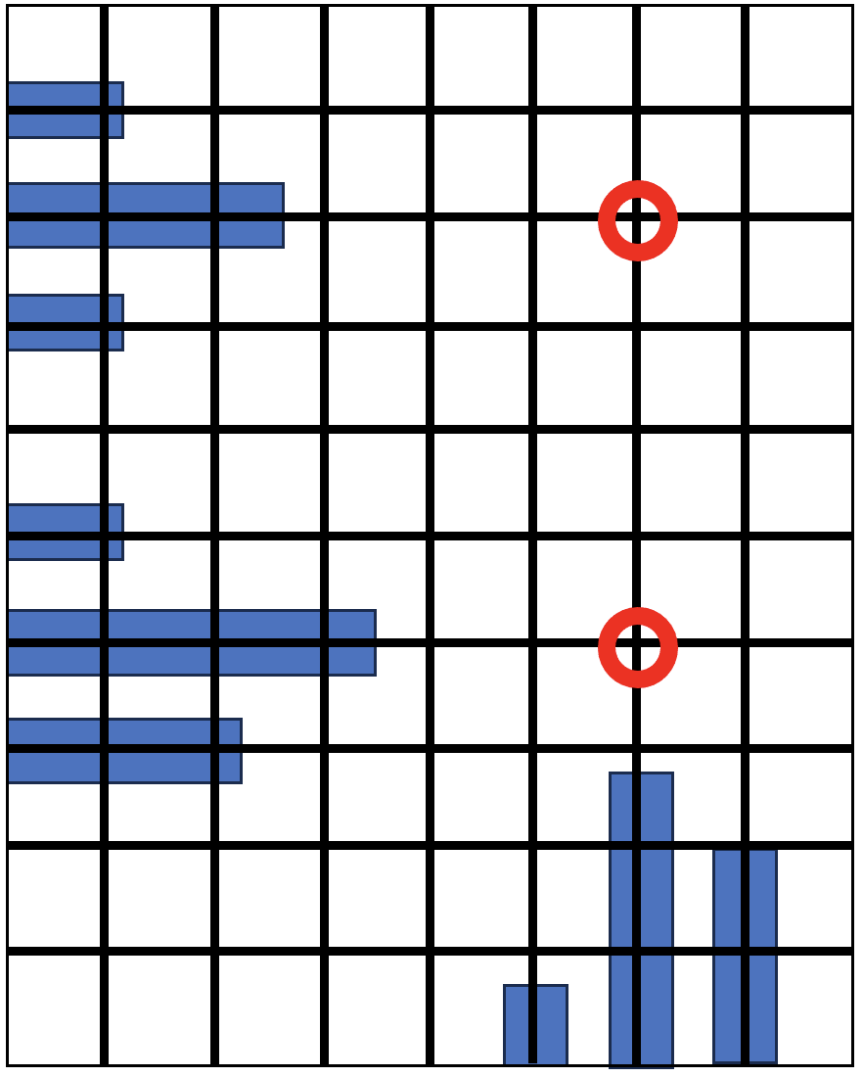
GEM Hit Reconstruction: 2D Hit Formation
2D hit formation: by comparing each U and V cluster
First check whether the 2D hit is within the detector active area / constraint region
Check U-V cluster ADC correlation via Pearson coefficient test
Check U-V cluster time difference
Check ADC asymmetry
If all this criteria is met, the 2D hit is marked to be “kept”

Slide 14
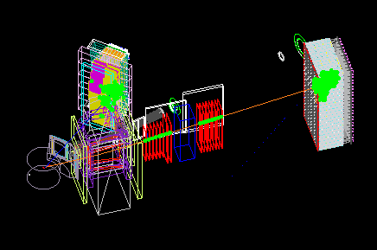
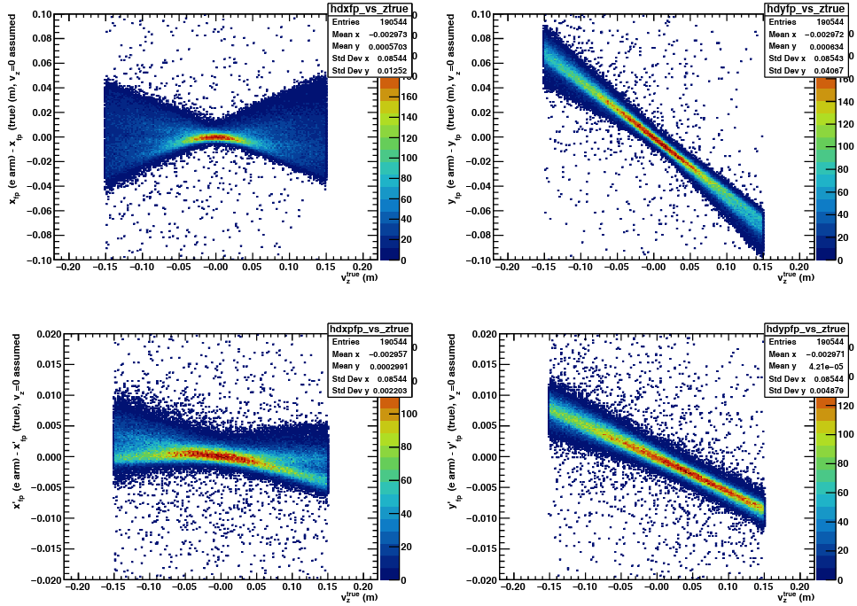
3D Track Reconstruction: Region of Interest
Region of Interest calculation on p-arm tracks from e-arm information
Attempting tracking using the entire GEM active areas impossible as combinatorics explode
Focus on “Regions of Interest” within the GEM modules(2D hit-finding)/layers(track-formation)
Use external detector constraints (calorimeter clusters) and heep (elastic) kinematics
Simulation: electron angles reconstructed from ECal/CDet assuming $v_{z}=0$
Ecal+CDet
HCal
e
FT
FPP
Target
Simulated heep event
Plots: A. Puckett
Notes:
The idea is to make many constraint points by breaking the target into several bins. We can benchmark this method by comparing simulated results to Monte Carlo truth information. The results of this for assuming Vz=0 are shown in these plots. The fact that we can reconstruct x,y,x’,y’ reliably for Vz_true=0 and Vz_assumed=0 using the ECal/Cdet means if we split up the target into Vz bins, we could reliably reconstruct the electron fp coordinates and hence proton fp coordinates.

Slide 15
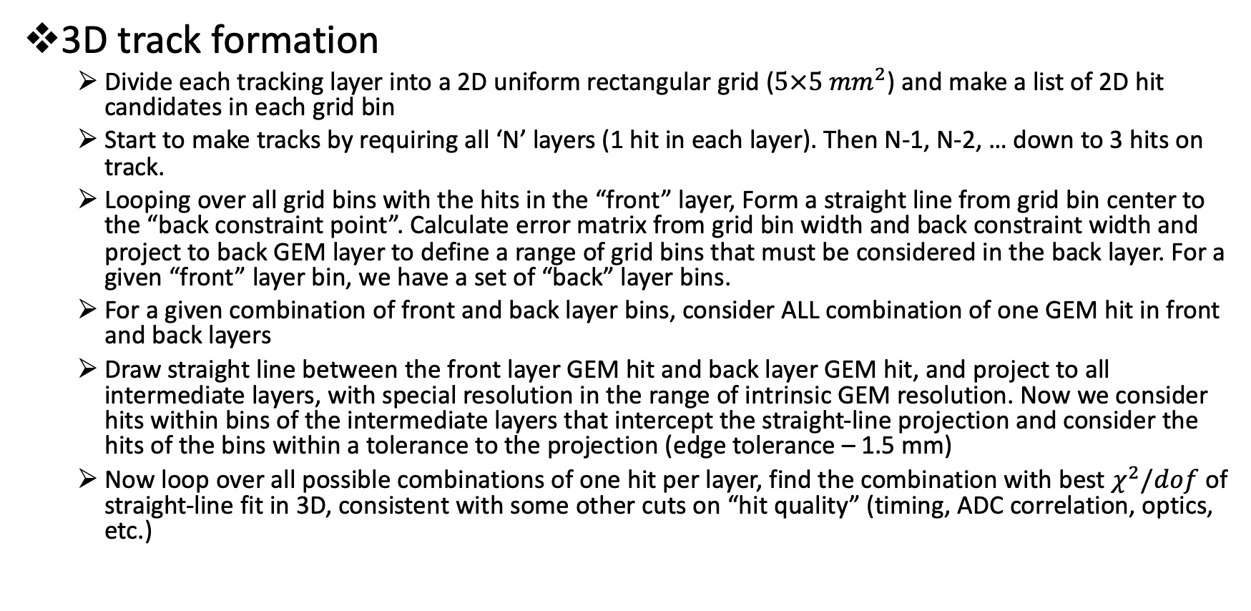
3D Track Reconstruction: Track Formation
3D track formation
Divide each tracking layer into a 2D uniform rectangular grid ($5×5 {mm}^{2}$) and make a list of 2D hit candidates in each grid bin
Start to make tracks by requiring all ‘N’ layers (1 hit in each layer). Then N-1, N-2, … down to 3 hits on track.
Looping over all grid bins with the hits in the “front” layer, Form a straight line from grid bin center to the “back constraint point”. Calculate error matrix from grid bin width and back constraint width and project to back GEM layer to define a range of grid bins that must be considered in the back layer. For a given “front” layer bin, we have a set of “back” layer bins.
For a given combination of front and back layer bins, consider ALL combination of one GEM hit in front and back layers
Draw straight line between the front layer GEM hit and back layer GEM hit, and project to all intermediate layers, with special resolution in the range of intrinsic GEM resolution. Now we consider hits within bins of the intermediate layers that intercept the straight-line projection and consider the hits of the bins within a tolerance to the projection (edge tolerance – 1.5 mm)
Now loop over all possible combinations of one hit per layer, find the combination with best $χ^{2}/dof$ of straight-line fit in 3D, consistent with some other cuts on “hit quality” (timing, ADC correlation, optics, etc.)

Slide 16
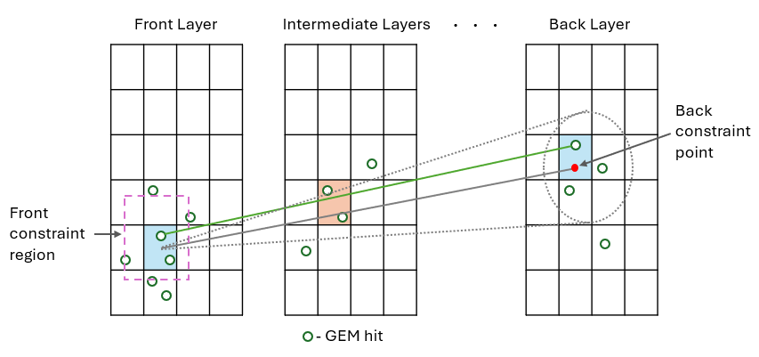

3D Track Reconstruction: Constraint Points
Finding constraints for FT and FPP trackers
Get front and back constraints for FT from ECal/CDet. For FPP, front constraint from ECal/CDet with proton track projected to analyzer mid-plane and back constraint from HCal cluster
Two modes of tracking currently developed: 1) FT first and then FPP 2) FPP first and then FT (faster; only one $v_{z}$ bin with smallest ‘sclose’ w.r.t FPP track)

Slide 17
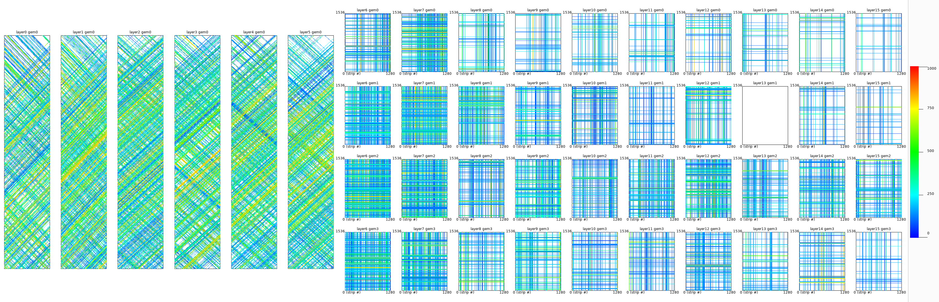
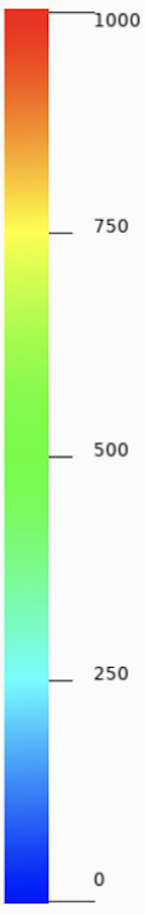
Challenges to Tracking: FT Occupancy
Main challenge by far is GEM tracking under high occupancy (space and time signal pileup) and low signal to background ratios
Large number of combinatorics → high computational times + (fake hits + fake tracks)
1D cluster formation and 2D hit reconstruction is especially affected by high occupancy → lots of fake hit reconstruction
Tracking portion itself is done in field-free regions → straight lines; hence not the most complicated part if the hits fed in are mostly true/real proton hits
Front Tracker raw fired strips in an event color coded in ADC strength.
22 uA on LH2 target; one of the highest background cases in SBS.

Slide 18
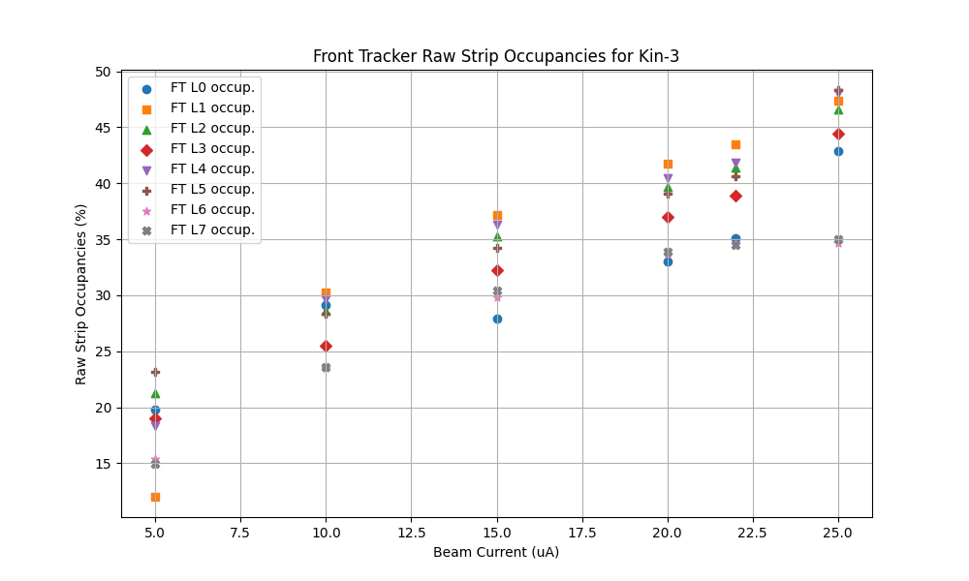
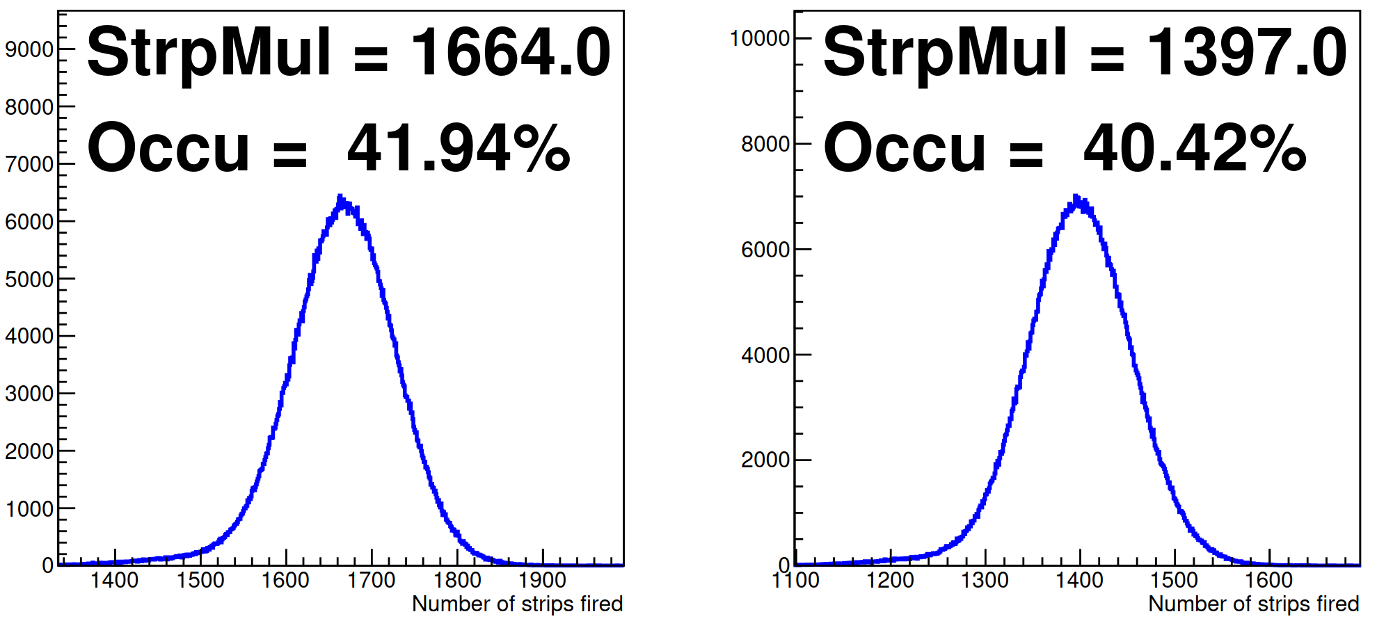
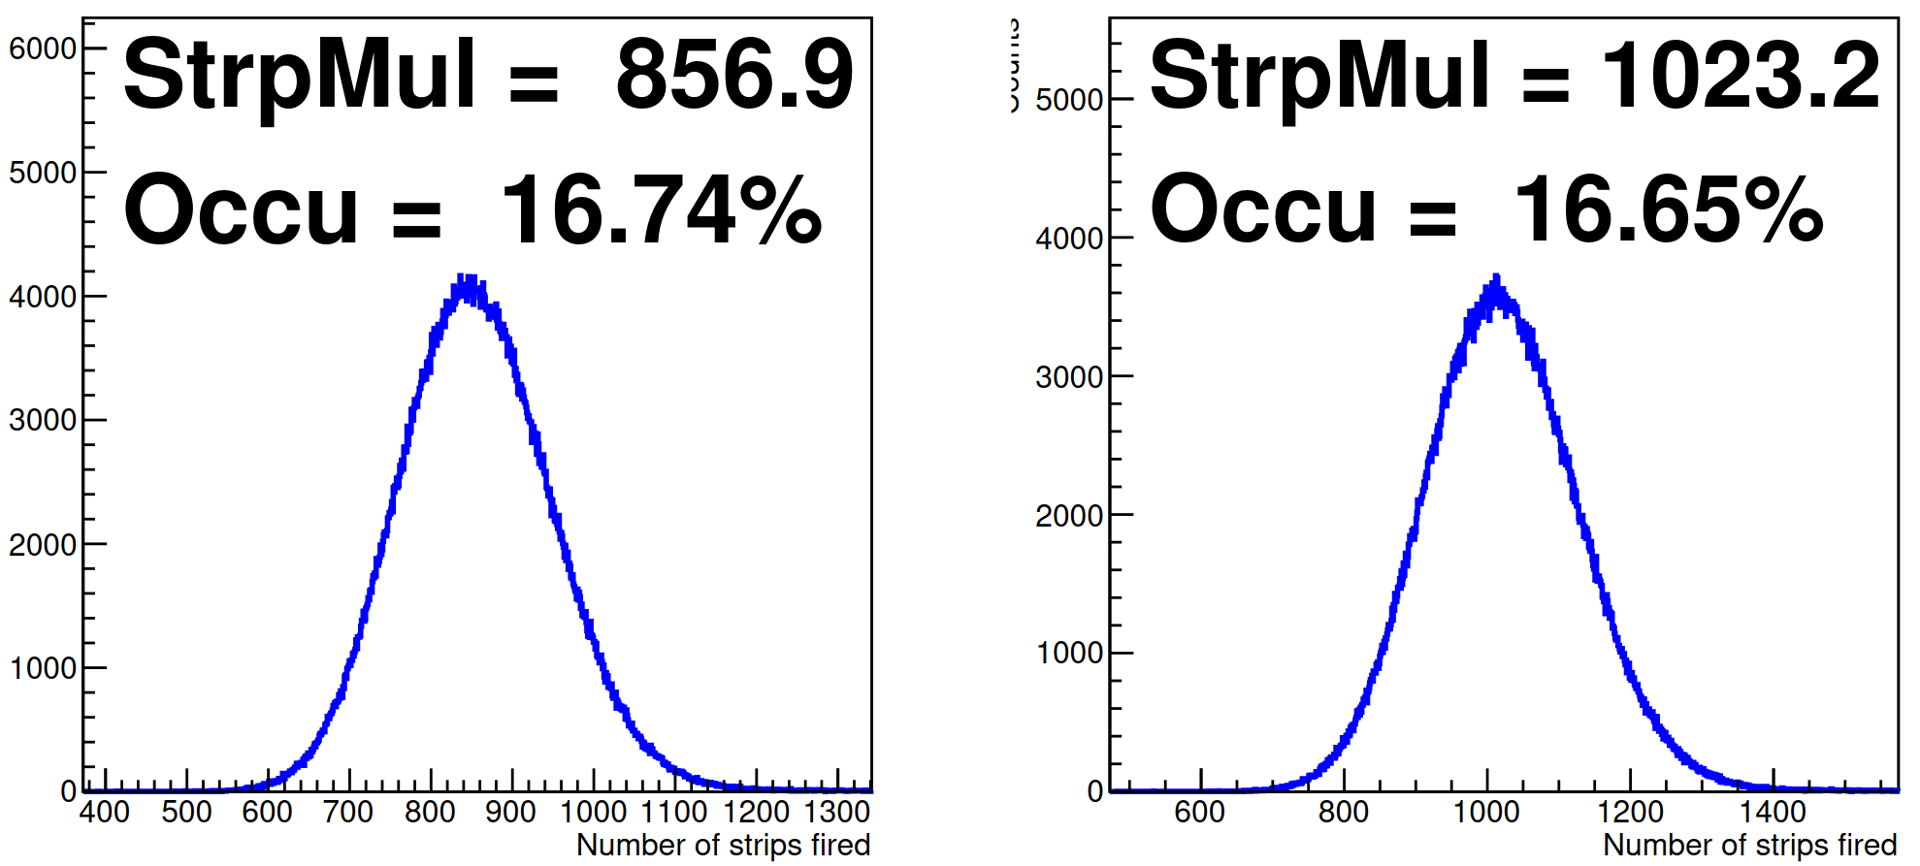
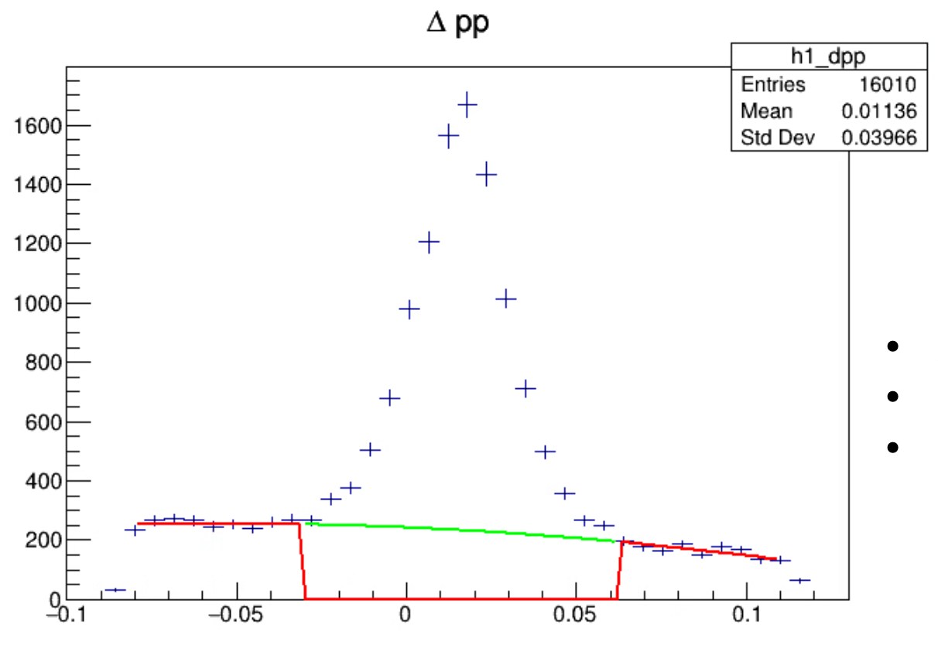
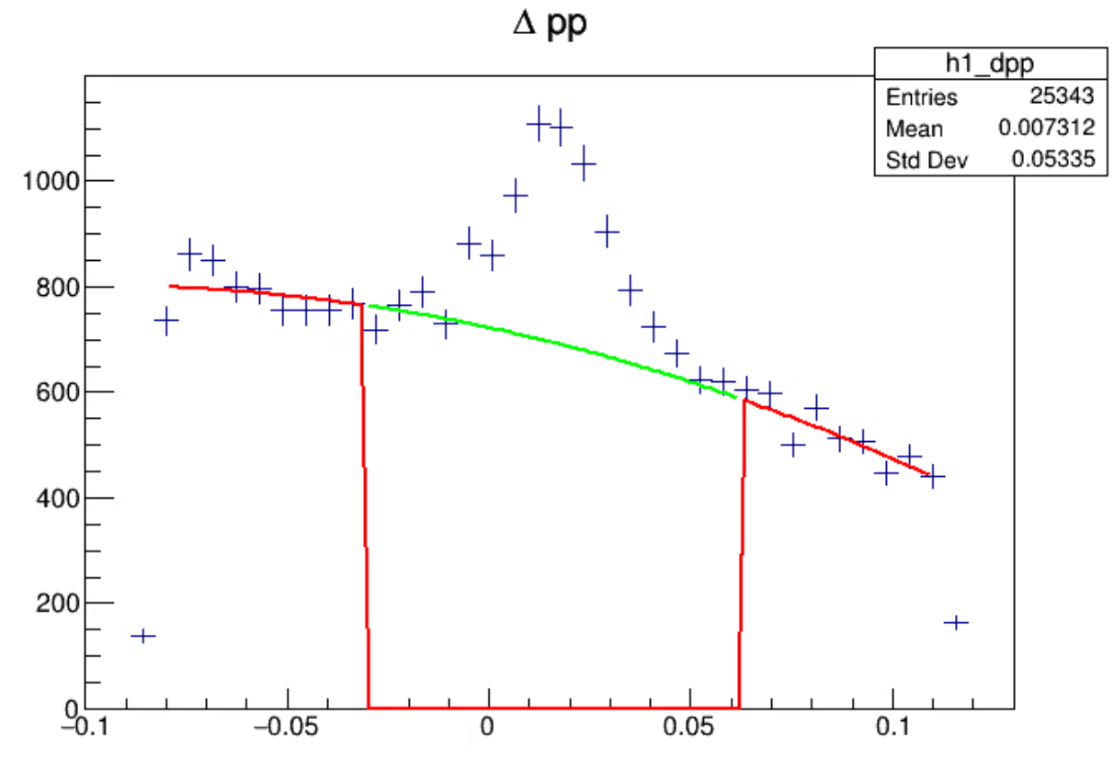
Challenges to Tracking: FT Occupancy
V strips
V strips
High raw strip occupancy in FT due to soft photon background of rate ~500 kHz/cm²
Elastic reconstruction suffers due to this high background
U strips
U strips
15 uA run elastic yield
22 uA run elastic yield
Plot: V. Vishvanath
Heep yield/C = 24K
Heep yield/C = 11K
Notes:
Fortunately, the large low energy photon background results in random uncorrelated hits from layer to layer, so these are much less likely to fall on a straight line.

Slide 19
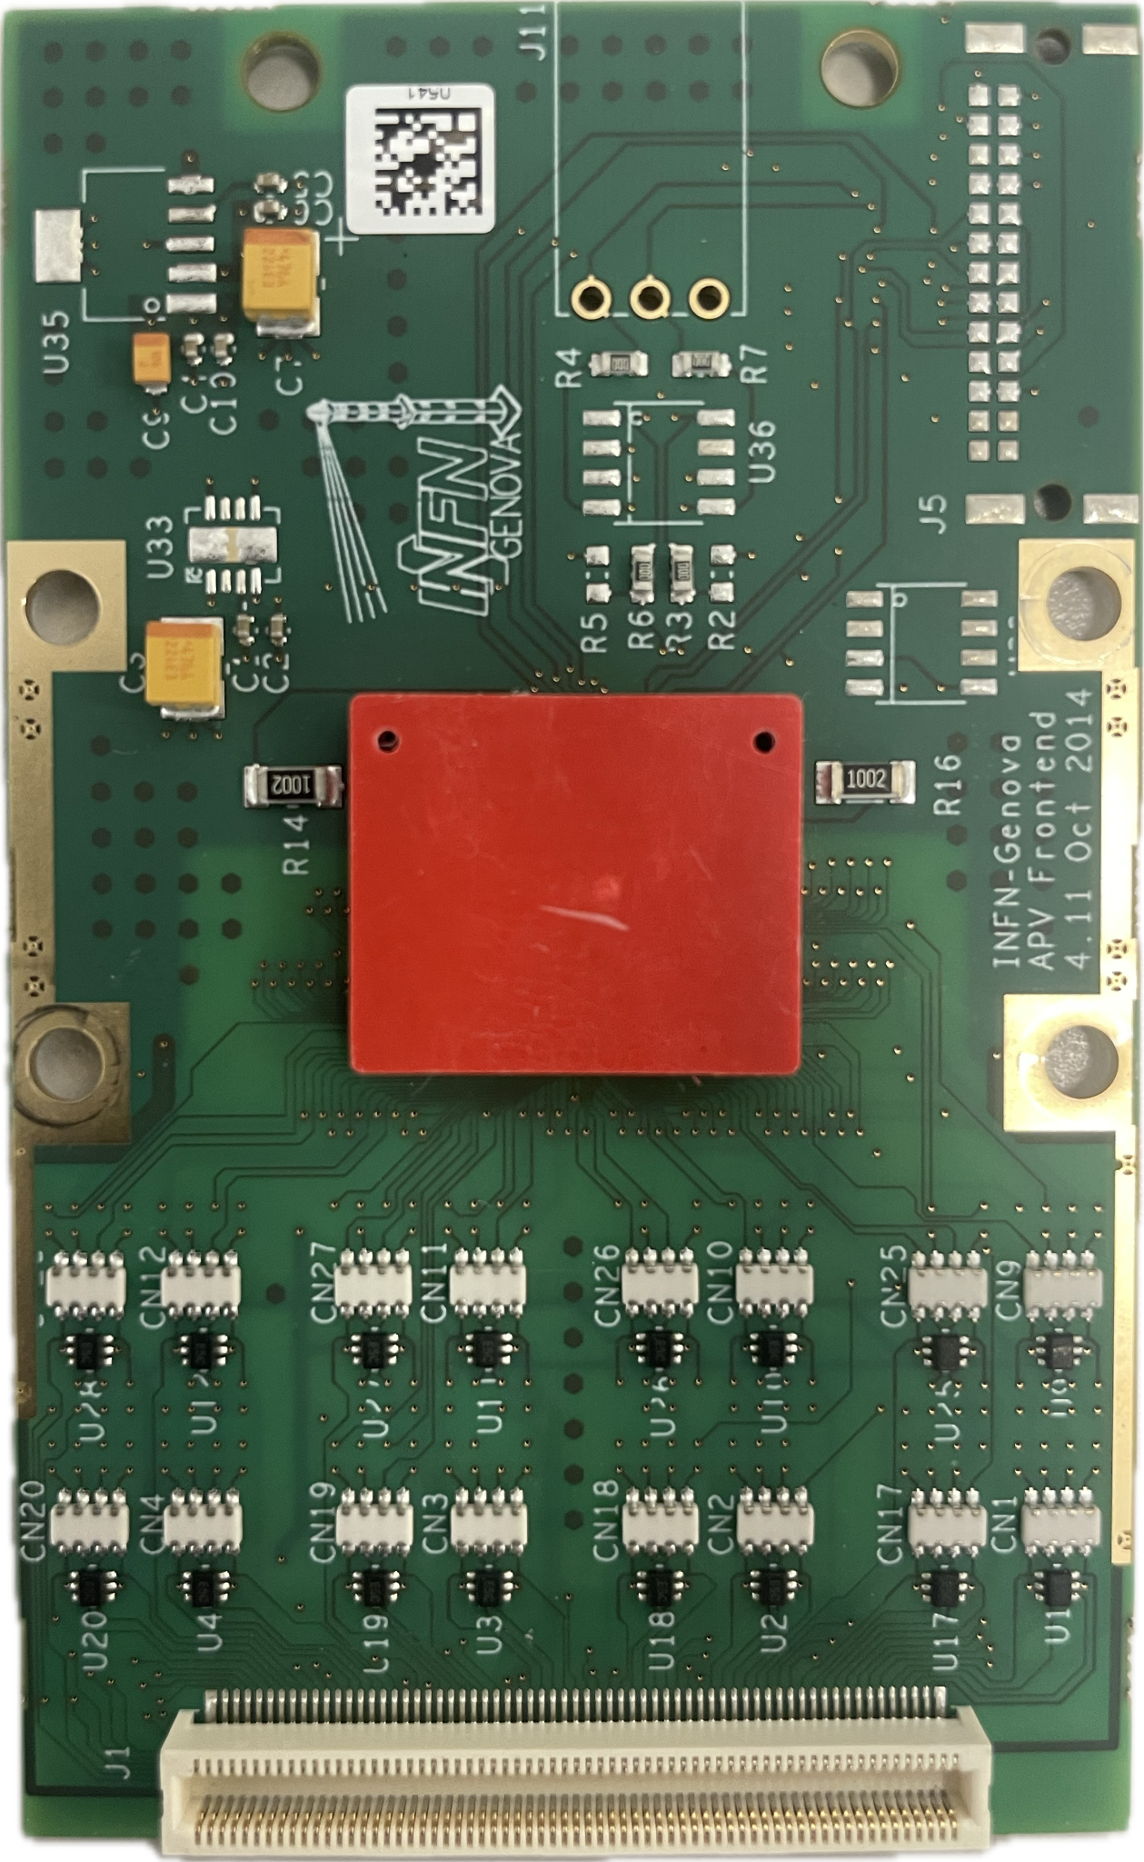
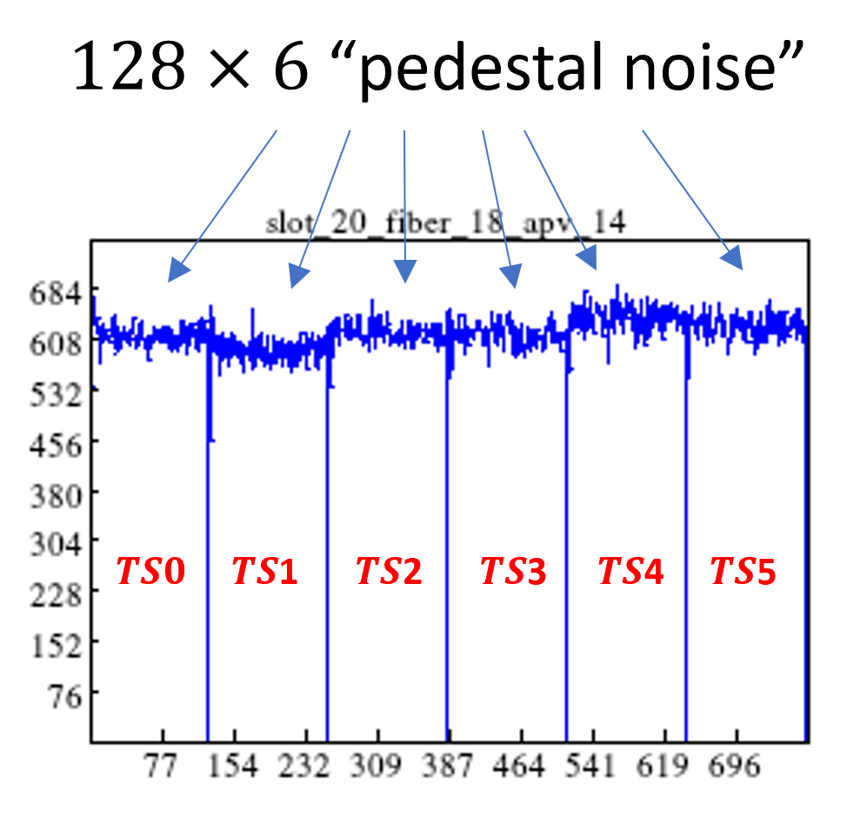
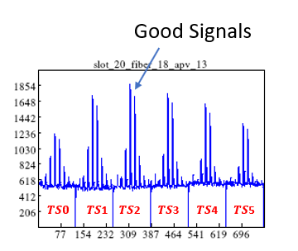
Readout Electronics
Gem detectors use the 128 channel APV25 chip
Operates on a 40 MHz clock
Each trigger takes 6 time samples over 150 ns
Baseline for each time sample has a pedestal offset referred to at the Common Mode (CM)
Each channel has some random electronic fluctuations around the CM referred to as the pedestal
A unique CM and pedestal is calculated for each APV using data without signals

Slide 20
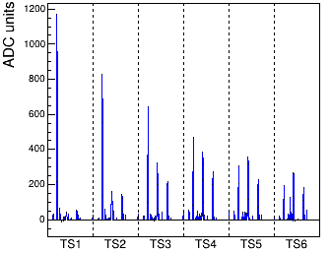
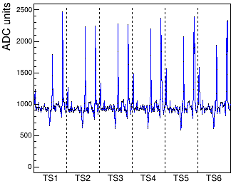
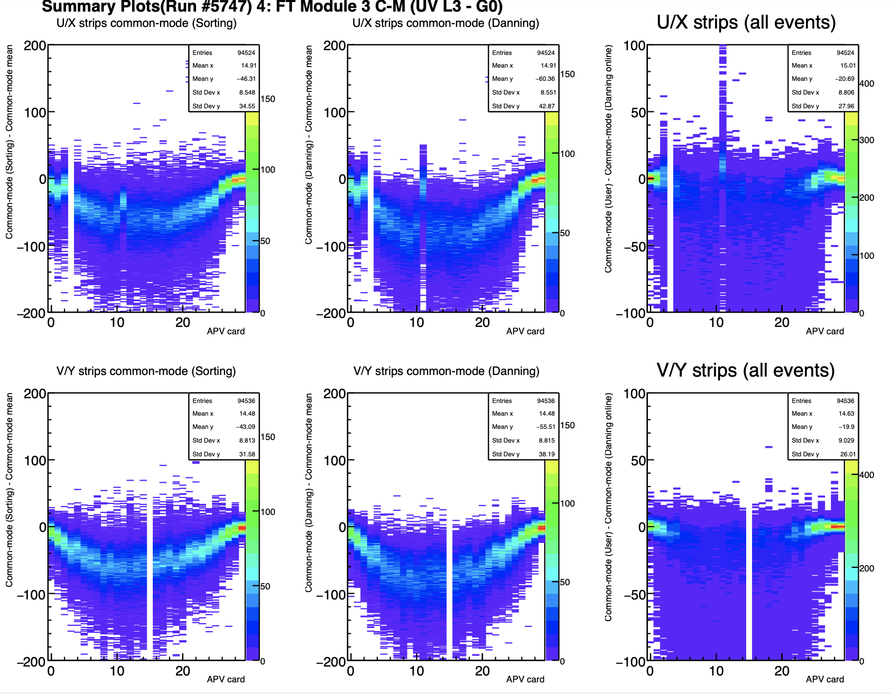
Baseline Sagging
Data undergoes online zero suppression to reduce data rates
Exception is every 1/100 event is saved as full read out for diagnostics
Events that fail the online ZS will be saved as FRO events
Under high rates, the APV25 RC circuit can cause negative pulses which appear to decrease the CM baseline calculated by the online algorithm
Figure: Zero Suppressed event
Figure: Negative pulses

Slide 21
Baseline Sagging
Negative bias in CM calculations leads to more strips passing zero suppression:
More ”fired” strips → higher reported occupancies → more computation time for event processing, fake hits, fake tracks, etc.
Potential solution (Work in progress!):
Using 1/100 FRO events, find an improved CM algorithm that better predicts the actual CM
Using improved CM algorithm, estimate a correction to the online CM calculation → reduction of falsely fired strips

Slide 22
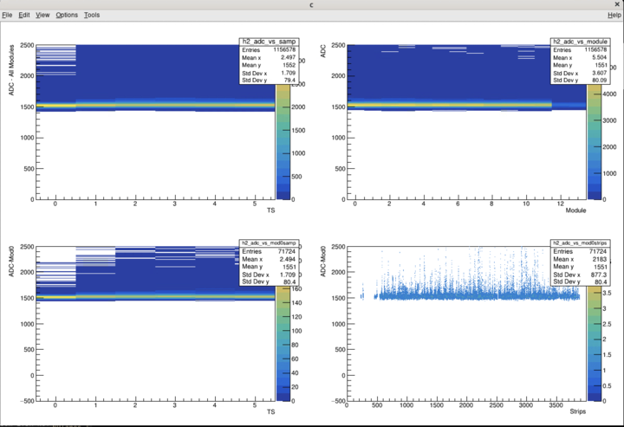
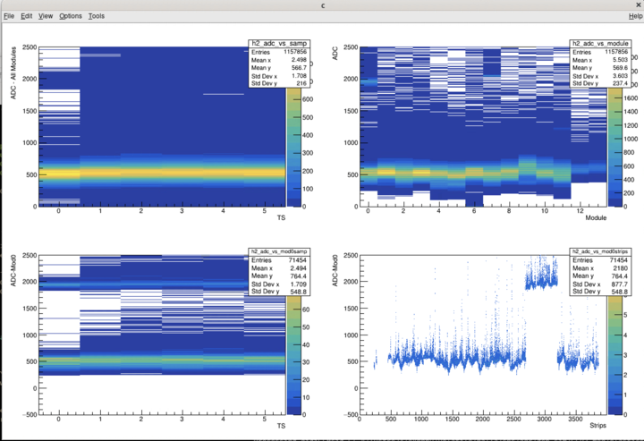
Machine Learning Approach
Idea: Train a ‘De-Noising CNN Auto Encoder’ to help with GEP tracking
Need to generate realistic Monte Carlo training data with known real tracks
Guidance and support from resident Hall B AI tracking expert Gagik Gavalian
Current simulated GEM data shows too idealistic noise and timing profiles
Ongoing efforts to improve MC GEM data to better represent the deficiencies in the real GEM data (lead by Anu)
Added: more realistic GEM common mode fluctuations and online ZS algorithms
Future work: Implement CM sagging issues
Future work: Changes in SBS_OFFLINE to carry-forward the ‘MC truth’ info up to the 2D hit reconstruction stage
This exercise will only help in the track-finding stage. Implementing a ML technique for 2D hit reconstruction is a possible future goal as well
Implementing GEM CM fluctuations and pedestal fluctuations to MC data.
Before
After
Notes:
Gagik- resident Hall B ML tracking expert

Slide 23
Summary
Improving track reconstruction is essential to meet GEp statistical goals
Many challenges to high-rate tracking
High raw occupancies
Readout electronics baseline sagging
Lots of ongoing efforts to improve GEp tracking
CM corrections, simulation improvement, possible AI/ML for track finding
Additionally, GEM alignment, optics matrix, timing and ADC threshold calibrations, etc.

Slide 24
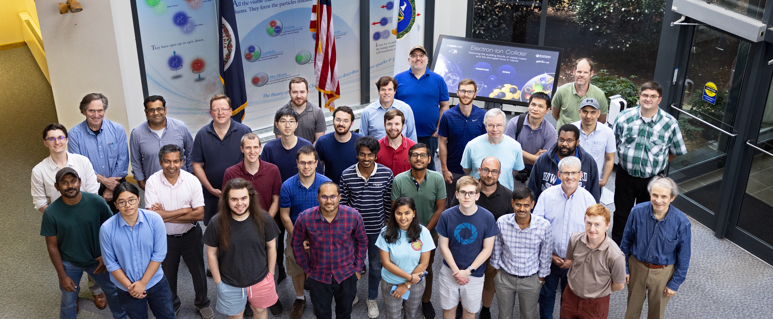
Thank you!

Slide 25
Backup slides

Slide 26
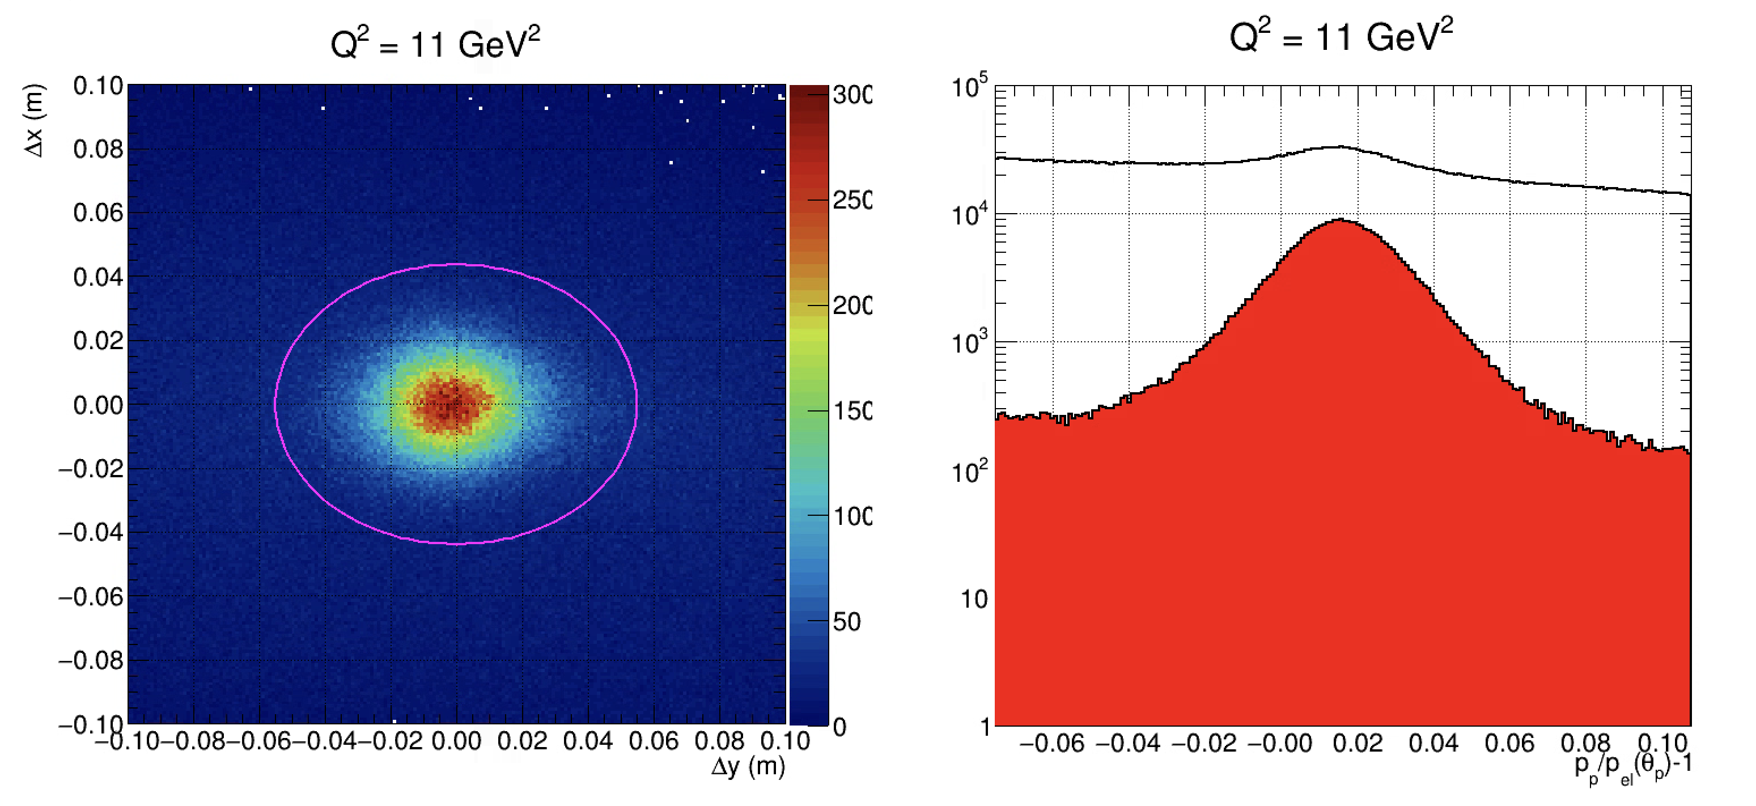

Elastic Event Extractions (GEP Kin3; 11.1 ${GeV}^{2}$)
Relative difference between reconstructed proton momentum via SBS magnet momentum analysis and and polar scattering angle of the proton + elastic kin. assumption
Difference between ECal clus. pos. and predicted elastic e’ hit pos on ECal by proton kinematics
Plots: A. Puckett

Slide 27
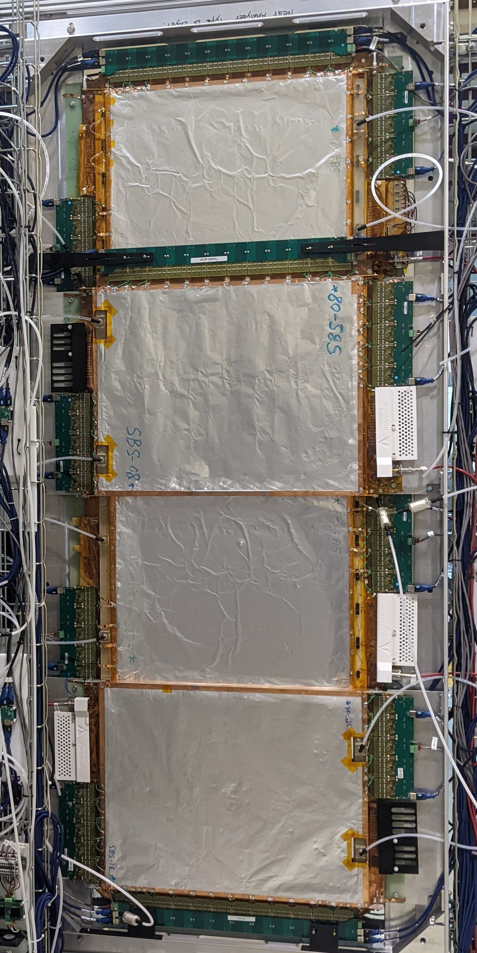
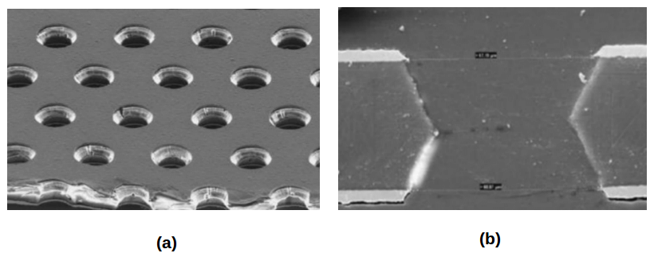
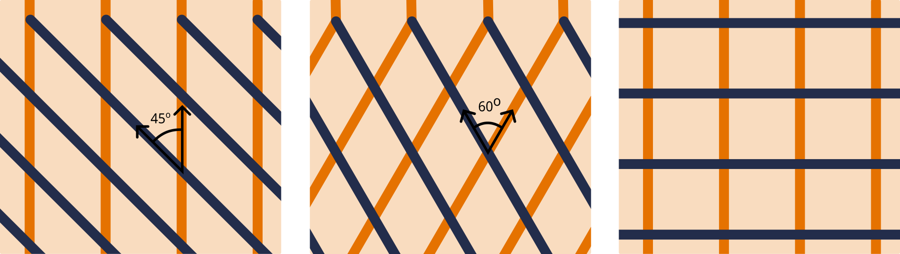
GEM Construction
A GEM foil has two copper layers separated by a Polyamide film.
Chemically etched to produced bi-conical holes.
Foils are then stretched and glued onto frames
Optimized shorter readout strip geometries in single modules to minimize signal degradation
XY, UV, XW differ by strip pitch
5μm
~70μm
XW
XY
UV
140μm
~50μm
50μm
Readout Strip Orientations
27

Slide 28
Common Mode Algorithms (Basic)
Sorting Algorithm: Takes all the strips and removes some number (generally 30) of the lowest and highest strips
The remaining strips should be only noise and should represent the baseline
Danning Algorithm: Requires a CM mean, CM RMS, and pedestal RMS
Get the average ADC of the strips in the cut range defined by ped parameters
Update parameters based on this average. Repeat.
Histogramming Algorithm
Slice the ADC range into bins, and count how many entries are in each bin
Add each strip to all bins in the scan window
The bin with the maximum number of counts is averaged
Bin size, number of bins in scan window, etc. must be carefully selected

Slide 29
Hit Diagram

