Slide 1


Overview of ECal for the SBS GEp Experiment
Kip Hunt
University of Connecticut
SBS Collaboration
Hall A Winter 2026 Meeting

Slide 2
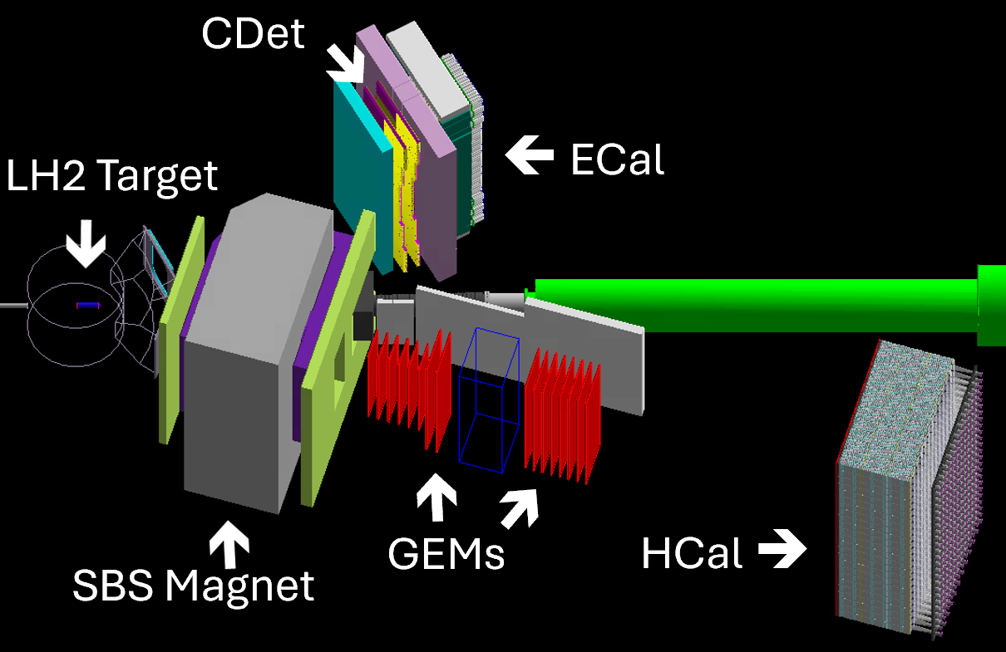
Motivation for an Electron Calorimeter
1
Cross section of elastic ep scattering goes like Q⁻¹², thus high luminosity and large solid angle is necessary
Inelastic scattering is the dominant process in these conditions
Data acquisition (DAQ) system sees significant drop in livetime at trigger rate ~4-5kHz
In coincidence with HCal, ECal allows for major background suppression and reduction of rates
Also useful for kinematic reconstruction and event selection, hopefully in tandem with the Coordinate Detector (CDet)

Slide 3
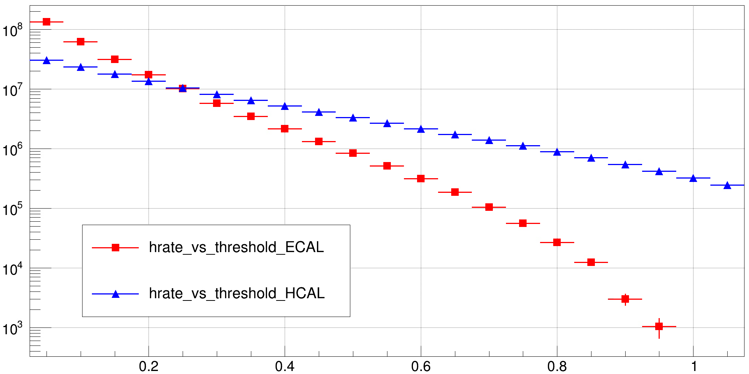

Simulated Singles Rates vs Threshold
2
Rate (Hz)
Simulated Single Arm Trigger Rates
(Global OR of clusters)
Ecal: ~30kHz
Hcal: ~3MHz
Trigger Threshold as a fraction of Expected Energy Deposition
The estimated 3MHz rate of HCal or even the 30kHz rate of ECal would overwhelm the DAQ system, thus a kinematic correlation between the two arms is necessary to form a coincidence trigger

Slide 4
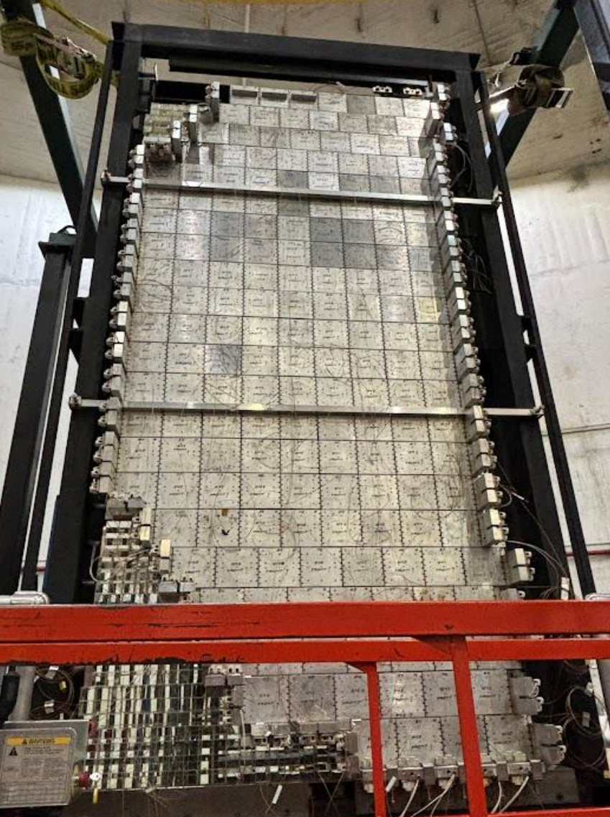
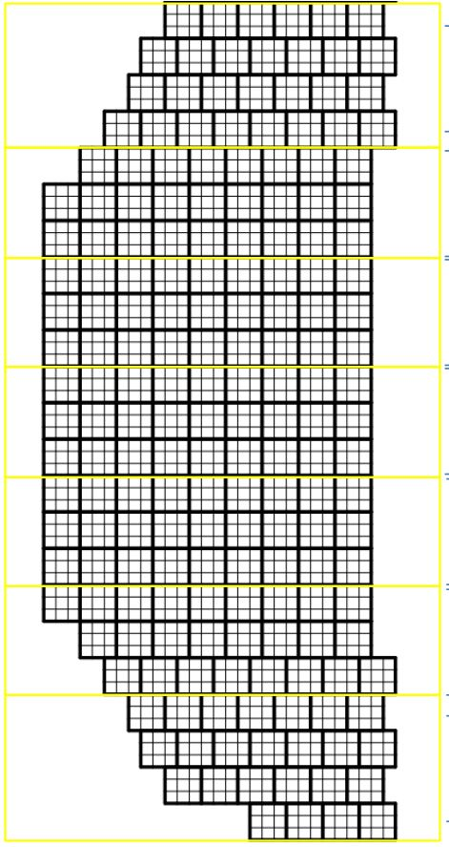
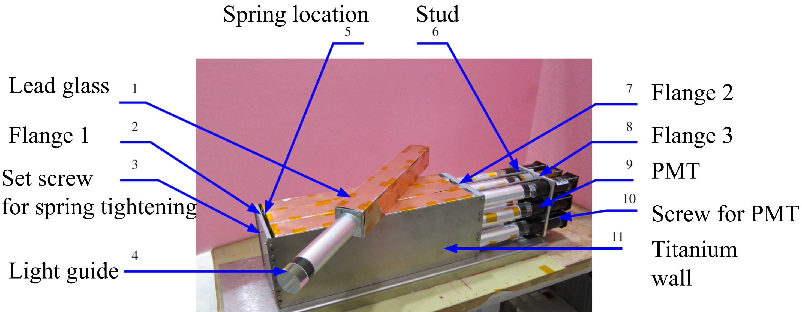
Detector Design
3
1656 channels (184 SM’s)
~9.5 feet tall and ~4 feet wide
Shaped to match acceptance
Lead glass Cherenkov based detection
Heated to ~180-220C for constant thermal annealing
Energy resolution ~12%
Position resolution ~6mm
Supermodule – 3x3 channels

Slide 5
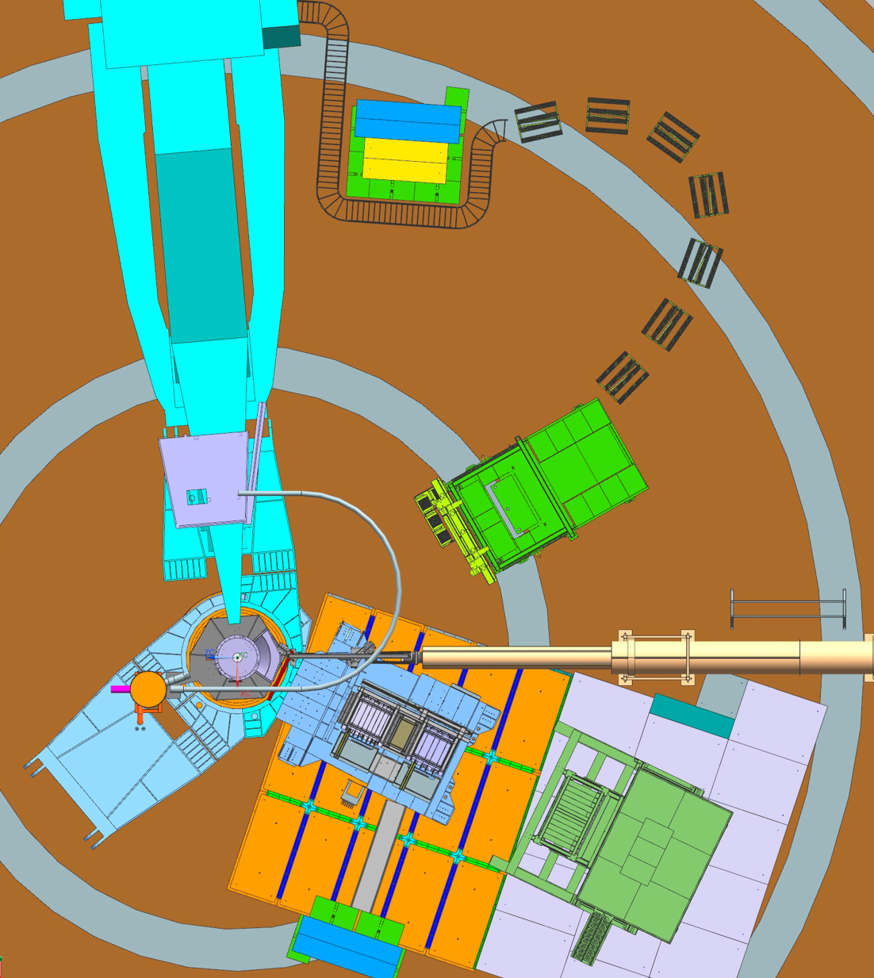
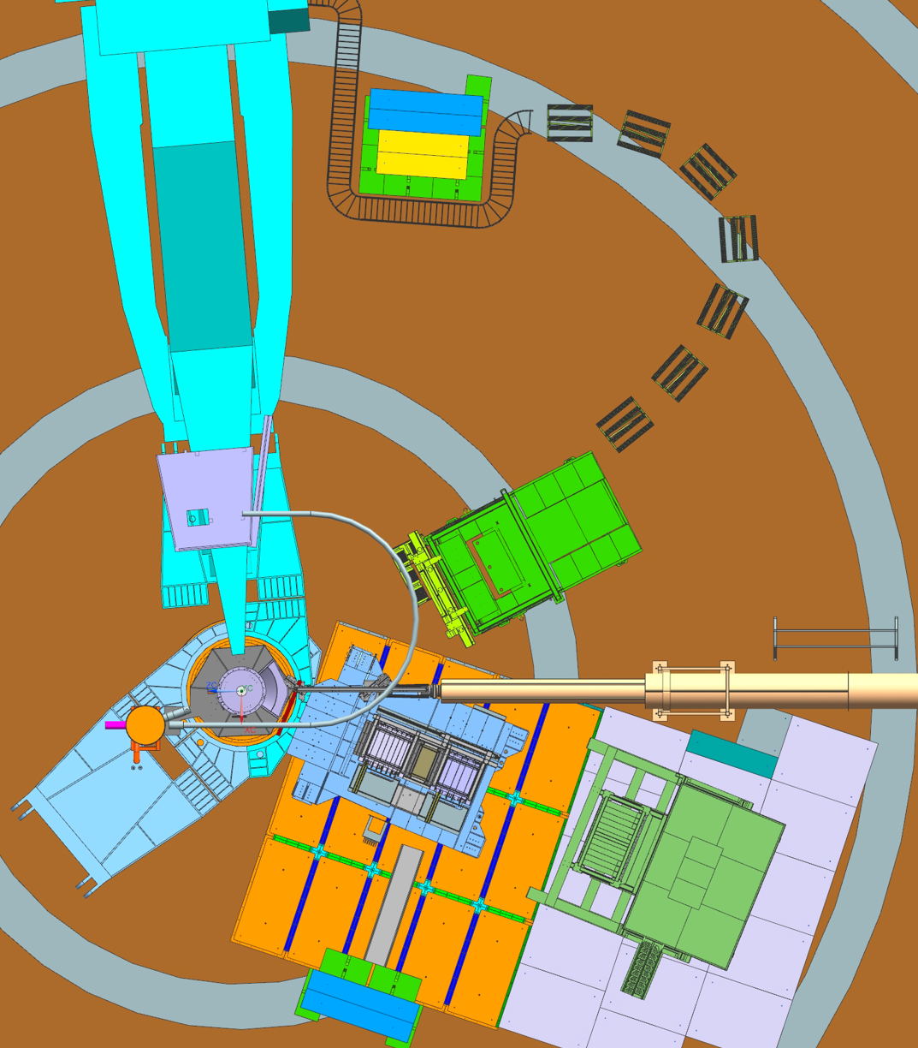
ECal Placements
4
Lower Q² kinematic placement:
ECal distance from pivot: 8.0m
ECal angle from beamline: 29.46^{O}
Higher Q² kinematic placement:
ECal distance from pivot: 6.0m
ECal angle from beamline: 27.0^{O}
Hadron arm should be at more forward angle here

Slide 6
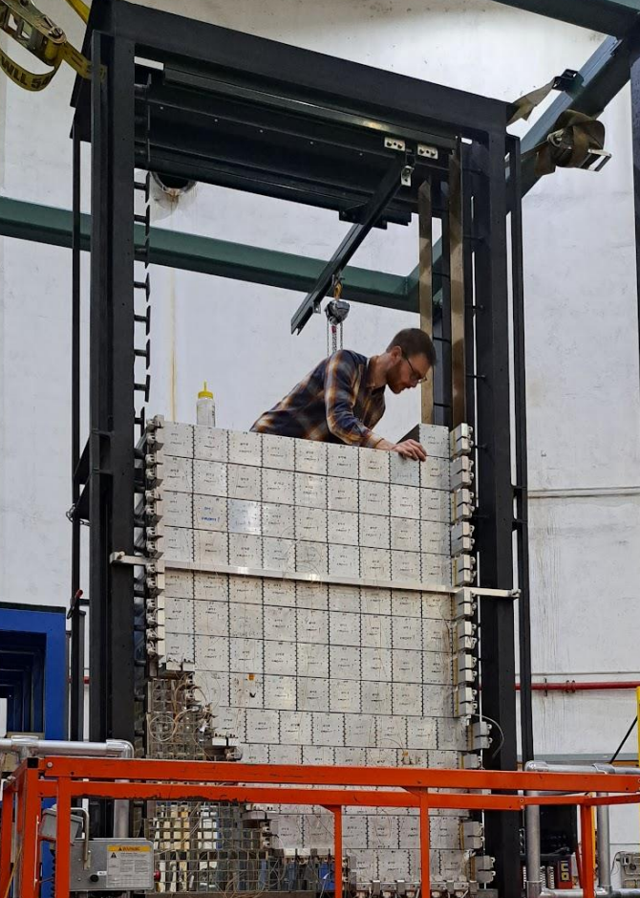
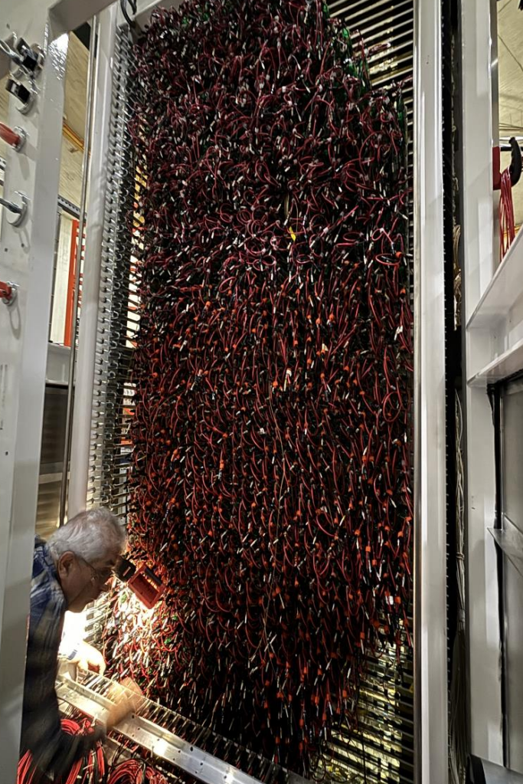
Assembly and Cabling: Detector Side
5
Left: Jimmy stacking supermodules in the frame of Ecal
Right: Samvel installing strain relief panels at the back of ECal, with the 3312 (HV+Signal) connections hanging out
Here at the platform, HV goes into patch panels and signal goes to summing modules, then all through the hall to DAQ bunker

Slide 7
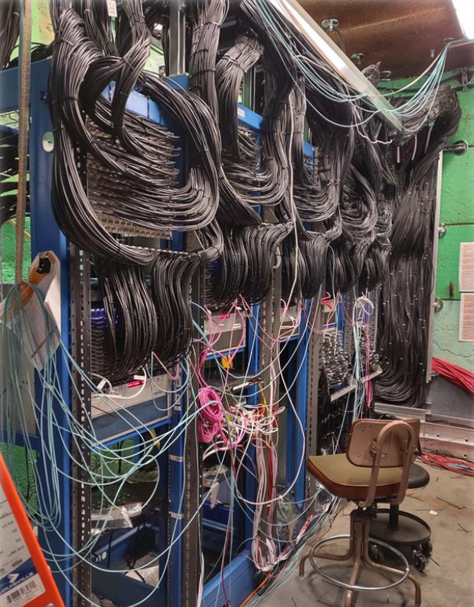
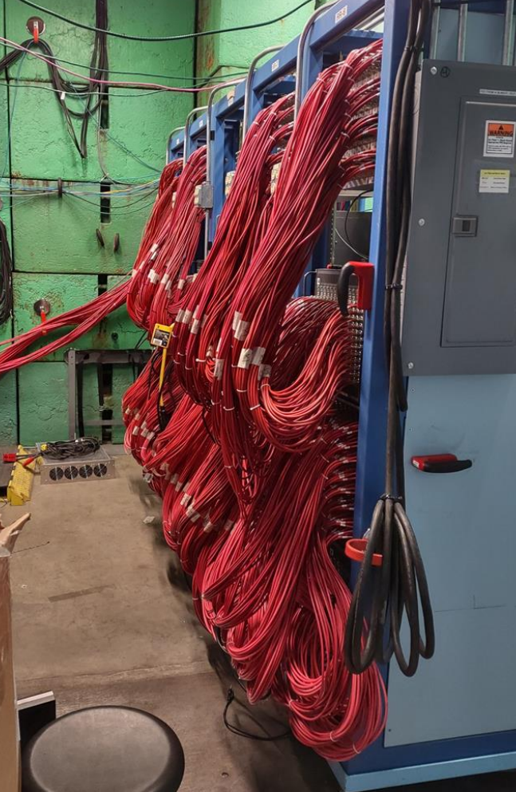
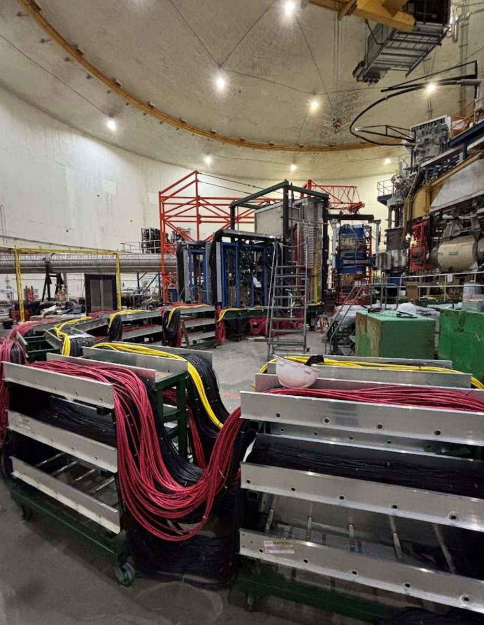
Assembly and Cabling: DAQ Bunker
6
Signal cables going into the VXS crates housing the FADC boards
HV cables going into LeCroy HV crates
Cables running from detector platform to DAQ Bunker

Slide 8
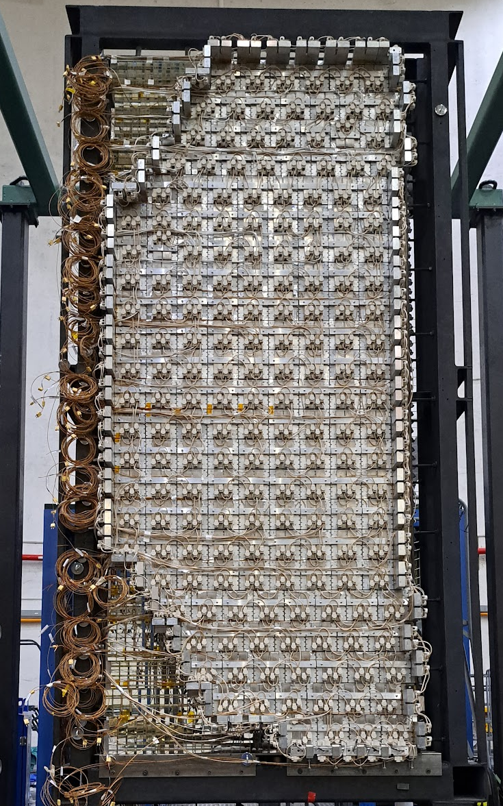
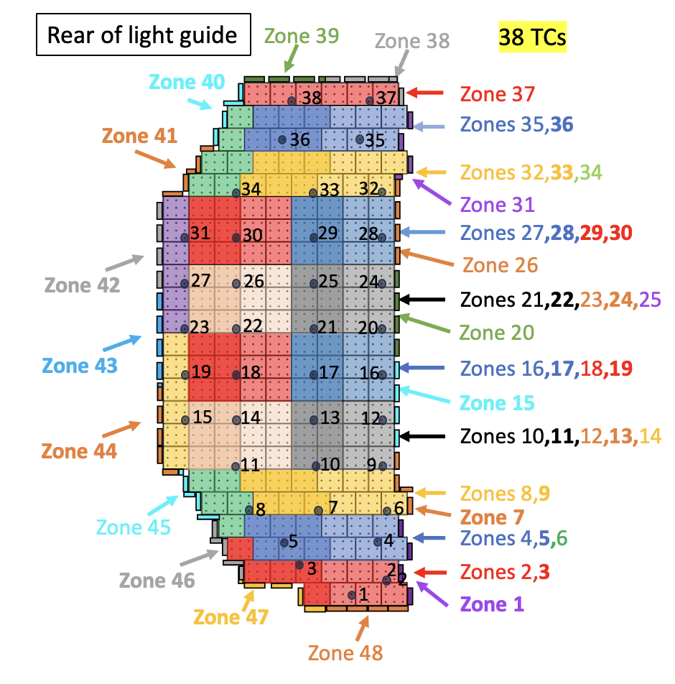
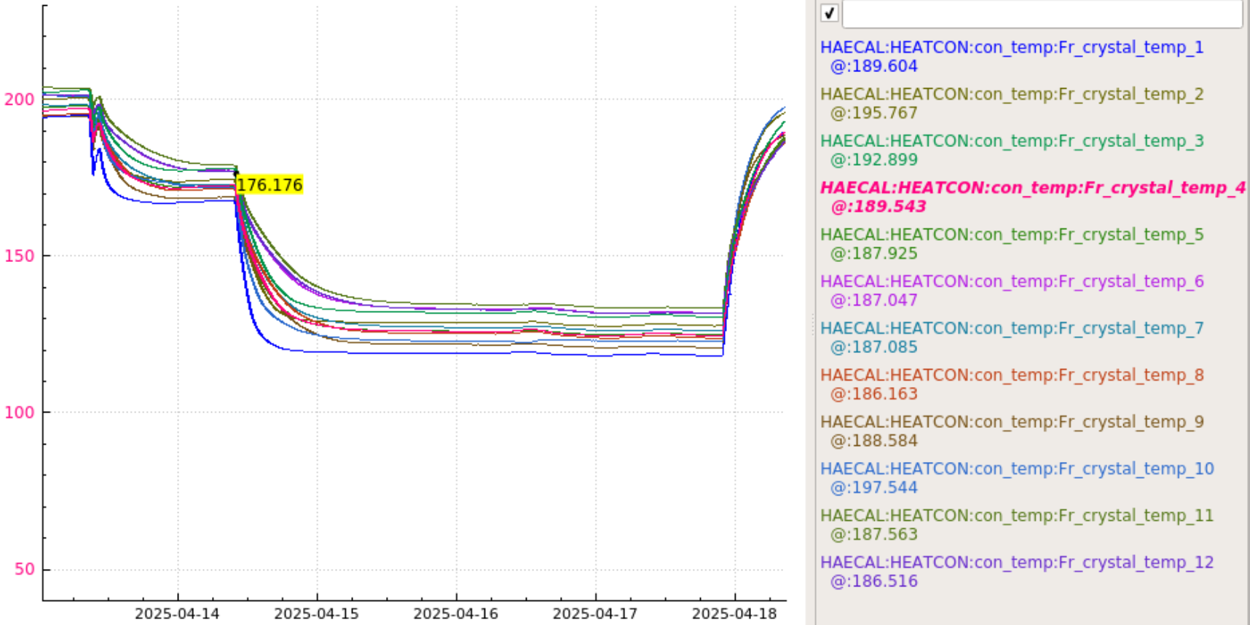
ECal Heater System
7
Supervised by Don Jones
Heater system designed to run on <50 VDC.
48 heater zones and >200 thermocouples
DSG (Marc McMullen) led heater controls and monitoring
Direct airflow to PMTs via cooling system to keep below 50C
ECal temp. monitor as viewed by shift crew over span of controlled temp. drops during low beam current running

Slide 9
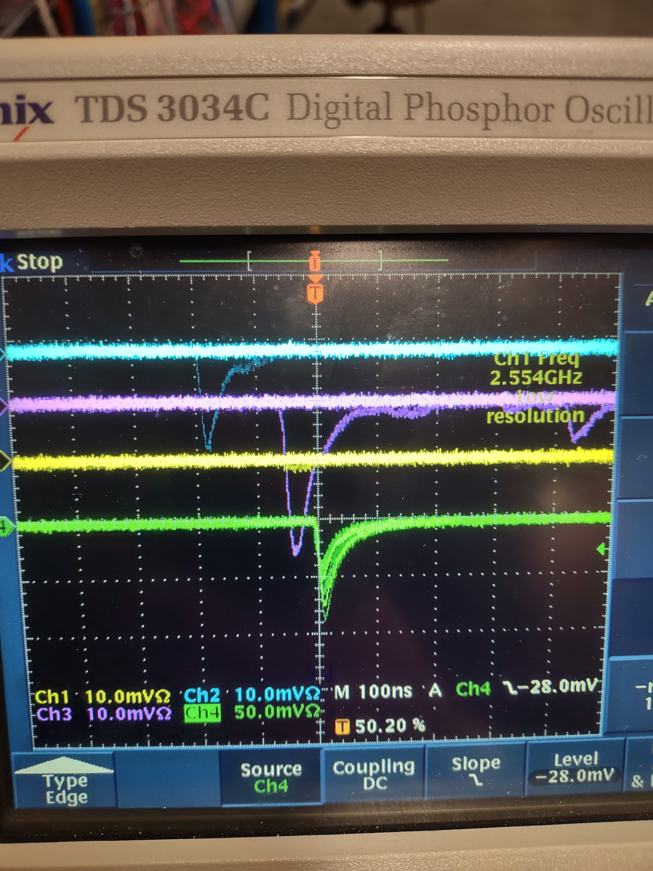
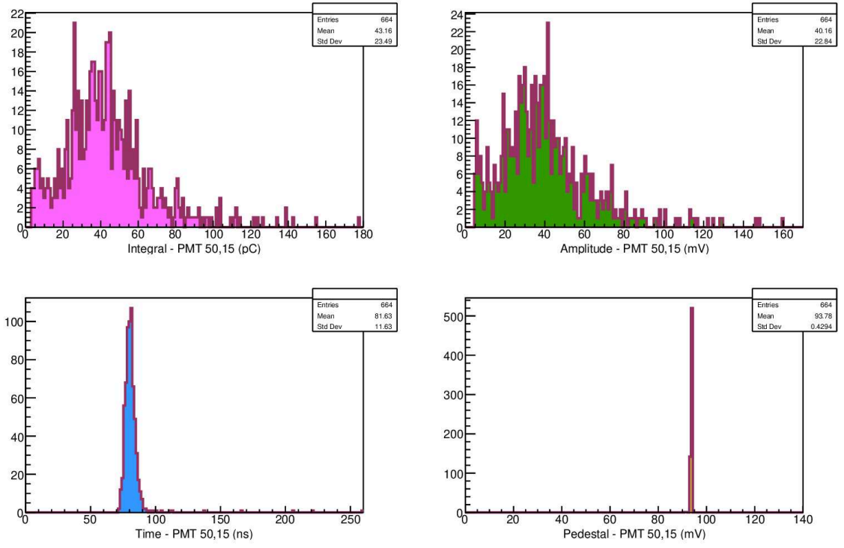
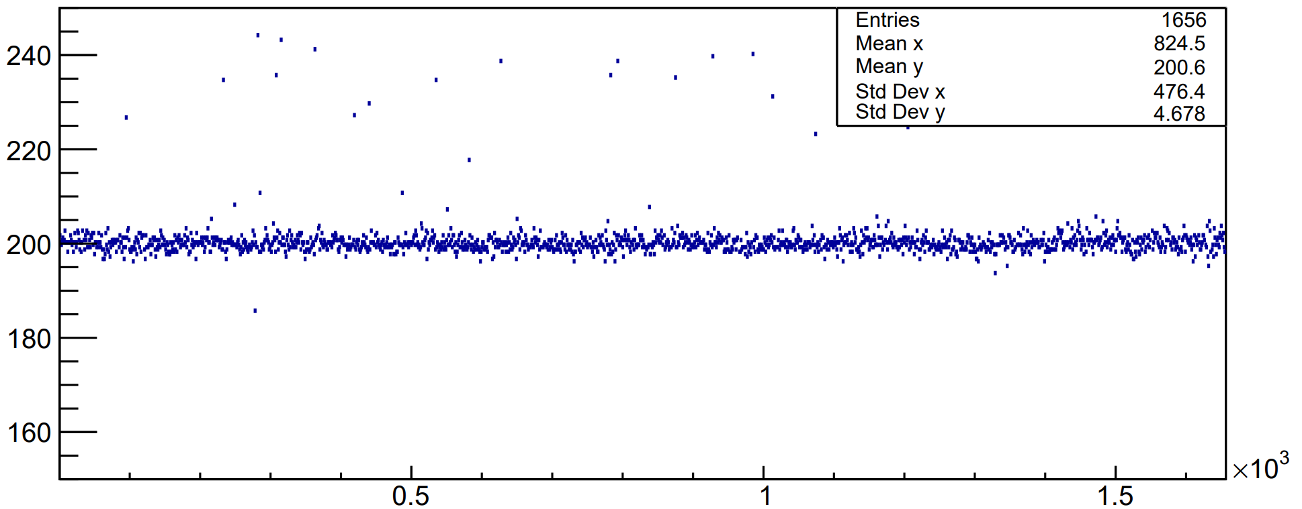
Testing with Cosmics
8
Worked on with Simona and Jhih-Ying
Each channel looked at on scope (with rough HV tuning) for issues with signal/hv cabling, dark PMTs, or bad voltage dividers
Placed a scintillator paddle atop ECal and took cosmics
Finding scintillator paddle timing relative to ECal channel
Single channel event display from cosmics
Timing alignment of all channels from cosmics
Channels

Slide 10
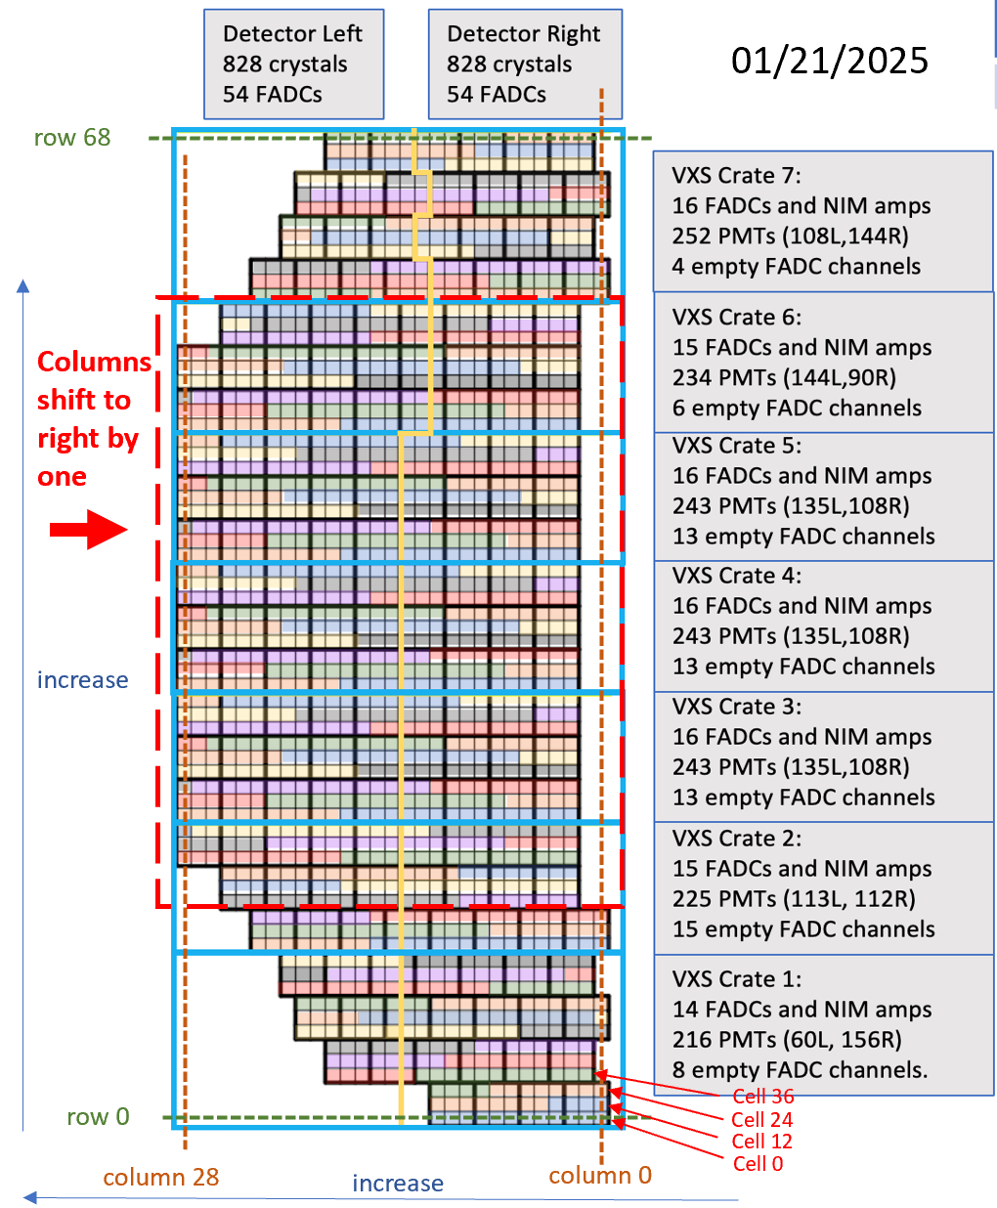
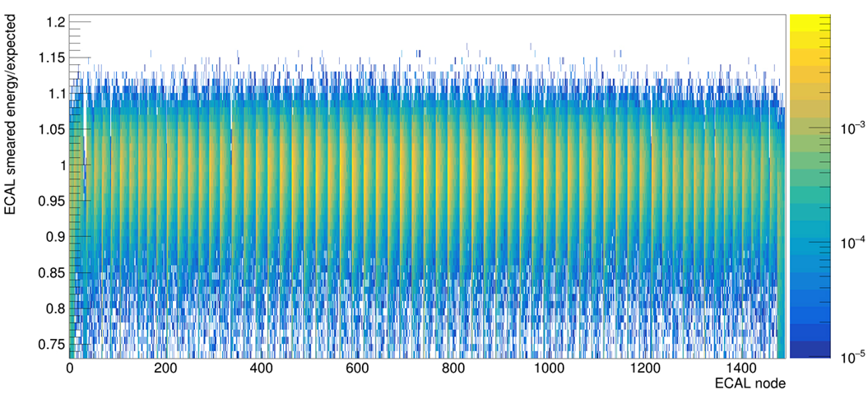
ECal Trigger
9
3x5 channels (horizontal x vertical) per cluster
Every non-perimeter channel is a cluster center (seed/node)
Identify cluster center by maximum energy deposition and sum any contributions from surrounding cluster blocks within timing window
Trig. thresholds defined as fraction of expected elastic peak to account for angular energy dependence
From Ben Raydo and Hanjie Liu: ECal VXS divisions with color coding by FADC board, note slight correction to geometry

Slide 11
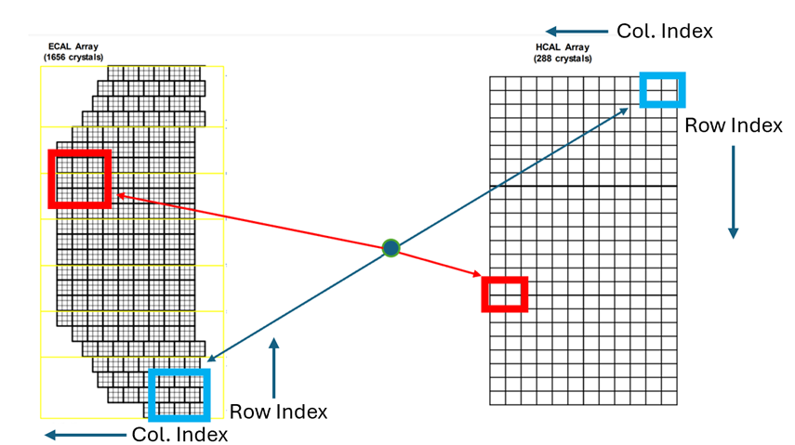
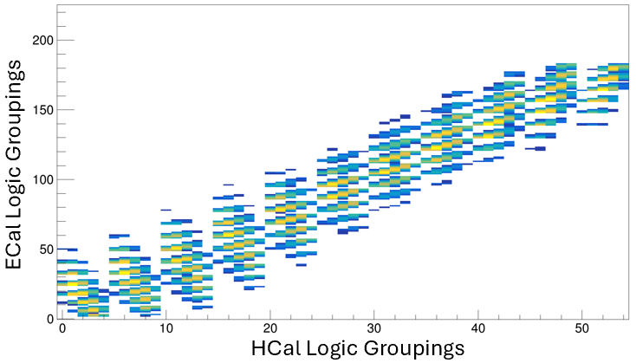
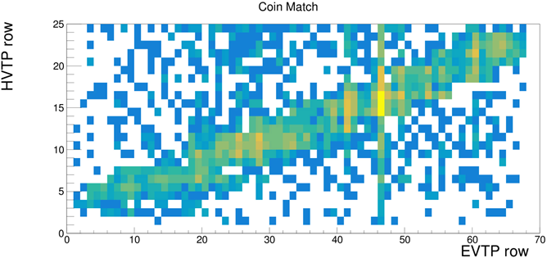
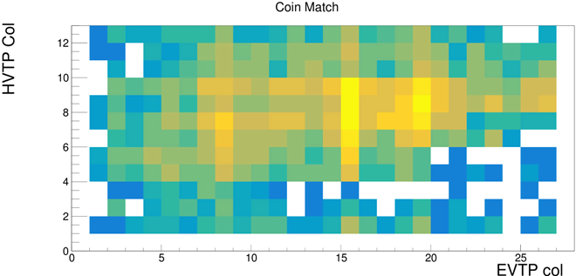
Coincidence Trigger
10
Simulate elastic events to find which clusters in each calorimeter should be grouped together for coincidence – form lookup table for use in experiment
GEANT4 sim. of elastic scattering hits above threshold in both calorimeters
Exploit scattering plane to form kinematic correlation
Horizontal Correlation
Vertical Correlation
Trigger correlation between ECal and HCal performance in actual experiment – strong horizontal correlation as expected!

Slide 12
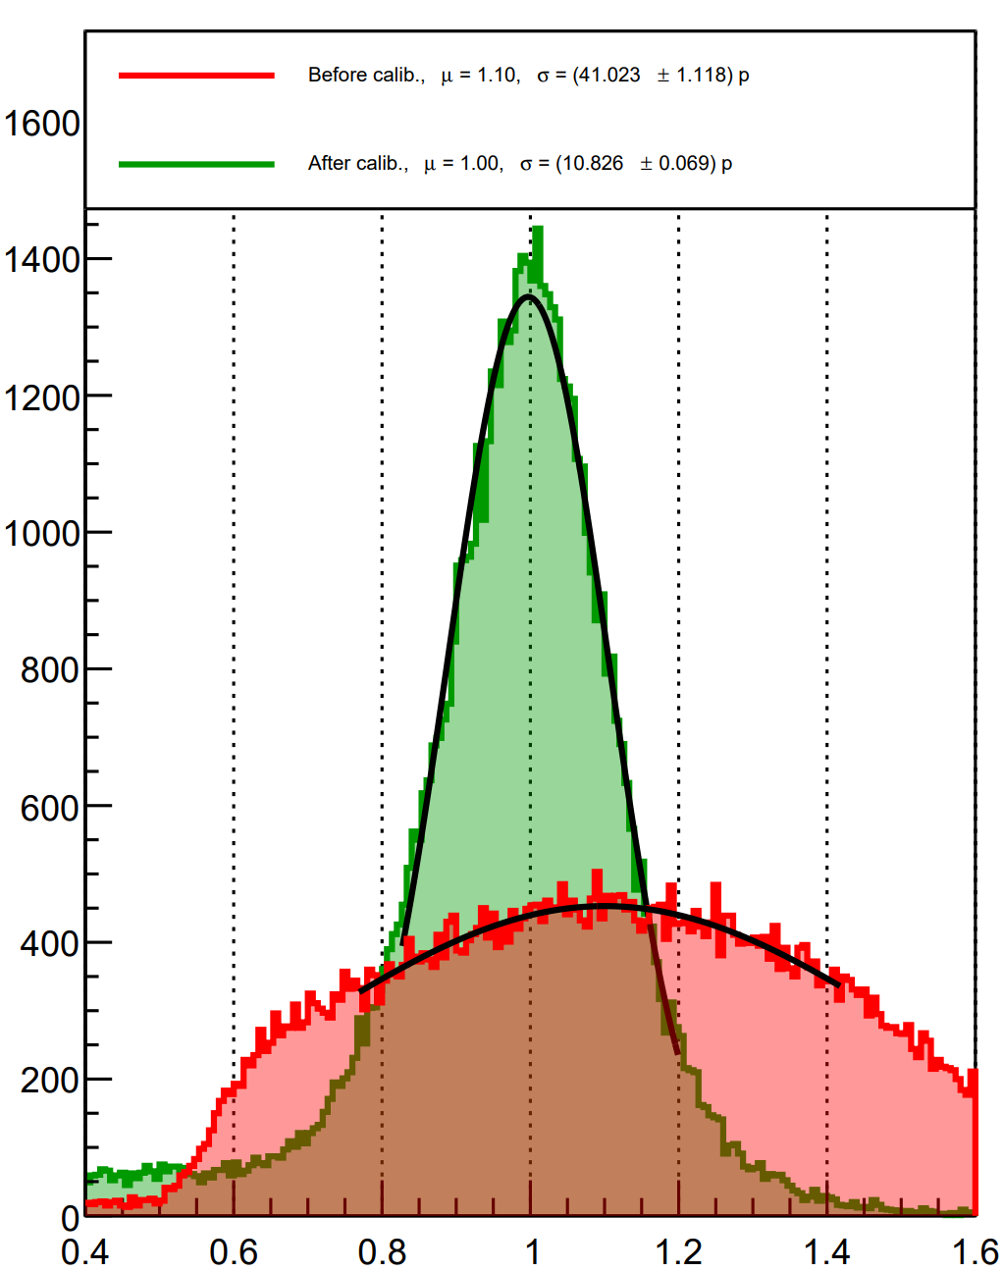
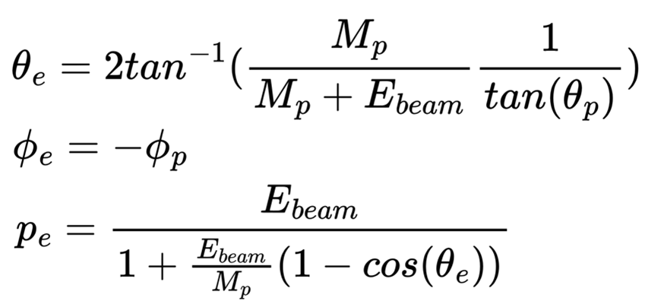

Elastic Calibration Method
11
GEM tracking allows for precise
proton angular reconstruction
Gather elastic events and compare reconstructed electron momentum to the energy measured by ECal
The same is done for HCal, but is complicated due to it being a sampling calorimeter
First iteration of ECal calibration performed during the experiment with initial elastic events

Slide 13
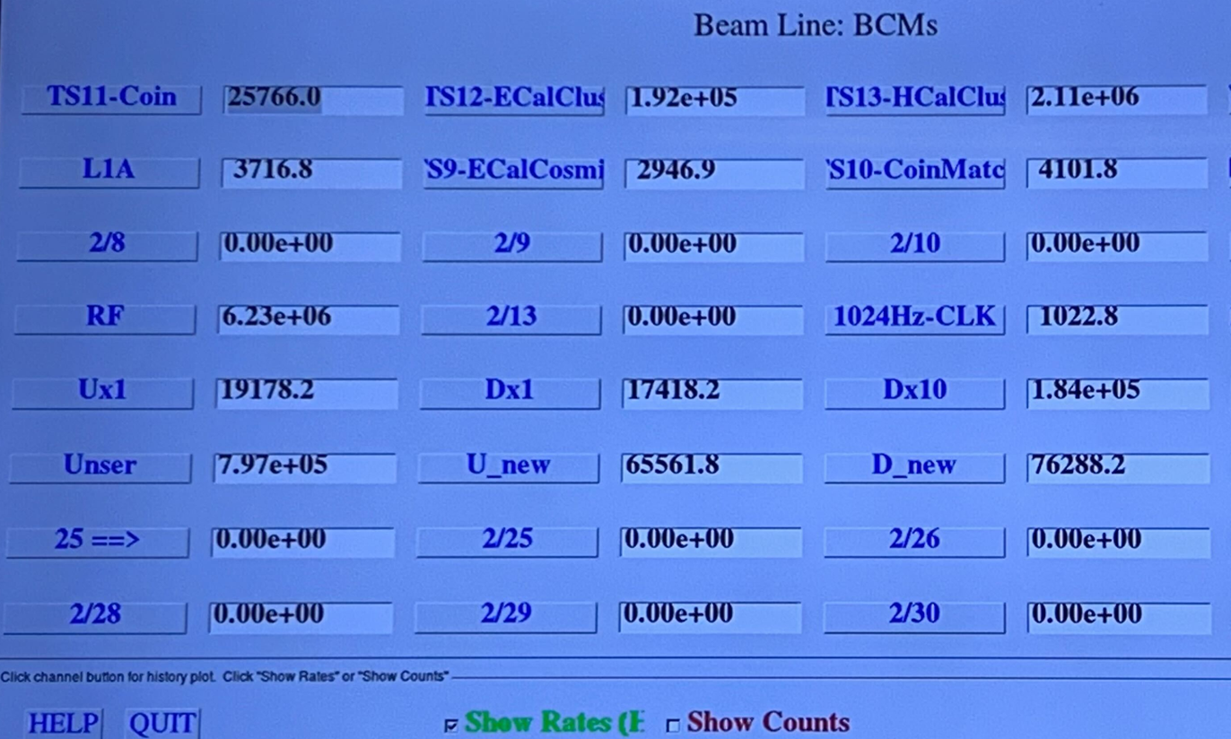
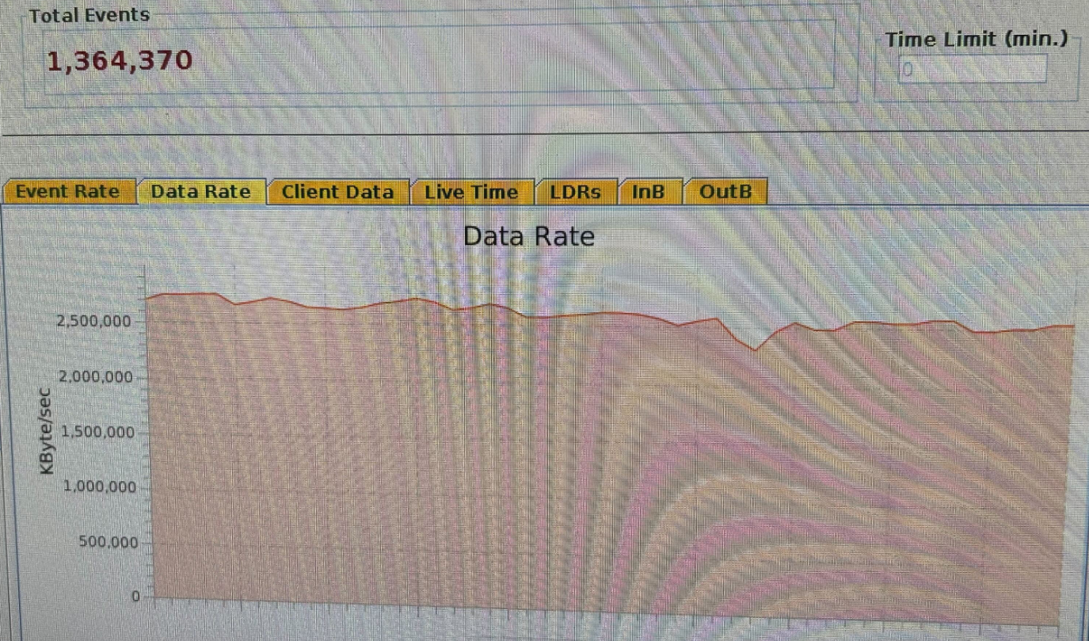
Maximizing DAQ Rates and Beam Current
12
Beam Current: 22uA
HCal Rate: ~2MHz
ECal Rate: ~200kHz
Open Coincidence Rate: ~26kHz
Kinematic Correlation Coincidence Match Rate: ~4.1kHz
Accepted Triggers Rate (L1A): ~3.7kHz
Live-time (L1A/CoinMatch): ~90%
Note: These rates were only achievable after much attention was given to the calibrations and trigger efficiency across ECal, more on this in following slides
~2.5 gigabytes/second

Slide 14
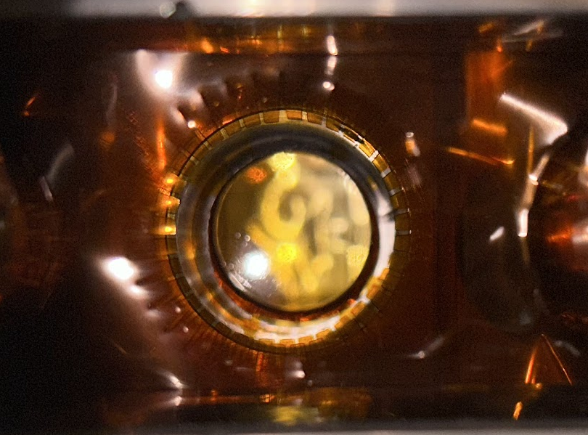
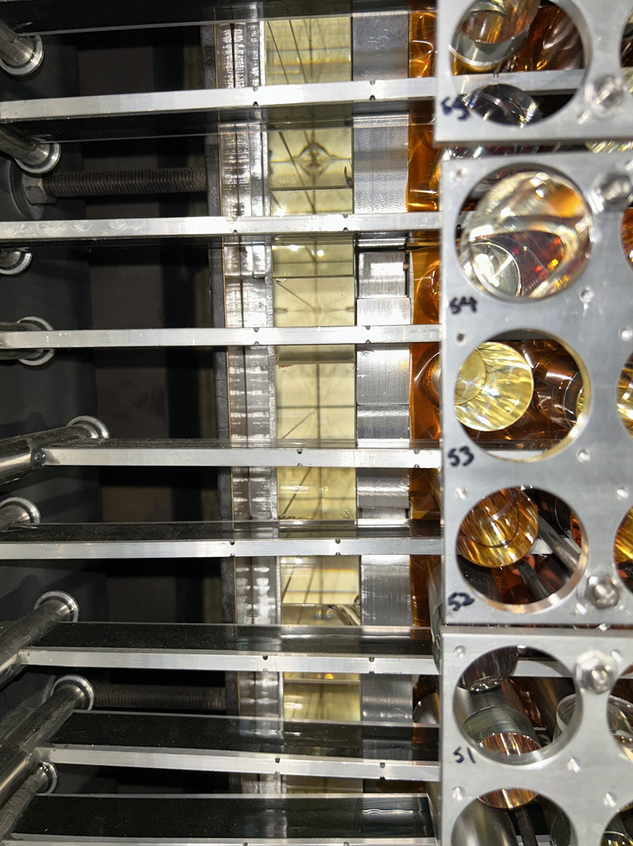
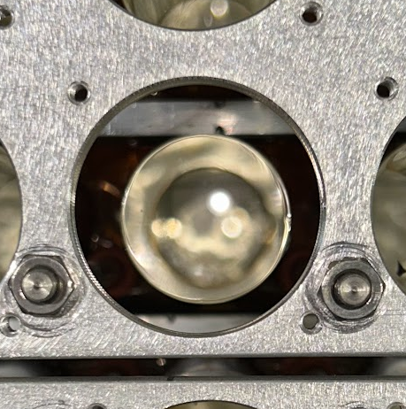
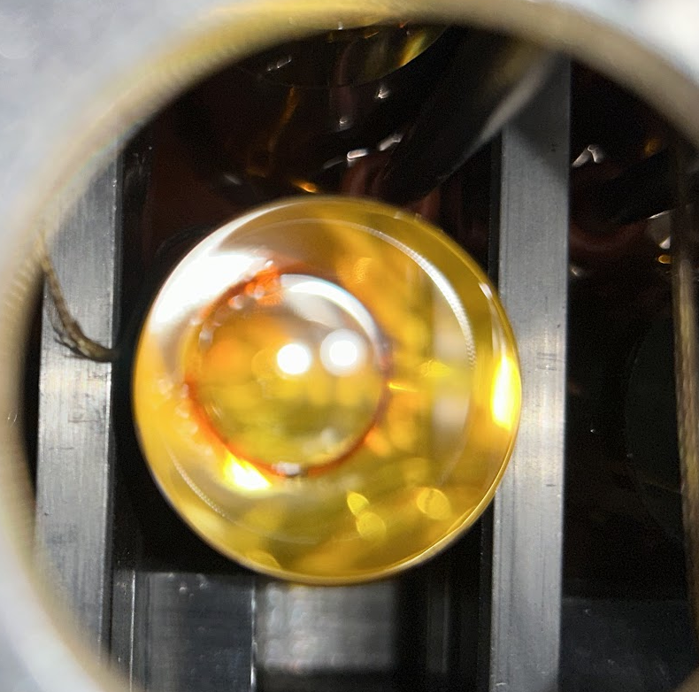
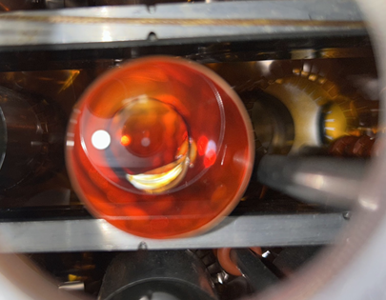
Post-Disassembly Analysis
13
Study performed by Don Jones
The thermal annealing was largely successful in maintaining crystal clarity
However, many glue joints between the crystal and lightguide came loose and showed darkening likely due to heat and air exposure
View of darkened glue on crystal after removing lightguide
Varied glue darkening seen through lightguide
Clear inactive crystals used for support
Little to no darkening of glue joint
Notable darkening of glue joint
Dramatic darkening of glue joint

Slide 15
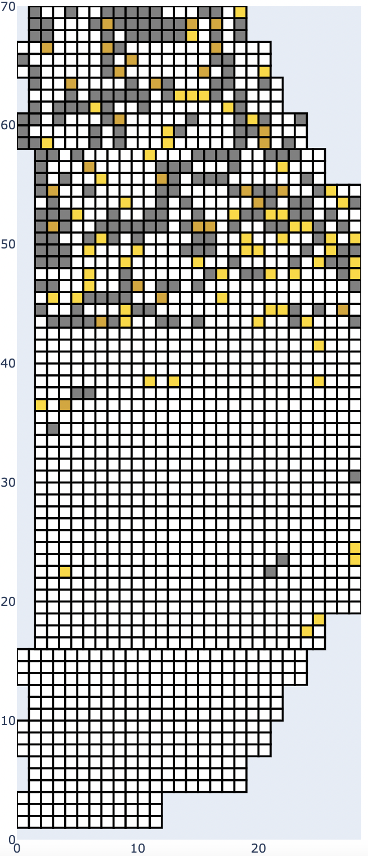
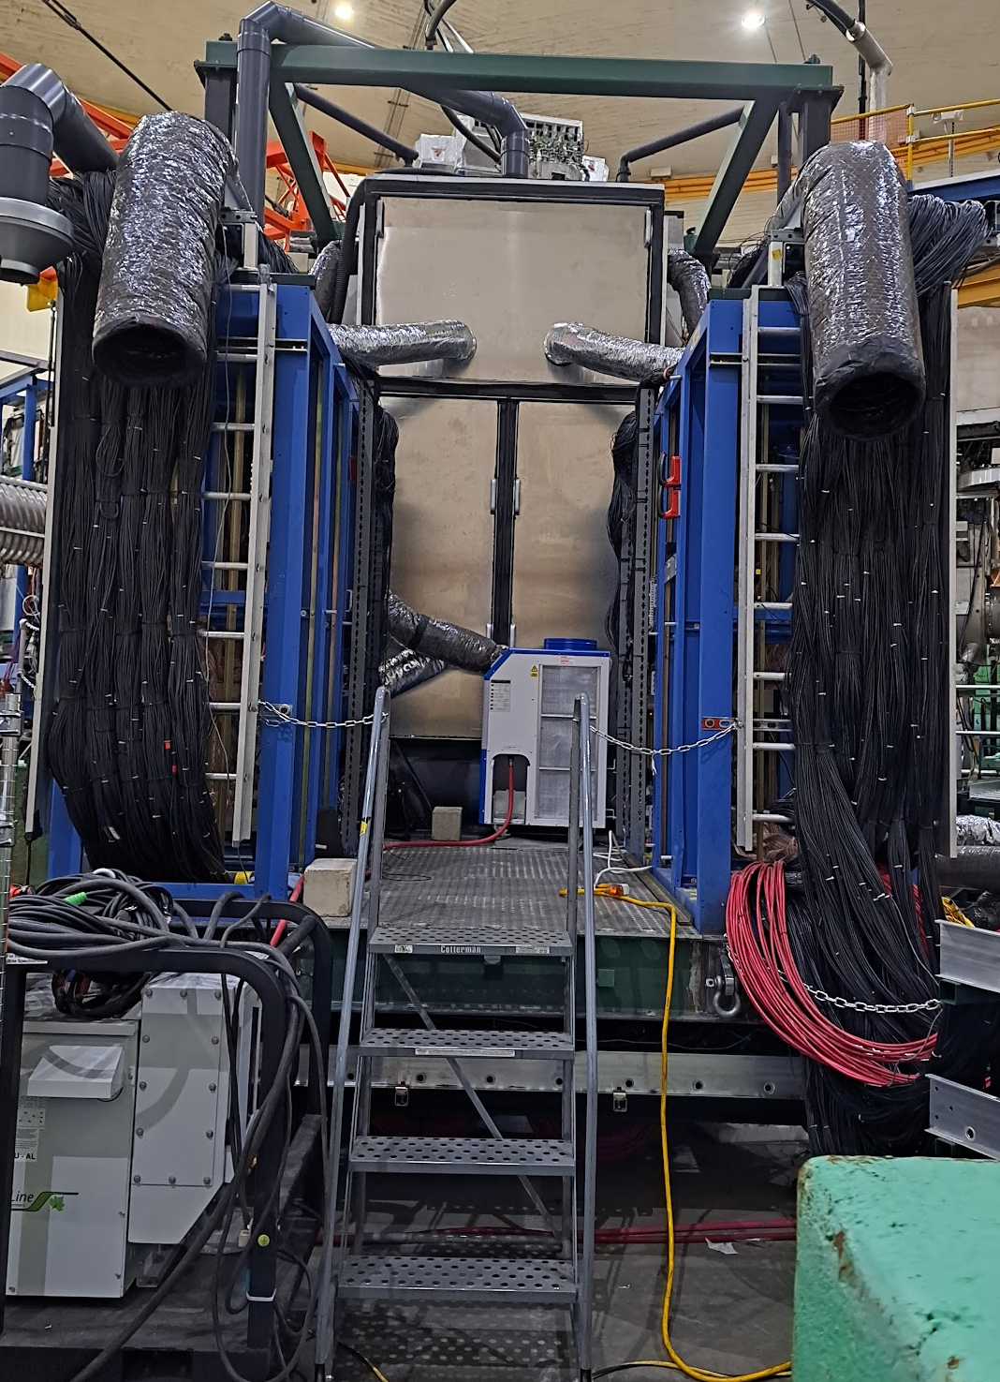
Map of light guide performance
14
Yellow and dark orange signify levels of crystal darkening
Gray signifies a loose light guide along with glue joint darkening
The onset of the glue joint failure in undecided – this is being investigated by Jhih-Ying
This top 1/3rd of the detector saw lower efficiency in earlier calibrations
Cooling
There was an overheating incident during testing prior to the experiment while only one AC unit was blowing into the bottom half of the enclosure and exiting through the top
After this test, two more air conditioners were added
At end of 3-pass running, more cooling exhaust vents added

Slide 16
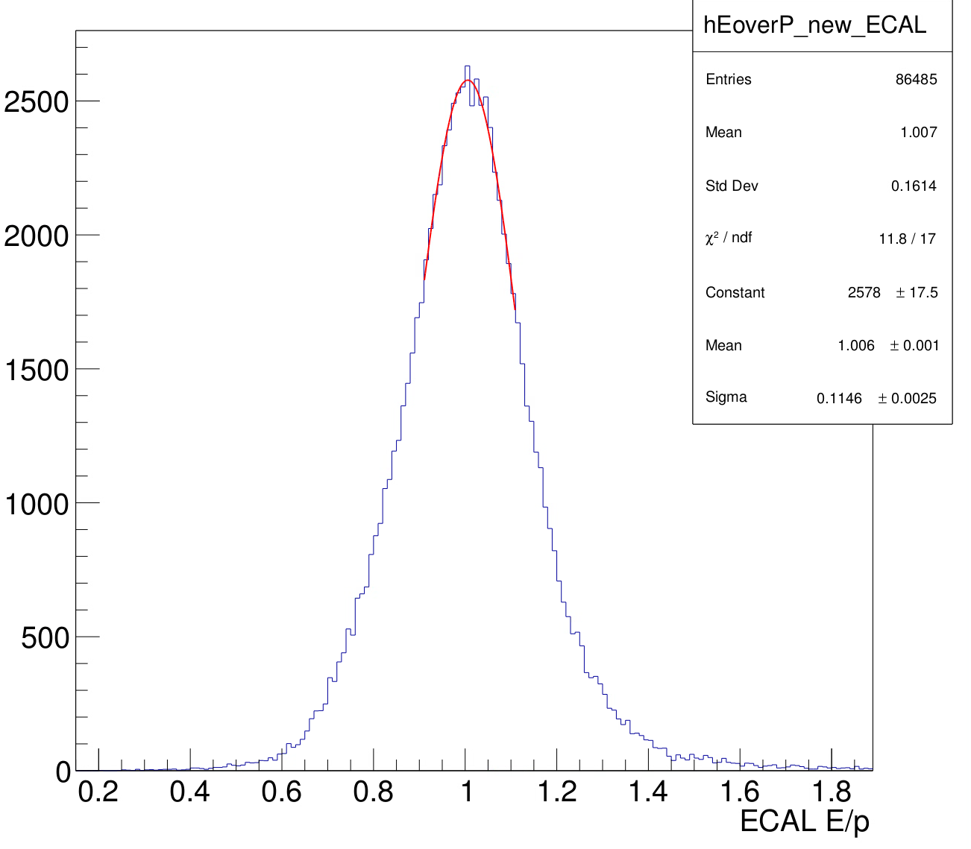
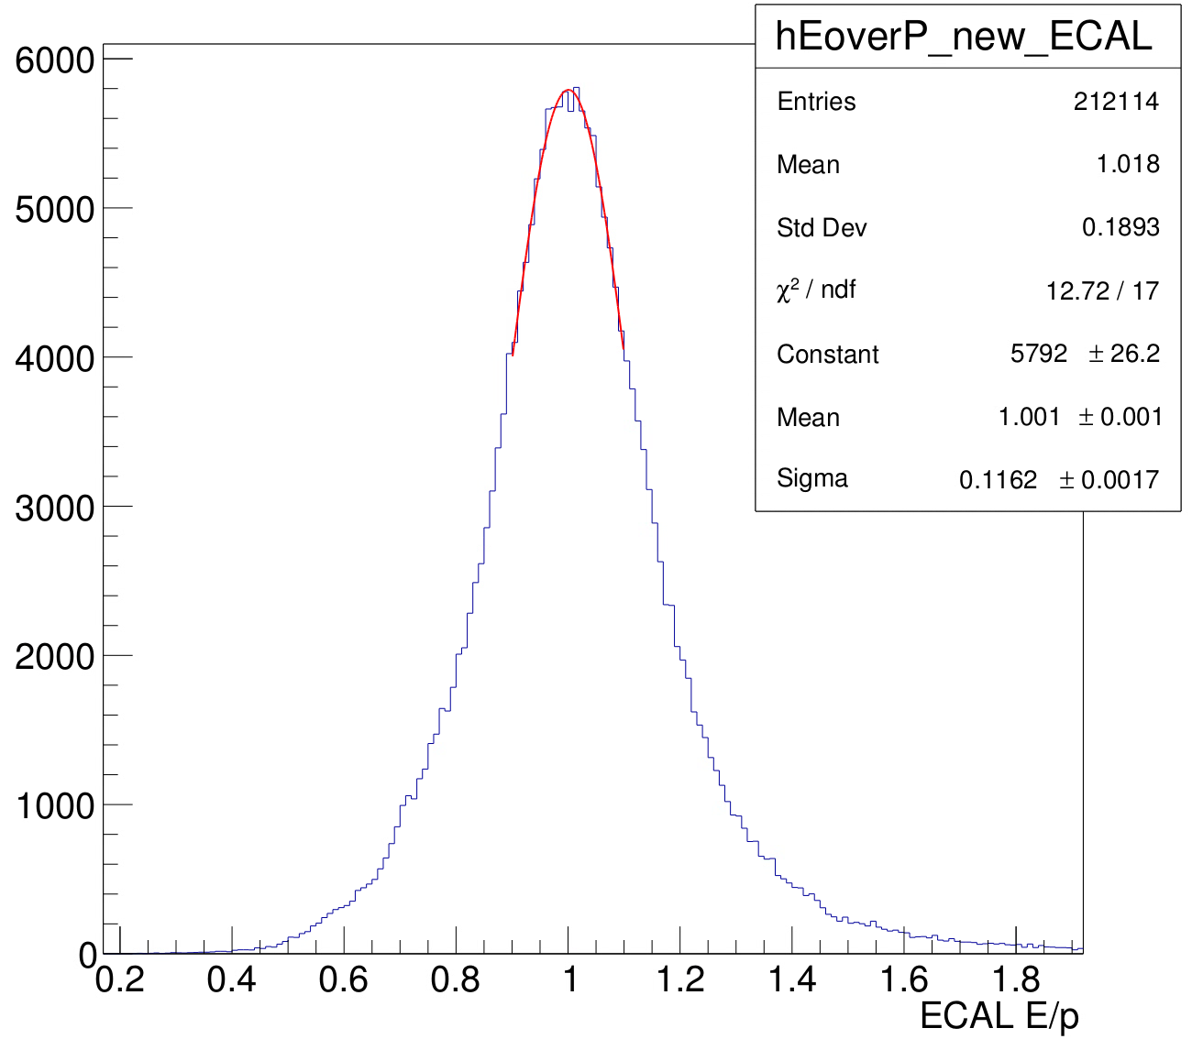
Post-Experiment Calibration
15
Multiple run ranges to calibrate
Lowest Q²(“Kin. 1”) had two HV changes for the entire detector
Highest Q²(“Kin. 3”) had 4 HV changes for ~10-20 channels
Shown here: most up-to-date elastic calibrations of the two largest sub-ranges of Kin. 3
Most run ranges consistently indicate energy resolution around 11-12% after calibration

Slide 17
Ongoing analysis efforts
16
Calibration: recent low-stats test replay using updated ECal and HCal gains seem promising, hopeful to implement new gains for larger replays soon
Multiple pulse finding: current algorithm in offline replay only finds the first pulse above threshold, but full waveform readout was used in experiment. Algorithm is being updated to search for best timed pulse
Timing calibration: recent effort towards timing calibration of HCal has shown progress, ECal timing from cosmics is decent, but there is room for improvement
Revisit Simulation: review details of GEANT4 geometry to better understand the lower energy resolution seen from data as compared to what was predicted by simulation

Slide 18
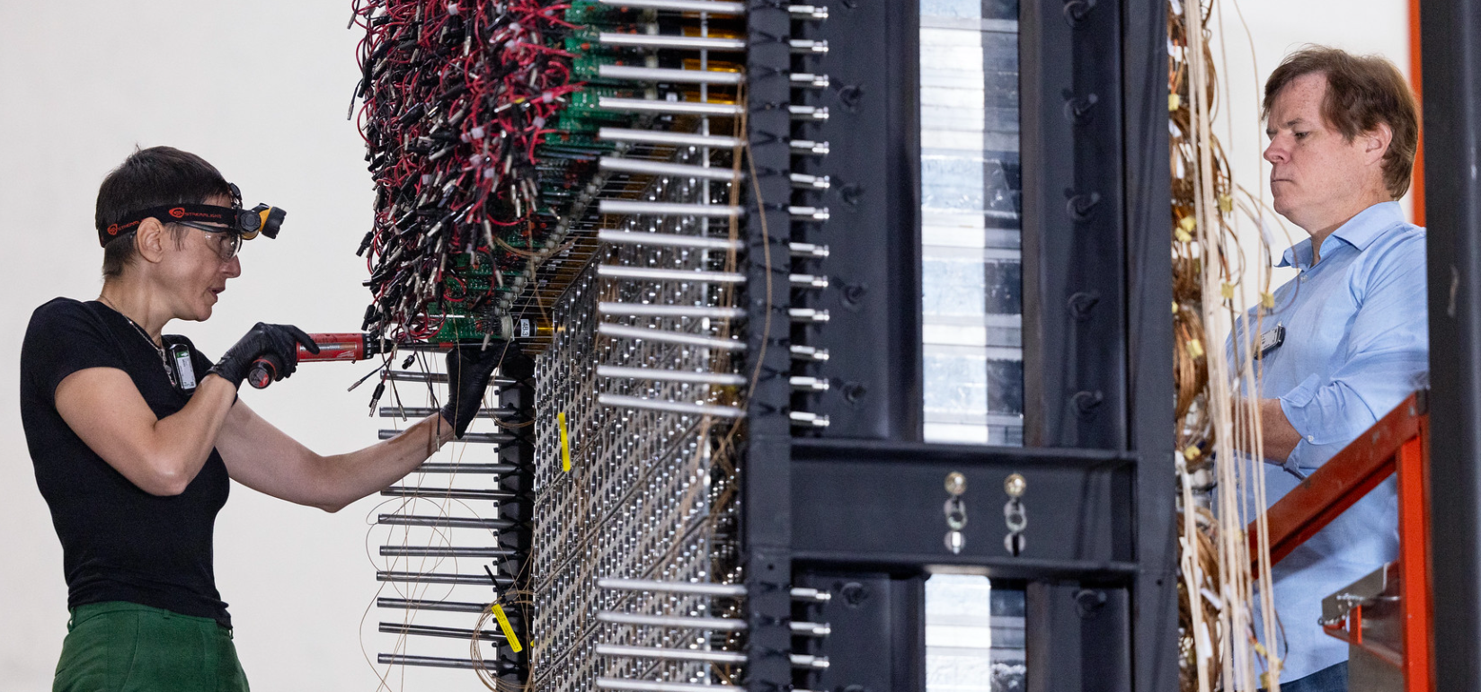
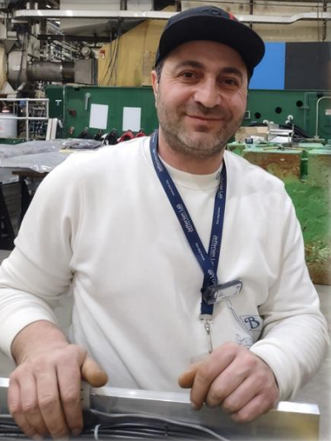
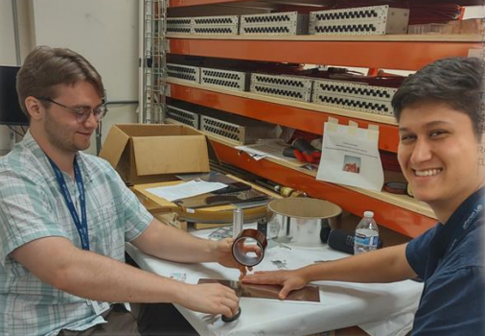
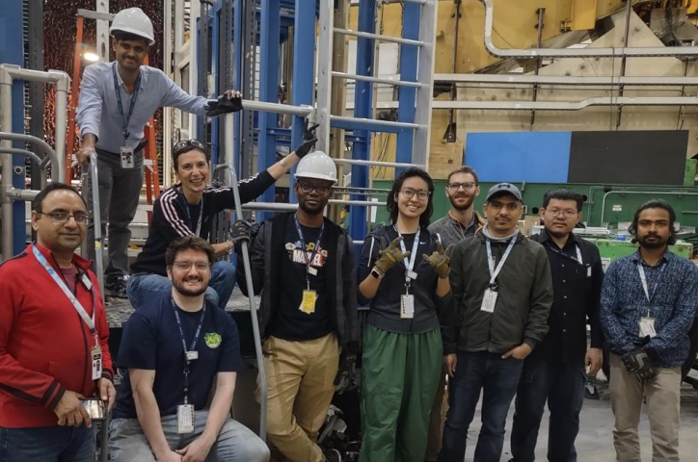
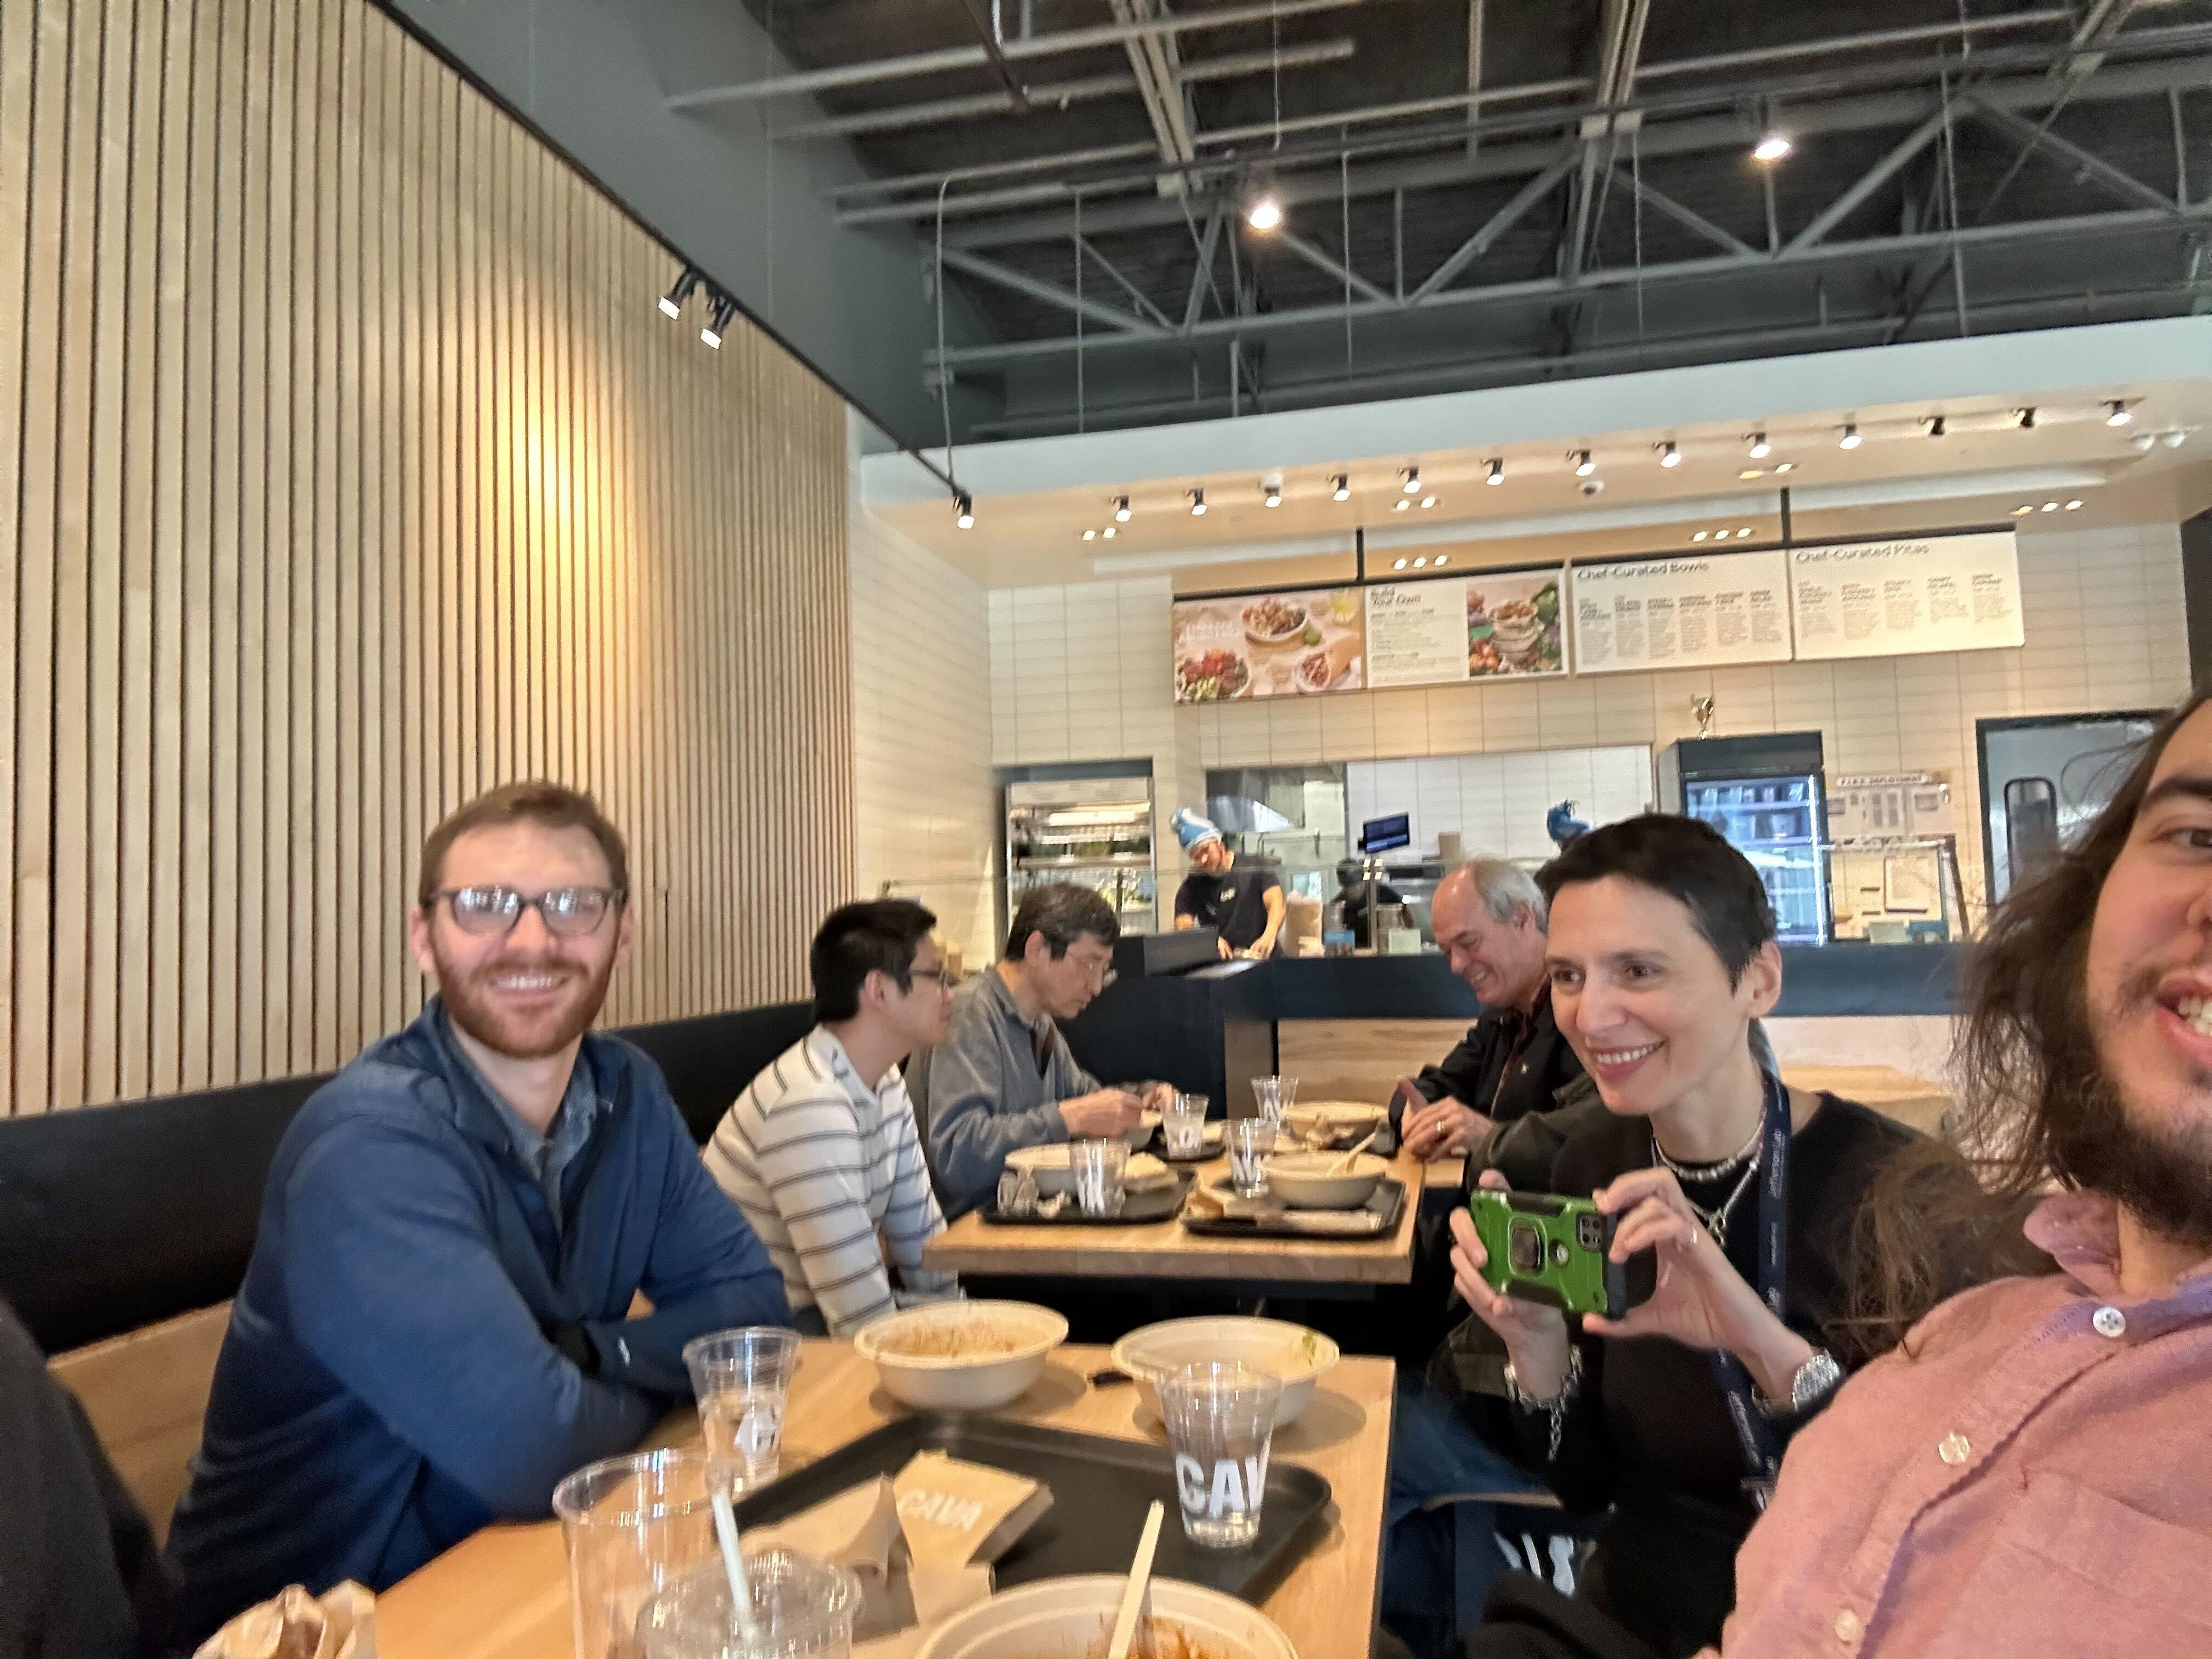
Thanks for all the help!
17
A *lot* of people worked to get ECal up and running, shown here are just some of those people

Slide 19
(Roughly) Everyone Involved
18
Installation Work: Simona, Don, Jimmy, Chandan, Jiwan, Ibrahim, Deb, Arna, Mahmoud, Keagan, Ryan, Hem, Jhih-Ying, Oliver, Andrew C., Ben S., Logan, Keegan, Provakar, Anu, Nunzio, Vicenzo, Prakash, Bill, Samvel, Aram
Software and Analysis Guidance: Andrew P., Mark, Provakar, Anu, Simona, Ben R., Hanjie
Special thanks to Jhih-Ying for constantly looking after ECal with me for about 5 months straight

