Slide 1

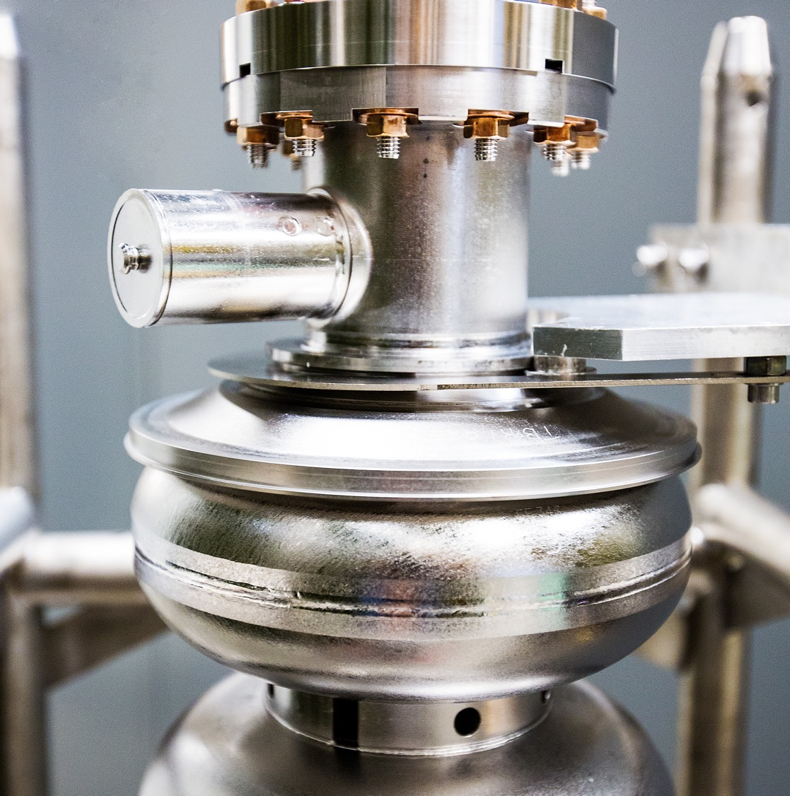
JSA Board Report
Jefferson Lab Status
And Updates
Kim Sawyer, Lab Director
Hall A Collaboration Winter Meeting
Jens Dilling & David Dean
January 21, 2026
March 19, 2025

Slide 2

FY25 CEBAF Operations
First time reaching the DOE goals since 12 GeV upgrade!
CEBAF delivers the highest polarized electron luminosity in the world (10³⁹ e/cm²/s)
Weekly and Accumulated CEBAF Reliability (%)
Run 2025
Run length, weeks | 22+2
Average Run Reliability | 86.7%
Total Delivered Beam Hours | 3,249
DOE targets for Run 2025:
22 weeks Physics (+ 2 weeks CEBAF restore)
85%, and 3000h
Reliability for previous runs
Run 2024 | 75.2%
Run 2023 | 72.5%
Hall A Collaboration Meeting_1/21/2026
Notes:
Guidelines: 6-8 bullets per slide; Use sentence fragments for bullets
To change the chart: Double-click on chart; different color options with theme colors available (Change Colors)

Slide 3

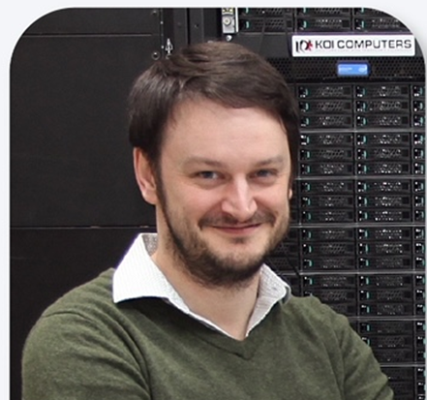
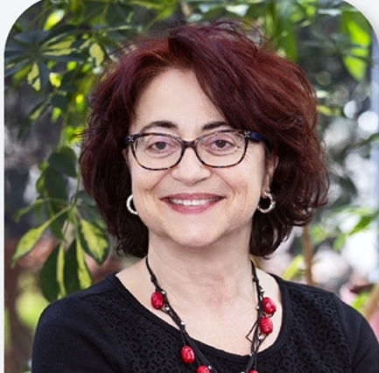
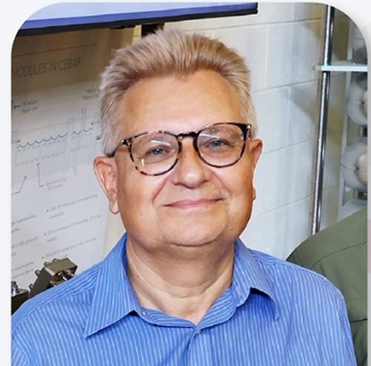


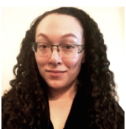
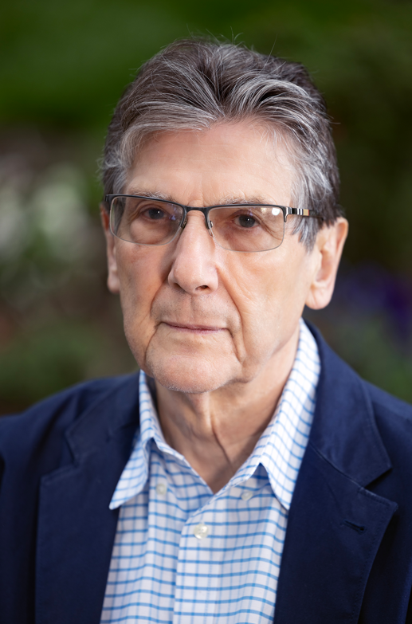
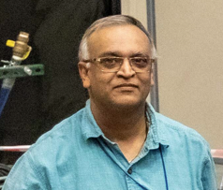
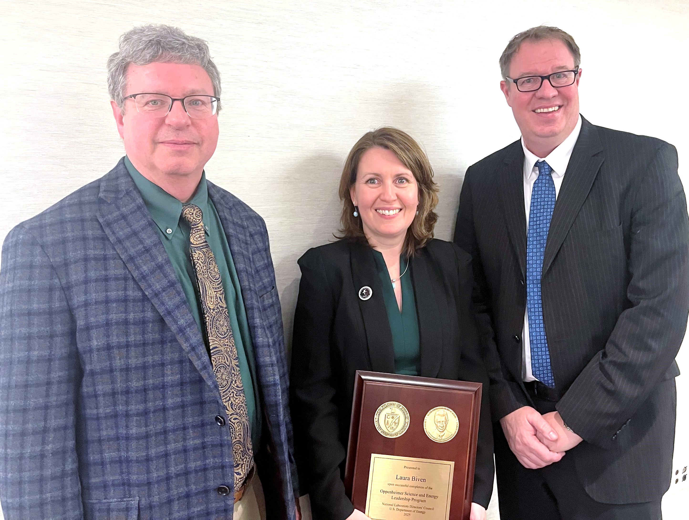
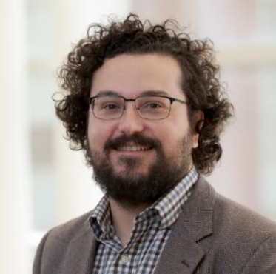
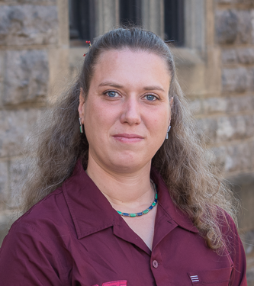
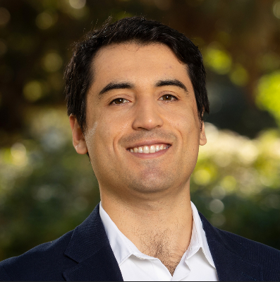
FY25 Awards and Recognition
FY25
2024 APS Fellow: Jozef J. Dudek
2024 APS Fellow: Patrizia Rossi
2024 APS Fellow: S. Alex Bogacz
2024 APS Fellow: Mark Kevin Jones
2024 DNP Distinguished Service Award: Bob McKeown
Stuart Jay Freedman Award in Experimental Nuclear Physics: Caryn Palatchi (JLab User/Indiana Univ.)
Tom W. Bonner Prize in Nuclear Physics: Volker Burkert
2025 IEEE Distinguished Reviewer Award: Probir Ghoshal
2024 DOE Early Career Award: Whitney Armstrong (JLab User/ANL)
2024 DOE Early Career Award: Marie Boer (Bridge Faculty/VA. Tech )
2024 DOE Early Career Award: Miguel Arratia (Bridge Faculty/UC Riverside)
DOE Oppenheimer Science & Energy Leadership Program 2025 Fellow:
Laura Biven
Notes:
Guidelines: 6-8 bullets per slide; Use sentence fragments for bullets
To change the chart: Double-click on chart; different color options with theme colors available (Change Colors)

Slide 4
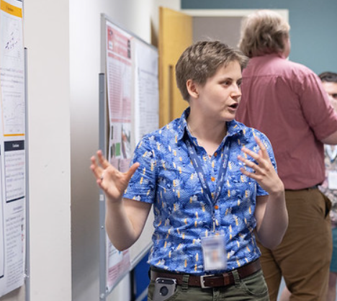
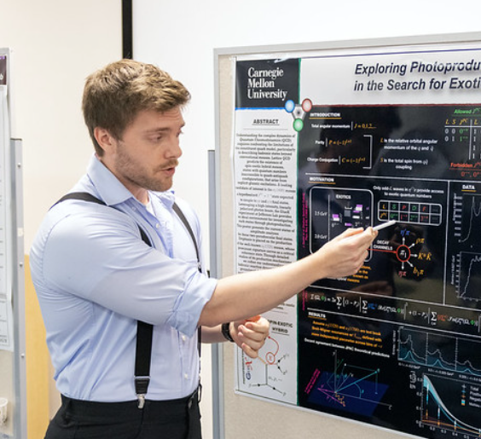
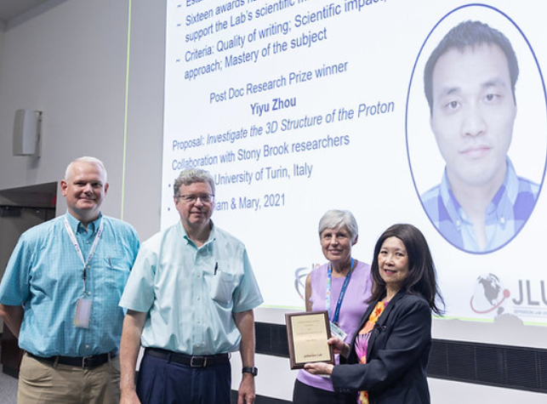
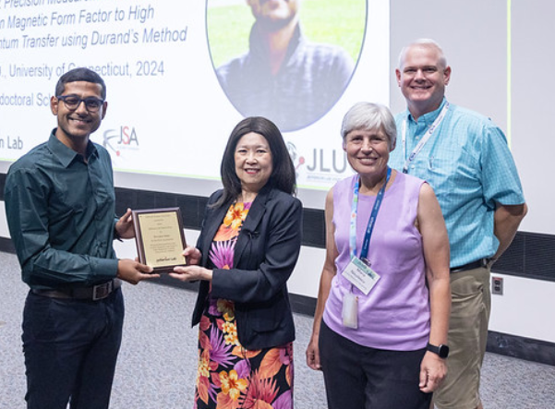
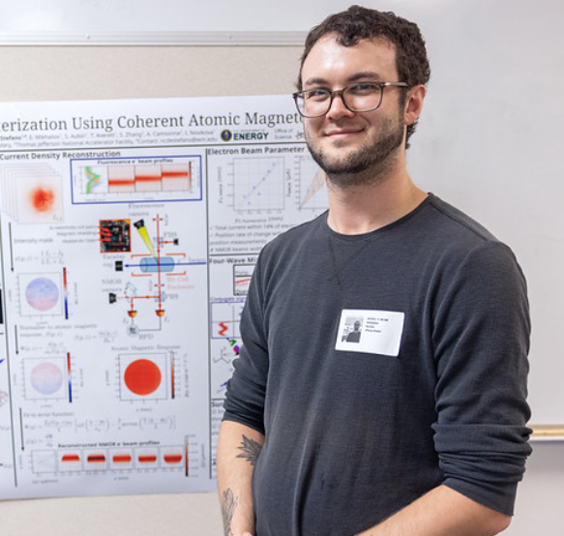
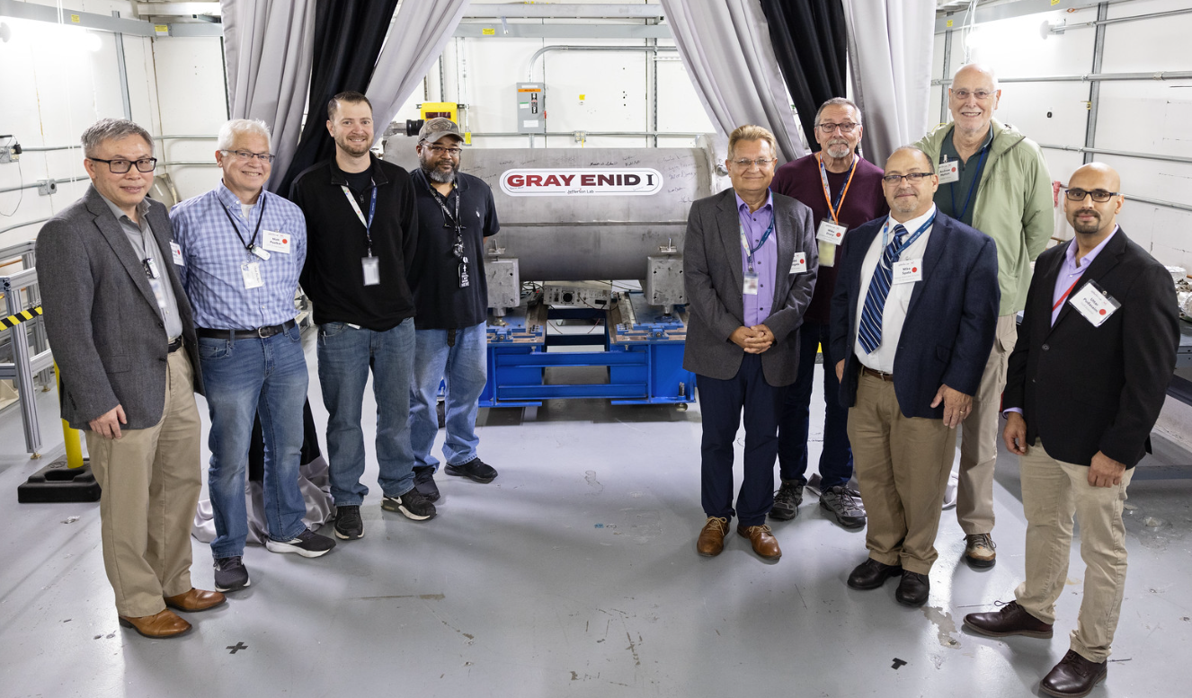
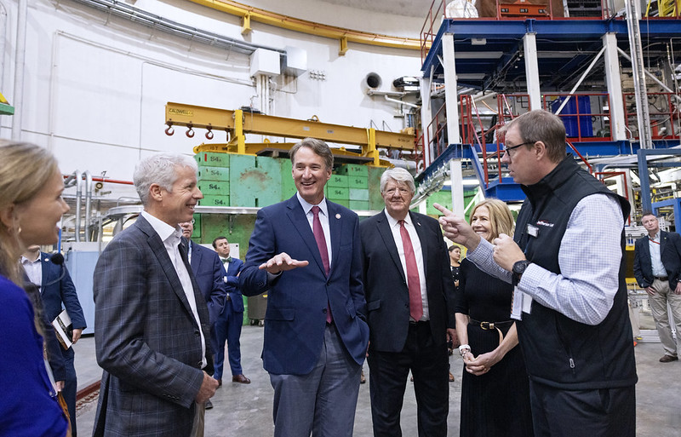
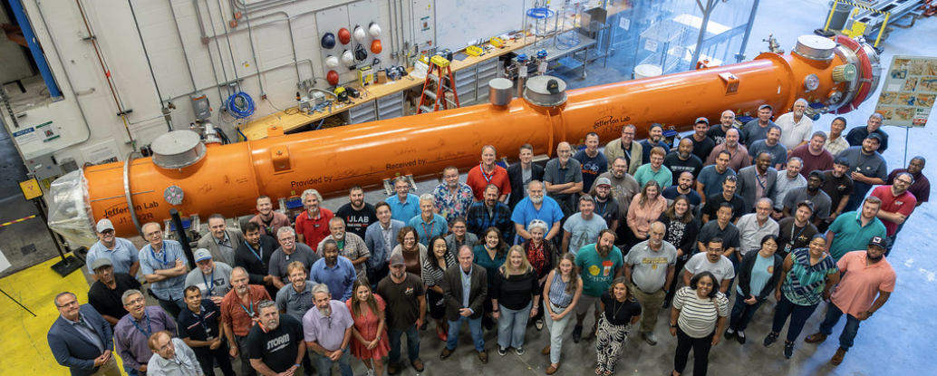
JSA Poster Prizes (A. Postuma, A. Baldwin, and N. DeStefano) | Jun. 25, 2025
JSA Post Doctoral Research Prize (Yiyu Zhou) and Thesis Prize (Provakar Datta) | Jun. 25, 2025
Visit by Secretary of Energy Chris Wright & Governor Glenn Youngkin | Aug. 21, 2025
Gray Enid I, Nb3Sn Cryomodule unveiling ceremony | Nov. 20, 2024
Visit by Secretary of Energy Chris Wright & Governor Glenn Youngkin | Aug. 21, 2025
4
LCLS-II-HE Cryomodule Production Completion Celebration | Aug. 28, 2025
LCLS-II-HE Cryomodule Production Completion Celebration | Aug. 28, 2025
Notes:
LCLS-II-HE
Scope:
Procurement for twenty-three cryomodules; assemble, test, and shipment of ten cryomodules. Beam Line Absorber (BLA) processing for thirty-one BLAs.
Budget at Completion - $35.3M
Status:
Completed cryomodule production in August 2025
Delivered last JLab cryomodule, J22R to SLAC in September 2025
Performance:
Favorable cost performance resulted in a $6.1M return to contingency in Q1FY25
Completed all Key FY25 Milestones
All cryomodules produced and tested at JLab have generously exceeded the 173MV energy gain requirement with an average of 194MV

Slide 5
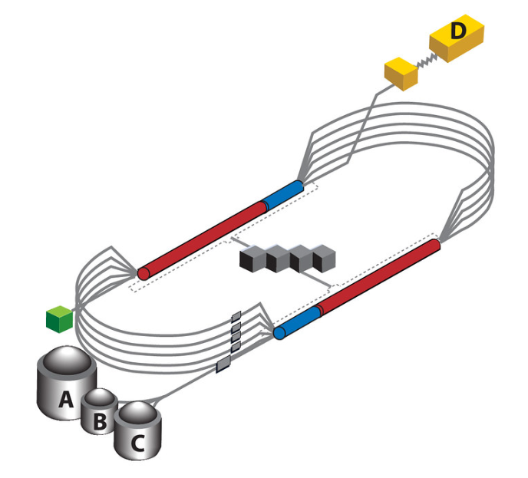
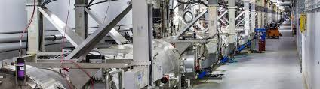
Government Shutdown
JLab managed the Government Shutdown successfully, with no furloughs, and manageable impact on science (SAM, projects).
Tough start on Oct 1st, with initial plans for furlough on Oct 24th.
Excellent teamwork throughout the organization and working with DOE: ‘Beg, steal & borrow’ and we managed to stretch furlough out to Dec 1st, thankfully Government Shutdown ended before.
Significant effort to manage impact, clear priorities: Be Safe, Wellbeing of the people and the organization, Execution of the DOE Mission.
We were leading many activities for the DOE National Labs (by necessity) and we did a detailed ‘lessons learned’.
DOE appreciated our proactive approach and provided solid funding in the CR for FY26.
Lessons Learned:
Formal documentation of all activities, including mitigation plans (benefits, H1-B visa, etc).
JLab business plan to include 6 weeks of reserve. Quarterly review and milestones
ISP is part of the efficiency gain to generate the reserve.
Longer term: multi-mission (as expected in the DOE M&O contract) to provide portfolio diversification.

Slide 6
VSP/ ISP Status
Workforce Restructuring Program to:
Optimize workforce levels to deliver on our core mission and contract requirements​
Align organizational structure with key priorities​, clear focus on PEMP Notable Outcomes
CEBAF operation and NP project (including Moller, EIC)
Overall, ~7% of staff impacted by Work Force Restructuring program
Phase I: Voluntary Separation Plan (VSP)
Phase II: Involuntary Separation Plan (ISP)​
Completed.
Offer VSP to all eligible staff
Goal is to attract ~7% participation of the staff​
Effective separation date for most: October 15, 2025
19 Employees participated in the VSP
Guiding principles throughout: Take care of our people with compassion and respect
Planned notification & departure date for ISP employees: this week
Extended timeline is driven by internal thorough review as well as DOE Review
Will use best practice to achieve separation of people with dignity and support for next steps.
Notes:
Guidelines: 6-8 bullets per slide; Use sentence fragments for bullets
To change the chart: Double-click on chart; different color options with theme colors available (Change Colors)

Slide 7
CEBAF Operation Plans for FY26
Planning for 22+ weeks physics run divided into two periods
During physics runs, Hall A will be down for the MOLLER installation.
CEBAF also supports beam studies
First period: A low energy run with approximately 360 MeV/linac.
Second period: A high-energy run at 1060 MeV/linac. (same energy as the FY25 run and the design energy for the upcoming MOLLER experiment)
Two-weeks to rescale and restore CEBAF in the middle of the run period.
Hall B: Proton Radius
Hall C: cryo-target experiments including Rosenbluth separations that require the low energy running along with high energy runs
Hall D: Finishing the GlueX-II high energy run as well as a newly approved low energy GlueX run
Parity Quality Beam studies in support of the MOLLER experiment.
Beam Degrader studies to baseline large emittance beam transport in CEBAF consistent with expected positron beam quality.
Beam energy spread measurement required for the upcoming Hyper-nuclear experiment.
Hall A Collaboration Meeting_1/21/2026
Notes:
Guidelines: 6-8 bullets per slide; Use sentence fragments for bullets
To change the chart: Double-click on chart; different color options with theme colors available (Change Colors)

Slide 8
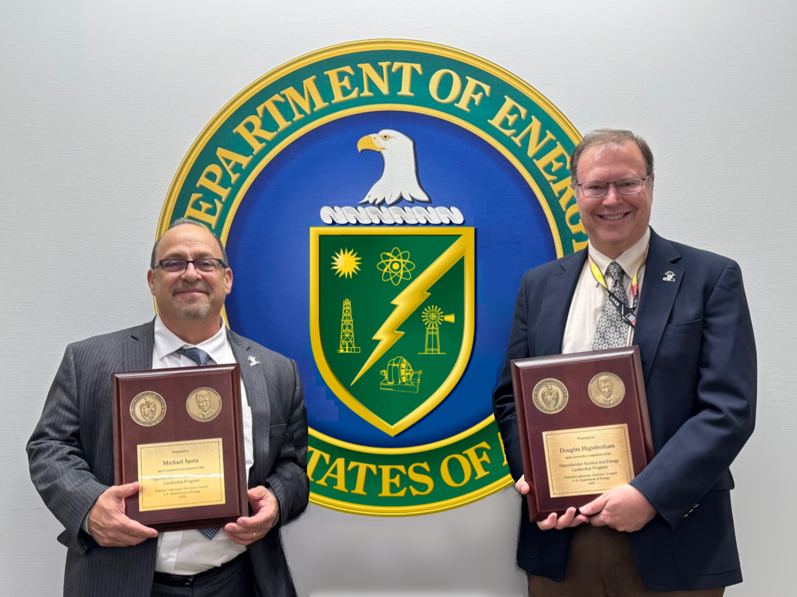
CEBAF Maintenance and Leadership Updates
Scheduled Accelerator Maintenance (SAM) Update
The 2025/26 SAM had been proceeding relatively smoothly.
The government shutdown/furlough planning required several systems, especially cryogenics, to be put into or kept in a low power mode, which pushed the CEBAF 2k cooldown until early January.
This has shifted the start of the experimental physics program to Friday March 13th.
The 2025/26 SAM had been proceeding relatively smoothly.
The government shutdown/furlough planning required several systems, especially cryogenics, to be put into or kept in a low power mode, which pushed the CEBAF 2k cooldown until early January.
This has shifted the start of the experimental physics program to March 13th.
Leadership Updates
Mike Spata: Acting Associate Director of Accelerator division.
Dougals Higinbotham: Acting Associate Director of Physics division.
Roger Ruber: Acting Director of Accelerator operations
Mike Spata, Acting Associate Director of Accelerator division
Douglas Higinbotham, Acting Associate Director of Physics division
Roger Ruber, Acting Director of Accelerator Operations
Mike Spata (left) and Douglas Higinbotham (right) after completing the Oppenheimer Science & Energy Leadership Program (OSELP) in December of 2024.
Hall A Collaboration Meeting_1/21/2026
Notes:
Mike and Doug bring that training and along with a combined 60+ years of CEBAF experience to the roles of acting associate directors of accelerator and physics divisions, respectively.

Slide 9
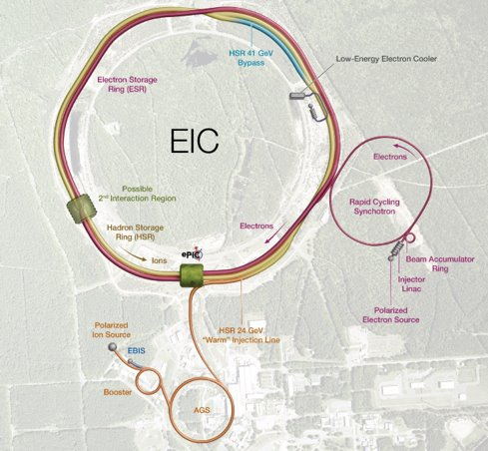
Electron-Ion Collider (EIC)
Jefferson Lab’s Role as Partner on EIC
Responsible for delivering SRF, magnet, cryogenics and detector scope, about 25% of the total project.
JLab Director chairs EIC Advisory Board to help navigate project strategy.
Responsible for delivering SRF, magnet, cryogenics and detector scope, about 25% of the total project.
JLab Director chairs EIC Advisory Board to help navigate project strategy.
JLab Deputy Lab Director for S&T co-chairs EIC Resource Review Board.
EIC Project Status
IPR held Aug 2025 recommended proceeding with subproject approach to EIC delivery.
Successfully met 3 PEMP evidentiary accomplishments in FY25.
EIC Strategy Workshop Dec 4 provided guidance on achieving NP budget targets and working with the science community to converge on achievable goals.
IPR held on Aug 2025 recommended proceeding with subproject approach to EIC delivery. Next IPR planned for Apr 2026 to assess readiness for CD-2 of first subprojects.
Successfully met 3 PEMP evidentiary accomplishments in FY25.
EIC Strategy Workshop Dec 4 provided guidance on achieving NP budget targets and working with the science community to converge on achievable goals.
Notes:
Guidelines: 6-8 bullets per slide; Use sentence fragments for bullets
To change the chart: Double-click on chart; different color options with theme colors available (Change Colors)

Slide 10


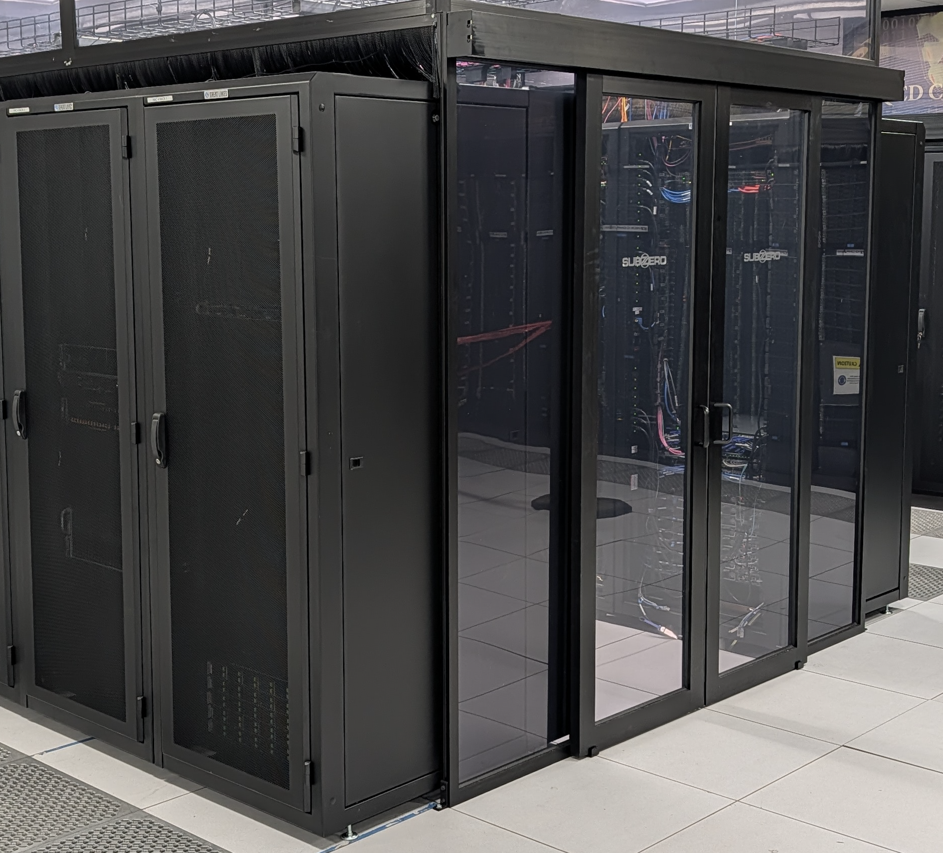
High Performance Data Facility (HPDF) and AmSC
Leadership Update: Graham Heyes, Interim HPDF Project Director
Significant effort recently dedicated to ASCR-issued American Science Cloud (AmSC) call (Lab 25-3555)
The infrastructure component of the AI GENESIS initiative
HPDF AmSC scope “recommended for funding” at $2.5M across JLab & LBNL, as proposed
AmSC is an accelerant for HPDF Project Will leverage lessons learned from AmSC to define HPDF Final Design
JLab leads AmSC Data Services effort Data services part of HPDF Conceptual Design adopted by AmSC
HPDF is installing testbed hardware at JLab and LBNL – supporting HPDF and AmSC activities
Hall A Collaboration Meeting_1/21/2026
Notes:
Guidelines: 6-8 bullets per slide; Use sentence fragments for bullets
To change the chart: Double-click on chart; different color options with theme colors available (Change Colors)

Slide 11


JLab Management and Operating Contract Timeline
6/1/26
New contractor
60 days
Transition period
7/29/25
DOE announced Request for Proposal
10/3/25
Proposal Due
10/28/25
Oral presentation
01/21/2026
Today
3/31/26
DOE announces
awarded contract
5/31/26
Current JSA/SURA
contract with DOE expires
Hall A Collaboration Meeting_1/21/2026
Notes:
6/1/26 New contractor to assume full responsibility (base 5 years then extension up to 15 years)

Slide 12



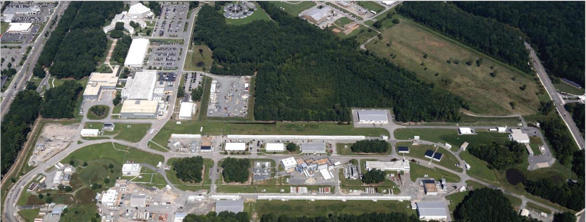
Near term focus and priorities:
Nuclear physics: delivering excellent science, safely and efficiently; we are the premier nuclear physics lab.
Maintain strong record of providing beam for CEBAF (over 85%) at required quality to produce impactful science for the Users & progress with priority projects. Train the next generation of scientists and leaders.
EIC: making project progress and achieve ‘budget goals’ from DOE NP, engagement strategy with the nuclear physics community.
Driving opportunities and progress for HPDF (AmSC & GENESIS) for JLab, nuclear physics and beyond.
Complete October/November ‘25 Shutdown related activities and achieve strong financial basis for JLab.
Prepare the lab for the transition and new M&O contract (June 1st, 2026)

Slide 13
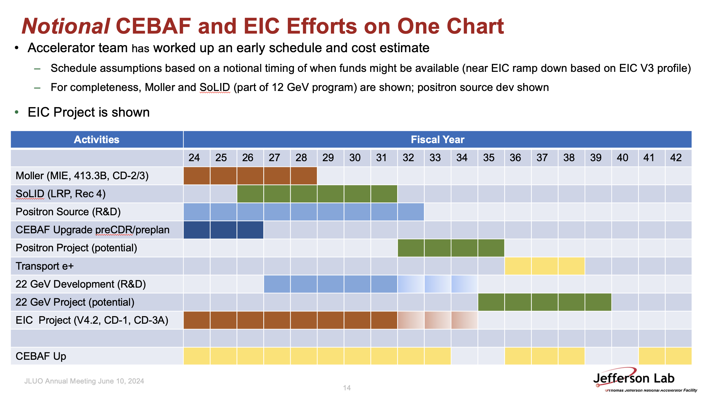
Unfolding the future
Dean first made this figure in late 2022, and revised it in early 2024.
Based on a particular EIC Project profile
Associated with the JSA contract and contractor.
The next contractor may have a different spin…or not…this feeds into us being a little vague as well.
Hall A Collaboration Meeting_1/21/2026

Slide 14
The long-term approach
Very manageable five-year projection: deliver on our promises to DOE: complete the Moller project, take data across all halls and run the full program with high reliability within the appropriated funding. This we are doing.
As the EIC moves past its peak funding needs, there will be opportunity for upgrades. We fully integrated into the success of the EIC. We are actively engaged in managing the EIC budget and profile.
SoLID. Requires a mission need statement from NP. Until then, R&D activities should continue. While SoLID is mentioned in Rec 4 in the LRP, the plan requires far more funding in NP to move. Optimizing the physics program viz a viz the other halls will be an important activity.
22 GeV. Mentioned in the LRP but not prioritized by the community. By the time of the next LRP, the scientific justification for an energy upgrade must be well thought out and articulated. This is something the community is working through (White Paper in preparation).
A similar statement holds for positrons. Highly-rated PAC approved experiments help in the scientific justification. Still, the path to any upgrade requires a lot of R&D prior to any major project.
Some program funding has gone into this
LDRD has gone into this
LDRD and program funding
have gone into this
Hall A Collaboration Meeting_1/21/2026

Slide 15




