Slide 1

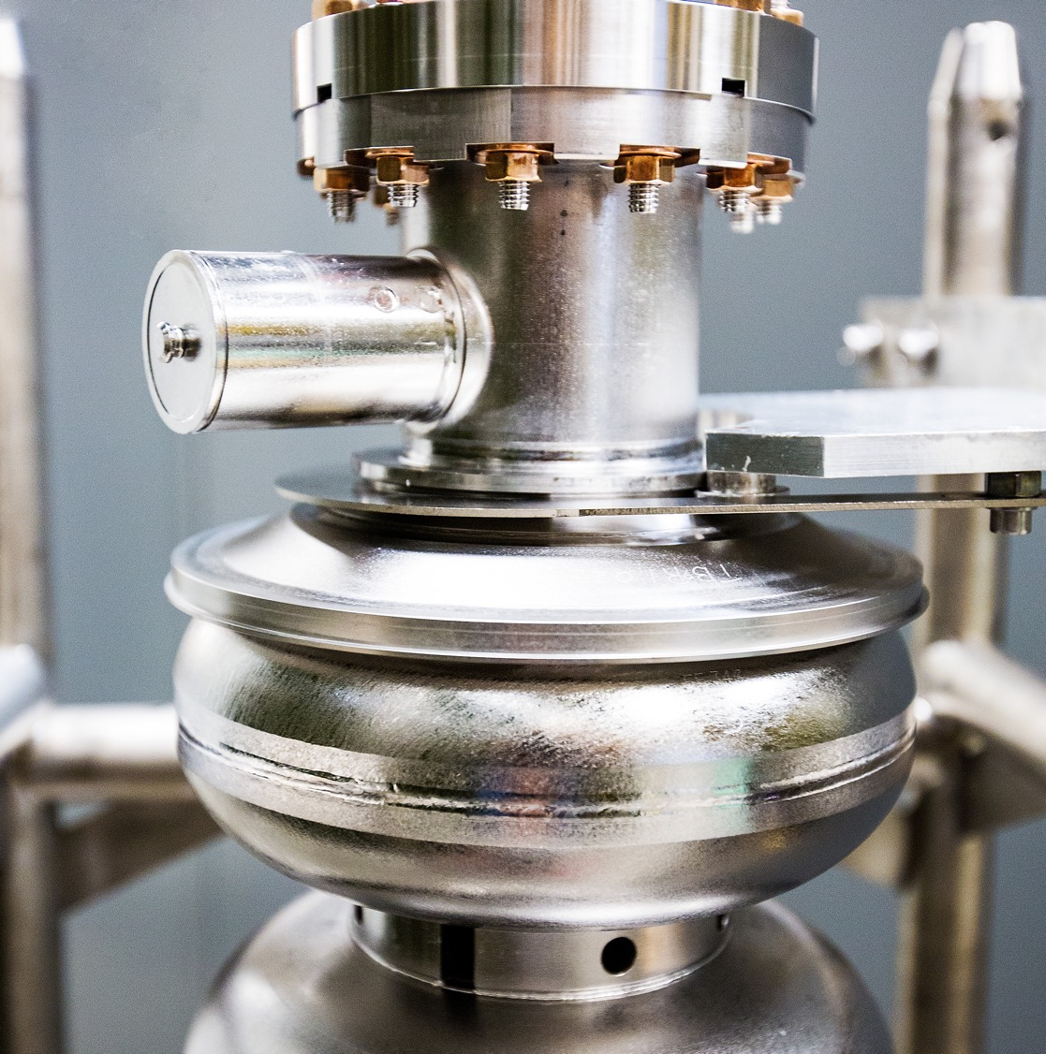
Jefferson Lab Schedule Status
21 January 2026
Douglas Weadon Higinbotham
Notes:
Tip: Keep titles under 60 characters for readability
To change the photo: Right-click on photo and select change photo

Slide 2
We had an amazing FY25 CEBAF run!
Energy of 1060 MeV/linac (up from 1047 MeV/linac in FY24 )
Beam Power > 800 kW
Low Number Beam Trips ( < 10 per hour )
This meant we were able to deliver on the experimental program as well as do the beam studies we need for the future program!
Notes:
Use for: Introducing new topics
To change the photo: Right-click on photo and select change photo

Slide 3
Dear Colleagues,
On behalf of the entire user community, the JLUO Board of Directors extends its gratitude to you, the staff of Jefferson Lab, for the successful CEBAF run completed on Sept. 3. This run significantly advanced the scientific program of the community, with highlights including:
Completion of the GEp run in Hall A, paving the way for the installation of MOLLER
Installation and operation of A Low Energy Recoil Tracker (ALERT) in Hall B and the completion of the four run group experiments
Completion of the Large Acceptance Detector (LAD) experiment in Hall C
Commissioning of a new calorimeter in Hall D and acquiring over 5 petabytes of raw data for the JLab Eta Factory (JEF) and GlueX experiments.
We deeply appreciate being able to call on you as engineers, technicians, machine operators, run coordinators and shift workers at any time, even in the middle of the night, and to have you answer that call with such support and enthusiasm for the scientific mission of the lab. You weren’t deterred by the challenges along the way, whether they were caused by the high-water table, the Virginia summertime heat or simply a curious snake!
Congratulations to you for setting a CEBAF reliability record in the 12 GeV era and doing so while operating at higher beam energy and current than in years past. We look forward to continuing to work together to pursue the ambitious future nuclear physics program that draws us to Jefferson Lab from institutions around the world.
With Sincere Thanks,
The Jefferson Lab Users Organization Board of Directors

Slide 4
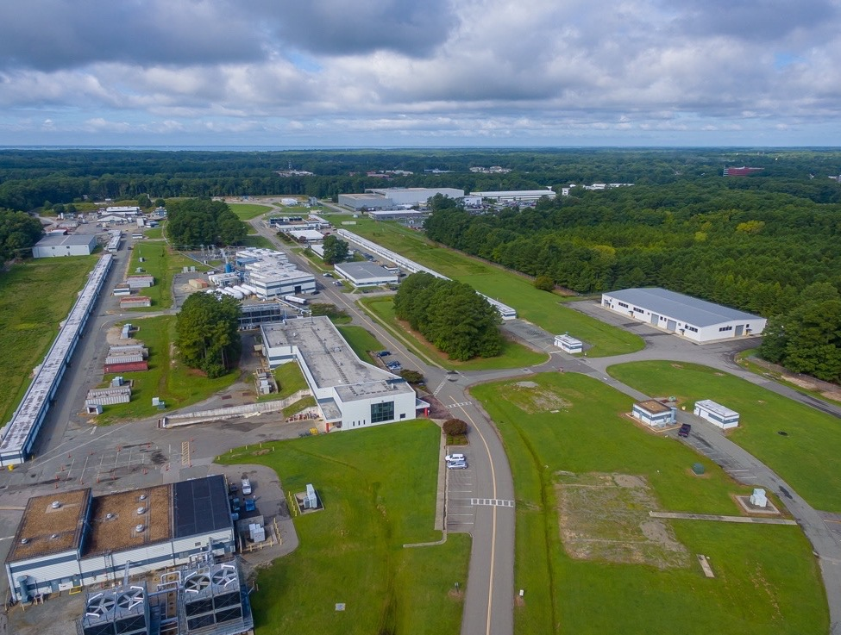
FY26 CEBAF Run Plan
Running Halls B, C and D
Part 1: Special 345 MeV/linac Run
  Hall B PRad-II ( large installation experiment )
  Hall C Low energy Cryo-target experiments
  Hall D special low energy GlueX experiment
Two Weeks To Re-scale the Machine
Part 2: Back to 1060MeV/linac
  Hall B High energy part of PRad-II then X17
  Hall C High energy cryo-target experiments
  Hall D Complete the GlueX-II / JEF experiment
Caption Here
Notes:
Guidelines: 6-8 bullets per slide; Use sentence fragments for bullets
To change the photo: Right-click on photo and select change photo

Slide 5
Accelerator Maintenance Schedule Overview of Key Dates
The accelerator down period started on 3 September 2025
In general, accelerator done a nice job staying on schedule, with the big exception being the government shutdown period where we needed to be planning for furloughs and to leave the lab in a safe state (i.e. we were warming things up instead of cooling down).
This caused about a month's delay, but we are now back on track, and we have completed the 2k pump-down of the main machine and are on-target for a March 13th startup in Hall B.
We have learned it is best to have a staggered start, so Hall D will start Monday the 16th and Hall C the 18th.

Slide 6
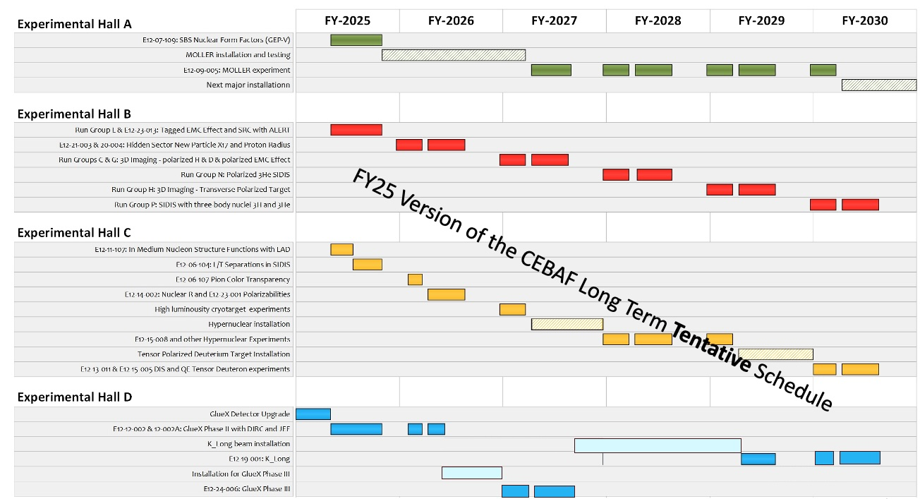
New version in progress: trying to always have at least three halls up during the upcoming run periods.
FIRM PLANS
FUZZY FUTURE
MOLLER RUNNING
FY27 ½ Hall C Cryotargets & ½ MOLLER
Hyper-nuclear
K-Long Experiment

Slide 7
Summary
The FY25 was truly outstanding with high energy, over 800kW, and low trip rates.
Going forward, we will mostly be running a three-hall machine with a series of major installations:
MOLLER Installation In Hall A
Hyper-nuclear and Tensor target installations in Hall C
K-Long in Hall D
FY26 will be running halls B, C, and D.
FY27 likely start with B, C and D and about half-way thru the run period switch to A, B and C as MOLLER starts its run and Hypernuclear starts its installation.
Finally, ALL experiments must pass their exp. readiness review (ERR) to run!!
Notes:
Before sharing your presentation, confirm:
Fonts are consistent
Images meet quality standards
Charts use template colors
Footer information is current
Spell check completed
Links are working
File size is optimized

