Slide 1


Update on x>1Measurement
Burcu Duran
With many thanks to Ramon Ogaz, Jordan O’Kronley, and Zoe Wolters
Hall C Winter Collaboration Meeting (Remote)
January 27, 2026

Slide 2
Outline
Short-range Correlations Physics
XEM2 Experiments in 12 GeV Hall C
Analysis of x>1 data and preliminary results

Slide 3
Outline
Short-range Correlations Physics
XEM2 Experiments in 12 GeV Hall C
Analysis of x>1 data and preliminary results

Slide 4
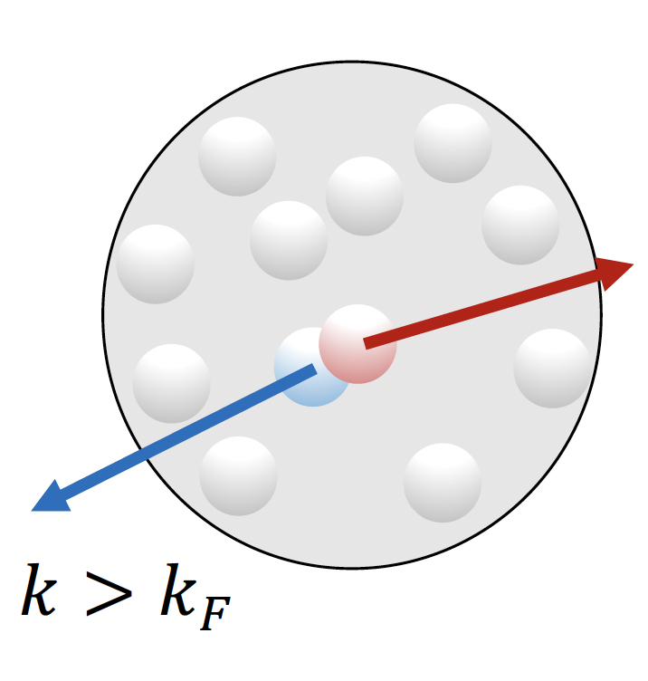
Short-range Correlations: A Universal Feature of Nuclei
All nuclei have them
Pairs of nucleons close together
High back-to-back, low center of mass momenta
Contribution to high-momentum distribution tails
~ 20% of nucleons in a nucleus
Notes:
The strong short distance interactions of nucleons in the nucleus create the short range correlations. These are essentially pairs of high momentum nucleons with large relative back to back momenta and low center of mass momenta

Slide 5
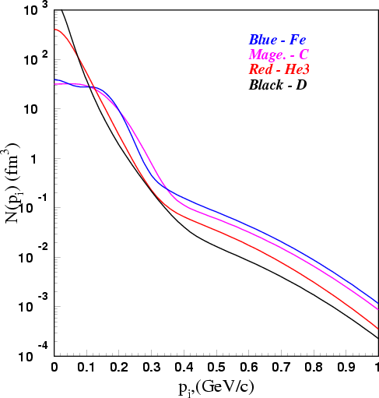
Short-range Correlations: A Universal Feature of Nuclei
All nuclei have them
Pairs of nucleons close together
High back-to-back, low center of mass momenta
Contribution to high-momentum distribution tails
~ 20% of nucleons in a nucleus
Notes:
The strong short distance interactions of nucleons in the nucleus create the short range correlations. These are essentially pairs of high momentum nucleons with large relative back to back momenta and low center of mass momenta

Slide 6
Short-range Correlations: Why do we study them?
(Short-distance) Nuclear Structure
High density neutron rich matter properties (neutron stars)
EMC effect and bound nucleon structure

Slide 7
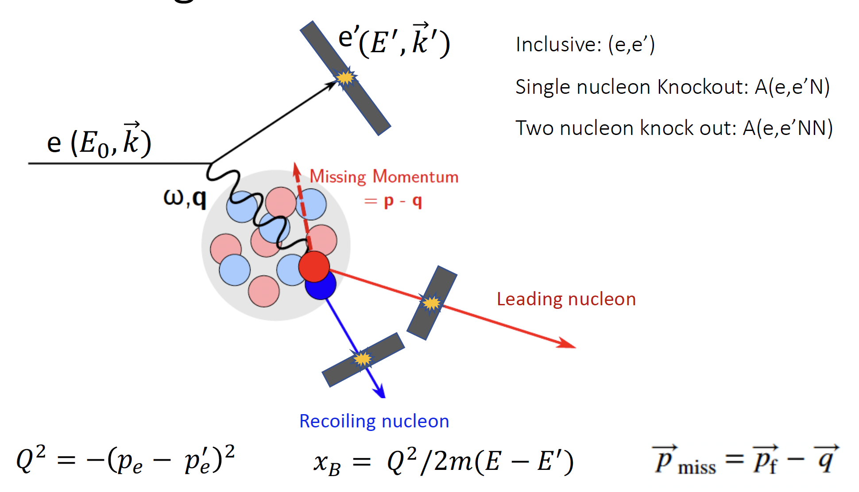
Short-range Correlations: What have we learned?
Inclusive:
The first evidence for 2N SRCs
Observed scaling of A/D cross sections
Quantifying relative contribution of SRCs in nuclei
Exclusive:
Pairing mechanism (which nucleons pair)
np pair dominance over pp and nn pairs
Cartoon Credit: Dien Nguyen
Quasi-elastic scattering: electron scatters elastically off an almost free nucleon

Slide 8
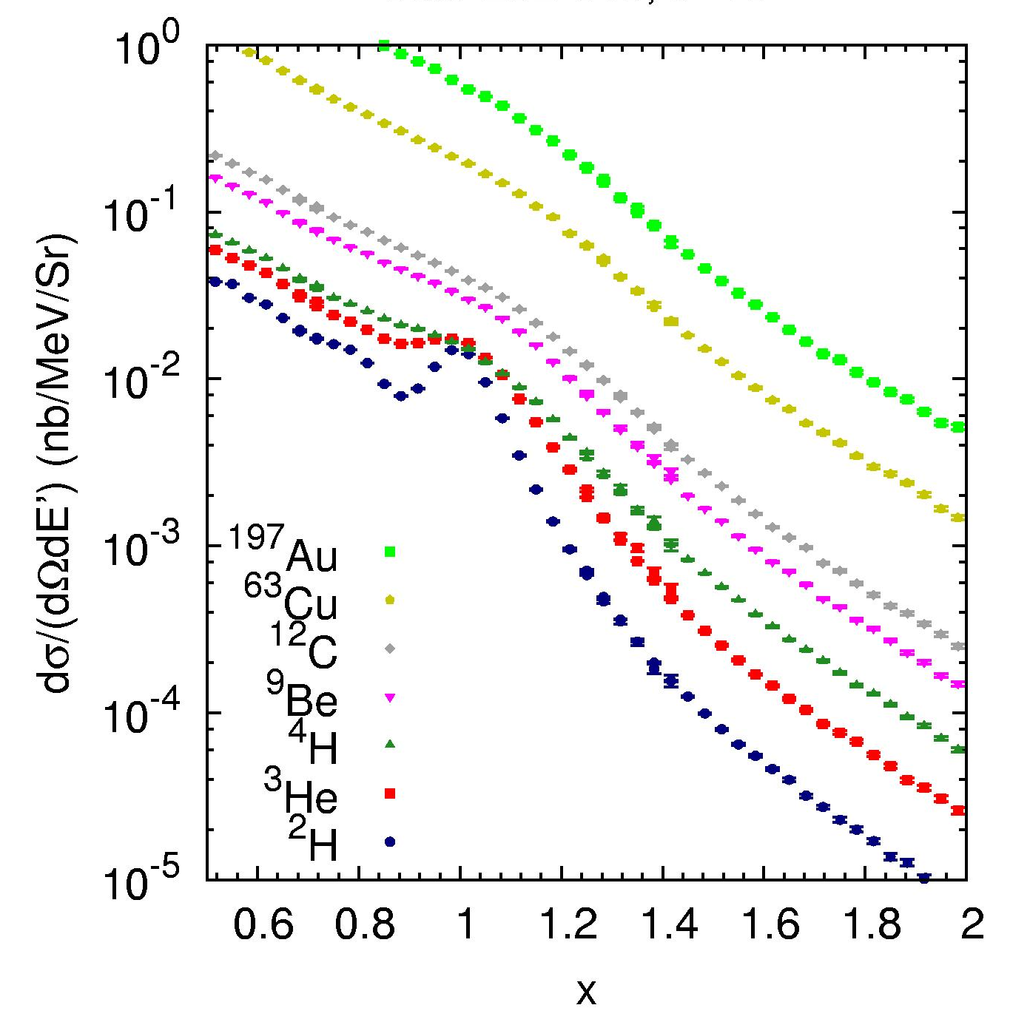
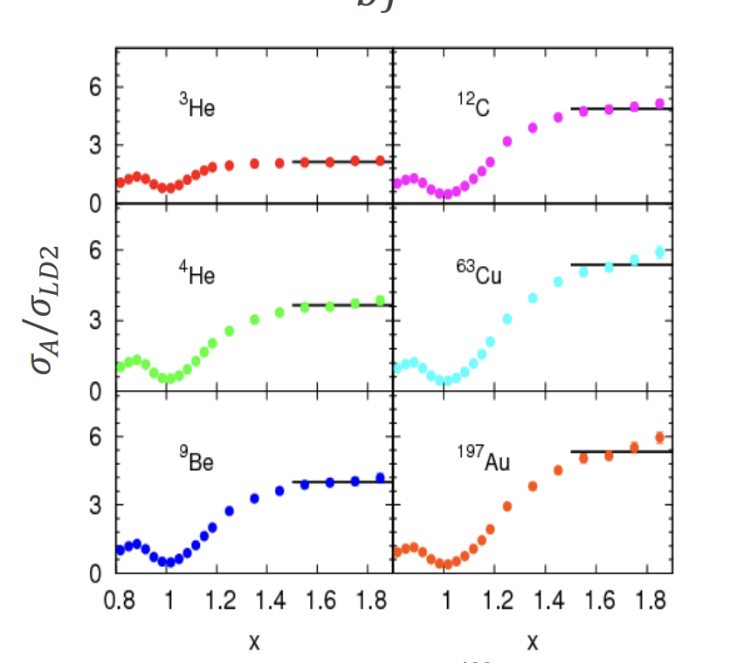
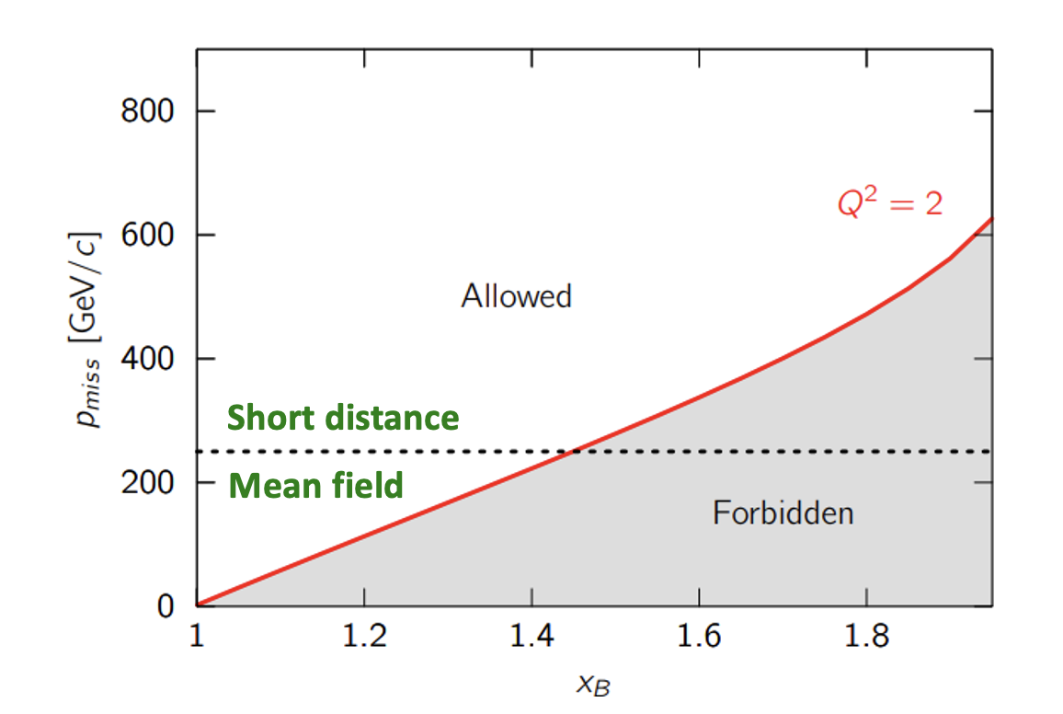
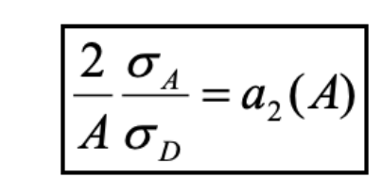
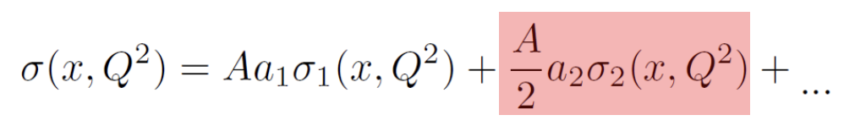
2N Short-range Correlations: Cross-section Scaling
QE
At large x, mean-field region excluded, should see universal behavior from 2N-SRCs: Cross section identical in all targets, A/D ratio independent of x and Q² (SRC cross section scaling)
N. Fomin, et al., PRL 108 (2012) 092052
Experimentally well established!
Notes:
For all nuclei QE peak is dominated by low energy MF nucleons but when we increase x and Q2 the minimum initial momentum of the struck nucleon below which the scattering forbidden increases too. This causes rapid drop in the MF contribution and SRC contribution dominates. With the assumption that srcs in nuclei are similar to those in deuteron up to a scaling factor then the cross section ratios should yield a constant ratio a2: the relative abundance of the src PAIR

Slide 9
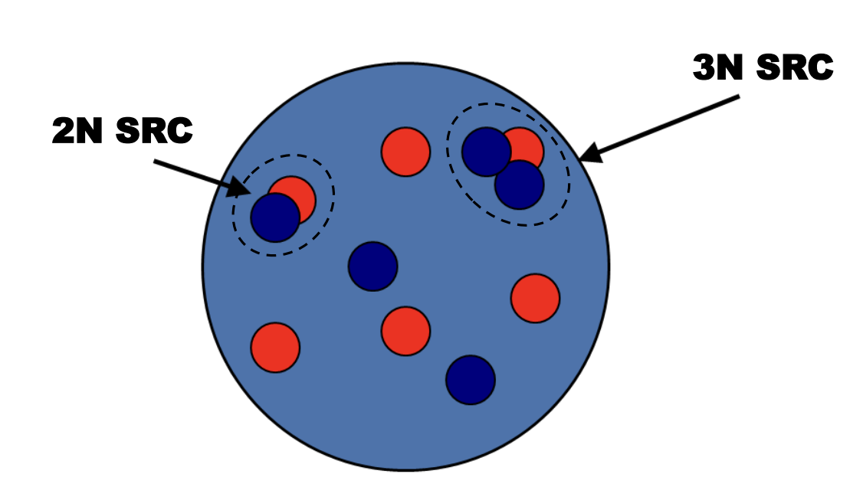
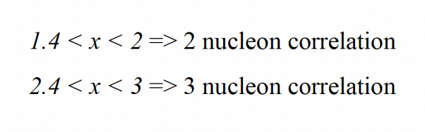
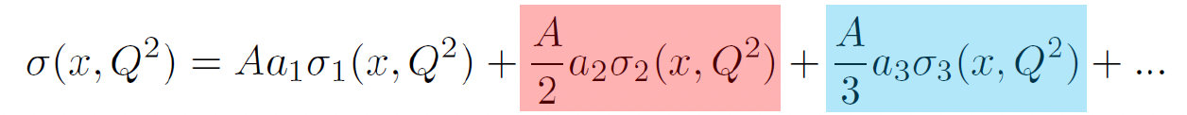
3N Short-range Correlations - where do we look at?
3N SRCs can lead to a second plateau (A/³He) at x>2
Rapid fall off of the mean field contributions → kinematic onset of the 2N SRCs
2N-SRCs fall off slowly compared to mean field → kinematic onset of the 3N SRCs
Kinematic onset is sensitive to the size and nature of the 3N-SRCs (model-dependent)
Notes:
It is less clear what happens when we go to higher x, particularly x>2. Do the 2N SRC contributions get small enough and three nucleon contirubtions take over? Would this give rise a second plateau at x>2?Observation of such plateau has been elusive.
at whatever Q2 values were accessible and look for a clear plateau in x for x well above 2, to suppress the 2N-SRCs

Slide 10
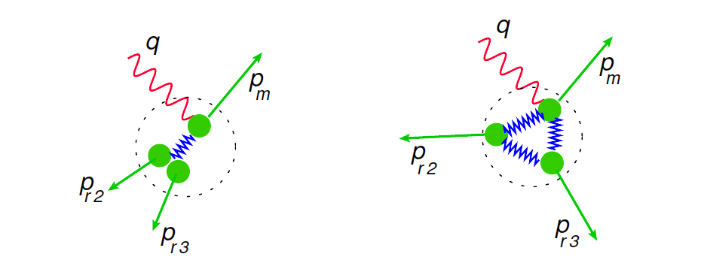
What would 3N SRCs look like?
p_{r2}=p_{r3} ~ p_{m}/2
equal momenta
D. B. Day et al, Phys. Rev. C 107, 014319, 2023
Notes:
2N SRC correlation geometry is straightforward 2 nucleons nearly balancing each other but in the case of 3N SRCs we have options.

Slide 11
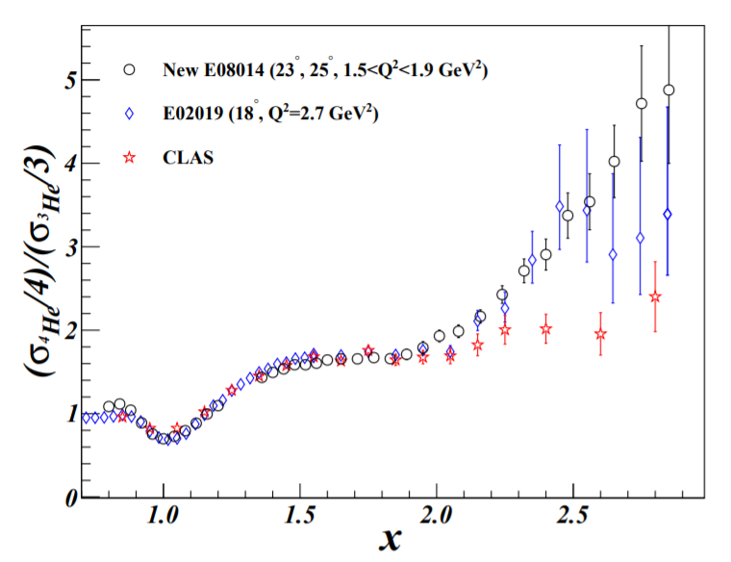
3N SRCs– Previous Searches
Jefferson Lab E08-014: longer cryogenic targets for higher statistics
Results consistent with Hall C data, disagreed with CLAS results
No second plateau observed in the modest Q² values
Minimal Q² needed to enhance the 3N SRC signal?
Dominant structure of the 3N SRCs in the nuclear ground state?

Slide 12
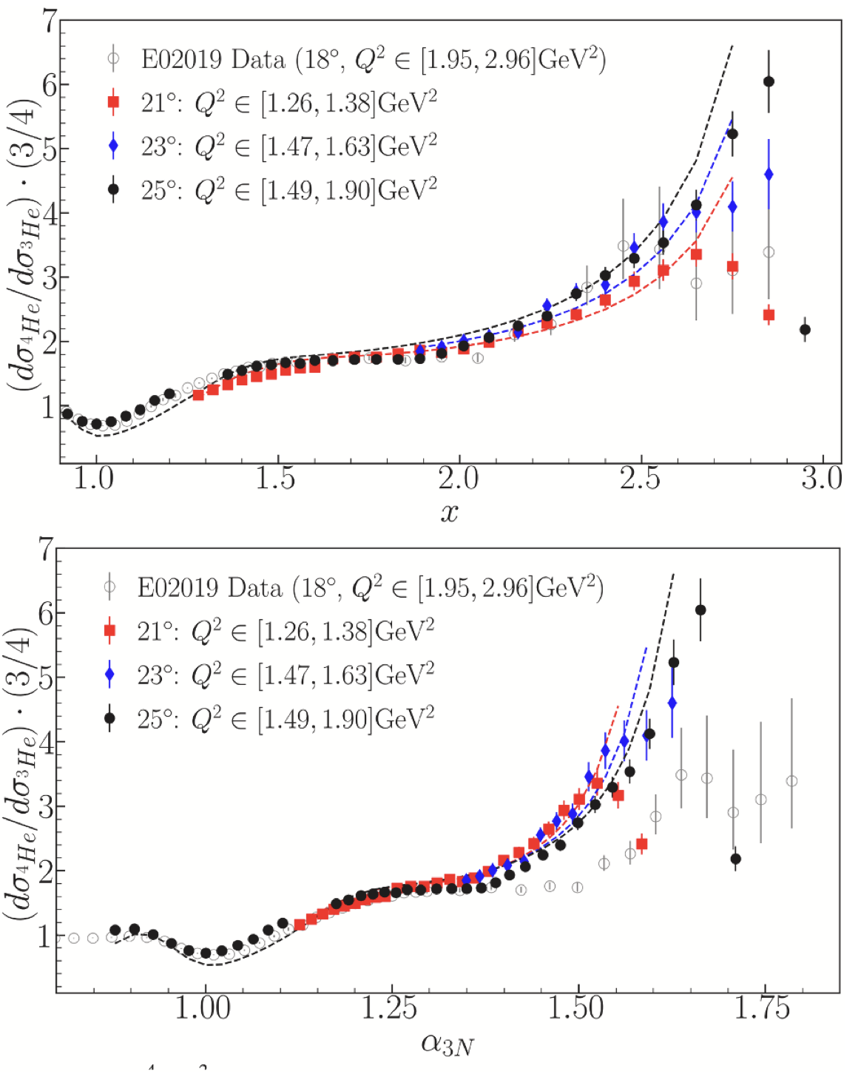
New results from E08-014 Experiment in Hall A
, ,
A/2H ratios consistent with the previous 2N SRCs observations
No 3N SRC plateau observed in the A/3He ratios.
Alpha3N coverage is limited to less than 1.6
Y.P. Zhang, Z.H. Ye, D. Nguyen et al
Phys Letters B 872, 2025

Slide 13
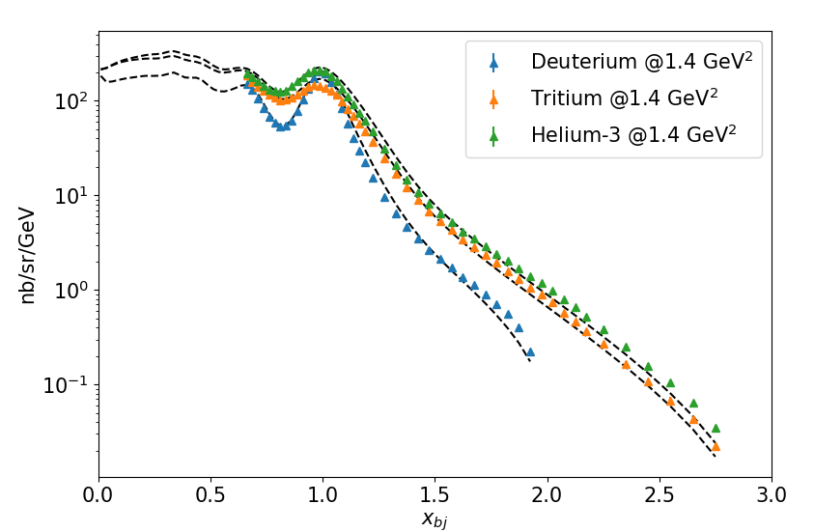
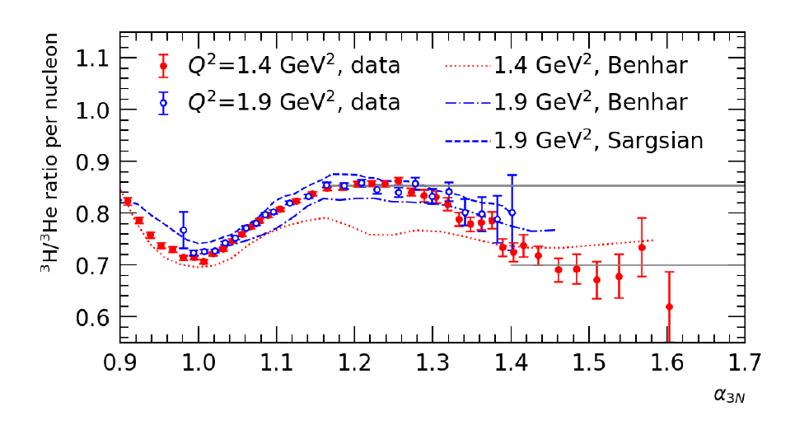
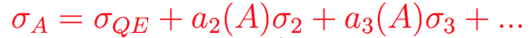
E12-11-112 Experiment in Hall A: Cross Section beyond x=2
For A=3, only 2N- and 3N-SRCs beyond mean-field
data consistent with a 3N plateau (within precision) calculations
3N ratio goes like (2N ratio) squared as predicted
A=3 is a special case: expect earlier onset to 3N-SRCs, and have more complete cancellation between any scale-breaking effects (FSI, CM motion of pairs, etc...), and because the isospin structure is known.
2N-SRC region
3N-SRC region??
2N- and 3N-SRCs
2N-SRCs
13
S. Li et al, Physics Letter B, Volume 868, September 2025, 139734

Slide 14
Dominating 3N SRC Configuration in Inclusive Scattering
3He electro disintegration suggests that 3N SRCs are predominantly formed by two consecutive 2N SRCs and the majority of them are in the linear configuratiion
p_{r2}=p_{r3} ~ p_{m}/2
equal momenta
D. B. Day et al, Phys. Rev. C 107, 014319, 2023
Notes:
3He electro disintegration suggests that 3N SRCs are predominantly formed by two consecutive 2N SRCs and the majority of them are in the linear configuratiion

Slide 15

Light cone momentum fraction in a 3N system
Relativistic nature of SRCs → light cone description
In light cone kinematics: Light cone momentum fraction of the interacting nucleon in the nucleus, alpha and transverse momentum
Advantages:
Removes Q² dependence of scaling onset
LC momentum distribution function isn’t altered by FSIs at large Q²
Notes:
Too small to shift a MF nucleon to 3N-SRC domain

Slide 16
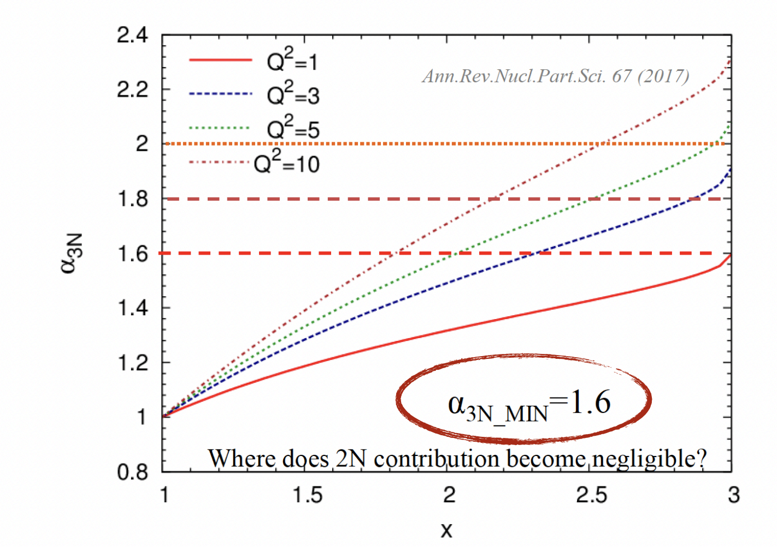
3N Short-range Correlations - where do we look at?
Light cone momentum fraction in a 3N system
Informed by the onset of 2N SRC kinematics → alpha>1.3
internal momenta of 300-350 MeV
For 3N SRCs: p_{min} ~ 700 MeV → alpha_3N=1.6 → two high
momentum spectators to belong to a 3N SRC
Notes:
distribution of the light-front density matrix

Slide 17
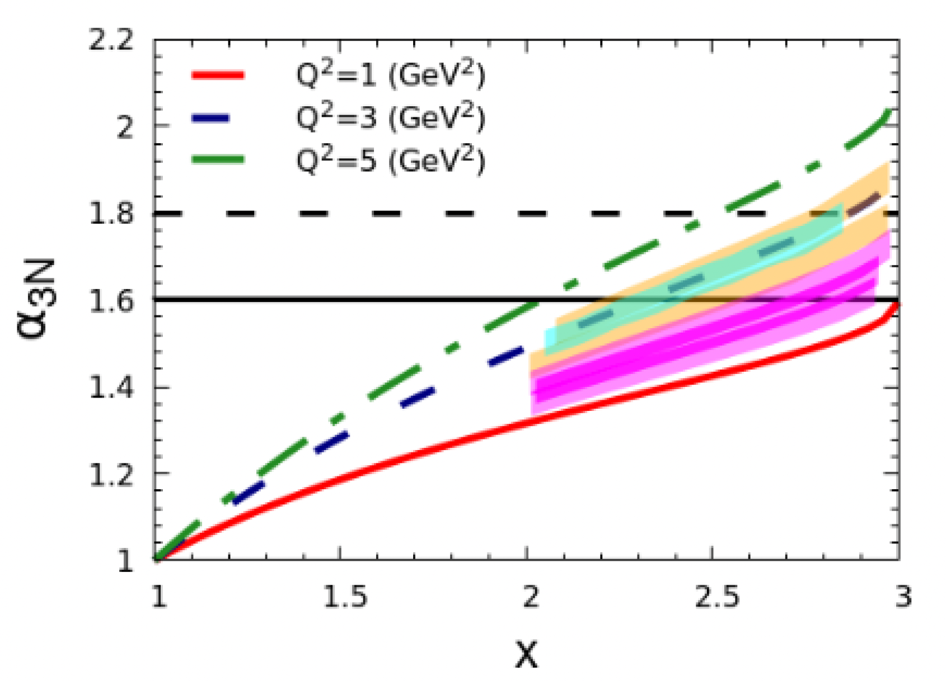
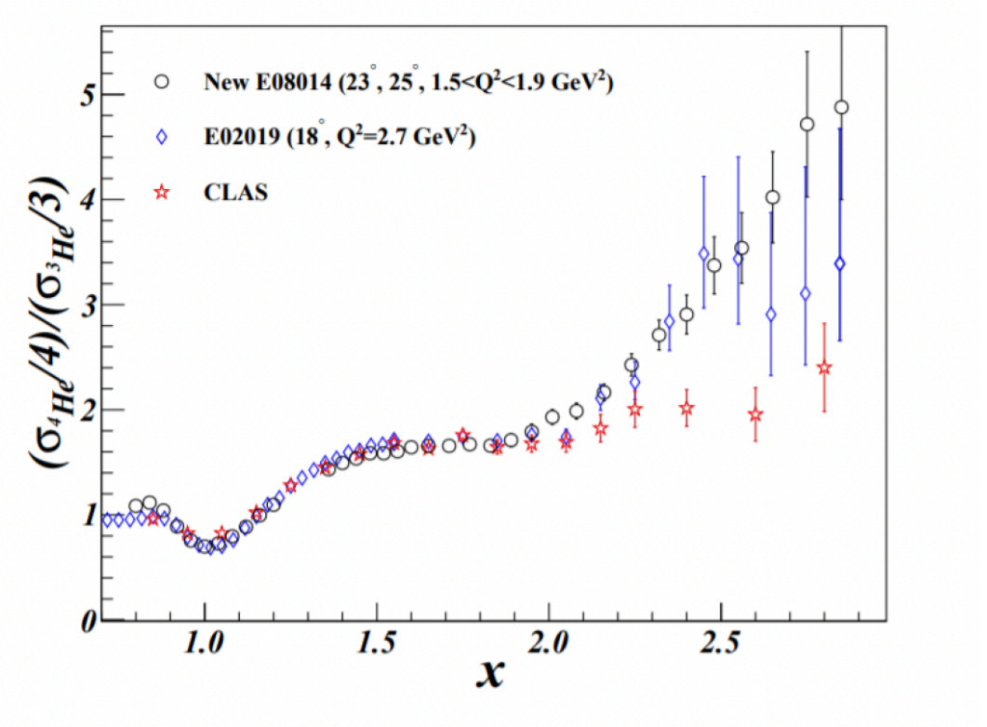
3N SRCs – experimental data so far…
Hall A data
Hall C data
Hall C (12 GeV) data
Notes:
distribution of the light-front density matrix

Slide 18
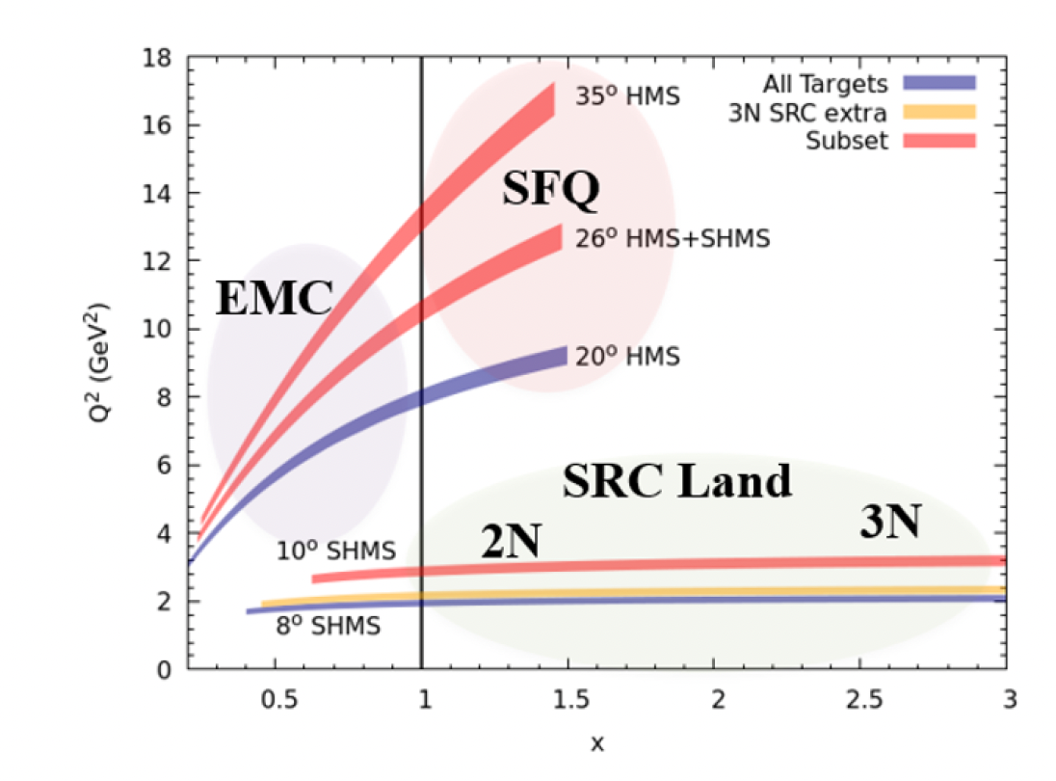
3N SRCs – experimental data so far…
Hall A data
Hall C data
Hall C (12 GeV) data
Notes:
distribution of the light-front density matrix

Slide 19
Outline
Short-range Correlations Physics
XEM2 Experiment in 12 GeV Hall C
Analysis of x>1 data and preliminary results

Slide 20
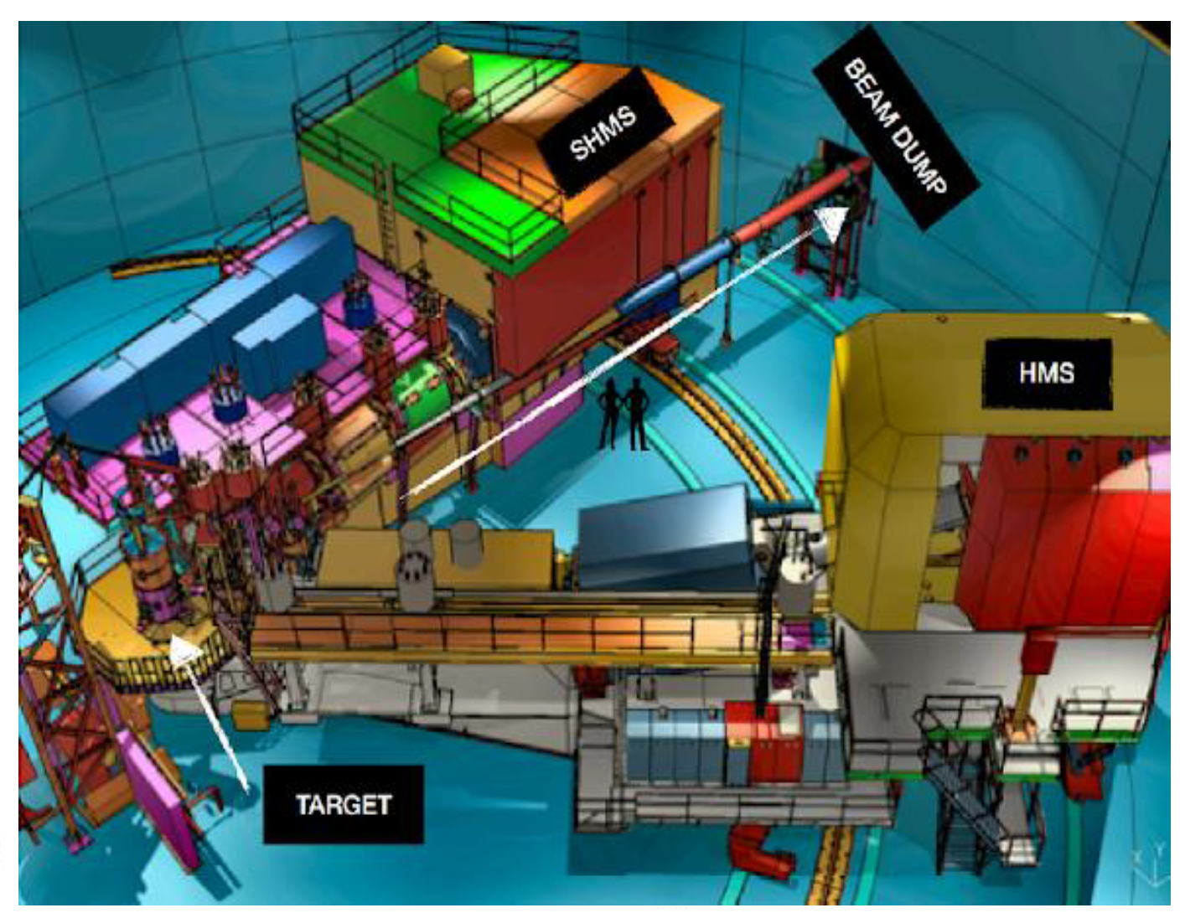
XEM2 Experiments (x>1 and EMC Effect ) in Hall C

Slide 21
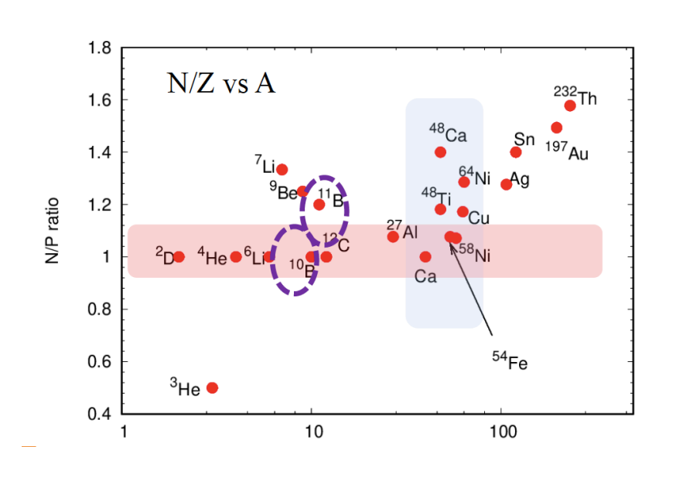
XEM2 Experiments (x>1 and EMC Effect ) in Hall C
See the next talk on the XEM2 EMC Analysis by Tyler Hague

Slide 22
Outline
Short-range Correlations Physics
XEM2 Experiment in 12 GeV Hall C
Analysis of x>1 data and preliminary results

Slide 23
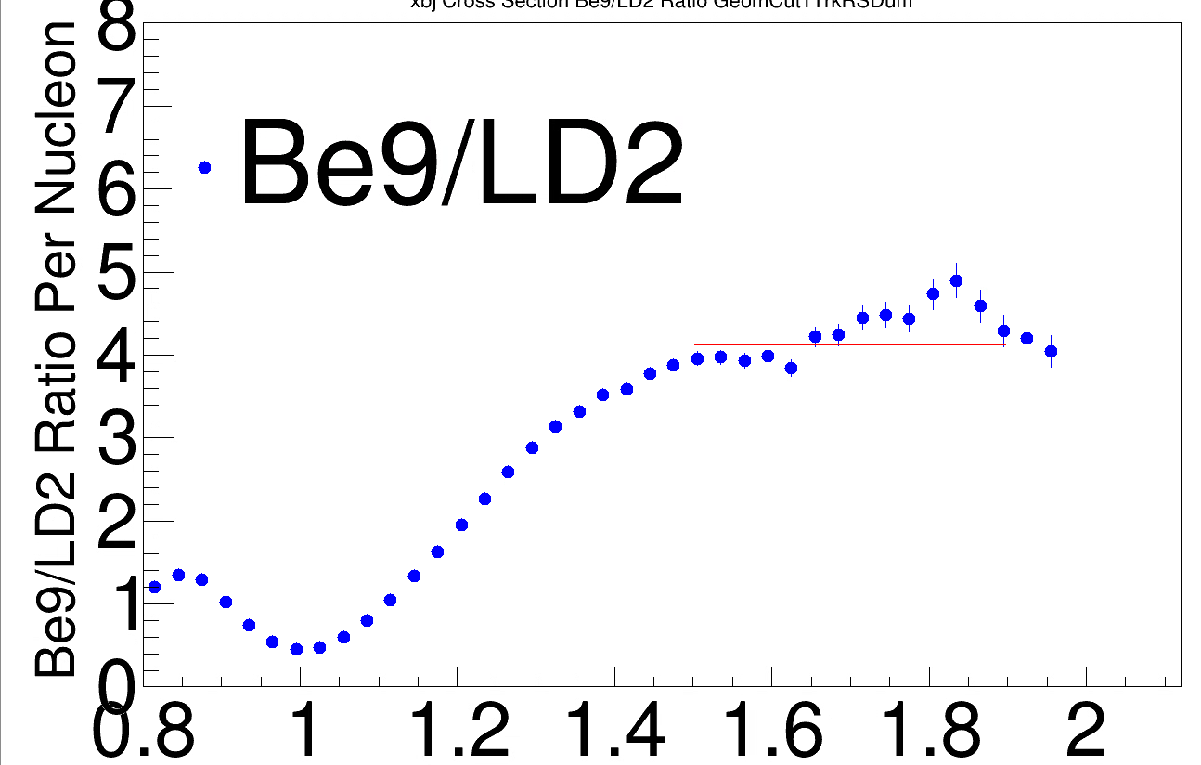
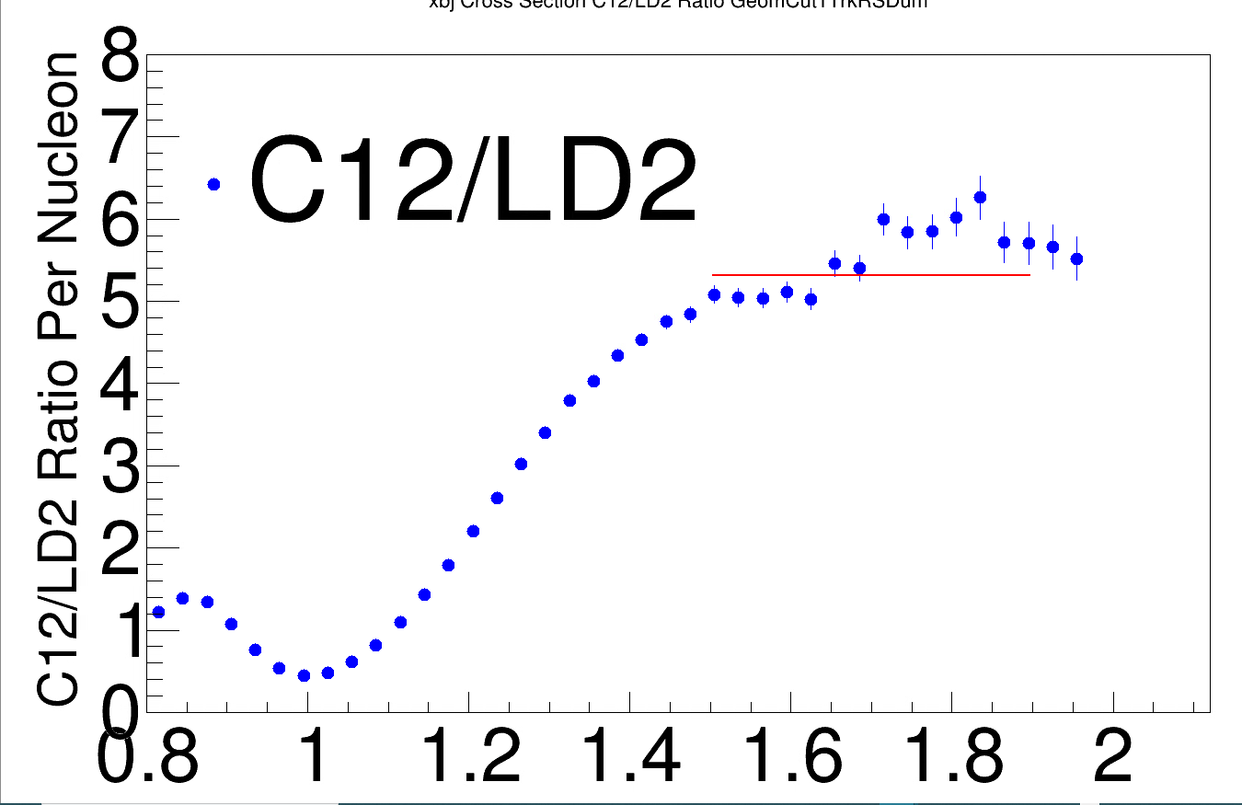
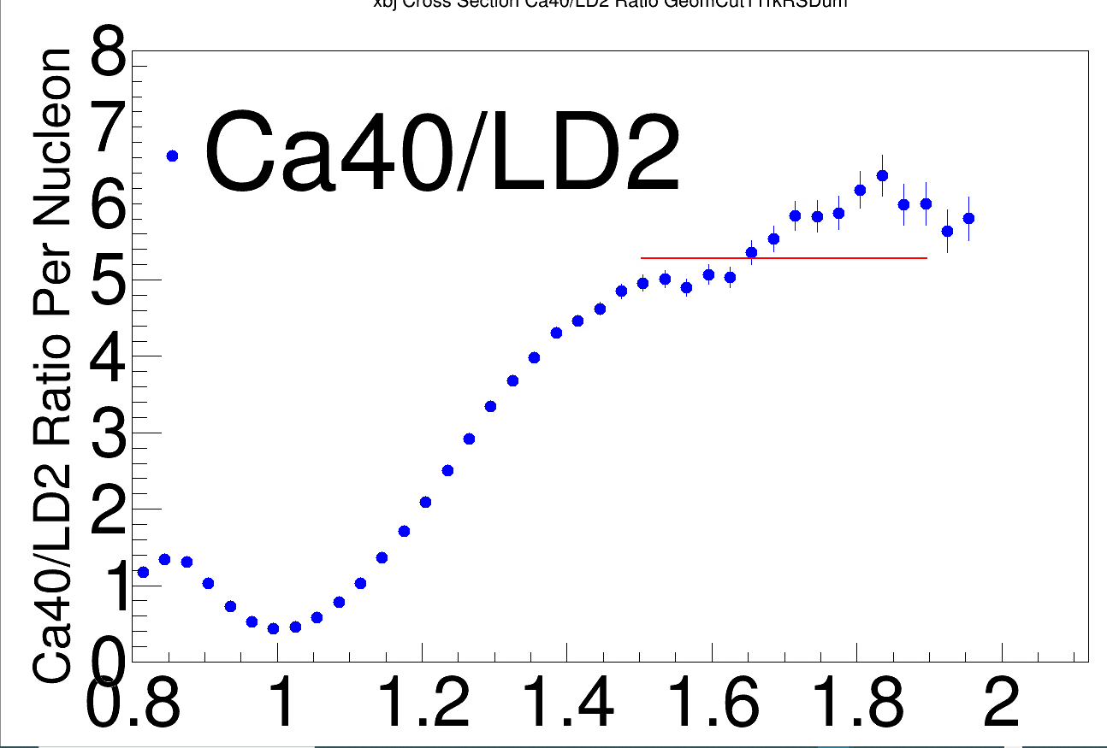
Bump feature in different nuclei
PRELIMINARY
PRELIMINARY
PRELIMINARY
A consistent bump feature plagues our data
It comes directly from our LD2 data (common denominator)
Work by Ramon Ogaz (UTK)

Slide 24
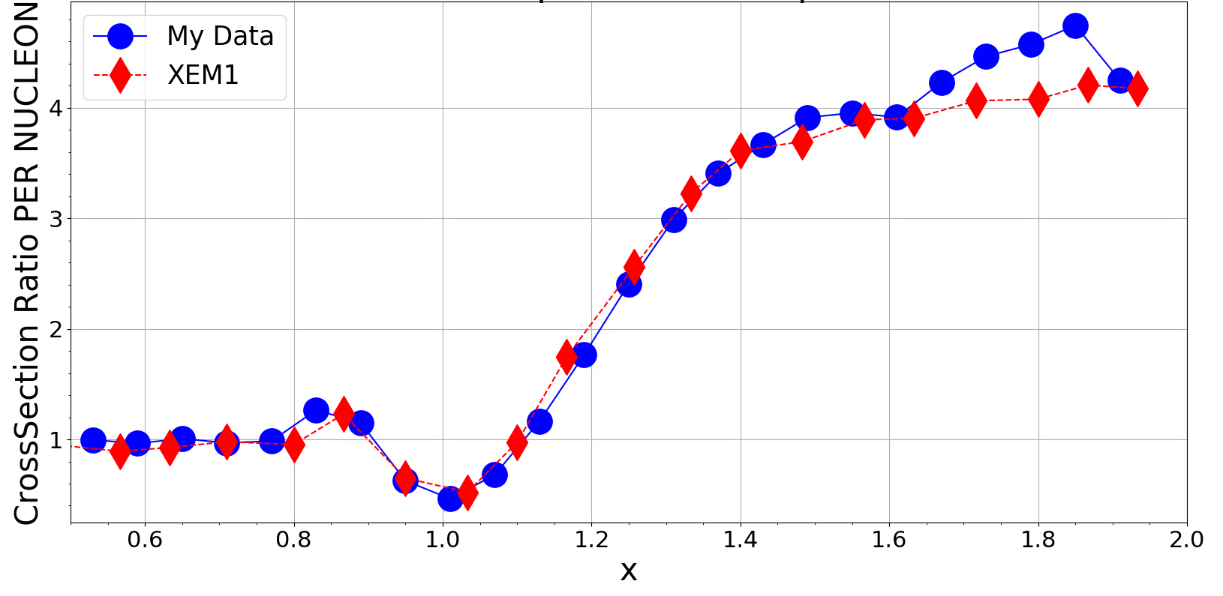
Comparison to 6 GeV Hall C Data
⁹Be
Fomin N et al. 2012 Phys. Rev. Lett. 108 092502
Work by Ramon Ogaz (UTK)

Slide 25
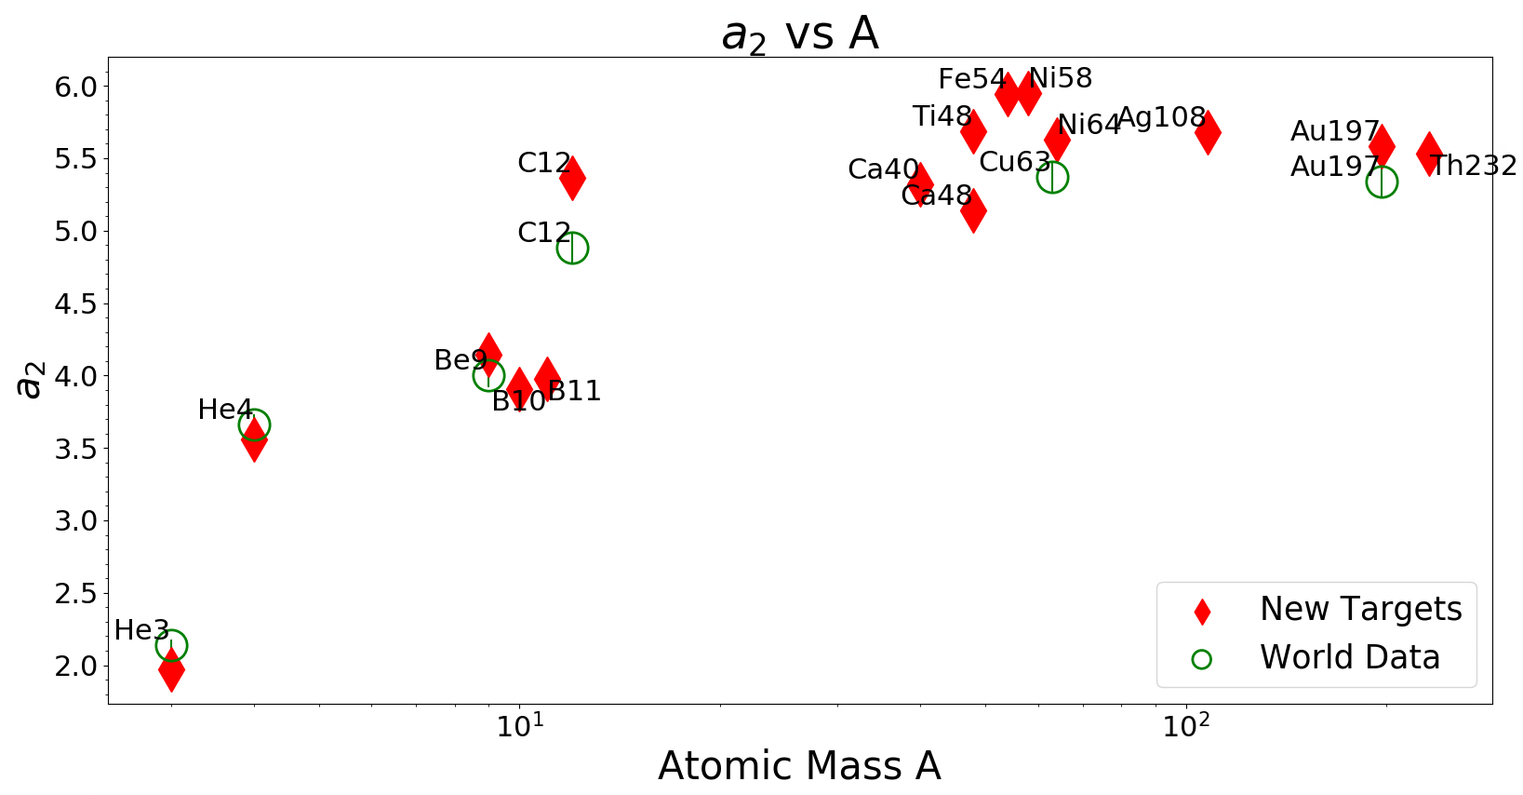
Nuclear Dependencies! – a₂ vs A
Statistical Uncertainties Only
Work by Ramon Ogaz (UTK)

Slide 26
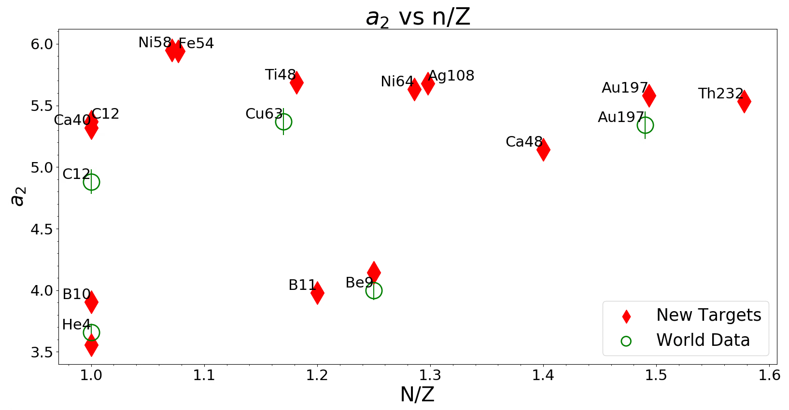
Nuclear Dependencies! – a₂ vs N/Z
Statistical Uncertainties Only
Work by Ramon Ogaz (UTK)

Slide 27
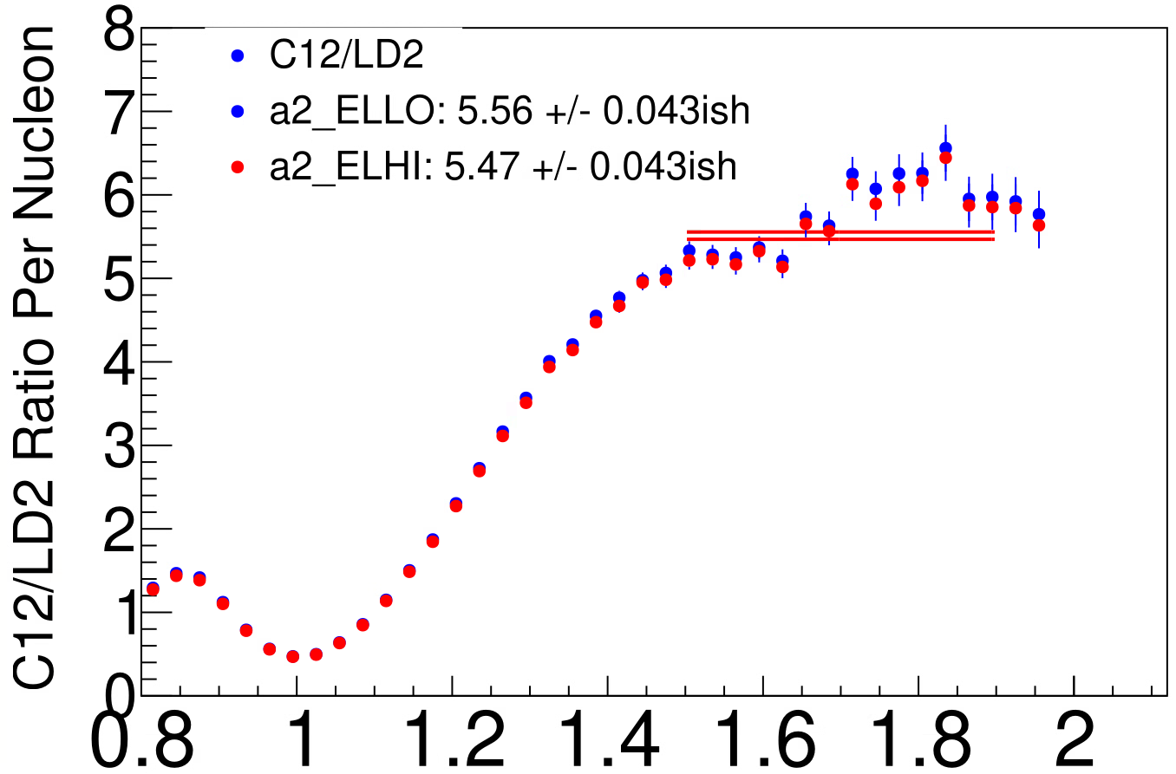
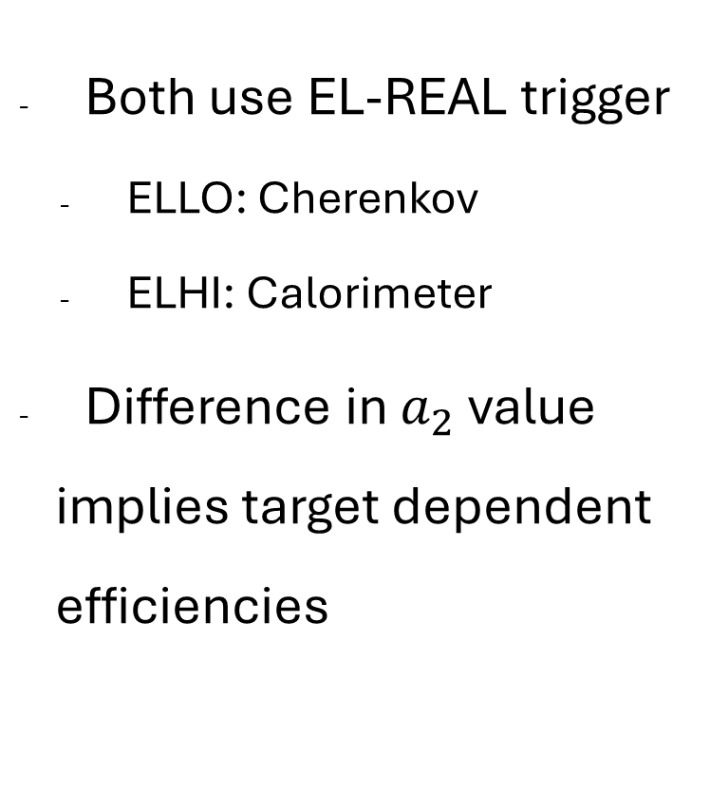
Different a₂ Results with Different Triggers
Both use EL-REAL trigger
  ELLO: Cherenkov
  ELHI: Calorimeter
Difference in $a_{2}$ value implies target dependent efficiencies
Work by Ramon Ogaz (UTK)
Notes:
ELLO has Cherenkov only and ELHI has Preshower only. And I'm using EL-REAL runs for that trigger study, which takes either one as an OR statement. It's weird because ideally most events have both triggers fire, but it seems one of them is a little biased depending on the target.

Slide 28
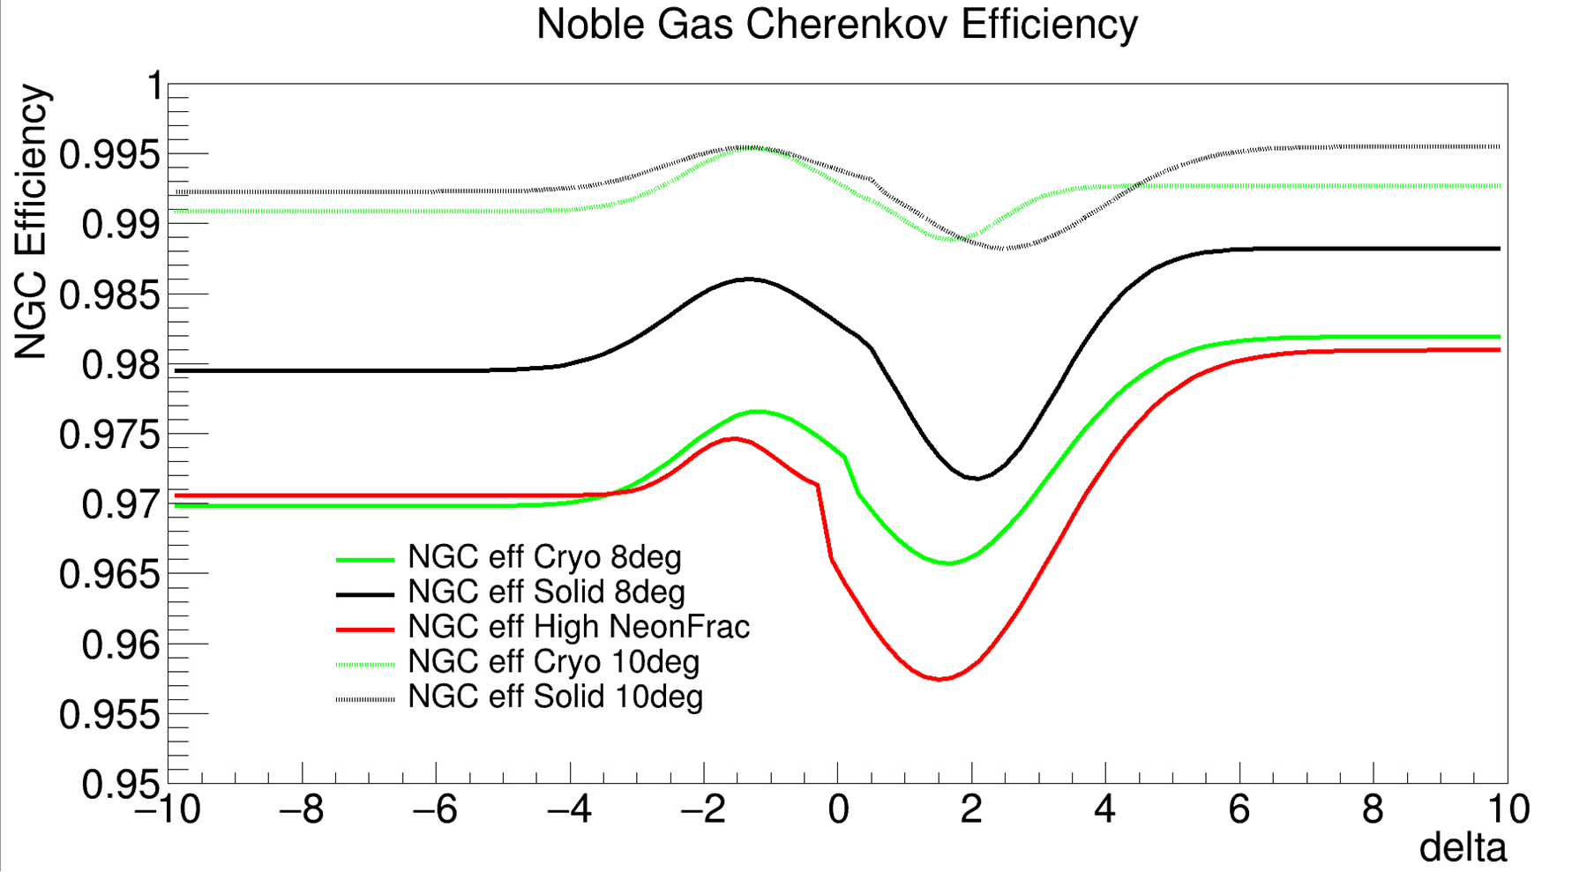
Work by Ramon Ogaz (UTK)

Slide 29
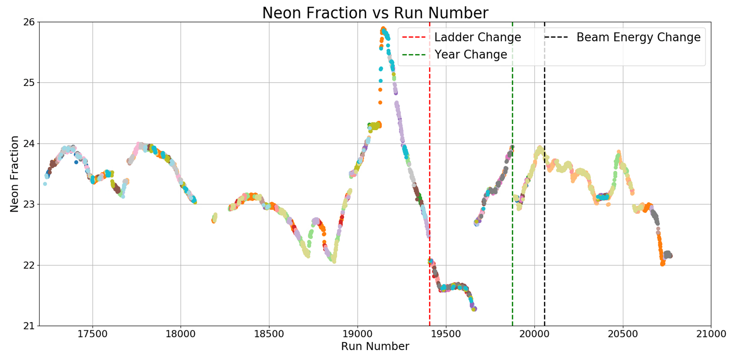
Neon fraction vs run number
Work by Ramon Ogaz (UTK)

Slide 30
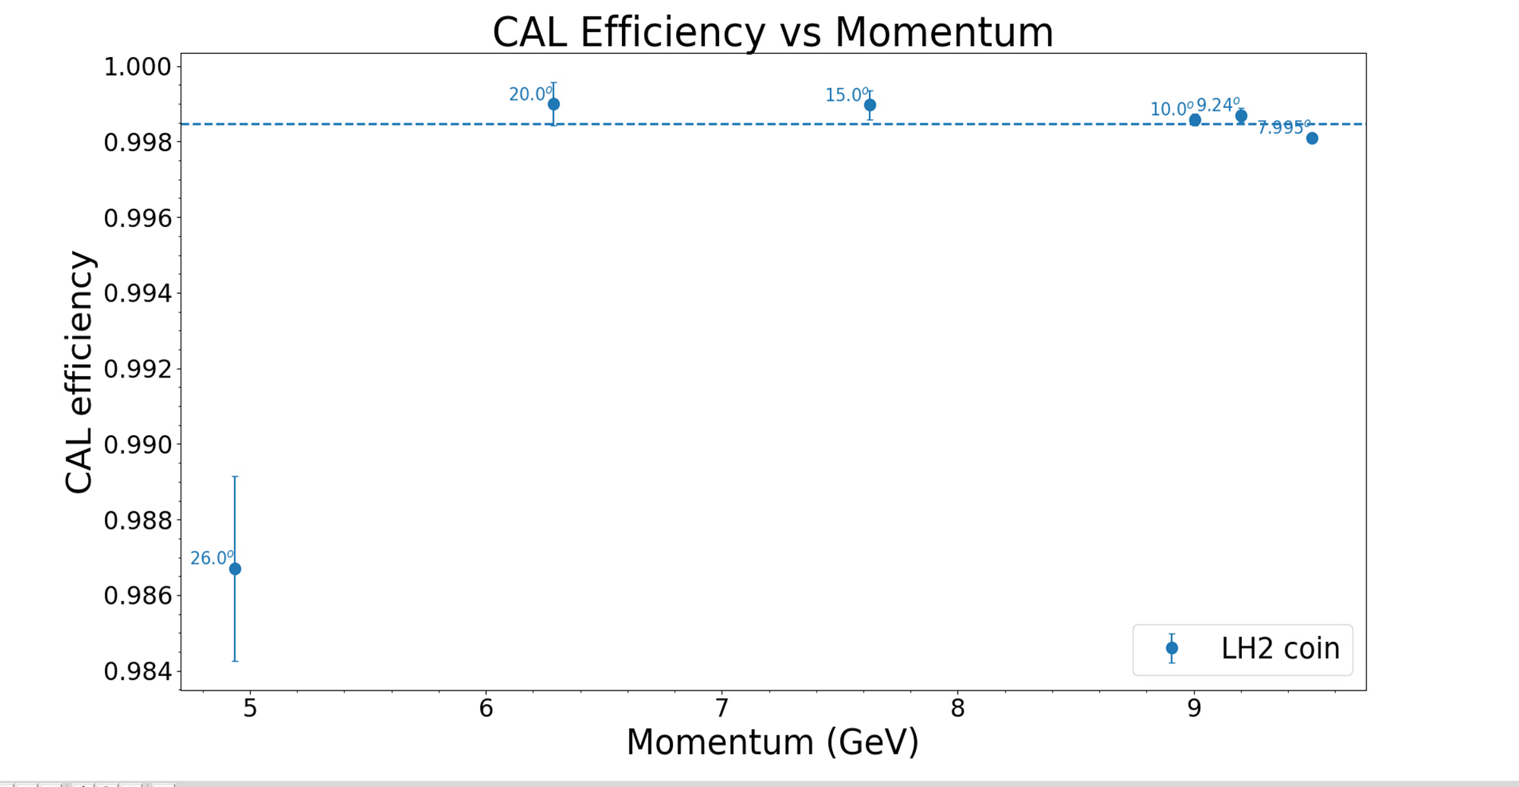
Calorimeter
Work by Ramon Ogaz (UTK)

Slide 31
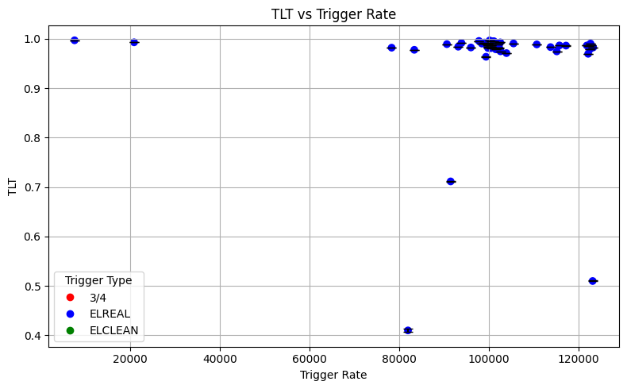
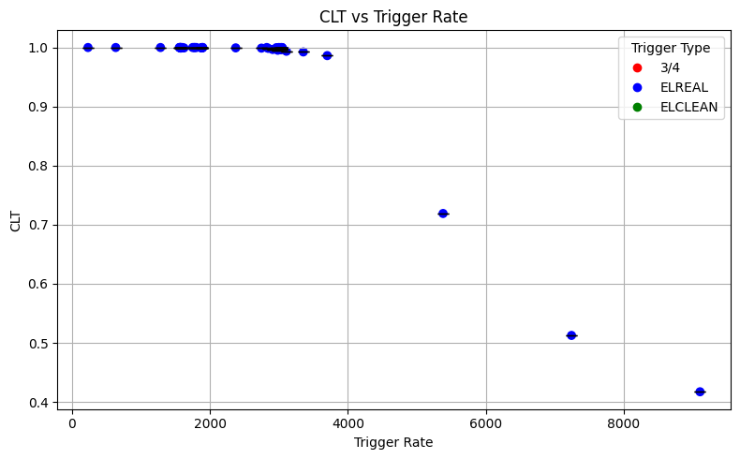
SHMS EDTM Study
Consistently get live times > 1
Calculate the true live times for:
  Total Live Time (TLT) =
(Prescale * EDTM Accepted Events) / EDTM Scalers
  Computer Live Time (CLT) =
[PS * (Trigger Accepted Events - EDTM Accepted Events)] / (Trigger Scalers - EDTM Scalers)
  Electronic Live Time (ELT) =
TLT / CLT
Work by Zoe Wolters (UNH)

Slide 32
SHMS EDTM Study
Comparing ELT to the trigger and hodoscope rates
  Which trigger effects the ELT the most?
  Rates to investigate:
¾, ELREAL, ELCLEAN, P1X, P2X, P1Y, P2Y, P1XP1Y,
and P2XP2Y
All live times are for only one kinematic and trigger:
  Carbon, P = -9.2 GeV² , 10°, ELREAL
Work by Zoe Wolters (UNH)

Slide 33
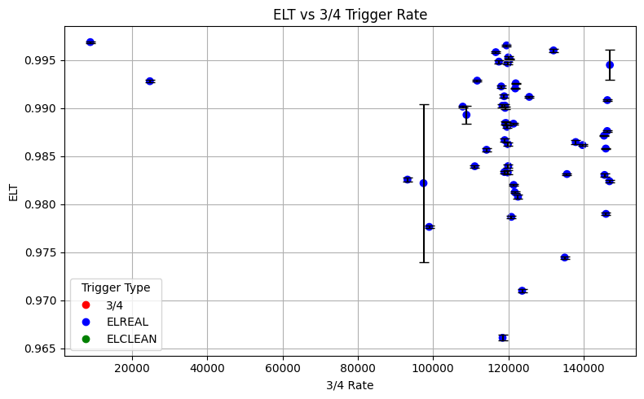
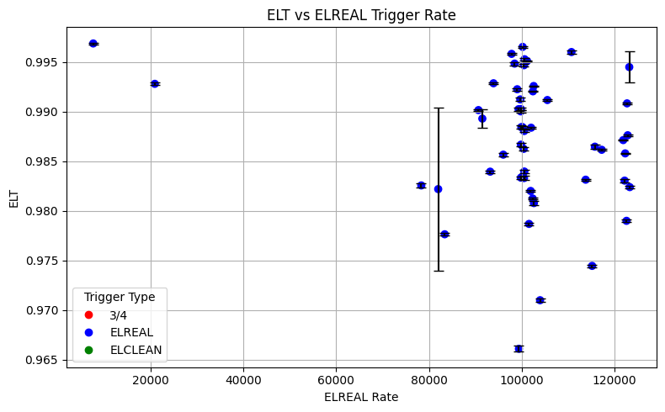
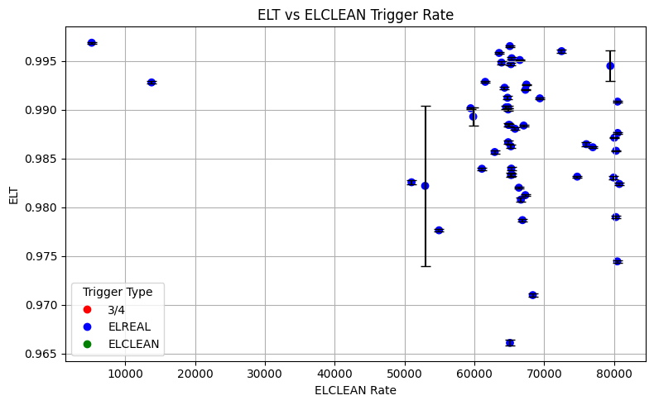
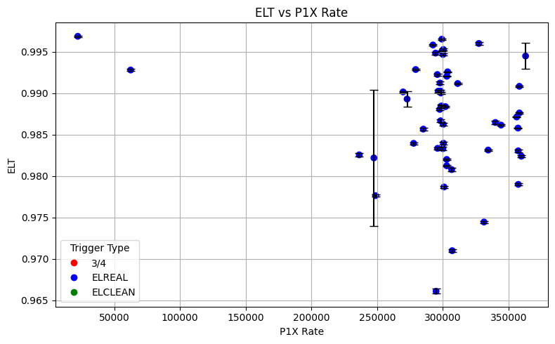
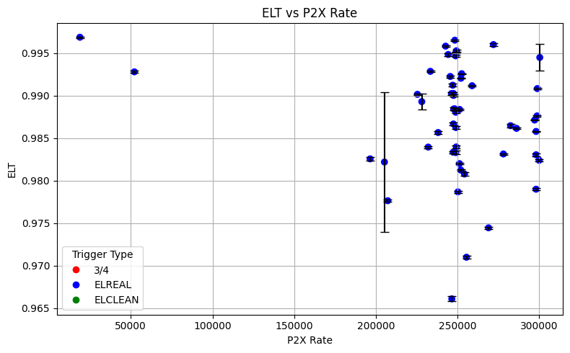
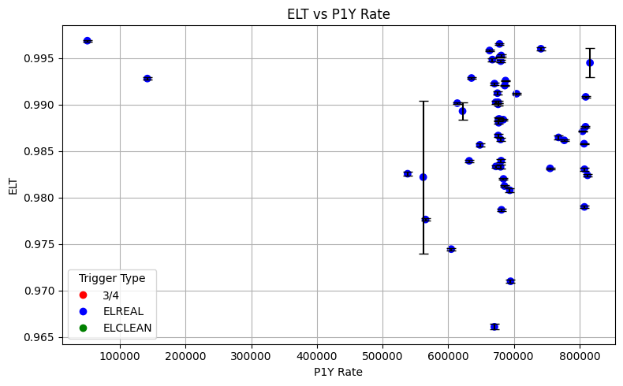
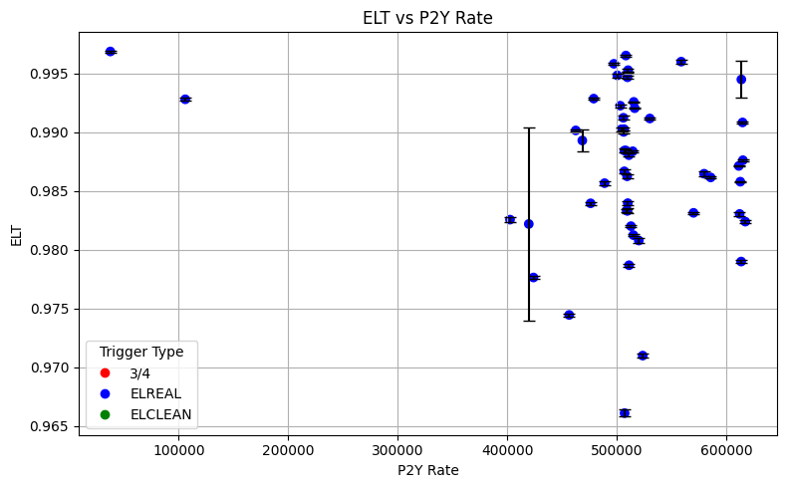
Possible Issues and Currently Investigating
Some SHMS production runs have CLT values are above 1.0
  Allowing for values 0.2% above 1.0 for now
There is not a clear relationship between the ELT and the rates
Exploring more kinematics, targets and rates

Slide 34
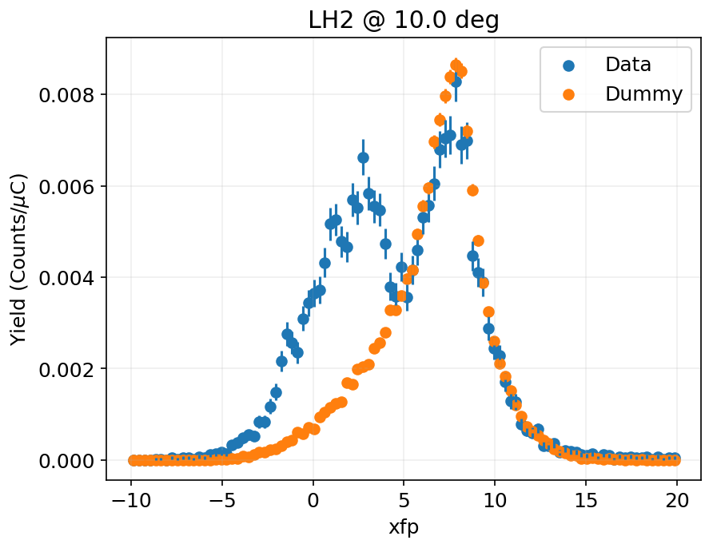

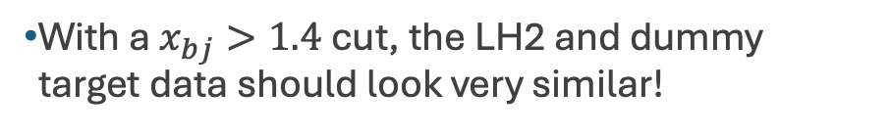
Multitrack ghost events in SHMS
Excess of multitrack events in the x > 1 region
Significant impact on cross section ratios
  SRC data is fairly sensitive to dummy subtraction!
  Both cryo and solid targets
Noticeable in a variety of targets
  LH2, LD2, He, Be9, C12, more
Lead to initial false 3N SRC plateau
Causes under subtraction of dummy target
Only using single track events
  Only lose ~10% of good events
  Use single tracking efficiency from report files
Still unsure of source of events
  Tend to have larger chi2 & drift chamber residuals
$$x_{bj}>1.4$$
Excess of multitrack events
Data and dummy match well
With a $x_{bj}>1.4$ cut, the LH2 and dummy target data should look very similar!
Work by Jordan O’Kronley (UTK)

Slide 35
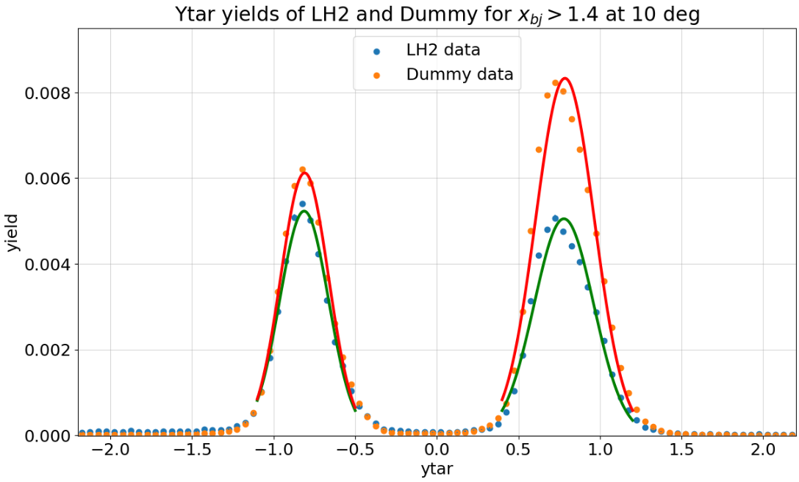
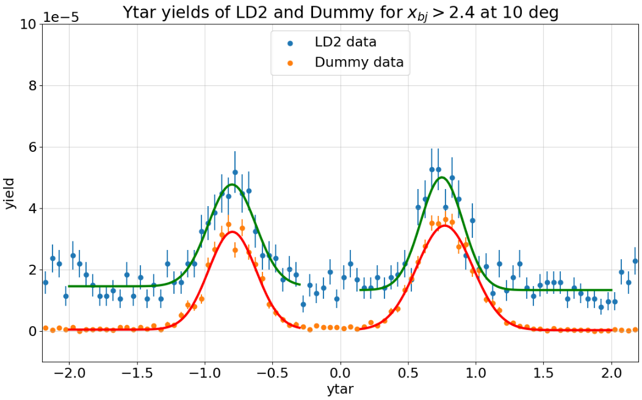
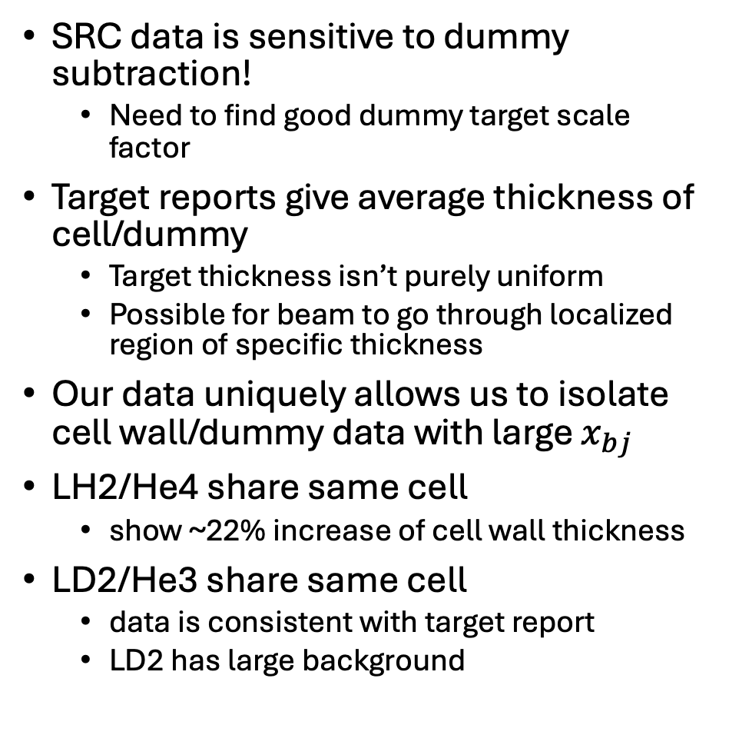
Dummy/cell wall thickness correction
SRC data is sensitive to dummy subtraction!
  Need to find good dummy target scale factor
Target reports give average thickness of cell/dummy
  Target thickness isn’t purely uniform
  Possible for beam to go through localized region of specific thickness
Our data uniquely allows us to isolate cell wall/dummy data with large $x_{bj}$
LH2/He4 share same cell
  show ~22% increase of cell wall thickness
LD2/He3 share same cell
  data is consistent with target report
  LD2 has large background
Work by Jordan O’Kronley (UTK)

Slide 36
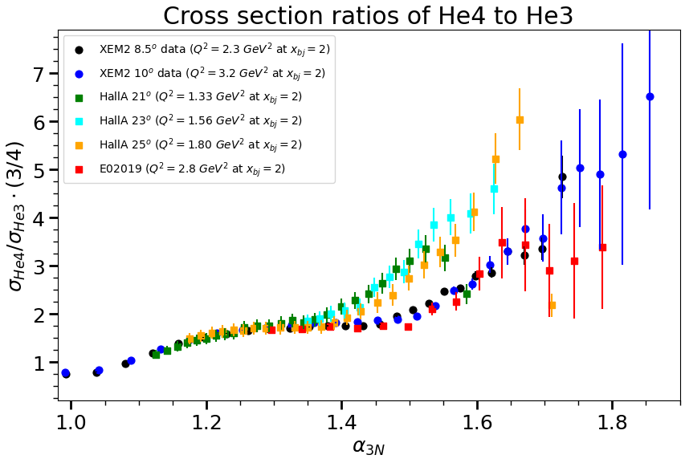
Work by Jordan O’Kronley (UTK)

Slide 37
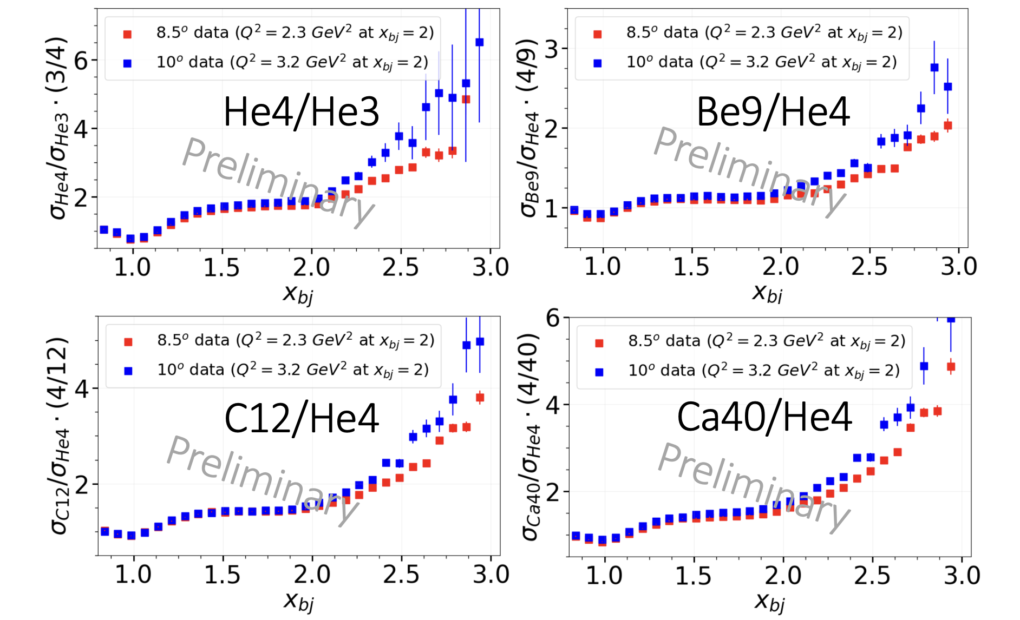
E12-06-105 Experiment in Hall C
Credit: Jordan O’Kronley (UTK)

Slide 38




He4/He3
Be9/He4
Preliminary
Preliminary
C12/He4
Ca40/He4
Preliminary
Preliminary
Work by Jordan O’Kronley (UTK)

Slide 39


Collaboration
Graduate Students:
Cameron Cotton (UVA), Abishek Karki* (MSU), Casey Morean* (UTK), Jordan O’Kronley (UTK), Ramon Ogaz (UTK), Abhyuday Sharda (UTK), Sebastian Vasquez (UCR), Zoe Wolters (UNH)
* = Graduated
Other Collaborators:
Miguel Arratia (UCR), Dipangkar Dutta (MSU), Shujie Li (LBL), Dien Nguyen (UTK),
Nathaly Santiesteban (UNH), Xiaochao Zheng (UVA), Burcu Duran (NMSU), Tyler Hague (JLab)
* = Graduated

Slide 40
BACK UP SLIDES

Slide 41


3N SRCs– Previous Searches
Artifact of bin migration associated with 1% momentum resolution in CLAS detector

Slide 42

3N Short-range Correlations - where do we look at?
Light cone momentum fraction in a 3N system
Notes:
distribution of the light-front density matrix

Slide 43
E12-11-112 Experiment in Hall A
QE scattering at large x from ²H, ³H, and ³He
  QE peak for 10 Q² values, 0.6-2.8 GeV²
    Neutron magnetic form factor
    S. Santiesteban, et al., PRL 132 (2024) 162501.
  Data to x ≈ 2 at Q² = 1.4, 1.9 GeV²
    Isospin structure of 2N-SRCs.
    S. Li, et al., Nature 609 (2022) 7925

Slide 44
E12-11-112 Experiment in Hall A
QE scattering at large x from ²H, ³H, and ³He
  QE peak in SRC region: 5 Q² values, 0.6-1.9 GeV²
    Low-Q² scaling violations in 2N-SRCs
  Data to x ≈ 3 at Q² = 1.4, 1.9 GeV²
    Potential for large 3N-SRC contributions
    S. Li, et al., arXiv:2404.16235

Slide 45
Mirror nuclei
Conventional searches: 3N isospin configurations (nnp, ppn, nnn, ppp) is compared to the npp SRC in 3He.
3N in heavy nucleus can have CM motion but 3He doesn’t have
3H/3He only a single isospin configuration is possible for each nucleus
Expanded scaling region due to smaller fermi motion in light nuclei → MF contributions expected to drop off at lower kf
The scaling violation affects should be nearly identical in mirror nuclei
Only 2N and 3N contributions at large x: any deviation from 2N SRCregime → 3N SRC contribution

Slide 46


