Slide 1
Upcoming Experimental Program: 2026 & Beyond
Douglas Higinbotham, Ph.D.
Acting Associate Director for Experimental Nuclear Physics
18 March 2026

Slide 2
Jefferson Lab had an outstanding 2025 Run Period
Hall A completed the SBS form factor mesaurements and started the installation of the MOLLER spectrometer.
Hall B completed the ALERT and ALERT-SRC experiments.
Hall C completed the Large Acceptance Device (LAD) experiment.
Hall D ran a significant fraction of the GlueX-II / JEF experiments.

Slide 3
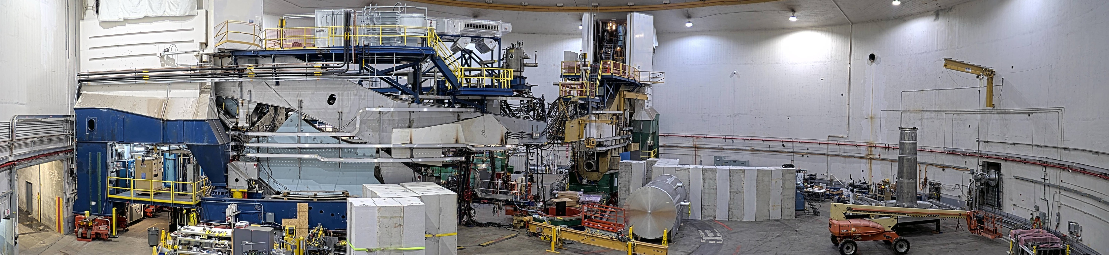
Hall A 15 March 2026
The MOLLER installation will continue into calendar 2027 and then transition from project to experiment.

Slide 4
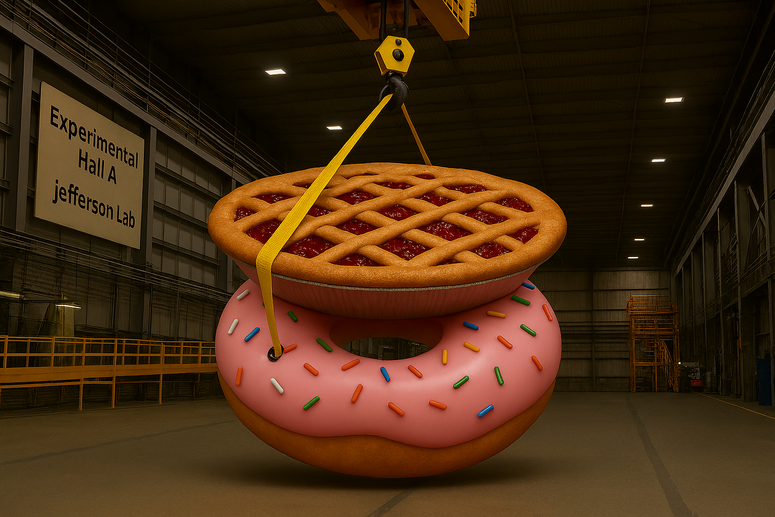
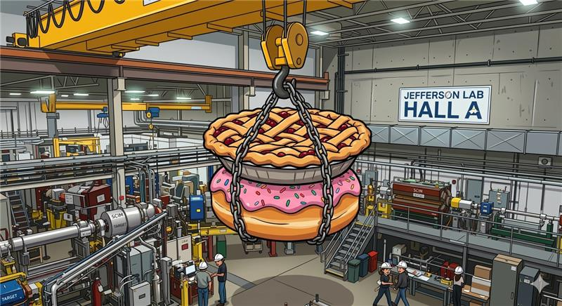
Daily talk about a Pion Doughnut at 8am Meeting
Prompted Pie on Doughnut AI Art
DWH with Microsoft’s co-pilot
Ryan Bodenstein in Gemini with nanobanana:

Slide 5
CEBAF at Multiple Energies
One thing that makes the CEBAF accelerator an amazing tool for experimental nuclear physics is its large range of beam energies that are possible.
Typically, that means 2.2, 4.4, 6.6, 8.8 or 11 GeV to Halls A,B,C and 12 GeV to Hall D, but CEBAF can be scaled to even lower energies when the science needs it.
For the upcoming run we are going to spend roughly half the time at 0.345 MeV/linac ( 0.7, 1.4, 2.1, 2.8 or 3.6 GeV to A,B,C and 4.3 GeV to Hall D.
For the second part of the run will be restore the machine to its nominal 1060 MeV/linac.
With this we will be doing TEN different experiments over 22 weeks!

Slide 6
While MOLLER is being installed, we will run experiments in the other three halls:
Hall B with run PRad-II and X17 [ 2 experiments ]
Hall C a series of cryo-target experiments: low energy N->Delta, VCS (low energy) and at high energy a pair of SIDIS experiments & color transparency [ 5 experiments ]
Hall D will run its first low energy experiment and then, at high energy, complete the GlueX-II / JEF run [ 3 experiments ]

Slide 7
Not Everything Is Going As Planned ( almost never does )
The injector wasn’t able to hold 200 kV and we have lower the voltage back to its classic 140 kV. This should not be a problem now, but we would like to get back to 200 kV for MOLLER.
Inject did run 200 kV for over a month, but at those voltages small defects can led problems over time; but injector group is working on this and does hope to get back to 200 kV at the end of the run.
A magnet required to get the beam to experimental Hall D is broken and since removing that magnet would stop the entire program, we are building the spare. If all goes well, it will be ready in early to mid-April.

Slide 8
Looking out the next 5 years:
Hall A MOLLER Experiment will be completed, and Hall A will start the transition to the next large-scale experiment.
Hall B will complete a number of run group experiments and start running the transversely polarized target SIDIS program. Looking beyond 5 years Hall B has pol. 3He, tritium and muCLAS.
Hall C will install and run the Hypernuclear experiment and once that is complete start the Tensor polarized deuteron experiments.
Hall D will run GlueX-III & the 2nd generation real photon SRC experiment and then install & run the K-Long experiment.

Slide 9
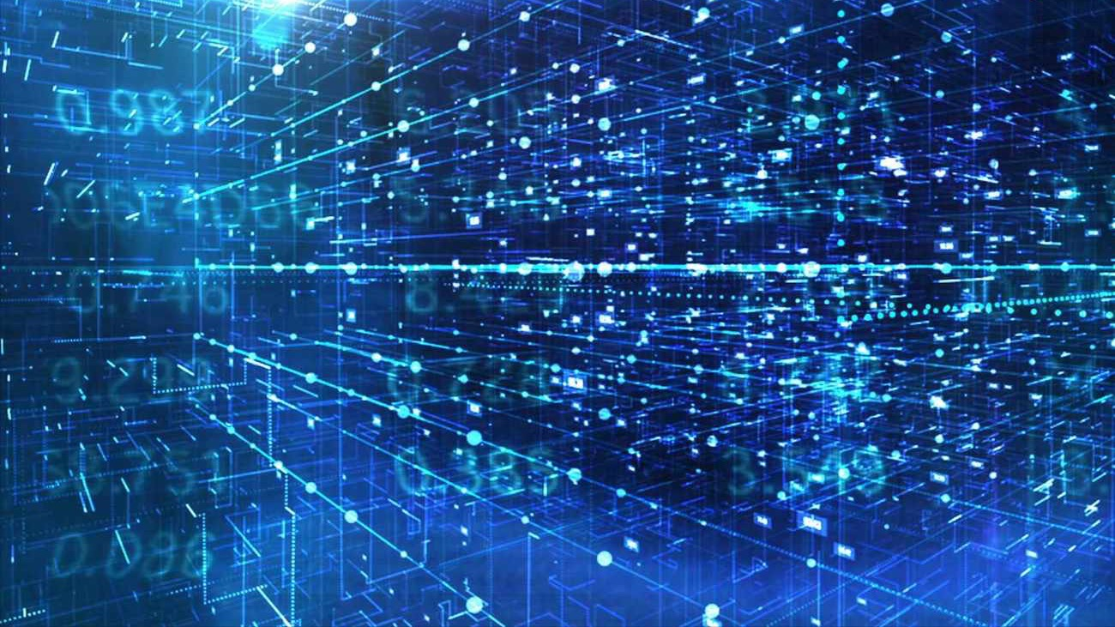
Discussion

