Slide 1
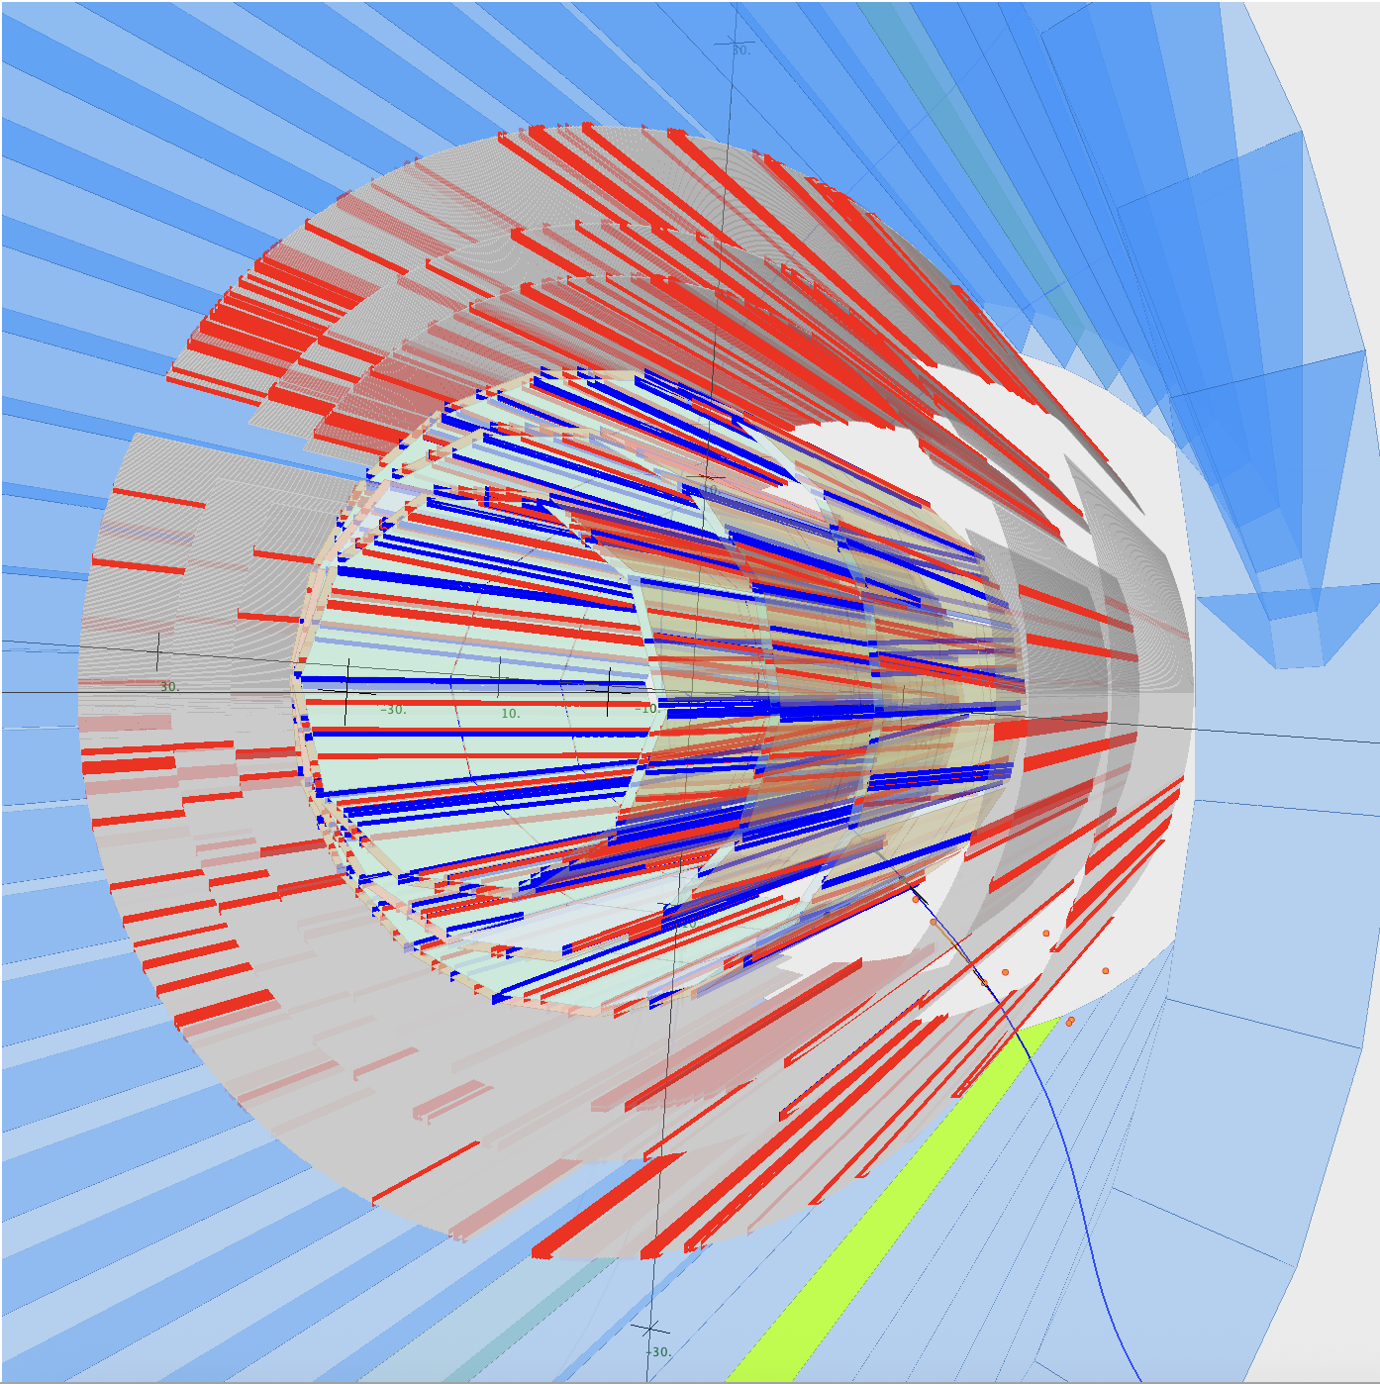
Plans for AI/ML Assisted and Conventional Central Tracking
Richard Tyson, Veronique Ziegler, Tongtong Cao, Raffaella De Vita
Pierre Chatagnon, Mathieu Ronayette, Bhawani Singh
CLAS12 Collaboration Meeting November 18, 2015

Slide 2
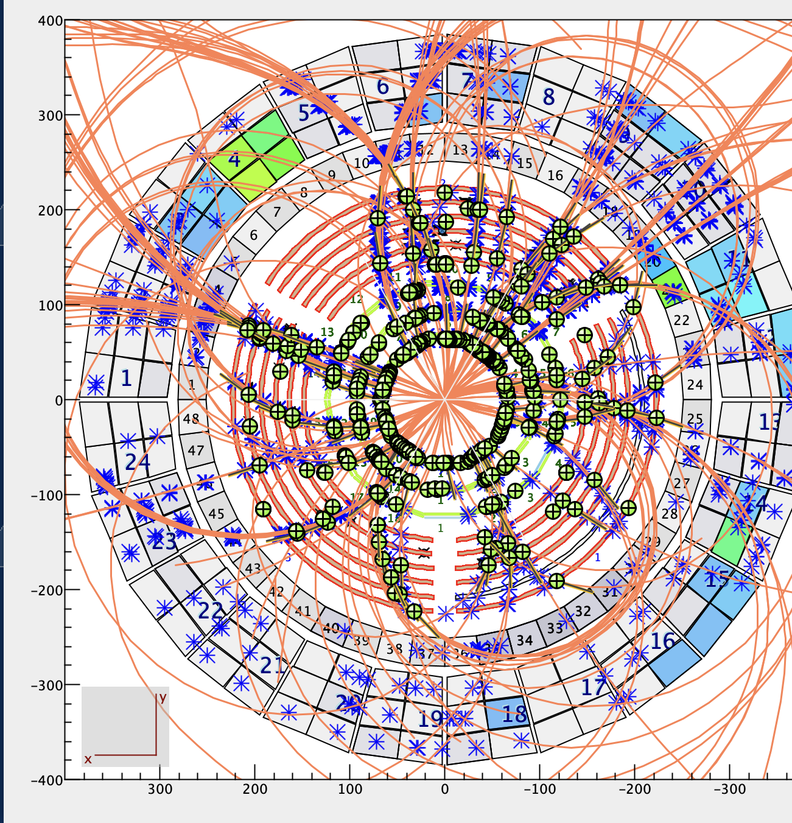
AI-Driven “Denoising” Algorithm for CVT Tracking ~ Motivation
Seed Multiplicity in CVT Tracking – RGE Data Example
Many seeds (track candidates) share clusters of hits.
Difficult to select the “good” candidate amongst a set of candidates that share clusters with it.
Leads to a large number of “fake tracks” → wrong clusters-on-track selection (combinatorials), loss of tracking efficiency, increased computation times
Worsening of track parameters resolution due to background hits polluting clusters, and resulting in wrong clusters-on-track selection
Need for development of denoising algorithm(s)

Slide 3
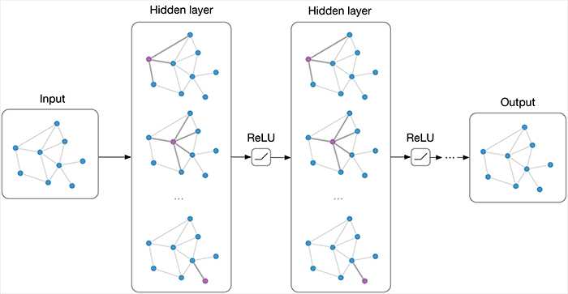
Denoising Model: Graph Neural Networks (GNN)
Graph are made of nodes (eg hits) & edges.
During learning, “message passing” updates each node with information from other nodes.
This is learned (eg what information is passed is the output of a small neural network).
GNNs can be used in different ways:
Node classification (denoising)
Edge classification (track finding)

Slide 4
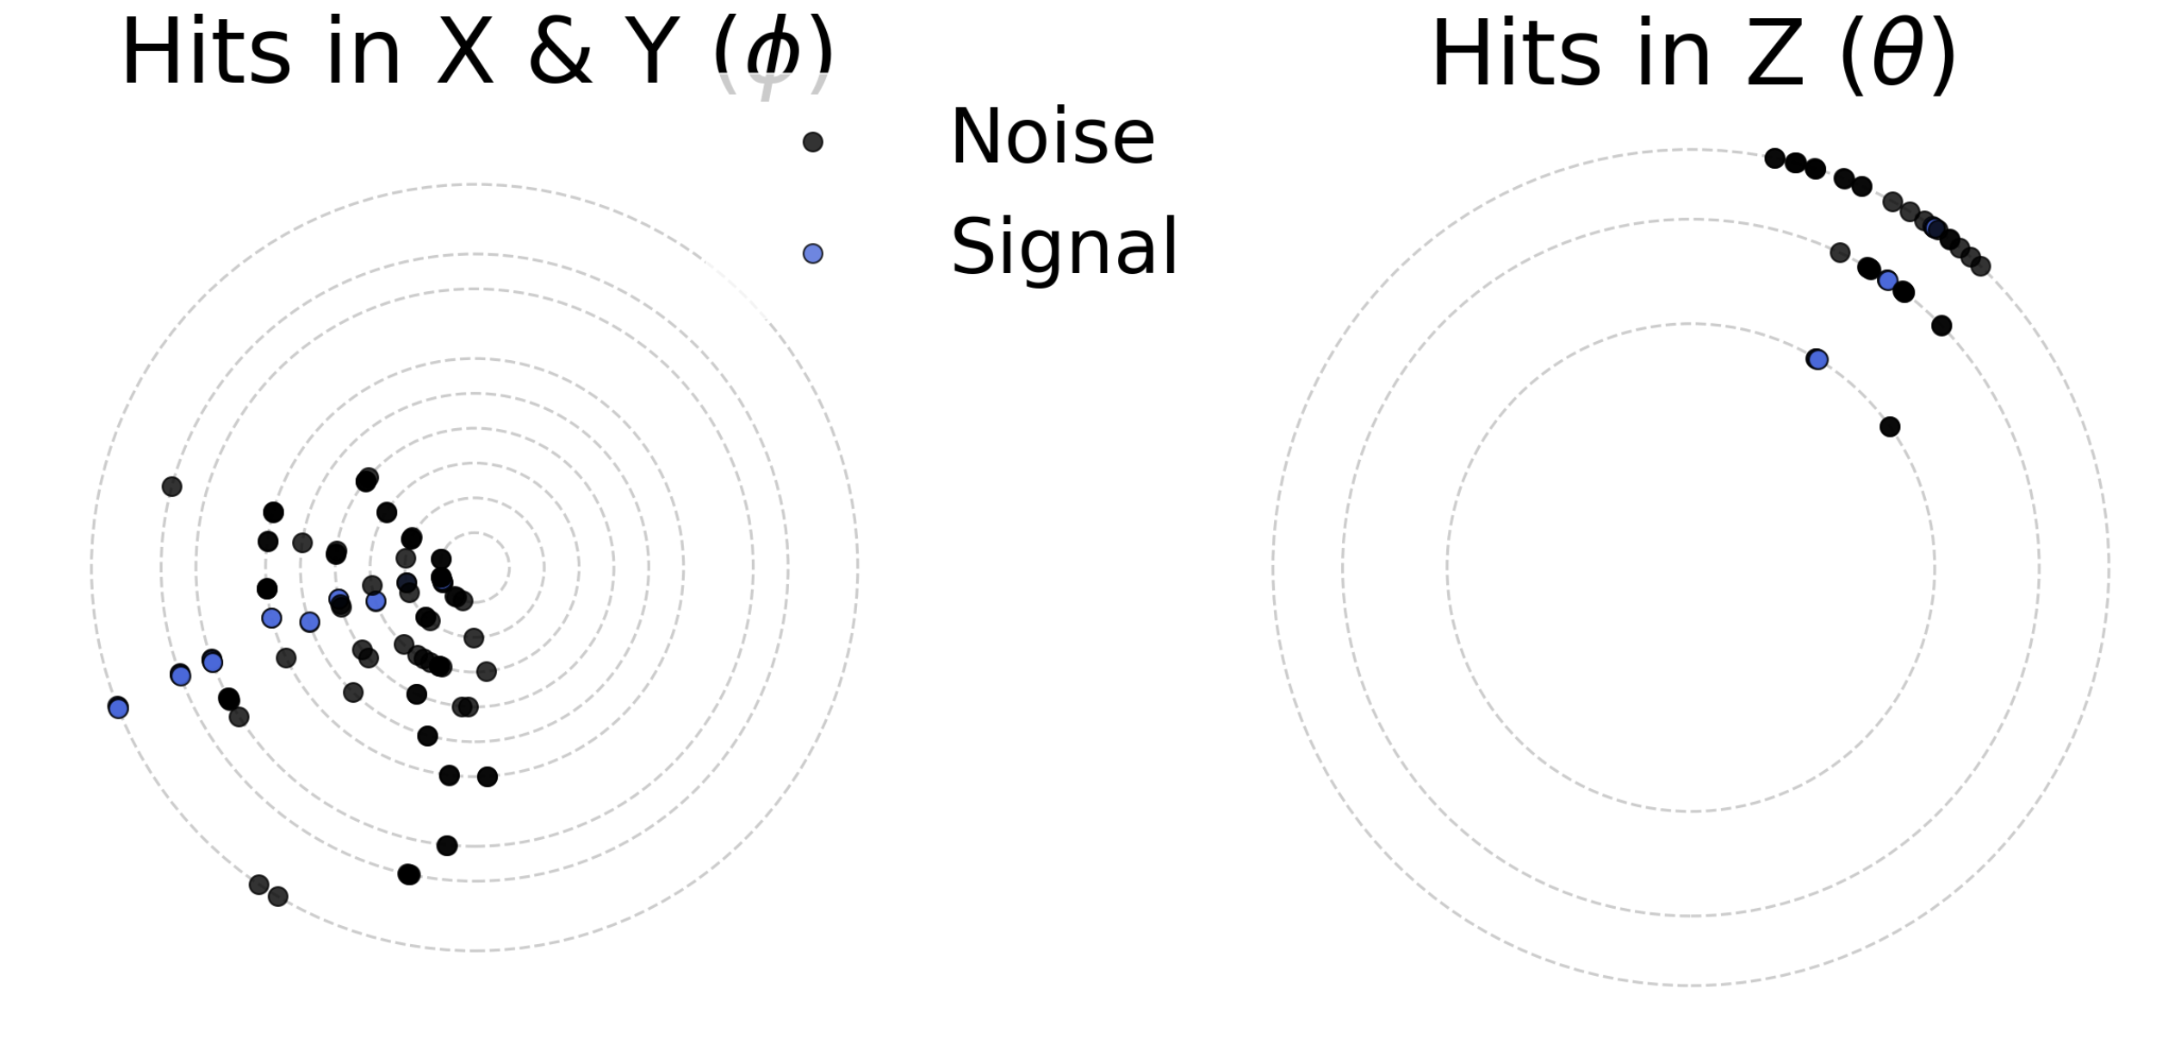
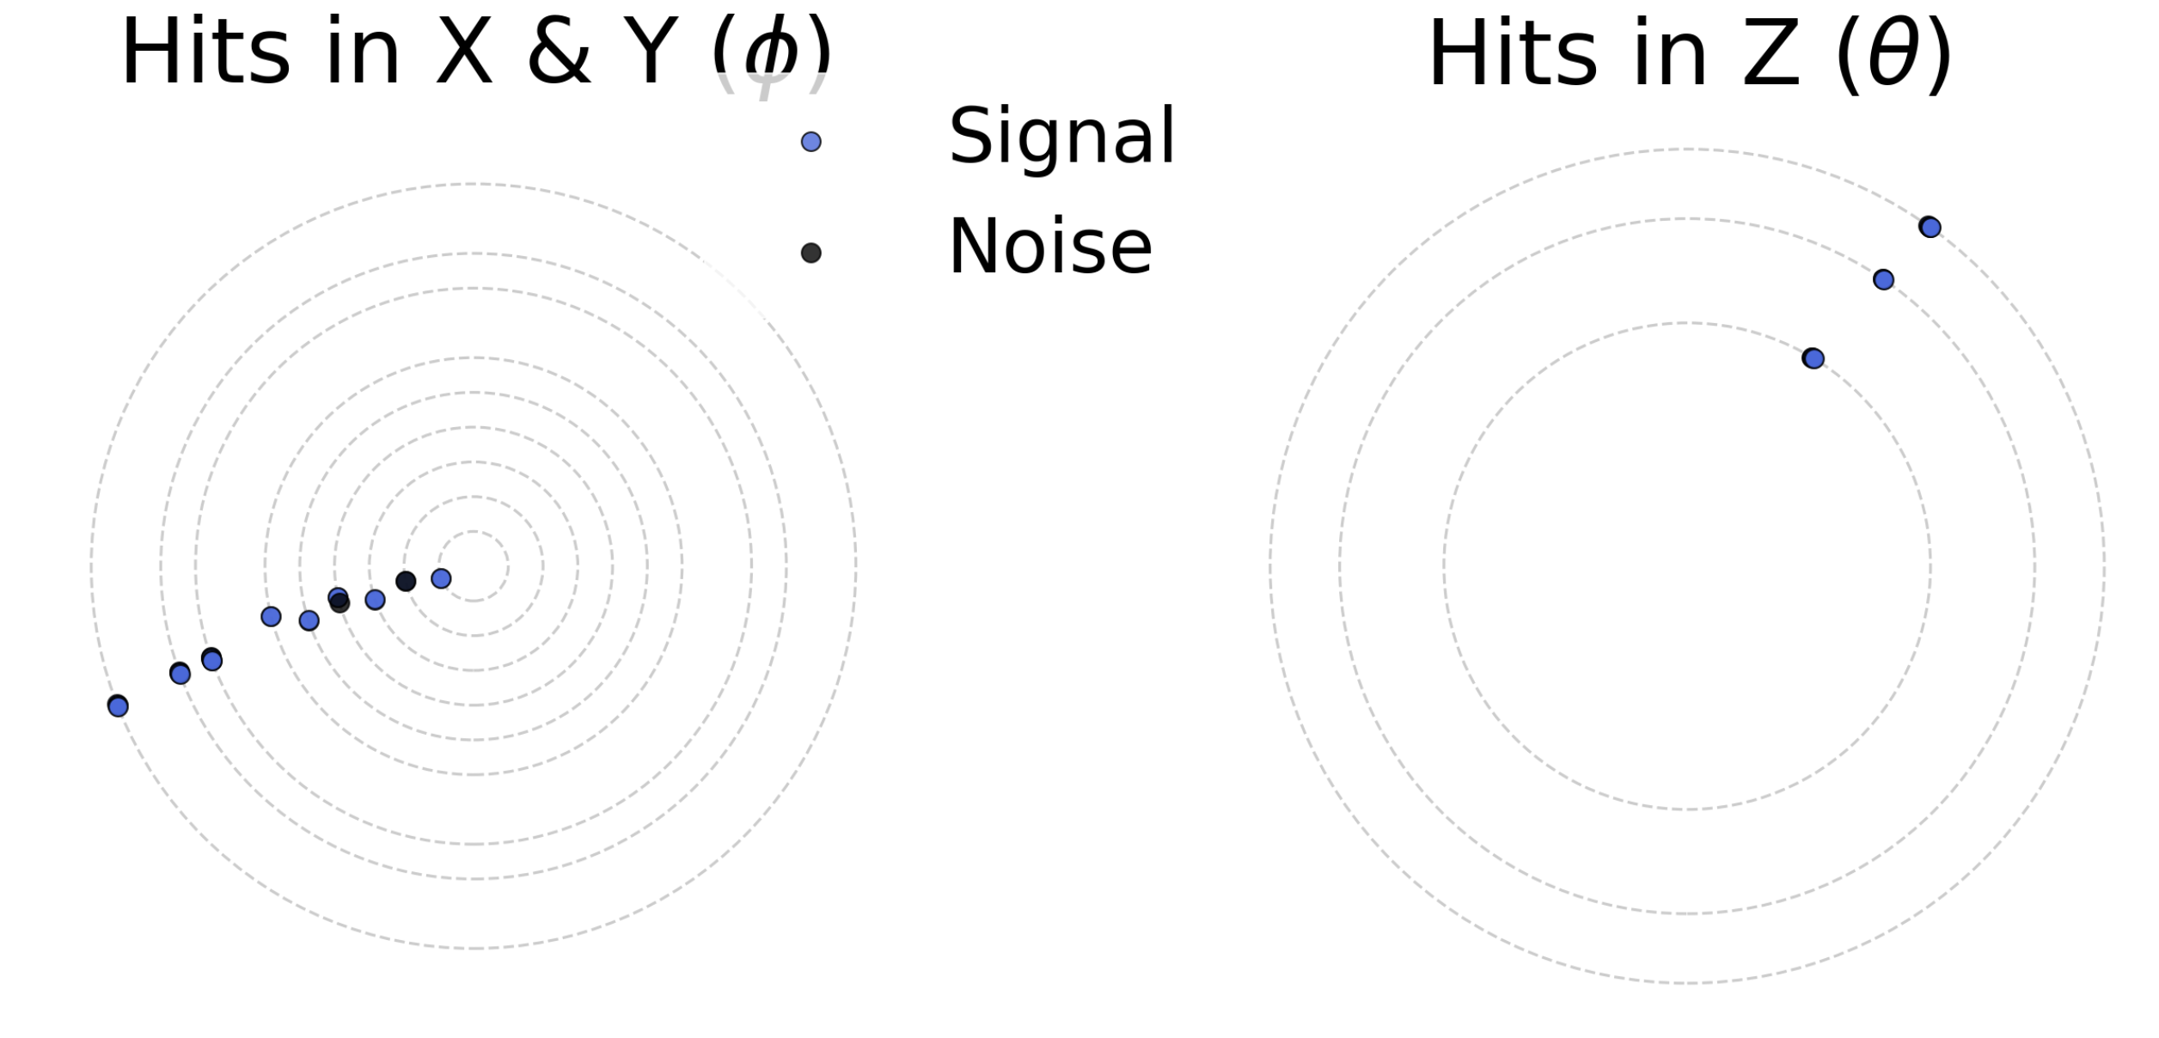
Denoising AI Development
MC sample with single generated muon track (signal hits, order 0) and merged background (order!=0).
Input variables are:
Sector, layer, strip
x, y, z (1 & 2)
Centroid and seed weights (normalized distance to cluster centroid/seed)
High segmentation in CVT means we cannot use fixed size arrays → employ different technology to FD (GNNs instead of CNNs).
Data processing, algorithm, training and coatjava inference code is available (see github).
Only Sector 1

Slide 5
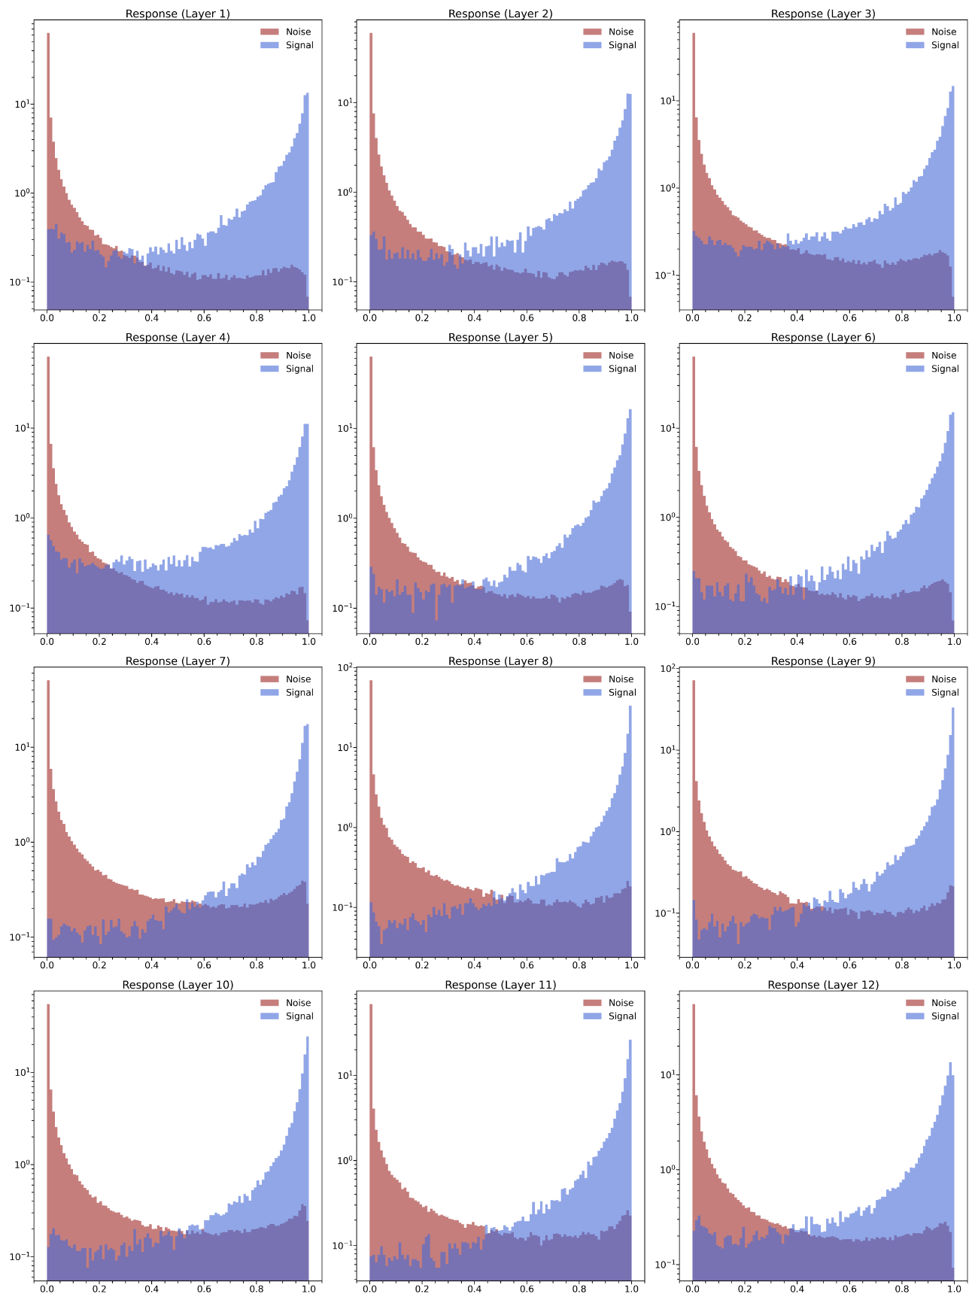
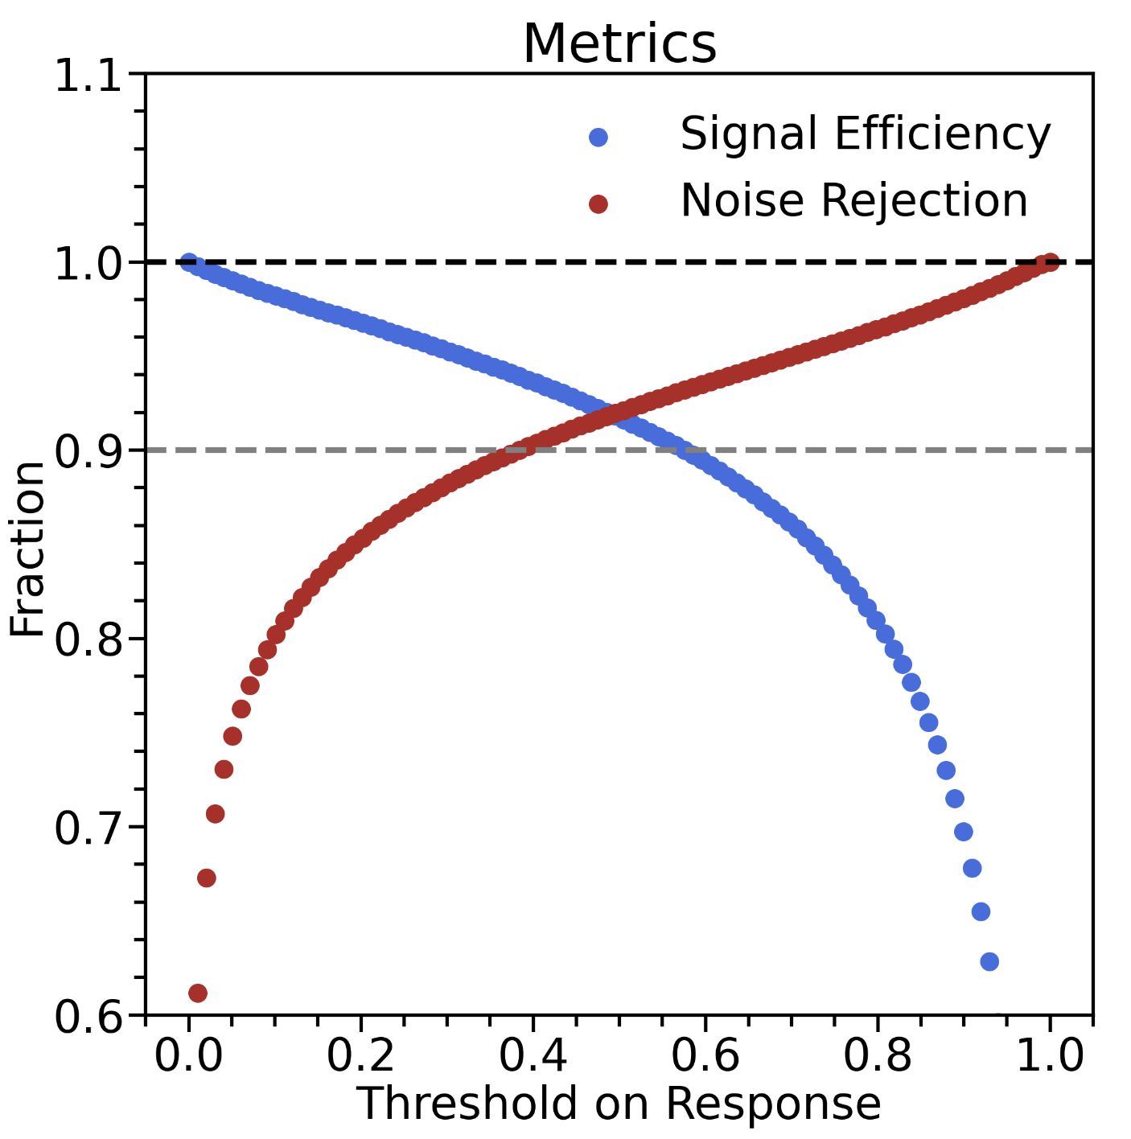
Performance
SVT Layer 1 SVT Layer 2 SVT Layer 3
SVT Layer 4 SVT Layer 5 SVT Layer 6
BMT Layer 1 BMT Layer 2 BMT Layer 3
BMT Layer 4 BMT Layer 5 BMT Layer 6

Slide 6
AI Developments Next Steps
Doing exploratory work on improvements to CVT.
We have preliminary results that look encouraging
There is still a lot to do → expect timescales of a year.
Workforce:
Mathieu, Pierre, Bhawani will work on improving AI/ML model
Veronique will work on conventional improvements to tracking
Tongtong & Veronique will work on coatjava integration and validation

Slide 7
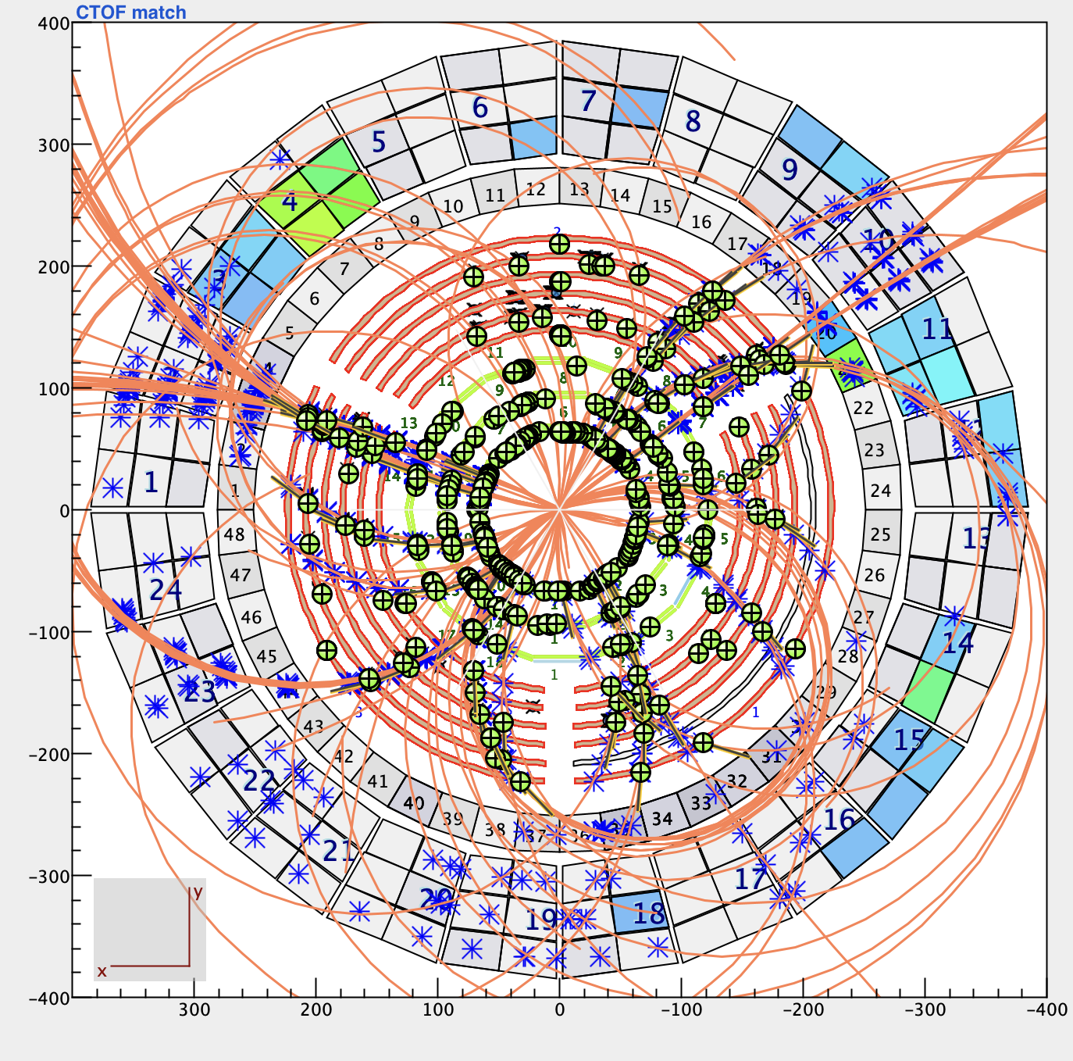
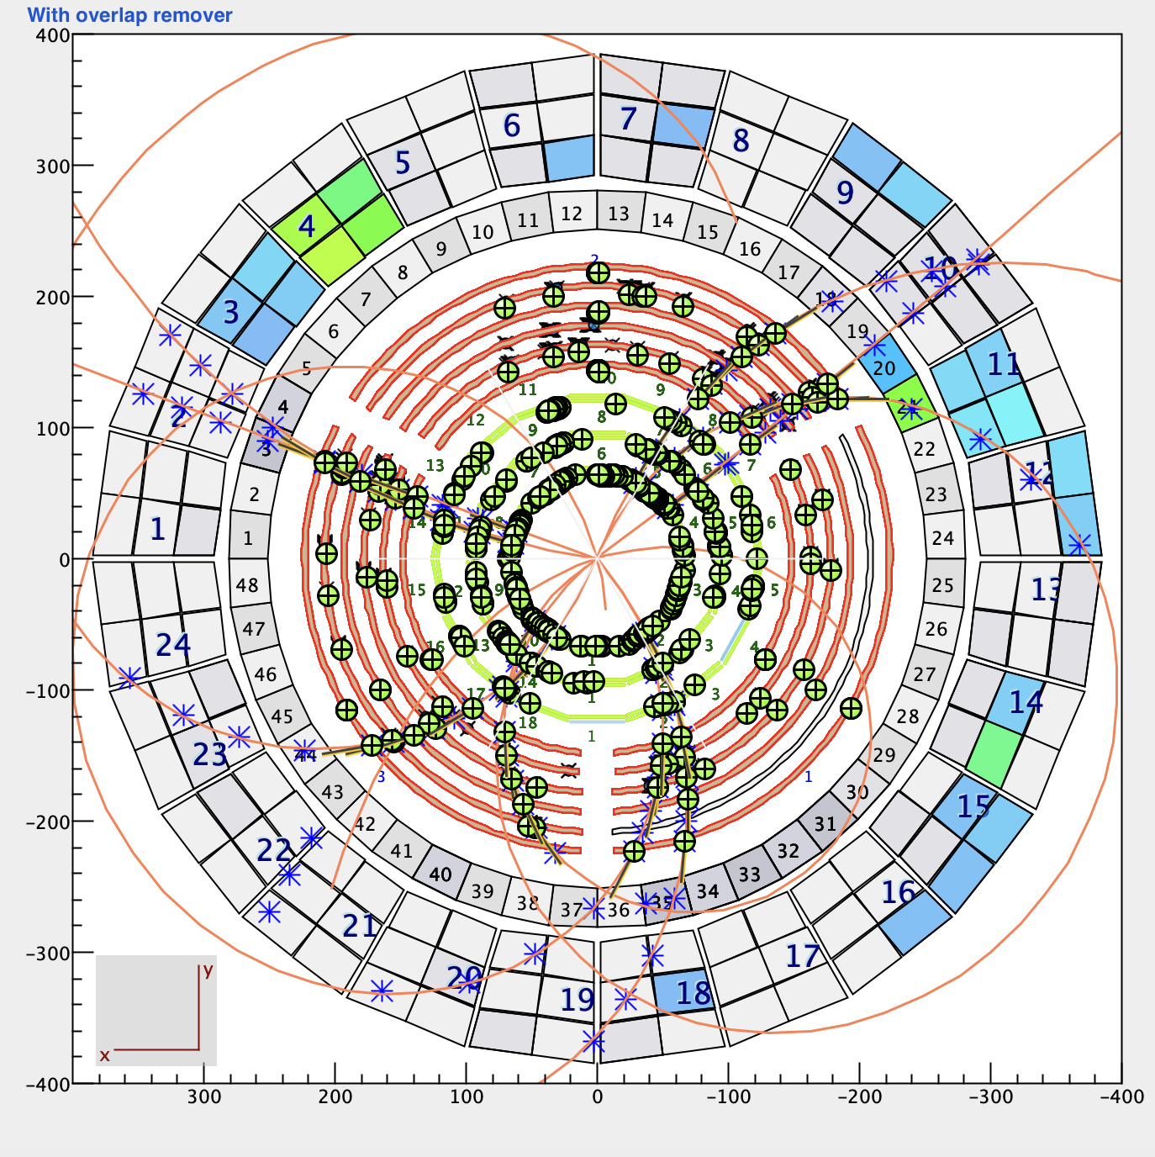
Conventional Tracking Improvements – CTOF Matching
All seeds
Many seeds (track candidates) share clusters of hits
Difficult to select the “good” candidate amongst a set of candidates that share clusters with it
Seeds are fit using a global method that assumes a constant 5-T field solenoidal field → using swimming to fit each seed not viable; global chi^2 and NDF used to select the seed from a set of seeds that share clusters → when the “real” seed (MC studies) has missing layer(s) in its trajectory, the wrong seed can be selected.
Seeds matched to the CTOF
Reducing the number of seeds is helpful to diminish the number of candidates sharing clusters and the overall number of seeds passed on to the fitter (faster tracking)
Matching to the CTOF done by reading the CTOF hits bank and selected hit with OR/AND TDC/ADC hits (only ADC hits are displayed in CED).
Selected seeds matched to the CTOF
Seeds remaining after “best” candidate selection amongst a group of seeds that share clusters of hits.
With CTOF matching, fewer selected seeds which have better chi^2/NDF
Reduction of ghost tracks to be validated in MC (with background merging)

Slide 8
Plans
Further improvements in seed selection
Current algorithm uses sorting algorithms by chi^2/NDF
Investigating missing hits on track using layer efficiency tables → if a hit on track is missing in an efficient layer ➔ flag as potential ghost track
Investigating using roads for SVT seeding
Concept:
Development of a precomputed pattern-matching algorithm (road finder).
A road = expected strip hits for a track hypothesis.

Slide 9
Conventional Tracking – Roads
Goal: Convert millions of compressed road patterns into an efficient lookup structure.
Process:
Load per-paddle .bin.gz files
Each file contains bit-packed roads, created by a script
Each road = sequence of (layer, sector, strip) hits created by computing helical tracks trajectories looping over, q, p, theta, phi, z, and determining the intersecting surface and nearest strip from geometry
Extract “index keys” (from file created by index-building script)
For each element: bin in phi corresponding to the strip implant end point (360 bins) key = (phiBin<<16 | sector<<8 | layer) embedded in a long
For each paddle, build temporary structure: Map< key → list of roadIds >
Compact into final UBER index: Map<Integer paddle → Map<Long key → int[] roadIds>>
Store full road list in RoadIndex.UberEntry[] roadTable → Each entry stores (paddle, bitOffset, nElements) → No full decode yet (lazy loading)
Roads required to intersect the CTOF → built-in CTOF-matching
For a given CTOF paddle each road (with trajectory landing on that paddle) saved in gz file:
short nElements
nElements:
long packedStripID (16-bit encoded sector+layer+strip)
UBER index built:
keys → road ID lists
roadTable → bit offsets

Slide 10
Conventional Tracking – Roads
Fast Road Lookup (Event Processing)
Input per event: A set of cluster keys per paddle
Reverse inverted index:
Instead of iterating roads → check clusters
We iterate clusters → check road membership
Complexity: O(clusterKeys + matchedRoads) No decoding done yet.
Lazy Road Decode + LRU Cache
Steps:
Build 64-bit cache key: [paddle:16][offsetBytes:32][nElements:16]
Check LinkedHashMap LRU cache (20k entries)
If miss:
Seek into paddle byte array using bit-skips (offsetBytes)
Read (layer, sector, strip) triplets
Build CompactRoad
Insert into cache
Why lazy decode?
50M+ possible roads
Only a few hundred decoded per event
Saves GBs of RAM

Slide 11
Conventional Tracking – Roads
Seeding SVT Tracks from Roads
Seed using roads with input: clusters, CTOF paddles, paddleBytes (bit packed roads information for a given paddle)
I. Obtain the list of CTOF paddles with hits in the event
II. Per paddle:
Build the same cluster keys used for road indexing
findRoad() → best matching UBER entry
getRoad() → decode only that road
matchRoadToClusters():
Match by (sector,layer)
Pick closest strip distance per element
If ≥ 4 matched clusters → accept as SVT seed
Seeding CVT Tracks from Roads
Seed CVT tracks using the conventional seeding algorithm (SSA, SLA) for each set of clusters matched to a road, including BMT clusters
Each such seed is fitted using the Kalman Filter algorithm
In development…

Slide 12
Conventional Tracking – Roads
Validations
Roads-building binning:
p → 10 MeV
Theta, phi → 1 deg.
z (RGA) → target length / 5 (small z sensitivity for SVT)
Performance
Memory footprint
Reconstruction speed
Tracking efficiency
Impact on resolution
Plans
Run validations on phase space coverage for roads
Validate feasibility of incorporation in reconstruction stack (performance)
Validate tracking performance

Slide 13
BACKUPS

Slide 14
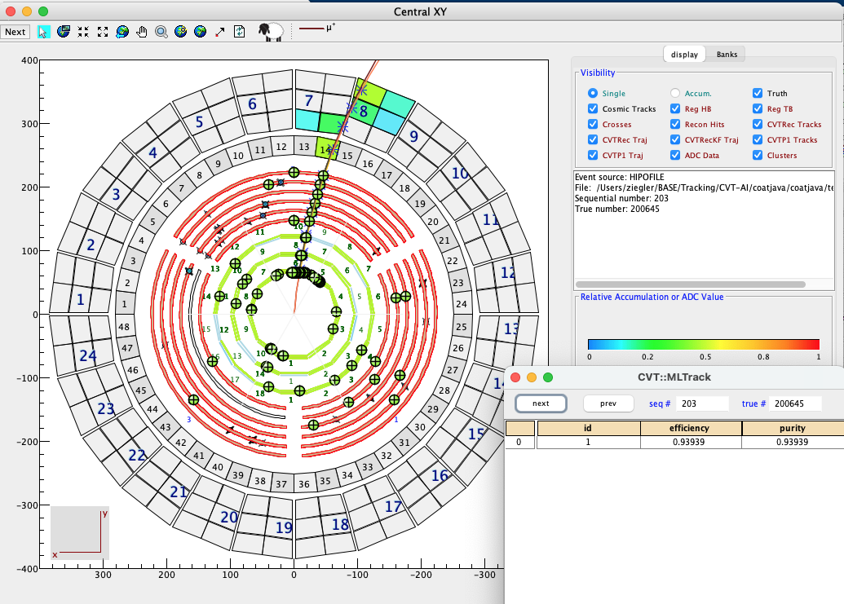
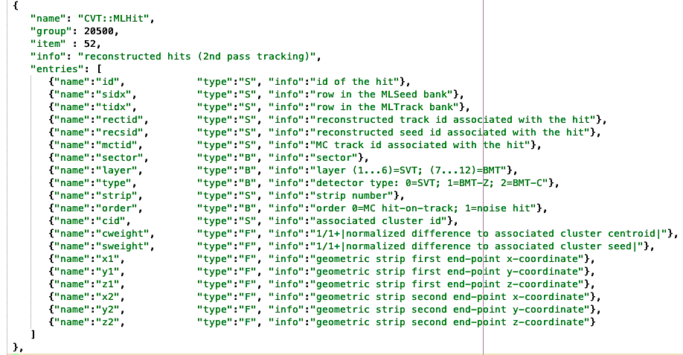
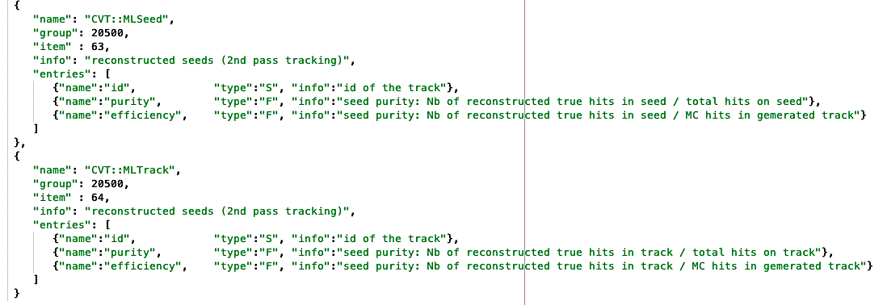
Dedicated ML Banks
Bankdefs: cvtnn.json
n_{T} = #reconstructed hits on track with order 0 (true hits on track)
n_{Tot} = #reconstructed hits on tracks
n_{G} = #generated hits belonging to simulated track
Purity = n_{T} / n_{Tot}
Efficiency = n_{T} / n_{G}
If purity < efficiency: list of HOTs contains fakes & # HOTs > generated HOTs

Slide 15
Denoising Model: Graph Neural Networks (GNN)
Graph are made of nodes (eg hits) & edges.
During learning, “message passing” updates each node with information from other nodes.
This is learned (eg what information is passed is the output of a small neural network).
GNNs can be used in different ways:
Node classification (denoising)
Edge classification (track finding)

Slide 16
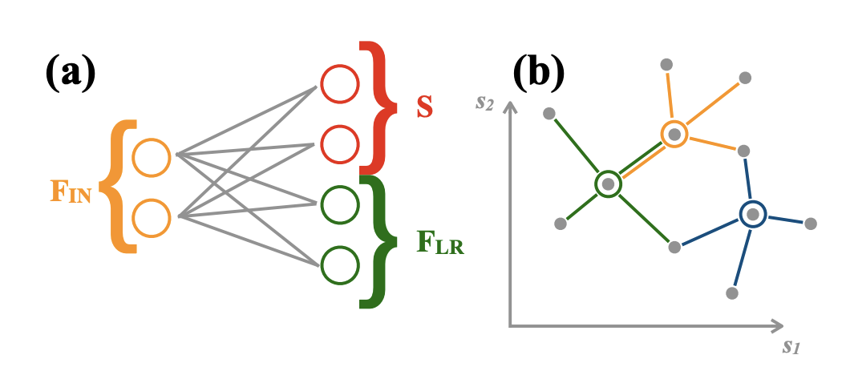
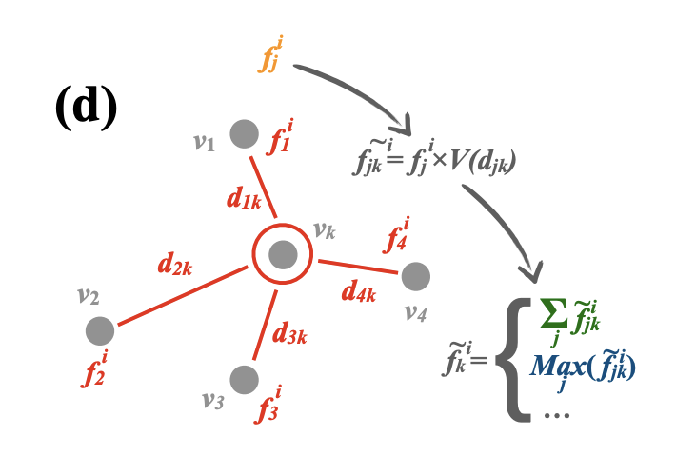
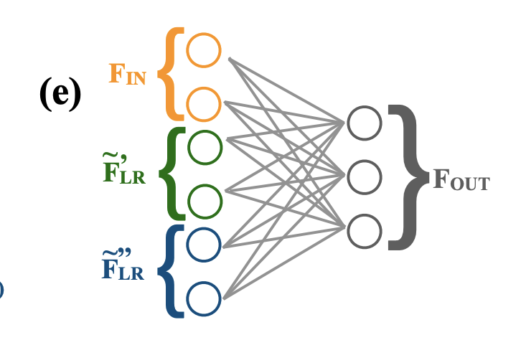
GravNet Layers (arxiv:902.07987)
GravNet offers a “smart” way of grouping nodes before message passing (useful due to high hit multiplicity).
A neural network predicts a latent space position for each hit
We group the hits by distance in latent space (kNN)
Message passing is weighted by distance
A neural network outputs the probability that each hit is signal, based on info from the hit and neighbours
Note: kNN in many dimensions is slow.
In 1D use sorting (fast).
In ND, first sort over random dimension, select 2*k, then do knn

Slide 17
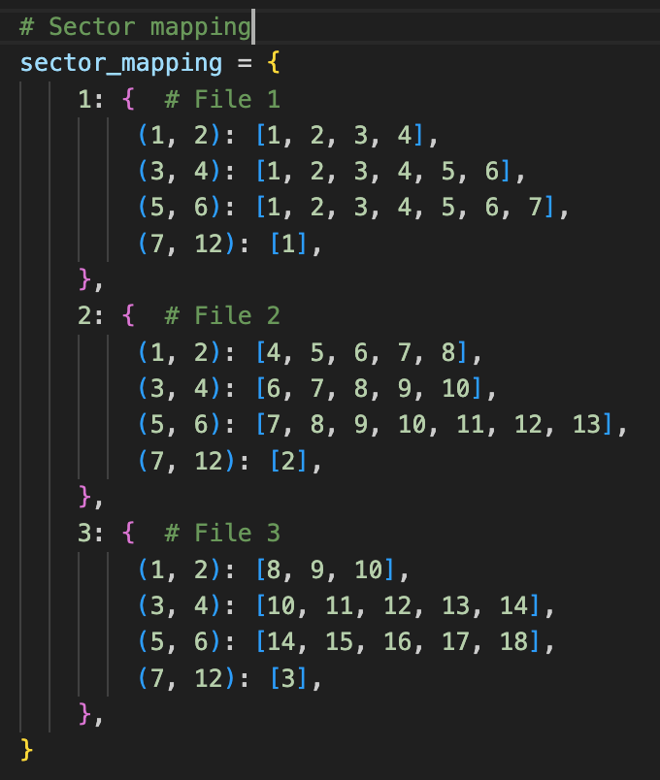
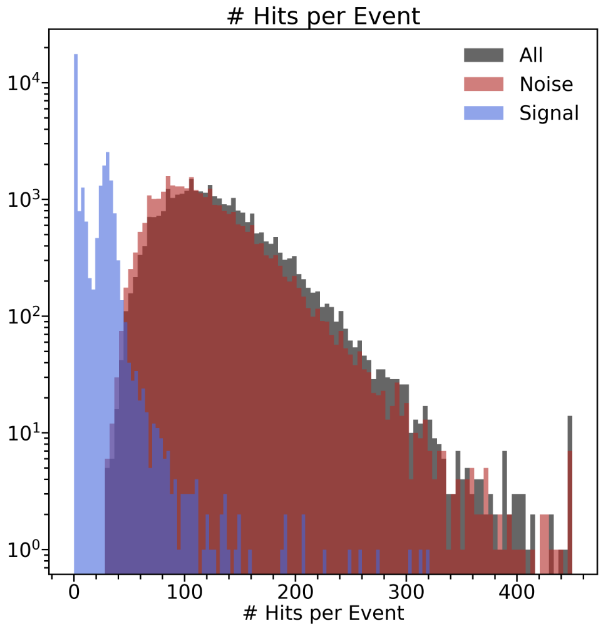
Model Restrictions
Due to number of hits per event, we cannot create edges between all hits:
GravNet reduces impact of this.
Further restrict hits to sectors (based on SVT)
Restrict by φ? Adjacent hits in a layer? Distance between neighbour layers?
I thought that the Deep Java Library in coatjava meant we need stick to standard PyTorch:
Use padding eg define a maximum number of hits per event, pad with zeros for the rest of it
Padded events are not included in message passing.

Slide 18
Improvements
To Do
Training Data
Events with only background, keep?
Events with partial track due to splitting into sectors, keep? More than 1 track per event
10x more data means ~20h training, we can randomly sample from full dataset and train in subsets of data for subsets of total number of epochs
Need 10x more training data
Further restriction in graph formation?
Sort out training data
Sort out variables
Try out different hyperparameters (record efficiency, purity, training and inference times) Integration in Coatjava
Variables
Polar coordinates instead of X/Y/Z?
Cluster info?
What variables are ”well” simulated?
Coatjava Integration
Hyperparameter
Example code in the github & networks in these slides
Can use similar engine to DC denoising
Needs functionality:
parse hits bank into arrays
change order based on output, mask in tracking
Measure full reconstruction efficiency & resolutions
Decrease learning rate for smoother loss v epochs
Latent space dimension (s=1 for now)
Number of neighbours (k=30)
Message passing space (34)
Number of GravNet layers (16)
Output neural net layout

