Slide 1


RG-D Experiments: Status and Analysis Plans
Mathieu Ouillon (Mississippi State University)
CLAS Collaboration (18-21 November 2025)

Slide 2
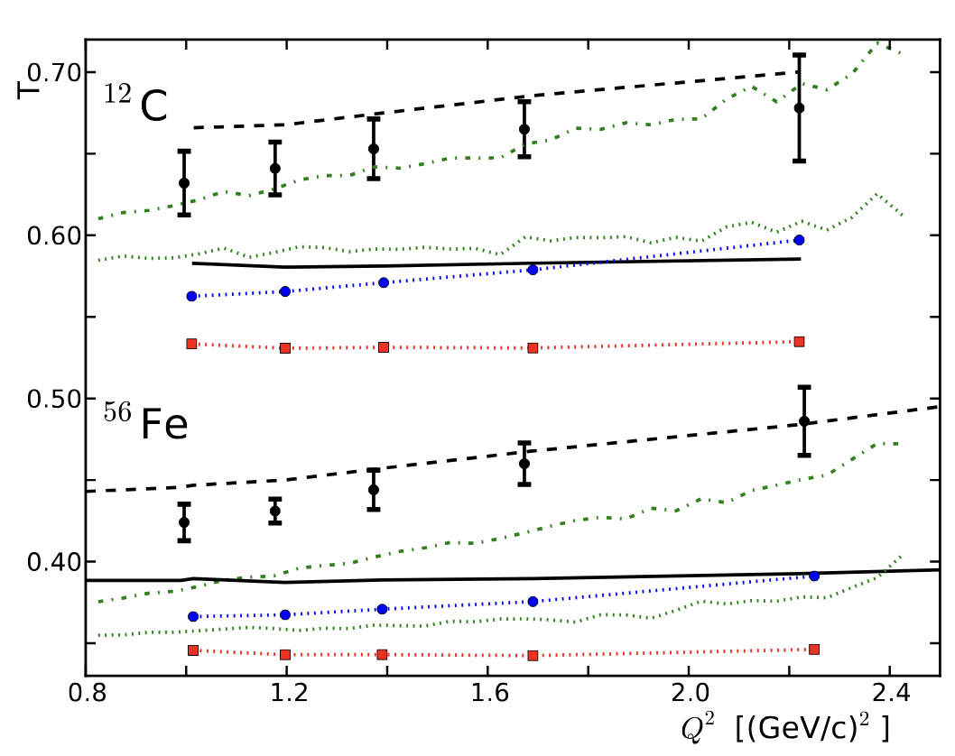
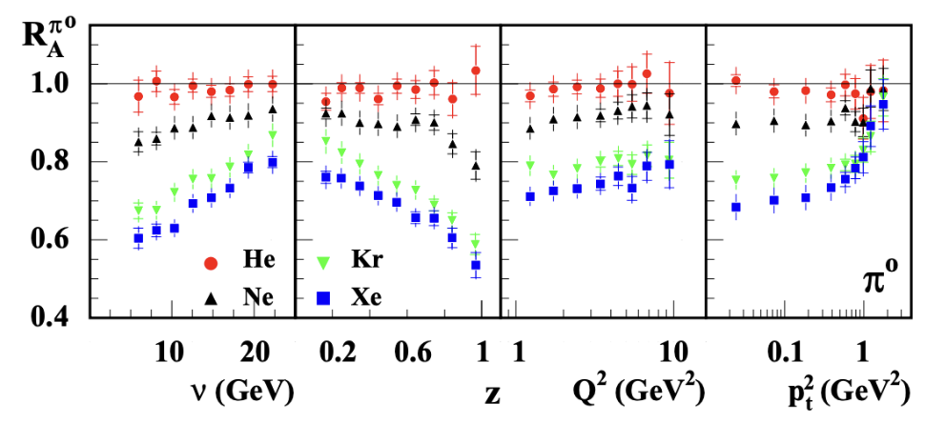
Run Group D
RG-D is composed of two experiments:
Study of Color Transparency (CT) in Exclusive Vector Meson Electro-production off Nuclei (E12-06-106)​:
Spokespeoples: W. Armstrong¹, L. El Fassi³, K. Hafidi¹, M. Holtrop⁴, and B. Mustapha^{1​}
Nuclear Transverse Momentum Distributions (nTMDs) in CLAS12 (E12-06-106A)​:
Spokespeoples: R. Dupré², L. El Fassi³, Zein-Eddine Meziani¹, and Holly Szumila-Vance​⁵
HERMES Collaboration
arXiv:0704.3270
W.~Cosyn and J.~Ryckebusch
arXiv:1301.1904
¹: Argonne National Lab, ²: IJCLAB, Orsay, France ³: Mississippi State U., ⁴: University of New-Hampshire, ⁵: Jefferson Lab

Slide 3
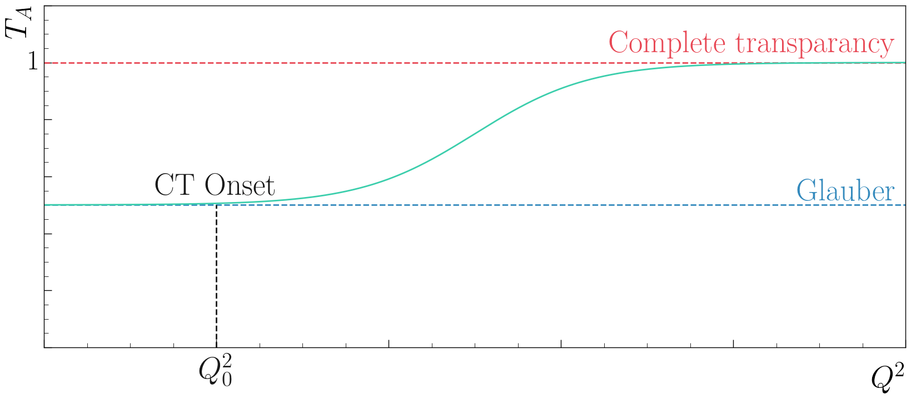
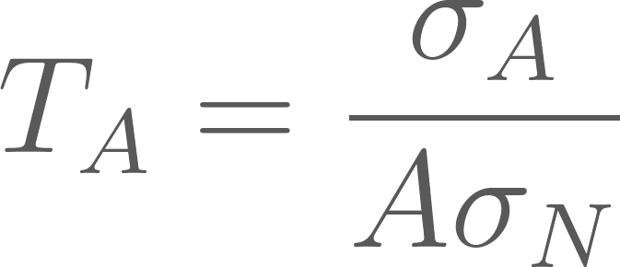
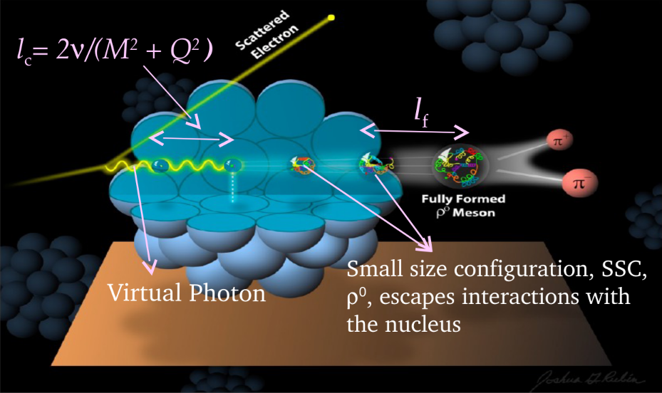
RG-D: CT Experiment​
E12-06-106: Color Transparency: suppression of interactions of colorless small size configuration in nuclear medium
Experimental signature: rise of the nuclear transparency, T_{A} as a function of Q²: ​
T_{A}: ratio of the cross section per nucleon on a bound nucleon to that on a free nucleon
σ_{A} − nuclei cross section
σ_{N} − free nucleon cross section
Objective: understanding the dynamical evolution from small-size configurations into ordinary hadrons, and validating the QCD factorization theorem
Coherence length, l_{c}: the lifetime of the qq-bar pair
Formation time, l_{f}: the time evolution of SSC to an on-shell ρ⁰ meson​​

Slide 4
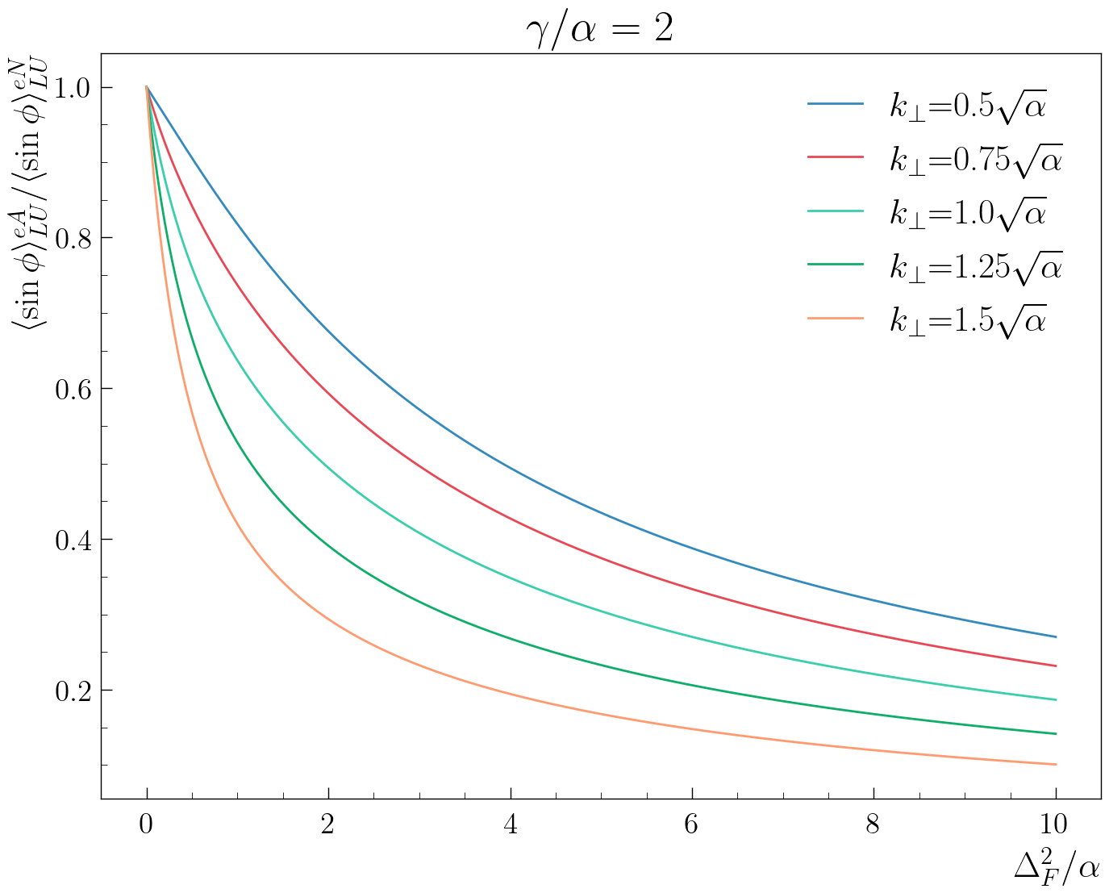
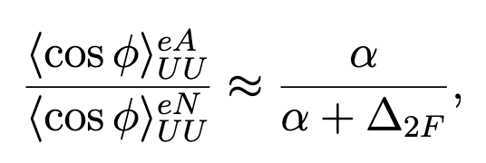
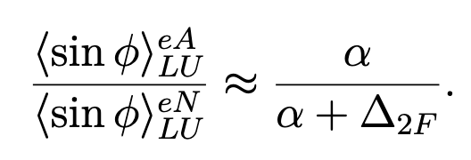
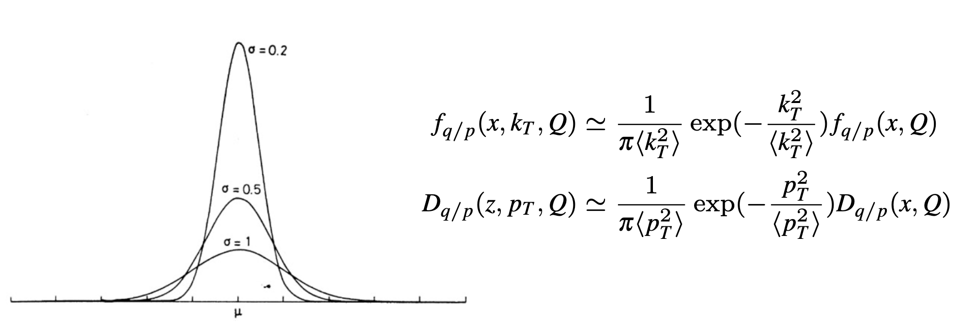
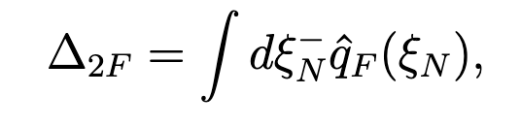
RG-D: Nuclear TMDs
E12-06-106A: nTMDs study uses the same CT running conditions except the beam polarization, and aims to study​:
Nuclear effect on SIDIS asymmetries
Transport coefficient of the nuclear matter
For that, measure different observables:
cos φ, sin φ, cos(2φ)¹ moments for different hadrons (π⁺,π⁻, and π⁰):
Song, Y. et al. (2014) Physical Review D, 89 014005.
q_{F}(ξ_{N}): the quark transport parameter
¹ No predictions exist for this observable
The heavier the nucleus, the wider the TMD gaussian width (Nuclear Broadening)

Slide 5
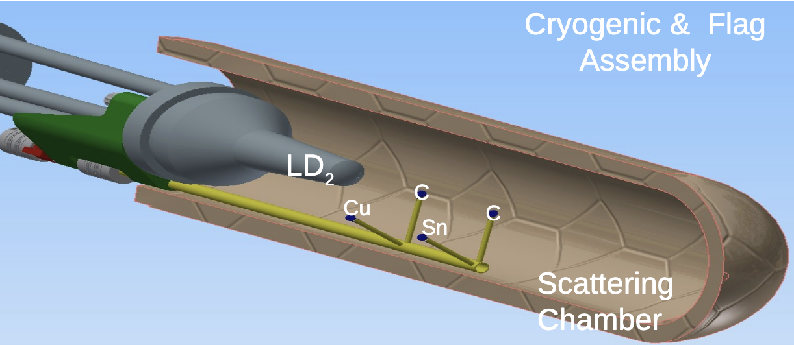
RG-D Run Configuration
RG-D experiments collected data in the fall of 2023 with
10.54 GeV polarized beam energy and 𝐼=5–175 nA for luminosity scans and production
Standard CLAS12 configuration with FT-OFF and three layers of FMT
Three target configurations, LD2, CxC, and CuSn, deployed with InBending and OutBending
New cryogenic LD2 and the nuclear-foil flag assembly centered at -5 cm for each configuration
Main run hiccups:
Faraday Cup vacuum contamination
Moller cone sagging
Sn target
Cu target
LD2 exit window
Scattering Chamber exit window
LD2 entrance window

Slide 6
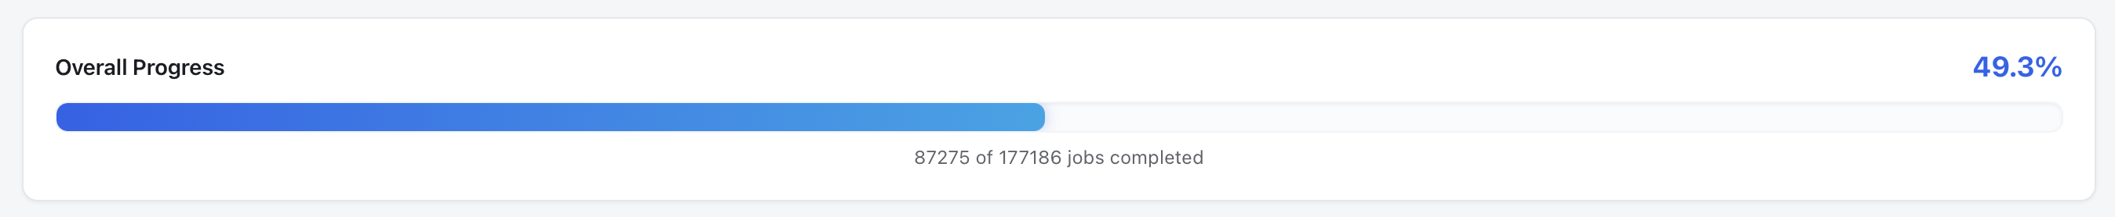
RG-D Status: Calibration Summary
RG-D successfully passed Pass1 review on May 27th
Pass1 cooking initiated on June 13th using COATJAVA 13.0.0
The cooking is at 49%:
Manly due to the high usage of the farm and recent modification of the job scheduling
Thanks to CalCom Experts for their support

Slide 7
Electron fiducial cuts
Since the last meeting, refinement cuts have been developed and finished to improve electron identification
Raw electron cuts:
pid = 11, status < 0
2000 ≤ |status| < 4000
|chi2pid| < 5
Refinements:
Sampling fraction vs momentum: should be constant for an electron
v and w for the calorimeter: defined at lengths that are multiples of 4.5cm
DC fiducial cut using chi2/ndf vs edge: remove the edges of each region
Vz cut: select an electron that comes from the target
p > 0.8 GeV/c: reconstruction below 0.8 GeV can’t be trusted

Slide 8
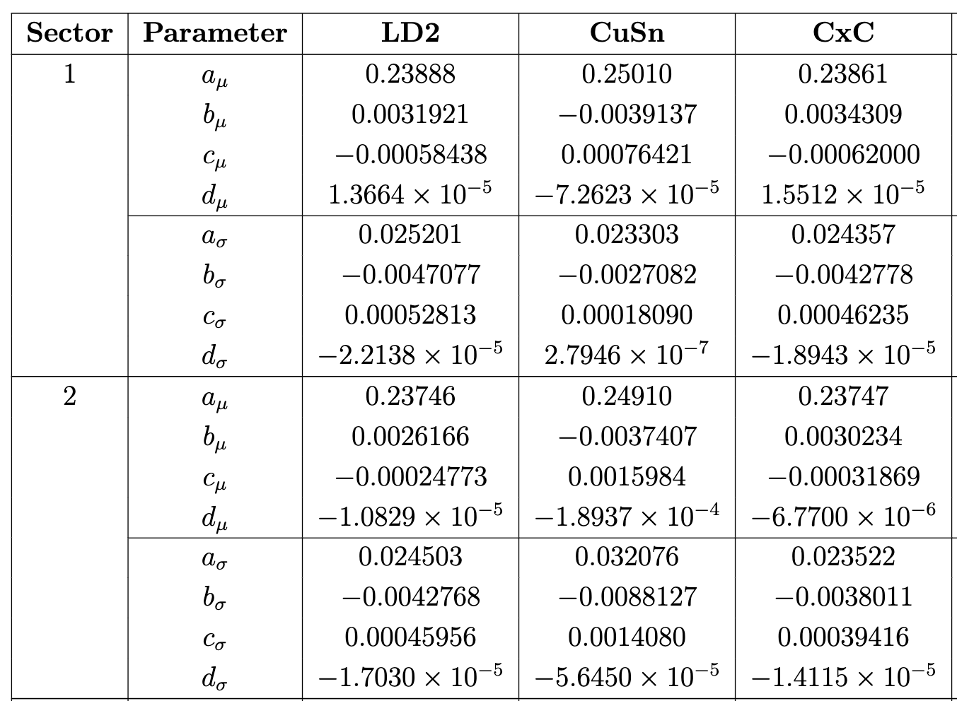
Electron fiducial cuts: Sampling fraction vs p
This cut is done by extracting μ and σ for 50 p slices by fitting with Gaussian.
Then fitting them with 3rd order polynomial function. This cut is sector, polarity and target dependent

Slide 9
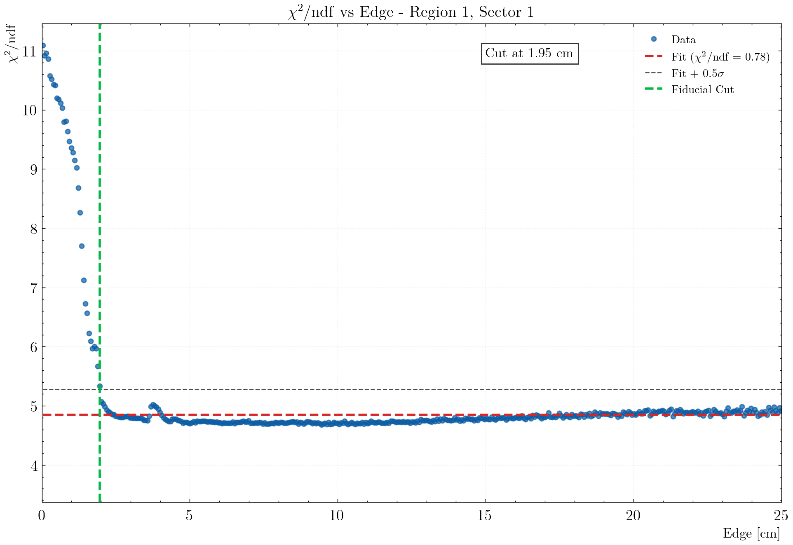
Electron fiducial cuts: DC Fidcual cuts
DC Fiducial cuts are applied on the variable edge and are define using chi2/ndf vs edge
Strategy:
Fit the part between 13 and 25 with a straight line
Get the distance between the fit and each data points, compute the std dev
Find 5 consecutive points above the line + std dev starting from the right
Sector independent cut, but different for each particle and target

Slide 10
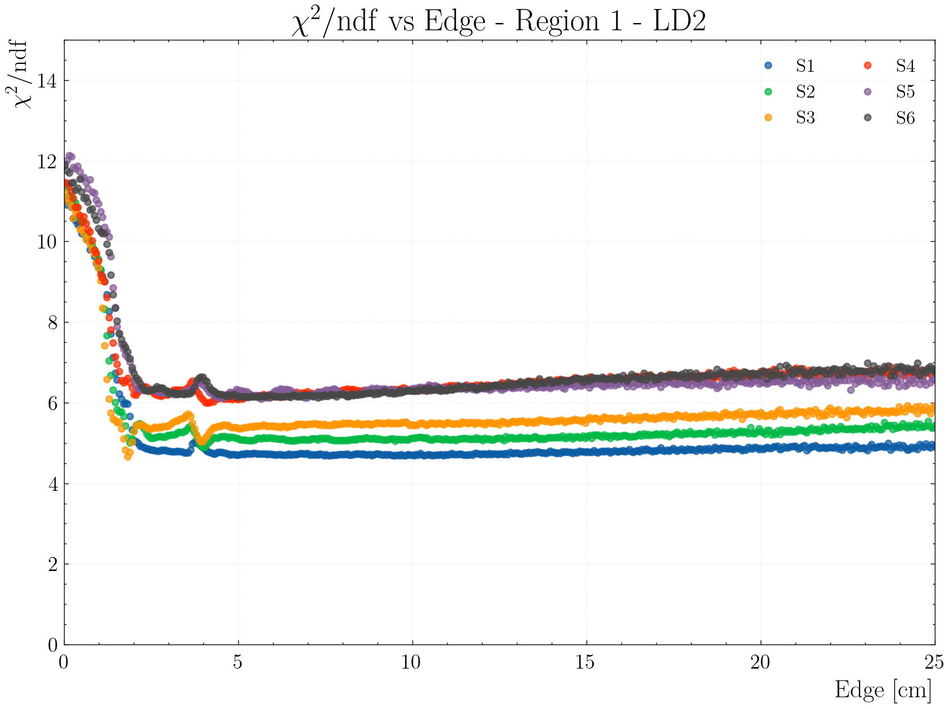
Electron fiducial cuts: DC Fidcual cuts
DC Fiducial cuts are applied on the variable edge and are define using chi2/ndf vs edge
Strategy:
Fit the part between 13 and 25 with a straight line
Get the distance between the fit and each data points, compute the std dev
Find 5 consecutive points above the line + std dev starting from the right
Sector independent cut, but different for each particle and each target

Slide 11
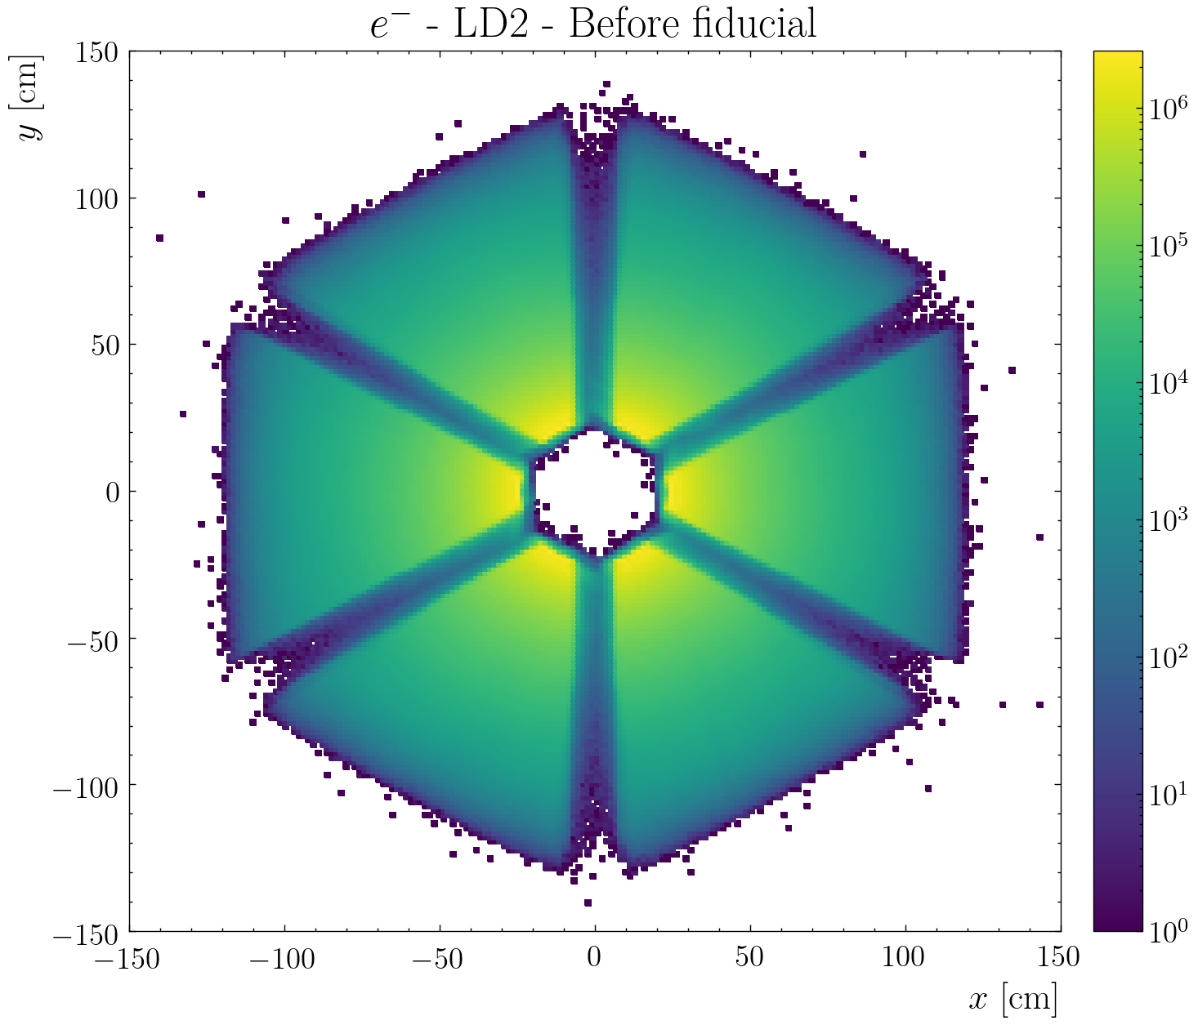
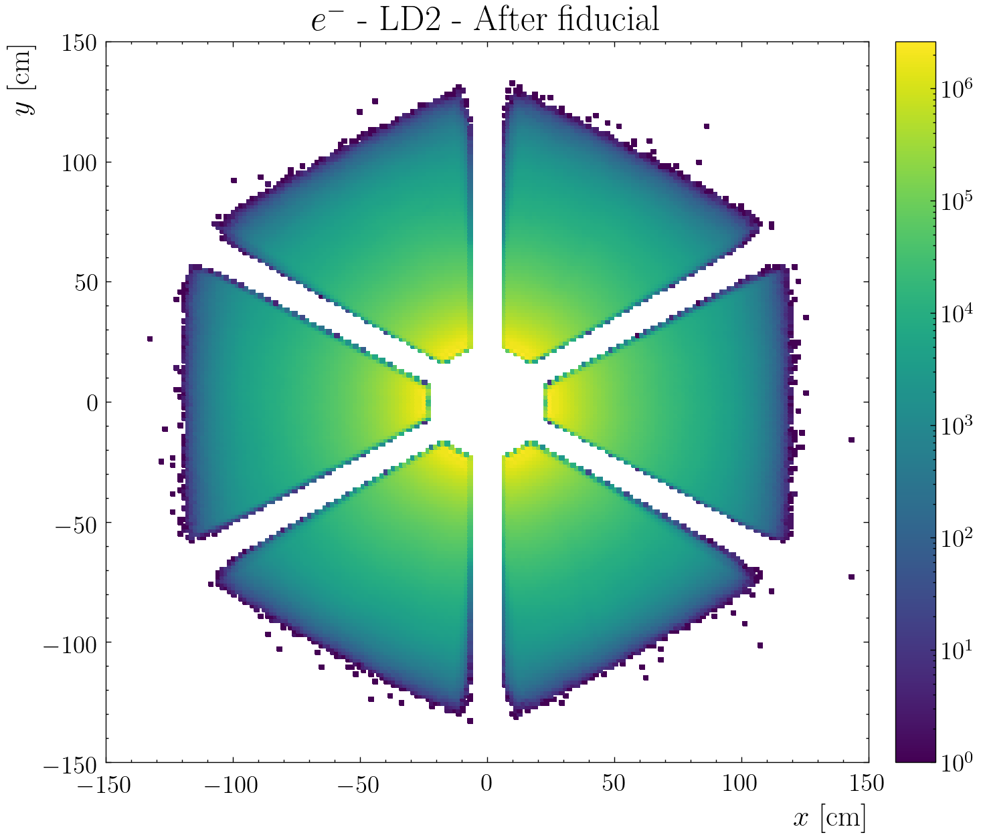
Electron fiducial cuts: DC Fidcual cuts
DC Fiducial cuts are applied on the variable edge and are define using chi2/ndf vs edge

Slide 12
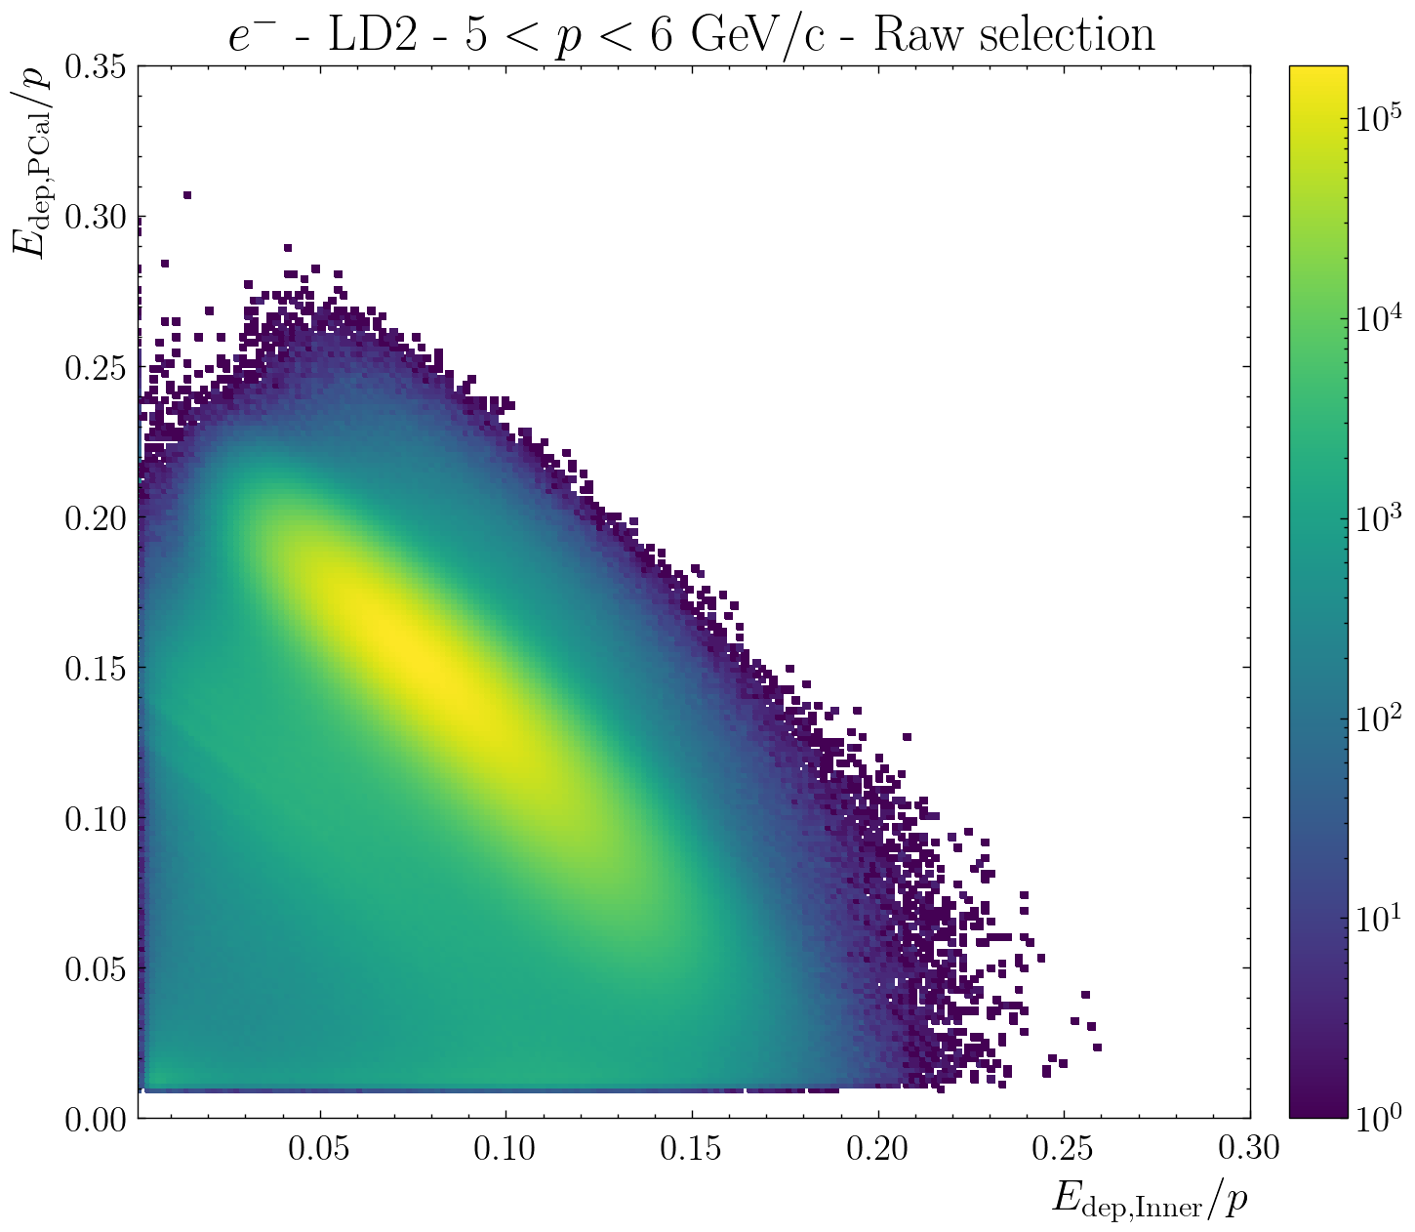
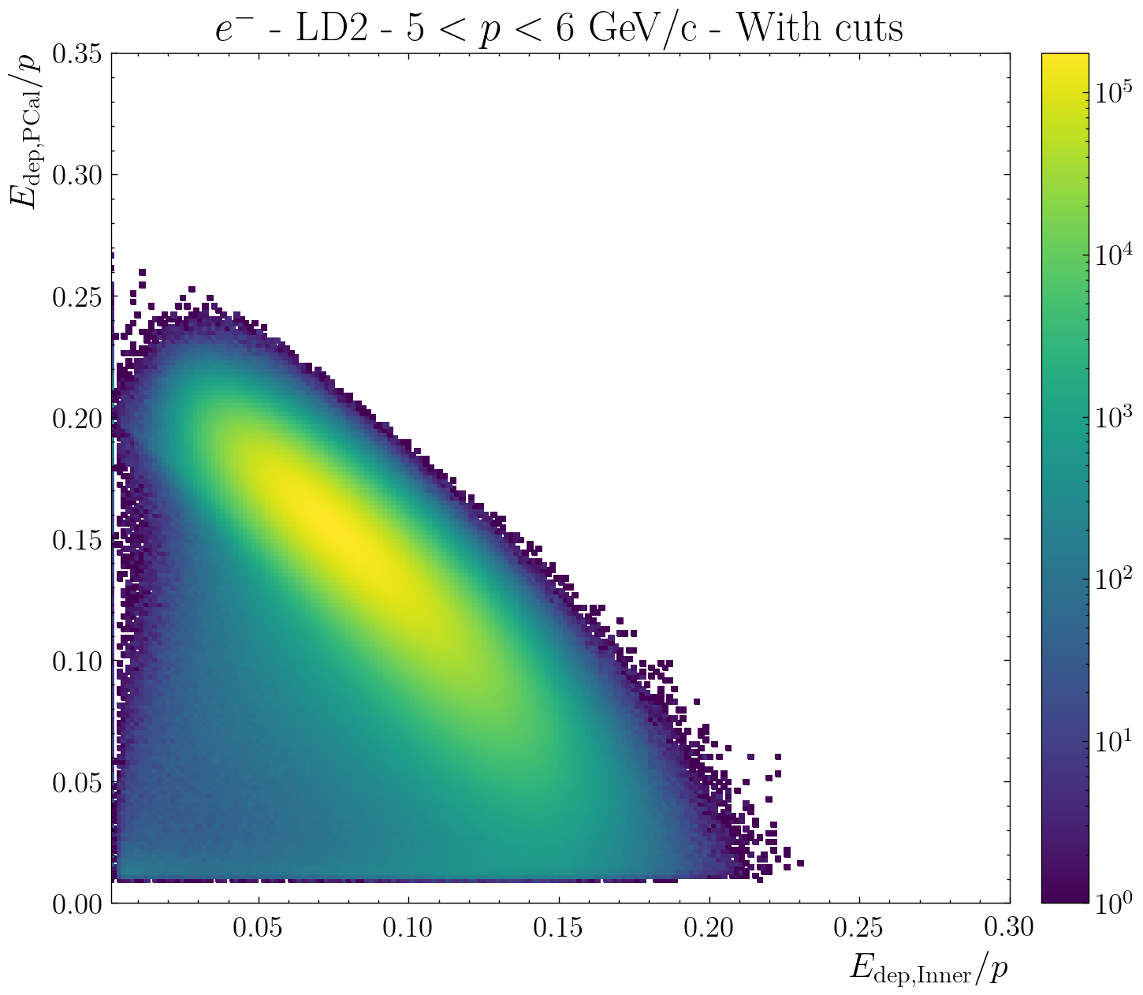
Electron identification: Triangular cut
RG-A/B developed a cut on the sampling fraction of the inner calorimeter and the PCAL: Goal is to reduce the π⁻ contamination in the electron sample
For RG-D, we found that the other cuts (SF and fiducials) are enough

Slide 13
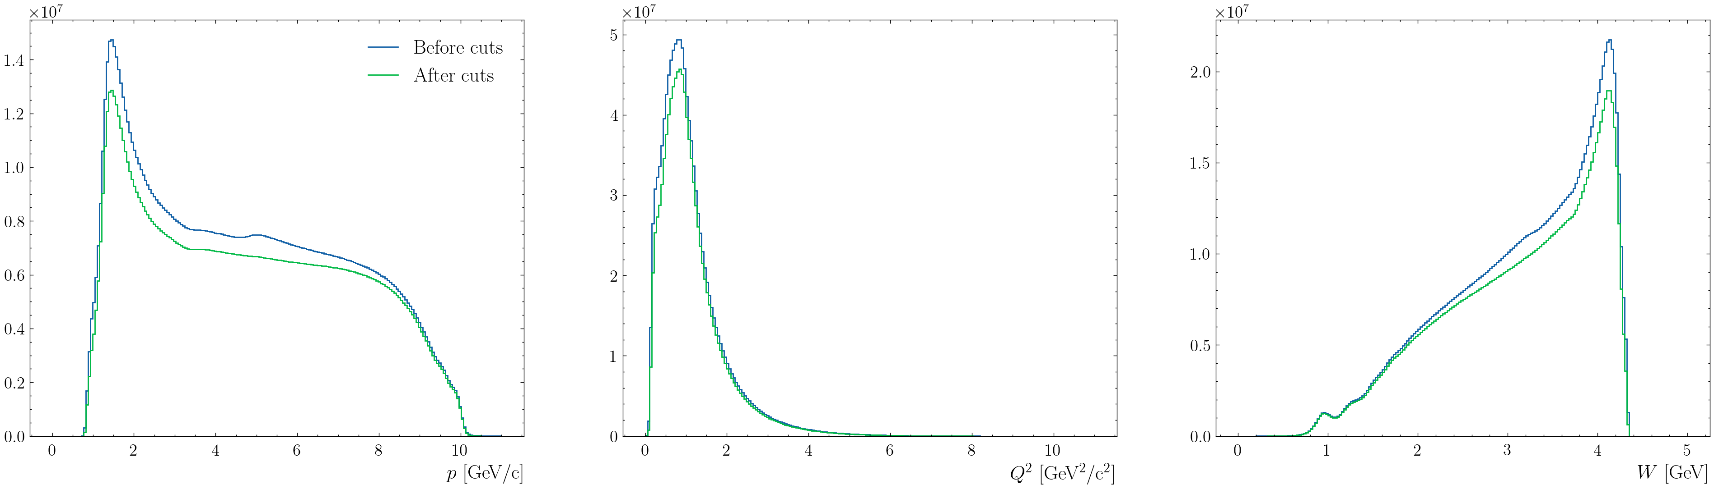
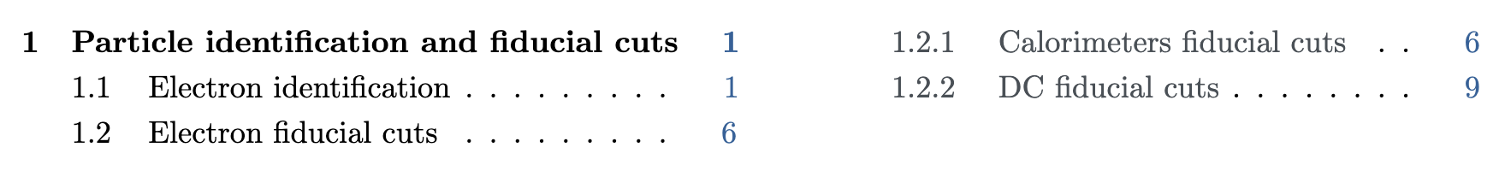

RG-D: Mathieu Ouillon Effect of the refinement cuts
The refinement and fiducial cuts on the electron, don’t reduce the phase space, only improving the electron sample
The electron cuts are finalized, and an RG-D Common Analysis note have been started

Slide 14
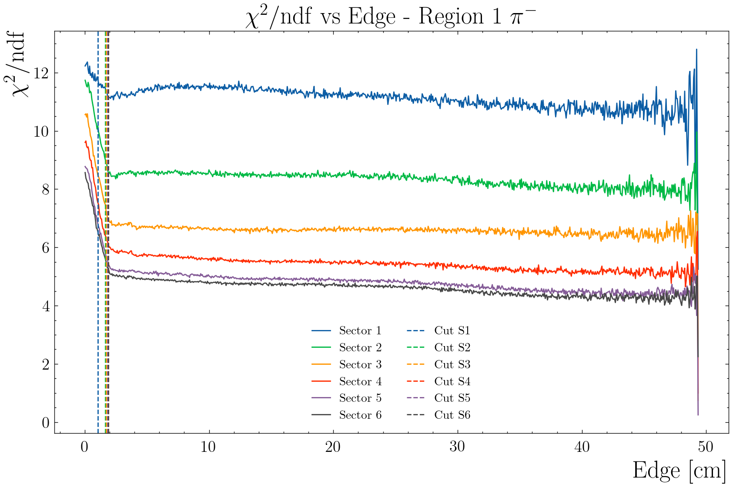
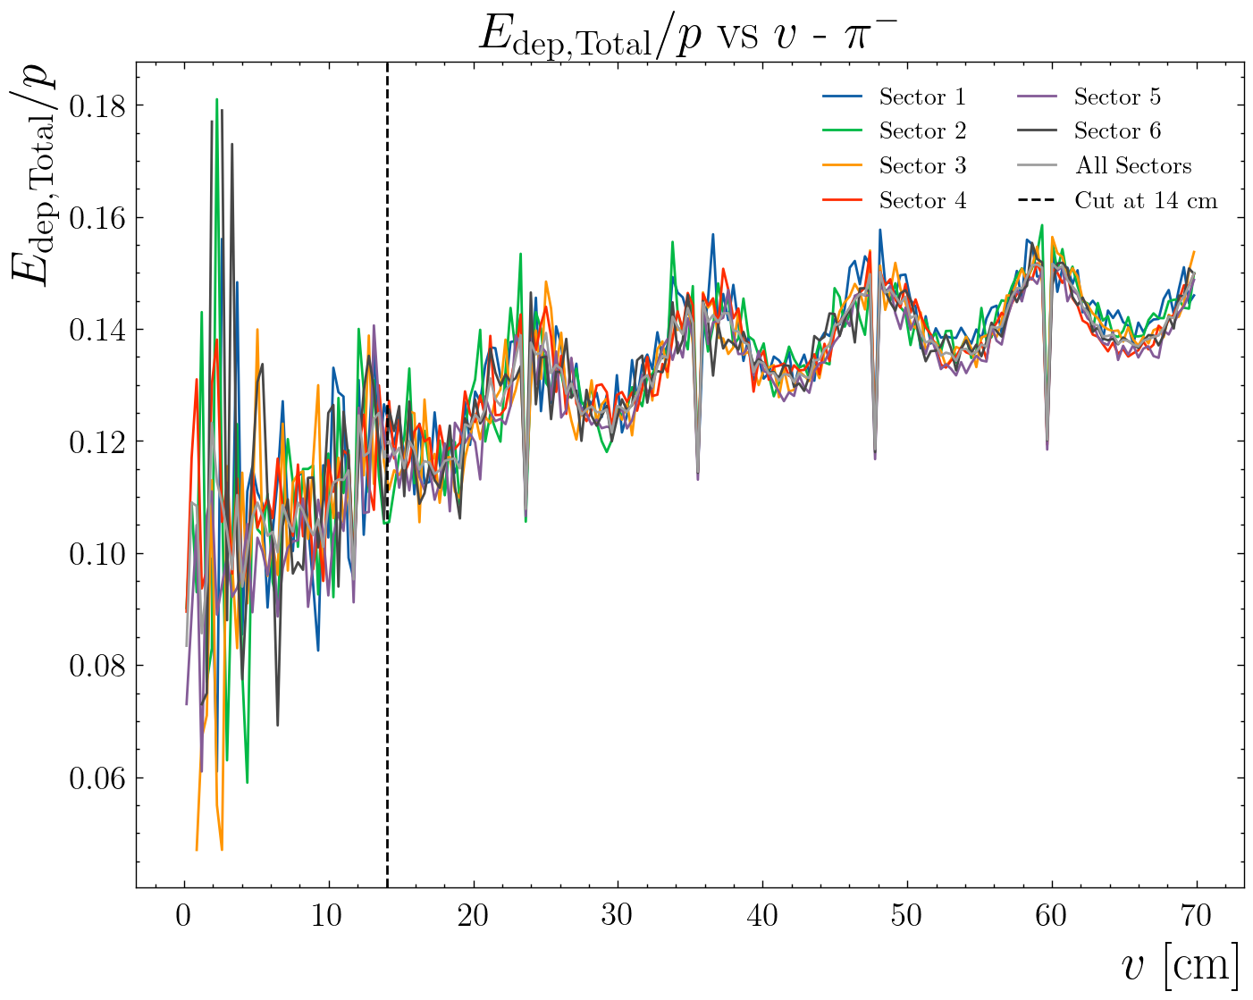
Hadron identification cuts
Improve the hadron identification for pions (both for CT and TMD studies)
Calorimeter fiducial cuts: v, w - 14 cm
DC fiducial cuts: edge - 1.67, 3.64, 8.86 cm (target and region dependent)
Study hadron contamination: Presentation by Suman Shrestha

Slide 15
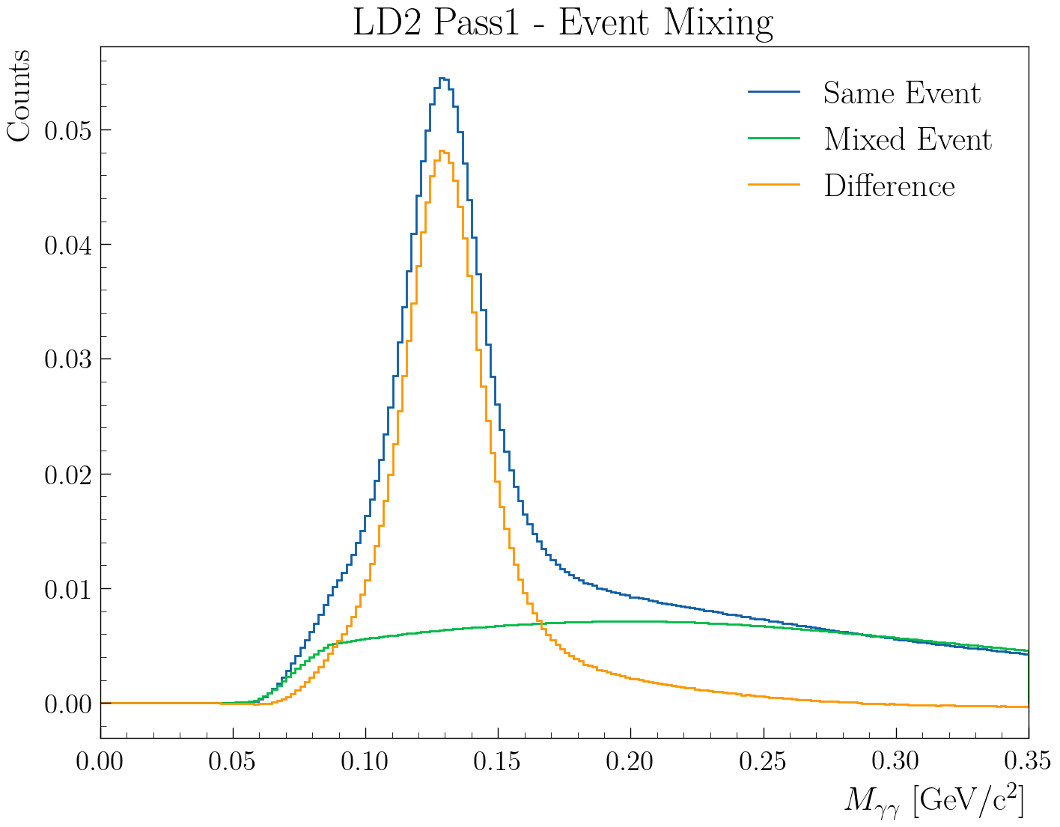
RG-D nTMDs Studies: π⁰ analysis
First look at the π⁰ channel to extract multiplicity ratios and azimuthal asymmetries:
In-progress efforts to employ the event mixing technique to subtract the background underneath the two-photon mass peak
Electron cuts: pid = 11, status < 0, 2000 ≤ |status| < 4000, |chi2pid| < 5 and Vz cut
Photon cuts: pid = 22 and E > 0.2 GeV
+ AI develop by Gregory Matousek

Slide 16
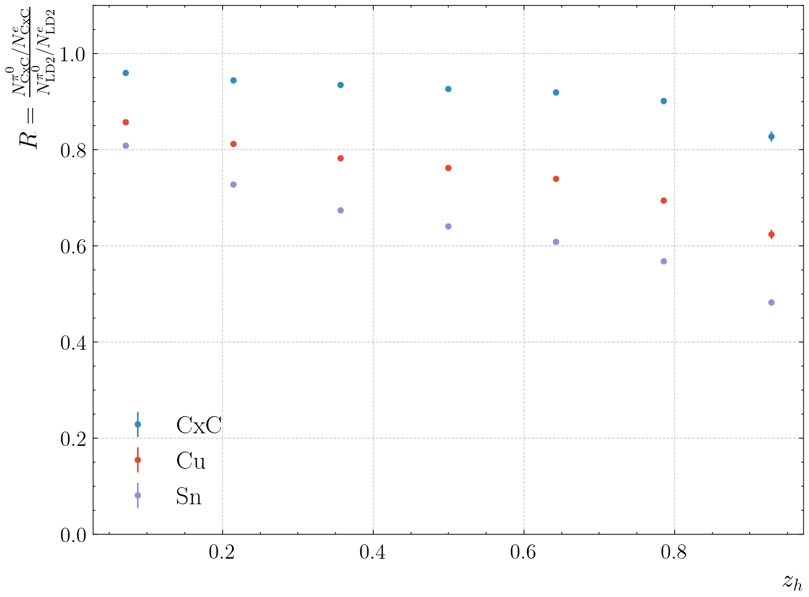
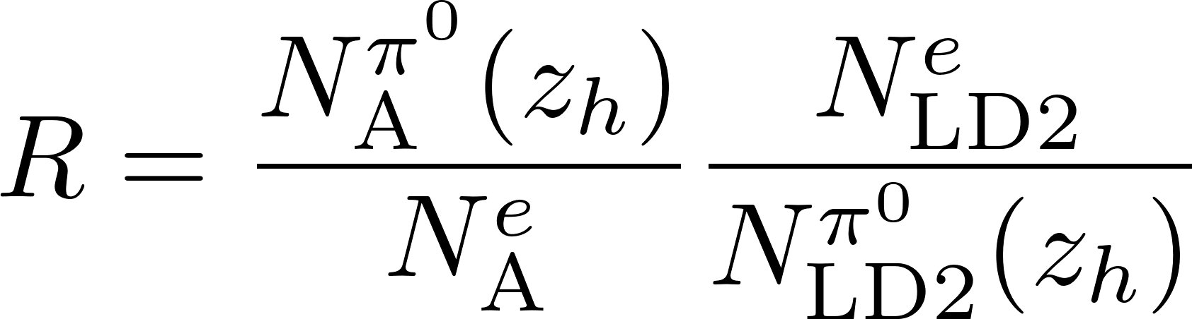
RG-D nTMDs Studies: π⁰ analysis
First look at the π⁰ channel to extract multiplicity ratios and azimuthal asymmetries:
1D multiplicity ratio: z_{h}
Statistical error only
SIDIS cut: Q² > 1 GeV², W > 2 GeV
Goal: multidimensional ratios
Very preliminary

Slide 17
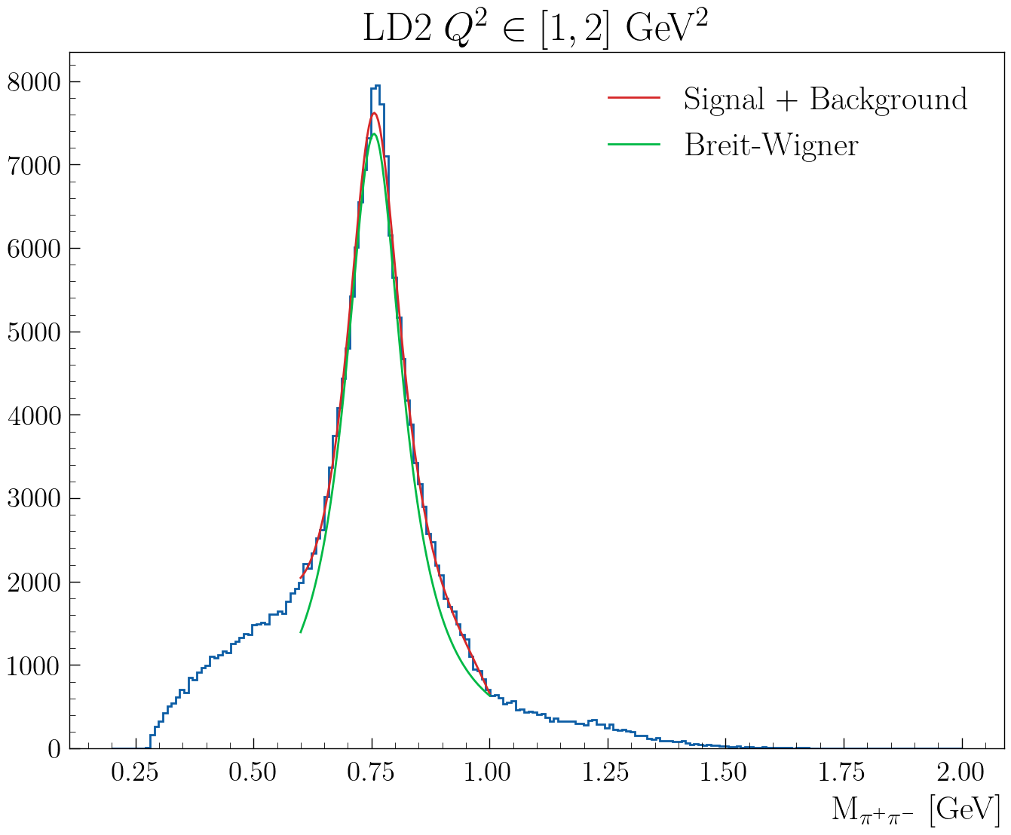
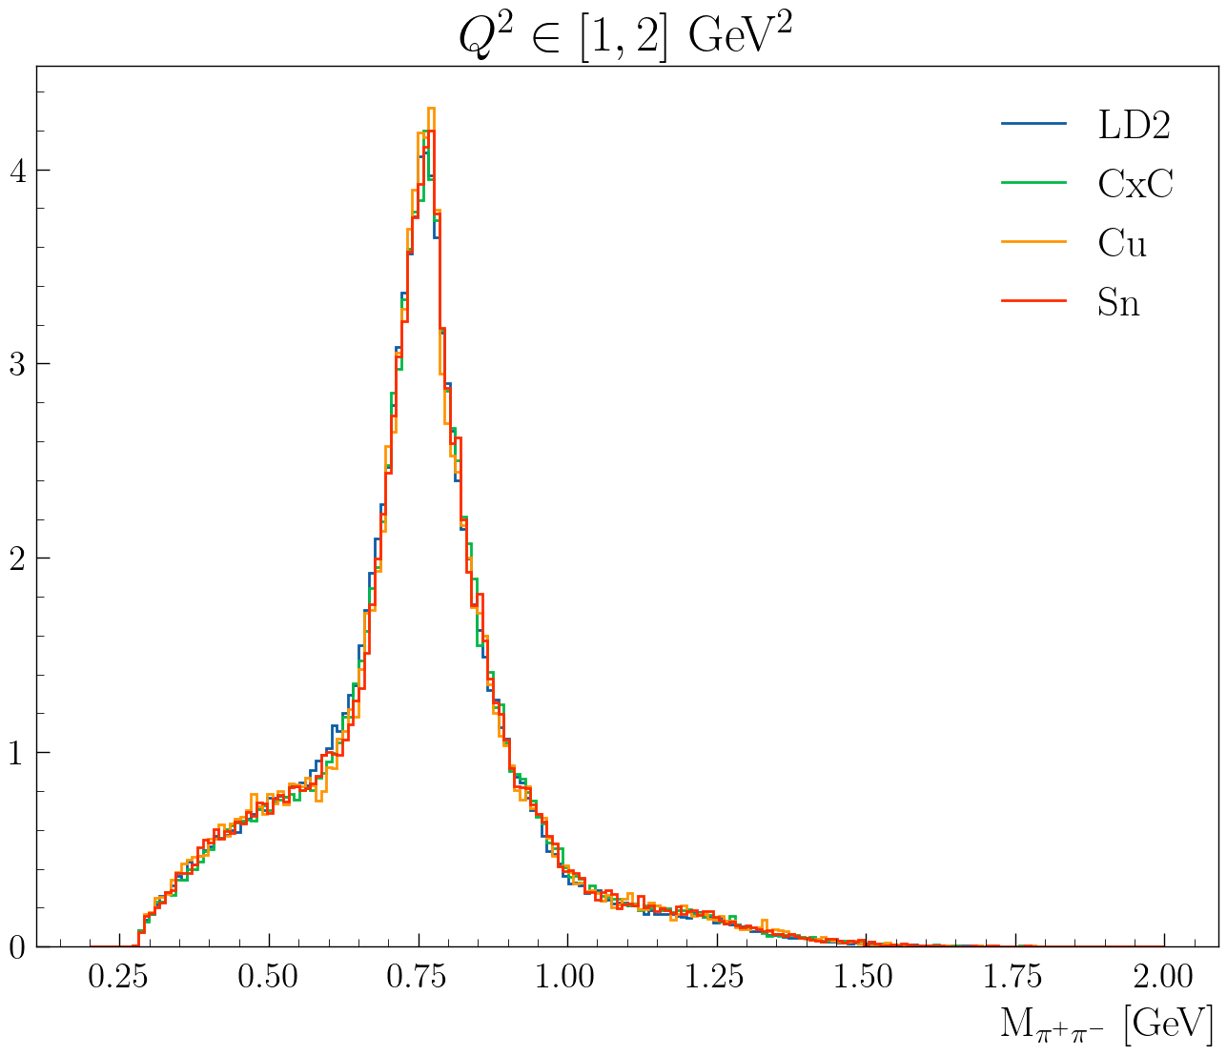
CT Study: Very Preliminary Nuclear Transparency
Fit oppositely charged pions invariant mass with a Breit-Wigner and 3rd-order polynomial function (the latter will be replaced with the simulated background shape)
Extract ρ⁰ yield by integrating the background-subtracted BW within a 3σ range
Ongoing analysis by M. Maynes

Slide 18
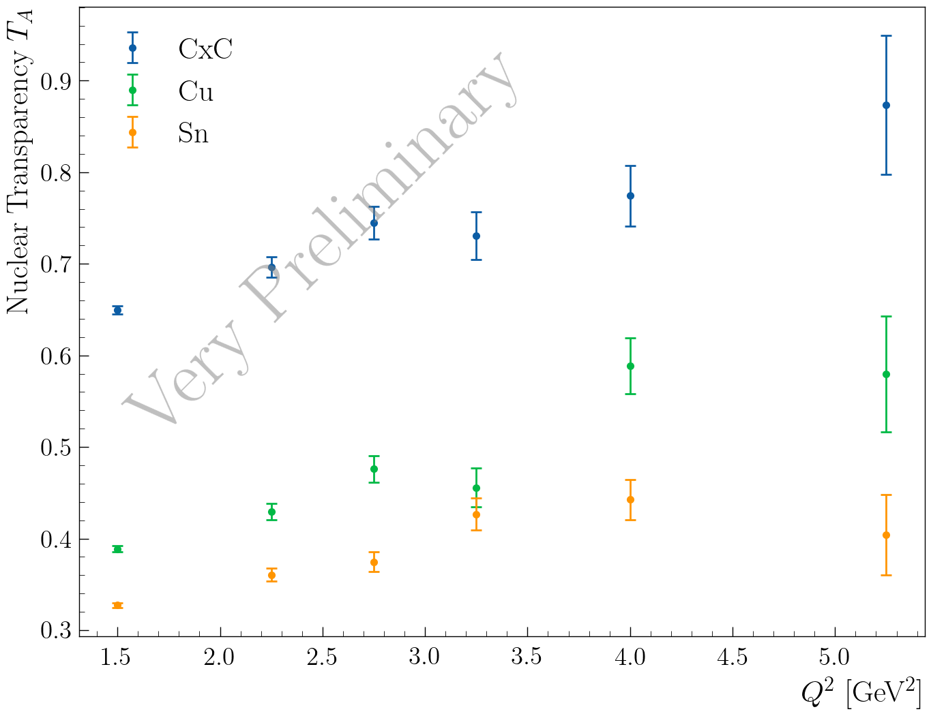
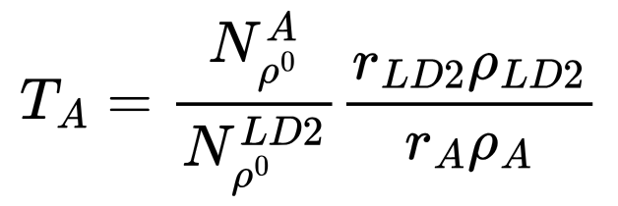
CT Study: Very Preliminary Nuclear Transparency
Extract (raw) nuclear transparency with currently available Pass1 data (around 10% of total)
r_{LD2}= 5 cm: LD2 thickness
r_{CxC} = 0.4 cm: CxC thickness
r_{Cu}= 93 μm: Copper thickness
r_{Sn} = 171 μm: Tin thickness
ρ_{LD2}= 0.164 g/cm³: LD2 density
ρ_{C}= 2.2g/cm³ : Carbon density
ρ_{Cu}= 8.96 g/cm³: Copper density
ρ_{Sn}= 7.31g/cm³ : Tin density
Ongoing analysis by M. Maynes

Slide 19
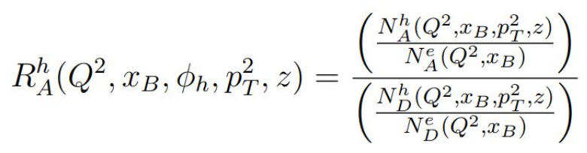
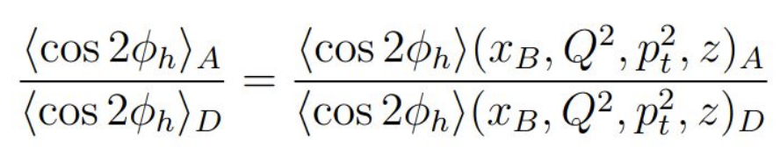
RG-D nTMDs Studies: π⁺ analysis
Motivation
SIDIS: Electron scattering off a target nucleus producing hadrons through virtual photon exchange. Nuclear effects influence SIDIS behavior in nuclear targets
TMDs: provide a 3D momentum-space description of quarks sensitive to transverse motion. This framework allows to separate initial and final state effects
Goal: compare nuclear targets to deuterium reference to study medium induced modifications
Analysis Tools
Adapted SIDIS simulation for RG-D set up with nuclear target configuration
Unfolding corrections using RooUnfold through custom response matrices
Main observables
Hadron multiplicity ratio
Transverse momentum broadening Δ⟨p_{T}²⟩
Azimuthal modulations over hadronic angle ϕ_{h}
Study in multi-dimensional bins (Q², x_{B}, p_{T}², z) covering different kinematic ranges
Ongoing analysis by D. Matamoros

Slide 20
Summary
RG-D has passed the Pass1 review, and the cooking continue
Cooking will take few more months
Optimizing analysis tools for CT and nTMDs studies to
Improve Particle Identification and implement fiducial cuts for all final-state particles
Study the hadron/electron contamination in pion sample
Correct for contamination with the CuSn target
Deploy the ρ⁰ event generator for the two-pion invariant mass background subtraction and apply necessary corrections for the extraction of the preliminary CT results
Finalize the π⁰ event mixing background-subtraction and extract its preliminary asymmetry results
Obtain the preliminary asymmetry results for charged pions nTMDs studies

Slide 21


