Slide 1

Cool-down Studies in
Horizontally Cooled Cavity
M. Martinello, A. Romanenko, M. Checchin, A. Grassellino
TTC Meeting - 04/23/2015

Slide 2
Outline
Cool-down Dynamics via T-map:
Introduction
Fast Cool-downs T-map
Slow Cool-down T-map
2. Geometrical consequences of trap flux:
Vertical vs Horizontal configuration
Axial vs Orthogonal field in horizontal configuration
Temperature rising on top:
  Axial vs Orthogonal Field
  Fast vs Slow Cool-down
Conclusions

Slide 3
1. Cool-down Dynamics via T-map

Slide 4
Introduction
Fast cool-down gives higher Q₀
2 predicted mechanism:
  1. High thermo-gradient helps magnetic field expulsion
  2. Slow cool-down has different SC nucleation regime
A. Romanenko, A. Grassellino et al. J. Appl. Phys. 115, 184903 (2014)

Slide 5
Introduction
  1. High thermo-gradient helps magnetic field expulsion
High thermal gradient provides depinning force allowing efficient magnetic field expulsion
Ultra-high Q₀ even in 190mG
A. Romanenko, A. Grassellino et al. J. Appl. Phys. 115, 184903 (2014)
A. Romanenko, A. Grassellino et al. Appl. Phys. Lett. 105, 234103 (2014)

Slide 6
Introduction
  2. Slow cool-down has different SC nucleation regime
Fast cool-down: sharp transition between NC and SC phases
Slow cool-down:
          NC zones encircled by SC area
          Magnetic field not energetically favorable to escape
A. Romanenko, A. Grassellino et al. J. Appl. Phys. 115, 184903 (2014)

Slide 7
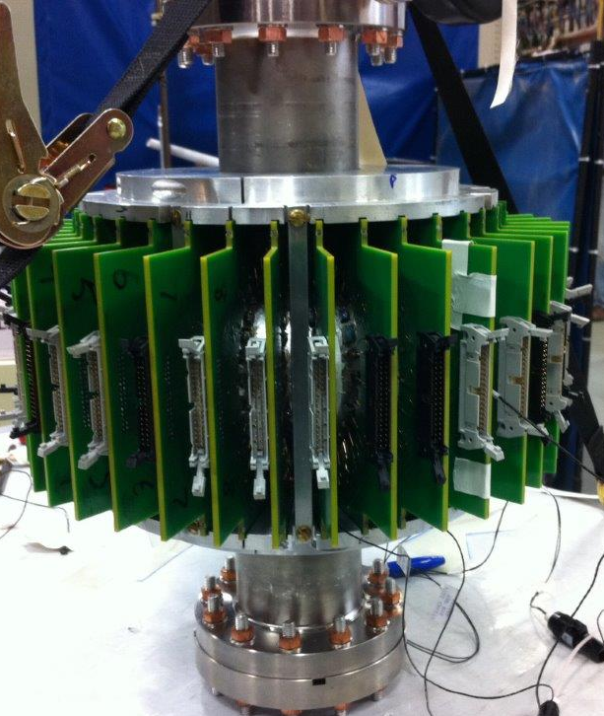
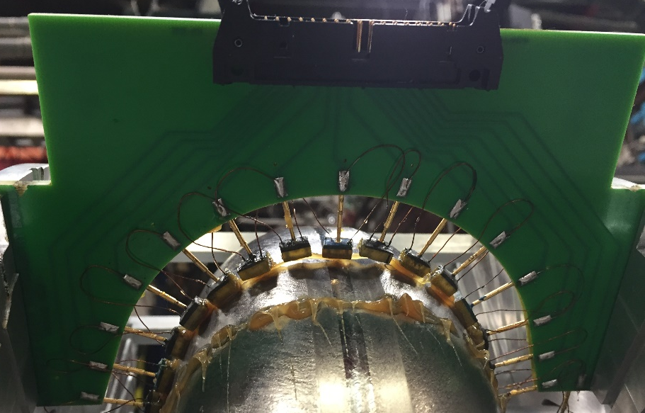
T-map apparatus
Cornell-based T-map system
36 boards with 16 thermometers each
576 thermometers
all around the cavity

Slide 8
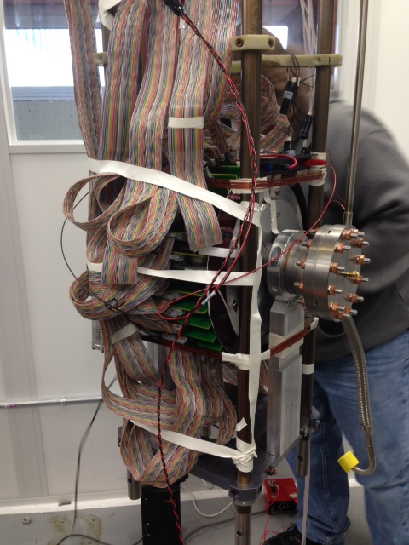
T-map apparatus
Thermometers calibrated from 2K to 100K during a warm-up

Slide 9
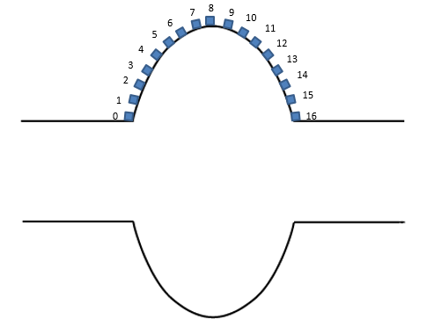
T-map images
IRIS L
EQUATOR
IRIS R
EQUATOR
IRIS L
IRIS R
TOP
BOARD #13
Top
13
NC REGION
BOARDS #22,4
Mid
BOTTOM
SC REGION
BOARD #31
Bottom
31

Slide 10
Fast Cool-down T-map
Starting T: 250K

Slide 11
Fast Cool-down From 250K

Slide 12
Fast Cool-down From 250K

Slide 13
Fast Cool-down From 250K

Slide 14
Fast Cool-down From 250K

Slide 15
Fast Cool-down From 250K

Slide 16
Fast Cool-down From 250K

Slide 17
Fast Cool-down From 250K
Sharp NC-SC transition interface

Slide 18
Fast Cool-down From 250K
Sharp NC-SC transition interface

Slide 19
Fast Cool-down From 250K
Sharp NC-SC transition interface

Slide 20
Fast Cool-down From 250K
Sharp NC-SC transition interface

Slide 21
Fast Cool-down From 250K
Sharp NC-SC transition interface

Slide 22
Fast Cool-down From 250K
Sharp NC-SC transition interface

Slide 23
Fast Cool-down From 250K
Sharp NC-SC transition interface

Slide 24
Fast Cool-down From 250K
NC zones encircle by SC material

Slide 25
Fast Cool-down From 250K
NC zone encircle by SC material

Slide 26
Fast Cool-down From 250K

Slide 27
Fast Cool-down T-map
Starting T: 50K

Slide 28
Fast Cool-down From 50K

Slide 29
Fast Cool-down From 250K

Slide 30
Fast Cool-down From 250K
Sharp NC-SC transition interface

Slide 31
Fast Cool-down From 250K
Sharp NC-SC transition interface

Slide 32
Fast Cool-down From 250K

Slide 33
Fast Cool-down From 250K
NC zones encircle by SC material

Slide 34
Fast Cool-down From 250K

Slide 35
Slow Cool-down T-map
Starting T: 12K

Slide 36
Slow Cool-down From 12K

Slide 37
Slow Cool-down From 12K

Slide 38
Slow Cool-down From 12K

Slide 39
Slow Cool-down From 12K

Slide 40
Slow Cool-down From 12K

Slide 41
Slow Cool-down From 12K

Slide 42
Slow Cool-down From 12K

Slide 43
Slow Cool-down From 12K

Slide 44
Slow Cool-down From 12K

Slide 45
Slow Cool-down From 12K

Slide 46
Slow Cool-down From 12K

Slide 47
Slow Cool-down From 12K

Slide 48
Slow Cool-down From 12K

Slide 49
Slow Cool-down From 12K

Slide 50
Slow Cool-down From 12K

Slide 51
Slow Cool-down From 12K

Slide 52
Slow Cool-down From 12K

Slide 53
Slow Cool-down From 12K

Slide 54
Slow Cool-down From 12K

Slide 55
Slow Cool-down From 12K

Slide 56
Slow Cool-down From 12K

Slide 57
Slow Cool-down From 12K

Slide 58
Slow Cool-down From 12K

Slide 59
Slow Cool-down From 12K

Slide 60
Slow Cool-down From 12K

Slide 61
Slow Cool-down From 12K

Slide 62
Slow Cool-down From 12K

Slide 63
Slow Cool-down From 12K

Slide 64
Slow Cool-down From 12K

Slide 65
Slow Cool-down From 12K

Slide 66
Slow Cool-down From 12K

Slide 67
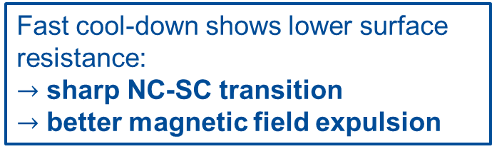
RF Test Results
Fast cool-down shows lower surface resistance:
$→$ sharp NC-SC transition
$→$ better magnetic field expulsion

Slide 68
Summary
Cool-down dynamics:
Fast cool down shows sharp NC-SC interface
  Only at the end it shows island of NC-SC phases
Slow cool down shows broad NC-SC interface
  NC randomly distributed island surrounded by SC phase

Slide 69
2. Geometrical implications on flux trapping and on residual losses due to trapped flux

Slide 70
Geometrical Considerations
Gaseous
Helium
Gaseous
Helium
Horizontal configuration:
The cavity equator does not pass through transition at the same time
Higher probability to trap flux at the equator because thermogradients are not constant
9.25K
9.25K
9.25K
9.25K
9.25K
9.25K
9.25K
9.25K
Cooling direction
Cooling direction

Slide 71
SC-NC interface dynamics
Thermo-gradients change during the cool-down dynamics
At the end of the transition thermo-gradients decrease because of thermalization (as seen from T-map)
Bottom to top thermogradients are not a sufficient indicator of an efficient cooldown!
What matters is thermo-gradient along the NC-SC interface

Slide 72
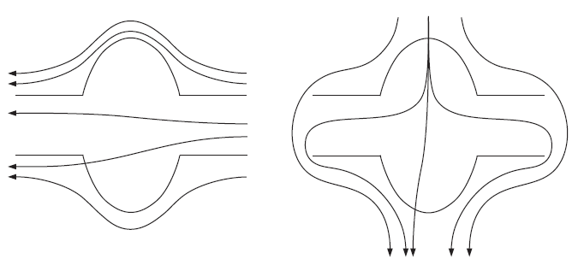
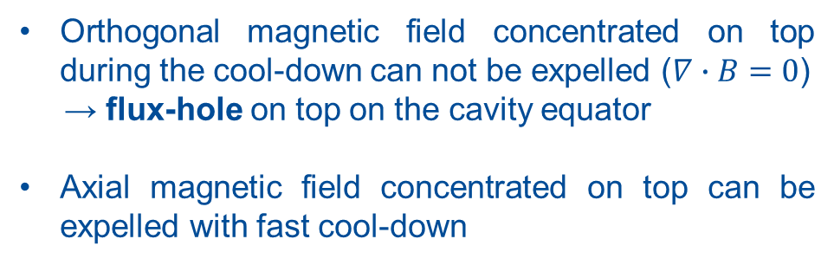
More Geometrical Considerations – field orientation
Orthogonal
Axial
Gaseous
Helium
flux-hole
9.25K
Orthogonal magnetic field concentrated on top during the cool-down can not be expelled ($∇∙B=0$)
→ flux-hole on top on the cavity equator
Axial magnetic field concentrated on top can be expelled with fast cool-down
Cooling direction

Slide 73
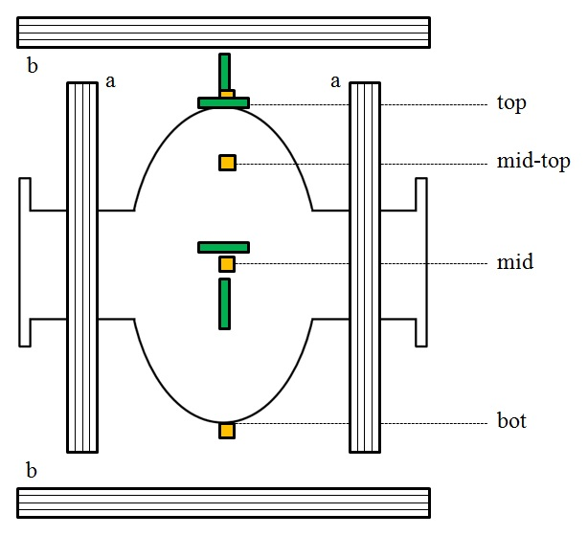
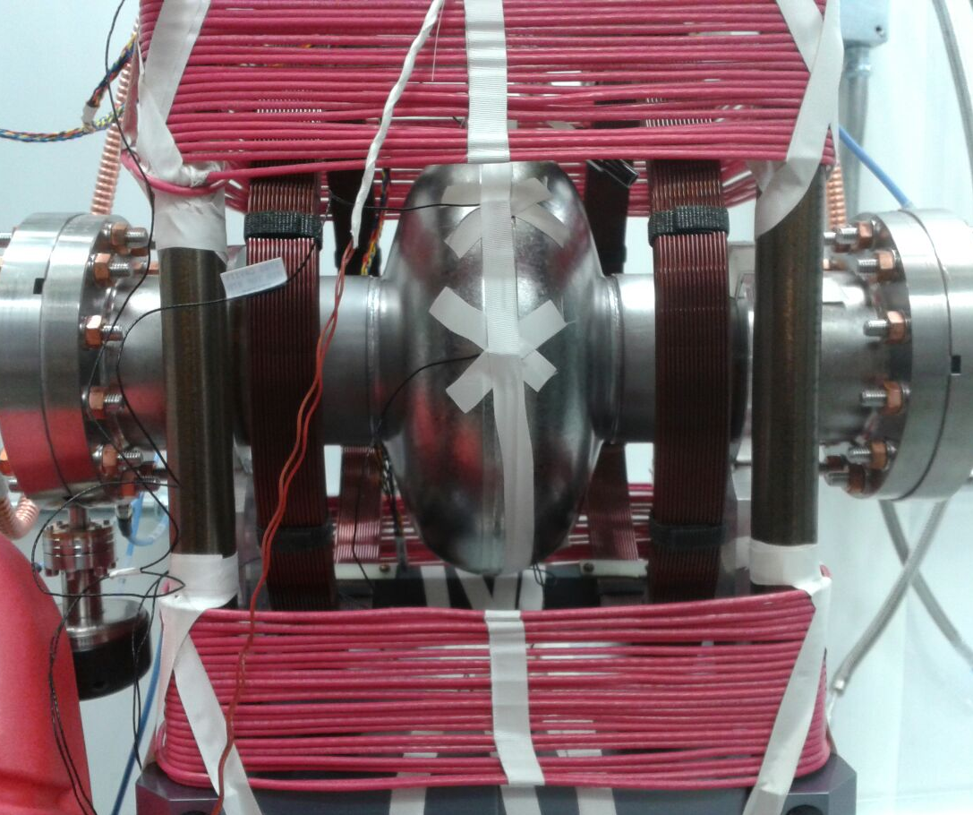
Instrumentation 1st experiment
2 Helmholtz Coils (orthogonal and axial field)
4 Thermometers (bottom, mid, mid-top and top positions)
4 Fluxgates (orthogonal and axial field mid and top positions)

Slide 74
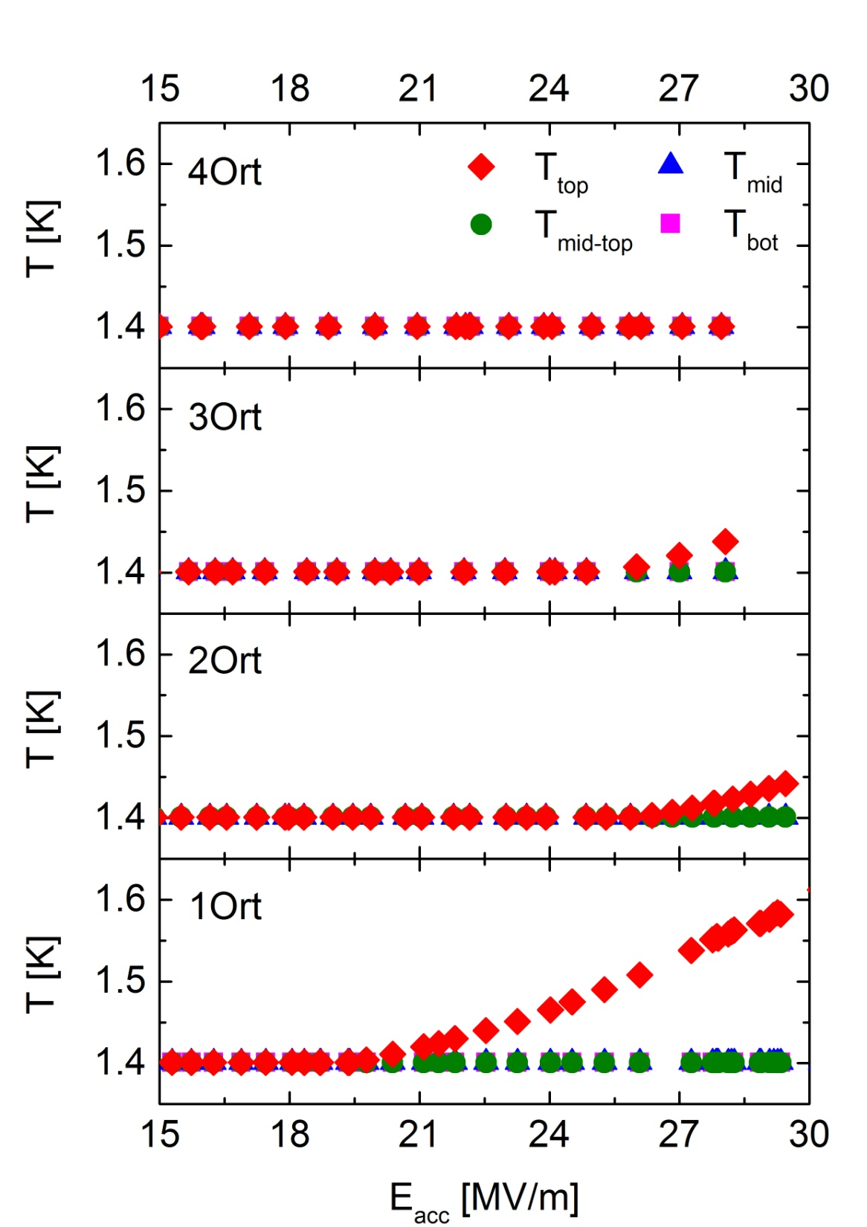
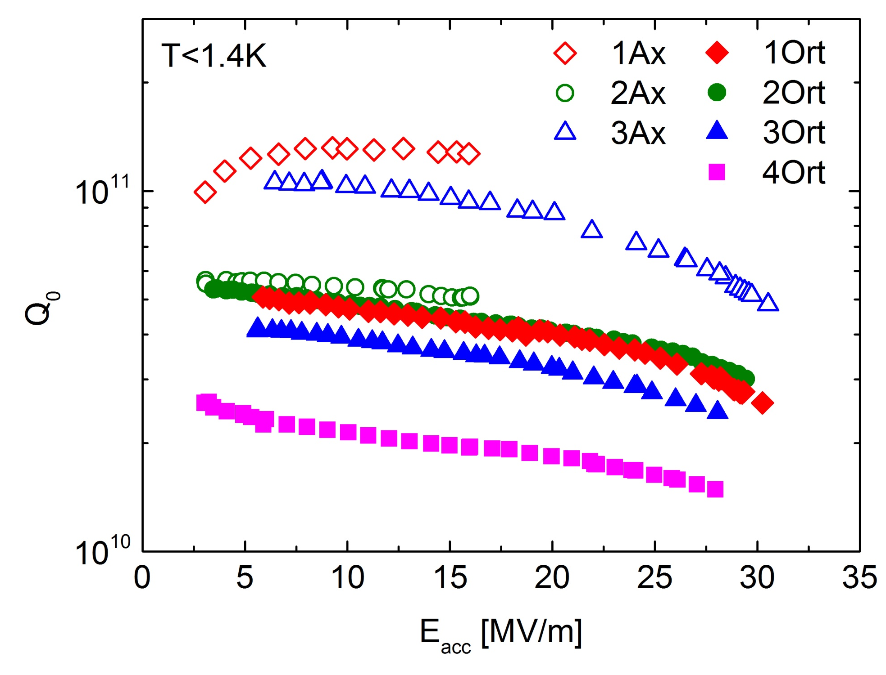
RF Test Result – Cool-downs in $\sim$10mG
Temperature rising on top only with orthogonal field applied

Slide 75
RF Test Result – Cool-downs in $\sim$10mG
No heating on-top when magnetic field is fully trapped

Slide 76
Instrumentation 2nd experiment
2 Helmholtz Coils (orthogonal and axial field)
4 Thermometers (bottom, mid, mid-top and top positions)
4 Fluxgates (orthogonal and axial field mid and top positions)
T-map

Slide 77
Fast vs Slow $\sim$16 MV/m
Fast Cool-down – Orth field
Slow Cool-down – Orth field

Slide 78
Fast vs Slow $\sim$ 21 MV/m
Fast Cool-down – Orth field
Slow Cool-down – Orth field

Slide 79
Fast vs Slow $\sim$ 26 MV/m
Fast Cool-down – Orth field
Slow Cool-down – Orth field

Slide 80
Orthogonal vs Axial $\sim$16 MV/m
Orthogonal field – Fast Cool-down
Axial field – Fast Cool-down

Slide 81
Orthogonal vs Axial $\sim$21 MV/m
Orthogonal field – Fast Cool-down
Axial field – Fast Cool-down

Slide 82
Orthogonal vs Axial $\sim 27$ MV/m
Orthogonal field – Fast Cool-down
Axial field – Fast Cool-down

Slide 83
RF Test Results
Heating on-top with fast cool down and orthogonal magnetic field
Same performance axial and orthogonal field

Slide 84
Summary
Horizontal cooling effects:
  Orthogonal magnetic field: for the first time, heating on top due to trapped flux concentration is observed
  Fast cooling in orthogonal field creates flux concentration, while slow cooling distributes flux all along, what is better? Higher Q is always achieved with fast. But if too much flux is concentrated at the top, quench may degrade. It is a balance, dependent upon ambient fields.
  Axial magnetic field: efficiency of magnetic flux expulsion depends on cool-down dynamics, but all flux can be expelled

Slide 85
Conclusion
Horizontal configuration is more complicated than vertical because thermo-gradients change along the equator
Slow cool-down
  trapped flux randomly into whole cavity
Fast cool-down
  better flux expulsion
  residual flux trapped on top (only orthogonal component)
Orthogonal component is worst than axial
  the heating effect can be relevant in case of high amount of field trapped

Slide 86
References
A. Romanenko, A. Grassellino et al. J. Appl. Phys. 115, 184903 (2014)
A. Romanenko, A. Grassellino et al. Appl. Phys. Lett. 105, 234103 (2014)
M. Martinello, M. Checchin, A. Grassellino et al. arXiv:1502.07291v3 (2015)
M. Martinello, A. Romanenko, M. Checchin et al. arXiv:1504.04441v2 (2015)
A. Romanenko, FCC conference (2015)
A. Grassellino, LCLS-II meeting (2015)

