Slide 1
TTC High Q WG meeting - 7
Quench studies 9 cell cavities for LCLS-II prototype – final results
Round 1 - baseline recipe
Round 2 - rework to raise quench fields
Ari D. Palczewski, SRF Scientists
Jefferson Lab, USA
04/23/2015

Slide 2
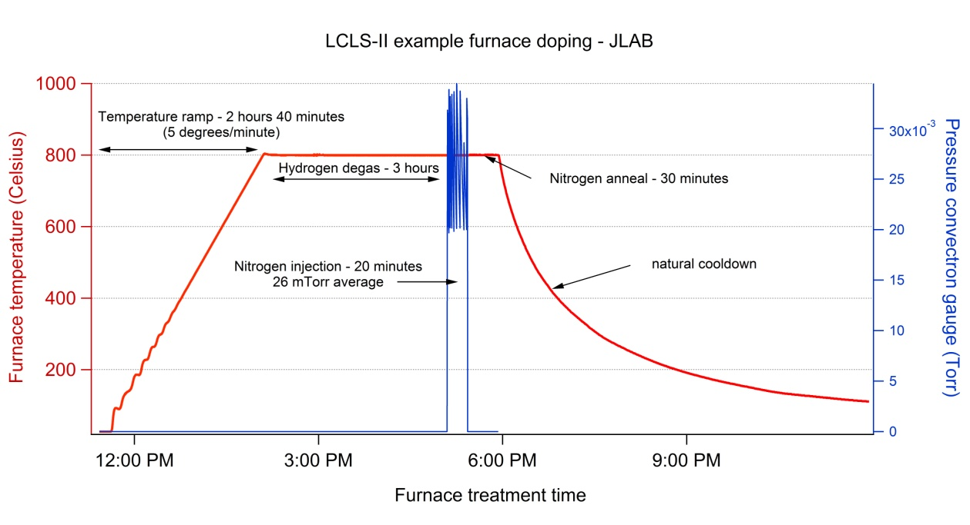
Doping treatment: small variation from standard XFEL/ILC processing recipe
Example from N20/A30 doping process:
Light BCP(internal) & Bulk EP (120)
800C for 3 hours in vacuum
Nitrogen @ 26mtorr & 800C (diffusion)
800 C for 30 minutes in vacuum
Vacuum cooling
16 microns EP
Ship to DESY
Cavity after Equator Welding
HOM Tuning
X
EP 140 um
120C bake
Short HPR
Leak Check
External 20 um BCP
Final Assembly
XFEL
X
Long HPR
Ethanol Rinse
VT Assembly
800C HT Bake
Helium Tank Welding Procedure
RF Tuning
Long HPR
EP 40 um
X
Ethanol Rinse
HPR
Thanks - Anna Grassellino FNAL

Slide 3
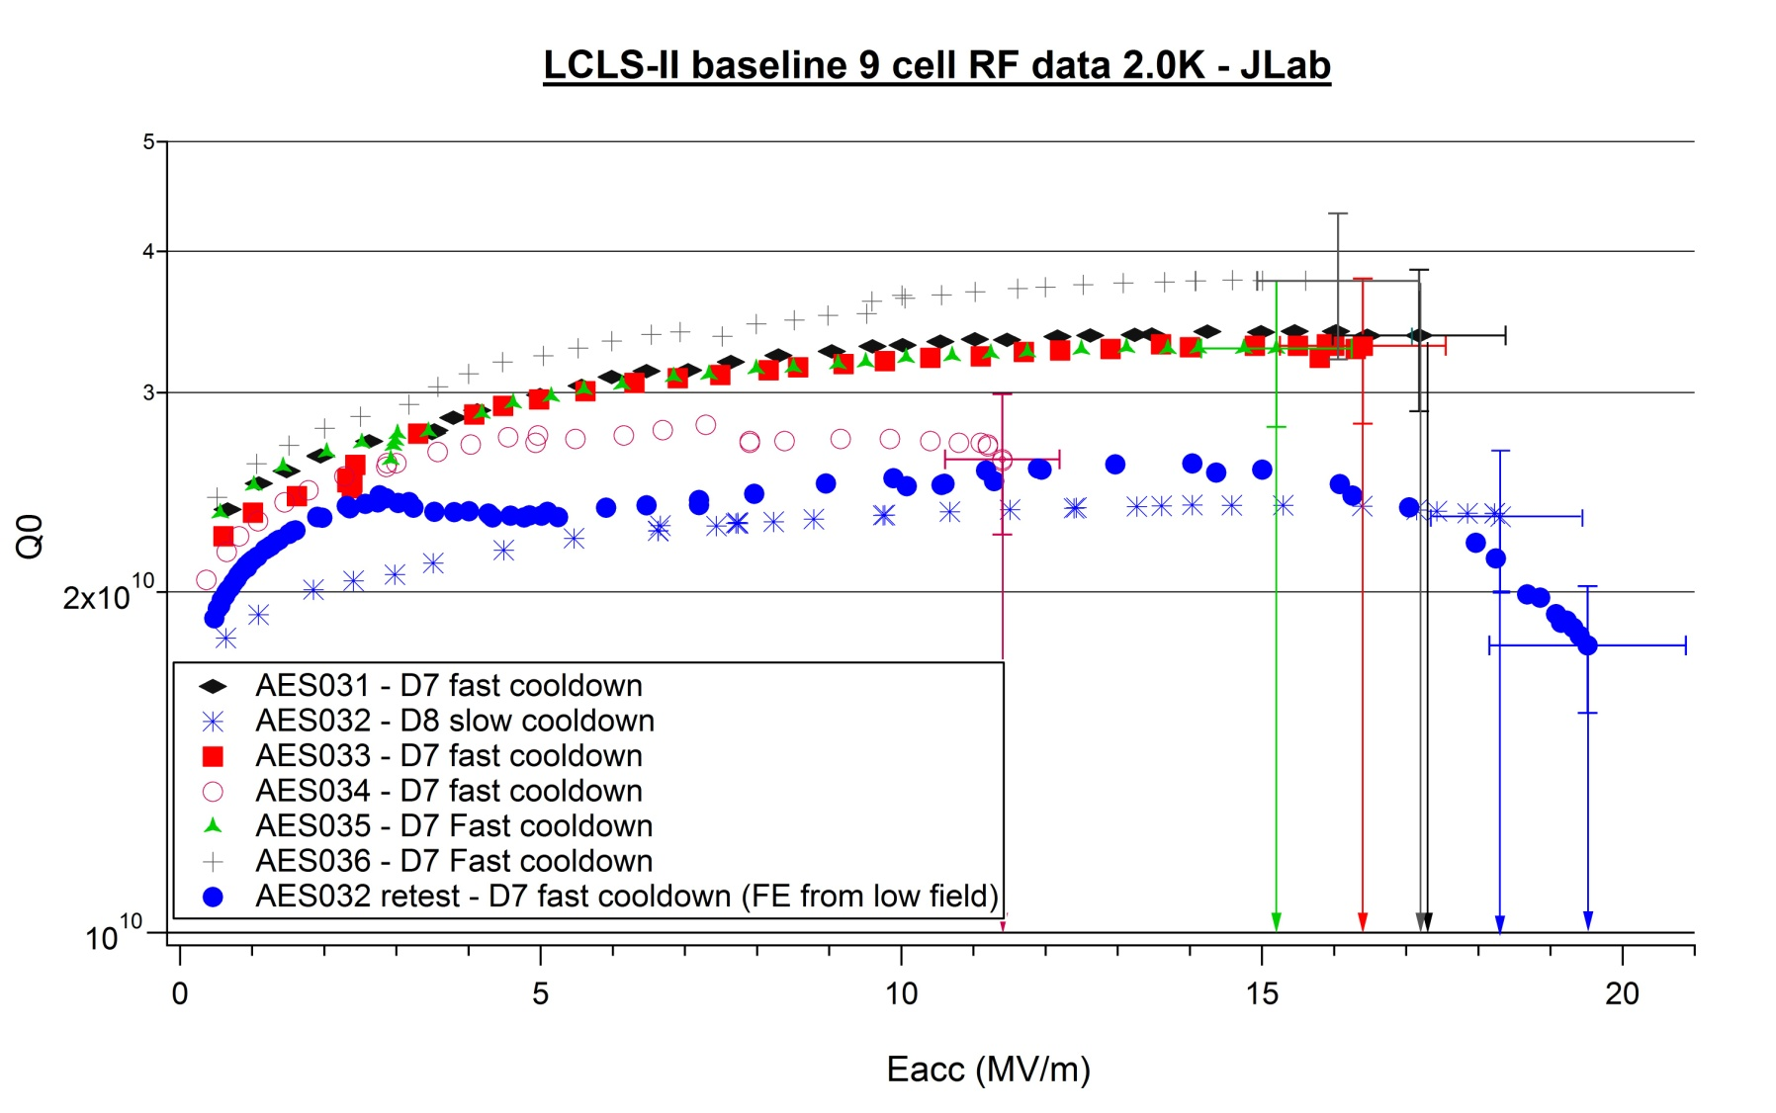
Round 1 - 9 cell tests
Nitrogen @ 26mtorr - 20min, Diffusion @ vacuum 30min + 16 microns EP

Slide 4
Reason for round 2
4 of 6 cavities “made spec”, while one had a lower than expected Q0 (FE), and one quench at low field (TB9AES034)
Quench fields too close to operating gradients, so all cavities would be reworked with new lighter doping to raise quench fields (single cell results from FNAL, JLab, Cornell and multi-cell results from FNAL results suggest this)
Cav ID | Round 1 parameters | Surface reset | Round 2 parameters
TB9AES031 | N20 A30 + EP16 | none | +EP10
TB9AES032 | N20 A30 + EP16 | EP50 | N2 A6 EP5
TB9AES033 | N20 A30 + EP16 | EP50 | N2 A6 EP5
TB9AES034 | N20 A30 + EP16 | CBP100 + EP50 | N2 A30 EP10
TB9AES035 | N20 A30 + EP16 | EP50 | N2 A6 EP5
TB9AES036 | N20 A30 +EP16 | EP50 | N2 A6 EP5

Slide 5
All LCLS-II 9 cell tests
All cavities when up in gradient by at least 5MV/m upon re-dope
All baseline cavities were Q-slope limited

Slide 6
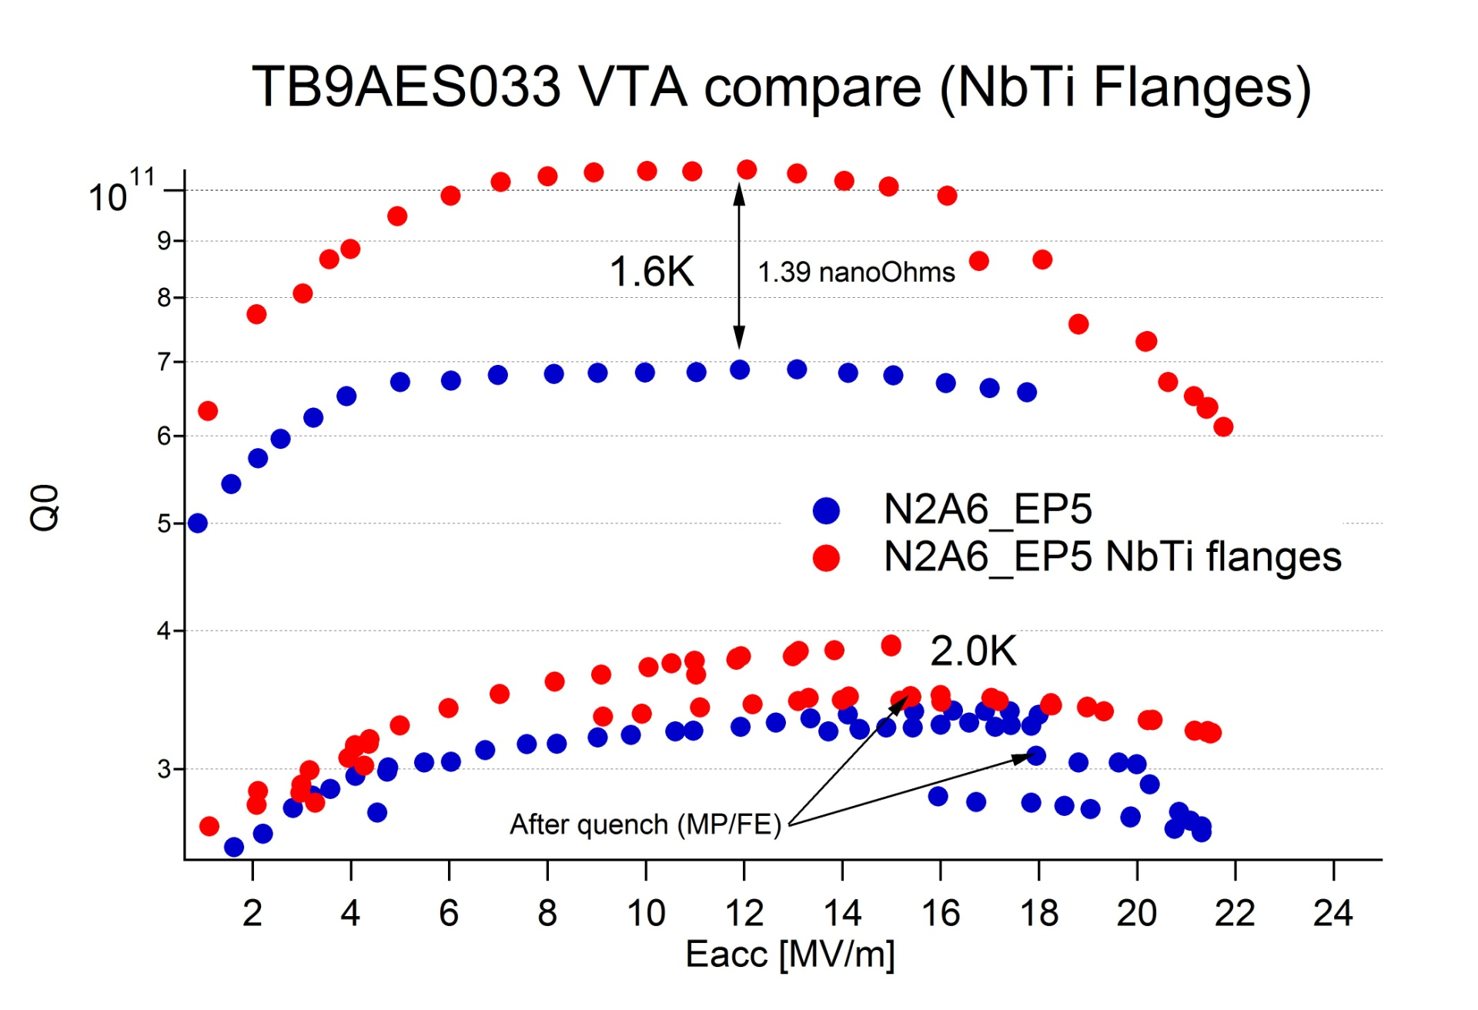
NbTi flange corrections

Slide 7
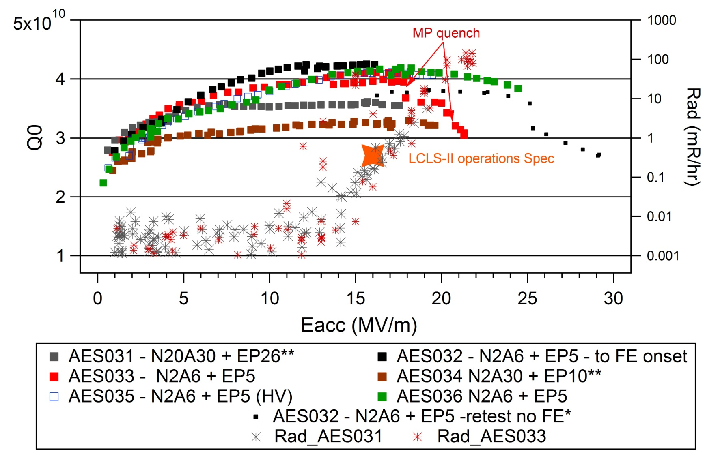
LCLS-II 9 cell final qualification FE- JLab
4 cavities - no FE
some needed reHPR to remove FE
2 cavities – W/ FE
passed specification No ReHPR needed
All cavity data corrected by 1.4nohms if SS flanges were used
* bad input cable Q0 not real
** R&D doping, expected lower Q0

Slide 8
Passband analysis

Slide 9
Doping round 2 - Passband with OST
AES031 - quench in cell 6, 7, 8
AES032 – quench in cell 1, 5, 7, 8
AES033 - NA
AES034 – quench in cell 4, 1, 2, 3
AES035 - NA
AES036 – quench in cell 1,3, 9, 6,

Slide 12
Conclusions
Large pit like defects will show a larger Q-drop at lower quench fields than standard cavities (TB9AES034)
For heavy doping quench location appears to be random at this point, especially compared to un-doped cavities – i.e. no defects, multiple quench location at ~ same field (TB9AES033)
Bulk re-rest of surface appears randomize quench location after re-doping (TB9AES032-TB9AES036)
Light doping after reset produces a higher quench field on average (All cavities)
Light EP after baseline heavy doping raised the quench field (small amount) but not likely to change quench location (TB9AES031)

Slide 13
backup

Slide 14
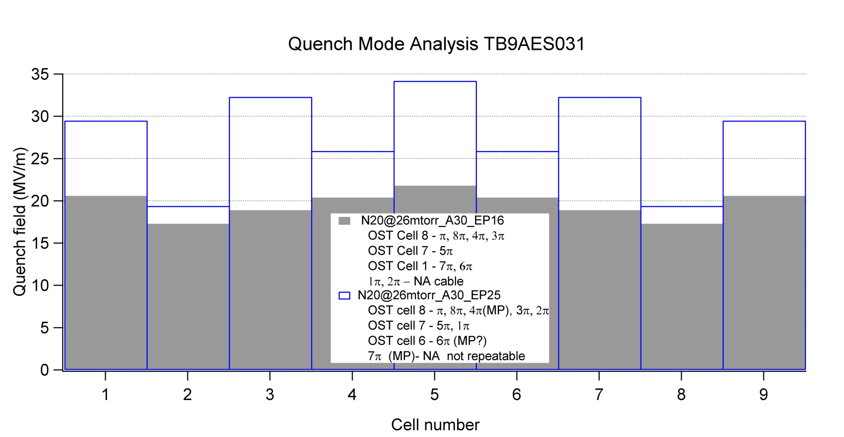
TB9AES031
Same quench location in Pi mode for both tests

Slide 15
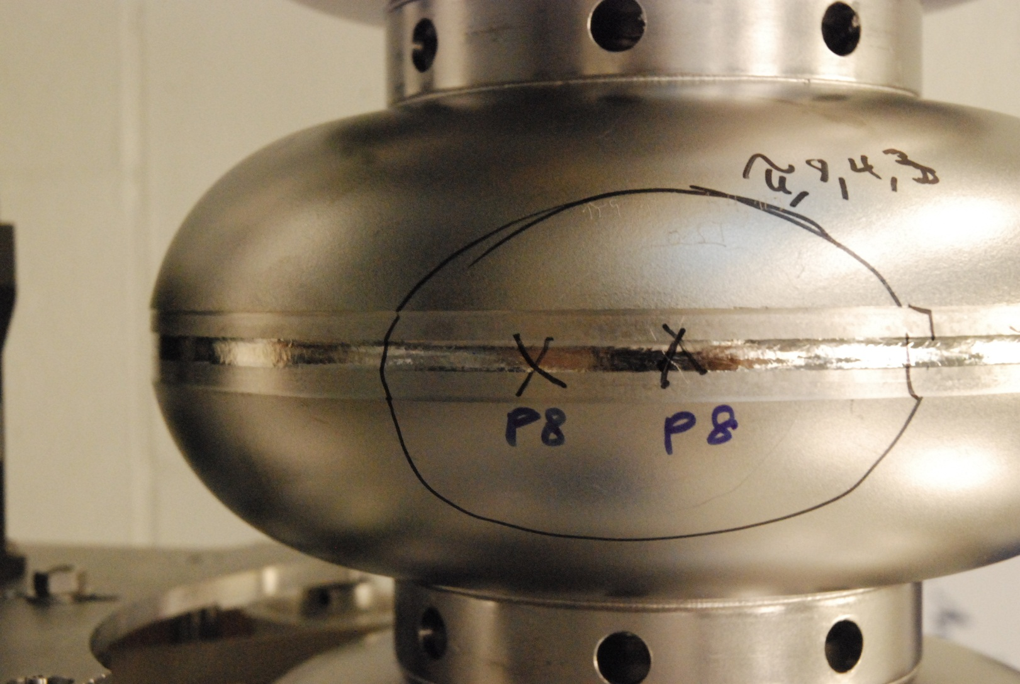
Optical inspection TB9AES031
Cell 7
No defect found
Cell 8
No defect found
~ cell 6 quench location after second EP
Cell 6
Φ=300
Φ=260
Inspection Courtesy of R. L. Geng before second EP

Slide 16
TB9AES033
Low filed quench cell appear similar between doping even after bulk removal - maybe

Slide 17
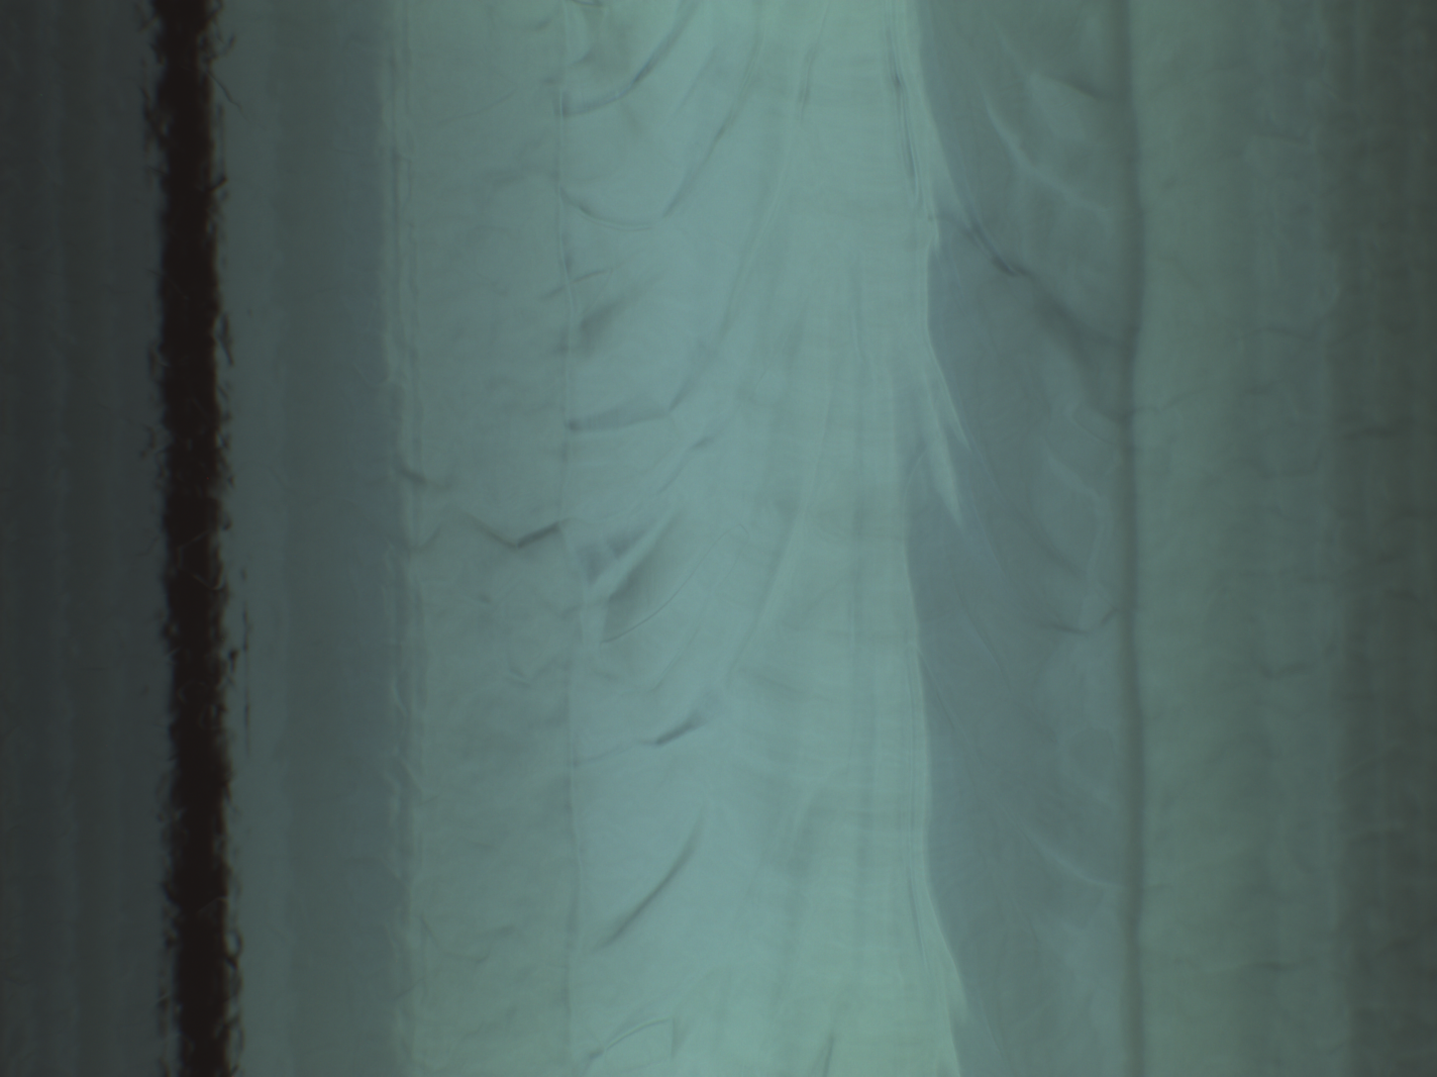
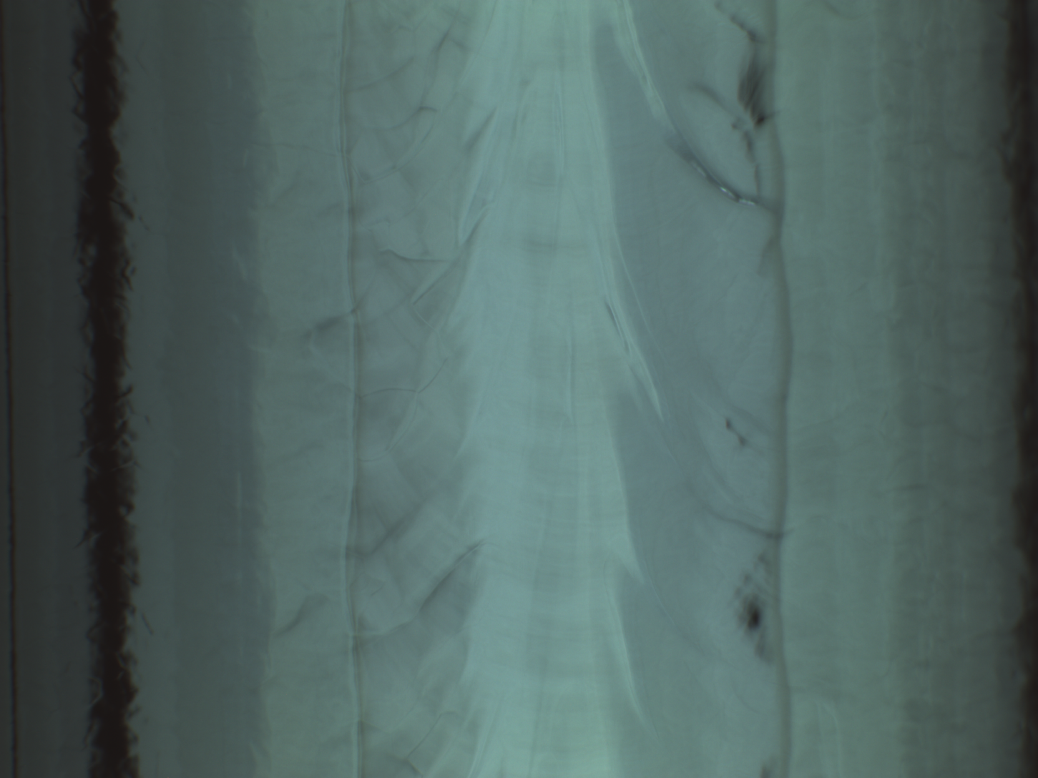
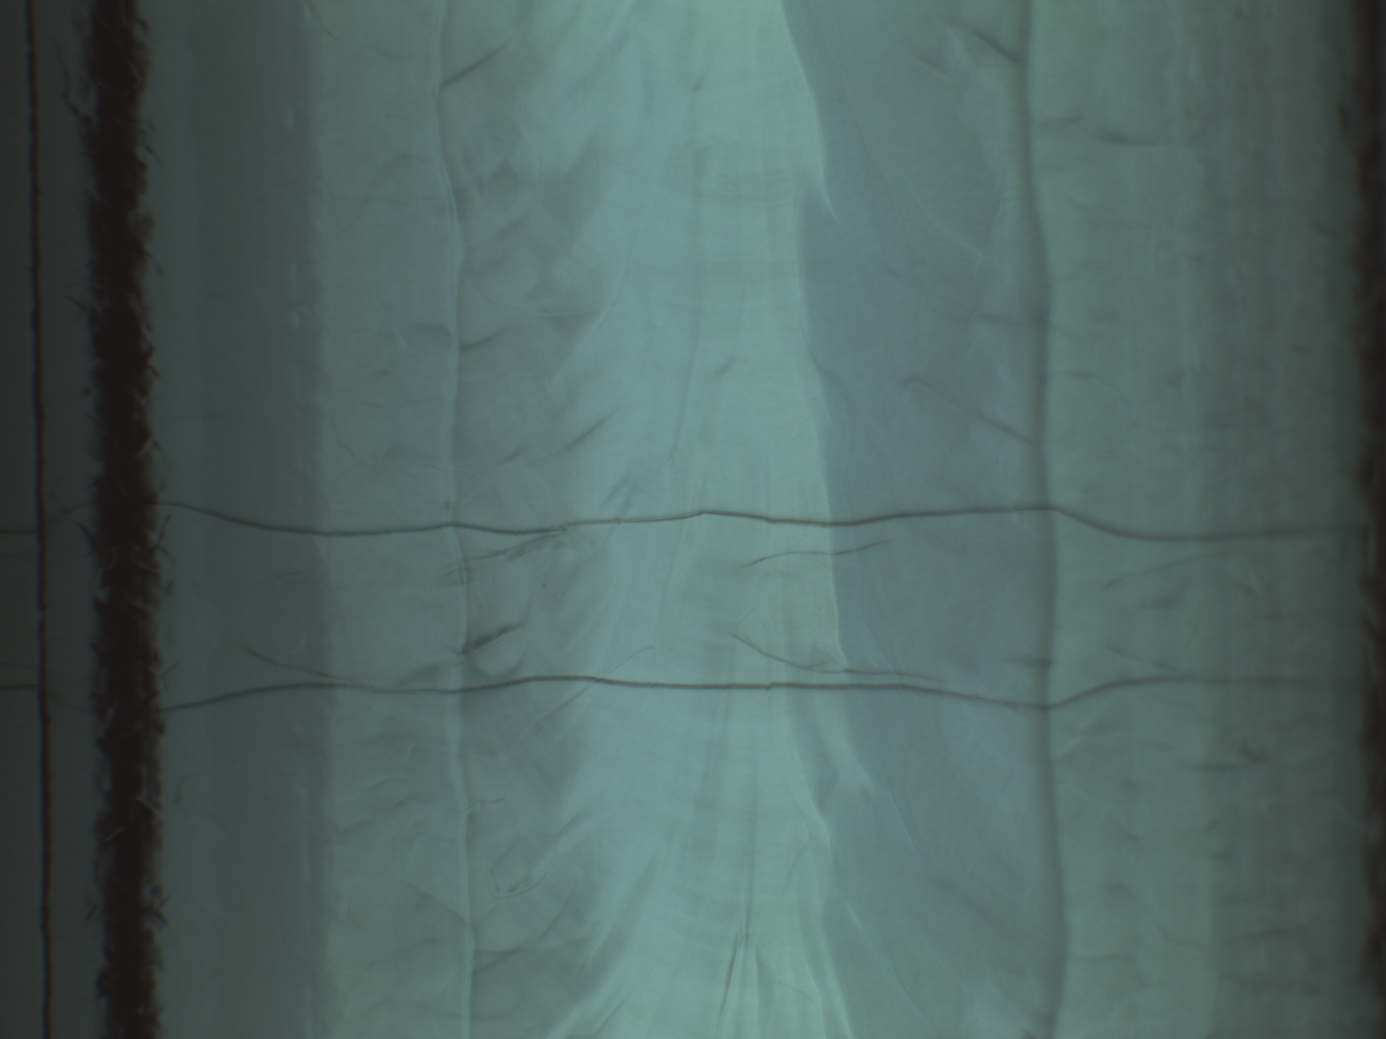
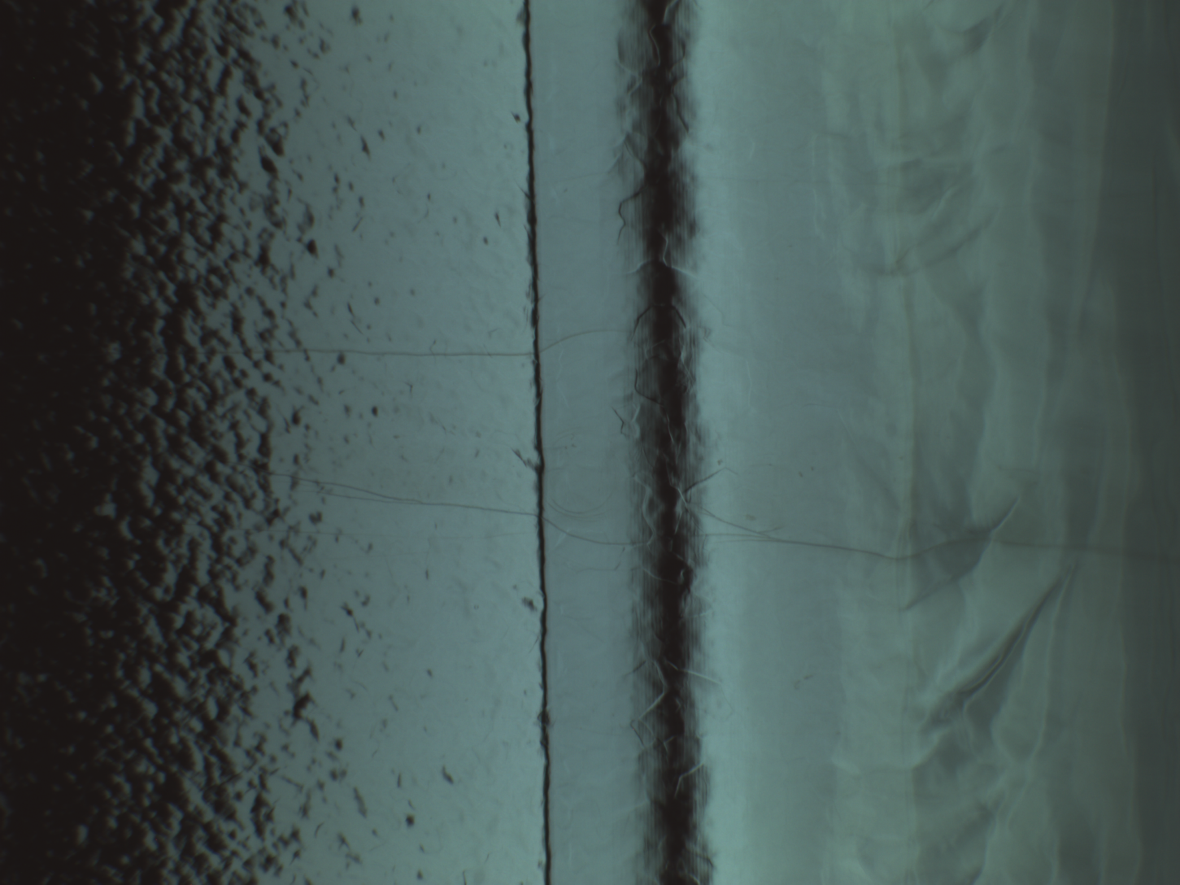
Optical inspection TB9AES033
Cell#8, fusion zone angle=150 degree stain away from quench (benign)
Cell#8, fusion zone, inside OST circle angle = 280 degree
No defect found
Cell#6 quench site angle=190 degree
No defect found
Cell#9 quench site, Machining line edge angle=170 degree
Possible stain
Inspection Courtesy of R. L. Geng before EP reset

Slide 18
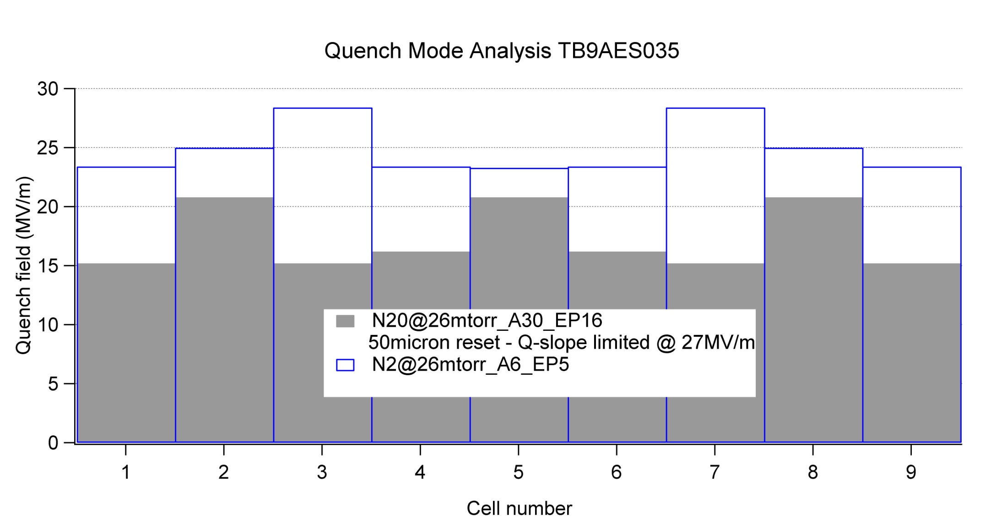
TB9AES035
No clear pattern for quench location, appears random after bulk reset and re-dope

Slide 19
TB9AES035
No inspection done after either round and in helium vessel now

Slide 20
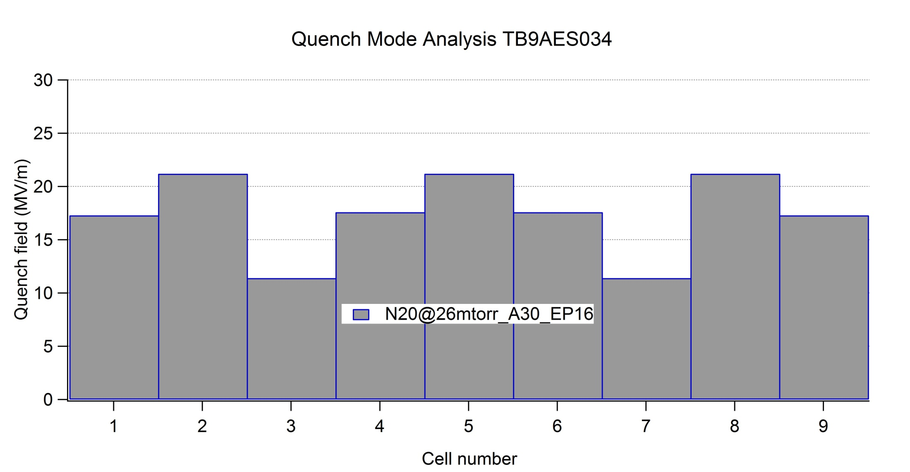
TB9AES034

Slide 21
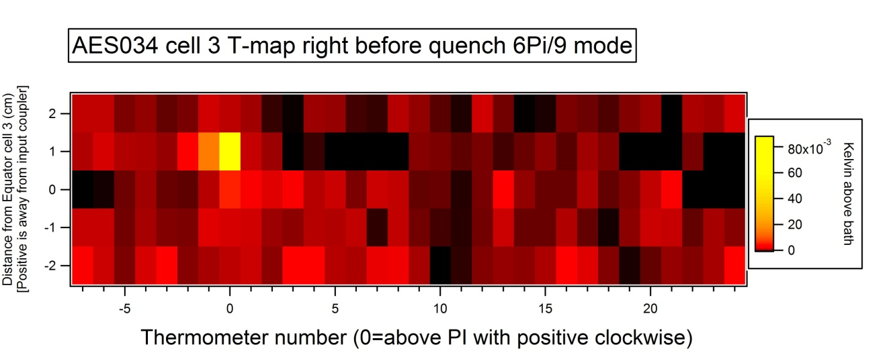
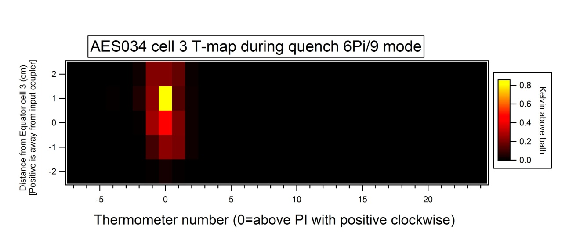
Optical inspection and T-map TB9AES034
Most outstanding feature
200 micron dia. Deep pit
Leading candidate defect for quench at 11 MV/m
during vertical test
Multiple other defects found – sent for CBP ~ 120micron
Inspection Courtesy of R. L. Geng before EP reset

