Slide 1
PRAD DAQ Status
Sergey Boyarinov
Sep 12, 2025

Slide 2
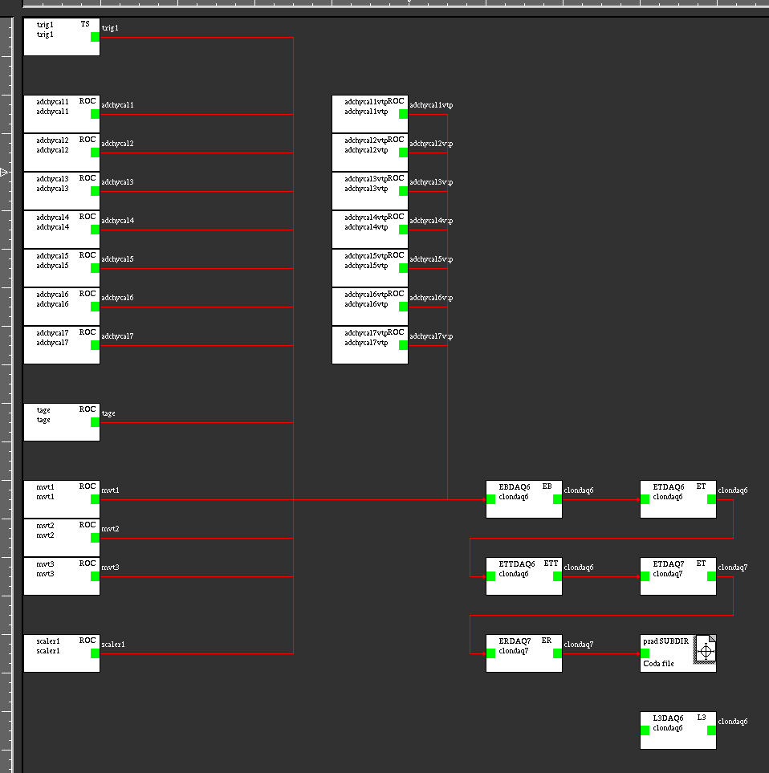
PRAD DAQ Diagram
HYCAL
TRIGGER
TAGGER
GEM

Slide 3
HYCAL
7 VXS crates (adchycal1,..,adchycal7) are operational, all boards installed except FAV3’s
TO DO:
FAV3 final firmware
FAV3 boards installation in 7 VXS crates
FAV3 boards cabling to HYCAL (in according to trigger map)

Slide 4
TAGGER
‘tage’ and ‘taggermac’ crates are operational, all boards installed
TO DO:
Run single pair cable from ‘tage’ area to the main trigger system (adchycal1 ?)

Slide 5
GEM
3 VXS crates (mvt1/2/3) available in the hall, they have CPUs, SDs and TIs, and can be used for GEM readout
TO DO:
Test everything in EEL/125
Move all electronics to the hall

Slide 6
TRIGGER
TO DO:
Connect all trigger components (7 VTPs, TAGE, TS, … - fibers, transceivers)
Install and test FAV3s and VTPs firmware/software in Hall B environment

Slide 7
Conclusion
All available equipment is installed in the Hall B
Major remaining projects: FAV3s installation and cabling, FAV3/VTP trigger firmware/software, GEM readout
Remaining equipment/firmware/software will be promptly installed and commissioned as soon as available in both EEL/125 and Hall B

