Slide 1
JLab Hall B
PRad II and X17 Engineering Status
Sep 2025
Bob Miller
Chris Guthrie

Slide 2
Outline
PRad II and X17 Upstream of the Tagger Magnet
X17 from Tagger Magnet to Hycal
Upstream Collimators
X17 Target Harp
X17 Vacuum Chamber Extensions
Vacuum Tank Stand
PRad II and X17 Vacuum Tank Windows
PRad II from Tagger Magnet to Hycal
PRad II Veto Scintillator
GEM Detectors
GEM Gas System
Hycal Collimators
Hycal to Beam Dump
Design and Engineering Status
A1
A2
B1
B1

Slide 3
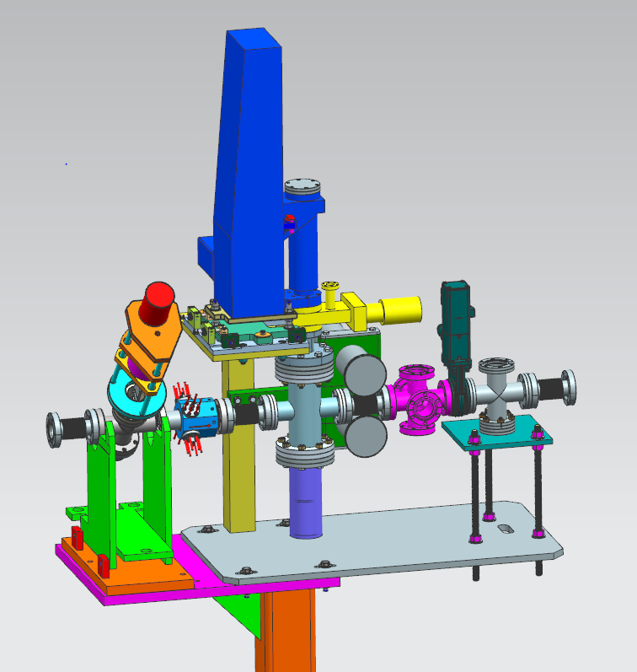
PRad II and X17 Upstream of the Tagger Magnet
Radiator Foils and Collimator Block
Halo
Counters
Valve and Gauges
Harp
Raster Magnets
Tagger Magnet
All components are due at JLab by October 10th
Installation scheduled for October

Slide 4
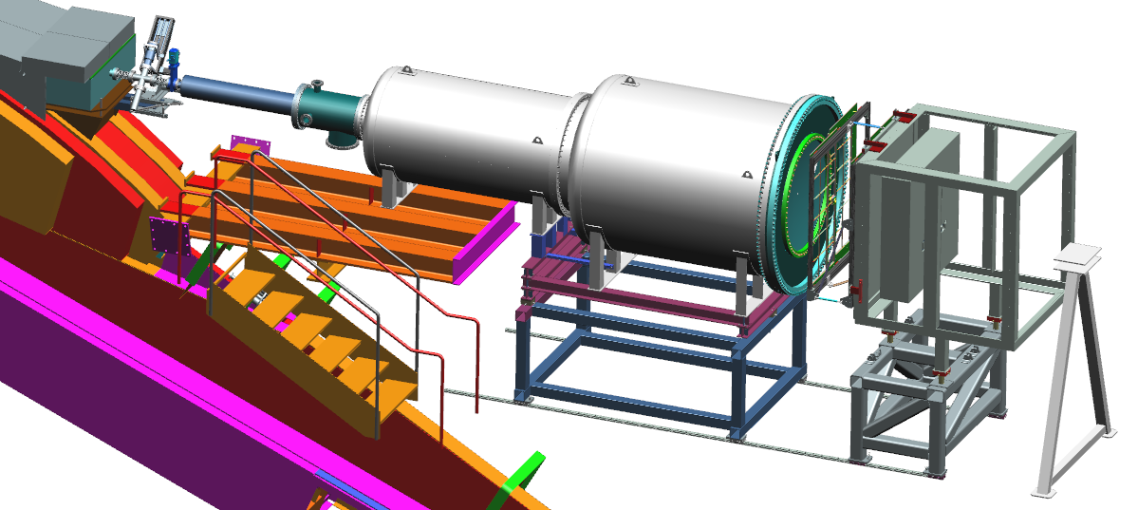
X17 from Tagger Magnet to Hycal
Collimator Box
Target & Harp
Vacuum Tube
Vacuum Tanks
1 Meter Window
GEM Detectors
Hycal
X17 Target to Hycal Lead Tungstate Counters is 7.5 Meters
A1
A2

Slide 5
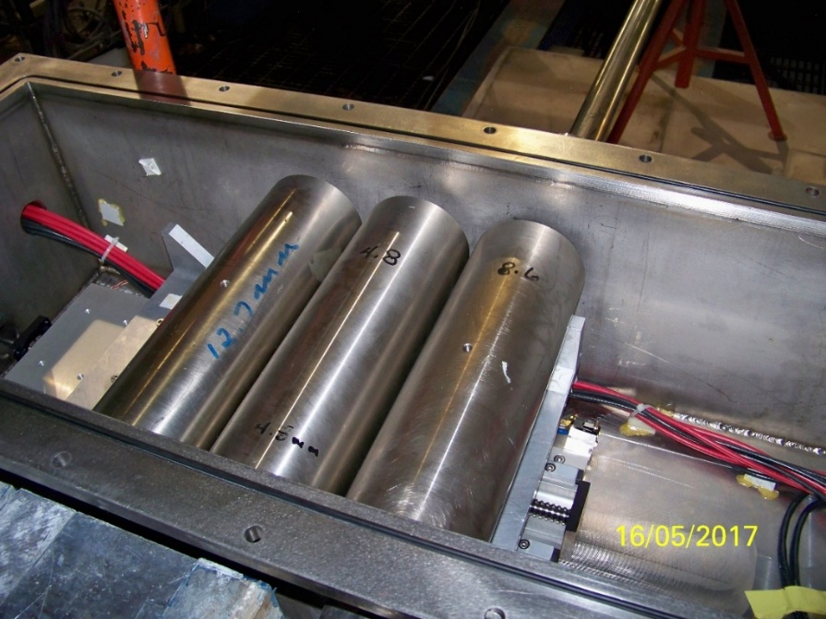
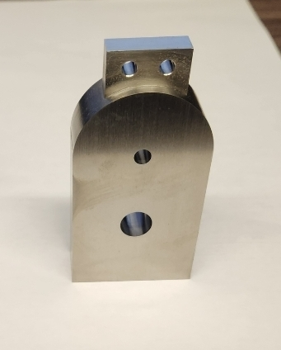
Upstream Collimators
20 mm Thick Tungsten Collimator on Radiator Stick
Nickel Collimators in Collimator Box Downstream of the Tagger Magnet
Change Collimators in Collimator Box scheduled for September

Slide 6
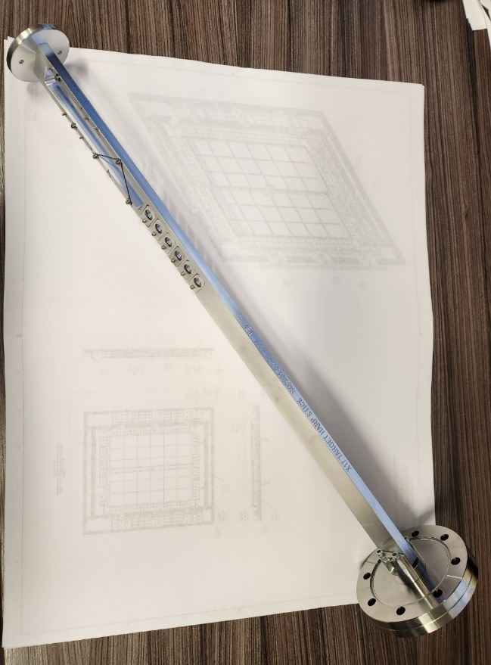
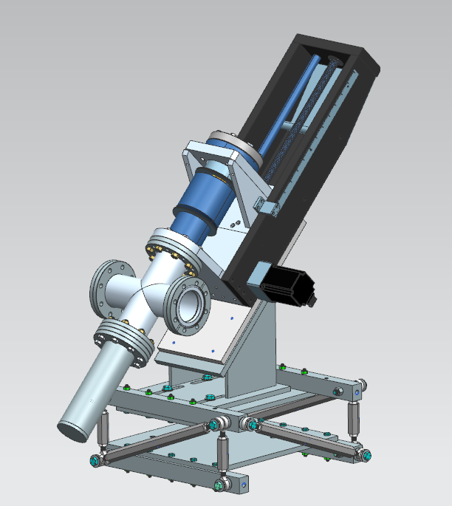
X17 Target Harp
Actuator and Mount
Harp stick with 6 target foils and 2 Harp wires
All components at JLab except actuator – due October 10th

Slide 7
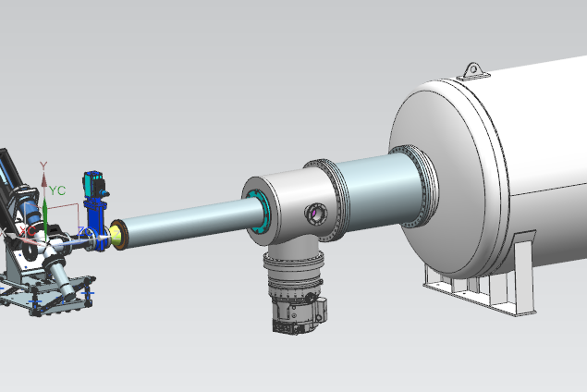
X17 Vacuum Chamber Extensions
Vacuum chamber extensions used in place of PRad II target
Ports for turbo pump, gauging, and TFF target
Components required in June 2026
Final design and procurement in November 2025

Slide 8
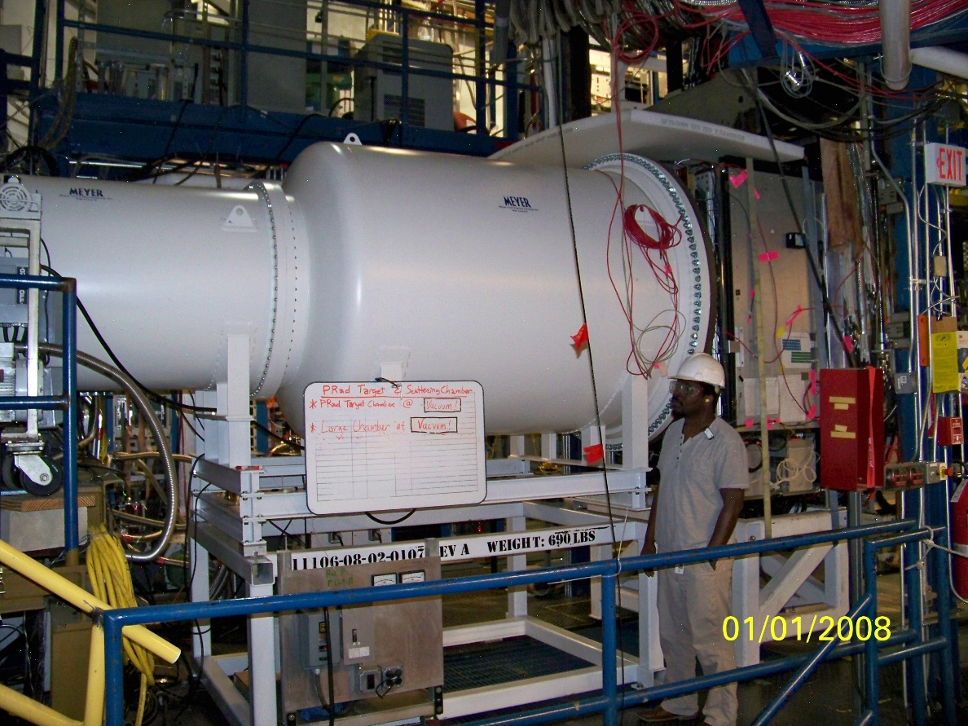
Vacuum Tank Stand
B1
The vacuum tank stand is no longer with us and a new one must be fabricated.
Working with the machine shop to get one made by the end of November.

Slide 9
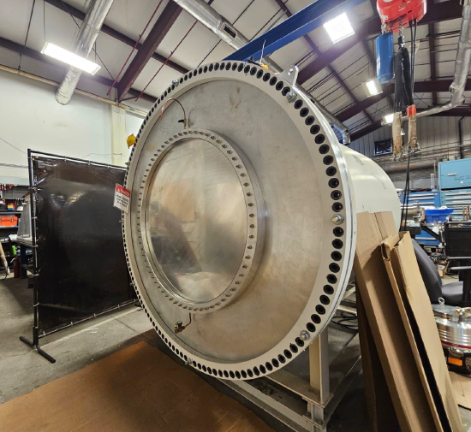
Prad II and X17 Vacuum Tank Windows
B1
All components are at Jlab
Windows have been formed, center holes will be machined by the end of September

Slide 10
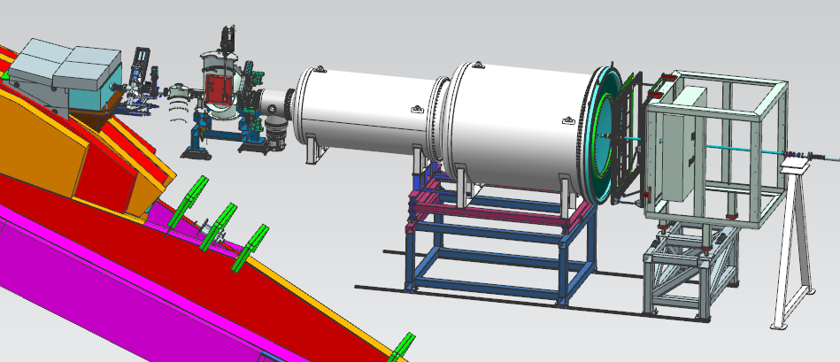
PRad II from Tagger Magnet to Hycal
Collimator Box
Harp
PRad Target
Veto Scintillator
Vacuum Tanks
GEM Detectors
Hycal
A1
A2
B1
B1
PRad II Target to Hycal Lead Tungstate Counters is 6.2 Meters

Slide 11
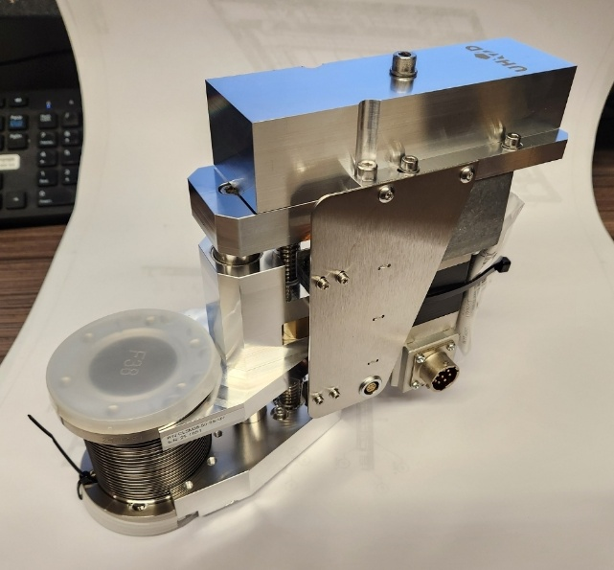
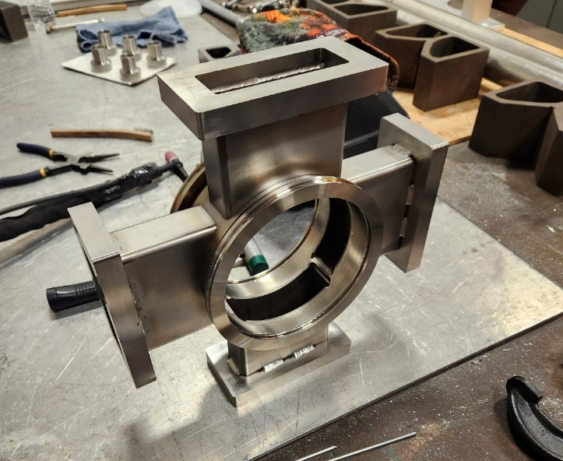
PRad II Veto Scintillator
Four scintillator paddles
Mounted to the downstream side of the target
Each paddle can move in and out independently
Paddle thickness is 3 mm
A1
A2
B1
B1
All components arrive at JLab by October 10th
All components ready to install in the Hall by the end of October

Slide 12
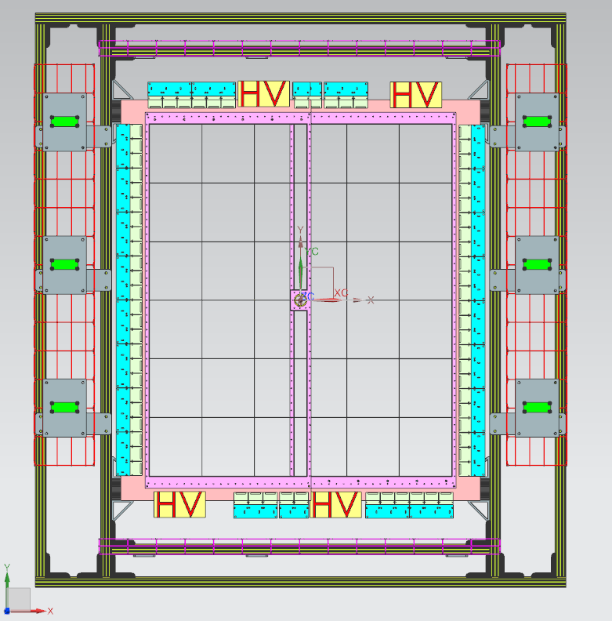
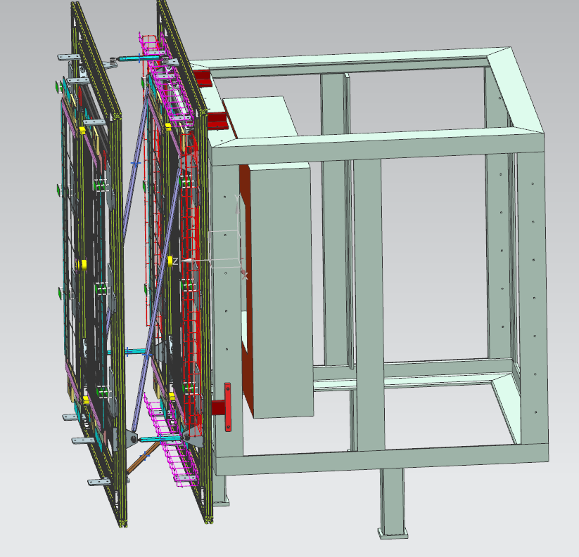
GEM Detectors
All components arrive at JLab by the end of September.
GEM frames will be assembled and placed in the EEL building by October 15th.

Slide 13
GEM Gas System
Each GEM requires up to 500 sccm of 70/30 argon/CO2
Modify Hall B MVT gas system to supply argon/CO2 to GEMS
Supplies 70/30 argon/CO2, mixture can be adjusted
GEM pressure controlled by oil bubblers
Overpressure protection supplied by separate oil bubblers
N2 supply for flushing and conditioning the GEMS
All gas panel components are at JLab and will be assembled by the end of September.
All mixing system components will be installed by the end of October.

Slide 14
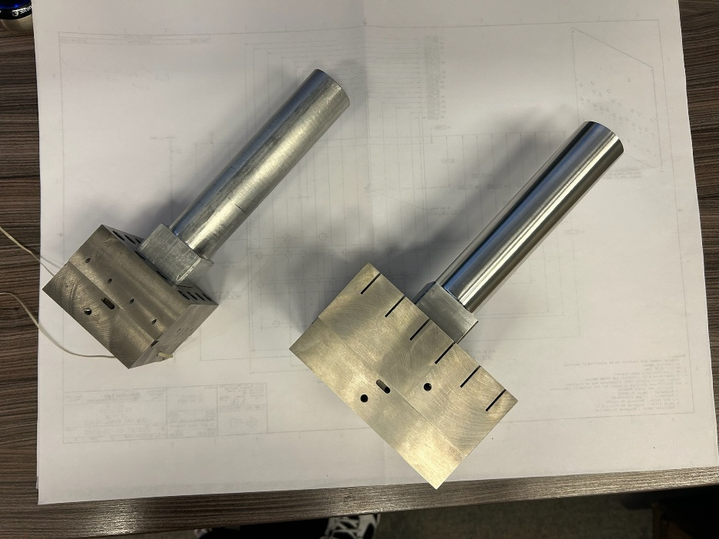
Hycal Collimators
PRad II Collimator
Covers 4 x 4 Crystals
60 mm Thick Tungsten
Used for PRad 1
X17 Collimator
Covers 6 x 6 Crystals
73 mm Thick Tungsten
All components are at JLab

Slide 15
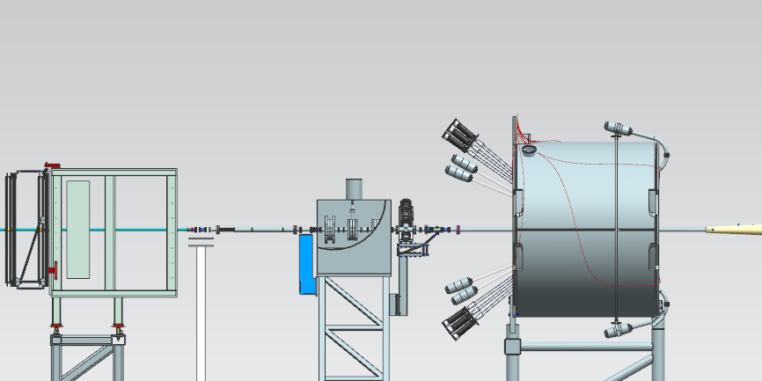
Hycal to Beam Dump
Hycal
Beam Tube inside Hycal
Beam Position Monitor
Harp
Vacuum Tubes to Beam Dump
Beam line tubes and supports will be ready by the end of October

Slide 16
Design and Engineering Status
Conceptual designs of all components are complete, except for X17 vacuum tube
All drawings are complete and have purchase requests submitted
Expect all components to arrive by the end of October

