Slide 1

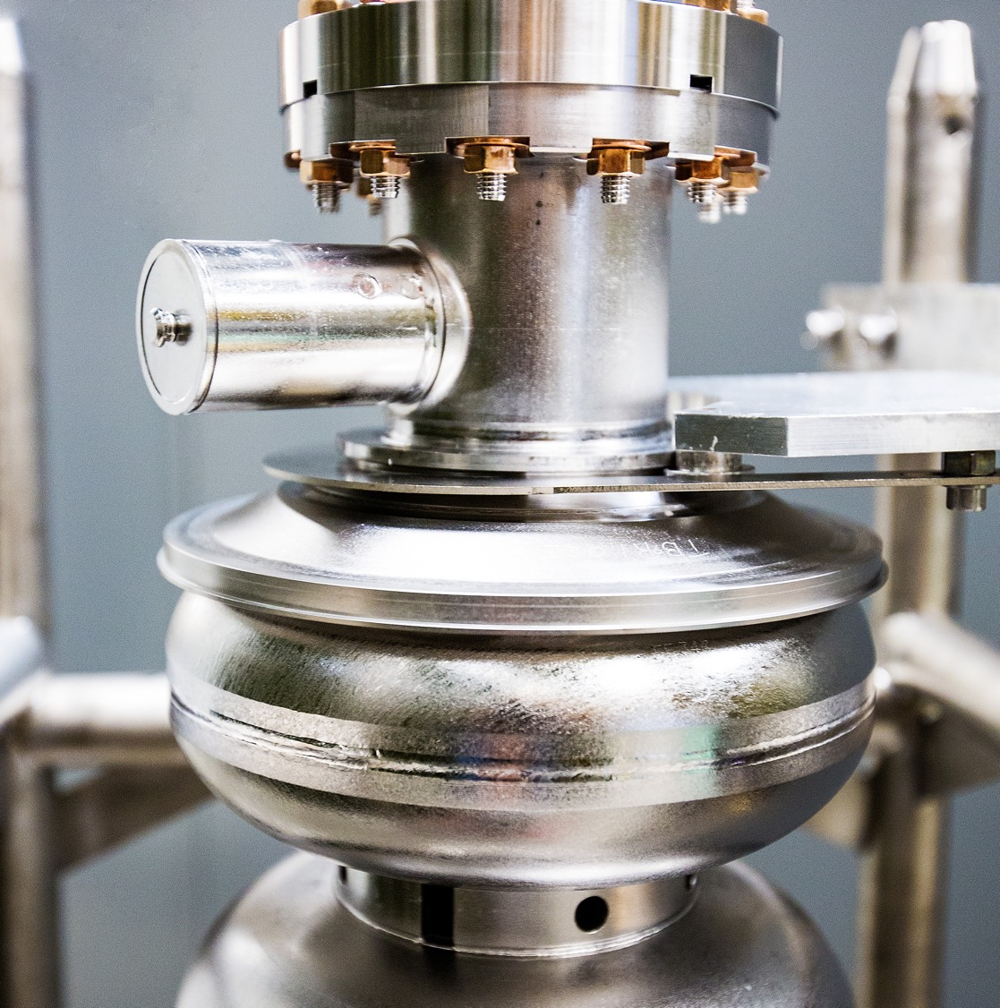
Update on the Experimental Schedule
12 September 2025
Douglas Weadon Higinbotham
Notes:
Tip: Keep titles under 60 characters for readability
To change the photo: Right-click on photo and select change photo

Slide 2
We just finished absolutely amazing FY25 CEBAF run!
Energy of 1060 MeV/linac (up from 1047 MeV/linac in FY24 )
Beam Power > 800 kW
Low Number Beam Trips ( < 10 per hour )
This meant we were able to deliver on the experimental program as well as do the beam studies we need for the future program.
Notes:
Use for: Introducing new topics
To change the photo: Right-click on photo and select change photo

Slide 3
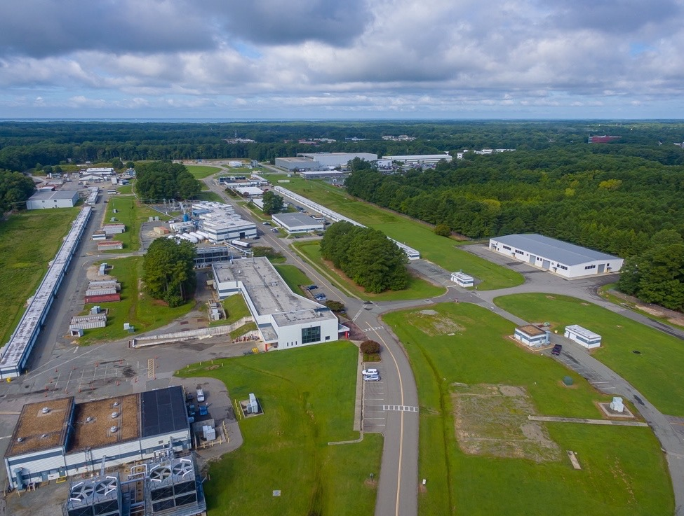
FY26 CEBAF Run Plan
Running Halls B, C and D
Part 1: Special 345 MeV/linac Run
  Hall B PRad-II ( large installation experiment )
  Hall C Low energy Cryo-target experiments
  Hall D special low energy GlueX experiment
Two Weeks To Re-scale the Machine
Part 2: Back to 1060MeV/linac
  Hall B High energy part of PRad-II then X17
  Hall C High energy cryo-target experiments
  Hall D Complete the GlueX-II / JEF experiment
Caption Here
Notes:
Guidelines: 6-8 bullets per slide; Use sentence fragments for bullets
To change the photo: Right-click on photo and select change photo

Slide 4
Accelerator Schedule Overview of Key Dates
SAM started: 0700 3-September-2025
  Personnel Safety System (PSS) lockouts/deactivation
  Central Helium Liquefier (CHL) warmup to 4k
2L03 C75 Upgrade Completion: 17-November-2025
PSS: 17-November-2025
CHL 2k pump-down: 1-December-2025
System Readiness Hot Checkouts: 5-December-2025
1L26 C100-03R installation complete: 12-December-2025
Accelerator 24h Lockup: 5-January-2026
Cryo-module commissioning complete: 29-January-2026
RF recovery complete: 4-February-2026
CEBAF Beam Restoration Starts: 5-February-2026

Slide 5
Key Dates for PRad-II/X17 ( current 24 week run schedule )
NOTE: 2 weeks of CEBAF restoration and 22 weeks of physics time which may be increased but we need to wait for a budget, so for now, sticking with this somewhat pessimistic scenario.
PRAD-II @ 3.5 GeV on 20 February 2026
PRAD-II @ 0.7 GeV on 27 March 2026
Low energy CEBAF off at 7am on 20 April 2026
PRAD-II @ 2.2 GeV on 2 May 2026 up to 1 June 2026
Change-over on my schedule 1-5 June 2026
X17 @ 2.2 GeV on 6 June 2026 until 7am 27 July 2026

