Slide 1
Echelon 0 – status and plans
Jeff Landgraf (BNL)
EIC Echelon 0-1 Mini-Workshop
October 8, 2025

Slide 2
Outline
What is Echelon-0 and how does it fit in with Electronics, DAQ and Slow Controls?
Timing Requirements & impact on calibrations
Data Volumes
ASIC data formats and ePIC data model
Interfaces to Echelon-1

Slide 3
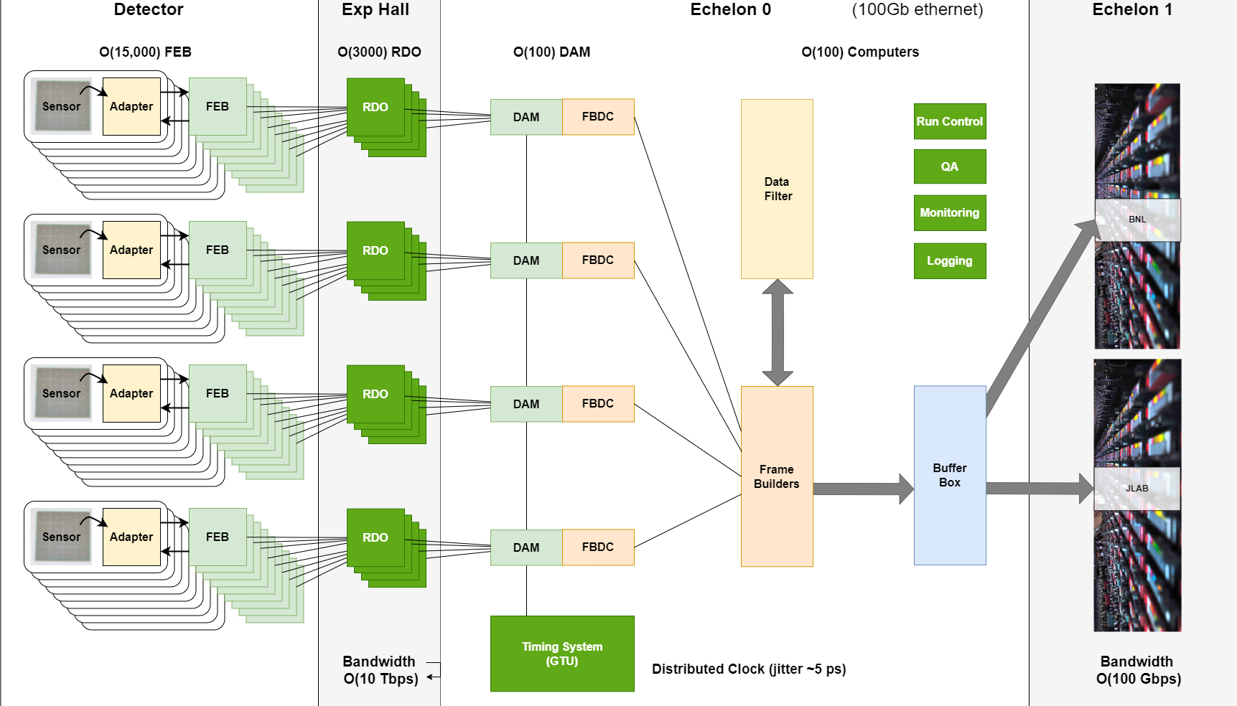
ePIC Streaming DAQ/Computing Architecture
EIC Specs
Bunch Crossing
~ 10.2 ns (98.5 MHz)
Interaction Rate
~ 2 us (500 kHz)
High Luminosity
-- up to 10³⁴ cm⁻²s⁻¹
-- Low occupancy physics signal
-- Background and noise
significant for some
sub-systems
Each bunch can have different polarization states
-- DAQ must tag data to specific bunch crossings
-- Need to track luminosity for each bunch crossing
(Computing)
Frame Builder
Data Concentrator
(FBDC Server)
Controls

Slide 4
EPIC Slow Controls Components (Is this echelon-0?)
Control GUIs
Alarm Handler
DB Display Interface
Conditions DB:
Echelon 1/X interaction and implementations
User Interfaces
By detector, to specify detector structure, and operating modes
Need to select GUI supported writing packages
Should be configurable to allow monitoring of any Epics data
Time series history for all variables
Selectable correlation
Synergy with collider?
Services
Epics
Server
Archiver
Echelon 0 DB Storage
Echelon XX DB Storage
Small number of LINUX servers
Communicate with Sensors and controls using Soft or Hard IOCs
Communicate with IOCs using ethernet network
Investigate!
EIC (custom/consult)
RDB archiver
SLAC archiver appliance
Channel Archiver
Assume relational DB such as mysql
Table design needs to have general storage mechanism including schema evolution
Replications of online DB at echelon 1, 2 institutions
DAQ FEB Control & Monitoring
Sensors
Controllers
Rack Power
Rack-End Circuit Breakers
Subsystems
Expect ~100 DAQ soft IOCs
Configuration of ASICs likely through DAQ configuration files, not EPICs. IOCs insert commands into DAQ link.
Controlled via Ethernet
Internal IOC or Soft IOC running on DAQ room computers
Controlled via Ethernet
Internal IOC or Soft IOC
Types: HV, LV, gas systems, motor control,
PDUs
PLC Based control?
Status is delayed with respect to many parts of system: e.g. no testbeds yet.
Scale has been surveyed:
~ 500k variables to be tracked, 55 TB/year, 70 Mbps network traffic
Electronics suggestions started, space needed on platform estimated, but needs revision

Slide 5
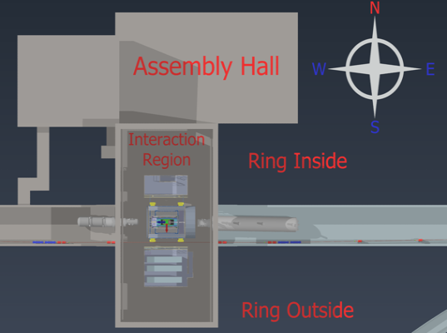
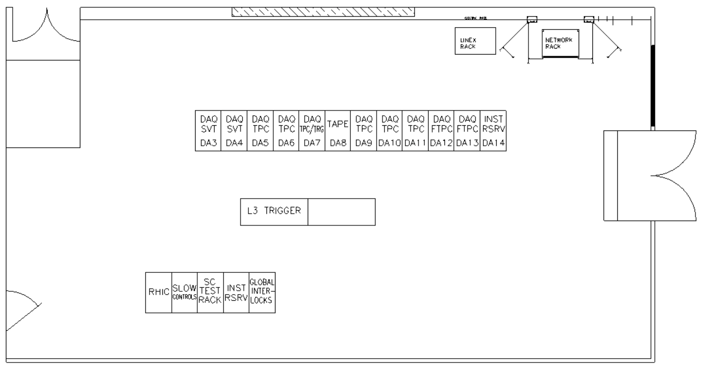


Physical Space
DAQ Room space
Main throughfare from control room to Assembly Building
Not state of art computing center
Space demands are significant
New EIC telecom room (services for outbuildings)
~100 EBDC Servers (Contain DAM Boards)
~100 Computing Servers
GTU Rack
EIC Controls Racks
Fiber Patch Panels
Network Switches (If in telecom room adds to size)
Cabinets
Workspace table
Power transformer and circuit breakers
Reduce as much as possible by moving COTS computing to SDCC
Control
Room
19’x12’
Requested
Telecom
Room
(EIC)
DAQ Room
26 ft
DAQ Room
48 ft
Assembly
Hall

Slide 6

Splitting of Echelon 0
ePIC DAQ and computing will require network connectivity at BNL between resources in IP-6, SDCC as well as development labs that is bandwidth guaranteed and minimizes routing.
To JLAB ePIC (Echelon 1)
Early DAQ & Electronics development will be in labs (Physics, early 2026-).
Initial computing needs for development would best be placed in a central location (SDCC, initially 1-2 racks, by Q2 FY27).
As construction and installation ramps up at IP-6 additional Echelon 0 computing resources can be placed in both sites (5-6 racks at SDCC, Q2 FY29).
For production running it is important to all network infrastructure in place (Q1 FY32) and have equal and transparent network access from SDCC to both Echelon 1 sites (BNL and JLAB)
SDCC
ESNET
400
Gb/s
400
Gb/s
ePIC DAQ
(100 computers)
BNL ePIC
Echelon 1
IP-6
4Tbps
(10x400 Gb/s)
DAQ Room
(100 computers)
100Gbps
Lab
Lab
Lab
Green indicated daq.local network & computers owned/administered by ePIC.
Physics

Slide 7
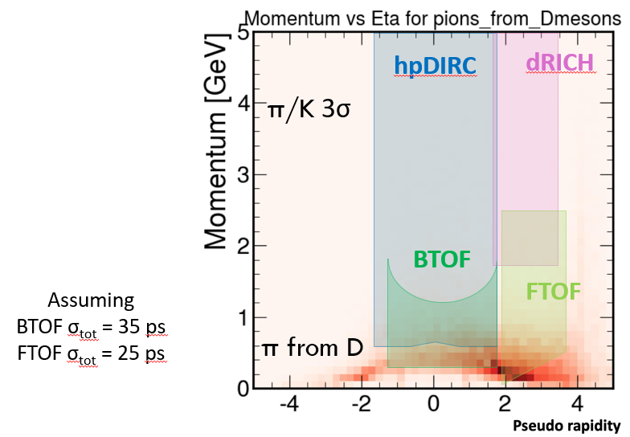

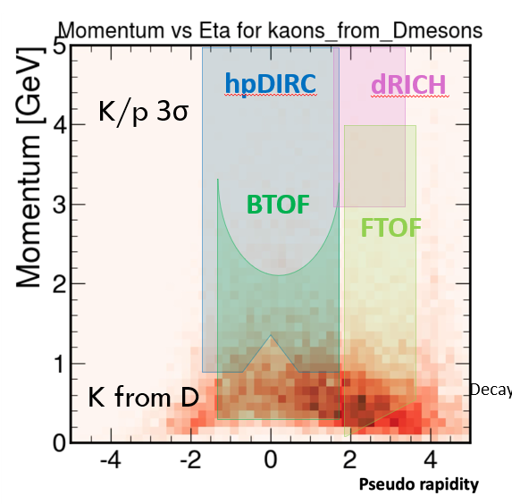
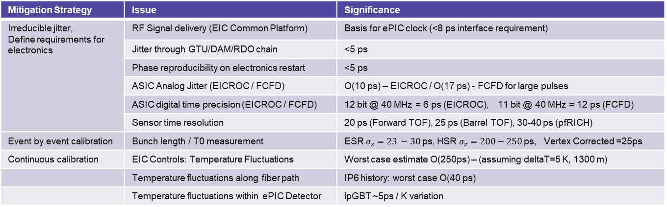
Requirements (GTU Timing)
EIC / ePIC physics has features which make the timing critical
10.15 ns bunch crossing separation
Each bunch crossing can have different polarization states → Events must resolve bunch crossing
The TOF detectors maximum momentum for PID depends upon clock resolution
Implementation of time window cuts for noise in dRICH
Mitigation Strategy | Issue | Significance
Irreducible jitter, Define requirements for electronics | RF Signal delivery (EIC Common Platform) | Basis for ePIC clock (<8 ps interface requirement)
 | Jitter through GTU/DAM/RDO chain | <5 ps
 | Phase reproducibility on electronics restart | <5 ps
 | ASIC Analog Jitter (EICROC / FCFD) | O(10 ps) – EICROC / O(17 ps) - FCFD for large pulses
 | ASIC digital time precision (EICROC / FCFD) | 12 bit @ 40 MHz = 6 ps (EICROC), 11 bit @ 40 MHz = 12 ps (FCFD)
 | Sensor time resolution | 20 ps (Forward TOF), 25 ps (Barrel TOF), 30-40 ps (pfRICH)
Event by event calibration | Bunch length / T0 measurement | ESR $σ_{z}=23 −30$ps, HSR $σ_{z}=200−250$ ps, Vertex Corrected =25ps
Continuous calibration | EIC Controls: Temperature Fluctuations | Worst case estimate O(250ps) – (assuming deltaT=5 K, 1300 m)
 | Temperature fluctuations along fiber path | IP6 history: worst case O(40 ps)
 | Temperature fluctuations within ePIC Detector | lpGBT ~5ps / K variation
F-DET-COMP.11: Global Timing Unit (GTU) will provide common timing information to all DET sub systems
P-DET-COMP.18: The GTU will deliver a stable high-resolution clock at the level of 100ps jitter to DET subsystems, with an option to deliver up to a 5ps jitter clock to DET subsystems requiring very high-resolution timing measurements.
Requirement is understood
Document needs to be refined
< 5 ps jitter for GTU/DAM/RDO
< 8 ps jitter for EIC interface
< 500 ps absolute time stability
P-DET-COMP.19: The DAQ system will require interfaces to the accelerator which provide timing and data exchange, and allow the accelerator to read the state and condition of detector systems.

Slide 8
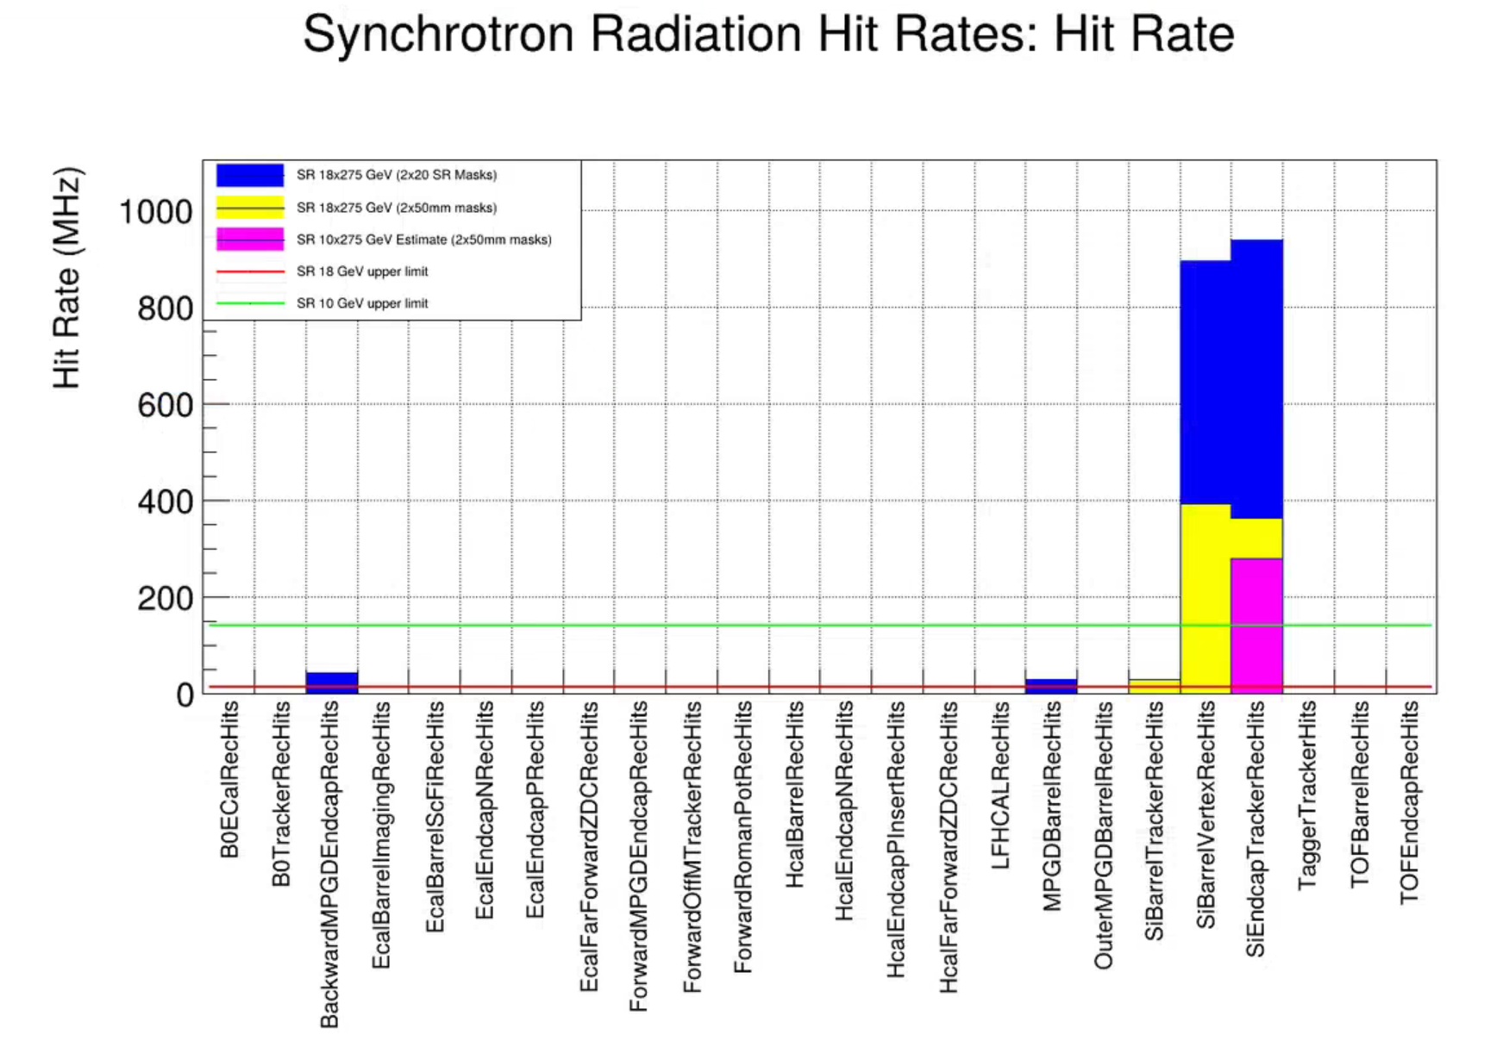
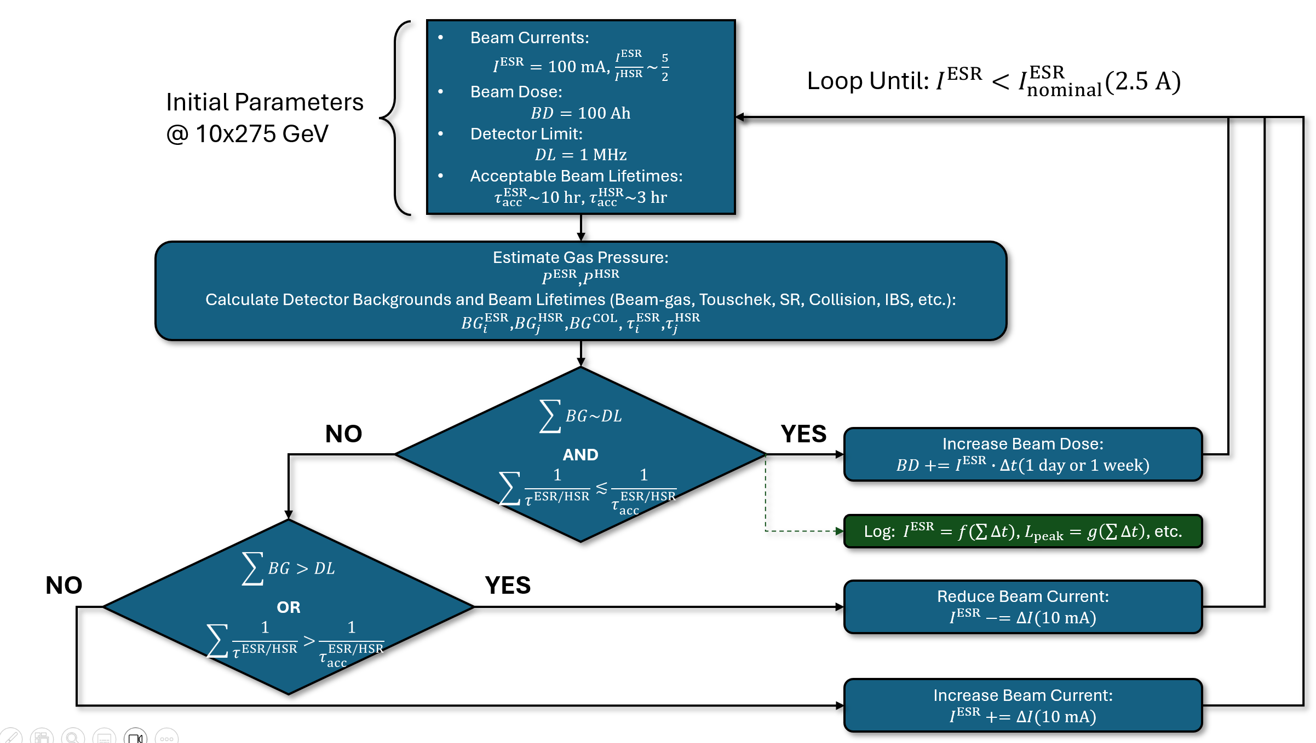
Requirements (Data Volumes)
Streaming readouts are particularly sensitive to backgrounds, noise, and data rate. These must inform our requirements
Understanding backgrounds is not simple for the EIC
For example, the relationship between vacuum and beam current is complex:
Our simulation assumptions reflect best expected vacuum (10,000 Ahr) and highest designed beam currents – at lower vacuum the beam current must be correspondingly lowered.
Synchrotron radiation is a known problem
Huge advances have been made in both simulations and beampipe design (SR masks) and could be read out at current estimates
Beam pipe modifications ongoing with goal of lowering rate by another order of magnitude
Simulations still provide only upper limits for many detectors. Each detector hit in simulation represents 14 MHz (140 MHz in 10x275 GeV)
Finding Correlation between Vacuum and Beam Current

Slide 9
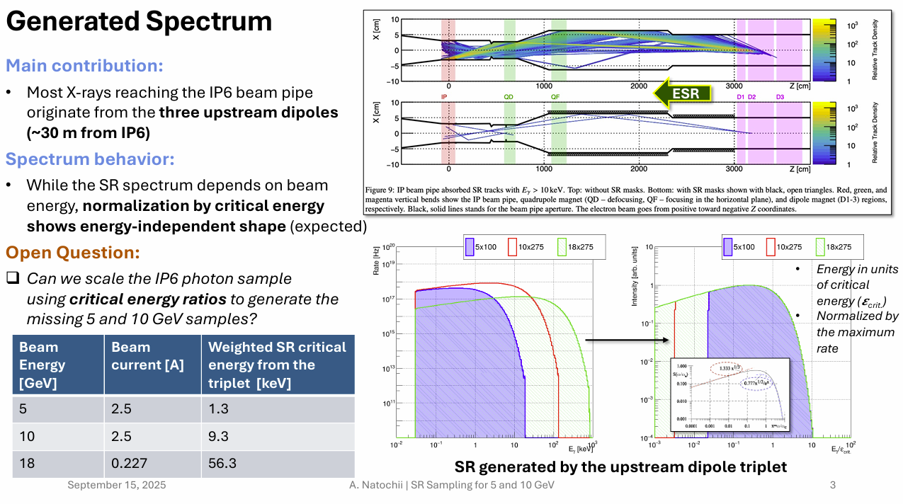
Synchrotron radiation study evolution…
18 GeV electrons simulated
Balance Beam Current vs Produced Radiation to
Project → 10 GeV/5 GeV
Energy of produced Synchrotron Radiation goes down by order of magnitude. Much less gets through beam pipe!
Conclusion:
18 GeV is Worst Case Synchrotron Radiation!!
Andrii Natochii

Slide 10
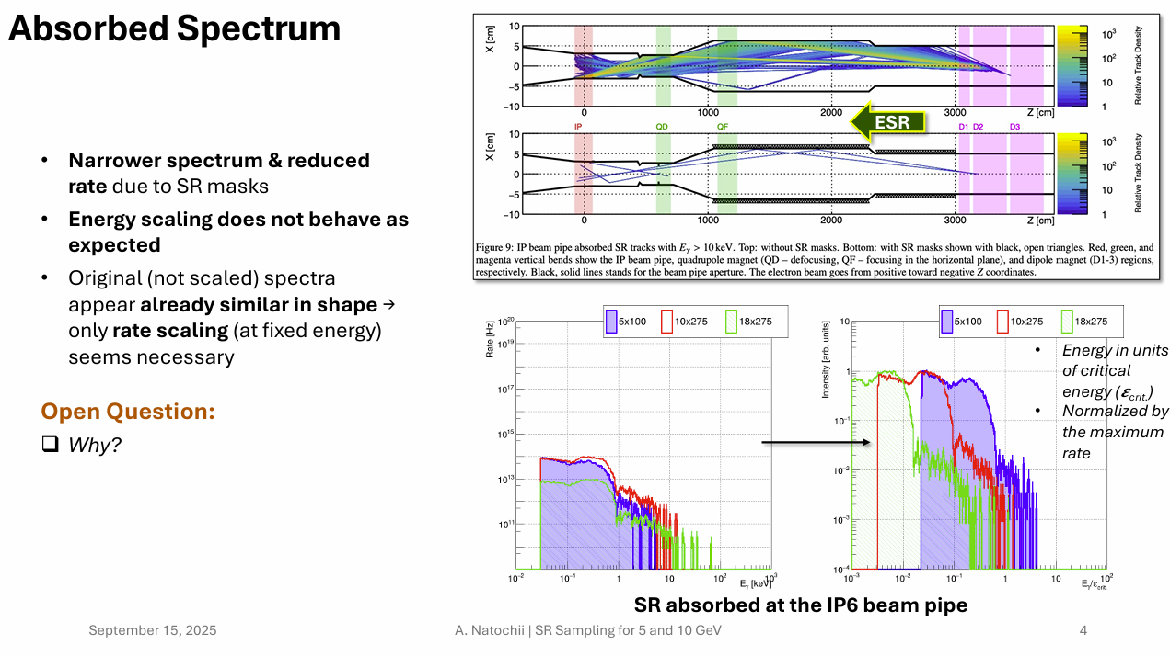
Synchrotron radiation study evolution…
10/5 GeV simulations
Absorbed Synchrotron Radiation doesn’t scale as expected
High energy radiation was already absorbed in beam-pipe, so distribution is nearly the same
Conclusion:
Only beam current matters. Expect an order of magnitude increase in effect from 18 GeV → 10 / 5 GeV!
Beam pipe design ongoing...
Andrii Natochii

Slide 11
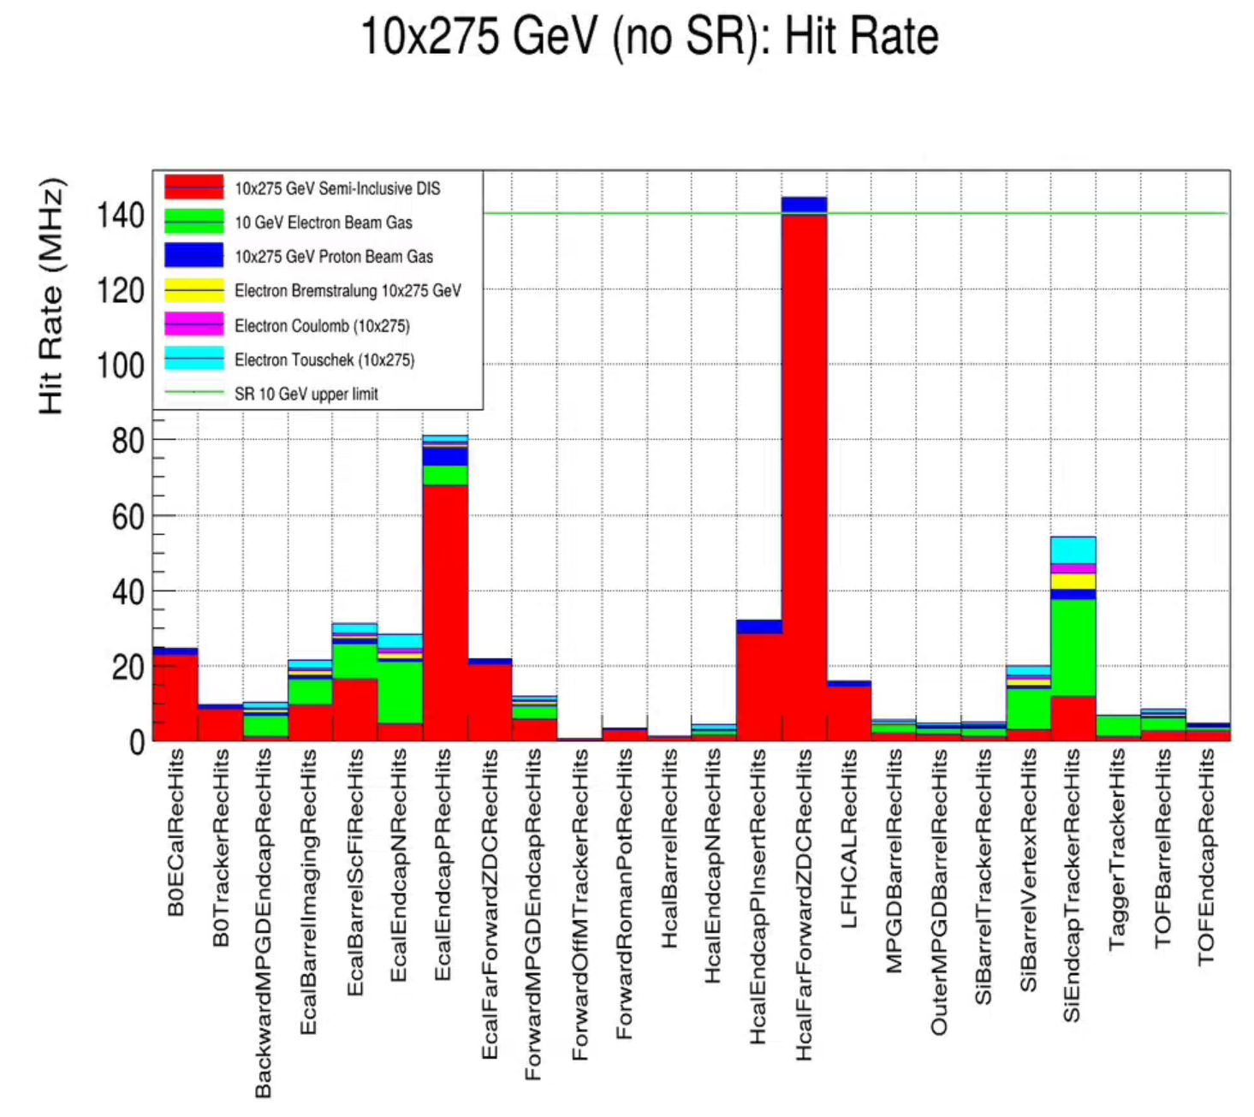
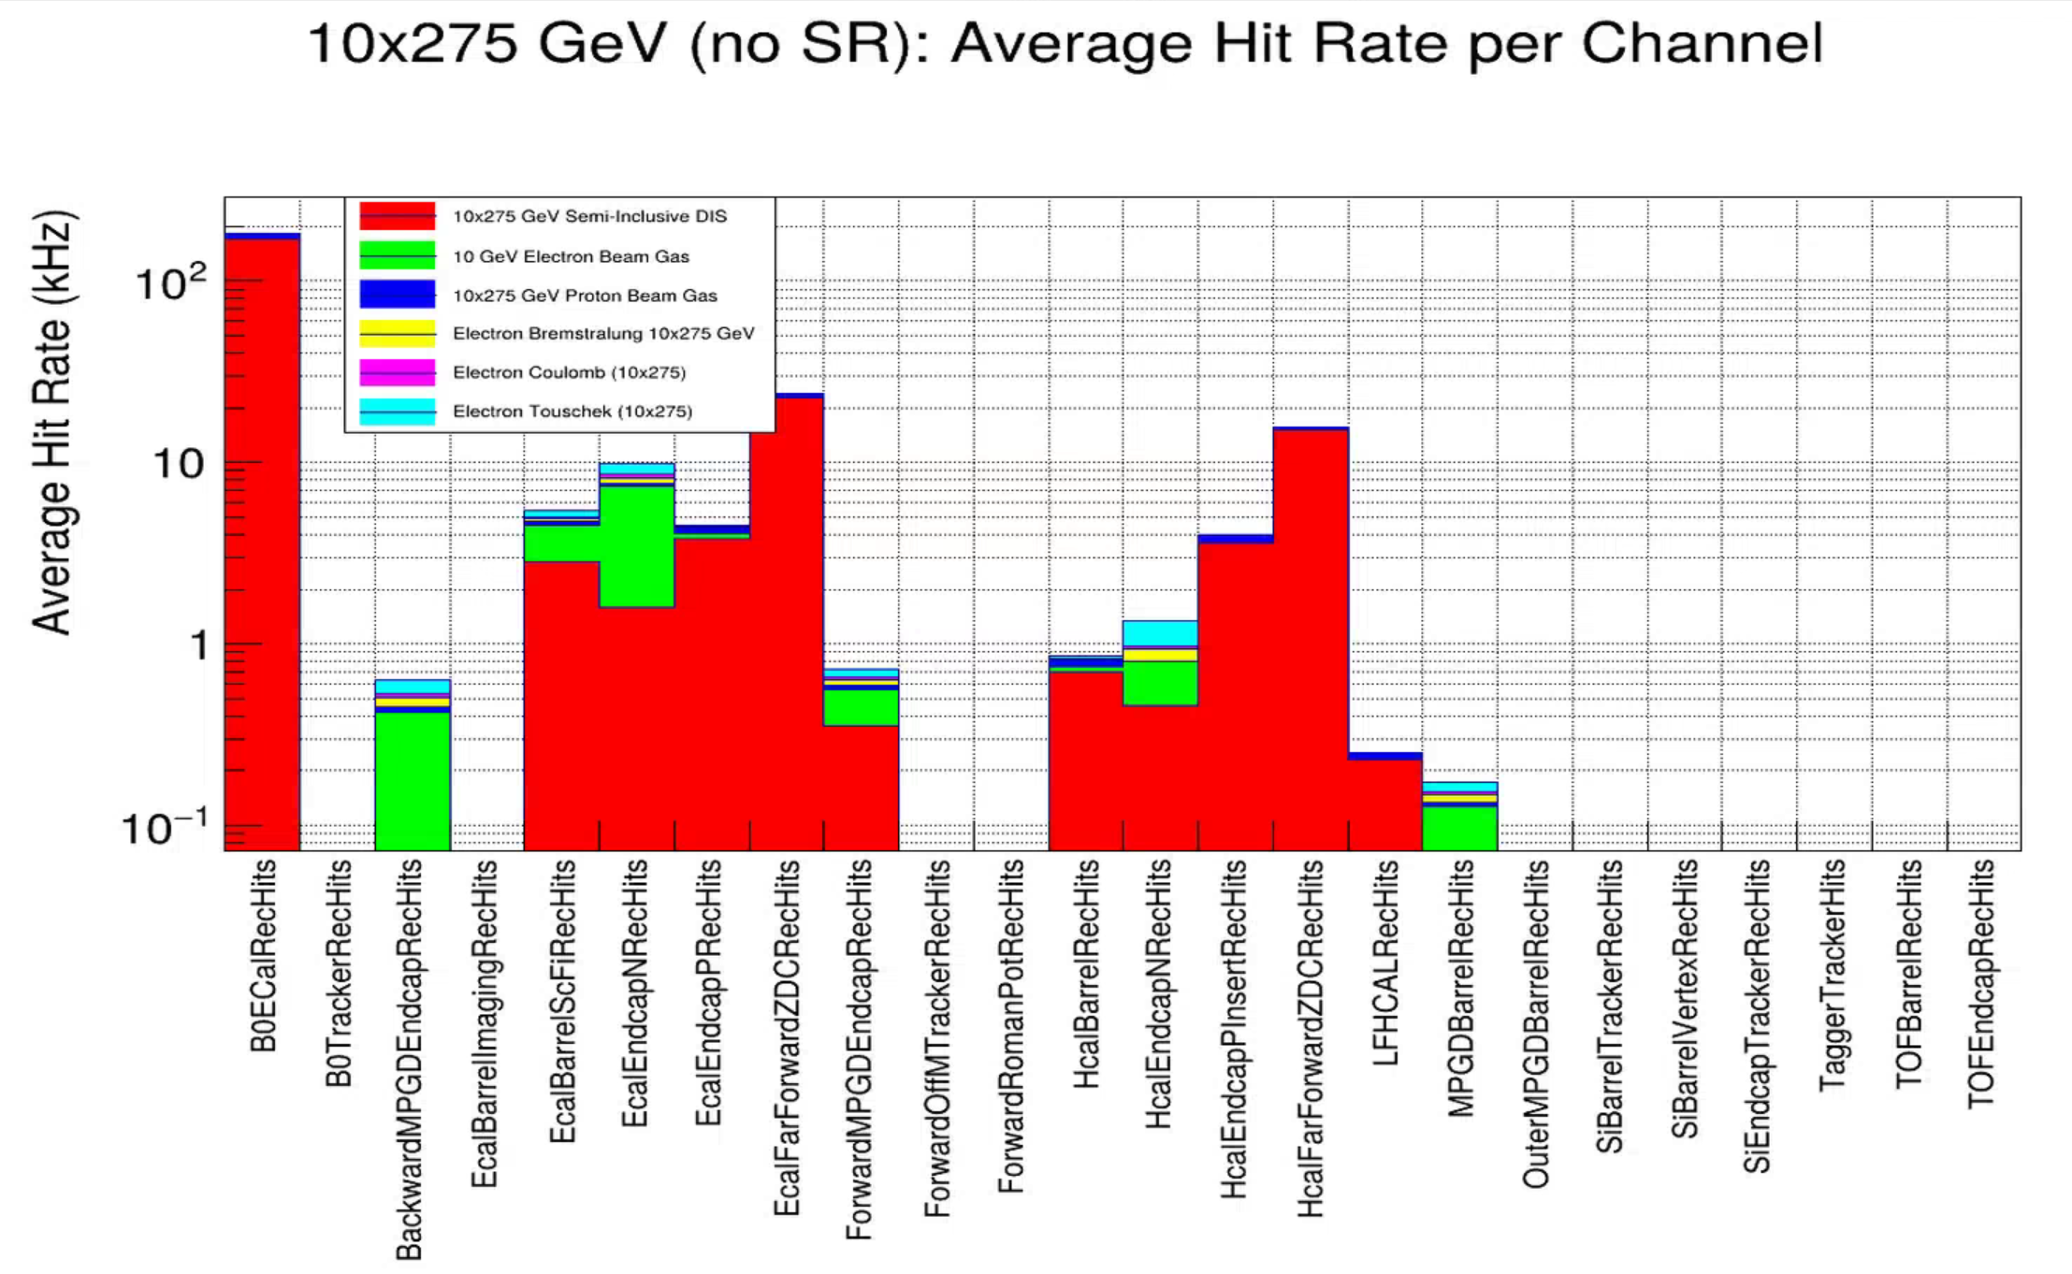
Requirements (Hit Rates)
Charge 1
CALOROC (50 kHz)
SALSA (25 kHz)
EICROC (350 Hz)

Slide 12
Requirements (Data Volumes)
Charge 1
Data volumes depend upon specific readout format and assumptions about the charge sharing / particle (C) and the number of time bins sampled for wave form readout (T).
Progress in the ASIC design / documentation give us detailed numbers for readout data
ASIC | Charge Share | Time Readout | Formula | Bits / Hit FEB | Old HitSize | Bits / Noise FEB | Bits / DAQ Output | Max Rate (ASIC) | Max Rate (Noise)
ITS-3 | 4 | 1 | 16 x (C+3) | 112 | 128 | 64 | 128 | Not simple | Not simple
Timepix |  | 1 | 64 | 64 | 64 | 64 | 64 | 600 MHz | 70 kHz / pixel
Discrete (FECAL) | 4 | 5 | 12 x C x (5 x T + 7) | 576 | 144 | 144 | 128 | 1.6 MHz | 50 kHz / ch
CALOROC | 4 | 5 | 32 x T x (4 + C) | 1280 | 480 | 800 | 128 | 3.2 MHz | 50 kHz / ch
EcalBarrelSciFi | 4 | 5 | 2 x ( 32 x T x (4 x C) ) | 2560 | 960 | 800 | 128 | 3.2 MHz | 50 kHz / ch
EICROC1 | 128 | 8 | (T x 24 + 8) x C | 25600 | 576 |  |  | 384 Hz | 12 hz / ch
EICROC2 | 9 | 5 | (60 + T x 8) x C | 900 | 576 | 900 | 128 | 358 kHz | 350 hz / ch
FCFD | 4 | 5 | 32 x T x (4 + C) | 1280 | 192 | 800 | 128 | 1.6 mHz | 50 kHz / ch
ALCOR | 1 | 1 | 64 | 64 | 64 | 64 | 64 | 19.2 mHz | 300 kHz / ch
SALSA | 4 | 5 | C * (T + 4) * 32 | 1152 | 320 | 288 | 128 | 1.6 mHz | 25 kHz / ch
These numbers are known to detector groups and bottle-necks are being / have been addressed by each group
dRICH – Single Photon response → high sensitivity to dark currents: High level ML filter implemented in FPGA (implemented in FELIX boards) (Pietro Antonioli Presentation)
Low Q2 Tagger – High rates from Bremstrahlung along beam pipe: High level filter based requiring hadron in central detector (Ken Livingston Presentation)
Calorimeters – Radiation to SiPM may limit thresholds to be consistent with noise rates: Calorimeter DSC organizing detector-by-detector noise simulation and analysis
Lumi Direct Photon Calorimeter – 100 channels of streamed ADC’s converted to sum / time integrated channel histograms by DAM board
Synchrotron Radiation – Synchrotron radiation simulations and beam pipe analysis & design ongoing
Electronics and DAQ groups – Ensure GTU / DAM protocol supports high level filters with cross detector data passing

Slide 13
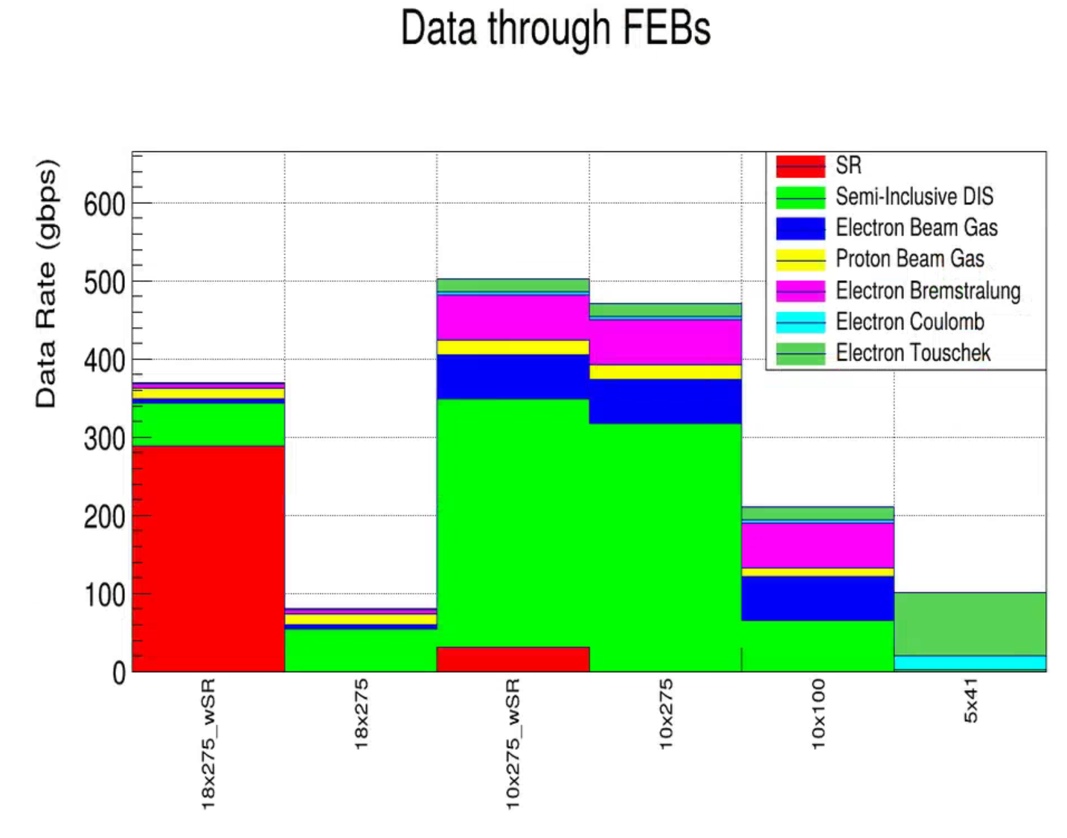
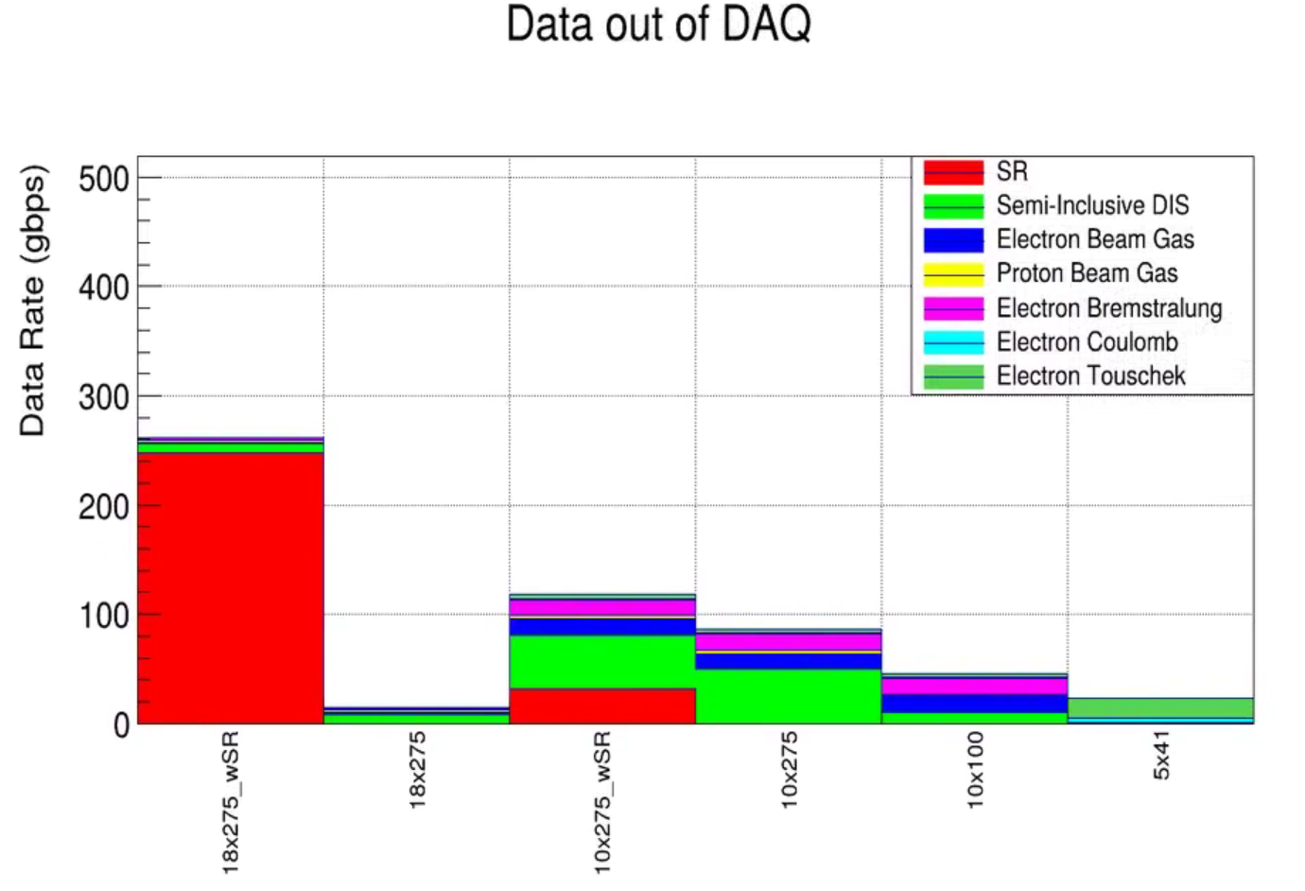


Requirements (Data Volumes)
Charge 1
These are well within our capabilities (ignoring for now the SR)
The goal of not touching the data at all in DAQ is not likely to be possible at high luminosities, however the ASIC formats are not very compressed, we can likely get to 100 gbps target via lossless repacking and/or simple analysis such as clustering
We need to evaluate the maximum rate regions of each detector to ensure the ASICs can keep up with the data volume.

Slide 14
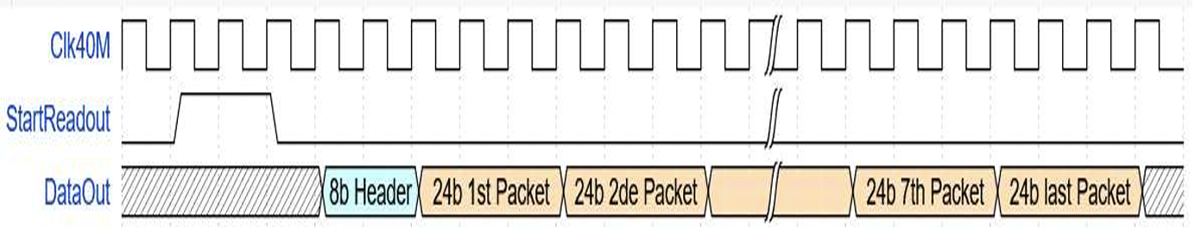
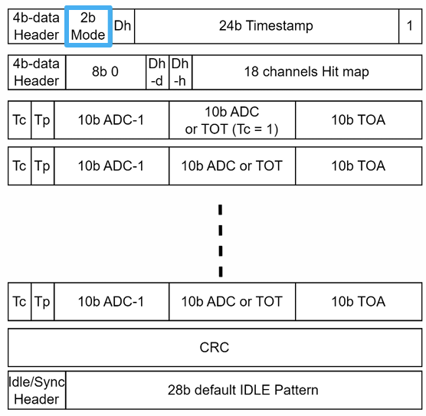
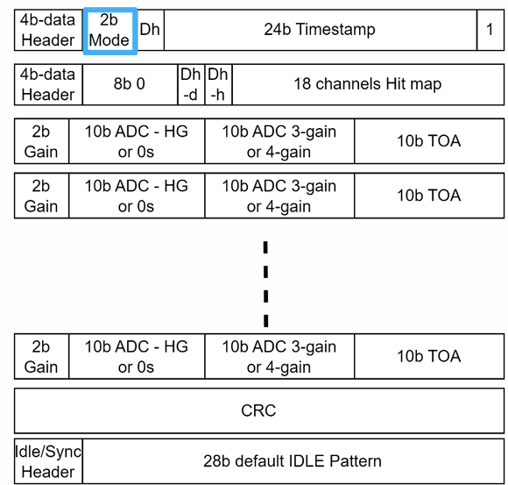
ASIC Data Formats → Data Model
EICROC1: (No ZS)
8 x (12b TCD/12b ADC)
To fill the gap between the data formats and the data model I propose:
Intermediate data formats:
RAW1 -- The raw ASIC banks with appropriate headers (Small fraction of evts)
RAW2 -- Information equivalent compressed versions (Small fraction of evts)
CLUSTER1 -- Compressed versions closer to data format (e.g. sum ADCs from all samples)
CLUSTER2 -- Further compressed versions (e.g. combine near channel hits to single hit with averaged positions)
(…)
Associated readers/analyzers for each format to convert to ultimate definition of the RawXXXHit data model entries
These assumptions are the source of the x5 reduction in data volumes (in most detectors) between the FEB data rates and the DAQ output rates.
The idea would be to adjust the event fractions for the RAW versions, to preserve as much “untouched” data as is consistent with bandwidth allocations.
EICROC2:
Caloroc A Caloroc B
DataModel:
edm4hep::RawCalorimeterHit:
Description: "Raw calorimeter hit"
Author: "EDM4hep authors"
Members:
- uint64_t cellID // detector specific (geometrical) cell id
- int32_t amplitude // amplitude of the hit in ADC counts
- int32_t timeStamp // time stamp for the hit
edm4eic::RawTrackerHit:
Description: "Raw (digitized) tracker hit"
Author: "W. Armstrong, S. Joosten"
Members:
- uint64_t cellID // The detector specific (geometrical) cell id.
- int32_t charge // ADC value
## @TODO: is charge appropriate here? Needs revisiting.
- int32_t timeStamp // TDC value.

Slide 15
Data Interface to Echelon-1
Currently being worked on in the context of the “Orchestration” workflow test bed. Interface to Echelon-0 is currently simple:
Part 1: DAQ writes STFs to the Rucio disk.
Part 2: Message interface between DAQ and orchestration
DAQ Broadcasts messages to Orchestration via ActiveMQ
Run Start → At the start of a run
STF Available → When STF is created on disk
STF Transfer → When STF is complete on disk
(Run Stop) → Assumed?
The most challenging part developing this into an automated system for executing reconstruction and calibration on the flow will be developing state machines and linking them to tasks that need to be done:
Definition of the data:
Which detectors are present? What condition are they in (production/calibration)? What special conditions (lasers, enabled/disabled features) are in place? What’s the status of beam? What’s the condition of Magnet, or environmental factors? Is the run valid for physics or is it for testing feature upgrades? Did the run complete properly?
Definition of ePIC’s situation:
What calibrations need to be done? What are the requirements for each? What data is needed to do each task?

Slide 16
Other interfaces to Echelon-1
Machine Learning Interface
The echelon-0 would contain a Model Context Protocol server for interface to AI/ML developments
This is a low overhead mechanism to publish arbitrary information on an opt-in model.
Provides a mechanism to design ML dataflows, but these require specification of information needed
Calibration flow from Echelon-1 to Echelon-0
Some calibrations need to be installed into FEBs (other places). E.g. Pedestal values.
Are some calibrations done in Echelon-0? Pedestals are a prime example. Gains? dRICH shutter channel-by-channel time window adjustments?
There is a distinction between continuous calibration values generated, and installed calibration values – these must be tracked and collaboration understanding of the difference must be clear
Mentioned before – but interface assumed not defined: Conditions databases. Run Log databases. Shift log databases.
EIC databases. Does access go through ePIC slow controls, or does echelon-1 have a direct interface to collider controls databases?

Slide 17
Questions / Discussion?

