Slide 1


Irradiating Ammonia at JLab
for
Polarized Solid Targets
Chris Keith
JLab Target Group

Slide 2
Outline
Irradiating ammonia & the results
Where to irradiate at JLab
Our plans
Current status

Slide 3
Irradiation and the results
Warm irradiation
Bonn/Bochum & Virginia
Performed in liquid argon (87.3 K)
Electron energy 10 – 20 MeV
Nominal fluence is about 10¹⁷ e⁻ cm⁻²
Produces about 4 x 10¹⁹ spins/g
Store samples in LN2
Test DNP results days or weeks later
Cold irradiation
Mike Seely (SLAC)
Performed in superfluid helium (1 K)
Electron energy 20 GeV
Fluence up to few 10¹⁵ e⁻ cm⁻² with anneals 10 – 40 K
Radical concentration unknown
Test DNP during irradiation
Results at 5 T & 1 K
NH3 reaches > 90%
ND3 reaches about 25%
Results at 5 T & 1 K
NH3 reaches > 75% (after anneal)
ND3 reaches about 25% (after anneal)

Slide 4
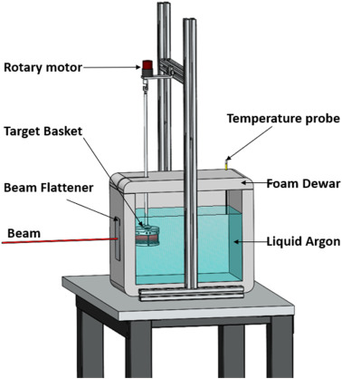
Irradiation cryostats
If the sample is submerged in liquid argon, the cryostat can be a simple styrofoam bucket or a more sophisticated metal dewar.
Periodically or continually rotate the sample for a more uniform dose.
ADVANTAGES
Cheap and simple
Not much can go wrong
Fixed temperature
DISADVANTAGES
Fixed temperature
A. Berlin, PhD thesis, Bochum (2015)
A. Conover et al, NIM, 1068 (2024) 169717

Slide 5
Irradiation cryostats
Variable temperature cryostats using forced convection of helium gas thru LN2 have been used in Germany and SLAC
ADVANTAGES
Temperature > 87 K
DISADVANTAGES
More complicate
Temperature > 87 K
S. Bultmann et al, SLAC-PUB-97904 (1998)
St. Goertz, NIM A 356 (1995) 20.

Slide 6
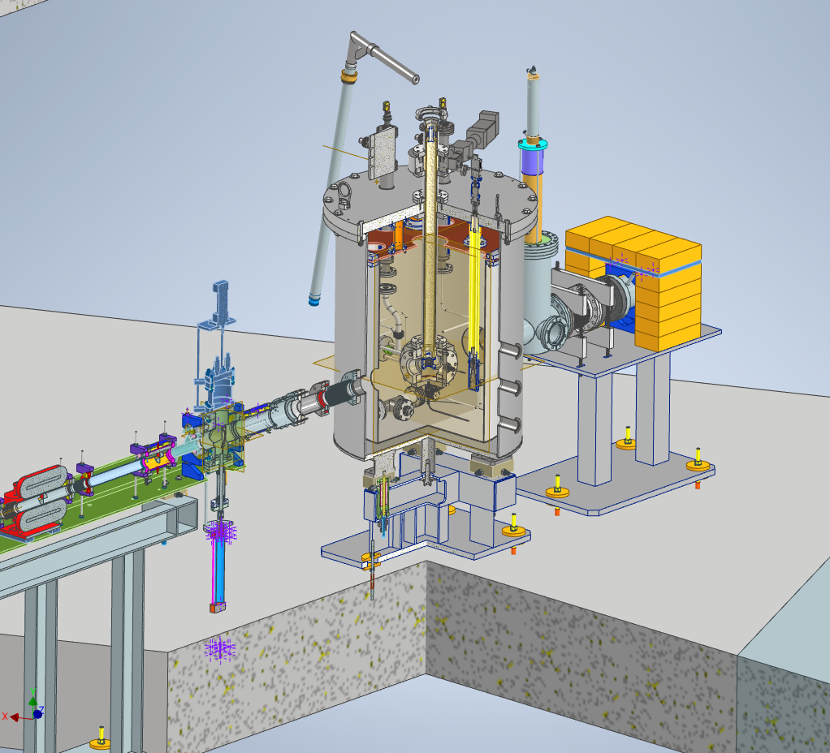
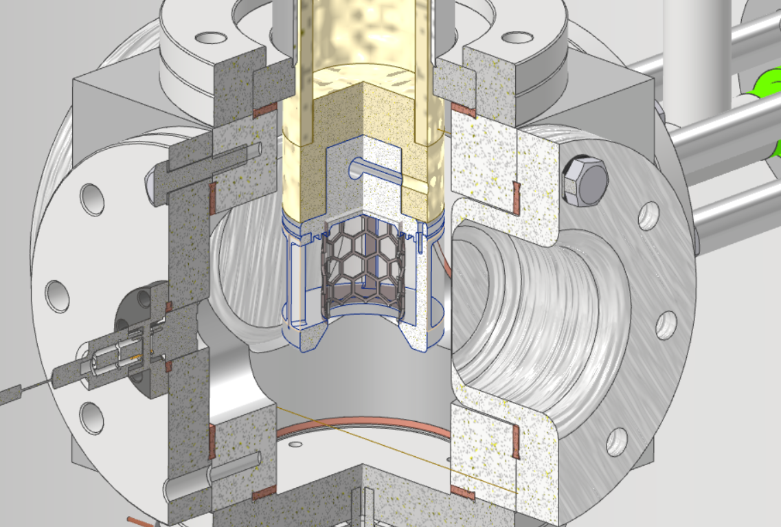
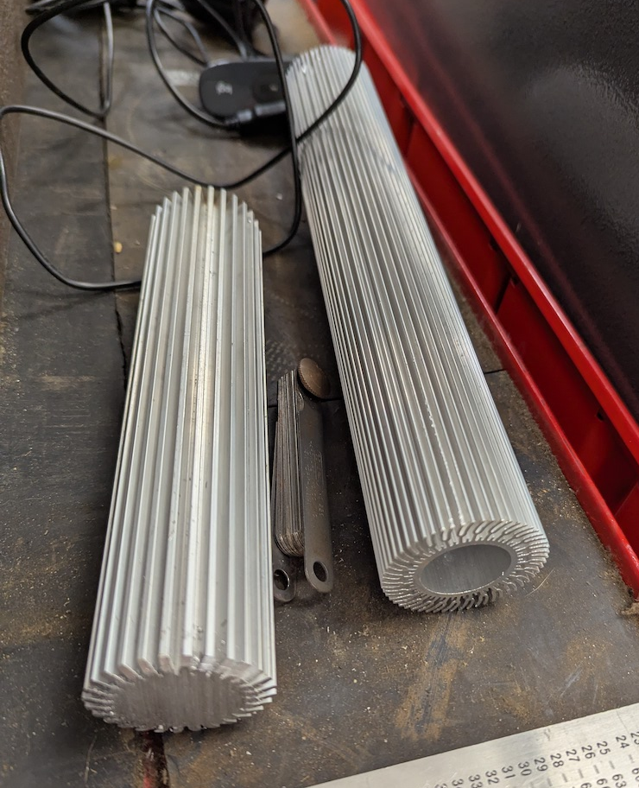
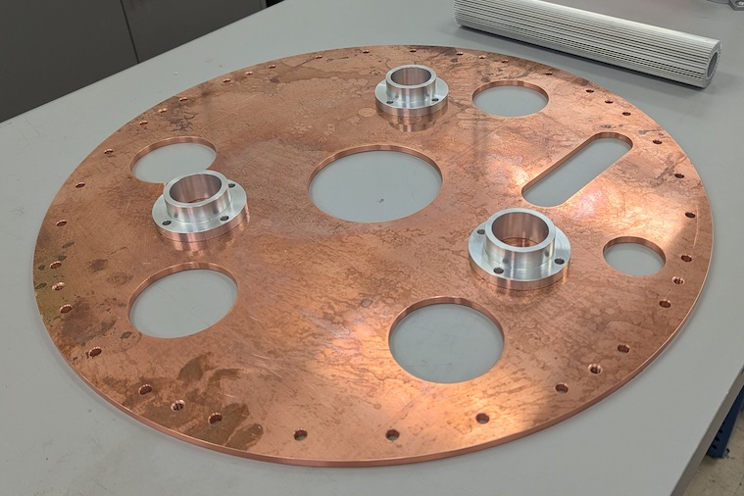
JLab Irradiation cryostat
We’re building a variable temperature using helium from one of JLab’s cryogenic plants.
Casey Flanagan, Daniel Akers

Slide 7
JLab Irradiation cryostat
We’re building a variable temperature using helium from one of JLab’s cryogenic plants.
ADVANTAGES
Temperatures 2 – 300 K
DISADVANTAGES
More complicated
Casey Flanagan, Daniel Akers

Slide 8
JLab Irradiation cryostat
We’re building a variable temperature using helium from one of JLab’s cryogenic plants.
GOAL PARAMETERS
Temperature: ≥ 2K
Beam energy: up to 8 MeV
Beam current: up to 10 μA
Sample size: up to 40 cm³
EXAMPLE: Warm Irradiation
Temperature: 85 ± 5 K
Fluence: 10¹⁷ e⁻ cm⁻²
Beam current: 10 μA
Irradiation time: 3-6 h
Heat load: 44 W
Helium flow: 0.85 g/s
EXAMPLE: Cold Irradiation
Temperature: 2 K
Fluence: 5 X 10¹⁵ e⁻ cm⁻²
Beam current: 1 μA
Irradiation time: 1-2 h
Heat load: 4.4 W
Helium flow: 0.2 g/s

Slide 9
Where to irradiate
Three accelerator facilities are on site, and they have ALL been recommended to me!
UITF (Upgraded Injector Test Facility)
LERF (Low Energy Recirculator Facility)
CEBAF Injector

Slide 10
Where to irradiate
Three accelerator facilities are on site, and they have ALL been recommended to me!
UITF (Upgraded Injector Test Facility)
LERF (Low Energy Recirculator Facility)
CEBAF Injector
The current plan!

Slide 11
Status
Cryostat design is 90% complete
Fabrication is about 50% complete (spending paused since August)
Dedicated beam line for target irradiation is under design
UITF functioning and stable at 8 MeV and 20 μA
Operational limit is 100 nA (additional shielding is necessary for 10 μA – waiting for quote)
UITF in operation (Brimrose Technolgy) until March/April 2026
BeamNetUS proposals now open
→ https://www.beamnetus.org/

Slide 12
Status
Cryostat design is 90% complete
Fabrication is about 50% complete (spending paused since August)
Dedicated beam line for target irradiation is under design
UITF functioning and stable at 8 MeV and 20 μA
Operational limit is 100 nA (additional shielding is necessary for 10 μA – waiting for quote)
UITF in operation (Brimrose Technology) until March/April 2026
BeamNetUS proposals now open
→ https://www.beamnetus.org/

Slide 13
The competition
HALL A
MOLLER cryotarget*
SoLID cryotarget*
SoLID polarized target*
HALL C
Cryotargets
Hypernuclear target*
Tensor polarized target*
Transverse polarized target*
HALL B
Cryotargets
Longitudinal polarized target*
Transverse polarized target*
Polarized ³He target*
Tritium target*
HALL D
Cryotargets
K-Long cryotarget*
Frozen spin target*
*Substantial construction and/or R&D

