Slide 1


g2p2 Experiment Preparations
Tensor Collaboration Meeting
10/14/25
David Ruth

Slide 2
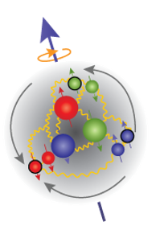
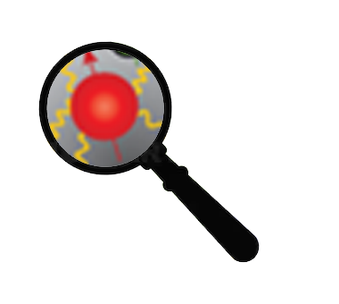
QCD
?
Low
Q²
High
Partons Combine to Form Nucleon
Confinement
Effective Theories: χPT
Can’t use Twist Approx.
Quark/Gluon Correlations
Lattice QCD
Higher Twists
Individual Partons
Asymptotic Freedom
Perturbative QCD
Leading Twist

Slide 3

How to study QCD and higher twist in the transition region?
In unpolarized systems, F₁ / F₂ structure functions describe quark-gluon distribution:
In a spin-½ polarized system, g₁/g₂ describe the spin distribution :
Nucleon Spin Structure
Quark-Gluon Correlations

Slide 4
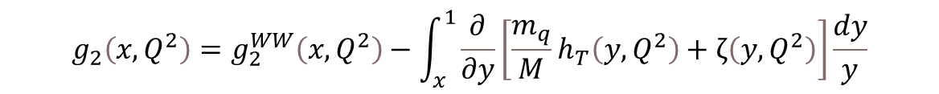

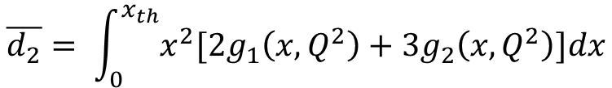
g₂ Structure Function enables direct tests of QCD and higher twist
Higher Twist:
Benchmarking (Lattice) QCD:
Small
$$g_{2}\left(x,Q^{2}\right)=g_{2}^{WW}\left(x,Q^{2}\right)−\int_{x}^{1}{\frac{∂}{∂y}\left[\frac{m_{q}}{M}h_{T}\left(y,Q^{2}\right)+ζ\left(y,Q^{2}\right)\right]\frac{dy}{y}}$$
$\overline{g_{2}}$ - Never measured for the proton!
Twist-3
Function of g₁
Weighted integrals (moments) of the spin structure functions can be directly calculated by effective theories:
Polarizabilities describe nucleon’s ensemble response to an external field
B-Field
$$\overline{d_{2}}= \int_{0}^{x_{th}}{x^{2}[{2g}_{1}\left(x,Q^{2}\right)+{3g}_{2}\left(x,Q^{2}\right)]dx}$$
Proton
Proton

Slide 5
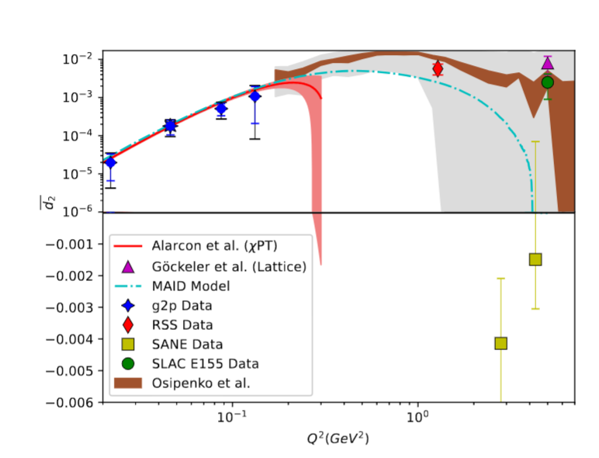
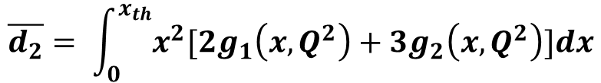
“Color Polarizability” d₂
$$\overline{d_{2}}= \int_{0}^{x_{th}}{x^{2}[{2g}_{1}\left(x,Q^{2}\right)+{3g}_{2}\left(x,Q^{2}\right)]dx}$$
At high Q²: color polarizability / “color Lorentz force”
Interesting differences in existing data motivate further study
Upcoming lattice predictions in this region need experimental benchmark!

Slide 6

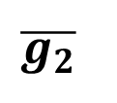
g₂ is the perfect quantity to study the transition regime…
$$g_{2}(x,Q^{2})$$
Examine quark-gluon correlations ✅
Study interaction dependent (twist-3) effects ✅
Benchmark Lattice QCD ✅
However…
$$\overline{g_{2}}$$
d₂

Slide 7
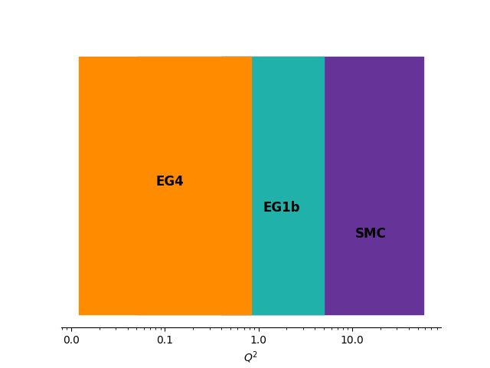
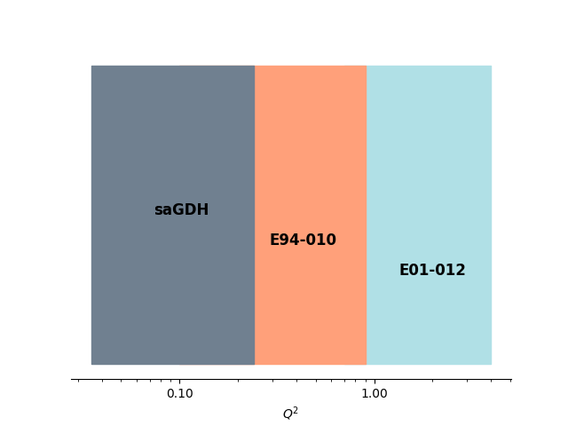
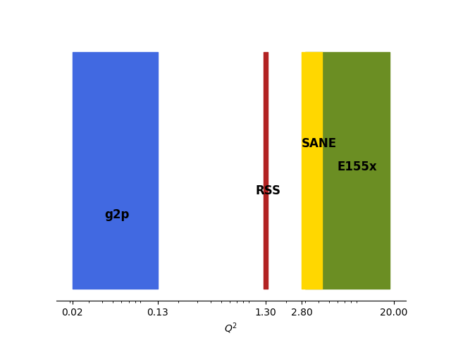
Proton
Neutron
g₁
g₂

Slide 8
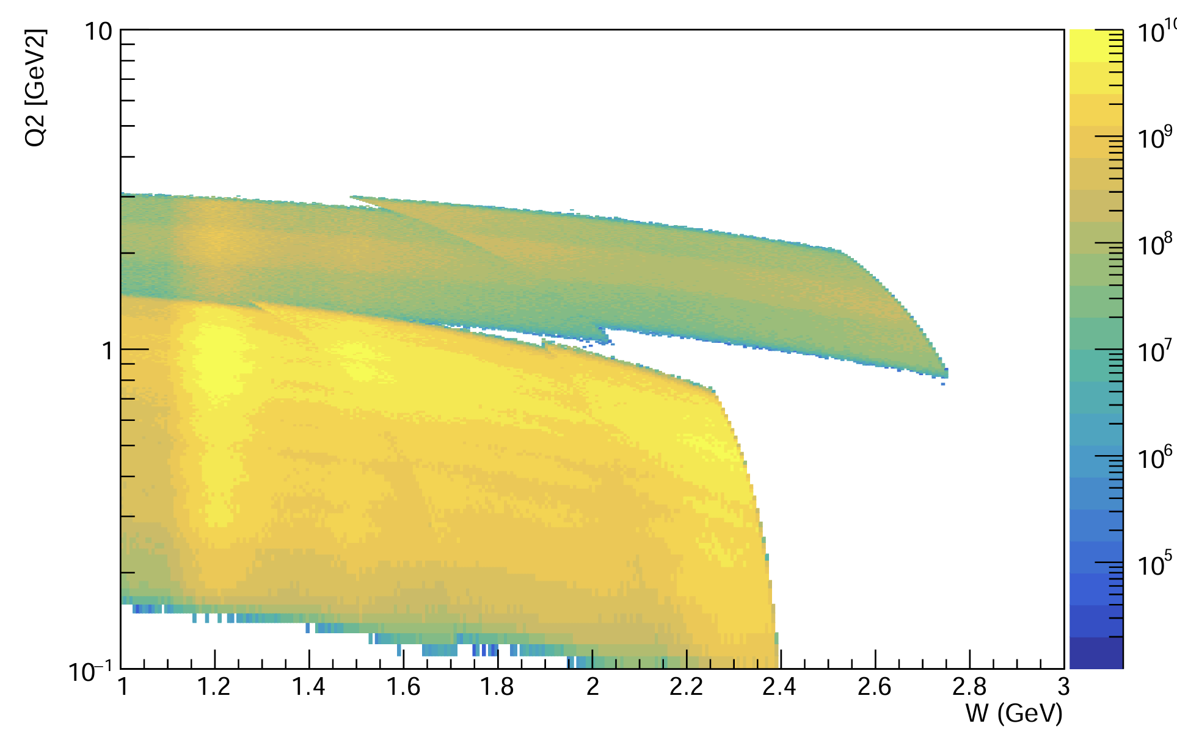
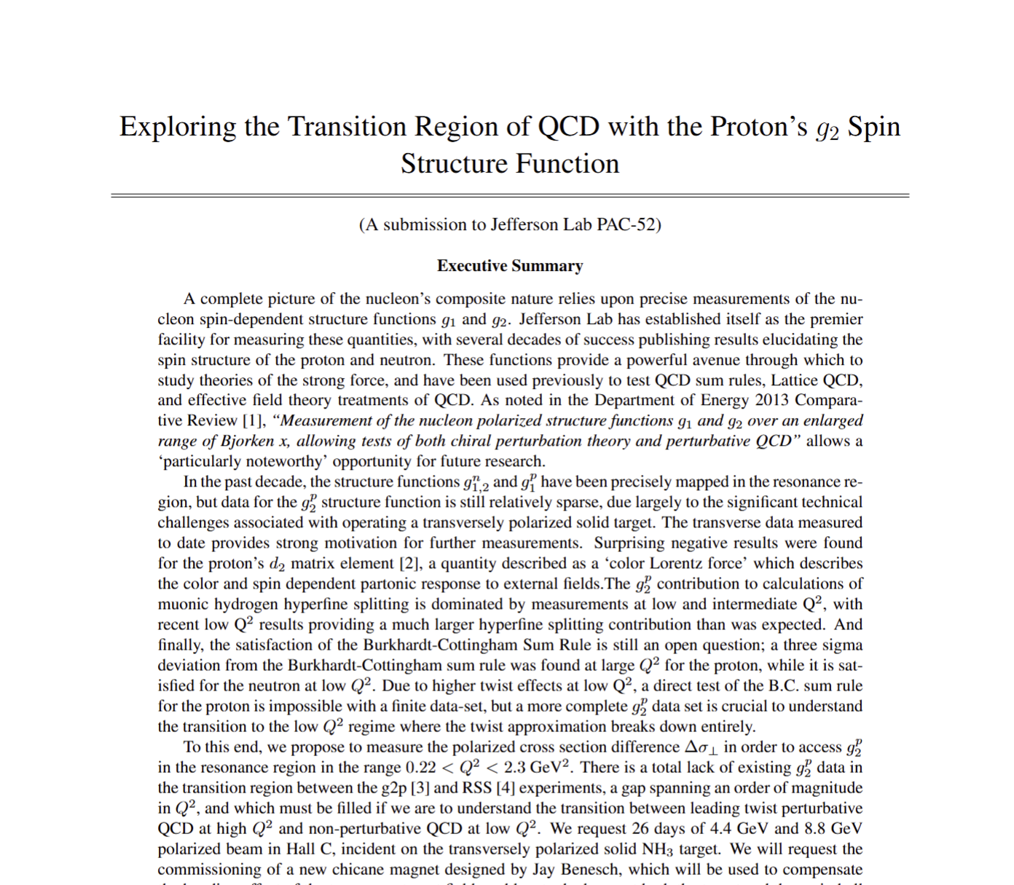
g2p2 Experiment (E12-24-002)
Measure proton g₂ in the resonance region for a full order of magnitude in Q² range from 0.2 GeV² - 2.2 GeV²
Use a transversely polarized NH₃ target and the SHMS spectrometer in Hall C
Collect the first transition region measurement of the proton’s g₂, and extract its moments and higher twist effects
8.8 GeV Beam
4.4 GeV Beam
Approved
A-
26 PAC Days

Slide 9
Synergy with Tensor Experiments
Hall C Experimental setup shares many equipment needs:
  Solid Polarized DNP Target
  Slow Raster
  Low Current Beamline Instrumentation
Differences:
  Tensor Enhancement Techniques
  Chicane Magnets
  Transverse Target Field
Currently plausible to be scheduled in sequence with b₁ and A_{zz}
Makes a lot of sense to collaborate on preparing the equipment and simulations
A lot of beamline work to be done…
See D. Gaskell talk yesterday

Slide 10
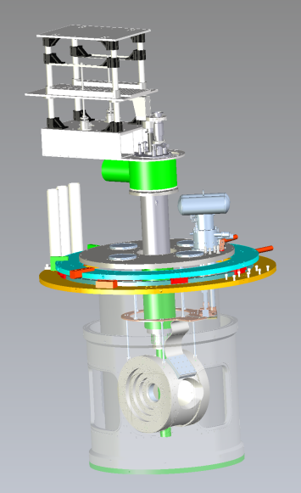


Solid Polarized Target
NH₃ (Ammonia) target
Dynamic Nuclear Polarization (DNP)
When target group has space, effort must begin to commission new superconducting magnet w/ scattering chamber and older UVA system fridge (1-2 years effort – C. Keith)
b₁ / A_{zz} / g2p2 collaborations should support this effort in whatever way target group recommends
Students from will be available to help

Slide 11
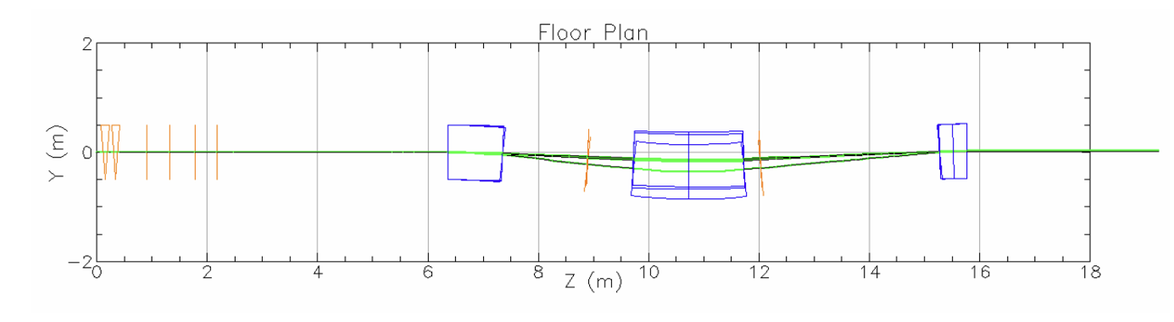
Chicane Magnet
See R. Bodenstein, JLAB-TN-25-023
The transverse target field needs pre-bending of the beam
Chicane design (J. Benesch) would replace two existing 1m dipoles
Further BMAD optimization performed by R. Bodenstein
High Priority: designs/drawings for the chicane and hoist-included beamline

Slide 12
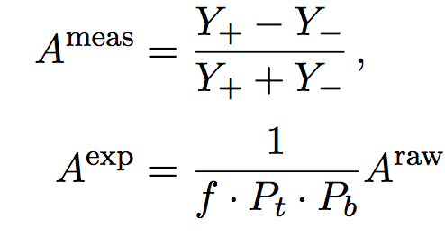
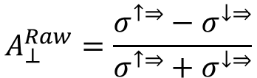
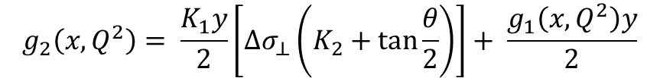


g₂ Extraction Method
Measure Asymmetry and Cross Section:
Form Polarized XS Difference:
Extract g₂
$$A_{⊥}^{Raw}=\frac{σ^{↑⇒}−σ^{↓⇒}}{σ^{↑⇒}+σ^{↓⇒}}$$
$$\frac{d2σ}{dΩdE′}=\frac{(ps)N}{N_{in}ρ(LT)ε_{det}}\frac{f}{ΔΩΔE′ΔZ}$$
Spin-Dependent Effects
Unpolarized
Scattering
$${∆σ}_{⊥} =2A_{⊥}^{exp}σ_{0}$$
Input from
Hall B Data
$$g_{2}\left(x,Q^{2}\right)= \frac{K_{1}y}{2}\left[Δσ_{⊥}\left(K_{2}+\tan{\frac{θ}{2}}\right)\right]+ \frac{g_{1}\left(x,Q^{2}\right)y}{2}$$

Slide 13
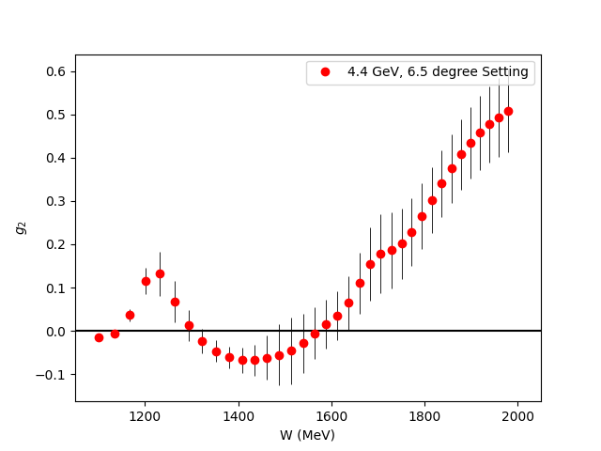
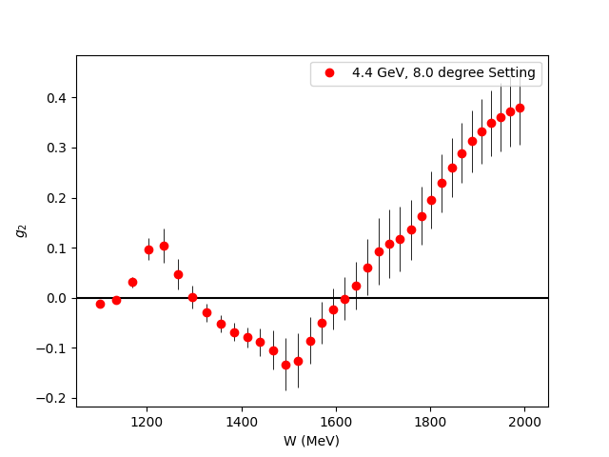
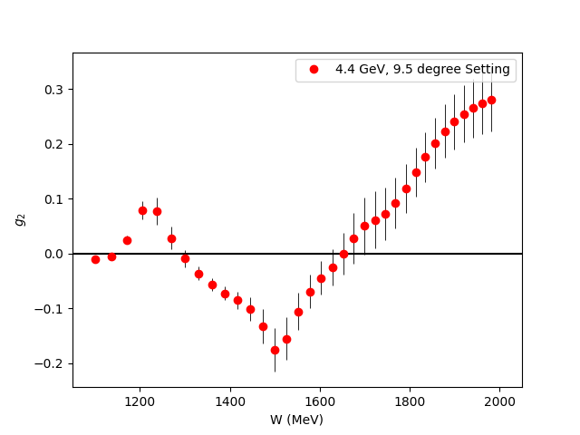
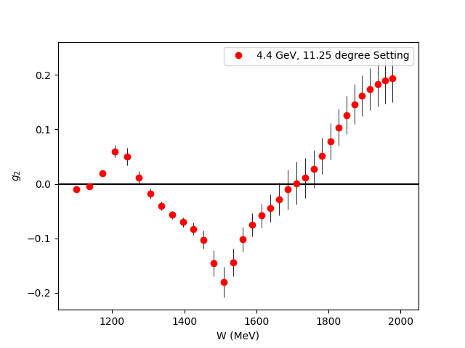
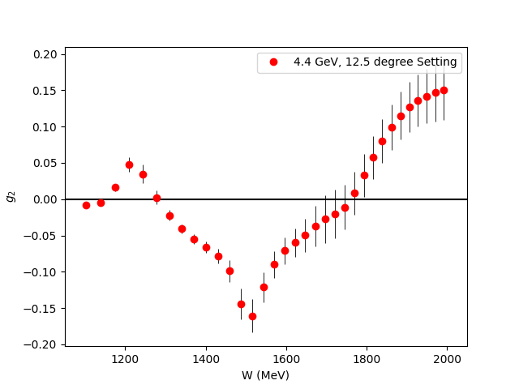
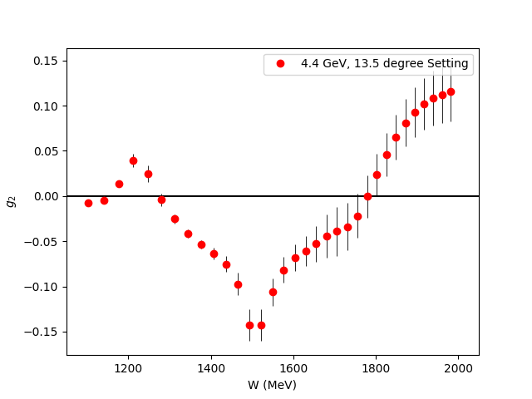
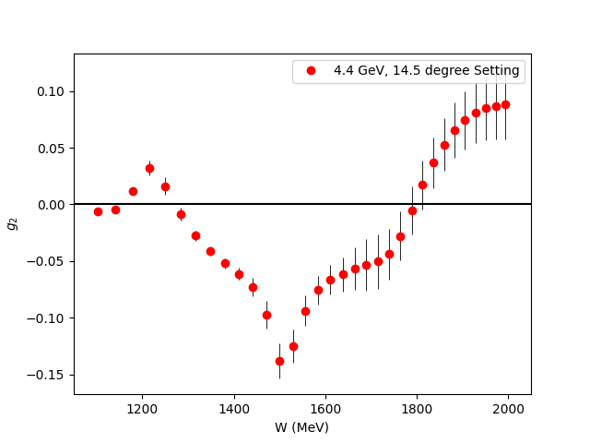
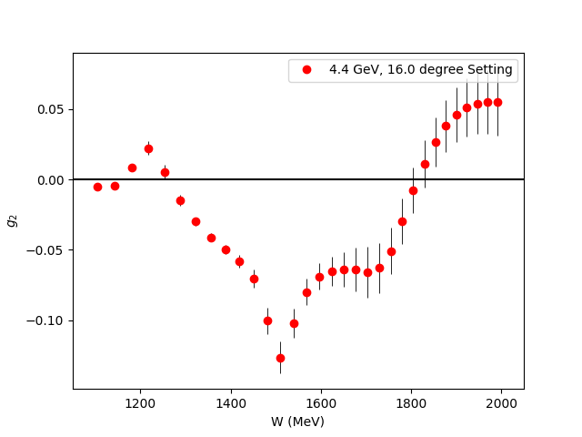
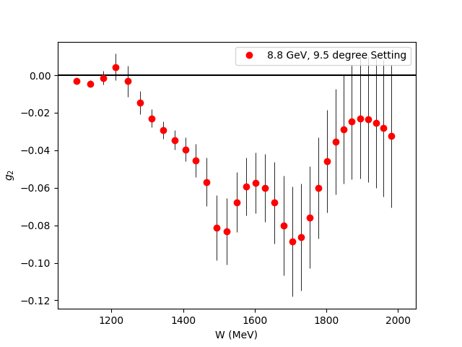
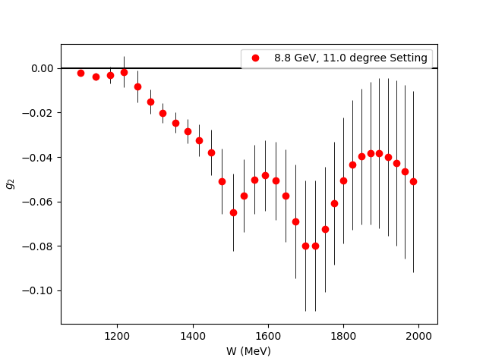
Projected g₂ Uncertainties
Fills the last major Q² spectrum gap for the nucleon spin structure functions
Covers almost the entire transition region

Slide 14
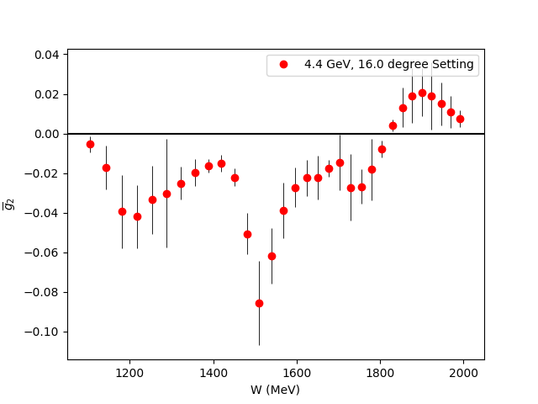


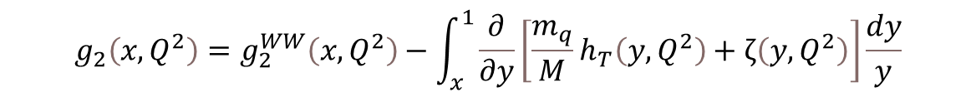
$\overline{g_{2}}$ (Twist 3 Extraction)
Small
$$g_{2}\left(x,Q^{2}\right)=g_{2}^{WW}\left(x,Q^{2}\right)−\int_{x}^{1}{\frac{∂}{∂y}\left[\frac{m_{q}}{M}h_{T}\left(y,Q^{2}\right)+ζ\left(y,Q^{2}\right)\right]\frac{dy}{y}}$$
$\overline{g_{2}}$ (Twist-3)
Utilize CLAS Hall B Results
for g₁ in same regime
Direct extraction of Twist 3 effects in the regime they contribute most significantly
Can also be used to study Dynamical Mass Generation
World First Extraction of this quantity

Slide 15
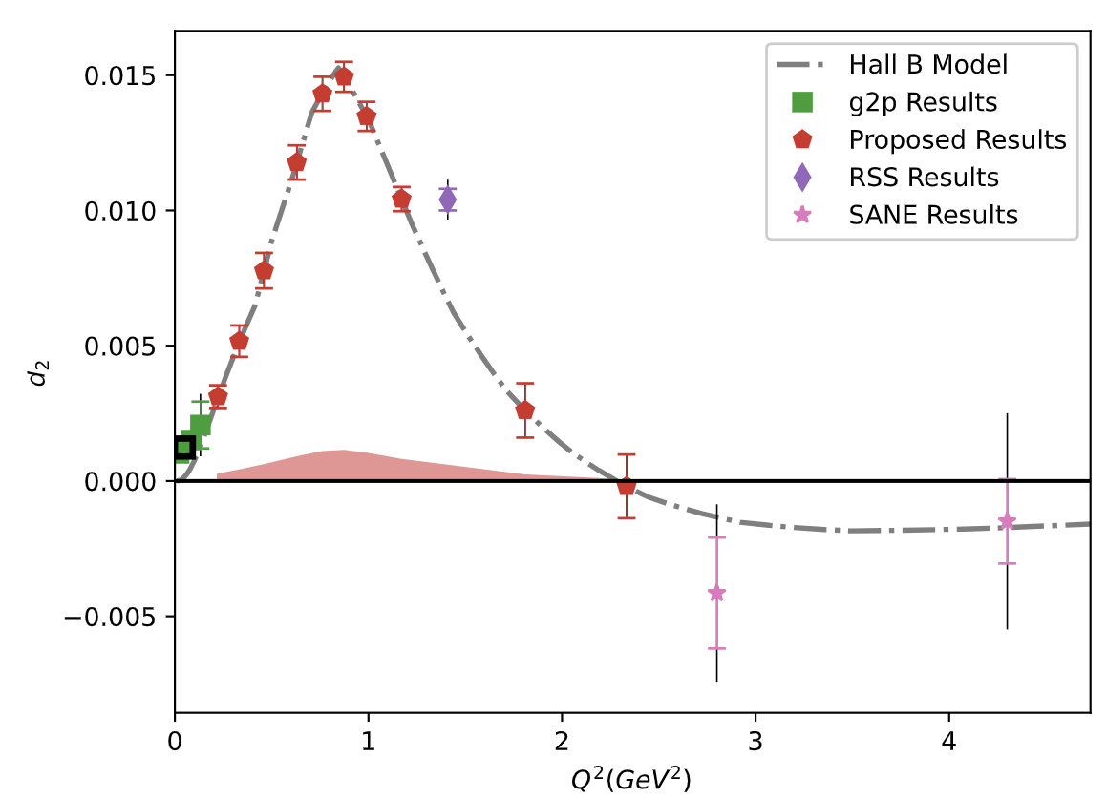

Projected $\overline{d_{2}}$ Uncertainties
Can benchmark Lattice QCD in the regime where Perturbative QCD starts failing
New Lattice calculations expected in next few years!

Slide 16
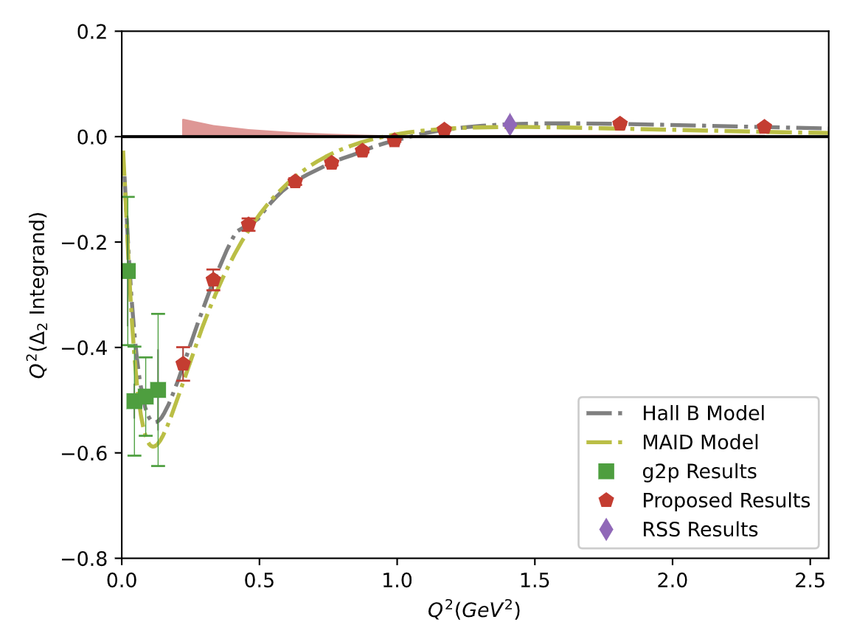
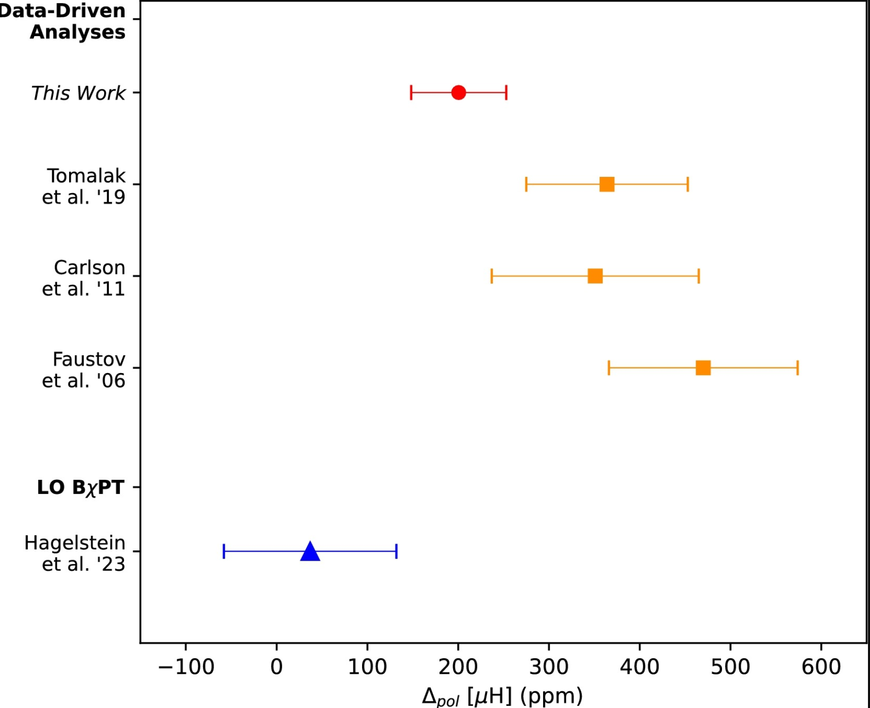
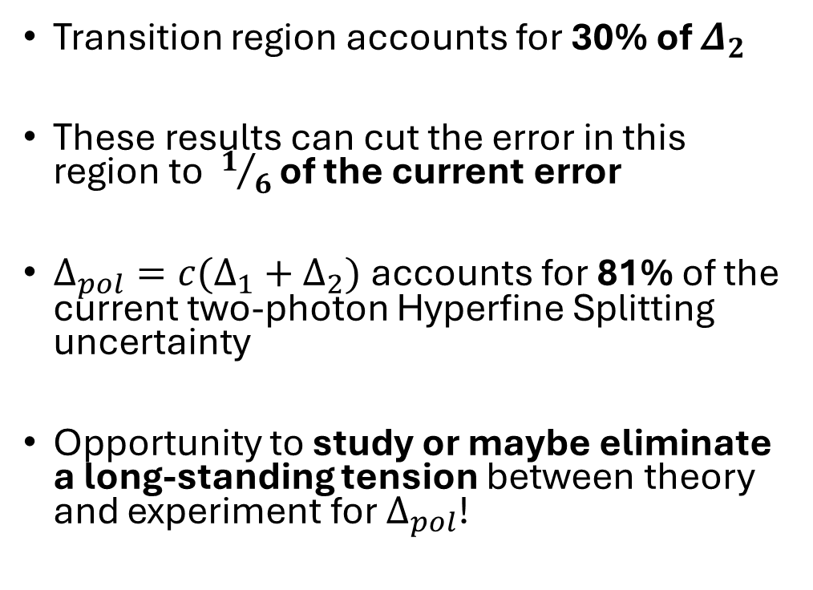


Hyperfine Splitting Impact
$$Δ_{2}=−24M_{p}^{2}\int_{0}^{∞}{\frac{dQ^{2}}{Q^{4}}}\int_{0}^{x_{th}}{\tilde{β_{2}}\left(x , Q^{2}\right)g_{2}\left(x , Q^{2}\right)dx}$$
Transition region accounts for 30% of $Δ_{2}$
These results can cut the error in this region to $1/6$ of the current error
$Δ_{pol}={c(Δ}_{1}+Δ_{2})$ accounts for 81% of the current two-photon Hyperfine Splitting uncertainty
Opportunity to study or maybe eliminate a long-standing tension between theory and experiment for $Δ_{pol}$!
Ruth
et al. ‘24
$$Δ_{pol}$$

Slide 17
Preparing for ERR
Not too soon to think about: Though it is early days for this experiment, the sooner we can be ready the more options the lab has to fit us into the schedule
Major Requirements (guess):
  Proving the transverse target will be operational in time
  Designs and drawings for beamline revision outlined by D. Gaskell
  Proving the beamline instruments can run at 85 nA (see D. Mack talk)
Possibility of a joint ERR with b1/Azz? More discussion needed since timetable is uncertain
Collaboration will be ready to send students, help build or obtain equipment, lobby with lab leadership about the importance of the experiment, or anything else that is needed/helpful
Relying on JLab staff to help us figure out where we can actually be helpful

Slide 18

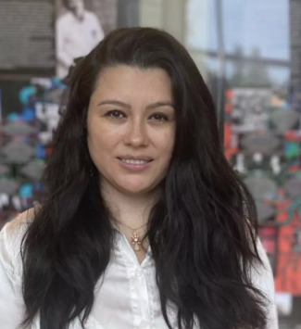
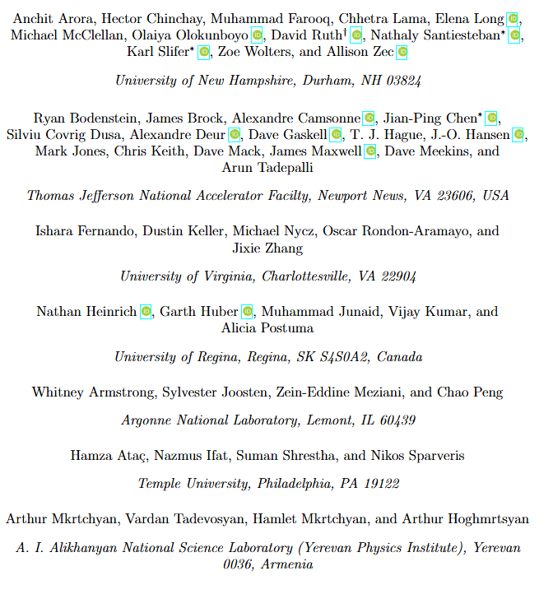
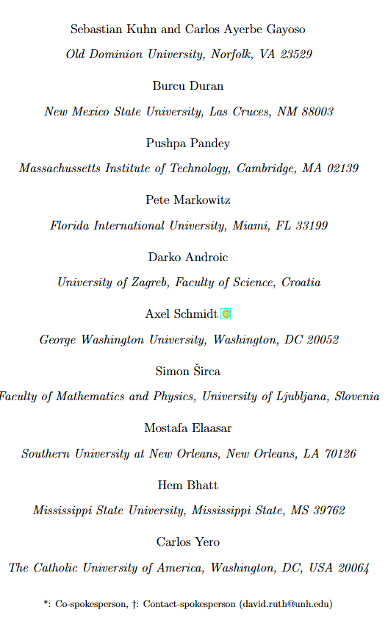
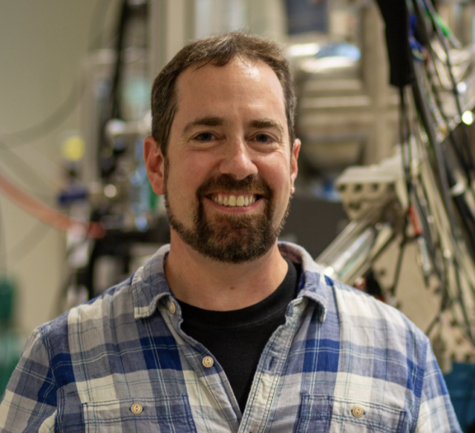
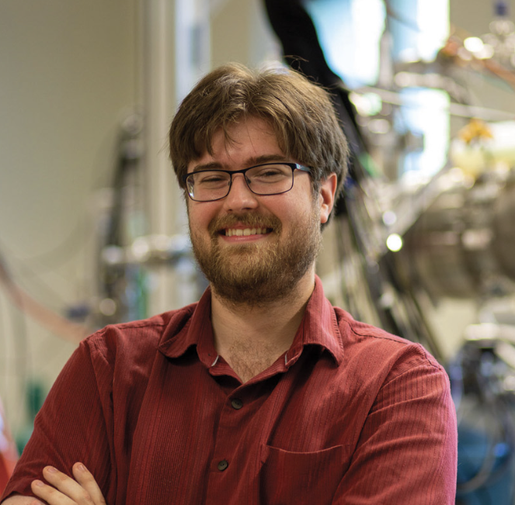
Thanks to the Collaboration!
Thanks especially to all the lab staff who helped us prepare the proposal:
Jian-Ping Chen
Nathaly Santiesteban
D. Gaskell
D. Mack
C. Keith
J. Benesch
R. Bodenstein
D. Higinbotham
M. Jones
S. Lassiter
And others…
Karl Slifer
David Ruth
Notes:
.

Slide 19
fin

Slide 20
Backup Slides

Slide 21
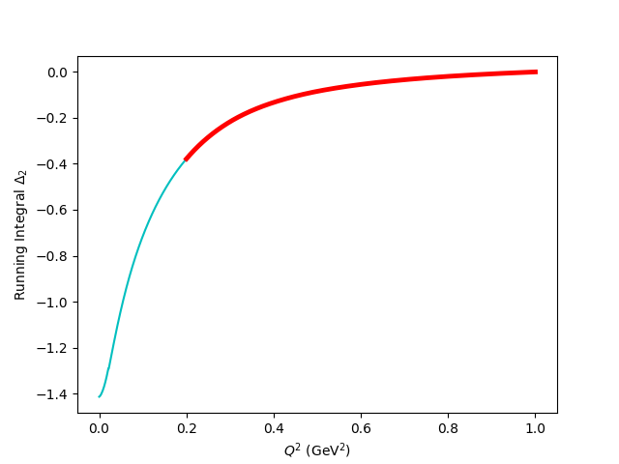

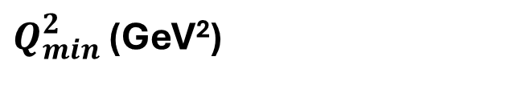
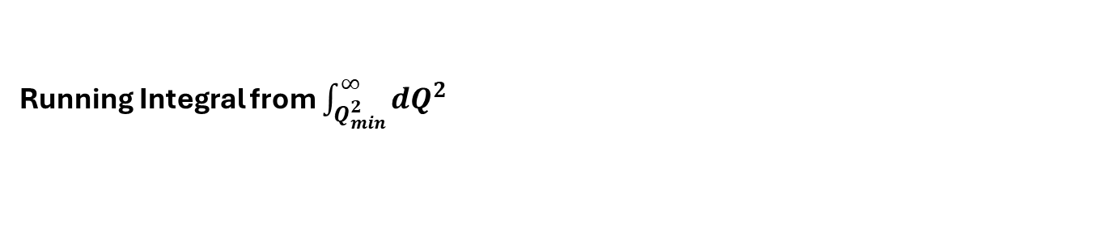
Hyperfine Contribution
Running Integral from $\int_{Q_{min}^{2}}^{∞}{dQ^{2}}$
$$Δ_{2}=−24M_{p}^{2}\int_{0}^{∞}{\frac{dQ^{2}}{Q^{4}}}\int_{0}^{x_{th}}{\tilde{β_{2}}\left(x , Q^{2}\right)g_{2}\left(x , Q^{2}\right)dx}$$
The leading error in theoretical calculations of the hydrogen HFS comes from these spin-structure function dependent integrals!
The subject of an ongoing tension between theory and experiment
The transition region accounts for ~30% of the integral!
Running Integral
$Q_{min}^{2}$ (GeV²)

Slide 22
Rates Table
E₀ (GeV) | Scattering Angle (deg) | P₀ (GeV) | Target Q² (GeV²) | Proton Rate (Hz) | Rate (kHz) | Time (h)
4.4 | 6.5 | 3.607 | 0.22 | 77 | 40.0 | 1
 |  | 2.661 |  | 65 | 25.1 | 1
 |  | 1.963 |  | 69 | 18.9 | 1
 | 8 | 3.607 | 0.33 | 41 | 21.4 | 1.3
 |  | 2.661 |  | 28 | 11.5 | 1.9
 |  | 1.963 |  | 30 | 8.3 | 1.8
 | 9.5 | 3.607 | 0.46 | 18 | 9.1 | 2.3
 |  | 2.661 |  | 14 | 5.9 | 3.0
 |  | 1.963 |  | 15 | 4.3 | 2.8
 | 11.2 | 3.607 | 0.62 | 7 | 3.7 | 6.0
 |  | 2.661 |  | 6 | 3.0 | 6.5
 |  | 1.963 |  | 7 | 2.2 | 5.9
 | 12.5 | 3.607 | 0.765 | 4 | 2.0 | 9.1
 |  | 2.661 |  | 4 | 1.9 | 8.5
 |  | 1.963 |  | 4 | 1.5 | 7.6
 | 13.5 | 3.607 | 0.892 | 2 | 1.3 | 16.5
 |  | 2.661 |  | 3 | 1.3 | 13.7
 |  | 1.963 |  | 3 | 1.1 | 12.1
 | 14.5 | 3.607 | 1.028 | 1 | 0.8 | 23.2
 |  | 2.661 |  | 2 | 1.0 | 17.4
 |  | 1.963 |  | 2 | 0.8 | 14.9
 | 16 | 3.607 | 1.250 | 0 | 0.4 | 50.8
 |  | 2.661 |  | 1 | 0.6 | 32.7
 |  | 1.963 |  | 1 | 0.5 | 26.6
8.8 | 11 | 7.213 | 2.3 | 0 | 0.5 | 33.3
 |  | 5.321 |  | 0 | 0.8 | 19.0
 | 14 | 7.213 | 3.44 | 0 | 0.1 | 101.8
 |  | 5.321 |  | 0 | 0.2 | 31.6
Total PAC Days:
13.0

Slide 23
Overhead
Overhead | Number | Time Per (hr) | (hr)
Target Anneal | 26 | 2.0 | 52.0
Beamline Survey | 10 | 8.0 | 80.0
Target Swap | 2 | 4.0 | 8.0
Target T.E. | 6 | 4 | 24.0
Target Field Ramp | 10 | 1.0 | 10.0
Carbon, Dummy, Empty runs | 28 | 0.5 | 14.0
Pass Change | 2 | 4.0 | 8.0
Momentum Change | 28 | 0.5 | 14.0
Moller Measurement | 10(+1 shift) | 4.0(+8.0) | 48.0
Pair-Symmetric Background | 2 | 4.0 | 8.0
Optics Calibration | 2 | 16.0 | 32.0
BCM Calibration | 2 | 4.0 | 8.0
Total: 12.7 Overhead Days (305.5)

Slide 24
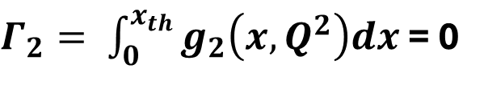
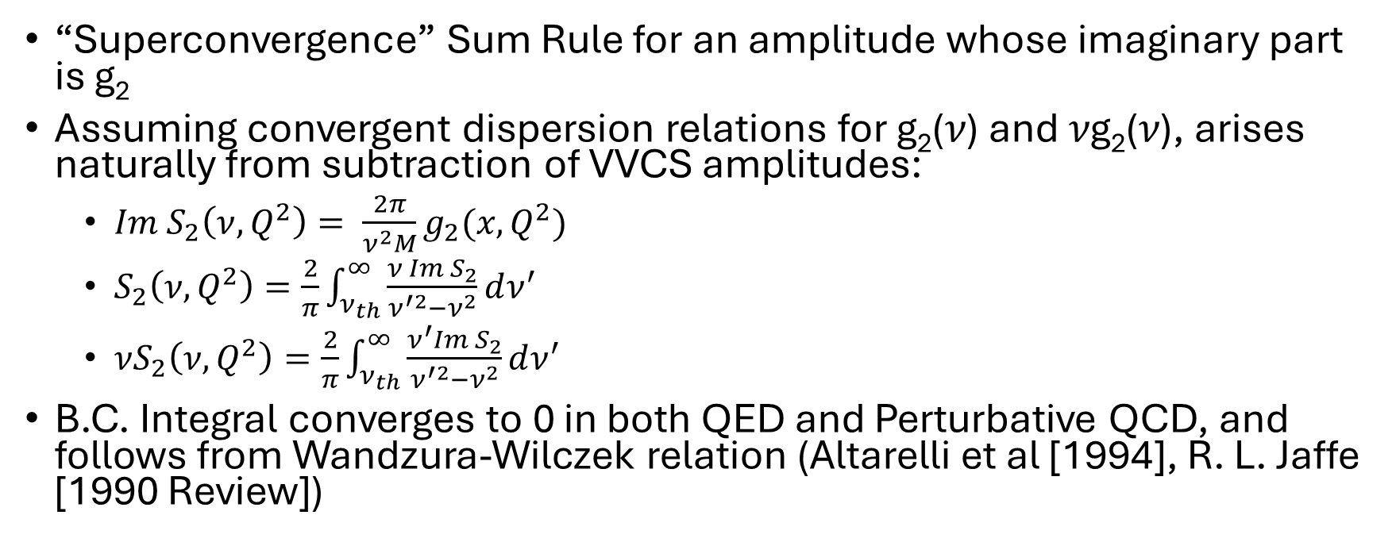
Burkhardt-Cottingham Sum Rule
$Γ_{2}= \int_{0}^{x_{th}}{g_{2}\left(x,Q^{2}\right)dx}$ = 0
“Superconvergence” Sum Rule for an amplitude whose imaginary part is g₂
Assuming convergent dispersion relations for g₂(𝜈) and 𝜈g₂(𝜈), arises naturally from subtraction of VVCS amplitudes:
  $Im S_{2}\left(ν,Q^{2}\right)= \frac{2π}{ν^{2}M}g_{2}(x,Q^{2})$
  $S_{2}\left(ν,Q^{2}\right)=\frac{2}{π}\int_{ν_{th}}^{∞}{\frac{ν Im S_{2}}{ν^{′2}−ν^{2}}dν^{′}}$
  $νS_{2}\left(ν,Q^{2}\right)=\frac{2}{π}\int_{ν_{th}}^{∞}{\frac{ν^{′}Im S_{2}}{ν^{′2}−ν^{2}}dν^{′}}$
B.C. Integral converges to 0 in both QED and Perturbative QCD, and follows from Wandzura-Wilczek relation (Altarelli et al [1994], R. L. Jaffe [1990 Review])

Slide 25
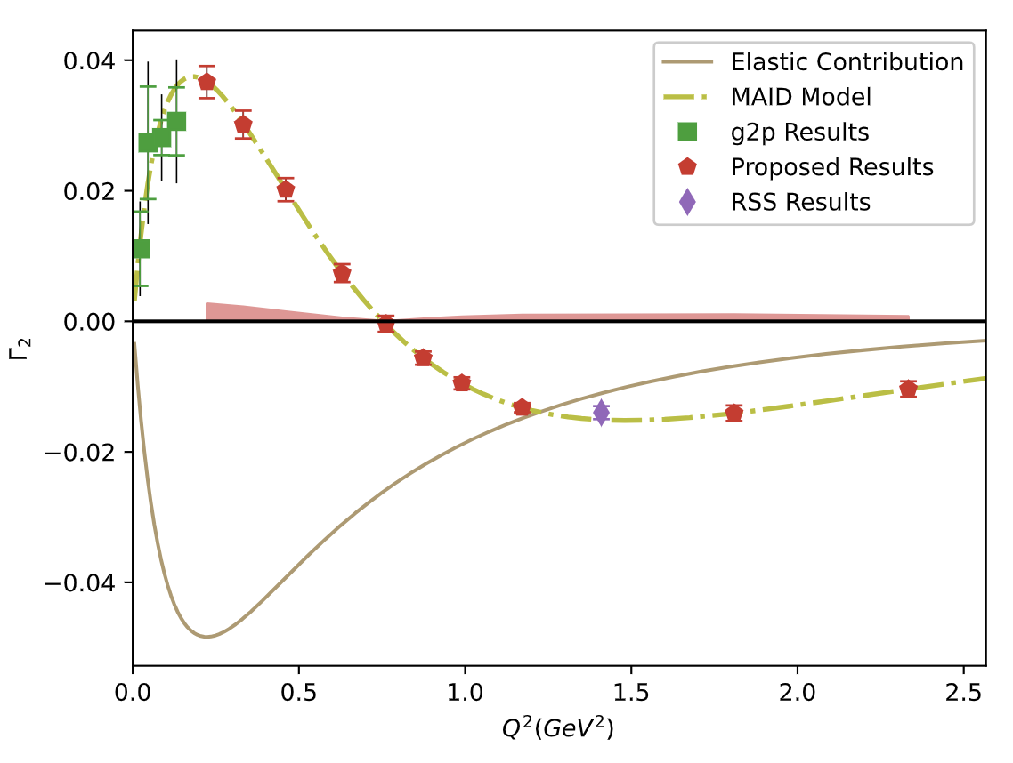
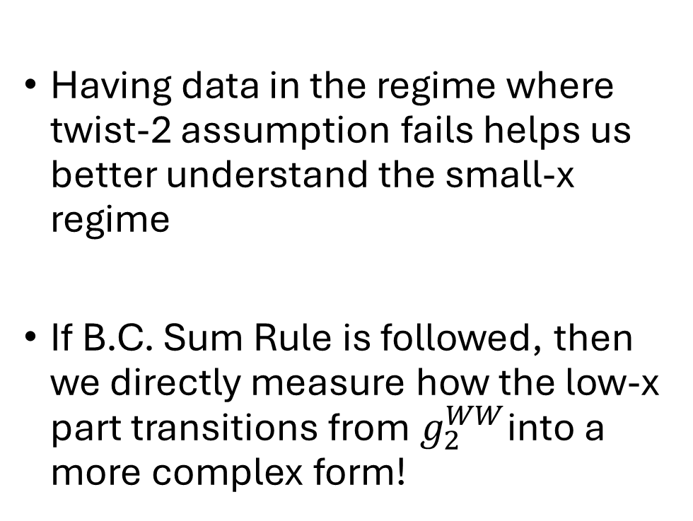

Projected $Γ_{2}$ Uncertainties
Having data in the regime where twist-2 assumption fails helps us better understand the small-x regime
If B.C. Sum Rule is followed, then we directly measure how the low-x part transitions from $g_{2}^{WW}$into a more complex form!

