Slide 1


Vector & Beam-Target Asymmetries from b1/Azz Data E. Long, EPJ A (in review)
Elena Long
Tensor Collaboration Meeting
Oct. 14th, 2025

Slide 2


Polarization Cross Section
General electron-deuteron scattering cross section:
For b1/Azz, we ideally want $h_{e}=0$ & $P=0$
But we can’t get $P=0$ w/ large $Q$ using a DNP target
$$σ\left(h_{e},P,Q\right)=σ_{u}\left[1+h_{e}\left(A_{e}+PA_{ed}^{V}+QA_{ed}^{T}\right)+PA_{d}^{V}+QA_{d}^{T}\right]$$
$$A_{d}^{T}=\frac{1}{2}A_{zz}$$
$$σ\left(0,P,Q\right)=σ_{u}\left[1+PA_{d}^{V}+QA_{d}^{T}\right]$$

Slide 3
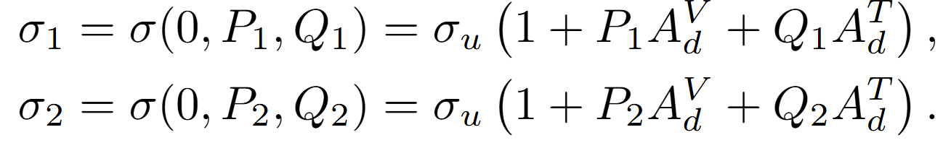
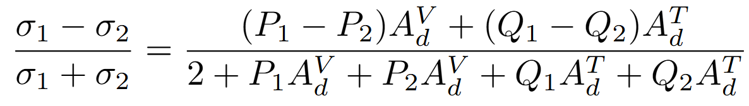
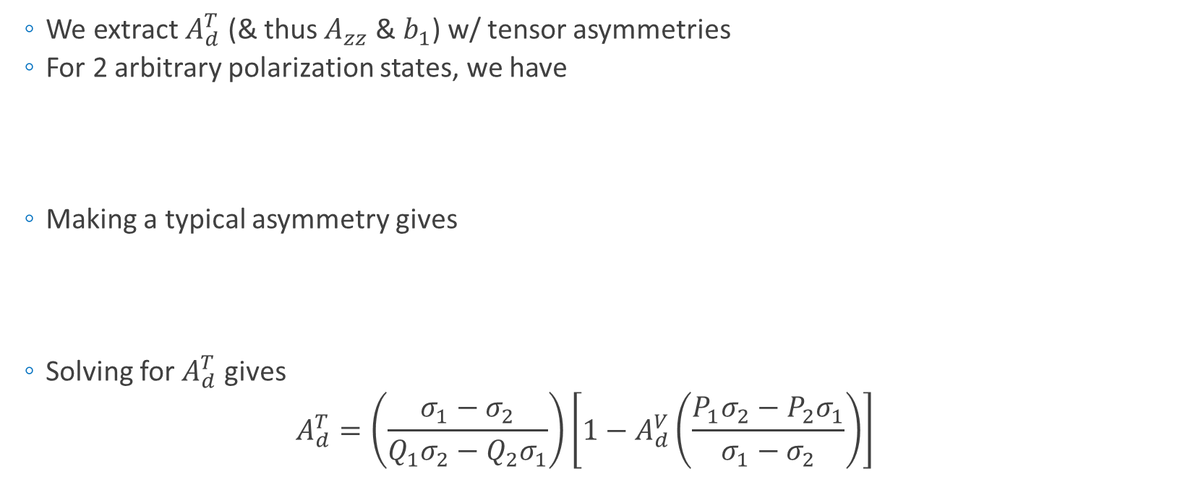
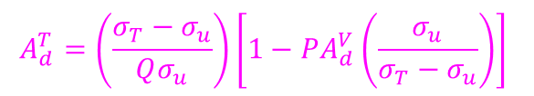
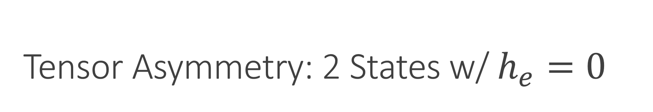
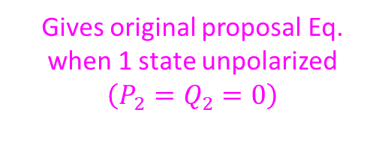
Tensor Asymmetry: 2 States w/ $h_{e}=0$
We extract $A_{d}^{T}$ (& thus $A_{zz}$ & $b_{1}$) w/ tensor asymmetries
For 2 arbitrary polarization states, we have
Making a typical asymmetry gives
Solving for $A_{d}^{T}$ gives
$$A_{d}^{T}=\left(\frac{σ_{1}−σ_{2}}{Q_{1}σ_{2}−Q_{2}σ_{1}}\right)\left[1−A_{d}^{V}\left(\frac{P_{1}σ_{2}−P_{2}σ_{1}}{σ_{1}−σ_{2}}\right)\right]$$
Gives original proposal Eq. when 1 state unpolarized $$\left(P_{2}=Q_{2}=0\right)$$
$$A_{d}^{T}=\left(\frac{σ_{T}−σ_{u}}{Qσ_{u}}\right)\left[1−PA_{d}^{V}\left(\frac{σ_{u}}{σ_{T}−σ_{u}}\right)\right]$$

Slide 4
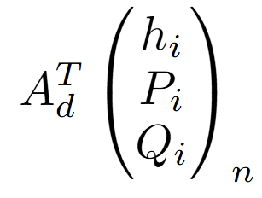
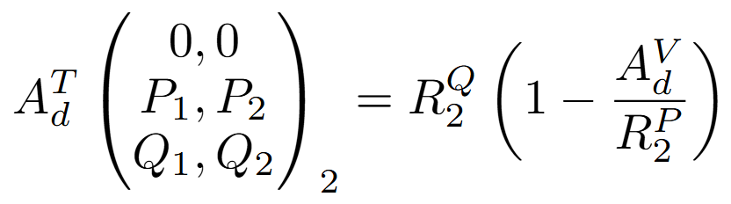
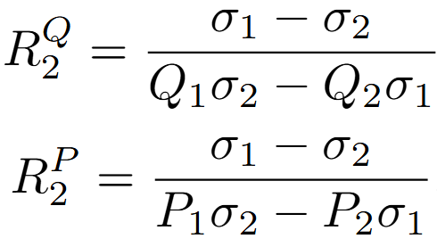
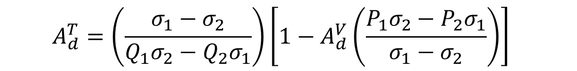
Formalism
$$A_{d}^{T}=\left(\frac{σ_{1}−σ_{2}}{Q_{1}σ_{2}−Q_{2}σ_{1}}\right)\left[1−A_{d}^{V}\left(\frac{P_{1}σ_{2}−P_{2}σ_{1}}{σ_{1}−σ_{2}}\right)\right]$$
Beam Helicity States
We can generalize this equation
Tensor asymmetry defined by polarization configurations
Target Vector States
Target Tensor States
Asym. to measure
# of configs
with
Primary Measurement
Contamination Term

Slide 5
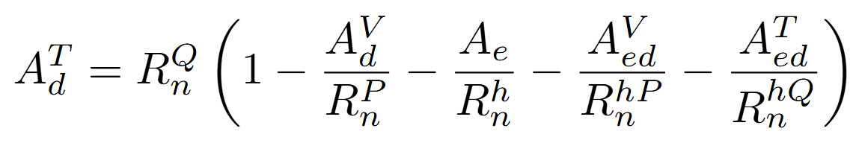
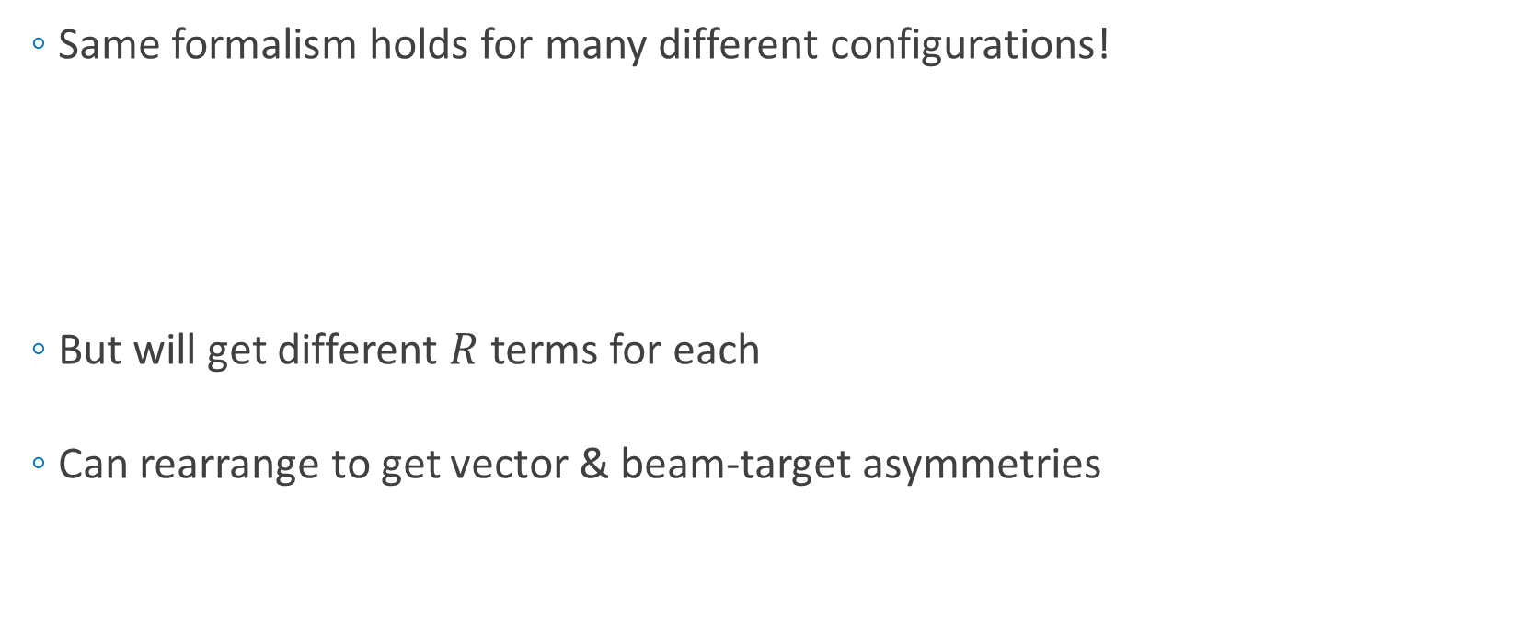
Formalism
Same formalism holds for many different configurations!
But will get different $R$ terms for each
Can rearrange to get vector & beam-target asymmetries

Slide 6
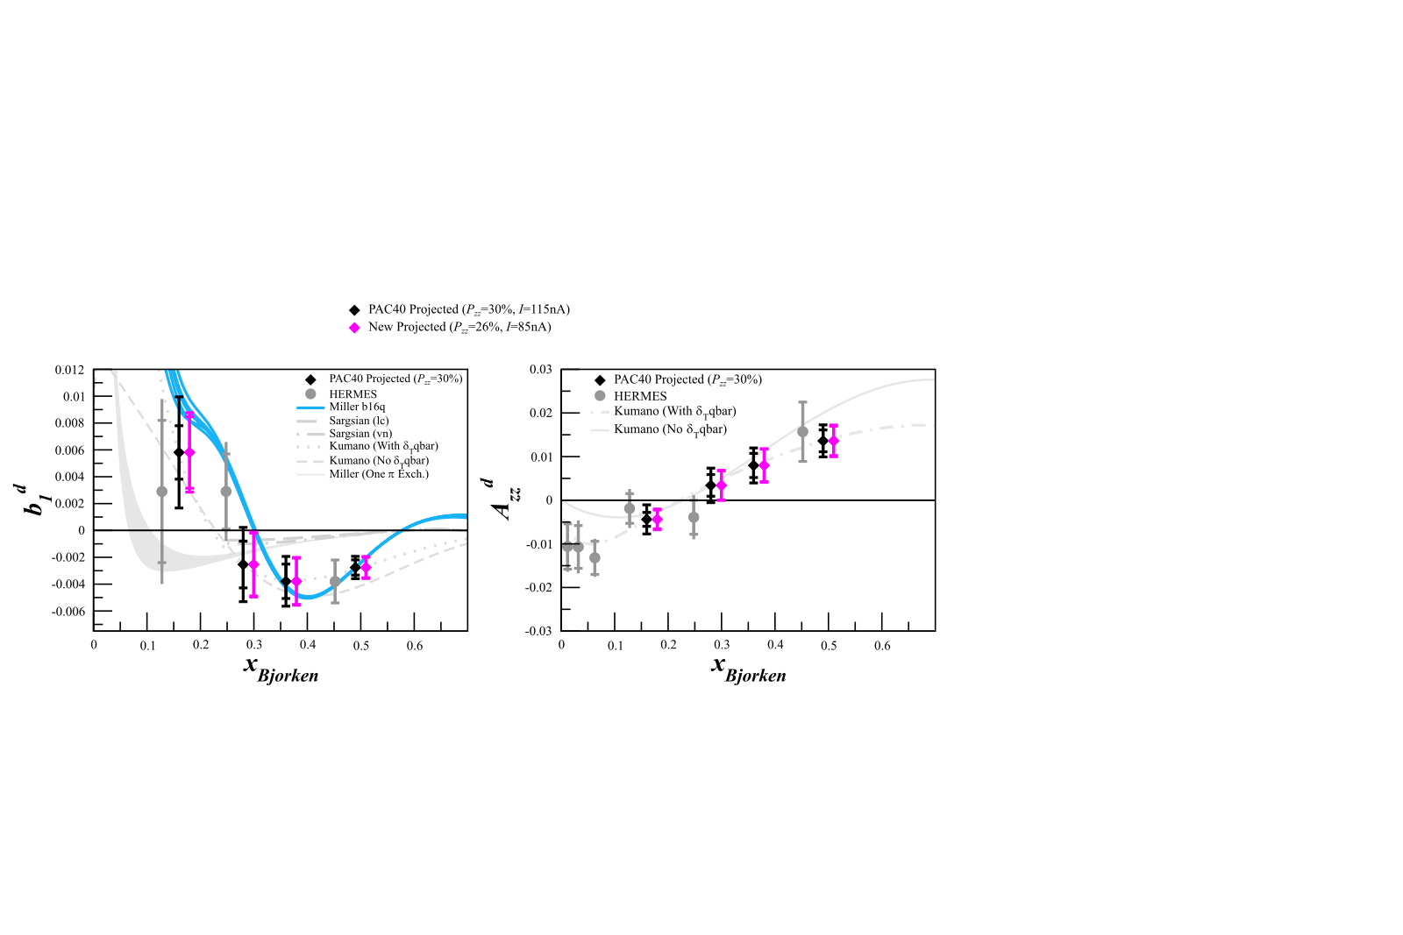
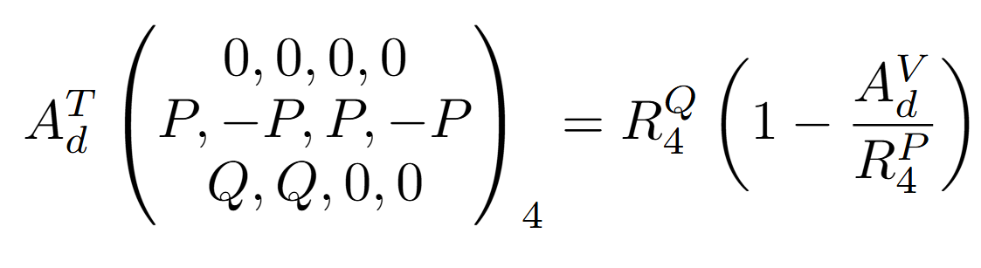
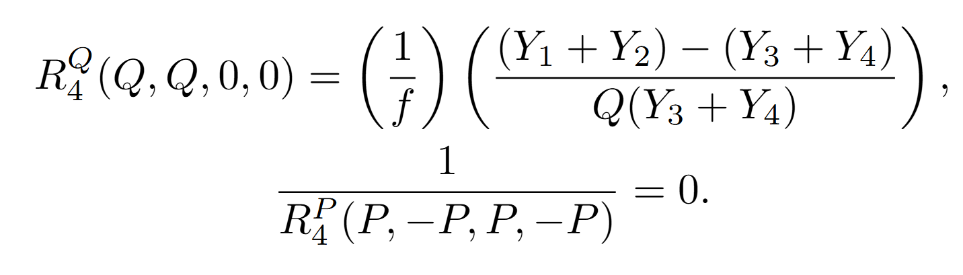

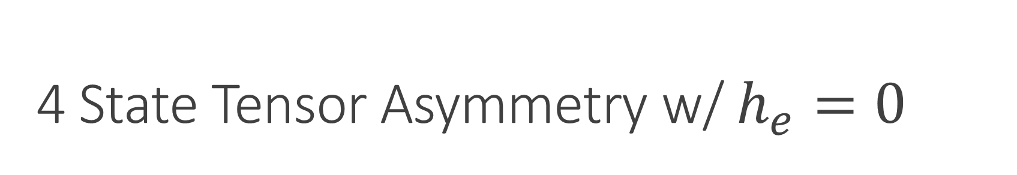
4 State Tensor Asymmetry w/ $h_{e}=0$
Target advances allow us to maintain large $P$ while enhancing or suppressing $Q$
Rapid tensor enhancement/suppression decreases systematic uncertainty
with

Slide 7
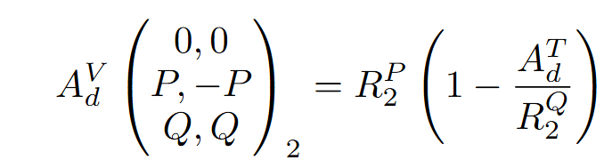
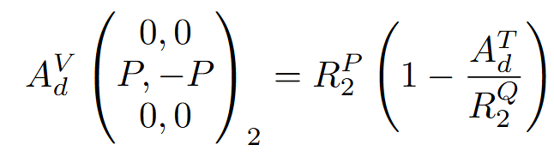
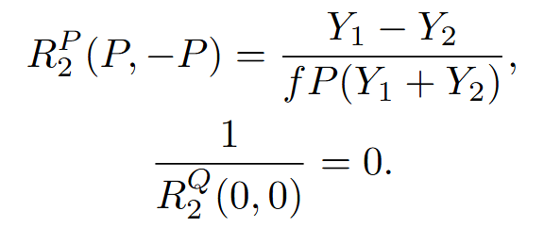
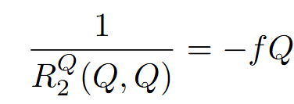
Parasitic Vector Asymmetry (2 State)
With b1/Azz data, we can extract the vector asymmetry in two different 2-state configurations
or
Statistics ~ the ½ that of Azz/b1
Statistics ~ the ½ that of Azz/b1

Slide 8
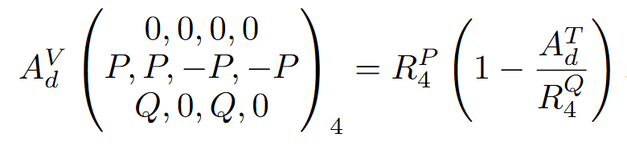
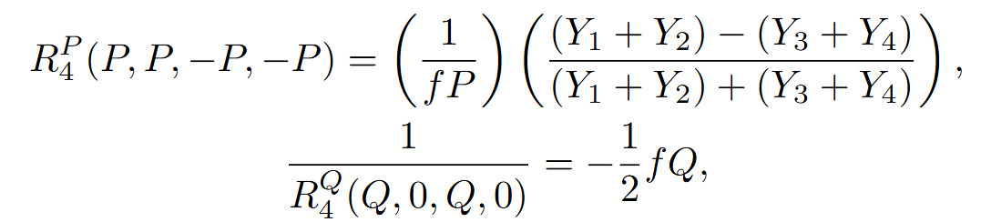
Parasitic Vector Asymmetry (4 State)
Can combine into a single 4-state measurement, increasing statistics but including tensor term

Slide 9
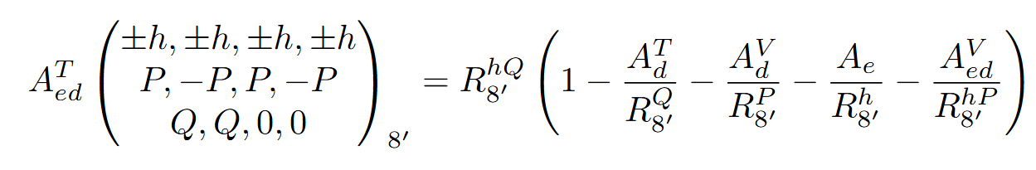
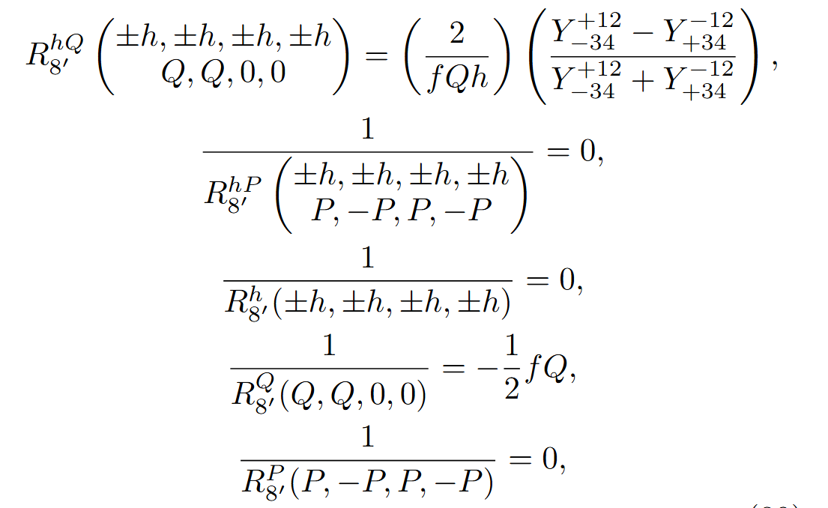
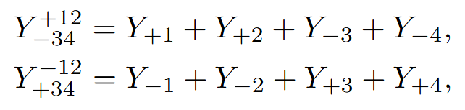
Parasitic Beam-Target Double Spin Asymmetries (8 states)
Since the JLab beam is polarized, we can split the beam helicities from our 4 state measurement to get 8 state measurements – Can extract vector & tensor DSA!
Tensor DSA
Statistics roughly the same as Azz/b1, but scaled by beam helicity

Slide 10
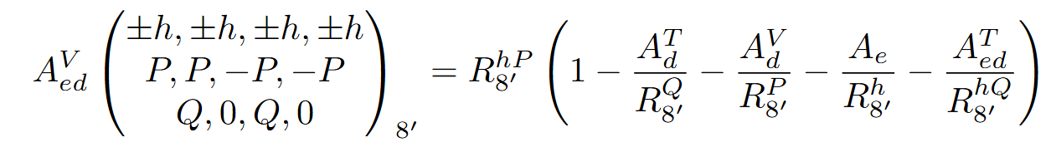
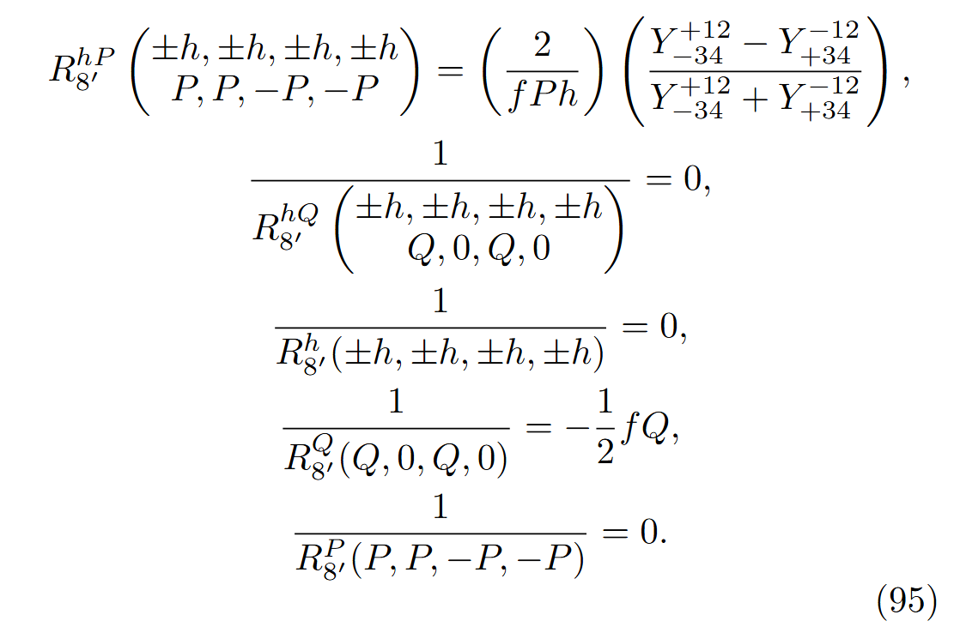
Parasitic Beam-Target Double Spin Asymmetries (8 states)
Since the JLab beam is polarized, we can split the beam helicities from our 4 state measurement to get 8 state measurements – Can extract vector & tensor DSA!
Vector DSA
Statistics roughly the same as Azz/b1, but scaled by beam helicity

Slide 11
Complications
Things get messier when polarizations aren’t exactly equal, but the algebra has all been worked out in upcoming EPJA paper
Also includes:
Configurations better suited for atomic beam source targets/collider experiments
3 state configurations are very useful w/ pure polarization states
Full uncertainty equations

Slide 12
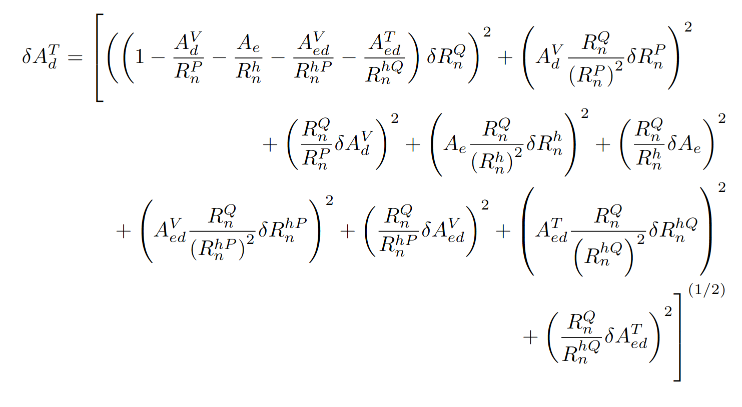
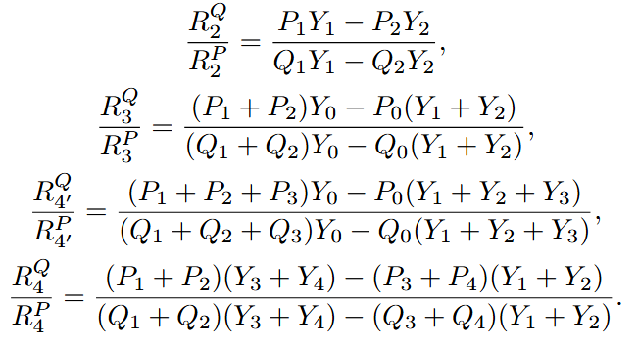
Uncertainties
Polarization Choice Can Reduce Uncertainty Terms

Slide 13
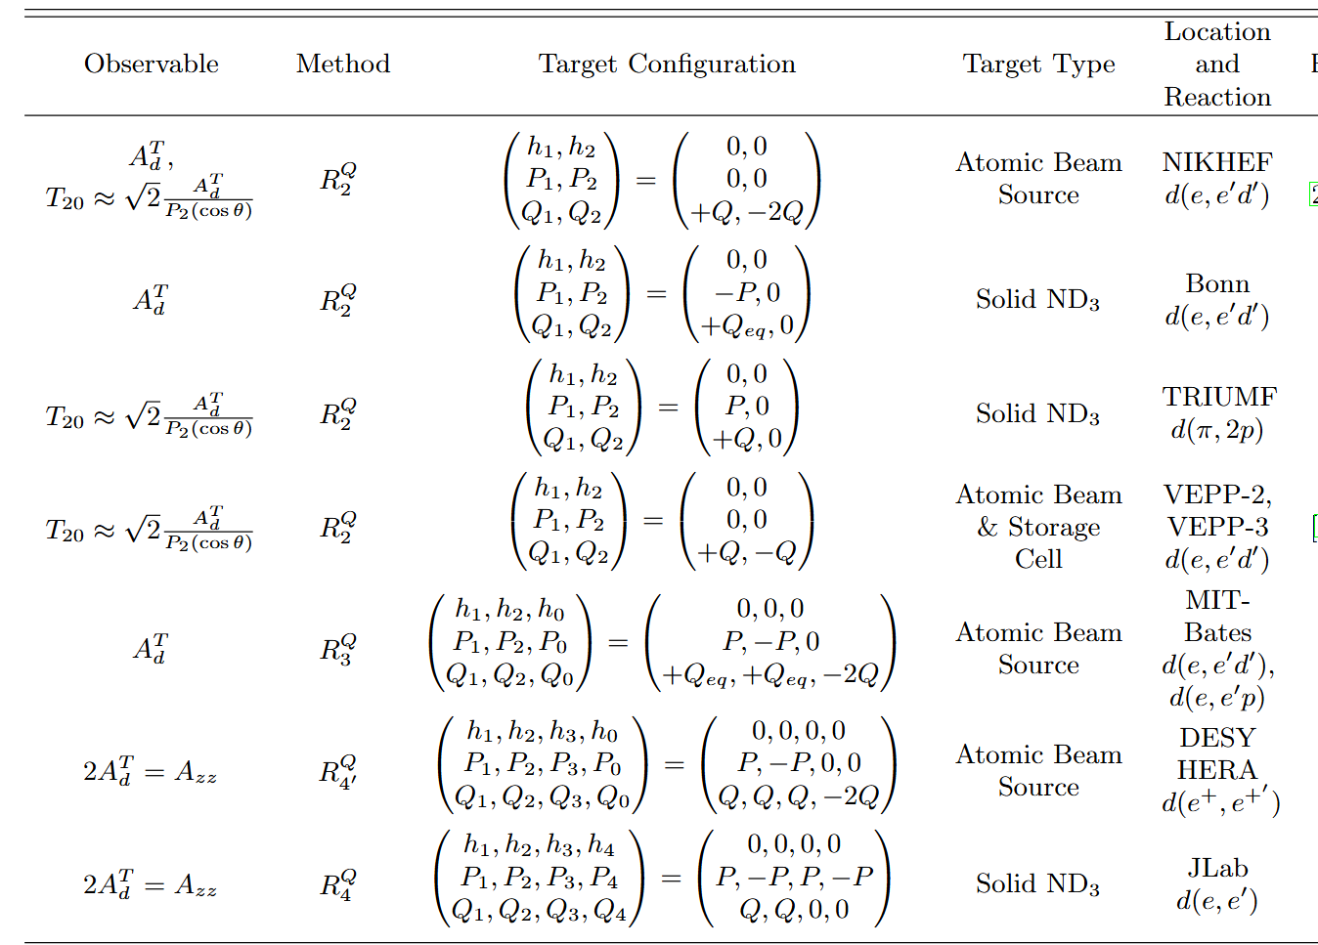
Existing & Upcoming Tensor Measurements

Slide 14
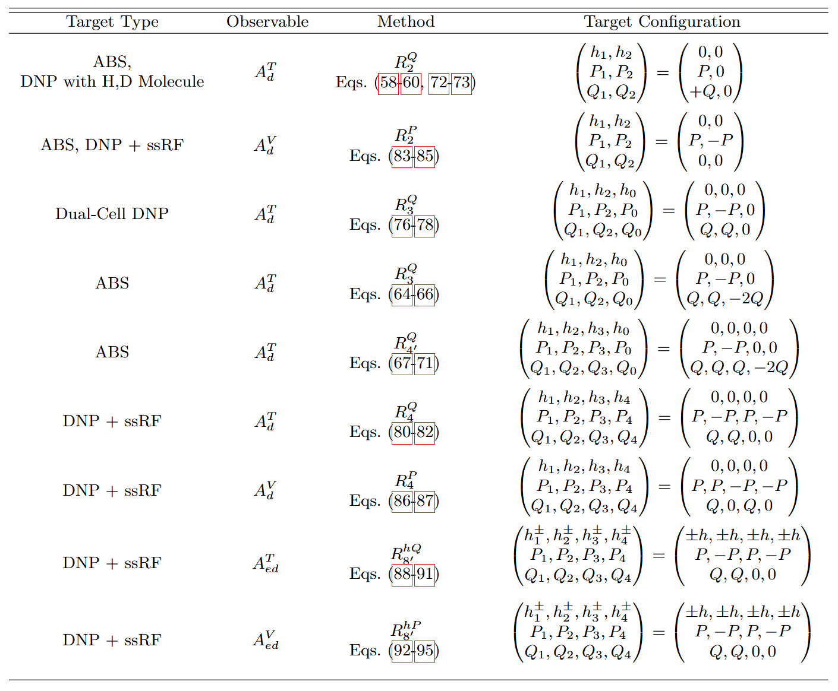
Optimal Experimental Configurations

Slide 15
Thank you!

