Slide 1
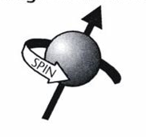
A model for T1 Extraction
Shane Clements, Dustin Keller
UVA Polarized Target Group
14.10.2025

Slide 2
Outline
Our goals.
What is spin-lattice relaxation?
First principles derivation.
T1 from experimental data.
The calibration constant.
Future plans.

Slide 3
Goals
Make predictions about the calibration constant from limited depolarization curve.
Minimize pause time taking data during the experiment.
More efficient experiment.
By using lots of experimental data at various temps, target life cycles, and radiation damage to build simulations and produce training data to construct a model to accurately determine a mapping between polarization and area under the signal curve prior to full relaxation.

Slide 4
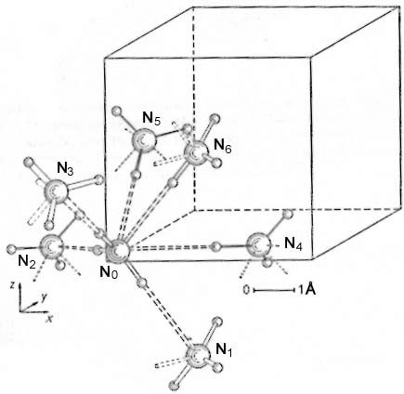
What is Spin-Lattice Relaxation?
Why Do We Care?
It is the energy diffusion from excited spins across the lattice, returning the spins to thermal equilibrium.
We need to extract the Spin-Lattice Relaxation time which characterizes the time interval of the relaxation process.
Unit Cell of NH₃ at 171 K.
https://www.researchgate.net/figure/The-crystal-structure-of-ammonia-at-171-K_fig11_30072616

Slide 5
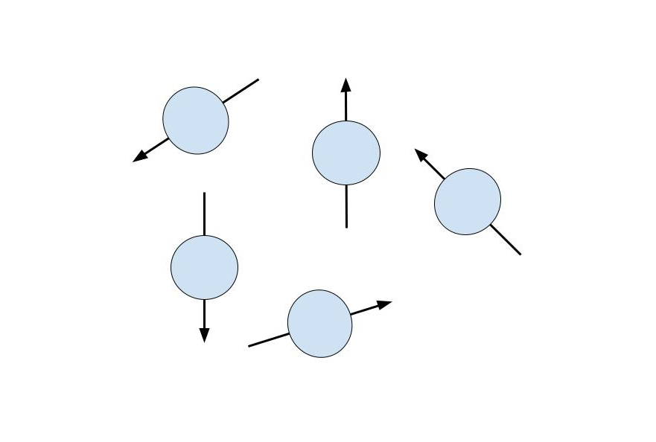
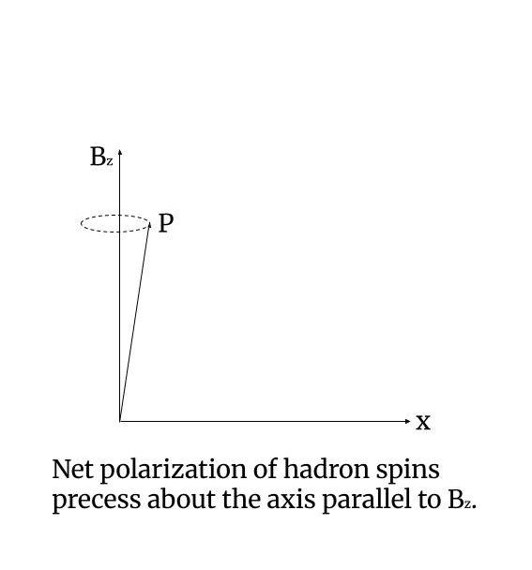
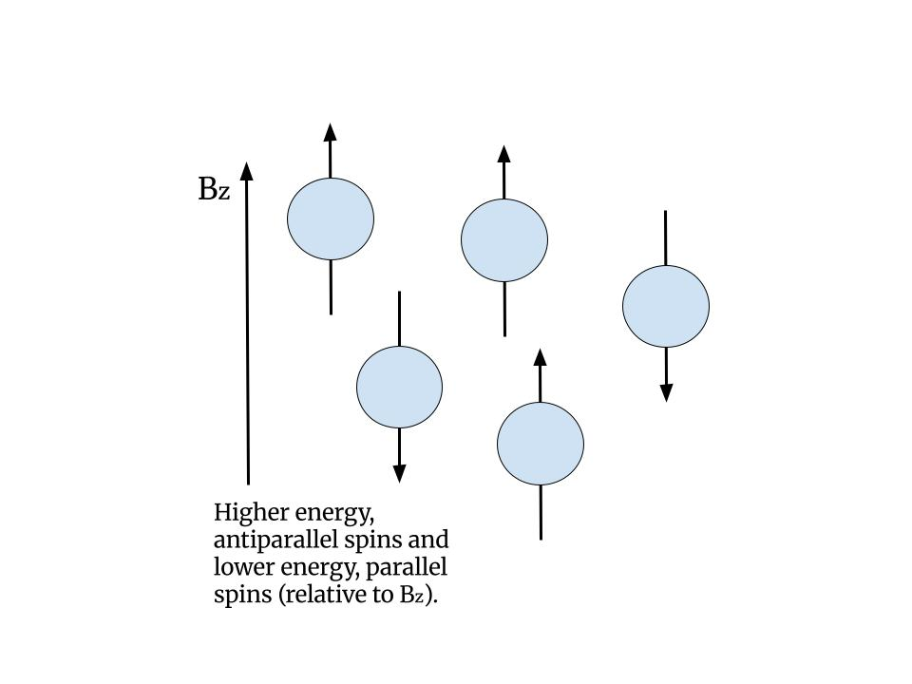

Slide 6
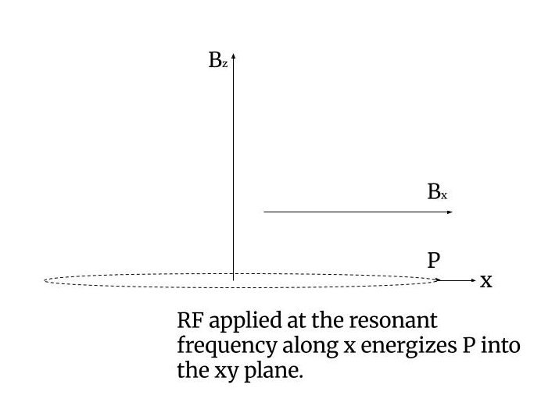
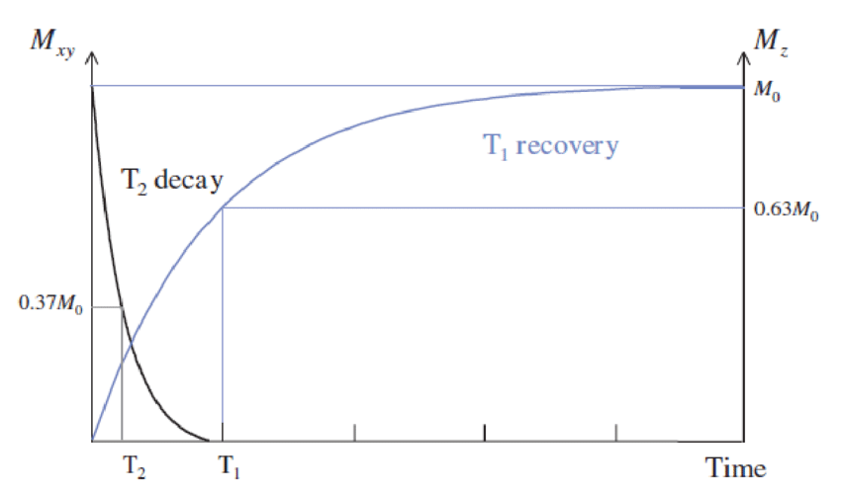
https://www.researchgate.net/figure/Relaxation-rates-T1-recovery-is-the-longitudinal-relaxation-and-T2-decay-is-the_fig6_340225510

Slide 7
T1 from First Principles
Computes constants for a combined prefactor.
Loops over all NN pairs to compute transition rates.
Idealized model: did not consider doping and paramagnetic centers, impurities, radiation damage, time since annealing.
Forms array based off geometry (fractional positions to Cartesian).
Diagonalize array of transition rate sums, and the inverse of the smallest nonzero diagonal element is .

Slide 8




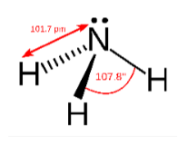


The Computation Single Spin

Slide 9
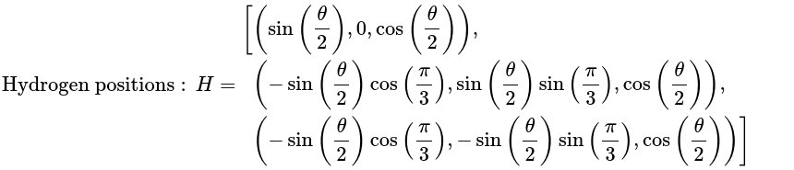

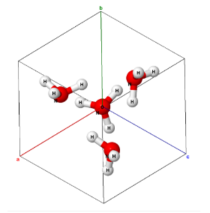
More Computation
(relative to N)

Slide 10
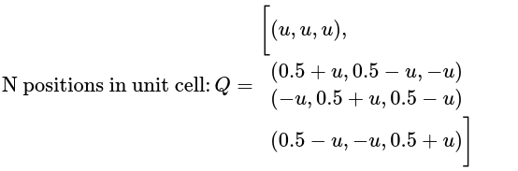
Loop to sum all transition rates between unit cell hydrogens and supercell hydrogens.
Loop over and add all elements of aQ and H to form the unit cell with 4 NH3.
Forms the supercell.
Loop over dx, dy, dz shifts times a, then loop over the unit cell protons to add the shifts to each.
Diagonalize relaxation matrix and use transition rate sum to get numerical T1.

Slide 11
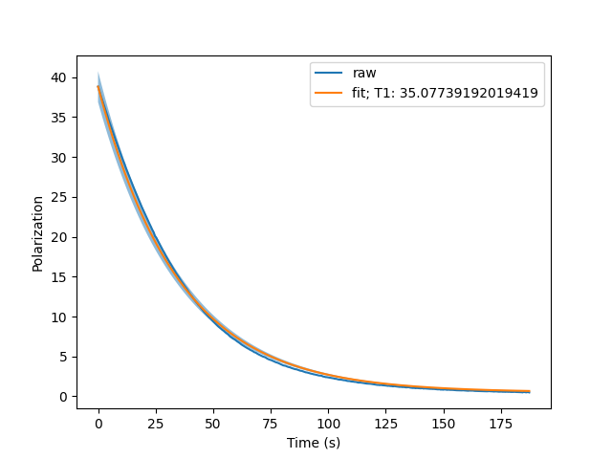
5% relative error.

Slide 12
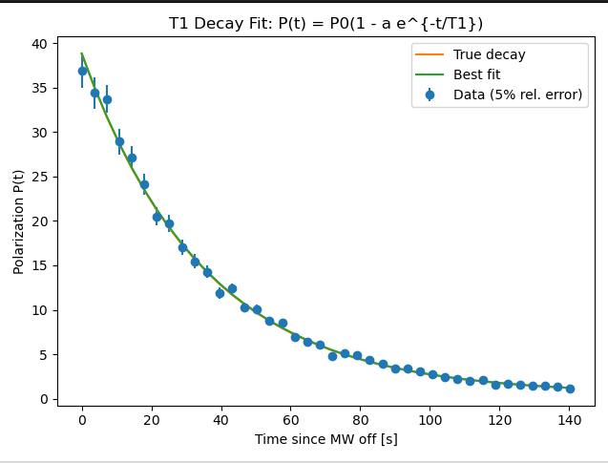
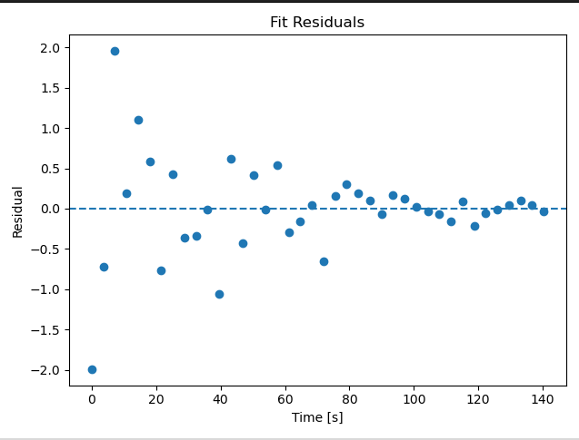

Slide 13




The Decay Curve

Slide 14
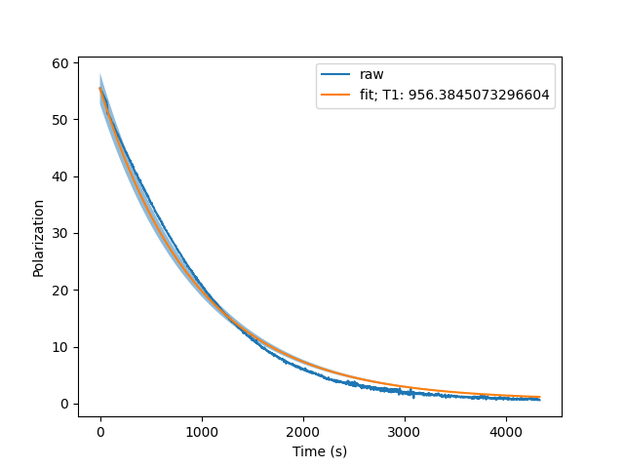
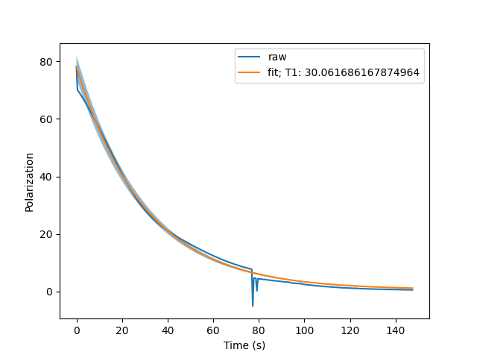
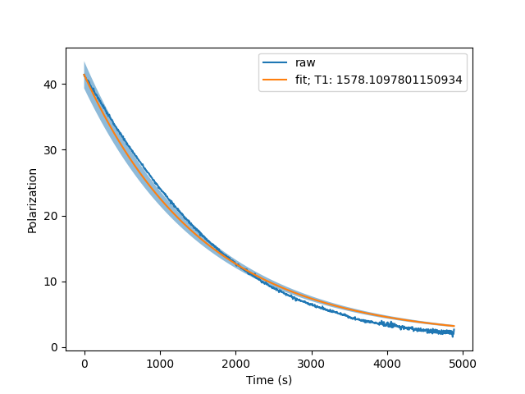
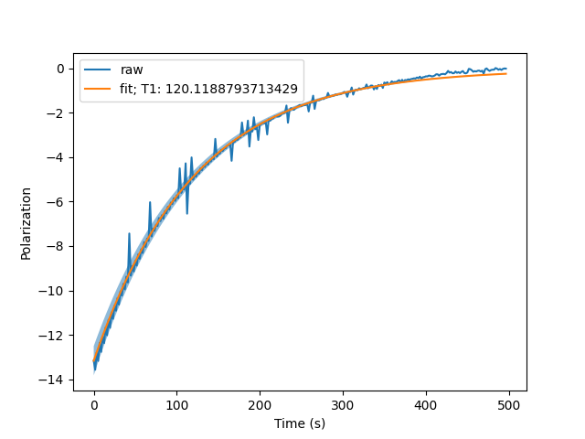
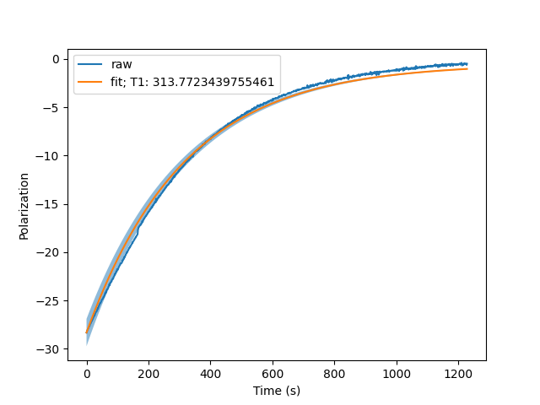
0
1
2
3
4
5

Slide 15
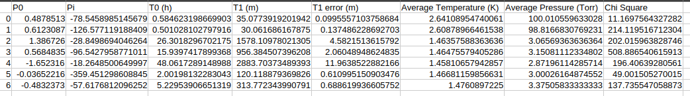

Slide 16

Results
Systematic error.
Event | T1 (m)
1 | 35.07∓0.0995 | 0.4878513 | -78.545 | 2.64
2 | 30.06∓0.1374 | 0.6123087 | -126.577 | 2.60
3 | 1578.10∓4.582 | 1.386726 | -28.849 | 1.46
4 | 956.38∓2.060 | 0.5684835 | -96.542 | 1.46

Slide 17
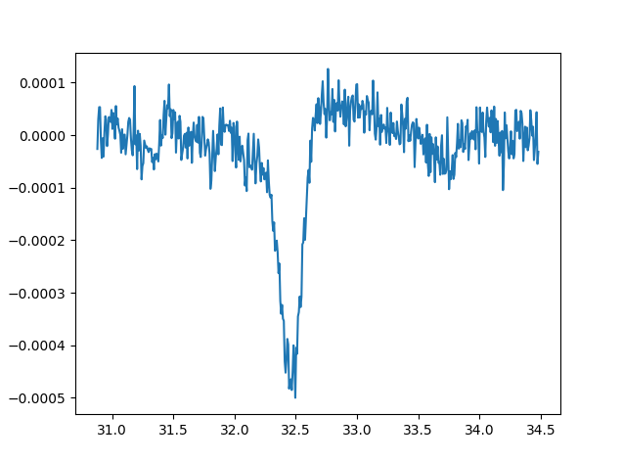

The Calibration Constant
A map between the area under the signal and the polarization.
We would rather not have to stop the experiment to calculate this.

Slide 18
Future Plans
prediction
from ex
from experimental data
Neural Network
Theoretical
Calibration constant prediction

Slide 19
Thank you.

