Slide 1
DNP Solid Effect: rate equation for spin 1
Ian Rangel and Dustin Keller

Slide 2
Outline
DNP
Solid Effect
Polarization for spin I=1: P_{I} and spin S=½ :P_{s}
Direction Transitions
Rate equations
Polarization form
Key Points

Slide 3

Dynamic Nuclear Polarization (DNP)
B(0)
AMMONIA
(NOT TO SCALE)
I=1
E
S=1/2
B(1)

Slide 4
Spin Diffusion
Process in which the polarization in the nuclear population spreads from the local cite of the radical
In the solid effect, the polarization transfer from the electron to the nucleus arises via the hyperfine interaction

Slide 5

dependence
The angle dependence arises from the misalignment of the magnetic field and the principal axis the EFG due to the quadrupolar interaction
AMMONIA
(NOT TO SCALE)
I=1

Slide 6
Solid Effect in DNP
Hyperfine coupling mediates the interaction between the electron and nucleus
Microwave field B1 drives electron transitions
HP
HP
B₁

Slide 7
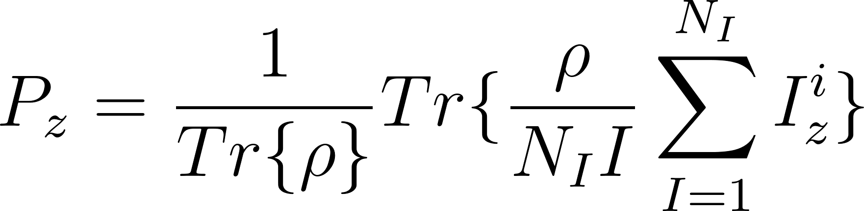
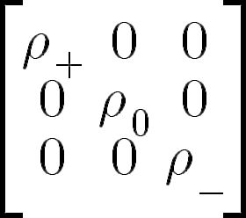
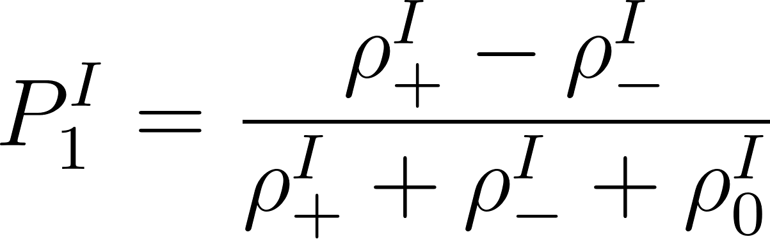
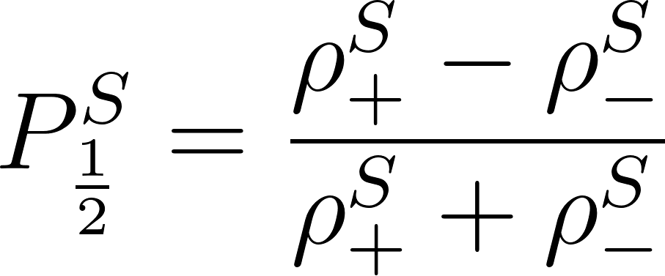
Polarization equations for I=1 and S=½
Standard equation for polarization of nucleus
Where the ρ is the density matrix of the nucleus, N_{I}:the number of Nucleons of spin I, I=1 and and I^{i}_{z} is the spin along the z axis
For ND3 the density matrix ρ is given by in the basis of the spinor S_{z}

Slide 8
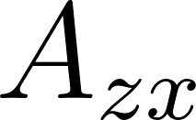

Hamiltonian for Solid Effect
S: total spin operator
A: hyperfine tensor
I: nuclear spin operator
ω: microwave frequency
ω_{0I} = γ_{I}|B₀| is the resonance frequency
ω_{0S} = -γ_{S}|B₀|
ω_{0S} = -γ_{S}|B1|
Nuclear Zeeman
Electron Zeeman
Microwave Driving field
Hyperfine interaction
We will treat this Hamiltonian using perturbation theory where we interpret the first two terms, the electron and nuclear Zeeman, as the unperturbed part of the Hamiltonian and the Microwave and Hyperfine as a perturbation.
The only terms that contribute to the solid effect, for the hyperfine tensor are: and
In ND3 we know that there is much more going on than the SE, but this is a good starting point.

Slide 9
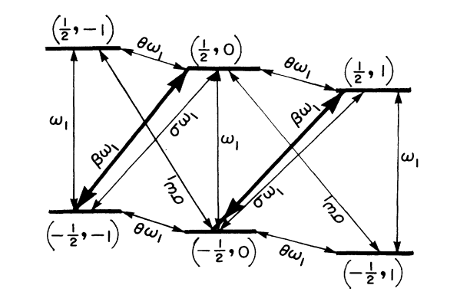
Energy transitions
Energy level diagram for ND3, I=1 and S=½, in a magnetic field
https://doi.org/10.1103/PhysRevB.35.3088

Slide 10

2nd order perturbation Theory
First order perturbation theory only allows transition for a spin nucleon since they have a single transition, from a + to a - state.
Need 2nd order perturbation for spin 1 to allow transitions from - to 0 and from 0 to + spin states

Slide 11
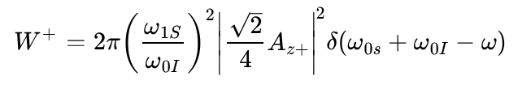
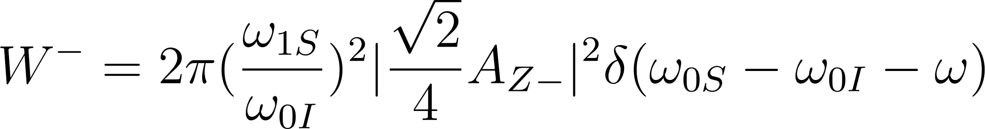
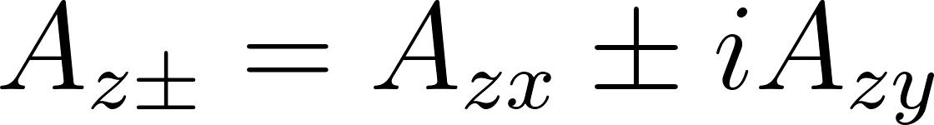
Transition Rates
Transition rate constant for polarization in the positive direction, going to I=+1
Transition rate constant for polarization in the negative direction, going to I=-1
Quantifies how strongly the electron spin flips interacts with the nuclear spin changes

Slide 12
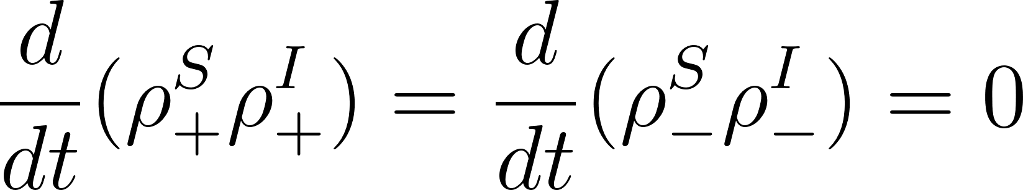
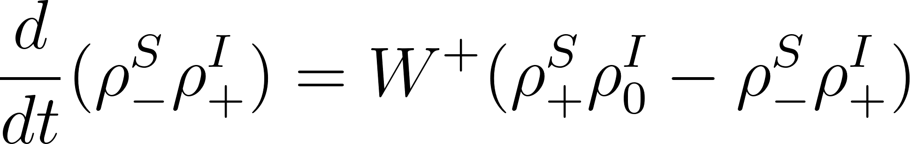
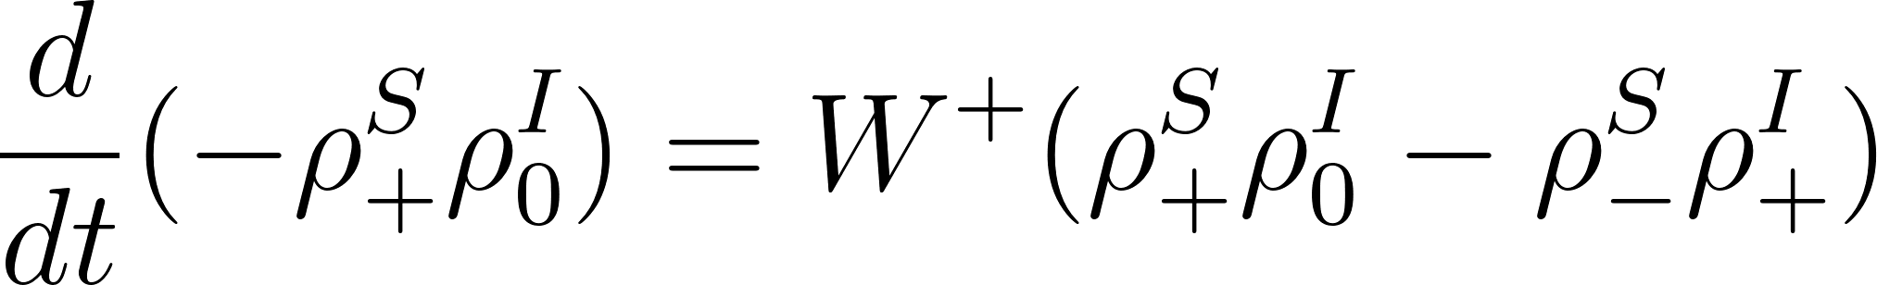
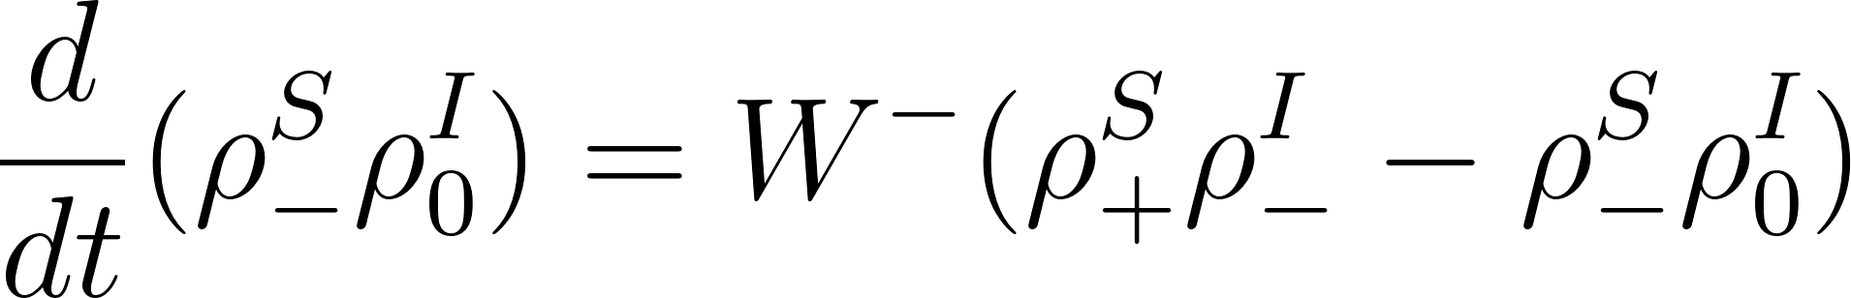
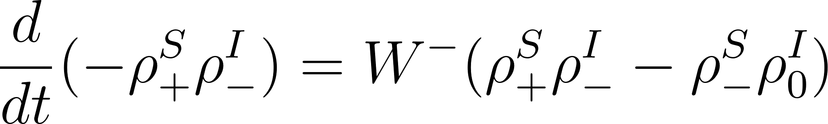
Rate equations
Rate equations for the probability
No change in the populations of the electron and nucleons in the ± spin states due to the forbidden interactions of electrons and nucleons transitions in the same direction
These are the rates only for the solid effect, other effects will have a different transition equations

Slide 13

Polarization form
The polarization direction is dependent on the microwave frequency.
In this case, as you polarize in the spin + direction, you have your microwave frequency set to

Slide 14
ND3 Planned Investigation of the rate equations
Compute rate equations for different types of SE.
Compute rate equations for Thermal mixing.
Compute rate equations for cross effect.
Explore different source and sink parameterizations.
Investigate which effects contribute significantly to ND3 polarization e.g. ISE, DSE, cross effect, TE,...
Verifying validity of equation by coding the equations introducing comparing to data
S-curve can help be used to disentangle the mechanisms
Putting Note together to share with details and comparisons to historic calculations.

Slide 15
Thank you for your time!

