Slide 1
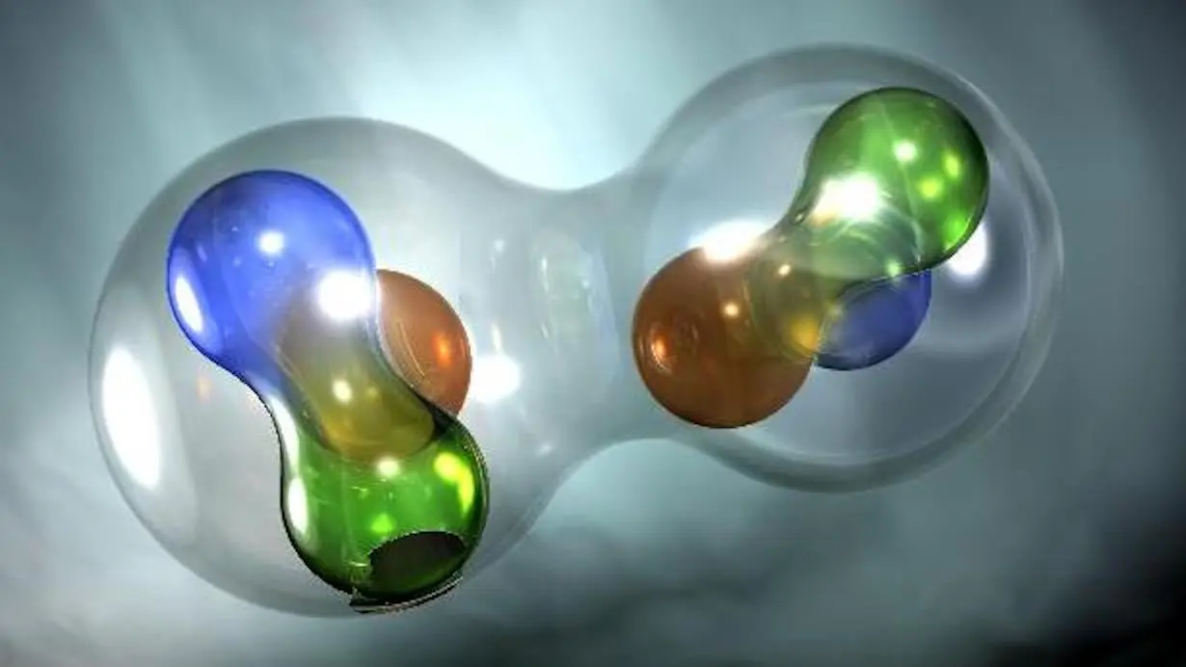


Measurement of ss-RF Decay Rate
Chhetra Lama
Date 10/13/2025

Slide 2





Acknowledgement
DOE Award DE-FG02-88ER40410
C12-13-011: The b₁ experiment
C12-15-005: A_{zz} for x>1
30 Days in Jlab Hall C
A⁻ Physics Rating
44 Days in Jlab Hall C
A⁻ Physics Rating
RunGroup Spokespersons
Chen, Day, Higinbotham, Kalantarians, Keller
Long, Rondon, Slifer, Solvignon
10/13/2025 b1/Azz Tensor Collaboration

Slide 3
Outlook
Motivation for ss-RF Decay Rate
Theoretical Background
Experimental Method
UNH Preliminary Result
Conclusion
08/22/2025 Proposal Defense Chhetra Lama
10/13/2025 b1/Azz Tensor Collaboration
08/22/2025 Proposal Defense Chhetra Lama

Slide 4
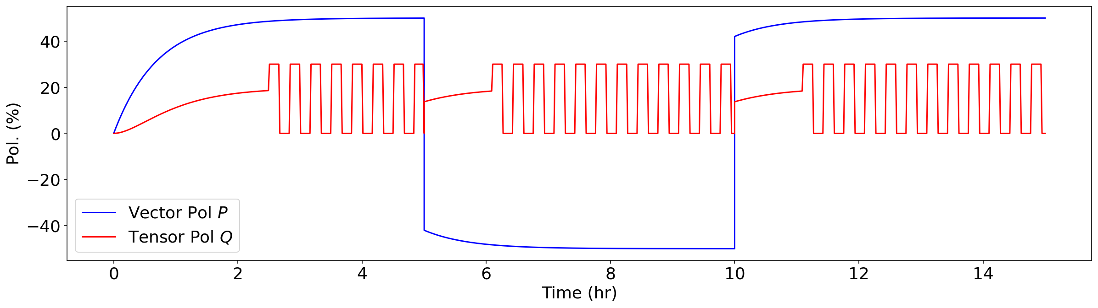
Motivation
Goal: Demonstrate full target polarization cycle for beam operations.
Current status:
ss-RF & NMR cannot happen simultaneously
Working towards optimizing measurement timing between ss-RF applications
08/22/2025 Proposal Defense Chhetra Lama
10/13/2025 b1/Azz Tensor Collaboration

Slide 5
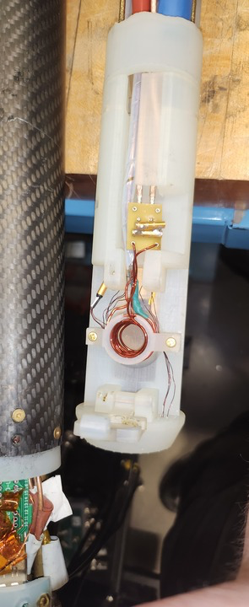
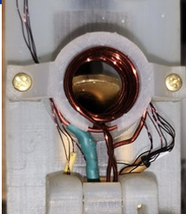
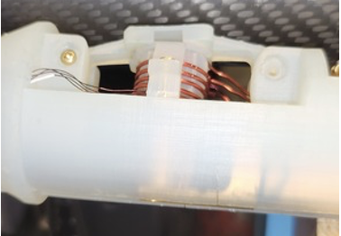
Experimental Setup for ss-RF at UNH
NMR Coil
ss-RF
NMR coil\
ss-RF
coil
08/22/2025 Proposal Defense Chhetra Lama
10/13/2025 b1/Azz Tensor Collaboration

Slide 6
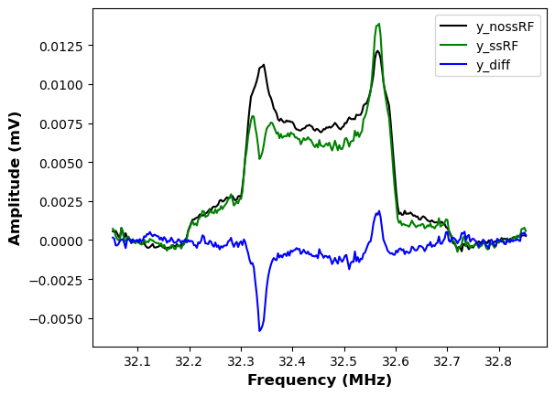
ss-RF/ Hole burning Effect
Black= no ss-RF line
Green= During the Pulse
Blue= Difference
Black= no ss-RF line
Green= During the Pulse
Blue= Difference
P~ 9% on warm irrad. ND3
08/22/2025 Proposal Defense Chhetra Lama
10/13/2025 b1/Azz Tensor Collaboration

Slide 7
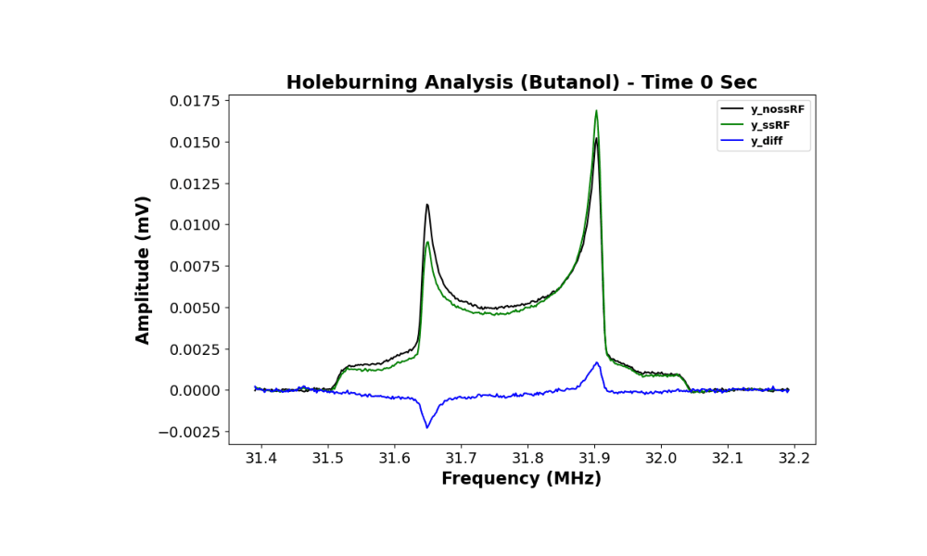
ss-RF/Hole burning Effect Continued
Black= no ss-RF line
Green= During the Pulse
Blue= Difference
P = 27%
08/22/2025 Proposal Defense Chhetra Lama
10/13/2025 b1/Azz Tensor Collaboration Chhetra Lama
10/13/2025 b1/Azz Tensor Collaboration

Slide 8
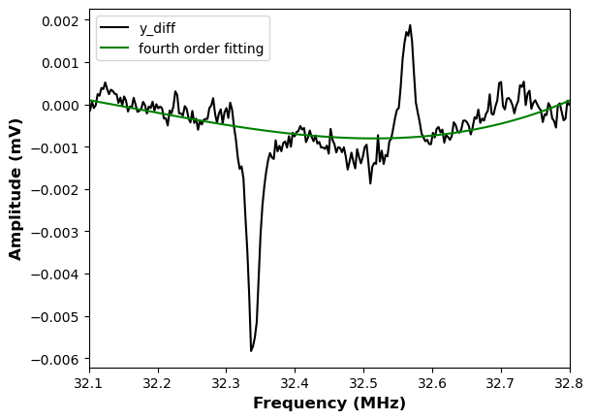
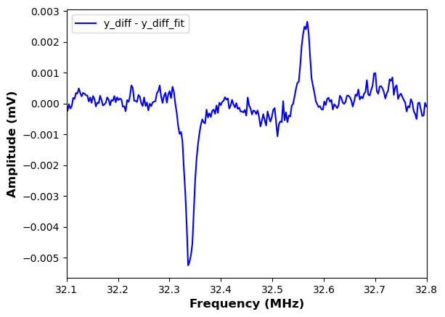

ss-RF Relaxation Extraction Technique
Total Power on Target = 223 mW
Duration =10 Sec
Black line – Green line. Blue
Just a difference between $ssRF−nossRF$
With the subtraction of fourth order polynomial fitting
08/22/2025 Proposal Defense Chhetra Lama
10/13/2025 b1/Azz Tensor Collaboration Chhetra Lama
10/13/2025 b1/Azz Tensor Collaboration

Slide 9
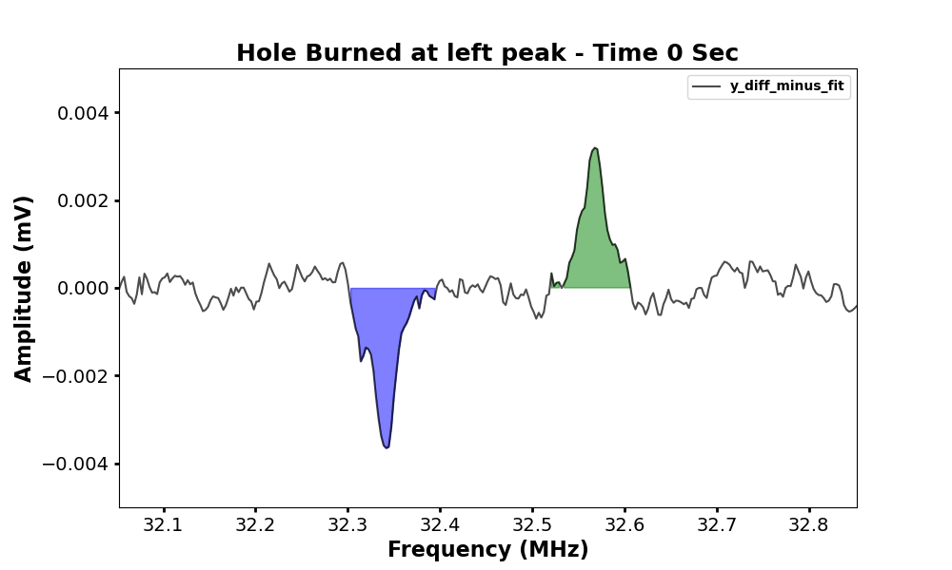
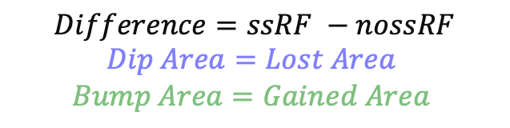
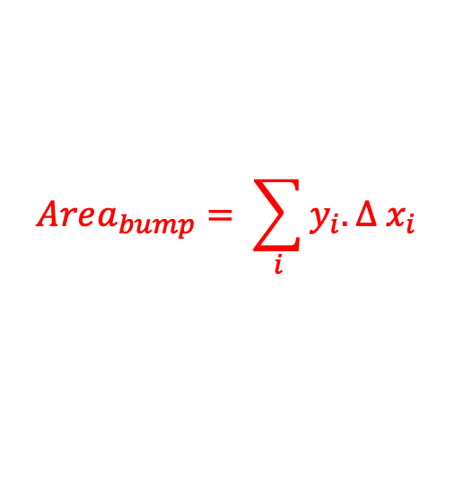
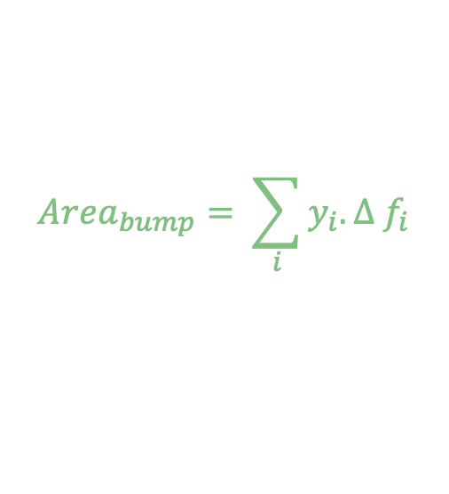
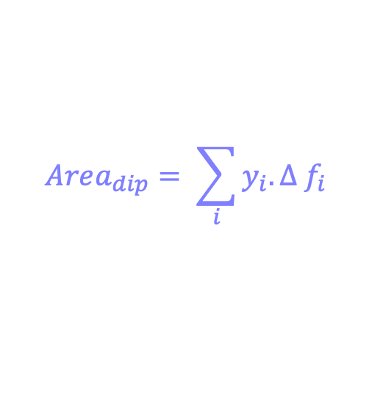
Relaxation Extraction Technique Continued
$$Difference=ssRF −nossRF$$
$$Dip Area=Lost Area$$
$$Bump Area=Gained Area$$
$$Area_{dip}= \sum_{i}{y_{i}. Δ f_{i}}$$
$$Area_{bump}= \sum_{i}{y_{i}. Δ f_{i}}$$
$$Area_{bump}= \sum_{i}{y_{i}. Δ x_{i}}$$
08/22/2025 Proposal Defense Chhetra Lama
10/13/2025 b1/Azz Tensor Collaboration

Slide 10
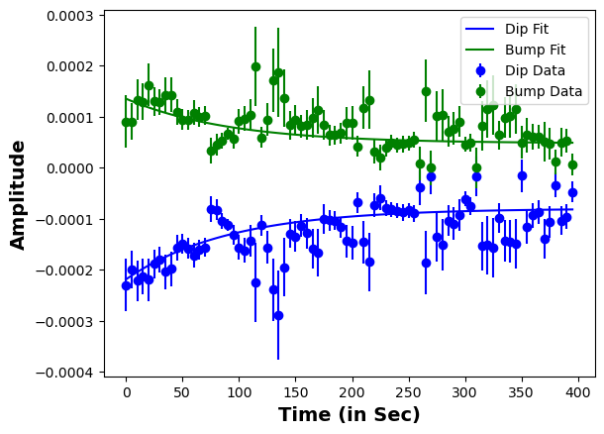
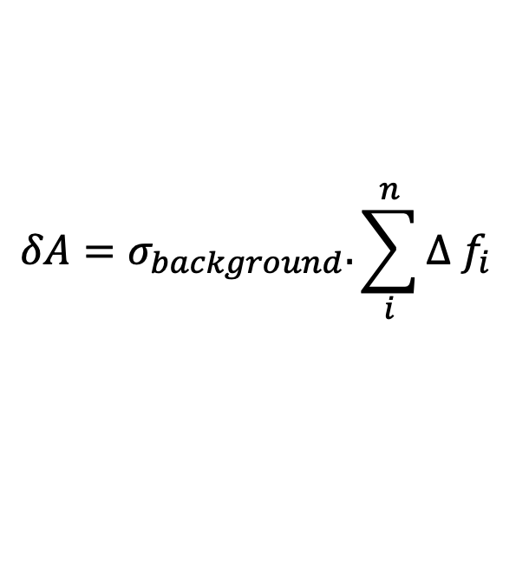
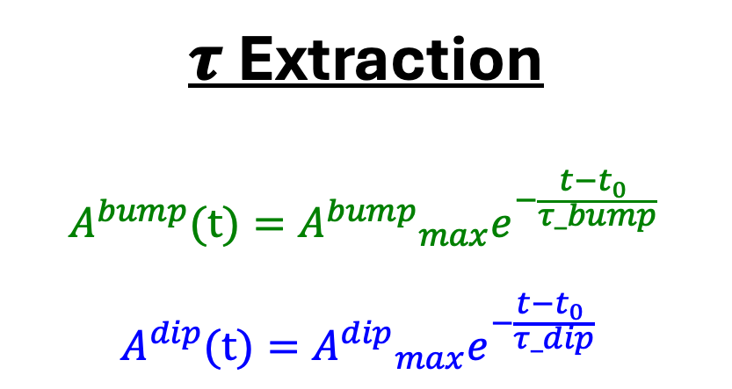
Relaxation Extraction Technique Continued
$$\text{τ} \text{Extraction}$$
$$A^{bump}(t)={A^{bump}}_{max}e^{−\frac{t−t_{0} }{τ_bump} }$$
$$A^{dip}(t)={A^{dip}}_{max}e^{−\frac{t−t_{0} }{τ_dip} }$$
$$δA=σ_{background}. \sum_{i}^{n}{Δ f_{i}}$$
DNP Microwave was on all the time
08/22/2025 Proposal Defense Chhetra Lama
10/13/2025 b1/Azz Tensor Collaboration

Slide 11
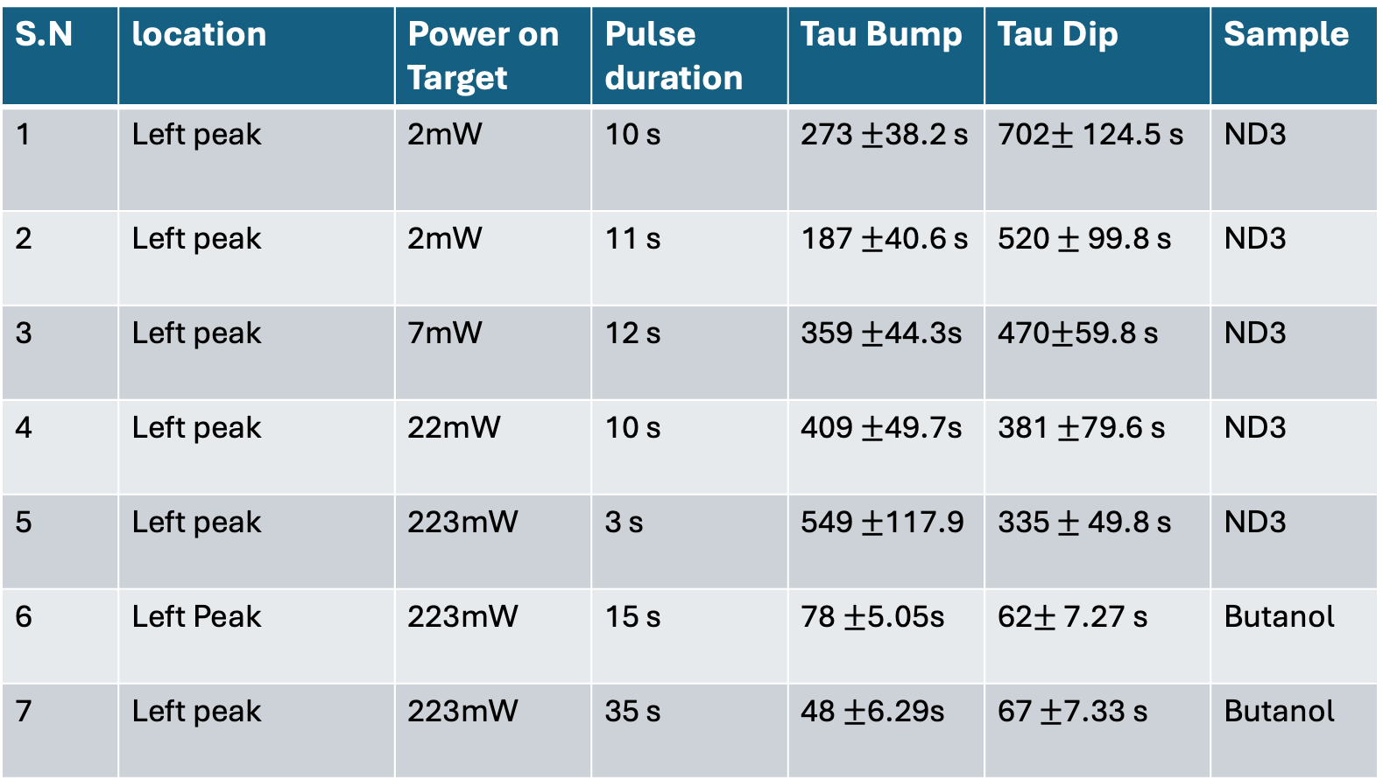
Preliminary Results
S.N | location | Power on Target | Pulse duration | Tau Bump | Tau Dip | Sample
1 | Left peak | 2mW | 10 s | 273 $±$38.2 s | 702$±$124.5 s | ND3
2 | Left peak | 2mW | 11 s | 187 $±$40.6 s | 520 $±$ 99.8 s | ND3
3 | Left peak | 7mW | 12 s | 359 $±$44.3s | 470$±$59.8 s | ND3
4 | Left peak | 22mW | 10 s | 409 $±$49.7s | 381 $±$79.6 s | ND3
5 | Left peak | 223mW | 3 s | 549 $±$117.9 | 335 $±$ 49.8 s | ND3
6 | Left Peak | 223mW | 15 s | 78 $±$5.05s | 62$±$ 7.27 s | Butanol
7 | Left peak | 223mW | 35 s | 48 $±$6.29s | 67 $±$7.33 s | Butanol
08/22/2025 Proposal Defense Chhetra Lama
10/13/2025 b1/Azz Tensor Collaboration

Slide 12
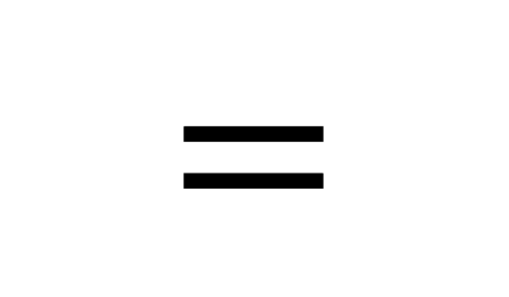

What is Goodness of Pulse ?
Power on target (mw)
Goodness of Pulse
$$=$$
Duration of Pulse(s)
It is basically the ratio of the power applied on target from the signal generator to manipulate the spins population to its duration.
It is measured in $mW/ Sec$
10/13/2025 b1/Azz Tensor Collaboration

Slide 13
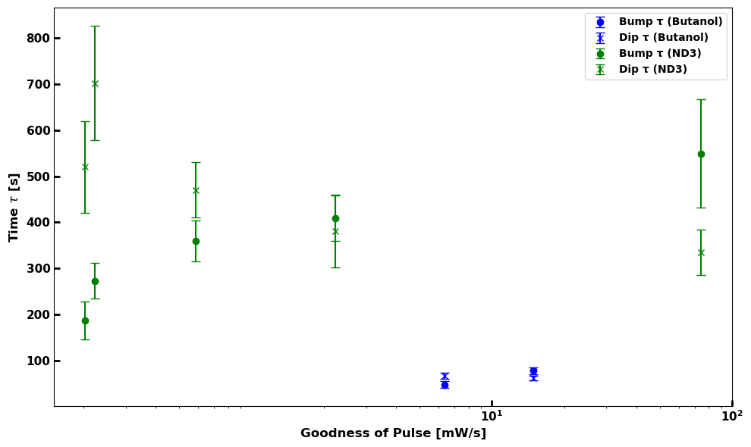
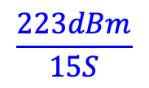
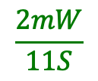
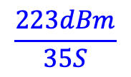
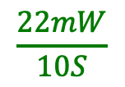
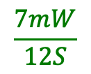
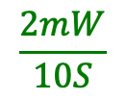
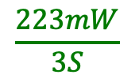
𝝉 vs Goodness of the Pulse
$$\frac{2mW}{11S}$$
$$\frac{2mW}{10S}$$
$$\frac{7mW}{12S}$$
$$\frac{22mW}{10S}$$
$$\frac{223dBm}{35S}$$
$$\frac{223dBm}{15S}$$
$$\frac{223mW}{3S}$$
𝝉_ND3 ~ (6-10) 𝝉_butanol
Preliminary
08/22/2025 Proposal Defense Chhetra Lama
10/13/2025 b1/Azz Tensor Collaboration

Slide 14
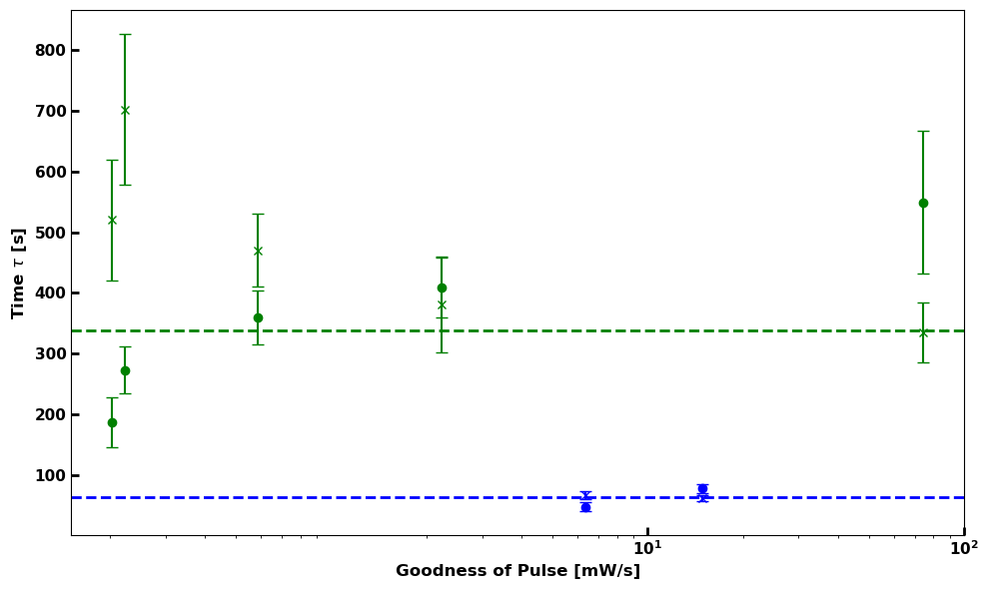
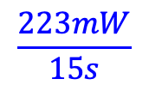
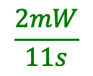
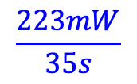
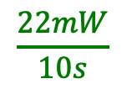
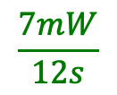
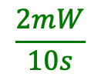
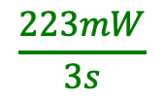
𝝉 vs Goodness of the Pulse
$$\frac{2mW}{11s}$$
$$\frac{2mW}{10s}$$
$$\frac{7mW}{12s}$$
$$\frac{22mW}{10s}$$
$$\frac{223mW}{35s}$$
$$\frac{223mW}{15s}$$
$$\frac{223mW}{3s}$$
𝝉_ND3 ~ (6-10) 𝝉_butanol
Preliminary
08/22/2025 Proposal Defense Chhetra Lama
10/13/2025 b1/Azz Tensor Collaboration

Slide 15
Main Takeaways
First step of the analysis is completed. Since data is noisy. We are planning to retake the data and come with the better and final version of the ss-RF tau for both the ND3 and butanol by the end of 2025.
The Preliminary result shows ss-RF effect on ND3 is sharper than Butanol
The Tau for ND3 is much longer than that for the Butanol.
We are ready to repeat with the cold irrad. ND3 (we need some please).
08/22/2025 Proposal Defense Chhetra Lama
10/13/2025 b1/Azz Tensor Collaboration

Slide 16
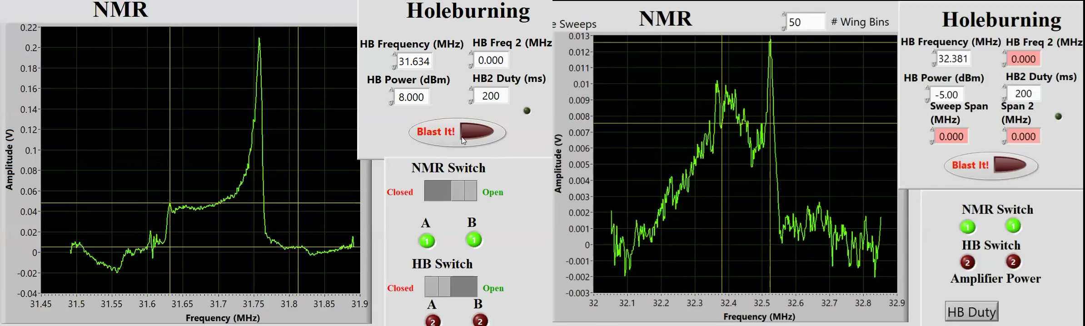
ss-RF visual comparison between Butanol and ND3
Irrad. Butanol
Warm Irrad. ND3
P ~ 40%
P ~ 9 %
Microwave was on
08/22/2025 Proposal Defense Chhetra Lama
10/13/2025 b1/Azz Tensor Collaboration

Slide 17
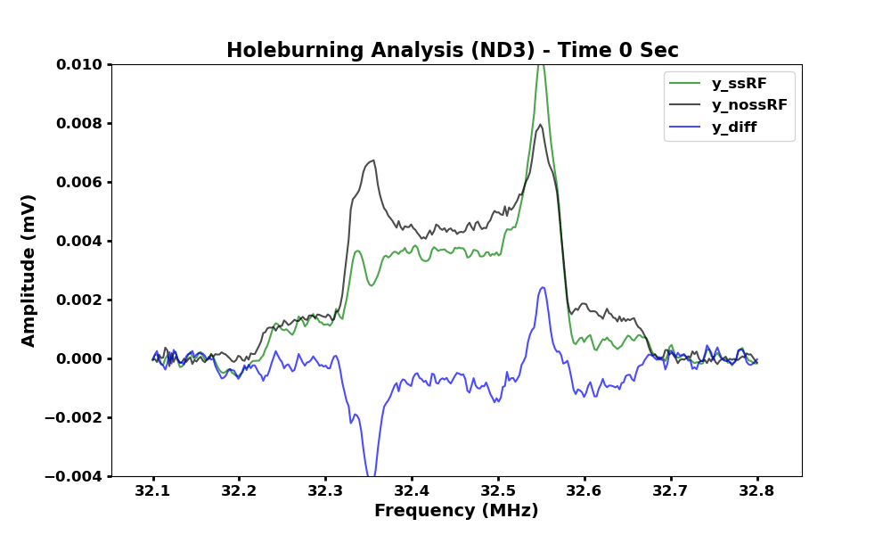
ss-RF visual comparison between Butanol and ND3
Black= no ss-RF line
Green= During the Pulse
Blue= Difference
Black= no ss-RF line
Green= During the Pulse
Blue= Difference
Note: Super Noisy data
08/22/2025 Proposal Defense Chhetra Lama
10/13/2025 b1/Azz Tensor Collaboration

Slide 18
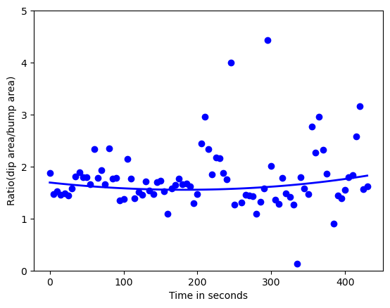


Area lost vs Area Gain visualization
Actual Power on the Target =33.48dBm
ratio of two lines
Area ratio
Note: super noisy
$$Ratio R=1.8±0.44$$
08/22/2025 Proposal Defense Chhetra Lama
10/13/2025 b1/Azz Tensor Collaboration Chhetra Lama

Slide 19
Power on a Target
RF generator
Switch
LZY-22 + Amp
Coil to target
Long Cables
# dBm
-1dBm
+43dBm
-3dBm
= total sum
$$P_{target}=P_{generator}+39 dBm+10\log_{10}{(1 −{\left(\frac{VSWR−1}{VSWR+1}\right)}^{2})}$$
S.N | Power on RF generator (in dBm) | Power on the Target(dBm)
1 | -5 | 33.48
2 | -15 | 23.48
3 | -20 | 18.48
4 | -25 | 13.48
08/22/2025 Proposal Defense Chhetra Lama
10/13/2025 b1/Azz Tensor Collaboration Chhetra Lama

Slide 20
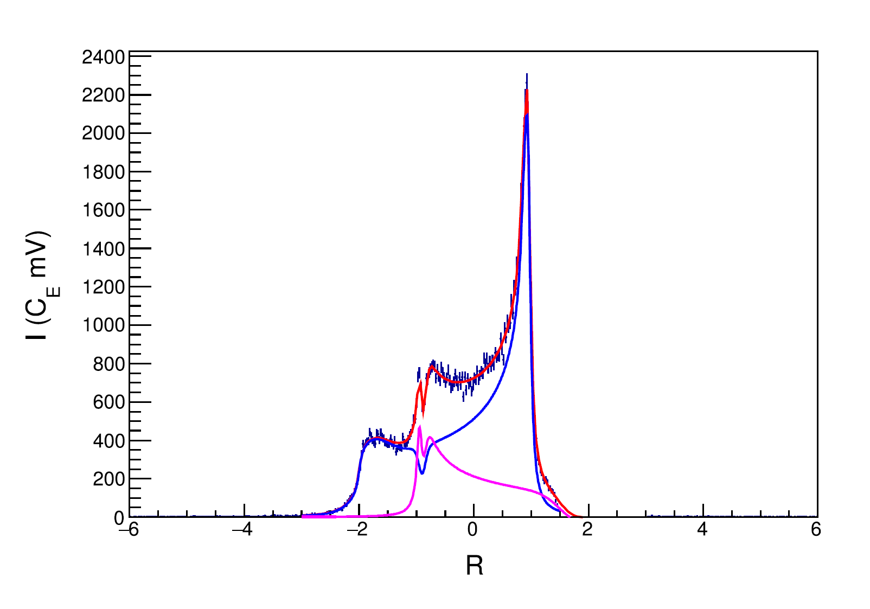
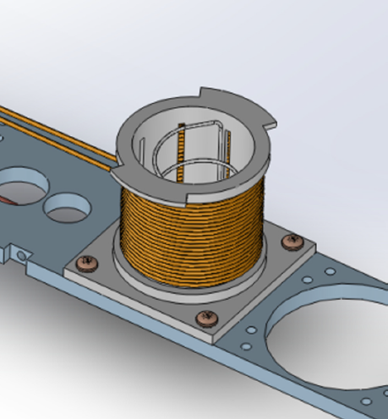

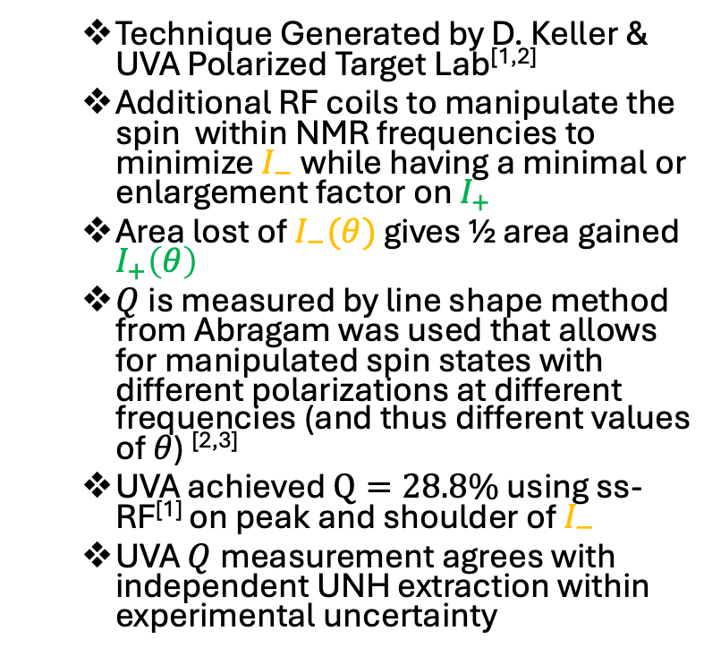
Experimental Setup for ss-RF
Technique Generated by D. Keller & UVA Polarized Target Lab^{[1,2]}
Additional RF coils to manipulate the spin within NMR frequencies to minimize $I_{−}$ while having a minimal or enlargement factor on $I_{+}$
Area lost of $I_{−}(θ)$ gives ½ area gained $I_{+}\left(θ\right)$
$Q$is measured by line shape method from Abragam was used that allows for manipulated spin states with different polarizations at different frequencies (and thus different values of $θ$) ^{[2,3]}
UVA achieved $Q=28.8\%$ using ss-RF^{[1]} on peak and shoulder of $I_{−}$
UVA $Q$measurement agrees with independent UNH extraction within experimental uncertainty
$$Q=28.8\%±5.7\% {(rel)}^{[1]}$$
^{[1]} D. Keller, et al., NIM A 981, 164504 (2020)
^{[2]} D. Keller, Eur. Phys. J. A 53, 155 (2017)
^{[3]} A. Abragam, Principles of Nuclear Magnetism (1961)
08/22/2025 Proposal Defense Chhetra Lama
08/22/2025 Proposal Defense Chhetra Lama

Slide 21
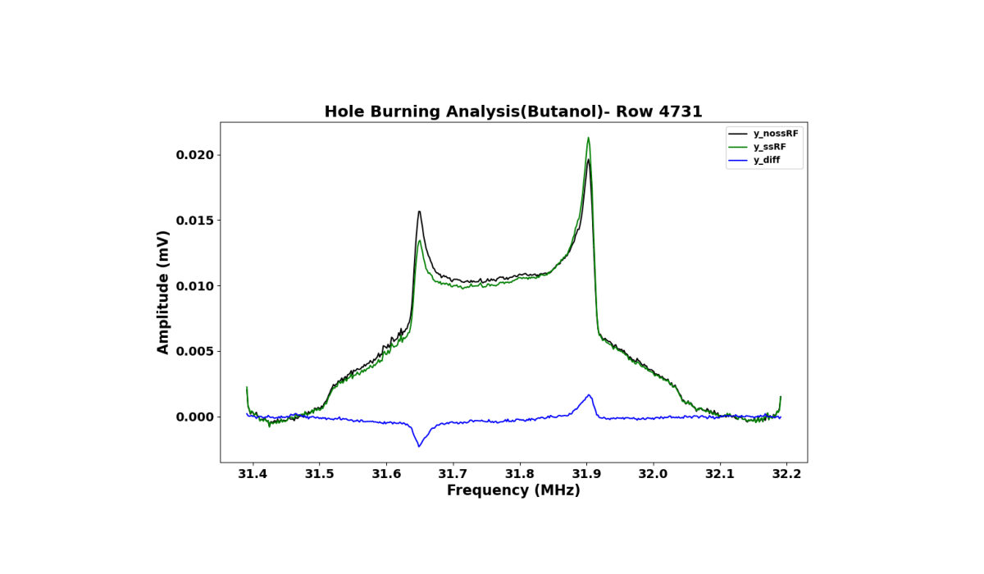
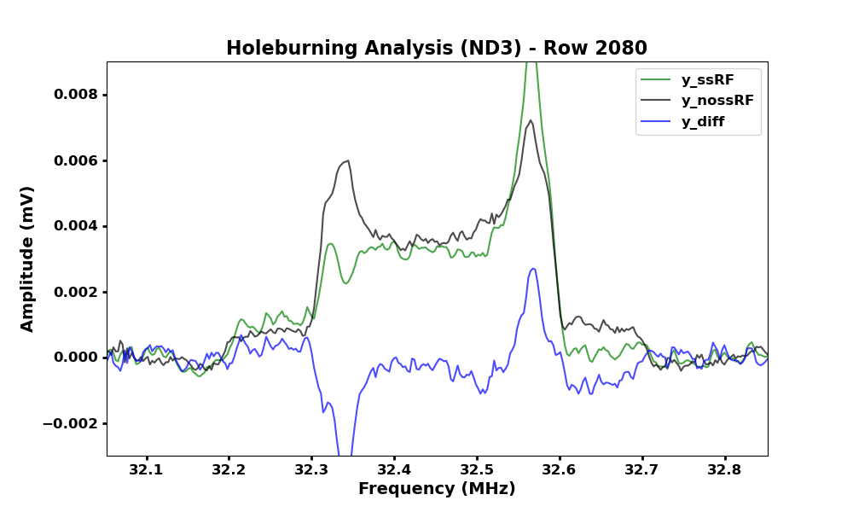
ss-RF/Hole burning Relaxation
Black= no ss-RF line
Green= During the Pulse
Blue= Difference
Black= no ss-RF line
Green= During the Pulse
Blue= Difference
08/22/2025 Proposal Defense Chhetra Lama
10/13/2025 b1/Azz Tensor Collaboration Chhetra Lama

