Slide 1
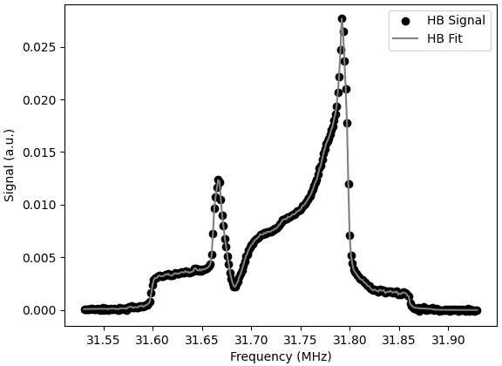


Fitting Complex Equilibrium
and Hole-Burnt Signals
Michael McClellan
October 13-14 2025
Tensor Collaboration Meeting

Slide 2
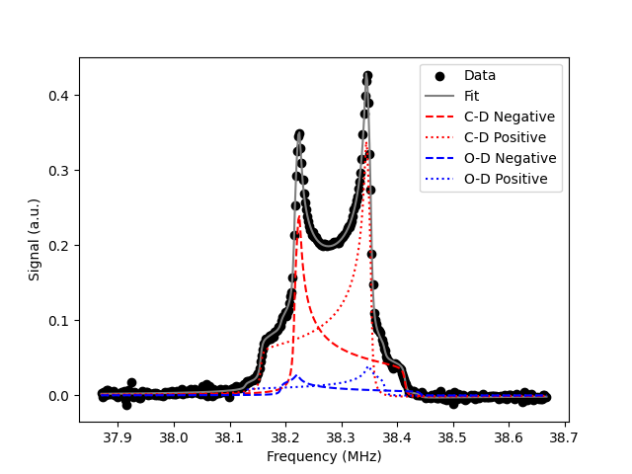
Equilibrium Signals
Deuteron NMR signals in Boltzmann equilibrium are well understood
Area method – compare to a TE signal (or “super TE”)
“Ratio” method – compare peaks, or more thoroughly curve fit using the Dulya equation

Slide 3
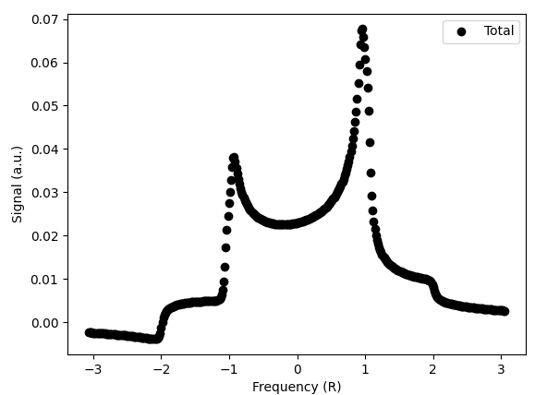
NMR Signals are Complex
Q-meter signals often aren’t exactly tuned to real
How do you get P and Q from out-of-tune signal?

Slide 4
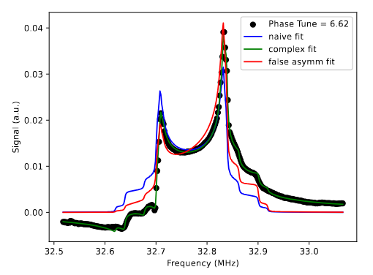
False Asymmetry?
Dulya suggests adding “false asymmetry” parameter, ξ
However, this only works for slightly out-of-tune signals
Better to add phase angle parameter, combining absorptive and dispersive functions

Slide 5
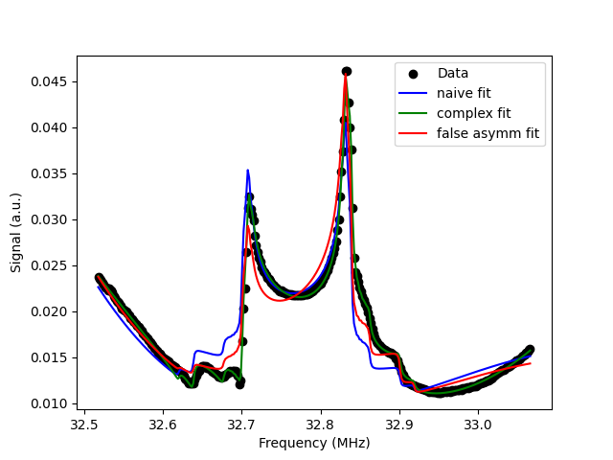
False Asymmetry?
Phase angle: -25.79°
Naive P: 17.36%
Phase P: 19.61%
False P: 12.59%

Slide 6
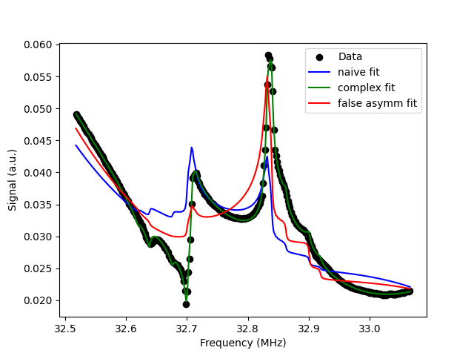
False Asymmetry?
Phase angle: -42.05°
Naive P: 14.31%
Phase P: 19.97%
False P: 6.85%

Slide 7
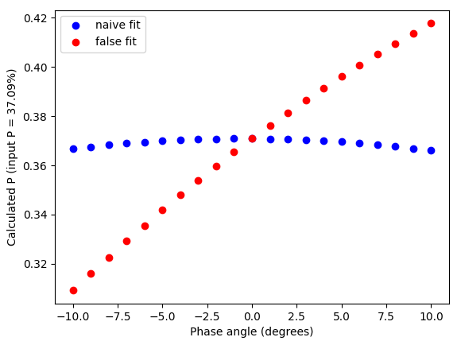
False Asymmetry?

Slide 8
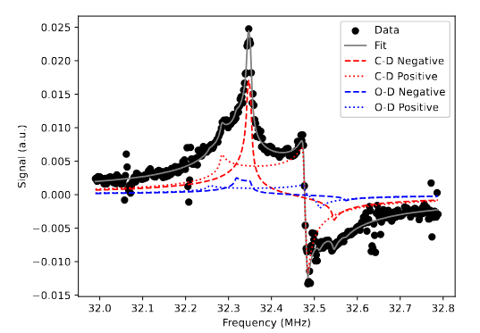
Fully Complex Fit
Using phase angle allows you to fit signals of any tune, including fully imaginary
Does still require Boltzmann equilibrium

Slide 9
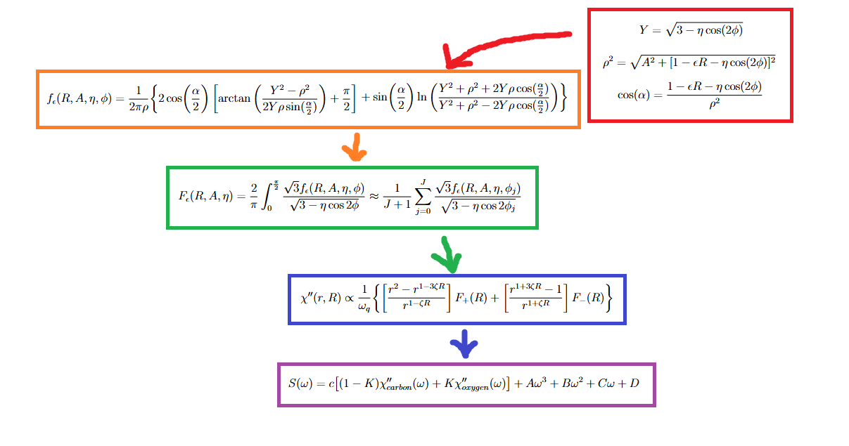
Real Fit
C. Dulya et al. A line-shape analysis for spin-l nmr signals. Nuclear Instruments &
Methods In Physics Research - Section A, 398:109–125, 1997.

Slide 10


Fully Complex Fit
Dispersive function:
Phi-averaged identically.
Phase angle combines dispersive and absorptive:
Compare to false asymmetry:
M. McClellan and E. Long. Complex deuteron NMR signals. EPJ-A, 61:176, 2025.

Slide 11
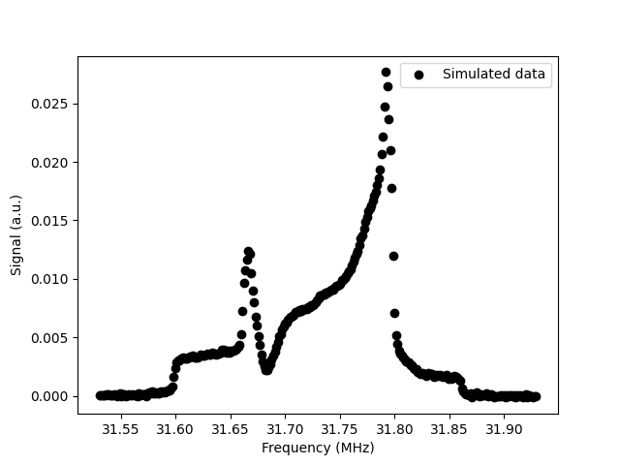
Hole-Burnt Signals
Performing ssRF on an equilibrium signal adds perturbations
Part of the signal is depolarized, and polarization is increased elsewhere
Used to increase tensor polarization (Q)

Slide 12
How Analyze Hole-Burning?
Area method from TE is fine for P, but whole point is to increase Q, which requires understanding of component spin-flip curves
Adding Lorentzian/Gaussian/Voigt to Dulya equation adds extra complexity to fit, exacerbated by possibility of multiple holes/bumps!
Can we fit a hole-burnt signal without adding new parameters?

Slide 13
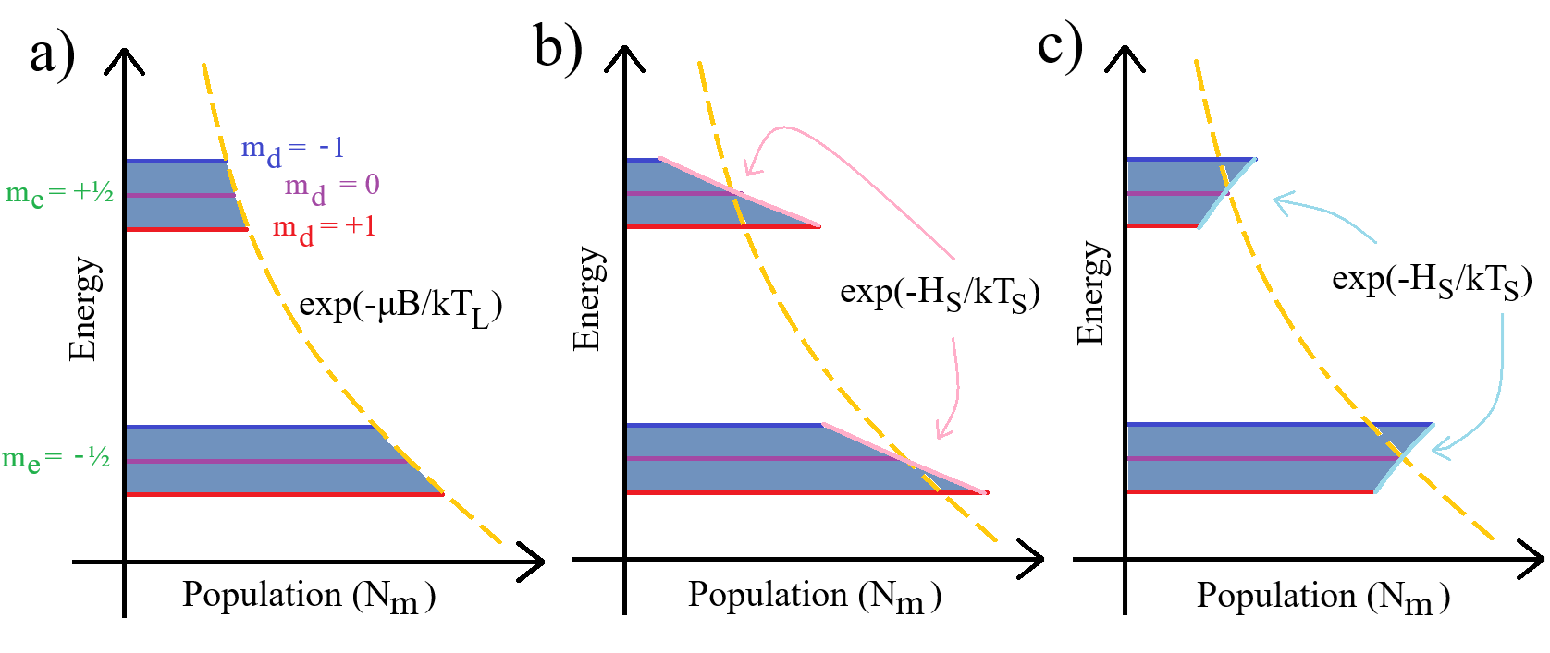
Spin-Temperature Consistency
J. Clement and D. Keller. Manipulation of spin-1 solid-state targets. Nuclear Instruments & Methods In Physics Research - Section A, 1050, 2023.
Material in Boltzmann equilibrium has a spin temperature, T_{S}
For TE signal, T_{S} = T
For DNP enhanced signal, T_{S} is the T the material would be at if it were a TE

Slide 14
STC Hole-Burning?
When ssRF depolarizes at a specific frequency (burns a hole), the deuterons at that frequency should all have the same T_{S}, even if it’s not the same T_{S} as the rest of the sample
This creates a range of T_{S} across the hole-burn NMR signal, which in turn means a range of signal asymmetry, r

Slide 15
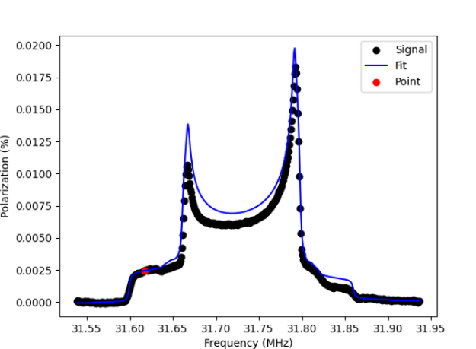
STC Hole-Burning
Bin by bin, we can fit each individual data point to find the r of an equilibrium signal that passes through that point

Slide 16
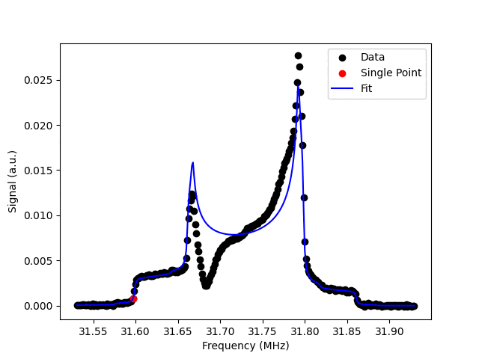
STC Hole-Burning

Slide 17
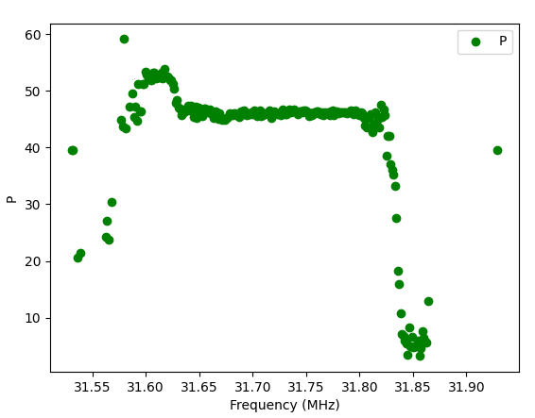
STC Hole-Burning

Slide 18
Bumps
An issue – while the depolarization of the hole follows STC, the gained polarization of the bump does not – it’s adding on top of an equilibrium polarization
We have to somehow model the STC loss of polarization of the hole being added at the frequency of the bump

Slide 19
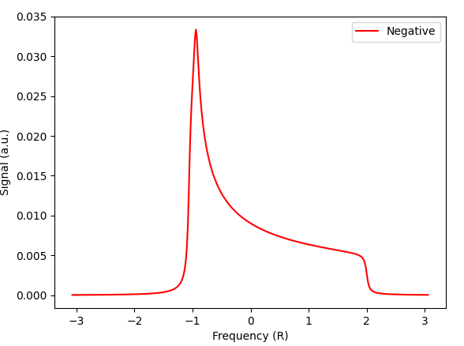
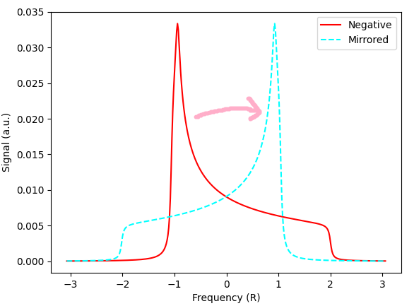
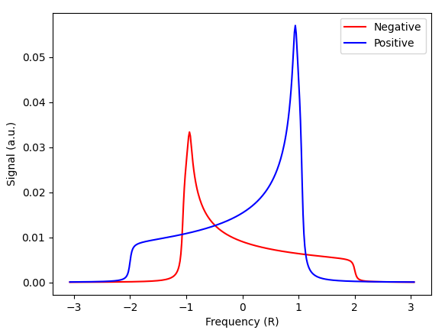
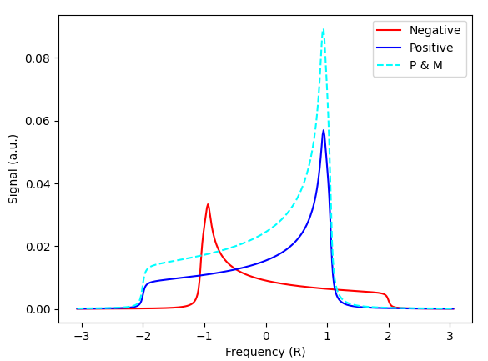
Bumps
Since the bump should be proportional to polarization lost from an equilibrium signal, let’s first model an equilibrium signal sitting on top of the spin-flip curve receiving the bump
This is a projected, mirrored version of the other spin-flip curve

Slide 20
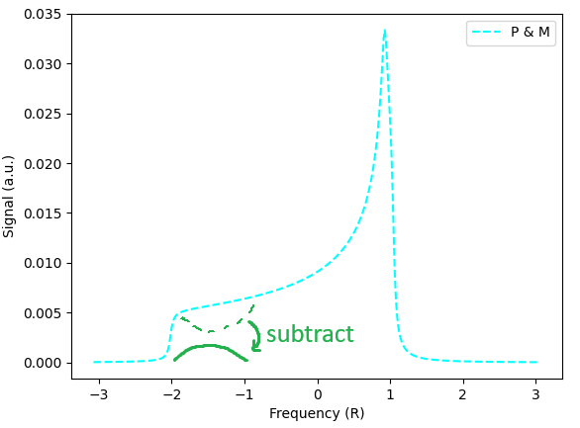
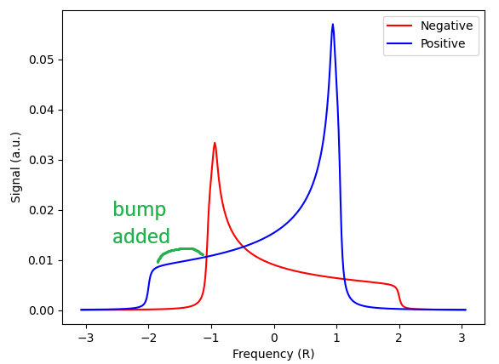
Bumps
We then model a second projected, mirrored spin-flip curve that has had a hole-burnt into it
By subtracting the hole-burnt PM signal from the equilibrium PM signal, we are left with a bump, derived in a STC manner

Slide 21
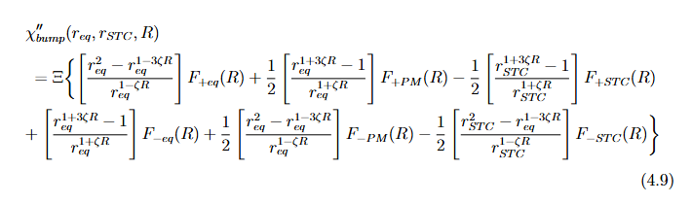
The Math

Slide 22
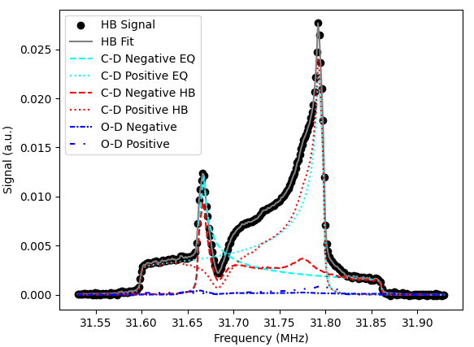
Result
Sim P = 12.44%
Fit P = 12.79%
This produces the component spin-flip curves of the hole-burnt signal
Then use area method to get P and Q
Analysis of simulated signal

Slide 23
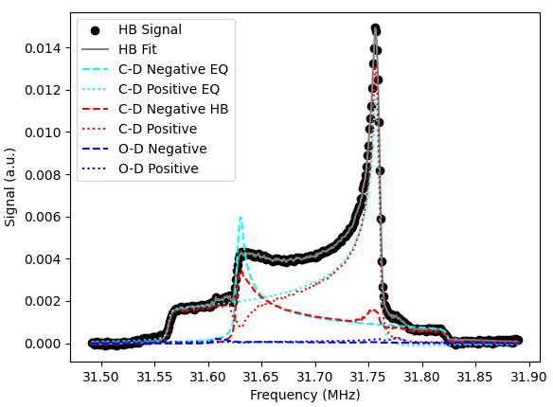
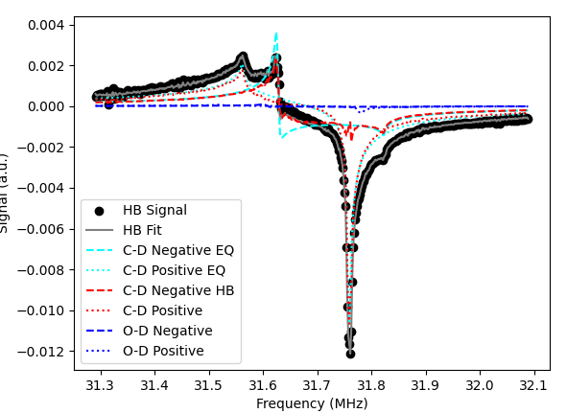
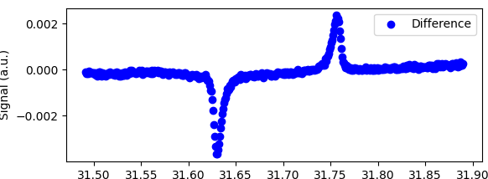
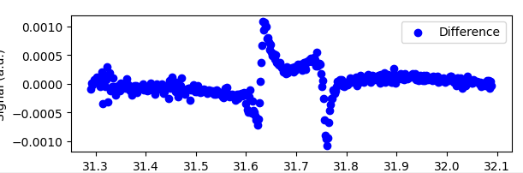
Data Results

Slide 24
Final Notes
Requires an equilibrium signal to get parameters
Requires a “first pass” to see where bumps are – anywhere r_{STC} > r_{eq}
Area method only works in fully real or fully imaginary signals – if using my explicitly complex version of Dulya, take only real/imag and scale it

Slide 25
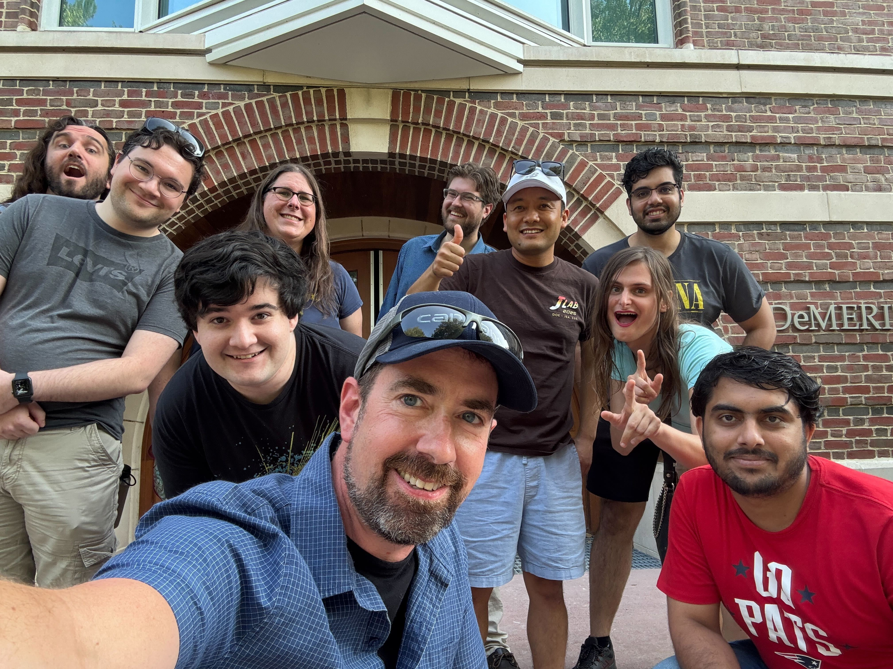
Acknowledgements
UNH DNP PIs:
  Elena Long
  Nathaly Santiesteban
  Karl Slifer
UNH DNP collaborators:
  Anchit Arora
  Hector Chinchay
  Muhammad Farooq
  Chhetra Lama
  Olaiya Olokunboyo
  Eli Phippard
  Sam Takwirira
  Jan Vanek
  Aden Whitney
  Zoe Wolters
This work is supported by the Dept. of Energy Grant DE-FG02-88ER40410.

