Slide 1
AI NMR Extraction for Spin-1 Signals
Devin Seay, Dustin Keller, Ishara Fernando

Slide 2
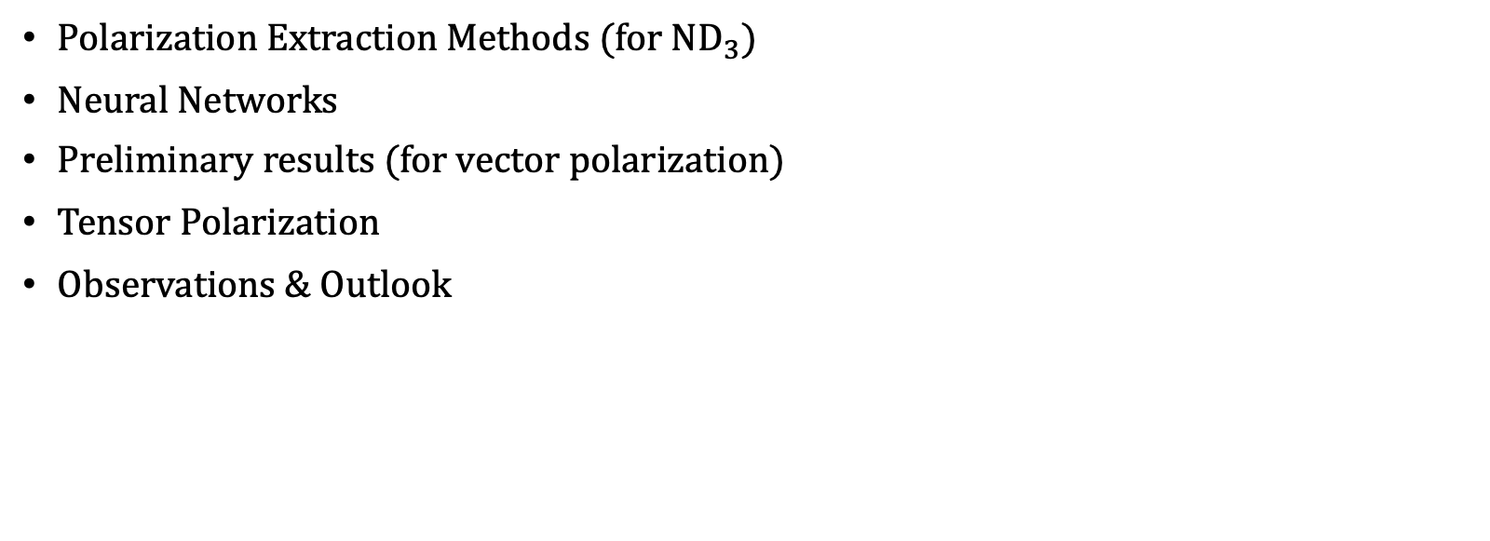
Outline
Polarization Extraction Methods (for $ND_{3}$)
Neural Networks
Preliminary results (for vector polarization)
Tensor Polarization
Observations & Outlook

Slide 3

Extracting Deuteron Polarization
Can fit a signal by average the dependance on the azimuthal angle
$F_{ε}\left(R,A,η\right)=\frac{2}{π}\int_{0}^{π/2}{\frac{\sqrt{3}f_{ε}\left(R,A,η, φ\right)}{\sqrt{3−ηcos\left(2φ\right)}}}dφ≈\frac{1}{J+1}\sum_{j=0}^{J}{\frac{\sqrt{3}f_{ε}\left(R,A,η, φ\right)}{\sqrt{3−ηcos\left(2φ\right)}}}$, $J=64, 0<φ<2π$
Polarization Approximated as
$P=\frac{r^{2}−1}{r^{2}+1+r}, r=\frac{I_{+}}{I_{−}}$

Slide 4
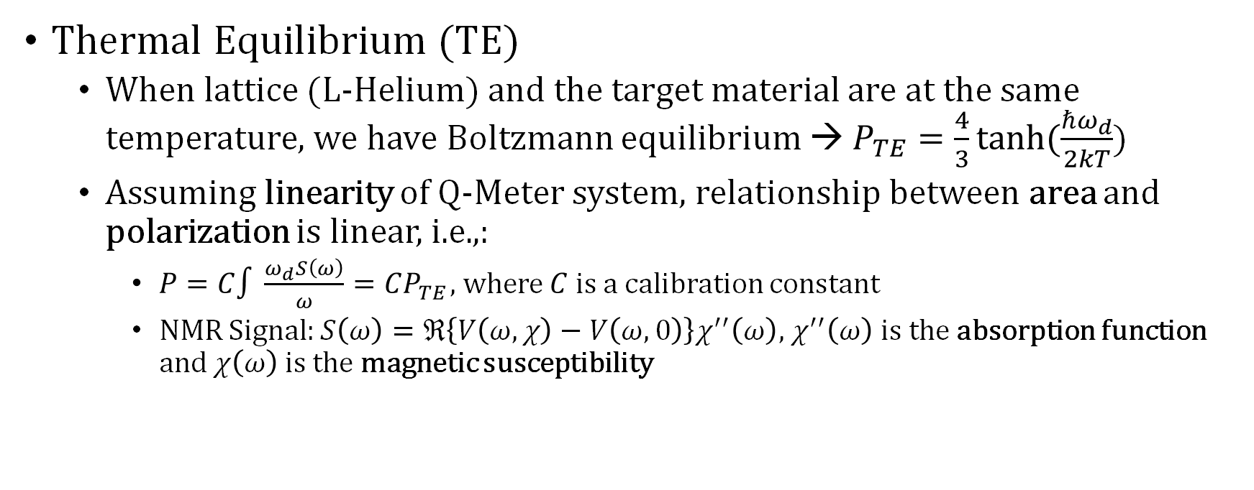
Extracting Deuteron Polarization
Thermal Equilibrium (TE)
When lattice (L-Helium) and the target material are at the same temperature, we have Boltzmann equilibrium → $P_{TE}=\frac{4}{3}tanh⁡(\frac{ℏω_{d}}{2kT}$)
Assuming linearity of Q-Meter system, relationship between area and polarization is linear, i.e.,:
$P=C∫\frac{ω_{d}S\left(ω\right)}{ω}=CP_{TE}$, where $C$ is a calibration constant
NMR Signal: $S\left(ω\right)=ℜ\left\{V\left(ω, χ\right)−V\left(ω,0\right)\right\}χ^{′′}\left(ω\right)$, $χ^{′′}\left(ω\right)$ is the absorption function and $χ\left(ω\right)$ is the magnetic susceptibility

Slide 5
Extracting Deuteron Polarization
TE method comes with considerable error (~4% relative error but sometimes as much as 7% for standard spin-1 fitting)
Error propagated from change in area of TE signal and fitted signal.
TE state takes very long to reach (can take several hours, ie ND3).
Dulya type fitting is prone to systematic errors and susceptible to signal-to-noise.
Dulya type fitting not possible for RF manipulated signal.

Slide 6
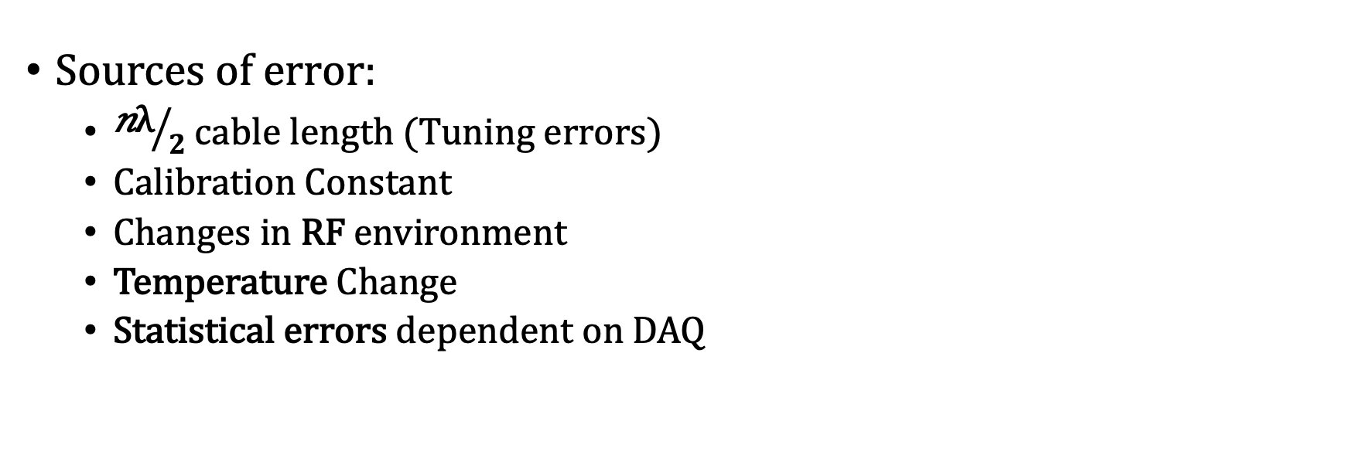
Q-Meter Limitations
Sources of error:
${\text{n}\text{λ}}/2$ cable length (Tuning errors)
Calibration Constant
Changes in RF environment
Temperature Change
Statistical errors dependent on DAQ

Slide 7
Artificial Neural Networks

Slide 8
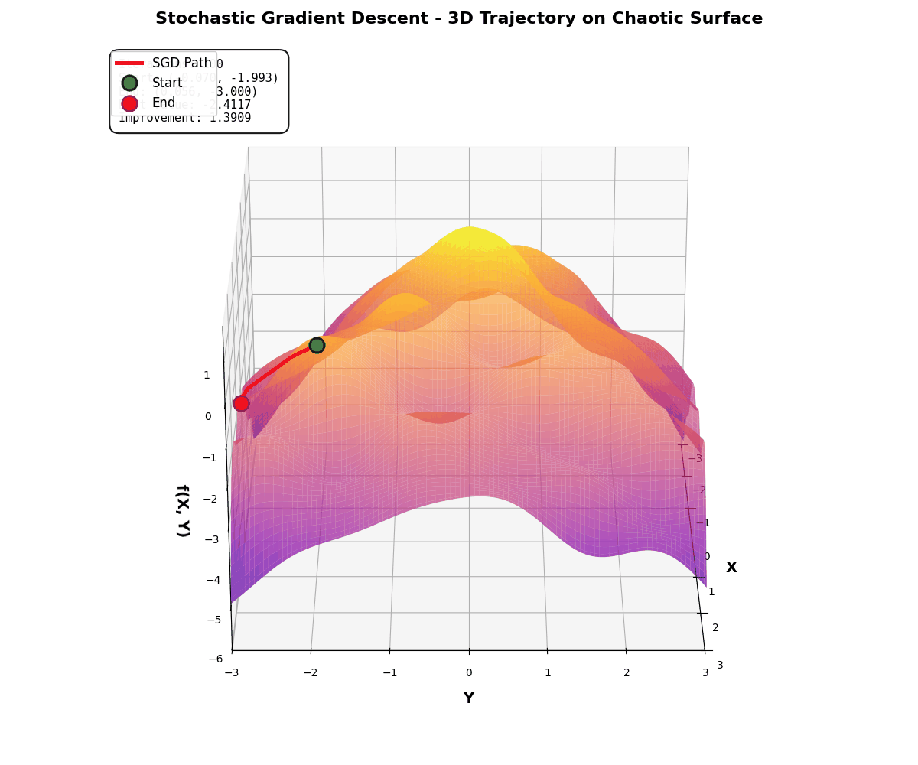
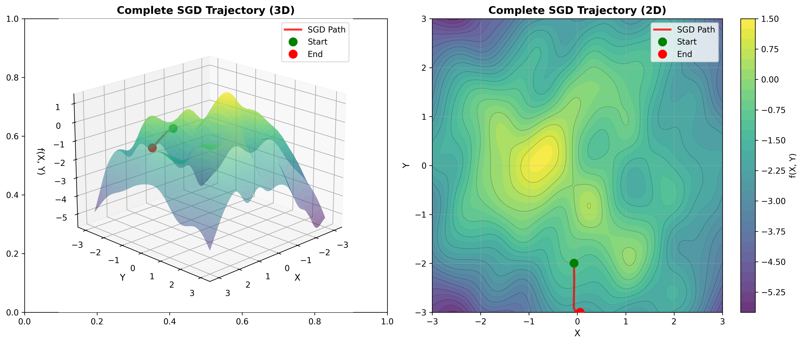
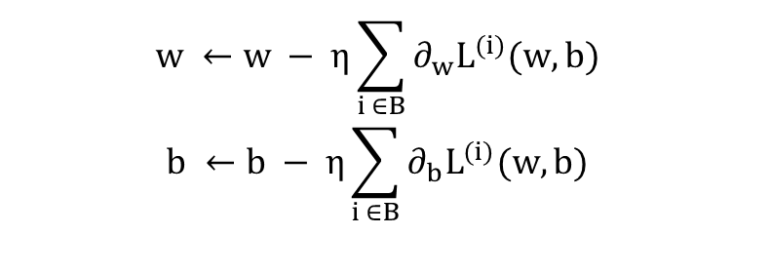


$$\hat{y}=Xw+b, X,w∈ ℝ^{d}$$
Loss Function: $L(w,b) (e.g., MSE, MAE)$
Minimize: $\left(w^{∗},b^{∗}\right)= argmin(L(w,b))$
$$w ←w − η\sum_{i ∈B}{∂_{w}L^{(i)}(w,b)}$$
$$b ←b − η\sum_{i ∈B}{∂_{b}L^{(i)}(w,b)}$$

Slide 9
Goals
(Reduce fit errors) increase accuracy and precision (for spin ½ and 1)
Achieve reliable results even with large range of noise and shifts
Develop flexible software that improves reliability even when working Q-meter outside its design specifications
Enable real-time polarization readings
Apply to ss-RF/AFP type manipulations

Slide 10
Why Neural Networks?
Most Flexible ML approach to regression problems (UAT)
Very fast inference is possible (~ms scale updates with standard GPU)
More accurate real-time polarization monitoring
Can do more with multidimensional information
Common libraries help to leverage basic hardware

Slide 11
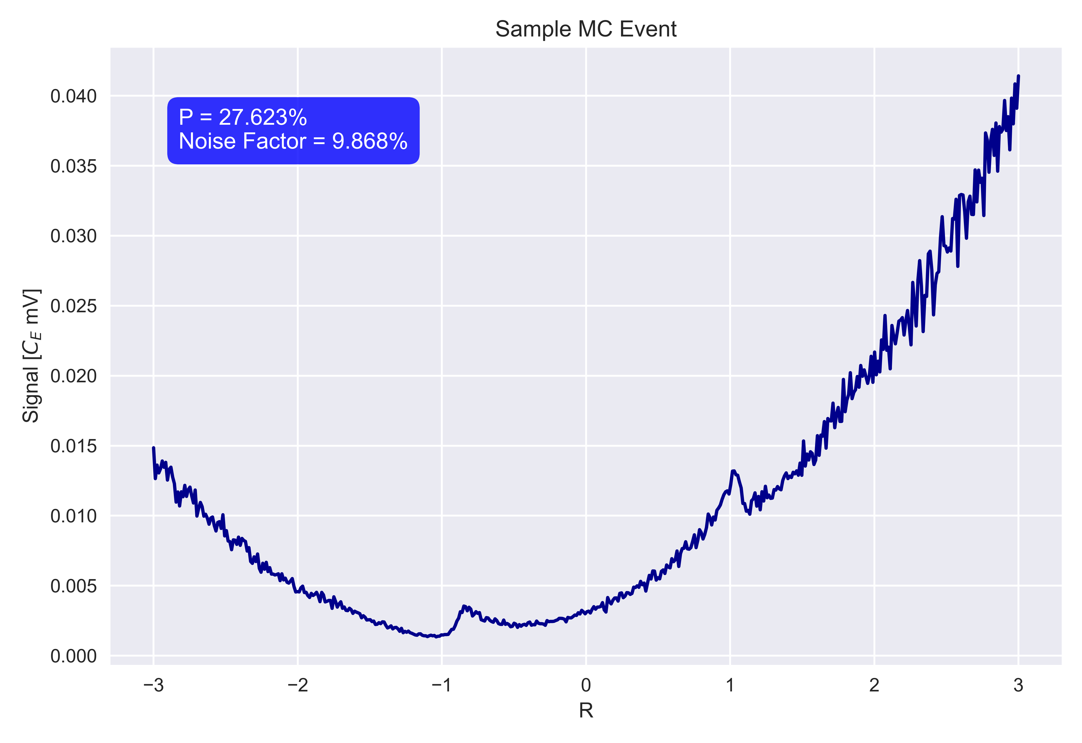
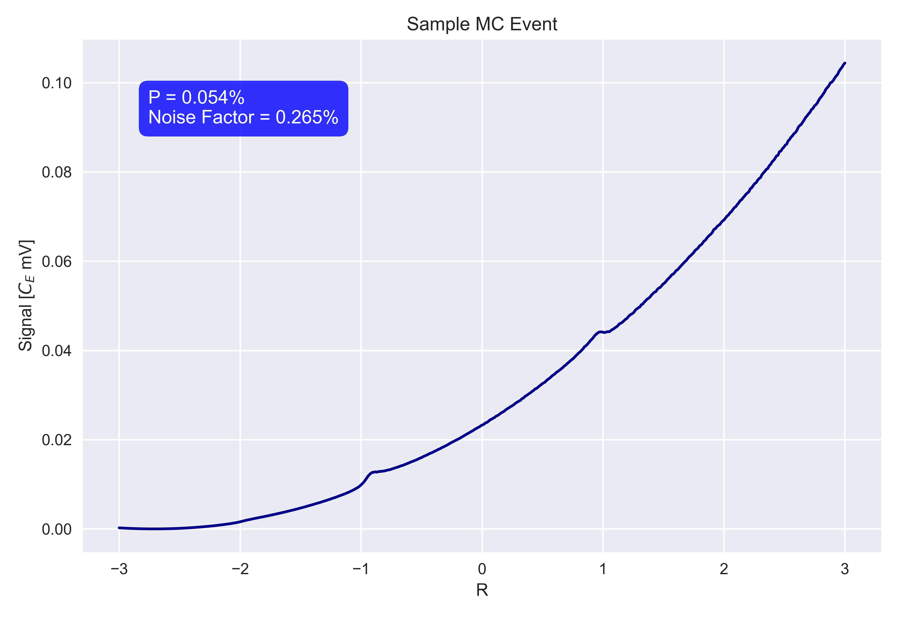
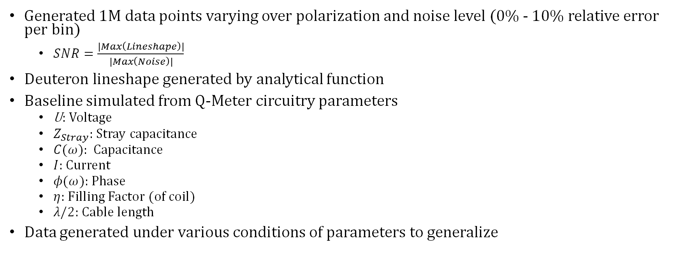
Data Generation
Generated 1M data points varying over polarization and noise level (0% - 10% relative error per bin)
$SNR=\frac{|Max\left(Lineshape\right)|}{|Max\left(Noise\right)|}$
Deuteron lineshape generated by analytical function
Baseline simulated from Q-Meter circuitry parameters
U: Voltage
$Z_{Stray}$: Stray capacitance
$C(ω)$: Capacitance
$I$: Current
$φ(ω)$: Phase
$η$: Filling Factor (of coil)
$λ/2$: Cable length
Data generated under various conditions of parameters to generalize

Slide 12
Preliminary Results

Slide 13
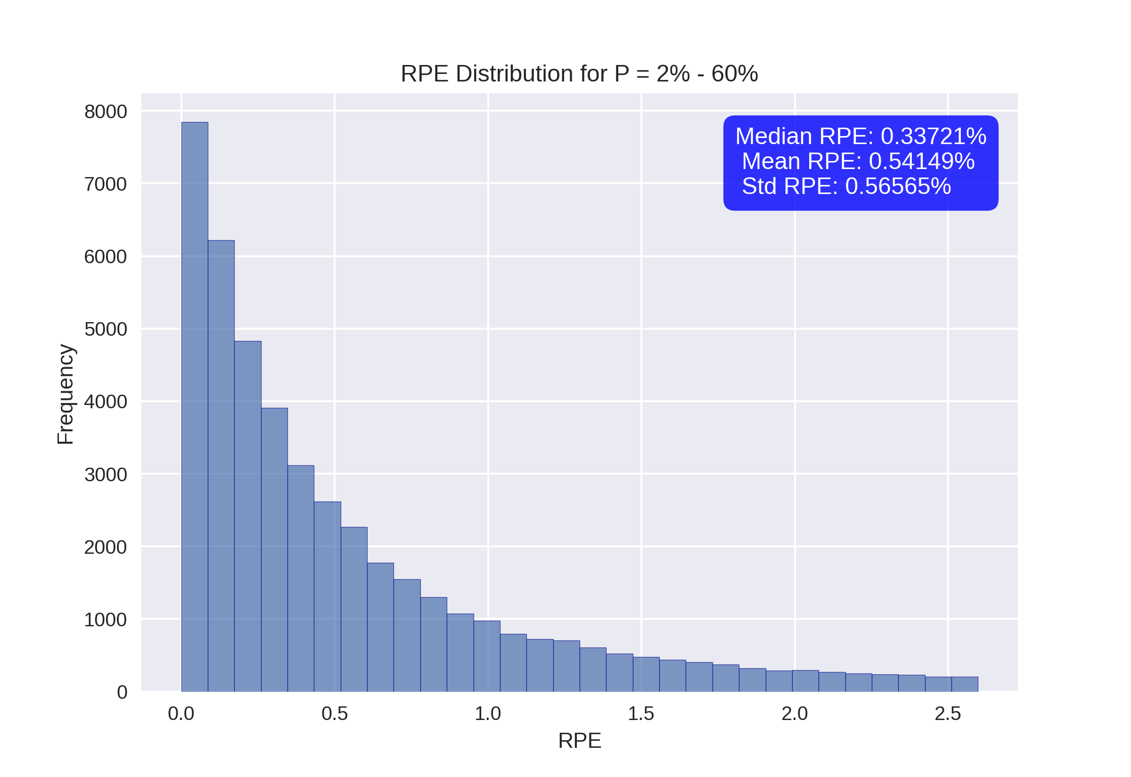
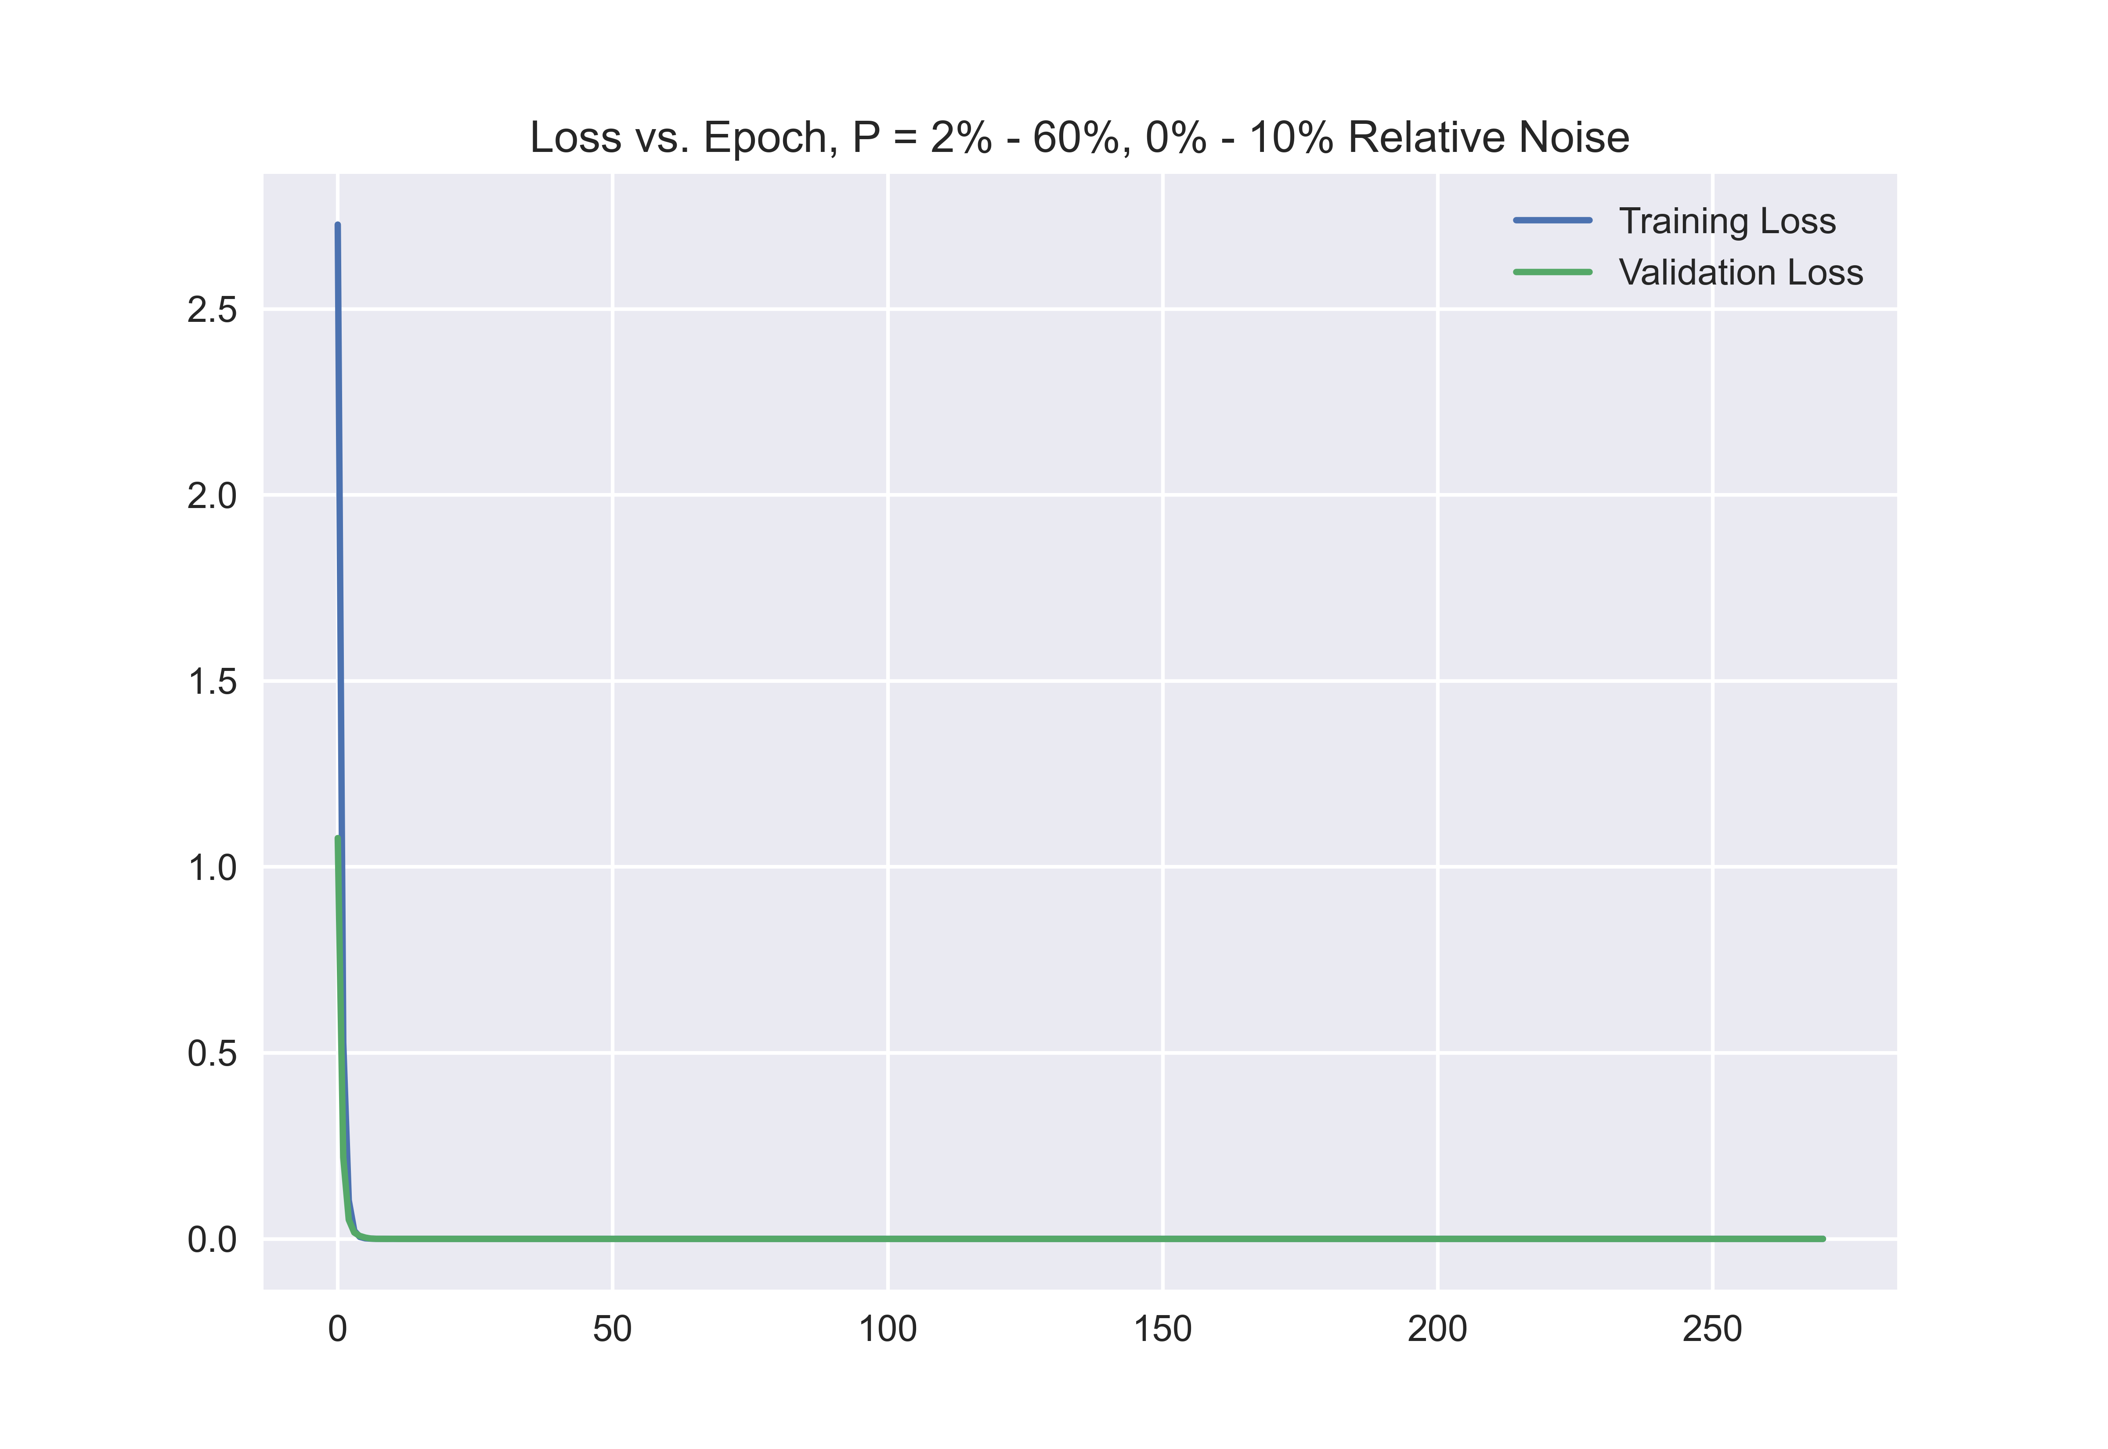
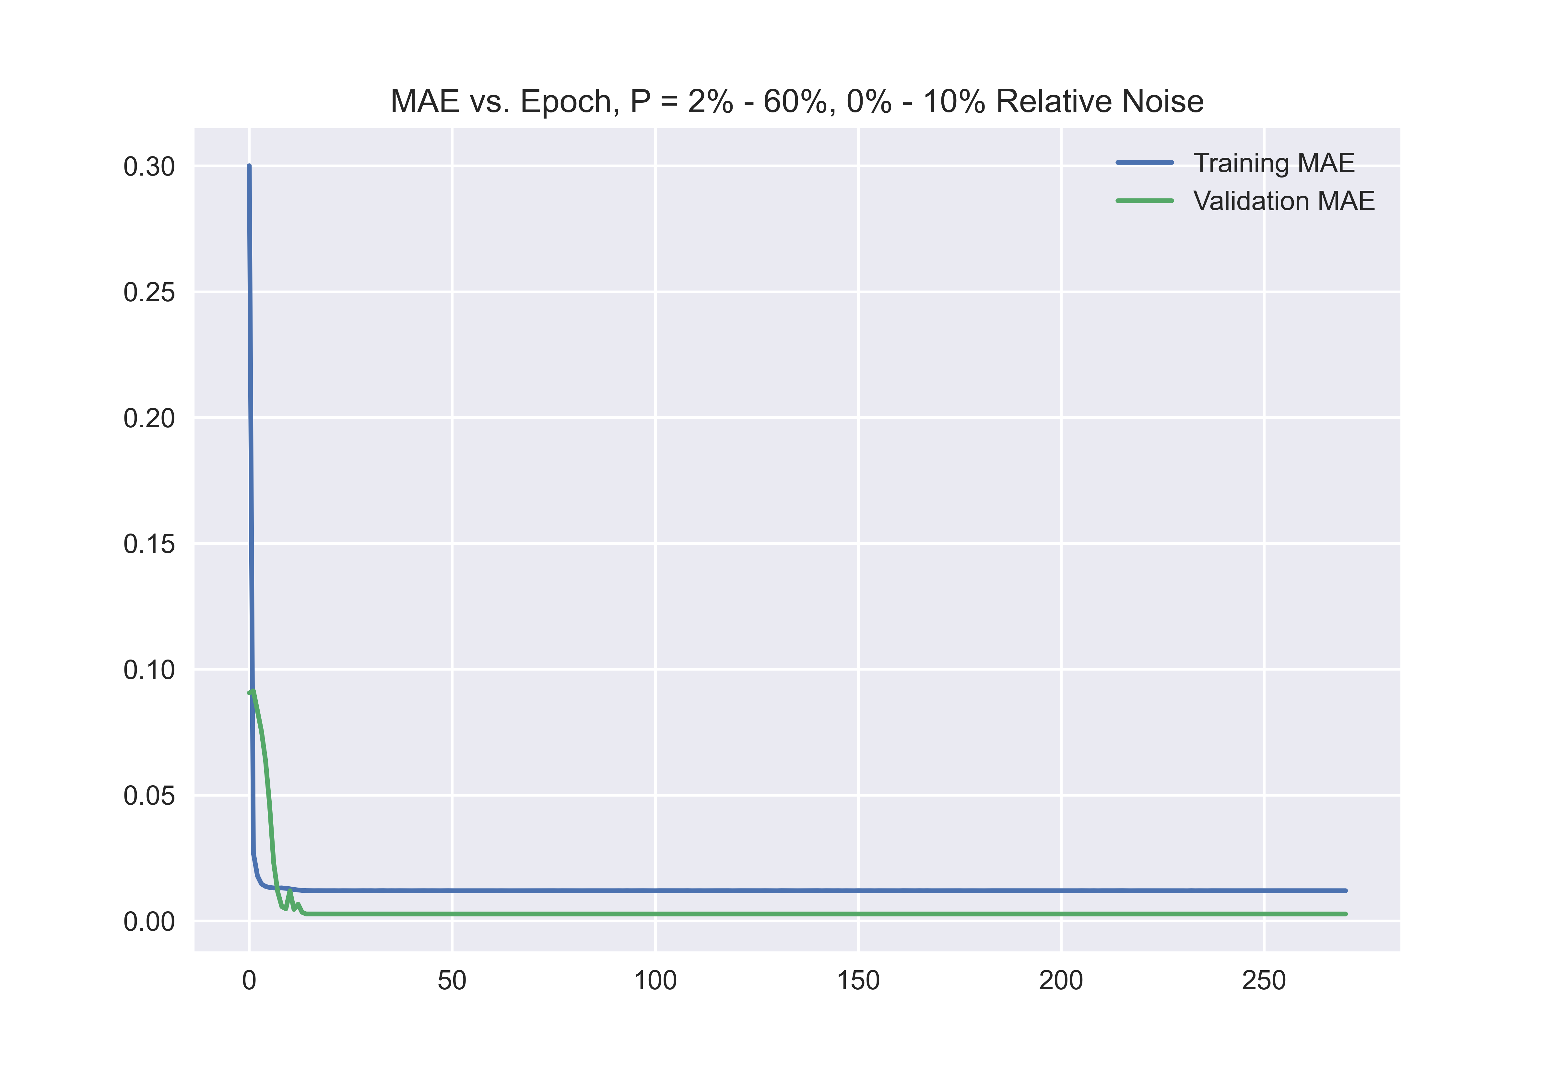
Results for P = 2% - 60%
Relative Error ~ 0 – 10% per bin
SNR ~ 1-2
Median RPE: 0.34%
Mean RPE: 0.54%
STD: 0.57%

Slide 14
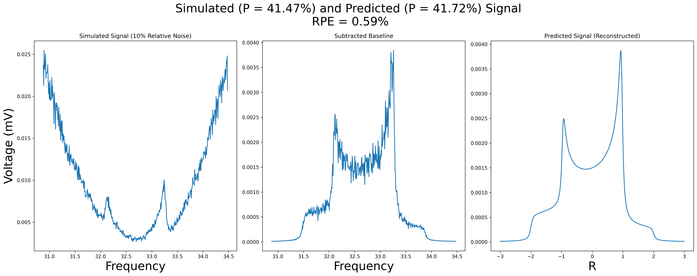
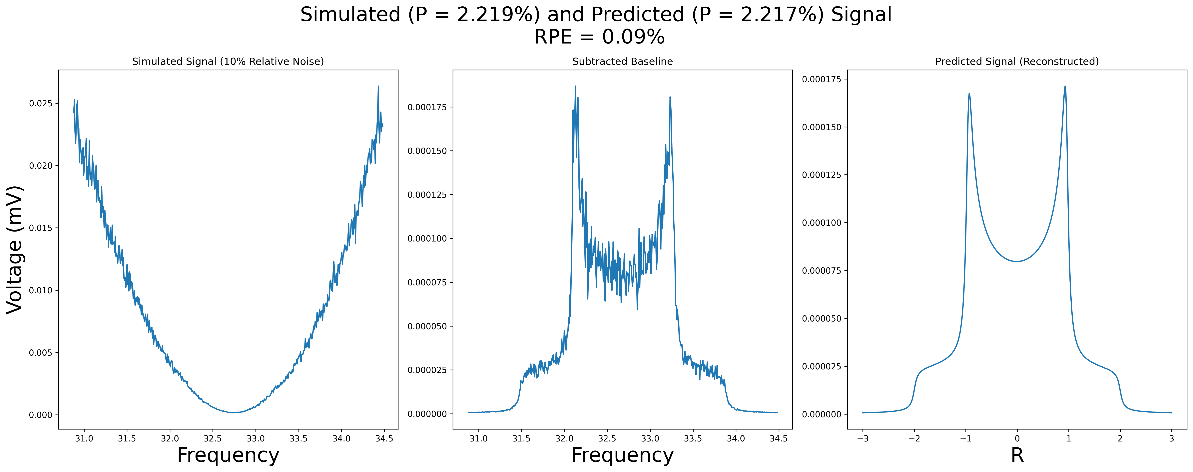

Slide 15
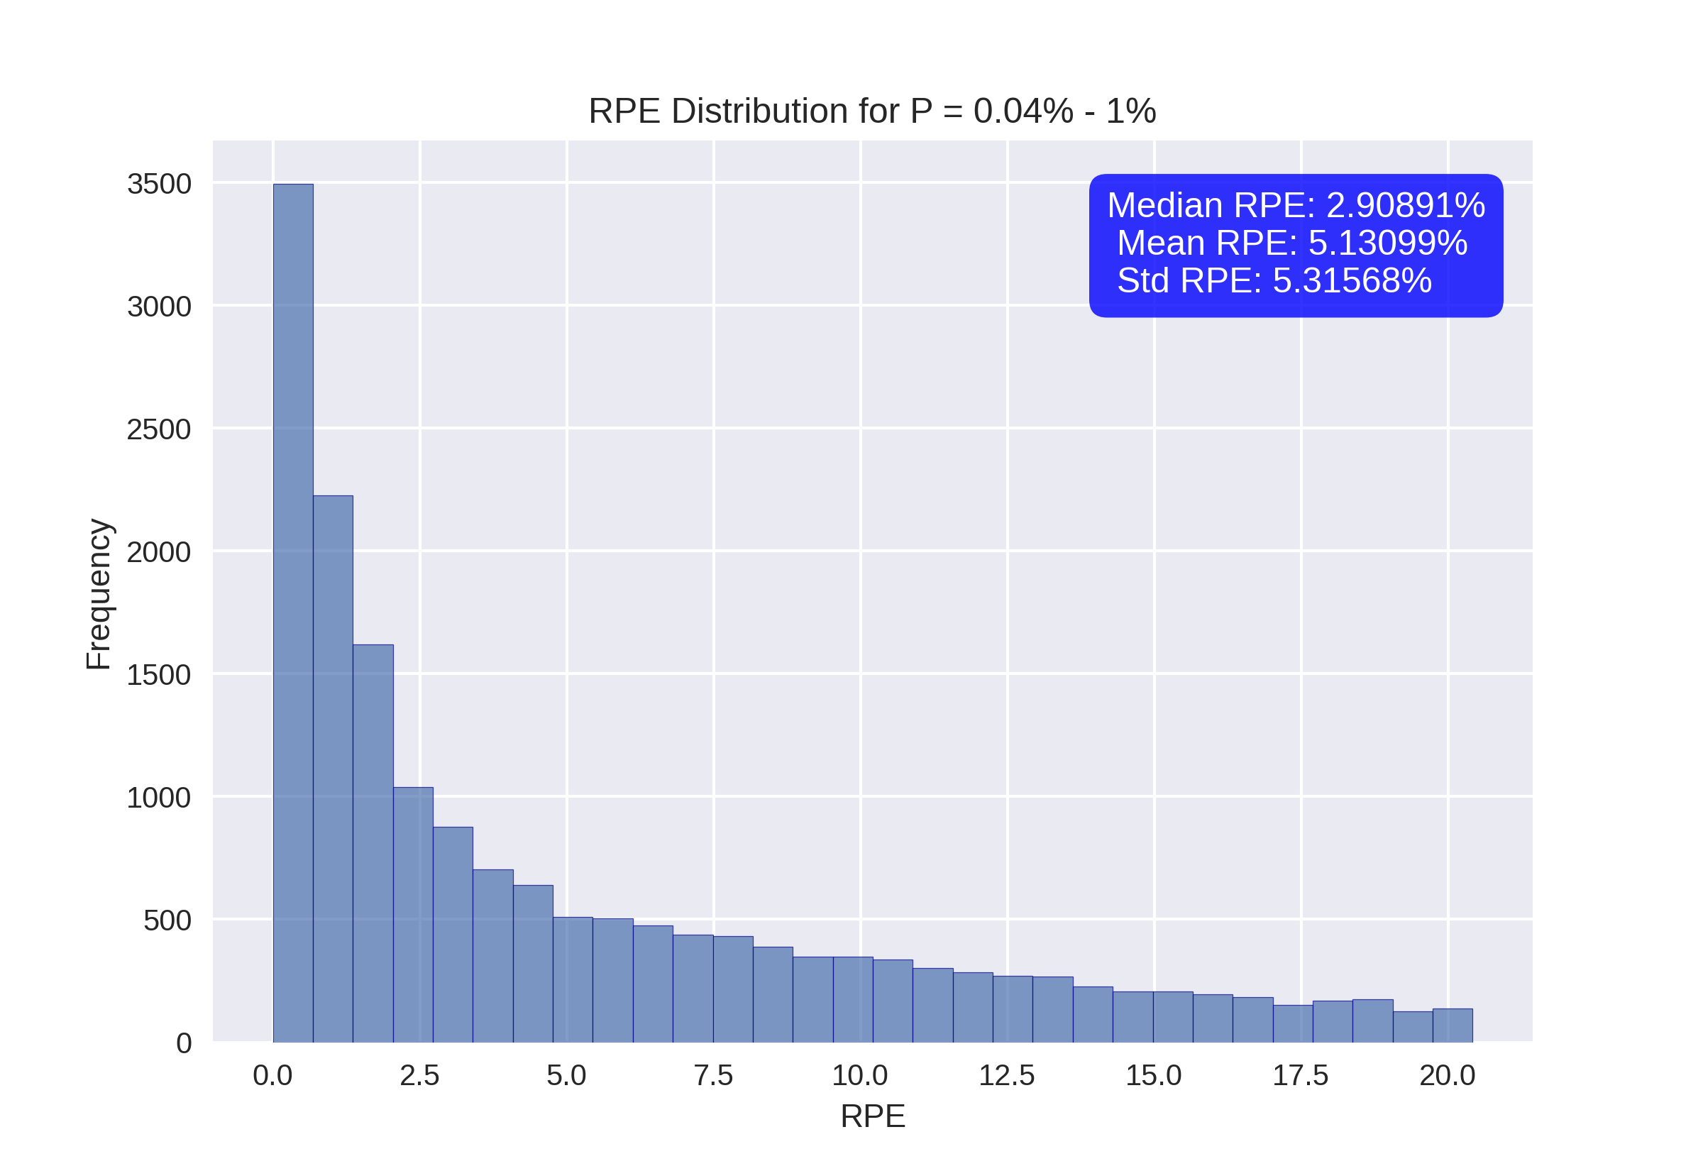
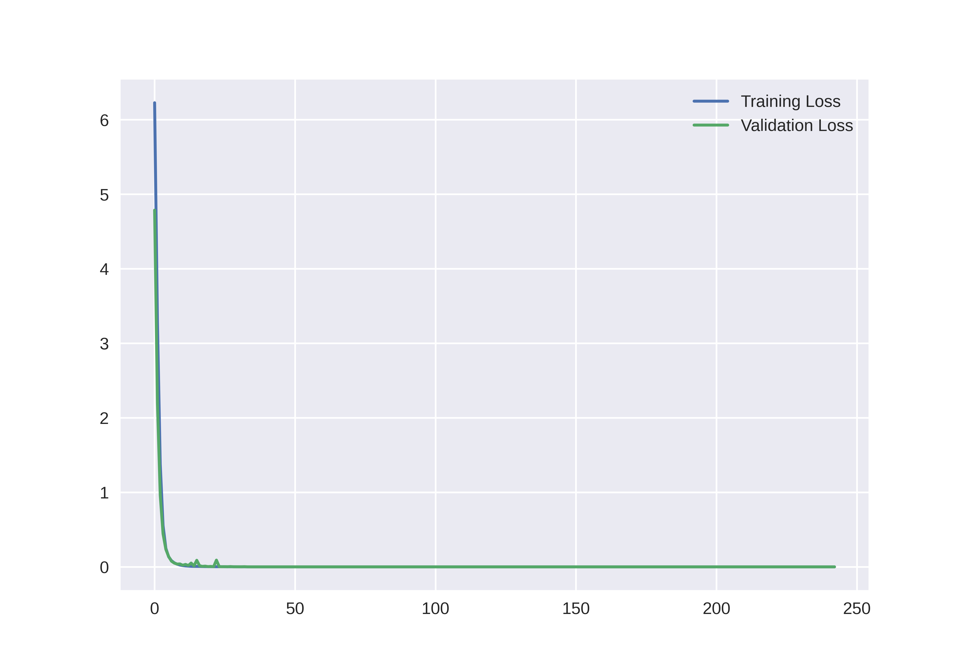
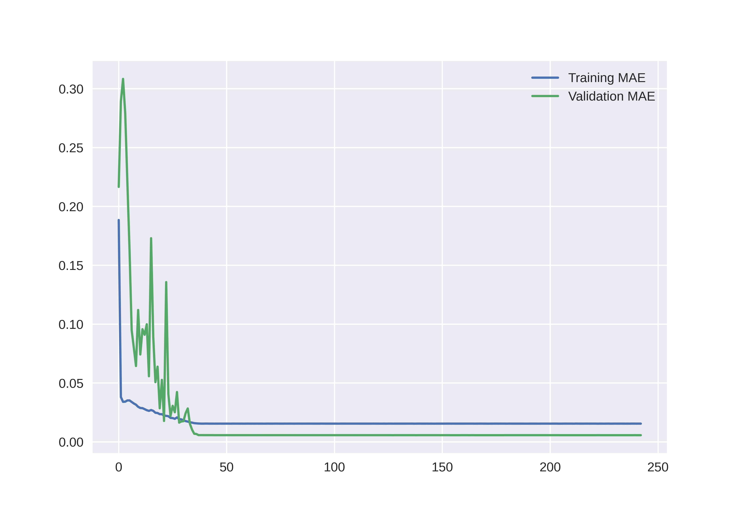
Results for P = 0.04% - 2%
Relative Error ~ 0 – 1% per bin
SNR ~ 1-2
Median RPE: 2.9%
Mean RPE: 5.13%
STD: 5.32%

Slide 16
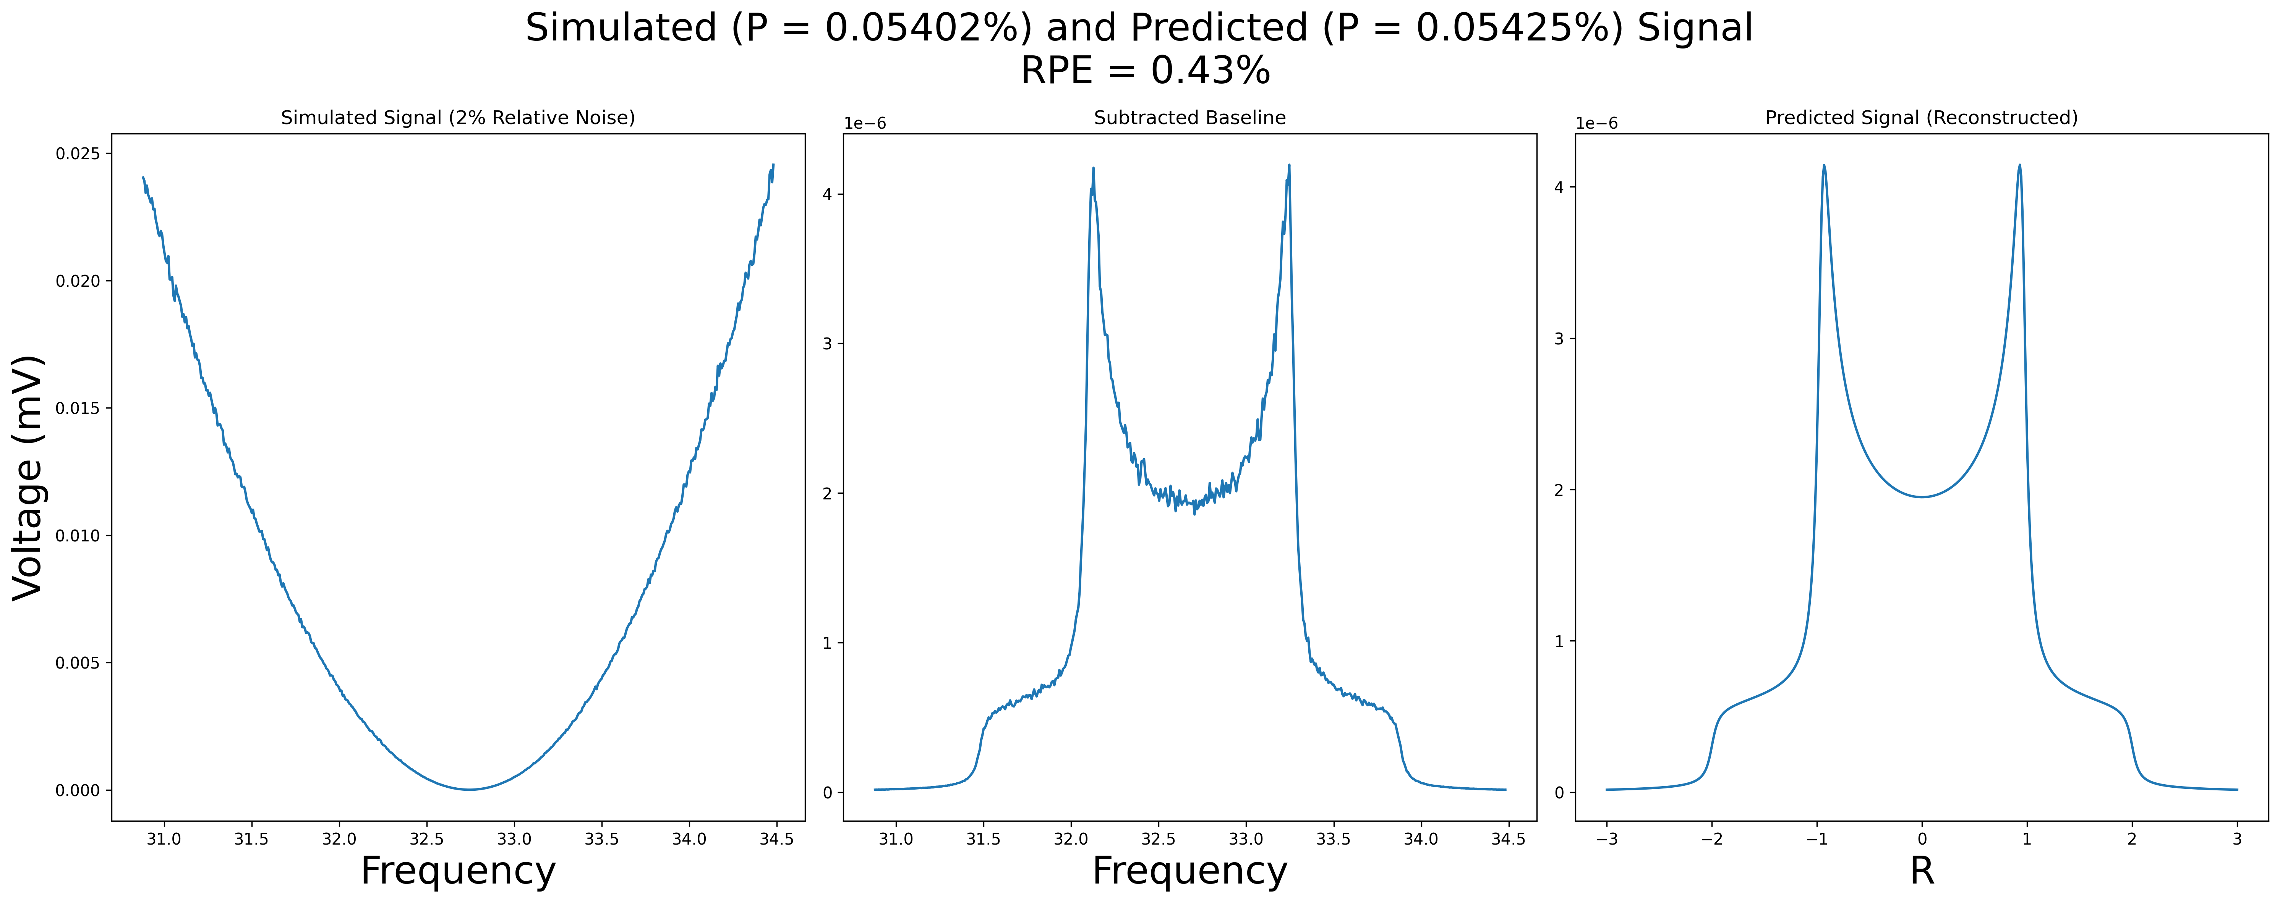

Slide 17
Tensor Polarization

Slide 18
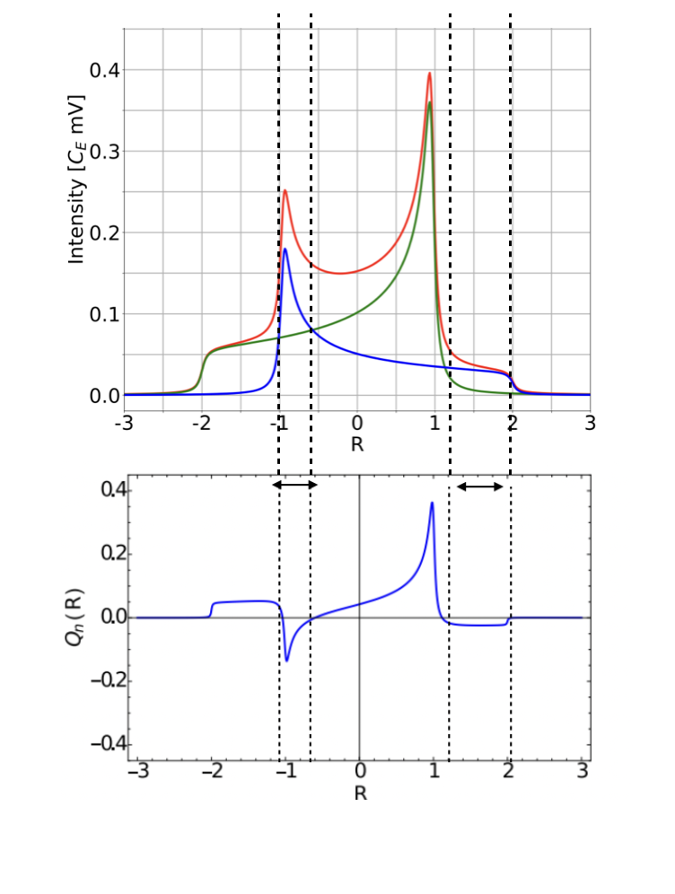
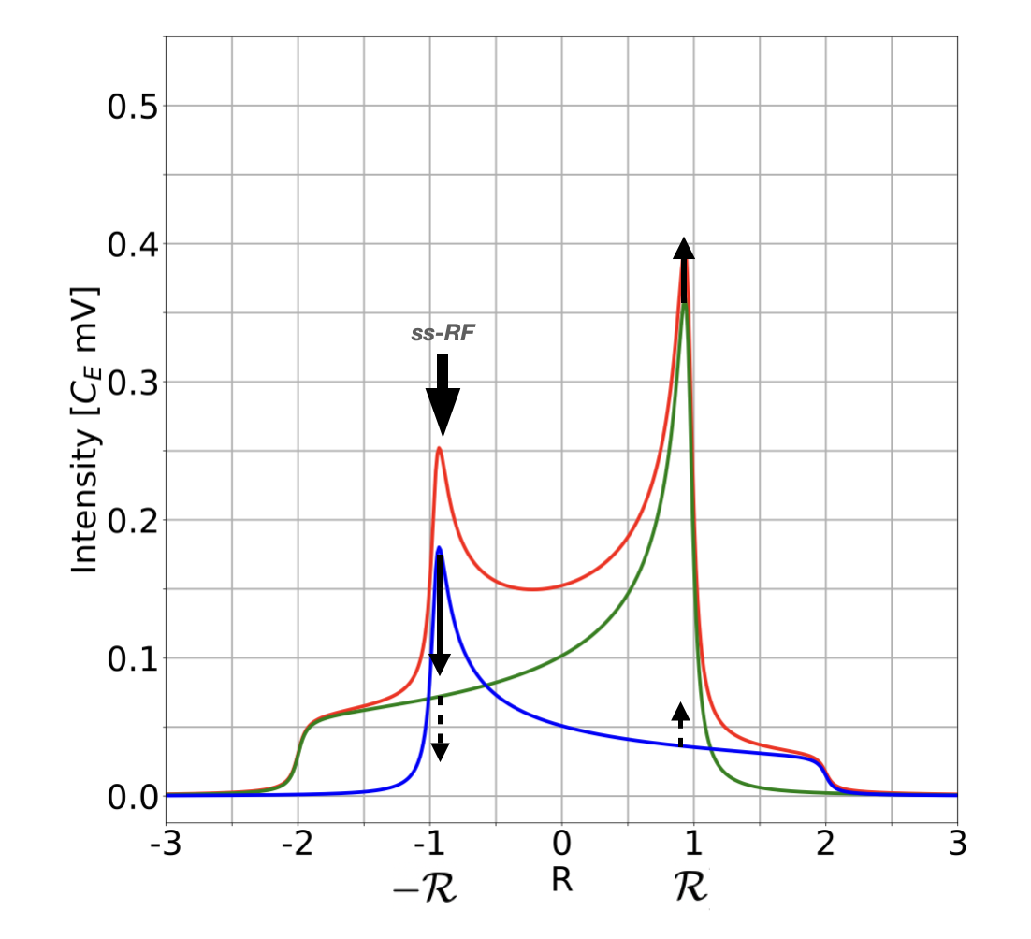
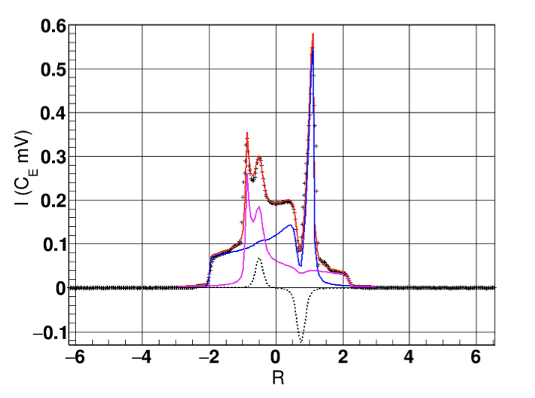
Semi-Saturated Radiofrequency (ss-RF)
Relaxation Pathways
https://arxiv.org/abs/1707.07065

Slide 19
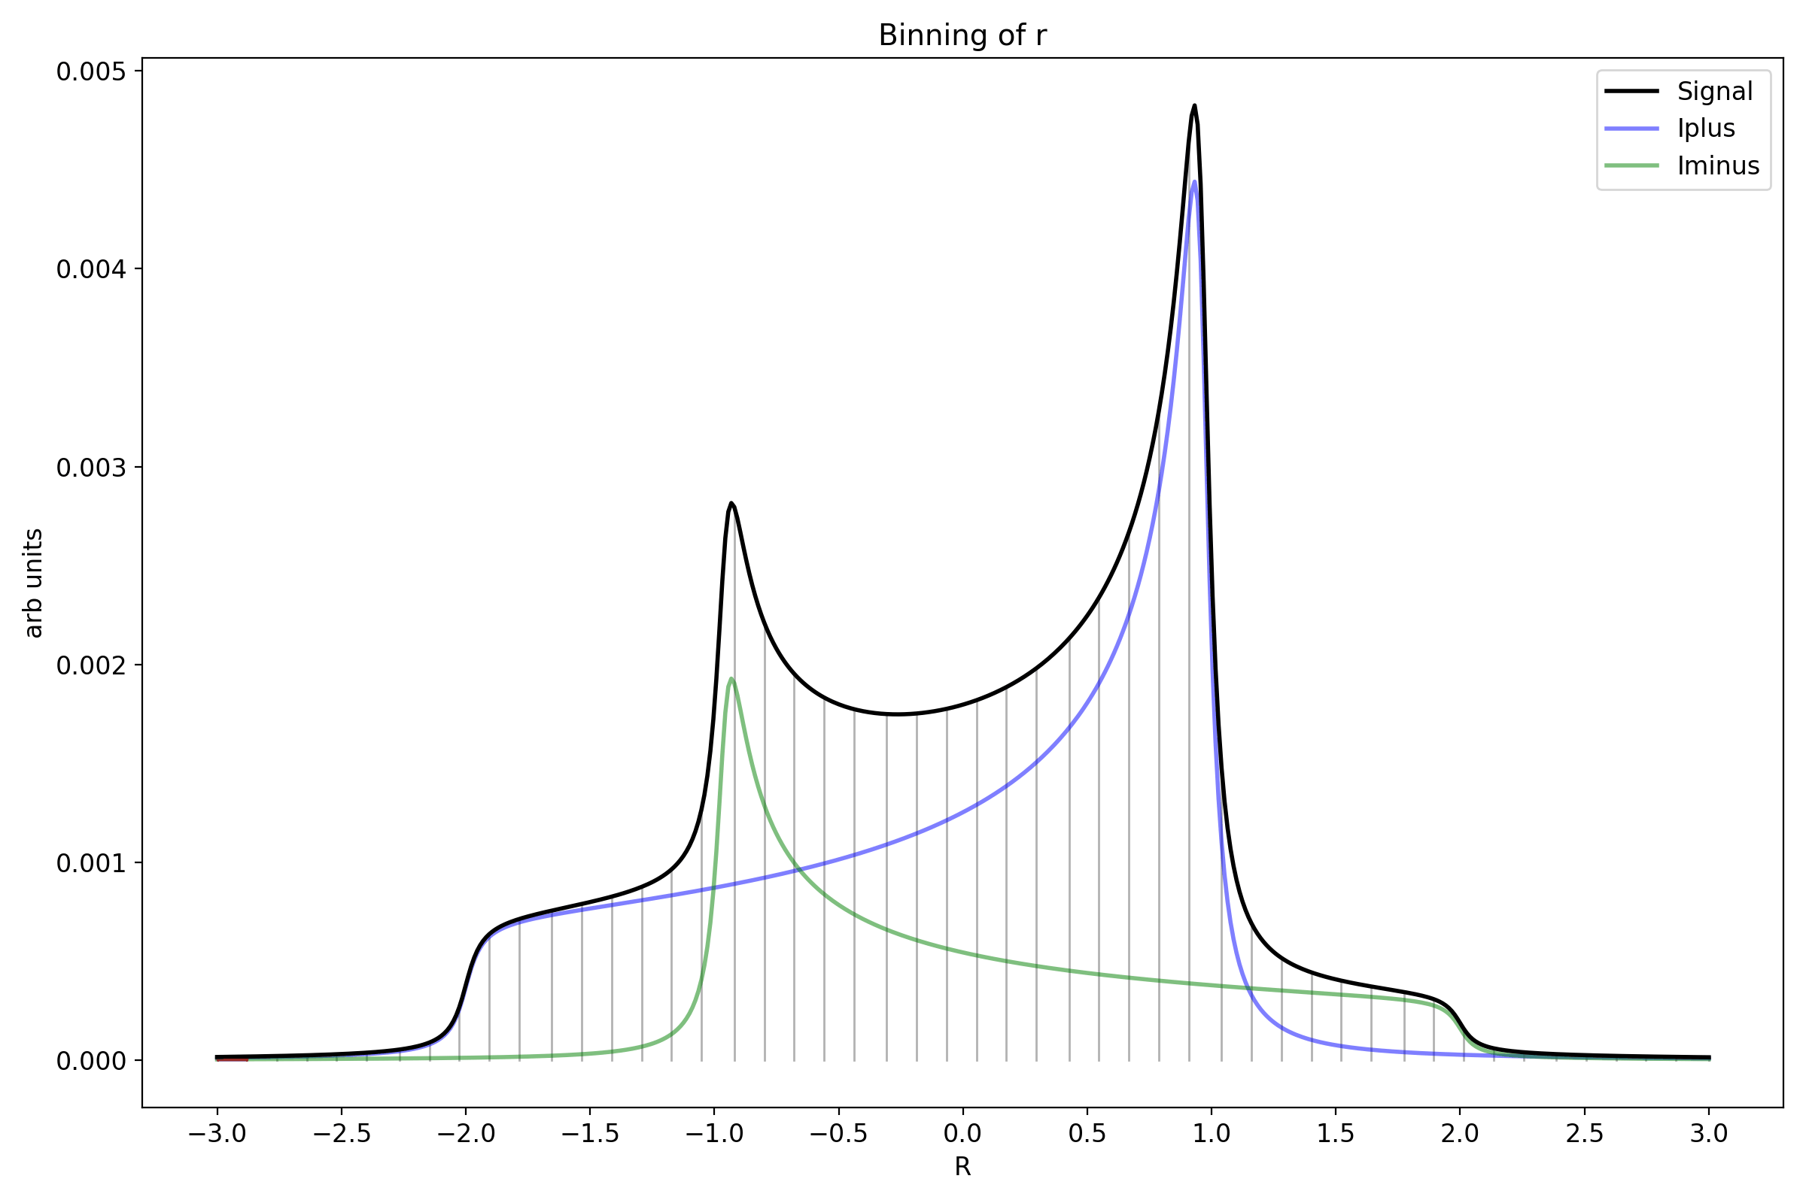
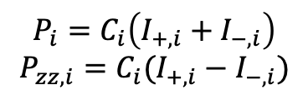

Principles of ss-RF
$$r=\frac{I_{+}}{I_{−}} →r_{i}=\frac{I_{+,i}}{I_{−,i}}$$
Spin-Temperature Consistency
Hole burning locally erases non-equilibrium state biases by restoring partial equilibrium
Burning acts as mirror image of DNP, driving spin transition in opposite direction
Differential Binning
Partitioning signal into frequency beams and manipulating/measuring each subset
Rates Response
Peak achieved from hole burning is ½ area of burned area (in high RF power limit)
$$P_{i}=C_{i}\left(I_{+,i}+I_{−,i}\right)$$
$$P_{zz,i}=C_{i}(I_{+,i}−I_{−,i})$$

Slide 20
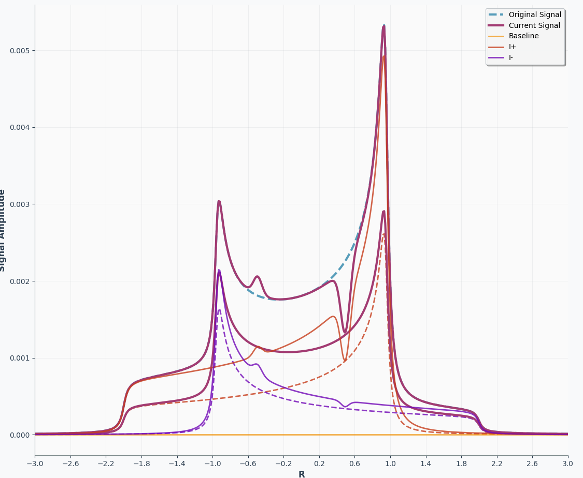
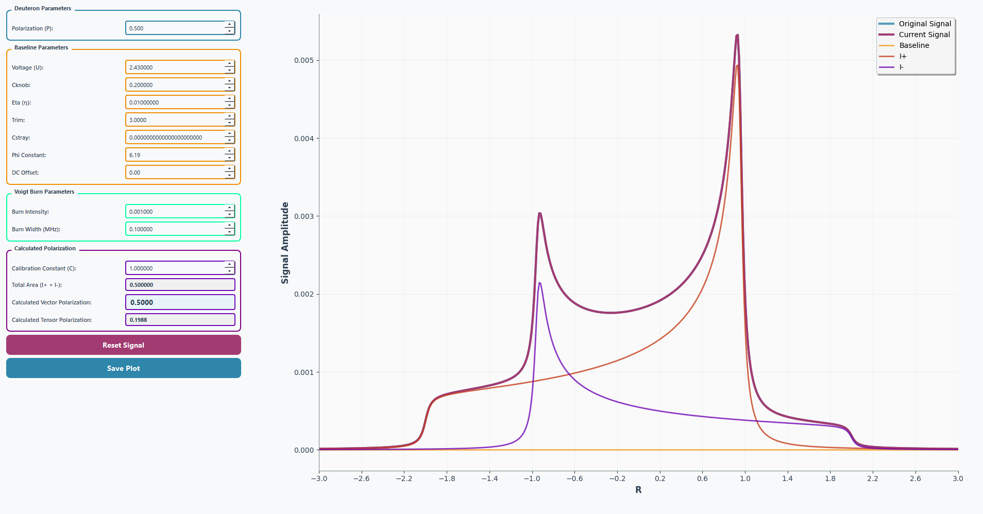


Burning Simulation
Applied Burn

Slide 21
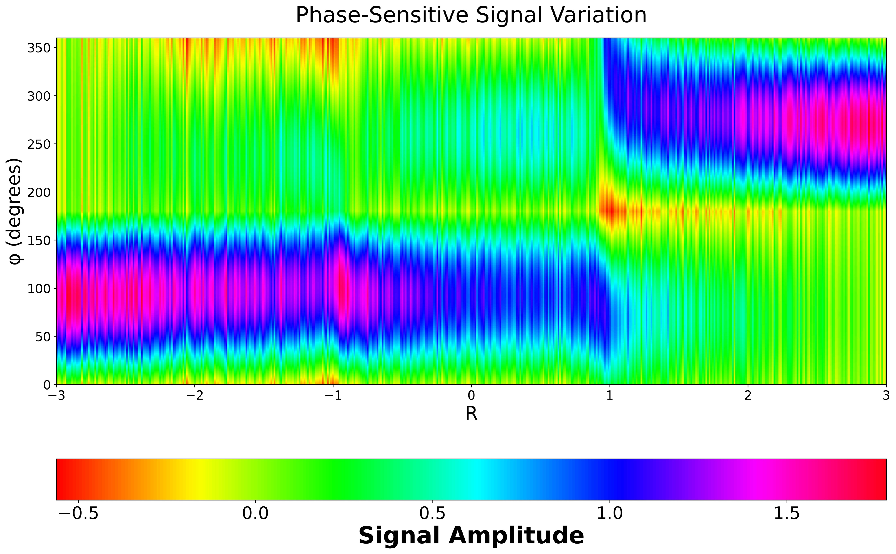
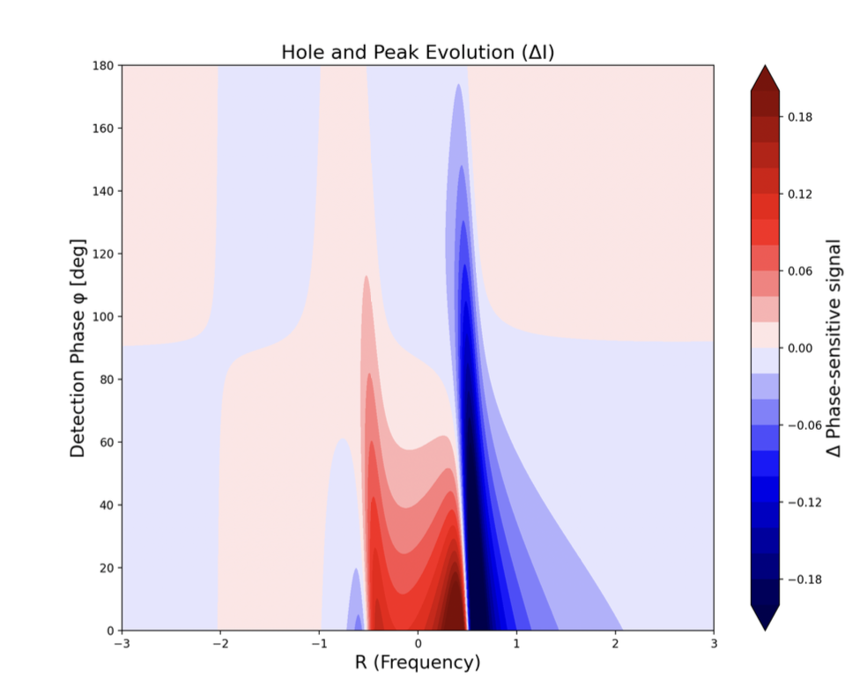
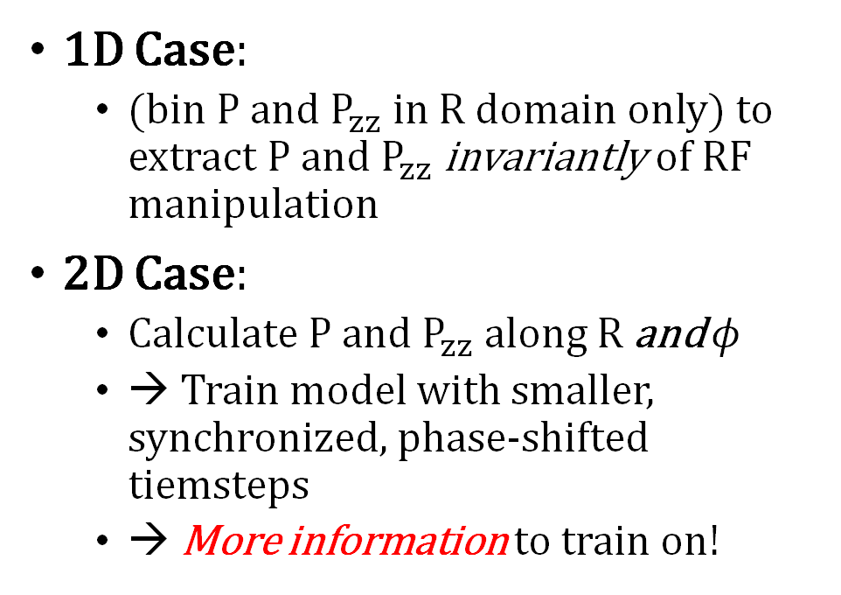
Future Machine Learning Endeavors
1D Case:
(bin $P$ and $P_{zz}$ in $R$ domain only) to extract $P$ and $P_{zz}$ invariantly of RF manipulation
2D Case:
Calculate $P$ and $P_{zz}$ along $R$ and $φ$
→ Train model with smaller, synchronized, phase-shifted tiemsteps
→ More information to train on!

Slide 22
Thank you!

Slide 23
Leftovers

Slide 24
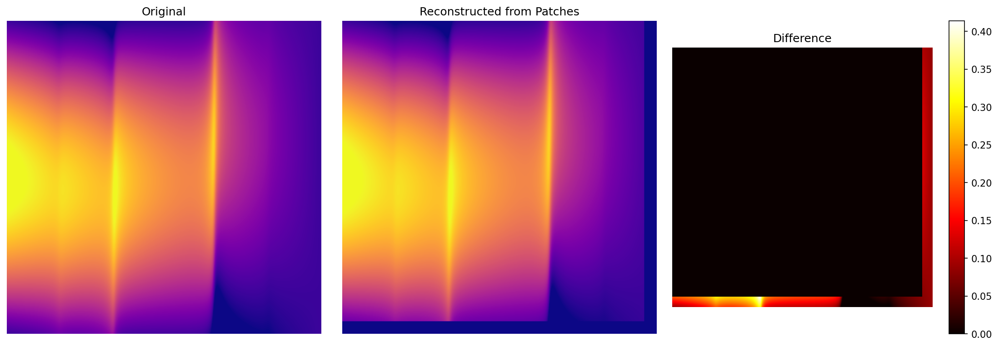

Slide 25
