Slide 1


Hardware (AFP, ssRF)
Forhad Hossain and Dustin Keller
University of Virginia
October 13, 2025
b1/Azz Tensor Collaboration Meeting

Slide 2
Outline
Spin 1 system (deuteron)
Vector and Tensor Polarizations
AFP and ssRF
Hardware Status
Summary

Slide 3
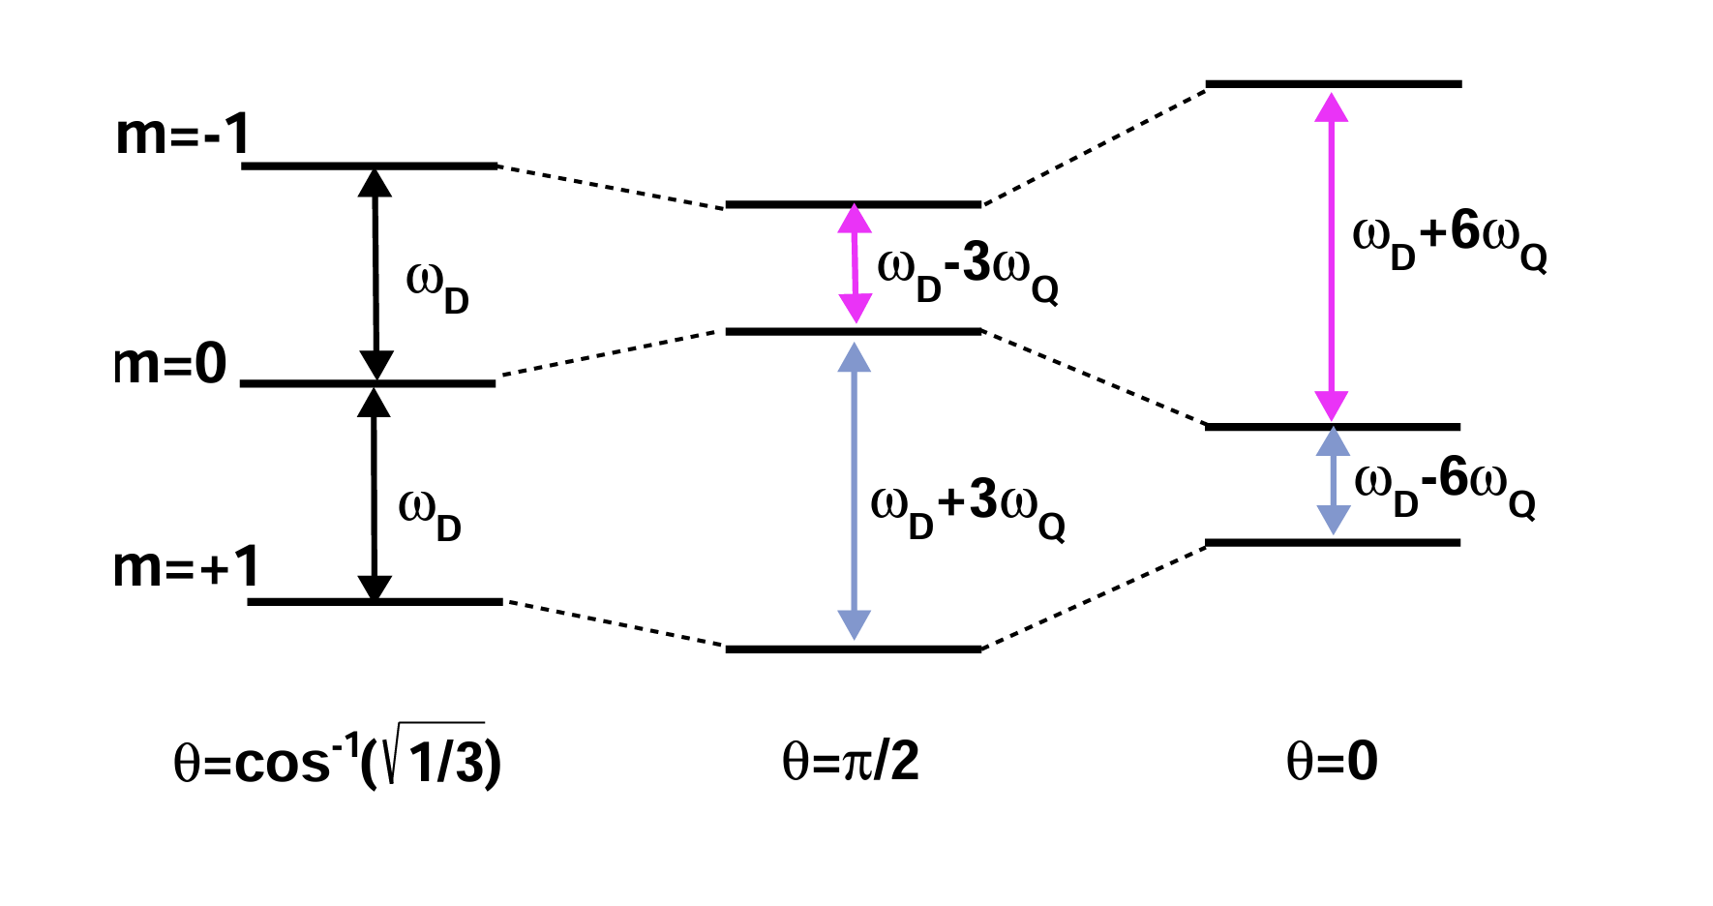
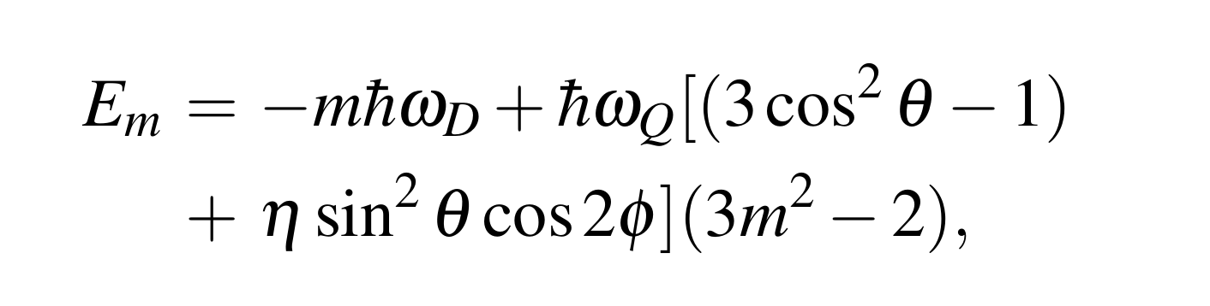
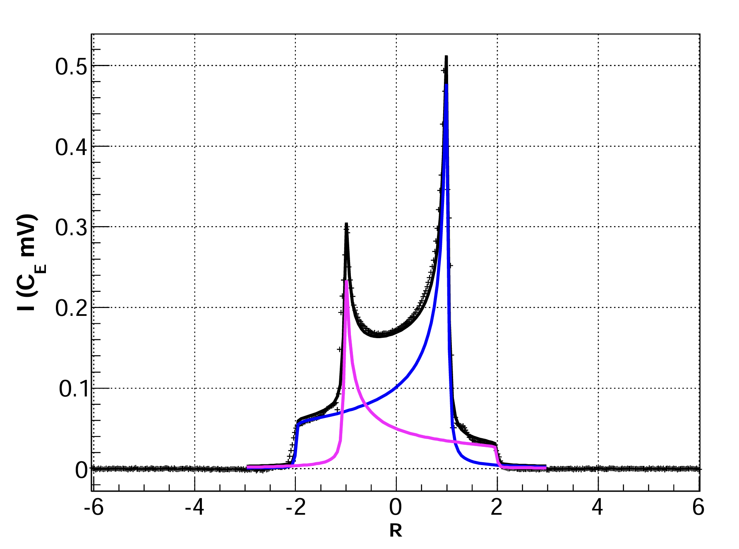
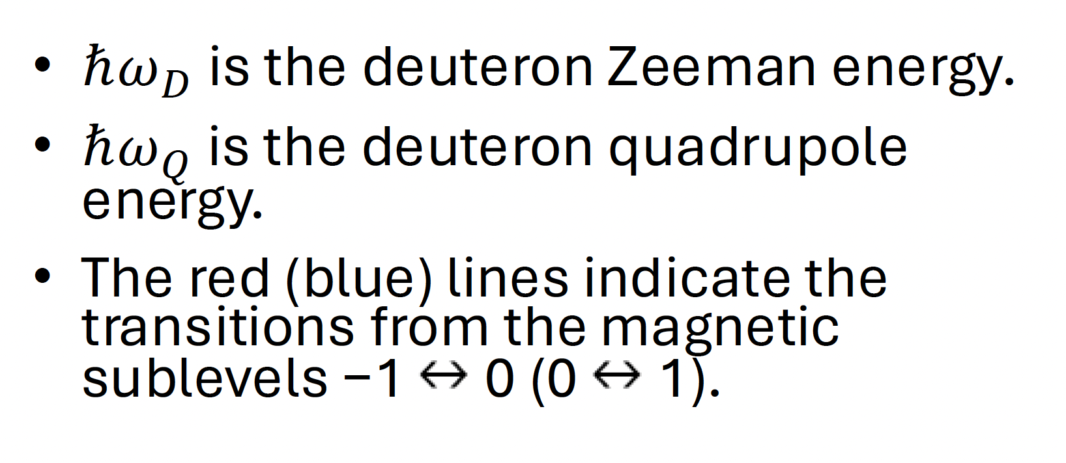
Spin-1 System (deuteron)
Energy level of a deuteron in a magnetic field
The energy level diagram (not to scale) for deuterons
Ref: https://arxiv.org/abs/1707.07065

Slide 4
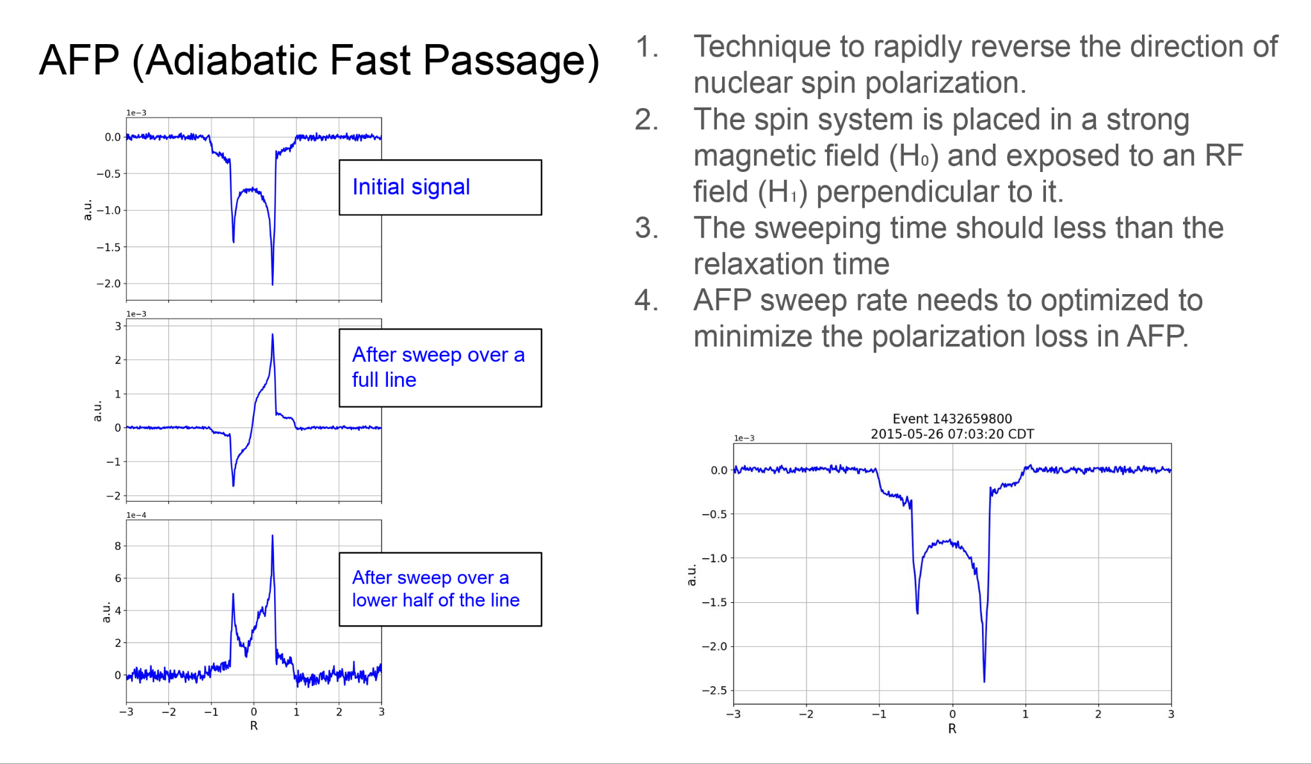
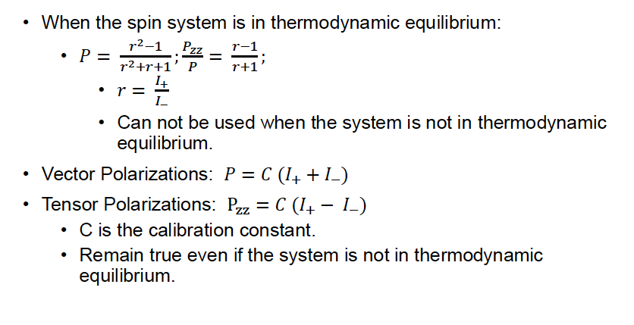
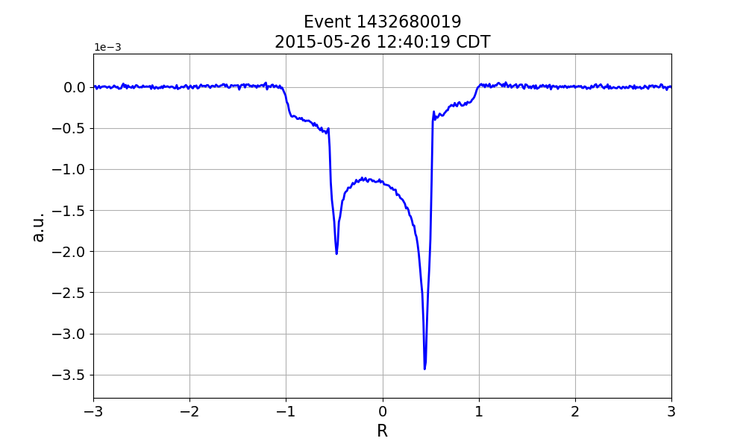
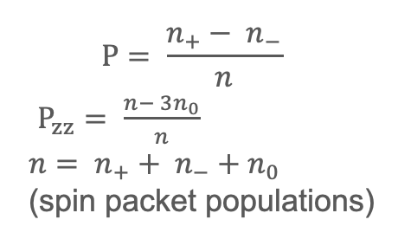
Vector and Tensor Polarizations
P= 42.3%
Pzz = 13.1%
Ref: https://arxiv.org/abs/1707.07065
Ref: NIM A 398 109-125 (1997)

Slide 5
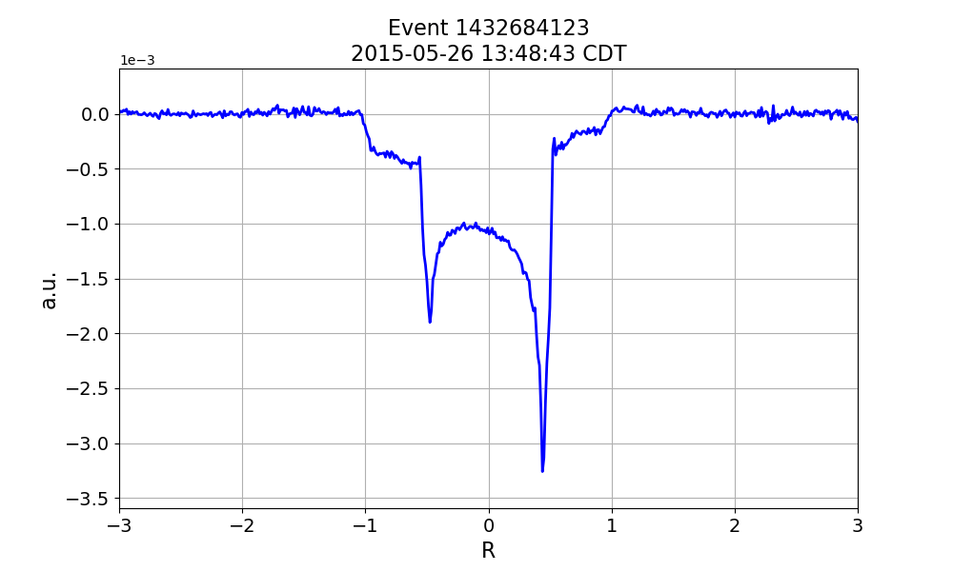
More AFP
ND3 AFP data from UVA (2015)

Slide 6
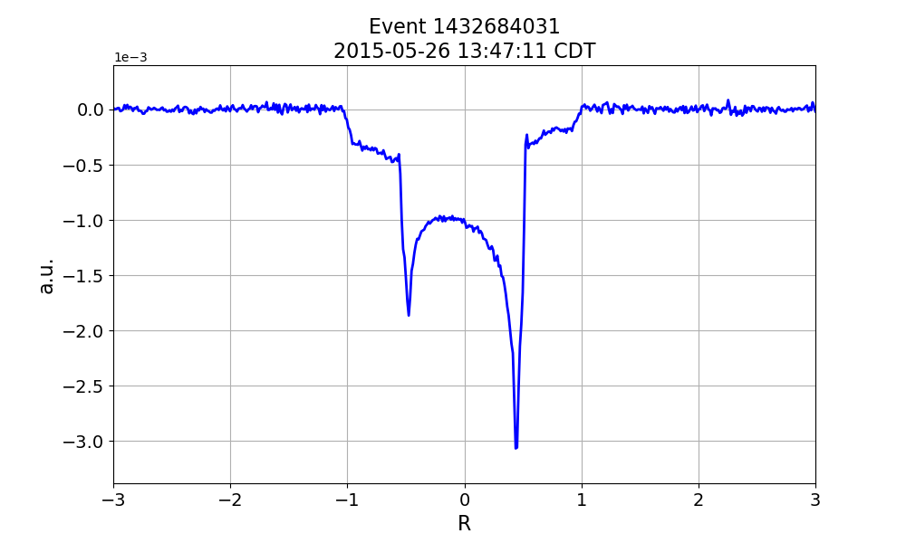
More AFP
ND3 AFP data from UVA (2015)

Slide 7
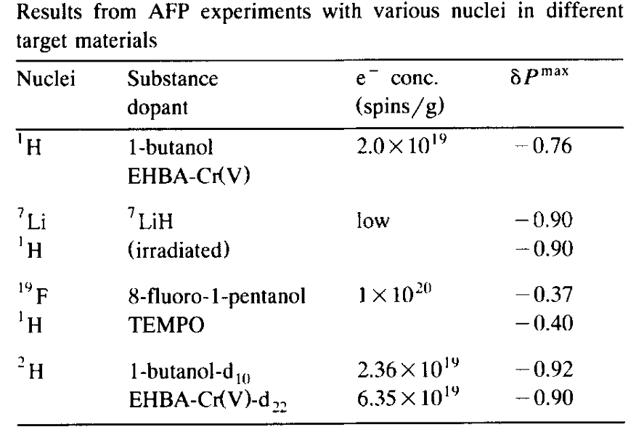
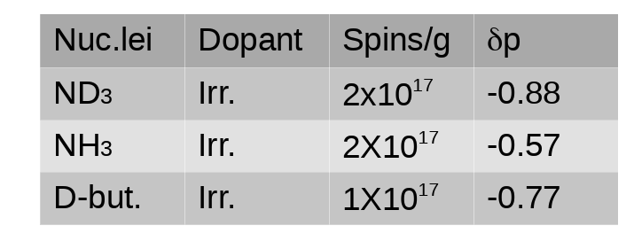
AFP efficiency
•AFP was performed on different target materials.
•Spin-flip efficiencies for different materials are shown below (δp = pol. ratio before and after spin-flip)
Slide is taken from D. Keller
Ref:https://twist.phys.virginia.edu/work/DrellYan2017/DrellYan2016.pdf
Ref: NIM A 356 (1995) 108

Slide 8
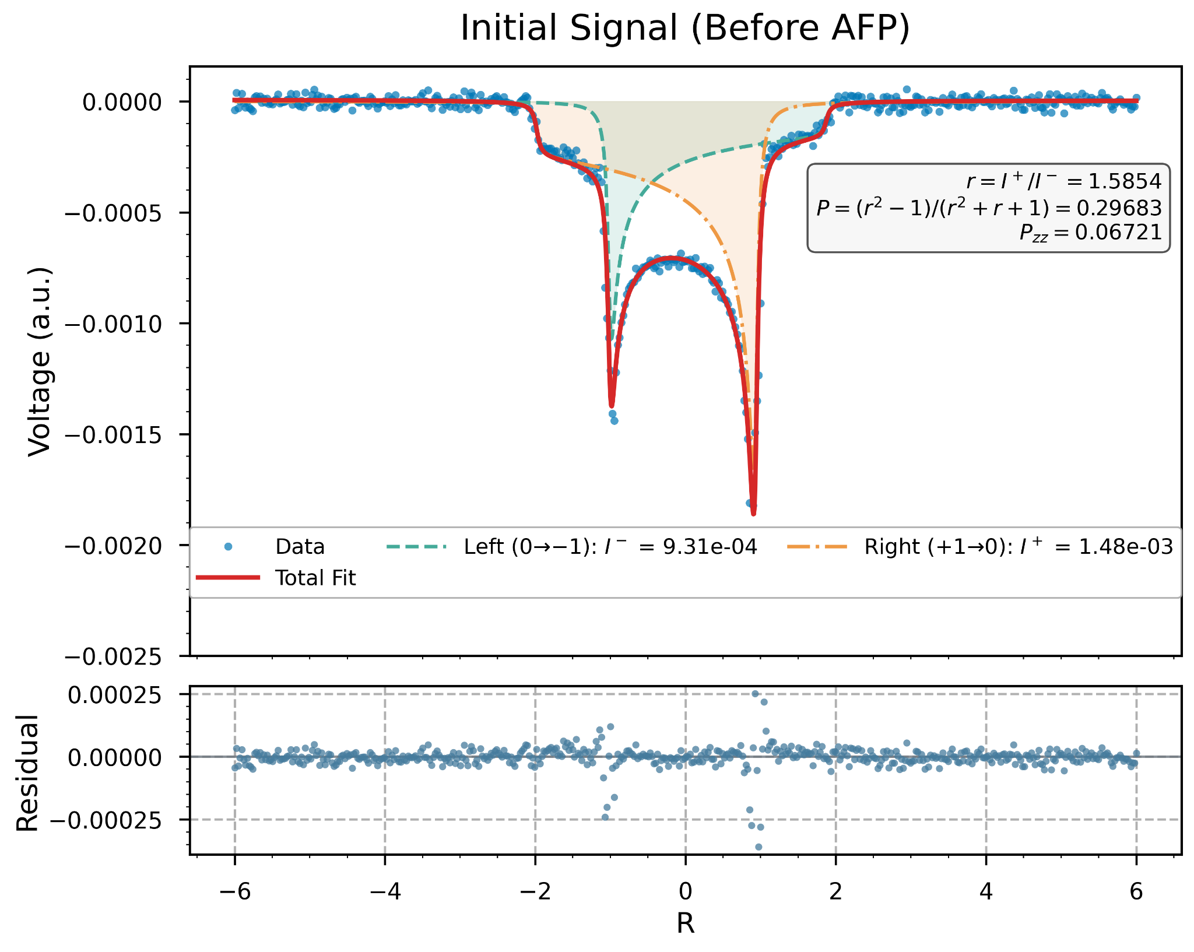
AFP (Adiabatic Fast Passage)
At thermal equilibrium, the vector and tensor polarizations of the deuteron signal are measured before performing the AFP process.
The calibration constant obtained from this initial state is then used to determine the vector and tensor polarizations during AFP operation.
Fit function Dulya like (Dulya et al., NIM A 398, 109 (1997)), using area rather than height (Eur. Phys. J. A (2017) 53: 155).

Slide 9
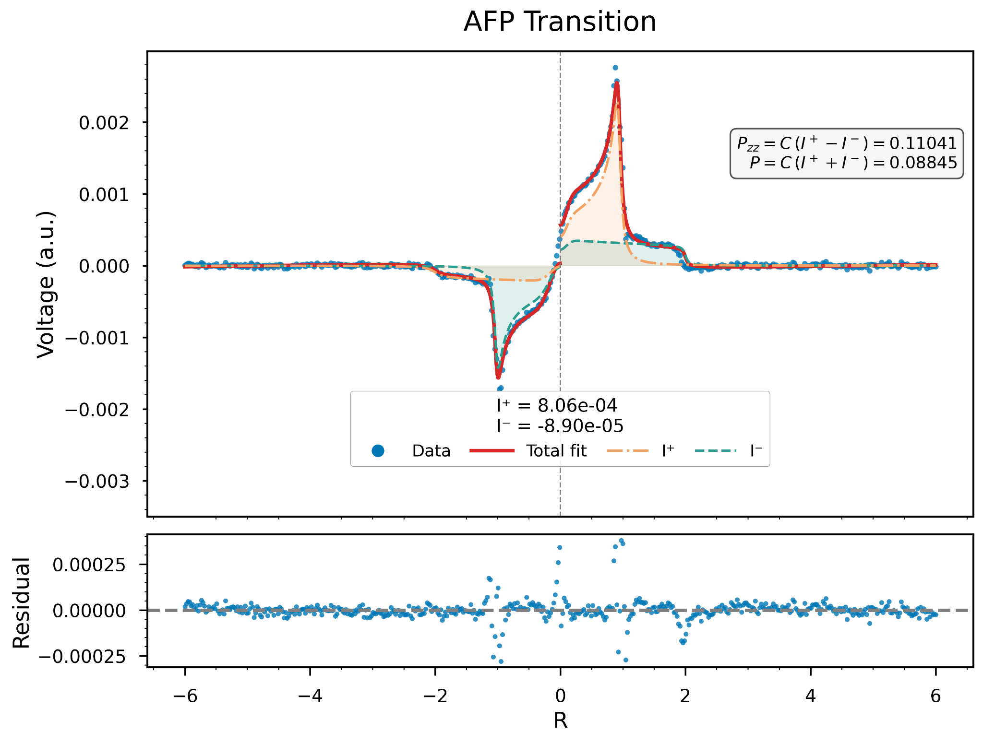
AFP (Adiabatic Fast Passage)
After sweep over a full line, we calculate the vector and tensor polarizations, where we already know the calibration constant from the initial signal.
The central region appears rounded rather than sharp, as predicted by the line-shape theory, because during AFP operation an additional ss-RF effect occurs, burns some area down—particularly in the center.

Slide 10
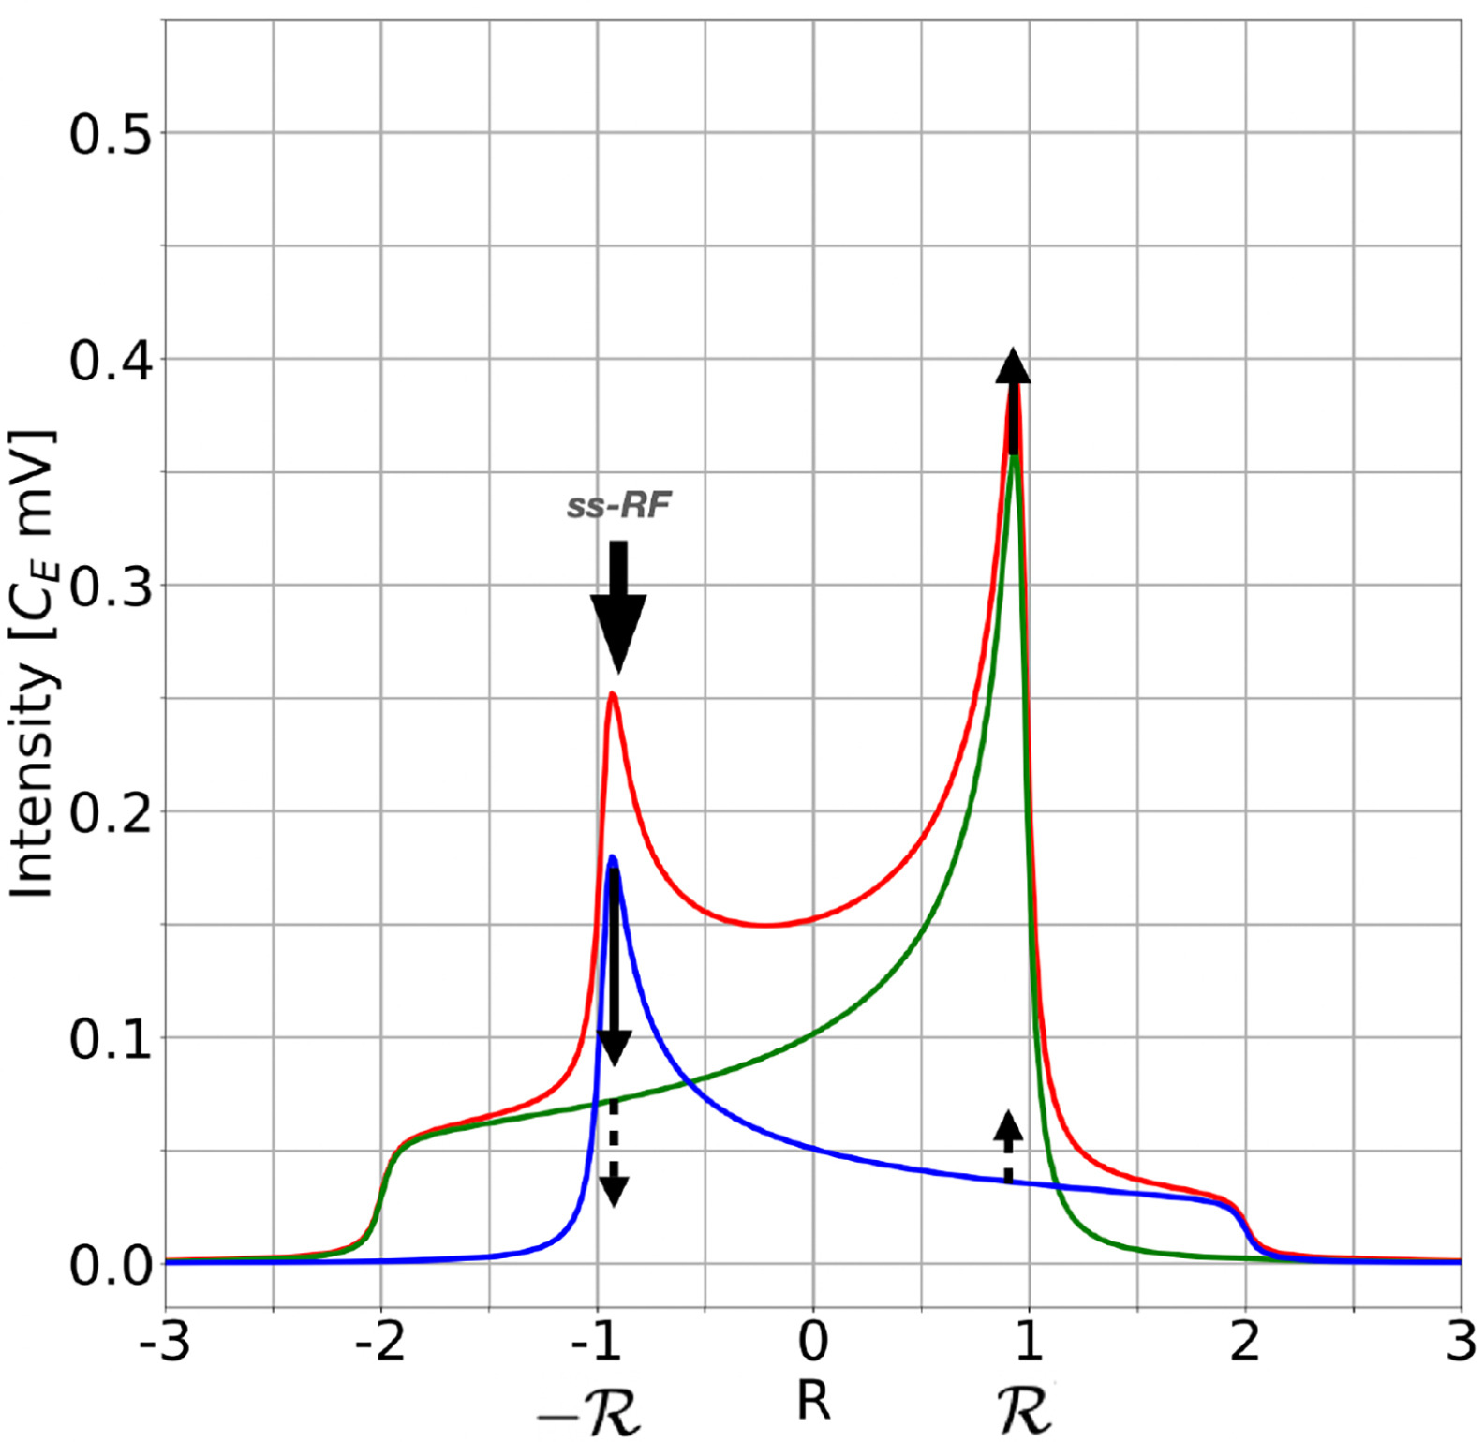
ss-RF (Selective Semi-Saturating RF)
Locally drives transitions at specific NMR frequencies to reshape or enhance vector/tensor polarization.
ss-RF acts selectively on local bins in frequency domain, allowing non-uniform spin-temperature manipulation.
When ss-RF is applied at a frequency region R, it depletes the signal intensity there while simultaneously increasing the intensity at the opposite region −R at half the rate.
Ref: NIM A 1050 (2023) 168177

Slide 11
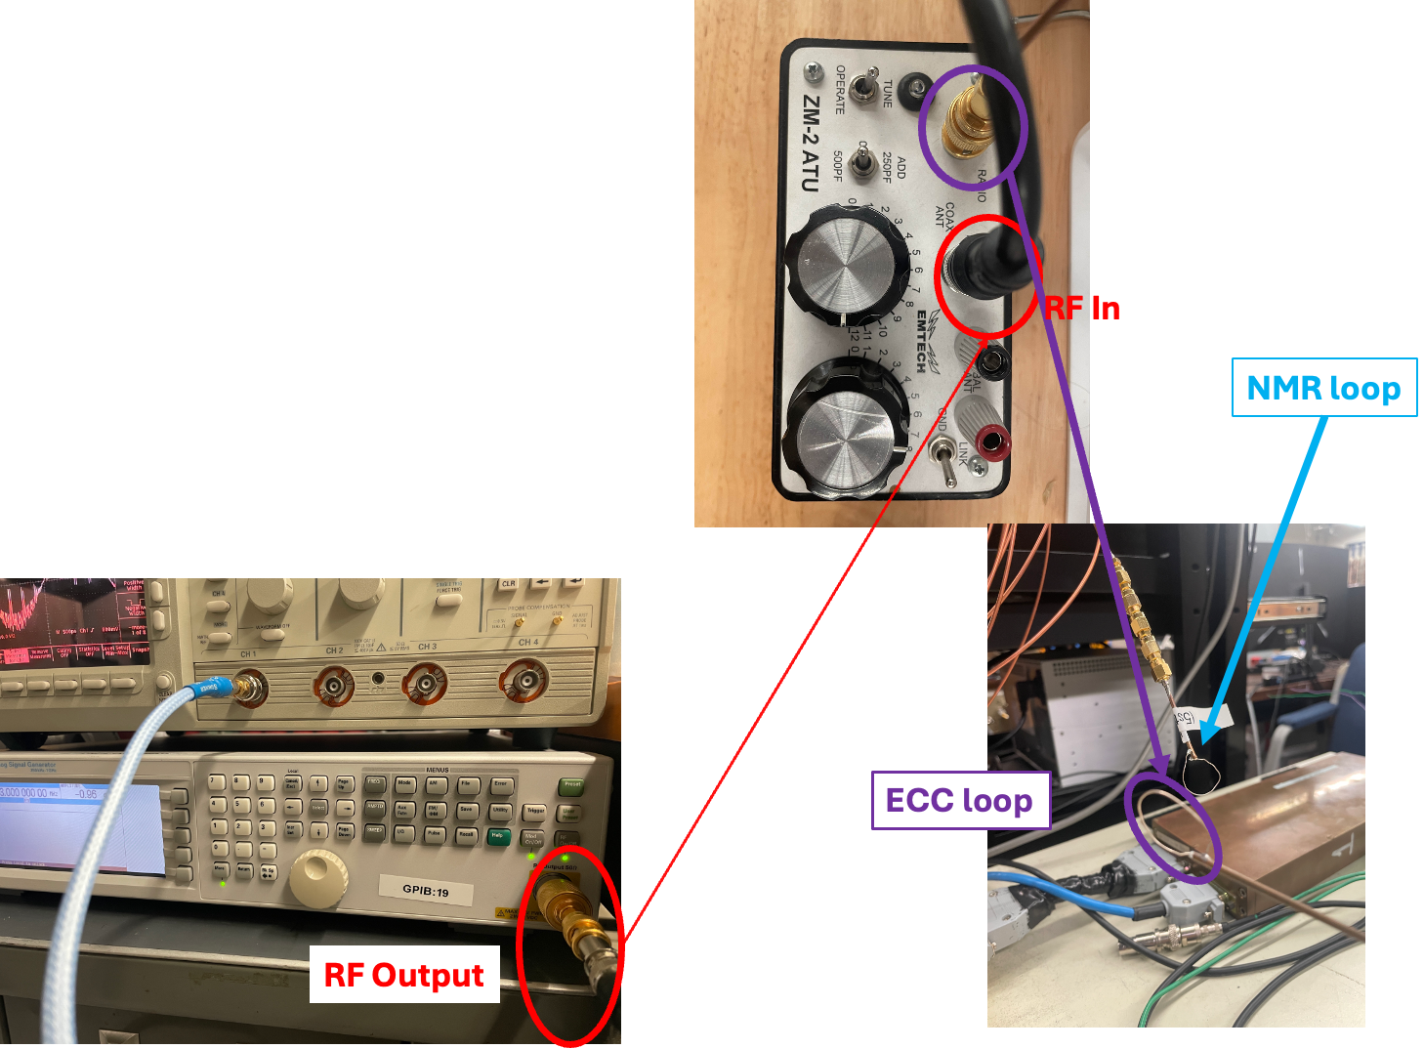
RF modulations on NH3 Baseline: Setup
Computer
NI Analog Board
Signal Generator
ZM-2 ATU Tuner
AFP/ssRF coil
Pick-up (NMR) coil
NMR System
The max update rate of NI PCIe-6321 is 900k samples/s.
It is fast enough for AFP.
The min dwell time of Agilent N5181A is 1 ms. It is not fast enough for AFP.
AFP Loop

Slide 12
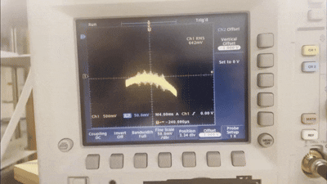
RF modulations on NH3 Baseline: Test
Computer
NI Analog Board
Signal Generator
ZM-2 ATU Tuner
AFP/ssRF coil
Pick-up (NMR) coil
NMR System
With mod frequency 400 kHz

Slide 13
Summary
The AFP method can be highly efficient, especially for achieving spin reversal. At UVA, this technique has been successfully applied to NH3, ND3, and deuterated butanol (D), with high efficiency.
The ss-RF technique is a powerful complementary method and can be used to enhance tensor polarization.
We are analyzing the AFP data taken from 2015.
Hardware and Software Progress:
Developing the LabView software for RF Control Coil.
Optimizing AFP parameters.
Integrating the new AFP cup into the target system.
Planning to test AFP with NH3/ND3 this winter.

