Slide 1


Irradiated Ammonia for Polarized Solid Targets
Chris Keith
JLab Target Group

Slide 2
Outline
Irradiated ammonia: a brief history
Behavior of irradiated ammonia
Radicals in ammonia
Summary, conjectures, and questions

Slide 3



Chronology of irradiated ammonia
1979: Niinikoski and Rieubland [CERN] irradiate NH₃ with a low dose of protons at 77 K. Reaches 90+% at 2.5 T and 0.3 K.
1980: Seely et al. [SLAC] irradiate NH₃ and ND₃ with a low dose of 20 GeV electrons at 1 K.
Reaches 75% (NH₃) and 25% (ND₃) at 5 T and 1 K.
Tapio Niiniikoski
Mike Seely
1980: Meyer et al. [Bonn] irradiate NH₃ and ND₃ with high dose of electrons at 87 K. Reaches 60% (NH₃) and 16% (ND₃) and 2.5 T and 0.5 K.
1990: Crabb et al. [Michigan] irradiate NH₃ with 10 GeV electrons at 87 K. Reaches 95% at 5 T and 1 K.
Werner Meyer
Don Crabb

Slide 4



Behavior of irradiated ammonia
One week
Two weeks
Four years
It turns purple
At 77 K the color slowly fades over time (not so for ND₃).
The polarizability remains (albeit slower).
Spin relaxation also slows.
→ Color centers are not essential for dynamic polarization.
Alexander Berlin, PhD thesis, Bochum University (2015)
NH₃
A single exponential can describe the spin-up curve.
Two spin-lattice times are required for the relaxation curve. This is especially true for freshly-irradiated materials.
Alexander Berlin, PhD thesis, Bochum University (2015)

Slide 5
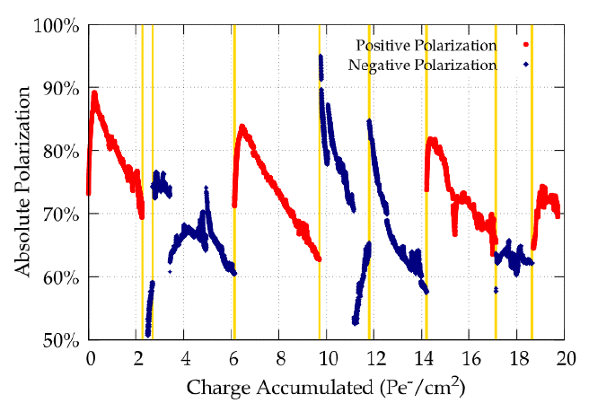
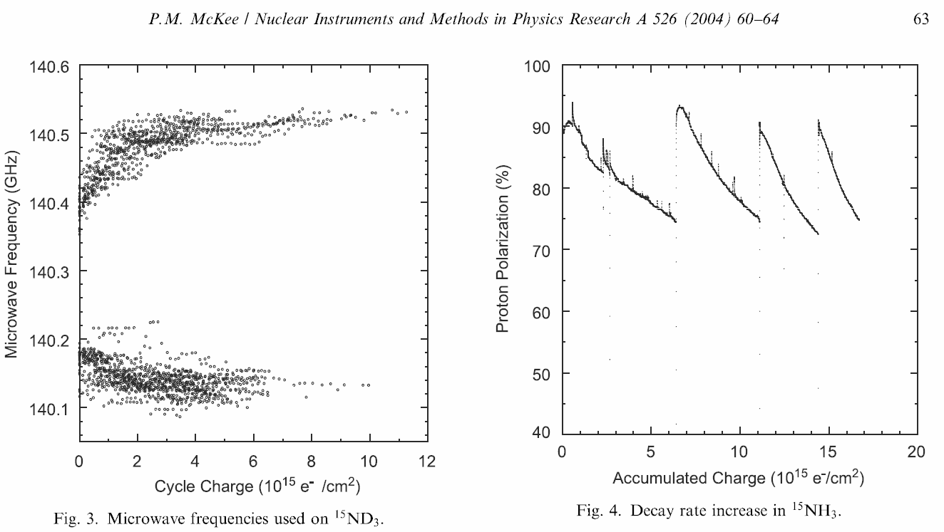
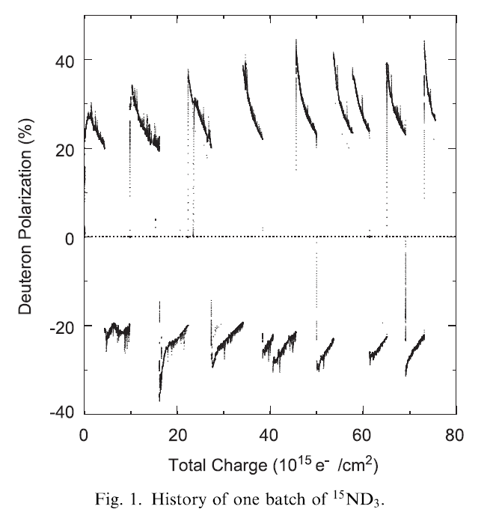
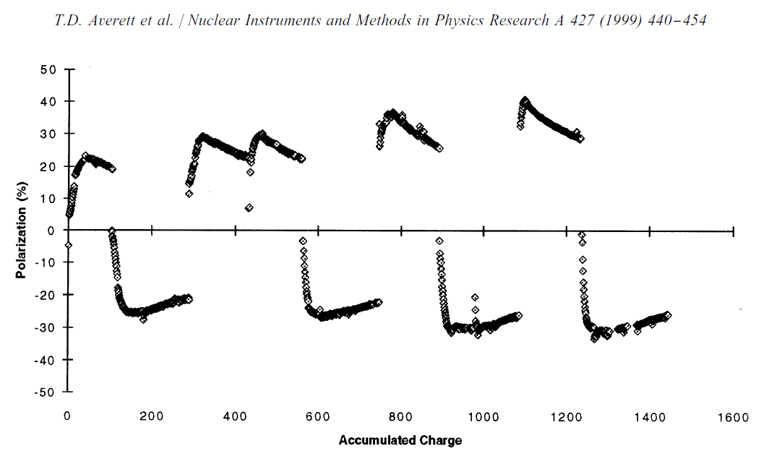
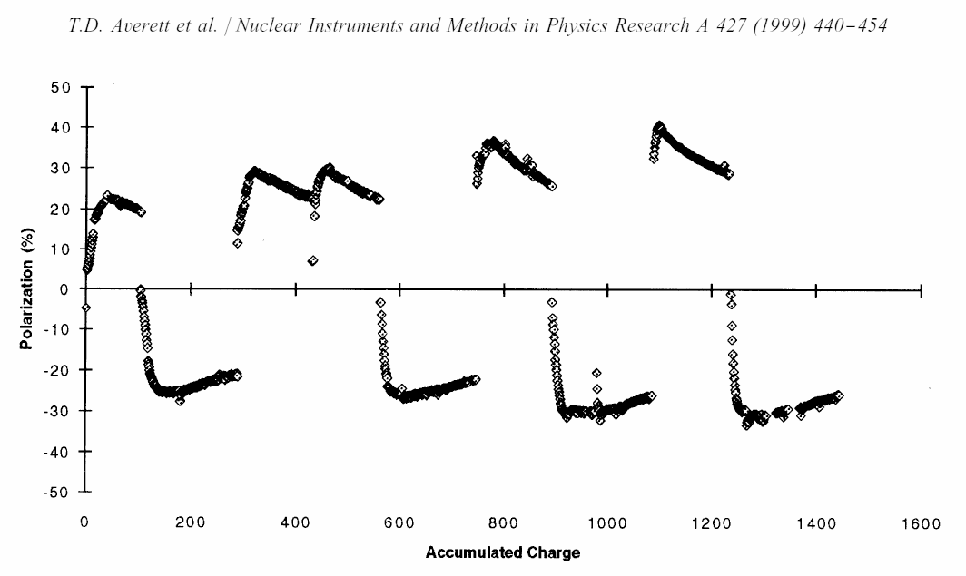
Behavior of irradiated ammonia
Radiation damage to NH₃ can be repaired multiple times by annealing the sample, up to a practical end of life of about 20 Pe⁻ cm⁻²
The polarization of ND₃ benefits significantly from a “cold dose” at 1 K.
It is up to 4x more radiation resistant than NH₃.

Slide 6
Behavior of irradiated ammonia
In NH₃ at 1K/5T the optimum frequencies are initially about 300 MHz apart and separate to 450 MHz with cold dose
Mike Seely, PhD thesis, Yale University (1992)
James Maxwell, PhD thesis,
University of Virginia (2010)
Cold dose only
5 x 10¹⁵ e⁻/cm²
300 MHz
(10 mT)
450 MHz
(16 mT)
0.16 kG
(450 MHz)
The frequency separation (warm dose only) is about the same at 2.5 T
330 MHz
Alexander Berlin, PhD thesis, Bochum University (2015)

Slide 7
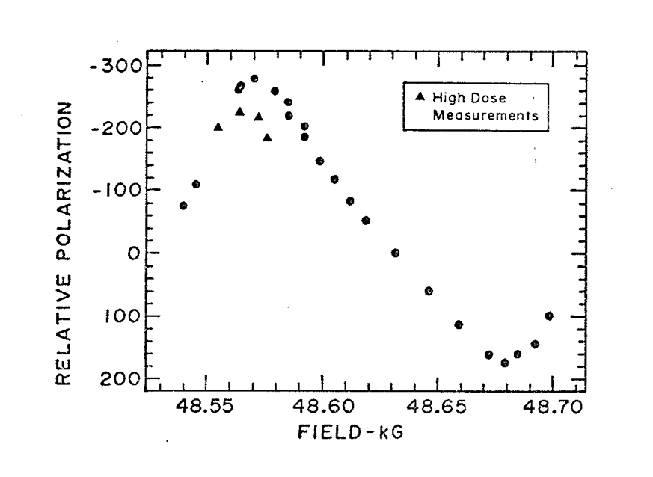
Behavior of deuterated ammonia
W. Meyer, NIM A 526 (2004) 12
Mike Seely, PhD thesis, Yale University (1992)
Warm dose
130 MHz
(5 mT)
3.8 x 10¹⁵ e⁻/cm²
Cold dose
330 MHz
(12 mT)
0.11 kG
(310 MHz)
P.M. McKee, NIM A 526 (2004) 60
250 MHz
400 MHz

Slide 8




A transition from the SE to TM with increasing concentration of trityl OX063
SE: 10 TM: 1.6
10 mmol
100 mmol
SE: 19 TM: 5
SE: 14 TM: 30
SE: 2 TM: 110
¹H enhancement factors at 7 T and 20 K in DMSO*/water + trityl-OX063 due to the Solid Effect and Thermal Mixing
Equbal et al, J. Phys. Chem. Lett (2020) 3718
*dimethyl sulfoxide

Slide 9
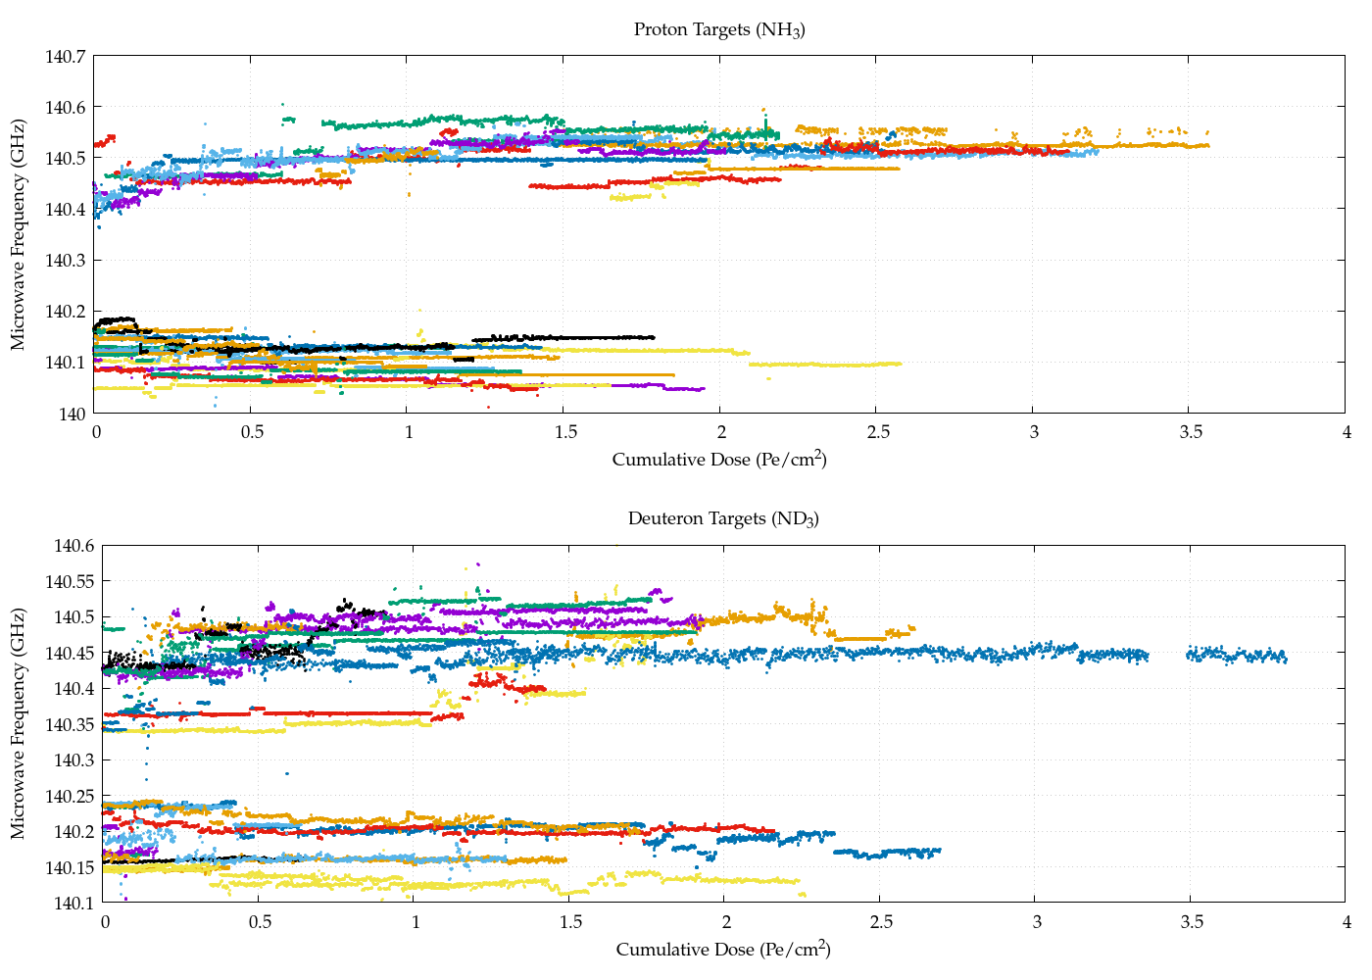
Behavior of deuterated ammonia
Run Group C
Protons follow the usual script
250 MHz
450 MHz
Run Group C
Deuteron data is inconclusive
330 MHz
150 MHz
Courtesy of James Maxwell

Slide 10
The ammonia molecule
Physicist’s model (incorrect!)
Hydrogen bonds with nitrogen’s 2p electrons
1s
H
Spin up
Spin down
2sp³
1s
H
N
2sp³
N
1s
2sp³
1s
H
2s
2sp³
H
1s
2p
1s
H
1s
H
Chemist’s model
Hydrogen & Nitrogen bond via four 2sp³ hybrid orbitals
1s

Slide 11
Radicals in irradiated ammonia
EPR studies at 0.33 T (X-band) and 2.5 T (V-band) have found that the dominate species produced by radiation at 87 K is the amine radical •NH₂ (or •ND₂)
M. Symons, 2nd Pol. Target Materials Workshop (1979)
“At 77 K only •NH₂ radicals are obtained.”
NH₃ → •NH₃⁺ + e⁻
•NH₃⁺ + NH₃ → •NH₂ + NH₄⁺
NH₄⁺ + e⁻ → NH₃ + •H
NH₃ + •H → •NH₂ + H₂
Spin up
Spin down
2sp³
2p
N
2sp³
1s
2sp³
H
1s
H
1s
Amine radical •NH₂ ²B₁ configuration

Slide 12
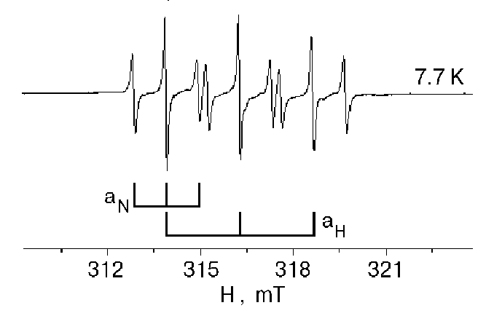

Radicals in irradiated ammonia
$$ℋ_{HF}=s∙a∙I$$
Hyperfine splitting:
The hyperfine interaction with the Nitrogen and Hydrogen nuclei produces
(2n_{N}I_{N}+1) (2n_{H}I_{H}+1) = 3 x 3 = 9 lines
The HFS width is about 9 mT (250 MHz),
independent of the field
N
H
H
•NH₂ radical trapped in solid Argon matrix at 7.7 K
E.Y. Misochko et al, Low Temp. Phys. 26, 727–735 (2000)

Slide 13
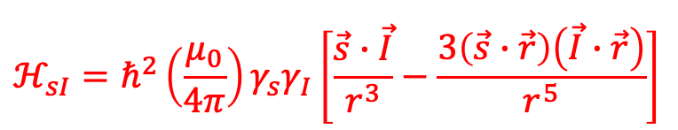
Radicals in irradiated ammonia
$$ℋ_{sI}=ℏ^{2}\left(\frac{μ_{0}}{4π}\right)γ_{s}γ_{I}\left[\frac{\vec{s}∙\vec{I}}{r^{3}}−\frac{3\left(\vec{s}∙\vec{r}\right)\left(\vec{I}∙\vec{r}\right)}{r^{5}}\right]$$
Dipolar Broadening:
Dipolar broadening increases the width by about 50%, independent of field.
N
H
H
•NH₂ radical in warm-irradiated NH₃
Alexander Berlin, PSTP2011, St. Petersburg

Slide 14

Radicals in irradiated ammonia
g-factor anisotropy
$$ℋ_{SO}=s∙g∙B$$
g-factor anisotropy increases the width by about 20%, proportional to the field.
N
H
H
•NH₂ radical at 2.5 T
Jorg Heckmann PhD Thesis, Bochum (2004)

Slide 15
Radicals in irradiated ammonia
g-factor anisotropy
$$ℋ_{SO}=s∙g∙B$$
Microwave frequencies for warm and cold irradiation
Integrated line shape
N
H
H
•NH₂ radical at 2.5 T
Jorg Heckmann PhD Thesis, Bochum (2004)

Slide 16
Radicals in irradiated ammonia
Alexander Berlin, PSTP2011, St. Petersburg
N
H
•NH₂ radical in fresh,
warm-irradiated NH₃
Alexander Berlin, PSTP2011, St. Petersburg
•NH₂ radical 16-year-old
warm-irradiated NH₃
Is the color center missing?
H

Slide 17

Radicals in irradiated ammonia
Other radicals have been observed at 77 K, such as
  atomic hydrogen
  atomic deuterium
  atomic nitrogen-14
  atomic nitrogen-15
  “hydrazine radical?”
⁻
N
1s
2s
H
2p
L.G. DeMarco, A.S. Brill, and D.G. Crabb
J. Chem. Phys 108 (1998) 1423
Also J. Heckmann & A. Berlin (Bochum)
1s
D
1s

Slide 18
Radicals in irradiated ammonia
⁻
  Atomic hydrogen
The HFS of hydrogen is about 50 mT (1.4 GHz), far outside our microwave scan
❌ DNP
✔️ Spin-relaxation
It decays about 30 K warmer than •NH₂
Symons: NH₃ + •H → •NH₂ + H₂ ??
•H
•H
•NH₂ and •H radicals in warm irradiated NH₃
Jorg Heckmann, PhD thesis, Bochum (2004)

Slide 19
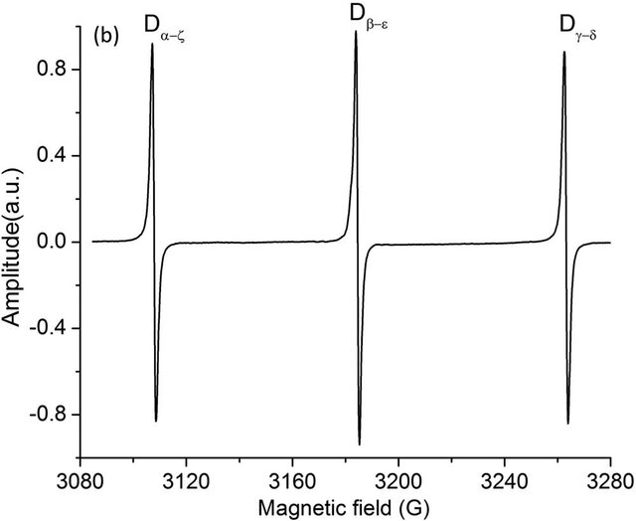
Radicals in irradiated ammonia
Atomic deuterium
HFS is much smaller than ¹H,
about 15 mT, low-to-high
•D
•D
Microwave freq.
warm & cold doses
x-band spectra of irradiated ND₃ at 100 K
Alexander Berlin, PhD thesis, Bochum (2015)
Demarco: “… the free radicals (•ND₂) decay at a higher temperature than do the D atoms.”

Slide 20
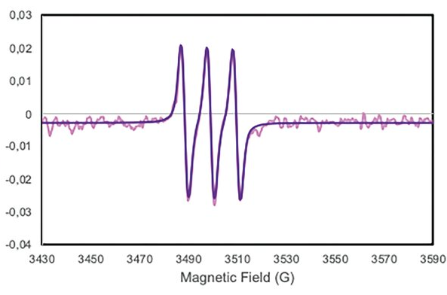
Radicals in irradiated ammonia
By 130 K, the •ND₂ radicals have completely disappeared, leaving resonance lines from one or more unidentified species.
HFS in ¹⁴N is narrower still, 1 mT
•¹⁴N
7 mT separation
“Hydrazine radical”?
x-band spectra of irradiated ND₃ at 130 K
Alexander Berlin, PhD thesis, Bochum (2015)

Slide 21
Summary, Conjectures, Questions
When ammonia is irradiated at 87 K, the dominant species are •NH₂ and •ND₂
The principle broadening mechanisms are the hyperfine and dipolar interactions
Other radicals are produced, each with a different activation temperature
Atomic hydrogen •H is probably the main source of radiation damage in NH₃
Atomic deuterium •D is not as damaging and may improve the polarization of ND₃
What is the “cold dose”?
Does it have to be cold?
How cold?
How long does it last at 77 K?
Can we perform in situ monitoring at 1 K?

Slide 22
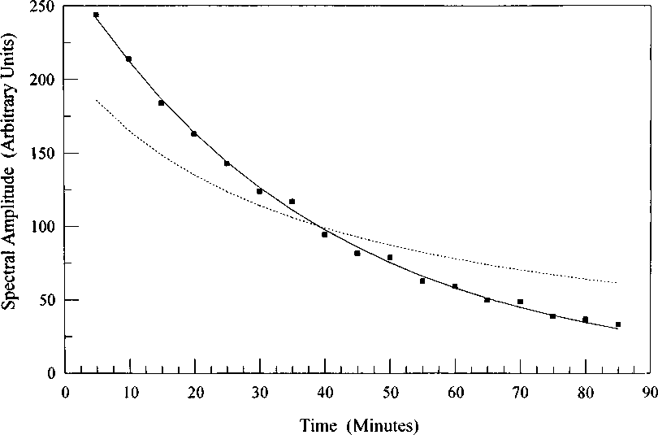
Decay of H-atom resonance at 102 K.
Solid line: First-order fit
Dotted line: Second-order fit
L. DeMarco et al, J. Chem. Phys., Vol. 108, No. 4, 22 January 1998

