Slide 1

ERR Task List & Run Plan
Elena Long
b1/Azz Tensor
Collaboration Meeting
Oct. 13th, 2025

Slide 2
ERR Task List
  3 Main Topics:
  Target Tasks
  Beamline Tasks
  Documentation Tasks
  + any additional tasks recommended from this morning’s talks

Slide 3
Target Tasks

Slide 4
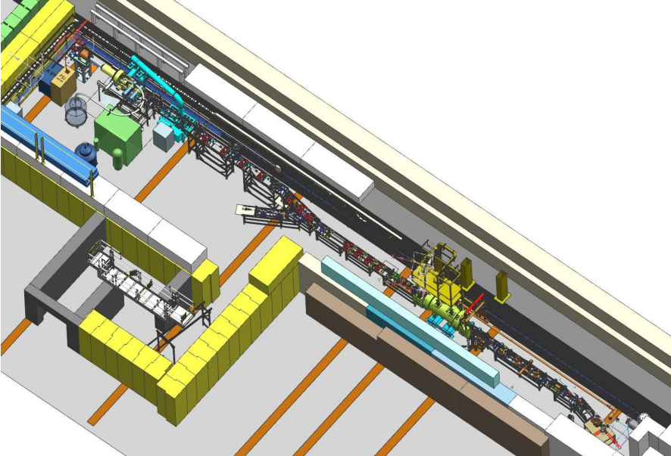
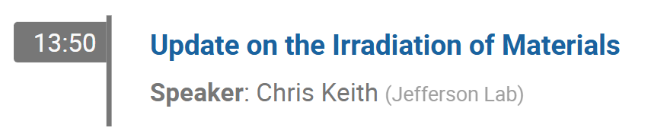
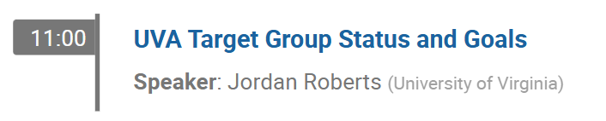
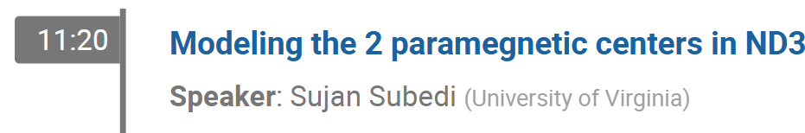
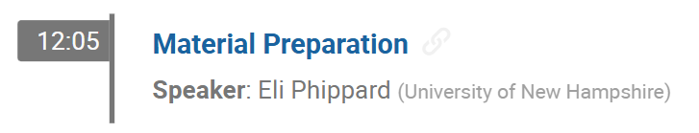
Target Tasks
◦ Maximize ND₃ vector polarization
In Progress
  The JLab Target Group is building a new test lab facility to irradiate ND3
    Irradiation optimization studies with both dose & irrad. Temperature
  Cryostat being built
  Beamline needs shielding for 10uA @ 8 MeV operation
  Aiming for irradiation operations in Spring ‘26
10/13
10/13
Irradiation
Target
Material
10/14
10/14

Slide 5
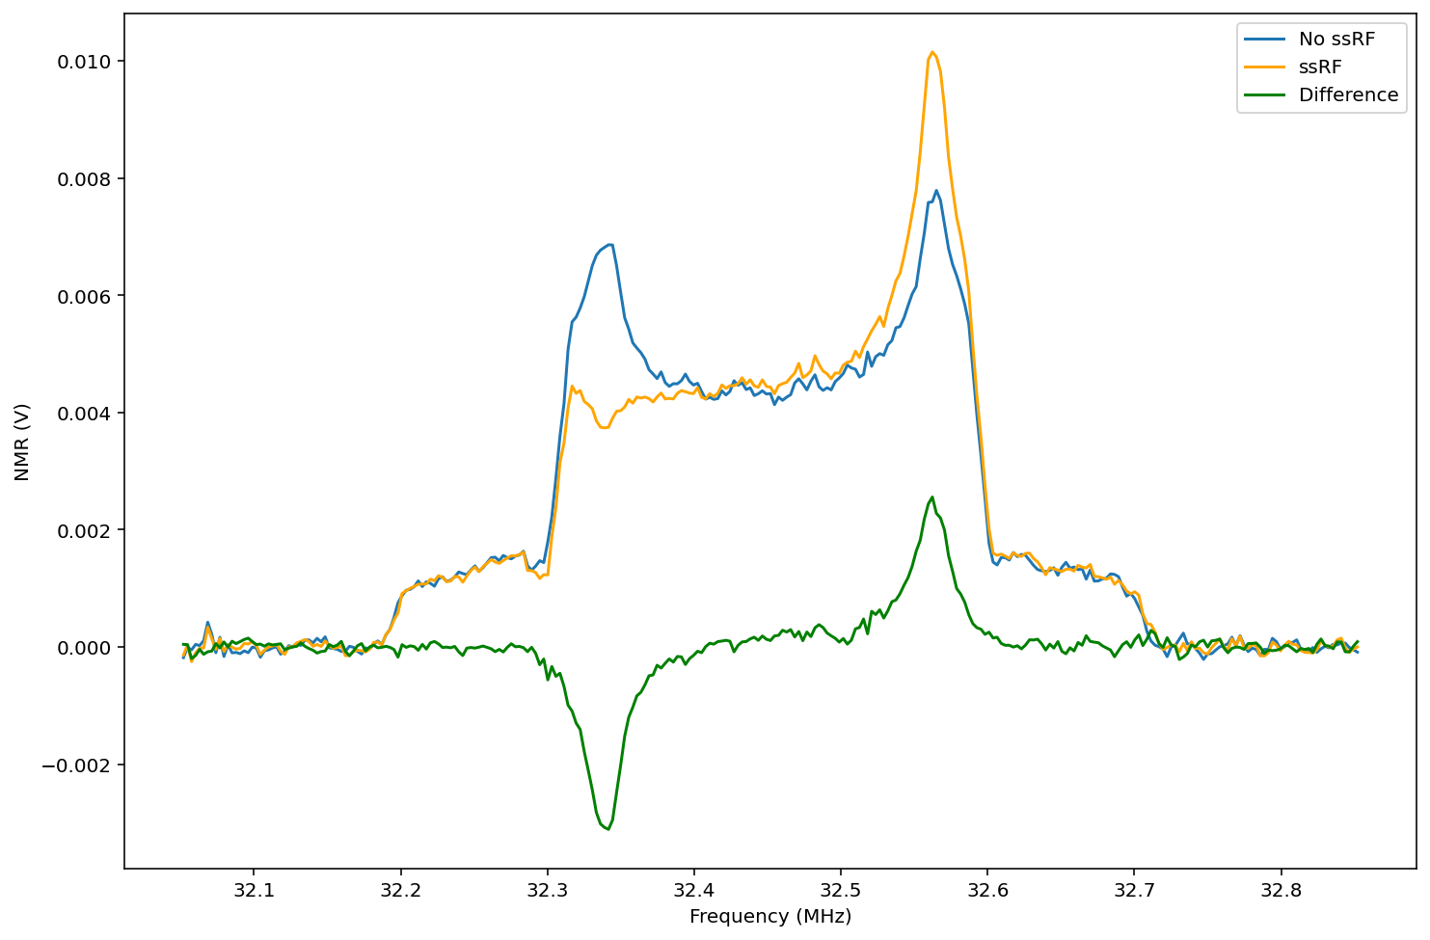
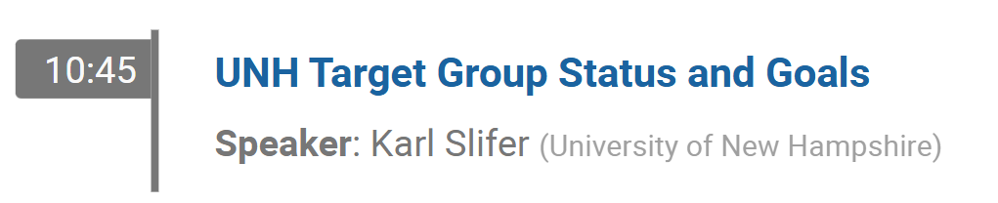
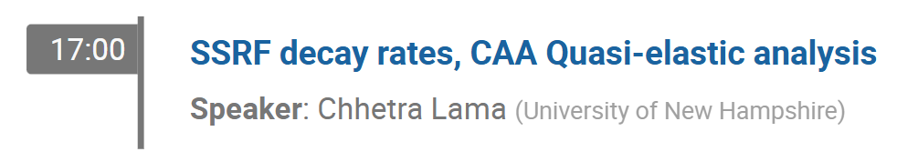
Target Tasks
◦ Demonstrate Tensor Enhancement on ND₃
In Progress
  Initial studies have been done on warm irradiated ND₃
    Compared w/ d-butanol, ssRF is sharper
    & lasts significantly longer
    Low vector pol. due to 84K irrad
  Cold (1-4K) irradiated ND₃ needed
Preliminary
10/13
10/13

Slide 6
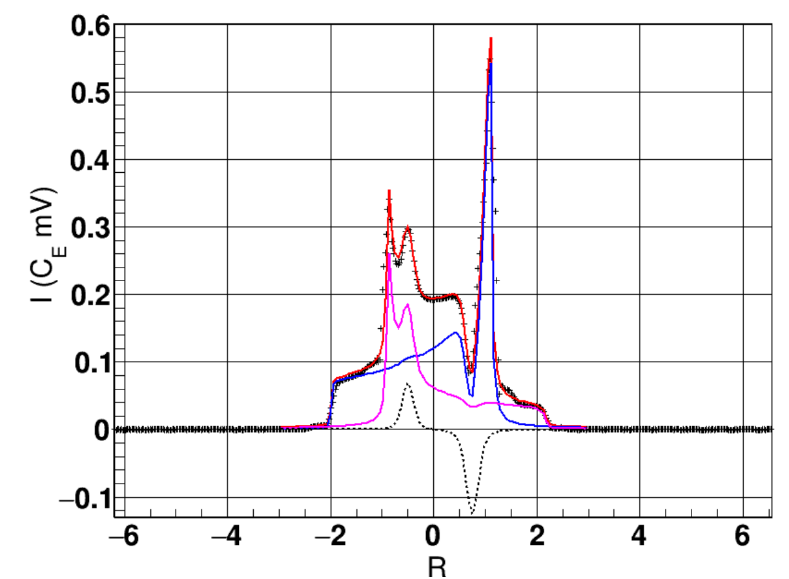
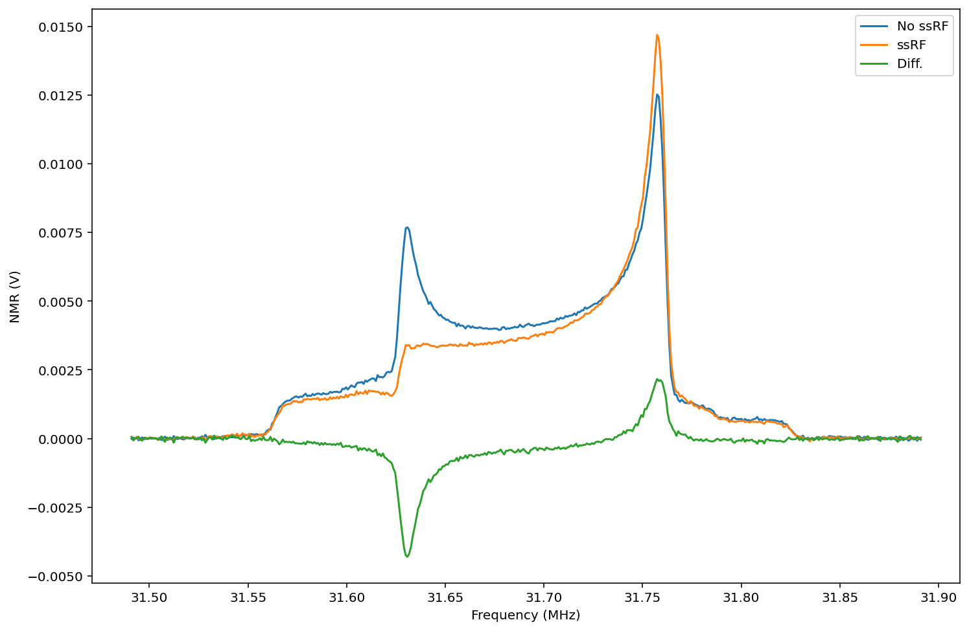
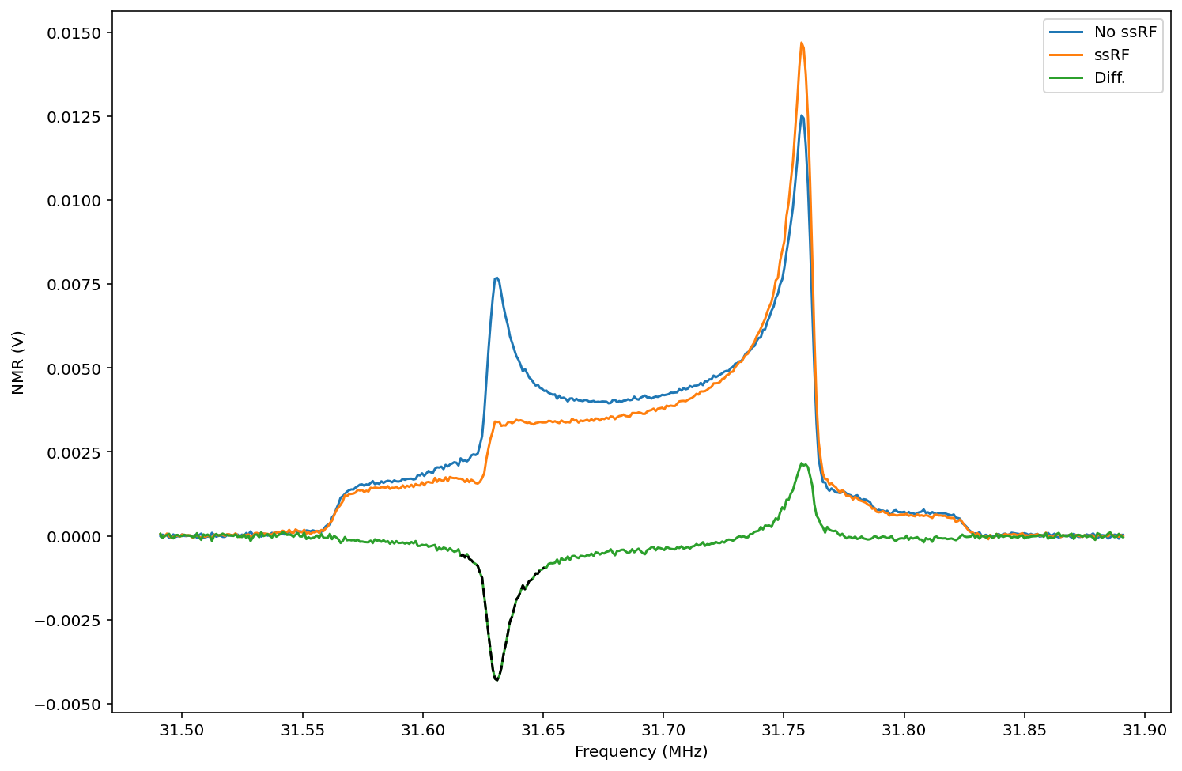
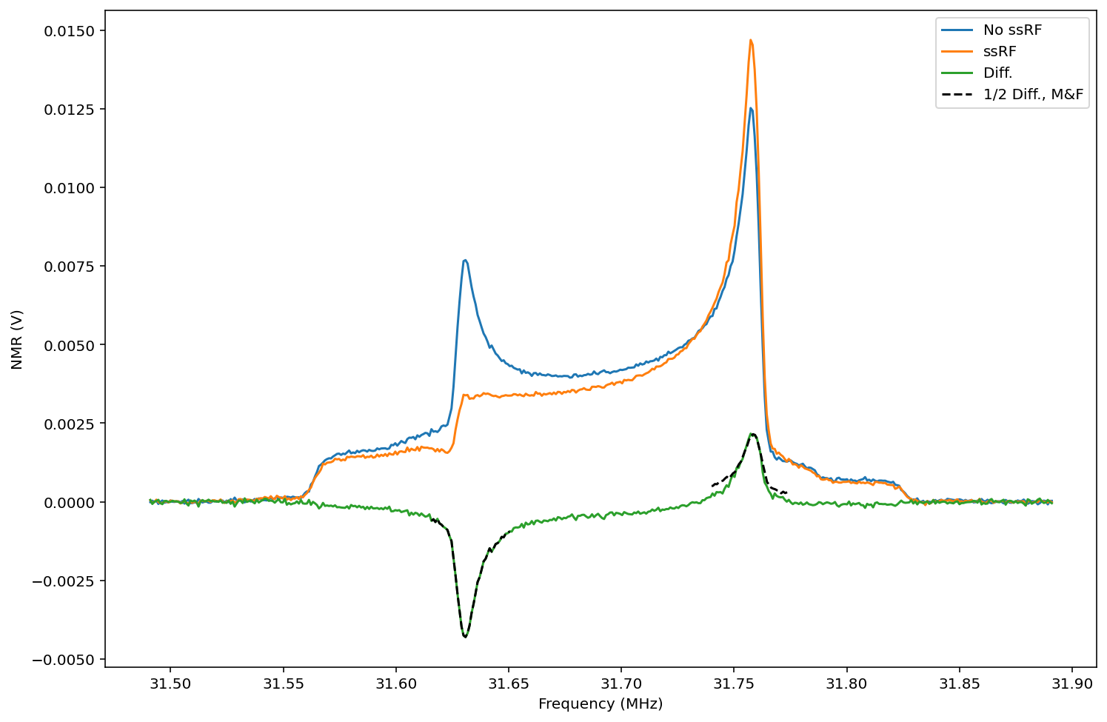

Target Tasks
◦ Demonstrate A_{lost} = 2 A_{gained} w/ ssRF
Complete
  UVA published results
    D. Keller, EPJ A 53, 155 (2017)
    J. Clements, D. Keller, NIM A 1050, 168177 (2023)
  UNH results in agreement
Preliminary
$$×\left(−\frac{1}{2}\right)$$
Mirror

Slide 7
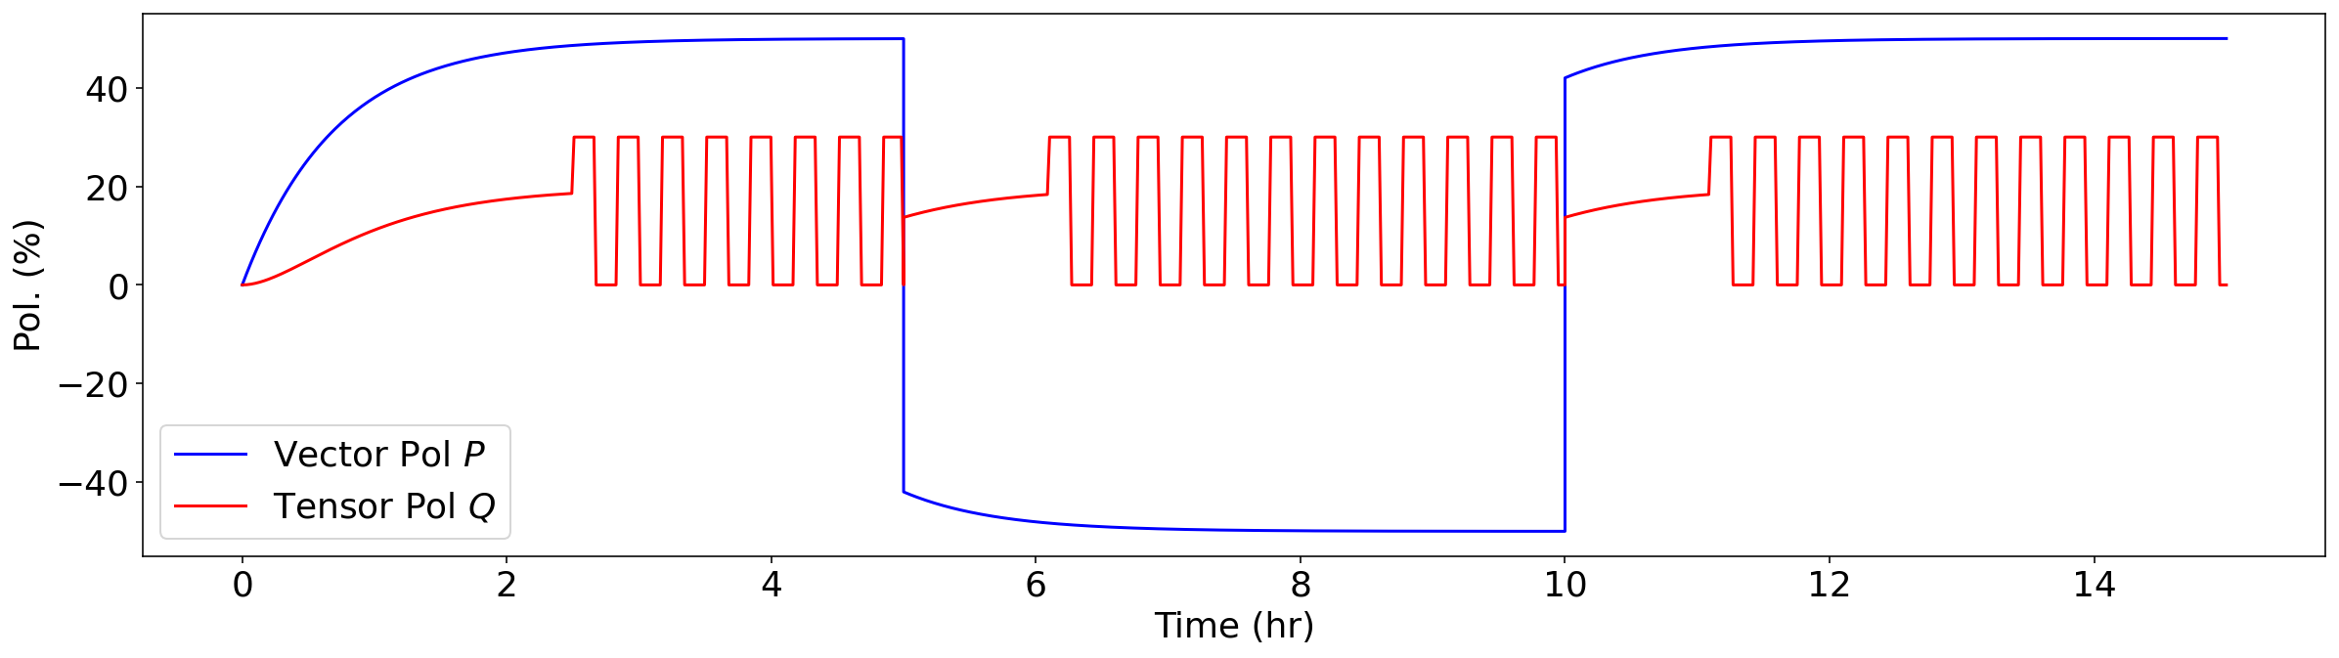
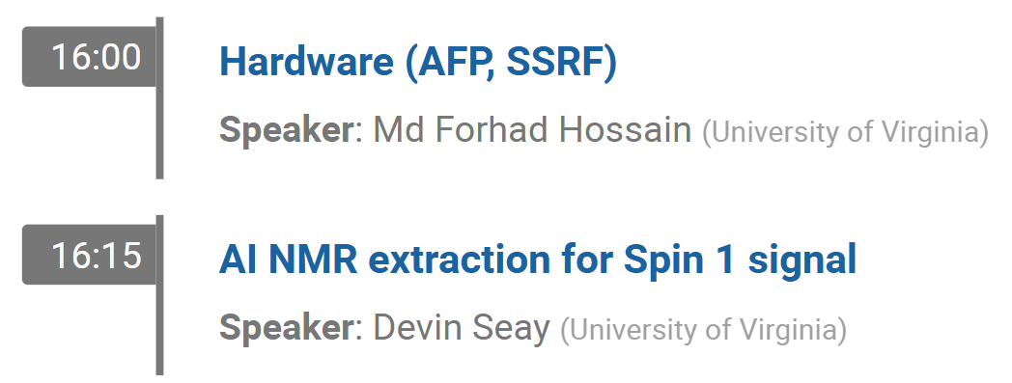
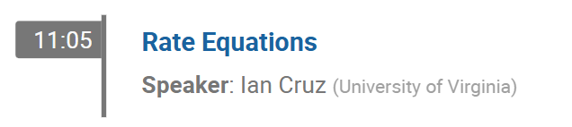
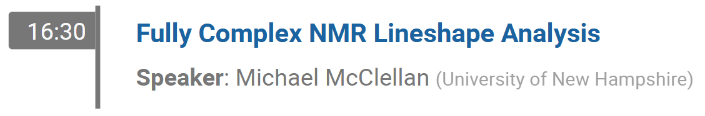
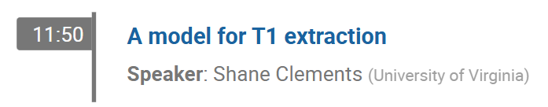
Target Tasks
◦ Demonstrate full polarization cycles (P & Q)
In Progress
  Goal is to create the following plot w/ data:
    Currently working on optimizing & automating ssRF application/measurement cycles + AFP
10/13
10/14
UNH
10/13
UVA
10/13
10/14
10/13

Slide 8
Target Tasks
◦ Design & Optimization of AFP and ssRF
In Progress
  Goal is to create the following plot w/ data:
    Currently working on optimizing & automating ssRF application/measurement cycles + AFP
      Hardware + Software
10/13
10/14
UNH
10/13
UVA
10/13
10/14
10/13

Slide 9
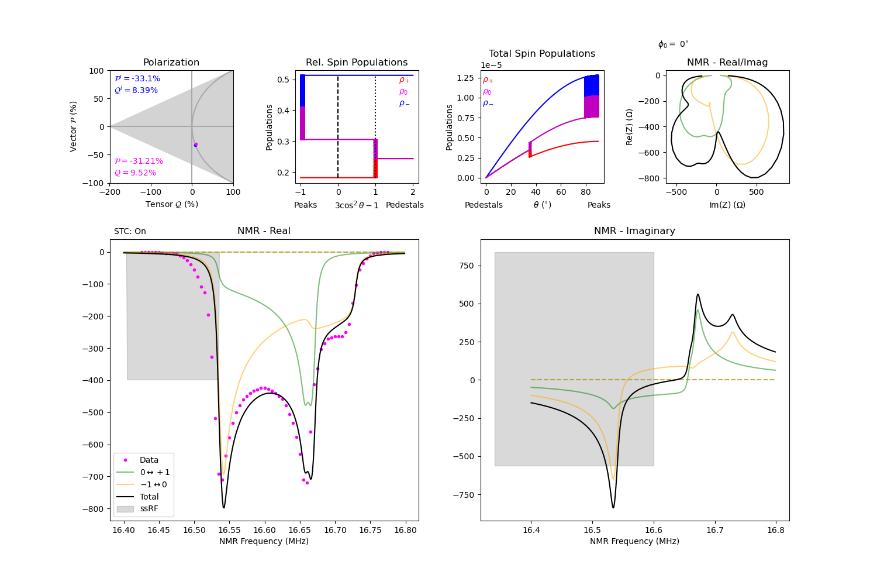
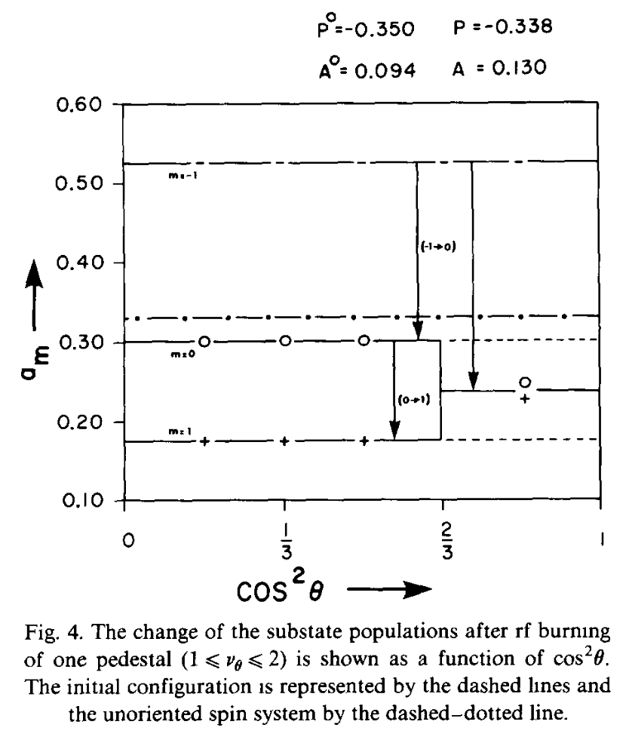
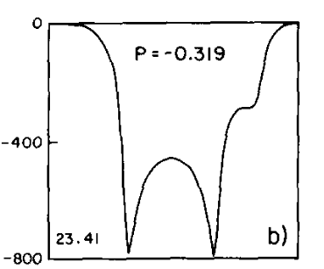
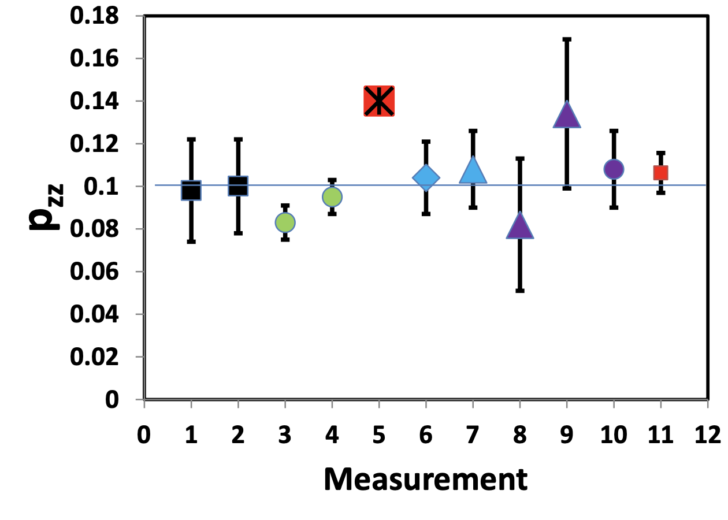



Target Tasks
◦ Revisit Triumf’s Tensor Target Results
Near Complete
  No uncertainty listed for $Q=14\%$
  Scattering data uncertainty is large
    No contradiction within uncertainty between either $Q=14\%$ or $Q=11.5\%$
$$Q=0.142$$
NMR
$$Q=0.095$$
Before HB
After HB

Slide 10
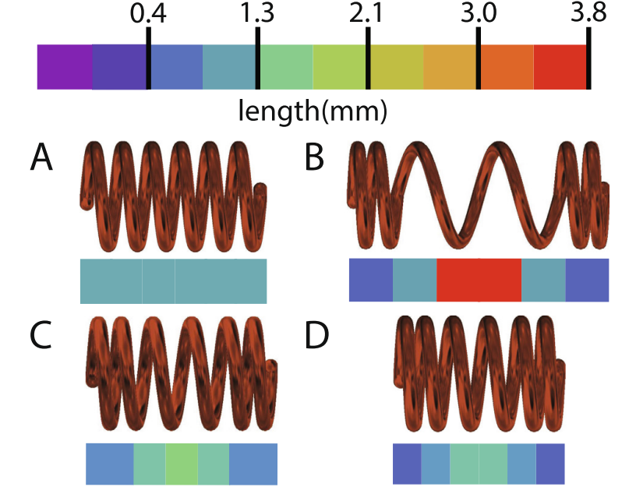
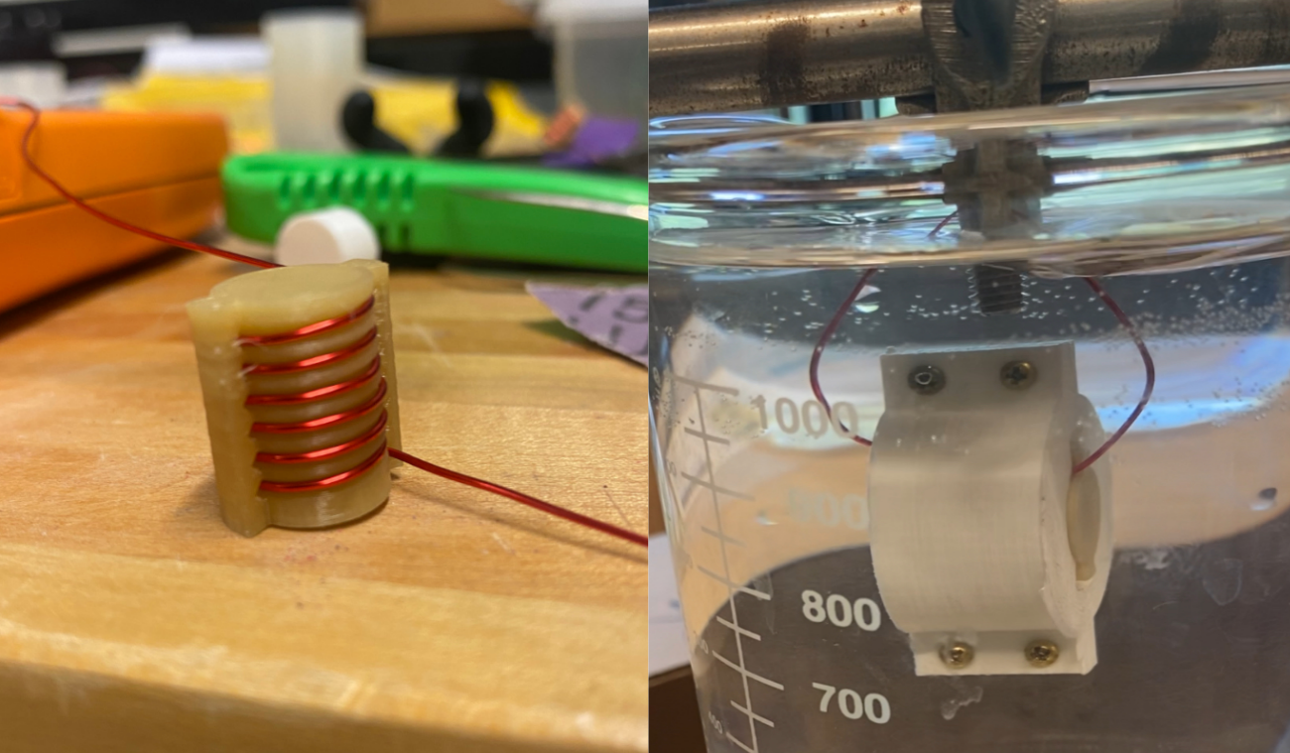
Target Tasks
◦ Ensure NMR/ssRF coil uniformity
In Progress
  Want to avoid line-shape issues encountered in Hall B RGC data
  b1/Azz will use NMR coils inside target cups, embedded in material
  Additional work:
    3D printing coil forms to improve uniformity
Variable pitch increases homogeneity
  J.Mag.Res. 50, 281 (1982)
3D printing coil forms
J. Mag. Res. 305, 89 (2019)
J.I.Kelz, et al, J. Mag. Res. 305, 89 (2019)

Slide 11
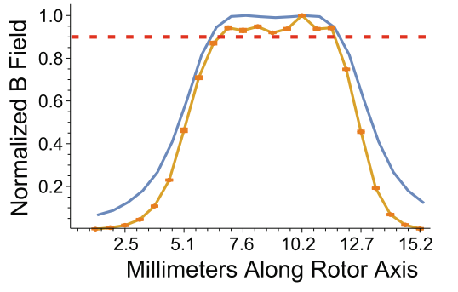

Target Tasks
◦ Ensure NMR/ssRF coil uniformity
In Progress
  Want to avoid line-shape issues encountered in Hall B RGC data
  b1/Azz will use NMR coils inside target cups, embedded in material
  Additional work:
    3D printing coil forms to improve uniformity
    Measuring coil uniformity w/ ball shift probe
Coil to Test
Flatness $∝$ Uniformity
Linear Actuator
Conductive
Sphere
L.C. Maier, J.C. Slater,
J.Appl.Phys. 23, 68 (1952)
VNA
  J.I. Kelz, et al, J. Mag. Res. 305, 89 (2019)

Slide 12
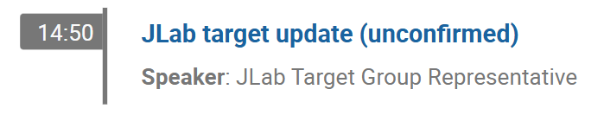
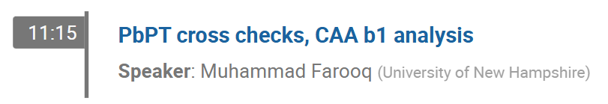
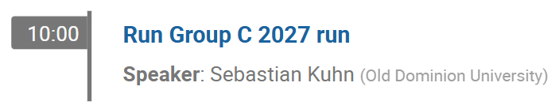
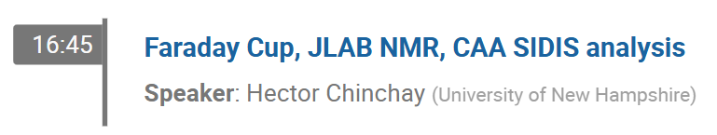
Target Tasks
◦ Confirm annealing/material change estimates w/ Hall B RGC data
Near Complete
  Analysis of Hall B RGC data in progress
  Target CLAS Note expected in the near future
10/14
10/13
10/14
10/14

Slide 13
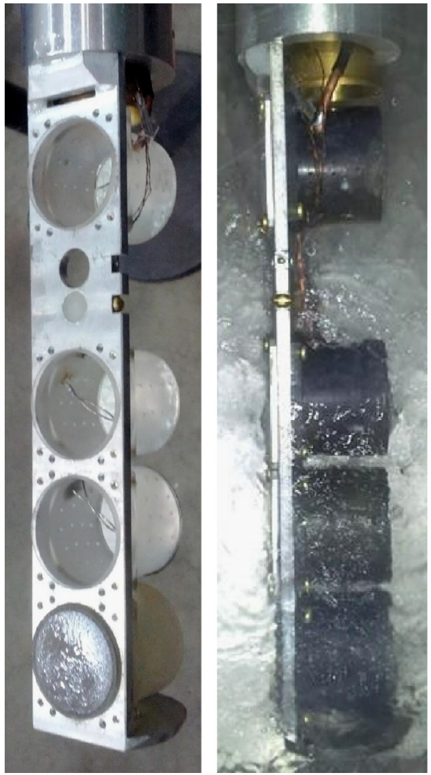
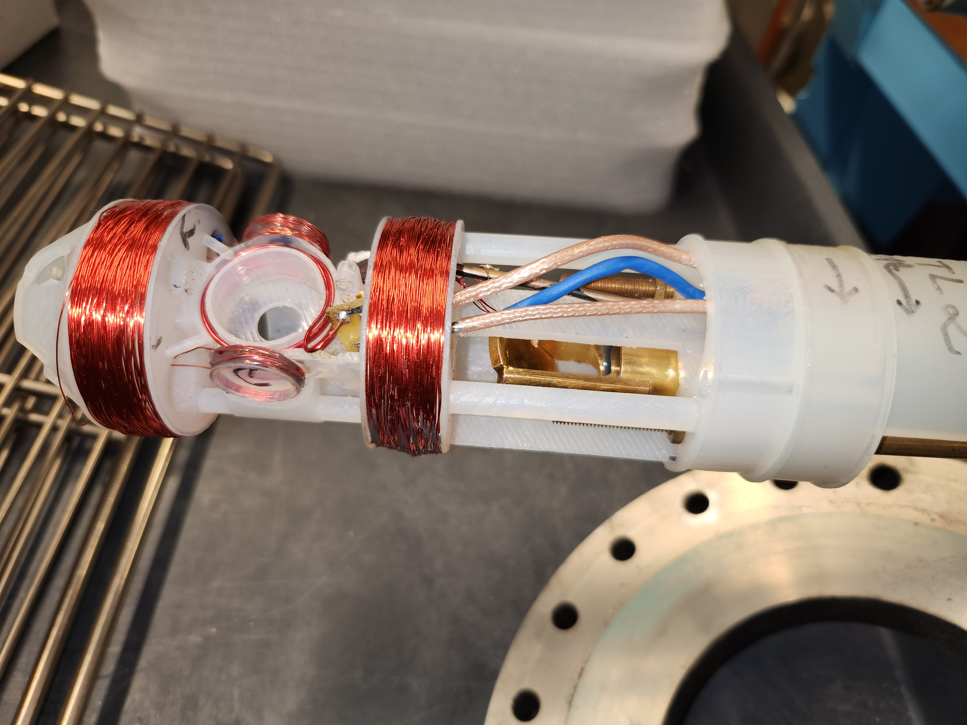
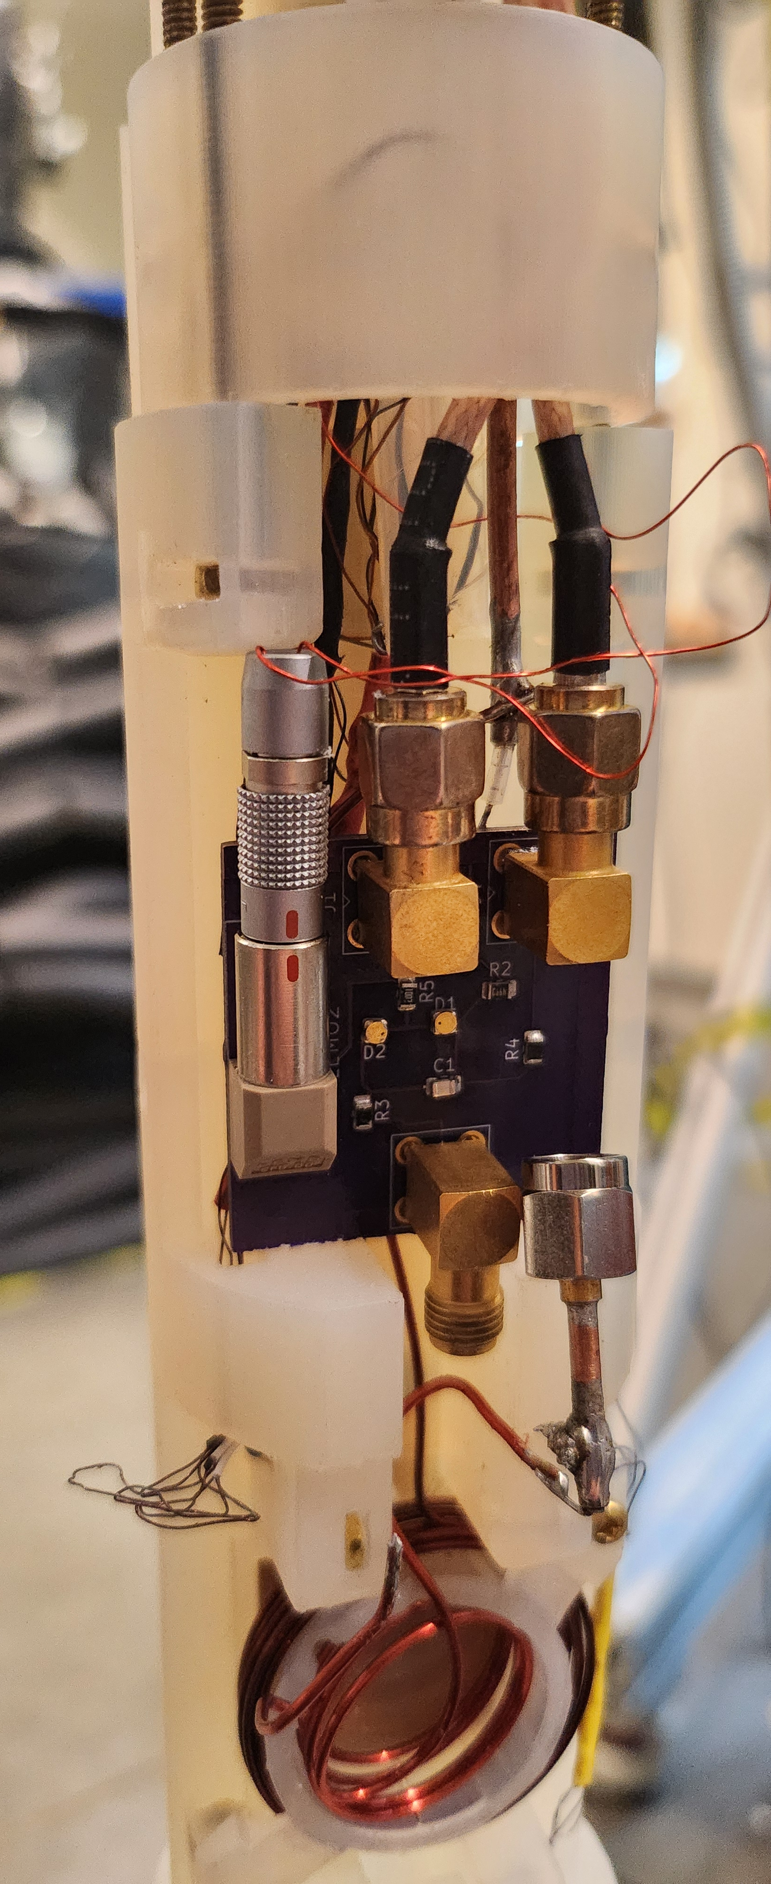
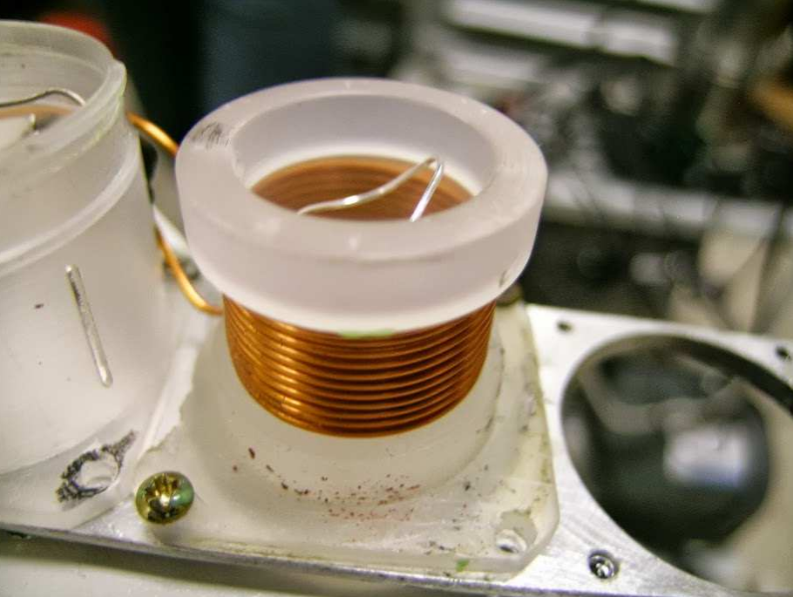
Target Tasks
◦ Final Design of Target Ladder & Coils
In Progress
  Will use target cups similar to g2p
  ssRF/AFP coil design and optimization in progress
    Currently testing in-line and Helmholtz-like configurations
Helmholtz-like
In-Line
J. Pierce, et al, NIM A 738, 54 (2014)

Slide 14
Beamline Tasks

Slide 15
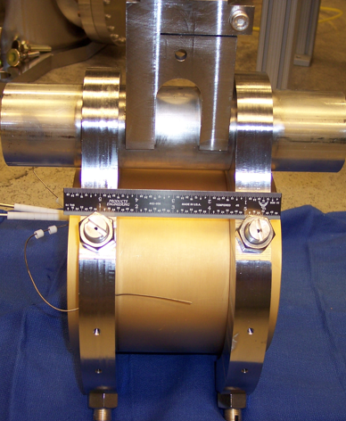
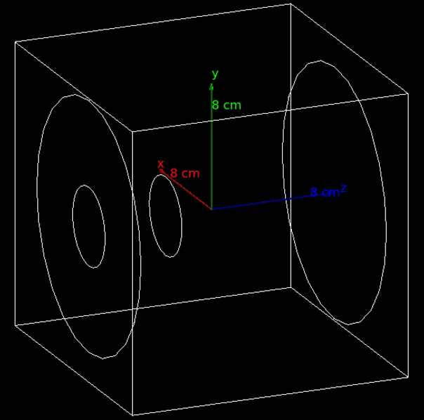
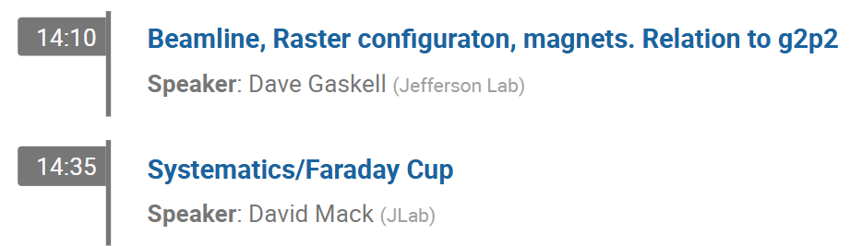
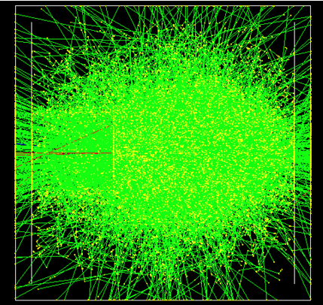
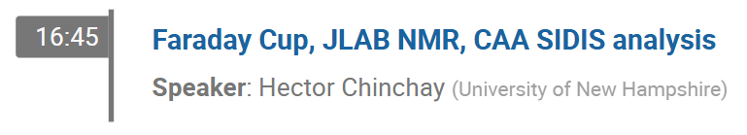
Beamline Tasks:
◦ Build Charge Monitoring Equipment
In Progress
  Need to keep charge uncertainty below the 10⁻⁴ level
  Faraday cup being built & studied for this purpose
    Recommissioned W-Cu calorimeter from Hall A
10/13
10/14

Slide 16
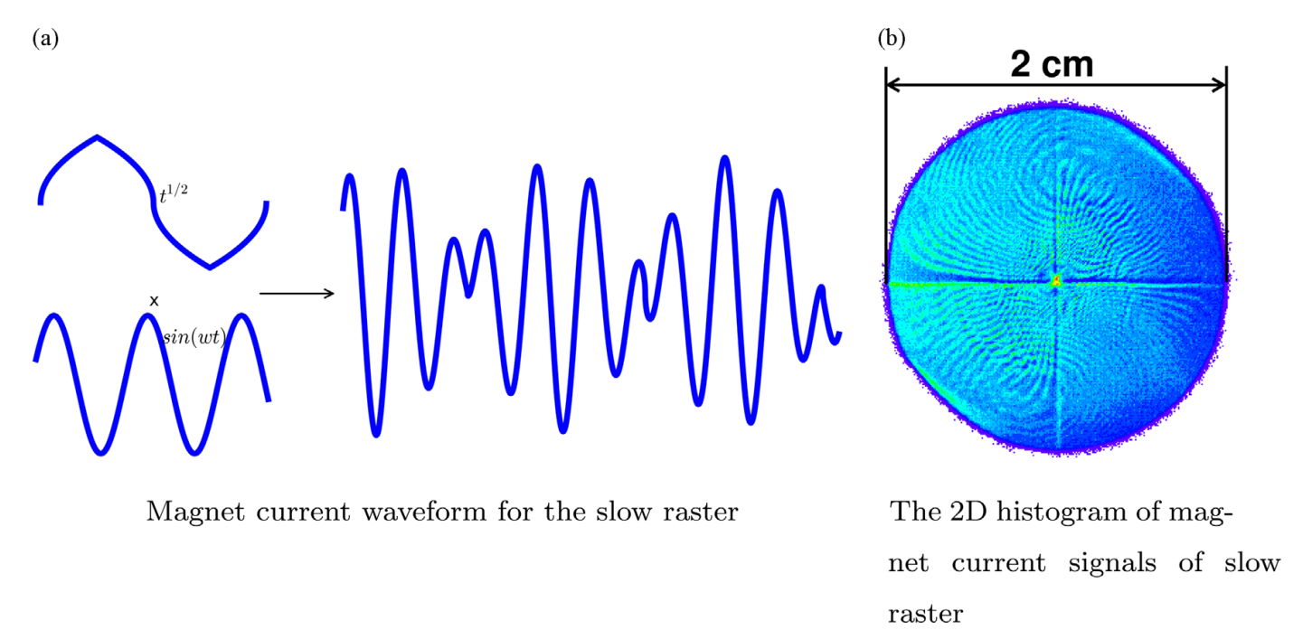
Beamline Tasks:
◦ Commissioning of Slow Raster
  Slow raster of electron beam required for DNP target
Hall A slow raster for g2p
P. Zhu, NIM A 808, 1 (2016)
10/13

Slide 17
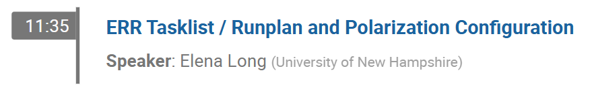
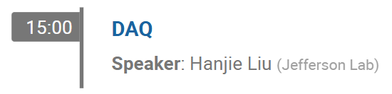
Beamline Tasks:
◦ List Detector & Trigger Configuration
In Progress
  Draft run plans have been created for both Azz and b1
10/13
10/13
10/13
10/13

Slide 18
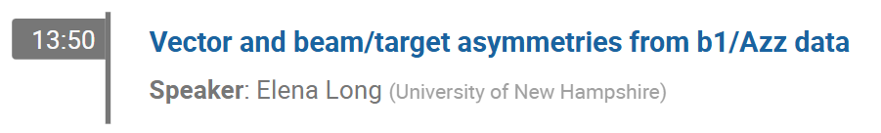
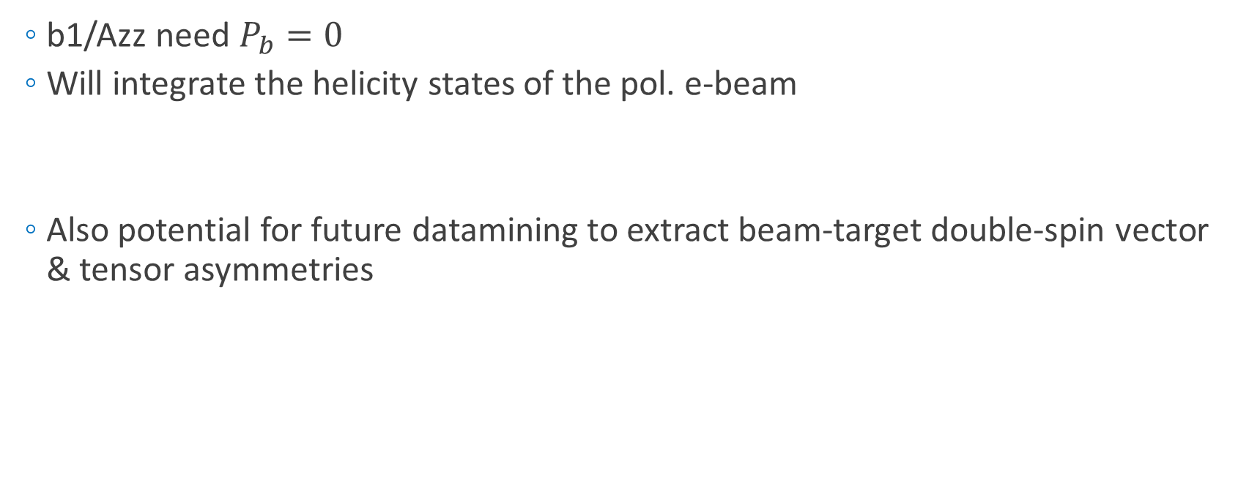
Beamline Tasks:
◦ Confirm Beam Pol. & Measurement
In Progress
  b1/Azz need $P_{b}=0$
  Will integrate the helicity states of the pol. e-beam
  Also potential for future datamining to extract beam-target double-spin vector & tensor asymmetries
$$σ\left(h_{e},P,Q\right)=σ_{u}\left[1+h_{e}\left(A_{e}+PA_{ed}^{V}+QA_{ed}^{T}\right)+PA_{d}^{V}+QA_{d}^{T}\right]$$
b1/Azz
10/14

Slide 19
Documentation Tasks

Slide 20
Documentation Tasks
Near Complete
  Workforce for running
  Write EH&S Documents
  Complete ERR documentation
Not Started
In Progress
10/13

Slide 21
Run Plan

Slide 22

Overhead Assumptions (Real Time)
Based on Hall B RGC Spin-Ups
Beam Assumptions:
Beam Current: 85 nA
Beam Efficiency: 0.5 (Scaled to 1)
Target Configuration Assumptions:
Target Cup Radius: 1.5 cm
Target Cup Configuration: 2 cups
| ||
|/ \ Microwaves
|ND3 Prod. Mat.
|ND3 Prod. Mat.
|C Optics
|EMP Empty Cell
|___
Target Annealing/Material Assumptions:
Dose between anneals: 5.25e+15 e/cm^2
Time Between Anneals for 2 Cups: 3 days, 5:42:46
Time required for Anneal: 1:00:00
Time required for Cup Change: 0:10:00
Time Between Cup Changes: 1 day, 14:51:23
Time required for target material change: 4:00:00
Dose between target material changes: 5.00e+16 e/cm^2
Time between target material changes for 2 Cups: 30 days, 20:07:20
Target Polarization, TE, & PF/Dilution Run Assumptions:
Time constant for vector pol. spin-up: 0:50:00
# of vector pol. time constants before beam: 3.91
Time required for vector pol. spin-ups: 3:15:30
Time between each vector pol. spin-up: 2 days, 0:00:00
Time required for target TE measurements for all 2 cups: 3:00:00
Time between TEs: 15 days, 10:03:40 (2 b/w Each Material Change)
Time required for packing fraction/dilution runs: 3:00:00
# of packing fraction/dilution runs per kinematic setting: 5
Time to Tensor Enhance: 0:00:30
Time to Tensor Unpol: 0:00:10
Time Between Tensor Pol/Unpol Cycles: 0:30:00
Beamline & Hall Configuration Assumptions:
Time required for BCM calibration: 2:00:00
Beam time between BCM calibrations: 7 days, 12:00:00
Time required for each Optics run: 4:00:00
Beam time between Optics runs: 20 days, 0:00:00
Time required for each Linac change: 8:00:00
Time required for each Spectrometer Momentum/angle change: 2:00:00
Based on data from P.M. McKee, NIM A 526, 60 (2004)
Based on UVA & UNH data

Slide 23
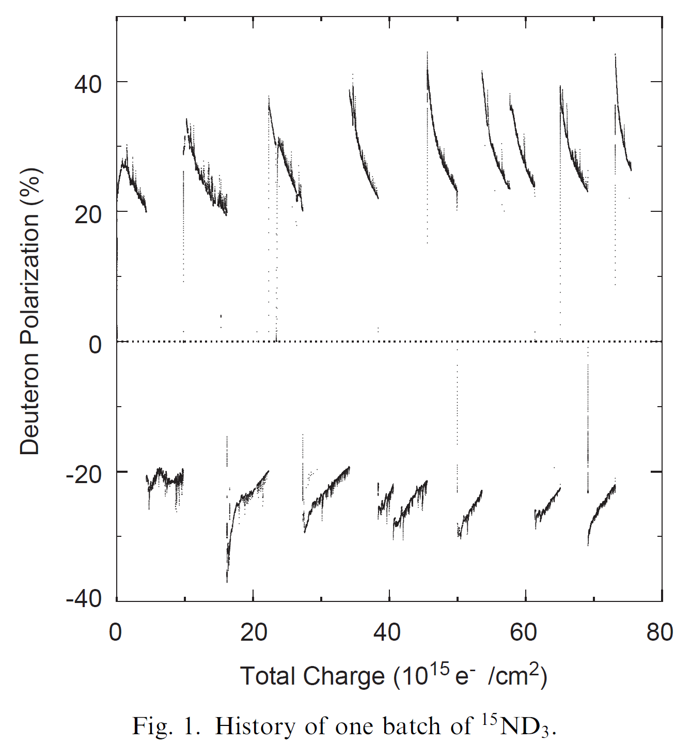














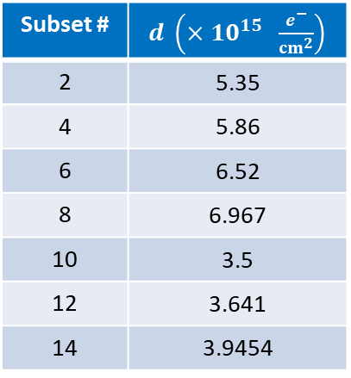








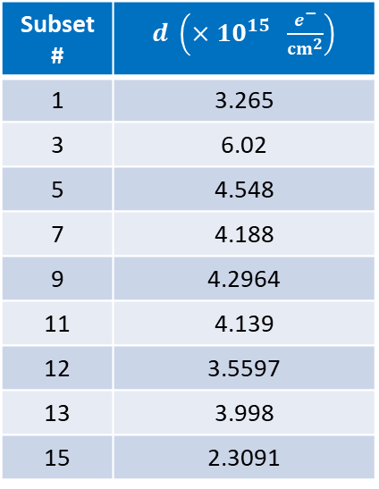
Dose Between Anneals & Mat. Changes
  Analyzed data from P.M. McKee, NIM A 526, 60 (2004)
$$5a$$
$$11a$$
$$15$$
Positive $P$
Negative $P$
$$13$$
$$3$$
$$7$$
$$9$$
Subset # | $d \left(×{10}^{15} \frac{e^{−}}{{cm}^{2}}\right)$
1 | 3.265
3 | 6.02
5 | 4.548
7 | 4.188
9 | 4.2964
11 | 4.139
12 | 3.5597
13 | 3.998
15 | 2.3091
$$1$$
$$5b$$
Subset # | $d \left(×{10}^{15} \frac{e^{−}}{{cm}^{2}}\right)$
2 | 5.35
4 | 5.86
6 | 6.52
8 | 6.967
10 | 3.5
12 | 3.641
14 | 3.9454
$$11b$$
$$2$$
$$4$$
$$6$$
$$8a$$
$$10$$
$$12$$
$$14$$
$$8b$$
Negative $d_{ave}=5.11×{10}^{15} \frac{e^{−}}{{cm}^{2}}$
Positive $d_{ave}=4.04×{10}^{15} \frac{e^{−}}{{cm}^{2}}$

Slide 24
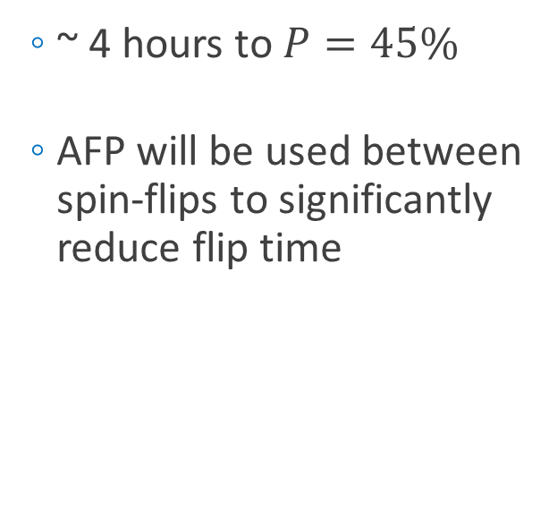
Hall B RGC Spin-Up
  ~ 4 hours to $P=45\%$
  AFP will be used between spin-flips to significantly reduce flip time
10/13

Slide 25
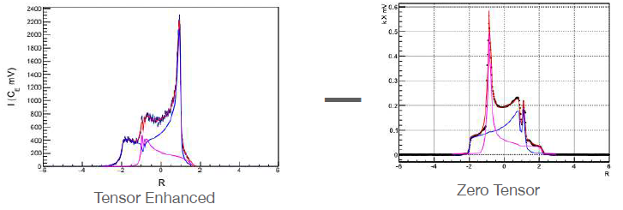
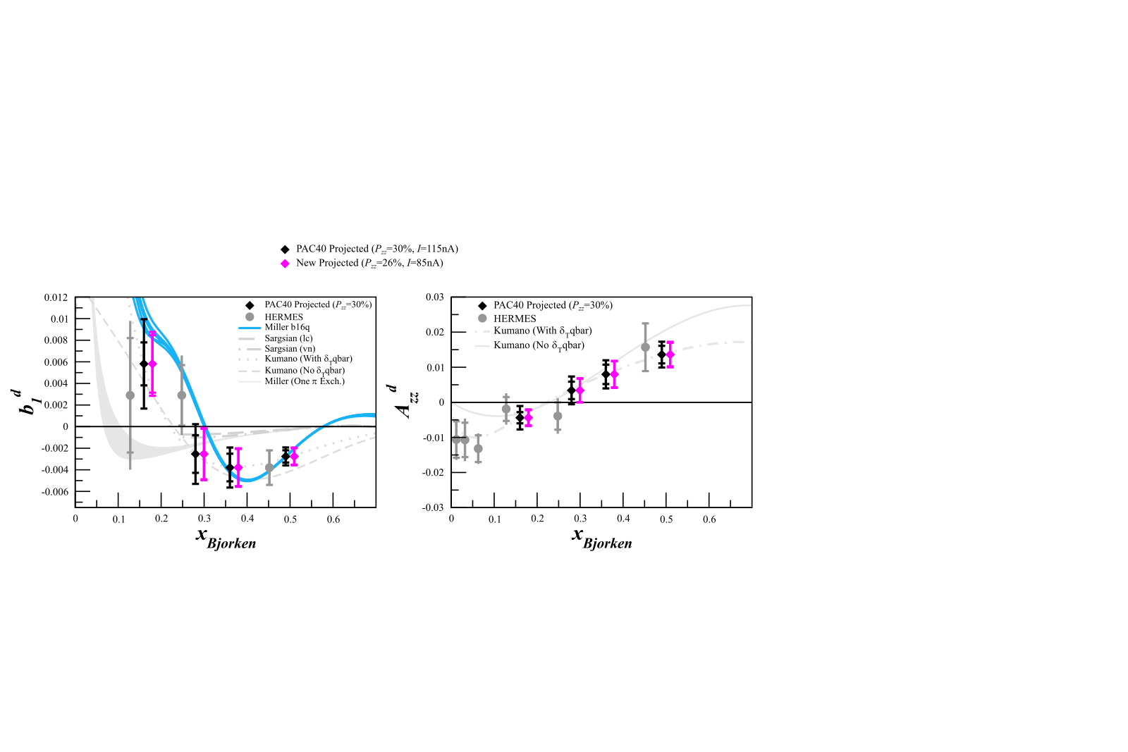
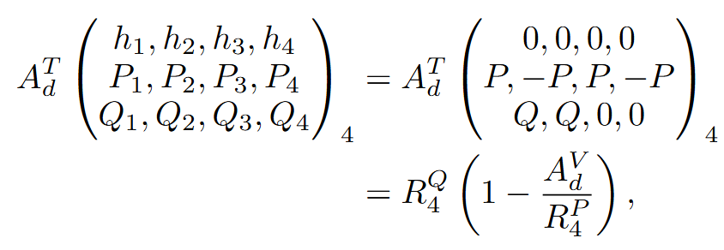


Rapid Tensor Flips: 4 State Measurement
  Rapid tensor enhancement/suppression while maintaining large vector polarization
    Highly suppresses drift effects on systematics
    1 cycle/hour instead of 1 cycle/day
    $δA_{zz}^{drift}∝\frac{1}{\sqrt{N_{flips}}}$ improved by $\frac{1}{\sqrt{24}}$
D. Keller
E. Long, EPJ A (in review)
10/14

Slide 26





b1/Azz Kinematics Running
$$Q^{2}$$
Azz
Draft run plan from smallest beam/detector energies to highest
$$x$$
b1

Slide 28
Thank you!

Slide 29

From P. Rossi’s Talk

Slide 31




Azz Kinematics & Overhead
$$Q^{2}$$
$$x$$

Slide 32


b1 Kinematics & Overhead
A
B
C
A+B+C

Slide 33
Target Tasks
◦ Demonstrate A_{lost} = 2 A_{gained} w/ ssRF
Complete
  UVA published results
    D. Keller, EPJ A 53, 155 (2017)
    J. Clements, D. Keller, NIM A 1050, 168177 (2023)
  UNH results in agreement
Preliminary

