Slide 1
Experiment Readiness Review
b₁/A_{zz} Tensor Collaboration – Jefferson Lab October 13, 2025
Patrizia Rossi

Slide 2
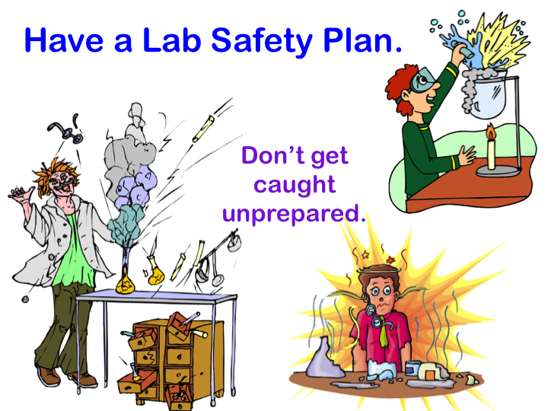
Experiment Readiness Review (ERR)
ERRs are standalone reviews required prior to delivery of any beam to the halls
Objective of the ERR is a safe, efficient and effective operation of the experiment
Operation will not result in injury to personnel and/or damage the equipment
  Automatic protection measures of personnel & equipment are in place during abnormal situations
Equipment performs as expected - no wasted beam time nor it interferes with other experiments
  Operating instructions & boundaries are defined as well as responsible staff
Experiment is successful in achieving its goals
Have an Experiment Safe & Efficient Plan !!
Don’t get caught unprepared
DECOMMISSIONING
2

Slide 3
From Proposal to Data: The Experiment Lifecycle
PROPOSAL PHASE
Submitting Proposals
TAC & PAC Process
PAC recommendations -> Director’s Decision
Approval
Conditional Approval
  C1 –pending technical review, no return to PAC
  C2 – pending further review by future PAC
Conditional Review (C1) for Tensor Polarized Target
A review was held Monday August 1, 2022 to consider the C1 conditional status of two experimental proposals, E12-13-011 and E12-15-005, both requiring a tensor-polarized target in Hall C. The requirement for full approval, imposed by PAC43 and reiterated by PAC45, is:
“… a tensor polarization of at least 30% be achieved and reliably demonstrated under experimental conditions.”
Based on the material presented at the review, we hereby remove the C1 condition. Still, we remind the collaboration that they are a long way from having truly viable experiments, and the bar for passing an eventual Experimental Readiness Review will be far higher. The panel unanimously agrees that substantial effort and continued R&D will be needed to make the two experiments truly viable under experimental conditions. Therefore, we endorse and encourage further cooperation between the lab and the collaboration to develop and
implement a plan to fully achieve the PAC condition and allow a meaningful scientific impact from the experiments under realistic conditions.
DECOMMISSIONING
3

Slide 4
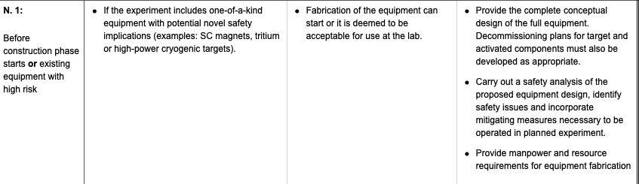
From Proposal to Data: The Experiment Lifecycle
PROPOSAL PHASE
Submitting Proposals
TAC & PAC Process
PAC recommendatios -> Director’s Decision
Approval
Conditional Approval
  C1 –pending technical review, no return to PAC
  C2 – pending further review by future PAC
⬇
PRELIM. PLANNING PHASE
Exp. Description and Requirements
Exp. Readiness Review Calendar
RESOURCE AVAILABILITY
⬇
DESIGN PHASE
ERR N.1
NO NEED
DECOMMISSIONING
4

Slide 5
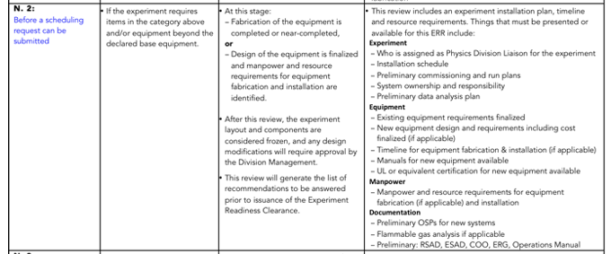
From Proposal to Data: The Experiment Lifecycle
PROPOSAL PHASE
Submitting Proposals
TAC & PAC Process
PAC recommendatios -> Director’s Decision
Approval
Conditional Approval
  C1 –pending technical review, no return to PAC
  C2 – pending further review by future PAC
⬇
PRELIM. PLANNING PHASE
Exp. Description and Requirements
Exp. Readiness Review Calendar
RESOURCE AVAILABILITY
⬇
DESIGN PHASE
ERR N.1
Before construction phase starts or existing equipment with high risk
⬇
ERR N.2
CONSTRUCTION PHASE
DECOMMISSIONING
5

Slide 6
Specific for this review
While the C1 conditional status has been lifted, the review panel reminded the collaboration that the bar for passing the Experimental Readiness Review will be significantly higher.
The next review will include the original charge elements:
What technique(s) will be used to produce “a tensor polarization of 30% under standard experimental conditions”
How will the tensor polarization be measured and with what uncertainty? What crosschecks or auxiliary measurements can be made to validate the results? Will this uncertainty be sufficient to achieve meaningful physics results?
What assumptions are made regarding the vector polarization of the target? How is the tensor polarization expected to respond as the vector polarization decays in beam?
What is the current experimental situation? What is the maximum tensor polarization that has been achieved under the anticipated polarizing conditions of 5 T and 1 K?
but will now incorporate an additional critical element focused on risk mitigation and scientific impact.
The collaboration must prepare to address the following new contingency planning questions:
What is the detailed plan if the average polarization of 30% is not reached?
Can the experiments still be run under those lower-polarization conditions?
What is the precise impact on the final scientific results (e.g., uncertainties, statistical significance) if the 30% polarization goal is not met?

Slide 7
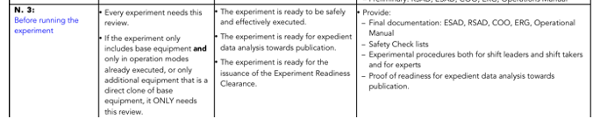
From Proposal to Data: The Experiment Lifecycle
PROPOSAL PHASE
Submitting Proposals
TAC & PAC Process
PAC recommendatios -> Director’s Decision
Approval
Conditional Approval
  C1 –pending technical review, no return to PAC
  C2 – pending further review by future PAC
⬇
PRELIM. PLANNING PHASE
Exp. Description and Requirements
Exp. Readiness Review Calendar
RESOURCE AVAILABILITY
⬇
DESIGN PHASE
ERR N.1
Before construction phase starts or existing equipment with high risk
⬇
CONSTRUCTION PHASE
ERR N.2
Before a scheduling request can be submitted
SCHEDULING OF EXPERIMENT
by JLab
⬇
⬇
ERR N.3
EQUIPMENT INSTALLATION
DECOMMISSIONING
RUN THE EXPERIMENT
7

Slide 8
From Proposal to Data: The Experiment Lifecycle
PROPOSAL PHASE
Submitting Proposals
TAC & PAC Process
PAC recommendatios -> Director’s Decision
Approval
Conditional Approval
  C1 –pending technical review, no return to PAC
  C2 – pending further review by future PAC
⬇
PRELIM. PLANNING PHASE
Exp. Description and Requirements
Exp. Readiness Review Calendar
RESOURCE AVAILABILITY
⬇
DESIGN PHASE
ERR N.1
Before construction phase starts or existing equipment with high risk
⬇
CONSTRUCTION PHASE
ERR N.2
Before a scheduling request can be submitted
SCHEDULING OF EXPERIMENT
by JLab
⬇
⬇
EQUIPMENT INSTALLATION
ERR N.3
Before running the experiment
Hall Leader requests approval for running the experiment
Readiness Certificate is issued by the Physics Division
DECOMMISSIONING
RUN THE EXPERIMENT
https://www.jlab.org/physics/experiment_process/np-pfx-chart
8

Slide 9
Questions?

