Slide 1

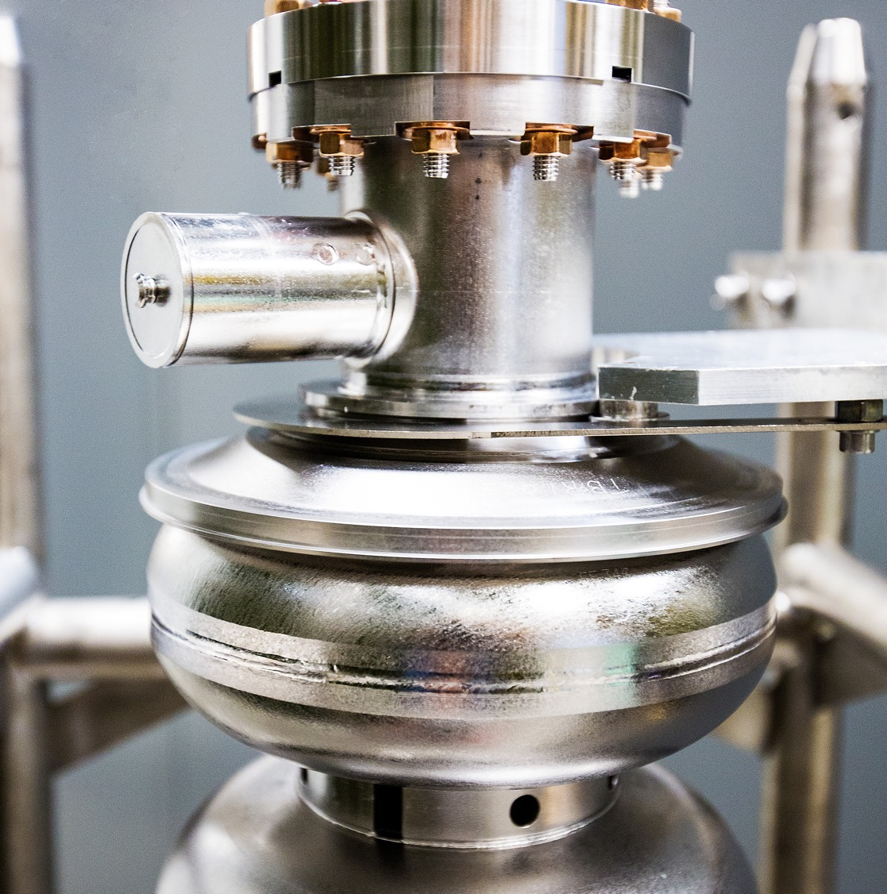
Accelerator Schedule
13 October 2025
Douglas Weadon Higinbotham, Ph.D.
Notes:
Tip: Keep titles under 60 characters for readability
To change the photo: Right-click on photo and select change photo

Slide 2
Dear Colleagues, On behalf of the entire user community, the JLUO Board of Directors extends its gratitude to you, the staff of Jefferson Lab, for the successful CEBAF run completed on Sept. 3. This run significantly advanced the scientific program of the community, with highlights including:
Completion of the GEp run in Hall A, paving the way for the installation of MOLLER
Installation and operation of A Low Energy Recoil Tracker (ALERT) in Hall B and the completion of the four run group experiments
Completion of the Large Acceptance Detector (LAD) experiment in Hall C
Commissioning of a new calorimeter in Hall D and acquiring over 5 petabytes of raw data for the JLab Eta Factory (JEF) and GlueX experiments.
We deeply appreciate being able to call on you as engineers, technicians, machine operators, run coordinators and shift workers at any time, even in the middle of the night, and to have you answer that call with such support and enthusiasm for the scientific mission of the lab. You weren’t deterred by the challenges along the way, whether they were caused by the high-water table, the Virginia summertime heat or simply a curious snake! Congratulations to you for setting a CEBAF reliability record in the 12 GeV era and doing so while operating at higher beam energy and current than in years past. We look forward to continuing to work together to pursue the ambitious future nuclear physics program that draws us to Jefferson Lab from institutions around the world. With Sincere Thanks, The Jefferson Lab Users Organization Board of Directors

Slide 3
Nuclear Physics Experiment Scheduling (NPES) Committee
The advice from our Program Advisory Committee is used to help set priorities and guide our making a schedule with up to four halls running at the same time.
Often schedules get built around a flagship measurement such as GEP-V in FY25, Prad-II in FY26, and in the out years MOLLER and then the committee works hard to deliver the best technically ready experiments in support of the mission of the lab.
The current NPES committee members are Eugene Chudakov, David Dean, Joe Grames, Douglas Higinbotham, Mark Jones, Cynthia Keppel, Eduard Pozdeyev (leaving Oct. 17th), Patrizia Rossi, and Mike Spata, with valuable input provided from both accelerator and physics division support groups as well as facilities and engineering teams.
After final review by the NPES committee, the schedule goes to the Jefferson Lab Director Jens Dilling for final approval and then is posted online and emailed to our user community.
Notes:
Guidelines: 6-8 bullets per slide; Use sentence fragments for bullets
To change the photo: Right-click on photo and select change photo

Slide 4
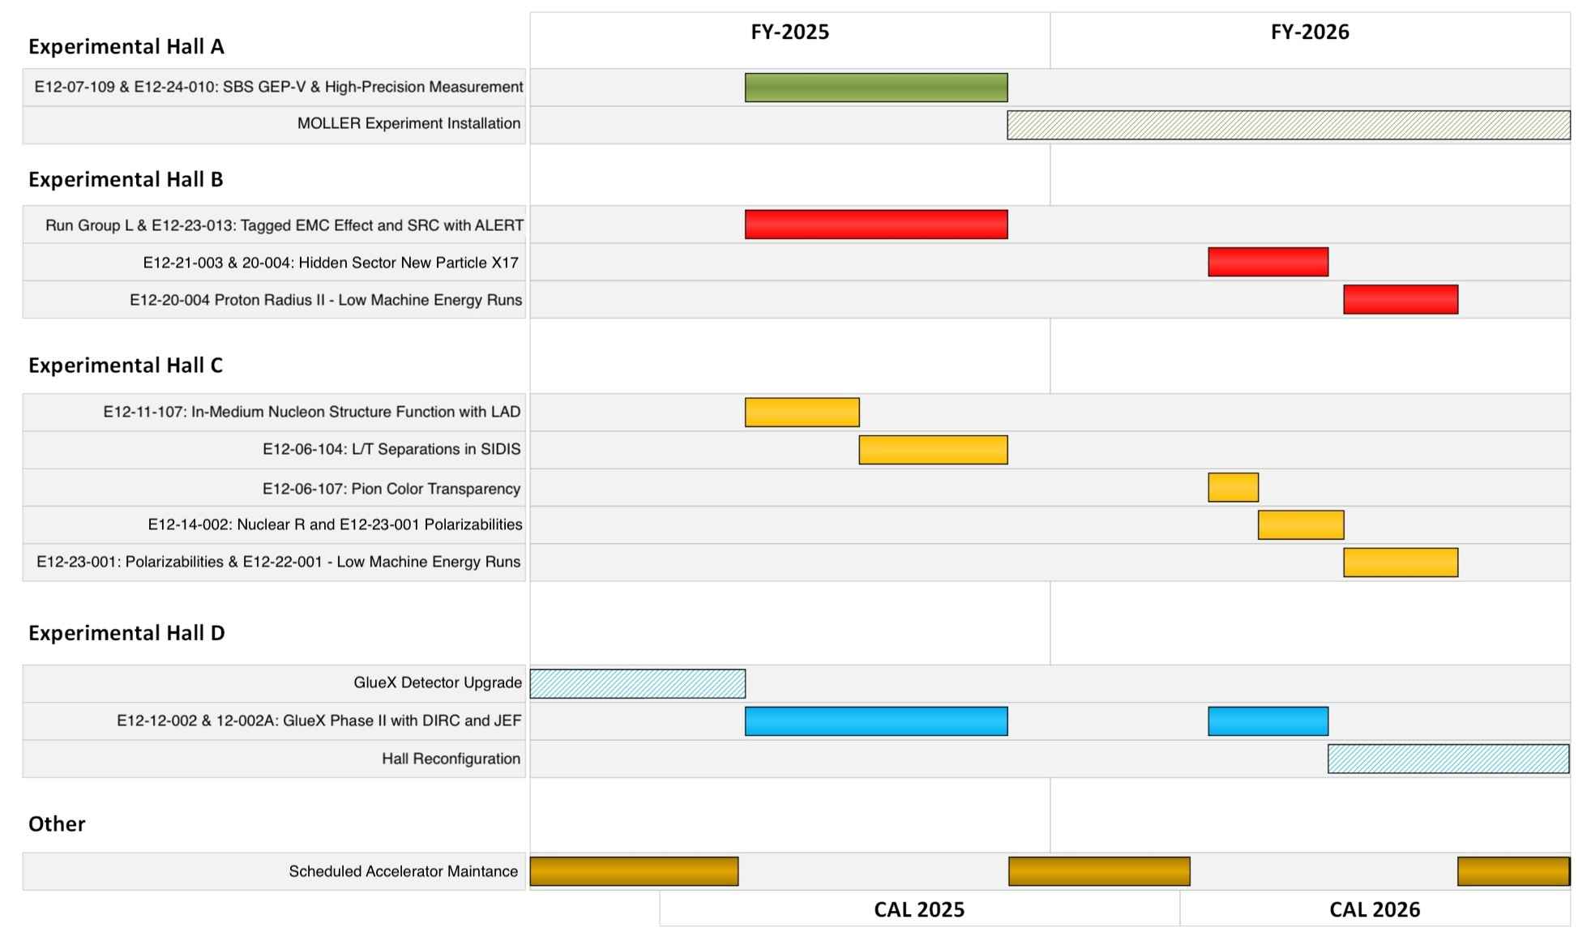
NOTE: New Version Coming With Next Scheduling Memo
Also see detailed xls file at: https://www.jlab.org/physics/experiments/schedule
NEW Hall D Low Energy Experiment Just Approved!

Slide 5
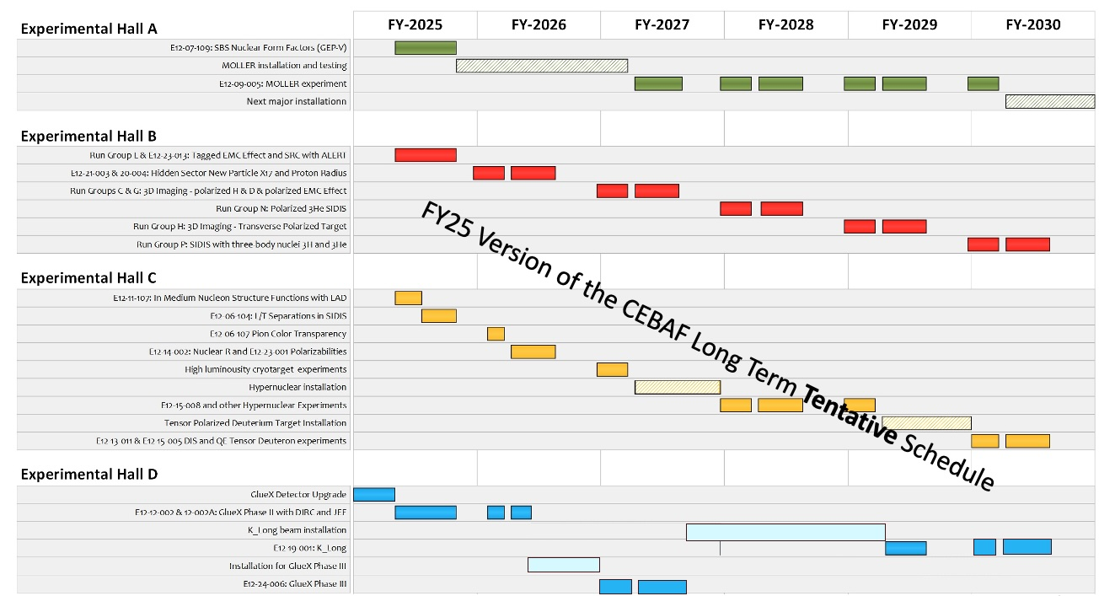

Slide 6
Summary
The FY25 was truly outstanding with high energy, over 800kW, and low trip rates.
Going forward, we will mostly be running at a three-hall machine with a series of major installations:
Moller Installation In Hall A
Hyper-nuclear and Tensor installations in Hall C
K-Long in Hall D
FY26 will be running halls B, C, and D.
FY27 likely start with B, C and D and about half-way thru the run period switch to A, B and C as Moller starts its run and Hypernuclear starts its installation. Tentative plan!
ALSO, ALL EXPERIMENTS MUST PASS THEIR EXP. READINESS REVIEW!!
Notes:
Before sharing your presentation, confirm:
Fonts are consistent
Images meet quality standards
Charts use template colors
Footer information is current
Spell check completed
Links are working
File size is optimized

