Slide 1
JLab Hypernuclear Beamline Update
Hypernuclear Collaboration Meeting
Dave Gaskell
Jefferson Lab
February 12-13, 2026

Slide 2
Hypernuclear Setup in Hall C and Beam Requirements
Hypernuclear target 6.6 meters downstream of nominal target position
Key requirements:
  Successfully transport beam to dump, mitigating stray fields from magnets close to beamline
  Beam energy spread <= 3 x 10⁻⁵ (70 keV at 2.24 GeV)
  Beam position precision and stability at target: σ = 0.1 mm

Slide 3
Beam Position
Existing BPMs (3H07A/B/C) are too far from hypernuclear target to provide required precision (0.1 mm) by themselves
  Δz_{BPM-target} = 9.8/8.8/7.9 meters for existing BPMs
  Assuming σ_{x/y}=0.1 mm for each BPM, σ_{target} = 0.65 mm
Additional position monitors will be added between pivot and hypernuclear target
  Will use existing polarized target girder
  Has 2 BPMs → 3.9 and 2.2 meters from target
  Using 3H07A/B/C + new BPMs, σ_{target} = 0.11 mm
In addition to girder installation work, BPM and harp readout will require support from I&C and Accelerator Software
Reminder

Slide 4
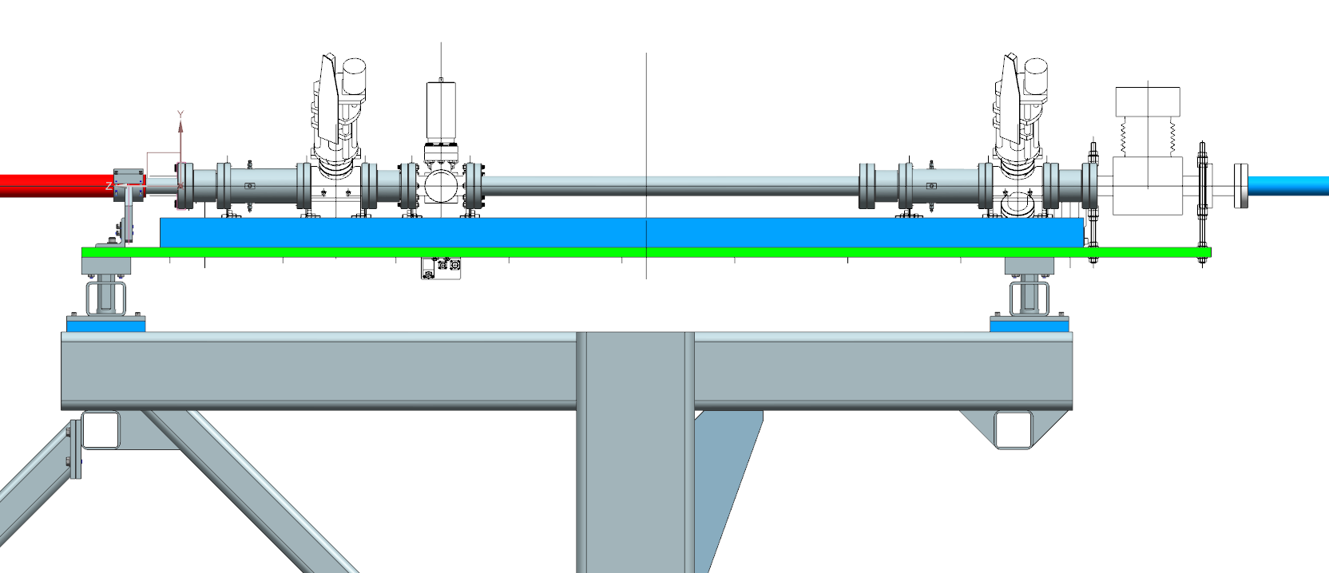
Polarized Target Girder
M20 (3 inch) BPMs
Add extra BPM?
Superharps

Slide 5
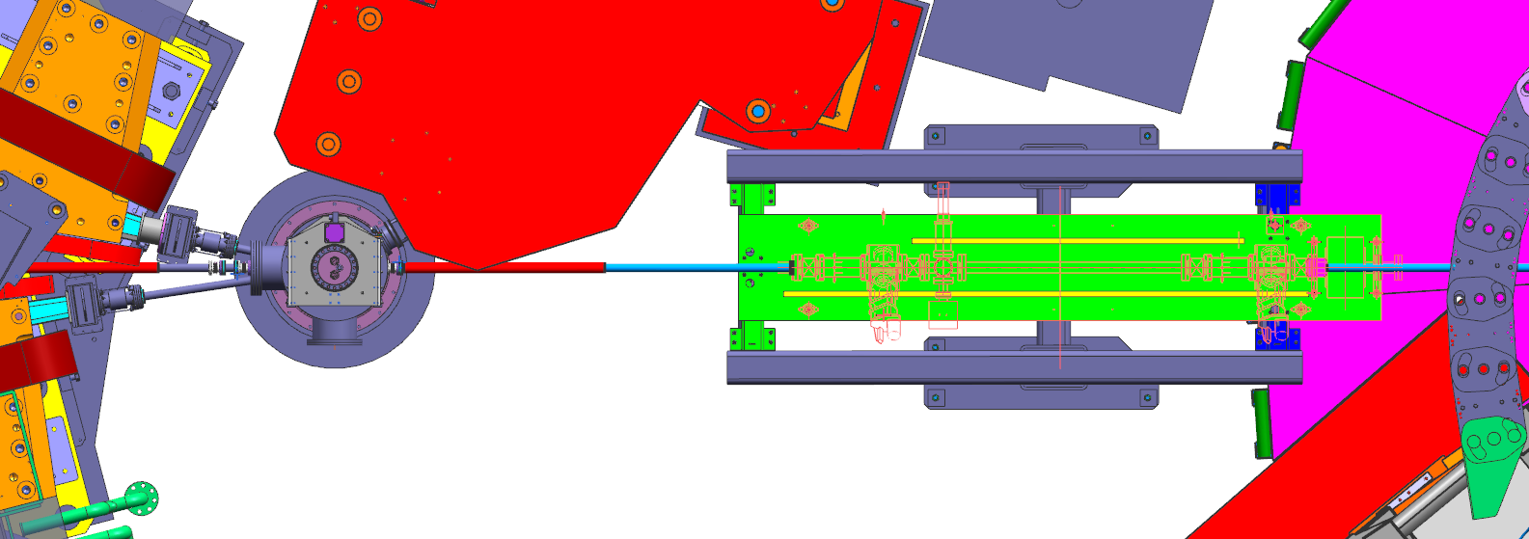
Downstream Diagnostic Girder
Hall C Pivot
Enge
Hypernuclear target
Diagnostic girder
Dean Spiers

Slide 6
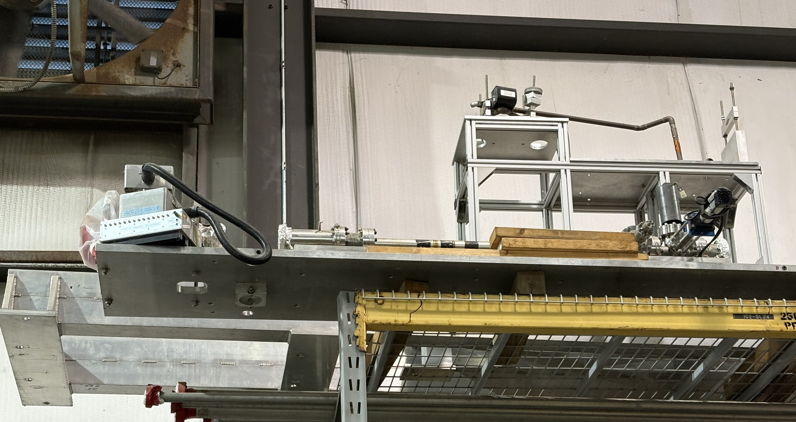
Polarized Target Girder
Polarized target girder was on top shelf at the back of Physics Storage
One harp has been removed → used elsewhere in machine
→ Could not verify from floor that both BPMs are still there

Slide 7
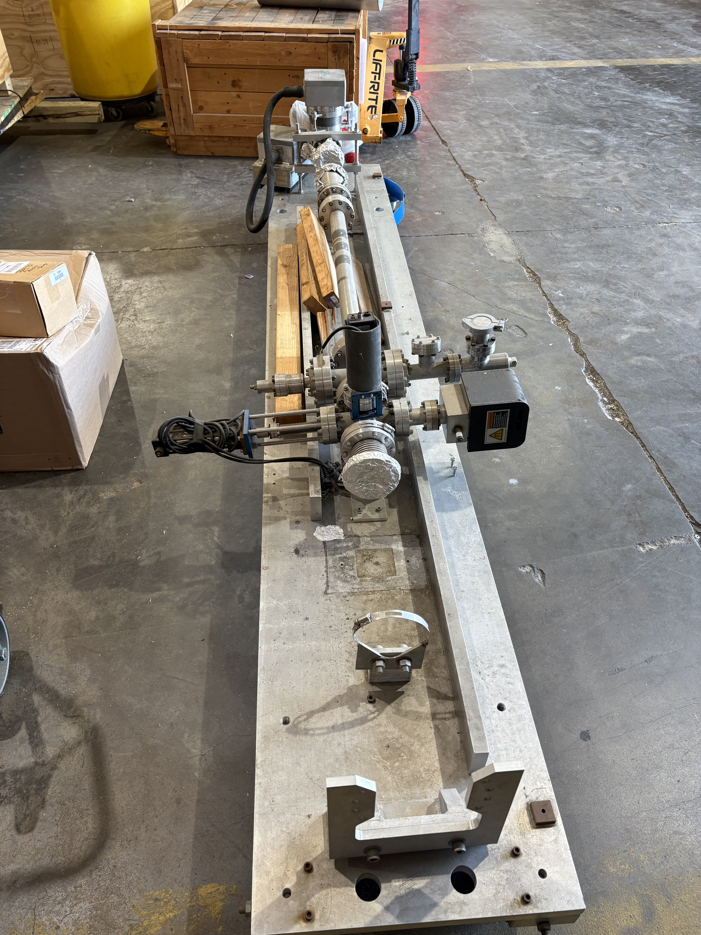
Polarized Target Girder in ESB
Since last collaboration meeting, Hall C techs have removed girder from shelf in Physics Storage
Staged in ESB
→ SEM has been removed → presence of beryllium made this a little problematic
Missing components now clearly visible
3-inch BPM – I&C has located a spare in good condition
Harp → need to find one from other location

Slide 8
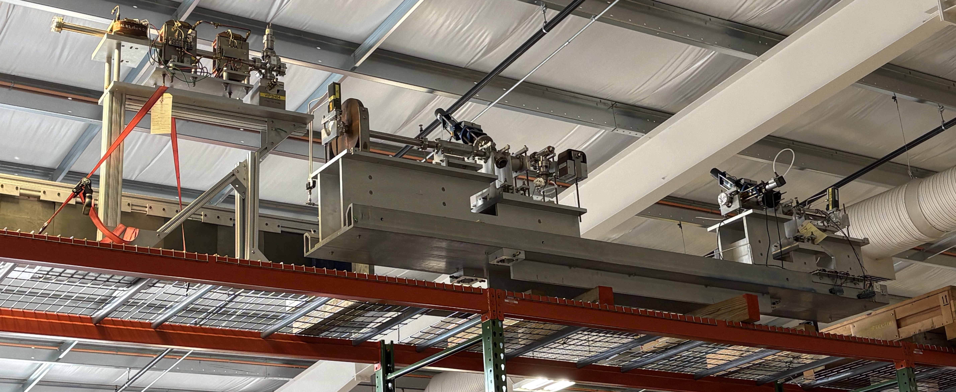
“Spare” Harps and BPMs
Girder used during Q-Weak experiment is stored in ESB → 2 harps and 2 BPMs available (and other things)

Slide 9
BPM readout
Hypernuclear experiments will require event-by-event readout of BPM information
  This has not been done in Hall C since Q-Weak experiment (2012)
  Hardware still in place → spares will become available after MOLLER installation in Hall A (switching to new technology)
  Will need additional FADC channels for readout → could “borrow” from HMS and/or SHMS

Slide 10
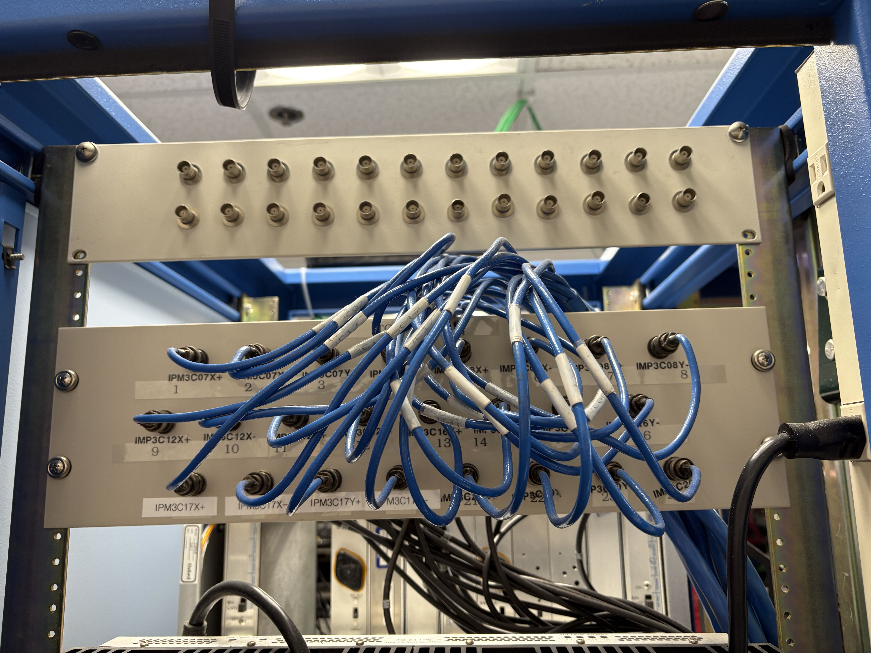
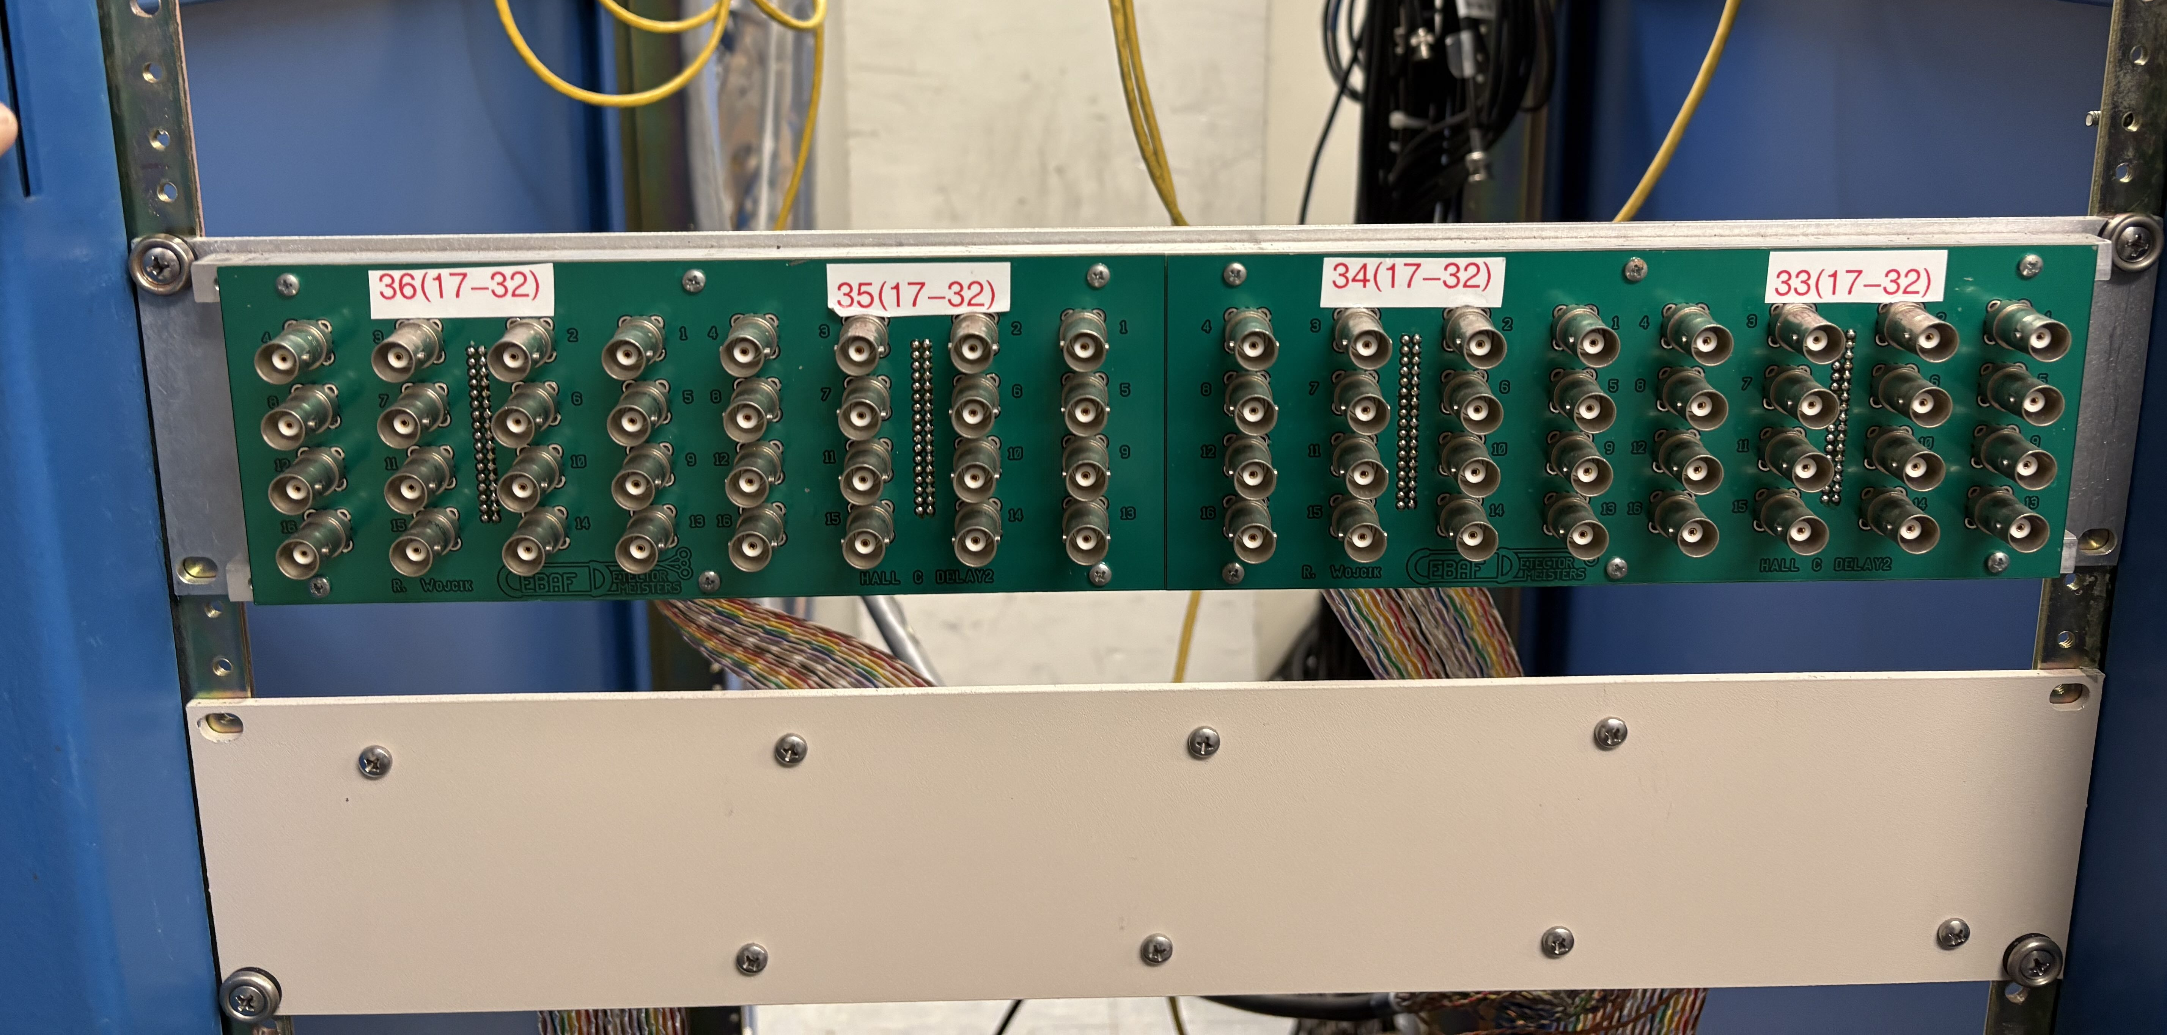
BPM readout
Located patch panels for connections from sample and hold cards
Hall BPMs on 2nd floor (”G0 cage”)
Beamline BPMs (3C12, etc.) in 1st floor electronics room in CH
VME crate, 1st floor CH

Slide 11
BPM readout test
BPM 3C12
Connected BPM signals from 3C12 to spare FADC channels in HMS/SHMS DAQ
Verified analog outputs from SEE BPM electronics still functional
BPM class has been added to hcana to simplify analysis
Would like to add more signals from Hall BPMs if time allows
y position
x position
Bill Henry

Slide 12
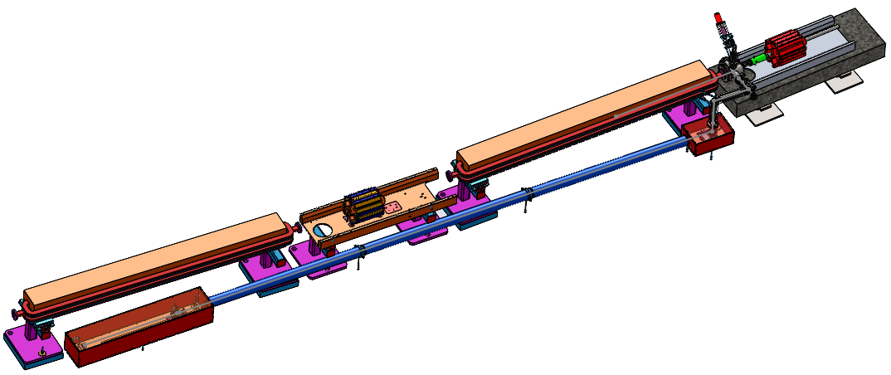
Synchrotron Light Interferometer (SLI)
Beam energy spread will be continuously monitored using new Synchrotron Radiation Interferometer
Dedicated beam test performed at end of last run period
High gradient beam (10.6 GeV at 5 pass → MOLLER run conditions)
Set up 1 pass beam in Hall C → Hypernuclear run conditions
3C12 GIRDER
Joe Gubeli
TURNING MIRROR
(TW0 AXIS SERVO)
CAMERA, SLIT STAGE

Slide 13
SLI Beam test Summary
Brief high level summary
  SLI saw synchrotron light and interference pattern
    Central peak too large/bright – could not fit interference pattern
  Used superharp scan to constrain beam energy spread: δE/E = 3.2 x 10⁻⁵
  Removed slit and monitored beam size overnight → energy spread drifted up to δE/E = 4.5 x 10⁻⁵
Nick Sereno (CASA) gave a more detailed summary at Physics staff meeting
  added full presentation to this meeting Indico
  a few excerpts in following slides

Slide 14
Nick Sereno

Slide 15
Nick Sereno

Slide 16
Nick Sereno

Slide 17
Nick Sereno

Slide 18
Summary
Making some progress on Hypernuclear beamline preparations
Highest priority is more tests with SLI to understand bright central peak
Will continue to work on adding a couple more BPMs to DAQ
Polarized target girder needs work, primarily from I&C and Vacuum group
  Both are busy with MOLLER preparations and getting ready for upcoming run
  Might be more cycles when 2026 CEBAF run starts

Slide 19
Backup

Slide 20
Beam Energy Stability: 9th Dipole
Additional information about relative beam energy can be provided using “9th dipole”
System used during previous hypernuclear experiment in Hall C
Not used for absolute beam energy measurement a la Hall A
BE magnet wired in series with Hall C arc magnets
NMR probe placed at fixed position in dipole
BE magnet still in place in BSY service building – needs modest amount of work to revive
Re-cable magnet leads
Locate and install NMR
Implement remote NMR readout

Slide 21
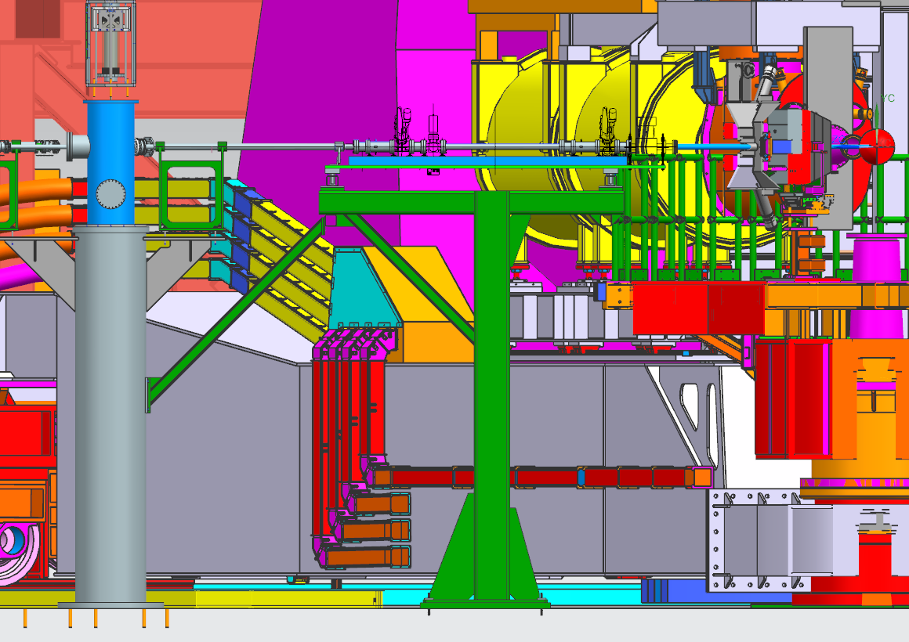
Downstream Diagnostic Girder
Dean Spiers

Slide 22
Polarized Target Girder
M20 (3 inch) BPMs
Viewer
Superharps

Slide 23
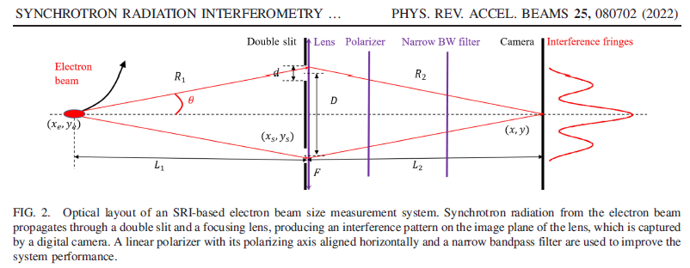
MEASURING THE BEAM SIZE [NON-INVASIVE]
SYNCHROTRON RADIATION INTERFEROMETER
Joe Gubeli

Slide 24
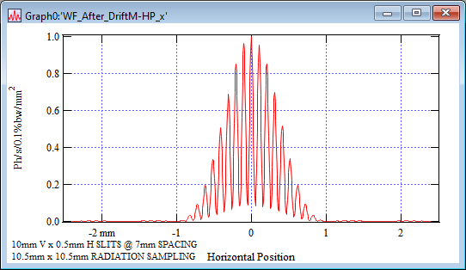
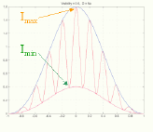
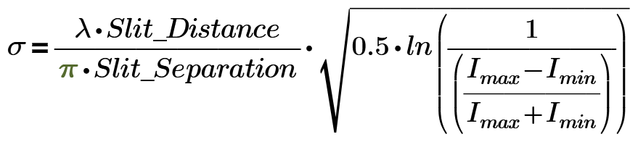
SYNCHROTRON RADIATION WORKSHOP (SRW) SIMULATIONS
TYPICAL FULL CAMERA FRAME
TYPICAL ZOOMED IN CAMERA IMAGE
HORIZONTAL SLICE THROUGH IMAGE CENTER
Joe Gubeli

