Slide 1
Hypernuclear Target Design, Schedule and Cost
David Meekins
12 February 2026

Slide 2
Design Status
Currently in very early stages of the design
Coarsely adapting the PREX/CREX target system to HKS needs
This includes the cryogenic fluid transfer subsystem
Only solid targets no gas cells
Enge location is challenging to chamber design and adds spacial constraints.
Preliminary thermal analyses show concept at least workable for 3 spectrometer operation for all solid targets at the proposed beam currents. We still need to fine tune this analysis
Students, JLAB staff.
Alignment of the target will be challenging.
Considering load/lock system to accommodate need for α source

Slide 3
Hall C HKS Layout
Target

Slide 4
Cryogenic Distribution System
Use standard 1.5” transfer lines with integrated control valves.
We have two such lines however they are too short and will have to lengthened.
The 1.5” lines will feed a transfer can to adapt to 0.5” transfer lines.
PREX T-Lines cannot be reused and new ones will need to be fabricated
The transfer can
Currently we are optimizing location for the transfer can.
We can then design (length only) and start fabrication of them.
Low power requirements
Compatible with MOLLER but we will still need to keep T-lines cold ~200W at 20K.

Slide 5
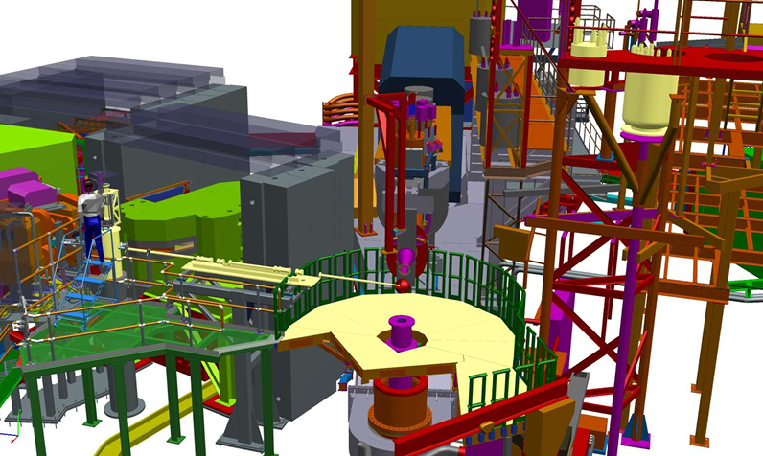


Chamber Location Side View
Cryo sup/return
Transfer
Can
HKS target
New decking attached to SHMS. Transfer can located on deck.
Nominal Pivot

Slide 6
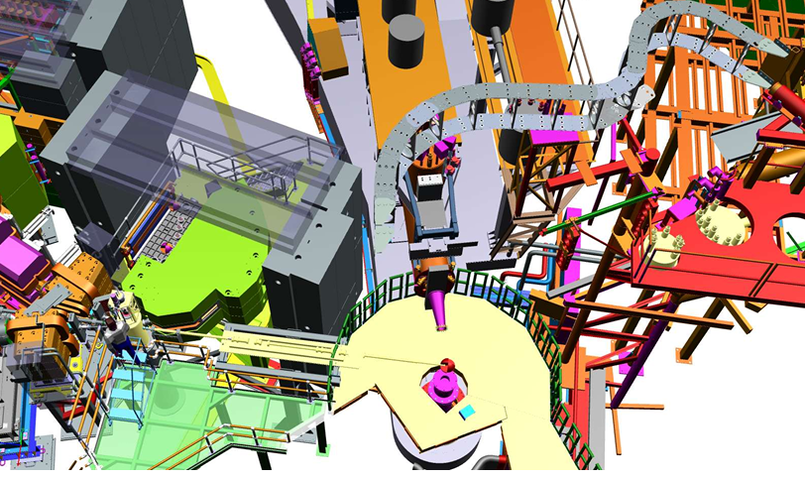
Chamber Location Top View
HKS Target
~260 in downstream from pivot

Slide 7
Scattering Chamber Requirements
Vacuum connections to three spectrometers
There will need to be some flexibility in the system for alignment purposes at least.
Target will hang vertically into the beam line
Alpha source swapping will require the chamber to be opened during the run
Ca, LiH, and Li targets will need to be protected from exposure to oxygen.
One possible solution is to develop a load/lock
Load/lock system presents some design challenges
Added length to motion system
Access ports well above beam line
Less rigid system so alignment might be sloppy

Slide 8

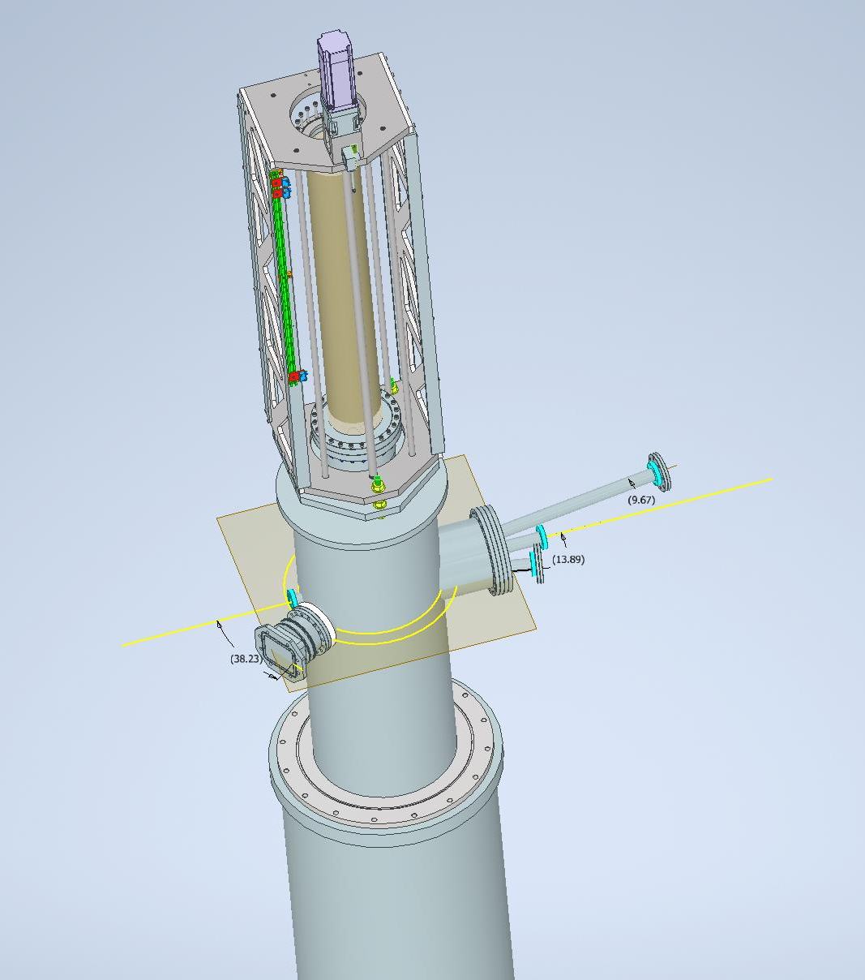
HKS Target Concept
Motion system
With possible load/lock
HES (10 deg)
Scattering Chamber
(norm beam height)
Beam
HKS 14 deg
Scattering Chamber post
Enge
45 deg

Slide 9
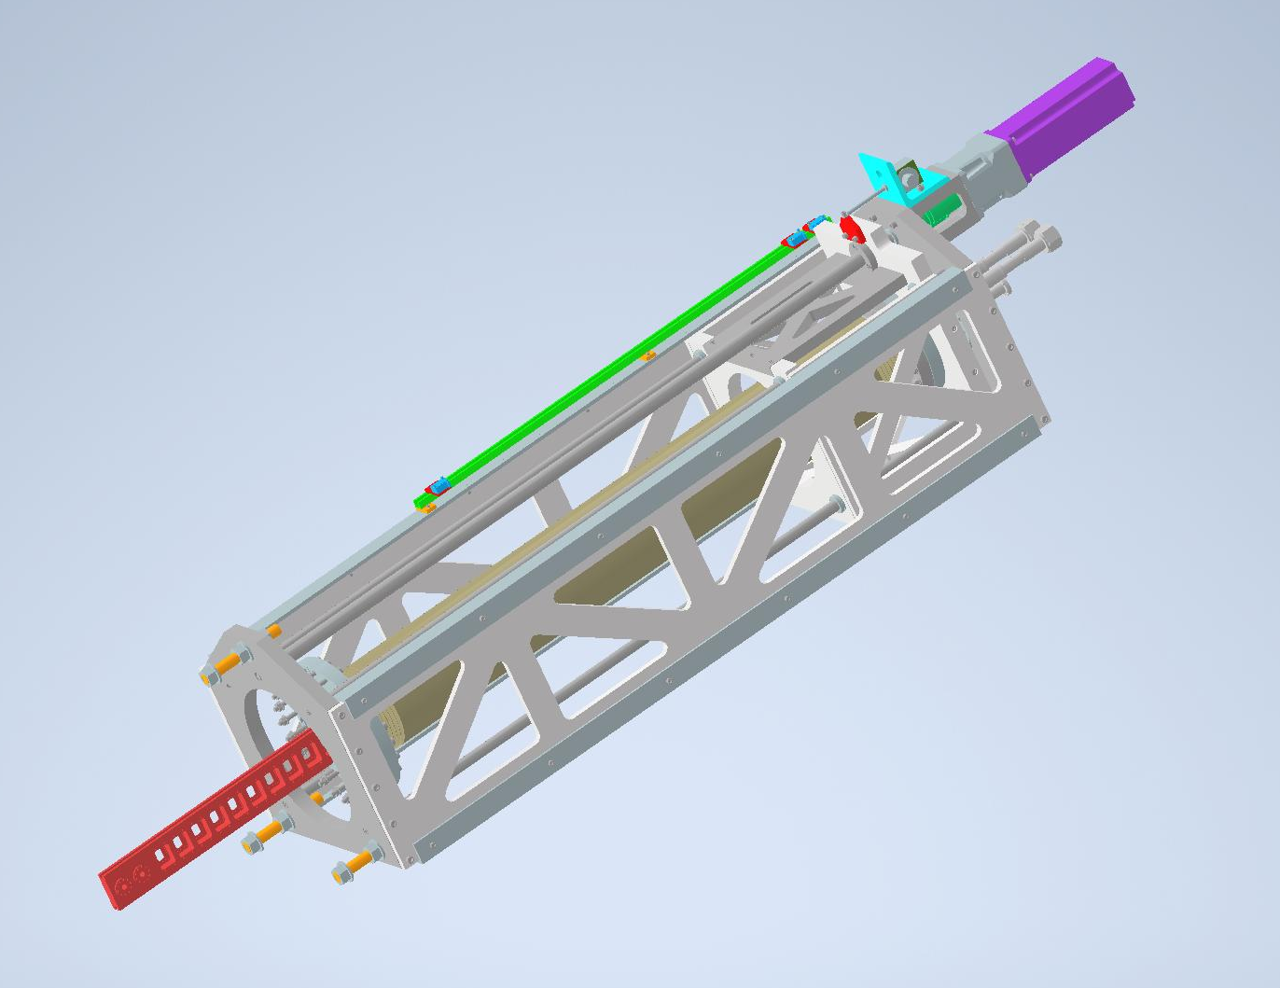
Motion System
Adapt principles of the PREX target to HKS.
Cryogenic system
Component design similar to PREX
Length of travel must be determined
This can accommodate all solid tgts
Extra length for load lock
Adding “x”, “z”, “θ” motion
“y” motion is normal vertical target motion
This will add to cost and add complexity to design
We can use much of the existing target control system
Epics based
New controls would be needed.
Software -> EPICS
Control cables would be needed. Might be possible to extend current cryotarget control cables

Slide 10
Solid Target Ladder
11+ solid target positions
Ca, Li and LiH should not be exposed to air for periods longer than few minutes.
Possible need for H2 target
H2O target cannot run when target is cold
Need details of alpha source to complete the ladder design.
There is effort from target group to develop LiH as target material
Needed for polarized target run as well.
LiH can release H atoms if temperature is too high. This “release” temp is below melting point.
LiH must handle raster off operation
LiH production may be inconsistent

Slide 11
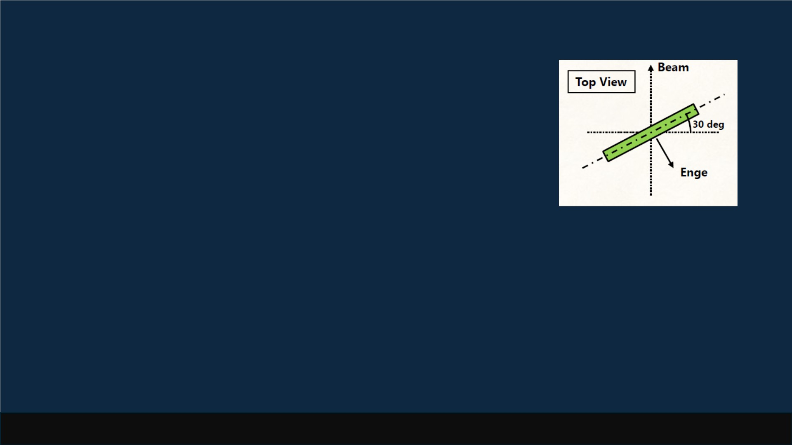
For ENGE
Figure from Sho
• 30-deg tilt
_{• 100 mg/cm}²
• Calibration target (α source)
• Same diameter as ^{40,48}Ca
• α target is unmounted during beamtime
• α target is next to carbon hole target (to be surer beam pos.)
• Other requirements
• ENGE vacuum is kept even when the scattering chamber is open
T. Gogami (Kyoto Univ.), HKS Target Meeting, Jan 27, 2026
/9

Slide 12
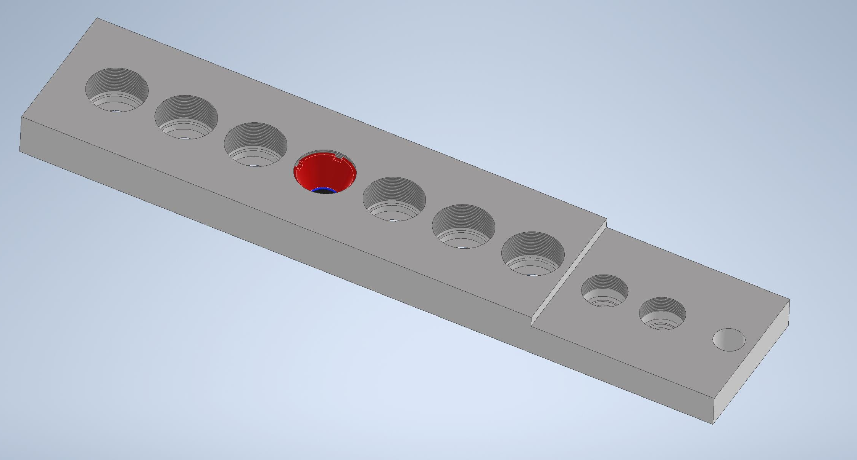
Concept Solid Target Ladder
Calcium target mount is recessed for cost saving.
Without recess, $120K more in Ca48
2 mm integrated hole
Other Solid Targets
Downstream Face
Ca40 and Ca48 Targets

Slide 13
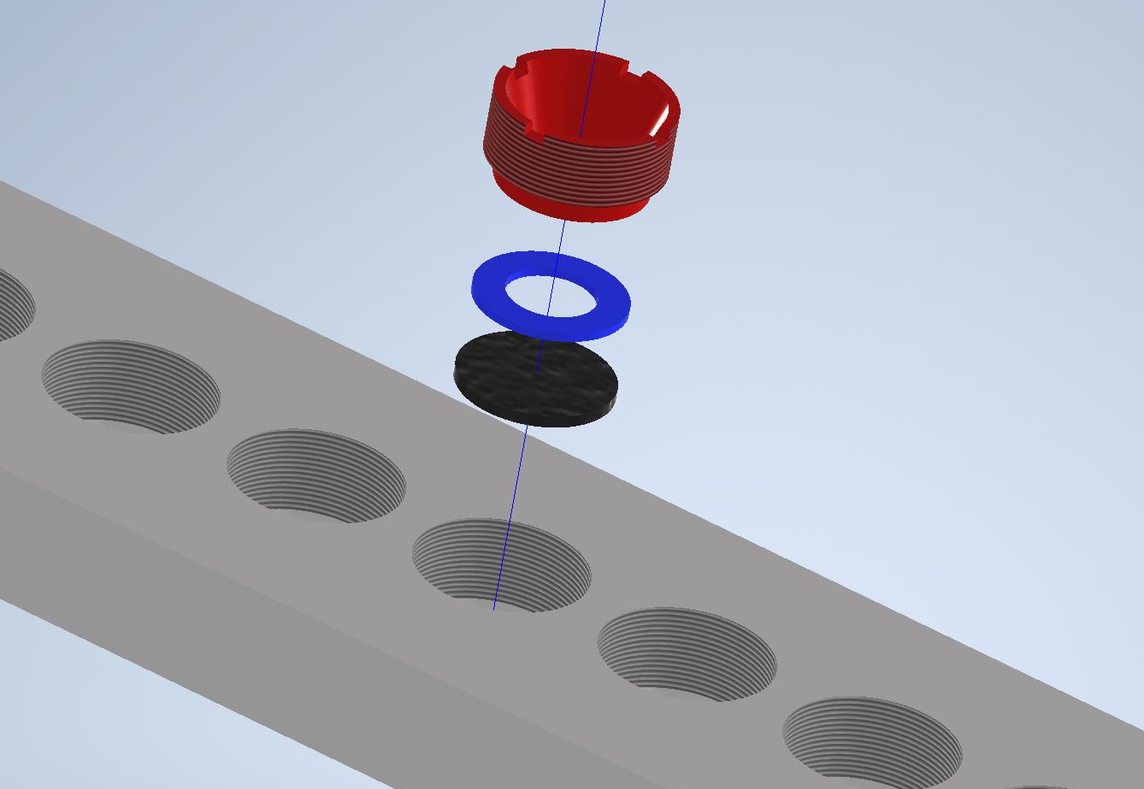
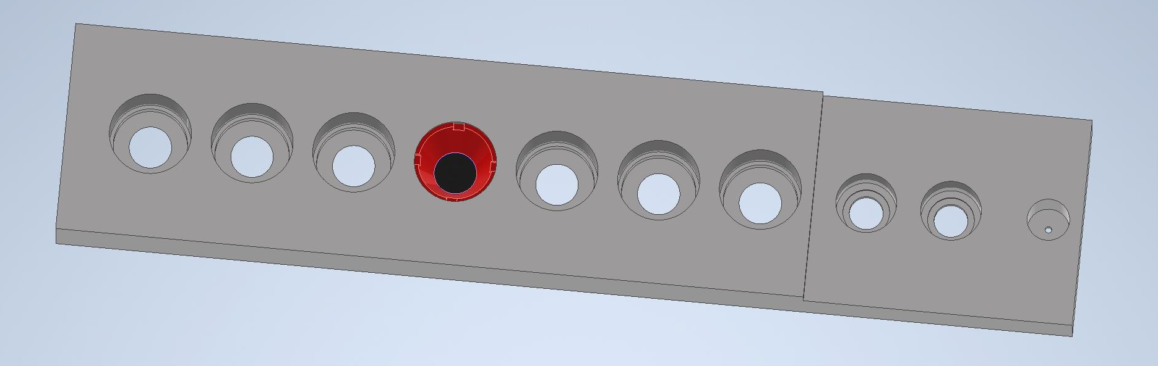
Concept Solid Target Ladder
All components (ex targets) are aluminum 7075
Nuclear grade antiseize used for better thermal cond and to prevent seizing
All 9 targets can be accommodated with full acceptance for all three spectrometers
Clamp
Mount
Clamp ring
Target material

Slide 14
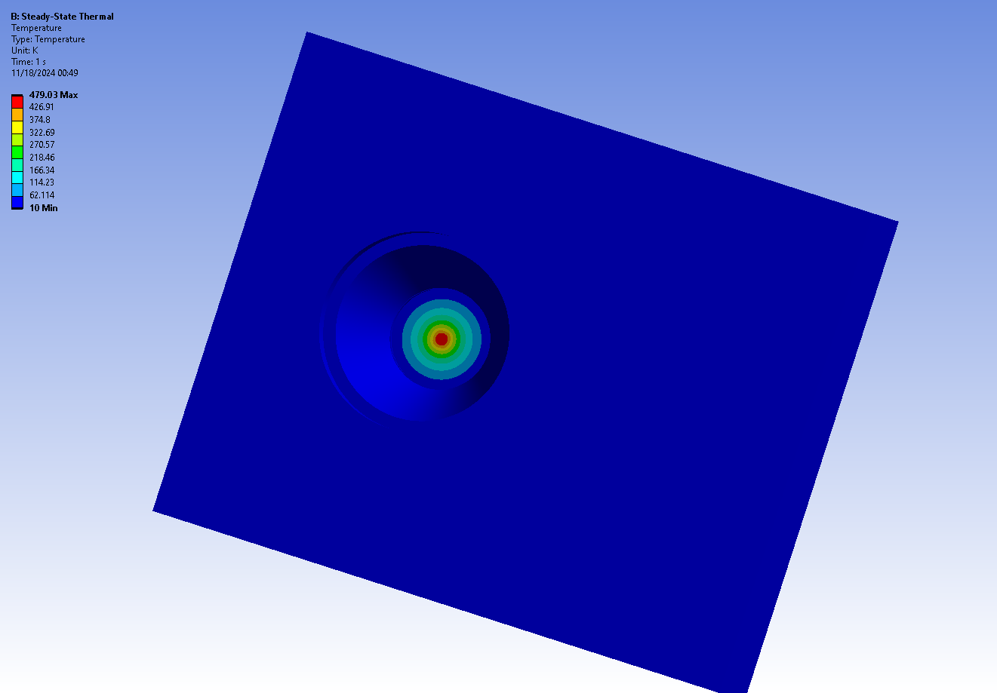
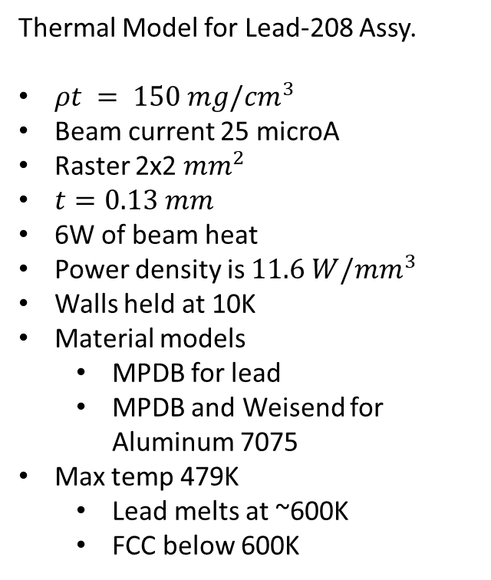
Thermal Model for Lead-208 Assy.
$ρt = 150 mg/{cm}^{3}$
Beam current 25 microA
Raster 2x2 ${mm}^{2}$
$t=0.13 mm$
6W of beam heat
Power density is $11.6 W/mm^{3}$
Walls held at 10K
Material models
MPDB for lead
MPDB and Weisend for Aluminum 7075
Max temp 479K
Lead melts at ~600K
FCC below 600K
Held at 10K

Slide 15
Ladder Summary
Design of ladder is critical to moving the design process forward for the entire target.
Rotation of the solid targets 30 deg from beam normal will present some challenges
Targets will need to be “wider”
Increase the cost for Ca48
Somehow, we will have to optimize the rotation with cost and function.

Slide 16
Cost Estimate Non-labor
Non-labor costs:
Target materials (detailed on next slide)
$200K
Motion system $50K
Frame $20K
Bellows $10K
Flanges/Fittings $10K
Drive/Misc $10K
Load lock $25K
T-lines $20K + $15K
Transfer Can
Reuse PREX can for solid targets only
Chamber/Stand $50K
Total: ~$400K to $450
Ca48 Cost will rise with larger targets. Have not priced in 2026

Slide 17
Solid target costs
Target | Z | A | Thick (mg/cm^2) | Density (g/cc) | Req Thickness (cm) | Required Mass (g) | Cost | Imax (microA)
LiH |  |  | 0.45 | 0.93 | 0.484 | 1.647 | $ ??? | 2
Lithium-6 | 3 | 6 | 0.1 | 0.458 | 0.218 | 0.366 | $ 5,000.00 | 50
Beryllium | 4 | 9 | 0.1 | 1.848 | 0.054 | 0.366 | $ 5,000.00 | 50
Calcium-40 | 20 | 40 | 0.15 | 1.55 | 0.097 | 0.230 | $ 10,000.00 | 50
Calcium-48 | 20 | 48 | 0.15 | 1.86 | 0.081 | 0.230 | $ 100,000 | 50
Carbon-12 | 6 | 12 | 0.15 | 1.8 | 0.083 | 0.549 | $ 500.00 | 50
B-11 (B4C) | 5 | 11 | 0.15 | 2.52 | 0.060 | 0.549 | $ 7,000.00 | 50
Aluminum | 13 | 27 | 0.15 | 2.699 | 0.056 | 0.549 | $ 500.00 | 50
Lead-208 | 82 | 208 | 0.15 | 11.4 | 0.013 | 0.549 | $ 25,000.00 | 25
Spare Lead
Spare LiH
CH2?
Without adjustments to Ca targets, cost would go up at least $120K.

Slide 18
Labor Resources/Time Required to Fabricate
Design solid targets only
Design Authority 480 hours
Load lock and alignment + 80
Designer 320 hours
Load lock and alignment + 100
Fabrication
6 months of calendar time at least for target group
Need welder, fitter, electrical, DA …
Machine shop work (build to print components)
Ca48 can take up to 12 months to procure if approved by DOE. This process has started recently.

