Slide 1
HYPER-NUCLEAR DESIGN STATUS Jamie Shiflett Hall C Lead Engineer shiflett@jlab.org (757) 269-6944 Feb 12, 2026
HYPER-NUCLEAR

Slide 2
HALL C
HYPER-NUCLEAR
Nansemond Pre Cast Concrete – Radiation Shielding
P.O. 25-D1718-0 - Deliverables late Sept-Oct 2026
62 WALL BLOCKS
18 MEDIUM BLOCKS
Cabling with Bill Henry
Cable routing
PCS
Metrology Survey Complete and data compared with drawings.
Power Supply Unit Procurement
Qty 3 Purchase Requisition(441768) on hold
Qty 1 Still needs PR submittal.
DELIVER HKS PSU TO TEST LAB FOR MOLLER TESTING
LCW
Preliminary Schematic Produced
Establish preliminary Bill of Materials
SCHEDULES
FUTURE TASKS

Slide 3
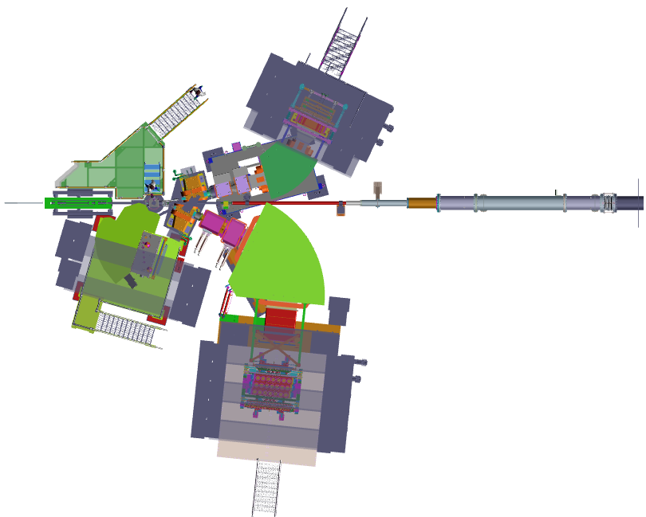
HYPER NUCLEAR – LAYOUT(TOP VIEW)
HES
High Energy Spectrometer
PCS
BEAM LINE
HKS
High resolution Kaon Spectrometer
ENGE

Slide 4
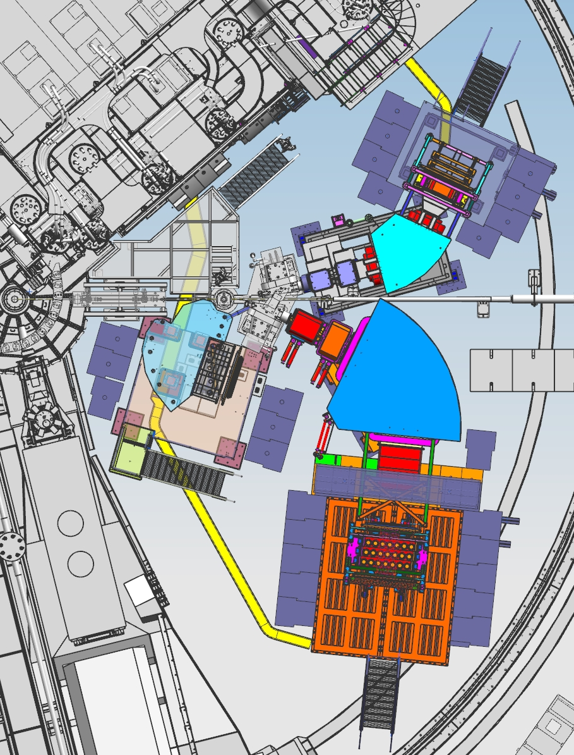
HYPER NUCLEAR – LAYOUT (TOP VIEW)
SHMS
HES
BEAM LINE
ENGE
HKS
HMS

Slide 5
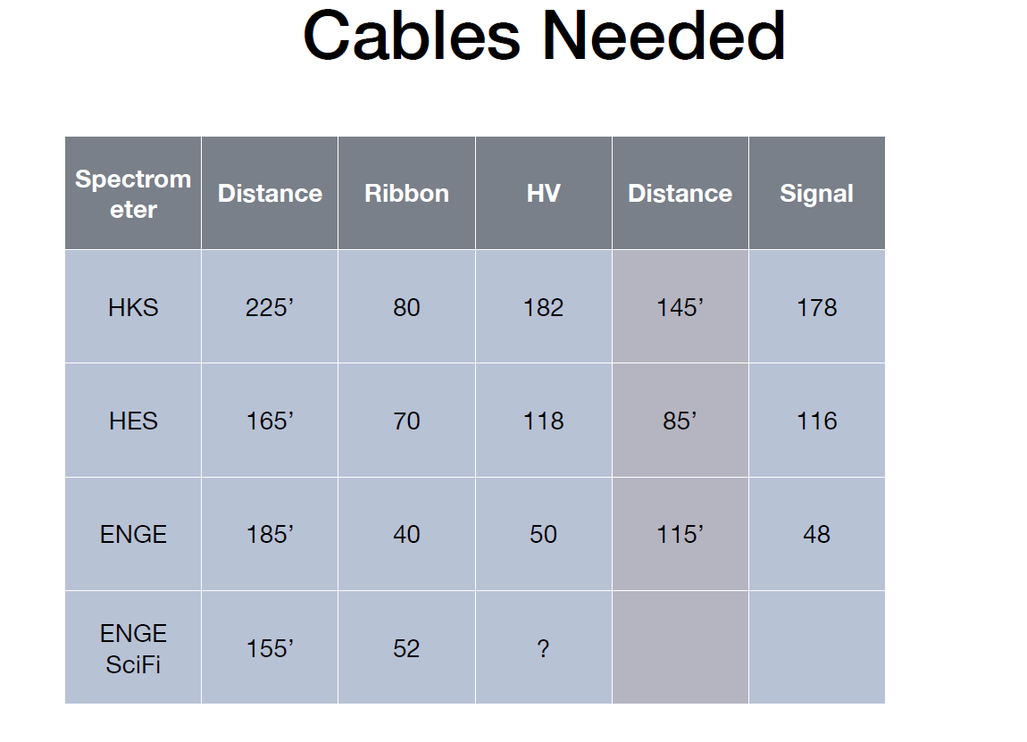
LOCATION
CDet
BigBITE
NPS
CAD
150
110
125

Slide 6
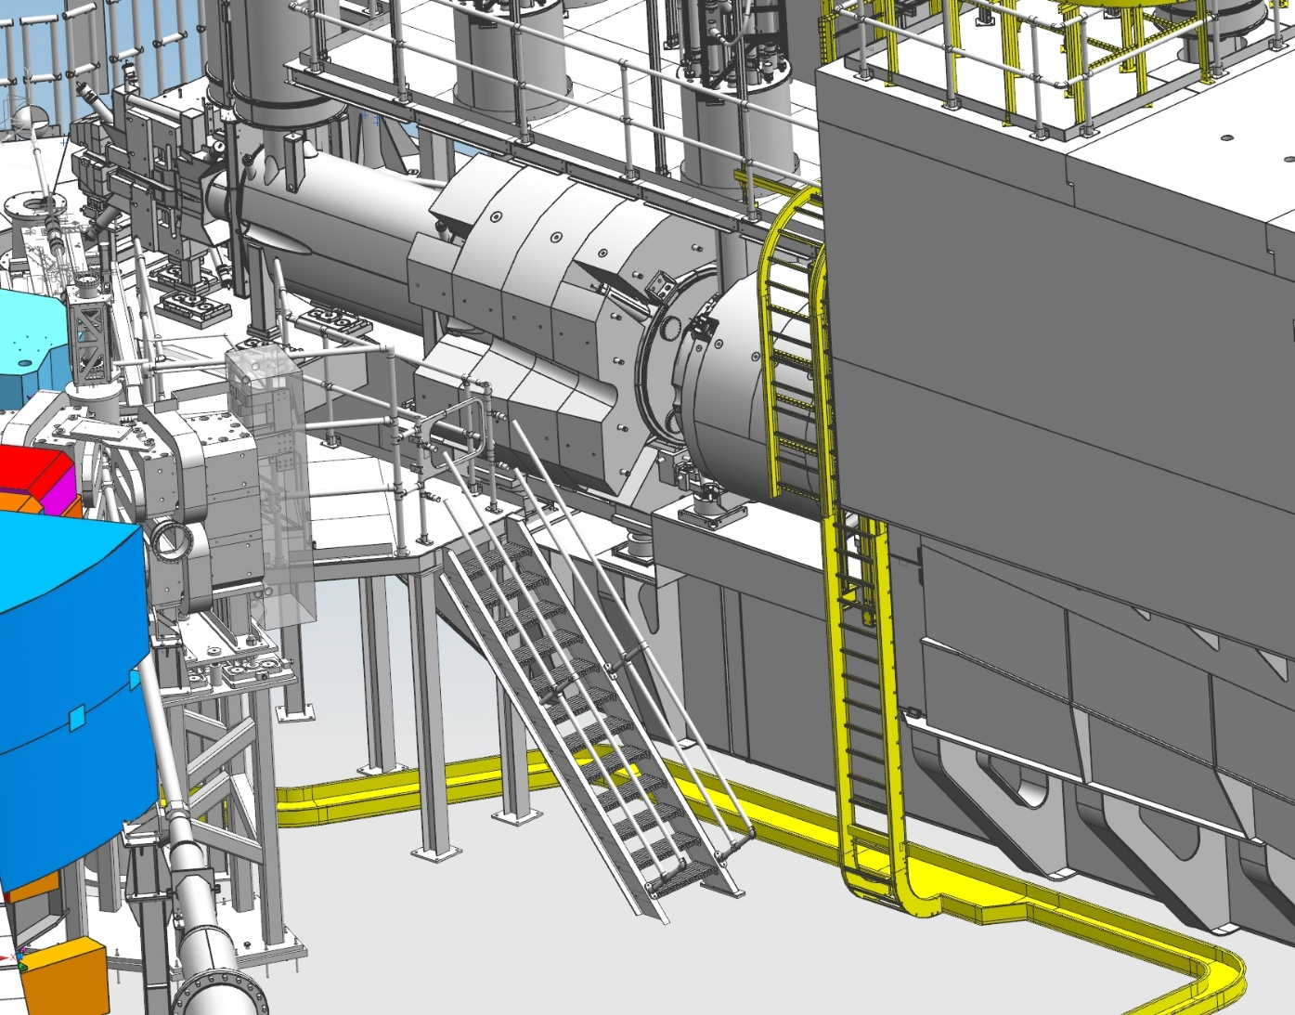
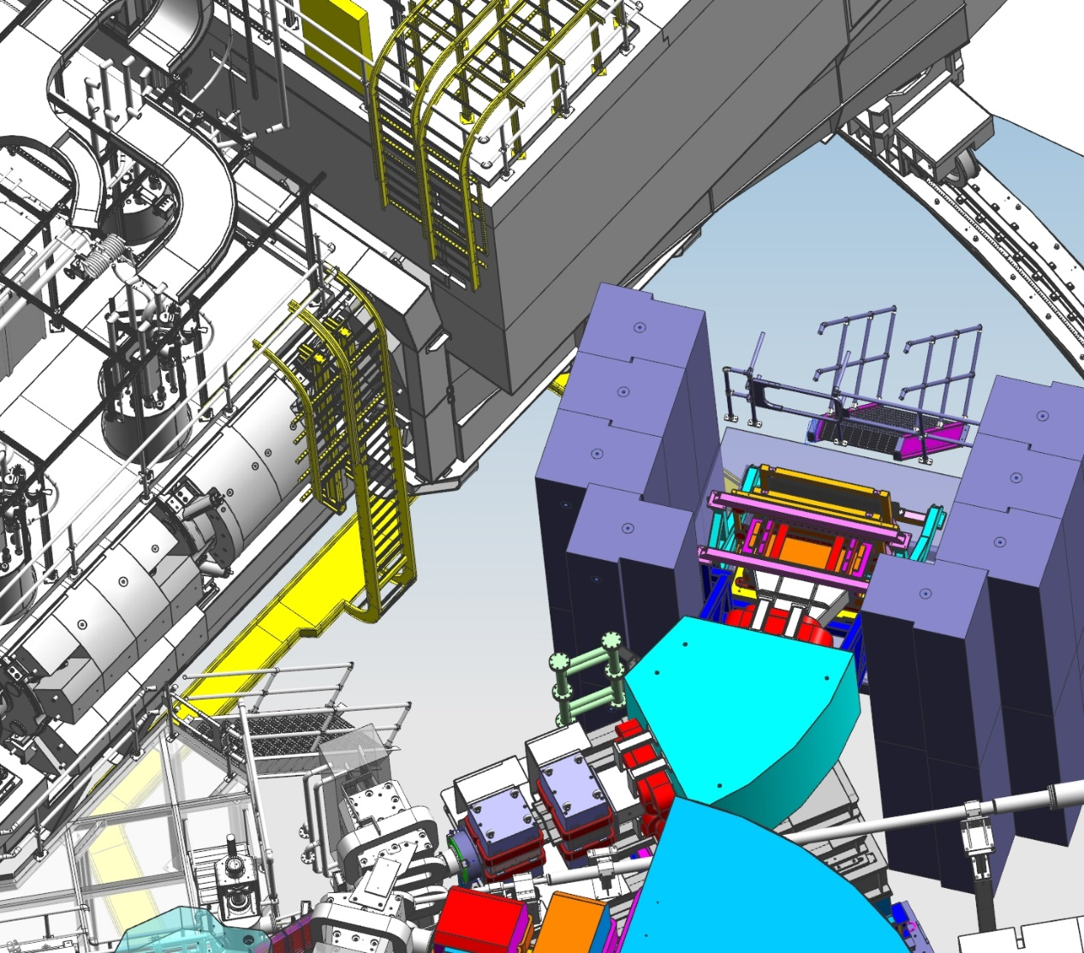
HYPER NUCLEAR – CABLE ROUTING
CABLE TRAY LAYOUT FROM SUPER HMS(YELLOW)

Slide 7
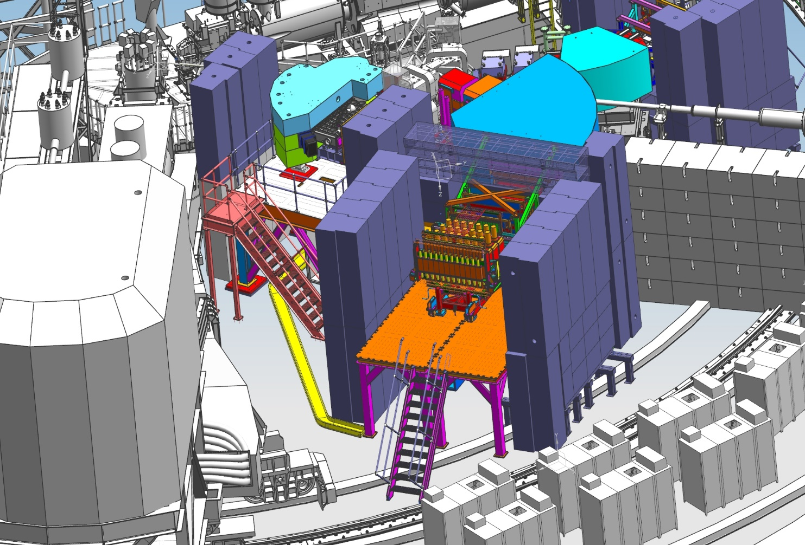
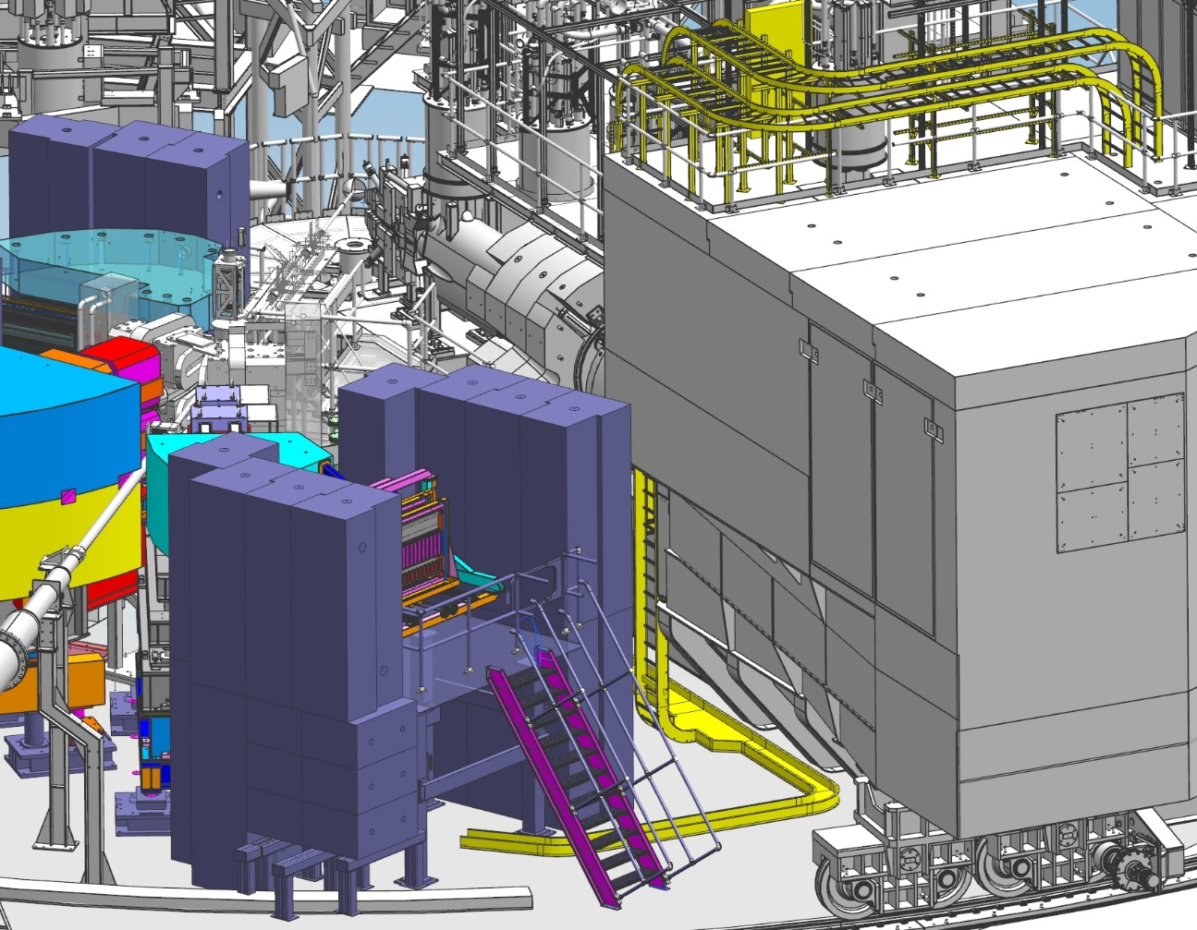
HYPER NUCLEAR – CABLE ROUTING
HKS
HES
CABLE TRAY LAYOUT FROM SUPER HMS(YELLOW)

Slide 8
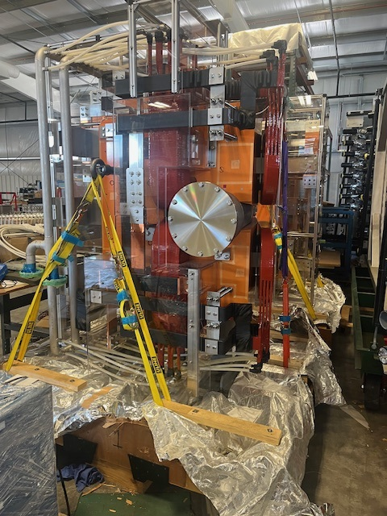
PCS MAGNETS
SURVEY MONUMENTS INSTALLED
MOUNTING INTERFACE CONFIRMED

Slide 9
HYPER NUCLEAR – POWER SUPPLY UNITS PROCUREMENT
Magnet | Current (with overhead for MOL) (A) | Voltage (V) | Magnet DC Power kW | Magnet LCW (L/min) | Inductance (H) | Magnet LCW pressure (MPa) | Magnet resistance (not including leads) | PSU – New or existing | PSU Water Flow (L/min) 0.6LPM/kW | PSU DC Power (kW) | Regulation (PPM)
HES E Dipole | 1,000 | 220 | 220 | 95 | 0.820 | 0.5 | 0.181/pole | Existing HES PSU | 45 | 220
HES E Q1 | 800 | 110 | 88 | 41 | 0.054 | 0.5 | 0.111 | Existing BB | 28 | 90
HES E Q2 | 800 | 110 | 88 | 41.4 | 0.056 | 0.5 | 0.109 | Left Q1 Hall A | 48 | 90
HKS Dipole | 1,140 | 165 | 188 | 135.1 | 1.95 | 0.67 | 0.145 | Existing HKS PSU | 45 | 190
HKS Q1 | 875 | 160 | 140 | 49.6 | No data Use HKS Q2 | 0.36 | 0.181 | Existing Compton PSU | 43 | 140
PCS (k) | 1,700 | 106 | 180 | 100 | 2.0 (from vendor report) | 0.16 | 0.06 | Existing SBB | 50 | 186 | 10
PCS (k) corr | 1,000 | 97 | 97 | 100 | 2.0 (from vendor report) | 0.16 | 0.01 | Existing NPS PSU | 32 | 97 | 10
Corrector magnet | 150A |  |  | Air cooled |  | NA |  | Existing (NPS) | NA

Slide 10
HYPER NUCLEAR – POWER SUPPLY UNITS PROCUREMENT
Magnet | Current (with overhead for MOL) (A) | Voltage (V) | Magnet DC Power kW | Magnet LCW (L/min) | Inductance (H) | Magnet LCW pressure (MPa) | Magnet resistance (not including leads) | PSU – New or existing | PSU Water Flow (L/min) 0.6LPM/kW | PSU DC Power (kW) | Regulation (PPM)
PCS (e’) | 1,800 | 130 | 180 | 100 | 2.0 (from vendor report) | 100 | 0.06 | PR 441768 ON HOLD | 112 | 186 | 10
PCS(e’) corr | 1,100 | 120 | 97 | 100 | 2.0 (from vendor report) | 100 | 0.1 | PR 441768 ON HOLD | 58 | 97 | 10
HKS Q2 | 500 | 60 | 28 | 17.3 | 0.36 | 0.38 | 0.119 | PR 441768 ON HOLD | 15 | 25 | 10
ENGE | 331 | 50 | 100 | 50 | 1.59 | 1.0 |  | IN PROCESS | 11 | 17 | 10
Sub Totals (both sheets) |  |  | 1,406 | 829.4 |  |  |  |  | 487 128 GPM | 1,338
WAITING FOR BUDGET OFFICE APPROVAL(All other signatures obtained)*

Slide 11
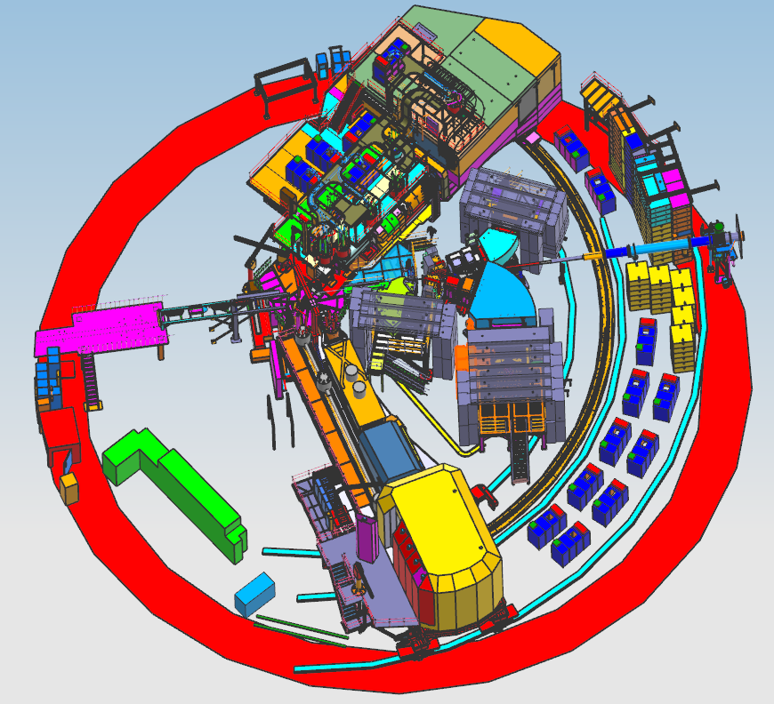
HYPER NUCLEAR – PSU/LCW LOCATION
PSU LOCATION
(BLUE)
LCW FROM HMS SIDE OF HALL

Slide 12
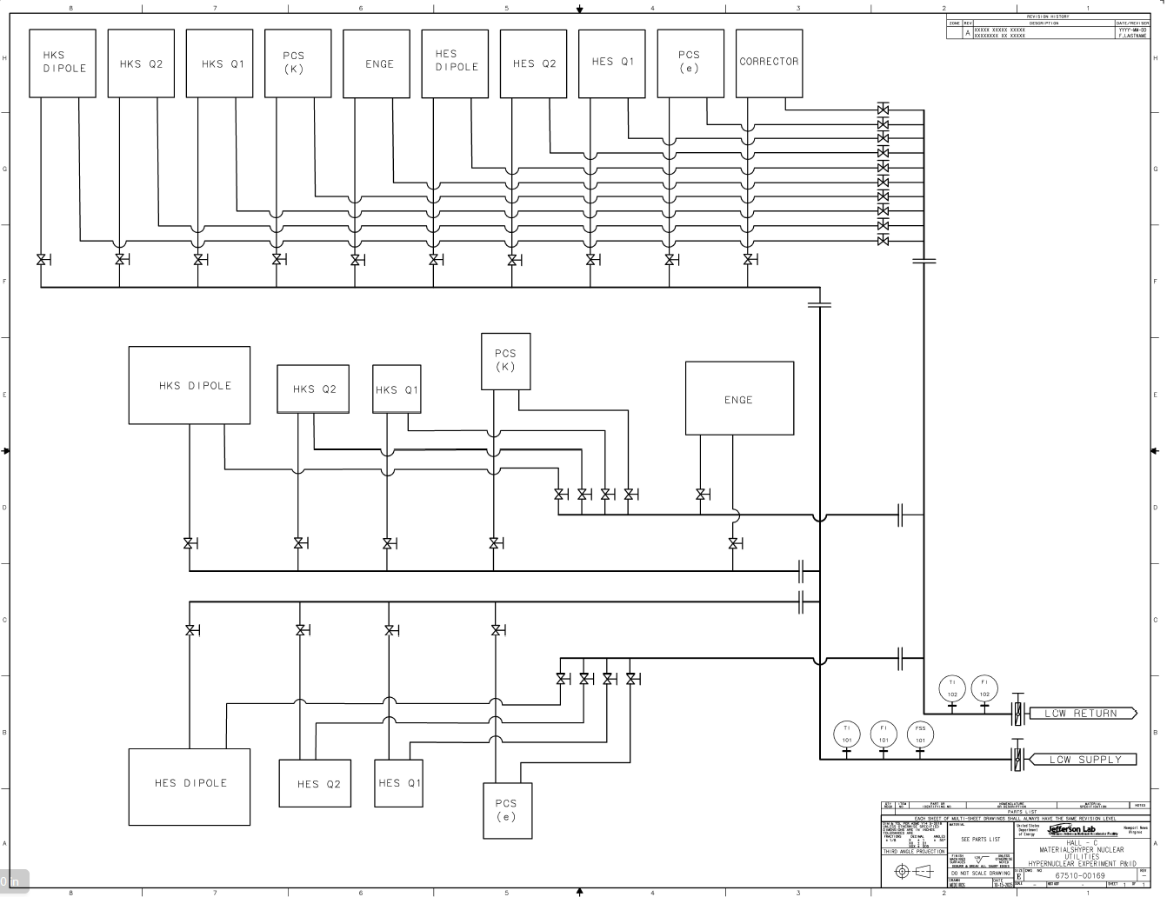
PRELIMINARY LCW SCHEMATIC

Slide 13
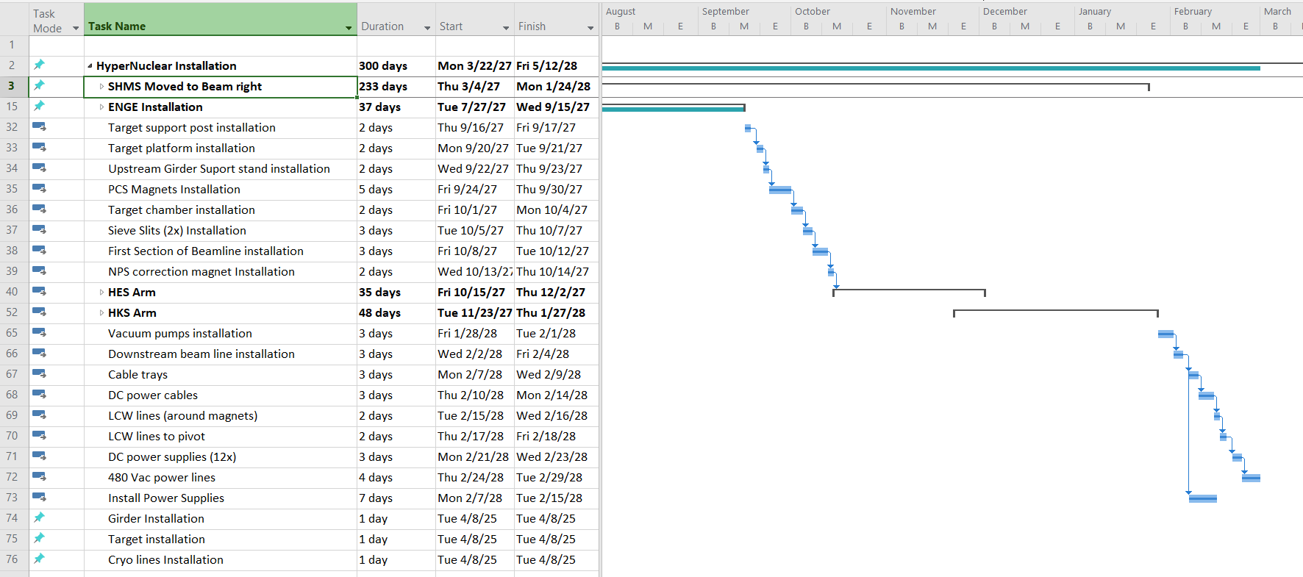
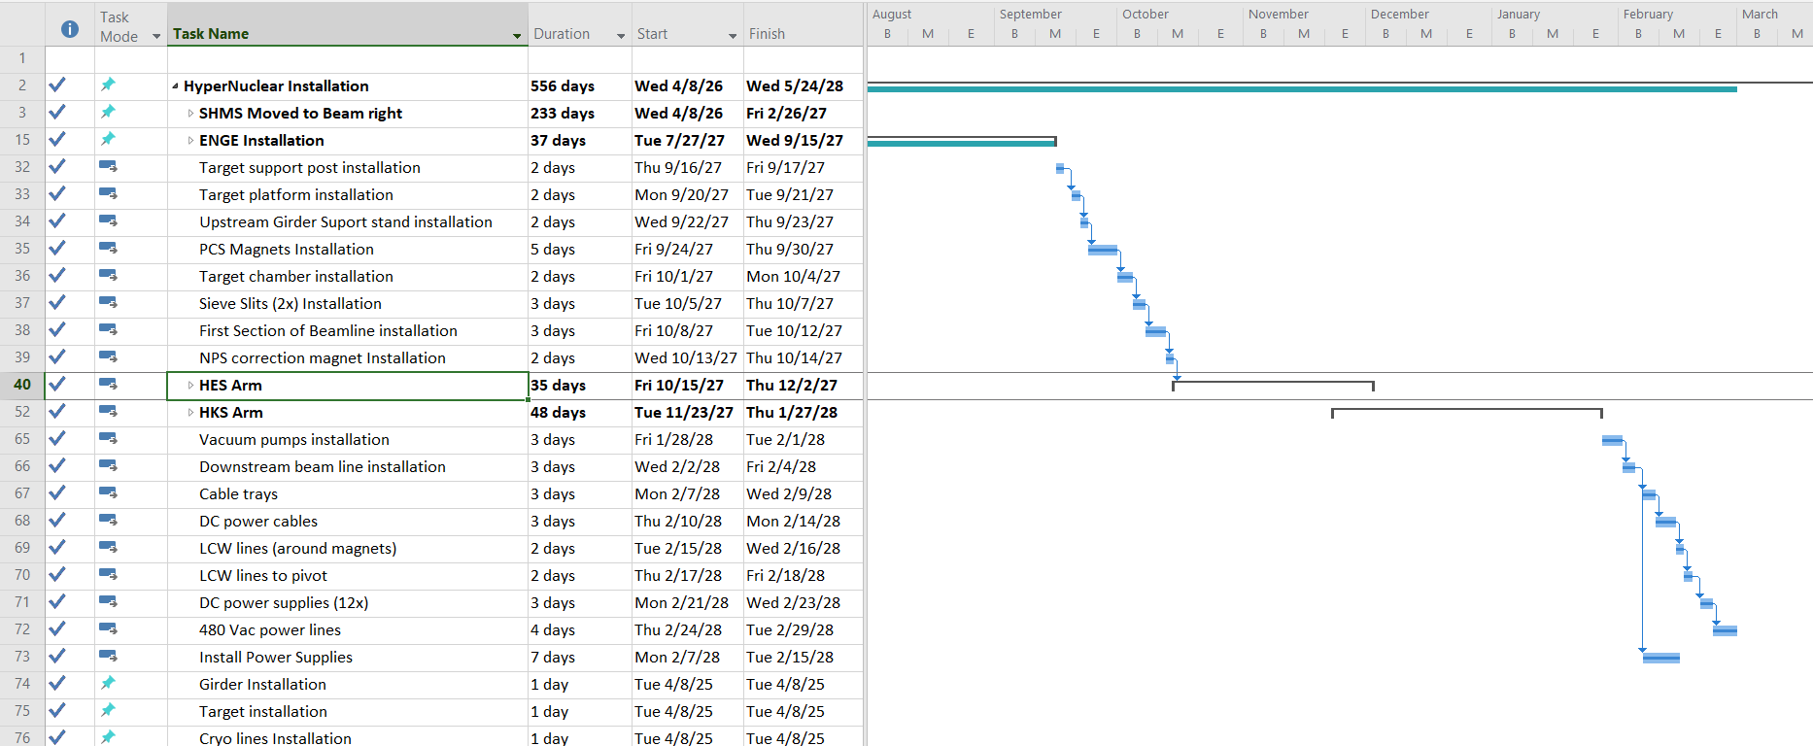
HYPER NUCLEAR – SCHEDULE

Slide 14
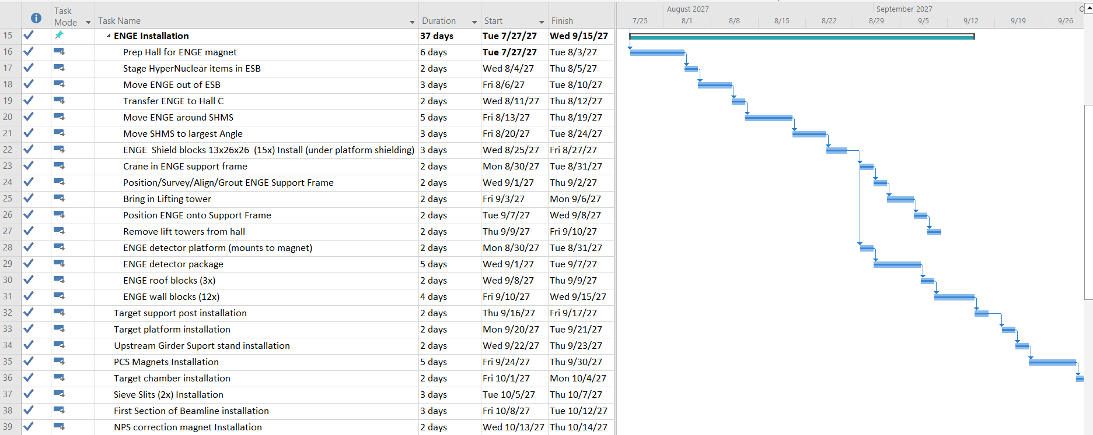
HYPER NUCLEAR – SCHEDULE

Slide 15
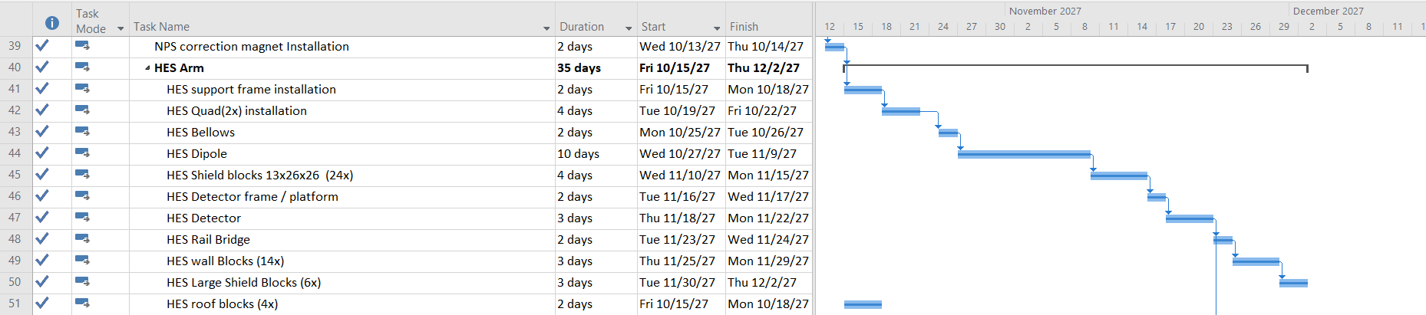
HYPER NUCLEAR – SCHEDULE

Slide 16
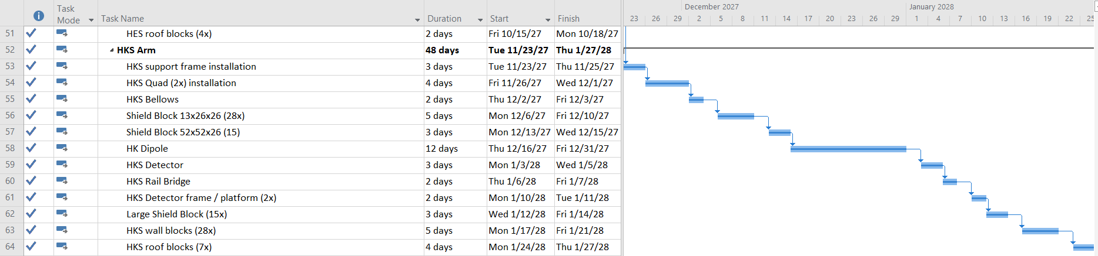
HYPER NUCLEAR – SCHEDULE

Slide 17
FUTURE TASKS
TIMELINE TO CHECKOUT EXISTING POWER SUPPLIES
TESTING OF PCS MAGNETS
VACUUM BEAMLINE
ASSEMBLY PROCEDURES AND PTW GENERATION
MANPOWER EXPECTATIONS
DESIGNER on loan from Hall A

