Slide 1

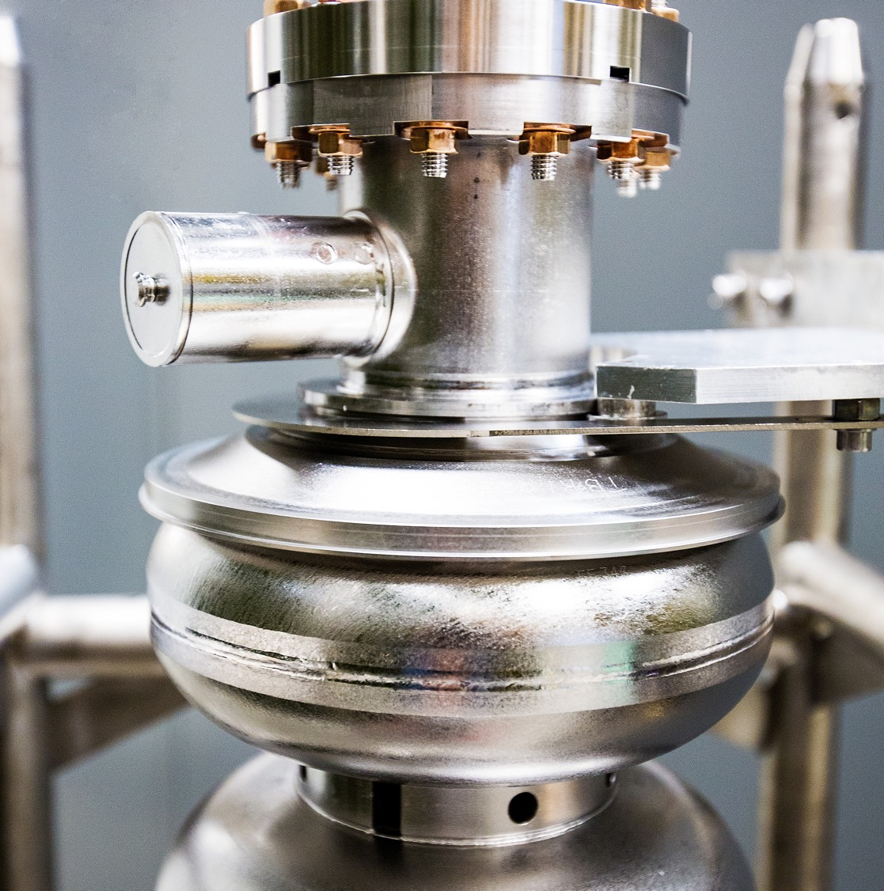
ES&H Essentials for
Safe Operations
2025 Pre-SAM Safety Briefing
September 2, 2025
Paul Gubanc
Notes:
Tip: Keep titles under 60 characters for readability
To change the photo: Right-click on photo and select change photo

Slide 2
Topics
Historical Context
LOTO & Exposed Magnet leads
ODH reminders
ePAS contract extension and after-hours support
Radiological concerns
Injury reporting and Occupational Medicine support
Working on accelerator Credited Controls
Q&A
Notes:
Guidelines: 6-8 bullets per slide; Use sentence fragments for bullets
To change the photo: Right-click on photo and select change photo

Slide 3

Historical Context
May 2023 Safety Pause – triggered by electrical safety concerns
May 2024 Safety Pause – triggered by Pre-Job and LOTO observations
February 2025 - last LOTO-related ORPS event
  while working in a tight space, an employee experienced an electrical shock from a 120v heater that had been left on to prevent ice buildup on the equipment.
May 2025 Safety Culture review – improvement noted. No major safety findings.
Annual LOTO proficiency evaluations – started June 2025, running thru Jan 2026
Last week, we had two RadCon-related events
We’ve been on an improving path. Let’s finish 2025 strong!
Notes:
Guidelines: 6-8 bullets per slide; Use sentence fragments for bullets
To change the photo: Right-click on photo and select change photo

Slide 4
LOTO Evaluation Schedule Adjustment
Annual LOTO evaluations (EVL-001)
started June 2025
71 people complete
  Successful evaluations
Opportunities
  Evaluation process lessons learned/improvements
  Work towards EVL-001 exemption for those only performing
  ADMIN or cord/plug LOTO
Remaining evaluations balanced through January 2026
MM/YY | # of staff to be evaluated | # of evaluations | Groups
09/25 | 8 | 2 | SRFOPS, MSSURV
10/25 | 12 | 4 | MSHOP, PERFAS, PHALD, PEIC
11/25 | 8 | 3 | FMENG, FMO, PHALA
12/25 | 46 | 3 | MSSURV, ACCCIS, SRFOPS, ACCCIS, AESDCP
01/26 | 18 | 3 | MSCRYO, FMO
Notes:
Guidelines: 6-8 bullets per slide; Use sentence fragments for bullets
To change the photo: Right-click on photo and select change photo

Slide 5
Exposed Magnet Leads
Current condition:
Consistent with CEBAF Tunnel training,
large dipole magnets with exposed terminations are de-energized when the tunnel is in an access state (restricted or controlled access)
Consistent with current practices,
when working on a magnet that involves contact with exposed terminals, LOTO is required
During the SAM,
complex LOTO is applied to the large dipole magnets
Ideal solution:
Install engineering controls, such as terminal guards, to isolate potential electrical hazard
Apply LOTO before guard removal
Reviews in progress:
Electrical Safety Committee met on this topic and the issue will be evaluated by the Safety Configuration Management Board (SCMB)
Terminal guards are under review (ES&H and Accelerator Division)
Notes:
Guidelines: 6-8 bullets per slide; Use sentence fragments for bullets
To change the photo: Right-click on photo and select change photo

Slide 6
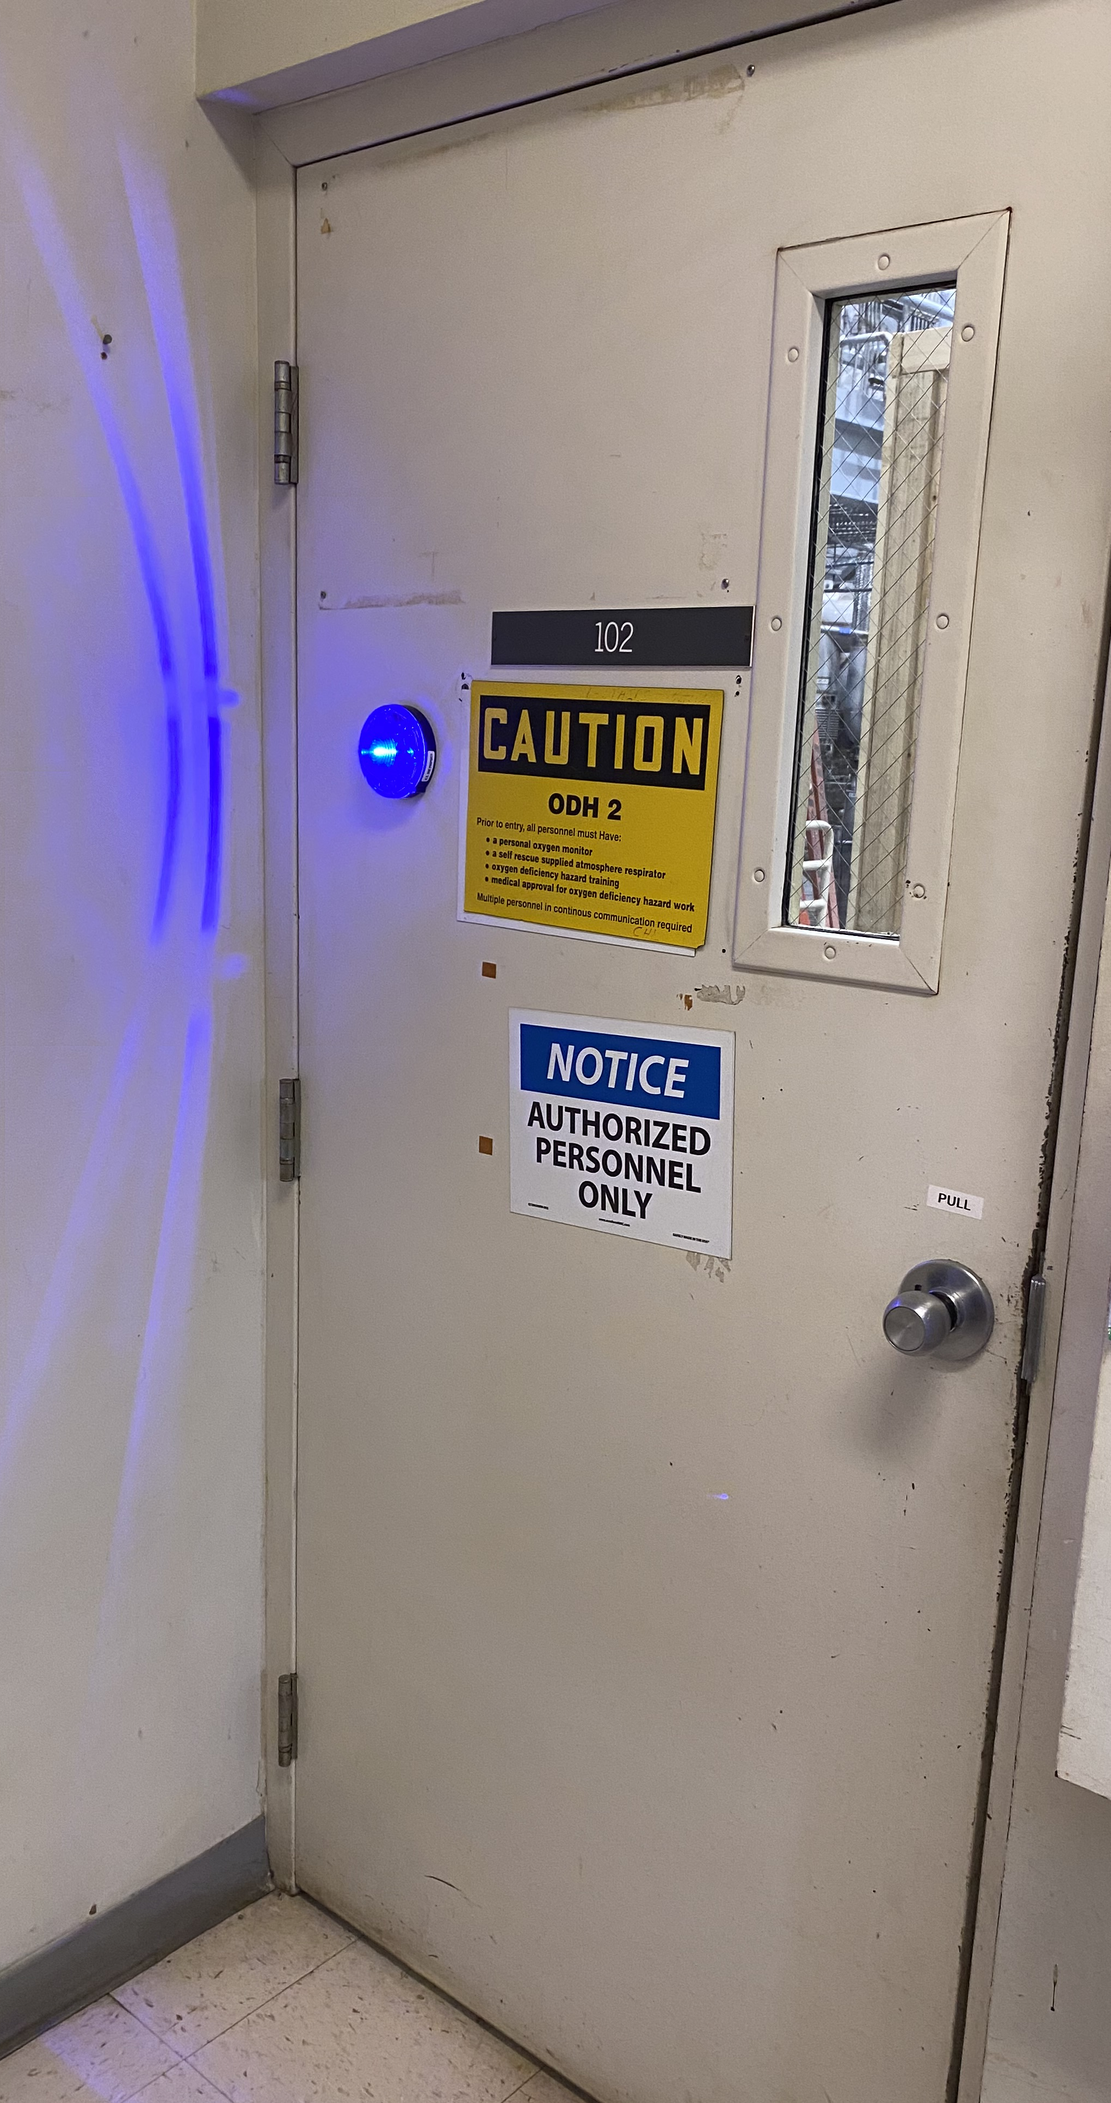
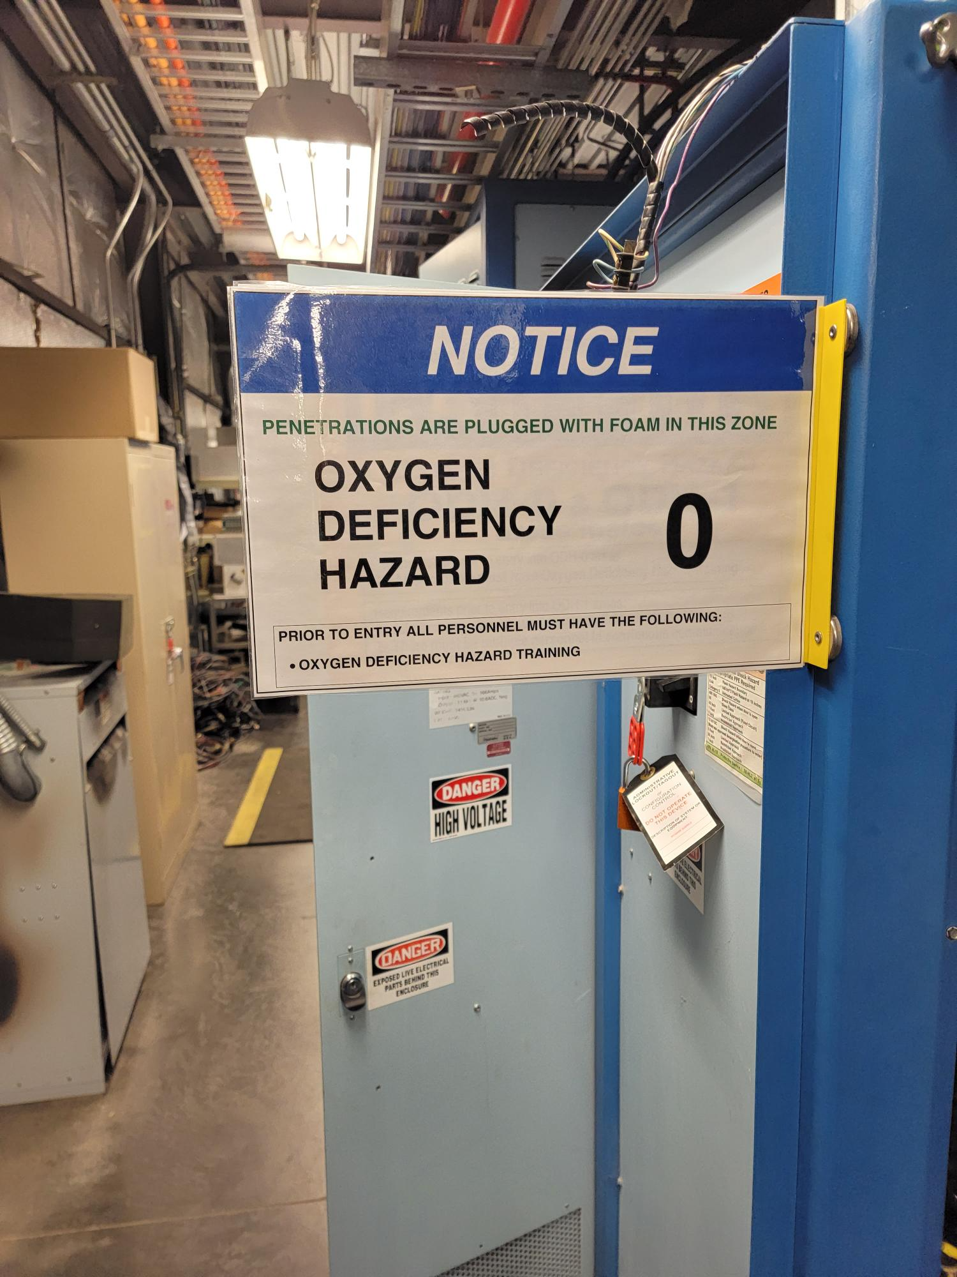
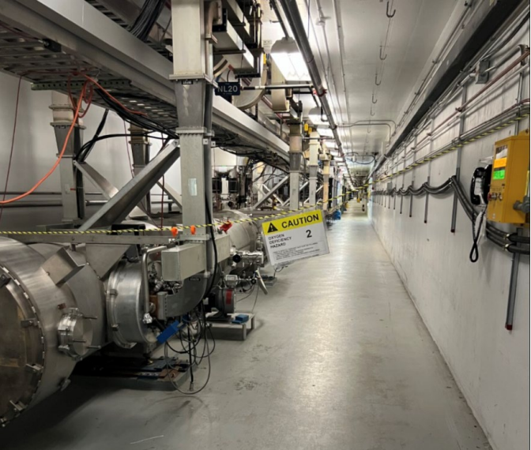
ODH Reminders
SAM activities resulting in temporary reclassification:
  Open penetrations in North/South Linacs
  Maintenance of oxygen monitoring units
(if backup not in-place)
  Manipulating RT Valves
Activities have a work control document, authorizes reclassification
System Owner/Group changing the condition is responsible for the ODH posting
  notify impacted workers
  draw attention to the posting change
Notes:
Guidelines: 6-8 bullets per slide; Use sentence fragments for bullets
To change the photo: Right-click on photo and select change photo

Slide 7
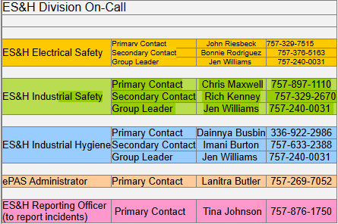
ePAS System Update
Prometheus (ePAS) Contract Extension
Extension is currently underway
ePAS v4 improvement of work categories
ePAS v5 will not be implemented during the SAM period
ePAS Support Availability
Support provided during daytime and after hours
Notes:
Guidelines: 6-8 bullets per slide; Use sentence fragments for bullets
To change the photo: Right-click on photo and select change photo

Slide 8
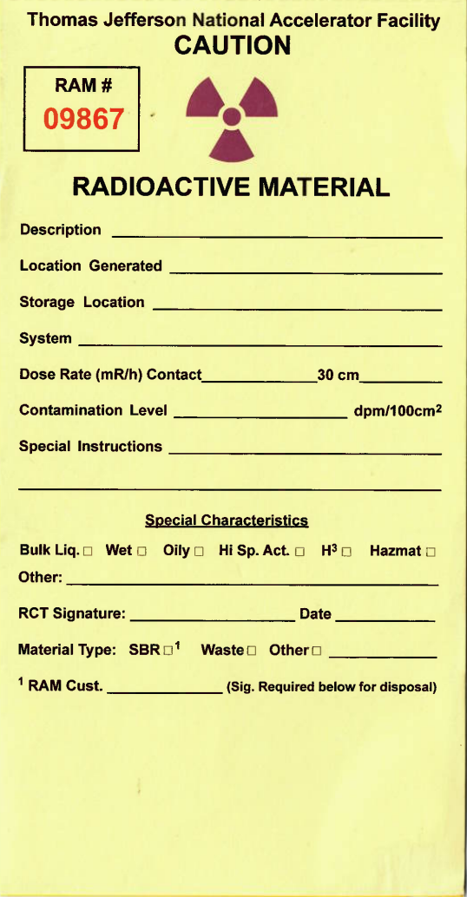
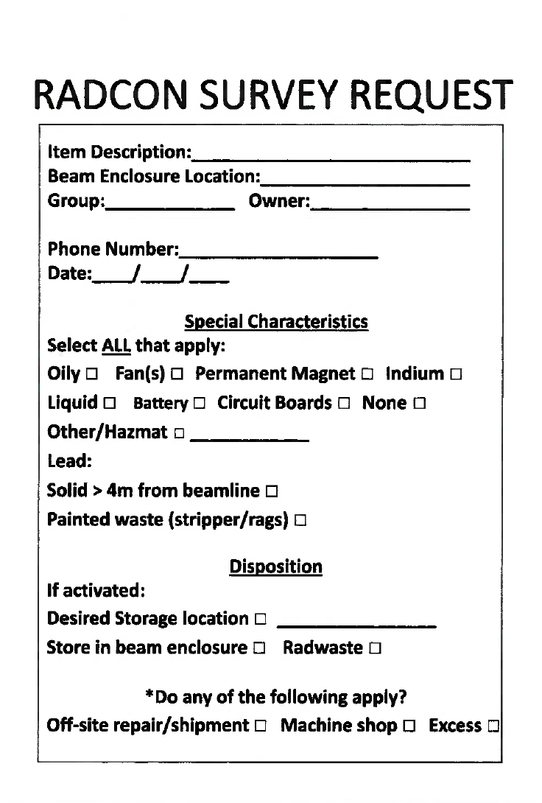

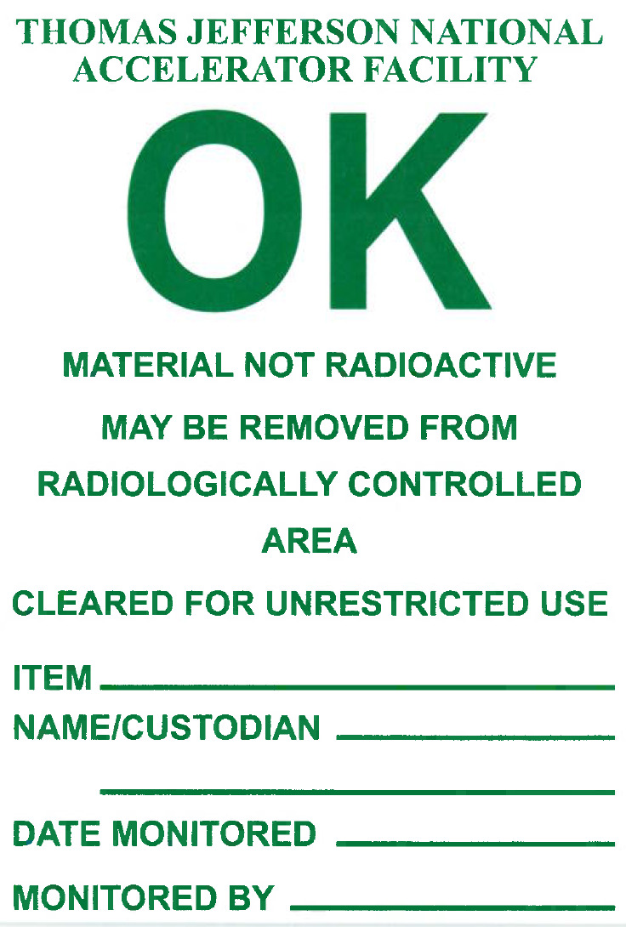
Bringing material outside of the accelerator
Activated
Material requires RCD Authorization for movement
?
Material present during beam/RF operations within:
CEBAF (includes Halls)
LERF
Released
Material removed from the enclosure and tag shall be removed
Completely fill tag and place item on survey rack

Slide 9
RAM Workflow
Request RCD approval
RCD Authorization Granted
Perform work
Verification
Disassemble*
Machining
Moving
* Be mindful of equipment with potential for contamination (e.g. water, filters, equipment racks)

Slide 10
Rad Boundaries
Pay Attention
&
DO NOT RELOCATE

Slide 11
Injury Assessment Action Plan FY25Q3
Hand and Finger Injuries - 42% (10 out of 24) Minor Abrasions, Lacerations and Burns
  Use gloves when appropriate
Strains and Sprains - 29% (7 out of 24) Overexertion, poor ergonomics
  Get assistance with heavy loads (over 40 lbs)
  Maintain proper lifting form
  Avoid awkward postures/positions
Slips, trips and falls - 21% (5 out of 24) Walking surfaces (poor housekeeping)
  Keep workspace surfaces clean
  Notify Facilities of any issues with walking surfaces

Slide 12
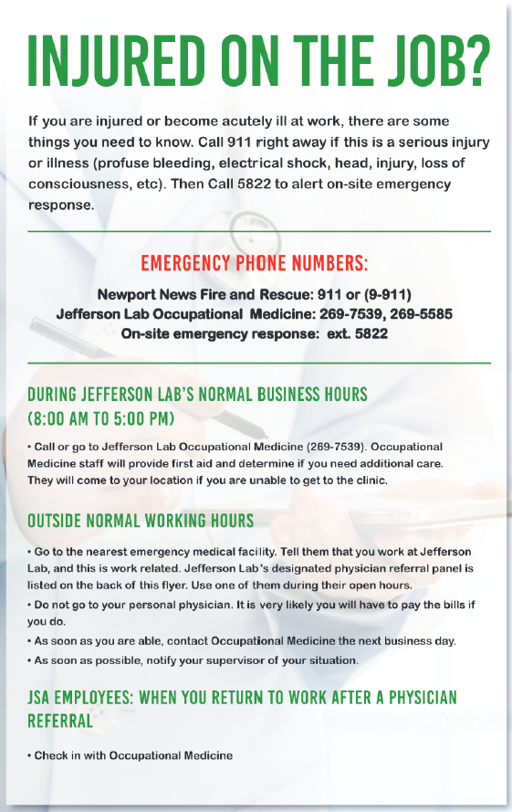
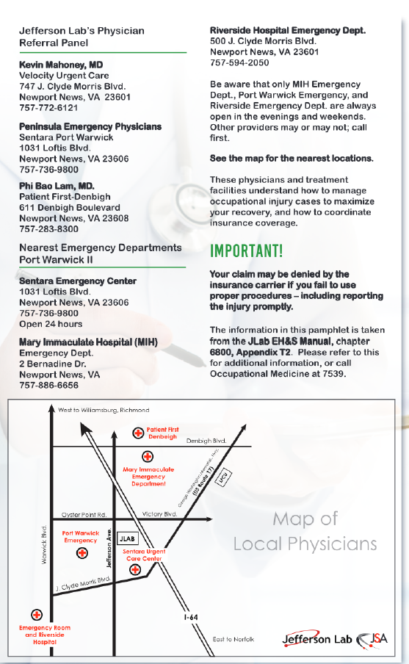
Reporting Injuries
During Business Hours (8am-5pm)
  Report to Occupational Medicine
    757-269-7539
    SSC Rm 28
Outside business hours
  Check flyer in first aid box for locations
  Go to nearest emergency facility as noted on flyer (designated physician panel); tell them you work at Jlab and work related.
  Do not go to personal physician!
  Report to Occupational medicine the next business day
  Notify Supervisor)
If critical (major trauma, unable to mobilize) – call 911 (will go through Guards)
  Contact Occupational Medicine

Slide 13
Credited Controls
During the SAM, conditions will be changing – read all postings and signs carefully.
There will be work on systems which interface with the Plant Safety System (PSS) and other Credited Controls (e.g., shielding, ODH controls).
  If you plan to work on systems or components that have Credited Control labels, contact the System Owner using the information on the Credited Control label
If you are not sure about what you are dealing with, stop, contact your supervisor or your Division Safety Officer (DSO) before proceeding

Slide 14
What is a Credited Control?
CCs have responsible parties that manage their configuration and operability
PSS Components are labeled with
yellow stickers
Note that on the next slide, the door in the picture AND its interlock hardware COMBINED are the Credited Control
You must be authorized to work in or around (or on) CCs
For example, if you remove the door without obtaining Safety Systems Group (SSG, Jerry Kowal manager) permission EVEN IF YOU DON’T MODIFY THE PSS Interlock Sensors, it is still an UNAUTHORIZED modification to the Credited Control
If you see something that looks amiss, contact the SSG

Slide 15
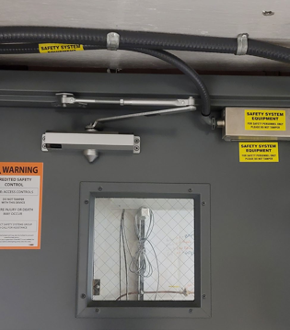
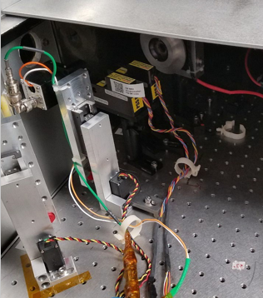
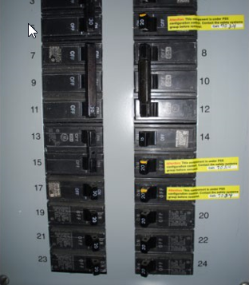
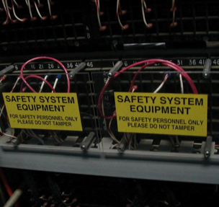
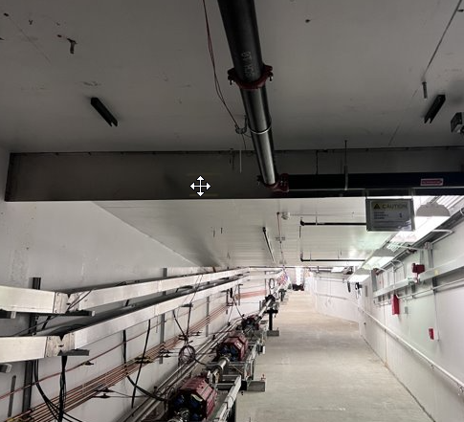
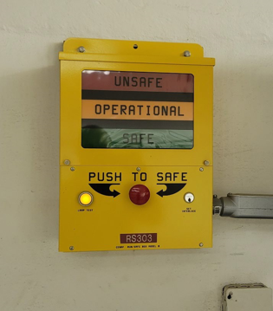
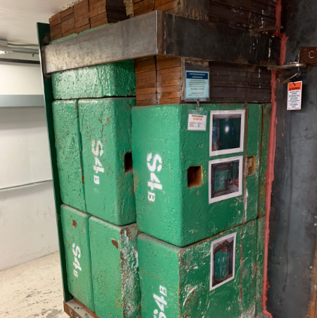
How do I recognize Credited Controls?

Slide 16
QUESTIONS?
Thank you for your time & attention!

