Slide 1
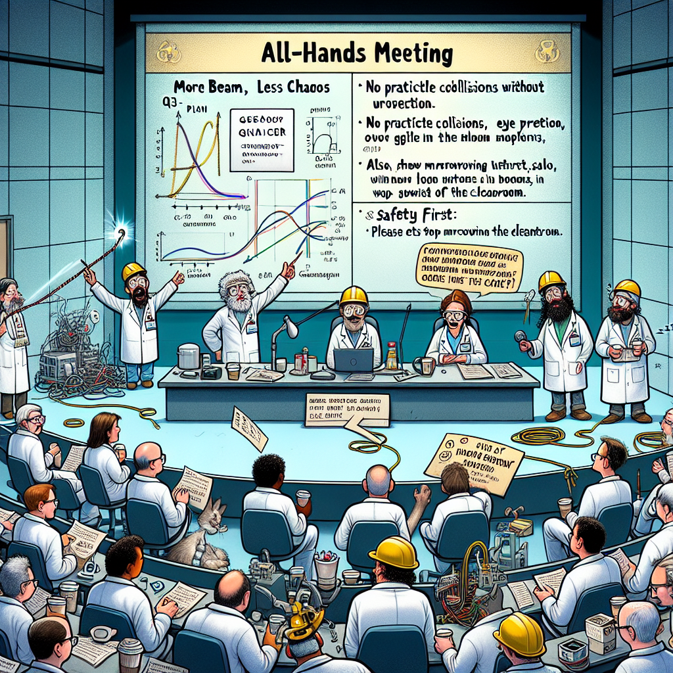
Accelerator Overview
SAM Safety kick-off
S. Frierson
CEBAF Operability Leader

Slide 2
The Goal – Spring ‘26 run
Start: 23-Feb (NPES)
3 Hall running (xA off)
  Staggered start
  xC to receive up to 80uA
  xD to receive polarized beam
Energy (GeV/pass)
  0.7 (~2.5 mos; special setup)
  2.1 (rest of run)
End: 26-Jul

Slide 3
Accelerator Overview – General Info.
Scheduled Accelerator Maintenance (SAM) period
  Wednesday, September 3rd to Monday, February 23rd 2026
Typical SAM day
  Daily 0800 Planning meeting
    Presided by Program Deputy (volunteered position; 2wks)
    Work planning and coordination
    Broad representation
  Daily group Toolbox meeting
    Talk through day’s plan
    Lead into management discussions/pre-job briefs (PJB)
  Wednesday 1330 SAM update meeting
    Presided by SAM oversight committee
    Work/Project progress updates
    Broad representation

Slide 4
Accelerator Overview – Guidance
Accelerator Operations Directives
  Document on conducting CEBAF maintenance and operation
  Chapters of interest
    CH1: Program Control – Safety guidance
    CH4: Maintenance & Tracking – How to conduct maintenance
Points of contact
  Emergency: 911 or Guard shack (x5822)
  Crew Chief (on-call): 757-630-7050
    MCC not staffed
  Work questions?
    Supervisor
    Shawn Frierson (x7296)
    Daniel Moser (x5028)

Slide 5
Accelerator Overview – Schedule
SAM starts 0700 3-Sept
  PSS lockouts/deactivation
  CHLs warmup (4K)
2L03 C75 upgrade complete: 17-Nov
PSS Certification: 17-Nov
CHL 2K pumpdowns: 1-Dec
System Readiness (HCO): 5-Dec
1L26 C100-03R install complete: 12-Dec
Accelerator 24h lockup: 05-Jan-26
CM/LLRF commissioning complete: 29-Jan
RF recovery complete: 4-Feb
CEBAF beam restoration starts 5-Feb

Slide 6
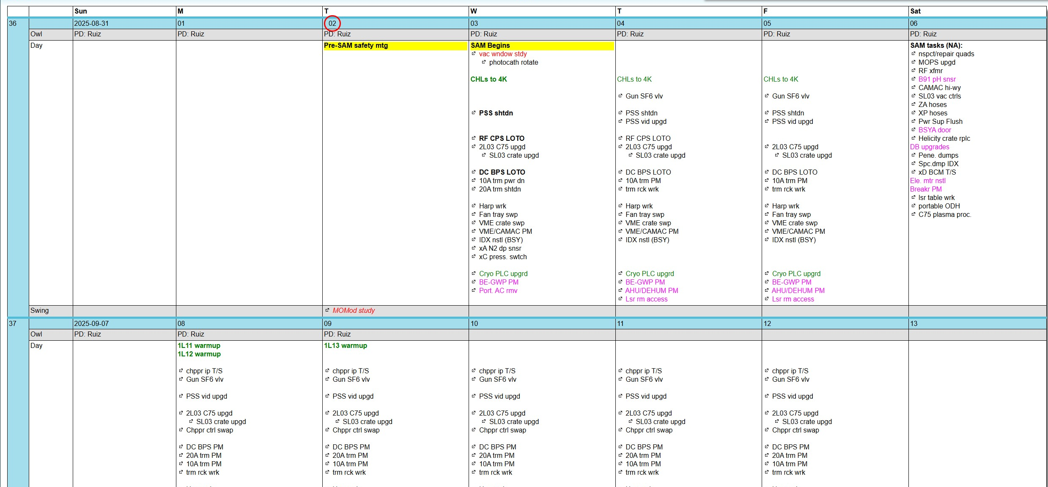
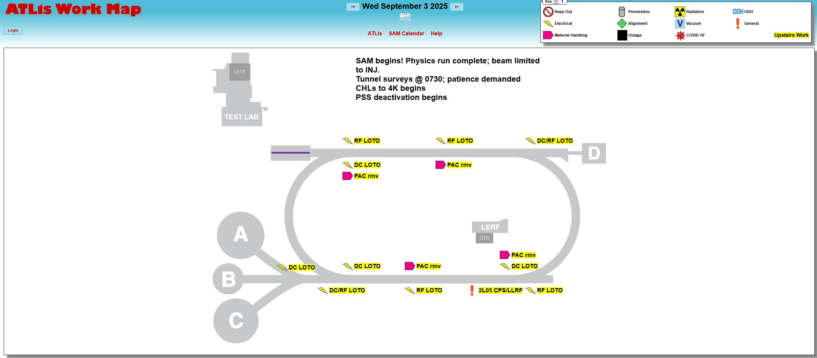
Resource Overview
Daily and weekly meetings
ATLis (tasklists.jlab.org)
  ePAS (jlab.org/esh/epas)
    FAQ (Good for general questions)
SAM Calendar (ace.jlab.org/calendar)
  Shown during daily meeting
  Day to day activities
ATLis Work Map (ace.jlab.org/workmap)
  Informed by calendar
  Announcements/Activities*
    Hazard safety
    Machine protection

Slide 7
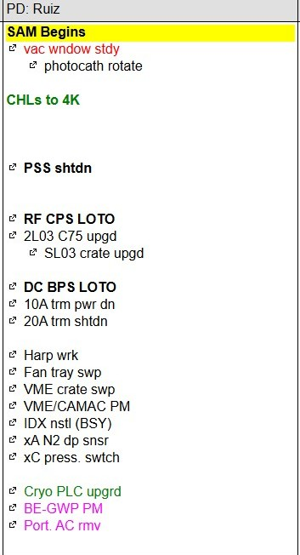
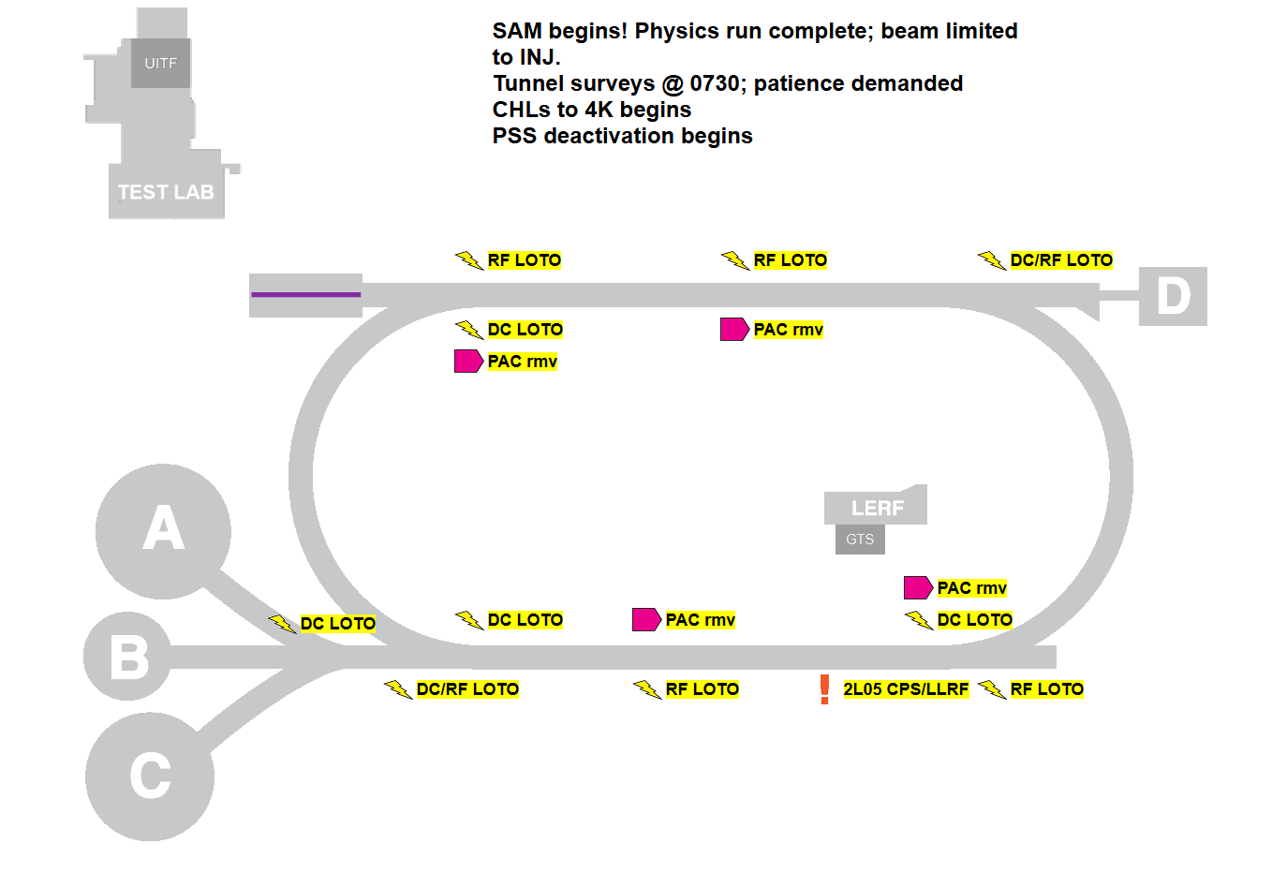
Tomorrow (3-Sept) Overview

Slide 8
QUESTIONS?

