Slide 1

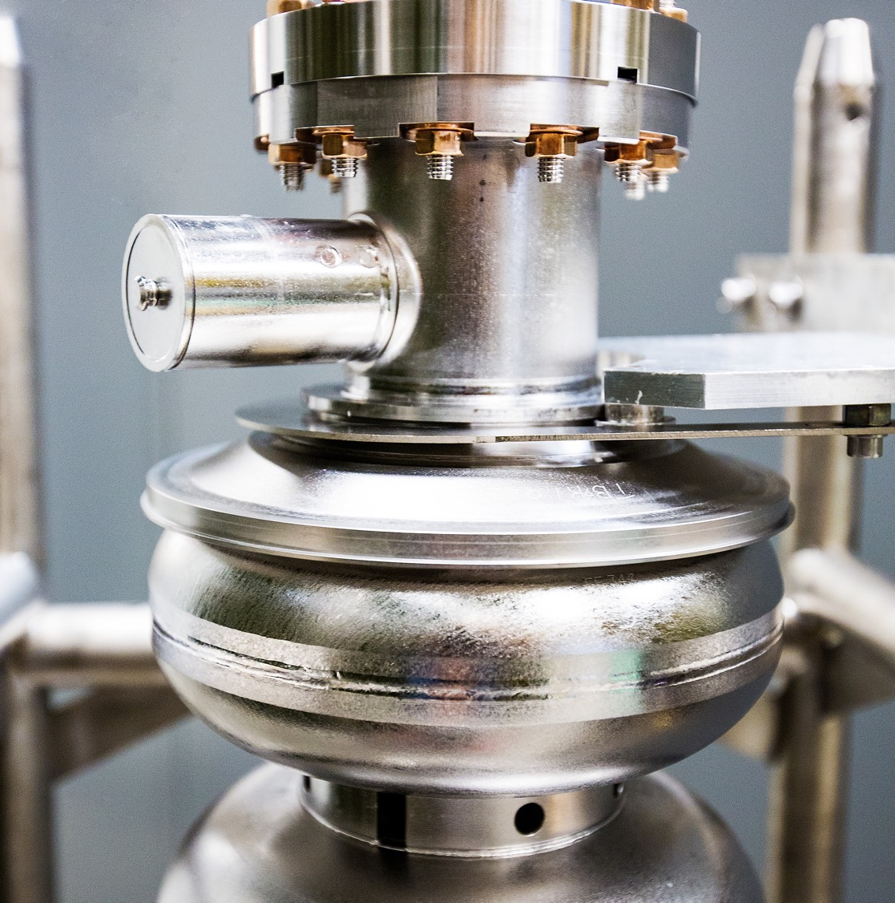
Scheduled Accelerator Maintenance Kick-off Meeting
2 September 2025
Douglas Higinbotham
Notes:
Tip: Keep titles under 60 characters for readability
To change the photo: Right-click on photo and select change photo

Slide 2
Thank you all for an absolutely amazing FY25 CEBAF run!
Energy of 1060 MeV/linac (up from 1047 MeV/linac in FY24 )
Beam Power > 800 kW
Low Number Beam Trips ( < 10 per hour )
This meant we were able to deliver on the experimental program as well as do the beam studies we need for the future program.
Notes:
Use for: Introducing new topics
To change the photo: Right-click on photo and select change photo

Slide 3
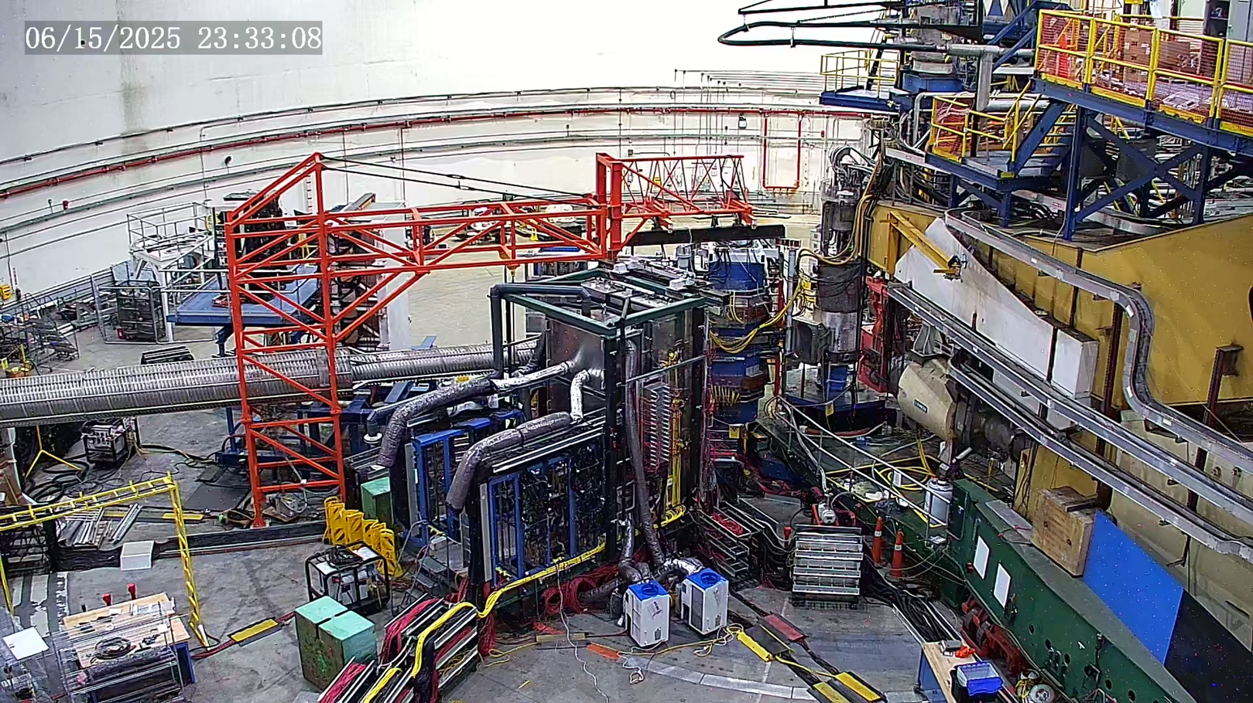
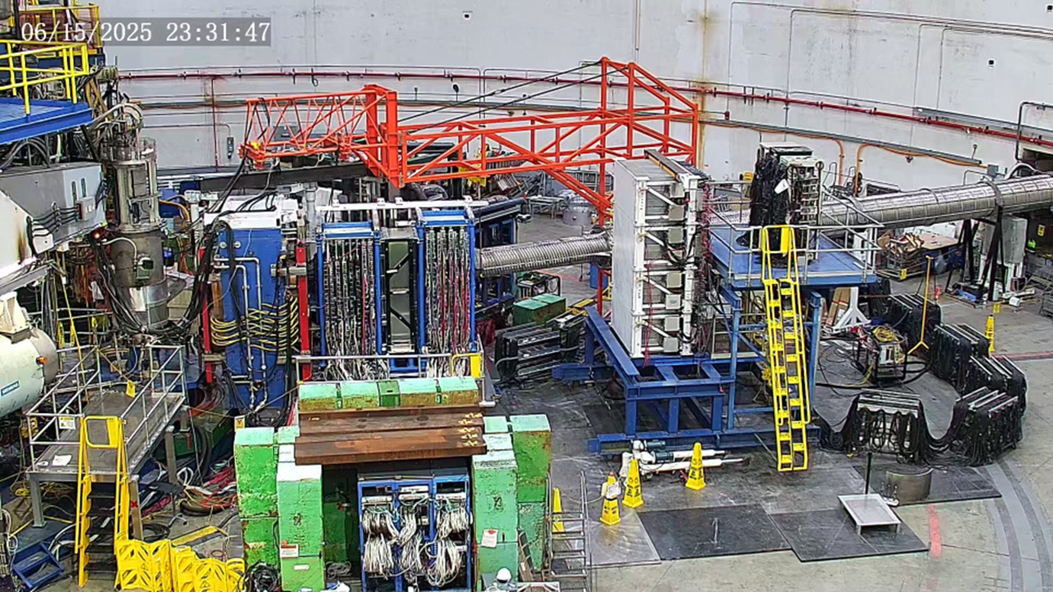
Hall A: Completed GEP-V Experiment
View of electron calorimeter with 1656 blocks
View of 16 GEMs planes of the SBS focal plane polarimeter and hadron calorimeter
De-installation of this equipment began Aug. 25th and in mid-November we will be officially starting MOLLER installation.
Notes:
Guidelines: 6-8 bullets per slide; Use sentence fragments for bullets

Slide 4
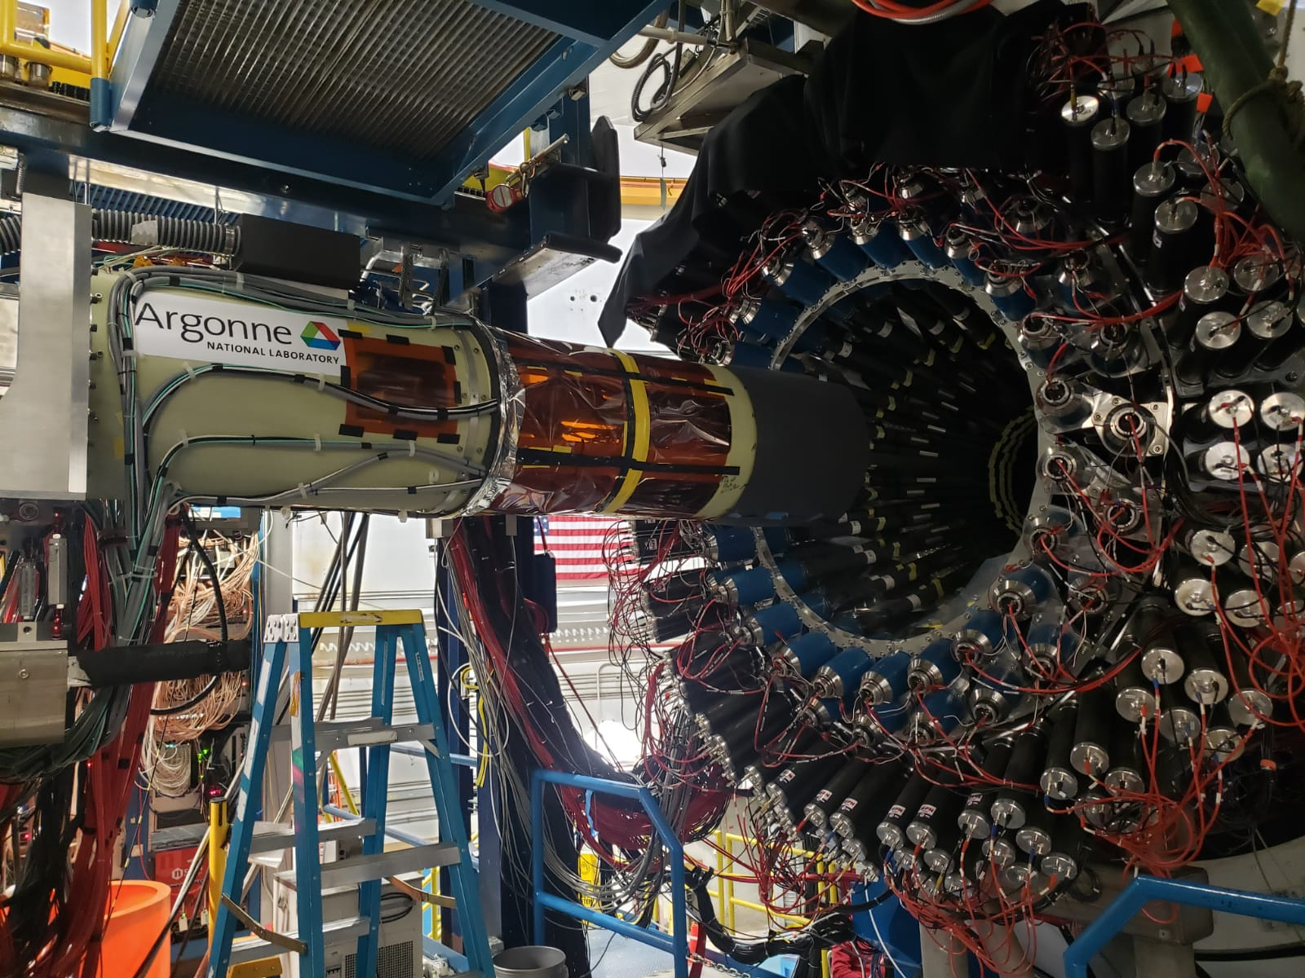
Hall B: Completed ALERT & ALERT-SRC Experiments
Notes:
Guidelines: 6-8 bullets per slide; Use sentence fragments for bullets

Slide 5
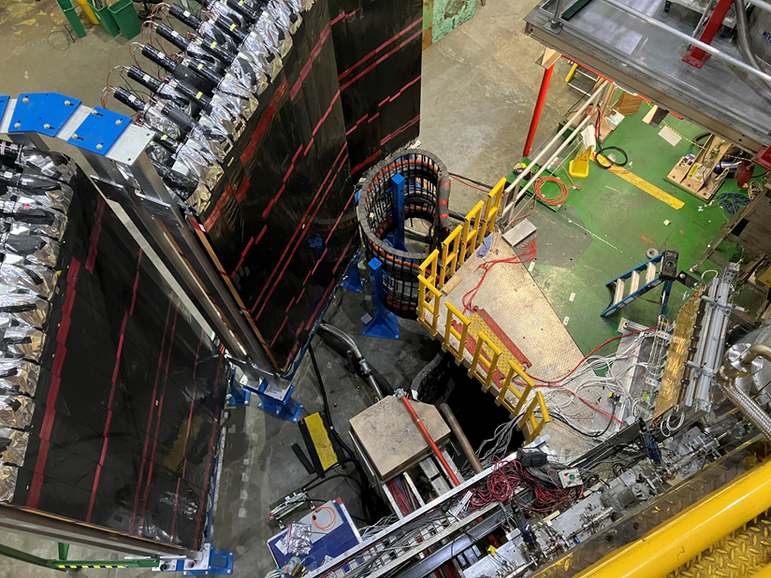
Hall C: Completed LAD Experiment & Started R-SIDIS
LAD planes
GEM
Notes:
Guidelines: 6-8 bullets per slide; Use sentence fragments for bullets

Slide 6
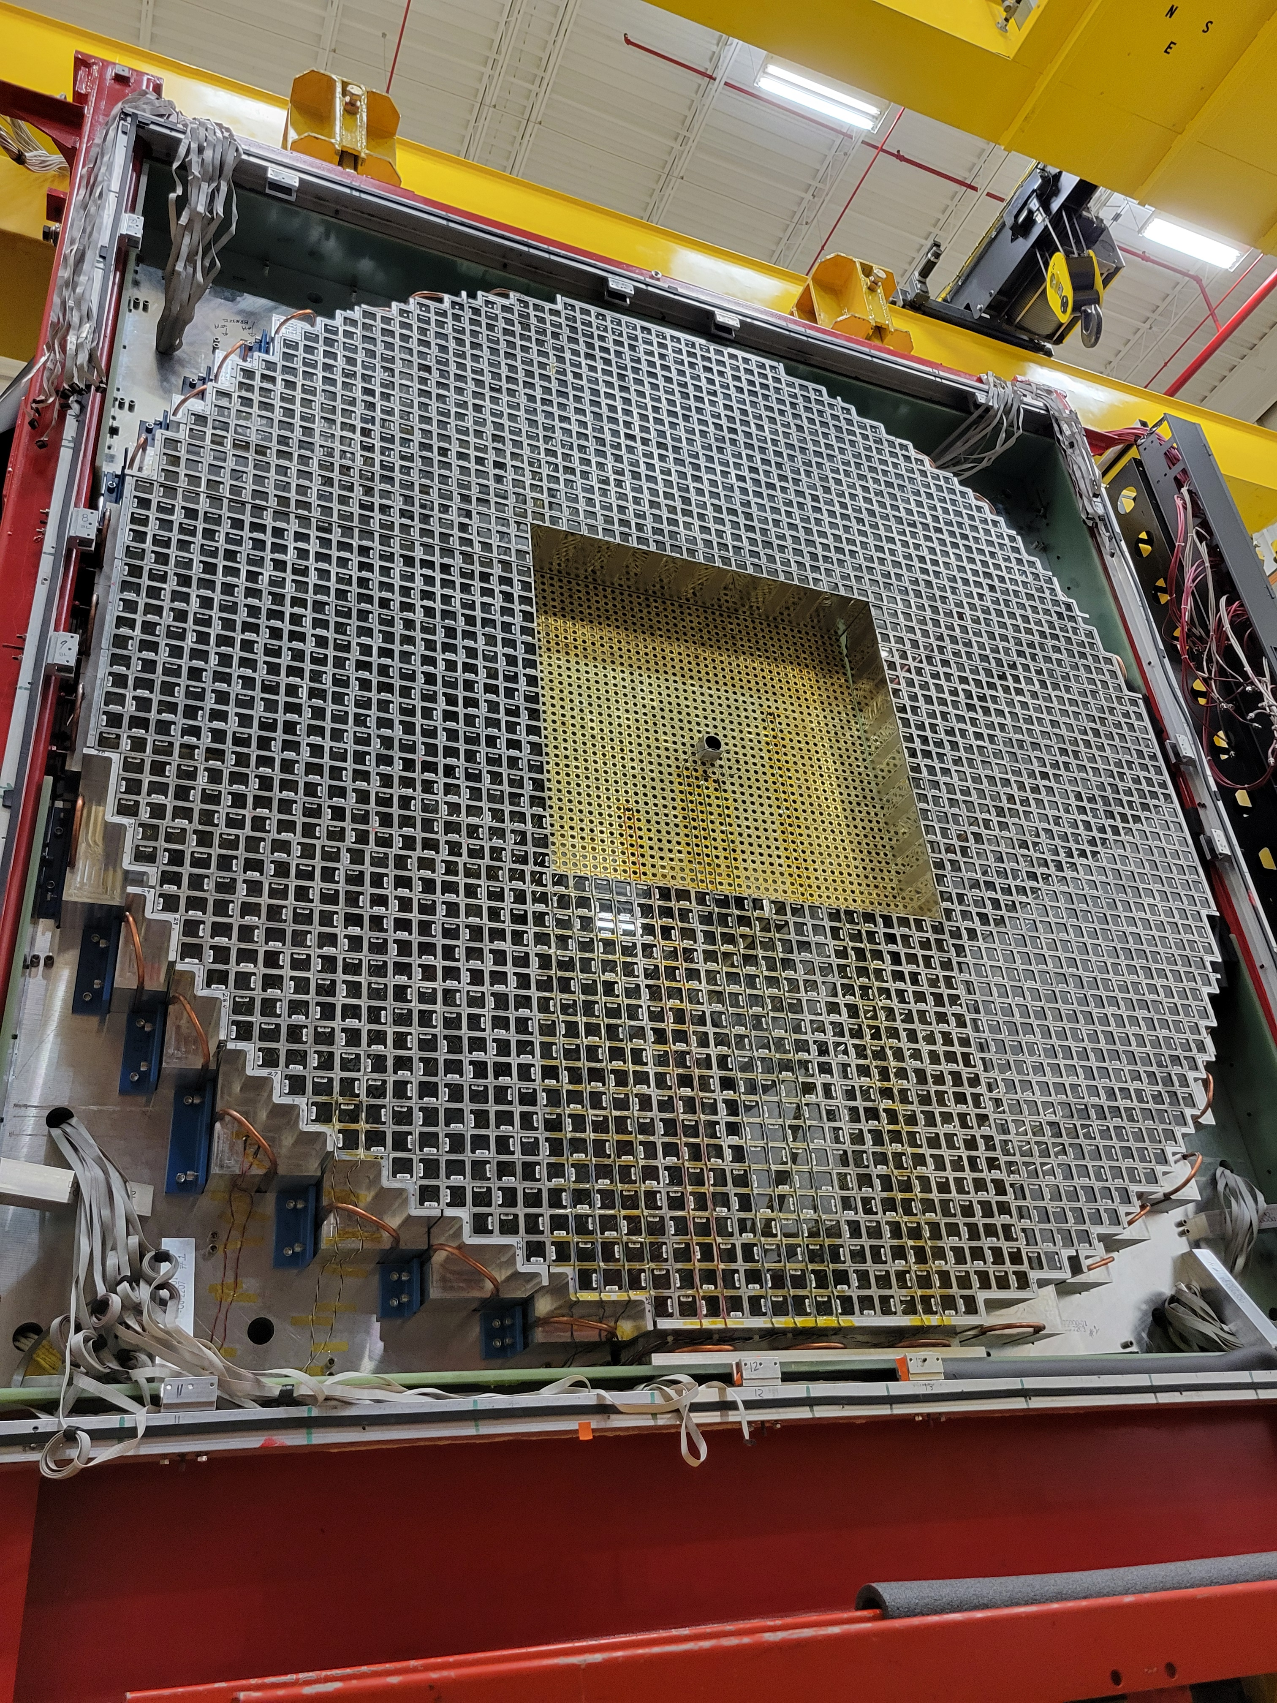
Hall D: Running the GlueX-II & JEF Experiments
Notes:
Guidelines: 6-8 bullets per slide; Use sentence fragments for bullets

Slide 7
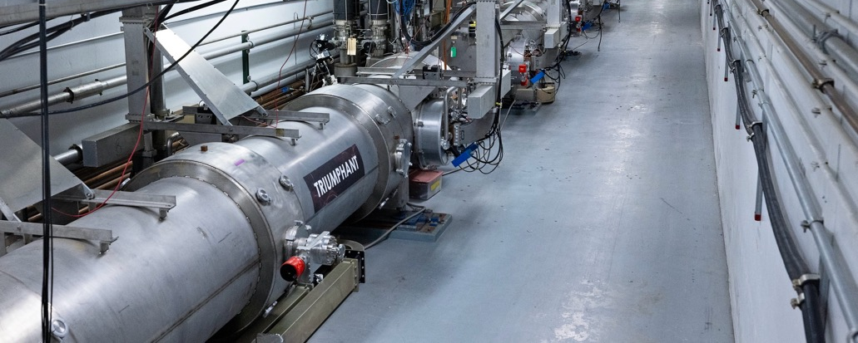
Maintenance days, recovering energy gradient, and those night late & weekend repairs in both the halls and in the accelerator, being done safely, made it possible!
Notes:
Use for: Introducing new topics
To change the photo: Right-click on photo and select change photo

Slide 8
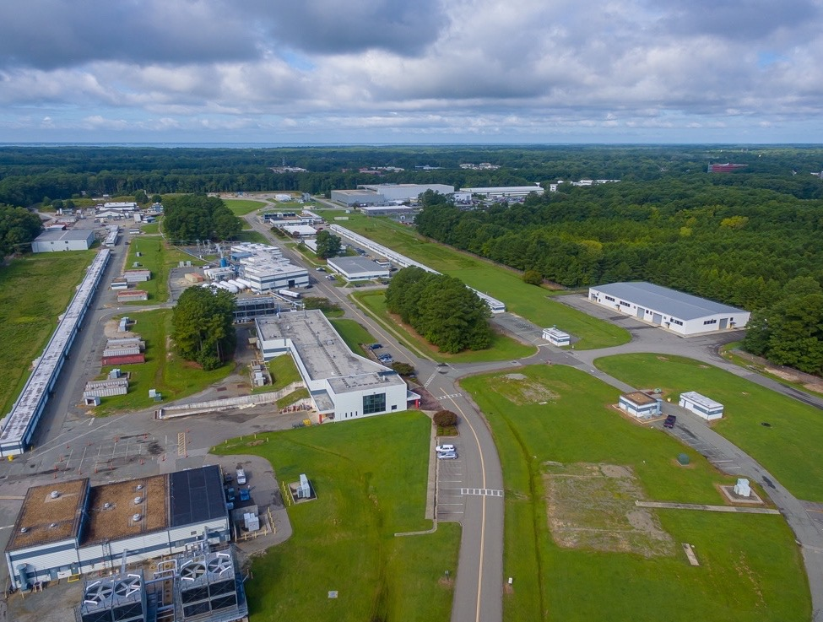
FY26 CEBAF Run Plan
Running Halls B, C and D
Part 1: Special 345 MeV/linac Run
  Hall B PRad-II ( large installation experiment )
  Hall C Low energy Cryo-target experiments
  Hall D special low energy GlueX experiment
Two Weeks To Re-scale the Machine
Part 2: Back to 1060MeV/linac
  Hall B High energy part of PRad-II then X17
  Hall C High energy cryo-target experiments
  Hall D Complete the GlueX-II / JEF experiment
Caption Here
Notes:
Guidelines: 6-8 bullets per slide; Use sentence fragments for bullets
To change the photo: Right-click on photo and select change photo

Slide 9
Major Work Being Done In The Halls
Hall A: remove the Super BigBite spectrometer and start the installation of MOLLER
Hall B: remove ALERT and install the Proton Radius (PRad) target & detector system
Hall C: remove the LAD detector and do preventative maintenance (e.g. breaker boxes)
Hall D: make minor repairs to the detectors and to preventative maintenance
NOTE: For physics division we make each of our experiments go through an experimental readiness review (ERR). Even though that is an administrative process, it is one of CEBAF’s credited controlled and something we take very seriously. It is at the ERR where the scope of work with each experiment’s installation is reviewed. Can be as simple as reviewing documentations for a standard equipment experiment or as complex as a week long review as we just did for the MOLLER experiment.
Notes:
Guidelines: 6-8 bullets per slide; Use sentence fragments for bullets

Slide 10
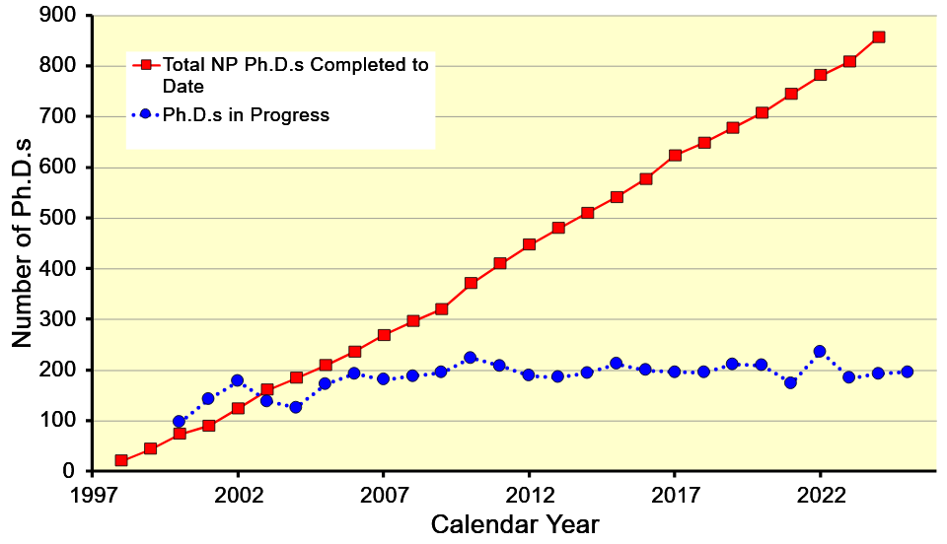
Doctoral Degrees
Total NP Ph.D.’s Completed
Ph.D.’s in Progress
Notes:
Use for: Introducing new topics
To change the photo: Right-click on photo and select change photo

