Slide 1

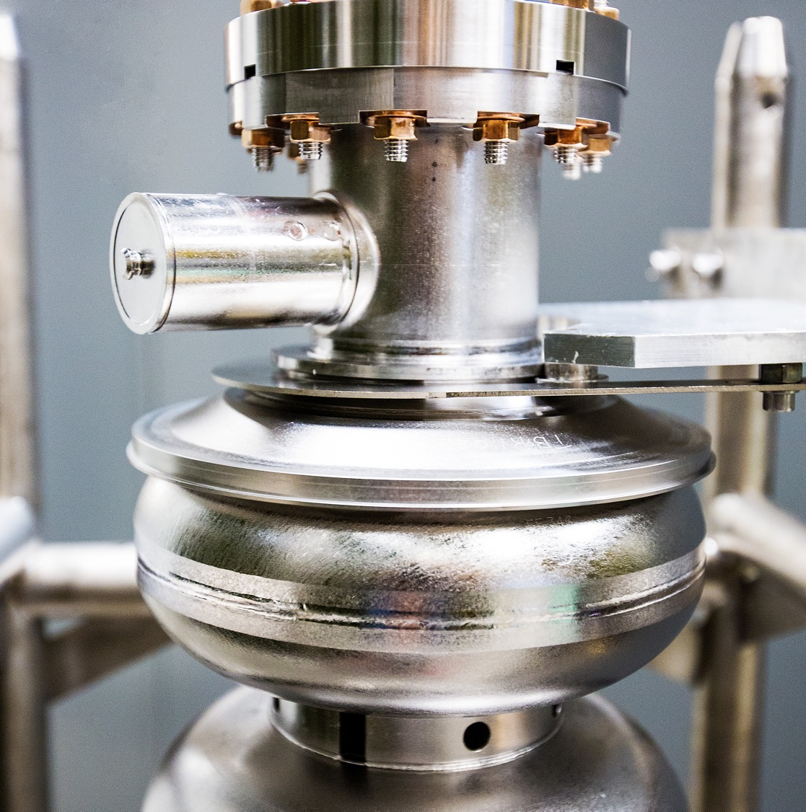
Beam Transport FY25
Downtimes and Run Analysis
10/7/2025
Jay Benesch, Daniel Moser, Jerone Samari, and Dennis Turner
Notes:
Tip: Keep titles under 60 characters for readability
To change the photo: Right-click on photo and select change photo
2

Slide 2
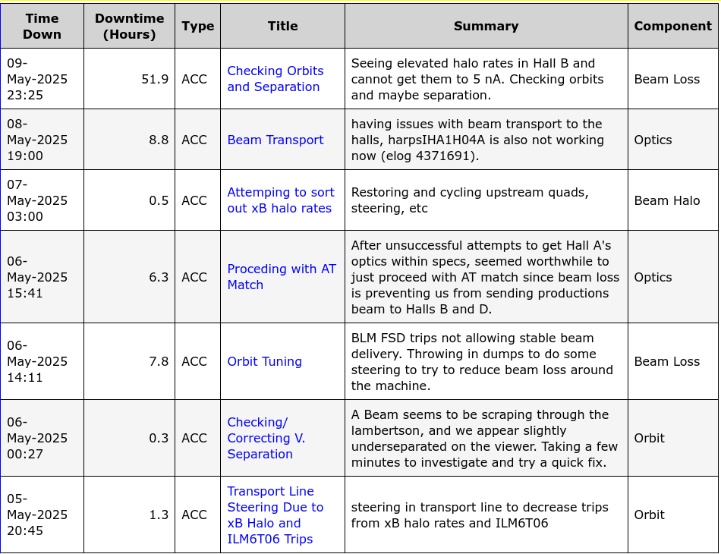
Beam Transport Team
Made in June 2025 to review and analyze Beam Transport-related downtimes including:
Beam Loss
Orbit adjustments
Beam Halo
Optics tuning
Routine operations
Handle weekly beam tune reports
Corrective actions generated from these reviews generate suggestions for Beam Team review
Members from:
Ops
Operability
CASA

Slide 3
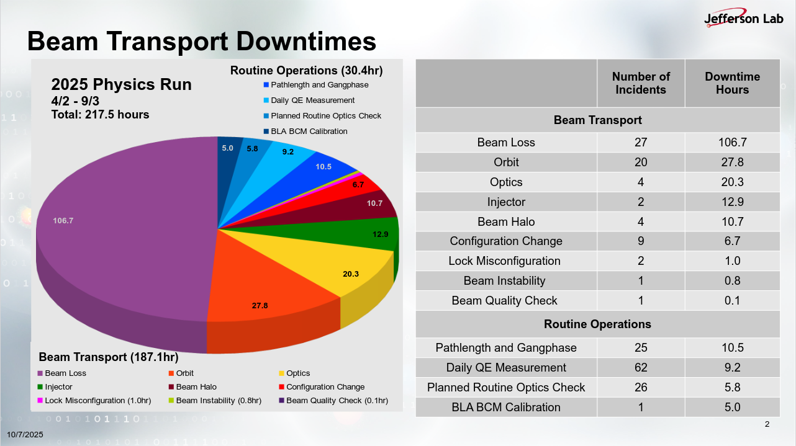

Slide 4
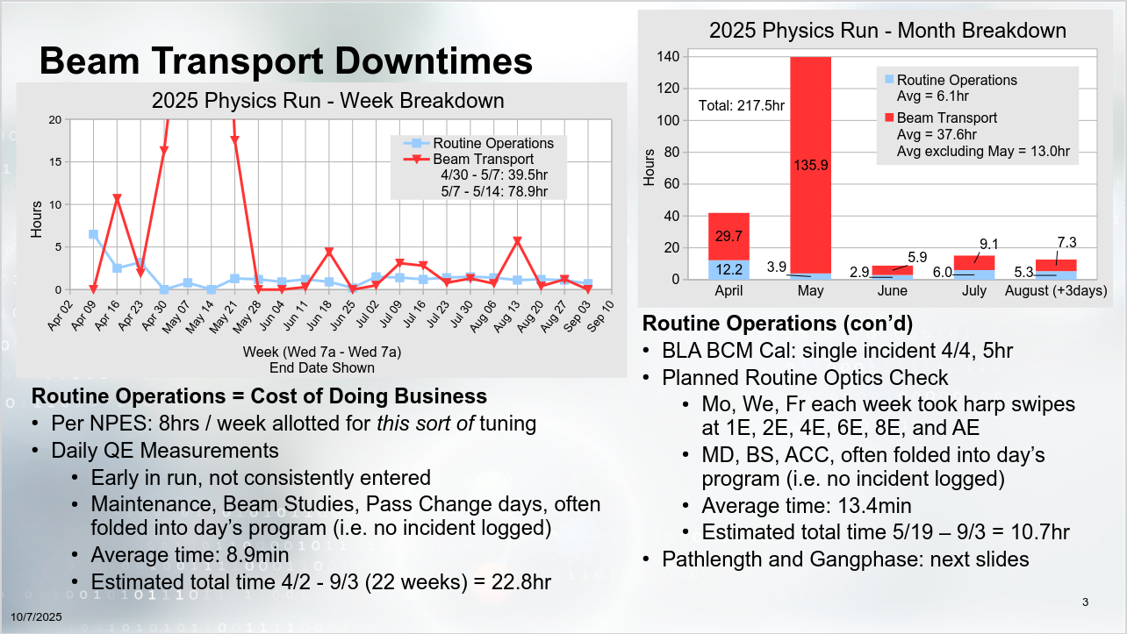

Slide 5
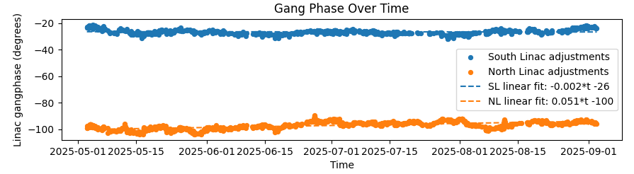
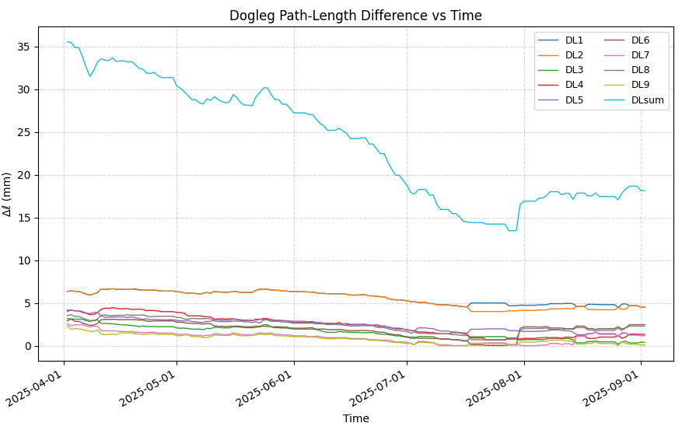
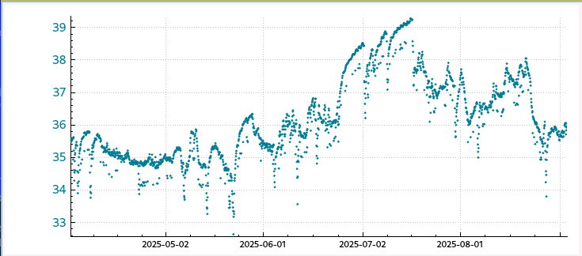
Pathlength & Gangphase
Frequent changes to gang phase:
NL 12 times per day
SL 7 times per day
8-degree change in NL GP over run
~1-degree change in SL GP over the run
Affected by first dogleg which moved 2mm (~4 degrees)
Corrective action: Revival of Momod
Adjusted pathlength once per 2 days on average
Rolled doglegs 1 and 2 in July to prevent zeroed possible correction
Running over summer with high power
Added Offsets in Arc 6, 7, 8, and 9 in Late July to add necessary room for correction
10/06/2025
2
Notes:
Guidelines: 6-8 bullets per slide; Use sentence fragments for bullets
To change the chart: Double-click on chart; different color options with theme colors available (Change Colors)
2

Slide 6
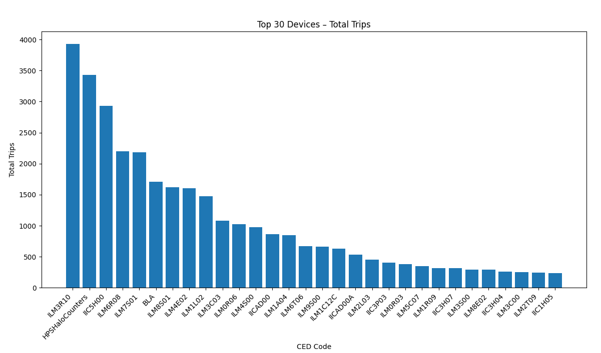
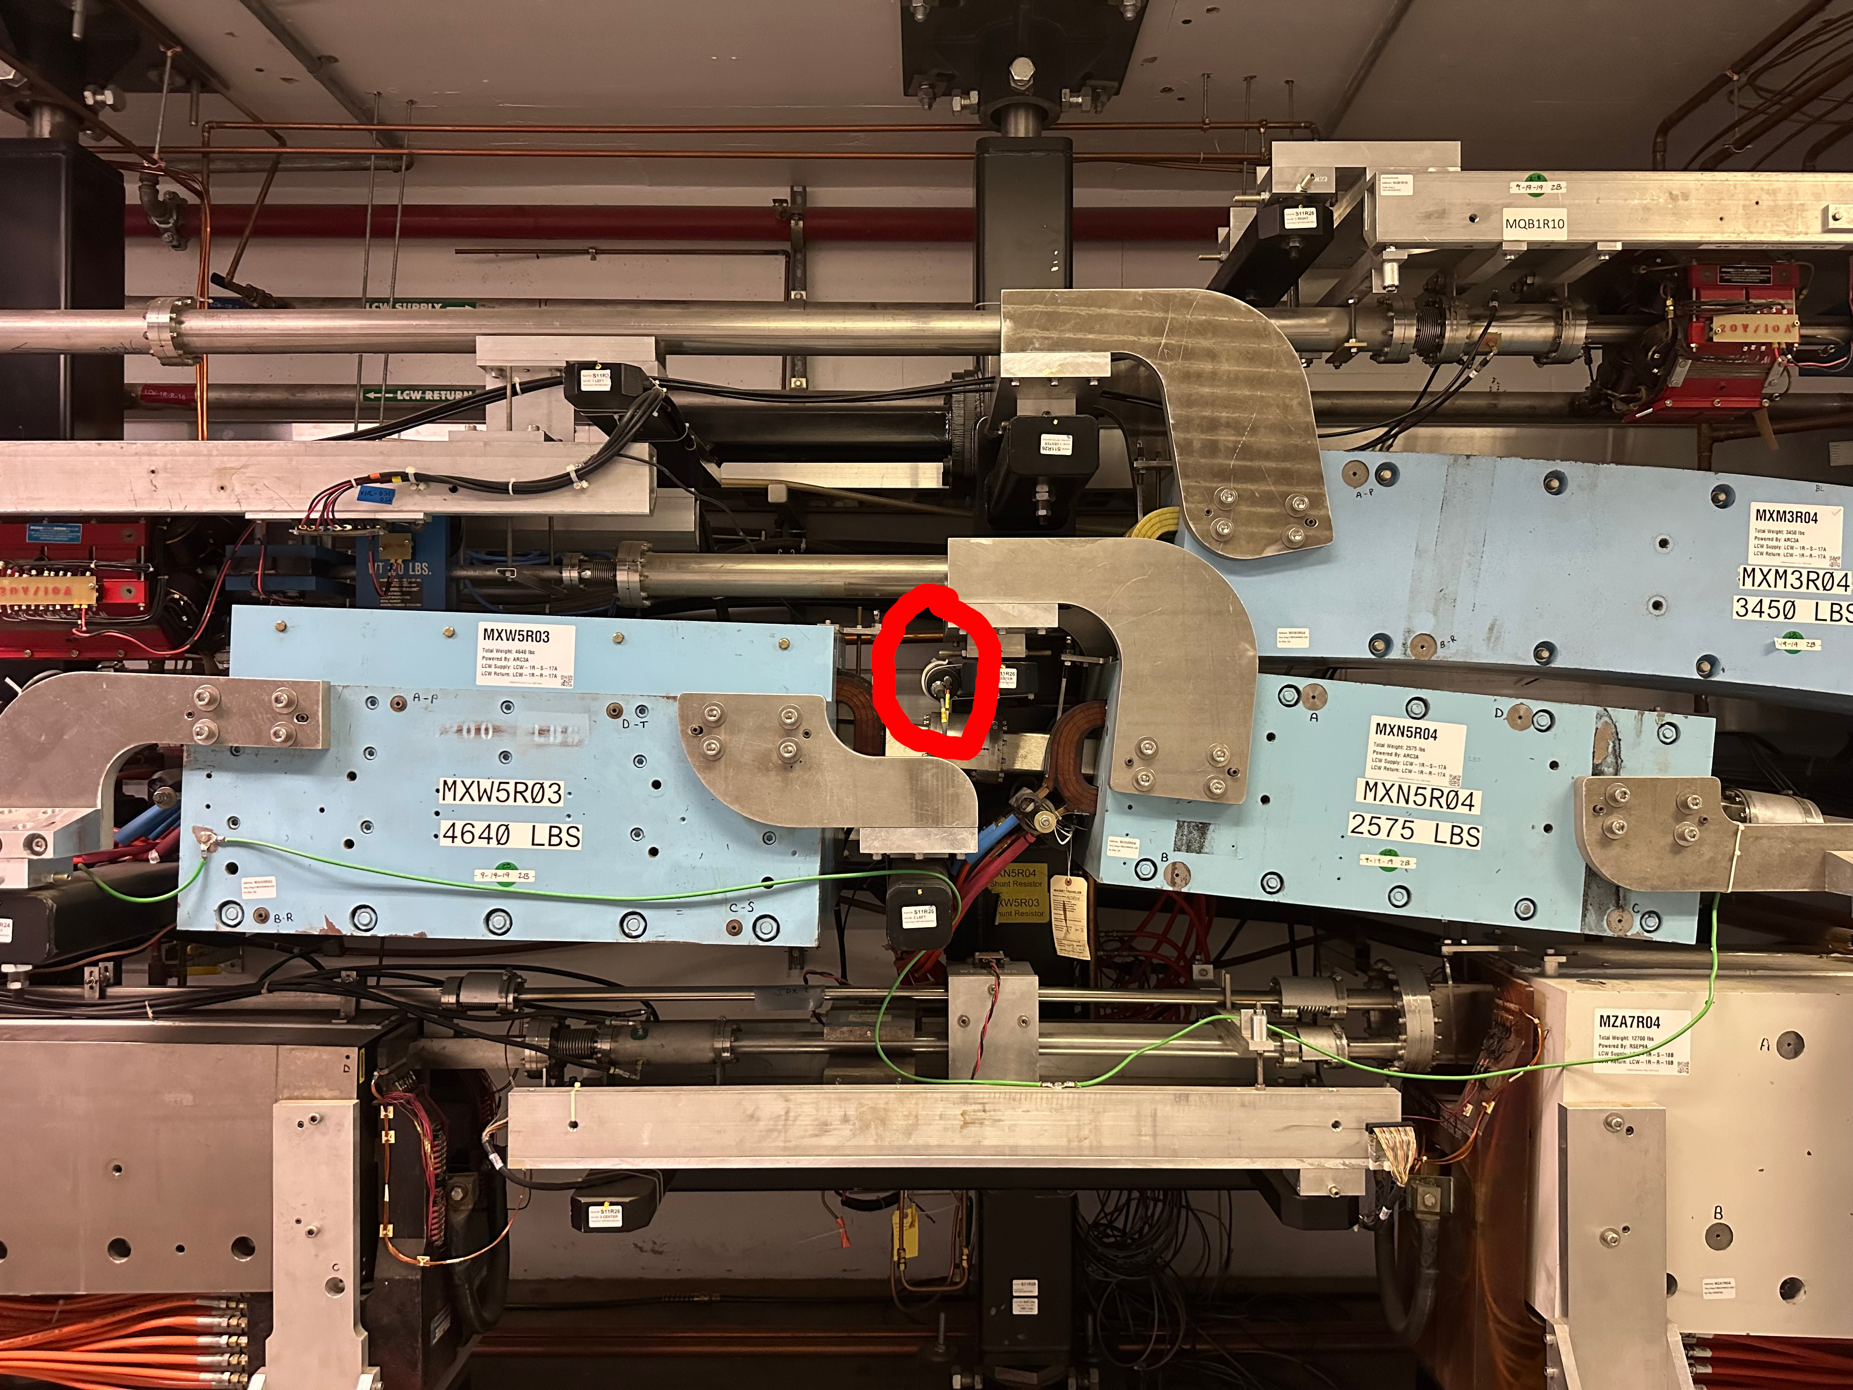
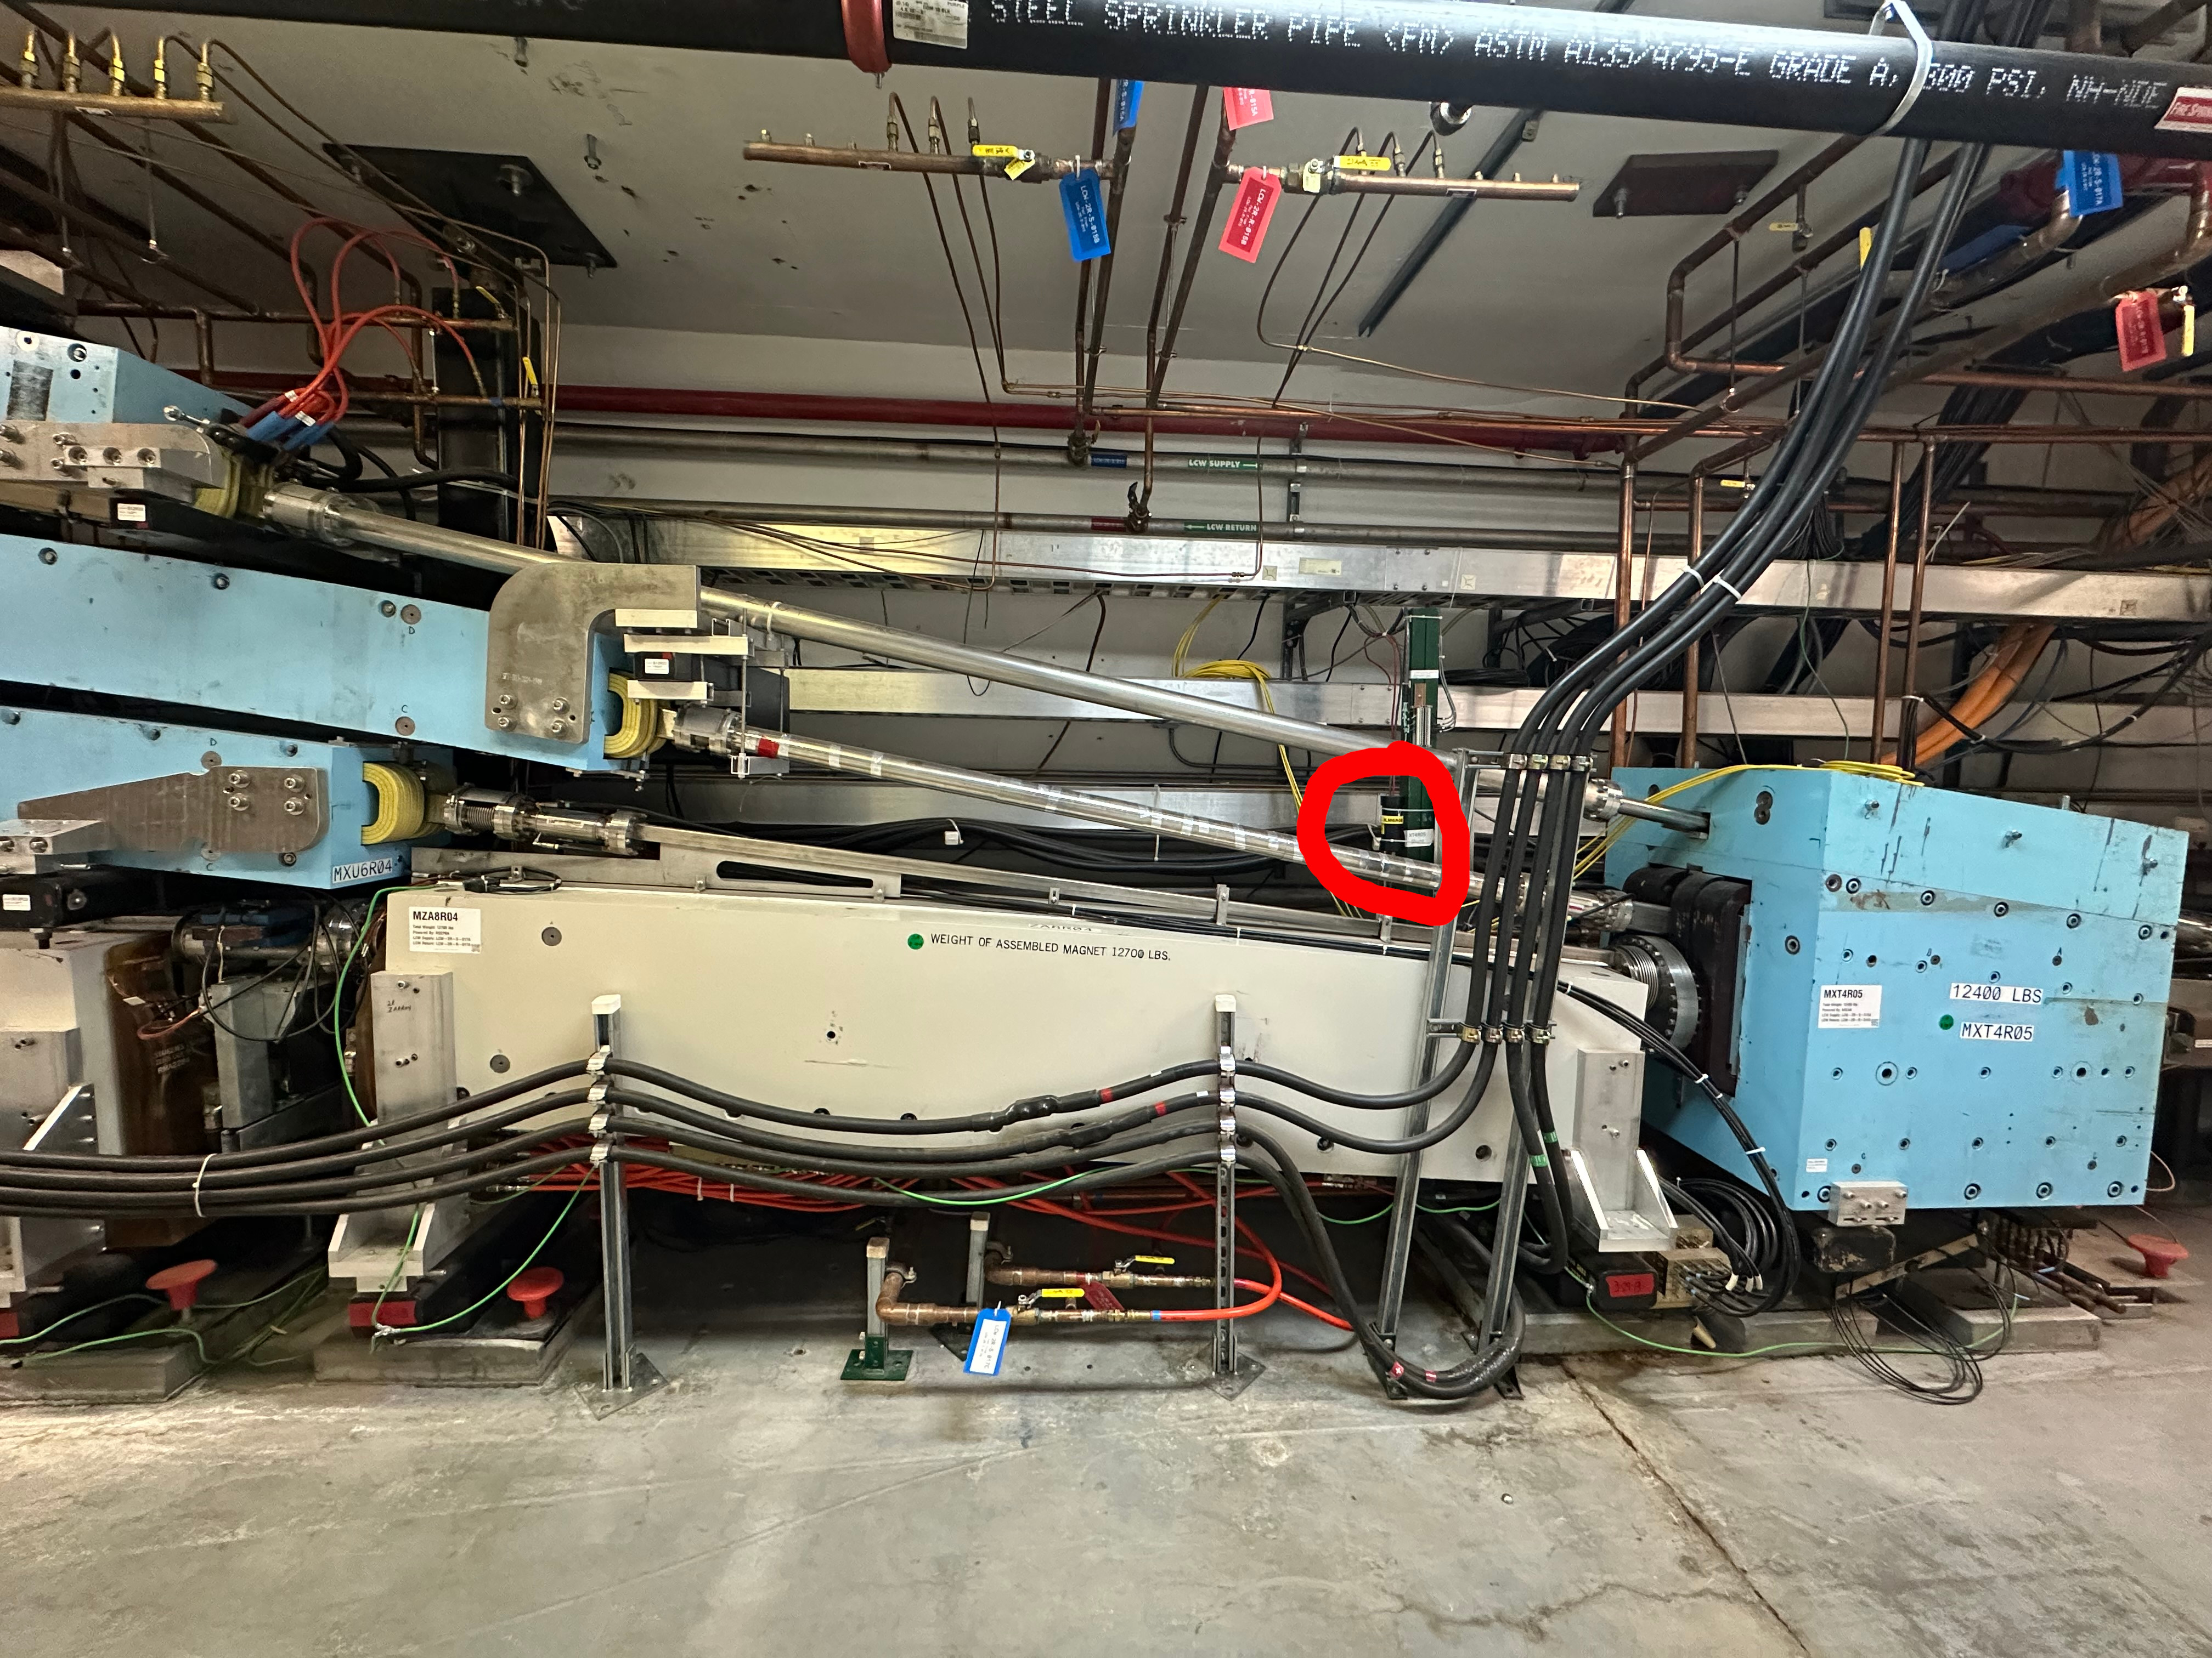
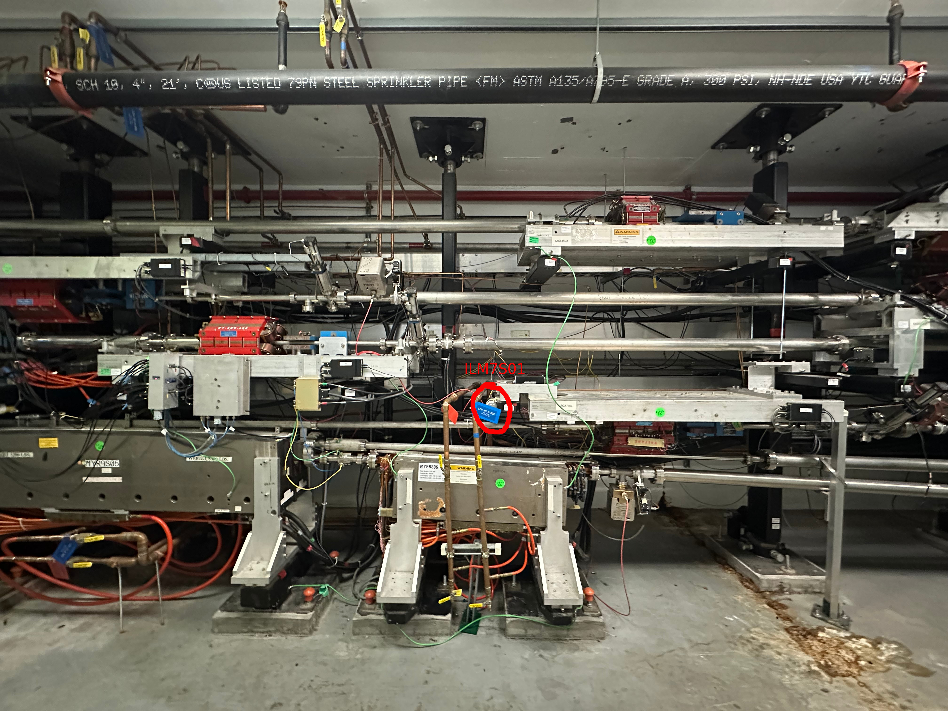
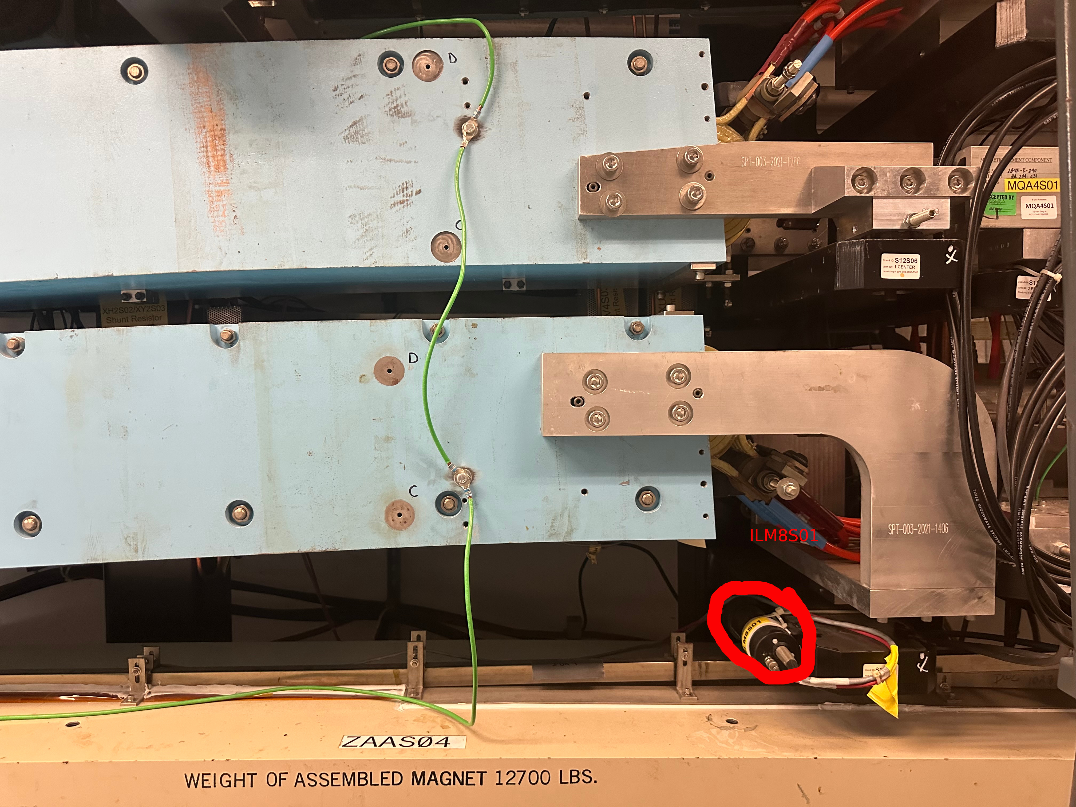
Where we Tripped
BLMs:
ILM3R10
ILM6R08
ILM7S01 (7 downtimes, 23 hrs)
ILM8S01
Halo Counters were by far our most sensitive radiation diagnostic
Hall D Tagger East Wall (IIC5C00) tripped when high current to Hall C turned off
BLA Calibration would trip on negative loss from Hall C at greater than 50 uA
Corrected by fine tuning calibration and raising constant loss factor
Corrective Actions:
procedural aperture scans in early spreaders and late recombiners
Move a xenon ion chamber (IDX) to 5S01 girder to bracket 7S01 BLM
IDX install in all spreaders and recombiners
Left to Right: ILM3R10, ILM6R08, ILM7S01, ILM8S01
10/06/2025
2
Notes:
Guidelines: 6-8 bullets per slide; Use sentence fragments for bullets
To change the chart: Double-click on chart; different color options with theme colors available (Change Colors)
2

Slide 7
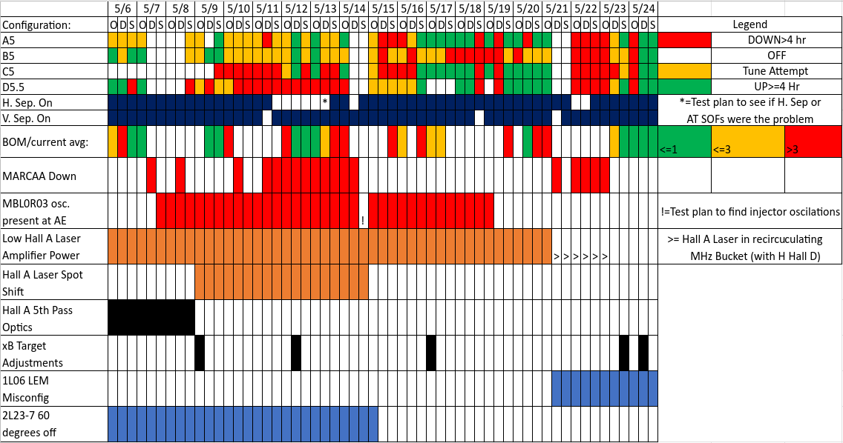
May Event Timeline
10/06/2025
2
Notes:
Guidelines: 6-8 bullets per slide; Use sentence fragments for bullets
To change the chart: Double-click on chart; different color options with theme colors available (Change Colors)
<number>

Slide 8
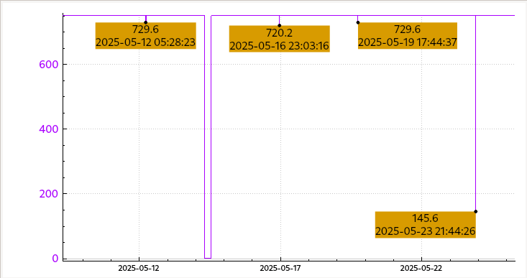
Steering Hall B
Hall B target was a 45 cm long by 6 mm diameter straw
Ops can see asymmetry at target entrance via the BOM
Downstream information is available only via the FTC, which Ops doesn’t monitor
Very difficult to initially send even 2 nA if steered incorrectly near the target due to halo monitor trips
Successful steering often entailed:
Senior Hall B personnel lowering the BOM voltage
allowing the trip points to be increased
providing target positions given angles from FTC
Corrective actions:
Update ops xB set up procedure to monitor FTC asymmetry PVs (via screen or plot)
Formalize when to call on senior xB personnel to reduce voltage after an impasse is reached
The four times the BOM HV was lowered by Hall B personnel during May, 2/4 resulted in production beam afterwards
10/06/2025
2
Notes:
Guidelines: 6-8 bullets per slide; Use sentence fragments for bullets
<number>

Slide 9
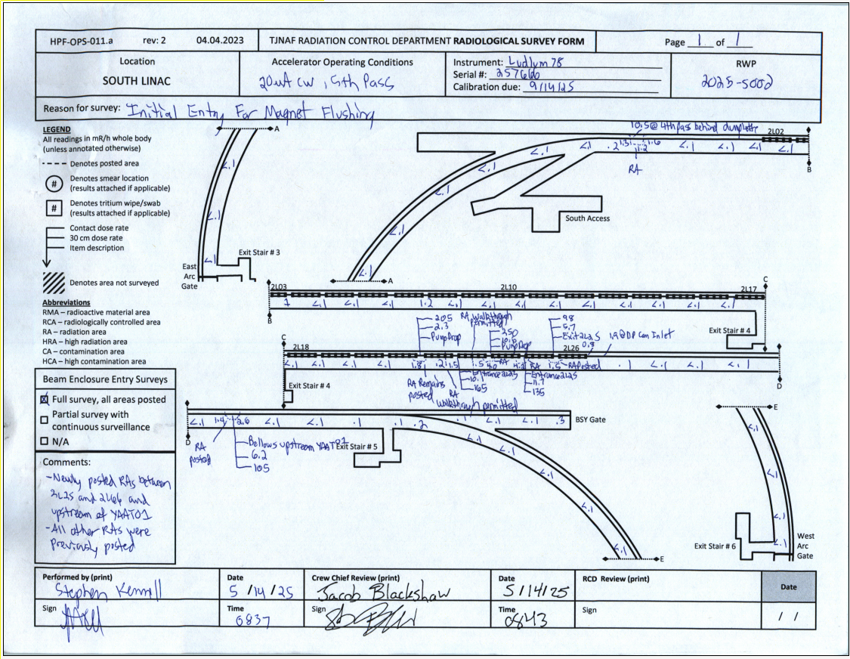
Investigating Transport and Extraction
On 5/12, we found could cleanly send to A, B, and C simultaneously with the horizontal separator off due to MARCAA power supply troubles
Prompted investigations on the Horizontal Separator
Cavity one initially suspected to be the culprit
Test plan was implemented on 5/13 to:
Reload SOFs into the AS/AT regions
Directly compare magnetic vs. RF extraction
With clean transport through AS/AT verified, still saw large difference in rates on difference of magnetic vs. RF extraction
RF group thoroughly verified that all power and phase readbacks were nominal
No smoking gun ever found
Corrective Actions:
SOF field integrated into CED
Radiation survey detailing activated bellows downstream of H. Sep, before YAAT01 after test plan
10/06/2025
2
Notes:
Guidelines: 6-8 bullets per slide; Use sentence fragments for bullets
<number>

Slide 10
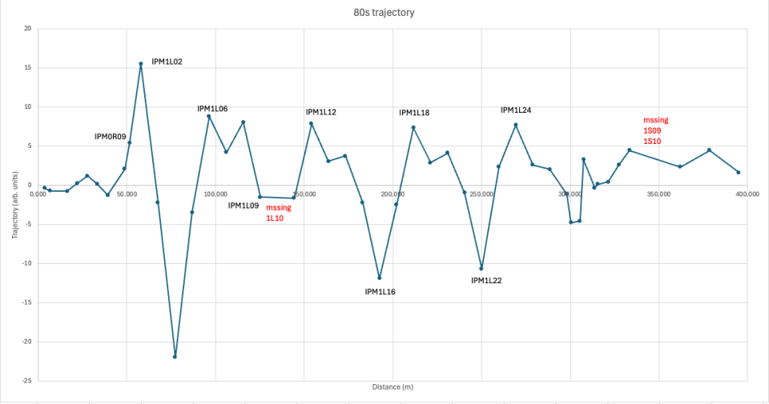
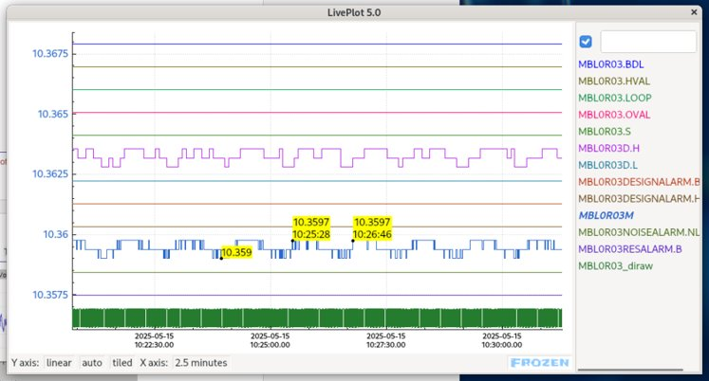
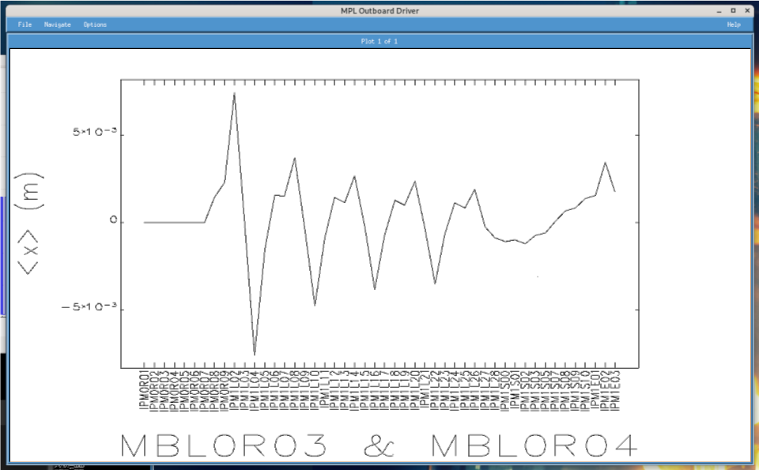
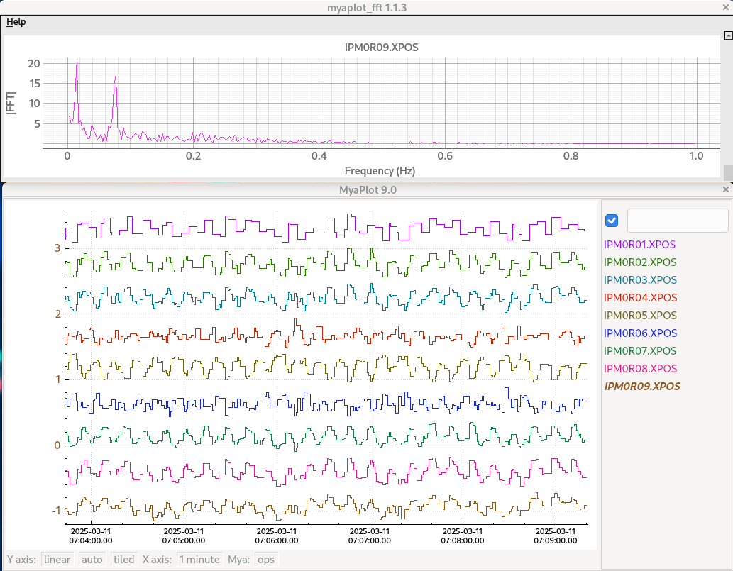
MBL0R03 Investigation
13s and 80s period oscillations discovered in injector chicane
13 s discovered to be caused by 0L03-8
80 s proliferated throughout the machine starting on 5/7
Locks compensated poorly, only shifting its phase
Corrective Actions:
FFT Tool developed by Adam Carpenter
LNS installed for all chicane magnets
Noise and Voltage alarm archival
Creation of the DCLOG
Future plans for:
daily magnet health autolog
Expert magnet alarm handler
Eduard’s measured trajectory of the 80s oscillation as seen by its phase advance Vs. Yves’ simulation of a trajectory given modulation MBL0R03 and MBL0R03
10/06/2025
2
Notes:
Guidelines: 6-8 bullets per slide; Use sentence fragments for bullets
To change the chart: Double-click on chart; different color options with theme colors available (Change Colors)
<number>

Slide 11
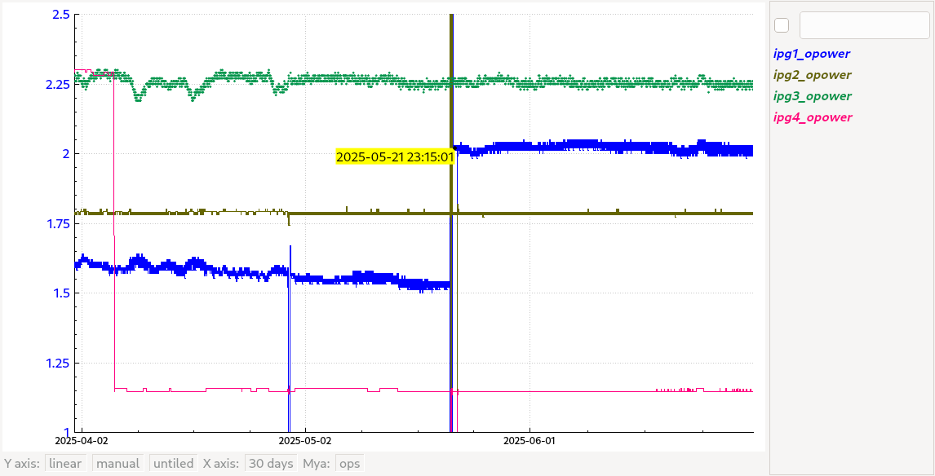
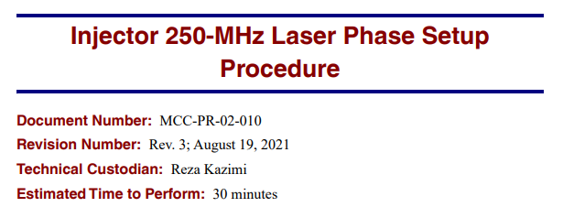
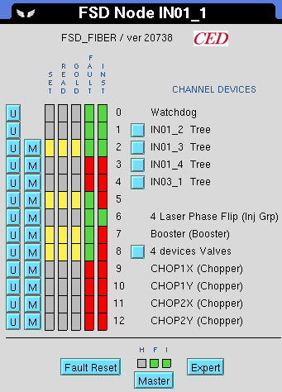
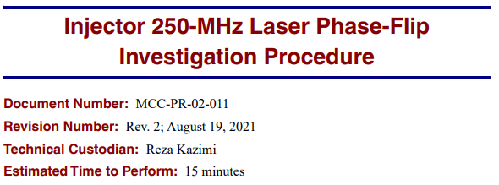
Early Injector Work
5/10 Hall A spot position had drifted as seen by QE drop, resolved by moving using picomotor on 5/16
Hall A laser power low until 5/21, when amplifier was swapped and injector was reoptimized, resulting in A laser phase being in the recirculating 750 MHz bucket
Hall A laser phase wasn't immediately checked with respect to separators
Can be checked with IPM1I02 (750 MHz reference)
Two times where injector phasing differences were missed:
5/2 After Chop1Y FCC Repair
5/21 After Hall A laser amplifier swap
Each time resulting in ~shift of downtime.
Corrective Actions:
Greater awareness of the 750 MHz setup and Troubleshooting procedures
Signals ipg*opower are laser output powers for Halls A1, B2, C3 and D4
10/06/2025
2
Notes:
Guidelines: 6-8 bullets per slide; Use sentence fragments for bullets
<number>

Slide 12
Questions

Slide 13
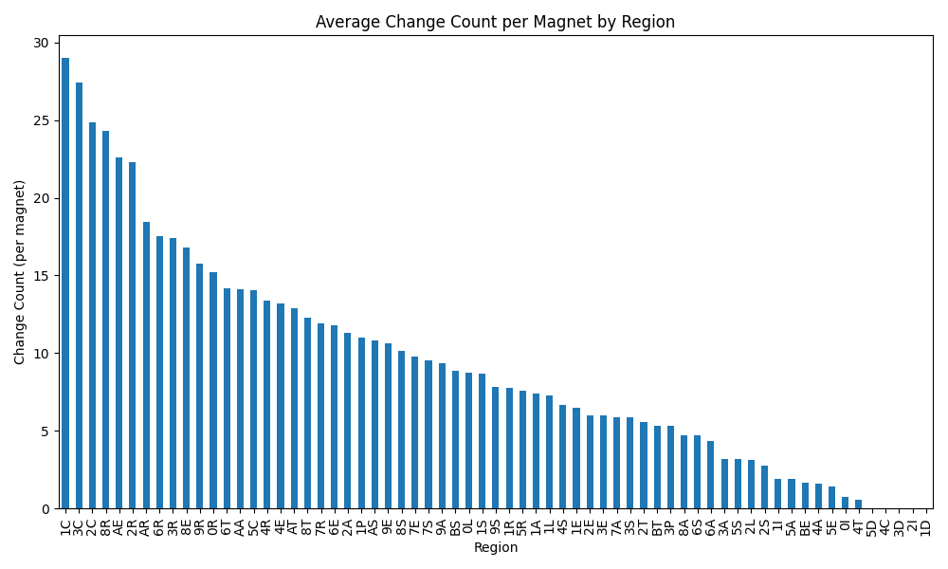
Where we Steered
Analysis done by removing lock correctors, and monitoring changes daily
Total number of changes over the run divided by number of magnets in the region
Hall Lines are corrected for pass changes frequently
Even recombiners are corrected more frequently than odd recombiners
Recombiner steering is done to correct entry into the Linac and subsequent spreader
The north linac has a larger beta function on higher passes by design
The 7/9/BS spreader has a tight aperture
10/06/2025
2
Notes:
Guidelines: 6-8 bullets per slide; Use sentence fragments for bullets
To change the chart: Double-click on chart; different color options with theme colors available (Change Colors)
<number>

Slide 14
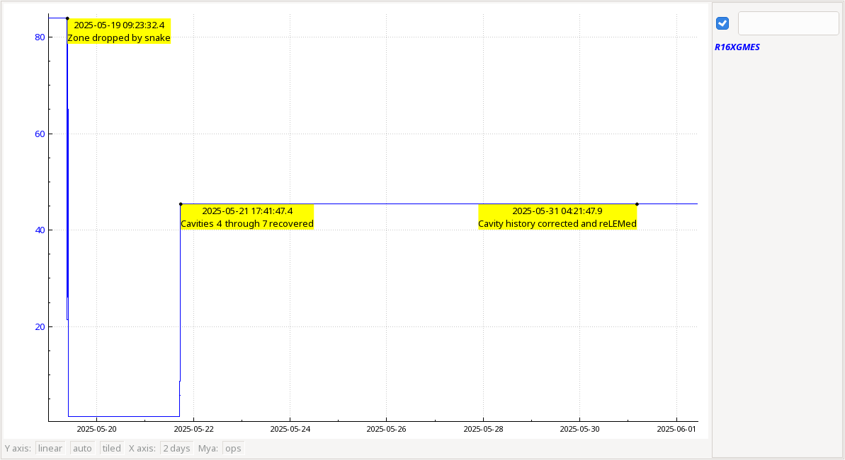
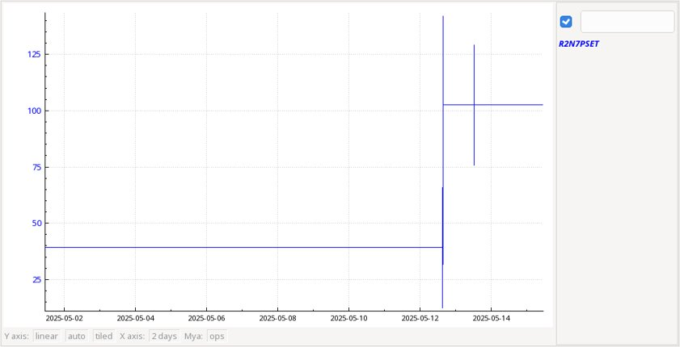
Energy Management issues
2025-05-12: 2L23-7 found >60 degrees off crest, Corrected, positive effect on halo
2025-05-19: 1L06 tripped due to standing water and a snake shorting out components.
2025-05-21: Cavities 4 through 7 were recovered.
2025-05-31: Ops discovered that although the cavity histories were updated for the recovered cavities, the history for the zone was still marked "RF Bad", so the zone was assumed by LEM to be bypassed.
For around ten days, the North Linac focusing and skew quads were not set correctly by LEM since the actual linac energy profile differed from the LEM energy profile.
Corrective Action:
Modify the rfCavHistory tool to prevent zone from being marked as bad when cavities in the zone are not (and the contrapositive)
Revive Krest to keep individual cavities on phase
1L06 total GMES from 5/9 to 6/1
2L23-7 PSET from 5/2 to 5/15
10/06/2025
2
Notes:
Guidelines: 6-8 bullets per slide; Use sentence fragments for bullets
<number>

