Slide 1
SAM and Next Run
2025 Run Retreat
S. Frierson
CEBAF Operability Leader

Slide 2
Scheduled Accelerator Down - Scope
Goal: Execute the physics run in spring 2026 at >80% machine availability
Scope: To perform work that aims to maximize RF gradient headroom which includes cryomodule swaps and control system upgrades; to execute upgrades and strategic preventive maintenance activities on machine components and systems that will increase overall reliability, and to perform the yearly accelerator credited control certifications in compliance with operational directives.

Slide 3
The Goal – Spring ‘26 run
Start: 23-Feb (NPES)
3 Hall running (xA off)
Staggered start
xC to receive up to 80uA
xD to receive polarized beam
Energy (GeV/pass)
0.7 (~2mos; special setup)
2.1 (rest of run)
Reconfig (~5d); beam restore (~7d)
May not be enough time
Passes
xB: 5th then 1st
xC: 2nd, 3rd, 5th, 4th, and 3rd
No vertical separation (for now)
End: 26-Jul

Slide 4
Accelerator Overview – Milestones
SAM started 3-Sept
PSS lockouts/deactivation
CHLs warmup (4K)
2L03 C75 upgrade complete: 07-Nov (Pwr/Controls); 2-Dec (Tunnel)
PSS Certification: 17-Nov
System Readiness (HCO): 17-Nov
CHL 2K pumpdowns: 1-Dec
1L26 C100-03R install complete: 12-Dec (girders – Jan. ‘26)
Accelerator 24h lockup: 05-Jan-26
CM/LLRF commissioning complete: 16-Jan
RF recovery complete: 4-Feb
CEBAF beam restoration starts 5-Feb

Slide 5
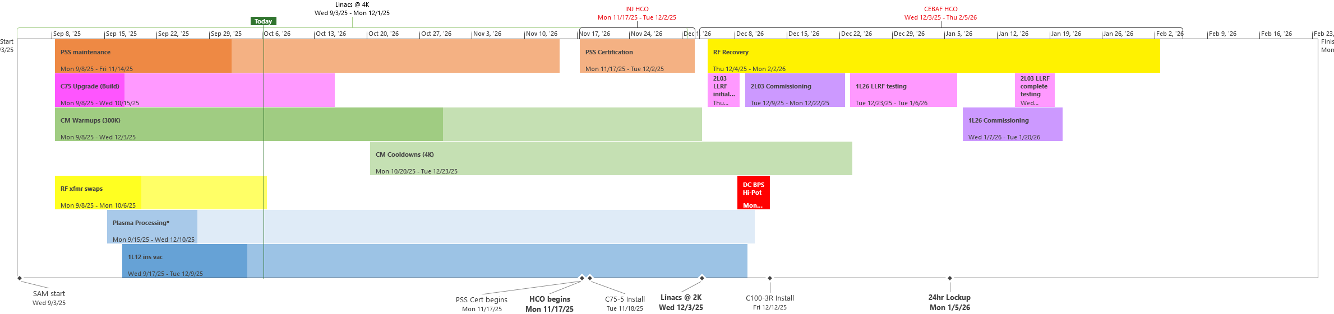
Accelerator Overview – Progress

Slide 6
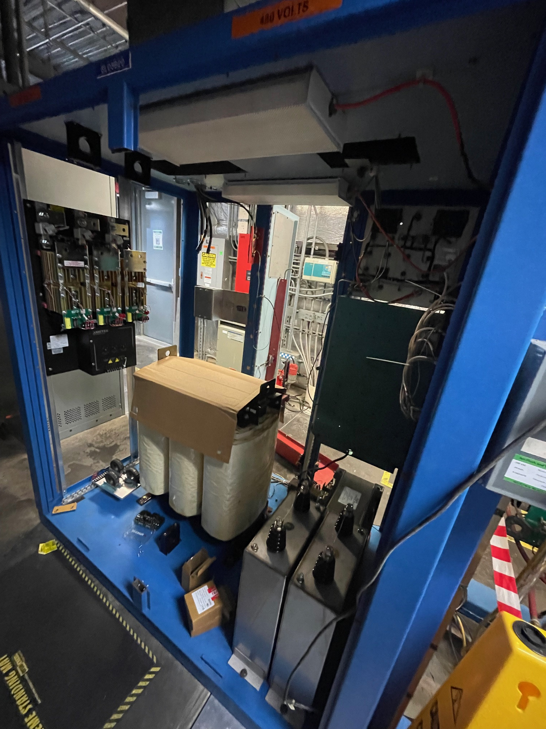
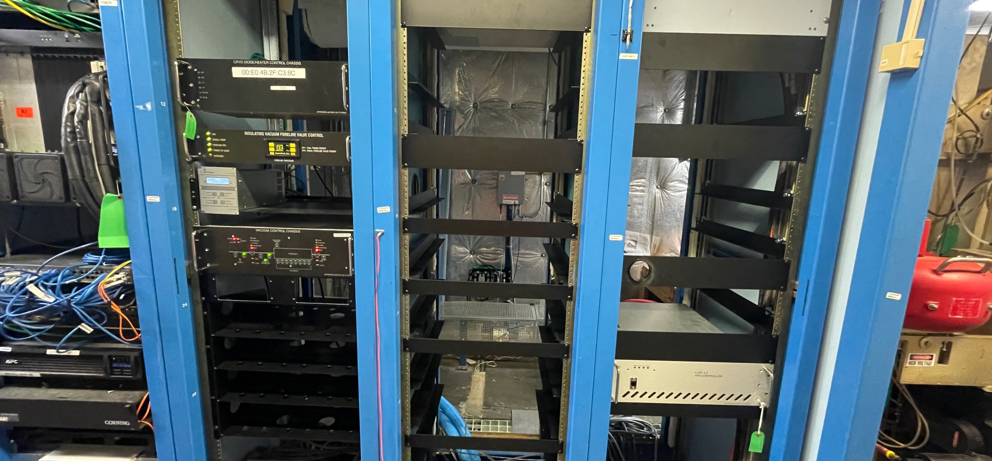
2L03 CPS/LLRF - progress
New shelving installed in recently cleaned out racks (B13/14)
Some cabling being installed, more being built
Some control chassis are populating the racks
CPS transformer install on going

Slide 7
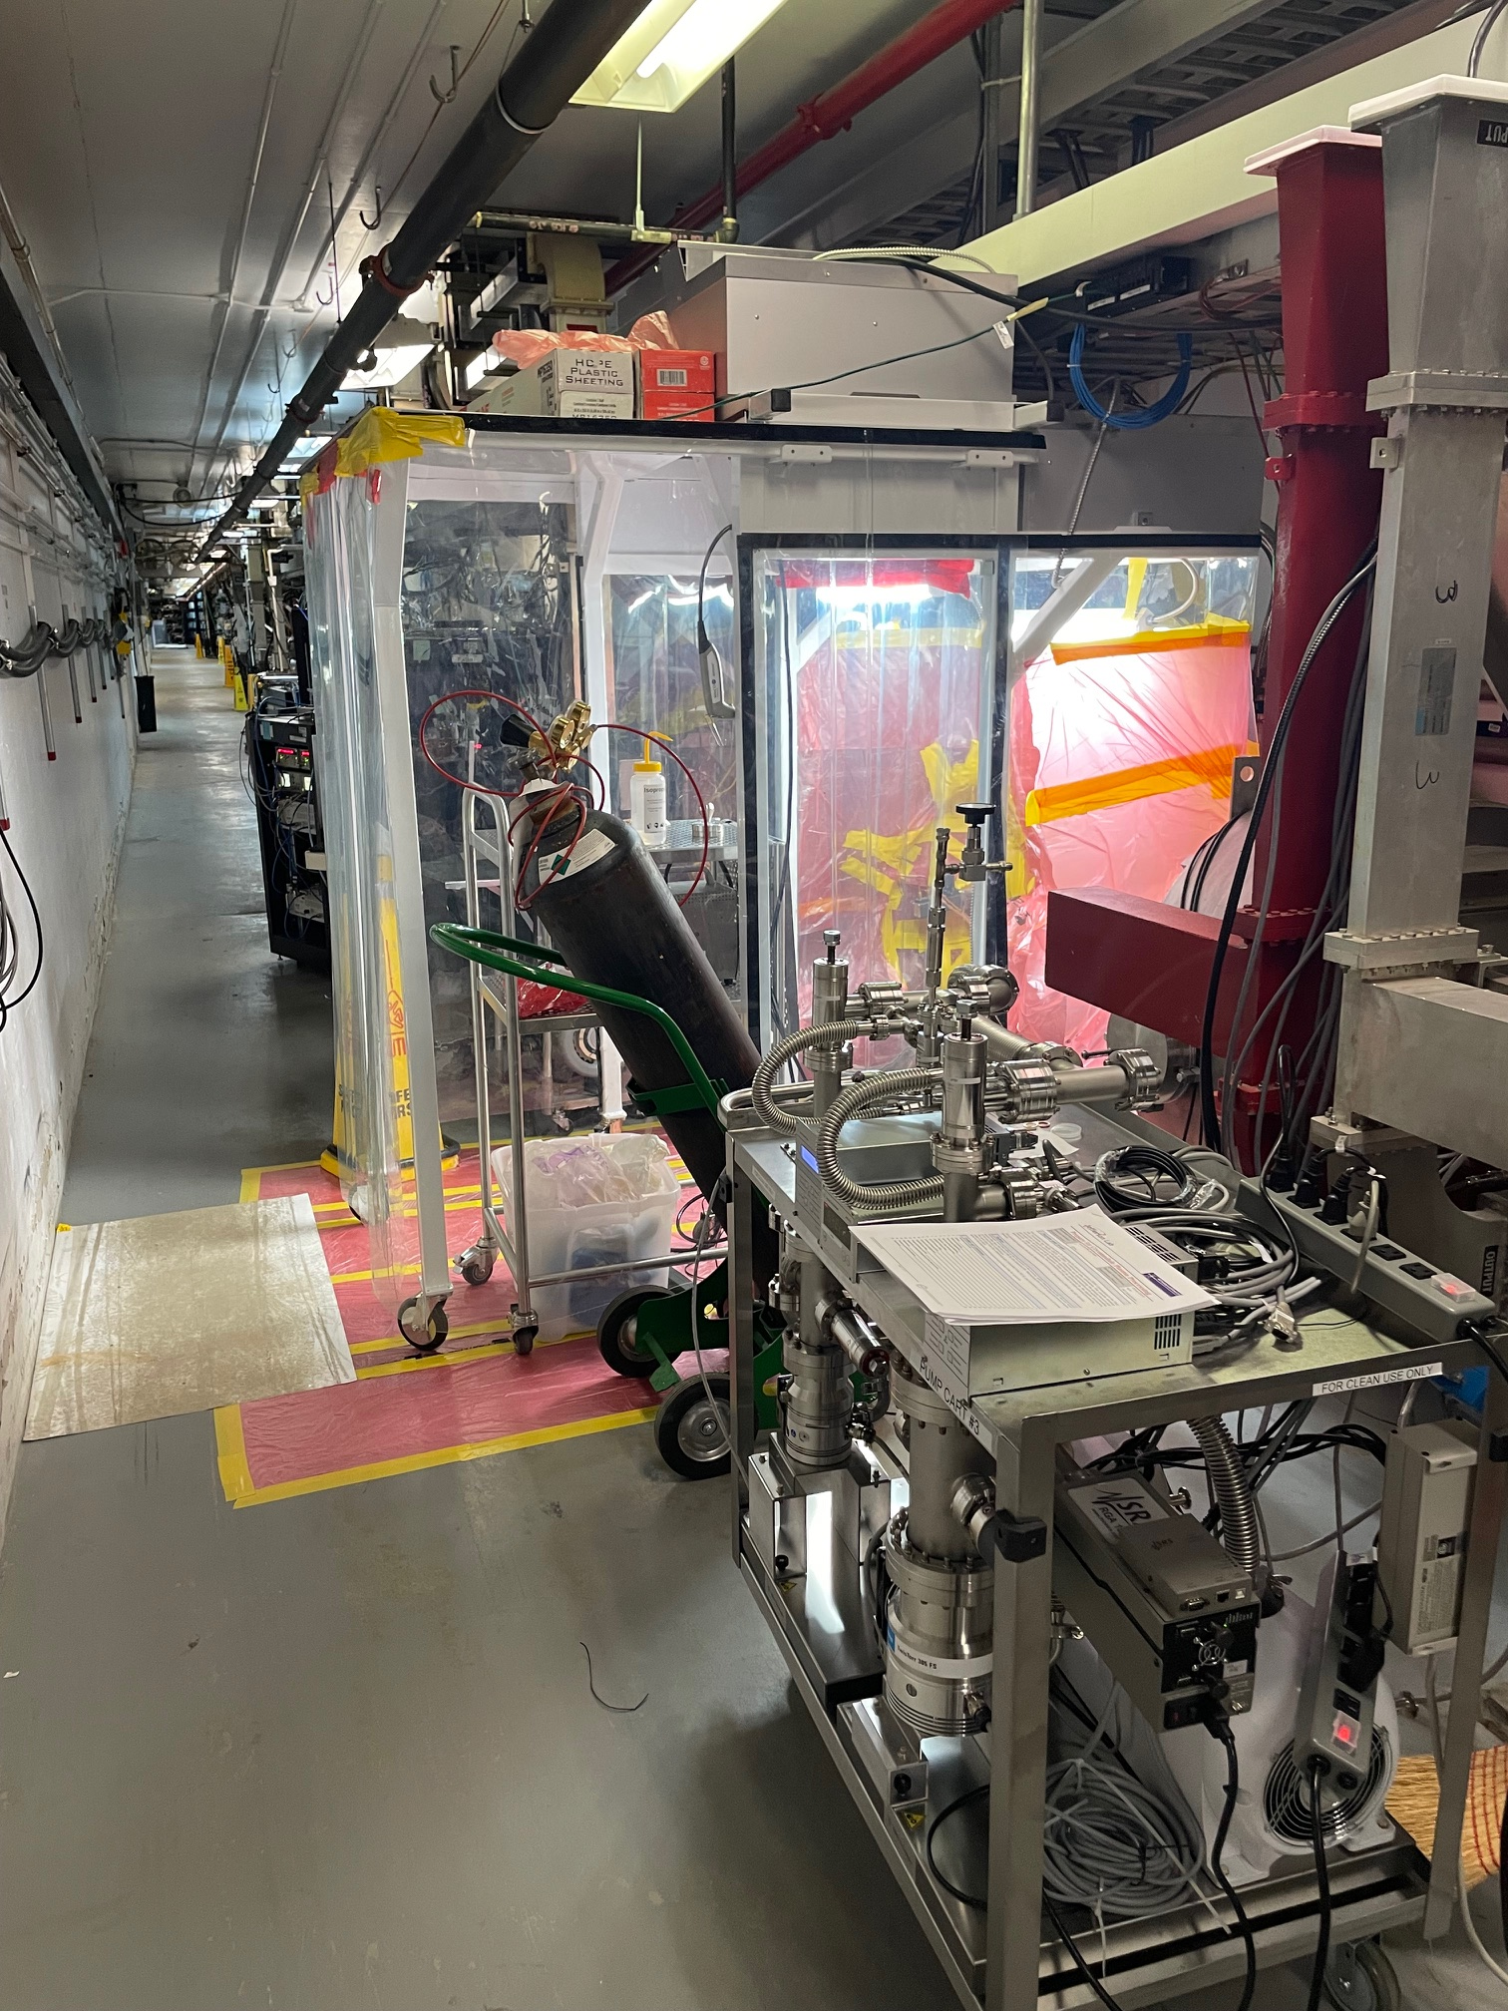
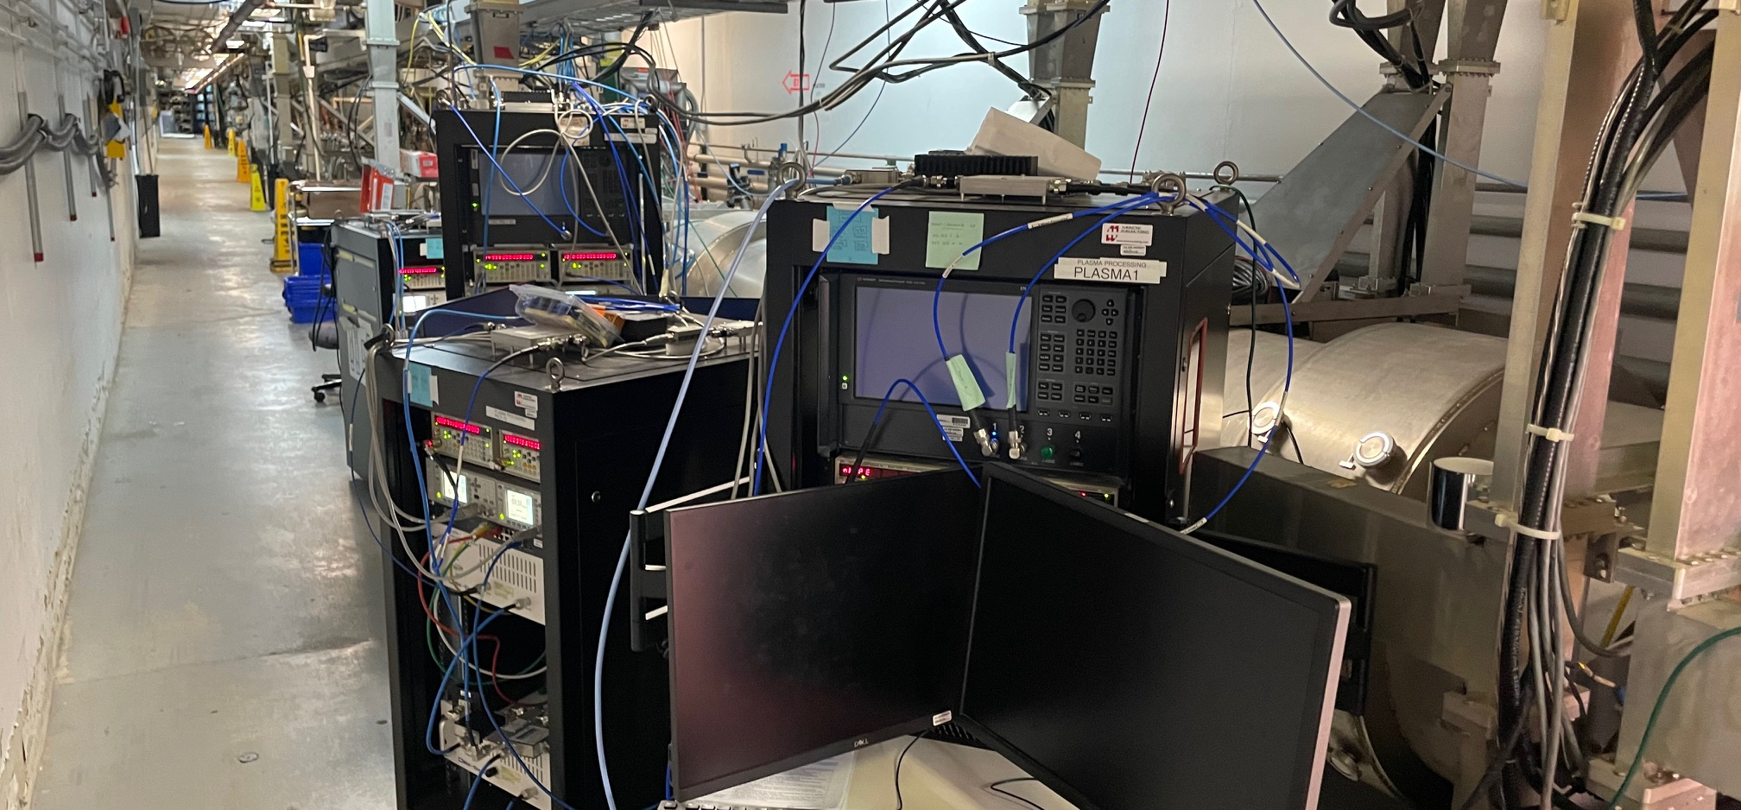
Plasma Proc. - progress
Modules (1L04/5/6) have been warm since beginning of SAM
Vac work determined valves leak; plasm proc. procedure modified
Equipment downstairs; setup will commence once Ops conditions met

Slide 8
Other projects/tasks
Vacuum beam line ion pump swaps
NL Master/Local Oscillator upgrade
C100 waveguide strut installation
RF 8kW circulator install
Diagnostic component upgrades/swaps
TAG5C power supply swap
Trim card 3 install
Magnet/Box supply flushing
N/S Access box room ducting
Electrical metering install
LCW/Cooling preventive maintenance
Girder stand/Quad magnet alignment checks
xA/xC BSY quad removal

Slide 9
QUESTIONS?

