Slide 1

Facilities Management & Logistics (FM&L)
Facilities Downtime – FY25 Run
Central Utility Plant (CUP) Upgrade Project
Reliability Initiatives
Water Intrusion
Energy Audits
Kent Hammack

Slide 2

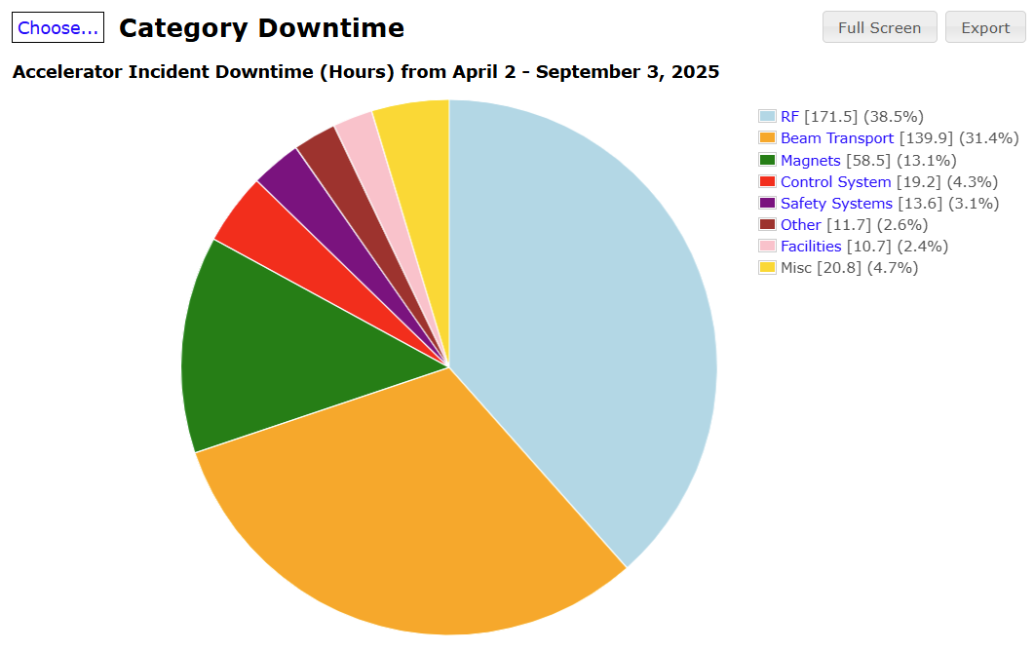
FY25 Run Summary
Facilities Downtime – FY25 Run
  >99% availability
  2 Events (10 hours 42 minutes total)
    Loss of Chilled Water (24 June)
    HVAC Chiller -1 Down (27 July)

Slide 3
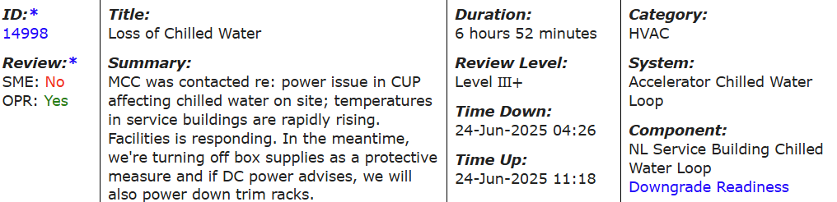
Loss of Chilled Water (24 June)
After a power transient at 0426 as a result of a line arrestor failure in Dominion's offsite equipment, lost a chiller at the CUP that cools water for CEBAF ServBldg HVAC. Ops powered down magnets and RF, reducing ServBldg heat loads. Facilities came on-site to restart, but encountered a few issues. Just before 0800, Ops got the go ahead to begin powering equipment back on, but about ~hour later found CUP not quite ready for full-fledged equipment operation, particularly in North ServBldgs (NLSB, E1, E2), so powered magnet and RF PSs housed in these buildings back off. Shortly after 1000, go-ahead given to power equipment back on. All systems back on with ServBldg HVACs working at full capacity just after 1100, outside heat index ~97F at that time.

Slide 4
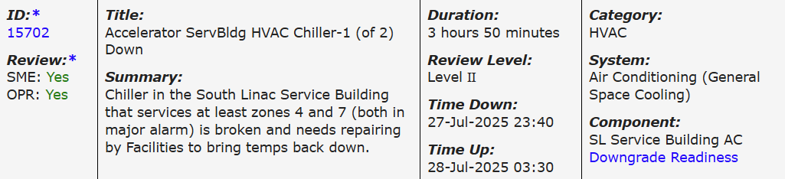
HVAC Chiller -1 Down (27 July)
Storms in the area Sunday night caused power disturbances that tripped one of the two 800ton chillers at the CUP that provide chilled water for Accelerator site service building HVAC. Additionally, two secondary pumps that pump the water to the service buildings tripped off. Facilities responded, and traced secondary pump issues to blown fuses; fuses replaced with on-hand spares and pumps returned to service. 800ton chiller was troubleshot, bringing in Johnson Control Expert on-call, and found to have a damaged variable speed drive card for the associated oil pump (oil used to lubricate chiller). Part needed to repair not on-hand, so for time being a 400ton chiller in basement of Test Lab was brought online, balancing with the one functioning 800ton chiller in CUP. Damaged variable speed drive card for oil pump repaired Tuesday and second 800ton chiller in CUP returned to service.

Slide 5
Central Utility Plant (CUP) Upgrade Project ($5.2M)
Mission Need:
  Increase chiller plant cooling capacity and system resiliency and reliability
Project Scope:
  Decommission 3 chillers in the Test Lab basement by installing an additional 800-ton chiller to the CUP
  Add a fourth 800-ton chiller to provide redundancy while responding to casualties and maintenance
____________________________________
(4) 800-ton Chillers
Fed from 2 independent sub-stations (Campus and Accelerator)
Scheduled Completed in Q1FY26

Slide 6
Reliability Initiatives
Cooling Tower Fan Maintenance
North and South Access Cooling Upgrades
Control System Upgrade Building 87
Power Monitoring
Pavement Upgrades
Preventive Maintenance Program
  Mechanical
  Electrical

Slide 7
Water Intrusion
Underground Infrastructure Condition Assessment (UCA): Completed December 2024. Intermediate project recommendations are on schedule for implementation, including crack repair, replacement of water collection and pumping stations, and upgraded electrical circuit installation.
  Leak Repair:
    Hall A Truck Ramp: Completed February 2025 with no additional leaks in this area.
    RFP for leak repairs issued, with work to be executed during the SAM period.
    GFE HEPA vacuum system and drills were purchased (to be pre-certified by RadCon) and will be provided to the repair contractor to enable quick repairs under time-constrained SAM periods.
  Electrical:
    Upgrade to permanent wiring in support of 17 water collection pump stations, scheduled to be completed during this SAM.
  Mechanical:
    Project to replace 10 water collection and pumping stations with permanent engineered solutions, on schedule for this SAM.
    Remaining seven stations will be refurbished until they can be replaced during the next SAM in FY26
  Long Term:
    Investigation of feasibility of localized lowering of the water table

Slide 8
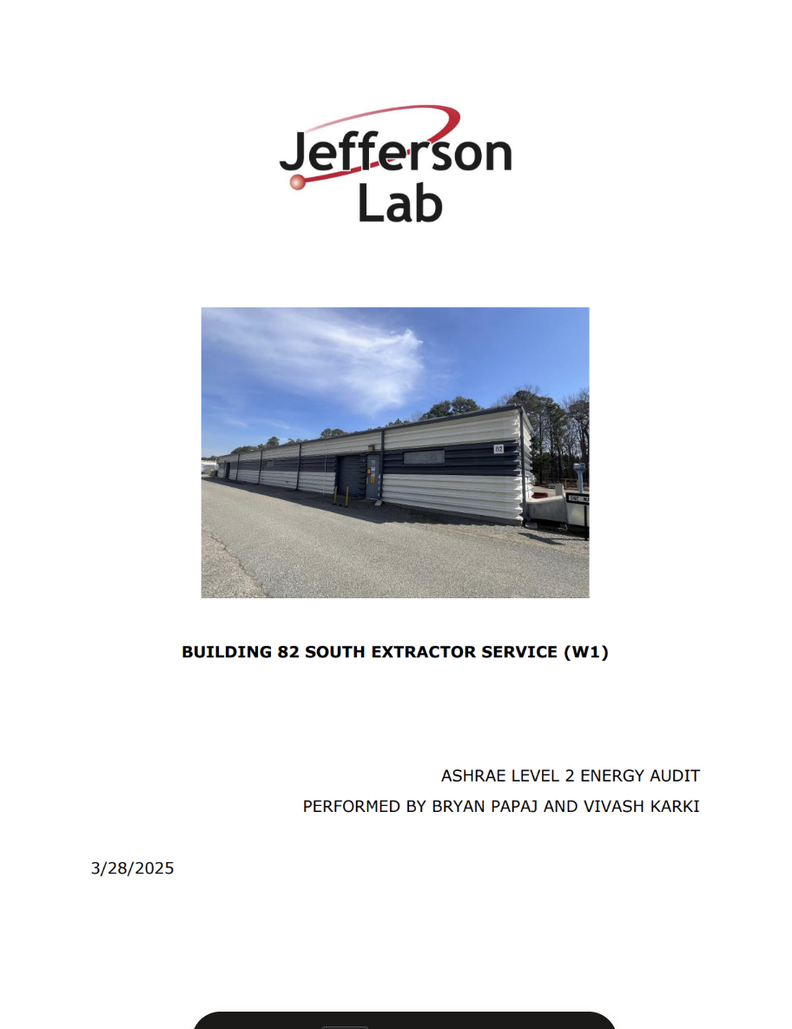
Energy Audits
EXECUTIVE SUMMARY:
Building 82 South Extractor Service (W1) is currently consuming more energy than
necessary for operations. Energy costs at this facility are approximately $72,614 annually.
Several energy conservation measures (ECMs) were identified to reduce the facility’s impact
on energy consumption and costs. If all the recommended measures in Table 1 were
implemented, the building would save approximately $2,953 annually in energy costs and an estimated $1,250 in maintenance costs. The bundled recommended measures provide
a simple payback of 7.7 years, for a $32,449 investment.

