Slide 1

ENG and CRYO Perspectives
Ken Baggett, Jonathon Creel
Neil Wilson, Chris Gould, Glenn Schrader

Slide 2
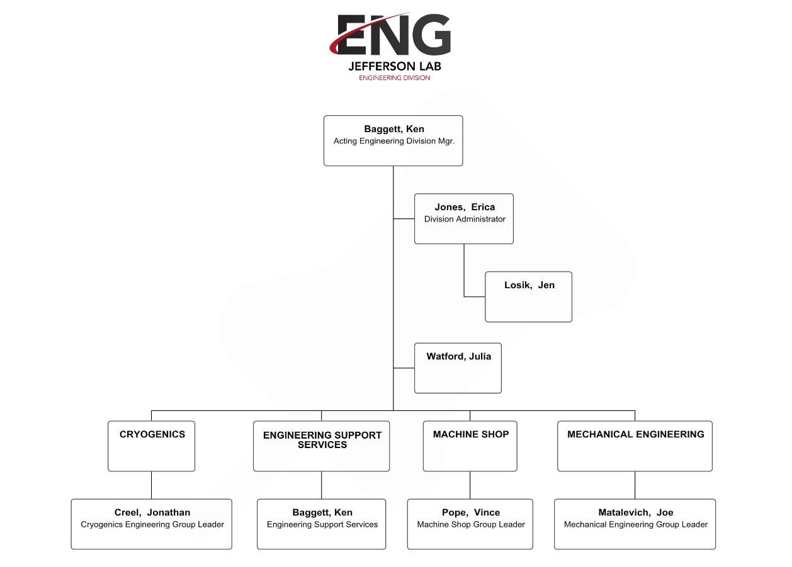
Organization

Slide 3
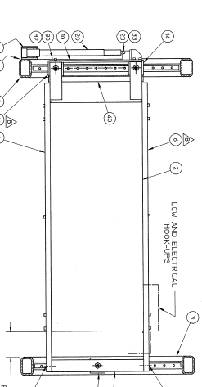
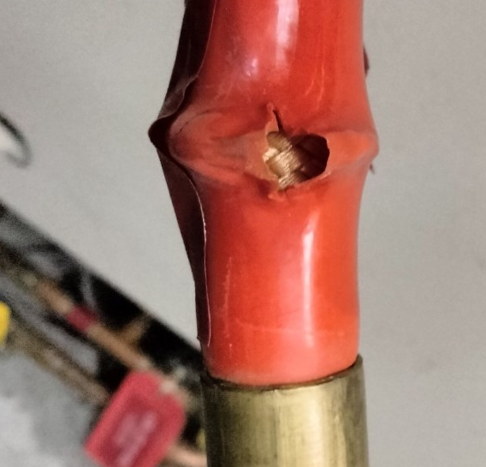
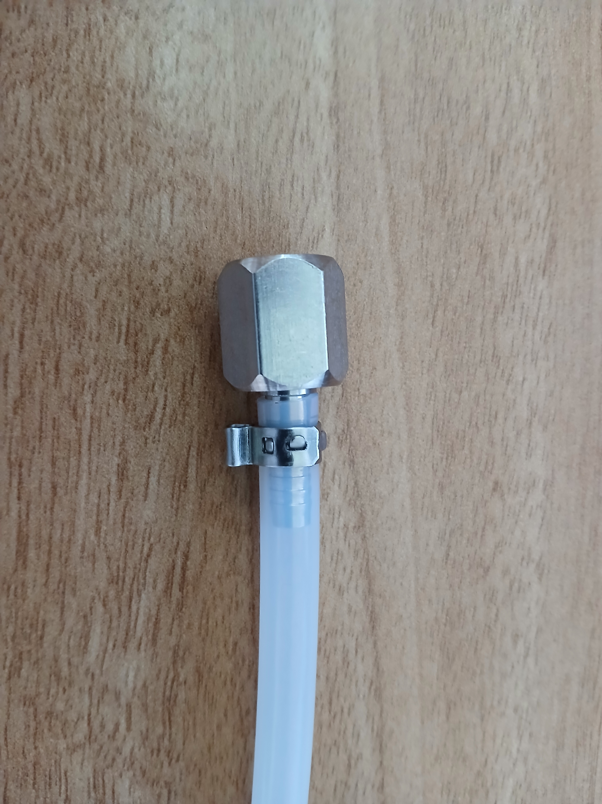
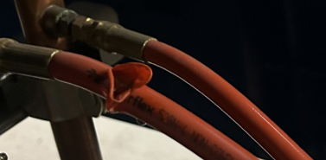
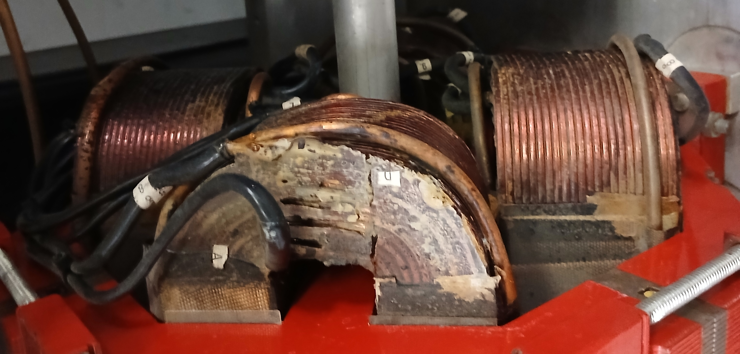
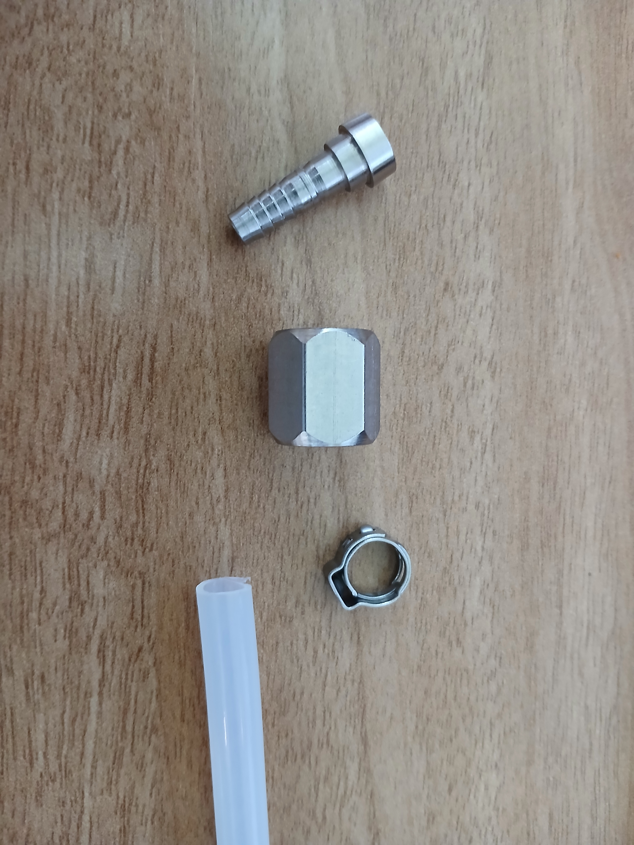
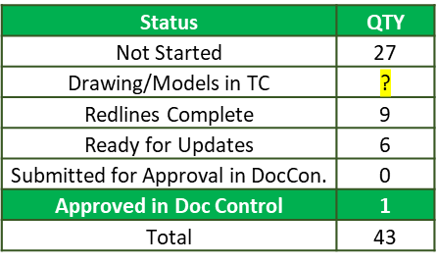
Engineering Reliability Initiatives
Dog Leg Rails
LCW Component Reliability
Hose Reliability
Water Quality
Descaling Improvements
Hall Dumps Engagement
Magnet Coils
Spares and Current Health Assessment
Inventory System
Engineering Work Request System
CEBAF Song Sheet Updates
I&C Updates
Drawing Corrections
Custom Polymer Radiation Shielding
Rail and Carriage
DWG: 28401-0800
ETFE
Ear clamp, Hose barb,
and JIC nut = $12.75
Major Degradation
Notes:
Guidelines: 6-8 bullets per slide; Use sentence fragments for bullets

Slide 4
SAM Support
Survey and Alignment
Re-torquing magnet stands
First noticed issue in 2018
Required an extensive initial re-alignment
Yearly checks keep changes minimal now
Re-fiducialize all quadrupoles in the machine.
Eliminates the use of alignment fixtures, improving efficiency and reducing potential sources of error associated with the tooling.
Perform alignment checks
Ensure there are no beamline misalignments preventing clean beam delivery.
During this SAM: Checked RF separators in the SW Extension
Mechanical Systems Support Group Flushing
Pre-emptive magnet flow checks – ZA’s, YB’s & XP’s to determine flushing requirements
Expanded magnet flushing – Pre-Emptive Measures
Additional power supply flushing – Halls B, C & D
Considering planned flushing ZA’s & YB’s mid Physics run – Based on ZA & YBBS06 & 06 overtemp. Trips during last run
Hose Inspection & Replacement –
Pre-Emptive hose inspections & replacement of ZA’s & XP’s
LCW Hose Alternative
Investigating alternative hose materials and fittings
Performance testing of alternative hose materials & fittings

Slide 5
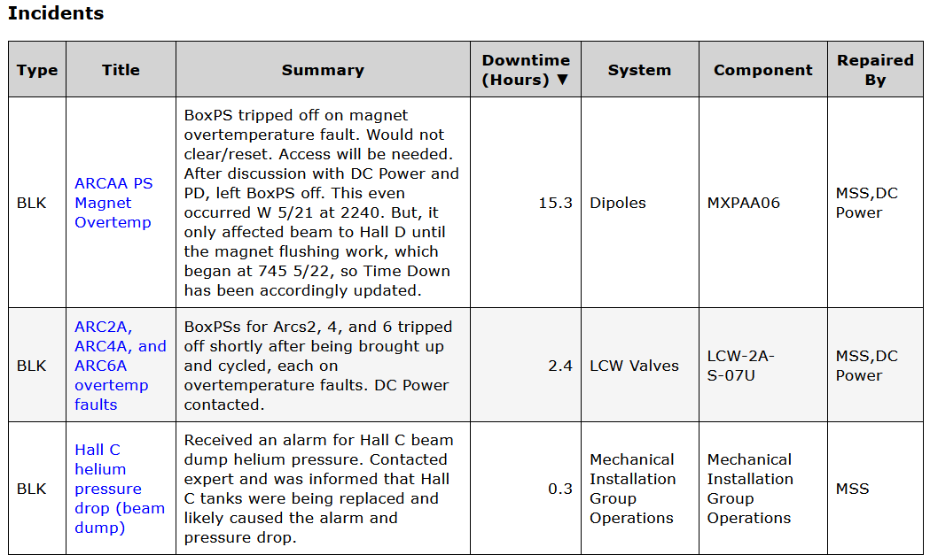
Issues or concerns
Personnel issues as a result of the VSP are minimal at this time.
Some loss for CEBAF support but mitigation plan in place or being discussed.
Cashflow
Most project parts are already purchased so this is not a major concern for this SAM
Schedule
The possible shutdown and mandatory vacation days will cause disruptions.
We need to monitor this closely and talk openly in the 1:30 meetings about impacts. Leadership is aware.
Some cryo plans already changing, Jonathan can say more.
Downtime
Need to make sure folks know how to look at downtime associated with their groups

Slide 6
Summarize the FY25 Run
Operated and maintained five cryogenic plants for the 2025 CEBAF run
Central Helium Liquefiers (CHL1 and 2)
CHL1, 3.5 hours, CHL-ESR Transferline Vacuum Issue
CHL2 0.0 hours
End Station Refrigerator 1/2
ESR1, 0.0 hours
ESR2, 0.5 hours, Turbine Pod T4 24V Issue
Hall D refrigerator
HDR, 0.0 hours
LINACs
2L11, 0.4 hours, Liquid Level Overshoot
Notes:
Guidelines: 6-8 bullets per slide; Use sentence fragments for bullets
To change the photo: Right-click on photo and select change photo

Slide 7
Strengths and Weaknesses
Strengths:
Ability to modulate operating point of cryoplants to save site wide electric power usage.
CHL1 optimization and wide operating range of the ESR2 cryoplants are few examples.
Supported single module pump down's which isn’t common around the DOE complex.
In-house troubleshoot and repair capabilities to quickly address alarms/trips/shutdowns.
In-house fabrication and installation capabilities to upgrade existing aging sub-system.
Weaknesses:
Aging 2K Cold Box [SC2N] for CHL2 cryoplant
Lack of helium gas recovery and purification capability at ESR2
Insulation vacuum leak issue at north LINAC return transfer line
Aging CAMAC

Slide 8
Improvements and Goals
Improvements [Ongoing and Completed]
ESR2 replaced aging ESR1 cryoplant after internal piping helium leak repair.
Addition of a new 10k Liter Liquide Helium Dewar at ESR2 provide us greater flexibility in helium inventory management
Addition of a new 20k gal. Liquid Nitrogen Dewar provided a boost for the onsite inventory
New CTF Shield Refrigerator [CB1] and distribution system
Refurbishment of old CTF Cold Box – 2 and a short run test so it can serve as a backup for cold box 3
Installation of warm cross connect piping to allow use of ESR1 compressor skid as a backup for ESR2 cryoplant
Replacing CAMAC with PLC control in the North LINAC
Goals:
Replace CHL2 2 K Cold Box [SC2N]
Upgrade CTF 2K/4K Recovery Refrigerator, Cold Box - 4
Recovery system and helium purifier for ESR2
Helium gas storage tank for ESR2
Refurbish helium compressors with high run time
Secure more operational spares such as MECOS cold compressor controls

Slide 9
Questions???

