Slide 1

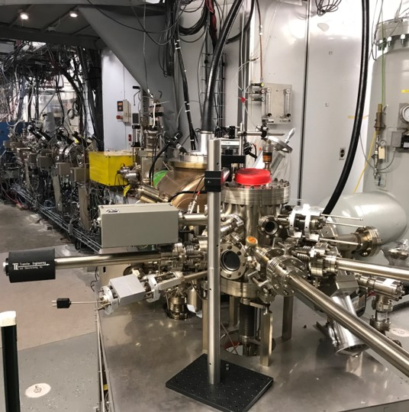
MOLLER Program – Progress and Plans
2025 Run Retreat
October 7, 2025
Riad Suleiman
Notes:
Tip: Keep titles under 60 characters for readability
To change the photo: Right-click on photo and select change photo

Slide 2
Outline
MOLLER 2025 Beam Studies:
Injector
Hall A
MOLLER Tasks – Status
Plans:
Non-Beam Activities: RTP HV Driver, IA HV Driver, Helicity Magnets Controller
SAM25 Activities
Injector Beam Studies
Other Activities: Laser Table, MOLLER Compton AI/ML, SBIR Phase II MeV Wiens
Notes:
Guidelines: 6-8 bullets per slide; Use sentence fragments for bullets
To change the photo: Right-click on photo and select change photo

Slide 3
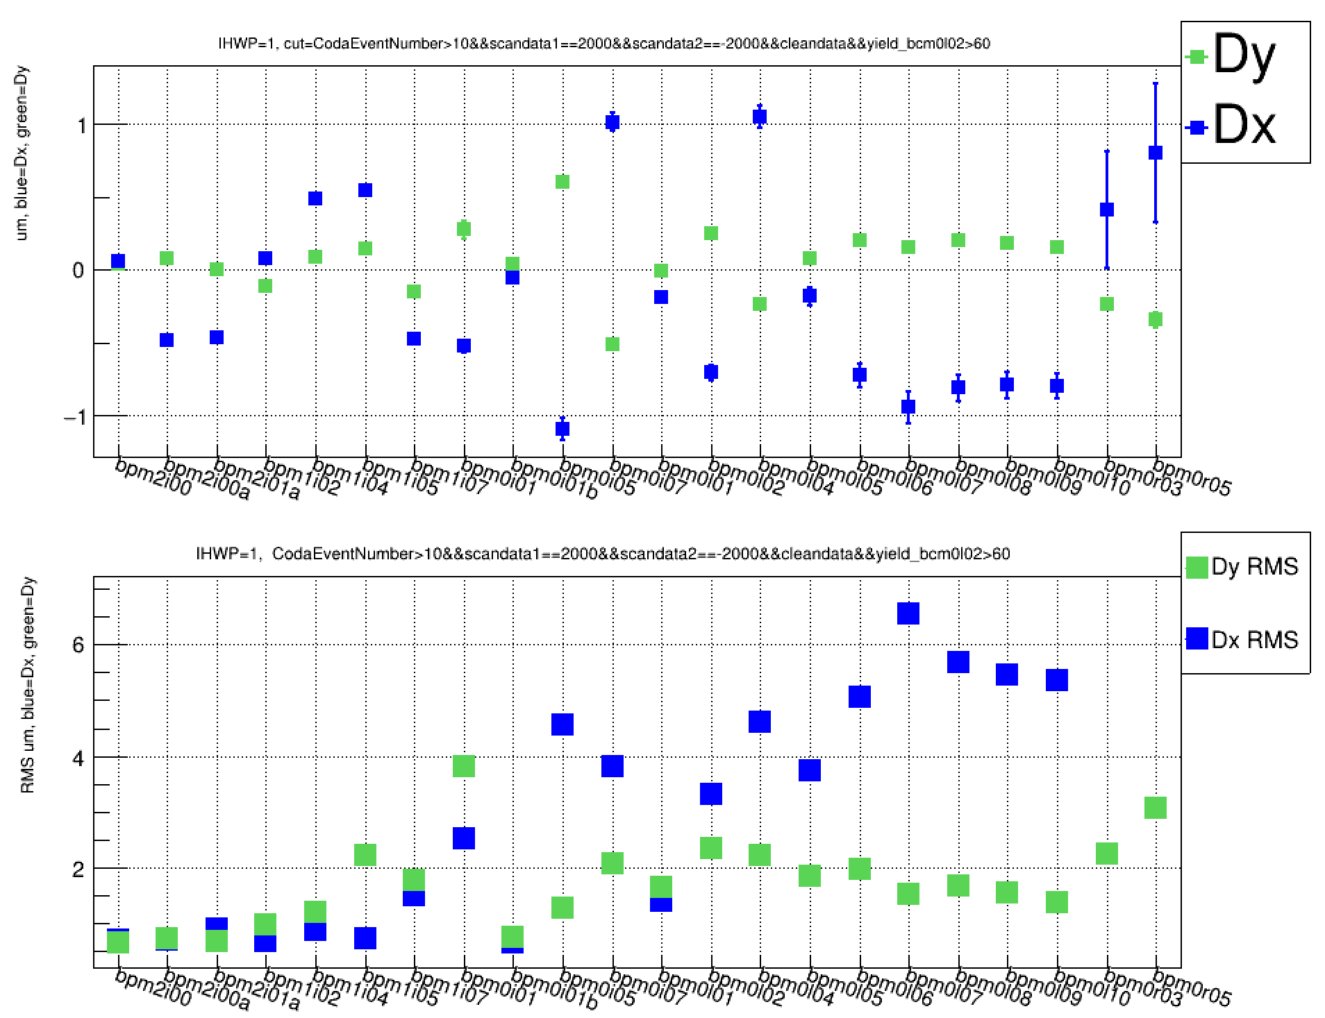
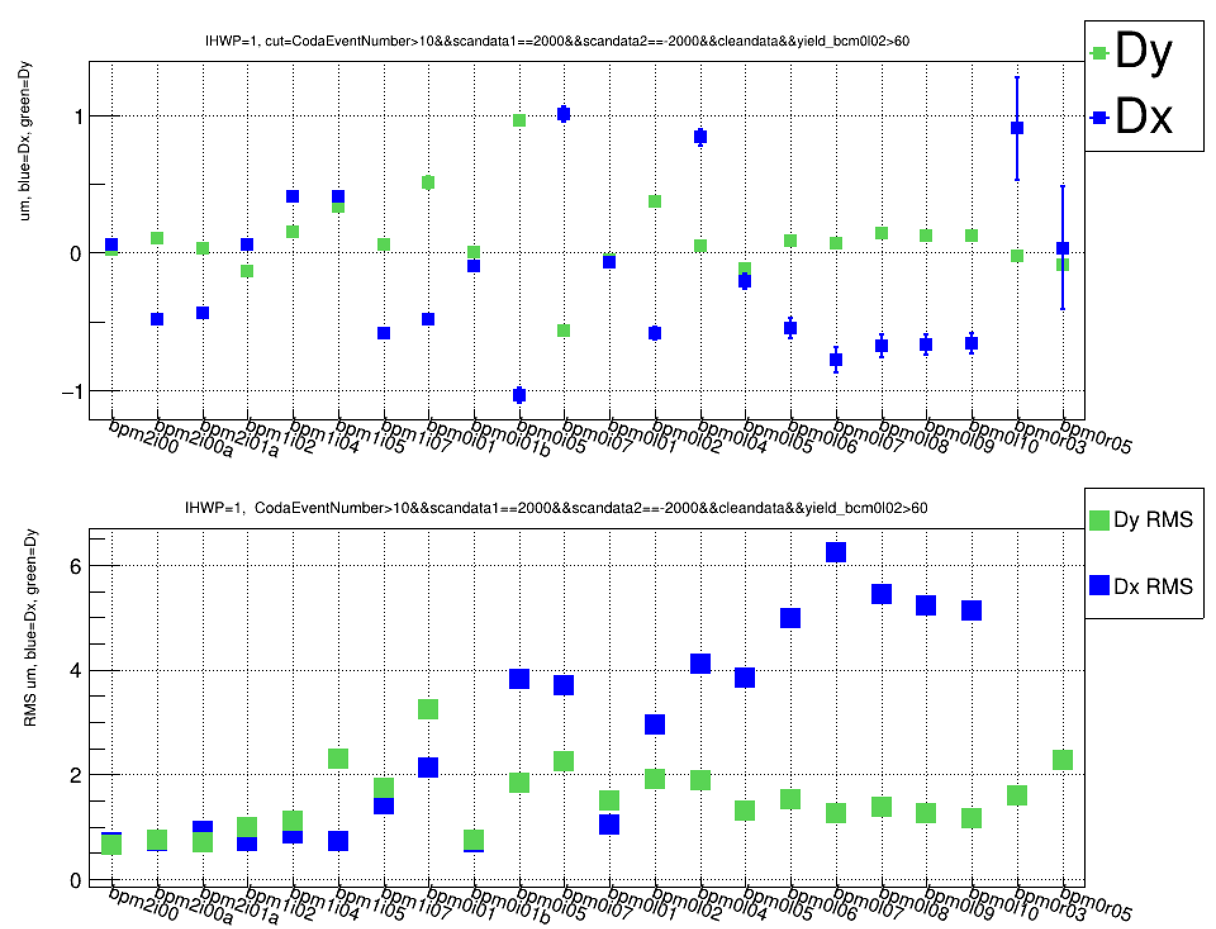
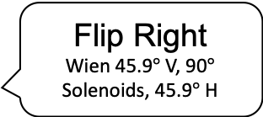
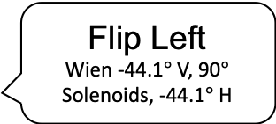
MOLLER Beam Studies – Injector
Completed initial studies in Injector at 200 keV with encouraging results:
Small helicity-correlated beam asymmetries
Good transmission (>98%)
Wiens slow helicity reversal (see Figure)
Charge and position feedbacks
Longitudinal beam polarization feedback using Wien
Measured adiabatic damping across Booster - transfer matrix shows adiabatic damping of about expected order of magnitude
Trained MOLLER students and postdocs
Continue with more studies
Flip Right
Wien 45.9$°$ V, 90$°$ Solenoids, 45.9$°$ H
Helicity-correlated position differences are very similar – good cancellation when combining data
Helicity Correlated Position Differences
Flip Left
Wien -44.1$°$ V, 90$°$ Solenoids, -44.1$°$ H
Injector Beam Position Monitor
Notes:
Guidelines: 6-8 bullets per slide; Use sentence fragments for bullets

Slide 4
MOLLER Beam Studies – Hall A
2025 run period was last opportunity for MOLLER beam studies in Hall A
Completed beam studies:
Studied Fast Feedback (FFB) system to reduce line-harmonics position and energy noise (system was routinely used in 6 GeV era but rarely after 12 GeV upgrade):
Hall A 2025 physics run had FFB ON during routine operations
Measured beam noise using MOLLER parity data acquisition system
Measured beam noise using accelerator LabJack
Measured adiabatic damping with accelerator tools (raytrace) – more work to develop this
Tested Beam Modulation (position, angle, and energy) – system is fully operational
Tested Polarization Feedback using Horizontal Wien – acceptable beam in Injector and Halls
More on FFB in next slide
Notes:
Guidelines: 6-8 bullets per slide; Use sentence fragments for bullets

Slide 5
Results of Fast Feedback Studies
FFB is designed to reduce rms motion at 60 Hz, 120, and 180 Hz line harmonics (and near dc). Most of motion above 200 Hz is either unaffected or slightly amplified by FFB
Beam studies showed that FFB system works as designed
FFB was designed to reduce rms motion in 60 Hz harmonics not rms differences in a band with aliased signals
FFB will always increase these rms differences when on
MOLLER still wants FFB on to reduce overall beam motion and stabilize beam energy (MOLLER ERR Comment)
Excessive noise in vertical position is due to SEE BPMs readout – any beam current noise adds artificial noise to vertical but not horizontal position (ERR Comment)
Investigate and reduce beam current noise
Many thanks to Nick Sereno
Notes:
Guidelines: 6-8 bullets per slide; Use sentence fragments for bullets

Slide 6
MOLLER Tasks – status
Task ID | Topic | Scope | Status | Comment | Completion
1 | Helicity Generator | Helicity board with new settings | Settings are available and tested at 2 kHz | Perform CEBAF-wide beam test to check readiness | 100%
2 | Helicity Decoder | New Boards for delayed helicity reporting | Built and distributed to few users | All DAQs must use – distribute boards to halls | 100%
3 | RTP Pockels Cell HV | Build, install a new 8-channel driver, with 10 µs risetime, electrically isolated | Final optimization | Install in SAM25 | 90%
4 | IA HV Driver | Build, install a new 4-channel driver, with 10 µs risetime, electrically isolated | Prototype design is ready | Build, test, and install in 2026 | 40%
5 | Helicity Magnets Controller | Build, install new control system, with 10 µs rise-time, electrically isolated | Requirement document is ready | Build, test, and install in 2026 | 20%
6 | Polarization Feedback | Provide Wien feedback to keep longitudinal polarization within 0.03° | Beam tests showed viability of using keV Wiens | Possible Phase II SBIR to build MeV Wiens | 90%
7 | Wien Filter Slow Reversal | Study Wiens Flip-Right and Flip-Left setups | Initial beam studies showed a reasonable reversal | Must fix vacuum spikes | 50%
8 | Injector Transmission and PQB | Optimize injector transmission for > 95% | Initial beam studies showed acceptable transmission | Evaluate apertures (A1, A2, A3, and A4) | 50%
9 | Matching and Adiabatic Damping | Deliver matched beam and adequate damping | Measured across Booster, Accelerator will use raytrace | Finish raytrace analysis | 80%
10 | Fast Feedback | Test and maintain existing system | FFB works as designed | Measure current noise affecting vertical position | 90%
11 | Compton Polarimeter Background | Setup beam thru polarimeter with low halo > 100 Hz/µA | Added harp. No beam to Hall A till 2027 | Working on Compton AI/ML | 50%
12 | Beam Modulation | Hot checkout and maintain system | Beam study showed a working system, need final results | Collaboration want current modulation (new request) | 100%
13 | Phase Advance | Design Hall A beam optics with sufficient phase advance | Was done before and designed optics with phase advance | Test in 2027 | 100%
14 | K-long Beam | Study photocathode effects and beam loading in Linacs | K-long is not running in Hall D during MOLLER | Propose to retire | --
14 | Low Beam Current | Deliver low beam current for detectors calibration | New Task, ERR Recommendation | MOLLER collaboration will provide requirements | 0%
15 | Control of Charge Asymmetry | Measure and control charge asymmetry of Halls B, C, D | New IA system was added in Hall D laser | Perform feedback tests for Hall B and D beams | 25%
16 | PQB in Injector and Hall A | Setup PQB in injector and Hall A and perform beam studies | Performed initial beam studies | More beam studies and reduce vertical position noise | 60%
17 | Hallo Monitors in Hall A | Install halo target and detectors and provide FSD and EPICS controls | New halo monitor is being built | Install halo monitor in Hall A beamline | 50%
18 | MOLLER Apparatus Protection | Protect apparatus from beam mis-steering | Comprehensive scheme has been outlined | Implement with Ops and RadCon Group (ERR Comment) | 10%
19 | BPM Receivers | New receivers in Hall A line instead of old SEE electronics | Digital receivers are ready | Implement during MOLLER installation | 60%
20 | BCM Receivers | New BCM receivers in Hall A line to meet linearity and noise requirements | Receivers meet linearity requirement but not resolution | Identify source of noise and rebuild digital receivers | 30%
Items for discussion
Notes:
Guidelines: 6-8 bullets per slide; Use sentence fragments for bullets

Slide 7
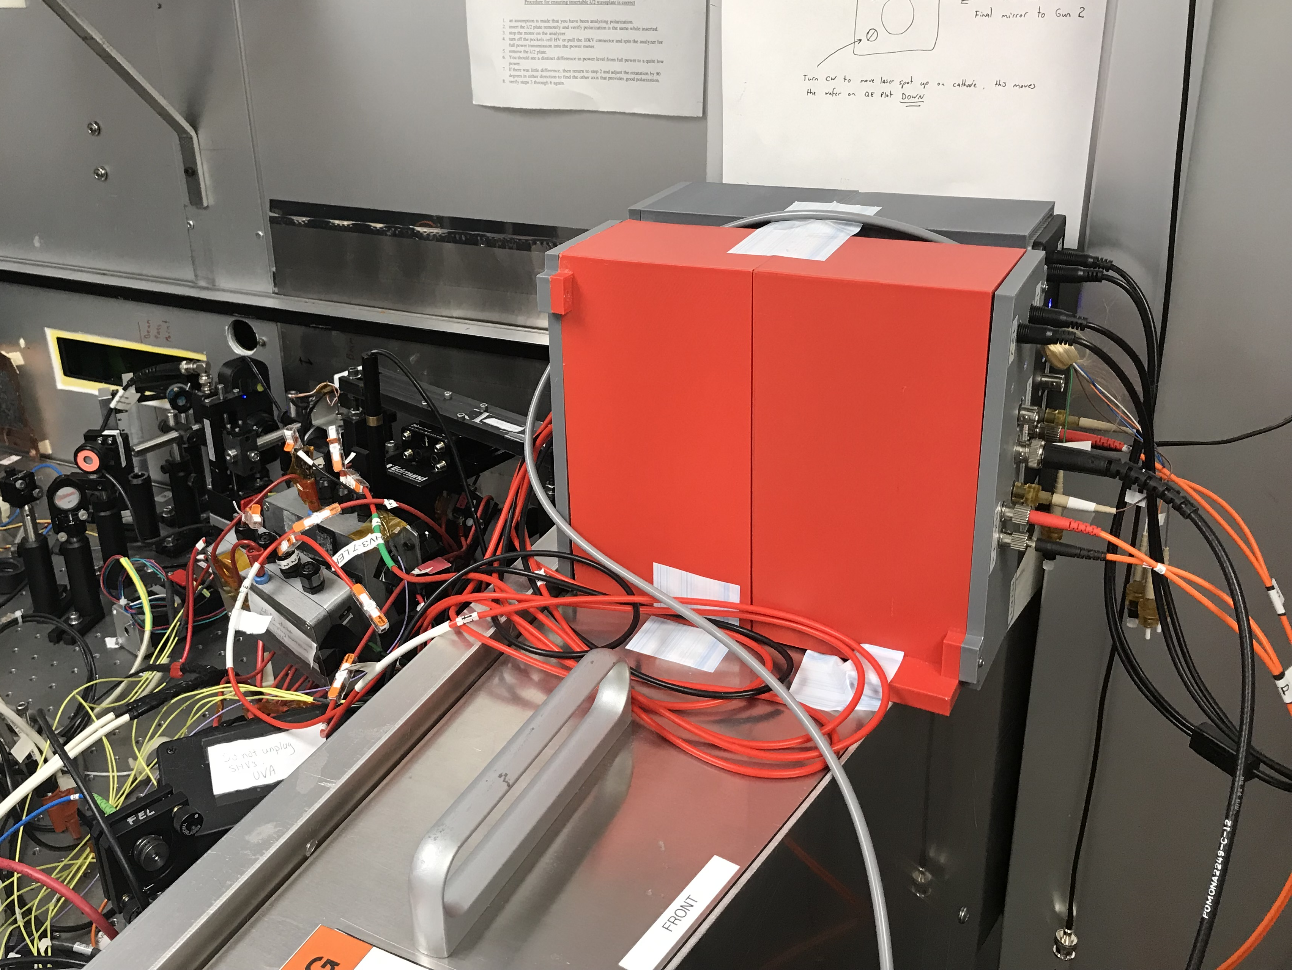
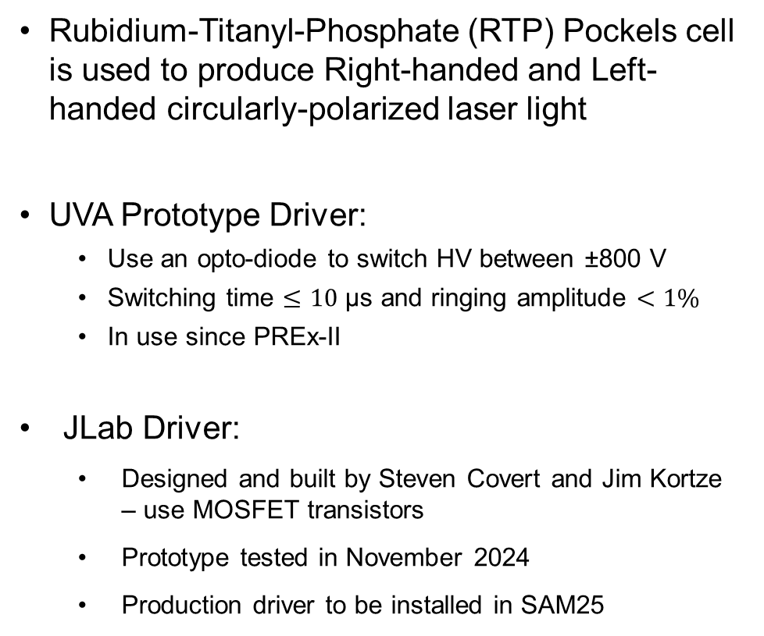
Plans – New JLab RTP HV Driver
Rubidium-Titanyl-Phosphate (RTP) Pockels cell is used to produce Right-handed and Left-handed circularly-polarized laser light
UVA Prototype Driver:
Use an opto-diode to switch HV between ±800 V
Switching time $≤10$ µs and ringing amplitude $<1\%$
In use since PREx-II
JLab Driver:
Designed and built by Steven Covert and Jim Kortze – use MOSFET transistors
Prototype tested in November 2024
Production driver to be installed in SAM25
RTP Crystals
HV Driver

Slide 8
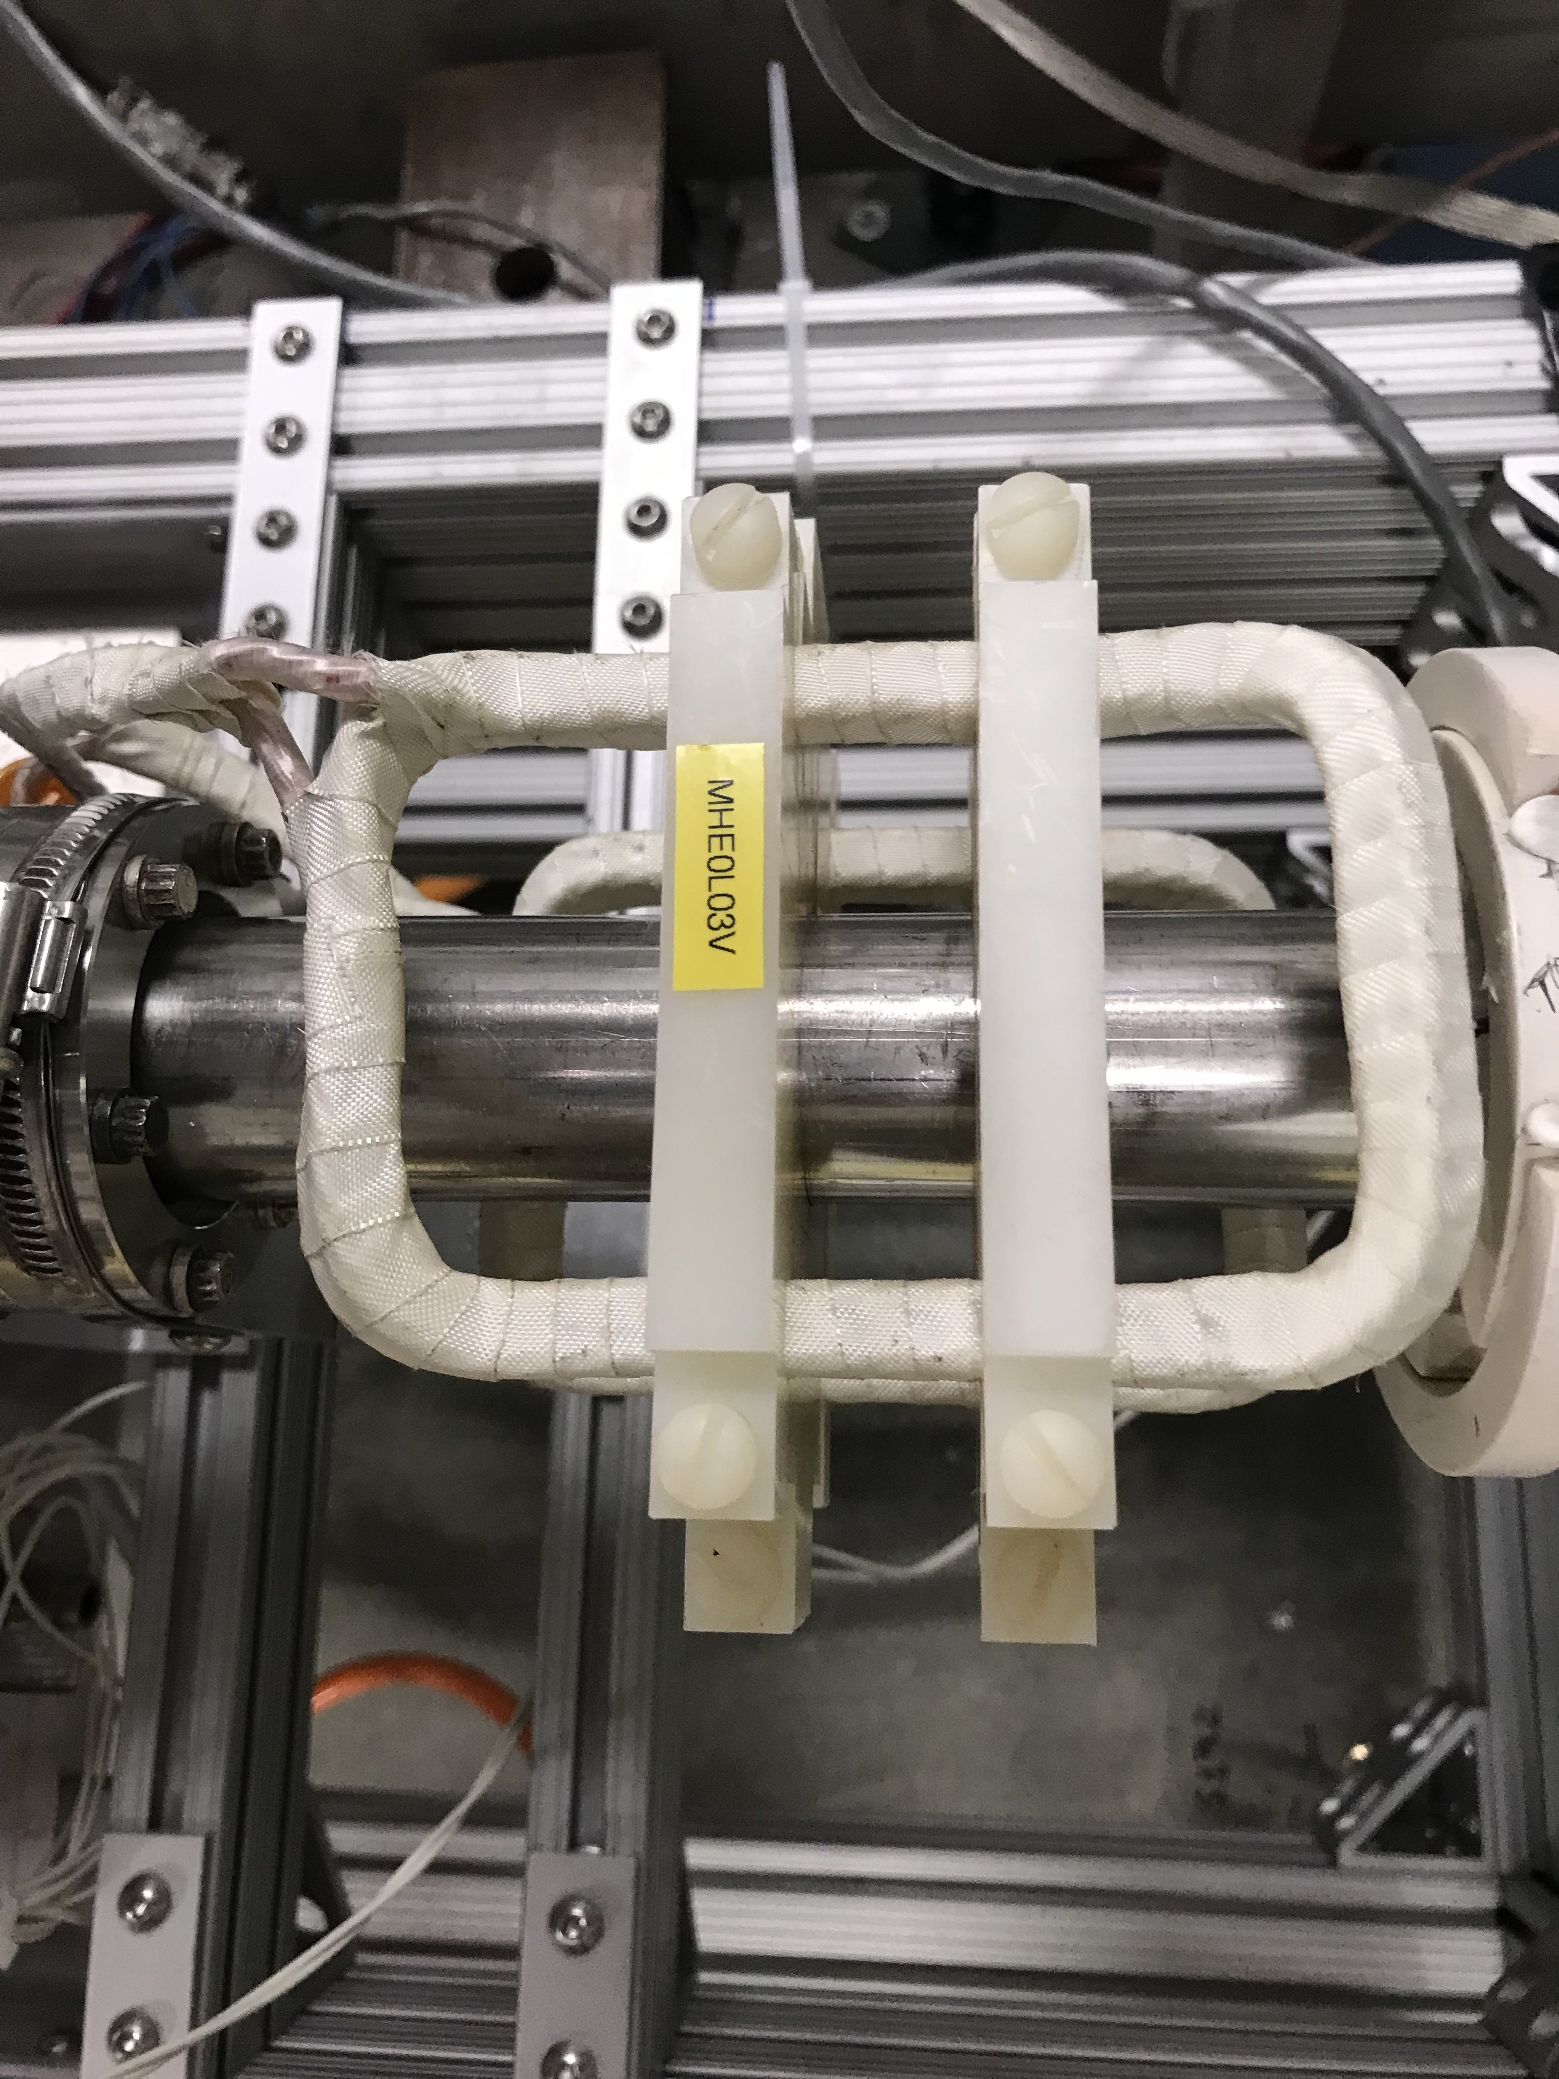
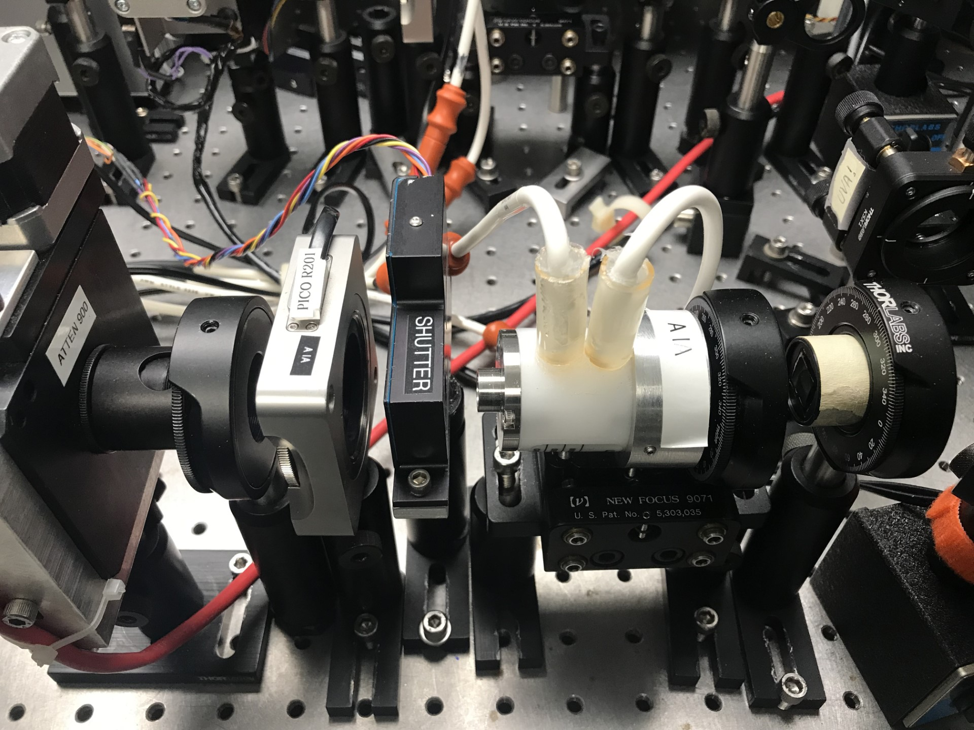


Plans – IA HV Driver and Helicity Magnets Controller
New Intensity Attenuator (IA) HV Driver is planned
Use ±105 V precision Operational Amplifiers
Switching time $≤10$ µs
IA system for each Hall (A, B, C, and D)
New Helicity Magnets controller is planned
Switching time $≤10$ µs – need to overdrive magnets or use ceramic pipes (ERR Comment)
Four air-core magnets made of Litz wire are installed in Injector MeV region
LP
λ/2 WP
KD*P PC
LP
Notes:
Guidelines: 6-8 bullets per slide; Use sentence fragments for bullets

Slide 9
Plans – SAM25 Activities
Investigate Wiens vacuum spikes
Laser Table Tasks:
Measure laser power noise spectra
Isolate why Hall A Tune-Mode-Generator extinction ratio is low
Determine root cause for Hall A laser drift
Measure photocathode analyzing power with anode biased at low voltage
Check laser beam position on vacuum window for different xy-stage values covering photocathode active area
Measure degree-of-linear-polarization before and after steering lens
Measure rise-time KD*P Pockels cell of IA system
Change reference laser to Hall A (MOLLER and high current laser) instead of Hall B
Install a camera to monitor laser beam size and pointing
Hall A Laser is not ready for MOLLER
Notes:
Guidelines: 6-8 bullets per slide; Use sentence fragments for bullets

Slide 10
Plans – Injector Beam Studies
Wien Flip symmetry measurements when using Vertical Wien and using Solenoids
Measure adiabatic damping in Injector using parity DAQ
Measure helicity pickup
Measure transmission and parity-quality beam – evaluate apertures (A1, A2, A3, and A4)
Commission Helicity Magnets and test position feedback
Measure vacuum window birefringence and photocathode analyzing power
Preform Chopper scans: measure electron beam properties along bunch
There are two spare photocathodes in prep chamber in addition to operation photocathode
Evaluate these three photocathodes (quantum efficiency, polarization, and analyzing power) and plan to run MOLLER with best one
Notes:
Guidelines: 6-8 bullets per slide; Use sentence fragments for bullets

Slide 11
Plans – Other Activities
Laser Table – next SAM, MOLLER Collaboration want to install a new RTP cell on laser table followed by a few weeks of laser alignment and parity-quality laser beam studies:
Need very clear roles and responsibilities
MOLLER Compton AI/ML:
Goal: minimize Compton detector background and deliver beam that achieves several competing objectives (beam sizes, phase advances, …)
Period-of-Performance: August 29, 2025 – October 31, 2027
Staff: CIS (Riad Suleiman), CASA (Randy Gamage and He Zhang), and ACG (Adam Carpenter)
SBIR Phase II: possibility of new 6.8 MeV Wiens for polarization feedback
This is the new theme in 2026, while beam studies was the theme of 2025
Notes:
Guidelines: 6-8 bullets per slide; Use sentence fragments for bullets

Slide 12
Thank you

