Slide 1
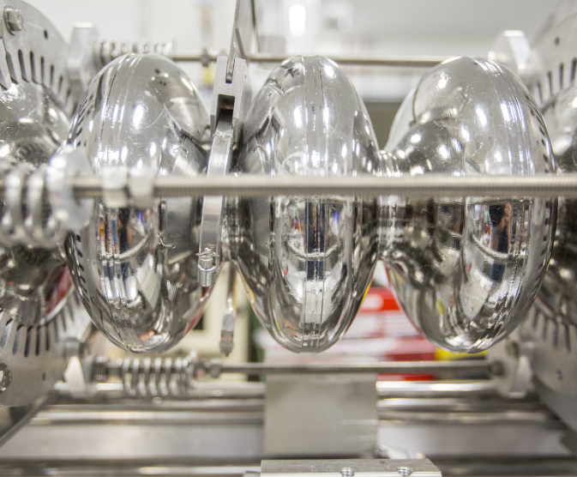
2025 Run Retreat
SRF Ops and Vacuum
M. Drury, A. Duzik, M. McCaughan, R. Ruber, H. Senevirathne

Slide 2
Energy Reach Plan for the FY24 SAD for Cryomodules
Run Summary: Starting Set Up
Plasma Processing Plans
Process (4) C100s in NL
Process 1L05 and 1L10 (C75s) in the NL
Overall for NL
Installed C100-08R into 1L22: +23 MeV
Installed C75-04 into 1L09: +35 MeV
Results in a potential gain of ~ 58 MeV
~98 MeV
~65 MeV
C100-08R
C75-04
Out for Rebuild
Out for Rebuild
1L05
C75@ 60 MeV
1L09
C50@ 0 MeV
1L10
C75@ 57 MeV
1L22
C100@ 75 MeV
Overall for SL
Installed C75-03 into 2L05: +26 MeV
Results in a potential gain of ~ 26 MeV
2L05
C20@ 17 MeV
~65 MeV
Out for Rebuild
C75-03
Note: Cryomodule MeV recorded from 12/18/23 data

Slide 3
Run Summary: Cryomodule Health
No major problems during the FY25 Run
  Major Problems – Problems that require CM taken offline or invasive repairs that halt operations
Some minor problems:
  Tuners frozen or otherwise misbehaving
  IR’s – dead or possible cable problems
  Pump Replacements (Turbo / Scroll)
  4 Appendage pumps added (and now removed)
Some decline in Energy Gain during Run
  ~10 MV in NL
  ~18 MV in SL
    Very rough assessment

Slide 4
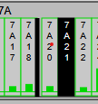
CEBAF Vacuum – FY25 Run
Beam Line Vacuum
  no major problems
Cryomodule Insulation Vacuum
  regular preventive maintenance/replacement of scroll pumps
  increased scroll pump capacity on 0L04 and 2L03 (Triscroll 300 → 600 ≡ 250 → 500 L/min)
Controls / EPICS Displays
  dead or not operated pumps were not included on EPICS displays
  we missed some such ion pumps when doing maintenance
  modified to include and identify by display in black
  seems similar for other beam line equipment such as vacuum gauges and BPMs
  consider if value to do a systematic effort to identify these equipment
  Thanks to Adam
Thanks to Adam Duzik

Slide 5
Run Summary: FE Before / After Run
FE data from the DecaRads.
Collected by Tom and Co. in Feb 2025 after any processing
And towards end of Run in July and August before any new processing
Data collected from 49 cavities in 1L05, 1L07, 1L09, 1L10, 1L26 and 2L23
Average change in the FE Onset gradient = -1.1 MV/m
We need more tracking with DecaRads
We need to push the dose rates lower administratively
  100 mR/hr? 1R/hr?

Slide 6
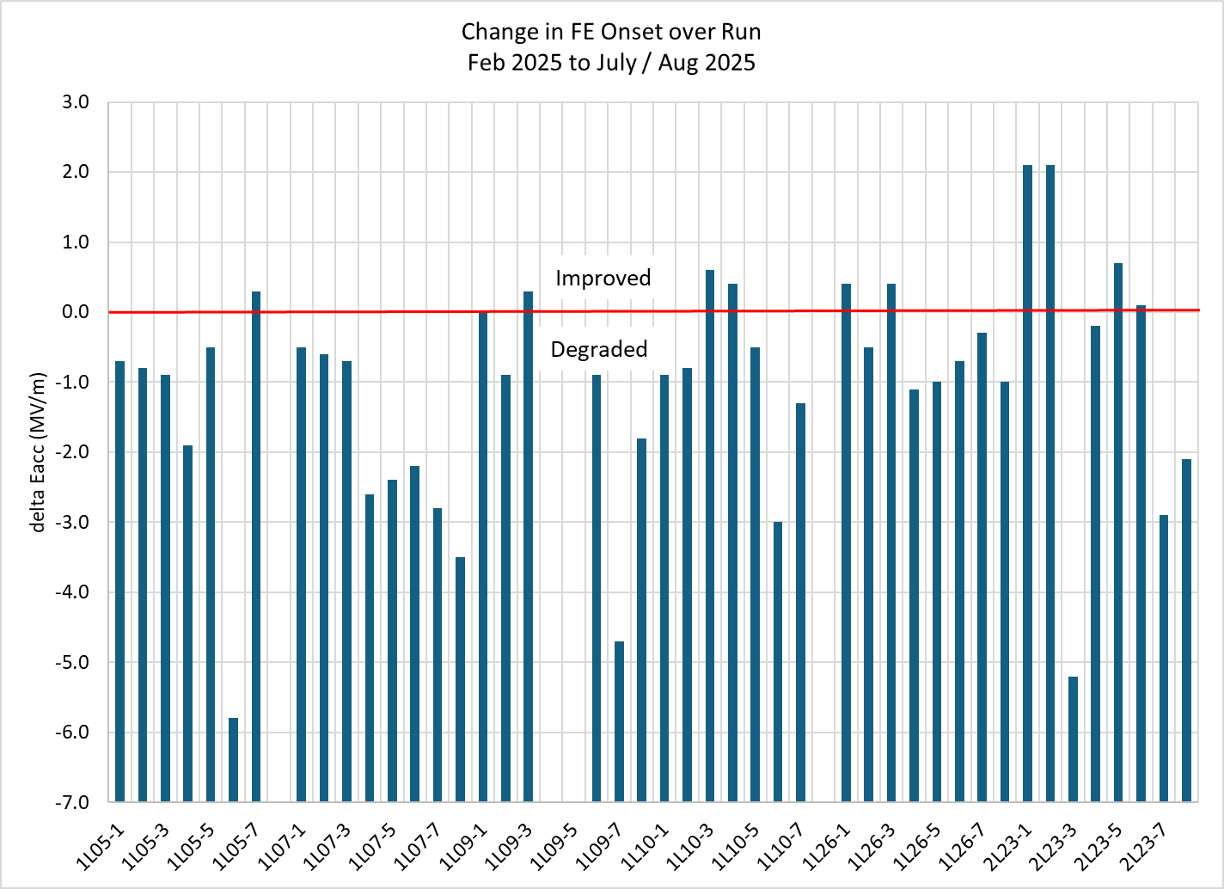
Run Summary: FE Before / After Run
Based on Tom Powers’ data

Slide 7
Strengths and Weaknesses
Strength:
  Many talented people supporting Accelerator Ops from SRF
Weakness
  Not enough talented people supporting Accelerator Ops from SRF
Frank – cold vacuum work
Mike D – work planning, testing
Mike M – Accelerator operations and maintenance functions
Tom, Peter, Harshani – microphonics, plasma processing, etc
Roger et al – Warm Vac work
Several Senior Staff heading towards retirement
Need a couple more Vac Techs
Unplanned Major Repairs can slow down other work as a result

Slide 8
CEBAF Vacuum – Strengths and Weaknesses
Strengths
  manage to keep the system operating with limited resources
Weaknesses
  limited resources, both people and spare parts,
  barely manage with our stock of spare parts:
    more pumps and valves not operational than we can fix during maintenance periods
    example is the AE line where pumps had to be changed out in March as then run was starting because spares only arrived a week before
  no funds for real improvements

Slide 9
Opportunities for Improvement
C75 Tuners
  Extensive Testing of Mechanical Tuners and Steppers during Acceptance Testing
Microphonics Mitigation
  Final round of Bracing in Progress
  Improvements to Damping Bags
Better FE tracking using Decarads or similar instrumentation
Improvements to procedures and Work Controls in progress
Improved CM hand-offs to begin with new installations
Implement the new DRVH scheme
  Requires input from all Groups with concerns about CM performance
Step up processing game.
  More Training
  Defined Team
  Make more efficient use of different processing techniques

Slide 10
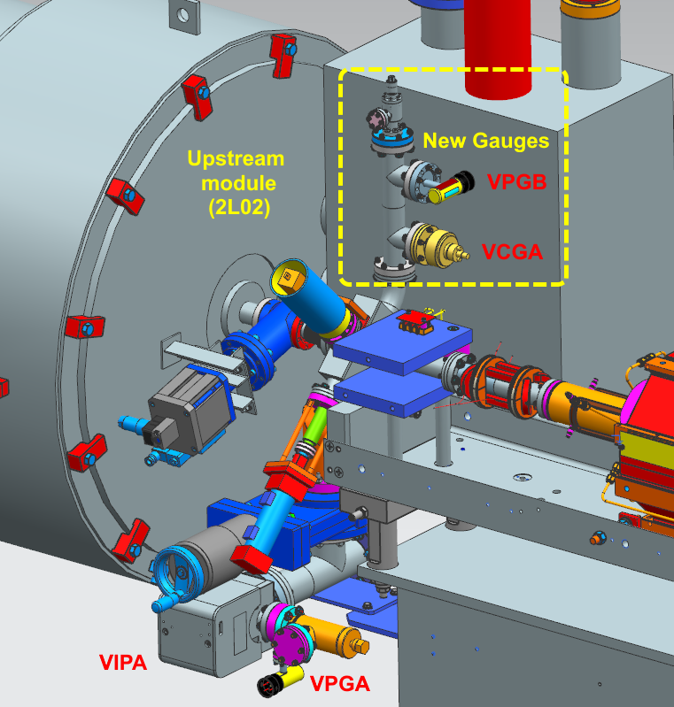
CEBAF Vacuum – Improvements
Warm Beam Line Sections in between Cryomodules
  add gauges to monitor vacuum pressure
    at present, using ion pumps
    gauges are closer to beam, and available if pumps off
  add venting valve
    avoid venting through ion pump
    also useful for plasma processing
  extend union-tee for ion pump
    to ensure sufficient clearance for HV cable connection
Differential Pumping Station
  replace NEG module with modern type
    shedding less particulate
  remove internal slotted beam tube
    to increase pumping capacity
  increase beam tube diameter
    decreases differential pumping effect
    increases beam steering aperture

Slide 11
Maintenance Tracking
Problems:
  No unified or simple way of recording maintenance events (valve seal replacements, ion pump swaps, turbo pump swaps, etc.)
  No system for tracking schedule maintenance
  Some spreadsheets have been tried, with limited success
    Usually lost in the folder structure
    Cumbersome to filter and sort
    Not accessible in tunnel
    Hard to add pictures
Proposed solution: adapt Pansophy for tracking maintenance
  Pansophy used for SRF traveler documentation
  Currently testing ideas

Slide 12
Energy Reach Plan for the 2025 SAM for Cryomodules
Overall for NL
Installed C100-03R into 1L26: +27 MeV
1L12 Insulating vacuum repair (U.S. O-ring)
Various Ion pump / Valve repairs
1L04-8 Tuner examination (6.5 MeV)
1L09-4 Tuner examination (10.5 MeV)
1L12-2 Tuner examination (5.6 MeV)
C100 Microphonics Stabilization
Potential NL net gain of ~ XX MeV
Plasma Processing Plans
Process (2) C75s in NL; 1L05 & 1L10: + XX MeV
~100 MeV
C100-03R
C100-5R Out for Rebuild
1L04-8
Tuner
1L05
C75
1L09-4
Tuner
1L10
C75
1L12
Ins. Vac.
1L12-2 Tuner
1L26
C100@ 72.5 MeV
2L25
Ins. Vac.
2L03
C20 @ ~25 MeV
Overall for SL
Install C75-05 into 2L03: + ~40 MeV
2L25 Insulating vacuum repair
C100 Microphonics Stabilization
~65 MeV
C20-029 (Norfolk) Out for Rebuild
C75-05
Note: Energy from 2025 run data

