Slide 1
The 2025 Run From an Operations Perspective
Ken Surles-Law
Michael Merz

Slide 2
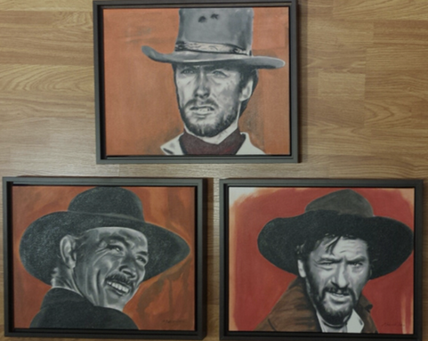
The Good, The Bad, The Ugly

Slide 3
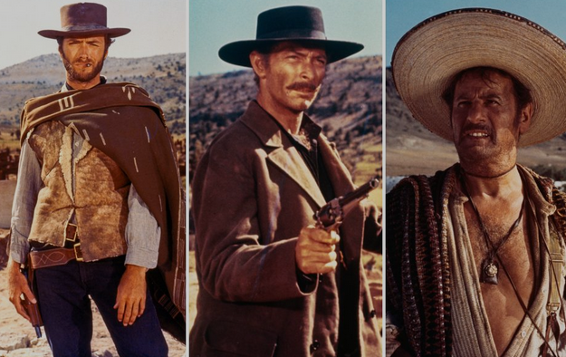
The Good
RF Maintenance: Great communication betwixt RF maintenance lead and on duty CC. The RF lead gave a pass down to the Crew Chief at the close of each RF Maintenance day.
Good support from Optics and DC power, during the Quad mislabeling trauma.
Good support from Optics assisting Ops with troubleshooting the consistent Hall B increased Halo rates.

Slide 4
The Good
Injector stabilization: great effort during the last SAM replacing the helium vent damper in the Injector to gain better control of injector tunnel temperature variations which indeed improved Injector stabilization. Not once did we have to turn on the Inj PID locks.
Great support and cooperation from CIS/Injector group with creating processes for Ops to better understand Injector steering from the laser to the ILD. We are finalizing procedures and processes for Ops to use for this upcoming restoration. Having these procedures available will also give Ops needed injector troubleshooting skills.

Slide 5
The Good
Great support from Optics working with Ops with devising a Beam restoration plan in the form of a BSList.
Great support from our technical writers and administrative assistant with putting together the documents needed to support the upcoming 2026 run.
Thanks to our Operations Director for his support and encouragement of his team, from the Supervisors to the New Operators.
Generating documents on best practices using IDX detectors as steering and scraping diagnostics.
Slowly but surely developing troubleshooting documents.

Slide 6
The Bad
1L06 and 2L06 : recovered after being tagged as bad in cavity history. Once restored, Cavity history not updated, LEM ignored that extra gradient and hence, no compensation made for it. Need better communication and action from CC and RF group. When a cavity or zone is brought back on-line, CC ensure that cavity history is updated. Note: Hall B BOM rates reduced considerably once 1L06 updated in cavity history and reLEM.

Slide 7
The Ugly
ORFP zig-zag woes (ORFP pushes forward towards higher arcs just to start over again in lower arcs: groundhog day). ORFP started 03/11, ended 04/02.
Hall B high BOM rates. On again, off again from: 04/10 – 05/31. Finally settled down 05/31.

Slide 8
Some Improvements
Ops will take an active role with assisting Operability with HCO.
Ops with SME input generating procedures and processes to restore beam after SAM from start to finish.
The CC will be responsible for ensuring that the cavity history is updated for any cavities/zones recovered or by-passed prior to performing a LEM (A simple LEM software reminder to the crew that will detect a cavity being “on” with a history stating it is bad).
Hall B Moller quad controls will be turned over to Ops (similar to Hall A and C).
CC to perform pre-job brief with ops and PI prior to performing BSList.

Slide 9
Improvements
More RF training on LLRF.
CASA assigned Hall SME should work closely with Ops Hall Liaison for developing procedures, troubleshooting guidance, and keeping procedures up-to-date for current experiments.

Slide 10
Versatility of Operations Personnel During the SAM:
Working with DC Power
RF Group
SRF Group
CIS Group
Injector Group
SSG
Operability
CCoC and PD
Software Group
RadCon

Slide 11

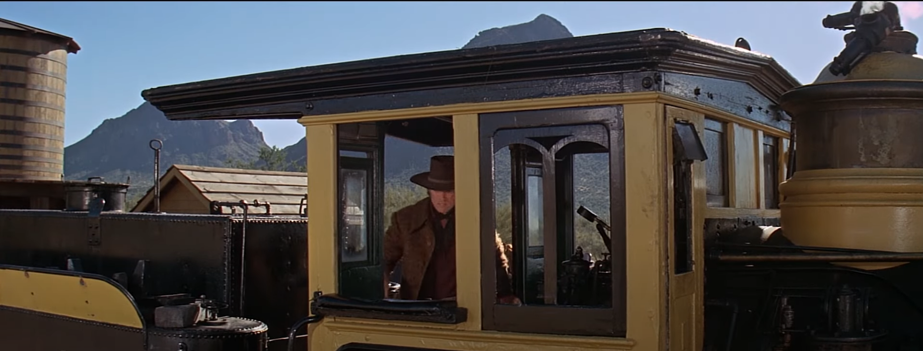
Training

Slide 12

Matt Janak
Jerone Samari
Sarah Shriner
Max Smith
Sweeps
ARM
Moodle
SSO
Notes:
About a year ago, we were fortunate to get 4 great new hires (near the beginning of the fiscal year). Unfortunately, the Safety Stop and other issues prevented running.

Slide 13
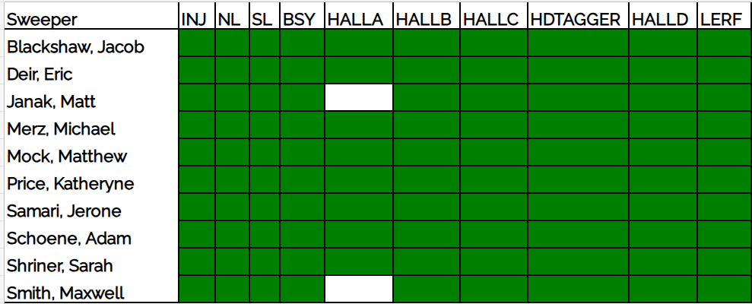
Sweep Qualified: overseen by Schoene
Notes:
We tried to keep them busy. They are Sweep Qualified for most segments. (1 shadow sweep; 1 pseudo-lead sweep)
Helped with a phone survey. Ryan Bodensten's magnet assembly.

Slide 14
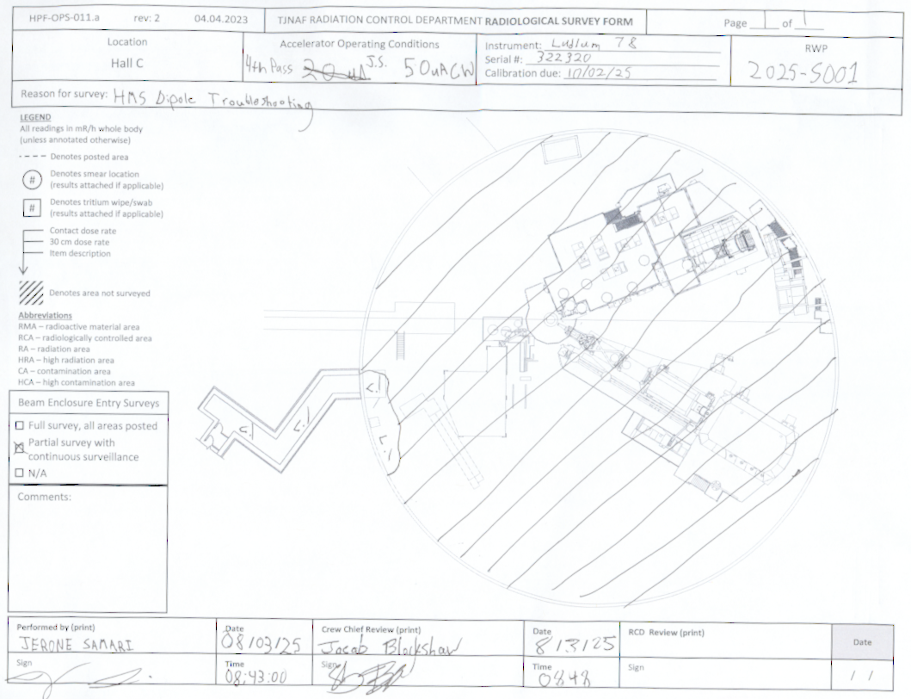
ARM Training: overseen by Blackshaw
About 10 hours of training surveys (Five 2-hour long sessions).
1 training survey of each segment (Injector is not included. LERF is included). For a total of 9 familiarization surveys each.
Two-part proctored exam.
Proctored mock survey of the calibration range (building 54) in which sources are strategically located to create radiological areas the trainees should recognize.
Notes:
Jacob trained them to be ARM qualified; having them follow in his footsteps to get ARM Qualified before SSO.

Slide 15
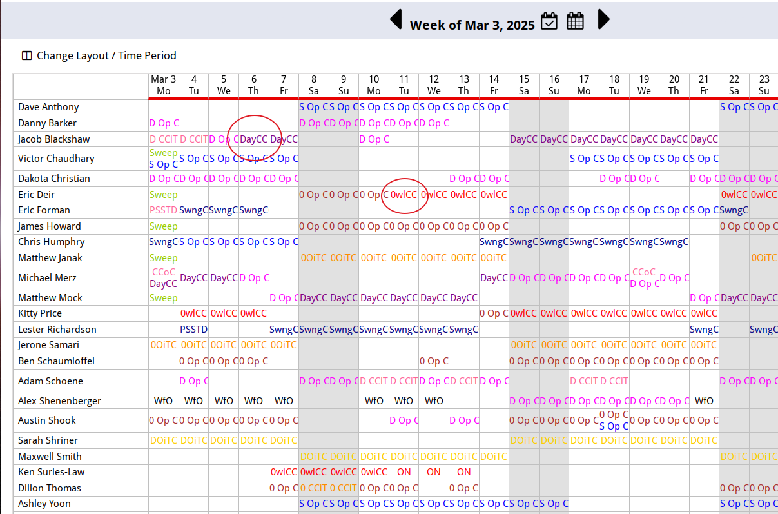
Congrat-ulations New Crew Chiefs!
Notes:
Come March, Jacob & Eric's Crew Chief promotions came through allowing a bit more flexibility in the schedule.

Slide 16
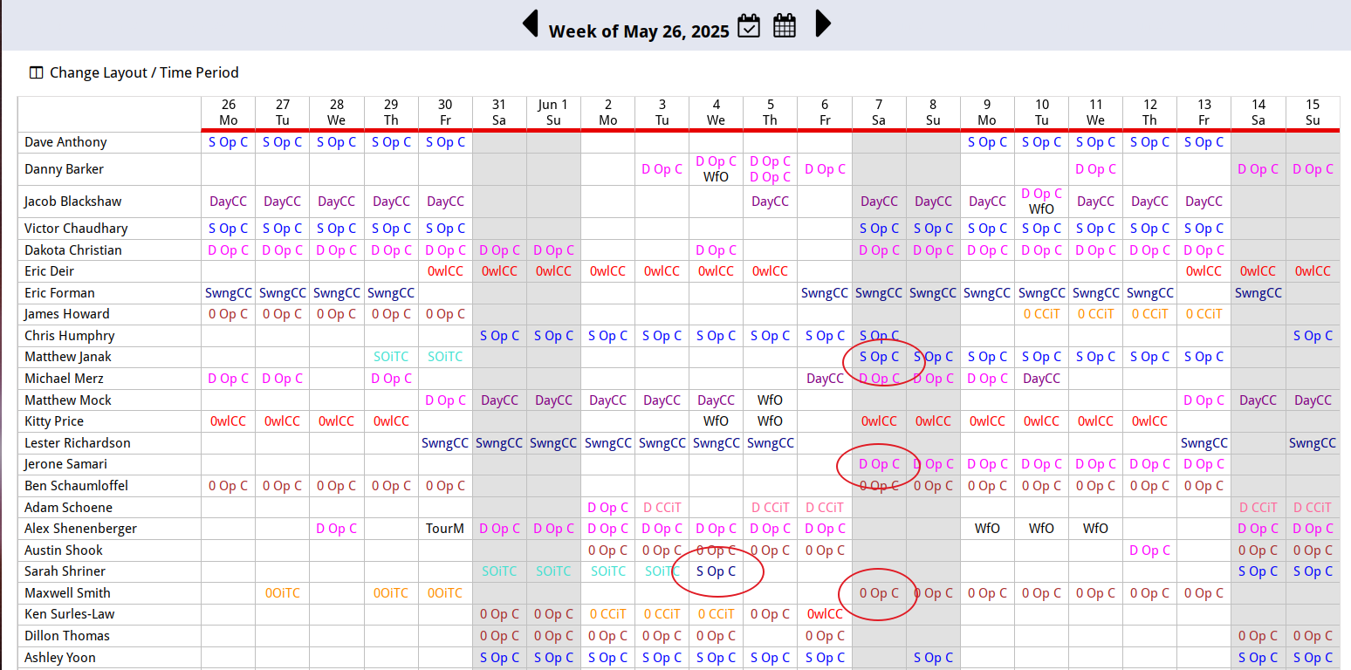
Operator Shifts!
Notes:
Then once we were finally sending to the halls for a respectable amount of time, the new hires were qualified! And performing to a high standard.

Slide 17
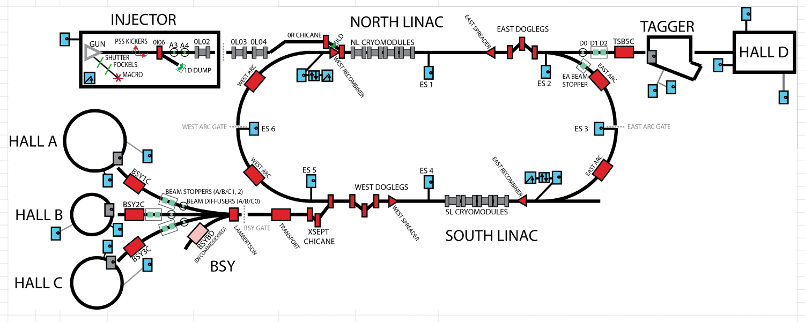
Safety System Operator
All new hires qualified in 2 attempts or less.
First update to official training since 2013 is underway! (See Adam, Jerry, or myself for access if your qualification is near to expiring and would like access to the Draft material.)
Notes:
SSO Qualifications followed at a more relaxed pace.
The additional Crew Chiefs & Operators allowed 4 person crews on all shifts. This was especially helpful on Maintenance & Beam Studies days. It lessened the strain of CCIT training. And of course makes scheduling less stressful when someone calls out!
SSO Jam session recordings online.

Slide 18
Crew Chief in TRaining
James Howard & Adam Schoene passed the Crew Chief Exam
Tests administered by Kitty

