Slide 1

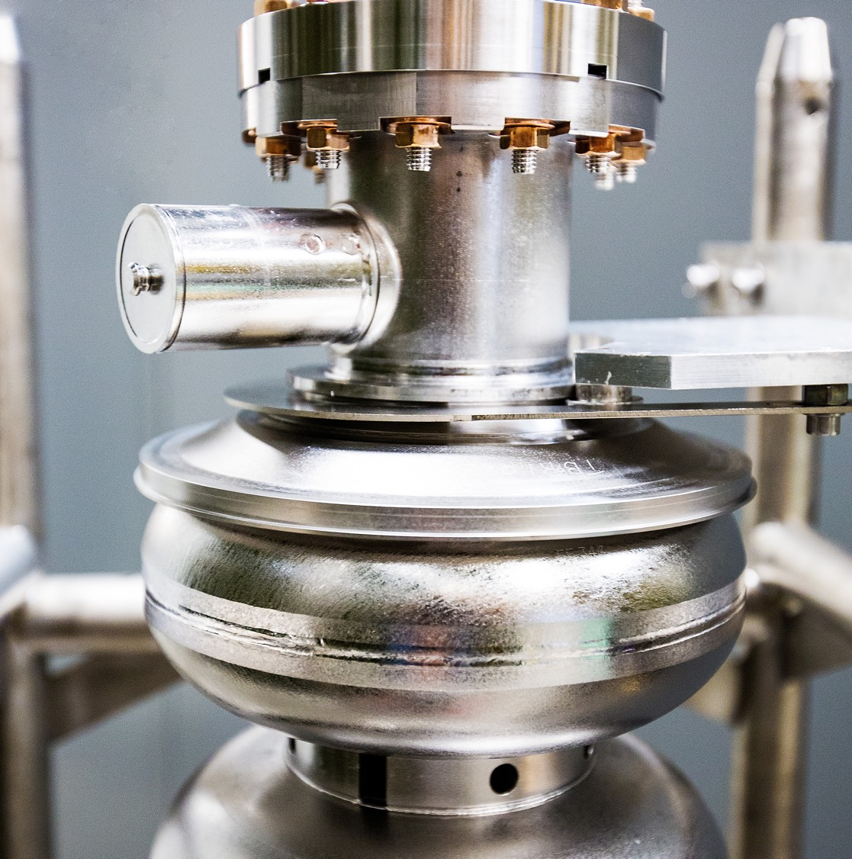
CIS perspective and plans
FY25 run
Strengths, weaknesses, and opportunities for improvement
Operational goals and technical plans
October 7, 2025
Joe Grames
Notes:
Tip: Keep titles under 60 characters for readability
To change the photo: Right-click on photo and select change photo

Slide 2
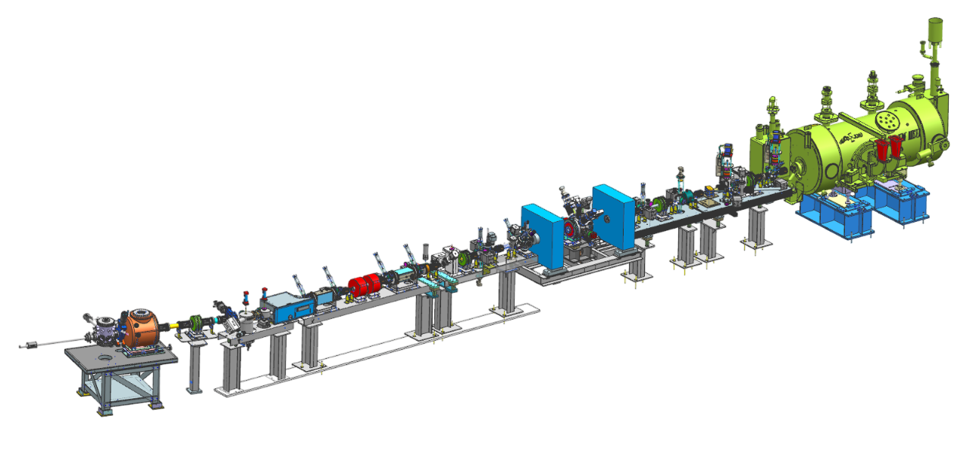
CIS – Key CEBAF objectives
Complete the 200 keV injector upgrade
Improve reliability
Prepare for Moller

Slide 3
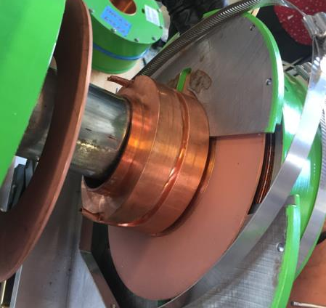
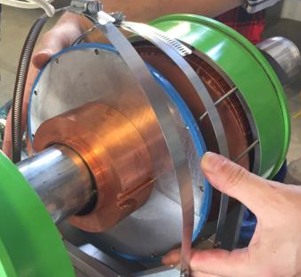
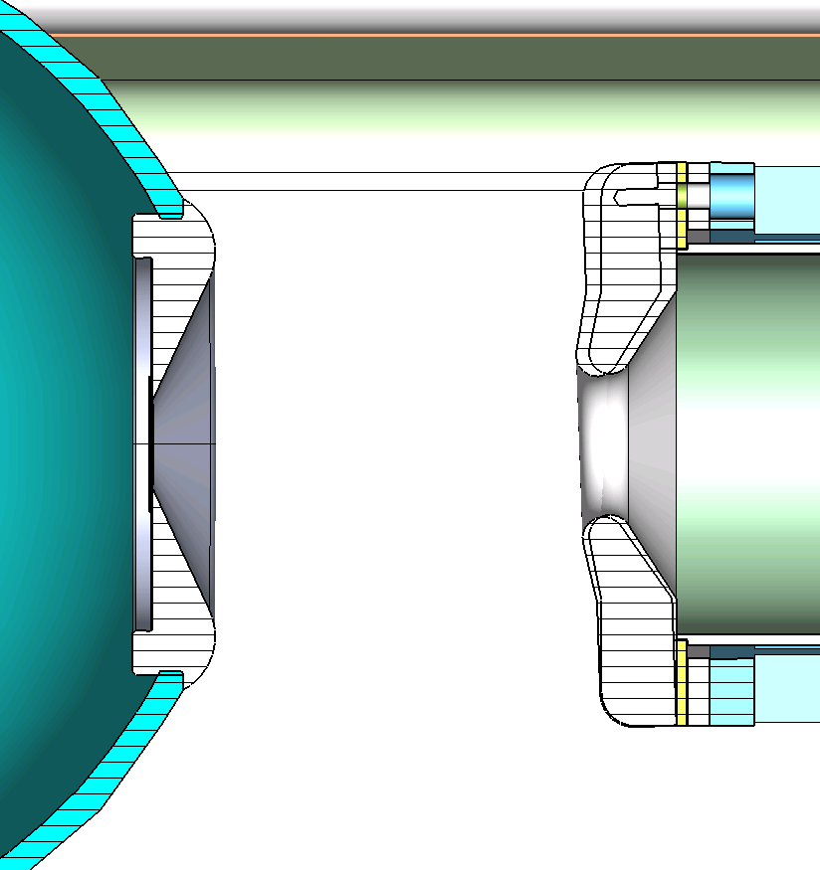
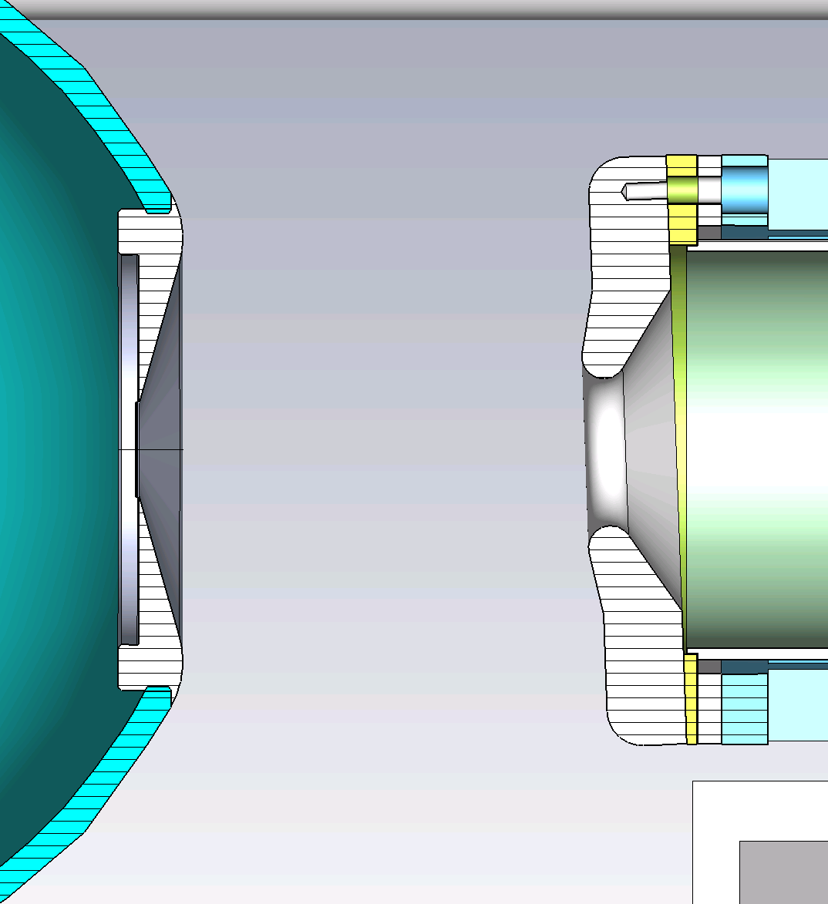
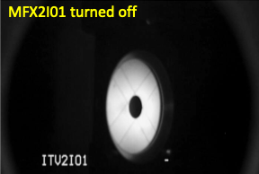
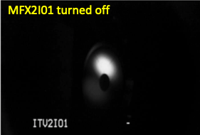
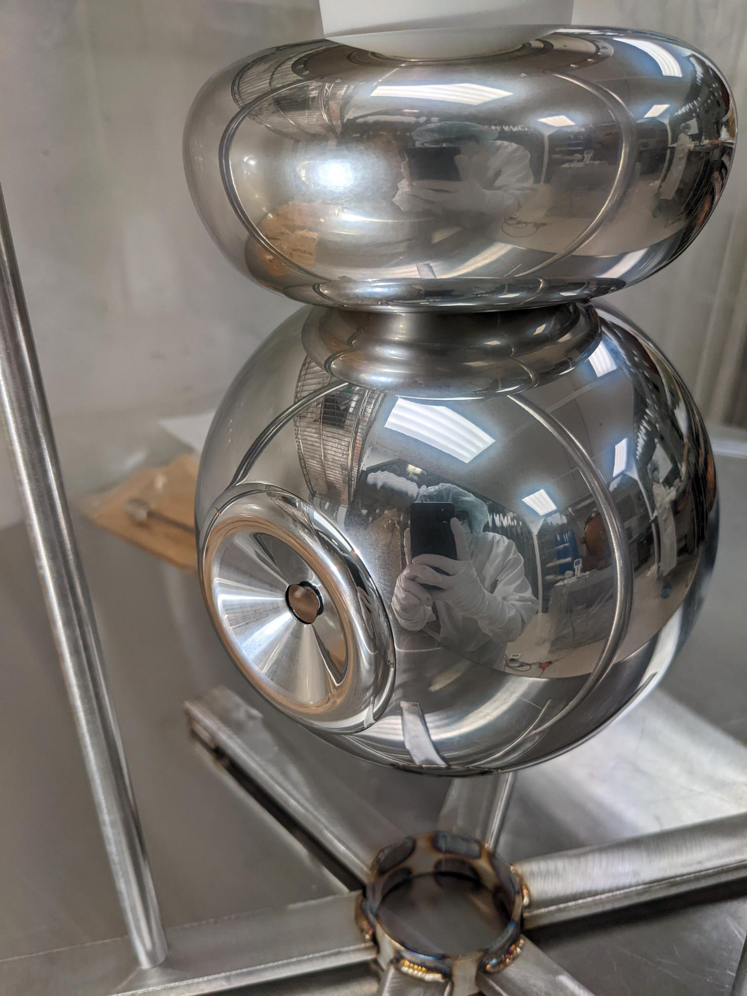
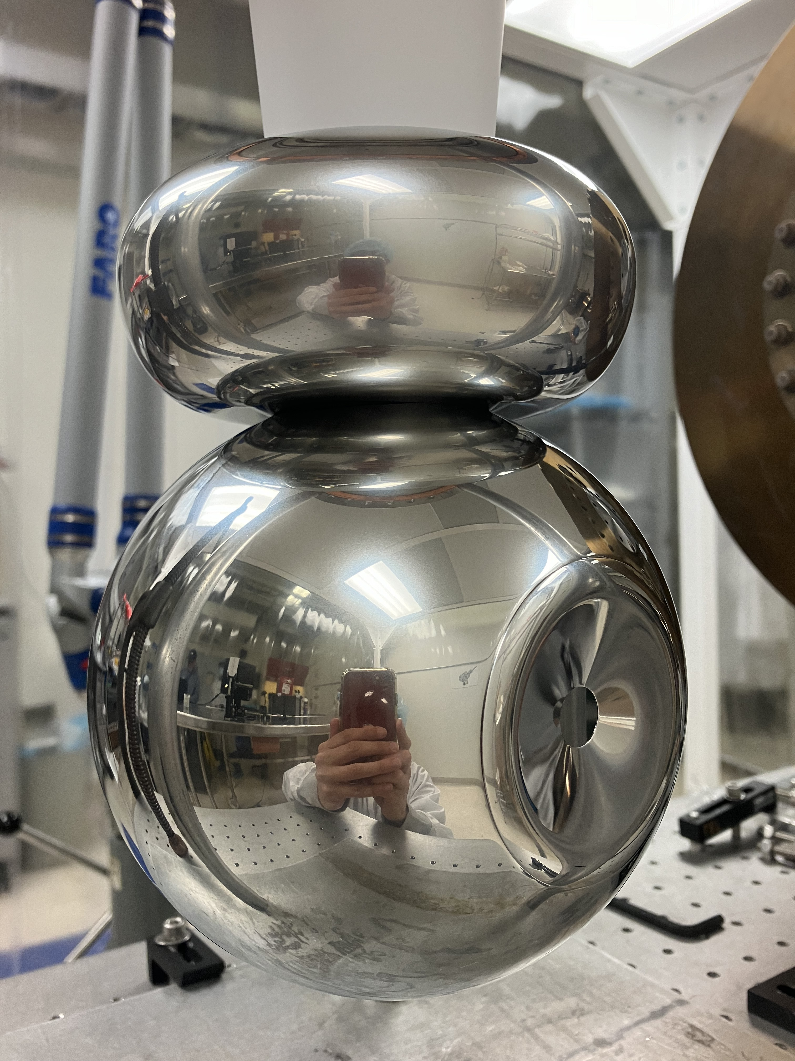
FY25 SAM – correcting work flow design errors
Short focal length of R30-3 gun led to overfocusing. Fixed by lowering cathode focusing strength
All solenoids repaired:
https://tasklists.jlab.org/atlis/tasks/110664
R30-3, 2023 (25 deg)
R30-4, 2024 (16 deg)
before
after
Notch in center plate
25° cathode angle
16° cathode angle
As built:
Notch caused skew multipoles
Repaired:
Correct response
https://tasklists.jlab.org/bslist/tasks/109864
M. Bruker, C. Hernandez-Garcia, A. Hofler, G. Palacios-Serrano, "Photogun simulation workflow: from geometry to beam dynamics". Technical Note JLAB-TN-24-015

Slide 4
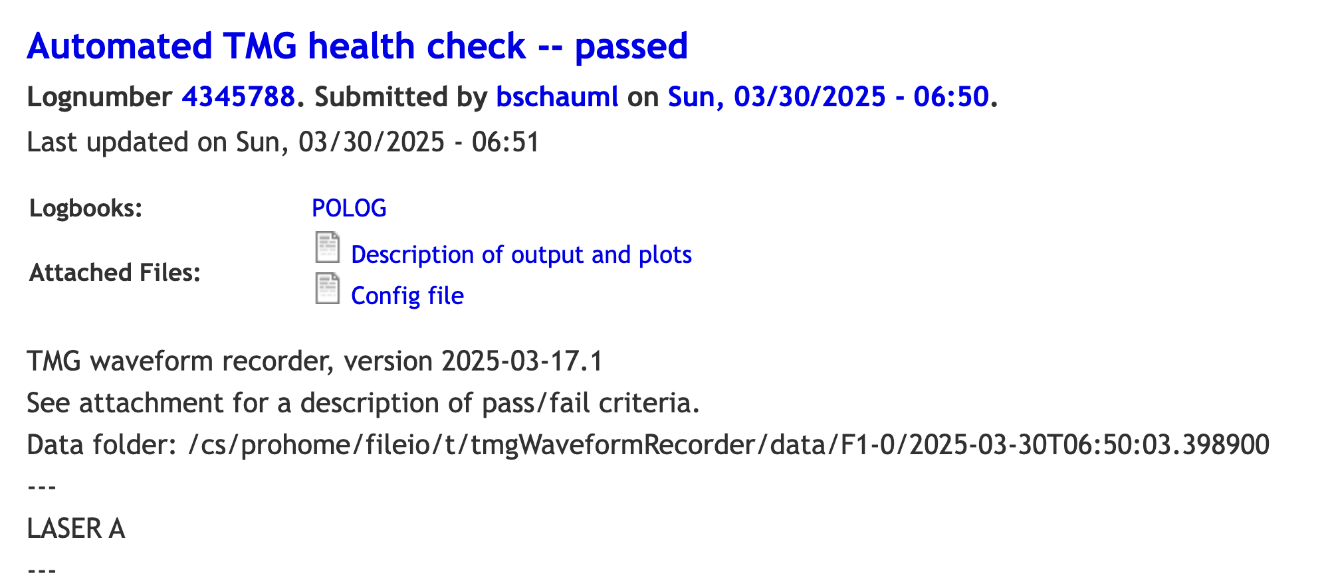
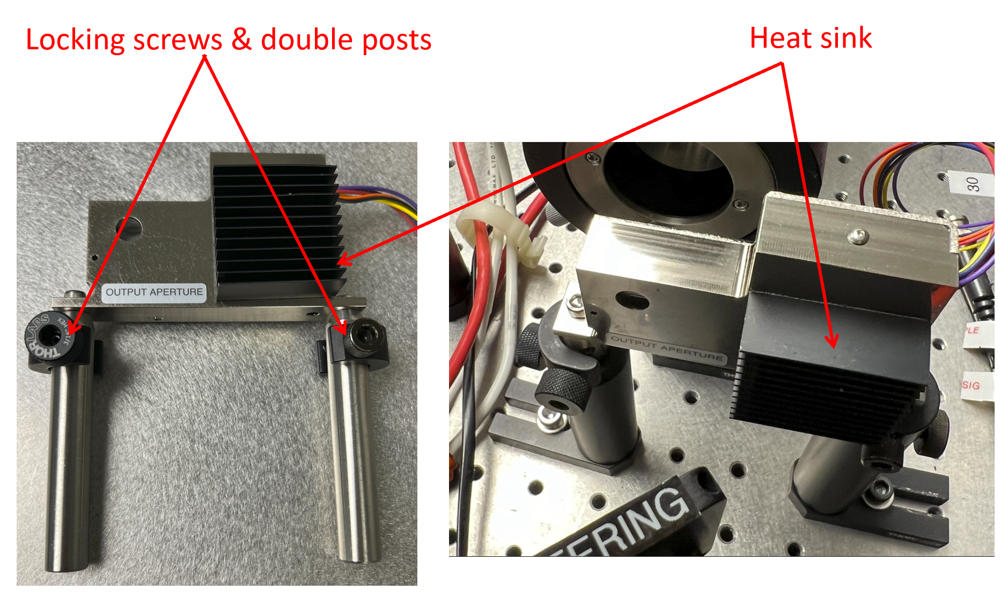
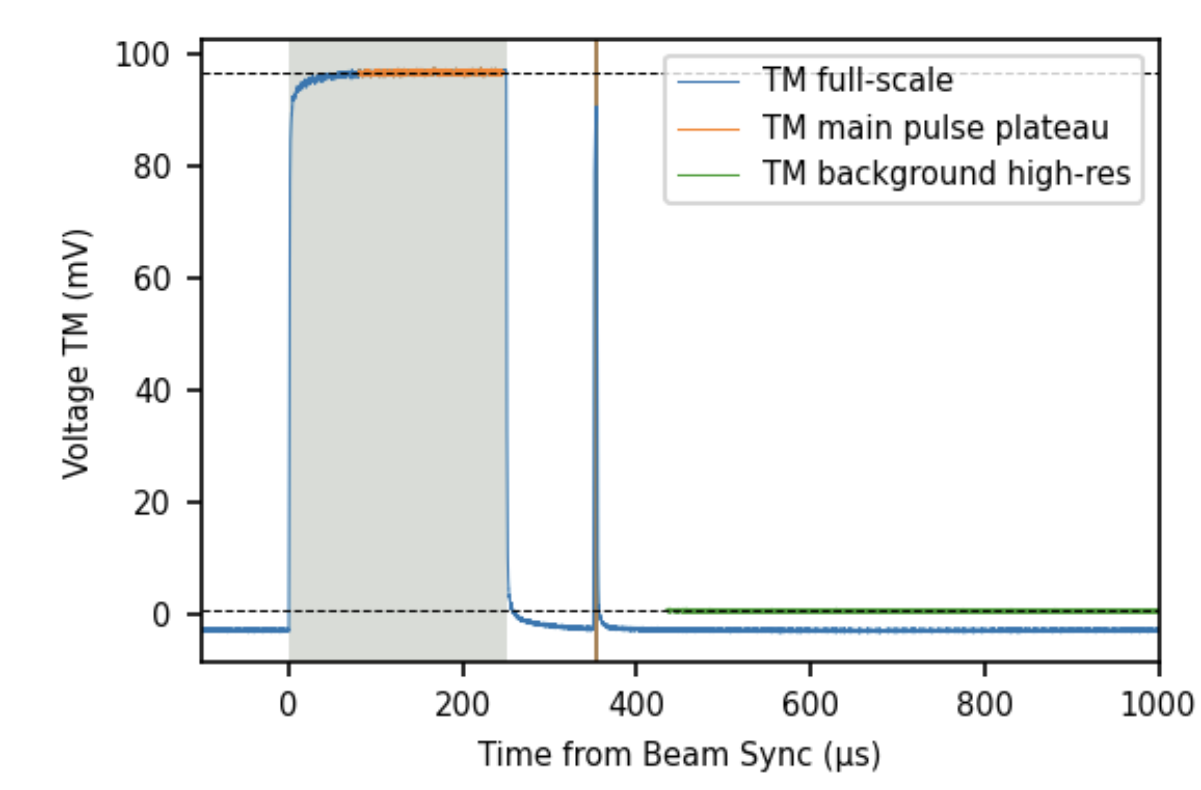
FY25 SAM – improving drive laser reliability
In FY24 we had a beam strike event, traced back to a misconfigured shutter on the laser table
The RAR process resulted in developing various laser system improvements
Replacing hand-aligned with tool-aligned fixturing
Developing configuration control of the laser table layout
Overhauling the hot-checkout process, now a detailed laser checklist
Installing a remote laser-control health check that Ops runs daily
Installing a new fast MPS laser shutter (this SAM)

Slide 5
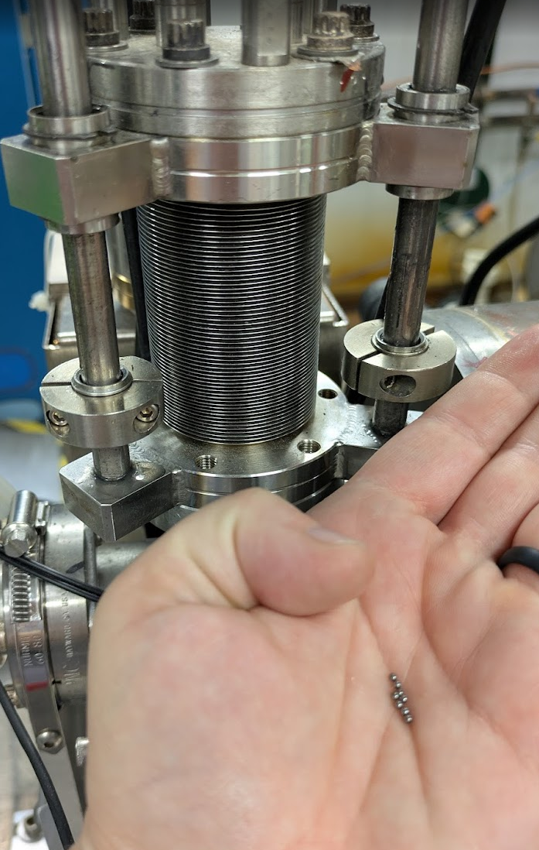
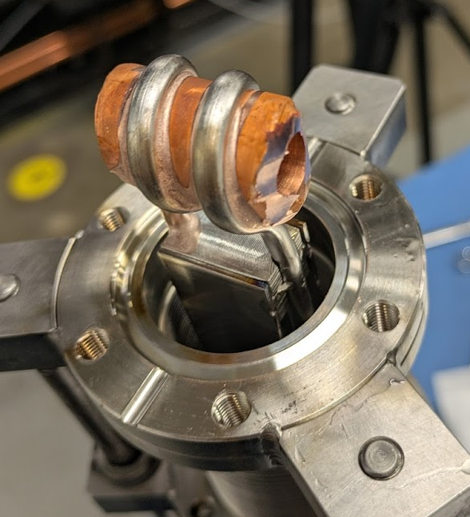
FY25 Restoration – over-cycled hardware
Insertable Faraday cups were not designed to be cycled as often as FSD trips
Bellows failures on FC1 and FC2
Bearings failure on FC1 (during FY25 restoration)
Bellows rate lifetime: 5,000-10,000 cycles.

Slide 6
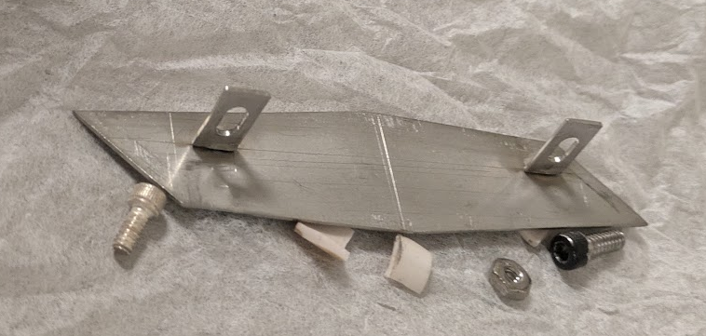
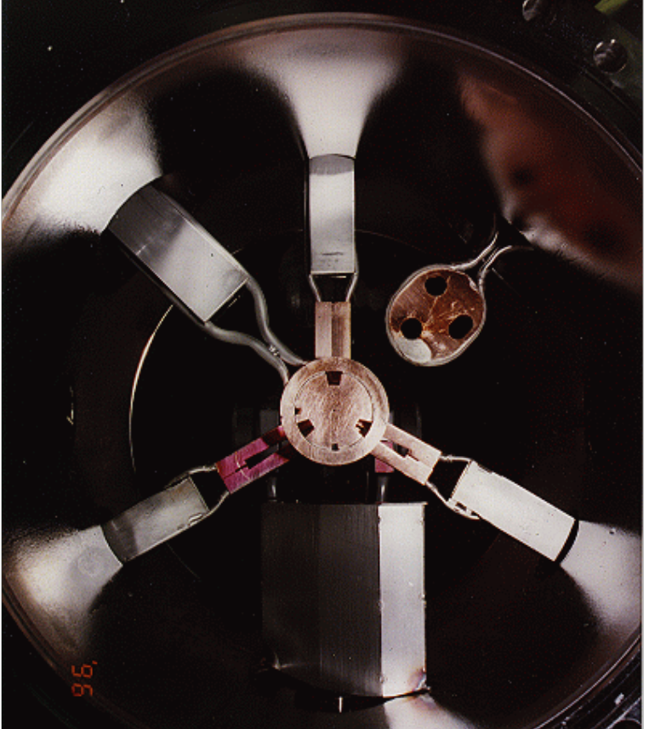
FY25 Restoration – 25+ year old chopper bellows failed
Chopper viewer bellows failed
Catching early indicators can help us avoid vacuum loss
Diagnosis was easy, but repair was confounded by unknown captured part
Options to react, e.g.
P > 5x10⁻⁵ Torr: Hard trip, close valves, pumps off
P > 1x10⁻⁶ Torr: Fast trip, close valves
P > 1x10⁻⁷ Torr: Slow trip – after 45 minutes above

Slide 7
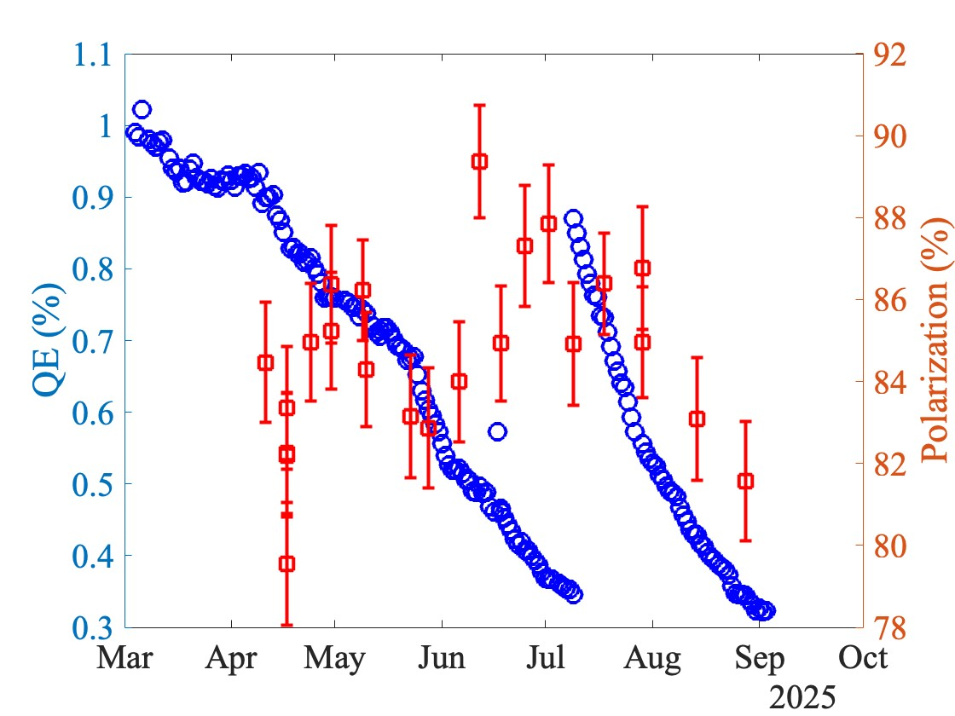
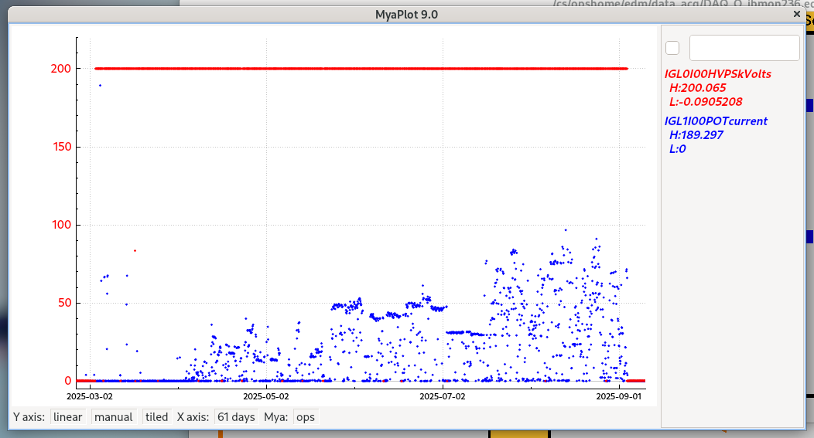
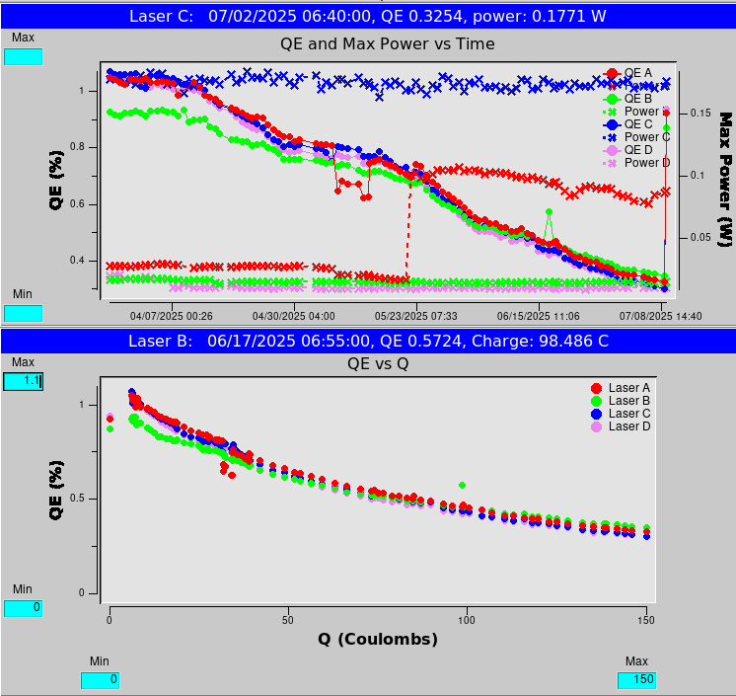
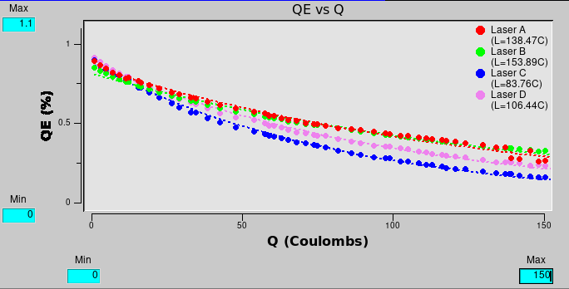
FY25 Spring Run source performance
Polarized Electron Source
Gun ran reliably @ 200 kV
Beam to 4 halls as needed
Produced 300 C from two spots (lifetime 100-150C)
Beam polarization was expectedly high 85-90%
150 C
150 C
Beam Current (uA)
Recent Downtime
FY24 – 350 hours
FY25 – ½ hour

Slide 8
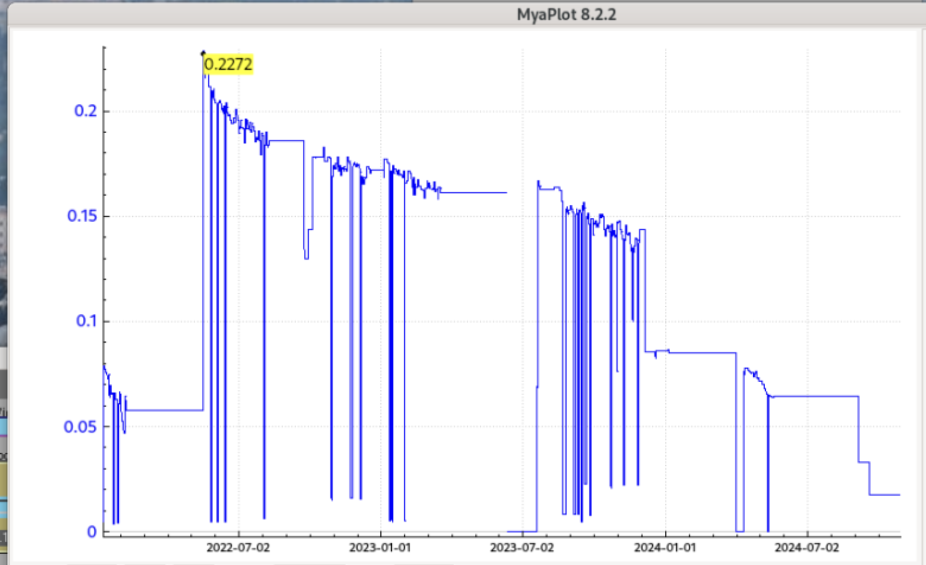
FY25 – keeping hardware on our radar
Like the RF system our lasers need amplifiers to boost the power needed for the program, typically 50-100 mW
They do have a finite lifetime, we use them as long as possible b/c they’re not cheap $25k
During the Spring run Ops struggled with transporting beam, until we ”coincidentally” swapped the aging Hall A amplifier…
No beam diagnostic revealed a smoking gun, but we can lobby for funds to replace amps sooner, and we’re adding some additional remote diagnostics for operators
Spring run - squeaking out last bit of power from Hall A amp
Power to cathode (Watts)
24 months

Slide 9
Now, FY26…

Slide 10
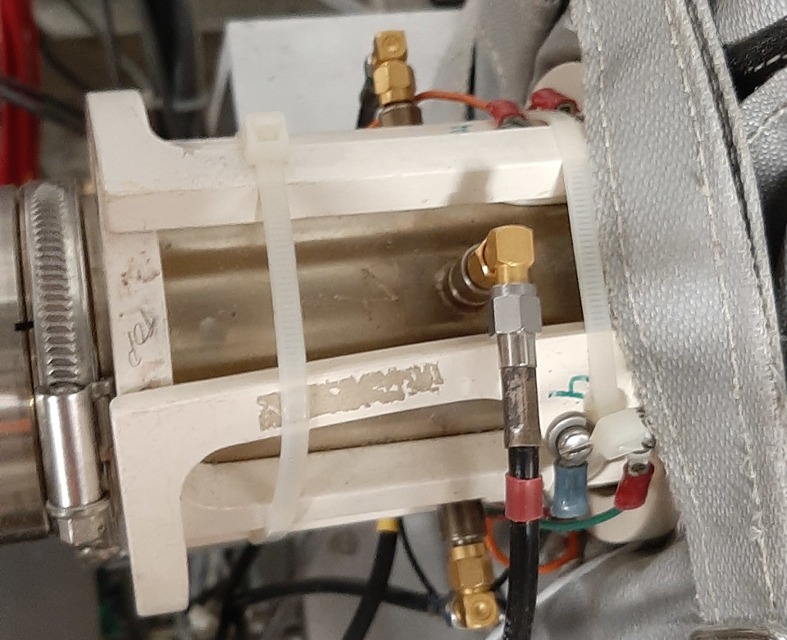
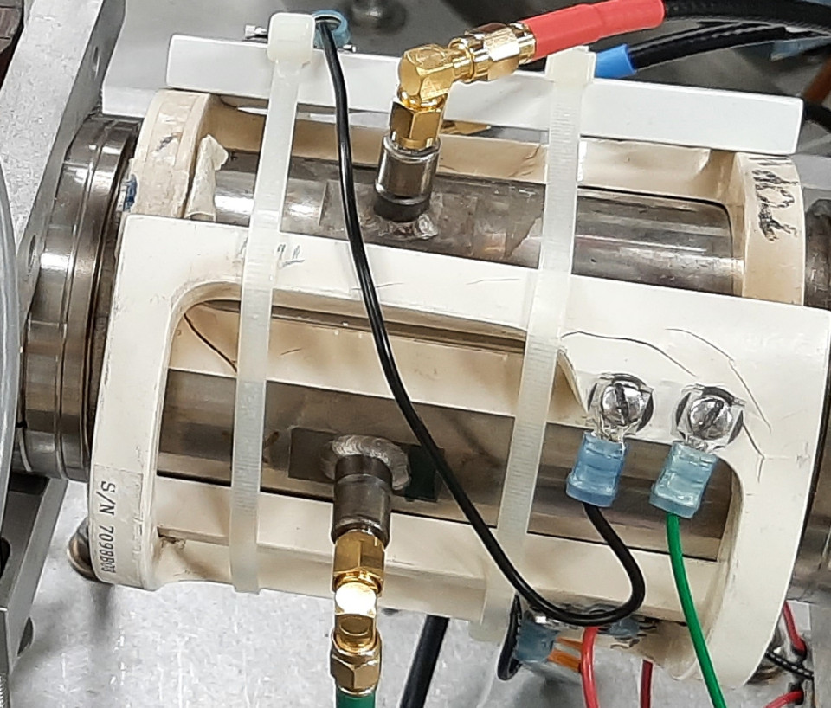
FY26 SAM – End of run HCO
We have now begun doing pre-SAM walkthroughs for equipment we provide or use for injector operations
Vacuum system
High voltage system
Magnets and RF
Laser
Identified some issues !!!
Failed air fitting seals at the pneumatics
Air core magnets that are deformed or cracked
Viewer that does not have proper stroke
Communication issues with laser amplifiers and possibly with LLRF stepper motor chassis (used for laser table stepper motors)

Slide 11
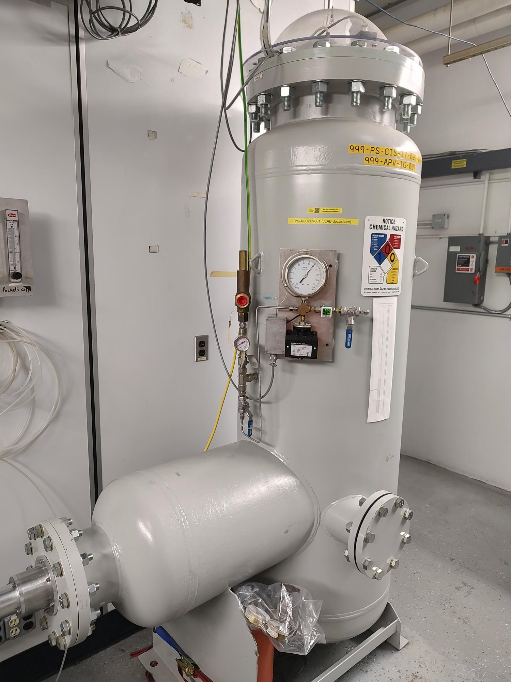
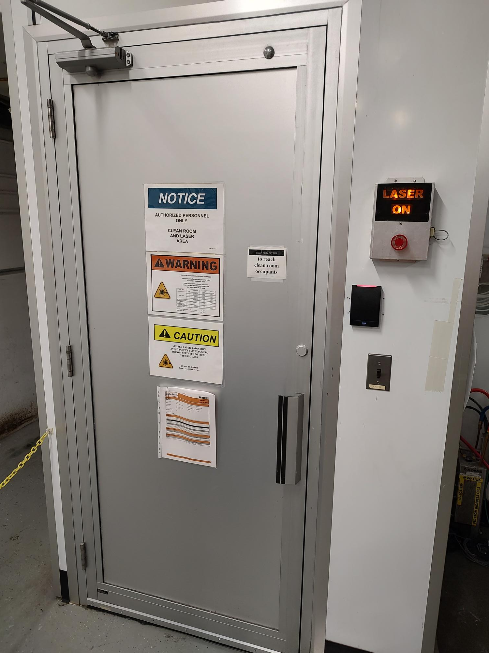
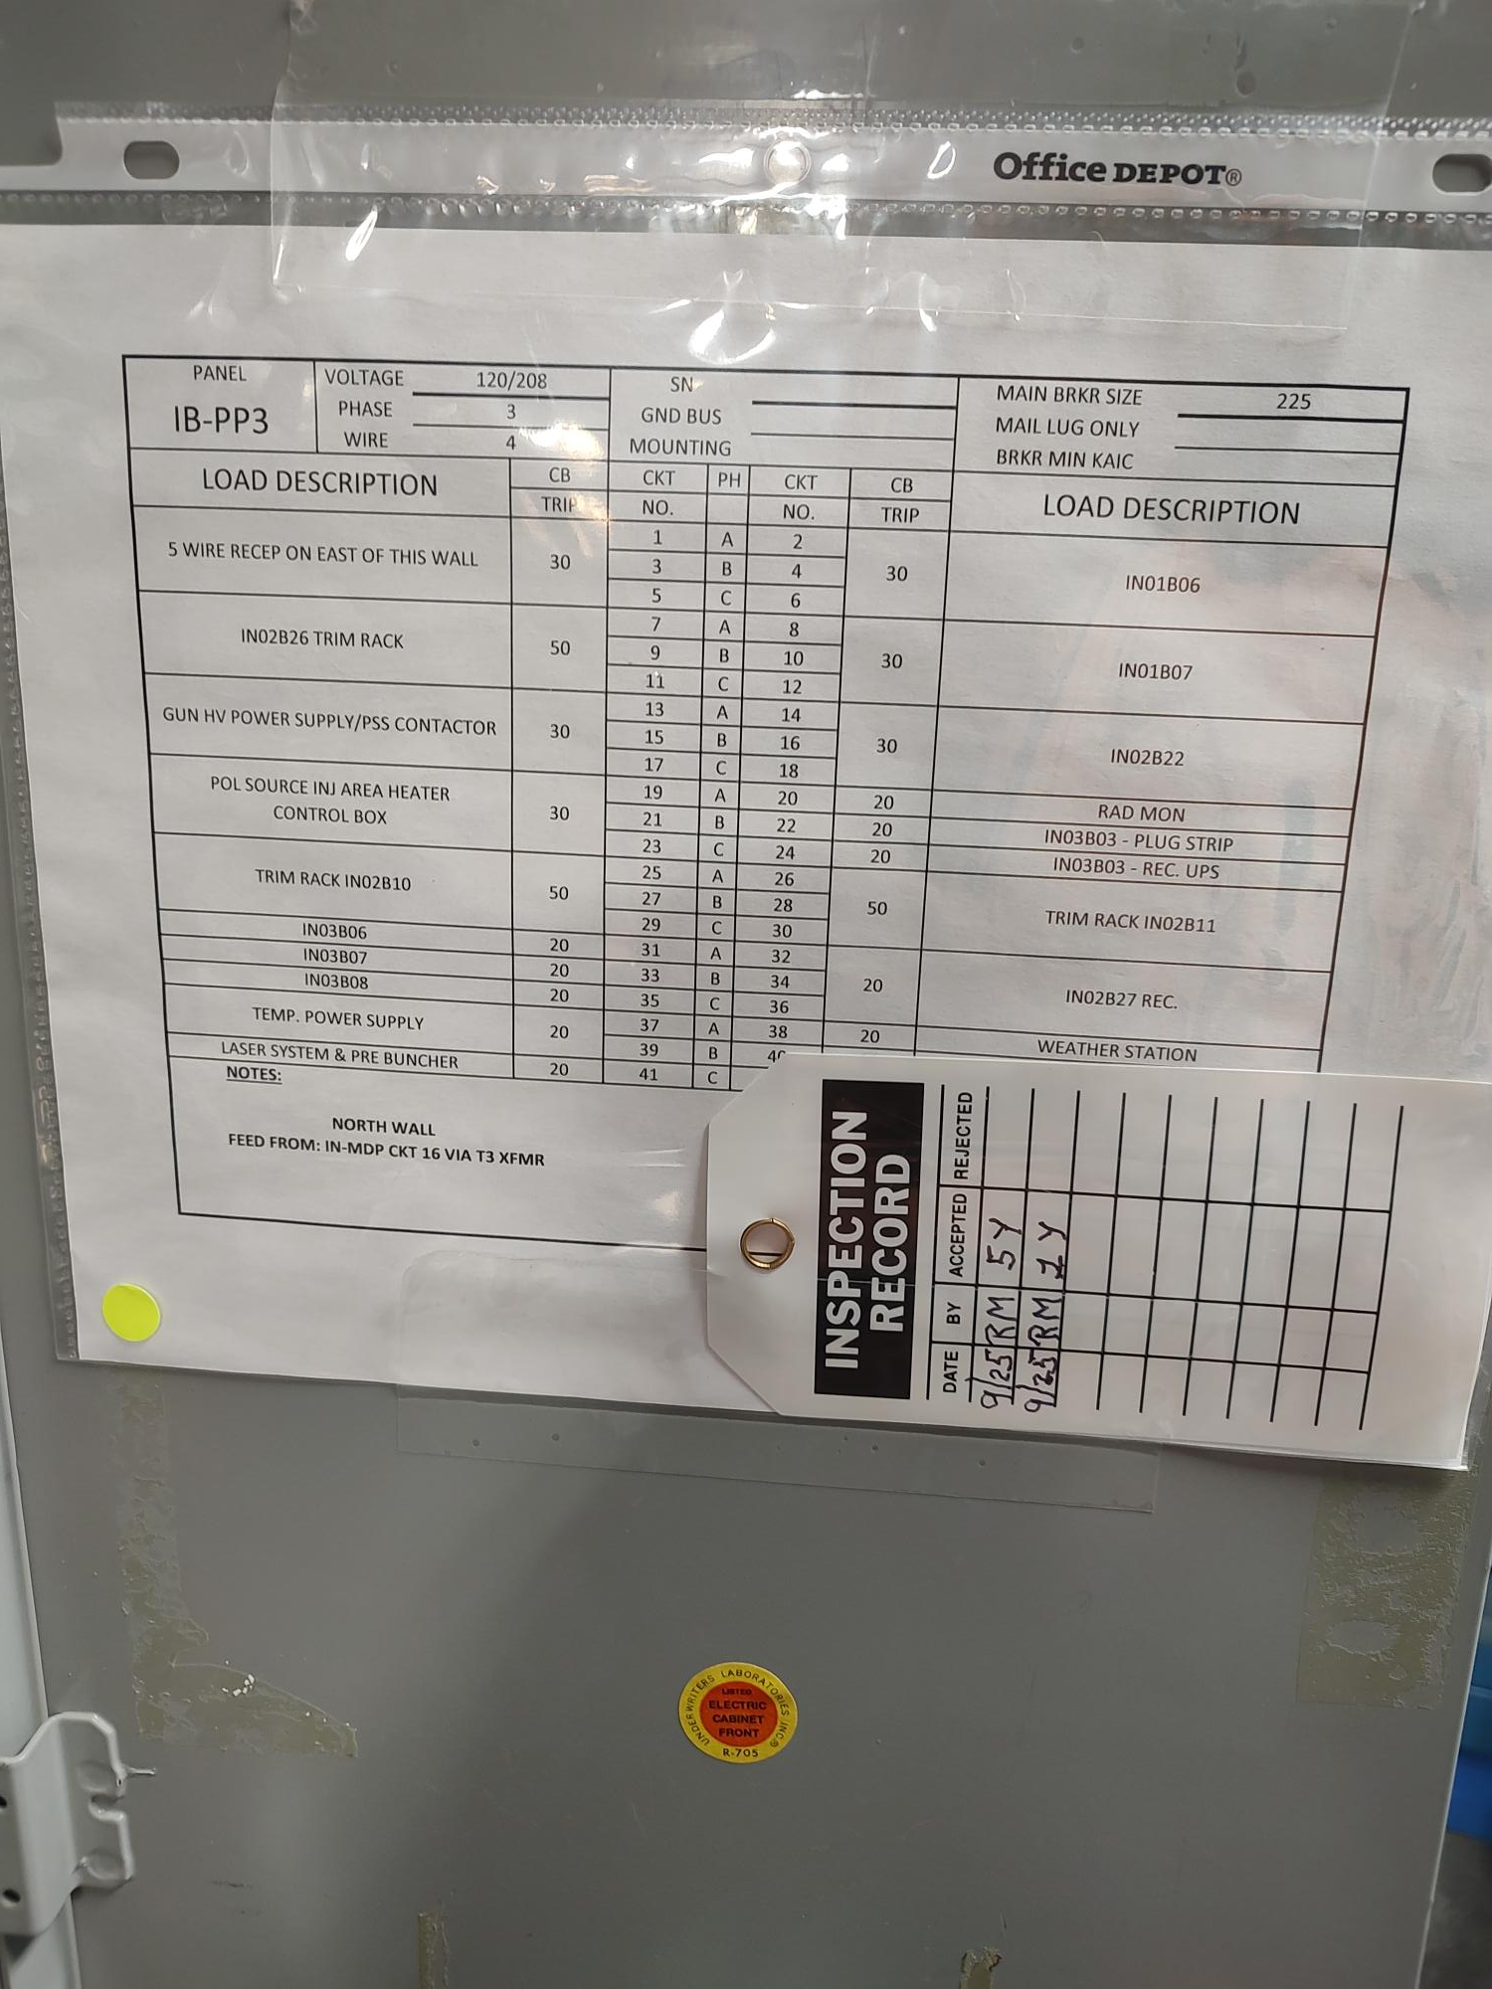
FY26 SAM – Prioritizing safety & inspection
SF6 relief valve exchange every 5 years (CATS item)
Upgrading driver laser room with CANS (CATS item)
Working with FML to prioritize our breaker panel PM (CAT1 PPE)

Slide 12
FY26 SAM –
200 keV Wien filters
Evaluate root cause trips
Test prototype solution
Prepare for Beam studies
Moller PQB studies (Dec FC1)
Degrader studies (Jan FC2)
Gun HVPS system
SF6 relief valve
Regrease HV connections
Vacuum system
Eliminate JLab UHV for I&C solution
Evaluate chopper ion pumps
Laser jobs (reliability)
Laser room CANS system
Upgrade helicity generator
Install fast MPS laser shutter
Install remote laser profile/position monitor
Evaluate root cause Hall A laser issues
Laser jobs (Moller)
Measure photocathode anisotropy
Characterize laser setup for 9/3 BS
Test prototype RTP switch
Measure IA risetime

Slide 13
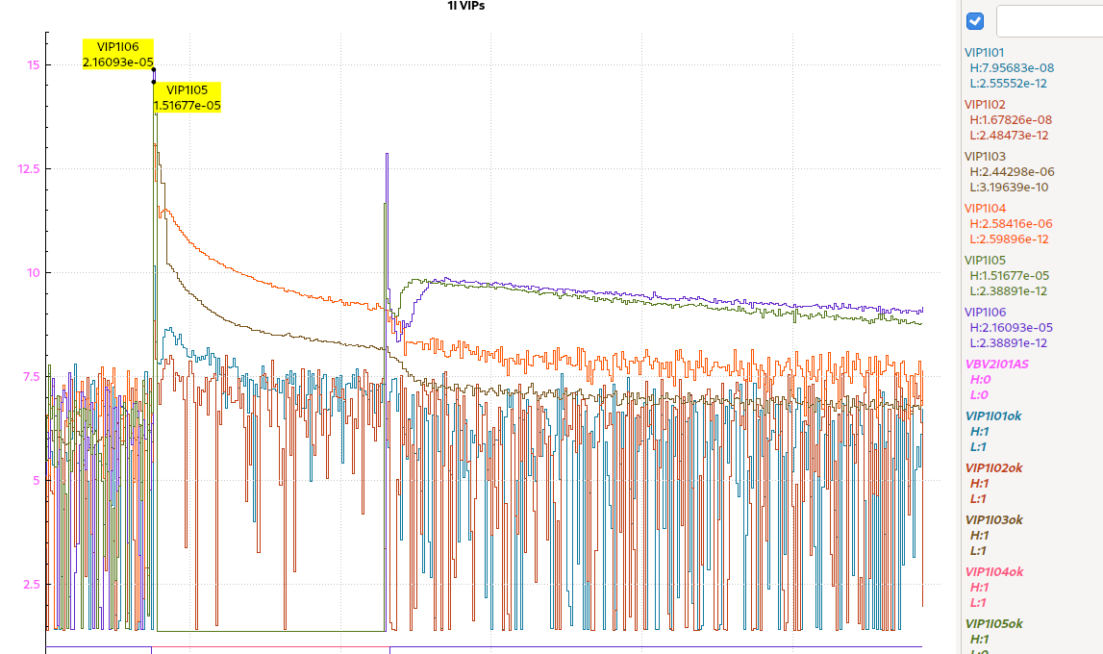
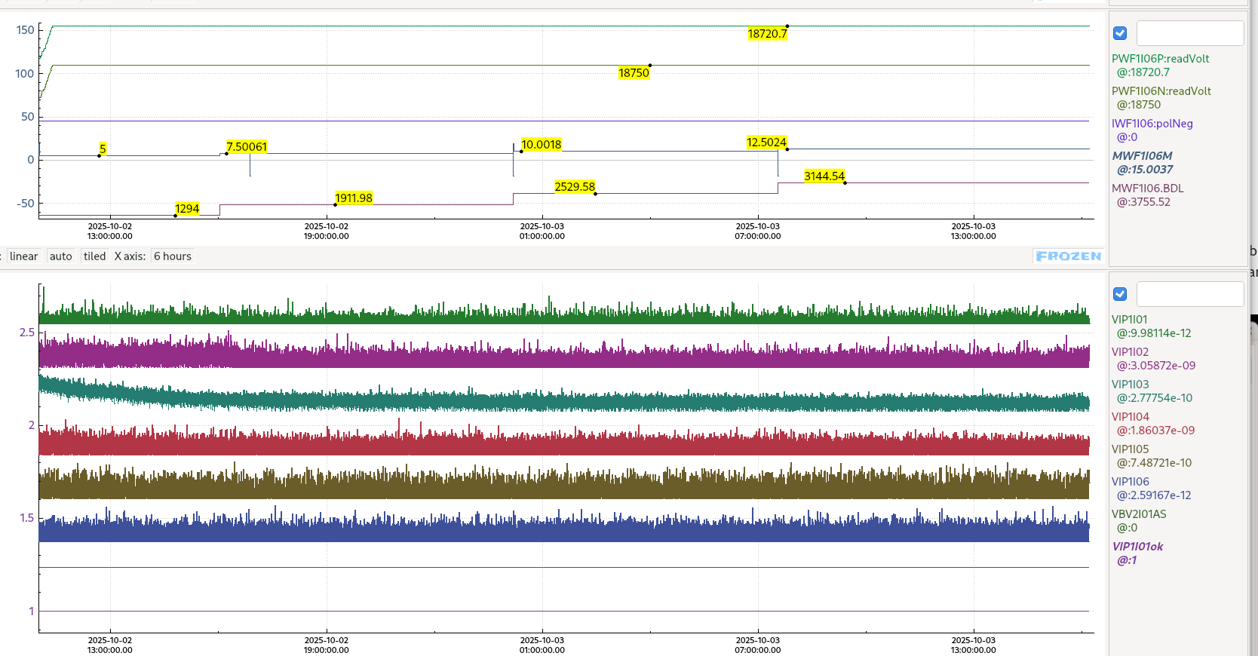
FY25 – 200 keV Wien filters
Vacuum activity: Electrodes at 19 kV, magnet 14.5 A
Wien filters upgraded SAM 2021
130 keV, 90 deg: 11 kV / electrode, B= 2,500 G-cm (~10 A)
200 keV, 90 deg: 18 kV / electrode, B = 3,633 G-cm (14.5 A)
Performance at 200 keV limited
In January learned 90 deg spin angle resulted in vacuum activity
Limited each Wien to 60 deg; then used both Wiens together to reach requirements for Spring program, worked well
Evaluated SAM 2025
Applied 19 kV per electrode over 3 days, no issues with magnet off
No vacuum issues with magnet set to 3,145 G-cm (12.5 A) and 19 kV per electrode (magnet yoke temp ~ 42 C)
Vacuum activity present with magnet set to 3,755 G-cm (15 A) and 19 kV per electrode (magnet yoke temp ~ 55 C)
Vacuum activity looks related to vacuum load due to magnet temp (heating beam pipe)
Cooling schemes will be tested this SAM
No vacuum activity: Electrodes at 19 kV, magnet up to 12.5 A
13

Slide 14
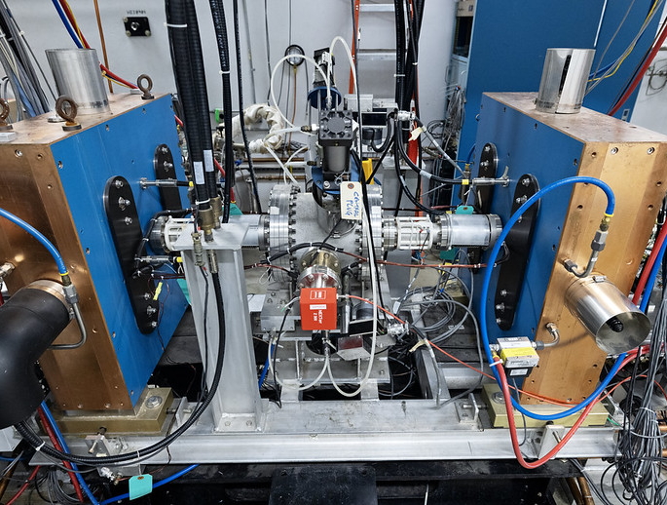
FY26 – Chopping chamber remediation plan
Chopping chamber critical for CEBAF operations
but, bellows of 6 critical function devices beyond end of life, have started to fail
and, not well documented, also those who serviced it have retired
Plan A – proposal submitted to design and build a new chopping chamber, improved alignment, fixturing, serviceability, solenoids
Plan B – in the meantime, develop an “emergency repair” by stakeholders involved in doing Plan A

Slide 15


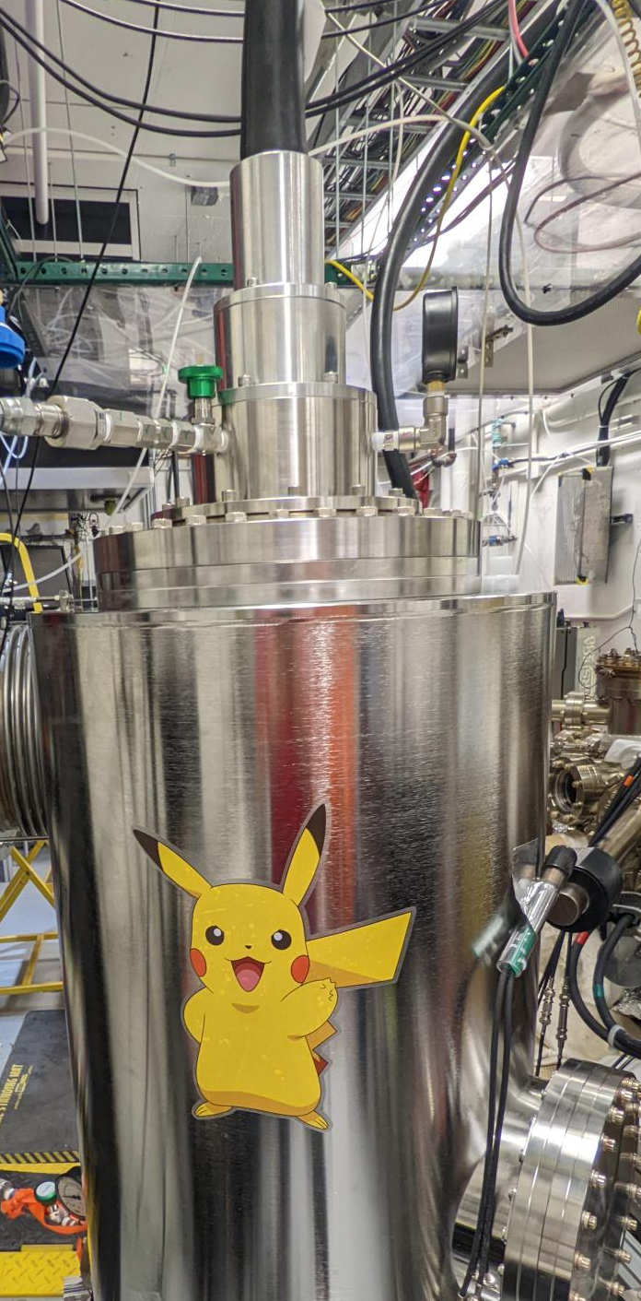
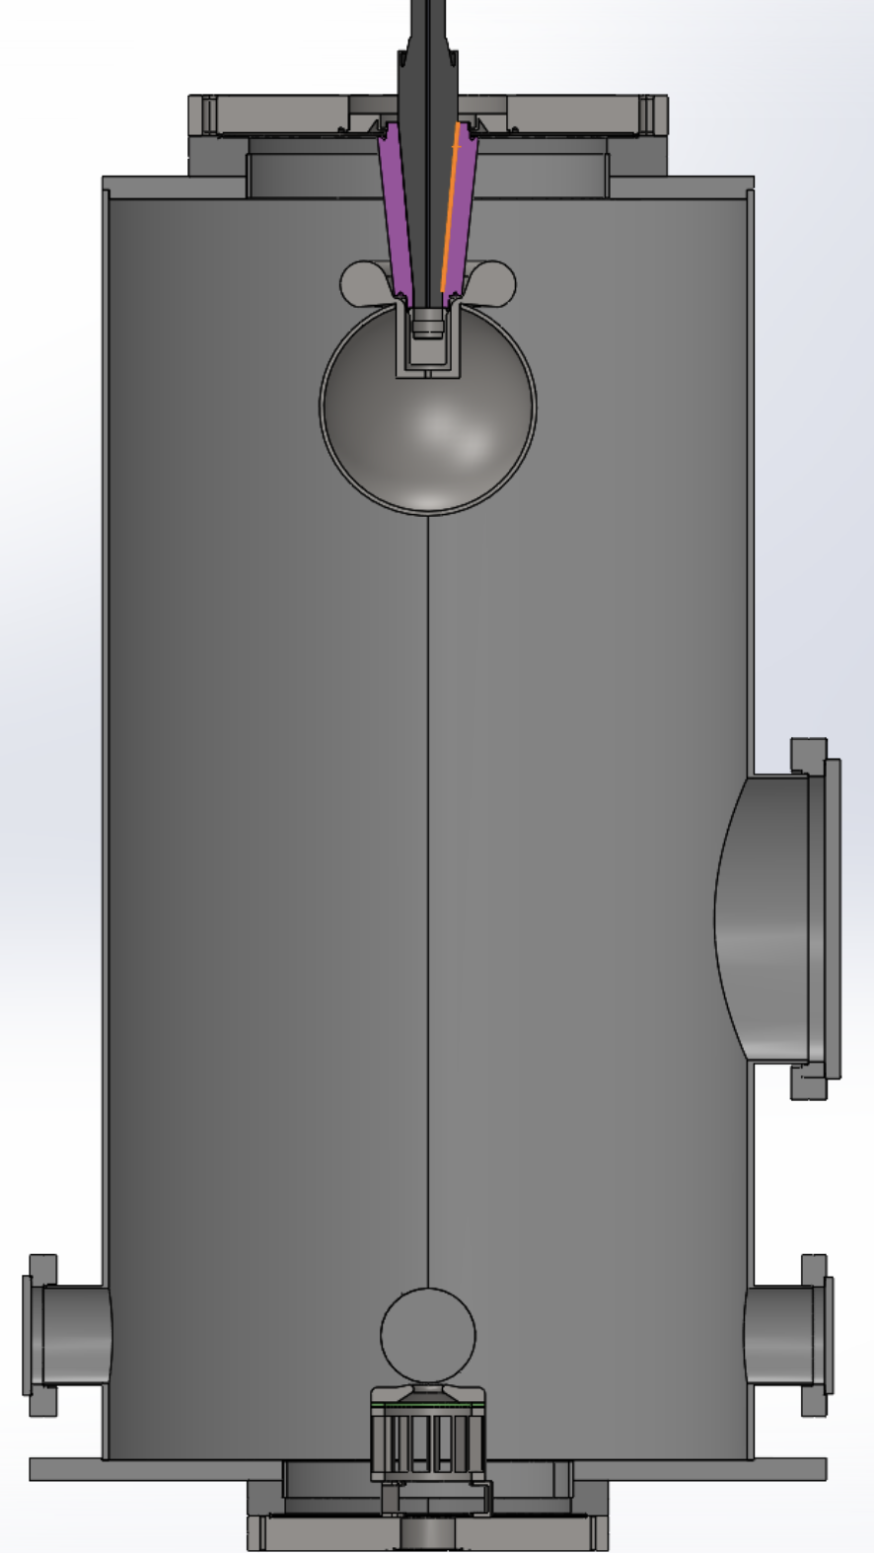
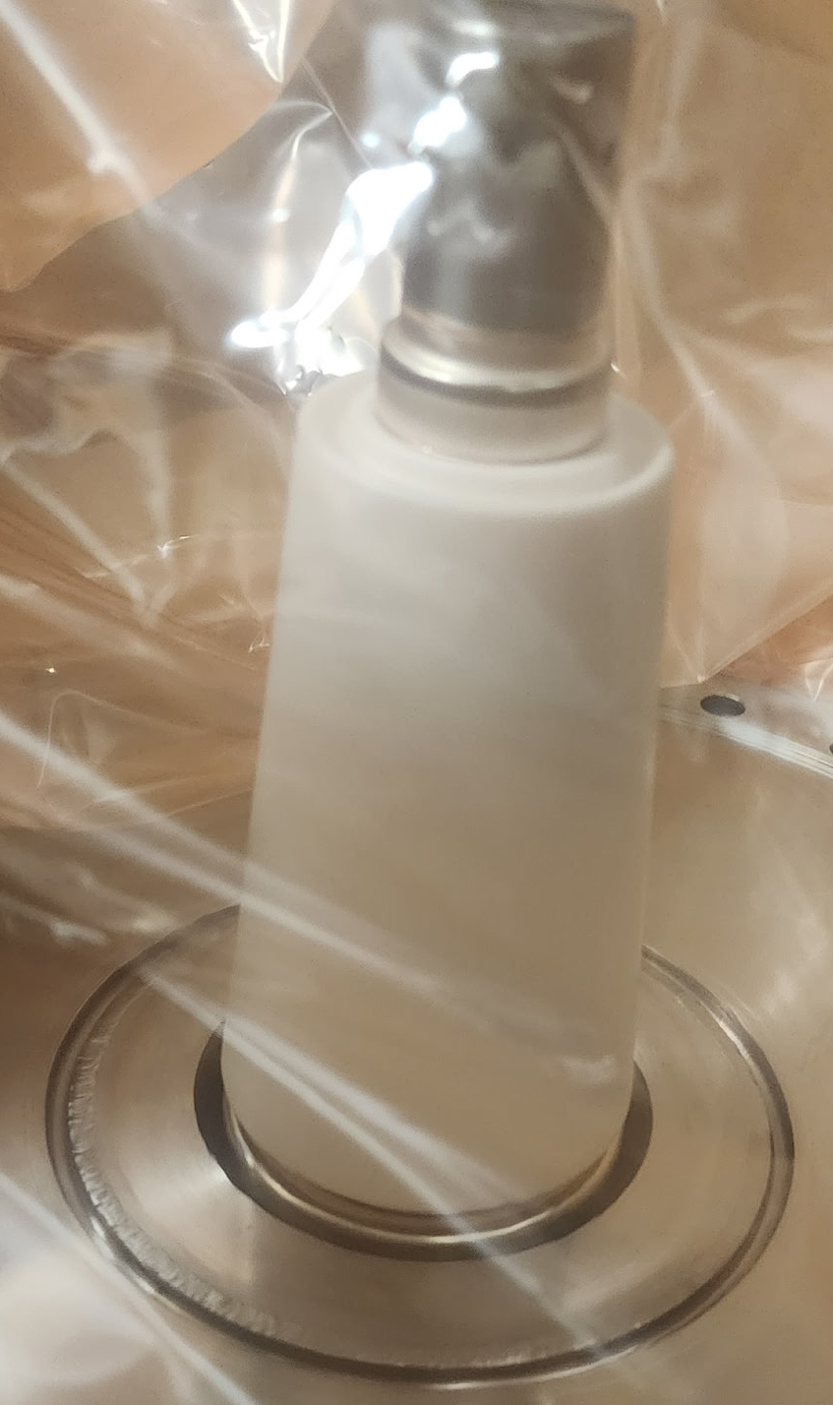
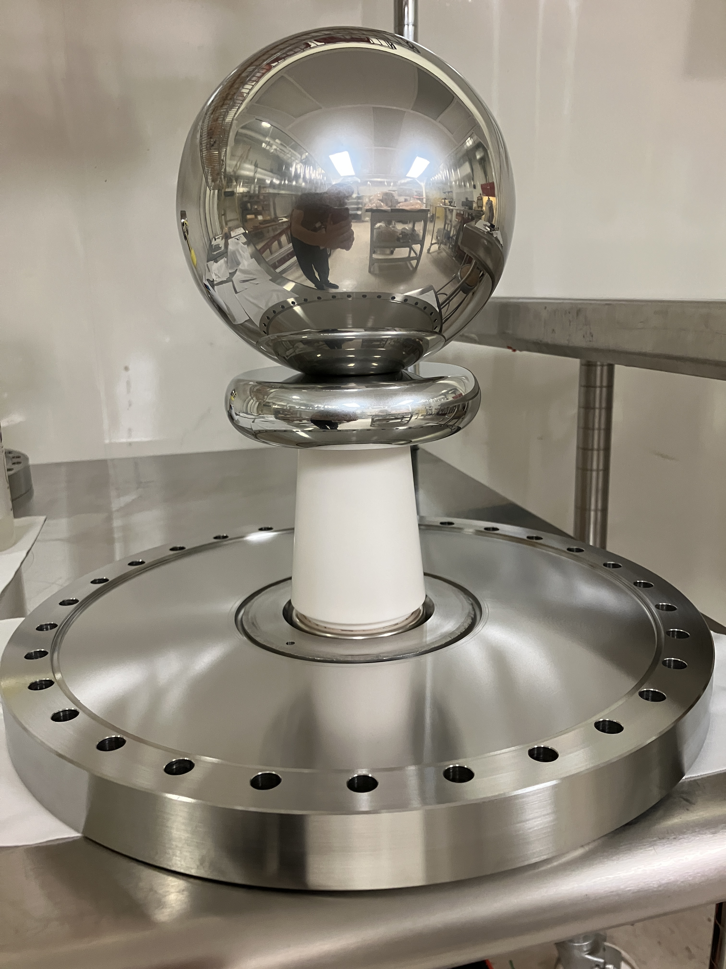
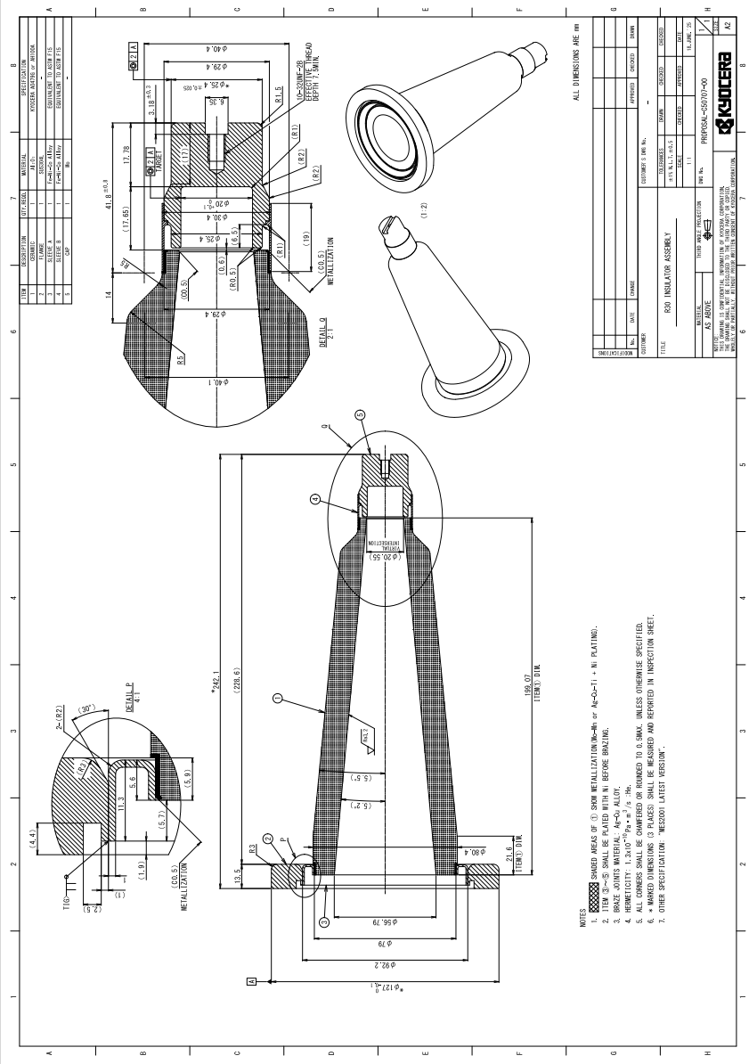
CIS R&D – Commercializing insulators (KEK/Kyocera/JLAB)
Slide courtesy Carlos Hernandez-Garcia, Jefferson Lab
Compact inverted insulators are ideal for mating a photogun to the high voltage power supply via a cable
Compared with cylindrical insulators, an inverted insulator reduces the electrode surface exposed to high voltage
The photogun vacuum chamber volume and surface area are reduced to reach lower ultimate vacuum
KEK received funding for Kyocera to manufacture a test insulator with low secondary electron yield
JLab manufactured test electrodes
JLab will be high voltage testing the Kyocera insulator with electrodes under vacuum
96 cm

Slide 16

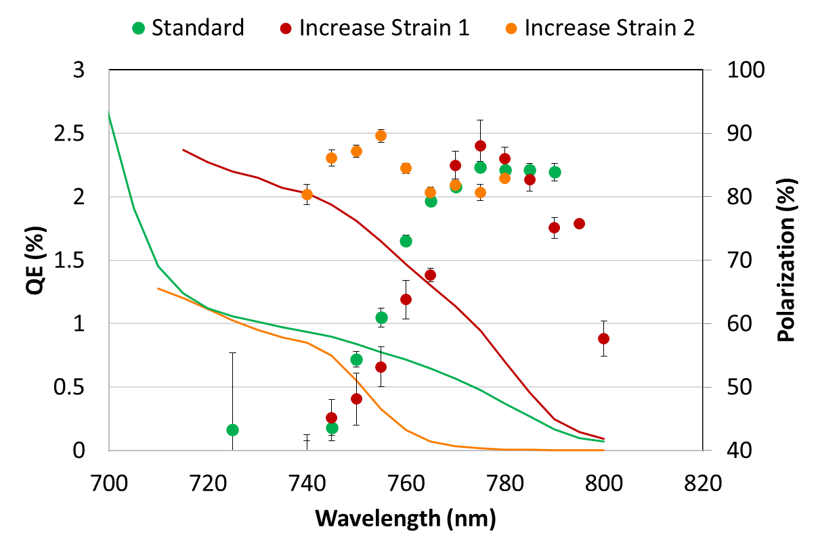
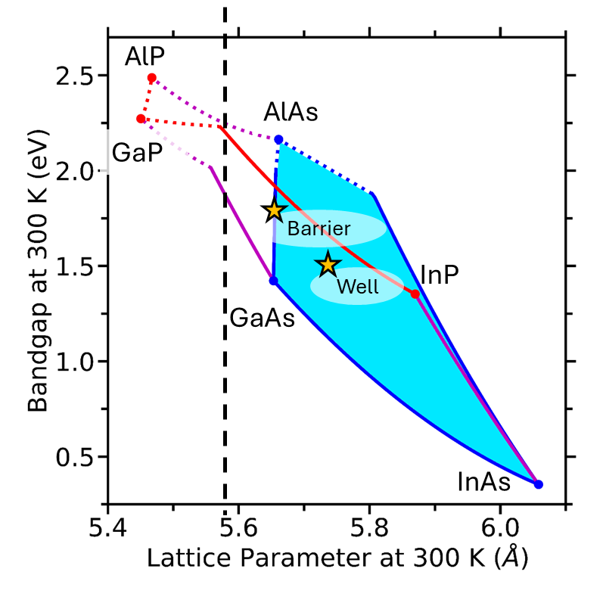
CIS R&D – strained AlGaAs/InAlGaAs high polarization photocathodes grown by MBE (UCSB/JLAB)
Slide courtesy Marcy Stutzman, Jefferson Lab
GaAs/GaAsP: phosphorus
Complicated in MBE systems
InAlGaAs: all common in MBE
Easier for commercial vendors
Commercial vendor can’t procure substrate GaAs at this time
Independent control of strain and band gap
Arsenic caps
Can increase polarization (strain) and bandgap (wavelength)
simultaneously
AlGaAs/InAlGaAs | Polarization (%) | QE (%)
Standard (green) | 85 ± 0.9 | 0.48
Best Pol. (orange) | 90 ± 1 | 0.33
Best overall (red) | 88 ± 4 | 0.95

Slide 17

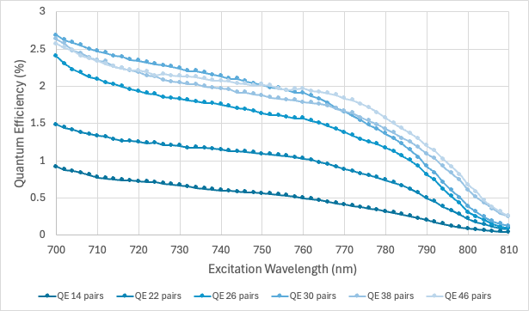
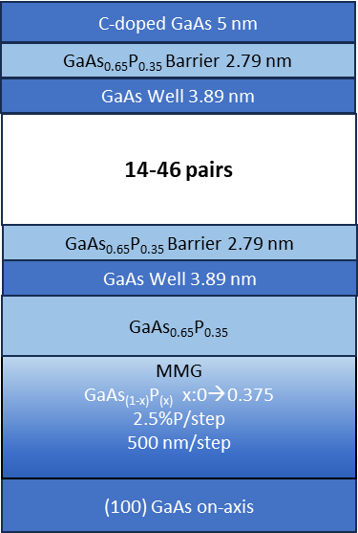
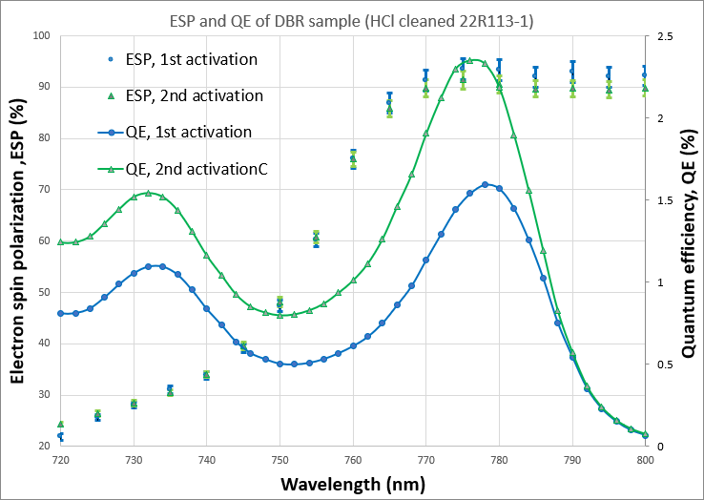
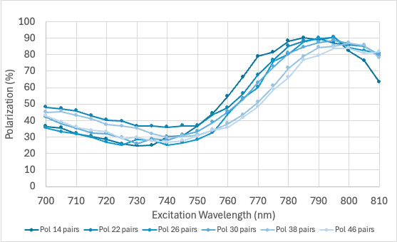
CIS R&D – strained GaAs/GaAsP spin polarized electron sources grown by MOCVD (ODU/JLAB)
Slide courtesy Professor Sylvain Marsillac, Old Dominion University
SPES successfully grown by MOCVD with and without Diffracted Bragg Reflector (DBR)
Polarization above 90% can be obtained
QE above 1% without DBR and above 2% with DBR can be obtained
Devices achieved 11 nC with the free limit range and 9 nC with an 8 mm diameter laser
No DBR: QE: 1.4%; Pol: 90% @ 780nm
DBR: QE: 2.3%, Pol: 92% @ 780nm
Device Structure

Slide 18
Outlook
The polarized source and injector contain critical and unique components
some are single points of failure, so require high reliability
some push the limits of performance, so require time to test-fail-learn
some like our photocathodes and insulator rely on critical R&D
The changing face of CIS
None of the “original” EGG are with the group, many were technical staff and the R&D was highly NP oriented
Today we have an older group, experienced scientists who are able to contribute to broader R&D interests, consequently less focused
We’re starting to move the needle, but need the lab’s support to hire, train and retain new and younger staff, to set priorities is essential

Slide 19
Questions ???

