Slide 1

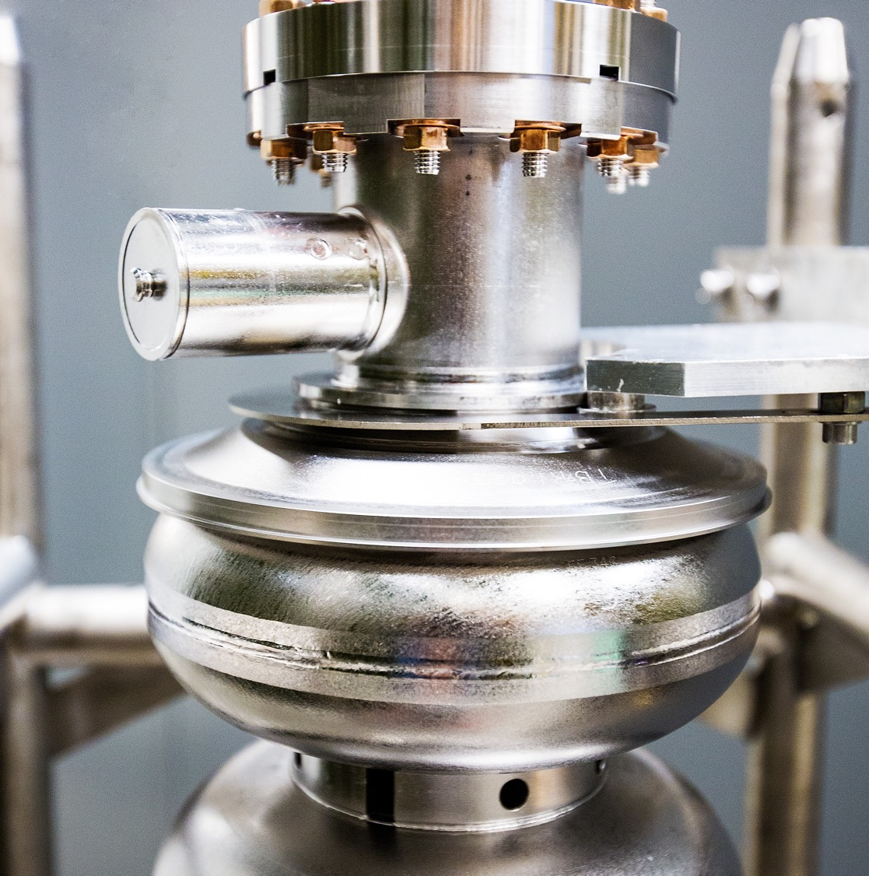
Beam studies, machine performance and future development
Yves Roblin, CASA
October 7th, 2025
Notes:
Tip: Keep titles under 60 characters for readability
To change the photo: Right-click on photo and select change photo

Slide 2
Outline
Timeline
Machine tuning and setup
Beam studies scope
Development for future projects
Optics characterization for model and procedural improvements
Targeted studies for resolving immediate machine issues
Analyzing time domain data
Use of AI
Analysis effort
Beam loss
Low energy run
Fast data Analysis
High speed data framework, global timing synchronization
White rabbit implementation ?
conclusions
Notes:
Guidelines: 6-8 bullets per slide; Use sentence fragments for bullets
To change the photo: Right-click on photo and select change photo

Slide 3
Timeline
Started setting up for 1060 per linac on March 19th.
March 19th : Starting Cold Startup (Nl/SL phasing, M56 adjustments in ARC1/ARC2)
March 20th 8pm, starting ORFP, 22:34 ARC1 match done
March 22th . 6pm starting ARC5 ORFP.
March 30^{h} 11pm finishing ARC8 ORFP
Apr 2nd 7pm beam extracted to Hall C.
Apr 3rd HALL D setup started.
Apr 4th Hall D setup done.
Apr 6th three halls taking CW beam. (B,C,D)
Along the way, found four swapped quadrupole channels, one miswired SL quad.
Within allotted time
Notes:
Guidelines: 6-8 bullets per slide; Use sentence fragments for bullets
To change the photo: Right-click on photo and select change photo

Slide 4
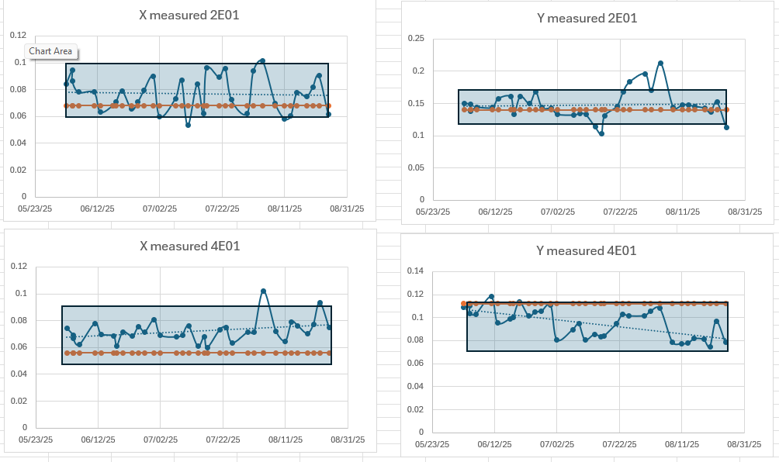
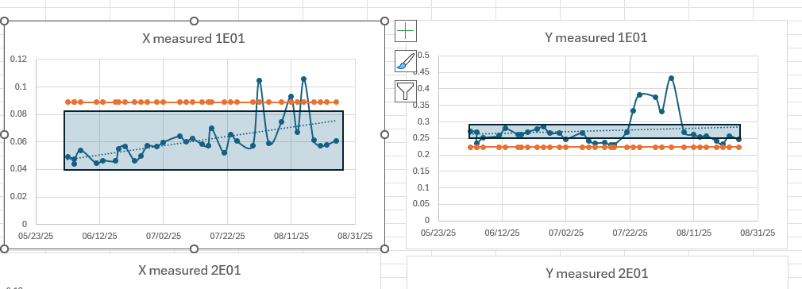
Analyzing machine tuning
Took regular beam envelope measurements (see talk by J. Samari). Very useful information for assessing transverse matching as well as off nominal running due to misconfigured components
prebuncher
Notes:
Guidelines: 6-8 bullets per slide; Use sentence fragments for bullets
To change the photo: Right-click on photo and select change photo

Slide 5
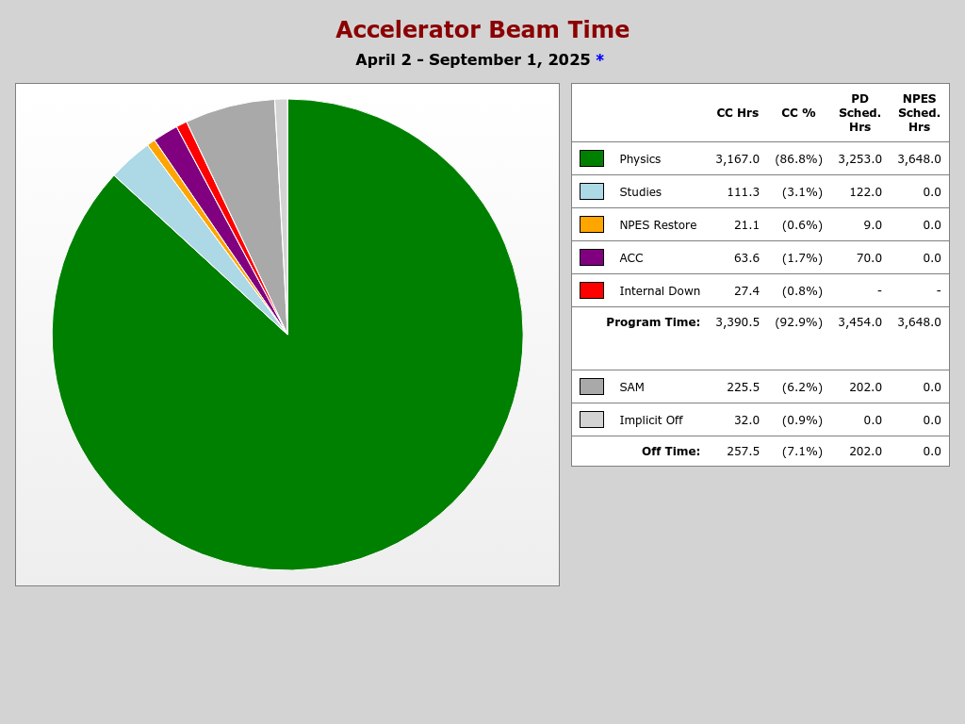
Beam studies
About 111.3 hours.
Mainly in three buckets:
Development for future projects
Optics characterizations for model impro.
Targeted studies for machine issues.
Essential part of successful machine running
Notes:
Guidelines: 6-8 bullets per slide; Use sentence fragments for bullets
To change the photo: Right-click on photo and select change photo

Slide 6
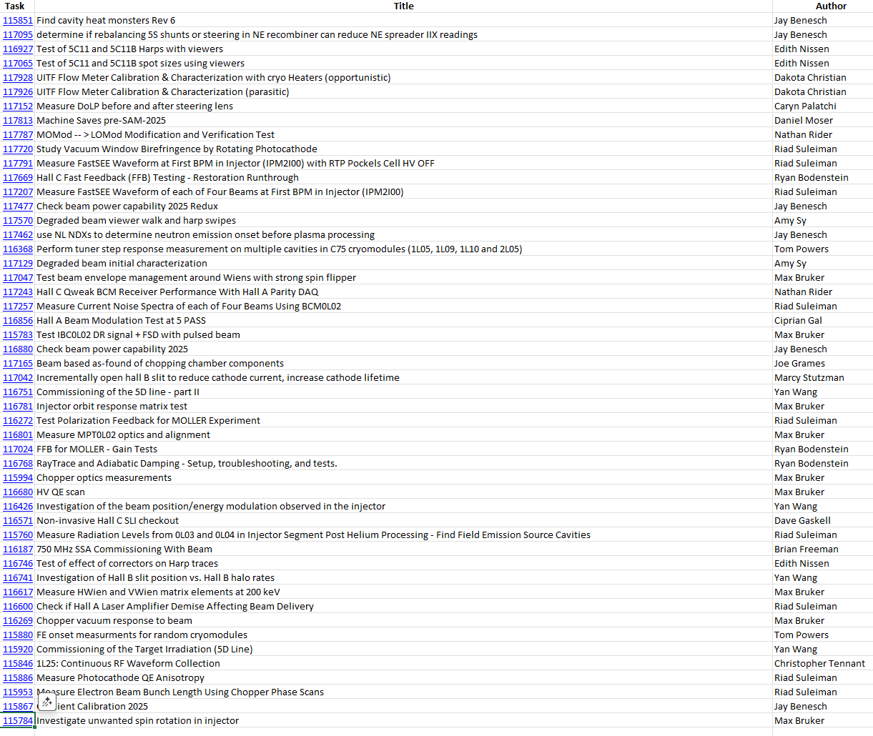
Beam studies (cont)
Managing list of beam studies could be better
In particular, tracking what is partially completed
Efficient use of machine maintenance time is key.
Notes:
Guidelines: 6-8 bullets per slide; Use sentence fragments for bullets
To change the photo: Right-click on photo and select change photo

Slide 7
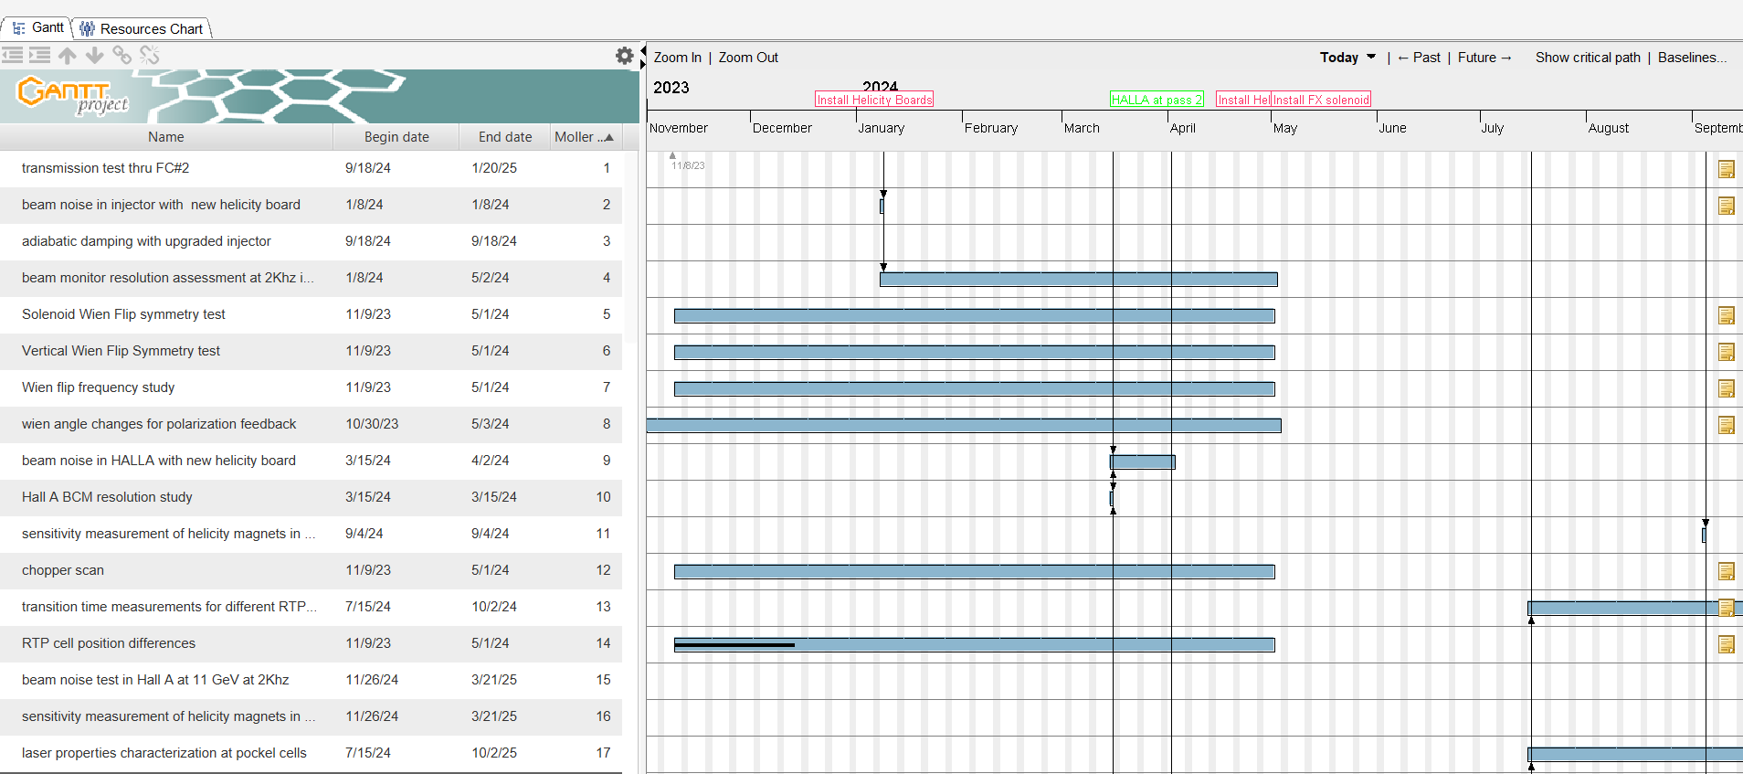
Beam studies for MOLLER experiment
MOLLER experiment required many beam studies to prove readiness.
Successfully completed most of ? them.
Compton polarimeter still need to be finalized (laser failure)

Slide 8
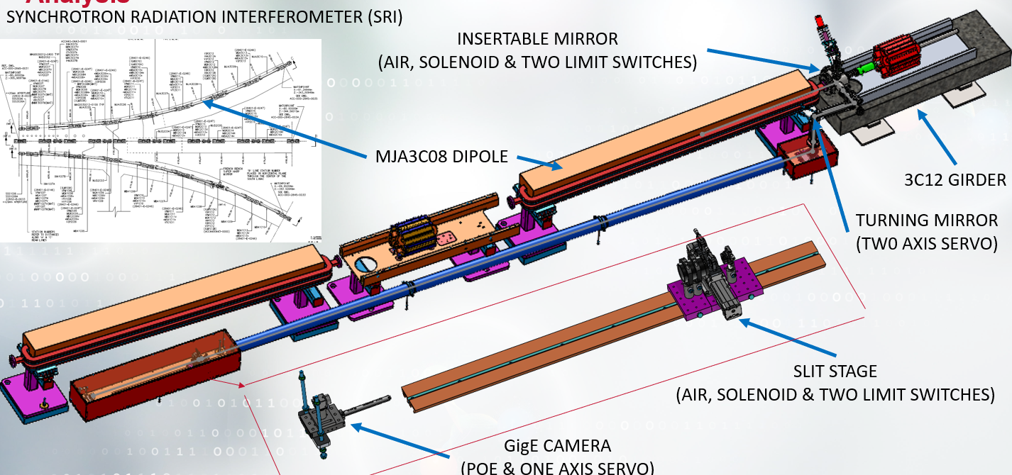
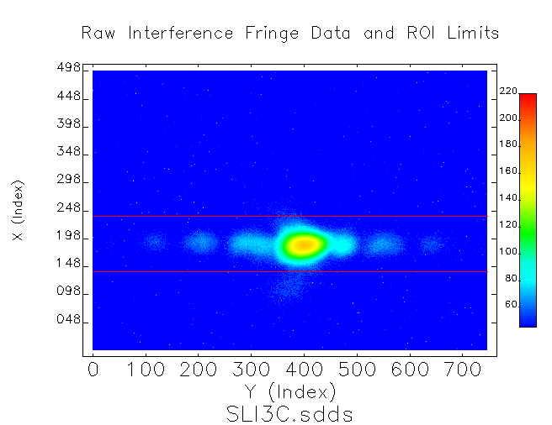
Beam studies for Hypernuclear exp. (SLI test)
Analysis continuing over SAM. SLI appears to produce interference pattern. Preliminary estimates using Harp at 3C12 indicate that energy spread was <5e-5.
MOMOD was revived successfully.
Future beam studies planned this next running period for reviving Krest, finish SLI and MOMOD commissioning.

Slide 9
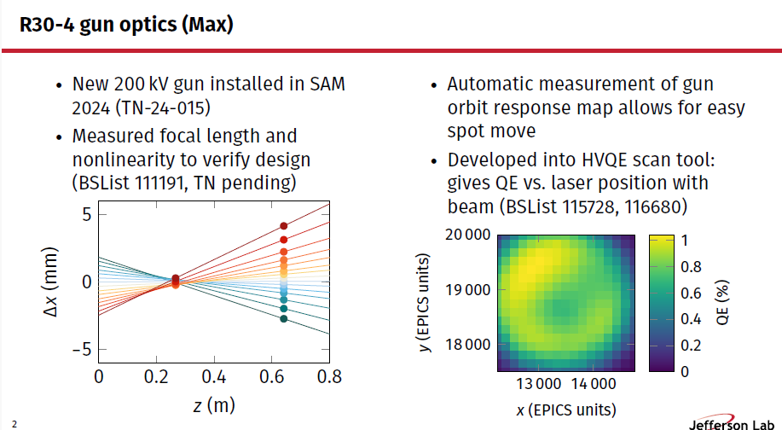
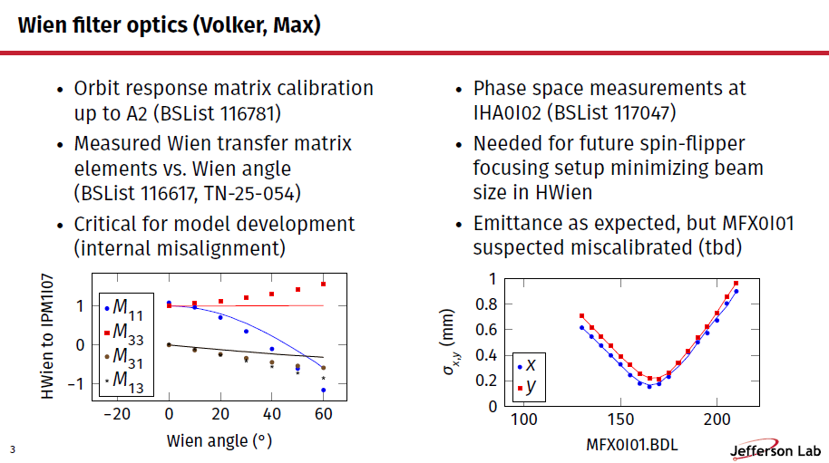
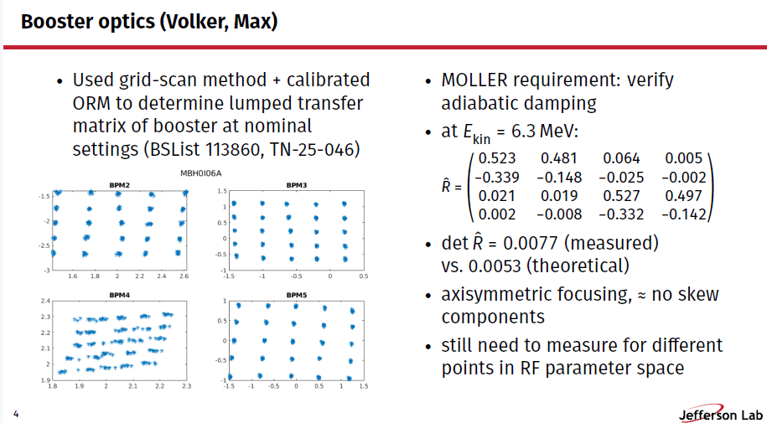
Beam studies for model improvement
Many of these studies were done by taking advantage of time available during machine maintenance days.
Resulting in new tools, procedural improvements and/or checking specifications against MOLLER requirements.

Slide 10
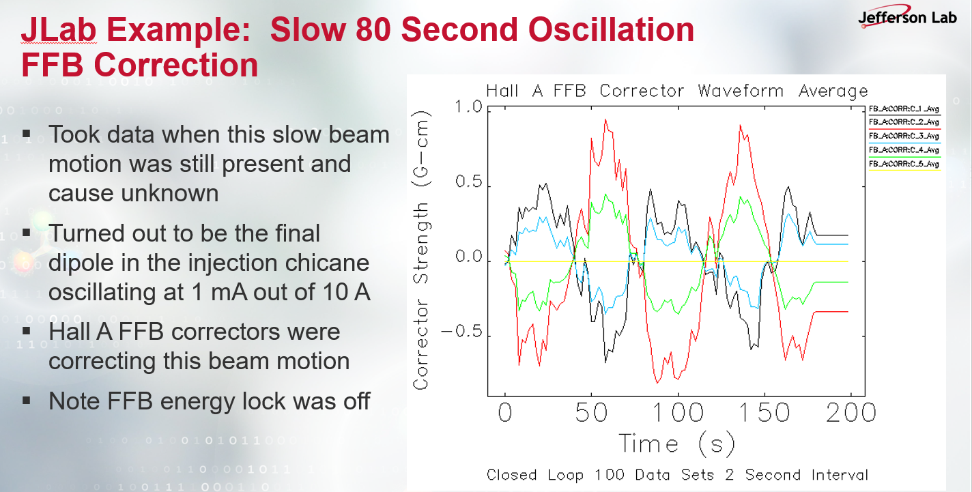
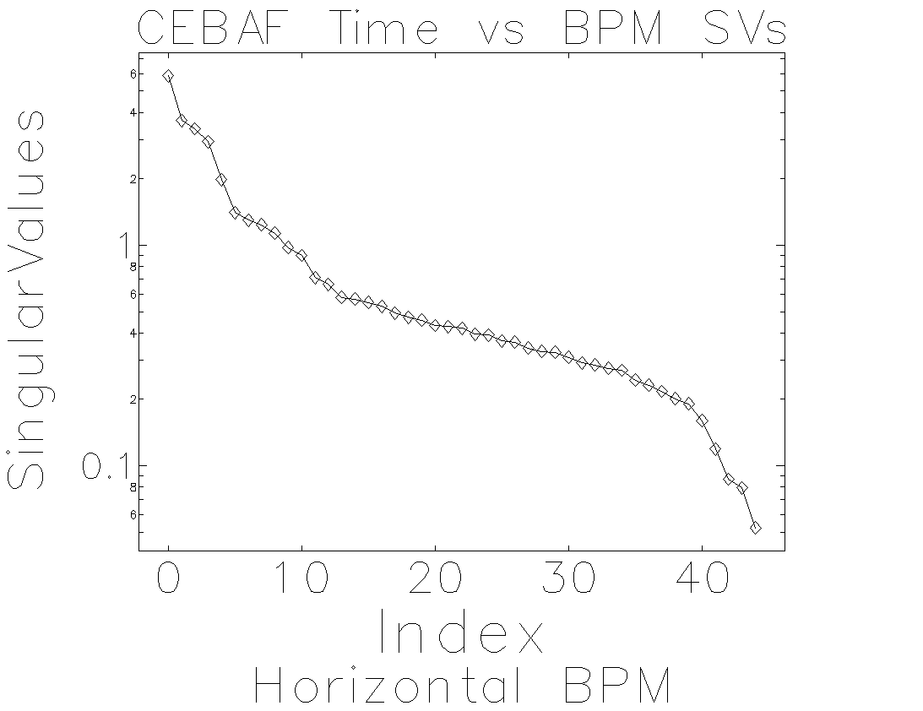
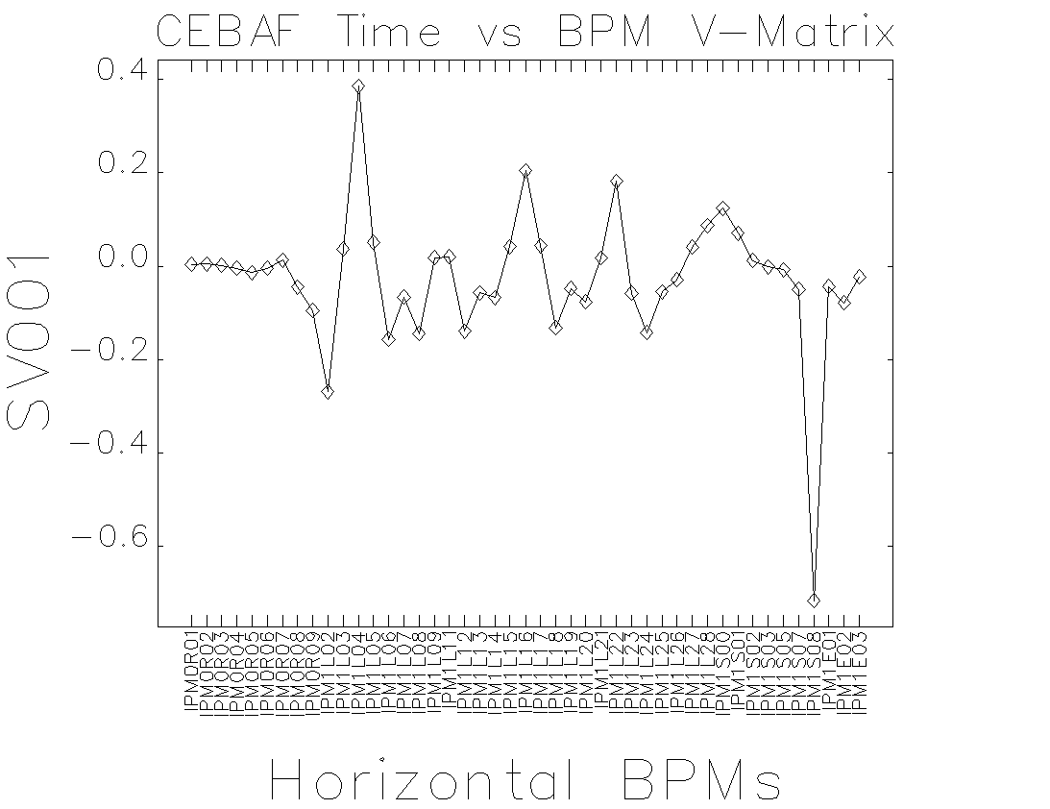
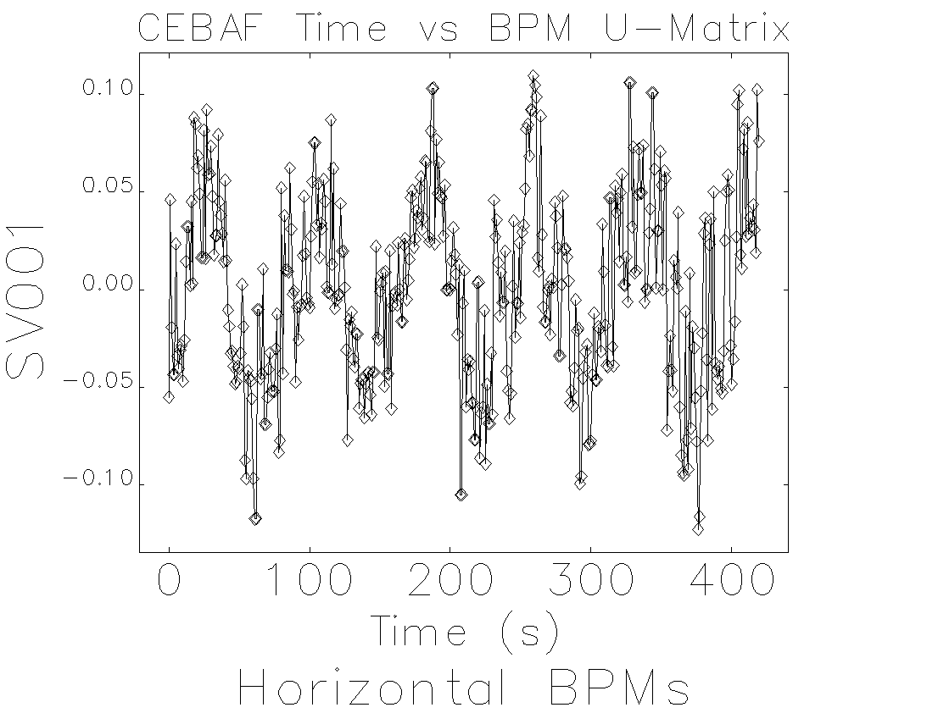
Beam studies in time and frequency domain
We
Analysis by N. Serano.
We can use SVD to look for abnormal beam motion.
Potential to develop a real time tool for monitoring the machine.

Slide 11
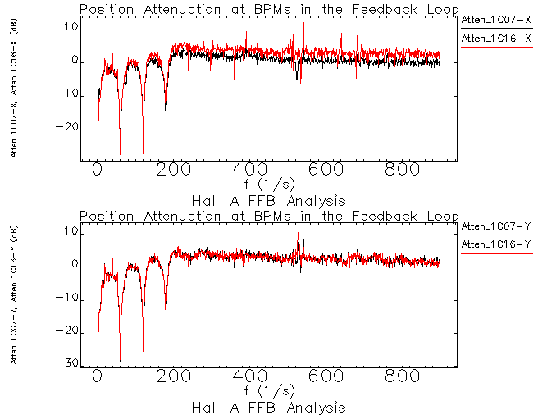
JLab Example: Hall A FFB Orbit/Trajectory Attenuation
BPM position/trajectory attenuation plots show effectiveness of feedback
Divide PSD Closed loop by PSD Open loop and express in dB
First look at in-loop BPMs 1C07 and 1C16
20-30 dB attenuation seen at 60, 120 and 180 Hz
Significant attenuation near DC too
No attenuation at 30 Hz
As expected not much suppression beyond ~200 Hz
Notes:
Guidelines: 6-8 bullets per slide; Use sentence fragments for bullets
To change the photo: Right-click on photo and select change photo

Slide 12
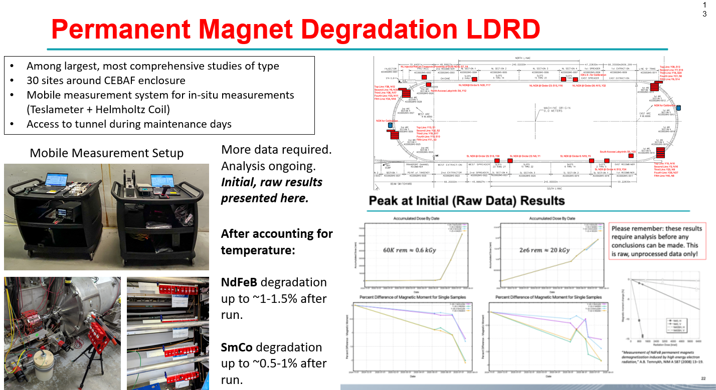
Making use of machine maintenance for beam studies
LDRD for 22GeV but can be the jumping point for beam loss studies for the CEBAF machine
Ryan Bodenstein
Notes:
Guidelines: 6-8 bullets per slide; Use sentence fragments for bullets
To change the photo: Right-click on photo and select change photo

Slide 13
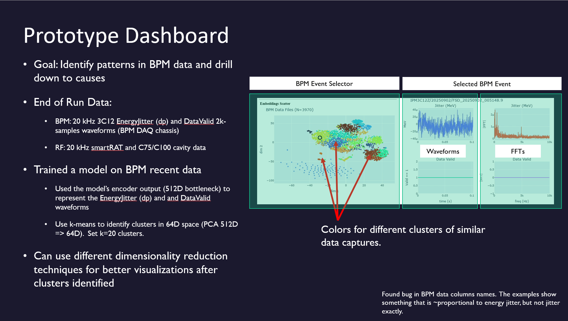
Using AI to identify machine patterns
Show the need for a data retention and storage policy
There is a vast interest in the accelerator community for developing techniques like these.

Slide 14
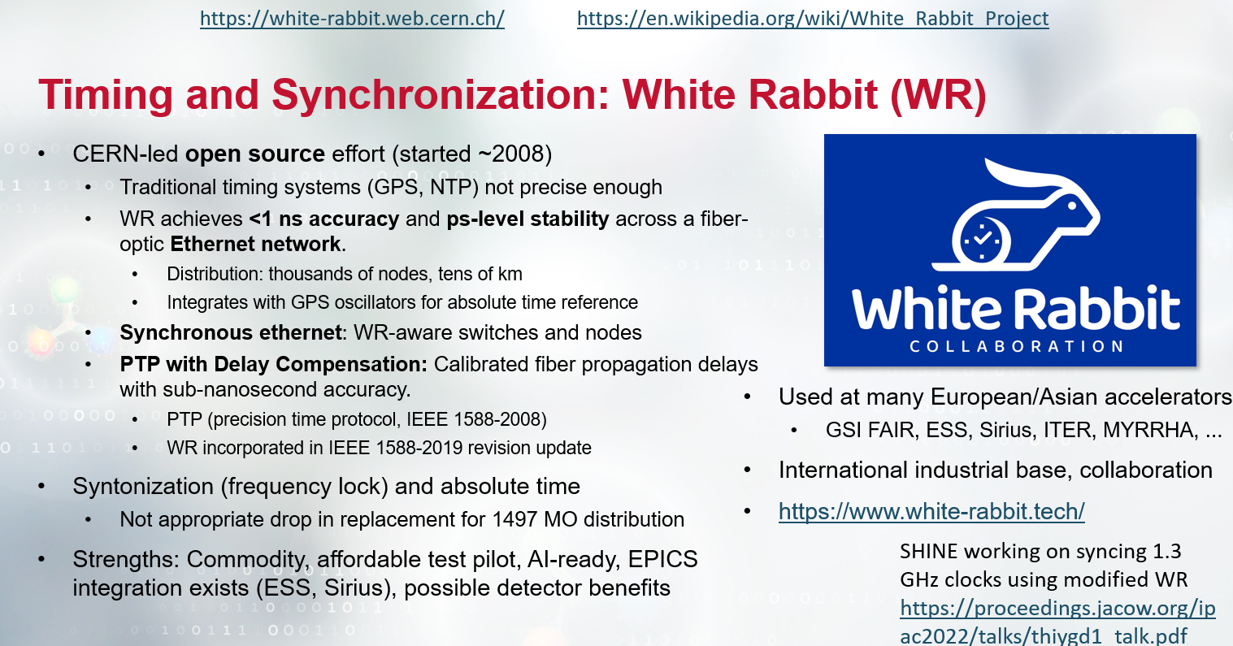
Global timing system?
Nate Ryder is leading the effort for the nextGEN bpm system which includes a global timing system. The next step is to consider synchronizing everything (diagnostics+hardware).
Other labs are looking at White Rabbit implementations. We suggest forming a working group to study this.
T. Satogata

Slide 15

Final Thoughts
Beam studies were carried out to address three different goals (future projects, model development, investigation of machine issues)
Efficient use of time during machine maintenance for further beam studies
Alternating between beam studies and machine maintenance optimizes time used for restoration
Future programs will require commissioning new diagnostics and capabilities
Developing a framework enabling the use of AI and fast data analysis is key
Working groups could be established to study specific issues. Beam loss, timing synchronization and management of fast data, integration with AI tools.
CASA is expecting to ramp up efforts in FY26 to support this effort ( PhD student/Ryan B.)
Identified issues will lead to beam studies for corrective action (BPM SOFS)
Notes:
Guidelines: 6-8 bullets per slide; Use sentence fragments for bullets
To change the photo: Right-click on photo and select change photo

