Slide 1

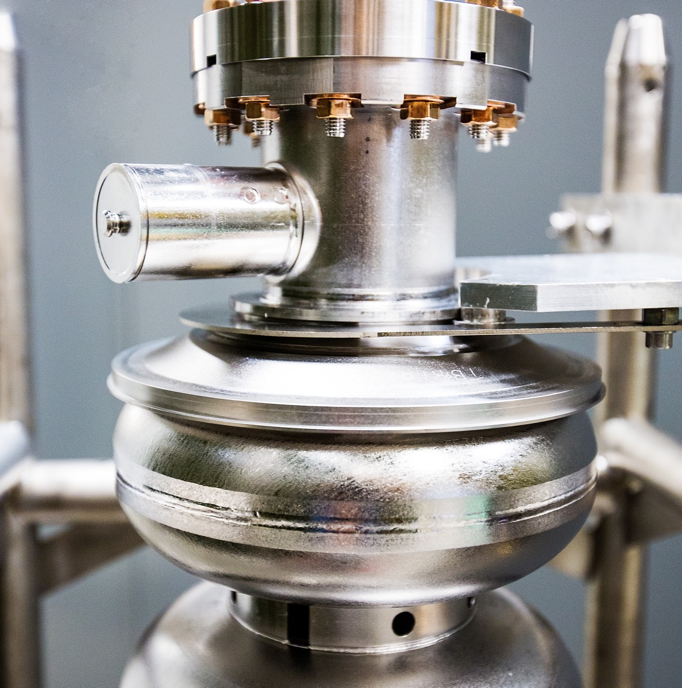
FY25 Run Summary and FY26 Projections
2025 Run Retreat
10/07/2025
Eduard Pozdeyev
Director of Accelerator Operations
Notes:
Tip: Keep titles under 60 characters for readability
To change the photo: Right-click on photo and select change photo

Slide 2
Retreat Goals
Summarize the FY25 run
Identify strengths and weaknesses. Identify opportunities for improvement
Outline goals and discuss technical plans, ensure they are aligned
Address charge with respect to your systems. Do others see it same way?
Written report after the Run with input from presentations

Slide 3
FY25 Run
22 weeks of Physics + 2 weeks of beam restore (03/19 – 09/03, 2025)
  Hall A operations stopped on 08/25 (21 weeks of Physics)
Energy gain 1060 MeV/linac (E_{5.5} = 11.7 GeV)
Delivered beam power up to 830 kW
Polarized beams to Halls A, B, C, D
FY25 Delivered Beam Statistics (hours)
DOE Requirement for FY25,
total delivered 3000 h,
exceeded by 8%.
Total delivered beam (h) | 3236
Delivered research (h) | 2767.4
Delivered beam study (h) | 142.9
Delivered tuning, setup, restore (h) | 325.7
Unscheduled failure (h) | 500
Total scheduled (h) | 3736
Reliability (%) | 86.6

Slide 4
FY25 Run Reliability
CEBAF reliability, weekly and average since 03/19 (beginning of the run) until 09/03.
The figure also shows the CEBAF average FY24 run reliability (09/23 – 05/24), 75.2%, for reference.

Slide 5
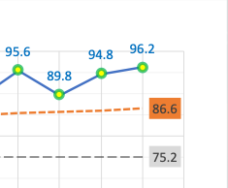
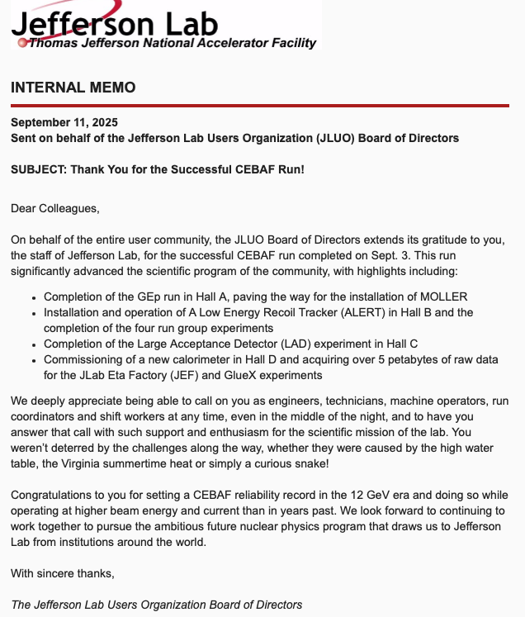
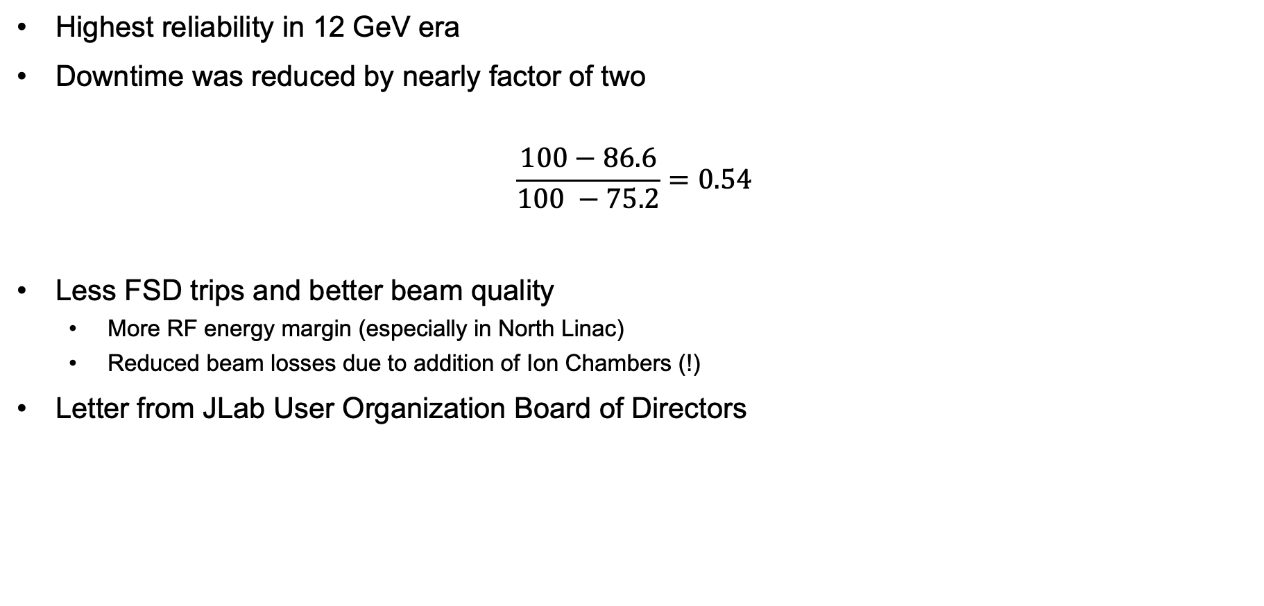
FY25 Run Was a Success
Highest reliability in 12 GeV era
Downtime was reduced by nearly factor of two
$$\frac{100−86.6}{100 −75.2}=0.54$$
Less FSD trips and better beam quality
  More RF energy margin (especially in North Linac)
  Reduced beam losses due to addition of Ion Chambers (!)
Letter from JLab User Organization Board of Directors

Slide 6
Factors Contributing to Higher Reliability
Fixed Time Accounting inconsistencies
  Fixed downtime assigned to accelerator in case of inability to deliver beam to a specific hall.
  Better planning for recovery time after maintenance, recovery, etc. Underpromise, overdeliver.
Better maintenance planning
  Improved RF Maintenance Planning (Jayendrika’s RF Table)
  Weekly RF maintenance supported gradient margin
  Less entries to the tunnel help with stable operations
Improved communication between technical teams
  Gradient Team
  SRF/RF/Ops meeting
  Communication between technical teams improved in general
Investment into CEBAF accelerator systems and infrastructure
  Reliability, Energy Reach, Beam Loss Detection, Injector, Facilities, and other projects.
Investment into personnel
  CEBAF Operator team staffing allows for operating CEBAF without extreme stress and training new operators

Slide 7
Other Developments
Upgraded gun and injector
Improvements in accelerator systems
  MO fiber distribution in North Linac
Progress with MOLLER studies and hardware development
Degrader installed and commissioned
5D line re-installed and commissioned
  Experimental cryostat is not ready yet
Fast Feedback revival and test
Deployment of LabJacks to monitor beam stability around CEBAF
Continuing development and deployment of software to monitor beam stability

Slide 8
Opportunity For Improvement (OFI): Beam Transport
We still can acquire significant downtime due to unexplained issues with beam
  Example: Hall B halo in May 2025
Beam-based information is utilized insufficiently
  Mis-wired quads during March Beam Restore
  Noise, oscillations, instabilities…
What can we do
  Improved and additional instrumentation
    Beam quality, Halo
    Continue deployment of ion chambers to improve beam loss detection – significant improvement in FY25
    System upgrades (BPM, timing, etc.)
  Focused interdisciplinary teams and campaigns (e.g., Ops/CASA Beam Transport Downtime Team)
  Development and use of new software stools to collect and process beam data
    Adam, Dennis, Kyle, Tom’s loggers and watchers
    ML/AI can provide significant help in processing data and detecting issues

Slide 9
OFI: RF and High Intensity Performance
Need to resolve issues with 8 kW circulators
  This issue impacts performance of C75 CMs
Need to improve performance of 13 kW klystrons
  Some improvement (~10%) was achieved last run
  Some klystrons still perform at ~8 kW level
CEBAF beam intensity limit needs to be understood
  CEBAF beam intensity limit is below expected value
  Possible contributors (not blaming, just asking):
    LLRF is not performing as expected - ?
      Klystron power-dependent phase shift was brought up as one possibility
      Did we have a comprehensive review
    Microphonics is larger than expected - ?
    Other sources of instability - ?

Slide 10
OFI: Project Planning, Approval, and Execution
We are lacking process to initiate, approve, and track CEBAF improvement projects
Projects do not follow best practices
  This is related in part to the first bullet but partially to established culture
This results in
  Underperforming or failed CEBAF systems
  Unplanned work requests, schedule conflicts, unplanned funding requests
  Inconsistent approach to reviews and approvals
We need to establish
  Process to initiate, approve, and track CEBAF projects on the division level
    Graded, with clear rules, tracking on the division level
  CEBAF configuration Control Committee to ensure projects follow established process and best engineering practices

Slide 11

Systematic Effort To Improve Reliability [1]
Systematic improvement of reliability requires systematic approach to addressing issues causing downtime
Continue investments in reliability of accelerator systems
Time to review and refresh inventory of critical spares
Need a well-thought, integrated plan to address Obsolescence
To address these issues efficiently, SMEs need to understand main contributions to downtime on the sub-system level
  Ops provide downtime report by accelerator systems – it is just an indicator, insufficient to understand what specifically causes downtime
  SMEs and system owners need to dig a level down into failure data to find main contributors to downtime
  Some system owners do it better than others
Obsolescence analysis is required to predict future needs

Slide 12
Systematic Effort To Improve Reliability [2]
DOE wants 85% CEBAF reliability
Data-driven approach to meet reliability is to
  Allocate reliability numbers for each high-level system
  Group leaders/system owners develop a plan how they are going to meet the allocated downtime number and provide the plan to the Director of Accelerator Ops and Division
  This requires understanding main downtime contributions for each system based on the actual downtime data and developing a plan
  This plan will have to be executed working with the Division
Target reliability numbers are those during June – August 2025
  I’ll distribute those numbers
  The numbers can be iteratively adjusted and redistributed depending on feedback and projected cost/effort
Analize what you need to do to meet those numbers
Develop and provide plans clearly showing analysis and response to it

Slide 13
FY26 Run Projections
Halls B,C,D
Polarized bam
FY26 Run to begin in February, Feb 6th (dates are tentative)
25 weeks of running including restore and reconfiguration: 23 + 2
Two runs in one
  Low energy run: 700 MeV/pass, Feb 20 – Apr 20
  High energy run: 2.1 MeV/pass, Apr 4 – Jul 27
Beam intensity and power: up to 80 uA to xC and 860 kW
Arc magnet reconfiguration between the low and high energy runs

Slide 14

Conclusions
Excellent FY25 Run with 12 GeV era record reliability
Issues and opportunities for improvement exist. They will be discussed today
Need consistent effort to maintain CEBAF Operations at this level
I WANT YOU
TO IMPROVE CEBAF OPERATIONS

Slide 15
FY25 Delivered Beam Hours
Integrated total delivered beam hours. The plot shows DOE expected hours calculated from the assumption of 3000h over 24 weeks (orange) and the actual delivered beam hours (blue).

