Slide 1



Slide 2
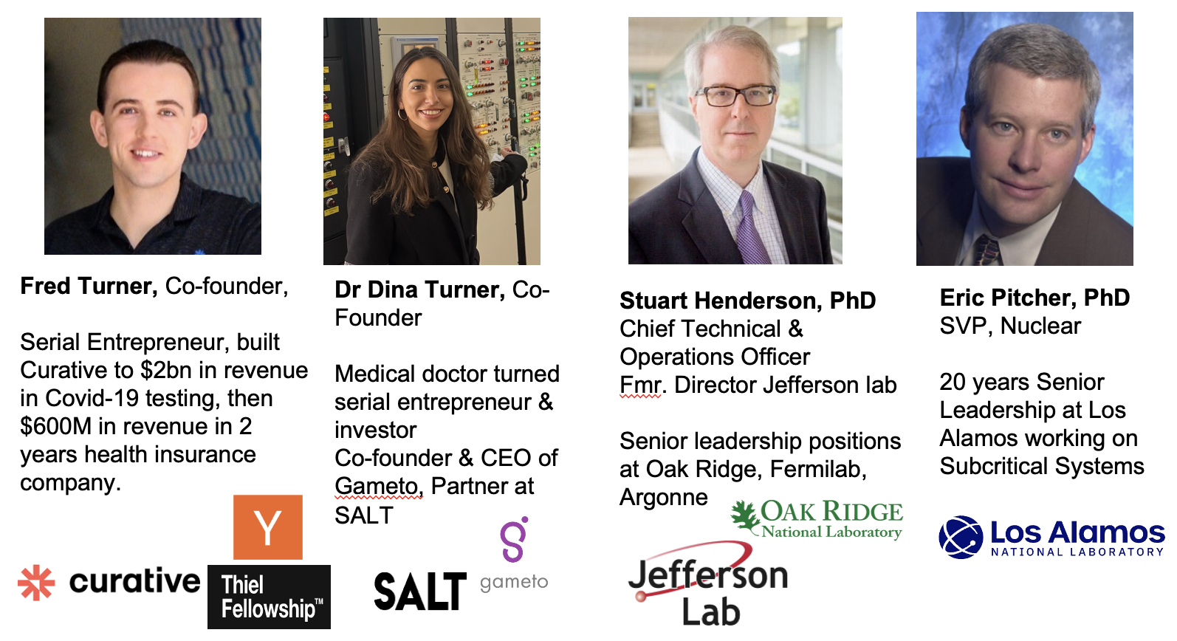
Subcritical Systems Inc.
Based in Austin, Texas, incorporated in early 2025 to bring the Energy Amplifier concept to the US to safely generate electrical power
Motivated by U.S. electricity demand forecast of nearly 150 GW needed in the next 5 years to power the AI revolution
Energy Amplifier consists of accelerator to sustain fission of nuclear fuel in a subcritical core. It is safe, can never go critical
A subcritical system will likely take a different licensing path within NRC, relative to a critical reactor
Founding team of entrepreneurs have built companies with billions in revenue and scientists and engineers with deep experience in the underlying technology

Slide 3
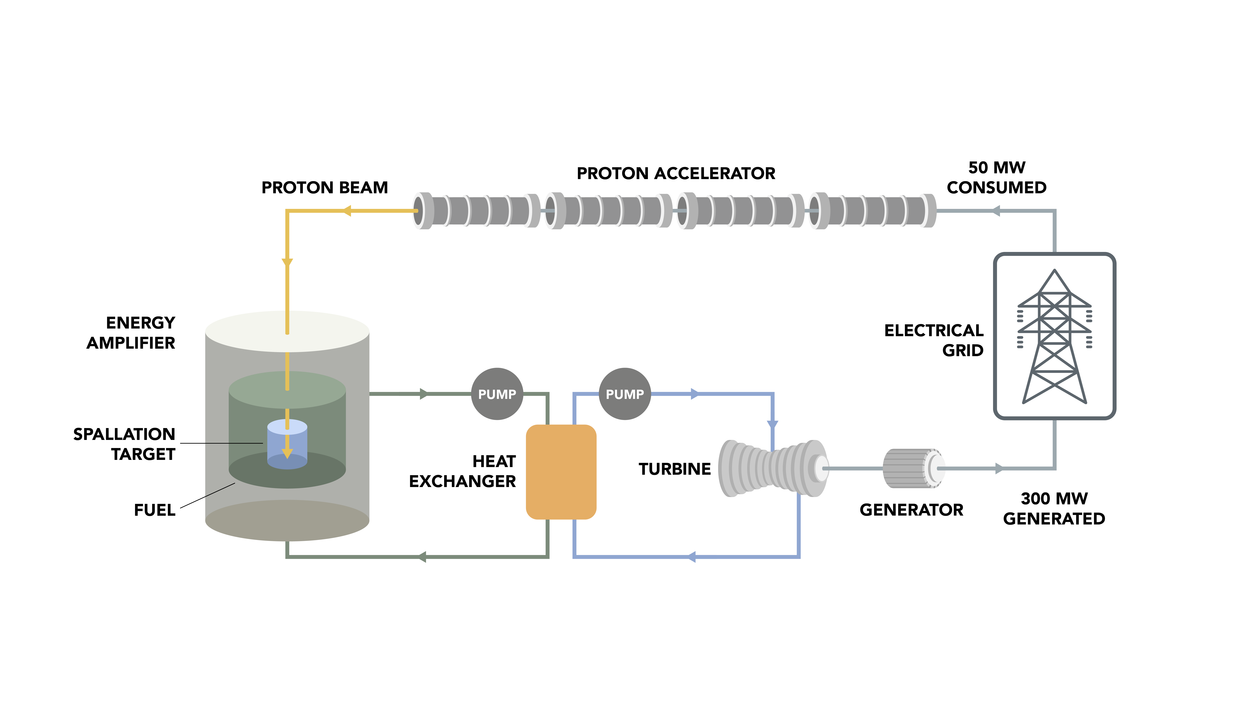

Energy Amplifier based on an Accelerator Driven Subcritical System
Subcritical System’s Energy Amplifier Concept
Proton accelerator provides an external, controllable source of neutrons via spallation
Neutrons sustain fission reaction in subcritical assembly
Fission of nuclear fuel (HALEU) generates heat and subsequently electrical power
Advantages of ADS
Safety since the particle accelerator provides a simple on-off switch for the fission process. The core can not reach criticality
Uses existing technology with minimal “R&D”
Licensing and regulatory process should be simpler, resulting in lower capital and operating costs relative to critical systems
Ideally suited to exploit fuel cycle evolution
$$P_{th}=P_{beam}\frac{G_{0}k}{1−k}$$
Energy Amplifier Plant: Energy output is proportional to proton beam power

Slide 4
Technical approach
The Energy Amplifier requires a high-power high-energy proton linear accelerator
Continuous wave operation
All-superconducting design starting from RFQ output
Very high reliability
In general utilize existing technology or technology that is “ready to go”; willing to pursue R&D to push almost-ready-to-go into ready-to-go
Cost is key in energy economics, both CAPEX and OPEX
Therefore, we are looking at all opportunities to reduce costs relative to present facilities; we want to exploit accelerator R&D developments over the last decade(s).
Two big cost drivers are cryomodules and the high-power RF systems.
We want to deploy Nb3Sn operating at 4K; interested in the cheapest possible approach, such as Nb3Sn on Copper
We want to use magnetron RF systems to significantly reduce the cost of the RF plant

Slide 5
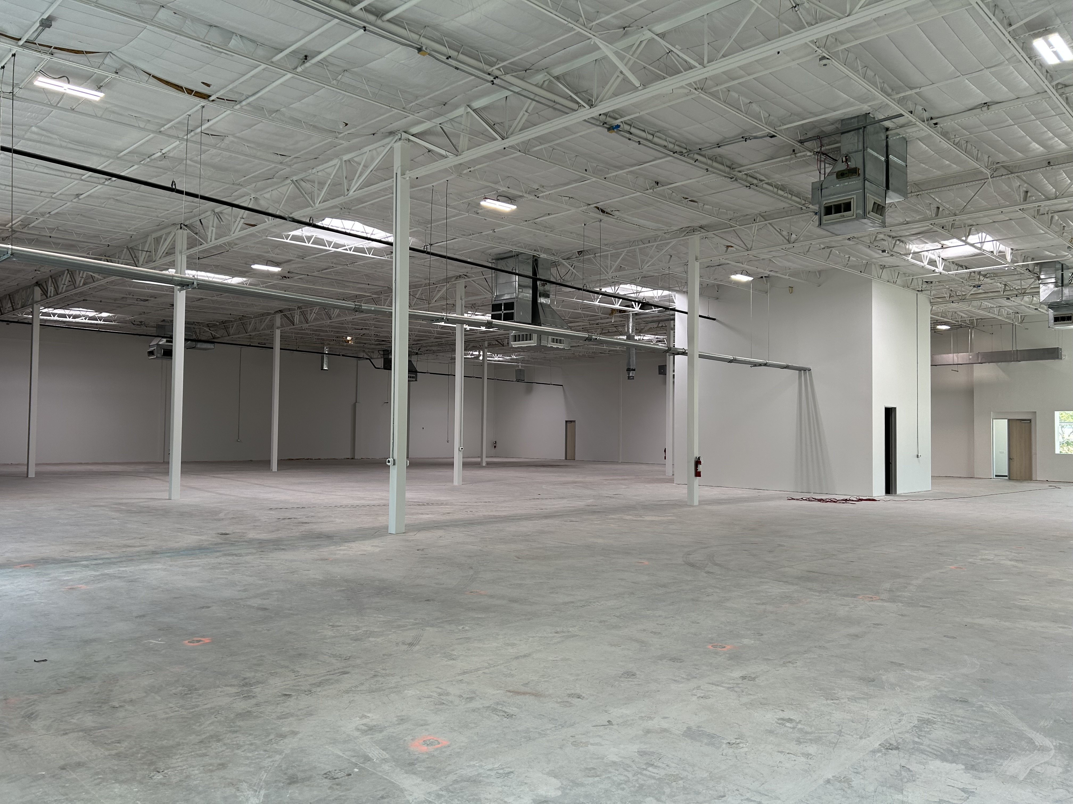
Subcritical Systems will build out SRF capabilities in our 20,000 sq. ft facility

